Slide 1
UTTPS FM System Performance Test
@Climate Chamber
Nov. 28, 2018@ RWTH-Aachen
Jan. 04, 2019@ RWTH-Aachen

Slide 2
Test content
Verify the leak test procedure for AAF fitting : 3 d (pump OFF)
FM 8 Thermal Cycle: 4 d
  Functional test: Pump 1A, 2A, 1B & 2B ( 15 mins/each)
  Thermal cycle (pump OFF)
  Functional check after thermal cycle: same as before thermal cycle
Accumulator control stability verification : 1 d ( Heat load ON /OFF)
  Pump 1A, Accumulator 10 C, 5C, 0 C, radiator outlet temp. orbital variation
System curve : Accumulator 0 C, radiator outlet temperature -5 C, chamber -5 C: 2.5 d
  Constant heat load from evaporator, change pump speed. 5500-6000-6500-7000 RPM: pumps 1A, 2A, 1B, 2B
  Constant pump speed 6500 RPM, increase heat load: pump 1A
Verify the pump protections : cavitation, overheating: 0.5 d
  Pump 1 A: POH and PTC
  Pump 2 B: POH and PTC
Verify the maximum power drained from UTTPE power cable : 0.25 d (pump 1a, 2b): wait until the radiator is installed

Slide 3
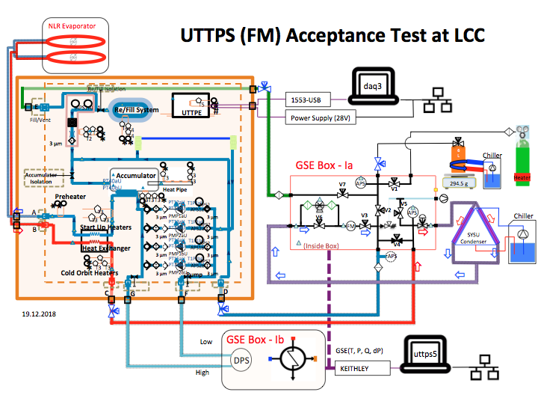
The radiator is not installed in this test. Using 6 mm OD tube to bridge the new radiator inlet and outlet

Slide 4
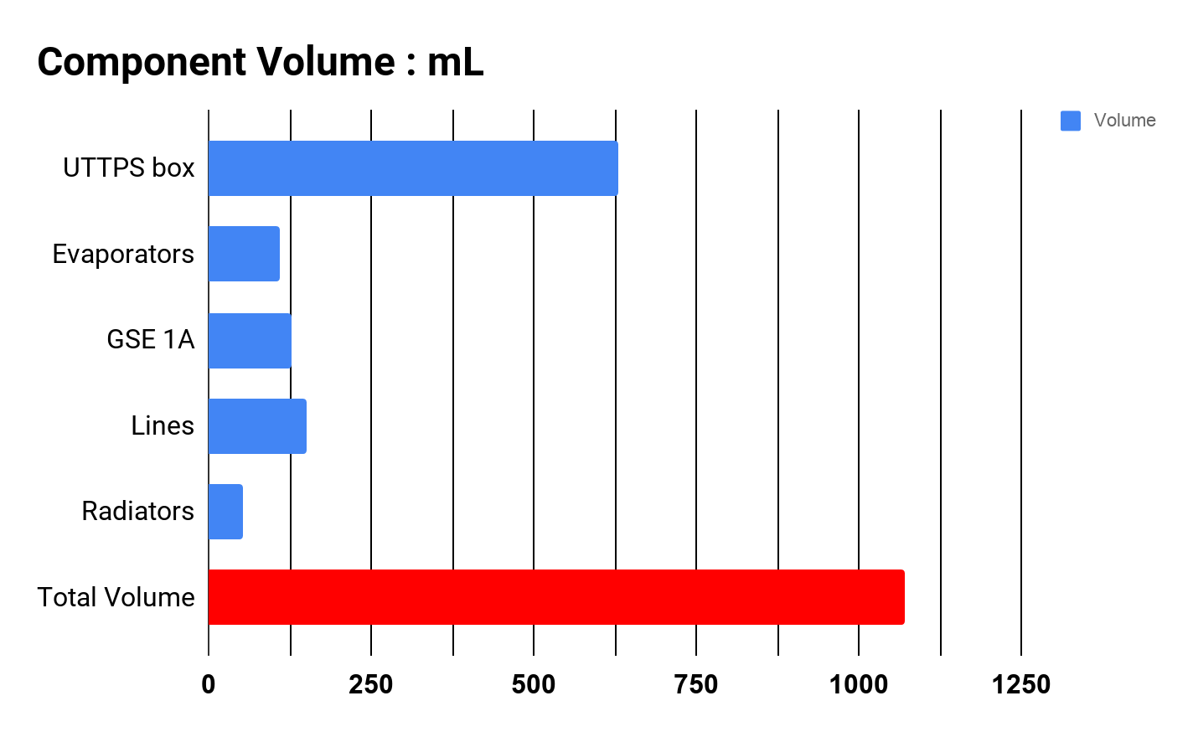
Volume Determination
UTTPS box: box+tube up to flange inside the climate chamber: Temperature constant & vary
Evaporators: Top+bot.： 21 C (constant)
GSE1A: 1 C (constant)
Lines: tubes up to the GSE1A +GSE1B: 21 C(constant)
Radiators: Ram +Wake ground radiator : -12 C & vary
630 mL
110 mL
128 mL
150 mL
53 mL
1070 mL

Slide 5
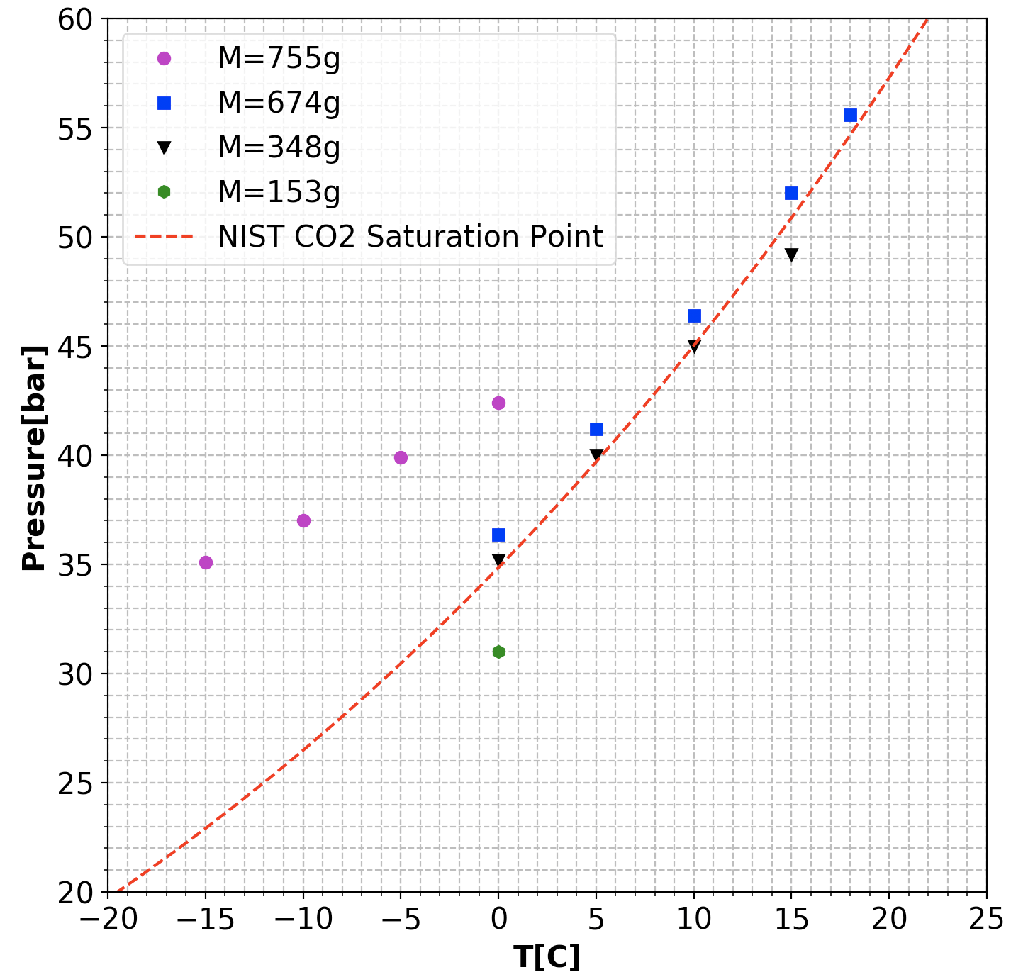
AAF Leak Tight Verification Method
For AAF fitting leak tightness check in space, the preferred pressure is between 27 bar and 40 bar
Fill whole system in liquid state (purple dots):
Large mass required 755 g
Pressure increases with temp. : 2 bar/ 5C
Suitable for temp range: -20 C to -5 C
Fill system in two-phase state (blue & black dots):
Medium mass required ~348 g to 700 g
Pressure increases follow the saturation curve: 5 bar/ 5C
Suitable for temp range: -10 C to 5 C
Fill system in gas state (green dot):
Less mass required < 300 g
Suitable for temp range: > 0 C
Preferred pressure upper limit < 40 bar
Preferred pressure lower limit > 27 bar

Slide 6
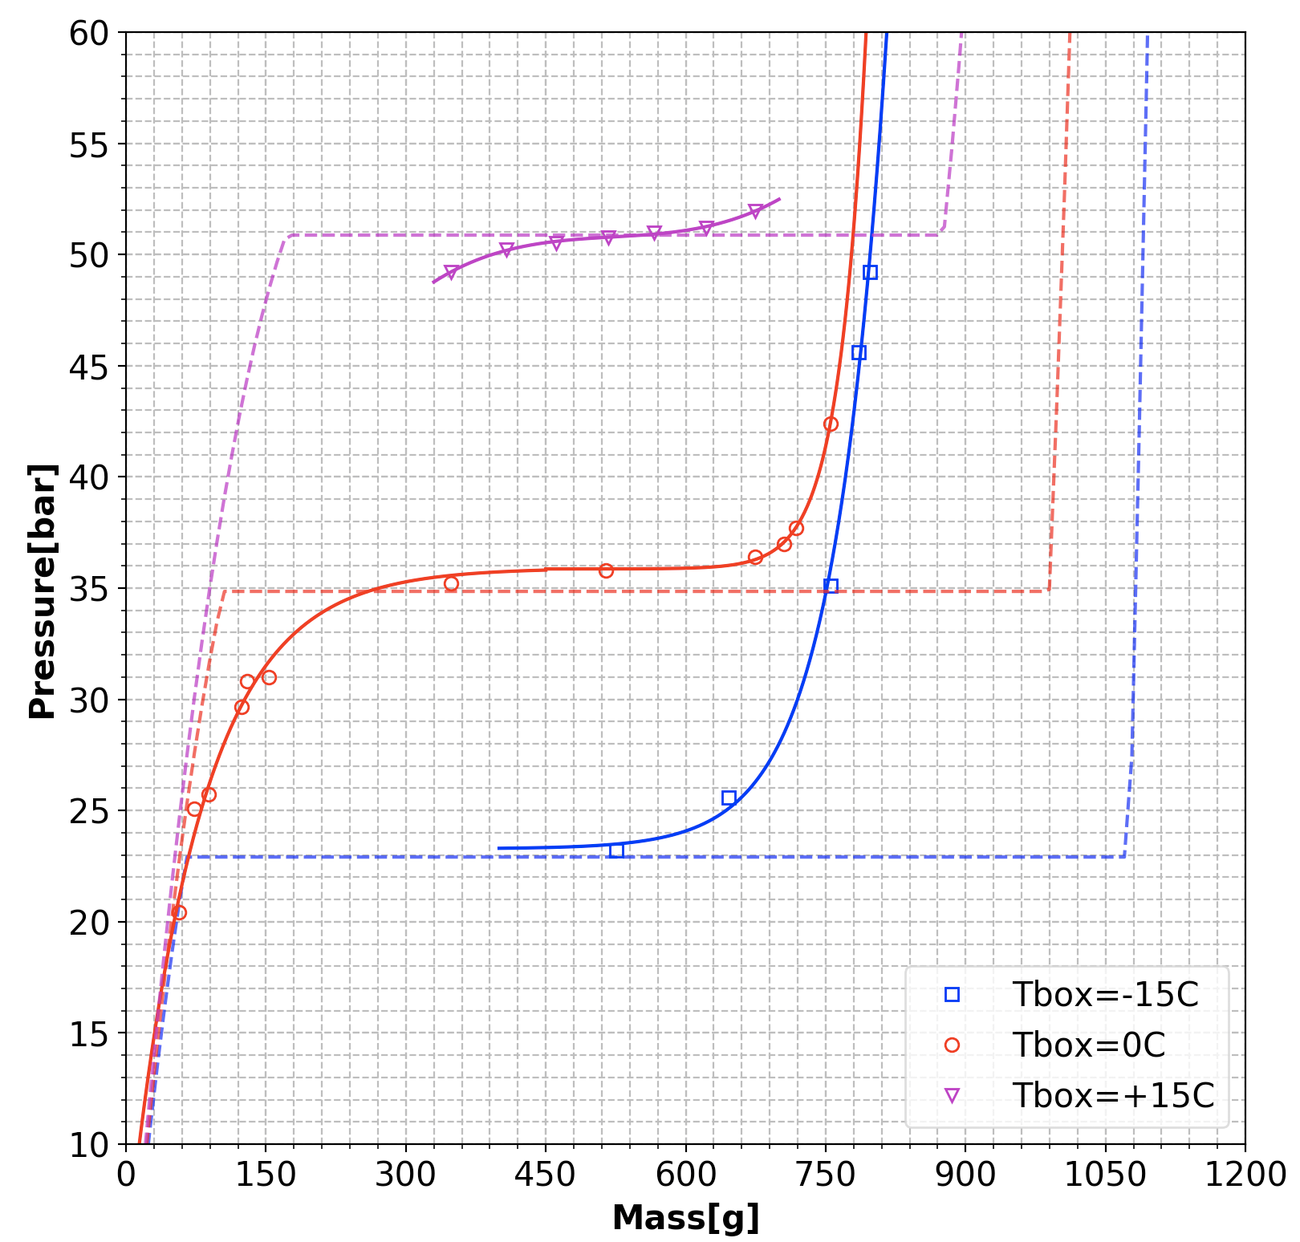
Fill CO2: Two-phase State
Radiator temp. constant -12 C
Change the box temp by climate chamber from -15 C to 15 C
Conclusion:
If the CO2 mass is between 200g and 700 g, the UTTPS box volume would act like an accumulator.
Two-phase CO2 inside the UTTPS box is controlling the system pressure
Two-phase

Slide 7
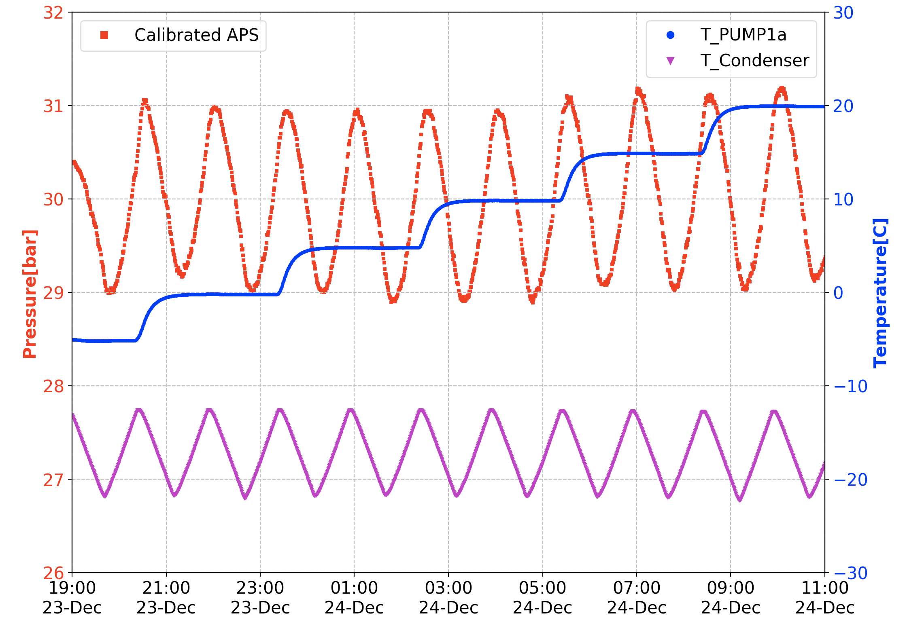
Fill 153 g of CO2 inside the system: Gas State
Radiator temp. Varies between -22 C and -12 C
Change the box temp by climate chamber from -5 C to 20 C
Conclusion:
In gas state, the pressure is mainly affected by the radiator temp. Variation, not the box temp.

Slide 8
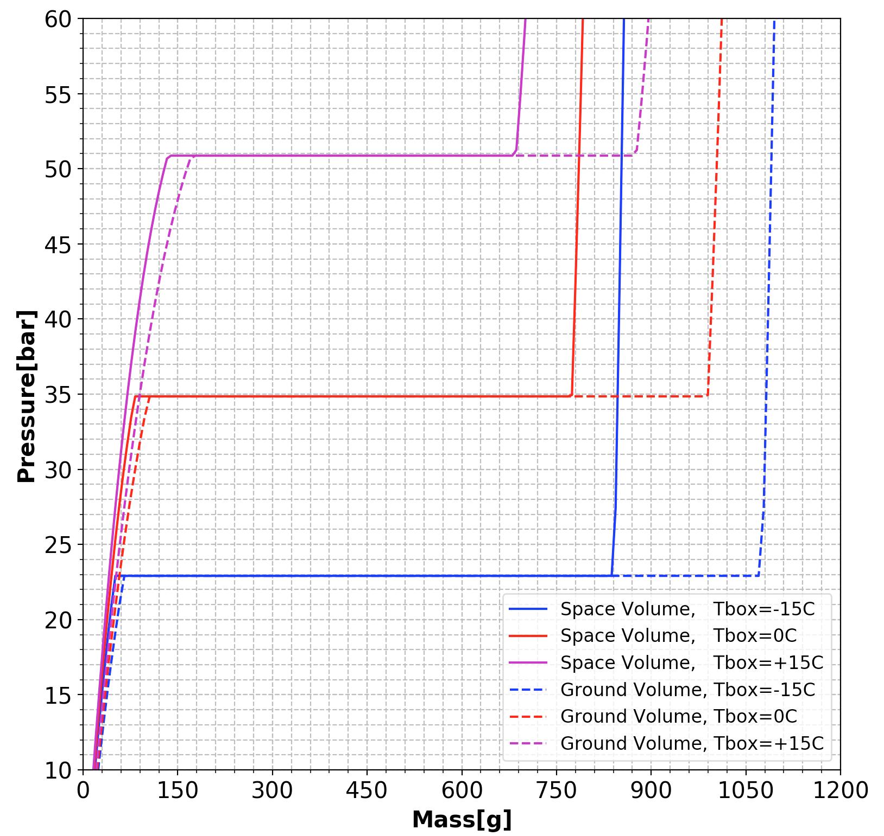
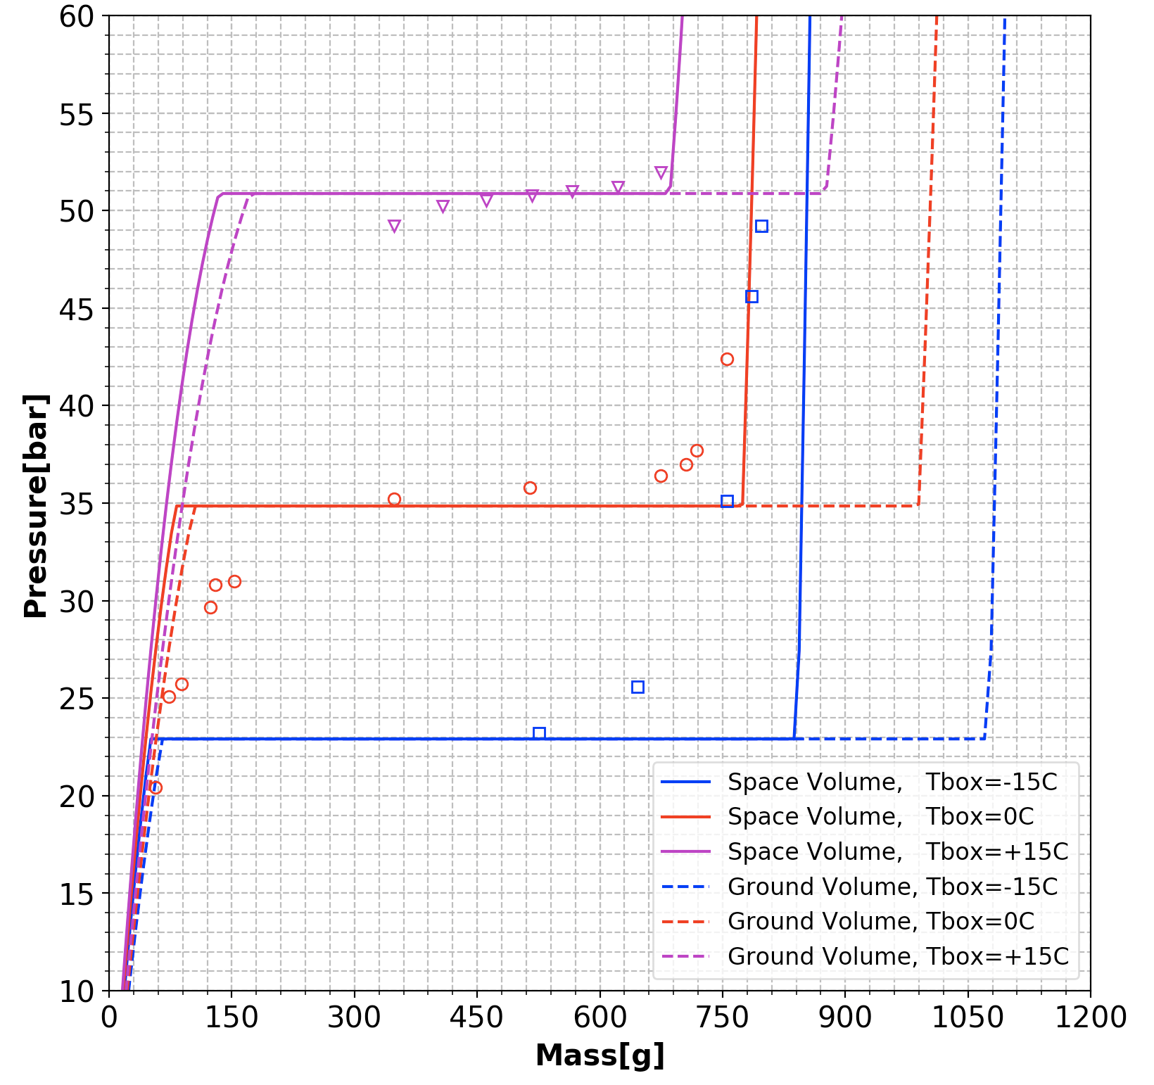
Test Data Comparison with NIST Chart:
MassGround=NIST_Density *Ground Volume (1070 mL)
MassGround=NIST_Density *GroundVolume (1070 mL)
MassSpace=NIST_Density*SpaceVolume (835 mL)

Slide 9
Pump Functional Check before Thermal cycle
Mass filled inside the loop: 1550 g
Mass inside the refill vessel: 4910 g
Test condition:
Accumulator 10 C
Chamber -5 C
Chiller -10
No heat load
Evaporators at environment: 21 C
Pump speed: 6000 RPM

Slide 10
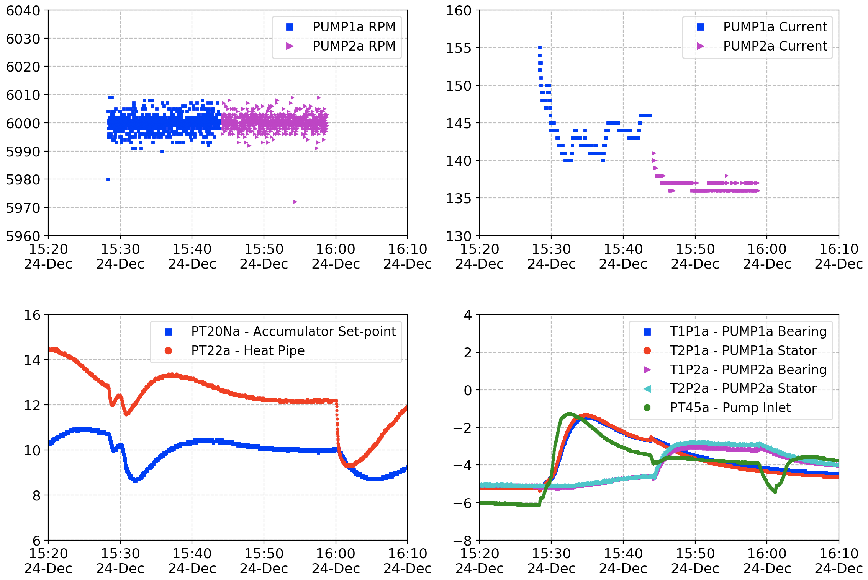
Functional Check of Pump 1a and 2a before thermal cycle
While running pump 1a, the evaporator is in two phase during the pump start-up, since the environment is at room temp. 21 C
Repeat the test for pump 1a

Slide 11
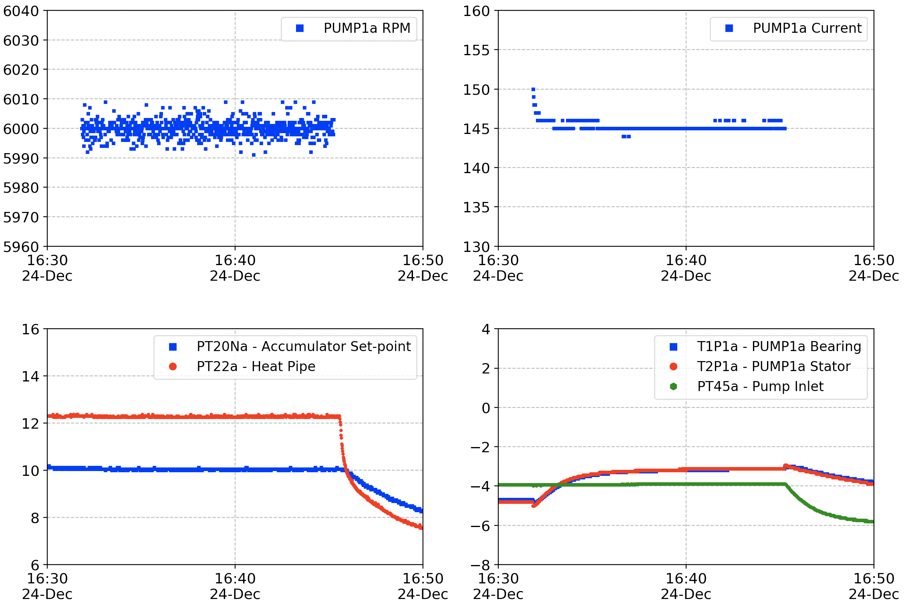
Repeat the functional check of pump 1a

Slide 12
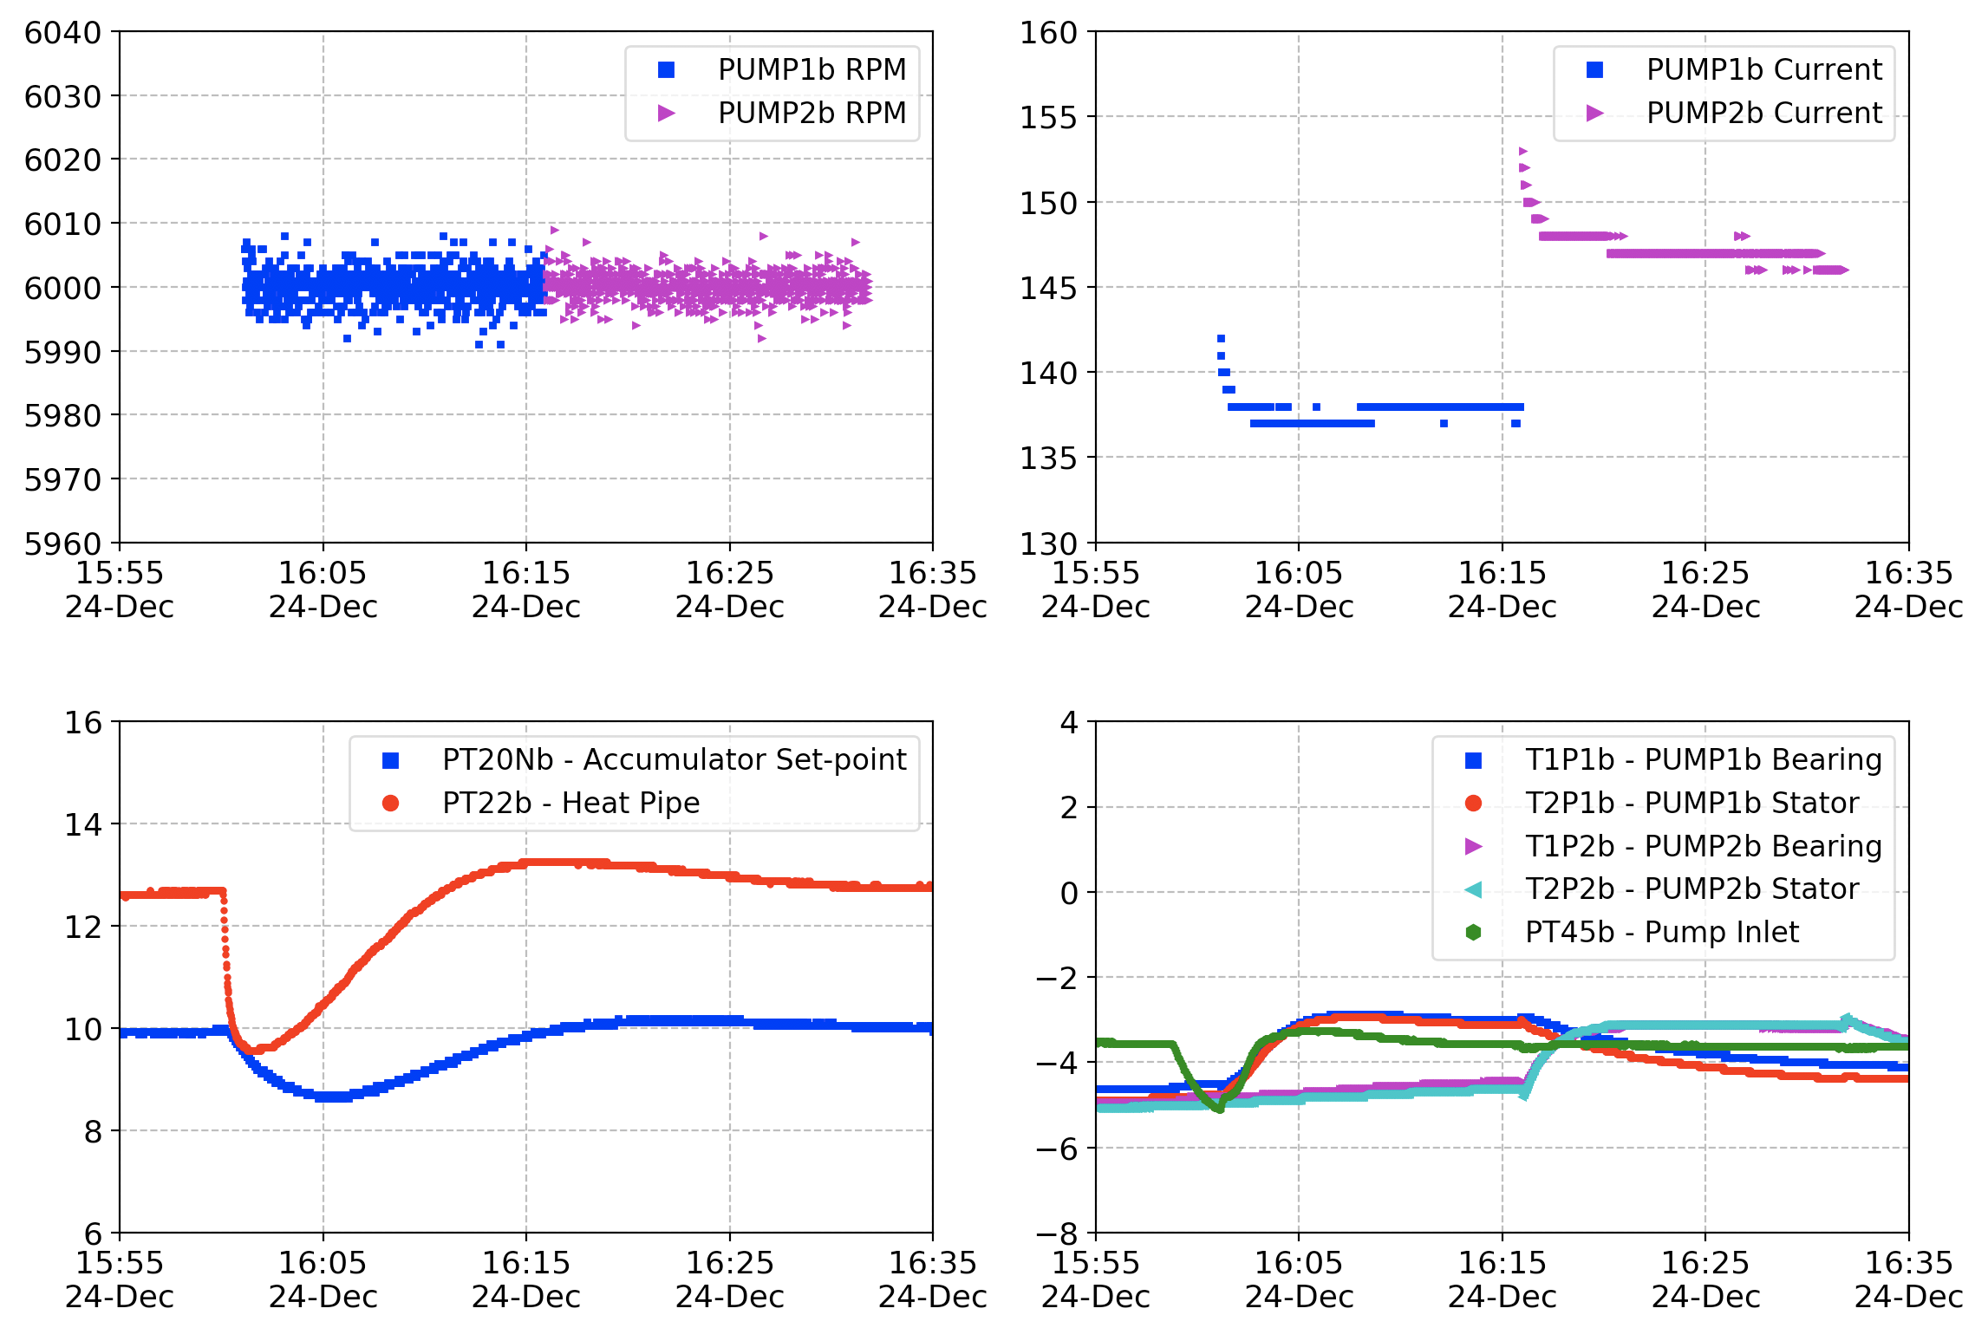
Functional Check of Pump 1b and 2b before Thermal Cycle

Slide 13
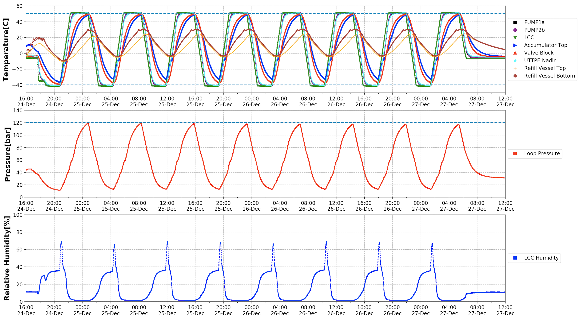
FM 8 Thermal Cycle : from -40 C to +50 C

Slide 14
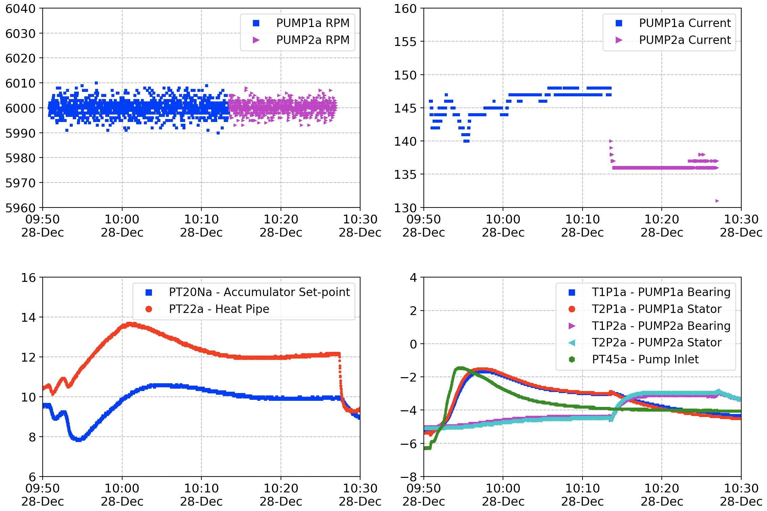
Functional Check of Pump 1a and 2a After Thermal cycle

Slide 15
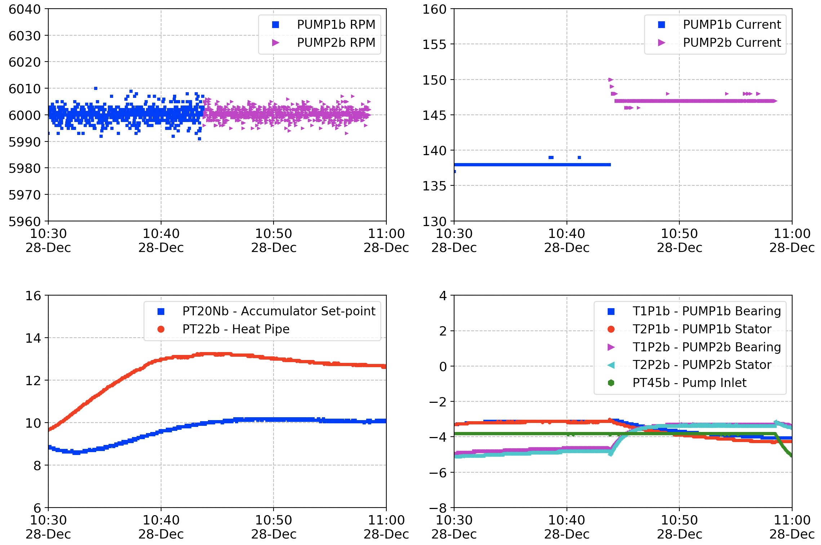
Functional Check of Pump 1b and 2b After Thermal cycle

Slide 16
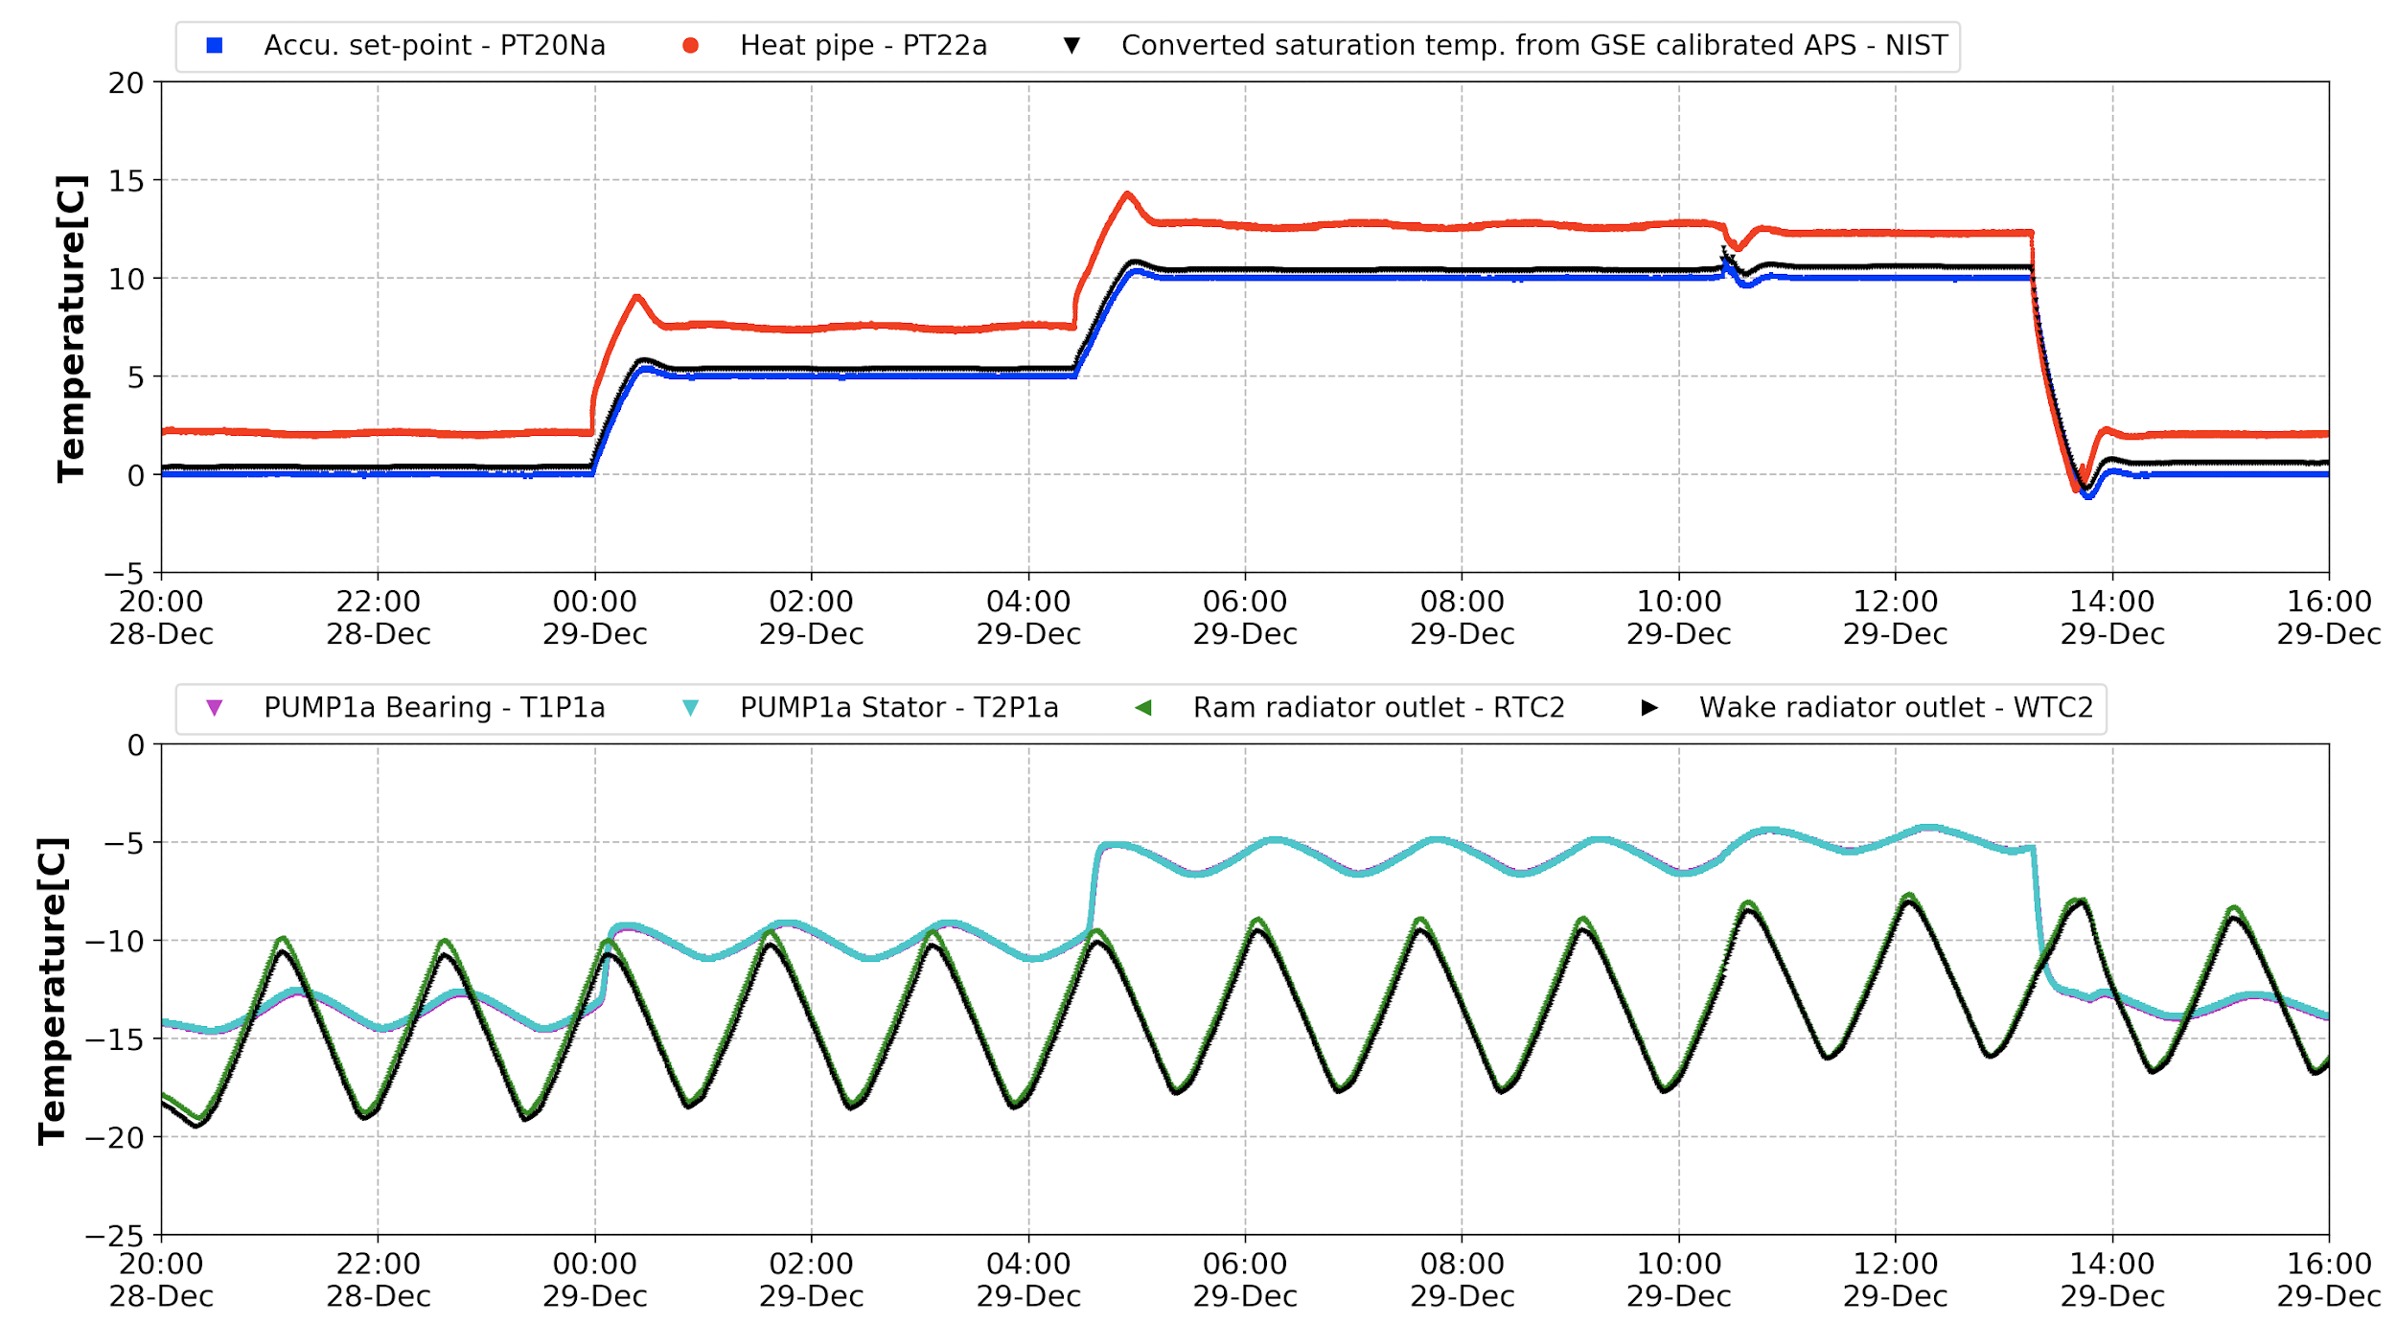
System Control Stability
Evaporator OFF
Evaporator ON [Ptop=85W, Pbot=65W]

Slide 17
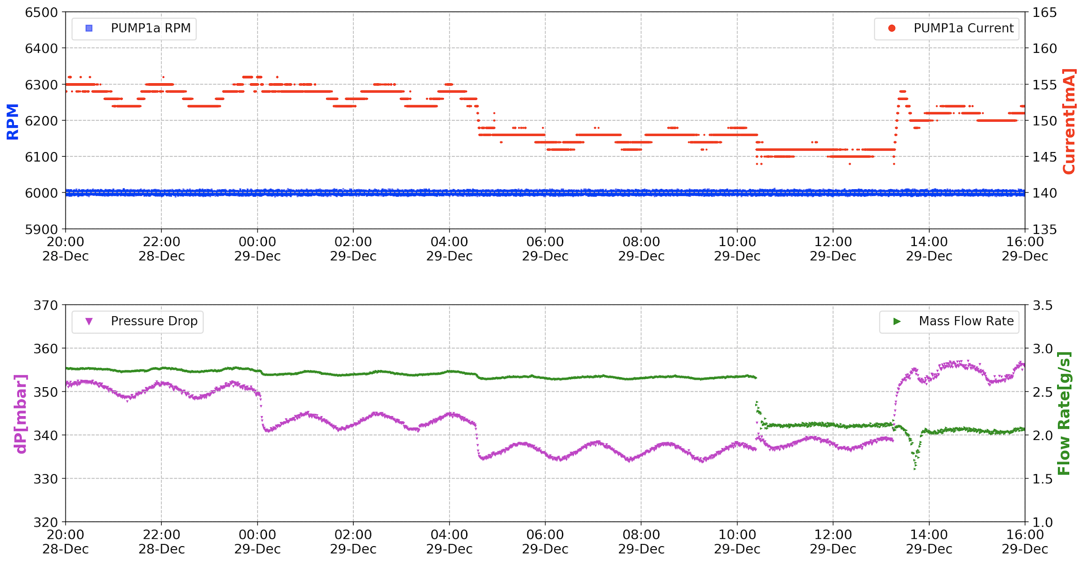
Pump Behavior during System Stability
Evaporator OFF
Evaporator ON [Ptop=85W, Pbot=65W]
Evaporator ON

Slide 18
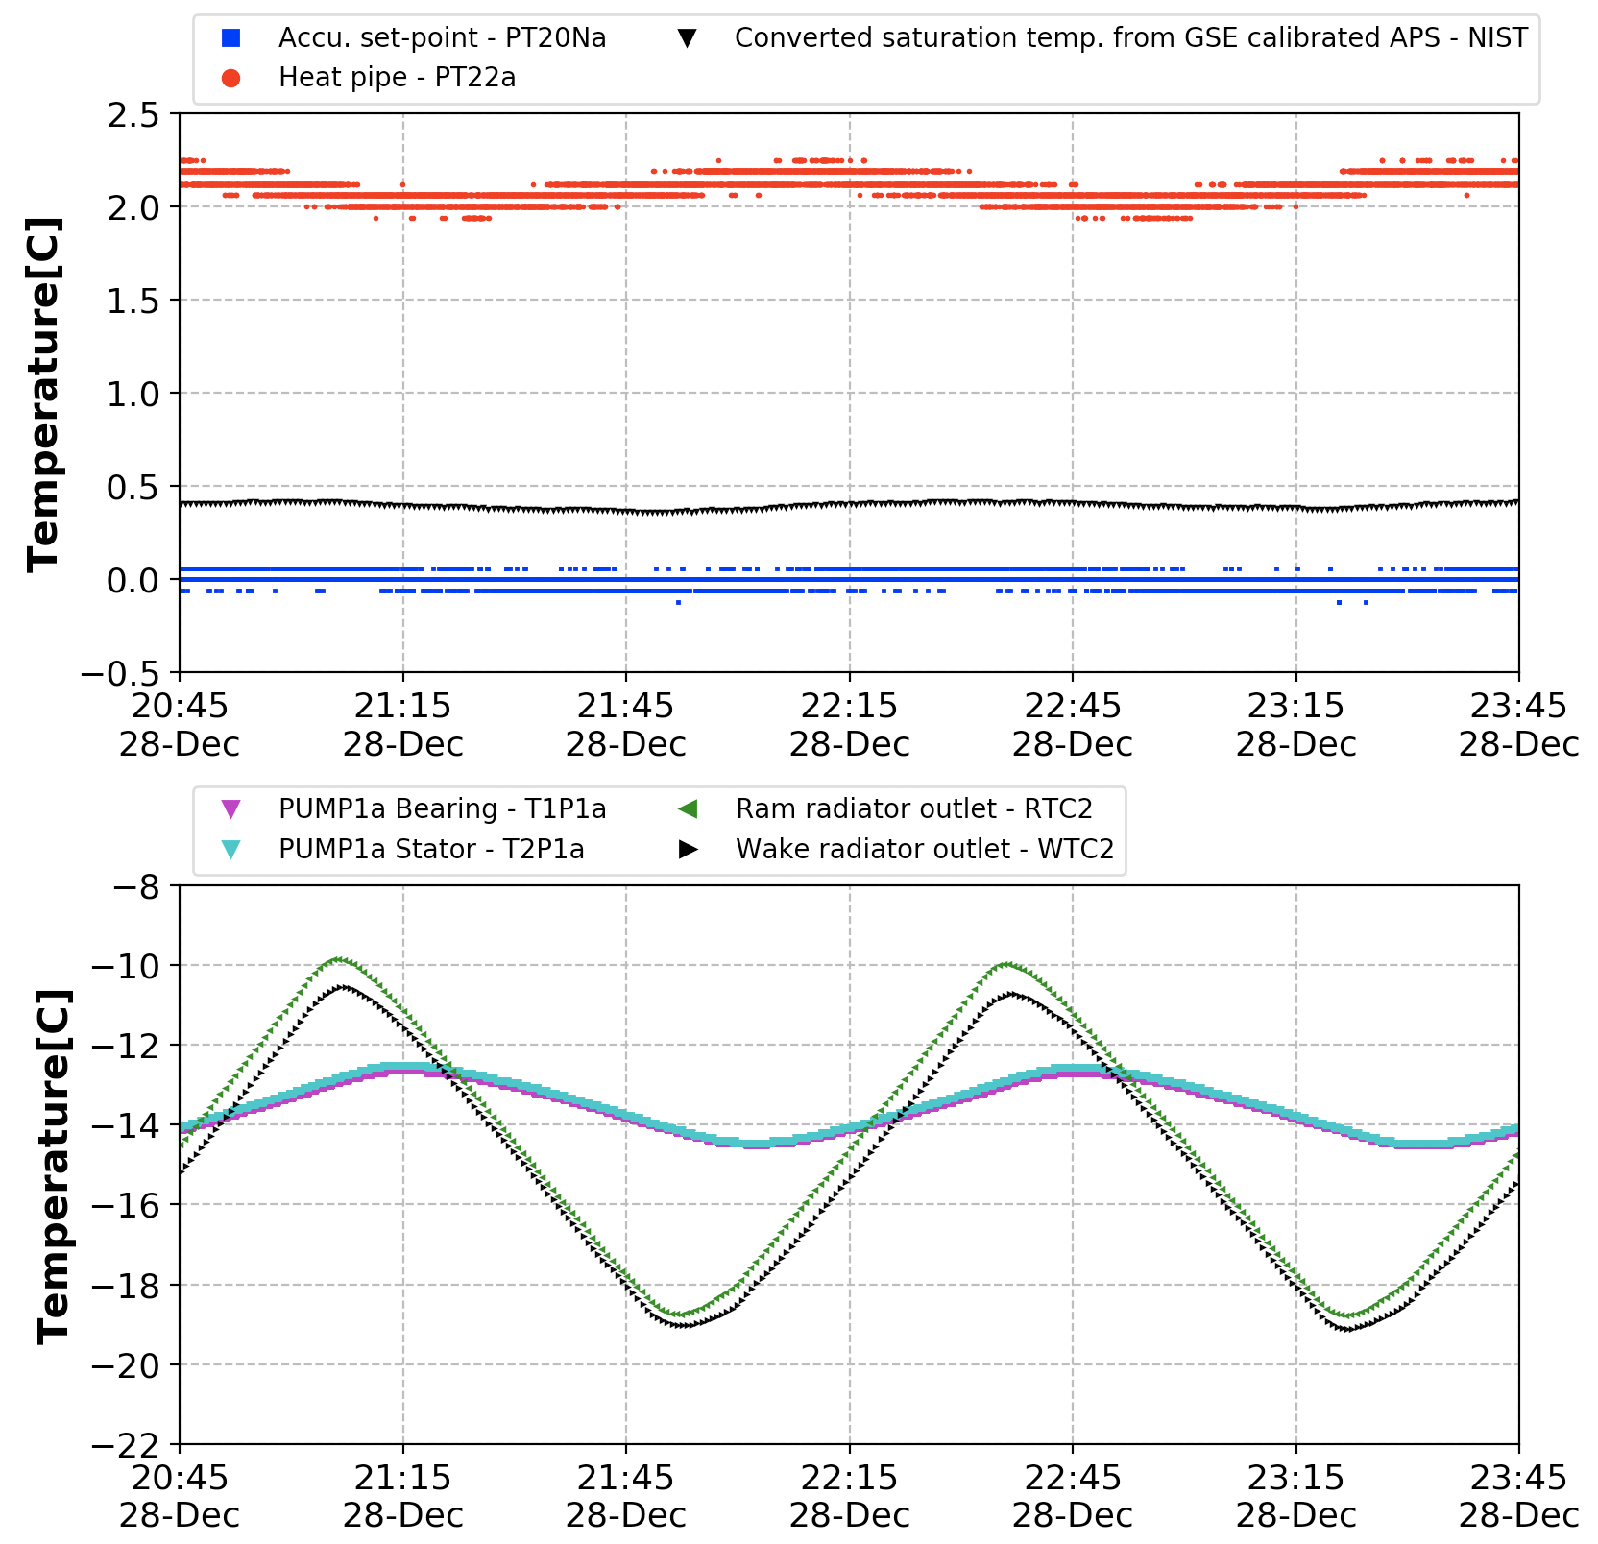
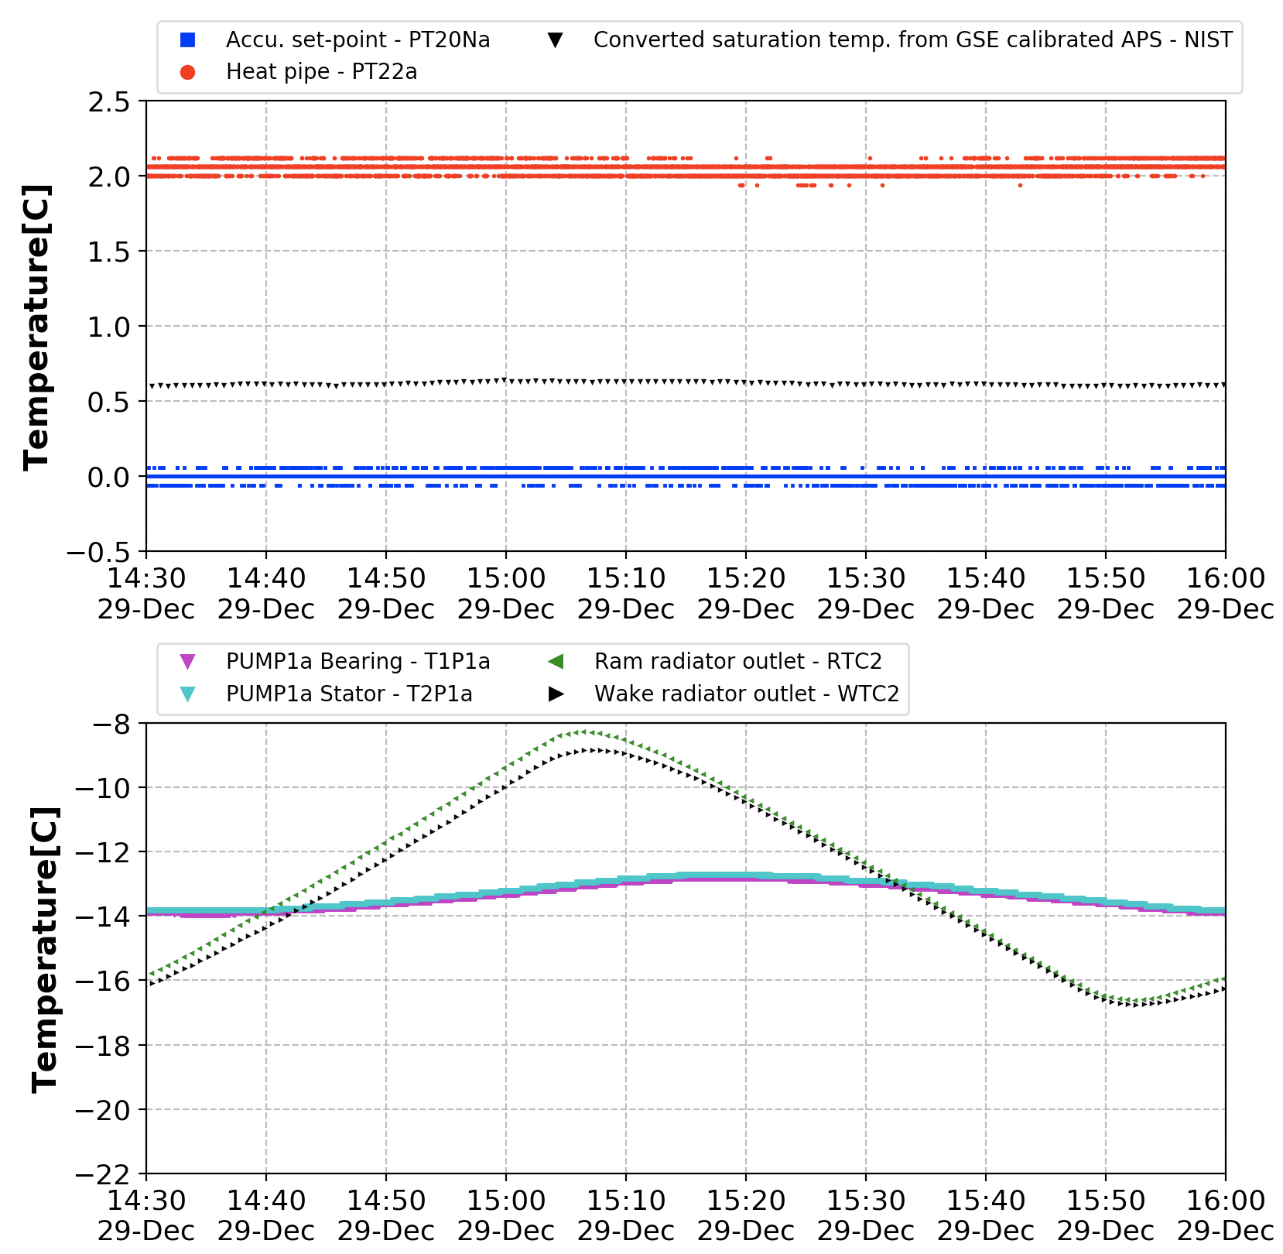
System Control Stability
Accu. set-point=0C. Chamber=-16C. Condenser varies between -15 and -30C [90mins]
0.40±0.02
0.62±0.01
0.00±0.03
0.00±0.03
Evaporator OFF
[single-phase]
Ptop=85W, Pbot=65W
[two-phase]

Slide 19
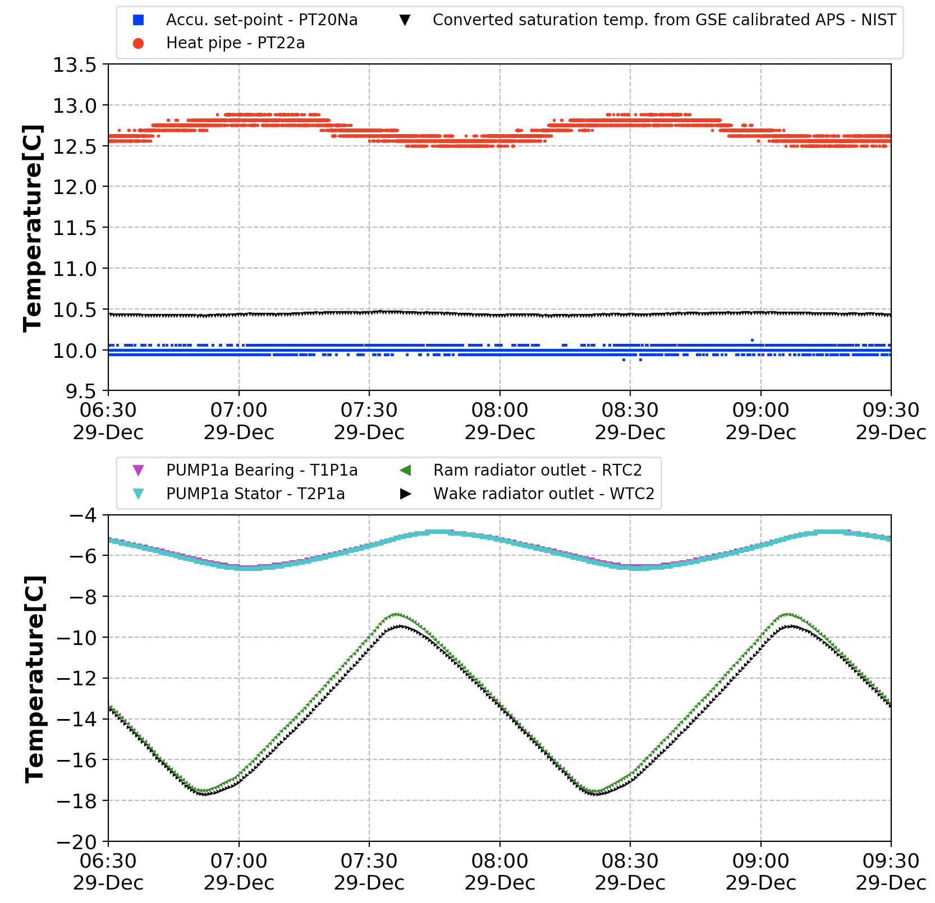
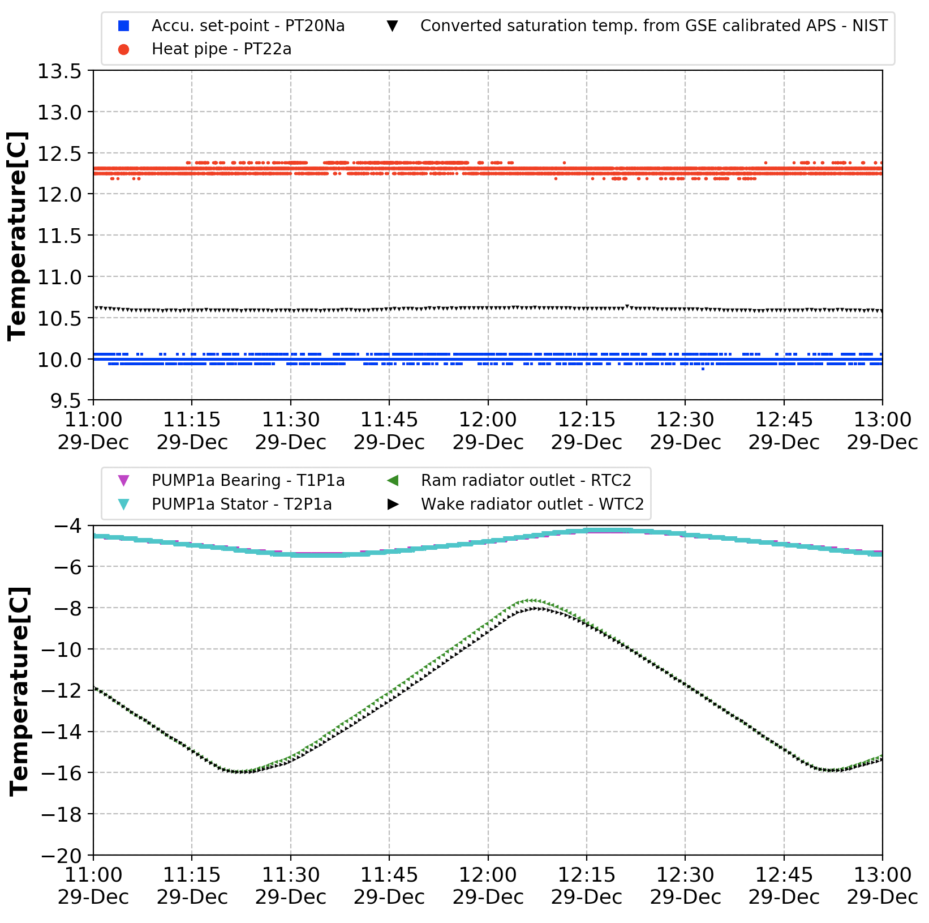
System Control Stability
Accu. set-point=10C. Chamber=-5C. Condenser varies between -15 and -30C [90mins]
10.44±0.01
10.60±0.01
10.00±0.03
10.00±0.03
Evaporator OFF
[single-phase]
Ptop=85W, Pbot=65W
[two-phase]

Slide 20
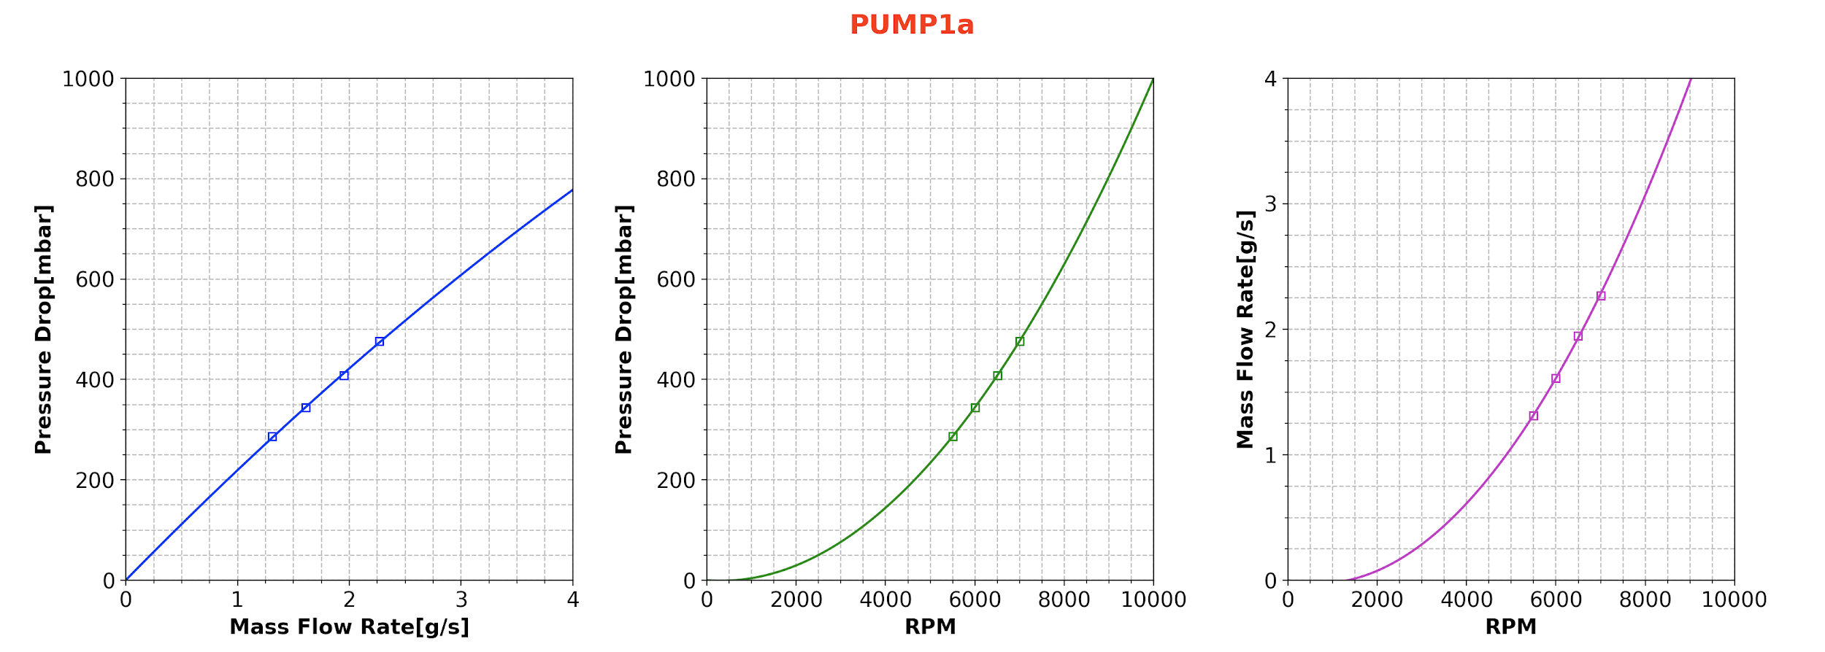
Pump Curve - Pump 1a
Accu. set-point=0C. Chamber=-10C. Condenser=-15C
Ptop=85W, Pbot=65W

Slide 21
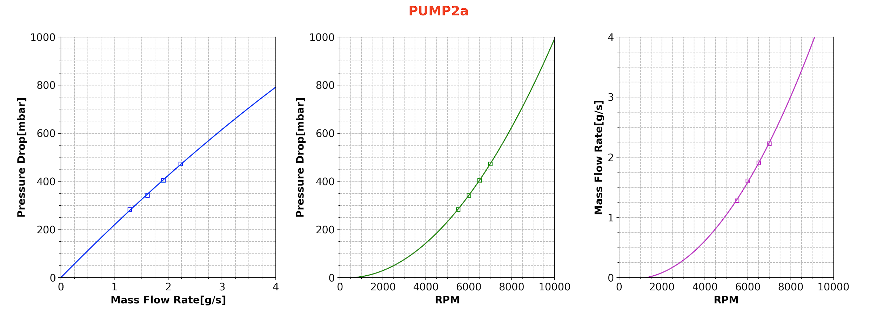
System Curve - Pump 2a
Accu. set-point=0C. Chamber=-10C. Condenser=-15C
Ptop=85W, Pbot=65W

Slide 22

Pump Curve - Pump 1b
Accu. set-point=0C. Chamber=-10C. Condenser=-15C
Ptop=85W, Pbot=65W

Slide 23

Pump Curve - Pump 2b
Accu. set-point=0C. Chamber=-10C. Condenser=-15C
Ptop=85W, Pbot=65W

Slide 24
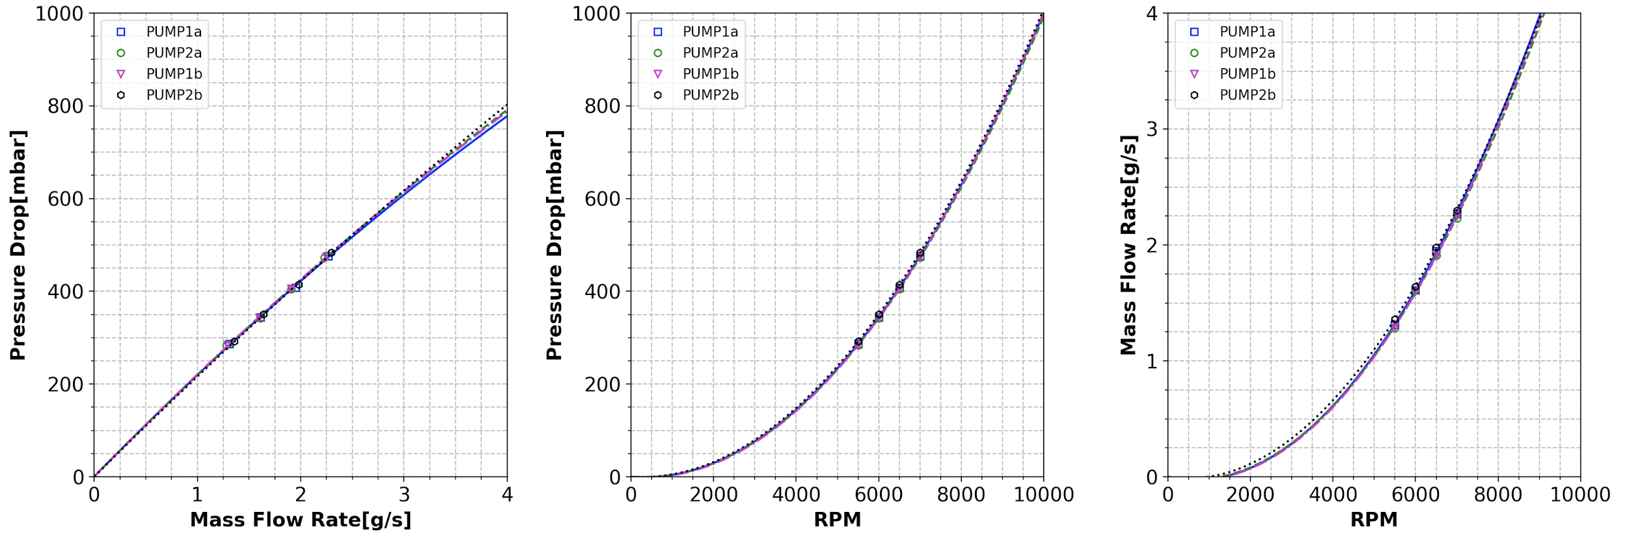
Pump Curve of All Four Pumps
Accu. set-point=0C. Chamber=-10C. Condenser=-15C
Ptop=85W, Pbot=65W

Slide 25
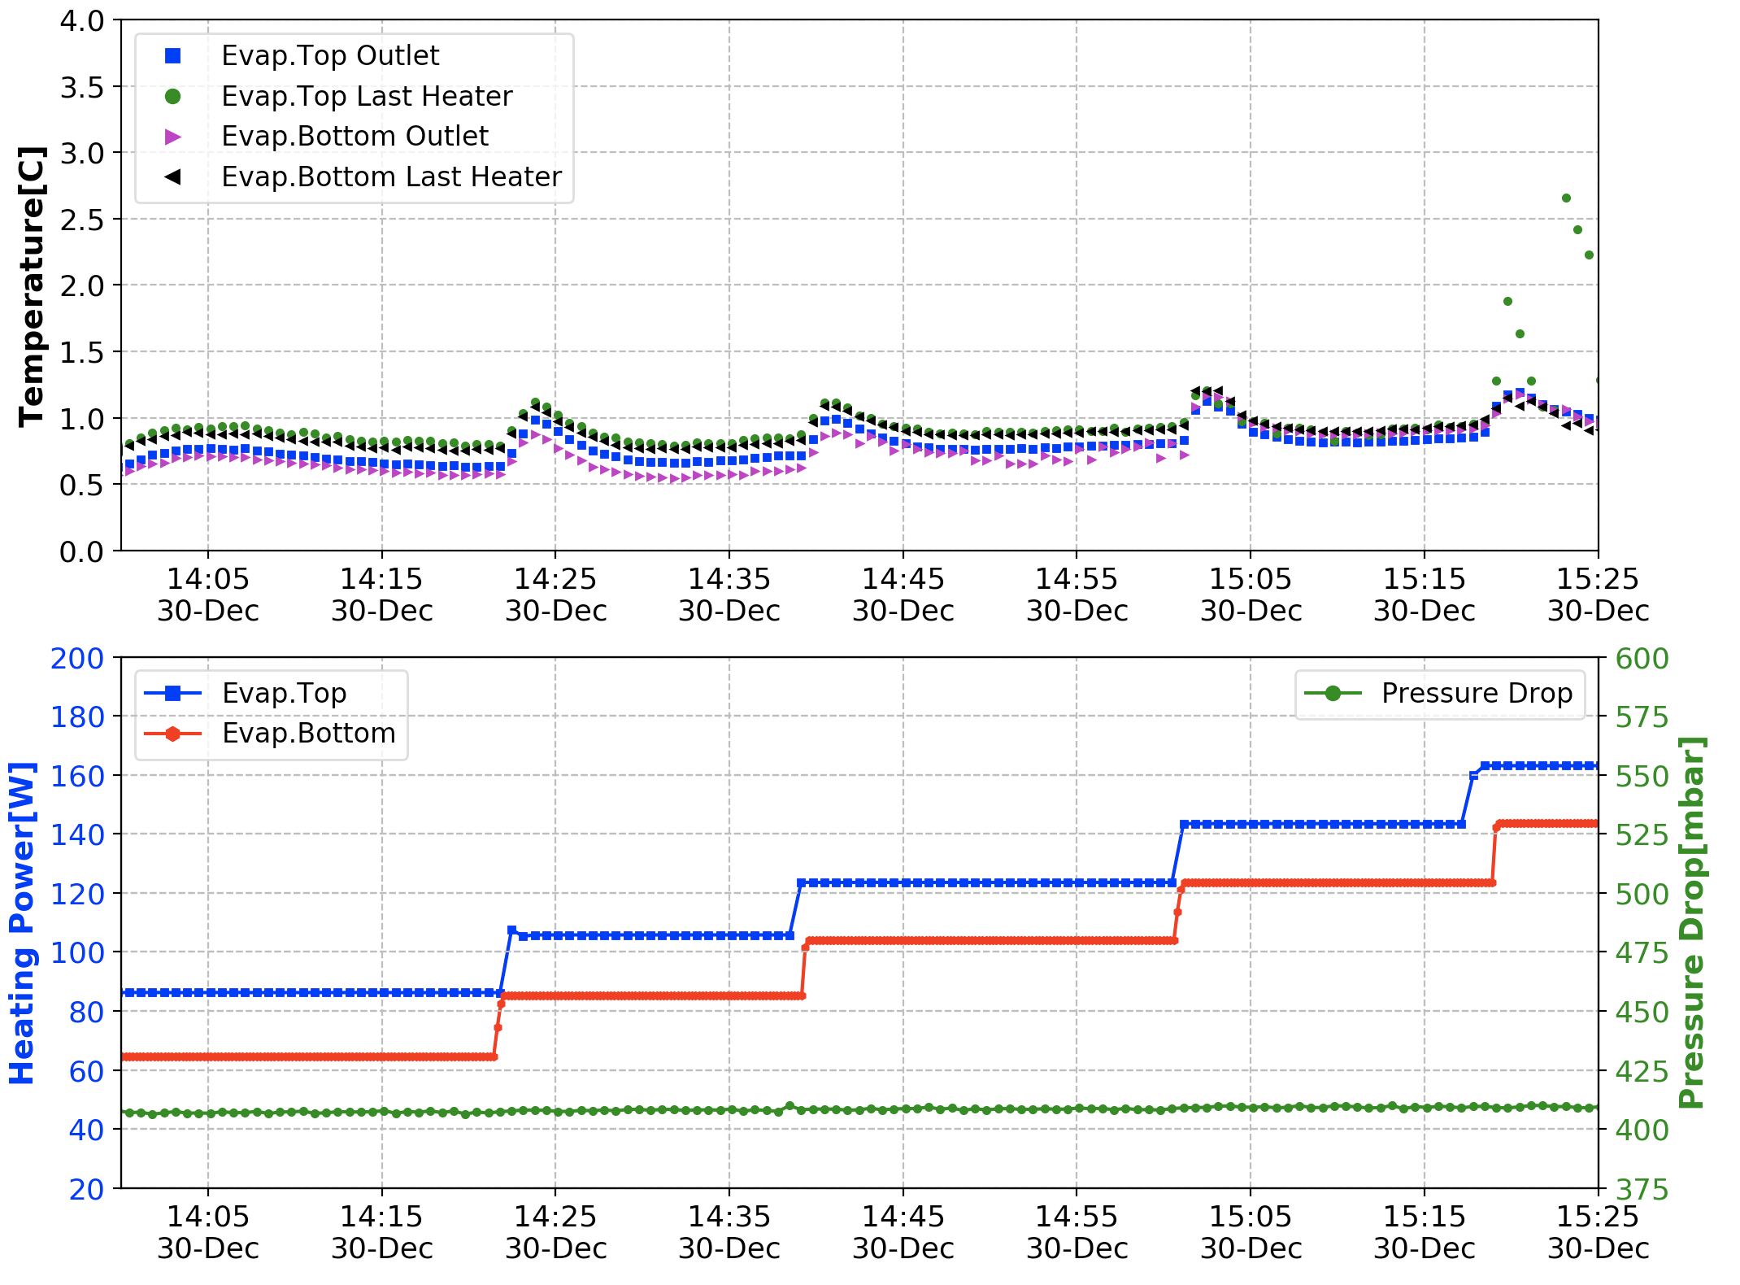
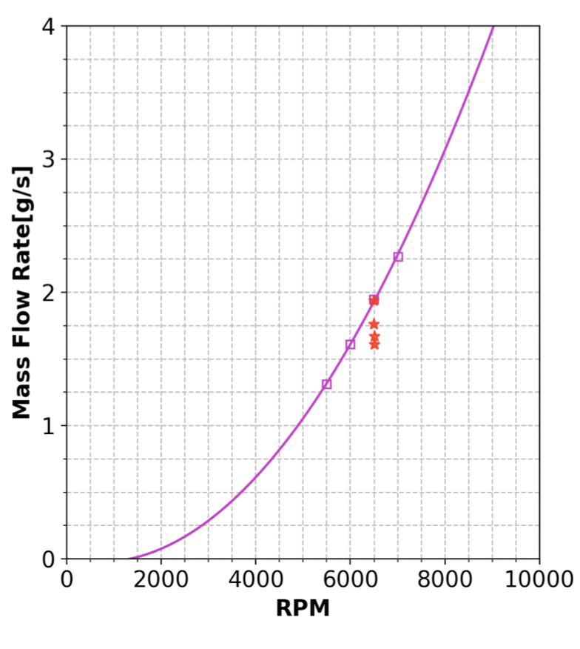
System Cooling Limit
Accu. set-point=0C. Chamber=-10C. Condenser=-15C. RPM@6500
Ptop=165W, Pbot=145W
Flow Rate= 1.6g/s

Slide 26
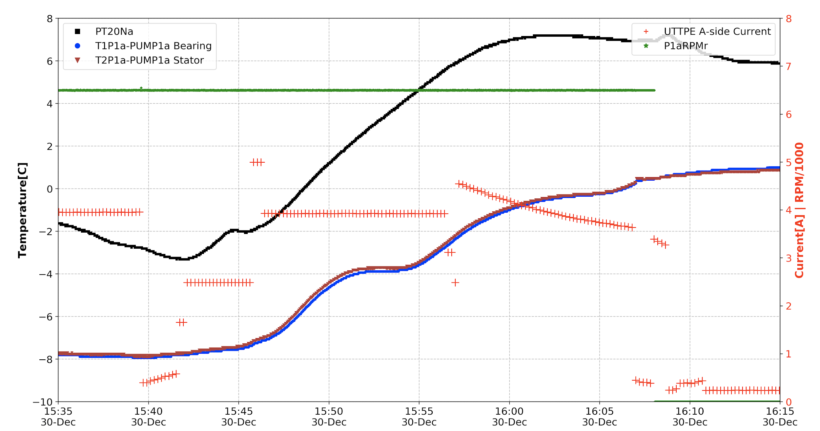
Pump Protections [A-side]
PTC is triggered
COR,PRE,SUP@50%
POH is triggered
PUMP stops

Slide 27
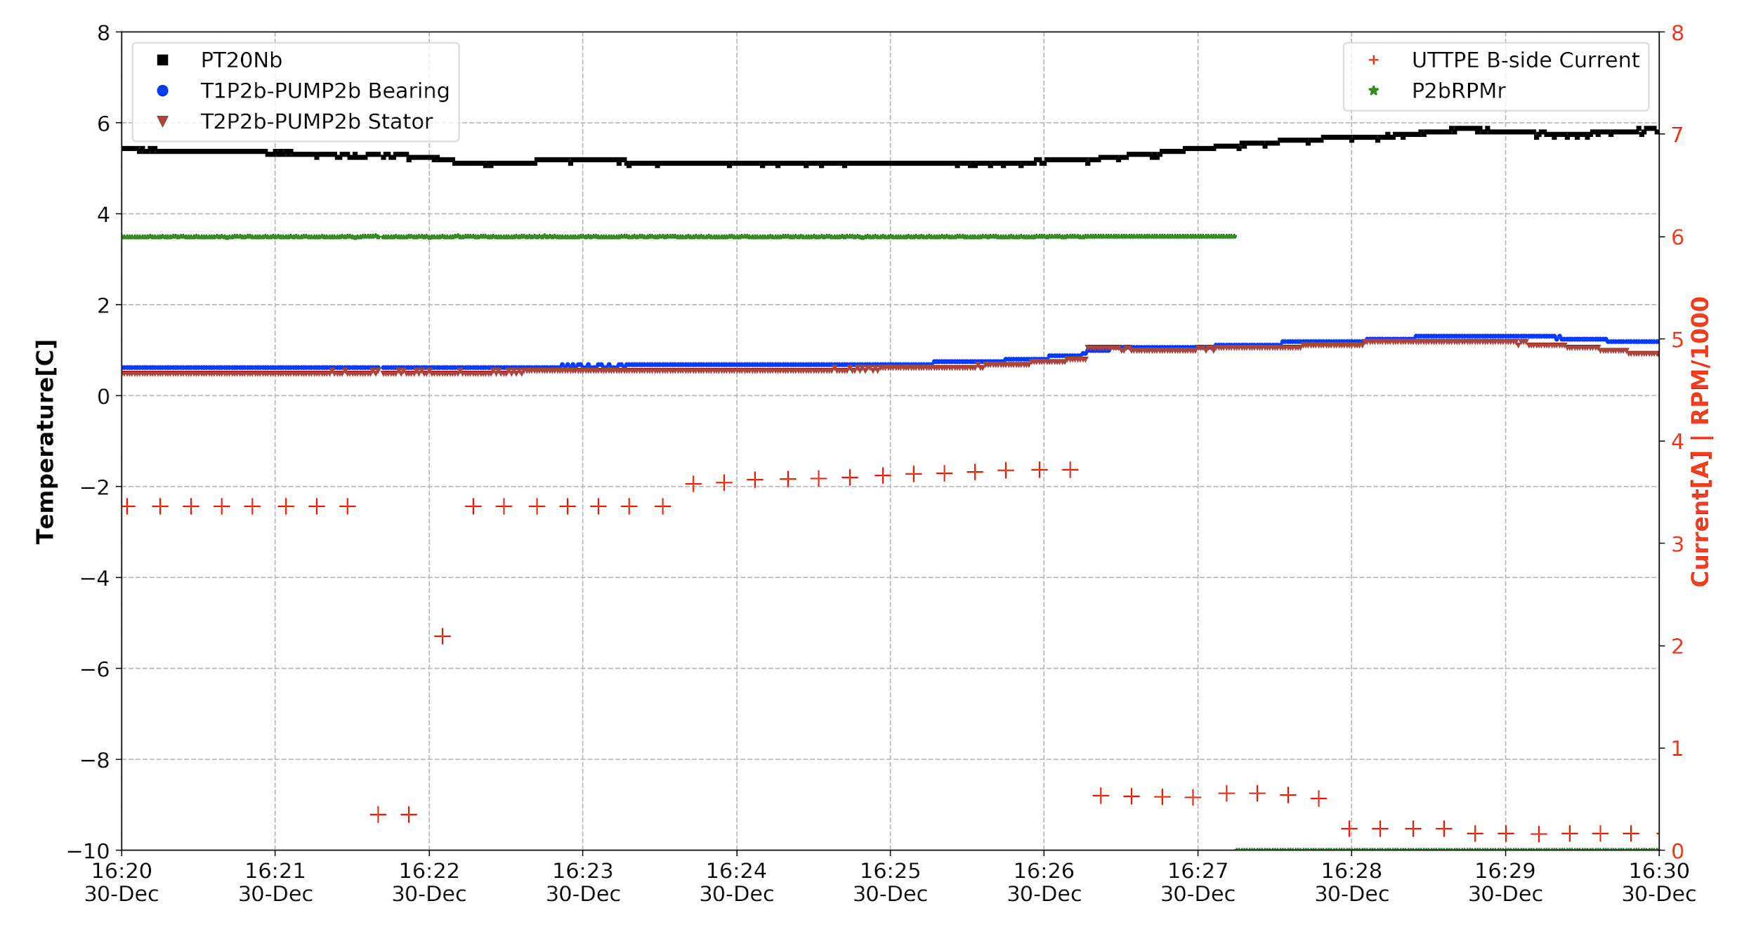
Pump Protections [B-side]
COR,PRE,SUP@50%
PTC is triggered
POH is triggered
PUMP stops

Slide 28
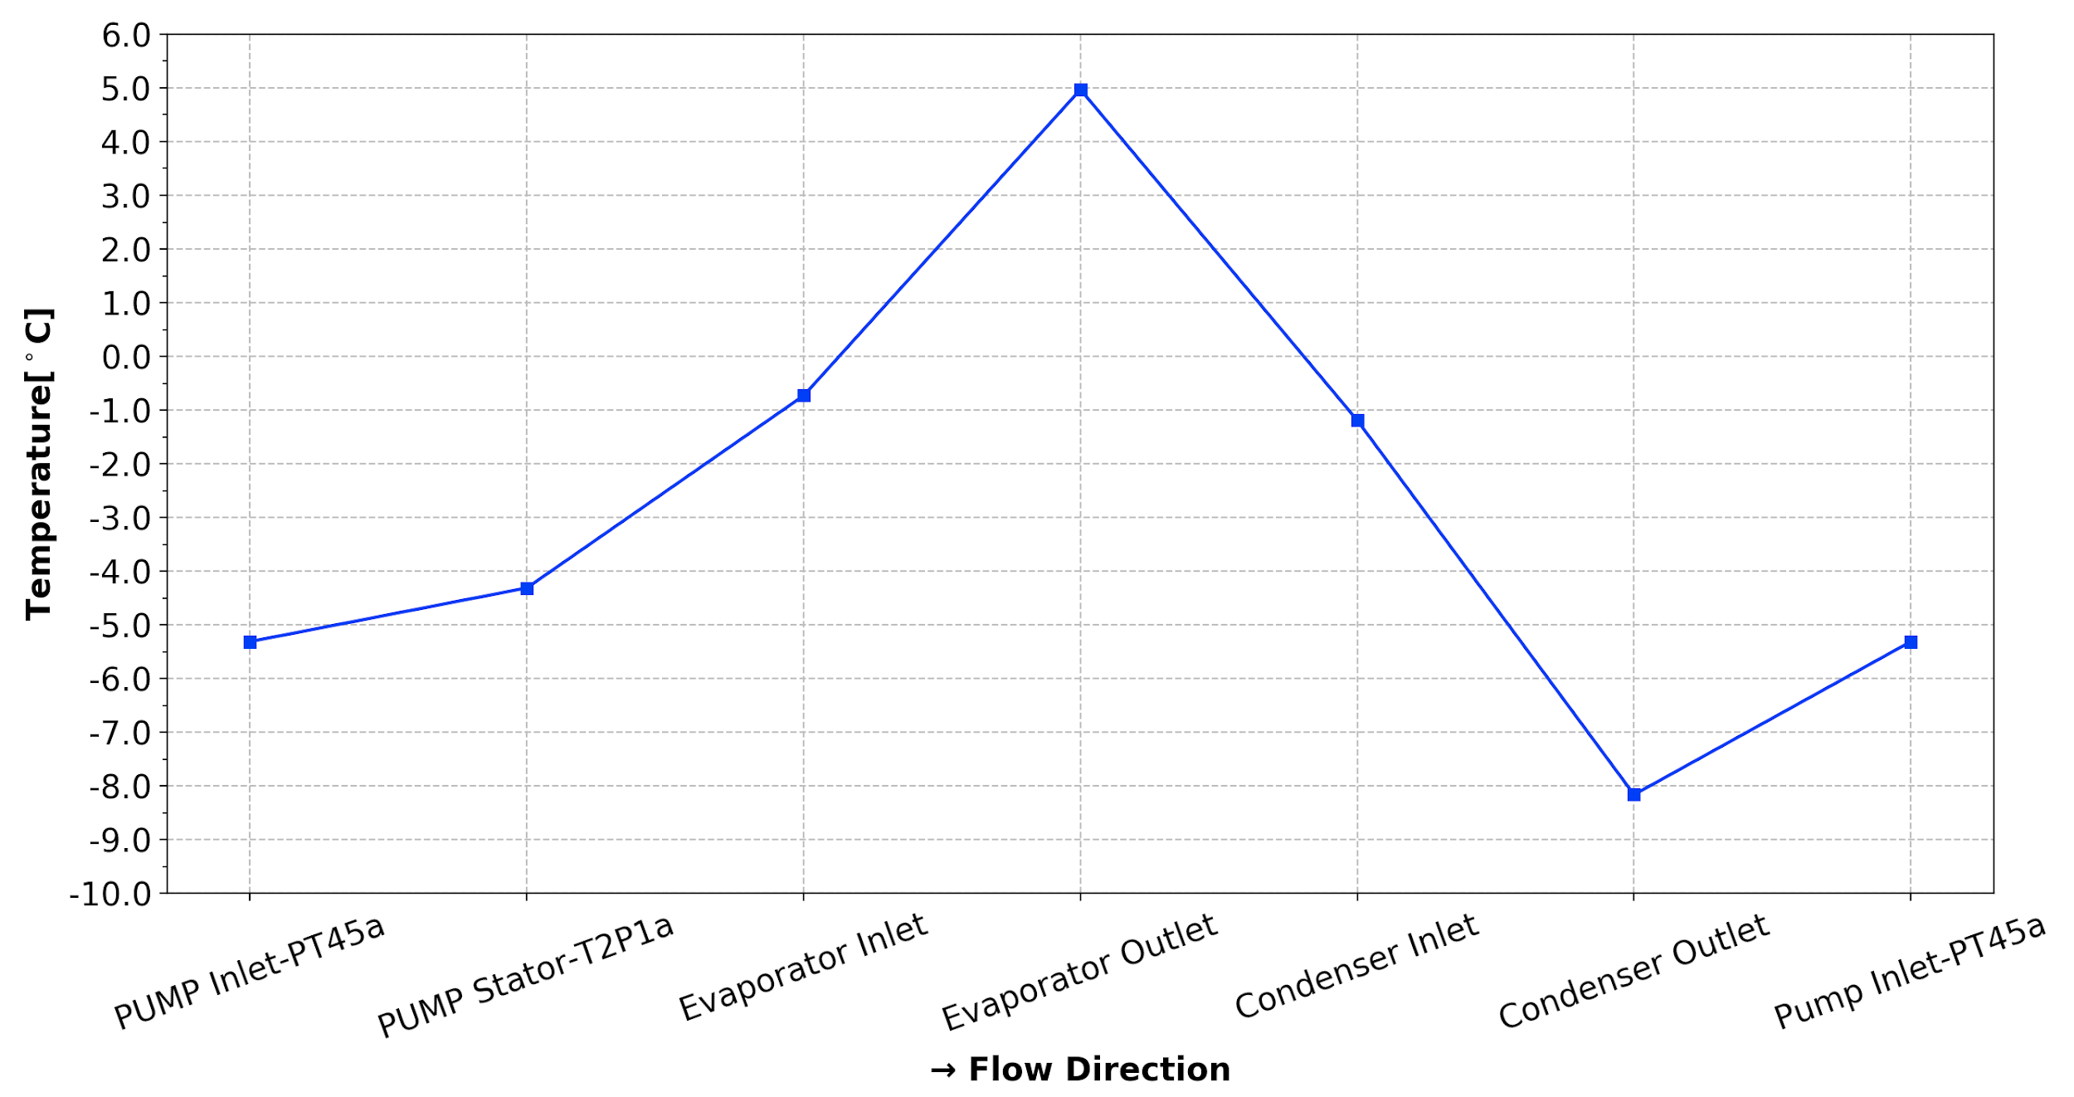
UTTPS FM Pump Burn-in Tests
Accu. set-point=5C. Chamber=-5C. Condenser=-15C
Accumulator Set-point [PT20Na]
Loop: dP=330.4mbar, Flow Rate=2.64g/s
Notes:
Pcalibration=39.99bar, Tsat=5.3C

Slide 29
Back-up

Slide 30
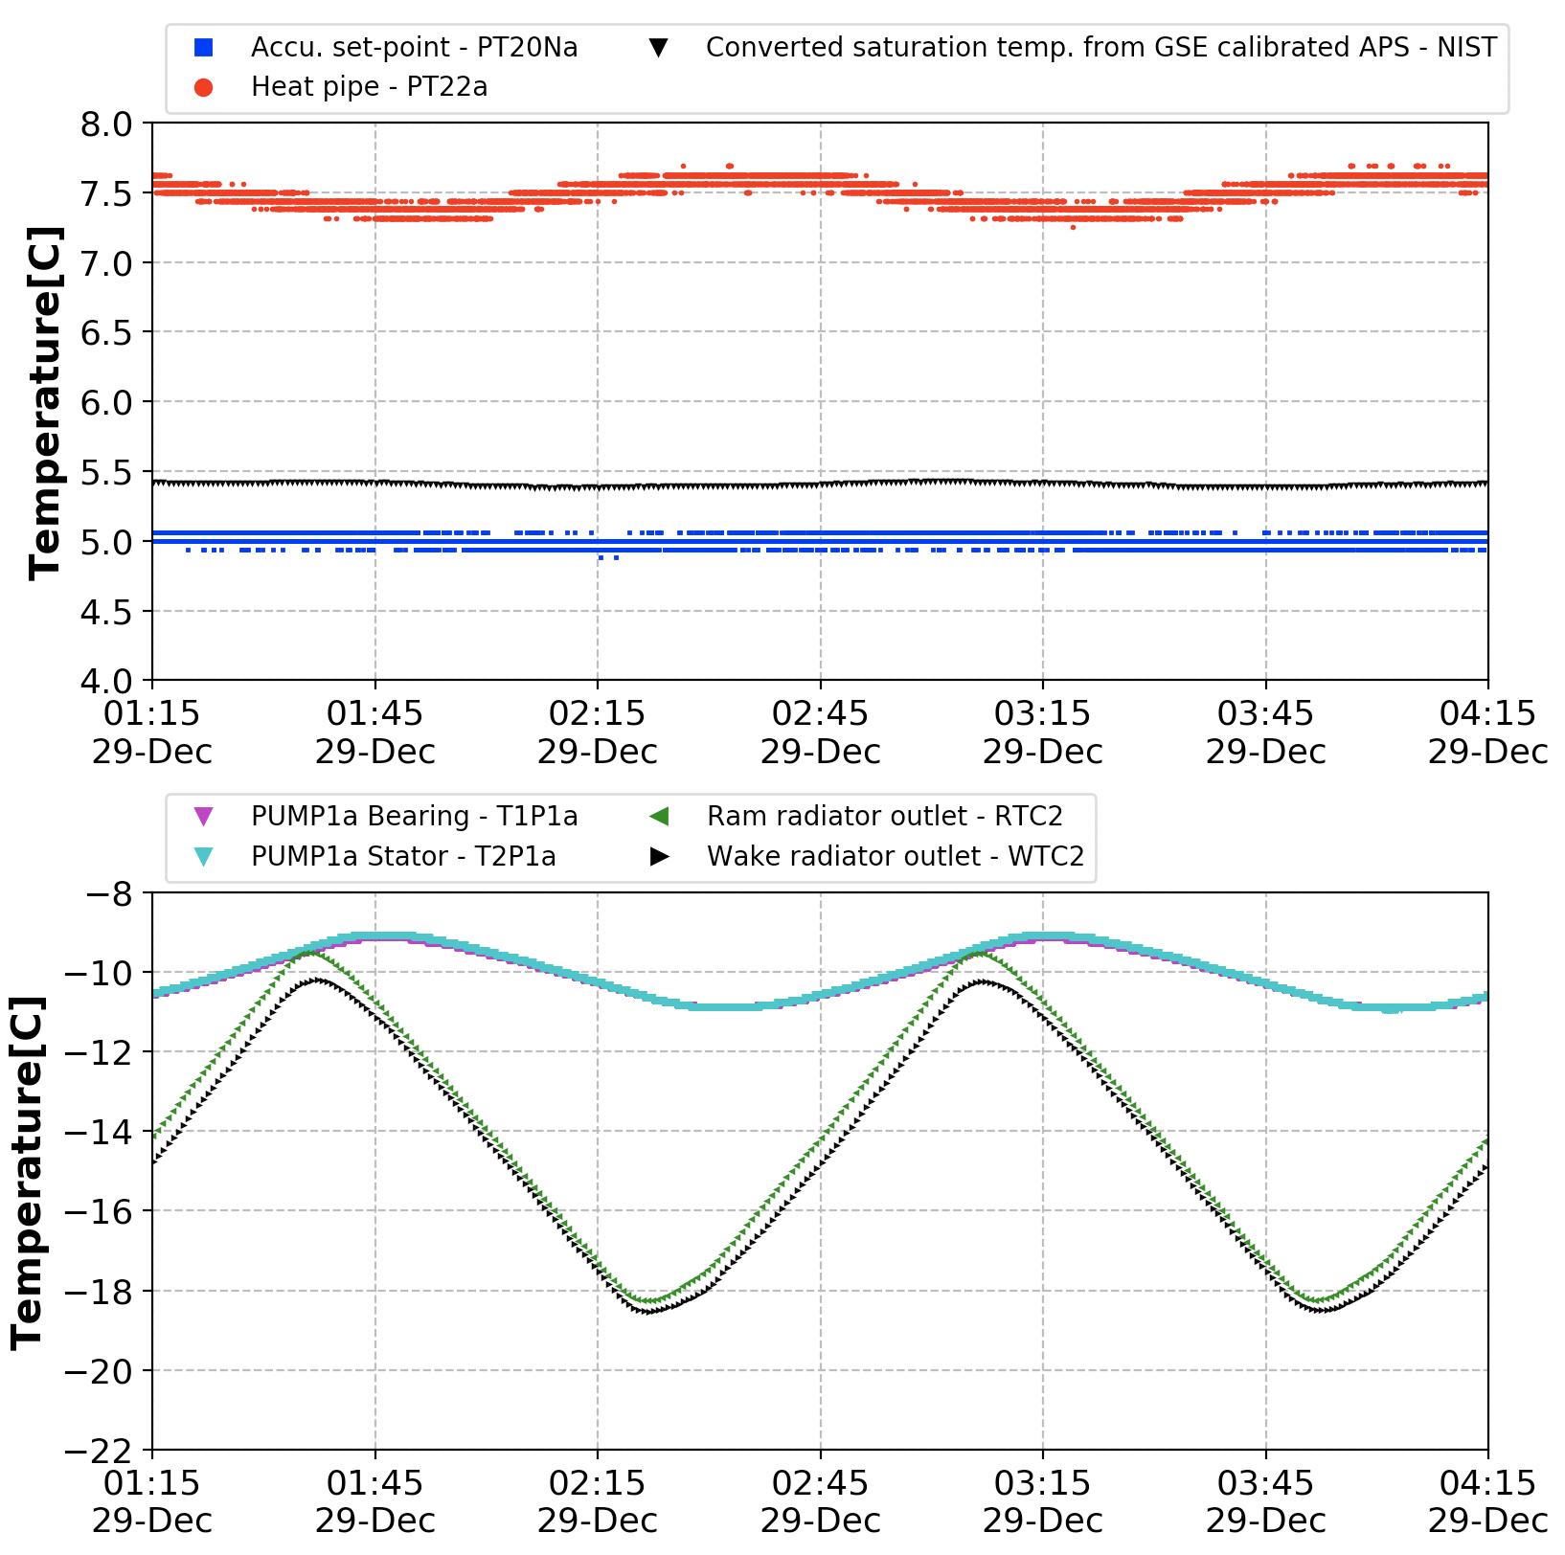
Accumulator Control Stability
Accu. set-point=5C. Chamber=-11C. Condenser varies between -15 and -30C [90mins]
5.41±0.01
5.00±0.03
Ptop=85W, Pbot=65W
[two-phase]
Skipped
Evaporator OFF
[single-phase]

Slide 31
