Slide 1
Industrial Involvement @ CERN
Report by Hakan KIZILTOPRAK
Special Advisor to TOBB President
CERN Industrial Liaison Officer for Turkey
Chair, CERN Industrial Liaison Officers Forum

Slide 2
The Union of Chambers and Commodity Exchanges of Turkey (TOBB)
The umbrella organization of the Turkish private sector
  1.5 million members
    85% of National Income
    77% of Investments
    100% of Exports

Slide 3
The Union of Chambers and Commodity Exchanges of Turkey (TOBB)
A strong organization, covering the whole economy
  365 Local Chambers and Commodity Exchanges
    81 Provinces
    160 Districts
  61 Sectoral Assemblies
  Offers over 60 different services to its members
  Manages over 40 national and international projects

Slide 4
The Union of Chambers and Commodity Exchanges of Turkey (TOBB)
SECTORAL ASSEMBLIES - Leaders of the sectors
61 different Assemblies in the primary sectors
Each sectoral assembly holds:
  The top 40 companies of the sector (as turnover)
  Senior bureaucrats of the relevant public institutions
  Sectorial associations
Overall, Sectoral Assemblies brings together:
  1.460 companies representing all regions
  15 ministries, 57 public institutions
  377 non-governmental organizations /associations

Slide 5
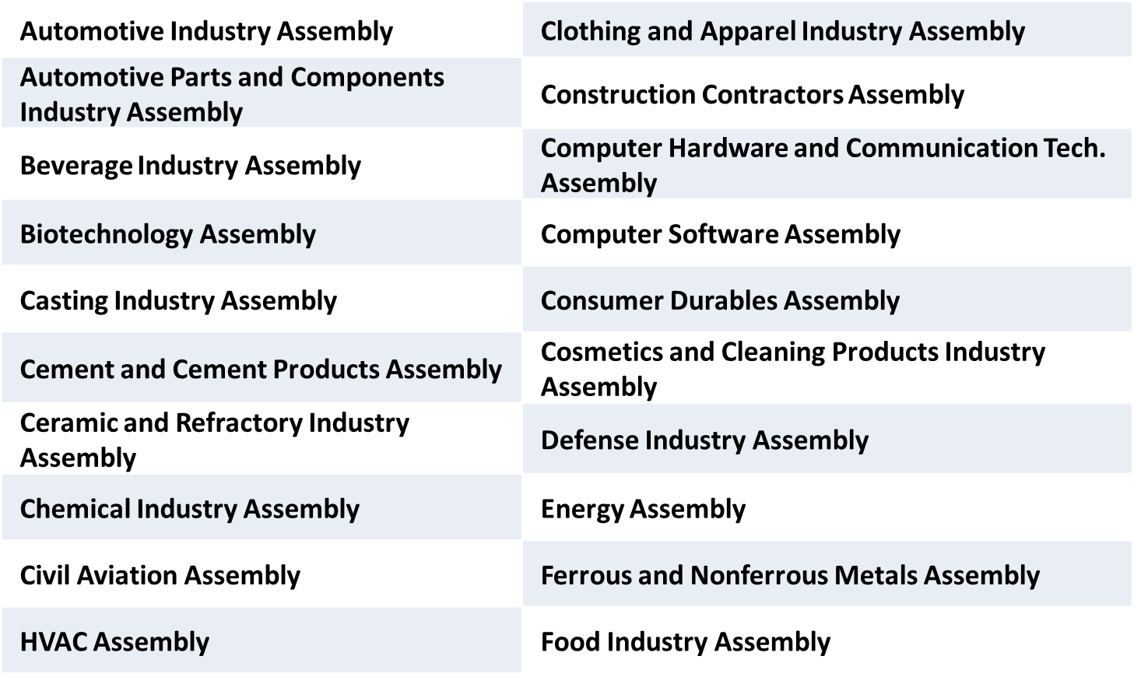
The Union of Chambers and Commodity Exchanges of Turkey (TOBB)
SECTORAL ASSEMBLIES – (Industrial)

Slide 6
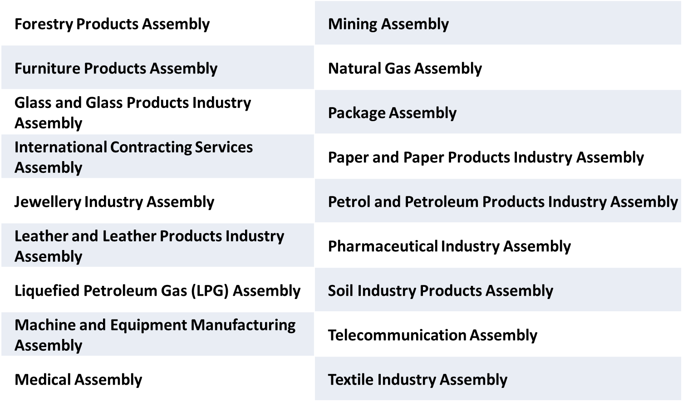
The Union of Chambers and Commodity Exchanges of Turkey (TOBB)
SECTORAL ASSEMBLIES – (Industrial)

Slide 7
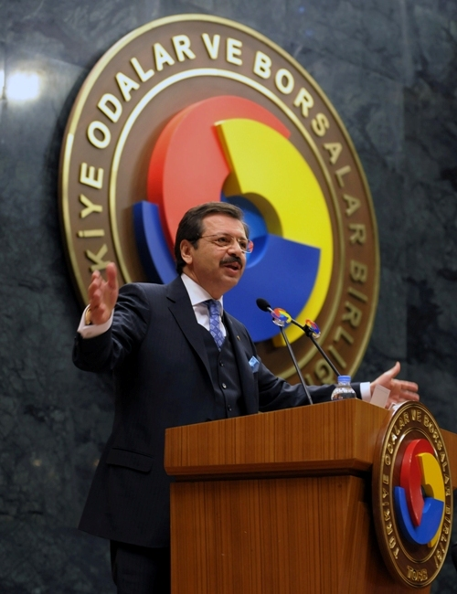
The Union of Chambers and Commodity Exchanges of Turkey (TOBB)
Very active President nationally and internationally
Vice President of EUROCHAMBRES
Vice President of Islamic Chamber of Commerce, Industry and Agriculture (ICCIA)
Member of the Executive Board of ICC (International Chamber of Commerce),
Chairman of ICC Turkey, ICC G-20 Advisory Group Member
B20 Turkey Chair
Vice President of the Confederation of Asia-Pacific Chambers of Commerce and Industry (CACCI )
Co-President of the Turkish-Arab Chamber
International President of the Jerusalem Arbitration Center
Member of the Board of the Association of Balkan Chambers (ABC)
Co-Chairman of the EU-Turkey Joint Consultative Committee
President of the Board of Trustees of TOBB University of Economics and Technology
President of TEPAV (The Economic Policy Research Foundation of Turkey)
Member of The Supreme Council for Science and Technology of TUBITAK (The Scientific and Technological Research Council of Turkey)
….

Slide 8
TOBB CERN Industrial Liaison Office
Journey of CERN
  May 2015 MOU with TAEK
  June 2015 First Council Meeting Attendance
  Aug 2015 First Visit to Heads of Departments
  Oct 2015 First CERN Industrial Event in Ankara
  Dec 2015 Training of Local Chambers’ Reps
  Apr 2016 CMS & Hi-Lumi Event
  May 2016 KT – TTO Summit
  Oct 2016 Hi-Lumi Event (Portugal)
  May 2017 Hi-Lumi Event (UK)
  March 2018 CERN2B as part of V. International Nuclear Power Plants Summit in Istanbul
  Oct 2018 CERN2B as part of ICCDA 2018 in Ankara

Slide 9
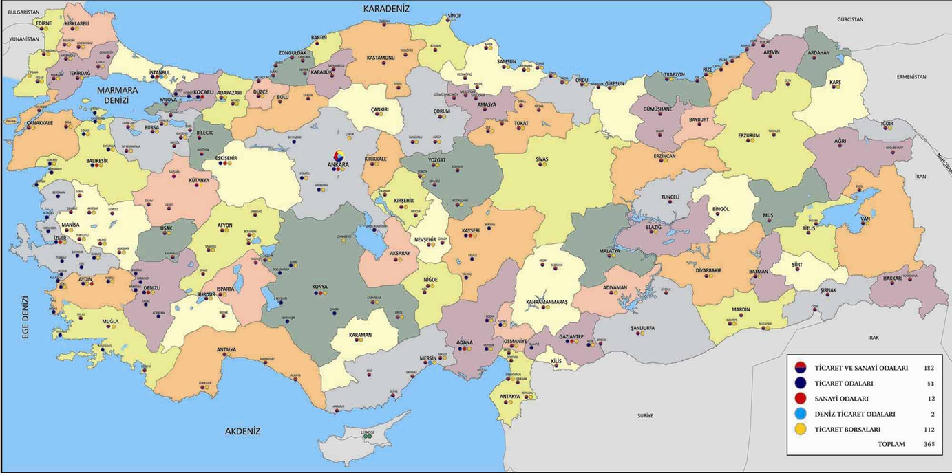
TOBB CERN Industrial Liaison Office
(56 events – 5 with CERN)
Journey of CERN

Slide 10
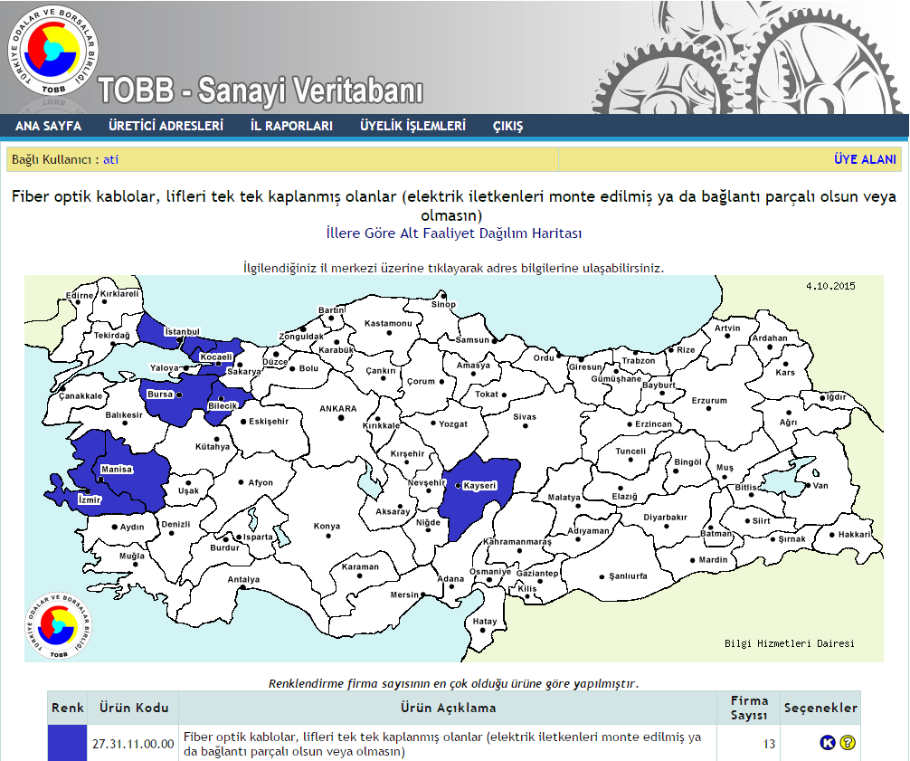
TOBB CERN Industrial Liaison Office
TOBB Industrial Database
Journey of CERN
  Industrial Database of Turkey
    Capacity data of industrial companies
      The company output with its available machinery and employees?
    Capacity reports of 73.000 companies
    Statistics of machinery and stock
    Province, product and sectoral basis searching
  Not all related to CERN Inquiries
  ~6.000 – 9.000 Solid Firms
  ~2.000 Med-Hi Tech to High-Tech
  ~1.200+ In our TOBB-CERN Network

Slide 11
TOBB CERN Industrial Liaison Office
Journey of CERN
  Have AccessOver 9.000 Companies in one of the following areas
    Civil engineering, building and technical services
    Electrical engineering and magnets
    Electronics and radio frequency
    Information technology
    Mechanical engineering and raw materials
    Vacuum and low temperature
    Optics and photonics
    Gases, chemicals, waste collection and radiation equipment
    Health, safety and environment
    Transport, handling and vehicles
    Office supply, furniture, communication and training
    On-site Services (nation-wide or internationally)

Slide 12
TOBB CERN Industrial Liaison Office
Journey of CERN – Our Network
  Variety of our Network
    Owners, Executives or HighLevel Sr. Representatives
    Associations of Major Sectors
    Local Chambers’ network
    Technoparks
    Industrial Zones
  Capacity of our Network
    They are good and busy…
    They want the challenge of CERN jobs but are carefull
    They are communicating each other and with us.
    Unique abilities

Slide 13

Representation at CERN
CERN Council
Finance
Committee
Scientific Policy Committee
Director General
TAEK
TOBB
KT Forum
(Technology Transfer representatives from each Member State)
ILO Forum
(Industrial Liaison Officers from each Member State)

Slide 14
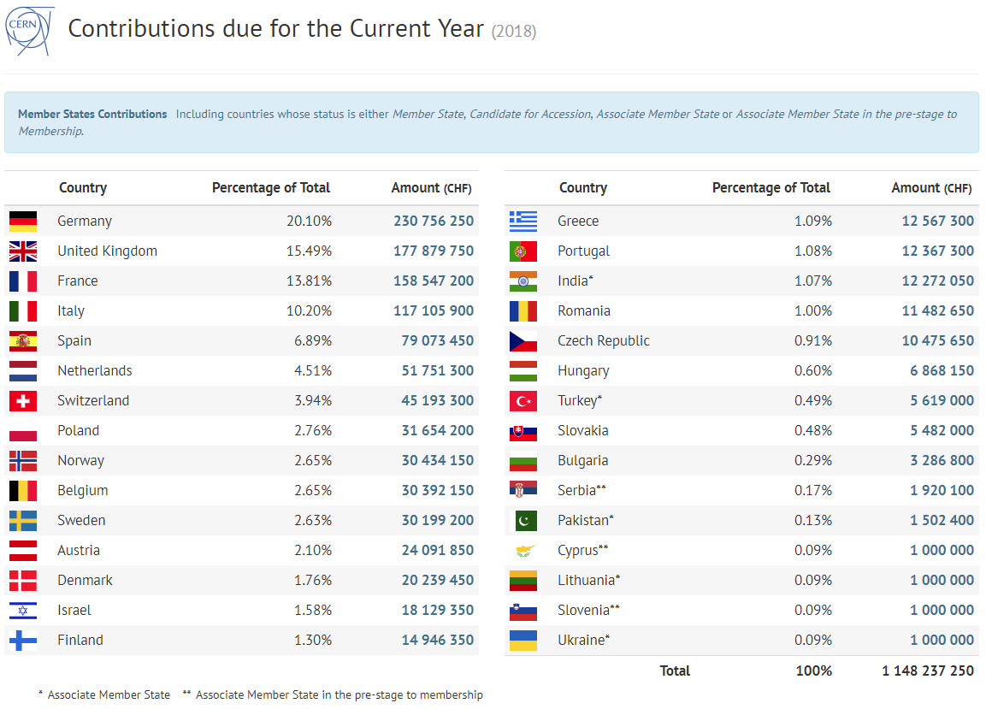

Slide 15
TOBB CERN Industrial Liaison Office
More than 2.000 companies actively involved
267 Companies – 31 Million CHF Tenders
25 Companies more than 85 orders worth of 6 million CHF
Companies ranked 2nd or 3rd in tenders overall worth of 13.5 million CHF

Slide 16
TOBB CERN Industrial Liaison Office
Journey of CERN – Overall
  Doubled return each year since 2015
  Increased Industrial Return and about to be well-balanced Member State at CERN starting 2020
  More variety of supplies and tenders participated
  Executive Support to CERN is very promising
  Press and Public closely following the details
  Our Company Network is now engaged in many other high-tech projects internally and externally

Slide 17
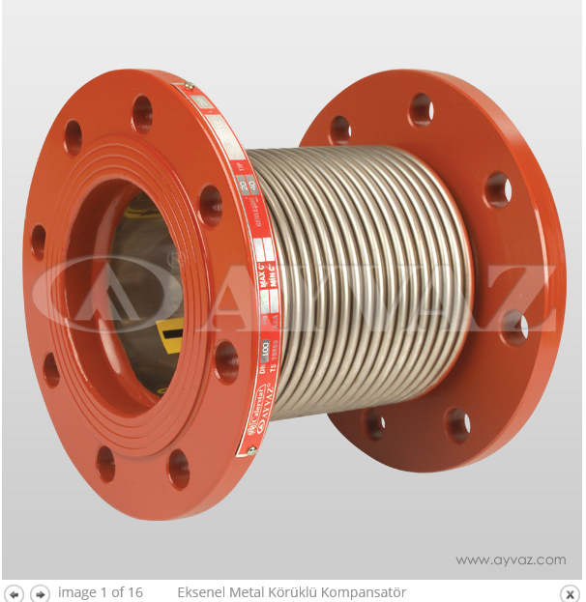
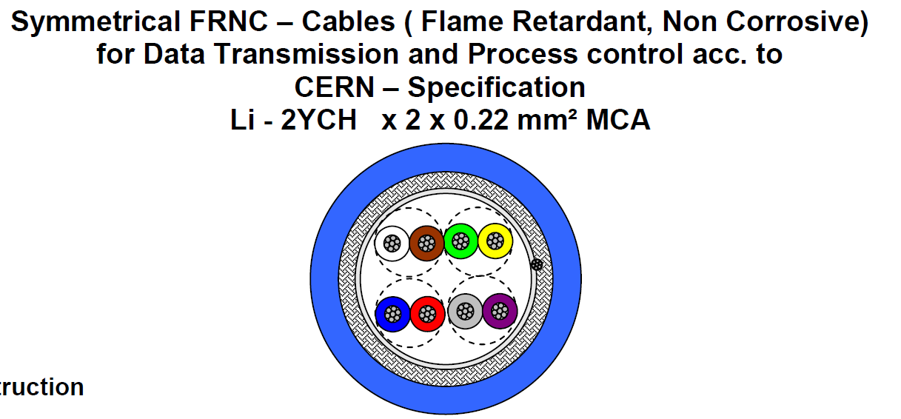
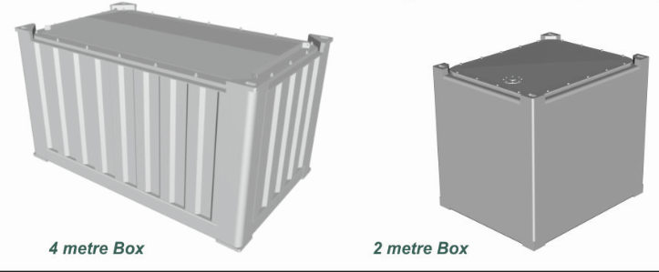
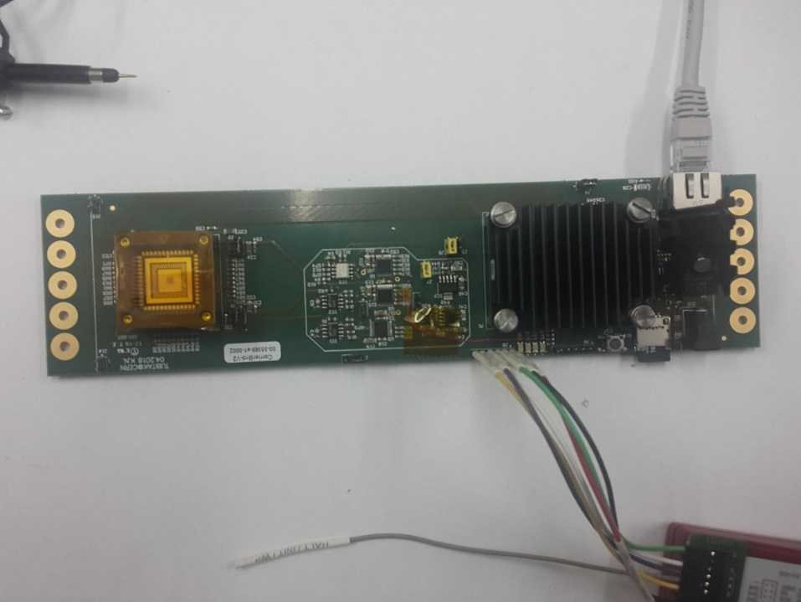
TOBB CERN Industrial Liaison Office
Ayvaz
Cable
Spain
HMS Makina
Cryo-CAN (THM-TEİ)
TAEK
TÜBİTAK
Universities
Ministries
Nuclear Power Plant
Projects
Notes:
Kablo $14/m, 1.35kg, $10.37/kg

