Slide 1
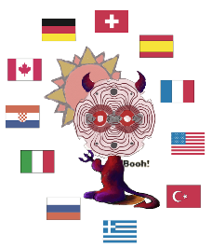

Update on the CAST experiment
Theodoros Vafeiadis
On behalf of the CAST collaboration
HEP 2019
17 April 2019, Athens

Slide 2
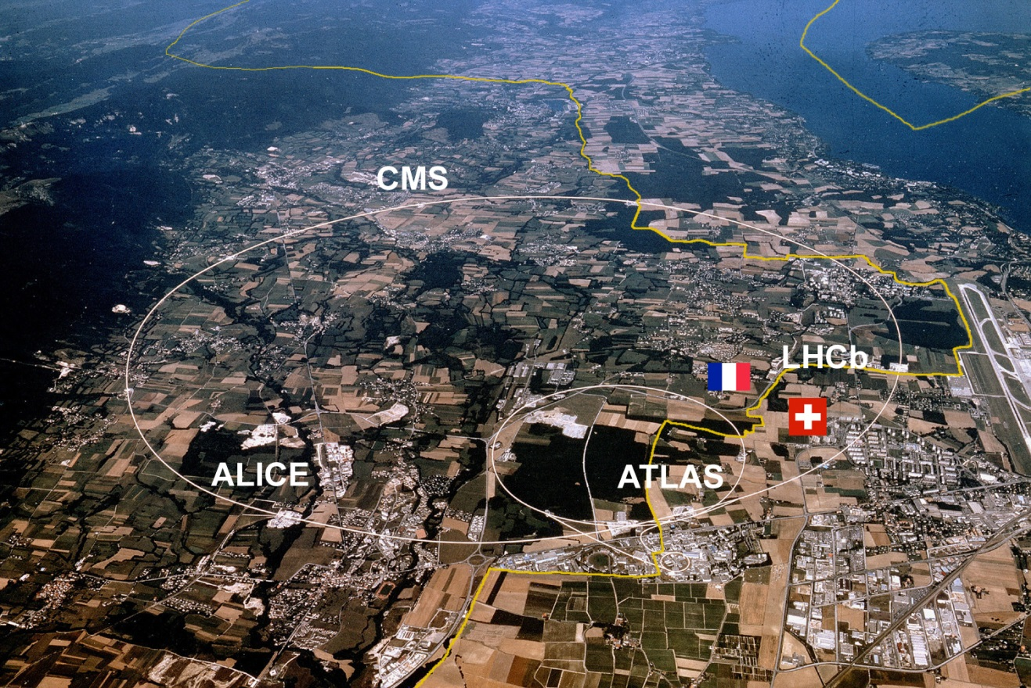
Contents
A bit of theory
The CAST experiment
  Scientific program
  Layout
CAST Detectors
  Micromegas
  CCD
  InGRID
  SDD
  Improvements roadmap
    CAST Detector Lab
  Sunset 2013-2015
  Sunrise 2013
  Sunrise 2014-2015
  Relic axion detectors
    RADES
    CAPP
  KWISP
Conclusions and future outlook
CAST
(SR8)

Slide 3
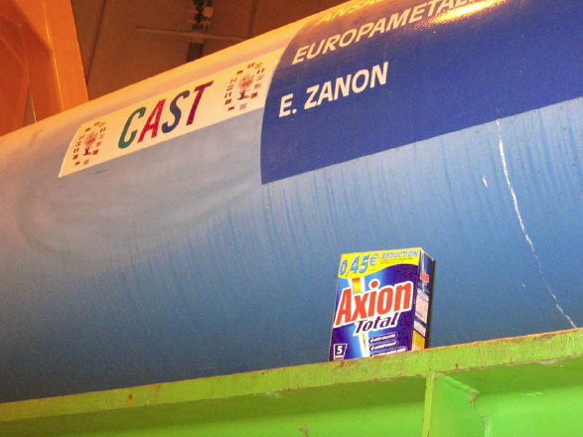
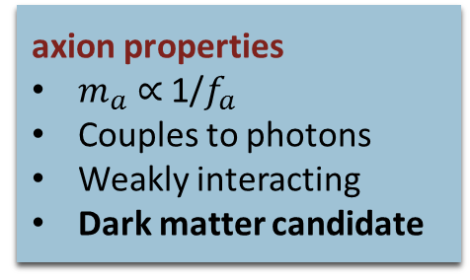
Axions
“I named them after a laundry detergent, since they clean up a long standing problem in theoretical physics.” Wilczek
Strong CP problem
Strong interactions do NOT violate CP symmetry
Elegant solution: Peccei & Quinn mechanism (Peccei & Quinn, 1977)
AXION : pseudo Nambu-Goldstone boson of spontaneous breaking of PQ symmetry (Weinberg and Wilczek , 1978)
axion properties
$m_{a}$ ∝ 1/$f_{a}$
Couples to photons
Weakly interacting
Dark matter candidate

Slide 4
Techniques
Axion : WANTED
Search strategy by Sikivie (axion couplings)
Most common : axion to photon coupling (Primakoff effect – exists in all models)
Helioscopes
Solar axions
Powerful magnet → transverse magnetic field
Primakoff effect (Tokyo, CAST)
Haloscopes
Relic axions produced in early universe.
Electromagnetic cavities in strong magnetic fields (ADMX, CARRACK, CAST)

Slide 5
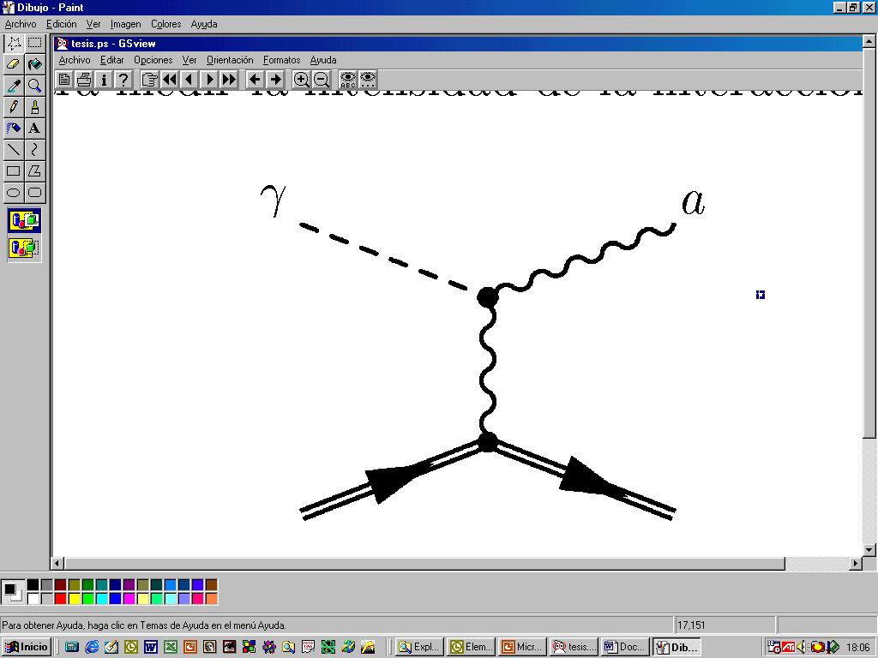

Helioscope technique
Primakoff
Axions are produced in the Sun via the Primakoff effect
Bahcall, Pinsonneault (2004)
Max at~3 keV
$〈E_{a}〉$=4.2 keV

Slide 6
Helioscope technique
Re-convert to photons in the presence of a strong magnetic field
P. Sikivie, Phys. Rev. Lett. 51, 1415–1417 (1983)
Signal: Excess of X-rays in detectors while the magnet is pointing to the Sun
Primakoff
Axions are produced in the Sun via the Primakoff effect
Bahcall, Pinsonneault (2004)
Max at~3 keV
$〈E_{a}〉$=4.2 keV

Slide 7
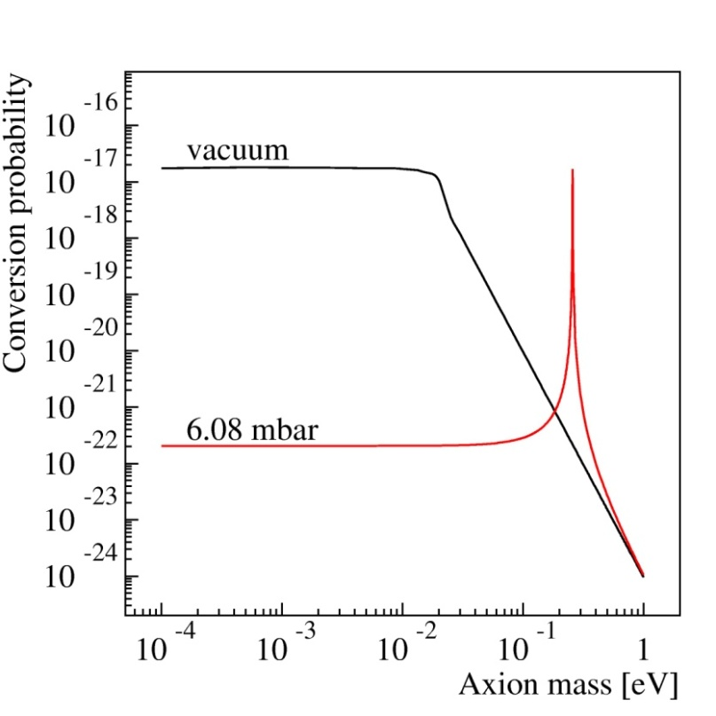
Helioscope technique
Re-convert to photons in the presence of a strong magnetic field
P. Sikivie, Phys. Rev. Lett. 51, 1415–1417 (1983)
Signal: Excess of X-rays in detectors while the magnet is pointing to the Sun
Primakoff
Axions are produced in the Sun via the Primakoff effect
Conversion probability:
Magnet (BL)²
Buffer medium
Bahcall, Pinsonneault (2004)
Max at~3 keV
$〈E_{a}〉$=4.2 keV
Coherence
Vacuum m_{a} <0.02 eV
Buffer medium:
Higher ρ restoration of coherence for higher m_{a}

Slide 8
Haloscope technique
Axions are natural cold dark matter (DM) candidates if their mass lies within the range 1–100 µeV.
The haloscope technique consists of a high-Q microwave cavity properly aligned in a magnetic ﬁeld.
The magnetic field triggers the conversion of axions to photons.
If the resonant frequency of the cavity corresponds to the frequency of the photon the probability of conversion can be significantly enhanced.
The probability of conversion is enhanced by the Q-factor, the volume, and the geometrical form factor G of the cavity.

Slide 9
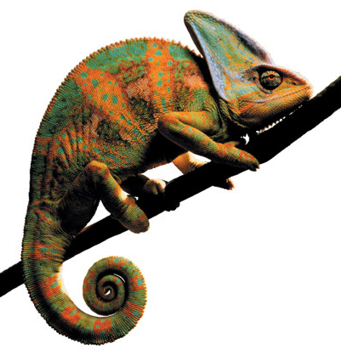
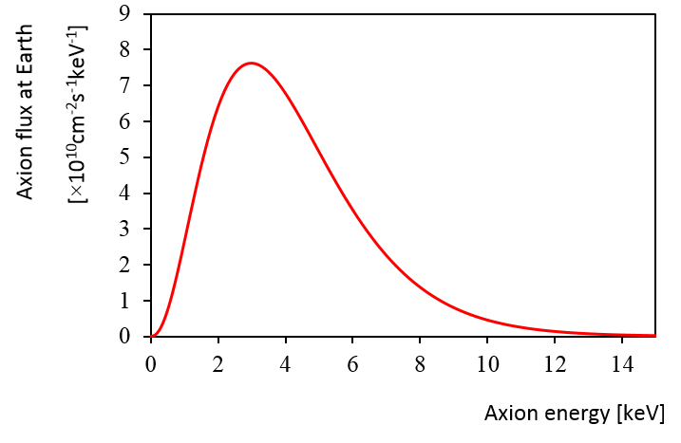
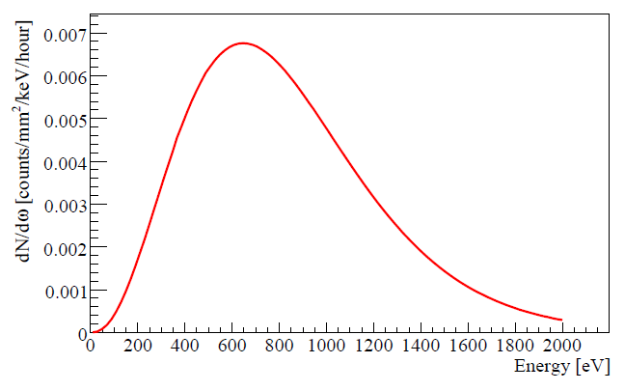
Chameleons
Brax, Lindner and Zioutas - Phys. Rev. D 85(2012), 043014
New searches in vacuum : Chameleons
Dark Energy candidates
Their mass depends on the energy density of the environment
Can be created by the Primakoff effect in the tachocline region of the Sun (R~0.7R_{ʘ} ) They can be converted to X-ray photons in CAST via the inverse Primakoff effect (like axions)
Detector requirements:
Low energy threshold
Low background
Good energy resolution
Axions
Chameleons

Slide 10
CAST – research program
CAST Phase I: vacuum operation (2003 - 2004)
m_{a} <0.02 eV
PRL 94 (2005) 121301
JCAP04(2007)020

Slide 11
CAST – research program
CAST Phase I: vacuum operation (2003 - 2004)
m_{a} <0.02 eV
PRL 94 (2005) 121301
JCAP04(2007)020
CAST Phase II: (2005–2011)
⁴He run, (2005–2006)
0.02 eV < m_{a} < 0.39 eV
JCAP02(2009)008
³He run (2008-2011)
0.39 eV <m_{a}<1.15 eV
PRL 107 (2011) 261302
PRL 112 (2014) 091302

Slide 12
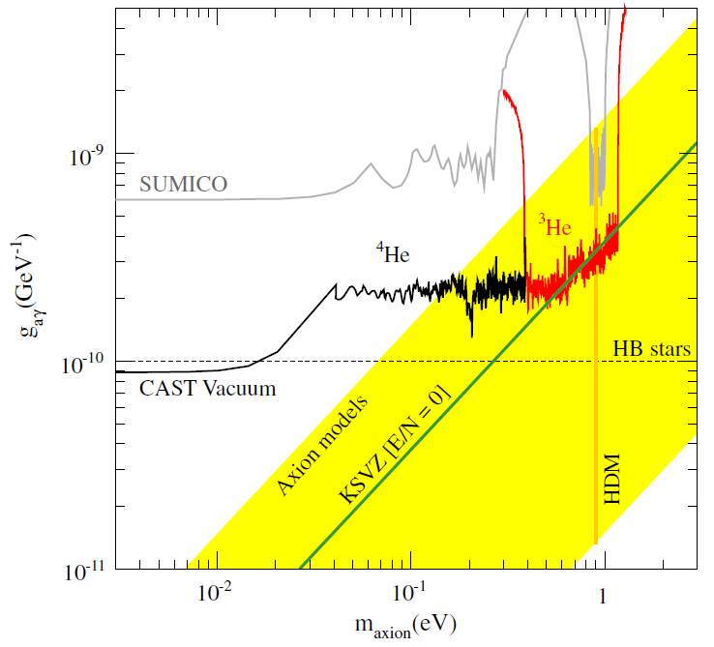
CAST – research program
CAST Phase I: vacuum operation (2003 - 2004)
m_{a} <0.02 eV
PRL 94 (2005) 121301
JCAP04(2007)020
CAST Phase II: (2005–2011)
⁴He run, (2005–2006)
0.02 eV < m_{a} < 0.39 eV
JCAP02(2009)008
³He run (2008-2011)
0.39 eV <m_{a}<1.15 eV
PRL 107 (2011) 261302
PRL 112 (2014) 091302

Slide 13
CAST – research program
CAST Phase I: vacuum operation (2003 - 2004)
m_{a} <0.02 eV
PRL 94 (2005) 121301
JCAP04(2007)020
CAST Phase II: (2005–2011)
⁴He run, (2005–2006)
0.02 eV < m_{a} < 0.39 eV
JCAP02(2009)008
³He run (2008-2011)
0.39 eV <m_{a}<1.15 eV
PRL 107 (2011) 261302
PRL 112 (2014) 091302
⁴He run (2012)
0.39 eV < m_{a} < 0.42 eV

Slide 14
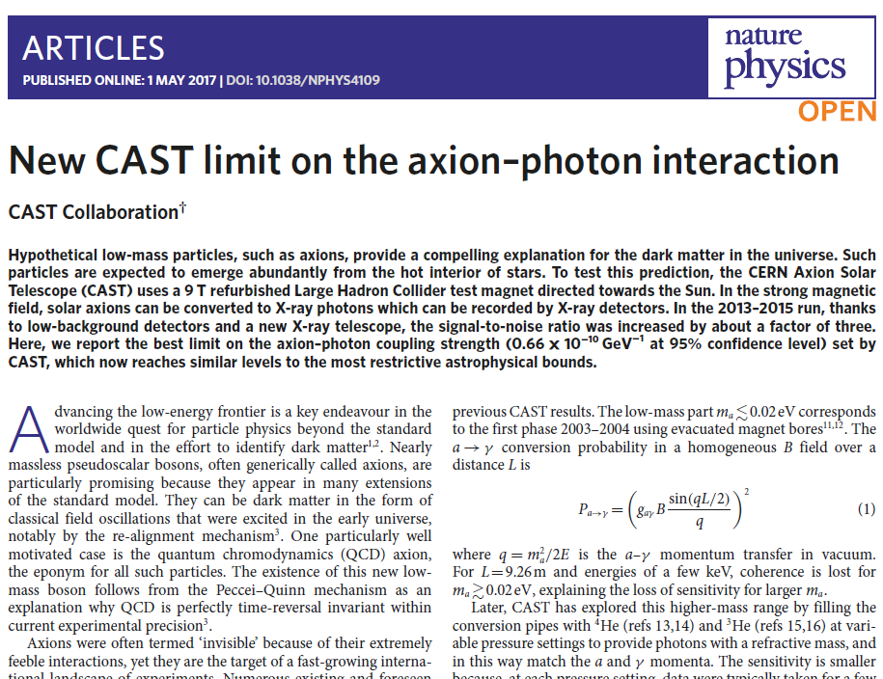
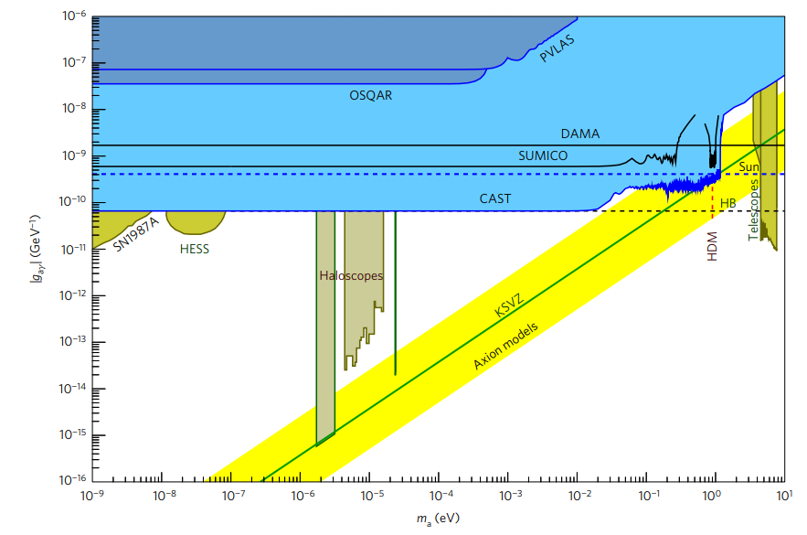
CAST – research program
Vacuum run (2013-2015) – factor 3 improved sensitivity
g_{αγ}= 0.66 × 10⁻¹⁰ /GeV at 95% C.L.
Nature Physics, Volume 13, pages 584–590 (2017)

Slide 15
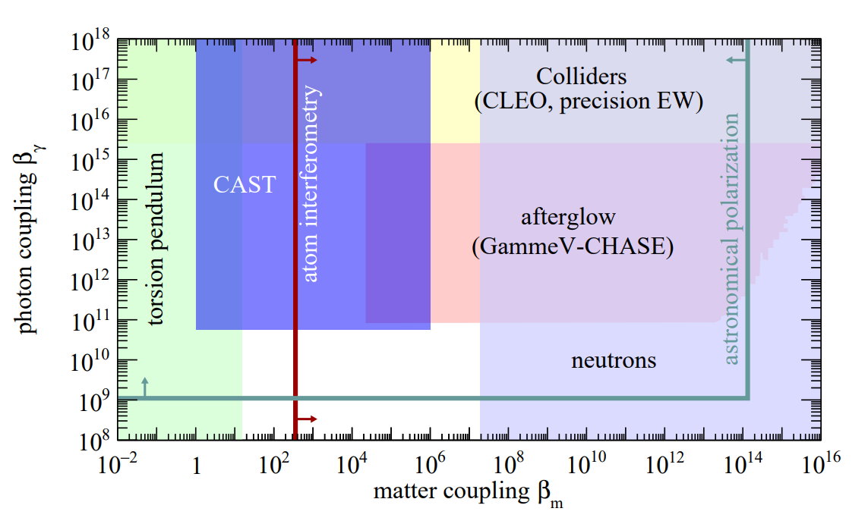
CAST – research program
Vacuum run (2013-2015) – Chameleons
Limit to β_{γ} ≤ 5.7×10¹⁰ at 95% C.L.
Valid for 1 ≤ β_{m} ≤ 10⁶
Phys.Lett. B749 (2015) 172-180
&
JCAP 1901 (2019) no.01, 032

Slide 16
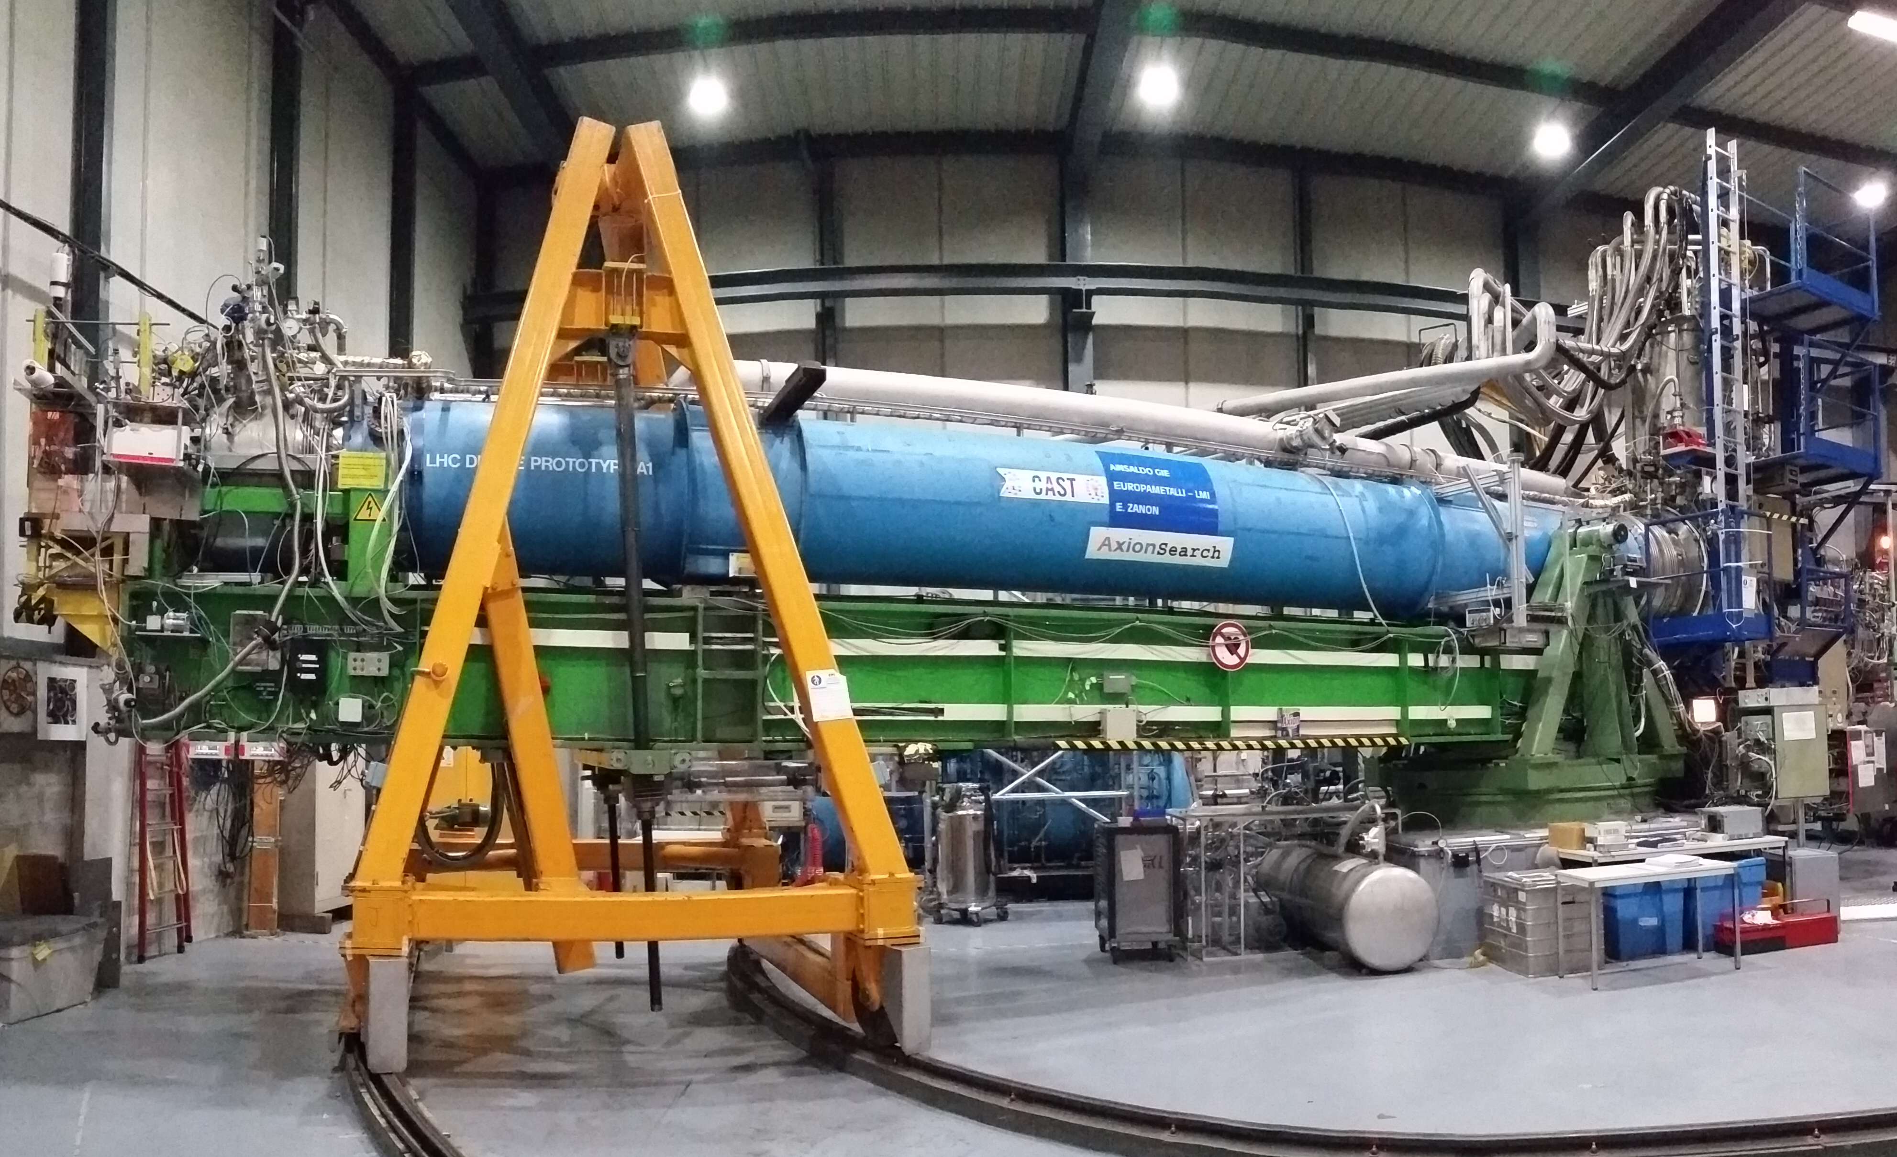
CAST – experimental layout
10 m decommissioned LHC prototype magnet (B ≈ 9 T, T≈ 1.8K)
Two cold bores of 43 mm aperture.
4 x low-background X-ray detectors - 2 focusing devices
Rotating platform : H= ±40°, V ±8°.
2 × 1.5 hours of tracking / day.
Sunset
detectors
Sunrise
detectors
Prototype LHC magnet

Slide 17
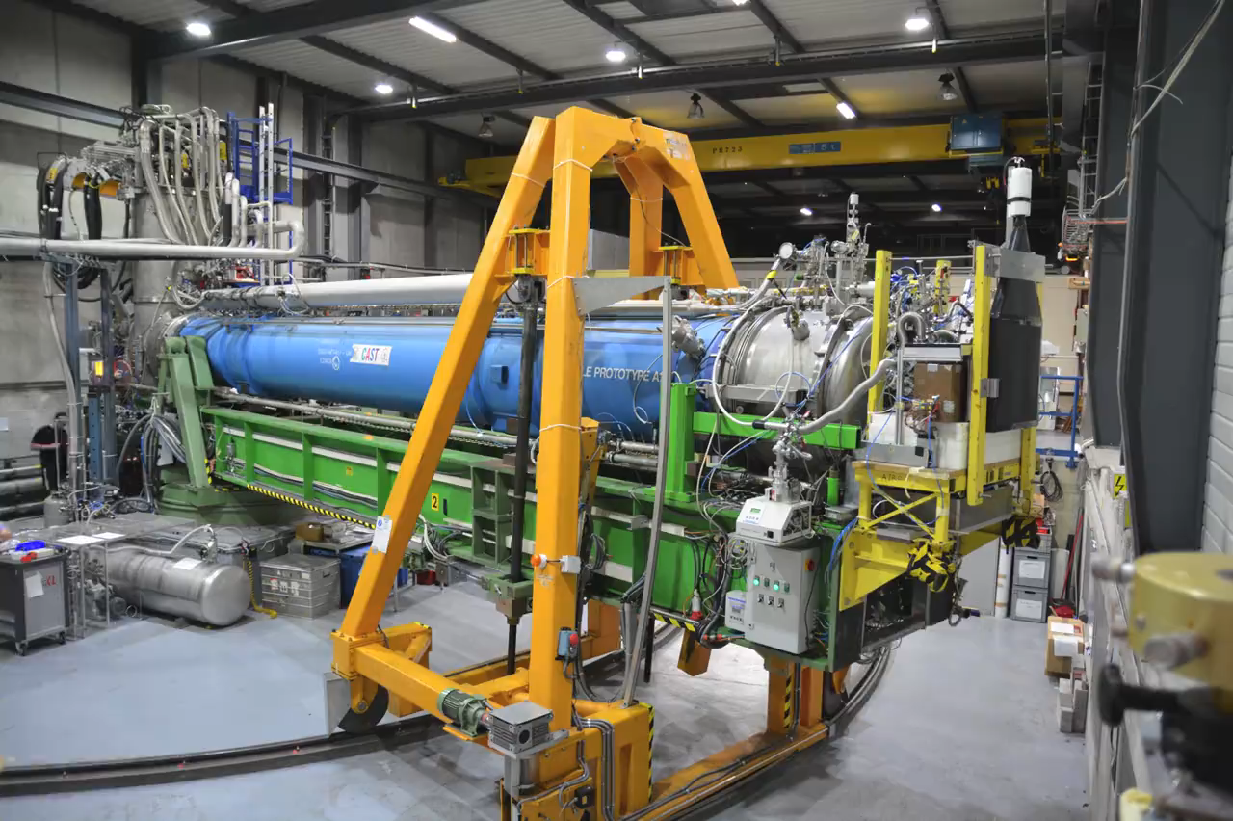
CAST

Slide 18
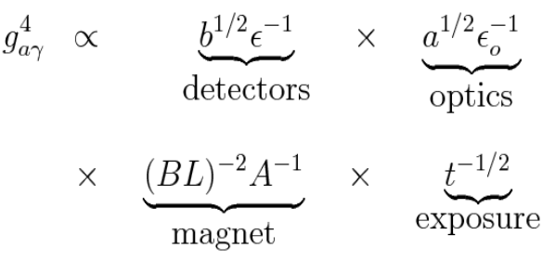
CAST Detectors
Requirements for high sensitivity:
Detectors
  -Constructed with radiopure materials
  -Signal topology and 2D reconstruction for offline background rejection
  -Good efficiency in the energy range of interest
Optics: Improve signal / background ratio

Slide 19
CAST Detectors
Requirements for high sensitivity:
Detectors
  -Constructed with radiopure materials
  -Signal topology and 2D reconstruction for offline background rejection
  -Good efficiency in the energy range of interest
Optics: Improve signal / background ratio
Solar axions
Micromegas, InGRID

Slide 20
CAST Detectors
Requirements for high sensitivity:
Detectors
  -Constructed with radiopure materials
  -Signal topology and 2D reconstruction for offline background rejection
  -Good efficiency in the energy range of interest
Optics: Improve signal / background ratio
Solar axions
Chameleons
Micromegas, InGRID
SDD, InGRID, KWISP

Slide 21
CAST Detectors
Requirements for high sensitivity:
Detectors
  -Constructed with radiopure materials
  -Signal topology and 2D reconstruction for offline background rejection
  -Good efficiency in the energy range of interest
Optics: Improve signal / background ratio
Solar axions
Chameleons
Relic axions
Micromegas, InGRID
SDD, InGRID, KWISP
RADES, CAPP

Slide 22
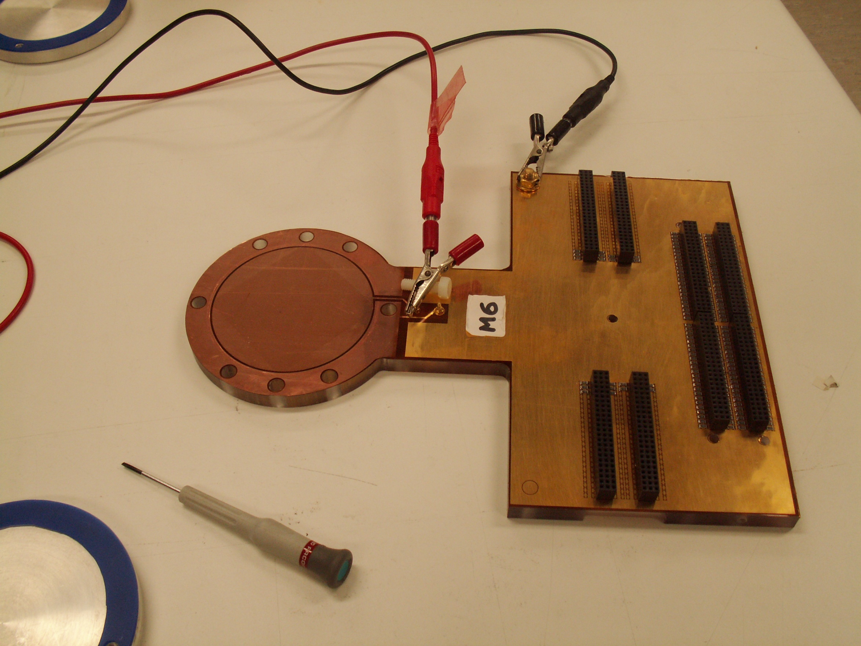
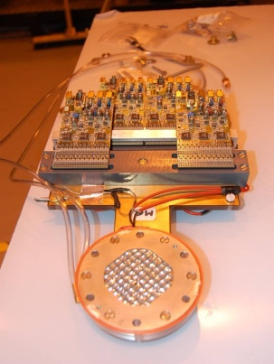
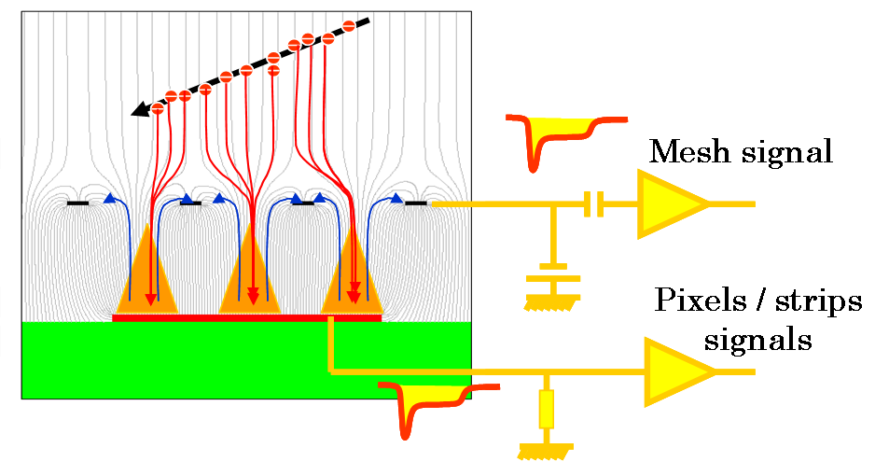
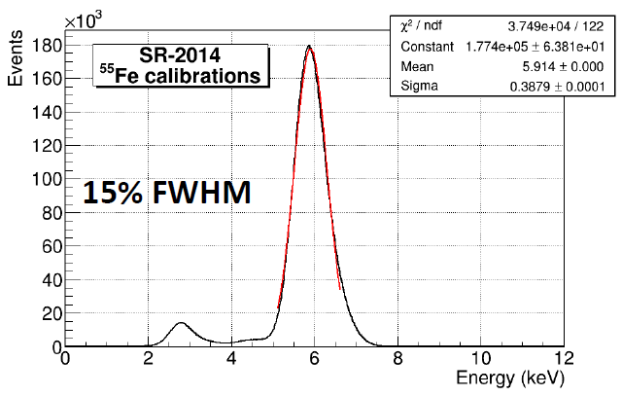
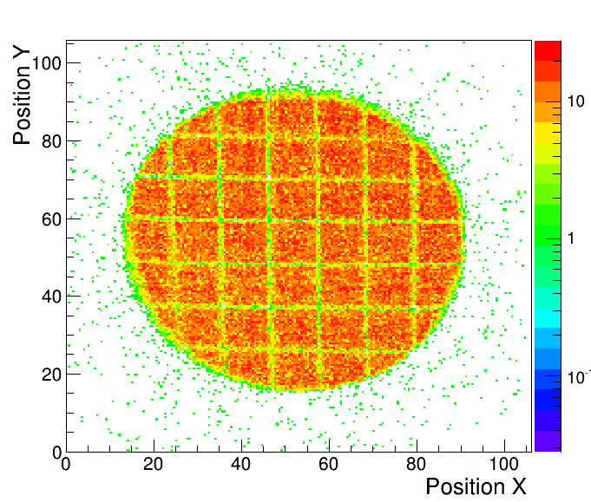
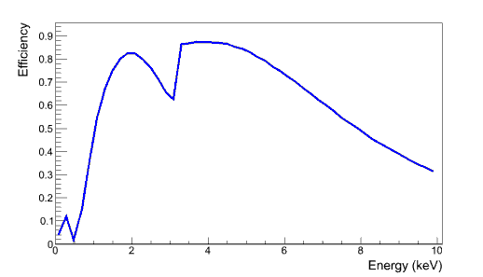
Micromegas
Y. Giomataris et al., NIM A 376 (1996) 29
MICRO MEsh GASeous Structure
High gain
Long term stability
Good energy resolution (~15% @ 6 keV)
Mesh pulse: Pulse shape analysis
Strips signal: Topological analysis
CAST Micromegas (Ar, 2.3% iC₄H₁₀)

Slide 23
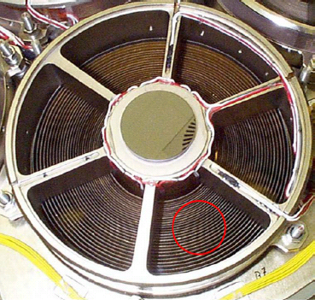
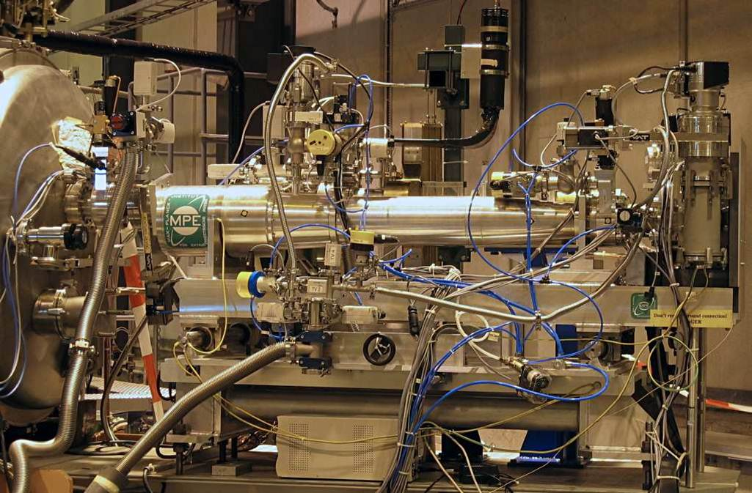
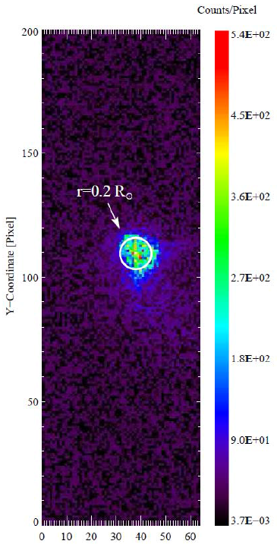
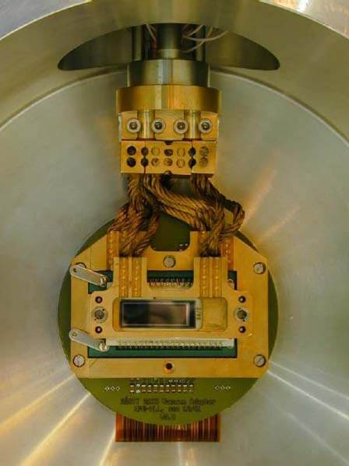
CCD (removed in 2012)
X-ray telescope
Focal length 1600 mm
14.5 cm² focused to ~9 mm²
pn-CCD
0.2 counts/h (1-7 keV)

Slide 24
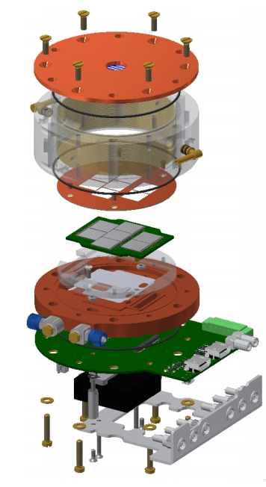
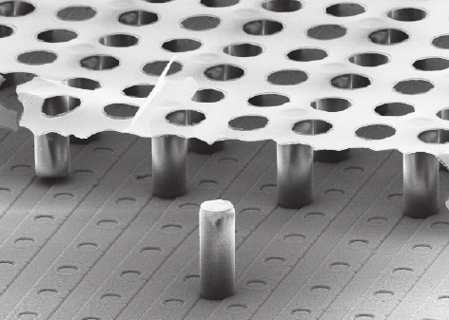
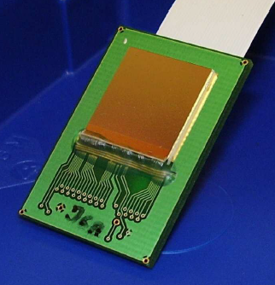
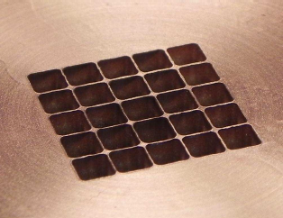
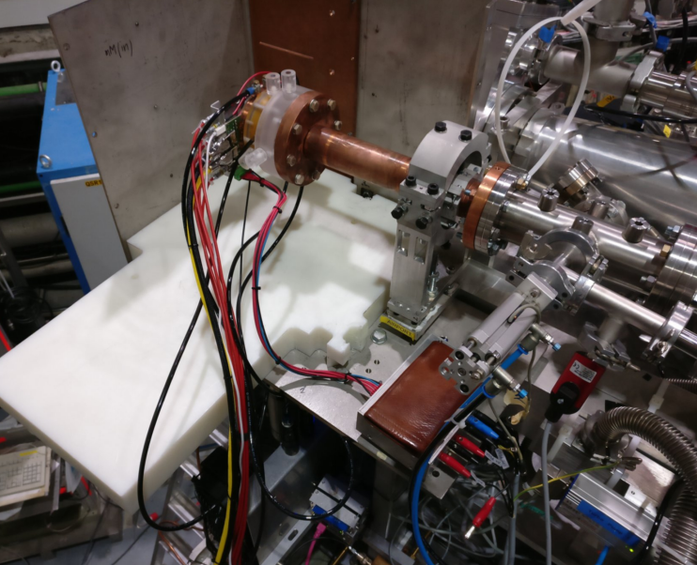
InGRID
Chefdeville et al - Nucl. Inst. Meth. A 556(2006), p 490
Integrated Micromegas – InGrid
Micromegas mounted on a pixel chip via photolithographic post‐processing
7 x Timepix chip
Threshold well below 1 keV
X-ray Window made of 2 μm Mylar
with copper strongback
New for 2017 : 300 nm SiN window
Simultaneous search for solar axions and chameleons

Slide 25
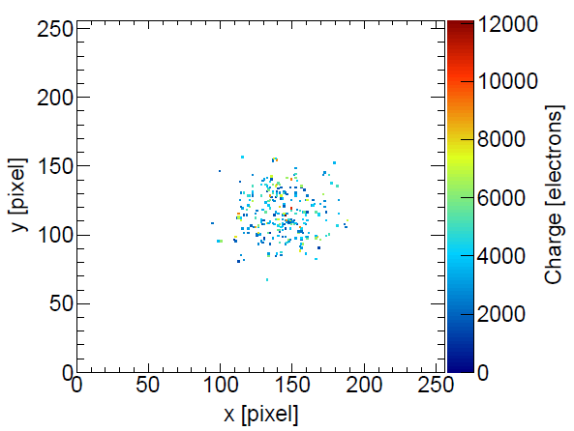
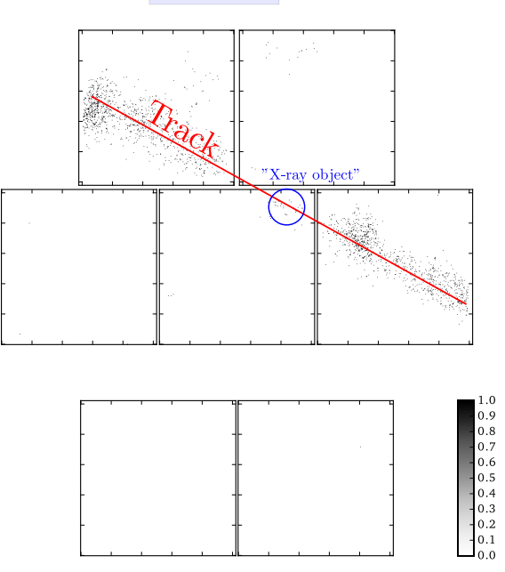
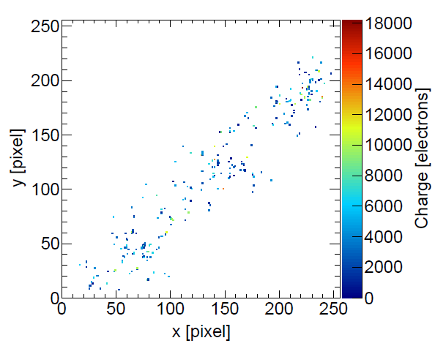
InGRID
Each avalanche is collected in one pixel
Detection of single electrons possible
Background rejection:
Shape of pixel hit pattern. X-rays (left), background (right)
1 chip
7 chips

Slide 26
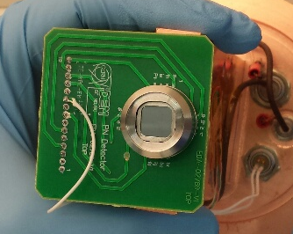
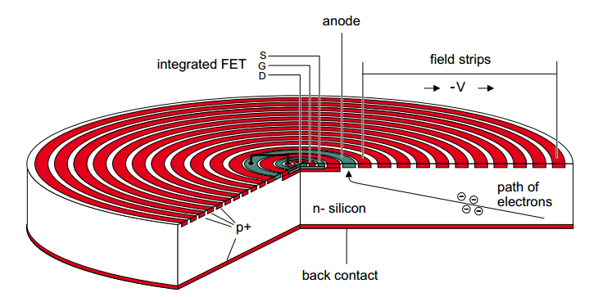
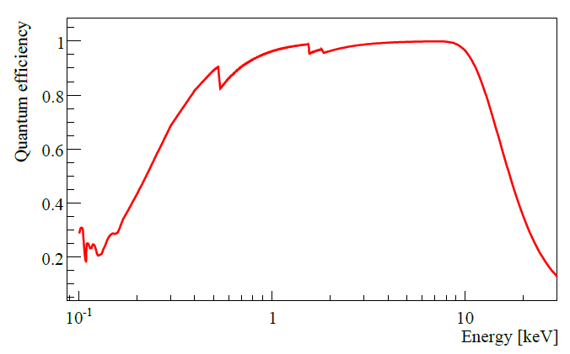
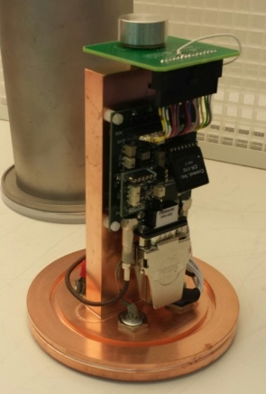
SDD
  For the 1st attempt on chameleon searches
  Took advantage of the available port due to MPE-XRT
  recalibration at the end of 2013
SDD (from PN-Detector) ~100 mm² surface without vacuum window
Detector system R&D at CERN

Slide 27
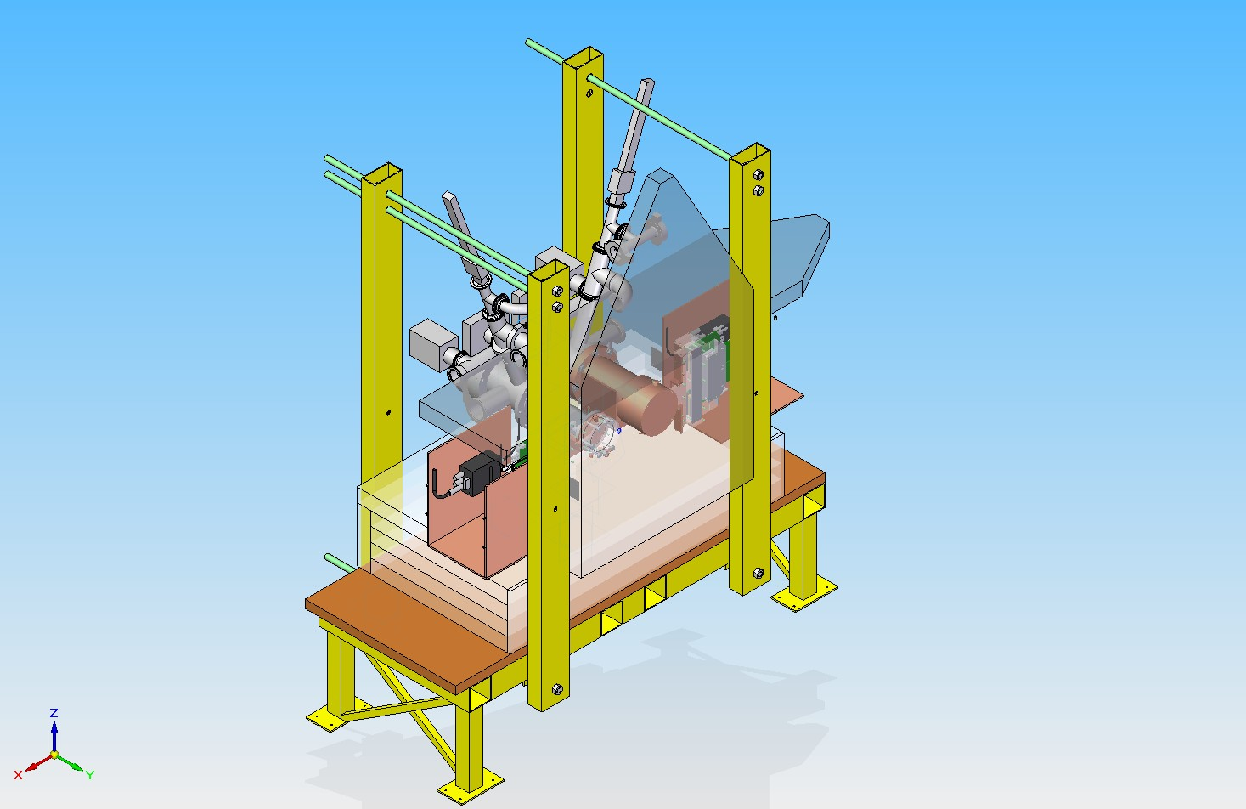
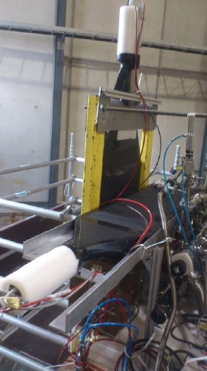
Sunset 2013
2 x Microbulk Micromegas
Installation of Muon veto (2013)

Slide 28
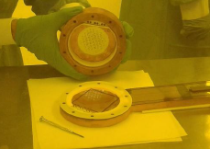
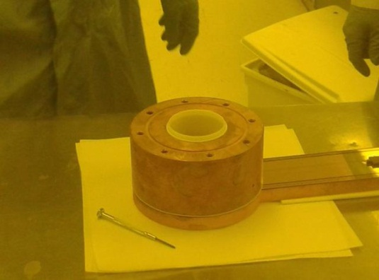
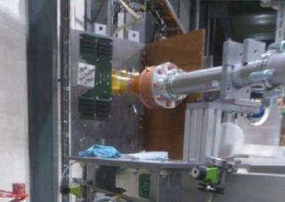
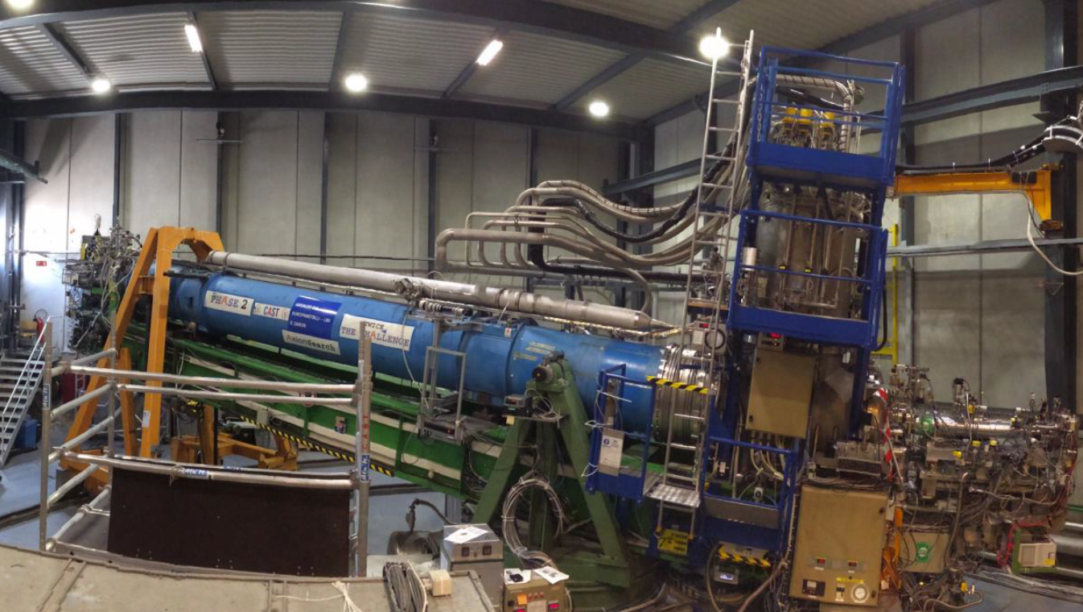
Sunrise 2013
New detector design
Field shaper
Cu body & support (serves as inner shielding )
Teflon layer to minimize 8 keV fluorescence Cu-peak
Hermetic lead shielding
1 x new Microbulk Micromegas

Slide 29
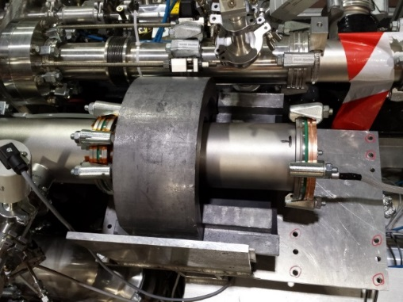

Sunrise 2013
SDD (Chameleon searches)

Slide 30
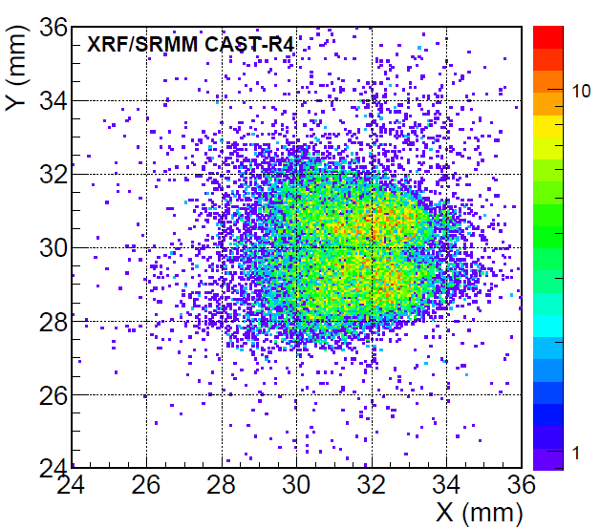
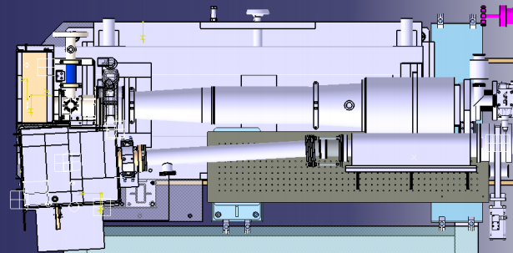
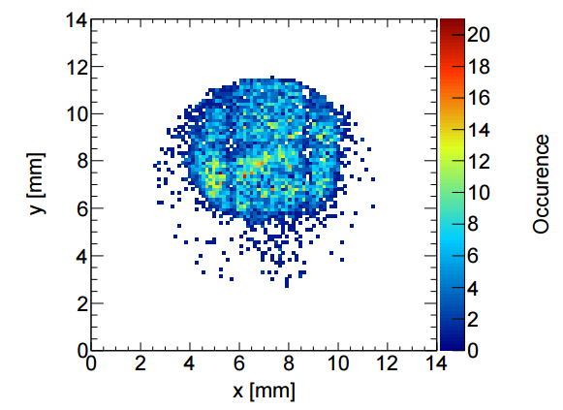
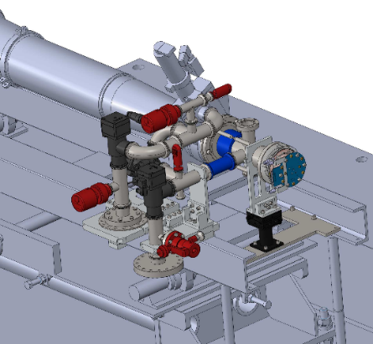
Sunrise 2014-2015
2 x X-ray telescopes
New Micromegas + muon veto
Background ~0.003 counts/h
InGRID
LLNL XRT
MPE XRT

Slide 31
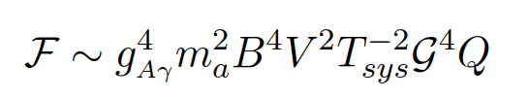
Relic axion detectors 2016 - today
Being non-relativistic, the axions convert to monochromatic photons with energy equal to m_{a}.
For a cavity resonant frequency matching m_{a}, the conversion is enhanced by a factor proportional to the quality factor of the cavity Q
Replicate a cavity many times and combine their output: CAPP/IBS Detector
The high-frequency resonant structure is an array of N small rectangular cavities connected with irises: Relic Axion Detector Exploratory Setup (RADES)

Slide 32


RADES 2017 onwards
arXiv:1803.01243v1 (prepared for JCOP)
Axion Searches with Microwave Filters: the RADES project
As a ﬁrst step, a small-scale RADES cavity with 5 elements and no tuning has been built and installed inside the CAST magnet.
New for 2019: 1 m long cavity will be installed beginning of summer.

Slide 33

RADES 2017 onwards
arXiv:1803.01243v1 (prepared for JCOP)
Axion Searches with Microwave Filters: the RADES project
As a ﬁrst step, a small-scale RADES cavity with 5 elements and no tuning has been built and installed inside the CAST magnet.
New for 2019: 1 m long cavity will be installed beginning of summer.
2019:
30 sub-cavities design

Slide 34


RADES 2017 onwards
arXiv:1803.01243v1 (prepared for JCOP)
Axion Searches with Microwave Filters: the RADES project

Slide 35


CAPP 2016 - 2017
DOI: 10.3204/DESY-PROC-2015-02/miceli_lino
Conference: C15-06-22.2, p.164-168
Haloscope axion searches with the cast dipole magnet: the CAST-CAPP/IBS detector
Test installation in 2016

Slide 36



CAPP 2018 onwards
4 tunable, phase matched cavities where installed in 2018.
1st Technical run completed, 2nd underway.
Physics run to start in July 2019.

Slide 37

CAPP & RADES @ CAST

Slide 38



KWISP 2016 onwards
Physics of the Dark Universe 12 (2016) 100–104
KWISP: An ultra-sensitive force sensor for the Dark Energy sector
100 nm Si₃N₄ membrane

Slide 39

KWISP 2016 onwards
Physics of the Dark Universe 12 (2016) 100–104
KWISP: An ultra-sensitive force sensor for the Dark Energy sector
Different methods to measure the
membrane displacement (displacement ~ force)
Michelson interferometer
mirror
KWISP 1.5
green laser
“low” sensitivity
high stability
“easy” to setup
membrane
100 nm Si₃N₄ membrane
KWISP 2.0
IR laser
high sensitivity (multiplied by finesse)
complicated to setup
(cavity mode matching and locking)
sensitive to environmental noise

Slide 40


KWISP 2016 onwards
FP cavity with membrane
chameleon beam
Monolithic breadboard housing the membrane chamber
Optics vibration isolated
Fully enclosed in a heavy rubber shielding for acoustic noise damping

Slide 41
Conclusions & future outlook
CAST has provided the best experimental limit on axion-photon coupling constant over a broad range of axion masses.

Slide 42
Conclusions & future outlook
CAST has provided the best experimental limit on axion-photon coupling constant over a broad range of axion masses.

Slide 43

Conclusions & future outlook
CAST has provided the best experimental limit on axion-photon coupling constant over a broad range of axion masses.
In 2013 CAST has provided the first limit for the chameleon-to-photon coupling constant with a helioscope and has continued the dark energy searches with the InGRID and KWISP detectors.
P R E L I M I N A R Y
InGRID

Slide 44
Conclusions & future outlook
Recently CAST became a haloscope expanding its range of searches even further.
In 2018 we have already collected data with RADES and InGRID and currently CAST is working with the following setup:
We are preparing a proposal for a 3-year run which will include the above projects and a roadmap for improvements.
RADES: Longer cavity (30 subcavities design)
CAPP: More cavities (up to 10)
KWISP: Cryogenic operation
airport
XRT
InGrid / Micromegas
RADES
CAPP
CAPP
CAPP
CAPP
KWISP
XRT
jura

Slide 45


Conclusions & future outlook
Micromegas run (20 months)
Reduce background by using Xe as gas & push for low threshold advances (thin windows).
Improve the result obtained in the 2013-15 phase & set a hard limit on g_{αγ}.
Determine statistical/systematic origin of some tensions.
Provide additional technical and operational experience for IAXO/babyIAXO.

Slide 46
Thank you

Slide 47

Baby IAXO: A full experimental stage
Two bores of dimensions similar to final IAXO bores
detection lines representative of final ones.
Test & improve all systems.
Risk mitigation for full IAXO
Will produce relevant physics
Move earlier to “experiment mode”
Magnet Technical Design ongoing at CERN
t ≅ 12h/day
α ≅ 2 x 0.2 cm²
b ~ 10⁻⁷c keV⁻¹cm⁻²s⁻¹
B ≅ 2.5T
L = 10m
A ≅ 2x0.4m²

Slide 48


View to the future: IAXO
JCAP 1106 (2011) 013
International AXion Observatory
The accumulated experience from CAST put into practice
All bores equipped with X-ray focusing devices and low background detectors.
Will improve the CAST limits by 1 order of magnitude
LoI submitted to CERN (CERN-SPSC-2013-022)
SPSC recommended that IAXO proceeds to a TDR
magnet
PROSPECTS
X-ray
optics
detectors

Slide 49


Controls & Operation –Pointing precision
Notes:
Once or twice per year we repeat position measurements and compare with previous ones to ensure our pointing accuracy.
In all we are aiming for a precision within 1 arcminute from the center of the sun.
Here you can see our latest results.

Slide 50



Controls & Operation –Pointing precision
Sun filming
March & September
Sun visible through window in the east-facing wall
SLR camera + optics aligned (Survey team)
Precision (R_{sun} = 1139±2 pixels, alignment ±25 pixels)
Not always easy…

Slide 51


Controls & Operation –Pointing precision
Sun filming
March & September
Sun visible through window in the east-facing wall
SLR camera + optics aligned (Survey team)
Precision (R_{sun} = 1139±2 pixels, alignment ±25 pixels)
CAST

Slide 52

Micromegas background evolution
Unshielded Micromegas (classic technology)
Improvement of two orders of magnitude in background over the years
Shielded Micromegas
(bulk and microbulk technology)
Shielding upgrade
Electronics upgrade
Canfranc, underground
laboratory

Slide 53



Background spectra
SR 2014
InGRID Oct/Nov 2014
PRELIMINARY
(0.8x10⁻⁶ cts/keV/cm²/s 2-7 keV)
SDD Nov 2013
(10⁻³ cts/keV/cm²/s
or 1.4 mHz
from 400-1500 eV)

Slide 54


Fabrication of detectors
Bulk Micromegas
Microbulk Micromegas

Slide 55

Fabrication of detectors
INGRID
Timepix
Starting with bare Timepix
Deposition of protection layer (4 or 8 μm Si_{x}N_{y})
Deposition of negative photoresist SU-8 (50 μm)
Exposure of SU-8
Sputtering aluminium (1 μm)
Putting mask on aluminium layer (photoresist)
Structuring aluminium layer by etching the holes
Development of SU-8, cleaning of interstitials

Slide 56





XRT – LLNL

Slide 57




CAST Detector Lab
New Micromegas
InGrid
SDD
-Calibration
-Selection criteria
-Weakness in design
-DAQ Software development
-Detector performance simulation/analysis
-New generation under study
-Vacuum interface
-Light tightness
-Definition of voltages

Slide 58

Backup - The trigger for axions
“I named them after a laundry detergent, since they clean up a long standing problem in theoretical physics.” Wilczek
Standard Model
Strong interactions do NOT violate CP symmetry
Experimental limit to neutron electric dipole moment $\left|d_{n}\right|≤2.9 ×{10}^{−26} e×cm$ (90% CL)
Elegant solution:
Peccei & Quinn (1977) proposed a spontaneously broken global symmetry (PQ)
AXION : pseudo Nambu-Goldstone boson of spontaneous breaking of PQ symmetry (Weinberg and Wilczek , 1978)

Slide 59
Controls & Operation –Pointing precision
Notes:
Once or twice per year we repeat position measurements and compare with previous ones to ensure our pointing accuracy.
In all we are aiming for a precision within 1 arcminute from the center of the sun.
Here you can see our latest results.

Slide 60
Controls & Operation –Pointing precision
Sun filming
March & September
Sun visible through window in the east-facing wall
SLR camera + optics aligned (Survey team)
Precision (R_{sun} = 1139±2 pixels, alignment ±25 pixels)
Not always easy…

Slide 61
Controls & Operation –Pointing precision
Sun filming
March & September
Sun visible through window in the east-facing wall
SLR camera + optics aligned (Survey team)
Precision (R_{sun} = 1139±2 pixels, alignment ±25 pixels)
CAST

Slide 62
Backup - Axion properties
Primakoff
Axion properties
Pseudoscalar boson
Color and charge neutral
Light
Long lived
Couples to photons
Weakly interacting
Dark matter candidate
*
* magnetic field
from the plasma of the center of the sun

