Slide 1












Recent Developments on
Precision Timing with PICOSEC-Micromegas Detectors
Performance, Modeling and Applications
Spyros Eust. Tzamarias
Aristotle University of Thessaloniki
on behalf of the
RD51 PICOSEC-Micromegas Collaboration
ARISTOTLE
UNIVERSITY OF
THESSALONIKI

Slide 2
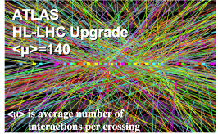
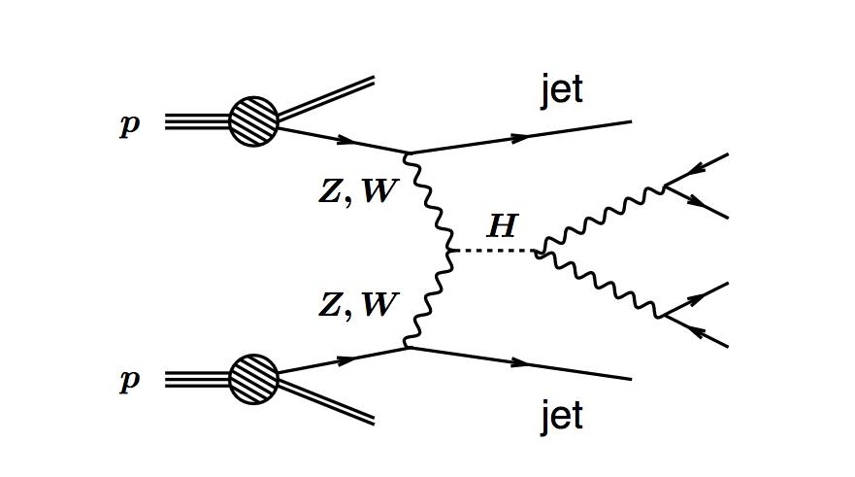
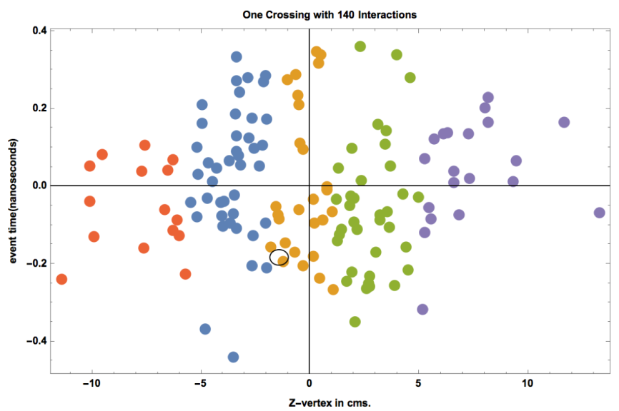
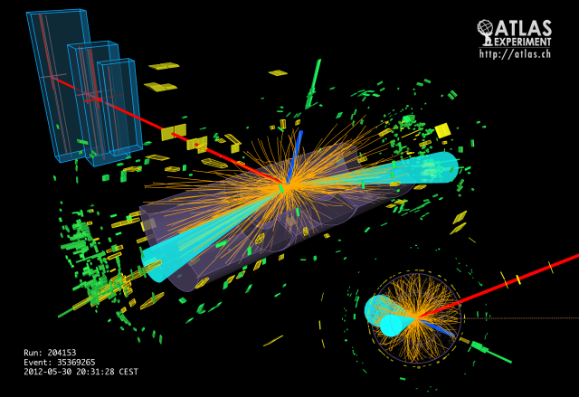
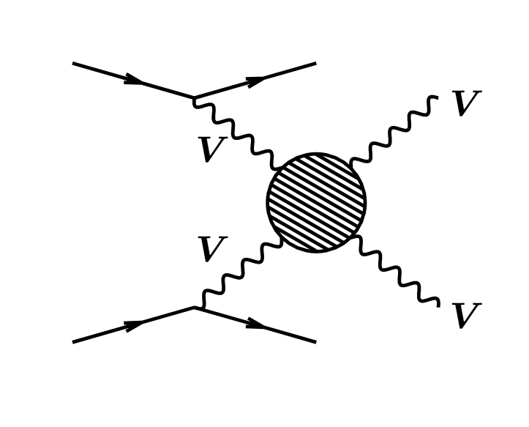
Timing with a few 10’s of picosecond
Needs for Precise timing bring us to the picosec domain
E.g., in the High Luminosity LHC, 140-200 “pile-up” proton-proton interactions (“vertices”) with happen in the same LHC clock, in close space (Gaussian +- 45mm).
Using precise timing can separate particles coming from the various vertices.
(3D) tracking of charged particles is not enough to associate them to the correct vertex . Including precise time offers an extra dimension of separation to achieve this.
Needed precision
~ order 30ps
The association of the time measurement to the energy measurement is crucial for physics analysis, and requires time resolution of 20-30ps.

Slide 3
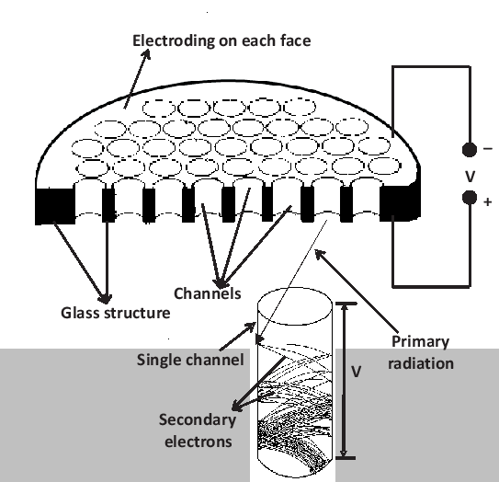
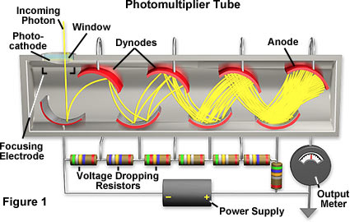
Existing Instrumentation:
e.g. Multi-Channel Plate (MCP) with σ_{t}~ 4ps but very expensive for large area coverage
PhotoMultiplier: σ_{t} >800ps
Since the hermetic approach at the LHC experiments requires large area coverage, it is natural to investigate both MicroPattern Gas and Silicon structures as candidate detector technologies. However, since the necessary time resolution for pileup mitigation is of the order of 20-30 ps, both technologies require significant modification to reach the desired performance.
Large area detectors, resistant to radiation damage, with ~10ps timing capabilities will find applications in many other domains, e.g.
particle identification in Nuclear and Particle Physics experiments
photon’s energy/speed measurements and correlations for Cosmology
optical tracking for charge particles
4D tracking in the future accelerators (e.g. FCC with a center energy of ~100TeV)

Slide 4
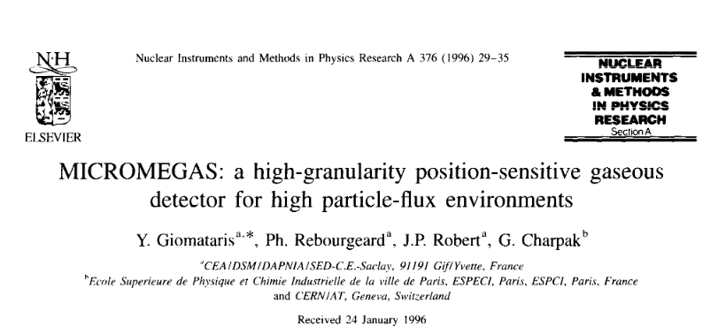
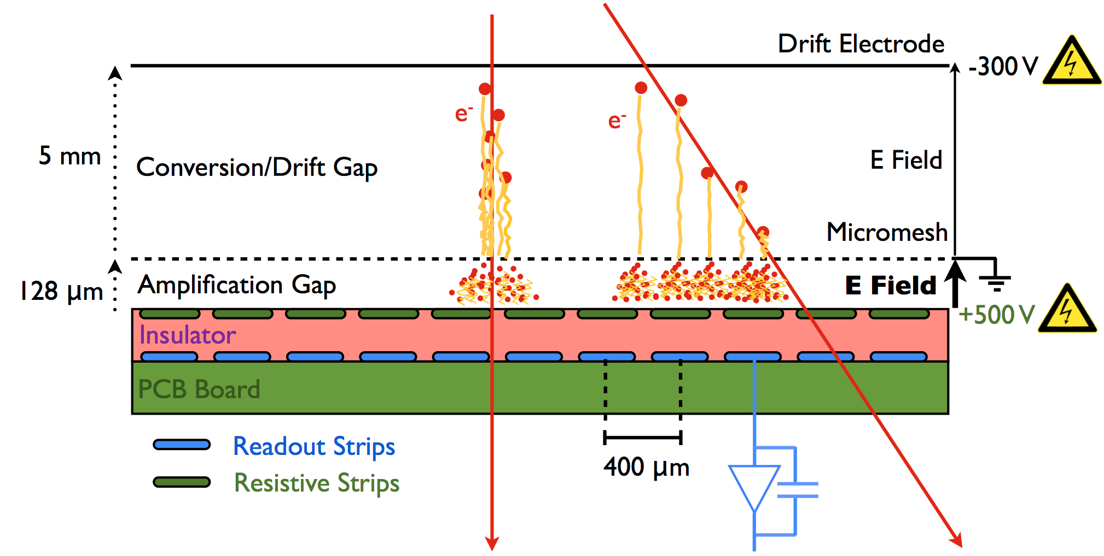
MicroMegas: Micro Pattern Gaseous Chambers
3mm
80μ

Slide 5



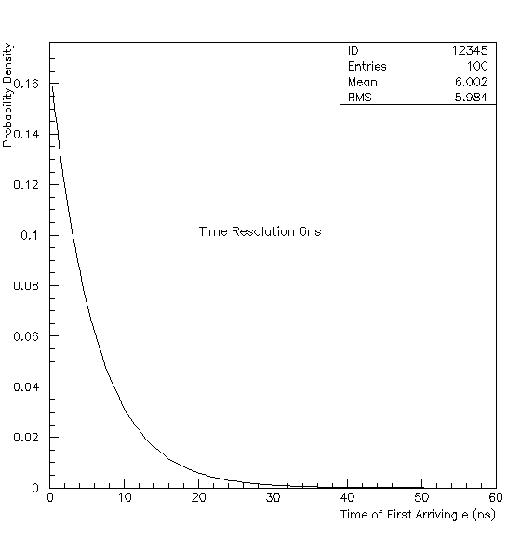


Let n be the mean number of the e-ion pairs produced by the charged particle along its track. Then the probability that k-pairs are produced by a single track is given by the Poisonian
However…
3mm
80μ
L
anode0
k-j pairs
j-1 pairs
z
The probability that an e-ion pair has been produced at Z=z is the same for any value of Z; p=1/L
Then, in case that k pairs are produced, the probability that the jth pair has been produced at Z= z is given by the binomial distribution
where x=z/L describes the probability that a pair is produced in the region 0-z
Using the drift velocity (V), we express the probability that the first electrons will reach the anode at time t as:
The probability that the jth pair has been produced at Z= z for any total number of e-ion pairs is given by
Setting typical values, i.e. V=50μm/ns and n=10 we conclude that:
Typical Time Resolution ~6ns
A typical MicroMegas cannot reach timing resolution at the level of tenths of ps
The probability that the last pair (i.e. the closest to the edge 0) has been produced at Z= z is given by (j-1=0):

Slide 6
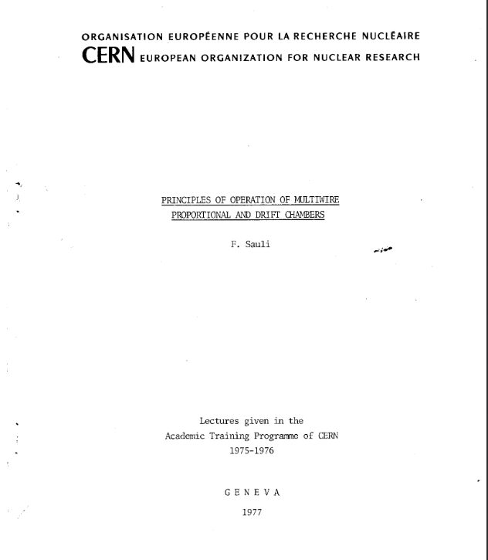
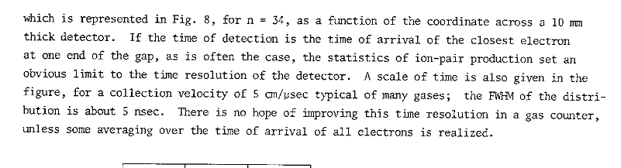
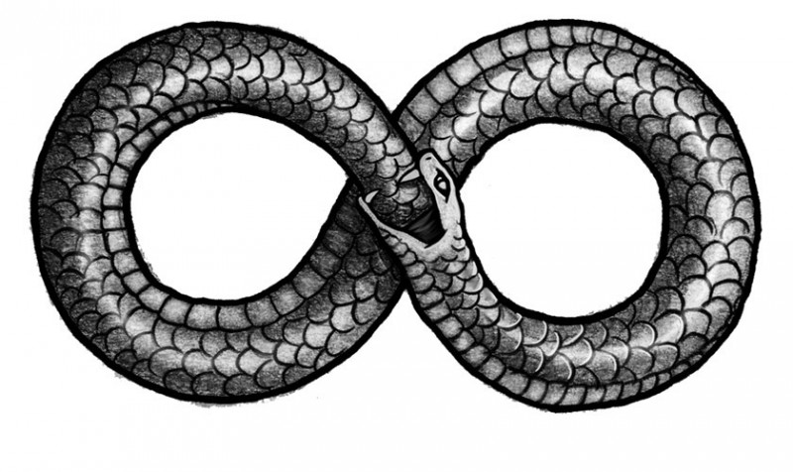
The Physics of Ionization offers the means for precise spatial measurements (high spatial resolution) but inhibits precise timing measurements
The ouroboros or uroborus from Greek οὐροβόρος from οὐρά, "tail," and -βορος, "devouring") is an ancient symbol depicting a serpent or dragon eating its own tail. Originating in ancient Egyptian iconography, the ouroboros entered western tradition via Greek magical tradition and was adopted as a symbol in Gnosticism and Hermeticism, and most notably in alchemy. Via medieval alchemical tradition, the symbol entered Renaissance magic and modern symbolism, often taken to symbolize introspection, the eternal return or cyclicality, especially in the sense of something constantly re-creating itself. It also represents the infinite cycle of nature's endless creation and destruction, life and death.
In order to use gaseous detectors for precise (ps) timing of charge particles we should turn other Physics phenomena against the stochastic Nature of ionization

Slide 7
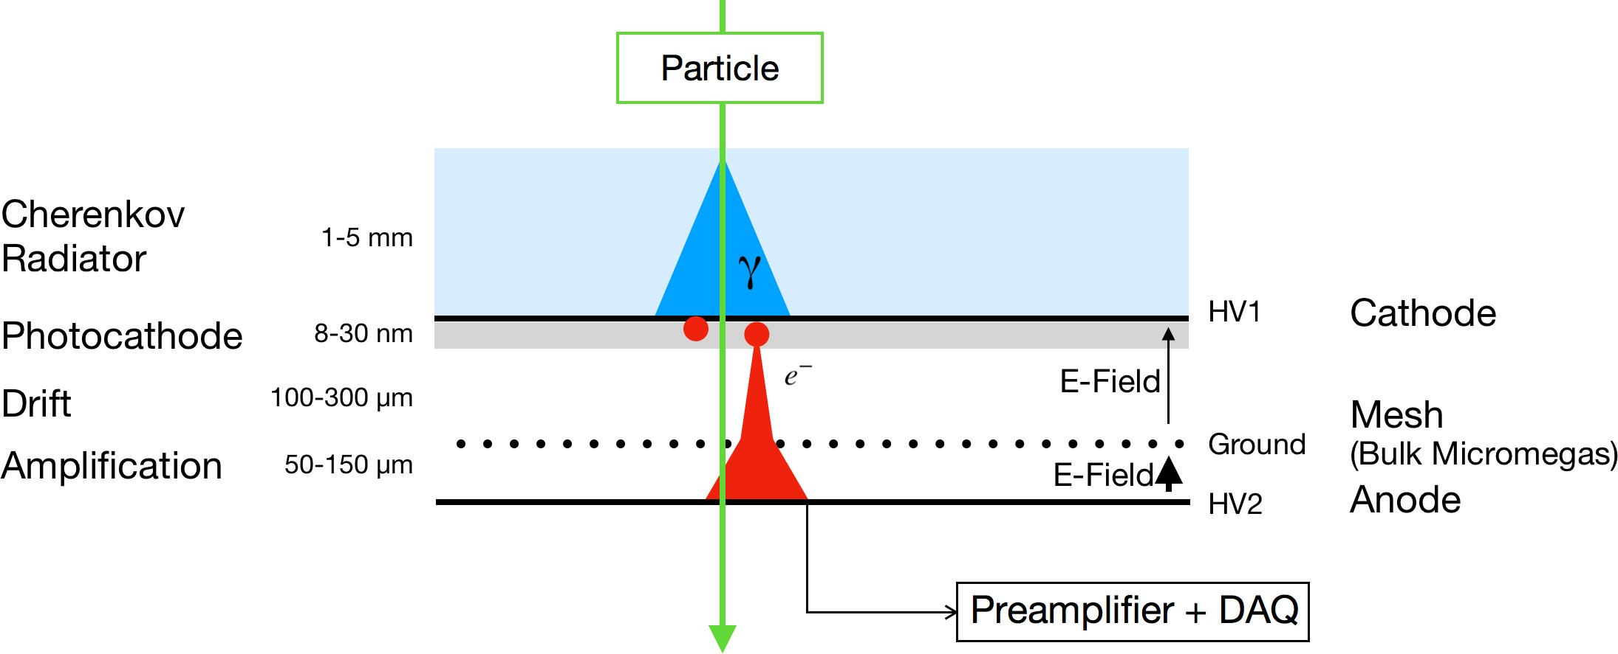
MicroMegas PICOSEC detector concept
PICOSEC is a hybrid a two-stage MicroMegas with Cerenkov radiator and a photocathode layer
Radiator: Particle passage produce Cherenkov UV light
Photocathode: UV → photoelectrons, emitted ~ synchronously;
These electrons enter the thin-gap MicroMegas chamber, in the “drift”/”pre-amplification” gap: which is small (~200microns) with high-field (~500V), and soon each electron initiates an avalanche in this region. Due to high gain in drift region jitter before first amplification minimised
Via the mesh, a fraction of these pre-amplification avalanche electrons pass to the lower “amplification” region, where each one starts a new avalanche and induces signal on the anode.
→ depending on how big is the (circular of hexagonal) readout-pad on the anode, it can see full or partial signal from the Cerenkov cone

Slide 8
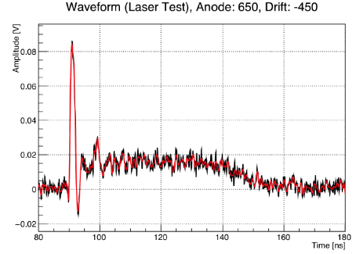
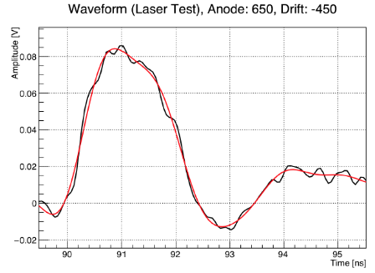
PICOSEC concept and specifics
Radiator: MgF₂ (3mm thick)
Photocathode:
CsI, metal, Diamond-Like Carbon
Drift gap = 200 μm
Amplification gap = 128 μm
Mesh thickness = 36 μm ( centered at 128 μm above anode)
COMPASS gas
(80% Ne + 10% CF₄ + 10% C₂H₆)
Pressure: 1 bar.
Anode voltage = 450 V
→ E = 35 kV/cm
Cathode voltage = 300-425 V
→ E in [15, 21] kV/cm
Note: depending on how big is the pad on the anode, it can see full or partial signal from the Cerenkov cone
Two-component signal:
* Electron peak (“e-peak”) → fast (~0.5ns)
* Ion tail (~100ns)
e-peak
Signal from Laser runs (right is zoom in e-peak)
Digitized Waveforms (at 50-100 ps sampling)
Time signal arrival with Constant Fraction Discrimination at 20% of e-peak.

Slide 9
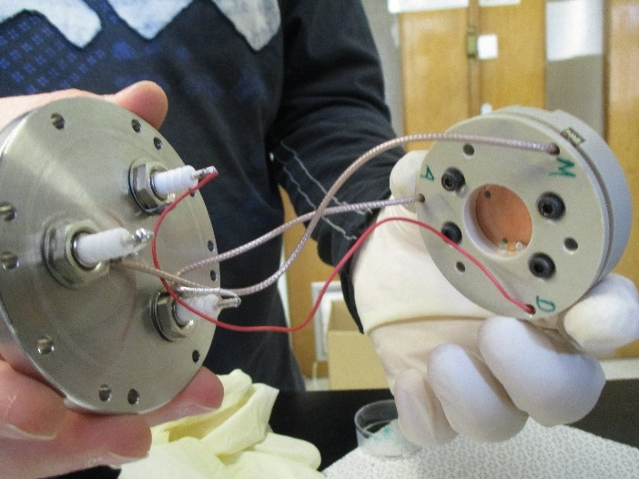
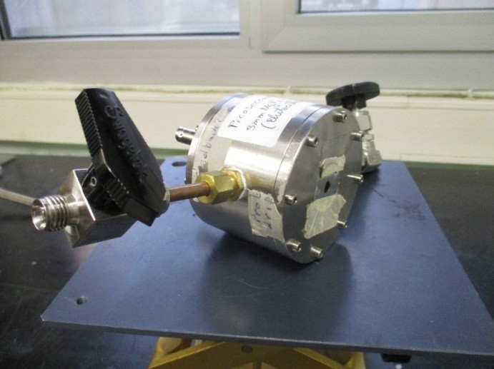
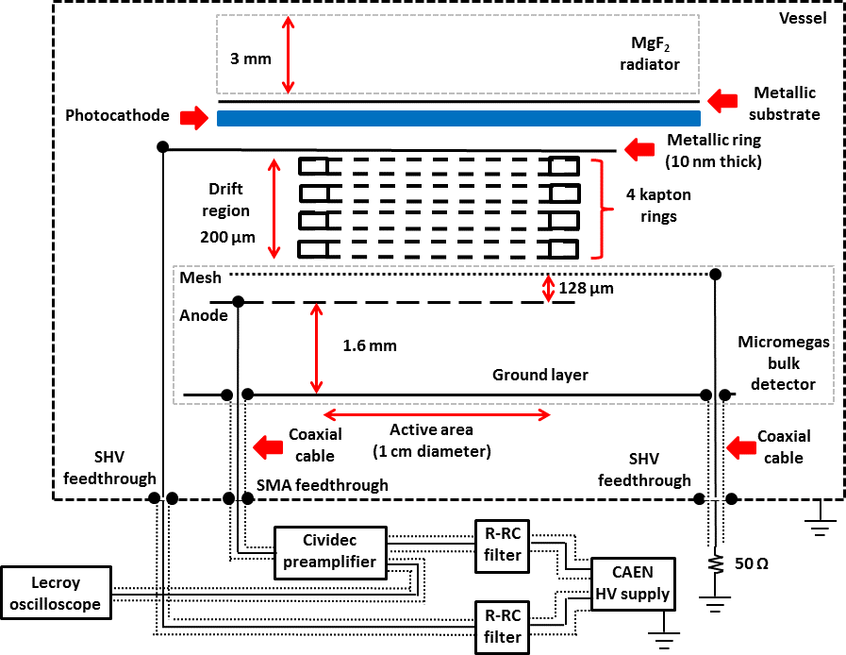
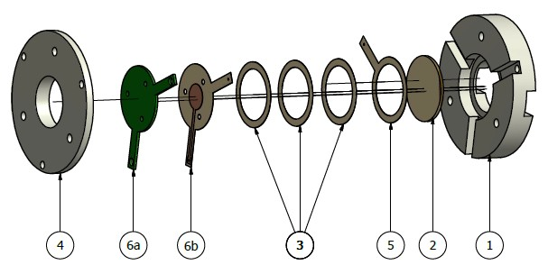
Single-pad prototype
→ 1 large channel :
1cm diameter
active area

Slide 10
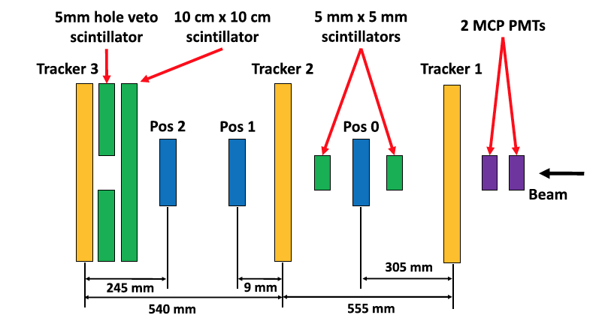
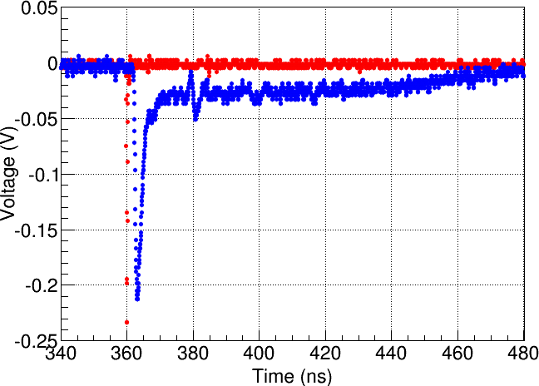
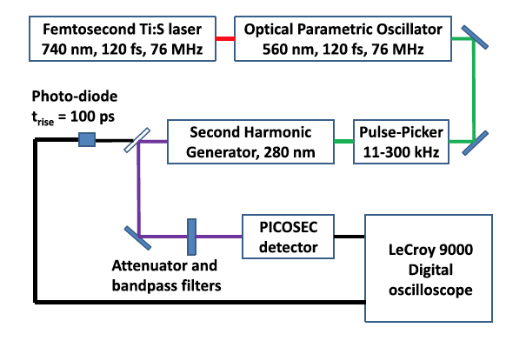
Testing prototypes in Particle and laser Beams
Muon beams & UV light
3 GEMs for tracking
and
* MCP for reference time
(red): <4ps accurancy
* PICOSEC: blue
Testbeam at CERN
Laser at Saclay
Notes:
10

Slide 11
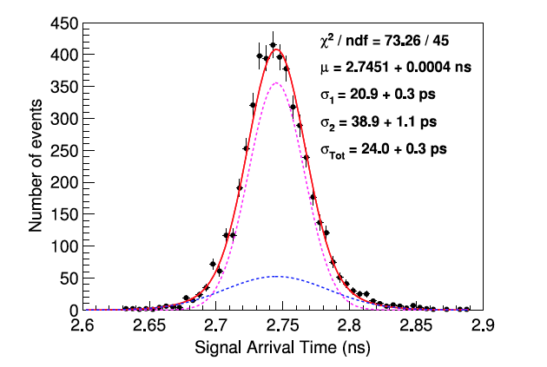
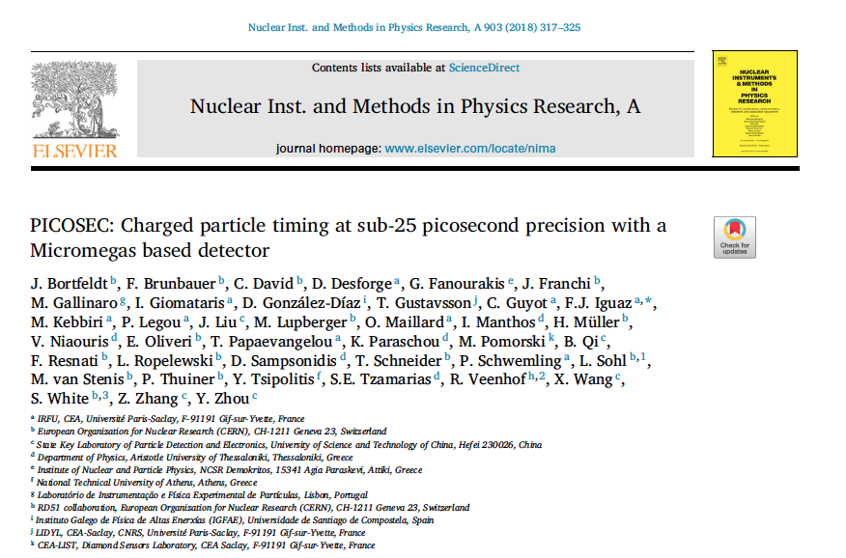
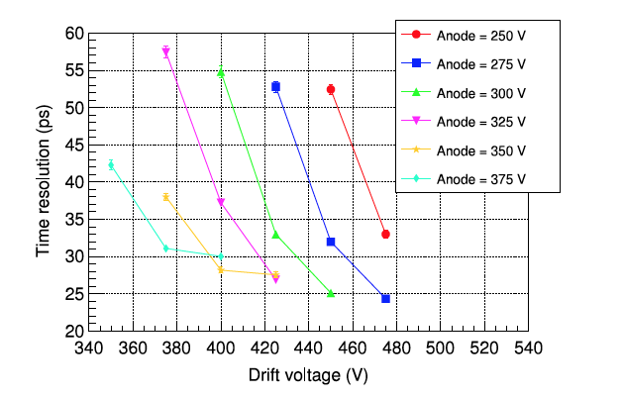
Notes:
11

Slide 12
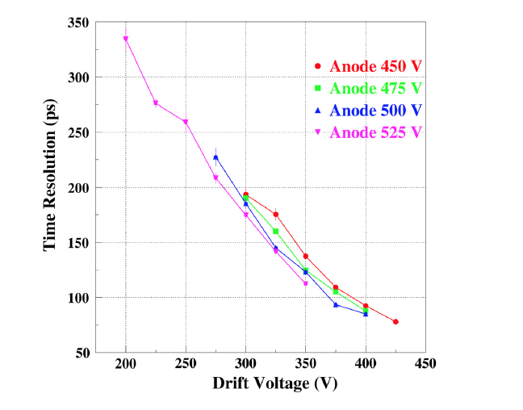
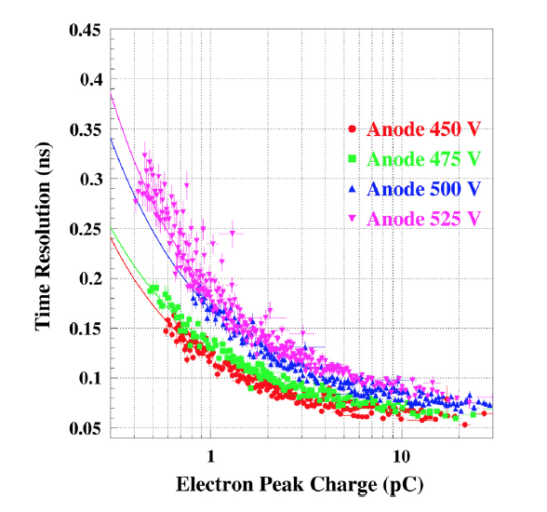
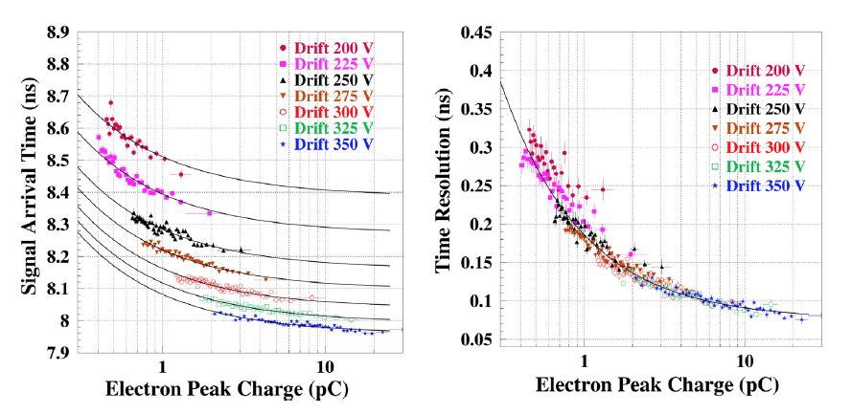
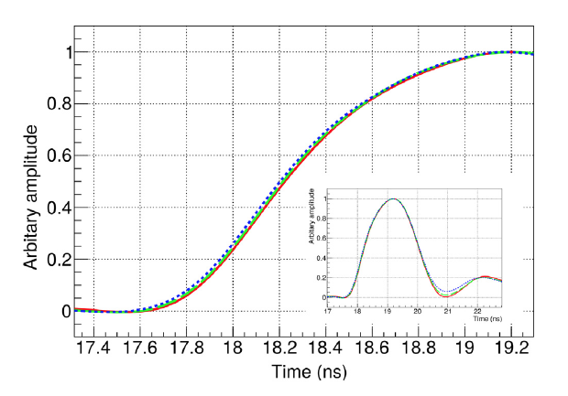
80 ps Timing Resolution for single-photon
Timing Resolution depends strongly on the drift voltage and less on the amplification field
The Signal Arrival Time (SAT) depends on the e-peak size in a non-trivial way

Slide 13
Identify the microscopic parameters which determine the Timing Characteristics

Slide 14
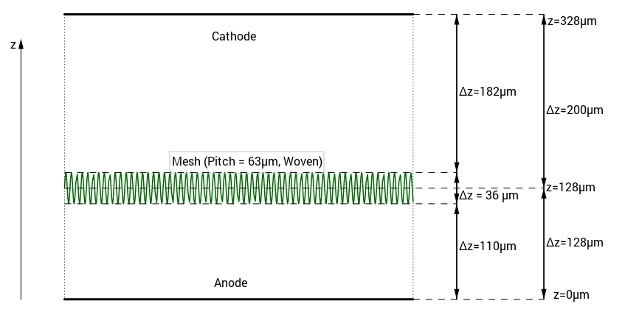
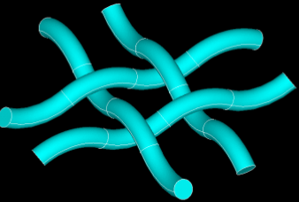
The details in the Garfield++ simulation (1)
Use Garfield++ to simulate PICOSEC
for single photoelectrons
COMPASS gas
(80% Ne + 10% CF₄ + 10% C₂H₆)
Pressure: 1 bar.
ANSYS for the electric field
Drift gap = 200 μm
Amplification gap = 128 μm
Mesh thickness = 36 μm
Anode volt age = 450 V
→ E = 35 kV/cm
Cathode voltage = 300-425 V
→ E in [15, 21] kV/cm
Photo-electron

Slide 15
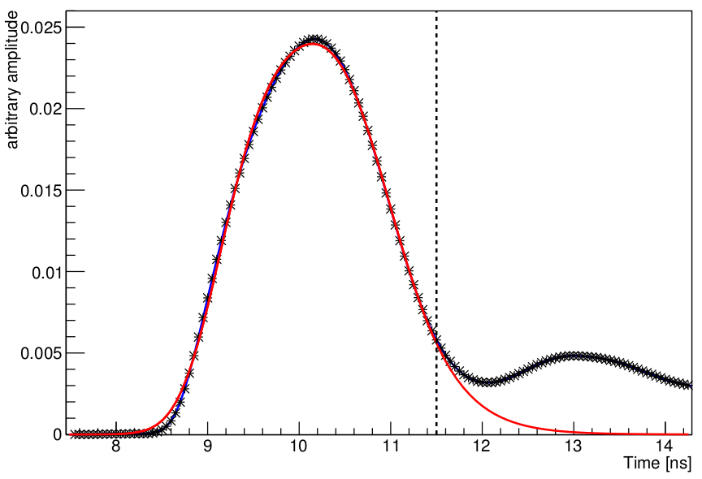
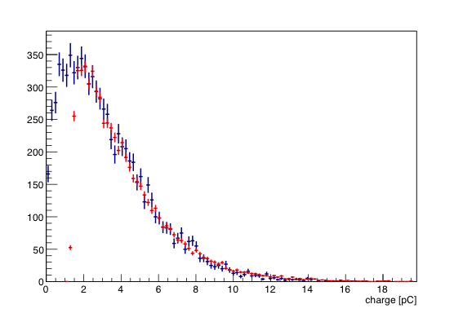
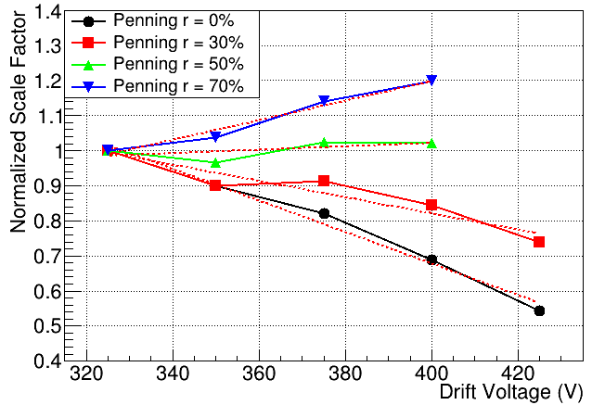
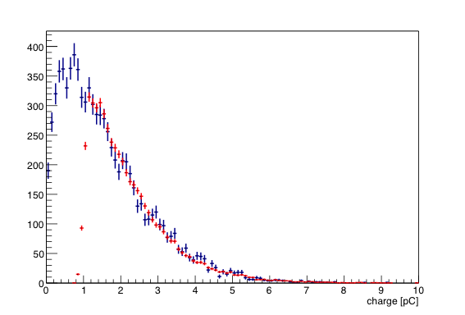
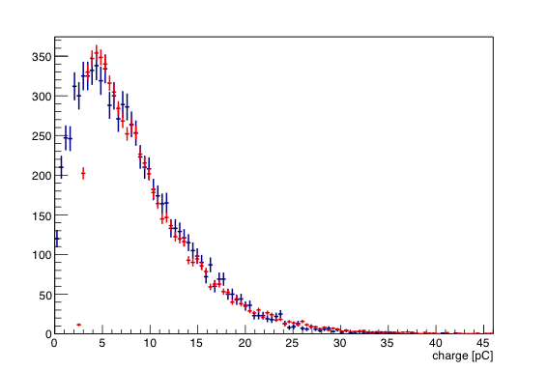
Describe the PICOSEC Response to a Single Photoelectrpn
using Detailed Garfield++ Simulation
including Penning Effect and the Electronics Response
Averaged PICOSEC waveforms in a certain e-peak charge region
E-peak Simulation Prediction (Garfield++ and Electronics Response)
An iterative method to determine the PICOSEC signal response (shape and amplitude distribution) to a single electron passing through the mesh and avalanching in the anode region
(80% Ne + 10% CF₄ + 10% C₂H₆)
450V – 400 V
Determination of the COMPASS-gas Penning Transfer Rate by comparing the simulated to the experimental e-peak charge distribution and demanding the related normalization factor to be the same, independent of the operating voltages
450 V-375 V
450 V- 425 V
K. Paraschou, “Study of the PICOSEC Micromegas Detector with Test Beam Data and Phenomenological Modelling of its Response”, Master’s Thesis, School of Physics, Aristotle University of Thessaloniki, https://ikee.lib.auth.gr/record/297707/ (2018).

Slide 16
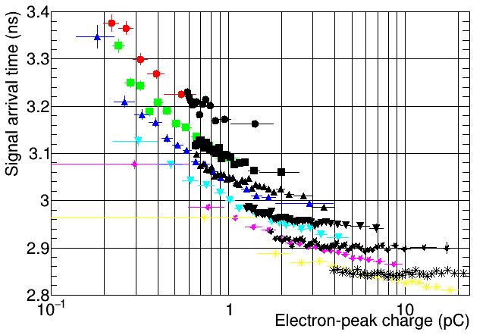
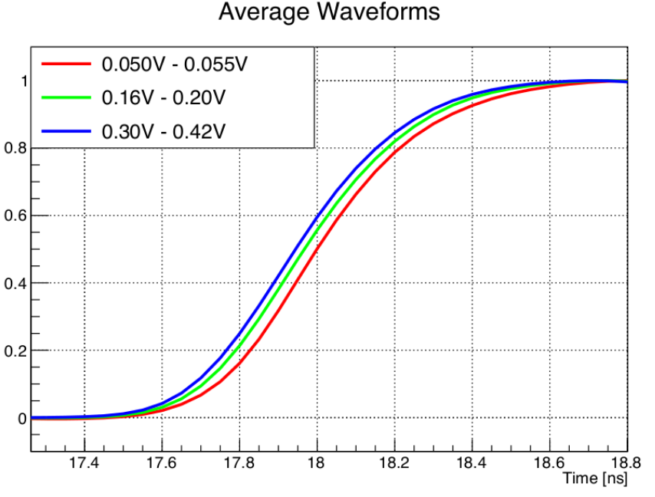
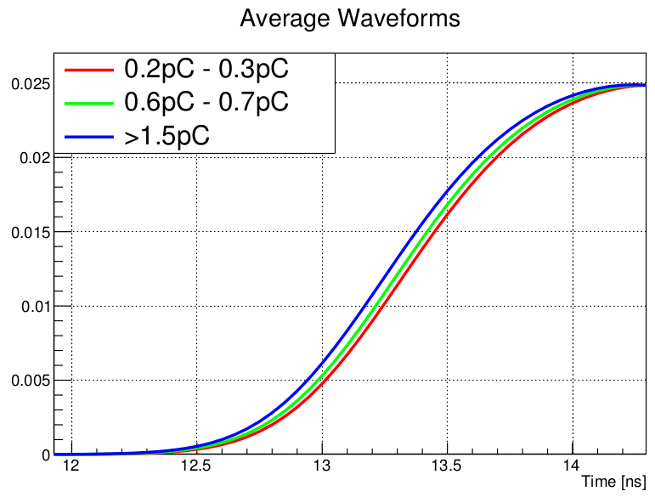
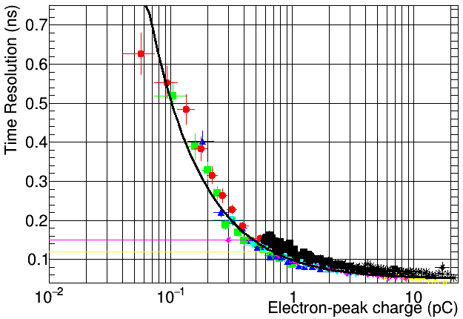
There is a very good agreement between the “trimmed” Garfield++ simulations and the experimental data
And all the behaviours we see in the data, are also seen in the simulation results.

Slide 17
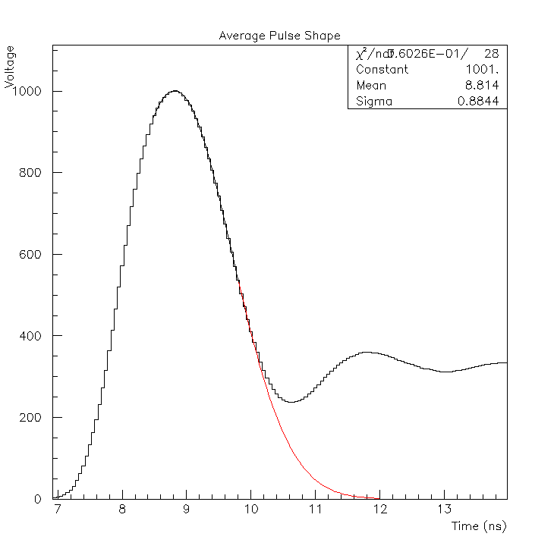
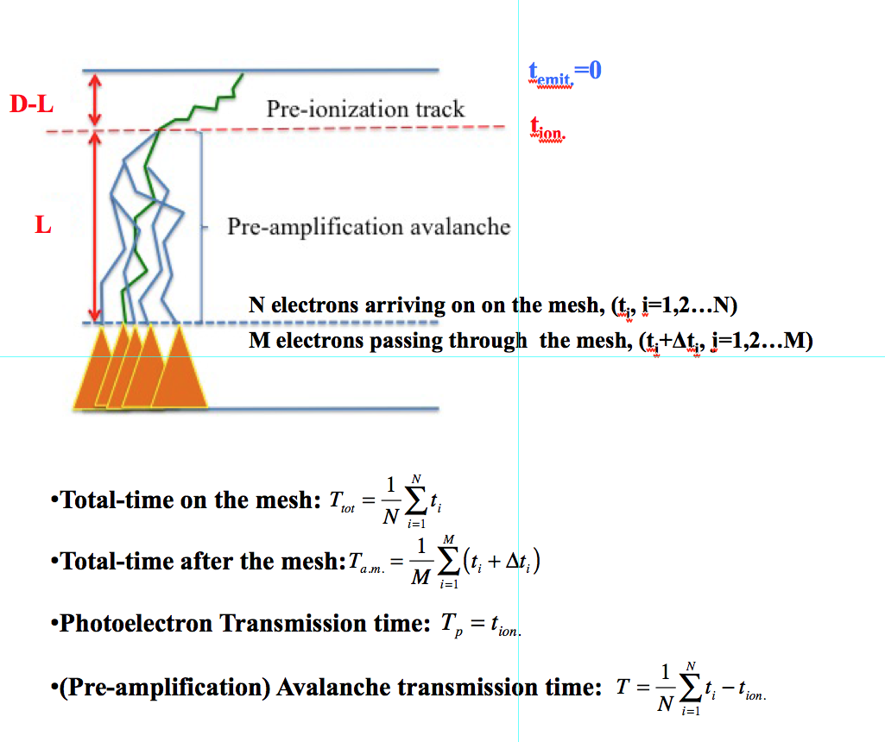
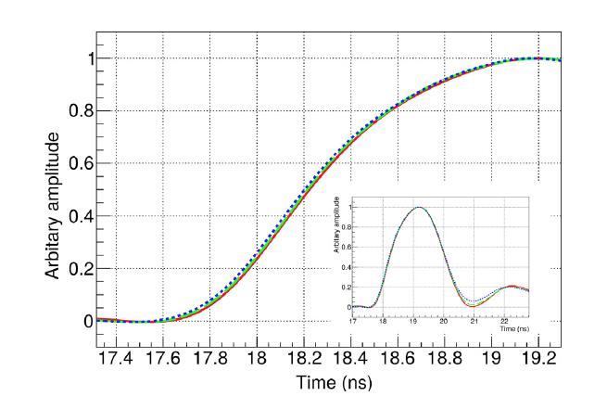

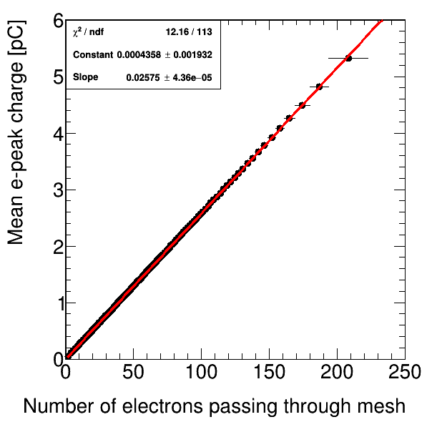
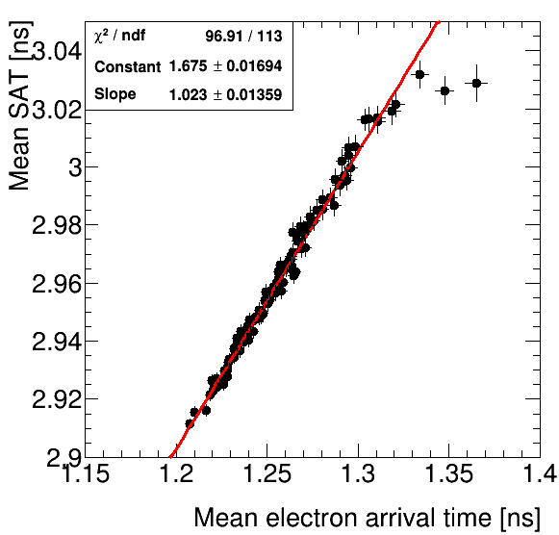
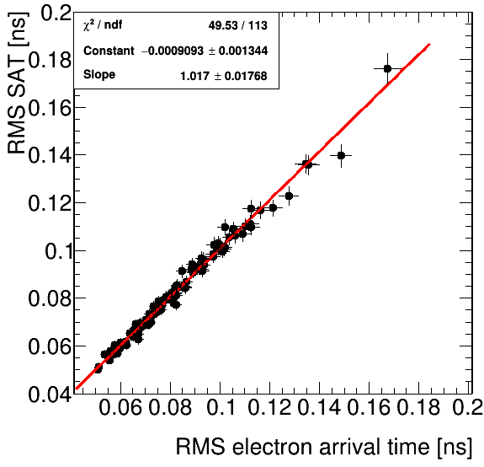
Correspondence between microscopic and macroscopic infromation
In the GARFIELD++ simulated PICOSEC response to a single photoelectron, we have available:
Microscopic Information
Macroscopic Information –Exp. Observable
T_{exp.} is a Random Variable
<T_{exp.}> is the S.A.T.
RMS[T_{exp.}] is the Timing Resolution
T_{exp.}
Correspondence of experimental Observables to Relevant Microscopic Variables
Sets of avalanches of a certain e-peak charge
PICOSEC Timing Properties → statistical properties for pre-amplification electrons which passed through the mesh (population M, and time Tm)

Slide 18

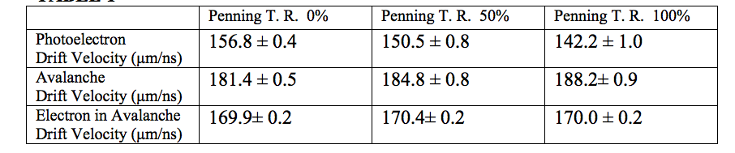
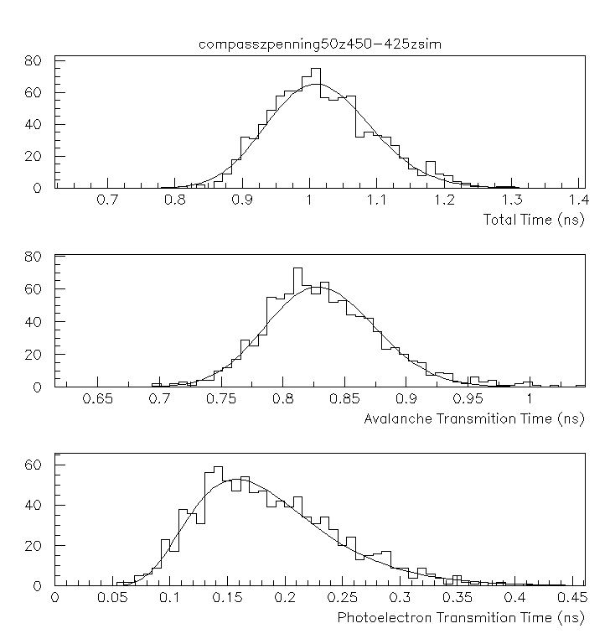
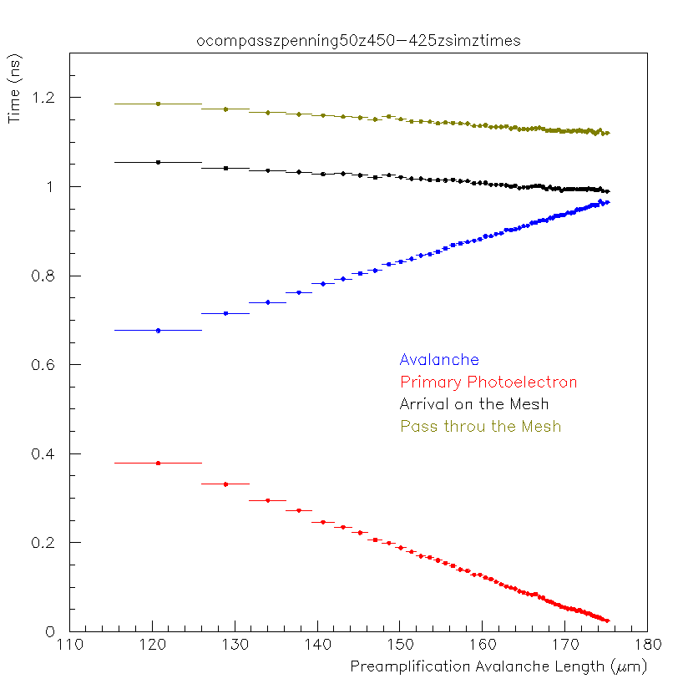
Arrival times vs. avalanche length
Drift times are expected to follow “inverse Gaussian” (= “Wald”) distributions.
.
The mean values of the transmission times depend linearly on the respective drift lengths.
The photoelectron drifts with less speed than the avalanche (as a whole) !!!
144.45 <L<144.75 μm
T_{tot}(L)
Time
T(L)
Passing through the mesh: just adds a constant time
T_{p}(L)
Avalanche length
18

Slide 19



(left) The arriving-time distribution of an avalanche’s electron at a longitudinal distance of 80μm from the start of the avalanche.
(right) The mean drift times of an avalanche electron versus the corresponding drift distances.
An individual electron in the avalanche drifts slower than the avalanche as a whole !!!
with a drift velocity independent of the Penning Transfer Rate !!!

Slide 20


Knowing already that the avalanche as a whole drifts faster than its’ constituent electrons, we examine how much earlier it arrives to the mesh compared to what would be the case if it was drifting with the speed of the constituents
The time gain got the avalanche as a whole (relative to the individual constituents) depends logarithmically on its electron multiplicity !

Slide 21

Timing Resolution as a Function of the Avalanche Length.
The time spread, which is related to the avalanche transmission is almost independent of the avalanche length!!
144.45 <L<144.75 μm
T_{tot}(L)
Time RMS
T(L)
T_{p}(L)
Avalanche length
1. Constant RMS for avalanche, no matter what it's length !!!
2. Photoelectron dominates time resolution, when it has enough drift length itself (large avalache length → small photoelectron drift length)
3. Avalanche and photoelectron contributions are statistically independent (at a given length the total RMS is the quadrature sum)
4. The passage through the mesh does not increase the time spread (black points on top of green points) when the drift voltage is high !!!
21

Slide 22

Timing Resolution as a Function of the Number of Pre-amplification Electrons.
1. the photoelectron & avalanche contributions to the total time spread are statistically, heavily correlated How comes this correlation?
2. The transmission through the mesh (~25%), at high drift voltages, does not affect the resolution of the PICOSEC !!!.

Slide 23

Summarize the effect of the mesh
The mesh transparency is almost constant (~25%), independent of the drift and anode voltages
The transmision through mesh adds a time delay, independent of the pre-amplification avalanche multiplicity
At lower drift voltages the mesh adds a spread which drops with the pre-amplification avalanche population !!!
At higher drift voltages the mesh does not affect the time spread !!!

Slide 24

GARFIELD++ adds with more questions than answers

Slide 25
Understanding the Physics of Precise Timing

Slide 26



A model inspired by the effect of quenchers in noble gasses:
Scatterings WITH some significant energy losses
Plots from Rob Veenhof
Scatterings WITHOUT significant energy loss
The more quencher we have, the faster we arrive somewhere forward.
The average forward speed of the very energetic rabbit is lower than the turtle!
Like a bounching ball:
if only elastically scattered, it goes backward with a lot of energy and it looses time before the Electric field brings it back to forward motion again!
So, with an inelastic collision, the photoelectron gains time compared to an elastic collisions! →

Slide 27


arXiv:1901.10779v1 [physics.ins-det]

Slide 28


arXiv:1901.10779v1 [physics.ins-det]

Slide 29



Very successful in predicting the Resolution vs Avalanche Length Dependence
The Input Parameters are the gas properties, i.e. single-e drift parameters, Townsend coefficient, Polya parameters

Slide 30



Anode: 450 V - Drift: 425 V
Penning Transfer Rate: 0%
Anode: 450 V - Drift: 425 V
Penning Transfer Rate: 100%
Anode: 450 V - Drift: 350 V
Penning Transfer Rate: 50%
Anode: 450 V - Drift: 325 V
Penning Transfer Rate: 50%

Slide 31




Very successful in predicting the Resolution vs Avalanche Multiplicity Dependence
Anode: 450 V - Drift: 425 V
Penning Transfer Rate: 50%
Anode: 450 V - Drift: 350 V
Penning Transfer Rate: 50%

Slide 32







Very successful in predicting the effect of the “transmission through the mesh” on the Timing Resolution

Slide 33

With the extra assumption that all the relevant time distributions can be expressed as inverse Gaussians, the Model describes stochastically all the timing characteristics of the PICOSEC detector in a very good agreement with the GARFIELD++ detail simulation

Slide 34

Conclusions
A simple phenomenological model has been developed which predict the timing characteristics of the PICOSEC signal, in terms of fundamental variables compiled in Table 8 for several drift voltage settings, in a very good agreement with results based on GARFIELD++ detailed simulations

Slide 35
Towards a robust detector
#1 robust anode
#2 robust photocathode
I. Maniatis talk

Slide 36

Best resolution was at voltages which give high currents on anode: robust anode
Readout beneath resistive layer: picks up signal from above
Copper Layer to HV via resistor; Readout “floating”
Developed in the MAMA project
Non resistive
← MAMA results →
With resistive strip
Current →
~ no discharges
discharges
Irradiation time →

Slide 37

Beam results with protected anodes
PRELIMINARY
PRELIMINARY
PRELIMINARY

Slide 38

Best resolution was at voltages which give high ion backflow? robust photocathode
Best time resolution (24ps for MIPs)
for CsI photocathode, but not robust
Robust photocathodes needed.

Slide 39

Investigating Photocathodes
And they have to be robust.
Most promissing performance results for non-CsI are from Diamond-Like Carbon (DLC), which also seems robust:
atmospheric conditions for a few months
irradiated with pions, in a resistive MM prototye →minimal reduction of Npe/MIP
3mm MgF₂ + DLC of different thicknesses :

Slide 40

Promising: Diamond Like Carbon (DLC) photocathodes
PRELIMINARY
PRELIMINARY

Slide 41
Towards a large scale detector
Results from a multi-channel prototype
I. Manthos talk

Slide 42

Multi-pad MicroMegas
Like the MgF₂/CsI/bulkMM/COMPAS gas single-pad PICOSEC which achieved 24ps per MIP
*
*
*
*
Hexagonal pads 5mm side
Readout 4 pads → 2 osciloscopes
(*** for multi-channel: have to move to chip solutions. Tried SAMPIC, no results yet)

Slide 43


Multi-pad: individual pad response vs. R
Like the MgF₂/CsI/bulkMM/COMPAS gas single-pad PICOSEC which achieved 24ps per MIP
Study response vs. R : distance of track impact from pad center
0<R<2mm:
full Cherenkov
cone (3mm)
inside pad
4.33 < R < 7.5mm:
Cherenkov cone (3mm)
mostly outside pad
e-peak charge should have all info about where is Cherenkov cone compared to pad. Indeed, universal curves vs. e-peak charge:
*
0. < R < 2. mm
2. < R < 4.33 mm
4.33 < R < 7.5 mm
*
*
0. < R < 2. mm
2. < R < 4.33 mm
4.33 < R < 7.5 mm
*
SAT (ns)
After corrections
Time Resolution (ns)
After corrections
PRELIMINARY
PRELIMINARY
<20ps for large e-peaks
Hexagonal pads 5mm side
e-peak charge (pC)
e-peak charge (pC)

Slide 44



Multi-pad: Same resolution as single-pad
At center of each pad (0<R<2mm):
a time resolution of 25ps for all pads
E.g.:
Individual pad response
σ_{tot}=25ps
PRELIMINARY
Individual pad response
ΔΤ = Time after all corrections (ns)
σ_{tot}=25ps
PRELIMINARY
ΔΤ = Time after all corrections (ns)

Slide 45






Multi-pad: Combining pads
Similar results all across thearea covered by the 4 pads
Combining pads event-by-event → Excellent time resolution
PRELIMINARY
μ=-2.0 ps
σ= 31 ps
Each individual pad: resolution worsens moving outwards
ΔΤ = Time after all corrections (ns)
μ=-2 ps
σ= 86 ps
PRELIMINARY
Excellent
Properties
of pull
Individual pad responses
PRELIMINARY
ΔΤ = Time after all corrections (ns)
ΔΤ / σ_{Τ}
μ=1.5 ps
σ= 81 ps
μ=-2.5 ps
σ= 70 ps
PRELIMINARY
PRELIMINARY
These are not the easiest regions
ΔΤ = Time after all corrections (ns)
ΔΤ = Time after all corrections (ns)
Pilars of ~650μm diameter
200μm inter-pad space

Slide 46
Conclusions
PICOSEC MicroMegas: a detector with precise timing:
  Single-channel prototype in Laser and Particle beams
  76ps for single photoelectrons, 24ps resolution for timing MIPs
A well-understood detector:
  reproduce observed behaviour with detailed simulations and a phenomenological model : valuable tool for parameter-space exploration
Towards a practical detector: robustness
  resistive anodes & robust photocathodes: promissing progress
Towards a large-scale detector: multi-channel
  response of multi-channel PICOSEC prototype: similar precision as the single-channel prototype, for any impact point of a MIP

Slide 47
RD51 PICOSEC-MicroMegas Collaboration
CEA Saclay (France): D. Desforge, I. Giomataris, T. Gustavsson, C. Guyot, F.J. Iguaz¹, M. Kebbiri, P. Legou, O. Maillard, T. Papaevangelou, M. Pomorski, P. Schwemling, L. Sohl.
CERN (Switzerland): J. Bortfeldt, F. Brunbauer, C. David, J. Frachi, M. Lupberger, H. Müller, E. Oliveri, F. Resnati, L. Ropelewski, T. Schneider, P. Thuiner, M. van Stenis, R. Veenhof², S. White³.
USTC (China): J. Liu, B. Qi, X. Wang, Z. Zhang, Y. Zhou.
AUTH (Greece): K. Kordas, I. Maniatis, I. Manthos, V. Niaouris, K. Paraschou, D. Sampsonidis, S.E. Tzamarias.
NCSR (Greece): G. Fanourakis.
NTUA (Greece): Y. Tsipolitis.
LIP (Portugal): M. Gallinaro.
HIP (Finland): F. García.
IGFAE (Spain): D. González-Díaz.
Now at Synchrotron Soleil, 91192 Gif-sur-Yvette, France
Also MEPhI & Uludag University.
Also University of Virginia.

