Slide 1








FCC-ee
Physics opportunities
M. Koratzinos
On behalf of the FCC study
LHC
PS
SPS
FCC
http://cern.ch/fcc
Work supported by the European Commission under the HORIZON 2020 projects EuroCirCol, grant agreement 654305; EASITrain, grant agreement no. 764879; ARIES, grant agreement 730871; and E-JADE, contract no. 645479
photo: J. Wenninger

Slide 2
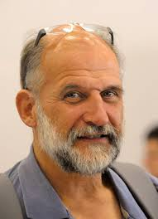
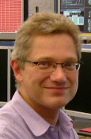
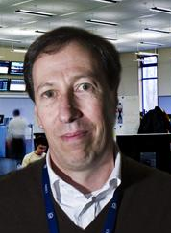

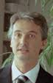
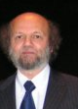
Acknowledgements
We should not forget the pioneers of the modern circular Higgs factory idea: Roy Aleksan, Alain Blondel, John Ellis, Patrick Janot, Frank Zimmermann, that promoted the idea when it was not fashionable
A. Blondel F. Zimmermann M. Koratzinos J. Ellis P. Janot R. Aleksan
I have taken material liberally from the CDR and from various talks, notably from Patrick Janot
FCC in this conference:
John Ellis: Back to the future, 17/4/2019
Emmanuel Tsesmelis: the FCC, 18/5/2019
Mike Koratzinos: FCC-ee physics opportunities

Slide 3

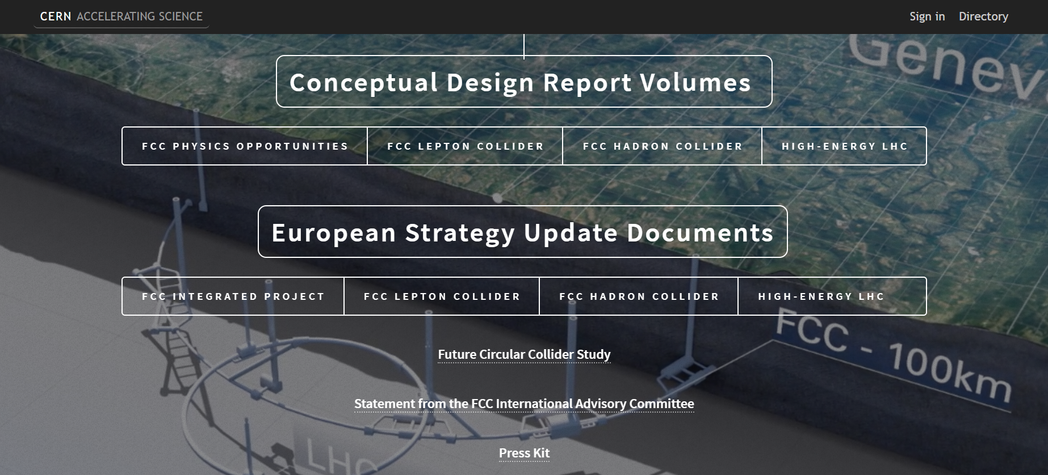
FCC study: CDR released on 15 January 2019
Four CDR volumes
10-page documents
I will only give a teaser here!

Slide 4
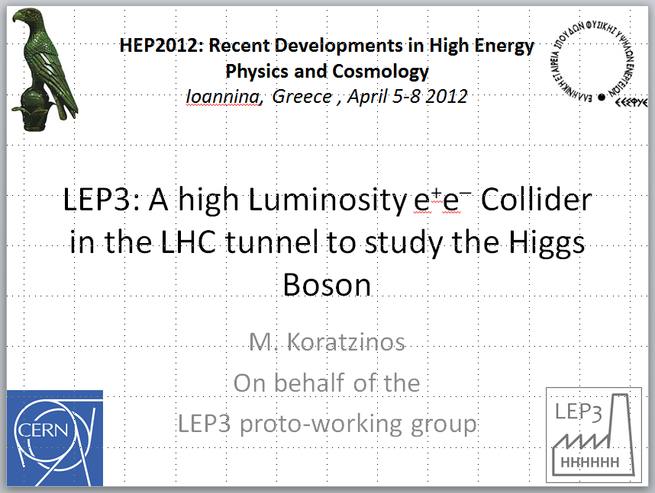
You have heard it here first!

Slide 5

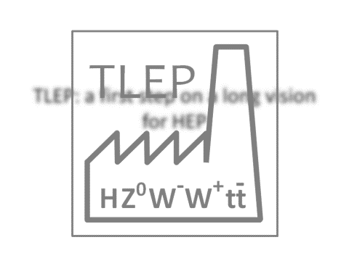
…and you have heard it again in Chios in 2013

Slide 6
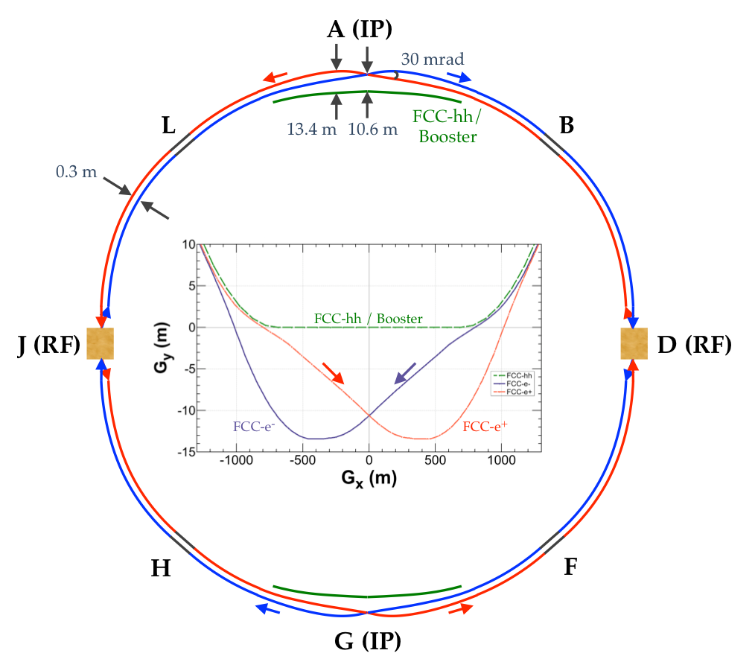
FCC-ee basic design choices
Double ring e+ e- collider ~100 km
Asymmetric “moustashe” IR layout and optics to limit synchrotron radiation towards the detector
2 IPs, large horizontal crossing angle 30 mrad, crab-waist optics
Synchrotron radiation power 50 MW/beam at all beam energies
Top-up injection scheme for high luminosity
Requires booster synchrotron in collider tunnel
The design can be modified to a 4-IP layout if needed

Slide 7
The FCC-ee accelerator – interesting facts
The FCC-ee accelerator is not simply a bigger LEP! It is a modern synchrotron that pushes the design envelope to the maximum.
The luminosity is so high that the beams burn up very quickly (beam lifetime 12 minutes at the ZH). Mandatory to use a full-size booster – the injector is the same size as the main ring and injects at top energy)
Full LEP physics dataset every 2 minutes!
Beam energy will be known to 100keV, whereas the (gravitational) effect of the moon passing overhead gives an energy change of 100MeV, one thousand times bigger.
The performance quoted in the CDR is not a paper exercise, it is fully backed by simulations, leading to stringent requirements: Colliding bunches must have the same charge to within 10%
Emittance blow up in the region ±2m from the IPs is equal to the emittance of the rest of the 100 kilometers – the area around the IP is very tricky and complex

Slide 8
FCC-ee collider parameters
parameter | FCC-ee |  |  |  | LEP2
energy/beam [GeV] | 45 | 80 | 120 | 182.5 | 105
bunches/beam | 16640 | 2000 | 328 | 48 | 4
beam current [mA] | 1390 | 147 | 29 | 5.4 | 3
luminosity/IP x 10³⁴ cm⁻²s⁻¹ | 230 | 28 | 8.5 | 1.5 | 0.0012
energy loss/turn [GeV] | 0.036 | 0.34 | 1.72 | 9.2 | 3.34
total synchrotron power [MW] | 100 |  |  |  | 22
RF voltage [GV] | 0.1 | 0.75 | 2.0 | 4+6.9 | 3.5
rms bunch length (SR,+BS) [mm] | 3.5, 12 | 3.0, 6.0 | 3.2, 5.3 | 2.0, 2.5 | 12, 12
rms emittance e_{x,y} [nm, pm] | 0.3, 1.0 | 0.84, 1.7 | 0.6, 1.3 | 1.5, 2.9 | 22, 250
Horiz.,vertical beta* [mm] | 150, 0.8 | 200, 1 | 300, 1 | 1000, 1.6
longit. damping time [turns] | 1273 | 236 | 70 | 20 | 31
crossing angle [mrad] | 30 |  |  |  | 0
beam lifetime (rad.B+BS) [min] | 68 | 59 | 12 | 12 | 434

Slide 9
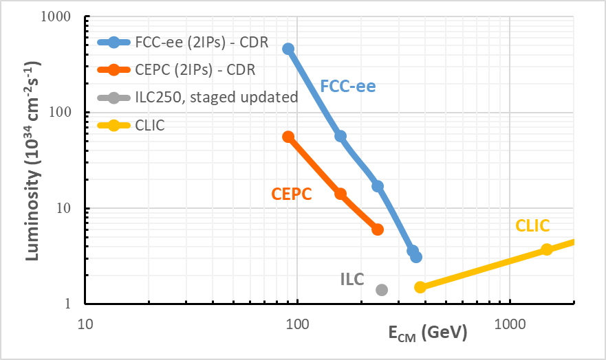
Lepton collider luminosities
ZH
240 GeV
ttbar
350 GeV
Z
91 GeV
WW
160 GeV
c.m. energy [GeV]

Slide 10
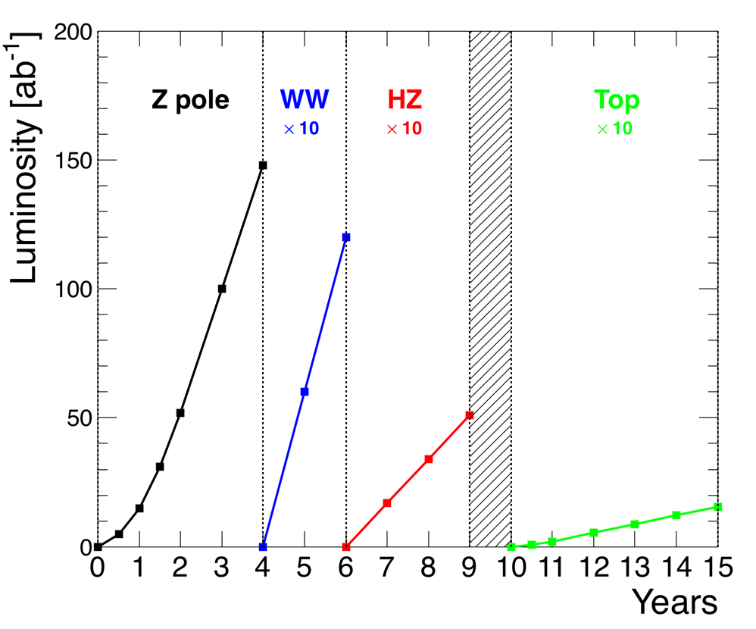
The FCC-ee operation model and statistics
185 physics days / year, 75% efficiency, 10% margin on luminosity
Working point | Z, years 1-2 |  | Z, later | WW | HZ | tt threshold… | … and above
√s (GeV) | 88, 91, 94 |  |  | 157, 163 | 240 | 340 – 350 | 365
Lumi/IP (10³⁴ cm⁻²s⁻¹) | 100 |  | 200 | 25 | 7 | 0.8 | 1.4
Lumi/year (2 IP) | 24 ab⁻¹ |  | 48 ab⁻¹ | 6 ab⁻¹ | 1.7 ab⁻¹ | 0.2 ab⁻¹ | 0.34 ab⁻¹
Physics goal | 150 ab⁻¹ |  |  | 10 ab⁻¹ | 5 ab⁻¹ | 0.2 ab⁻¹ | 1.5 ab⁻¹
Run time (year) | 2 | 2 |  | 2 | 3 | 1 | 4
Total : 15 years
Event statistics
√s precision
5×10¹² e⁺e⁻ → Z
10⁸ e⁺e⁻ → W⁺W⁻
10⁶ e⁺e⁻ → HZ
10⁶ e⁺e⁻ → tt
100 keV
300 keV
1 MeV
2 MeV
-

Slide 11
FCC-ee physics opportunities
FCC-ee will create vast physics opportunities due to its huge statistics and the centre-of-mass energy range it can cover (from 88 to 365GeV):
EW precision observable (EWPO) measurements sensitive to the 10-70TeV scale
Model-independent Higgs coupling measurements
Precise tests of flavour conservation/universality
Possible direct observation of very weakly coupled particles
Possible discovery of dark matter in invisible H or Z decays
…
    20 to 50 times improved precision on ALL electroweak observables
    m_{Z} , m_{W} , m_{top} , Γ_{Z} , sin² θ_{w}^{eff}, R_{b} , α_{QED}(m_{z}), α_{s}(m_{z} m_{W} m_{τ}), top EW couplings …
    ~10 times more precise and model-independent Higgs couplings measurements
FCC-ee is not only a Higgs factory! It is also a Z, W, and t factory

Slide 12
Important features for precision – EWPO regime
Statistics
  Very high statistics at the Z pole (70 kHz of visible Z decays) – we are systematics dominated at the Z!
  Beam-induced backgrounds are mild compared to linear colliders, but not negligible
    Readout must be able to cope with both
Luminosity measurement
  Aim at 0.01% from small angle Bhabhas
    Requires μm precision for LumiCal
    Requires calculation/measurement of outgoing e± deflection from the opposite bunch
  Need to study e⁺e⁻ → γγ to possibly reach 0.001%
√s calibration and measurement of √s spread
  50 keV “continuous” E_{BEAM} measurement with resonant depolarization
  Powerful cross checks from di-muon acollinearity and polarimeter/spectrometer
    Requires muon angle measurement to better than 100 μrad
Flavour tagging
  Beam pipe radius (15 mm) smaller than at linear collider (vertex detector 1st layer). 10 mm radius is currently investigated!
    New CEPC studies claim Purity × Efficiency ~ 97% for H → bb. And at FCC-ee ?

Slide 13
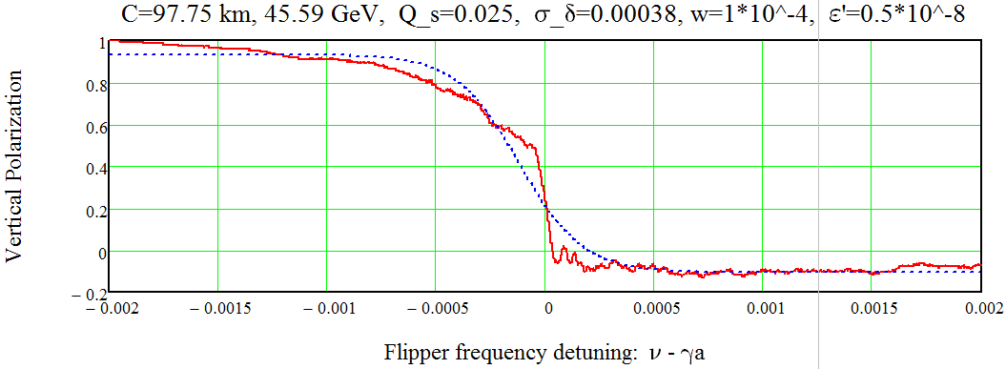
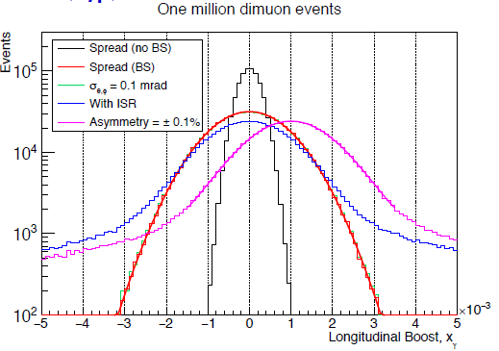
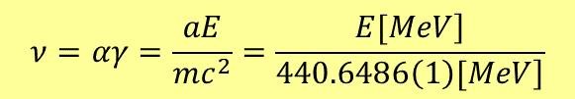
Beam Polarization and Energy Calibration
Simulations show adequate transverse polarization at the Z and WW energies
  Energy calibration by resonant depolarization every 10 mins on pilot bunches
    UNIQUE TO CIRCULAR COLLIDERS
    Total √s uncertainty of 100 keV @ Z pole, and 300 keV at the WW threshold
Energy spread (~100 MeV) will be measured
  From e⁺e⁻ → μ⁺μ⁻ longitudinal boost
    10⁶ events every 4 mins @ Z pole
      Continuous 35 keV precision on δ√s
    Also measures ΔE = E⁺ − E⁻ to at both IPs
Principle of the resonant depolarization method
Spin tune (spin prerecession frequency):
$$ν=αγ=\frac{aE}{mc^{2}}=\frac{\left.E[MeV\right]}{\left.440.6486\left(1\right)[MeV\right]}$$
Resonant Depolarization precision: 50keV (instantaneous)
Unique to FCC-ee: a helping hand from dimuon events
260 seconds sweep of depolarizer frequency

Slide 14
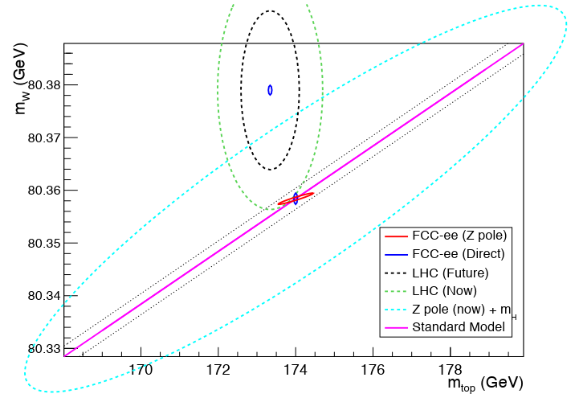
Combination of all EW measurements
With m_{top}, m_{H} and m_{W} known, the standard model has nowhere to hide!
Effect of BSM physics is to modify EW observables through quantum effects (cf top & H @ LEP)
LEP + M_{H} @LHC
LHC (now)
FCC-ee is here
LHC (future)
Standard model
FCC-ee direct
FCC-ee Z-pole
Need to measure all ingredients!
Improving theory predictions mandatory.

Slide 15
A note on attainable precision
Example: the W mass
Prediction:
before FCC
After FCC
direct measurement:
Essential to reduce theory error: necessitates calculation up to 3-4 loops. Effort has already started. 2 loop calculations finished – 3 loops started.
There is good hope that the theory error can be reduced so that it does not dominate the calculations
If only one ingredient is missing, the sensitivity to new physics may entirely vanish

Slide 16
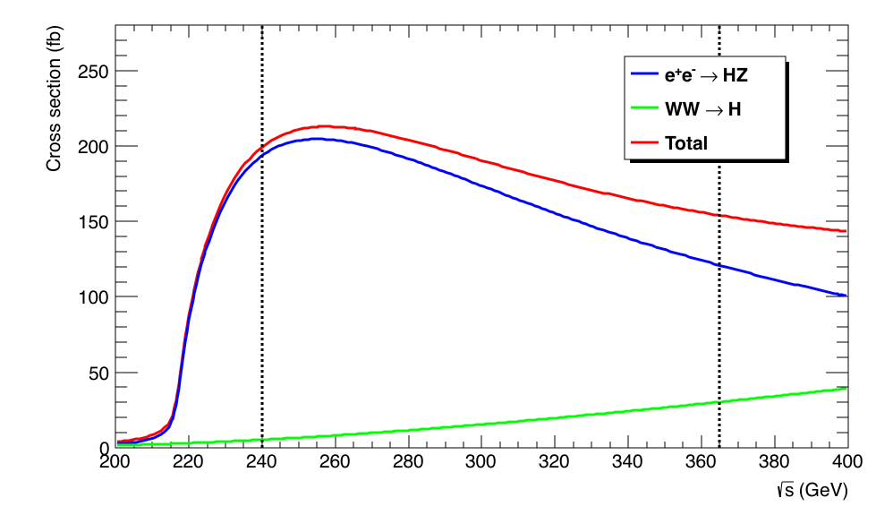
The FCC-ee as a Higgs factory
Higgsstrahlung (e⁺e⁻ → ZH) event rate largest at √s ~ 240 GeV : σ ~200 fb
  10⁶ e⁺e⁻ → ZH events with 5 ab⁻¹ – cross section predicted with great accuracy
    Target : (few) per-mil precision on couplings, statistics-limited.
    Complemented with 200k events at √s = 350 – 365 GeV
      Of which 30% in the WW fusion channel (useful for the Γ_{H} precision)

Slide 17
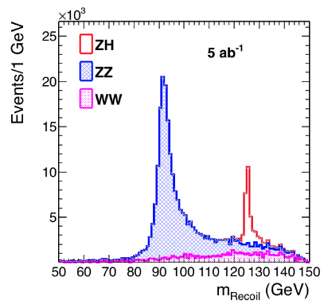
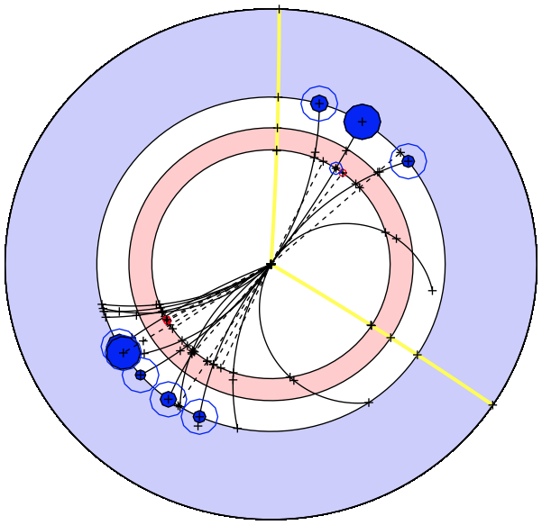
Absolute coupling and width measurement
Higgs tagged by a Z, Higgs mass from Z recoil
  Total rate ∝ g_{HZZ}² → measure g_{HZZ} to 0.2%
  ZH → ZZZ final state ∝ g_{HZZ}⁴ / Γ_{H} → measure Γ_{H} to a couple %
  ZH → ZXX final state ∝ g_{HXX}² g_{HZZ}² / Γ_{H} → measure g_{HXX} to a few per-mil / per-cent
  Empty recoil = invisible Higgs width; Funny recoil = exotic Higgs decays
Note: The HL-LHC is a great Higgs factory (10⁹ Higgs produced) but …
  σ_{i→f} ^{(observed)} ∝ σ_{prod} (g_{Hi})² (g_{Hf})² / Γ_{H}
    Difficult to extract the couplings : σ_{prod} is uncertain and Γ_{H} is largely unknown
      Must do physics with ratios or with additional assumptions.
μ⁻
μ⁺
e⁺e⁻→ HZ

Slide 18
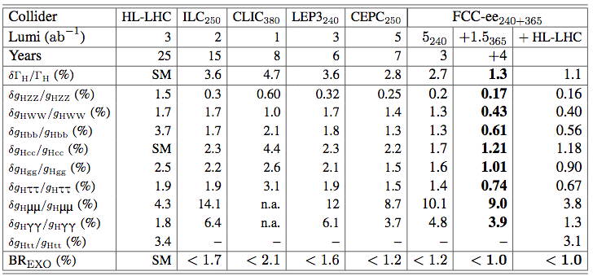
Result of the “kappa” fit
Same fit applied to all Higgs factories inputs (for unbiased comparison)
  The FCC-ee precision better than HL-LHC by large factors (for the copious modes)
    The FCC-ee is best on the e⁺e⁻ Higgs factory market
  It is important to have two energy points (240 and 365 GeV), as it is the case at the FCC-ee
    Combination better by a factor up to 2 (4) than 240/250 (365/380) GeV alone
  The FCC-ee improves precision of HL-LHC by large factors (copious modes)
      With no need for additional assumptions – best on the e⁺e⁻ collider market
  It is important to have two energy points (240 and 365 GeV)
      Combination better by a factor 2 (4) than 240 (365) GeV alone

Slide 19
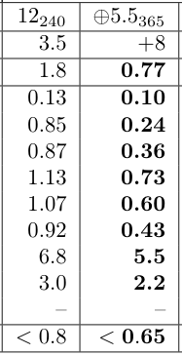
Result of the “kappa” fit in 4 IP scenario
Same fit applied to all Higgs factories inputs (for unbiased comparison)
  The FCC-ee precision better than HL-LHC by large factors (for the copious modes)
    The FCC-ee is best on the e⁺e⁻ Higgs factory market
  It is important to have two energy points (240 and 365 GeV), as at the FCC-ee
    Combination better by a factor up to 2 (4) than 240/250 (365/380) GeV alone
  The FCC-ee improves precision of HL-LHC by large factors (copious modes)
      With no need for additional assumptions – best on the e⁺e⁻ collider market
  It is important to have two energy points (240 and 365 GeV)
      Combination better by a factor 2 (4) than 240 (365) GeV alone

Slide 20
Comment about longitudinal polarization
The FCC-ee e⁺ and e⁻ beams will not be longitudinally polarized
  Unlike at linear colliders where 80% polarized e⁻ can be injected and accelerated
    And, with some difficulty and money, may get 30% polarized e⁺ as well.
Effect of longitudinal polarization at 240/250 GeV for Higgs couplings
  Polarization causes σ_{HZ} to increase by 1.4 (1.08) in e⁻_{L}e⁺_{R} (e⁻_{R}e⁺_{L}) configuration
    Similar increase for the backgrounds (except for WW : 2.34 and 0.14)
      Precision better by 20% with the same luminosity in the κ fits
  EFT fits benefit from different polarization states to constrain additional operators
    At circular colliders, constraints come from EW precision measurements
      Precision still better by ~20% or less with the same luminosity in the EFT fits
      The only coupling for which polarization brings significant gain is g_{HZγ}
        Much better measured at hadron collider (e.g., FCC-hh) anyway
At the FCC-ee, longitudinal polarization is not worth the induced luminosity loss
  NB. Without polarization, one year at the FCC-ee with 2 (4) IPs at √s = 240 GeV offers the same Higgs coupling precision as 8 (16) years with ILC polarized e⁺ and e⁺
    Similar remark holds for EWPO or top EW couplings measurements at other √s
J. De Blas

Slide 21
Comment about longitudinal polarization
The FCC-ee e⁺ and e⁻ beams won’t be longitudinally polarized
  Unlike at linear colliders where 80% polarized e⁻ can be injected and accelerated
    And, with more difficulty and money, may get 30% polarized e⁺ as well.
Effect of longitudinal polarization at 240/250 GeV for Higgs couplings
  Polarization causes σ_{HZ} to increase by 1.4 (1.08) in e⁻_{L}e⁺_{R} (e⁻_{R}e⁺_{L}) configuration
    Similar increase for the backgrounds (except for WW : 2.34 and 0.14)
      Precision better by 20% with the same luminosity in the κ fits (slide 21)
  EFT fits benefit from different polarization states to constrain additional operators
    At circular colliders, constraints come from EW precision measurements
      Precision still better by ~20% or less with the same luminosity in the EFT fits
      The only coupling for which polarization brings significant gain is g_{HZγ}
        Much better measured at hadron collider (e.g., FCC-hh) anyway
At the FCC-ee, long. polarization is not worth the induced luminosity loss
  NB. Without polarization, one year at the FCC-ee with 2 (4) IPs at √s = 240 GeV offers the same Higgs coupling precision as 8 (16) years with ILC polarized e⁺ and e⁺
    Similar remark holds for EWPO or top EW couplings measurements at other √s
Beam polarization brings no information
that cannot be obtained otherwise.
There is no obvious need for it.

Slide 22
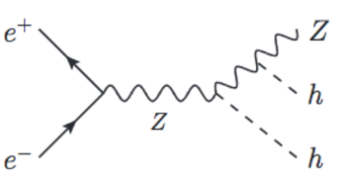
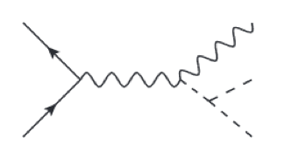
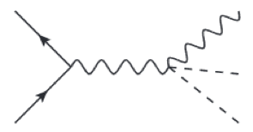
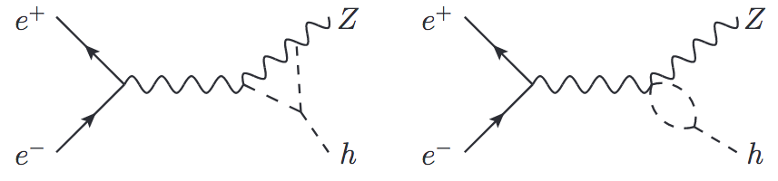
Is a √s = 500 GeV upgrade required/useful ?
According to the white book of ESU 2013 :
  The same arguments are used by some documents submitted to ESU 2020!
  So, should we foresee an upgrade of FCC-ee at √s = 500 GeV ?
    For the total width and the coupling to the top quark : the answer is NO (slide 17) – there is a much better prior measurement (HL-LHC) which becomes model-independent after 7 yers of FCC-ee higgs physics
    For the Higgs self-coupling (κ_{λ}):
https://cds.cern.ch/record/1567295/
At energies of 500 GeV or higher, such a machine could explore the Higgs properties further,
for example the coupling to the top quark, the self-coupling, and the total width.
Z
Z
At √s = 500 GeV
h
−
h
Di-Higgs
production
κ_{λ}
κ_{H}
h
h
At FCC-ee
+
σ_{HZ}
κ_{λ}
M. McCullough
arXiv:1312.3322
κ_{λ}

Slide 23
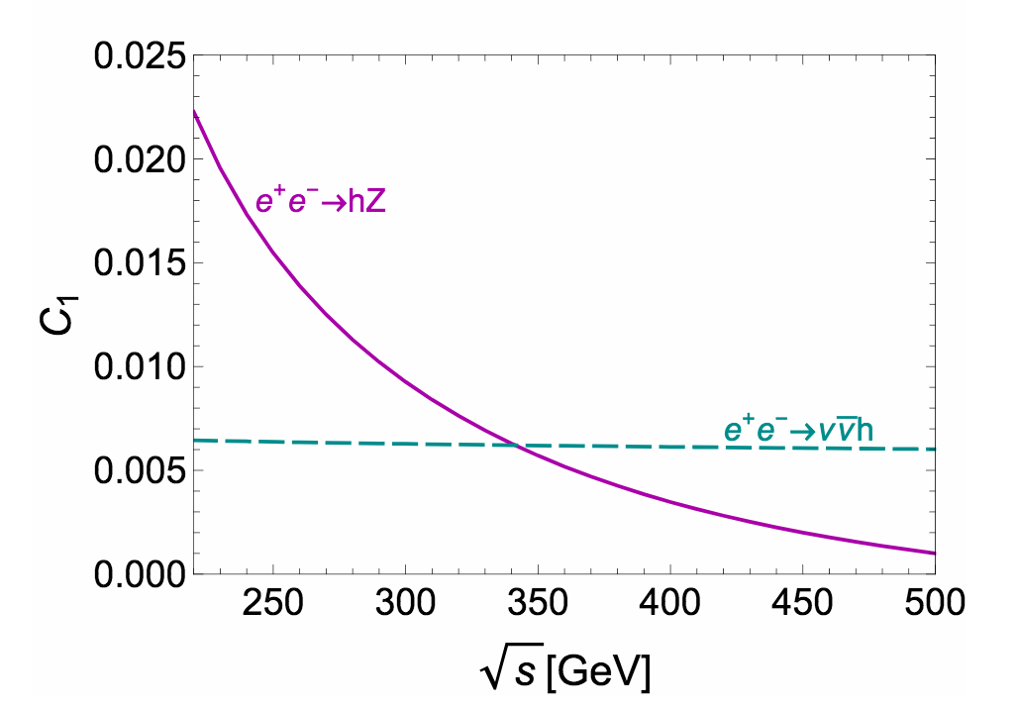
Higgs self-coupling at the FCC-ee
Effect of Higgs self coupling (κ_{λ}) on σ_{ZH} and σ_{ννH} depends on √s
  Two energy points lift off the degeneracy between δκ_{Z} and δκ_{H}
    Precision on κ_{λ} with 2 IPs at the end of the FCC-ee (91+160+240+365 GeV)
      Global EFT fit (model-independent) : ±34% (3σ); in the SM : ±12%
    Precision on κ_{λ} with 4 IPs : ±21% (EFT fit) (5σ); ±9% (SM fit)
      ~5σ discovery with 4 IPs instead of 2 – much less costly than 500 GeV upgrade (in time and funds, in view of FCC-hh)
And, most importantly
  Only FCC-hh, in combination with FCC-ee, can measure κ_{top} and κ_{λ} to 1% and 5%, respectively.
C. Grojean et al.
arXiv:1711.03978
Up to 2% effect on σ_{HZ}
Δσ
σ
δκ_{Z}
A. Blondel, P. J.
arXiv:1809.10041

Slide 24
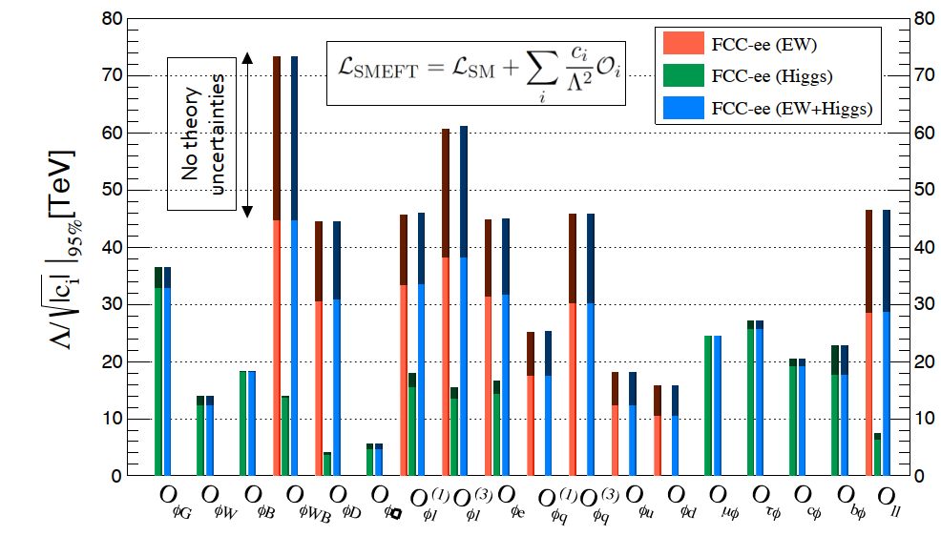
Precision ⟺ Discovery
Sensitivity to new physics: Combining precision Higgs and EW measurements in SMEFT*
Deviating operators may point
to the new physics to be looked
for at the FCC-hh
FCC-ee reach for new physics: from typically 20TeV all the way to 70TeV
Dark bars: neglecting theory uncertainties
  Higgs and EWPO measurements are well complementary
  EWPO are more sensitive to heavy new physics (up to 50-70 TeV)
  Larger statistics pays off for Higgs measurements (4 IPs ?)
  Further improvement in theory predictions pays off for EWPO measurements
(*)SMEFT The Standard Model effective ﬁeld theory is a model-independent framework for parameterising deviations from the Standard Model in the absence of light states.

Slide 25
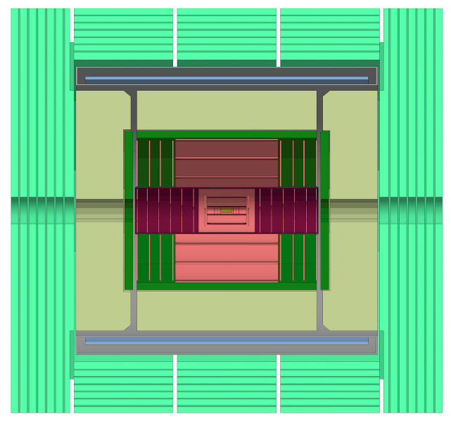
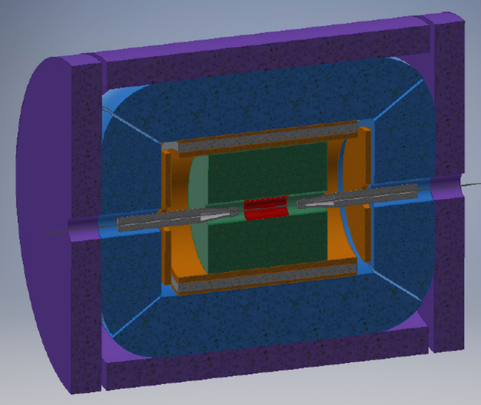
FCC-ee detector design concepts
Two designs studied so far
  It was demonstrated that detectors satisfying the requirements are feasible
    Physics performance, invasive MDI, beam backgrounds
More complete studies, with full simulation, needed
  Towards at least four detector proposals to be made by ~2026
    Light, granular, fast, b and c tagging, lepton ID and resolutions, hadron ID
    Cost effective
    Satisfy constraints from interaction region layout
Two different concepts have been demonstrated to work, one a proven concept and the other with a thin solenoid and simple calorimeter (and a factor 2 cheaper)
Proven concept
Known performance
Ultra Light
Innovative
Cost effective
2T
Si-W Calo
DR Calo
2T
DCH
Si Tracker
LumiCal
CLD (~CLICdet)
IDEA
We are now open to detector collaborations!

Slide 26
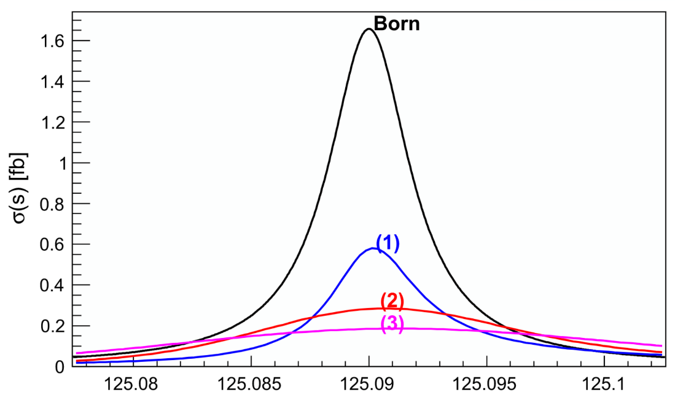
Unique at FCC-ee : First generation couplings
If schedule allows or calls for a prolongation of FCC-ee, can spend few years at √s = 125.09 GeV
  For s-channel production e⁺e⁻ → H (a la muon collider, with 10⁴ higher lumi )
  Expected signal significance of ~0.4σ / √year in both option 1 and option 2
    Set a electron Yukawa coupling upper limit : κ_{e} < 2.5 @ 95% C.L.
    Reaches SM sensitivity after five years (or 2.5 years with 4 IPs)
  Unique opportunity to constrain first generation Yukawa’s
S. Jadach, R.A. Kycia
arXiV:1509.02406
(1): with ISR
(2): δ√s = 6 MeV
(3): δ√s = 10 MeV
FCC-ee monochromatization setups
  Default: δ√s = 100 MeV, 25 ab⁻¹ / year
    No visible resonance
  Option 1: δ√s = 10 MeV, 7 ab⁻¹ / year
    σ(e⁺e⁻ → H) ~ 100 ab
  Option 2: δ√s = 6 MeV, 2 ab⁻¹ / year
    σ(e⁺e⁻ → H) ~ 250 ab
  Backgrounds much larger than signal
    e⁺e⁻ → qq, ττ, WW*, ZZ*, γγ, …
–
Monochromatization:
E
E
e⁻
D. d’Enterria
arXiV:1701.02663
e⁺

Slide 27

Come and join us!

Slide 28
Conclusions
FCC-ee has tremendous physics potential due to its
  Huge statistics
  Great precision
It can improve EWPO by factors of ~20 to 50 compared to the situation today
It can measure Higgs couplings to sub-percent precision
It is sensitive to energy scales for new physics of 20-70TeV
It has excellent upgrade potential: the FCC-hh, an 100TeV-plus hadron collider
Come and join the adventure!

Slide 29
Extra slides

Slide 30
Measuring the beam energy and energy spread
Measuring the beam energy and energy spread is essential at the Z and W running.
We aim for errors of ~100keV for ECM. Use the resonant depolarization method (transverse polarization needed)
  Note that statistical error for the Z mass determination is only 5keV (5.10¹² Zs!)
  Also note that the daily variation of the energy due to terrestrial tides would be ~130MeV
  LEP experience: M_{z} measured to 2MeV
A working group has been set up (chaired by A. Blondel) and a workshop was organised at CERN
Please note that measuring the beam energy necessitates the use of dedicated hardware, so it needs to be designed early.

Slide 31
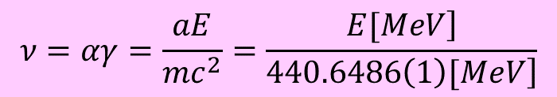
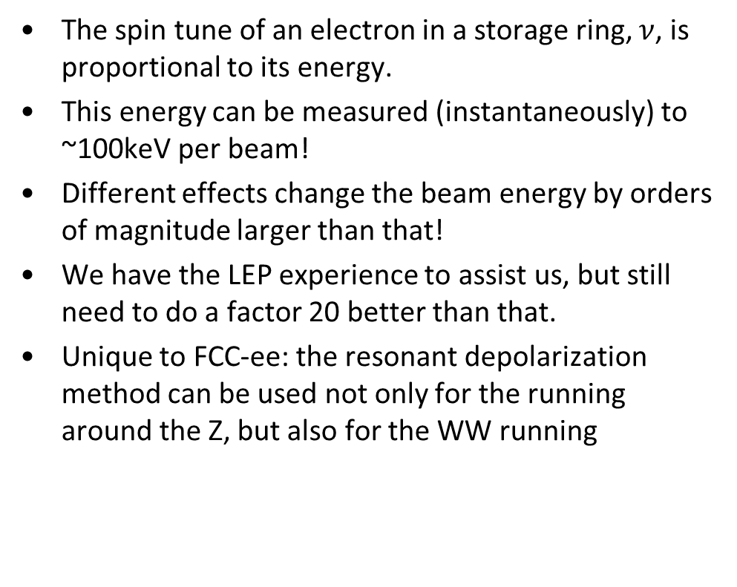
The resonant depolarization method
$$ν=αγ=\frac{aE}{mc^{2}}=\frac{\left.E[MeV\right]}{\left.440.6486\left(1\right)[MeV\right]}$$
The spin tune of an electron in a storage ring, $ν$, is proportional to its energy.
This energy can be measured (instantaneously) to ~100keV per beam!
Different effects change the beam energy by orders of magnitude larger than that!
We have the LEP experience to assist us, but still need to do a factor 20 better than that.
Unique to FCC-ee: the resonant depolarization method can be used not only for the running around the Z, but also for the WW running
At the Z, polarization times are high (200 hours) – use dedicated wigglers
Transverse polarization of a few % is sufficient for a measurement – every 5 mins / both beams
Unique to circular colliders
Careful machine preparation + harmonic bump tuning

Slide 32
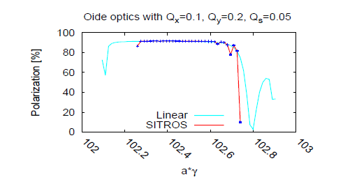
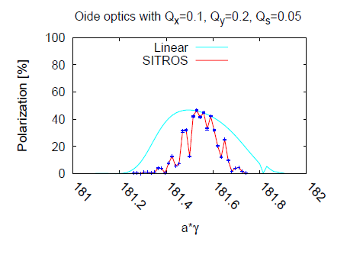
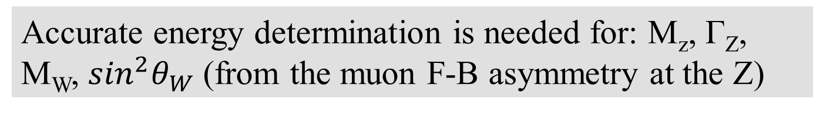
Achieving polarization
Accurate energy determination is needed for: M_{z}, Γ_{Z}, M_{W}, $\sin^{2}θ_{W}$(from the muon F-B asymmetry at the Z)
To depolarize you must first have achieved polarization; ~10% polarization sufficient
A real (imperfect) machine depolarizes fast – need careful corrections to restore polarization levels
Would this be possible? Simulation code SISTROS says yes both for the Z and for the W. Correcting an imperfect machine (quad misalignments + BPM errors) restores polarization levels.
45 GeV
80 GeV
Machine with imperfections after correction
Minimum polarization level required
Energy spread increases σ_{Eb} ∝ E_{b}²/ρ and polarization level decreases.
At the W expectation similar to LEP at Z
→ enough for energy calibration
Excellent polarization at the Z (but slow)
E. Gianfelice-Wendt

Slide 33
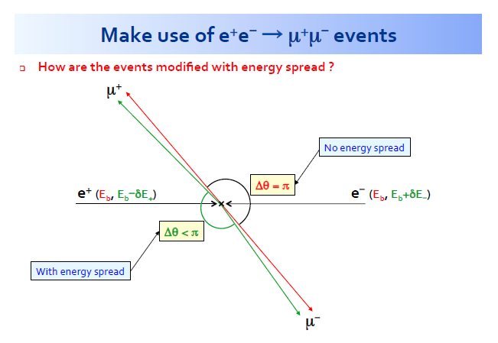
Energy spread determination
At the Z peak we collect 10⁶ μμ events every 5 minutes.
Their kinematics is affected by:
energy spread
e+ vs e- energy difference.
P. Janot has shown that indeed both
can be determined with extremely
good precision with these events.
The energy difference is an important ingredient in understanding the RF model

Slide 34
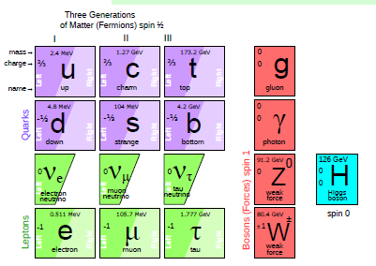
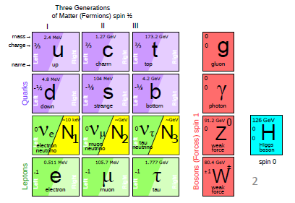
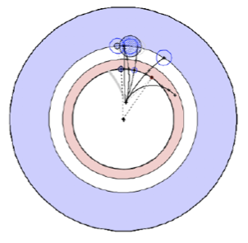
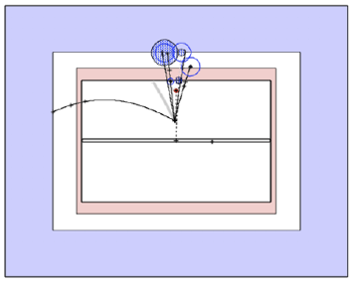
Direct discoveries
Discover right-handed neutrinos
  νMSM : Complete particle spectrum with the missing three right-handed neutrinos
    Could explain everything: Dark matter (N₁), Baryon asymmetry, Neutrino masses
  Searched for in very rare Z → νN_{2,3} decays
    Followed by N_{2,3} → W∗𝓵 or Z∗ν
The SM
The νMSM
A. Blondel et al.
arXiv:1411.5230
Very small νN mixing : long lifetime, detached vertex
100

Slide 35
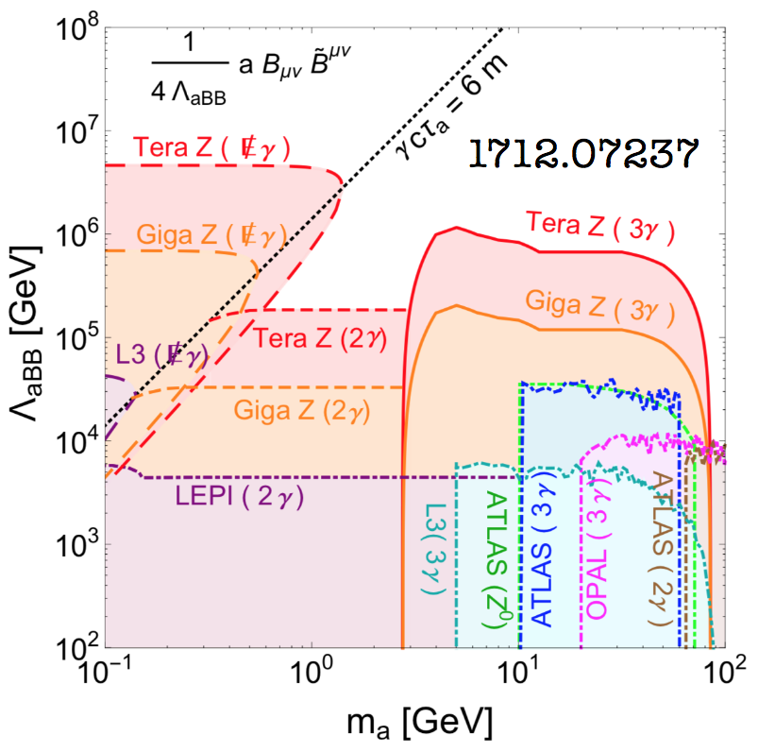
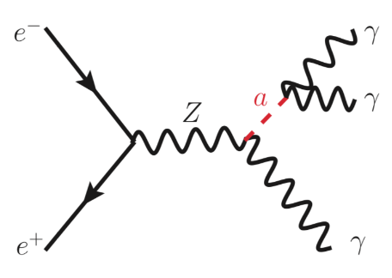
Direct discoveries (cont’d)
Discover the dark sector
  A very-weakly-coupled window to the dark sector is through light “Axion-Like Particles” (ALPs)
      γ + E_{MISS} for very light a
      γγ for light a
      γγγ for heavier a
    Orders of magnitude of parameter space accessible at FCC-ee
1712.07237

Slide 36
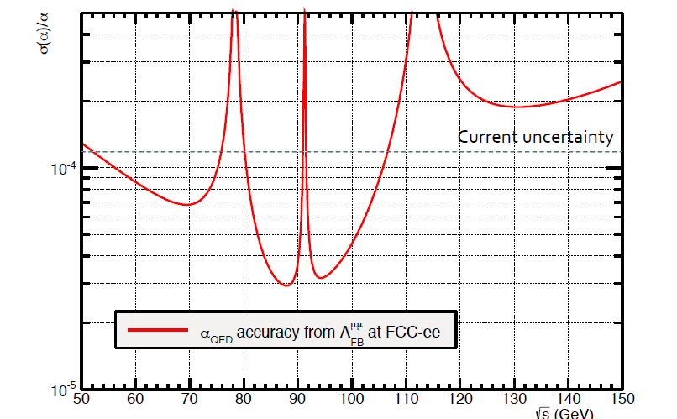
Statistics needed at/around the Z pole
This is statistical uncertainty – systematic uncertainty cancels when we measure 2 points
P.Janot, eeFACT2016, Daresbury

Slide 37
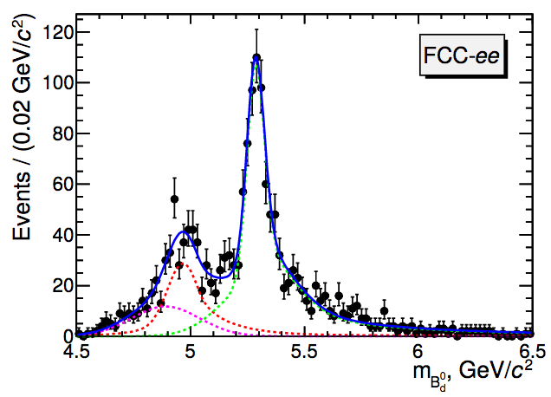
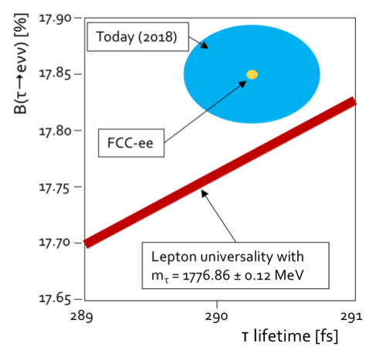
Flavours : B anomalies, τ physics, …
Lepton flavour universality is challenged in b → s 𝓵⁺𝓵⁻ transitions @ LHCb
  This effect, if real, could be enhanced for 𝓵 = τ, in B→ K⁽*⁾ τ⁺τ⁻
    Extremely challenging in hadron colliders
    With 10¹² Z → bb, FCC-ee is beyond any foreseeable competition
      Decay can be fully reconstructed; full angular analysis possible
Not mentioning lepton-flavour-violating decays
  BR(Z → eτ, μτ) down to 10⁻⁹ (improved by 10⁴)
  BR(τ → μγ, μμμ) down to a few 10⁻¹⁰
  τ lifetime vs BR(τ → eν_{e}ν_{τ},μν_{μ}ν_{τ}) : lepton universality tests
Talk from A. Bondar
J.F. Kamenik et al.
arXiv:1705.11106
-
Also 100,000 B_{S} → τ⁺τ⁻ @ FCC-ee
Reconstruction efficiency under study
B0→ K* (892) τ⁺τ⁻
~SM

Slide 38
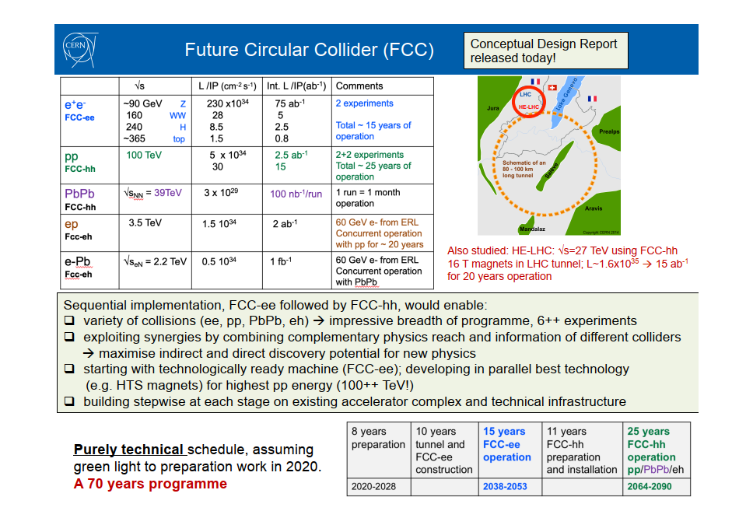
F. Gianotti 15/1/2019

Slide 39
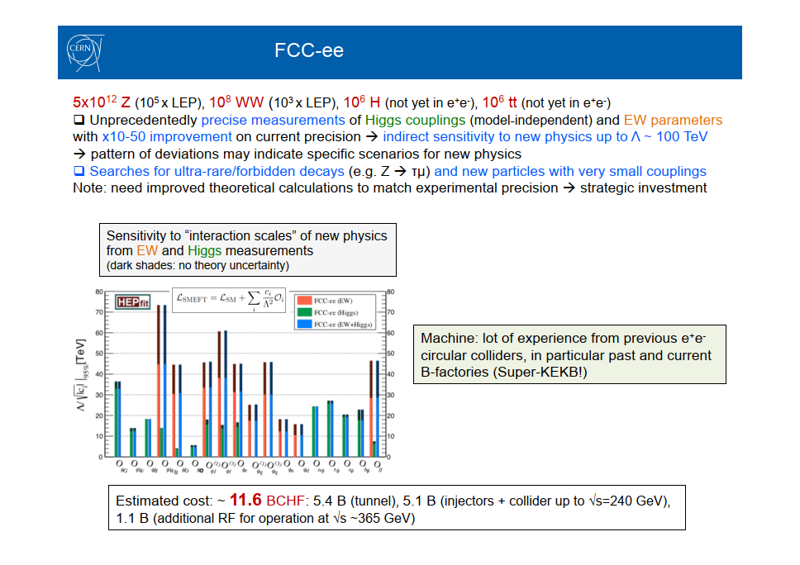
F. Gianotti 15/1/2019

Slide 40
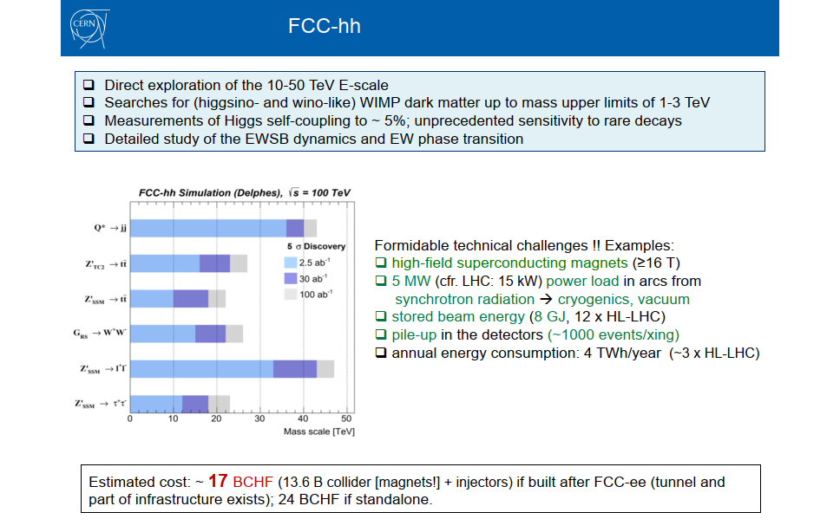
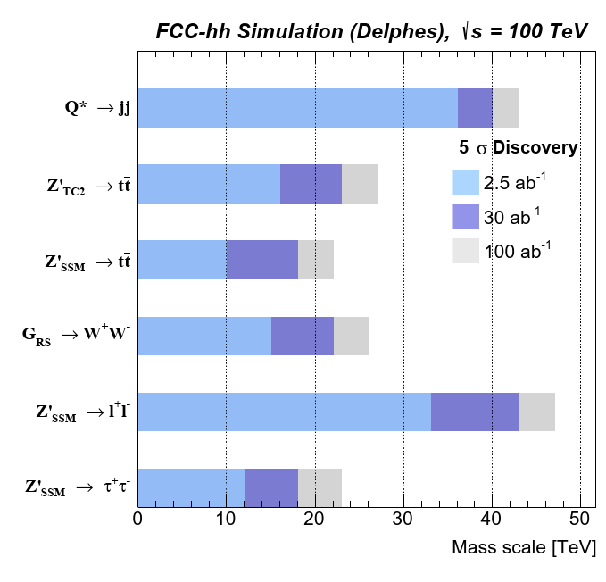
F. Gianotti 15/1/2019
FCC-hh mass reach for different s-channel resonances

Slide 41
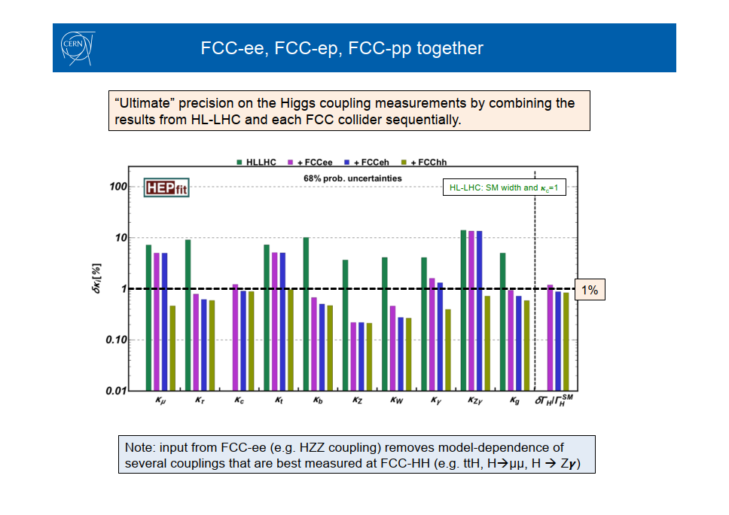
Number of Higgs bosons produced:
FCC-ee: 10⁶
FCC-eh: 2. 10⁶
FCC-hh: 10¹⁰
F. Gianotti 15/1/2019
One-sigma precision reach at the FCC on the different Higgs coupling scaling factors within the κ-framework

