Slide 1
Integrated dynamical approach from small to large colliding systems
International Workshop on Forward Physics and Forward Calorimeter Upgrade in ALICE
CCS, Tsukuba Univ., March 7-9, 2019
Tetsufumi Hirano (Sophia Univ.)
References:
TH et al., Prog. Part. Nucl. Phys. 70, 108 (2013).
Y.Tachibana, TH, Phys. Rev. C90, 021902 (2014); C93, 054907 (2016).
K.Murase, Ph.D thesis, the Univ. of Tokyo (2015).
S.Takeuchi et al., Phys. Rev. C92, 044907 (2015).
M.Okai et al., Phys. Rev. C95, 054914 (2017).
Y.Kanakubo et al., PTEP 2018, 121D01 (2018).
A.Sakai et al., (in preparation)

Slide 2
Outline
Introduction
  Importance of dynamical modeling in high-energy nuclear collisions
  Standard picture and dynamical modeling
  Current situations in our group
Recent analyses
  Integrated dynamical approach to soft physics in heavy-ion collisions
    Fluctuating hydrodynamics
    Rapidity decorrelation from hydrodynamic fluctuations
  From large to small colliding systems
    Dynamical initialization with core-corona picture
    Enhancement of multi-strange hadrons in small colliding systems
Summary and outlook

Slide 3
Introduction
Towards understanding of
  Bulk and transport properties
  Structure of vacuum (chiral symmetry restoration)
  Electromagnetic radiation
  Stopping power
  Thermalization/Fluidization mechanism
  New physics
  …
in high-energy nuclear collisions, “Standard Model” of dynamics is mandatory.

Slide 4
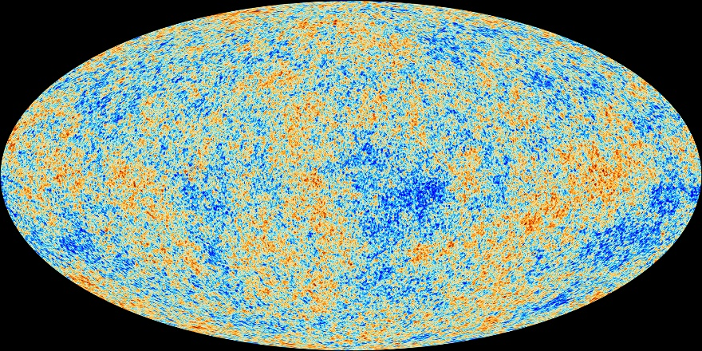
Analysis tool
Observational cosmology
Cosmological parameters
Energy budget
Hubble constant (life time)
Curvature (flatness)
Information about inflation
…
CAMB, CMBFAST,
CosmoMC,…
Cosmic Microwave Background
Fluctuations of temperature (Planck)
http://www.esa.int/spaceinimages/Images
/2013/04/Planck_CMB_black_background

Slide 5
Analysis tool
Bottom-up approach in high-energy nuclear collisions
Physics properties of the QGP
Equation of state
Shear viscosity
Bulk viscosity
Stopping power
…
?
Y.Zhou, talk at QM2018
Need Standard model/Analysis tool/Event generator
for high-energy nuclear collisions

Slide 6
Standard picture of dynamics
Hadronic observables
time
Hadron gas
Recombination
Fragmentation
QGP
fluid
(Mini-)
jets
interaction
collision axis
Glasma
0
Gluon saturation
Dilute parton gas
Soft sector
energy scale
Hard sector

Slide 7
(Ideal?) Dynamical modeling
hadronic
observables
Hadronic transport
time
jet
jet
hadron gas
string
fragmentation
Recombination
model
QGP fluid
Hydro-
dynamics
Modification of
jet structure
hydro+jet
model
Glasma
collision axis
Classical Yang-Mills
0
Gluon
saturation
CGC theory
pQCD
Soft sector
energy scale
Hard sector

Slide 8
Our current situation (model SOFT)
TH et al. (2013); K. Murase (2015); S.Takeuchi et al. (2015); A.Sakai et al.(2019).
hadronic
observables
JAM (Hadronic transport)
time
jet
jet
hadron gas
string
fragmentation
Recombination
model
QGP fluid
Fluctuating
hydrodynamics
Modification of
jet structure
hydro+jet
model
Glasma
collision axis
Classical Yang-Mills
0
Gluon
saturation
MC Glauber(+BGK)/KLN
pQCD
Soft sector
energy scale
Hard sector

Slide 9
Our current situation (model SOFT-HARD)
Y.Tachibana, TH, (2014, 2016); M.Okai et al., (2017); Y.Kanakubo et al., (2018).
hadronic
observables
Hadronic transport
time
jet
jet
hadron gas
string
fragmentation
Recombination
model
Ideal
hydrodynamics
Parton energy
loss
QGP fluid
hydro+jet
model
Glasma
collision axis
Classical Yang-Mills
0
Gluon
saturation
CGC theory
PYTHIA (Heavy Ion)
Soft sector
energy scale
Hard sector

Slide 10
Recent analyses
Integrated dynamical approach to soft physics in heavy-ion collisions
From large to small colliding systems

Slide 11

Integrated dynamical approach to soft physics in heavy-ion collisions (model S)
hadronic
observables
Main purpose:
Description of low $p_{T}$ hadrons from soup to nuts in large colliding systems
Investigation of hydrodynamic fluctuations on observable toward understanding of initial conditions along rapidity and transport properties
JAM (Hadronic transport)
Recombination
model
string
fragmentation
Fluctuating
hydrodynamics
Modification of
jet structure
hydro+jet
model
Classical Yang-Mills
MC Glauber(+BGK)/KLN
pQCD
Soft sector
energy scale
Hard sector
JAM: Y.Nara et al., Phys. Rev. C61
024901 (2000)

Slide 12
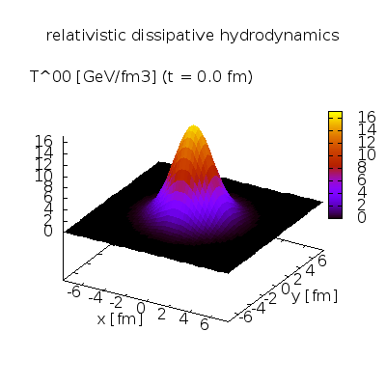
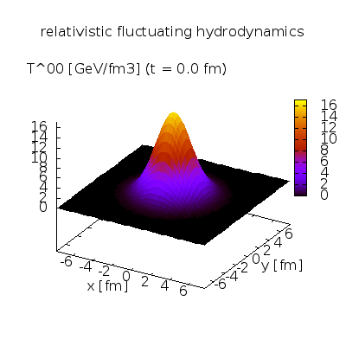


Hydrodynamic fluctuations
PeraltaRamos, Calzetta (2011), Kapusta, Muller, Stephanov (2011),
Moore, Kovtun, Romatschke (2011), Hirano, Murase (2013),
Young(2014), Akamatsu, Mazeliauskas, Teaney (2017)…
Fluctuation-Dissipation
relations
QGP fluid simulation in a box
Courtesy of K.Murase
Entropy
$$S=S_{0}+δS+δ^{2}S+…$$
$$<0$$
Dissipative hydro
(2nd Generation)
Fluctuating hydro
(3rd Generation)
State
Fluctuations around
maximum entropy state
Dissipations ←→ Fluctuations

Slide 13








Correlations along collision axis
$$τ=0^{+}$$
$$y$$
$$y$$
$$x$$
$$η_{s}$$
$$x$$
Heavy ion collision as a chromoelectric capacitor
→ Approximately boost-invariant formation of color flux tubes
→ Correlation embedded in wide rapidity region

Slide 14






Decorrelation from initial conditions and hydrodynamic fluctuations
PbPb $\sqrt{s_{NN}}=2.76 TeV$
Aligned event plane angle
rapidity
$$r_{2}=1$$
Factorization ratio
A. Sakai, talk at QM2018
“Random walk” of event plane angle
rapidity
$$r_{2}<1$$
New opportunity to constrain initial conditions in rapidity space and transport coefficients
$$−2.5<η_{p}^{a}<−2.0$$
$$2.0<η_{p}^{a}<2.5$$
$$3.0<η_{p}^{b}<4.0$$

Slide 15
From large to small colliding systems (model S-H)
hadronic
observables
Hadronic transport
Main purpose:
Universal initialization from small to large colliding systems
Investigation of core-corona picture on bulk observables
Recombination
model
string
fragmentation
Ideal
hydrodynamics
Parton
energy loss
hydro+jet
model
Classical Yang-Mills
PYTHIA: T. Sjöstrand et al.,
Comput. Phys. Commun. 191, 159 (2015).
*Heavy ion mode available from ver.8.230
CGC theory
PYTHIA (Heavy Ion)
Soft sector
energy scale
Hard sector

Slide 16
Core-corona picture
Bozek (2005,2009), Aichelin, Werner (2009), Becattini, Manninen (2009),
Pierog et al. (2015), Akamatsu et al. (2018), Kanakubo et al. (2018)
Figures: Courtesy of Y.Kanakubo
Chemically
equilibrated
matter
Core:
→QGP fluids
Corona:
Unscathed partons
Low
Multiplicity
High
Key to describe dynamics
from small (low) to large (high) systems (multiplicity)

Slide 17





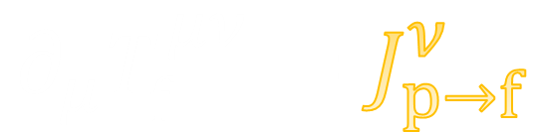




Dynamical core-corona initialization
$$∂_{μ}T_{f}^{μν}=J_{p→f}^{ν}$$
Phenomenological parametrization for source term
M.Okai et al. (2017)
$$J_{p→f}^{μ}=−\sum_{i}{\frac{d{p_{i}}^{μ}}{dt}}G(x−x_{i}(t))$$
$$G$$
: Gaussian smearing
$$p_{i}$$
: Parton four momentum
$$x_{i}$$
: Parton position
Fluidization rate per particle
Y.Kanakubo et al. (2018)
$$\frac{d{p_{i}}^{μ}\left(t\right)}{dt} =−a_{0}\frac{ρ_{i}\left(x_{i}\left(t\right)\right)}{{p_{T,i}}^{2}}{p_{i}}^{μ}\left(t\right)$$
$$≈−\frac{{p_{i}}^{μ}\left(t\right)}{λ_{i}}$$
$$ρ_{i}$$
: Parton density
$$a_{0}$$
: Control parameter
$$λ_{i}$$
: Mean free path
core and corona
soft and hard
Automatic separation between

Slide 18
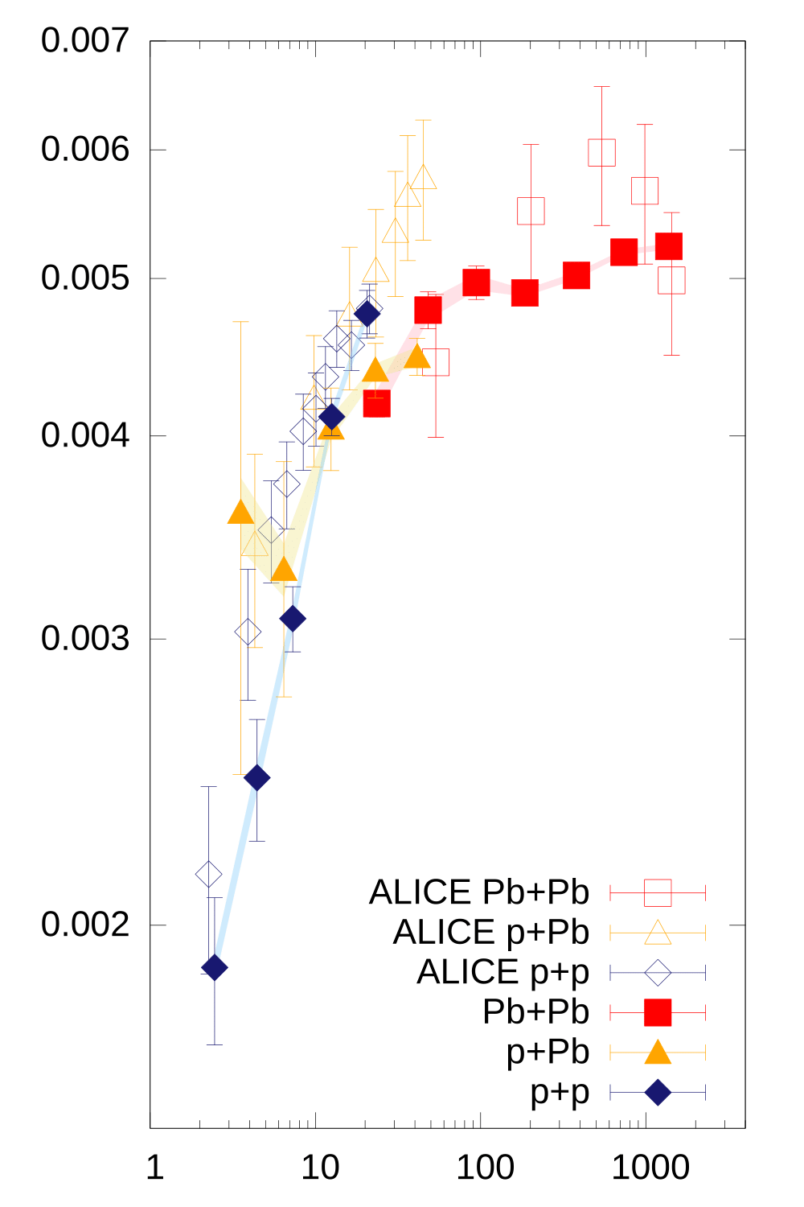







Core-corona effects on ratio of cascades to pions
QGP limit:
hadron production only from fluids
(Chemically equilibrated matter)
$$Ξ$$
$$\frac{dN_{ch}}{dη}>100$$
QGP formation dominance
$${N_{Ξ}}/{N_{π}}$$
$$\sim$$
$$\frac{dN_{ch}}{dη}<100$$
Partial creation
of QGP
$$\sim$$
String fragmentation limit:
hadron production only from
string fragmentation
$${dN_{ch}}/{dη}$$
Y.Kanakubo et al.(2018)

Slide 19
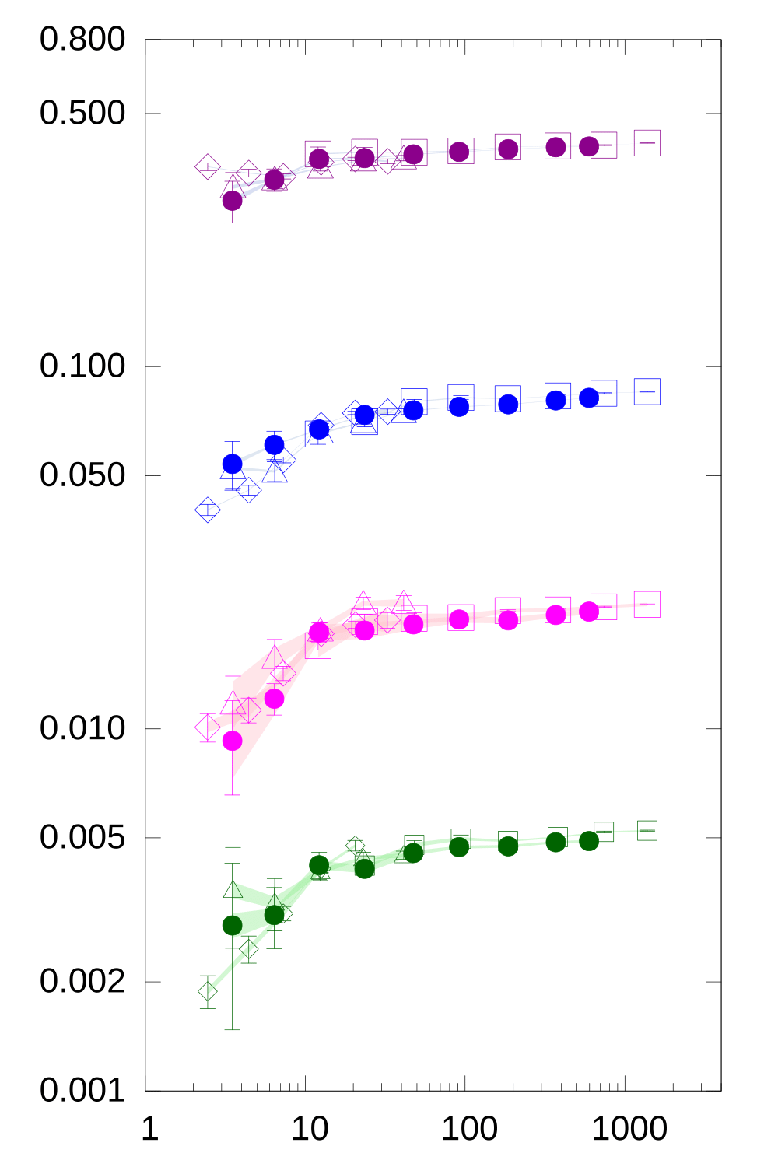
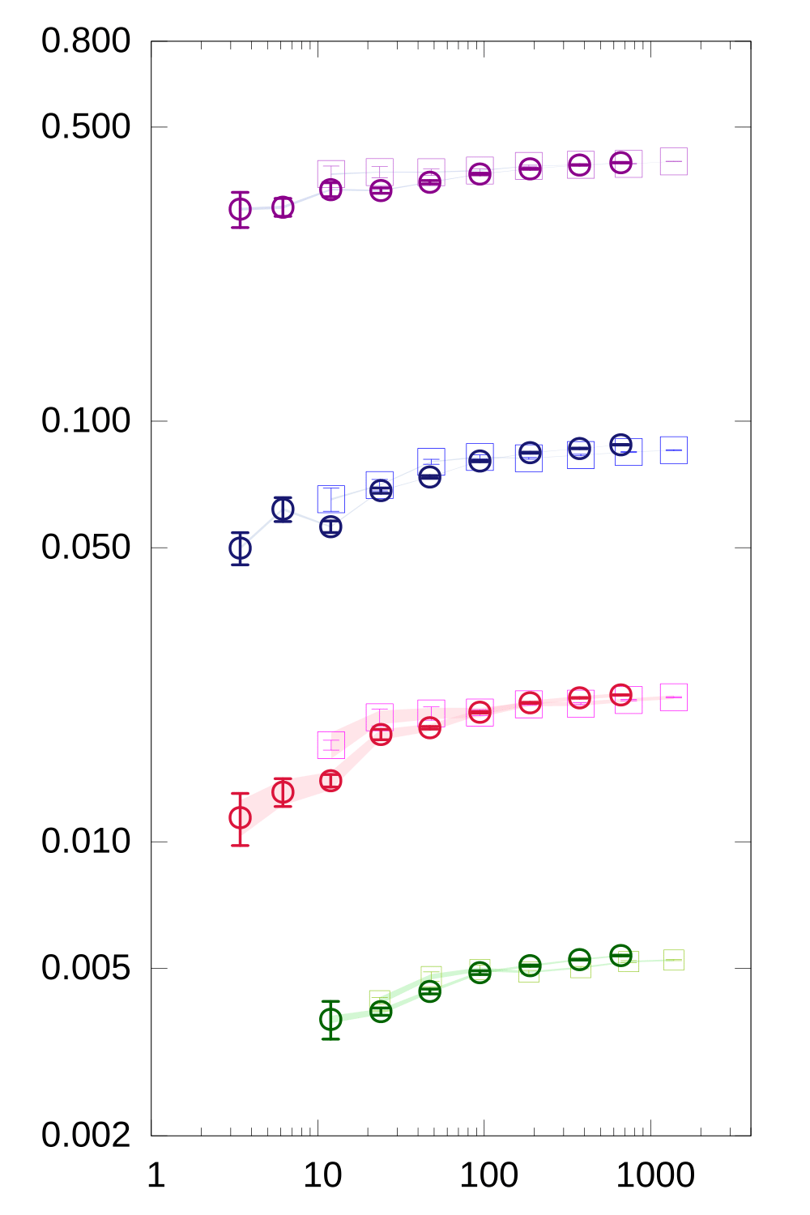












Size and collision energy dependence
XeXe (closed) vs.
pp, pPb and PbPb (open)
PbPb@2.76TeV (thin)
vs. AuAu@0.2TeV (thick)
$$p(×6)$$
$$p(×6)$$
Almost no size or collision energy dependence
in dynamical core-corona model
$$Λ$$
$$Λ$$
$${N_{i}}/{N_{π}}$$
$${N_{i}}/{N_{π}}$$
$$φ(×2)$$
$$φ(×2)$$
$$Ξ$$
$$Ξ$$
$${dN_{ch}}/{dη}$$
$${dN_{ch}}/{dη}$$
Y.Kanakubo et al. (in preparation)

Slide 20
Combination of model S and S-H
Y.Kanakubo, K. Murase, Y. Tachibana, TH (work in progress)
hadronic
observables
JAM (Hadronic transport)
time
jet
jet
hadron gas
string
fragmentation
Recombination
model
Fluctuating
hydrodynamics
Modification of
jet structure
QGP fluid
hydro+jet
model
Glasma
collision axis
Classical Yang-Mills
0
Gluon
saturation
CGC theory
PYTHIA (Heavy Ion)
Soft sector
energy scale
Hard sector

Slide 21


Toward “Standard Model” from small to large colliding systems
$${ p}_{T}$$
high
Fragmentation
from
hard particles
High $p_{T}$
suppression
small
large
System size
Collective
flow from
hydrodynamics
Collectivity in
small systems
low

Slide 22
Summary and outlook
Development of standard model for high-energy nuclear collisions from small to large colliding systems
Current status
  Rapidity decorrelation as a tool to investigate initial conditions in rapidity direction
  Universal description of dynamics brought by dynamical core-corona initialization
Check list for future dynamical model in backups

Slide 23
Backups

Slide 24
Expectation to LHC-ALICE experiment
Fill the blank
(forward/backword)
region?!

Slide 25
Check lists towards future dynamical model
Initial conditions
Hydrodynamics
Hadronization and hadronic transport
Caveat:
All topics are IMHO.
Some topics include long-standing problem(s)

Slide 26

Initial conditions
Event-by-event basis
Full 3D (No boost invariance)
Colliding energetic hadron/nuclei as “unified” parton distribution
  Color glass condensate (small $x$)
  Collinear PDF ($Q^{2}≫Q_{s}^{2}\left(x\right)$)
Non-equilibrium evolution to hydrodynamic regime
Definition of hydrodynamization rate?
Energy-momentum conservation as a whole
Separation between soft and hard

Slide 27

Hydrodynamics
Full 3D (no boost invariance)
Event-by-event basis
(Hydrodynamic) Fluctuations and dissipations
Dynamical initialization with core-corona separation
Interface with jet physics
Critical dynamics $(n_{B},σ)$
Equation of state
  $N_{f}=2+1$ or $2+1+1$from lattice QCD
  Finite $μ_{i}$ $(i=B, S, I_{3})$ (Caveat: Sign problem)
  Critical point and first order phase transition (optional)

Slide 28
Hadronization and hadronic transport
Development of a transport theory/model between hydrodynamics and Boltzmann eq.
Interface with hydrodynamics
  ← Beyond Cooper-Frye prescription
    Negative contribution
    ← Simultaneous simulation with hydro
Energy-momentum conservation on event-by-event basis
Hadronization between soft and hard

Slide 29



Model S-H
3. Hadronization
Core: Particlization through Cooper-Frye
formula ($T_{sw}=170 MeV$) + correction
factors for resonance decays
Corona: Lund string fragmentation (PYTHIA)
$$t$$
2. Dynamical initialization
+ fluid evolution
Y. Tachibana, TH, Phys. Rev. C 90, no. 2, 021902 (2014).
M.Okai et al., Phys. Rev. C 95, 054914 (2017).
+Core-corona picture
Y. Kanakubo et al., PTEP 2018, 121D01
$$z$$
Initial parton generation
→ PYTHIA ver. 8.230
T. Sjöstrand et al.,
Comput. Phys. Commun. 191, 159 (2015).
Notes:
In this model, we have two different processes to hadronize.
For corona part, hadronize them using PYTHIA which is besed on string fragmentation model.
For core part, we particlize the fluids at the chemical freezeout temperature 160 MeV using Cooper-Frye formula as a conventional hydrodynamic model.
We take into account of resonance decay for final hadronic products by multiplying a resonance factors.
which is borrowed from statistical model.

Slide 30



Dynamical initialization in hydro models
M.Okai, K.Kawaguchi, Y.Tachibana, TH (2017)
Conventional
hydro simulations
Vacuum
$$τ$$
$$0$$
Formation time
of partons
hydro
initial time
Fluids
$$∂_{μ}T_{f}^{μν}=J_{p→f}^{ν}$$
Partons
“Fluidization” through source terms
→ Energy-momentum conservation as a whole

Slide 31

Energy density and transverse flow fluctuations without core-corona picture
Pb+Pb $\sqrt{s_{NN}}=2.76 TeV$, $b=10.08 fm$
Initial parton phase space distribution from event to event
Dynamical initialization obeying momentum conservation
Initial random transverse
flow velocity
Anisotropy interpreted from initial random (geometry+flow)
energy density
distribution
transverse flow
velocity distribution
M.Okai (2018)

Slide 32
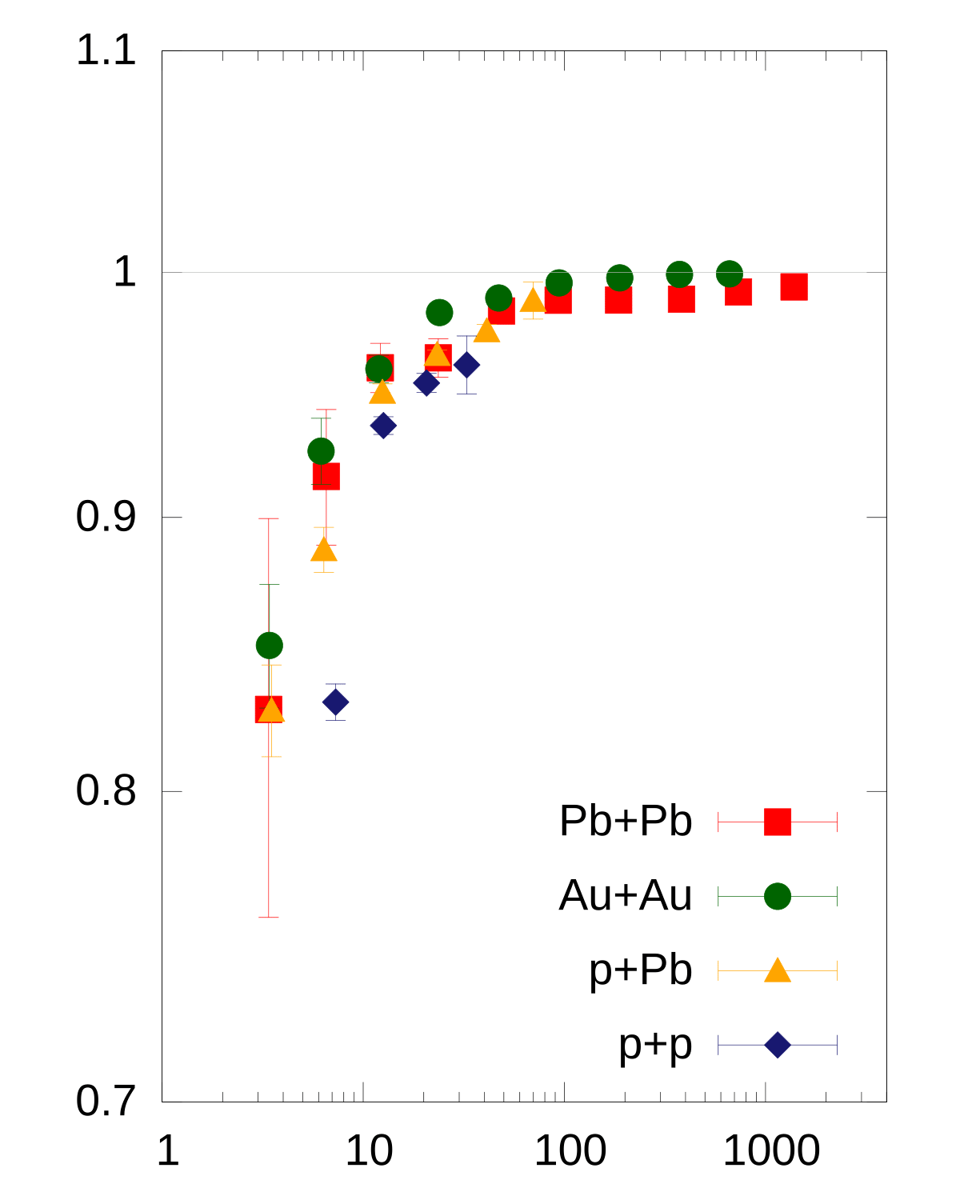



Fluidization rate
Core energy at midrapidity
$$R=\frac{dE_{core}/dη_{s}}{dE_{tot}/dη_{s}}$$
$$R$$
Total energy at midrapidity
← Partons forced to be fluidized at the first time step
Monotonic increase + saturation
→ Core part dominance in high multiplicity events
$${dN_{ch}}/{dη}$$

Slide 33
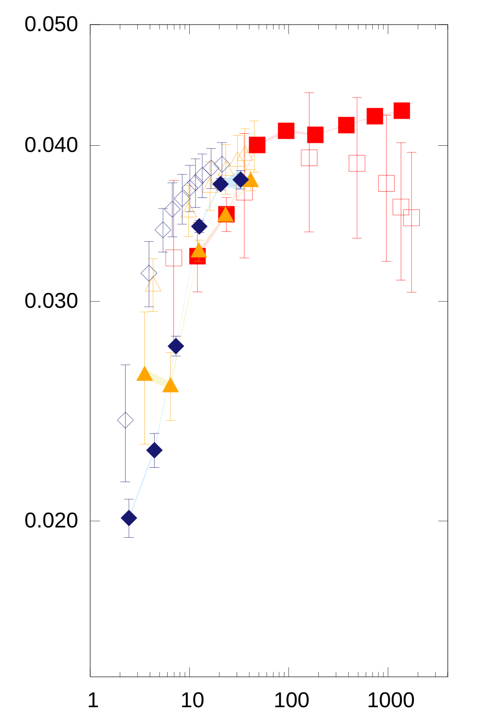
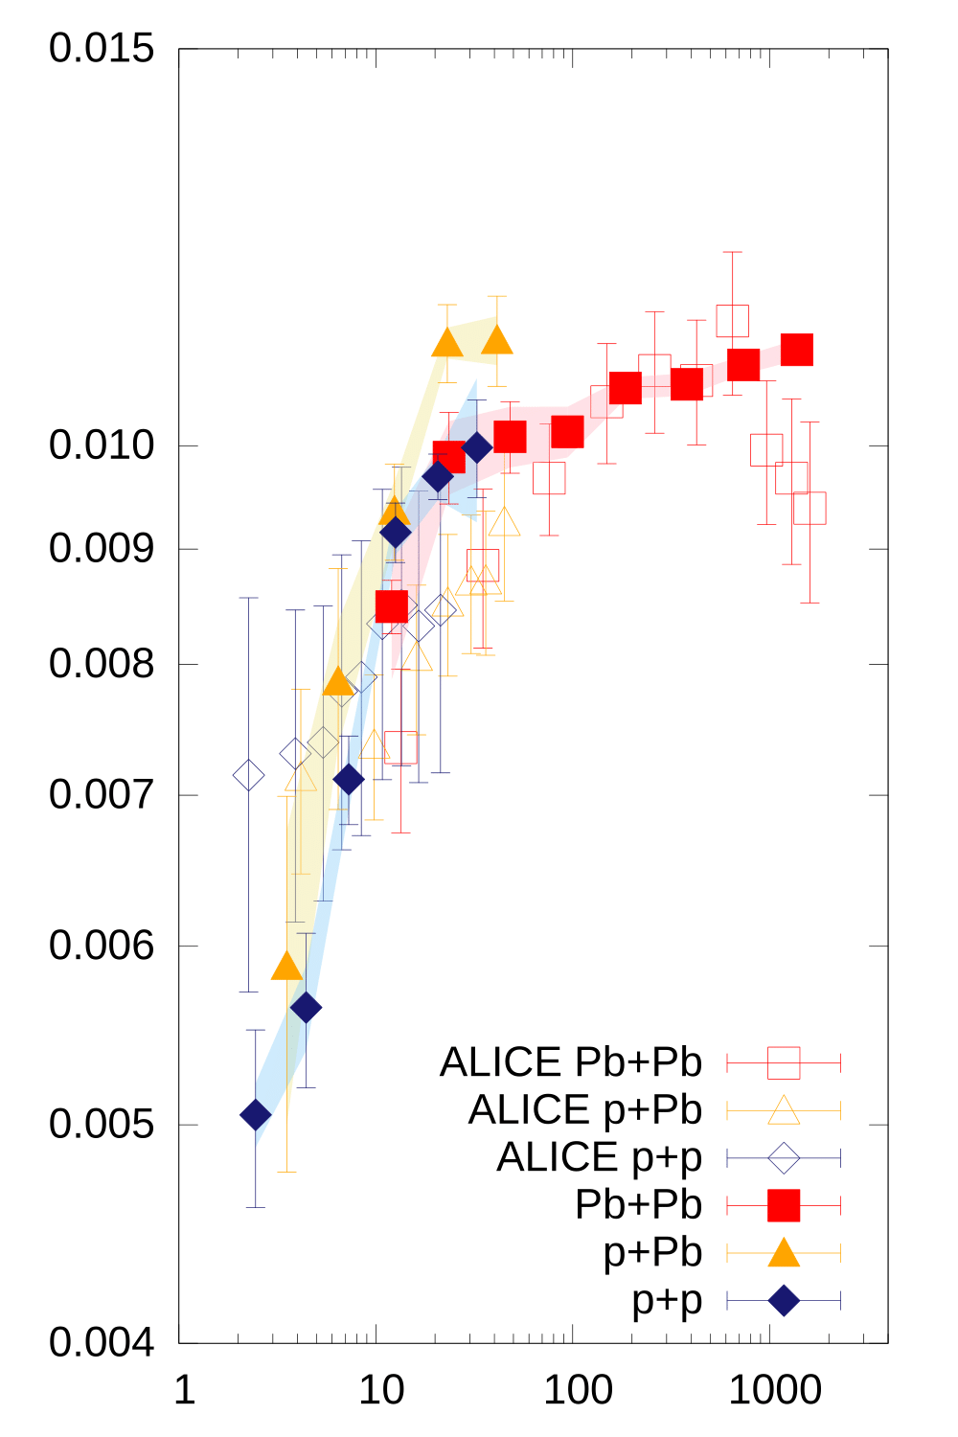





Lambdas ($\left|S\right|=1$)
$$Λ$$
Similar trends to Cascade ($\left|S\right|=2$)
Rapid increase with multiplicity
Saturation above ${dN_{ch}}/{dη}\sim 100$
Scale solely with multiplicity regardless of system size
$${N_{Λ}}/{N_{π}}$$
$${dN_{ch}}/{dη}$$

Slide 34



Phi mesons ($\left|S\right|=0$)
Similar trends to Lambda and Cascade
→ Enhancement of ratio with multiplicity even for $\left|S\right|=0$
$$φ$$
(*Same conclusion as in, e.g., Becattini and Manninen (2009))
$${N_{Λ}}/{N_{π}}$$
Canonical suppression scenario
Suppression of strange hadron yields due to absence of bath of strangeness in small systems
Phi mesons are NOT suppressed
$${dN_{ch}}/{dη}$$
See, e.g., Vislavicius and Kalweit, arXiv:1610.03001

Slide 35
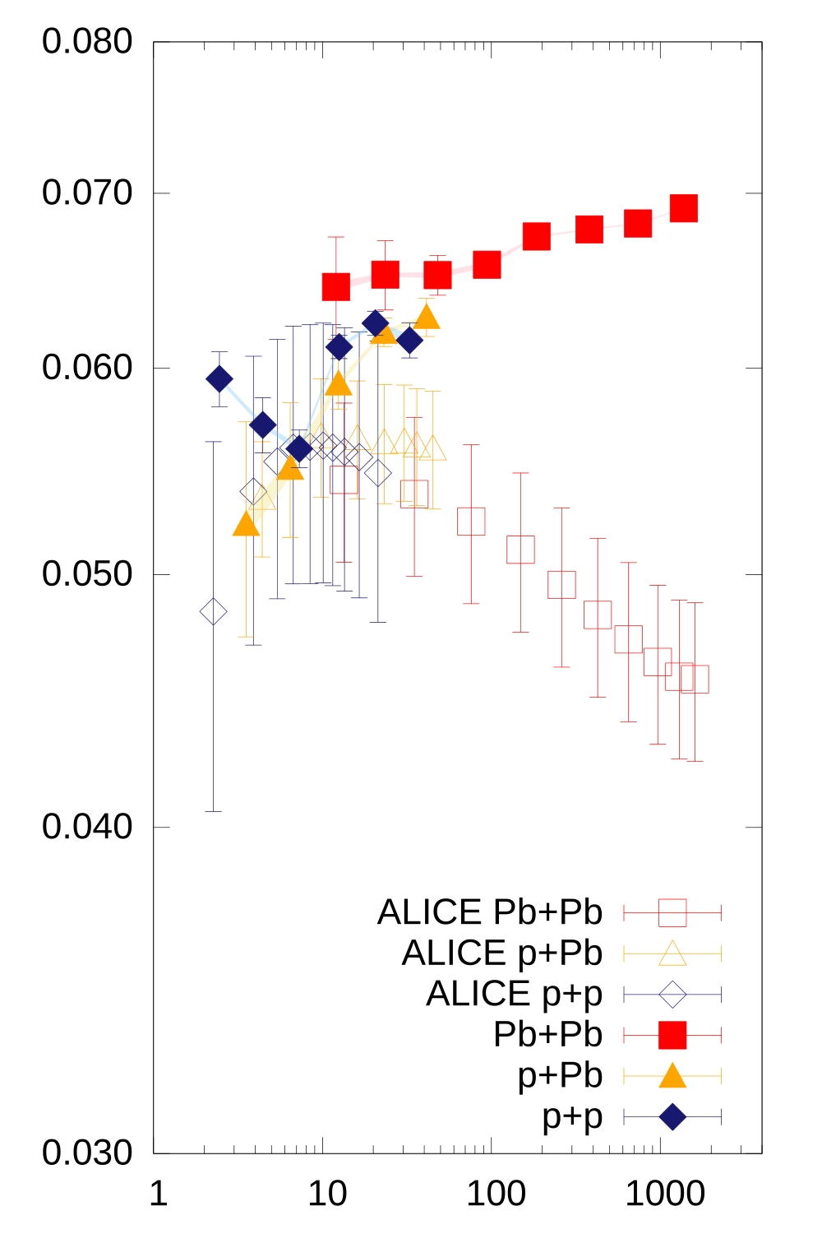



Protons
$$p$$
Opposite trends to exp. data
Moderate enhancement in dynamical core-corona model
  ← similar ratios both in hydro and string fragmentation
p-pbar annihilation at high multiplicity could resolve the discrepancy
  ← Need hadronic afterburner
$${N_{p}}/{N_{π}}$$
$${dN_{ch}}/{dη}$$

