Slide 2
LBDS kickers:
HW upgrade
L. Ducimetière , V. Senaj
Wit contribution from: L. Allonneau, M. Barnes, W. Bartmann, C. Bracco, E. Carlier, B. Goddard, S. Huon, N. Magnin, V. Senaj, T. Stadlbauer, W. Weterings, C. Wiesner and all our TE-ABT and other CERN colleagues involved

Slide 3
Outline
LBDS kickers, reminder
Present limitations and actions foreseen during LS2
  Erratics: origin and consequences
  Mitigation being implemented
    HV GTO Switches
    MKD & MKB generator evolution
    Maintenance procedures
  Impact on RUN 3
Risk of flashover in MKB magnets
  Flashover in magnet and consequences
  Roadmap and cost
Conclusion

Slide 4
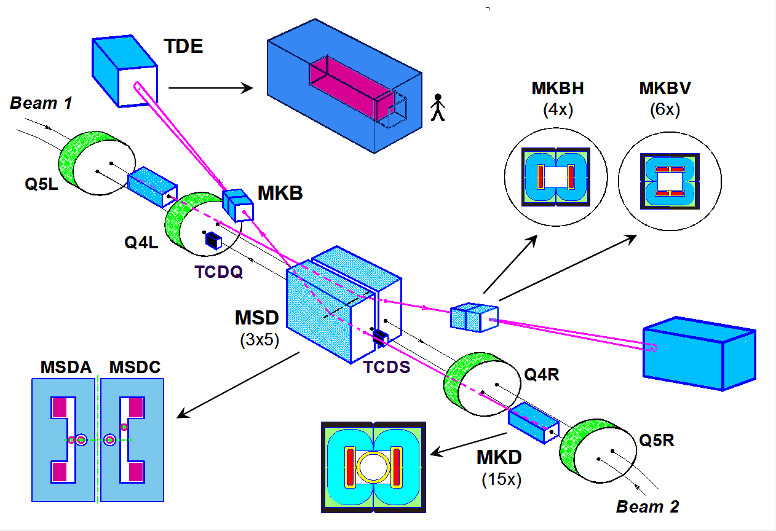
LBDS kickers, reminder
15 extraction generators (MKD) and 10 dilution generators (MKB) per beam
Altogether 80 HV switches (800 GTOs) in operation;
Extraction generator current rise time < 2.7 µs; Abort Gap duration = 3 µs
Pulse duration > 91 µs

Slide 5
Present limitations and actions foreseen during LS2
Main limitation on generator side is “Erratic”
Two types of erratic identified:
  Type 1: - Spurious firing of GTO stack, slow commutation (Tr> 2.7 us); origin: sparking of charge accumulated on insulators, intermediates amplitude noise coupled to re-trigger line, Single Event Burnout (SEB).
  Type 2: - Fast commutation (Tr ~ 2.4 us, missing current in GTO stack); origin: direct sparking between metal surfaces with +HV and ground potential – accumulated dust/insect initiated streamer leading to arc
  Type 3: ~Normal commutation of multiple generators; Origin: strong perturbation on retrigger line (observed once without beam with 3 generators fired)
Risk of erratic firing strongly dependent on voltage – 6.5 TeV vs. 7.0 TeV
An erratic on MKD causes and asynchronous dump (AD) with risk to protection devices
An erratic on MKB causes a partial dilution with risk to dump block
Two types of action:
  Limit the occurrence
  Limit the consequences

Slide 6
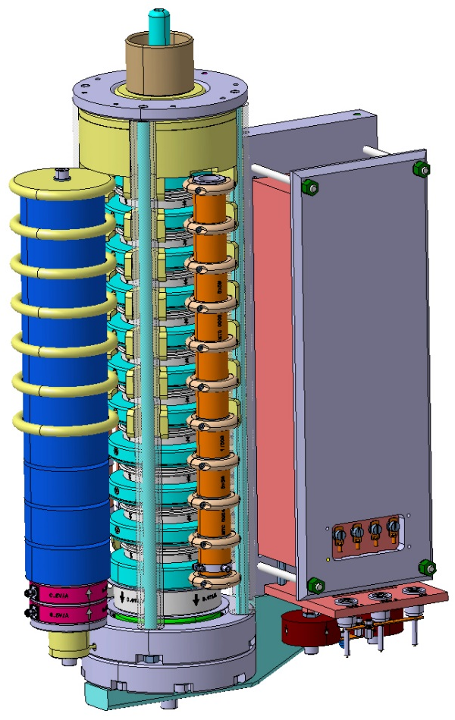
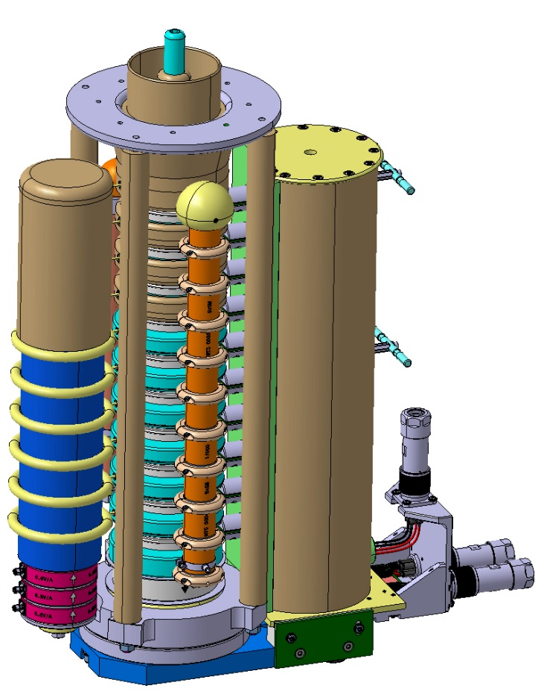
HV Switches - Re-designed for MKD and MKBH
LS2
RUN 2
RUN 3

Slide 7

HV GTO Switches - Re-designed for MKD and MKBH
E-field < 1.5 MV/m (1/2 of air ionisation limit)
sparking immunity in case of pollution
Simplified maintenance
increased stack inductance
New stack insulation
Extended return bars
New snubber insulation
Snubber capacitors
voltage sharing resistors
Additional spark detection
New pressure mechanism
New support
New ultrafast trigger transformer with independent magnetic cores
Low inductance triggering cables/
connections
Low inductance integrated diodes

Slide 8
MKD & MKBH generator evolution
(MKBV works at lower voltage)
Generator | MKD | MKBH
New GTO switch assembly | x | x
New ultrafast trigger transformer | x
New trigger cables and connectors | x | x
Third capacitor equivalent +18% total for -9% operating voltage | x
New compensation capacitor | x
New larger main capacitor |  | x
Segmented panels independent access to non-sensitive compartments |  | x
Dust trap & protection | x | x
+ Full set of improvements on Electronics & Controls (EC, next talk) | x | x

Slide 9
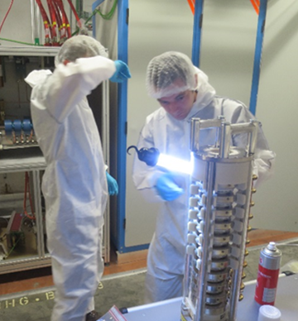
Maintenance procedures
Systematic HV testing of GTO stack after maintenance above nominal voltage with sparking surveillance
Endoscopic inspection of critical parts of generator and GTO stack after maintenance
Cleanroom clothing and dedicated tools for maintenance of “sensitive compartments”
Regular cleaning of UA in generator areas, using dust mats…

Slide 10
Impact on RUN 3
 | RUN 2 6.5 TeV | RUN 3 7.0 TeV
MKD nominal voltage | 26.7 | 25.6 | kV
MKD rise time * | 2.55 | 2.65 | μs
Abort gap requested | 3 | 3 | μs
Total SEB failure rate probability MKD | 0.1 | 0.005 | y⁻¹
Number of asynchronous dump / beam | <1 | <1 | y⁻¹
MKBH nominal voltage | 24.7 | 23.5 | kV
MKBV nominal voltage | 13.7 | 14.8 | kV
Total SEB failure rate probability MKB | 0.15 | 0.0003 | y⁻¹
Number of partial dilution / beam | <1 | <1 | y⁻¹
+ additional surveillance and actions on Electronics & Controls (EC, next talk)
* Combined effect of lost in stack, lost in capacitor increase and gain with trigger transformer and power trigger

Slide 11
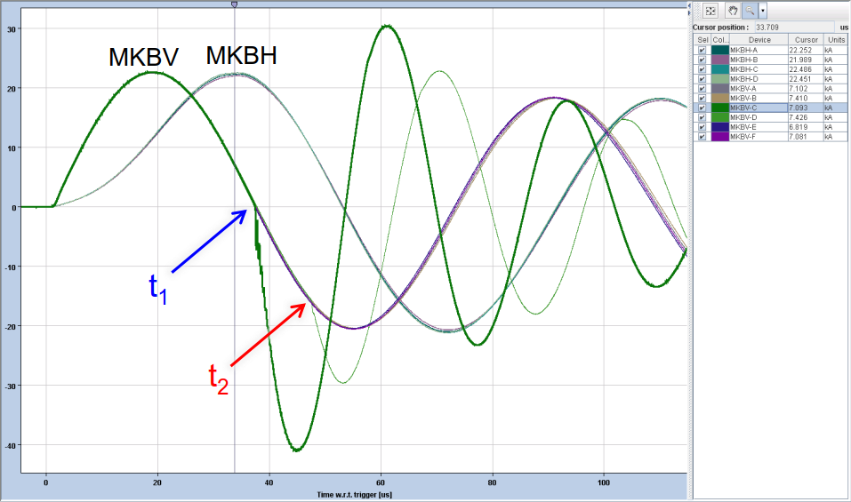
Risk of flashover in MKB magnets
MKBV flashover on 14th July 2018 - Beam 2, RA63 with beam, 6.5 TeV
Magnet MKBV.C, 10 us later propagated to MKBV.D (same tank)
→ This flashover highlights new failure mode
Event fully presented by Wolfgang Bartmann
  LMC / 1 August 2018:
  https://indico.cern.ch/event/747798/
  Local reconditioning, then - 20% voltage
More details by Chiara Bracco
  HL-LHC TCC / 4 October 2018:
  https://indico.cern.ch/event/761078/
  No inspection possible during the TS
  Present assumptions by L. Ducimetière
    TE-TM / 22 November 2018:
  https://indico.cern.ch/event/762916/

Slide 12
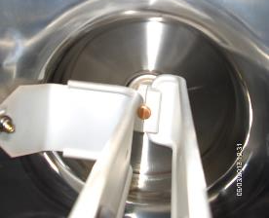
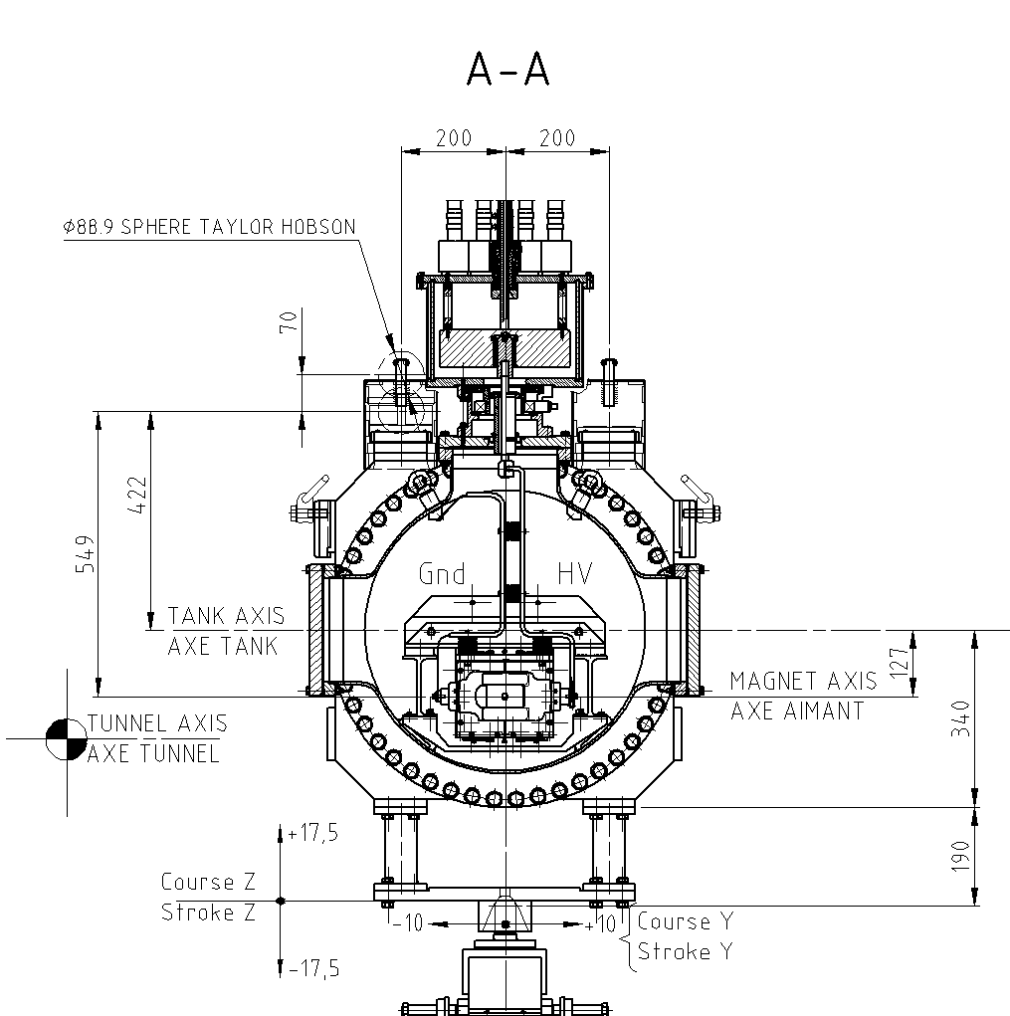
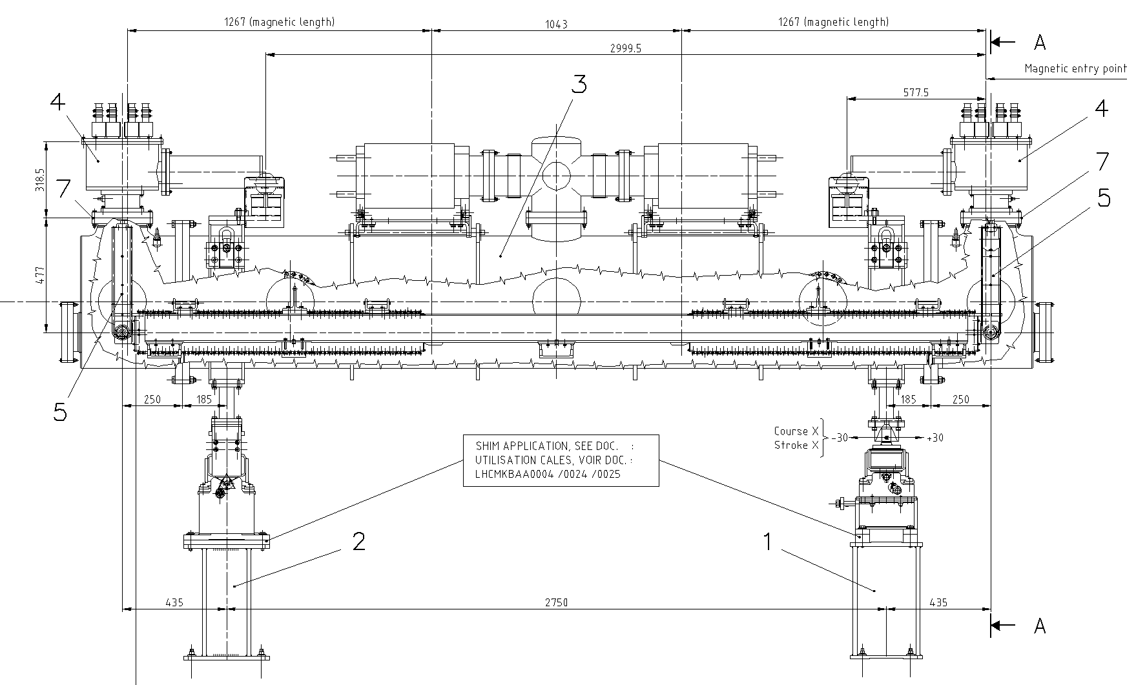
Incident 2018: assumption
Primary flashover, potential locations:
Between HV and Gnd busbar
Between HV and magnet ground
Between HV and vacuum tank
On the surface of an isolator
On the surface of the HV feedthrough
HV Generator
Current
Flash-over propagation through plasma
MKBV.C
MKBV.D
Ch. Bracco, HL-LHC TCC, 4/10/2018

Slide 13
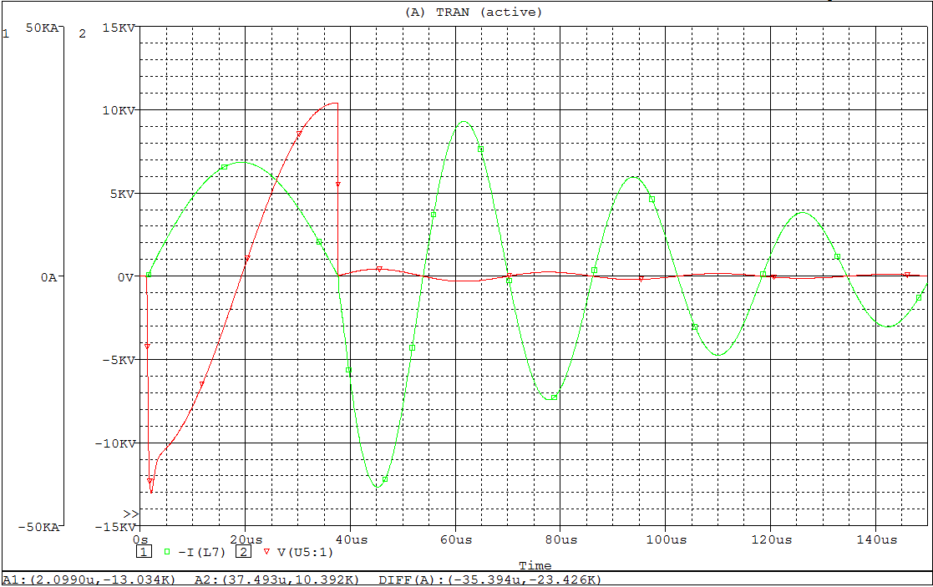
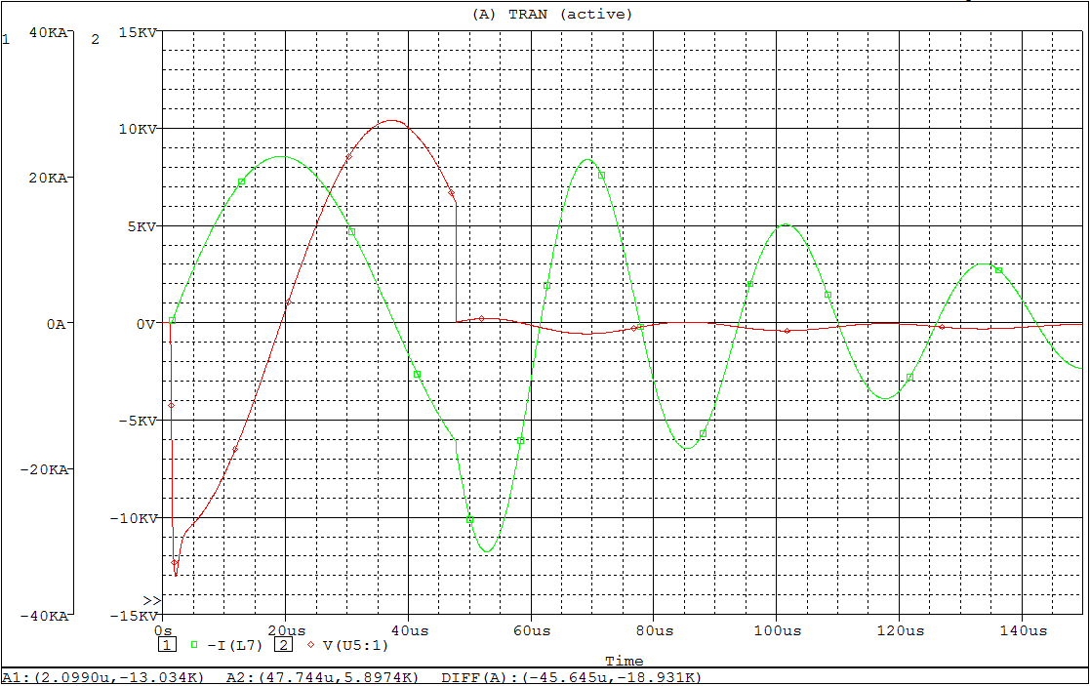
Incident 2018: new failure mode
1st flash-over after 37 μs
0 Current in the magnet (max voltage between busbars)
2nd flash-over 10 μs later
Some current in the magnet
Antiphase with other kickers ➔ loss of 3 MKBVs
MKBV.C
Simulation V. Senaj
MKBV.D

Slide 14
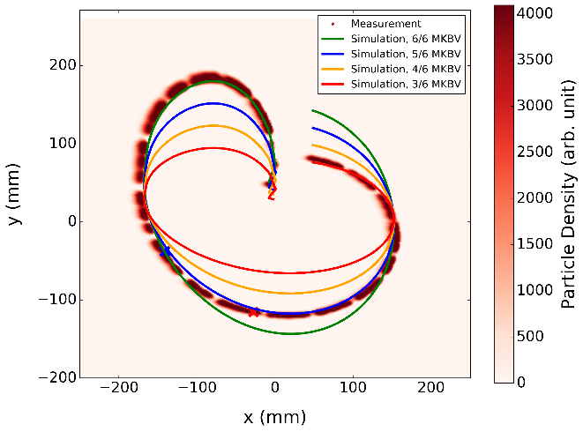
Incident 2018: new failure mode
A flashover on a MKB magnet results in loss of up to 3 magnets:
Second loss by flashover due to plasma propagation in common vacuum vessel
Third loss by antiphase current
Acceptable for MKBV, but
critical if it happens on MKBH
(4 MKBH magnets only)
Lost ~3 MKBV at the end of the sweep
Ch. Bracco, HL-LHC TCC, 4/10/2018

Slide 15

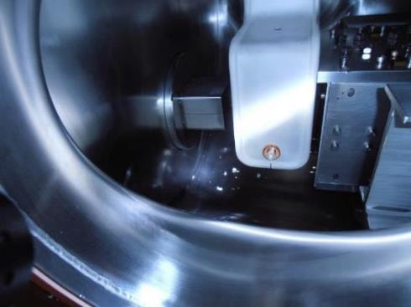
Investigation and action during LS2
MKBV.C and .D will be inspected during LS2
Origin of the flashover ?
Damage due to large plasma discharges
Spare MKBV full tank (2 magnets) ready for replacement during LS2 - PLAN #11651
No design error identified so far – brainstorming ABT engineers
7.0 TeV operation higher risk of flashover, but still within design values

Slide 16
Roadmap and cost
Consolidation / upgrade of MKBH considered as a priority
Preferred option: (discussed in TCC and TE-TM) adding 2 MKBH magnets / systems per beam during LS3 (not yet approved!)
+/- 3.6 MCHF
Only option to reduce risk and consequence to any possible failure of MKBH
 | 2019 | 2020 | 2021 | 2022 | 2023 | 2024 | 2025
Approval
Mechanical drawings
Procurement
Production
Assembly and tests
Installation
Material cost MCHF |  | 0.3 | 0.7 | 0.9 | 0.7 | 0.5 | 0.5

Slide 17
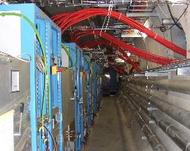
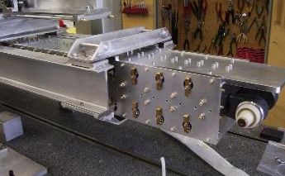
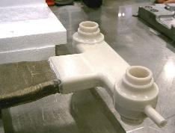
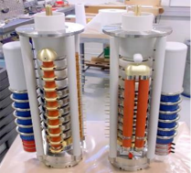
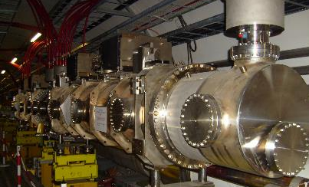
Additional MKBH systems
Long process, as many technologies involved:
Wound magnetic tape
HV conductors
Hot pressed mica-epoxy insulation
Epoxy moulding under vacuum
Metal-ceramic feedthrough
HV capacitors
HV semiconductors
HV resistors
HV cables
Mechanical components
UHV components
Control electronics
PLC
...

Slide 18
Summary
LS2 upgrades on generators and switches will further improve system reliability and availability for RUN 3 at 7.0 TeV operating energy
No change of Abort Gap length
All modifications should maintain present specified rate of
    < 1 asynchronous dump / beam and year
    < 1 partial dilution / beam and year
The construction of 2 additional MKBH systems per beam is recommended for installation during LS3 but not yet approved

