Slide 2
LBDS Control Upgrades
LBDS Review and its readiness for the Run3 and HL-LHC operation
L. Allonneau, C. Boucly, E. Carlier, L. Ducimetiere, N. Magnin, T. Mottram, V. Senaj, L. Strobino, J.P. Rodziewicz, P. Van Trappen, B. Vez, N. Voumard
5 February 2019, CERN

Slide 3
Plan
LS2 Upgrades (Ongoing):
  New PTM / New PTC
  New Re-Triggering system for MKD / MKB
  IPOC extension / SAM system
  HV Generators controls maintenance
  PLC systems maintenance
LS3 Upgrades (In baseline):
  Upgrade of PLC systems (hardware and software)
LS3 Upgrades (Not in baseline):
  Upgrade of IPOC digitisers
  Upgrade of BETS hardware
  Upgrade of TSU hardware
  Upgrade Capacitor Charging Power Supplies
  Provide controls for additional MKBH tanks
Summary

Slide 4
Some Controls Problems during Run I & II
Poor triggering of GTO stacks / Long Re-Triggering time
  => New PTM & HV Trigger cables / New PTC
Erratic of MKBH generator coupled to neighbour / Antiphase of erratic MKB
  => New MKB Re-Triggering system / MKB Re-Trigger boxes
Attenuation of pulses propagated on Re-Trigger line (diagnosis problem)
  => New MKD Re-Trigger system / MKB Re-Trigger boxes
Sparking activity inside HV generators (Regularly checked during TS)
  => Sparking Activity Monitoring system
Missing diagnosis on HV generator in case of erratic / Validation of Re-Trigger line state:
  => IPOC System Extension
Bad contacts on PLC-HV generator controls cables / PLC communication problems
  => Renew HV generator connections and PLC communication architecture/hardware

Slide 5
LS2 Upgrades (Ongoing)

Slide 6
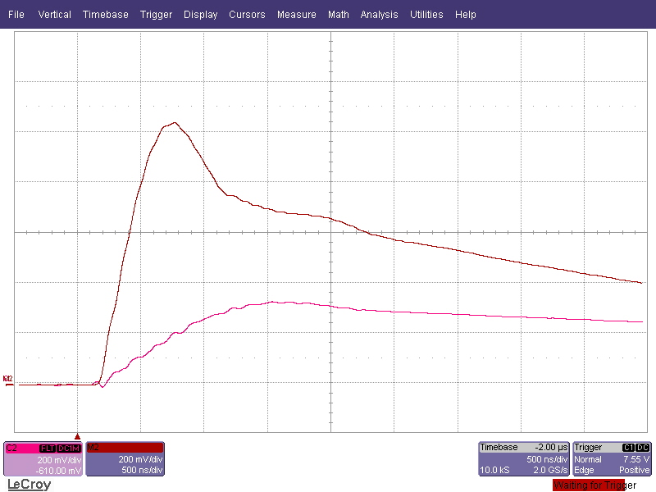
LS2: New PTM
Motivation for a new Power Trigger Module (PTM):
Increase trigger current and dI/dt for a better GTO switching
=> Lower turn-on delay and magnet current rise-time.
Reduce propagation delays in electronics
=>Lower global LBDS Re-Trigger time
Adapt to new HV trigger cables and trigger transformer on GTO stack.
Precise fixed Re-Trigger input level to avoid partial triggering of PTM or HV generator coupling.
Improve diagnosis of output current and HV IGBT state
Status: Ongoing OK
Development and prototyping done
Production of 260 units ongoing
First 4 production units tested successfully
Budget: OK
HL-LHC-CONS
Trigger current Old/New PTM
~3x more peak current: (~320 -> 1000 A)
~6x more dI/dt: (~300 -> 2000 A/us)

Slide 7
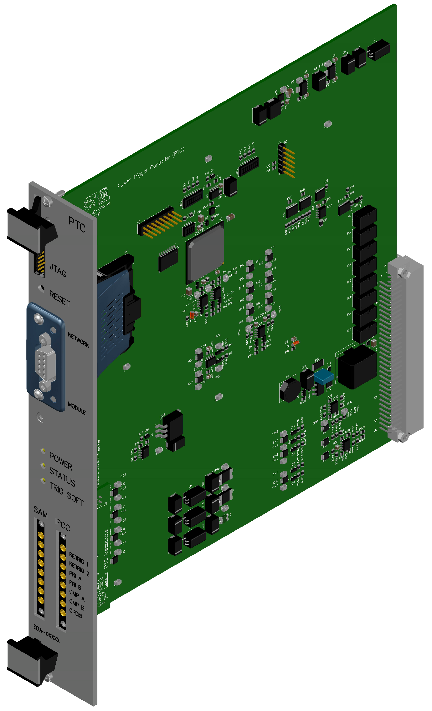
LS2: New PTC card
Motivation for a new Power Trigger Controller (PTC) card:
Upgrade obsolete hardware components
Adapt to the changes in new PTM
Improve diagnosis of output current and HV IGBT state
Provide Re-Trigger signals to IPOC / SAM systems
Add diagnosis of diodes in Re-Trigger boxes
Status: Ongoing OK
Design of schematics and PCB finished
Prototype production ongoing
Budget: OK
HL-LHC-CONS
New PTC card - 3D view

Slide 8
LS2: New MKB Re-Triggering System
Motivation for a new Re-Trigger system for MKB:
Synchronous dump with all MKB in phase for MKB erratic
Solves problem of coupling between generators for MKB erratic
MKB GTO stack is re-triggered by PTM in case of erratic (Like MKD)
Budget: OK
LHC-CONS
Status: Ongoing OK
Simulations of Re-Trigger lines done
Measure to confirm/adjust model done
Development of MKB Re-Trigger box done
Solution presented at MPP: OK
Decoupling box (diodes):
MKB erratic not propagated to MKDs
New MKB Re-Trigger box:
MKB inject energy on the Re-trigger line
MKB Re-Triggering concept:
(Orange parts are added)
MKB Re-Trigger line connected to TSUs to perform sync dump in case of MKB erratic

Slide 9
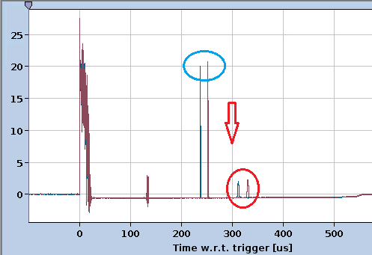
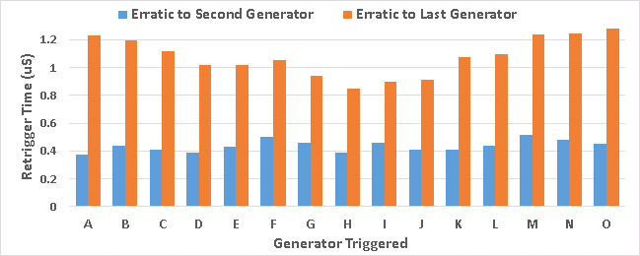
LS2: New MKD Re-Trigger System
Motivation:
Attenuation of redundant pulses on the Re-Trigger line
(Diagnosis problem)
Added redundant pulses on the Re-Trigger Line
for new MKB Re-Trigger system implementation
Avoid domino effect for re-triggering of all generators
Provide good pickup signals to PTC for IPOC / SAM systems
Add diagnosis of diodes in Re-Trigger boxes
Status: Ongoing OK
Development of new MKD Re-Trigger boxes started
Advanced from LS3
Budget: OK
HL-LHC-CONS
IPOC – Pulses propagated on Re-Trigger line
(Pulses attenuation through 15 MKD)
Re-Trigger delay (Second / Last)
in case of Erratic of MKD at 7 TeV

Slide 10
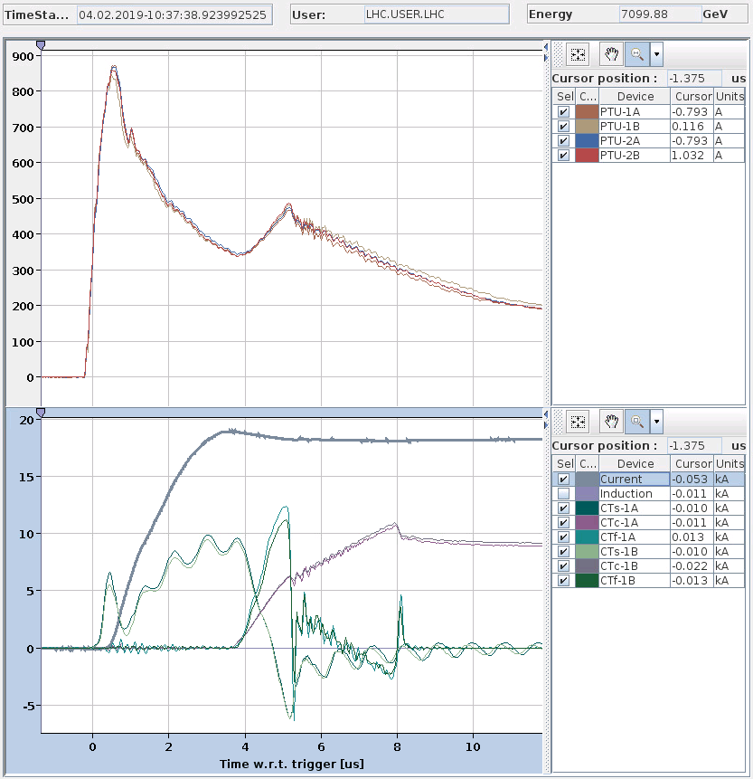
LS2: IPOC Systems Extension
Motivation for Internal Post Operation Check (IPOC) systems extension:
Capture of waveforms for (Now only signal presence is detected):
  Re-Trigger pickups inside generator.
  Re-Trigger boxes outputs to PTM
Allow to validate the correct behaviour of Re-Triggering system after every dump.
Try to detect signature of sparking during normal pulse
More diagnosis in case of HV generator erratic
Status: Ongoing OK
Software development ongoing
Prototype deployed in LHC on MKBs
Digitisers procurement started
Budget: OK
HL-LHC-CONS / LHC-CONS
IPOC – Waveforms of PTM currents
IPOC – Waveforms of HV generator internal pickup currents

Slide 11
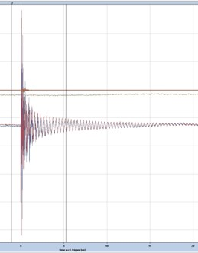
LS2: SAM Systems
Motivation for a Sparking Activity Monitoring (SAM) system:
Detect & capture HV spark signals on: pickups inside HV generators.
Detect & Capture spark signals on all Re-Trigger line outputs to PTM.
Provide statistics on spark activity for all LBDS HV generators
Monitoring of sparking activity, and alarm in case of high spark rate
(SIS interlock, etc…)
Status: Ongoing OK
Prototype system deployed on test cages in 867.
Prototype system deployed on MKB generators in LHC.
Digitisers procurement started
Budget: OK
HL-LHC-CONS / LHC-CONS
SAM prototype – HV spark captured on test bench

Slide 12
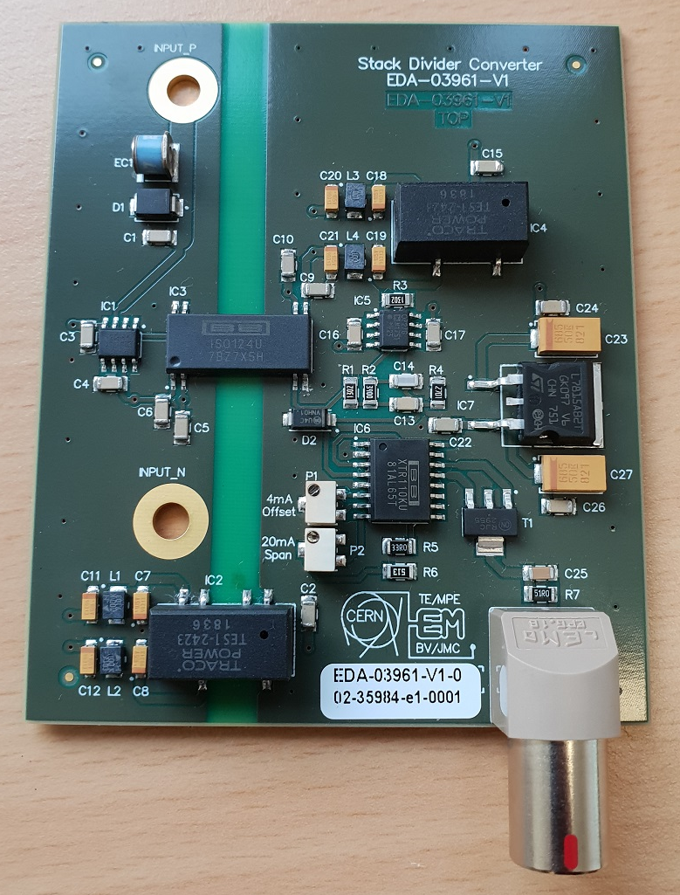
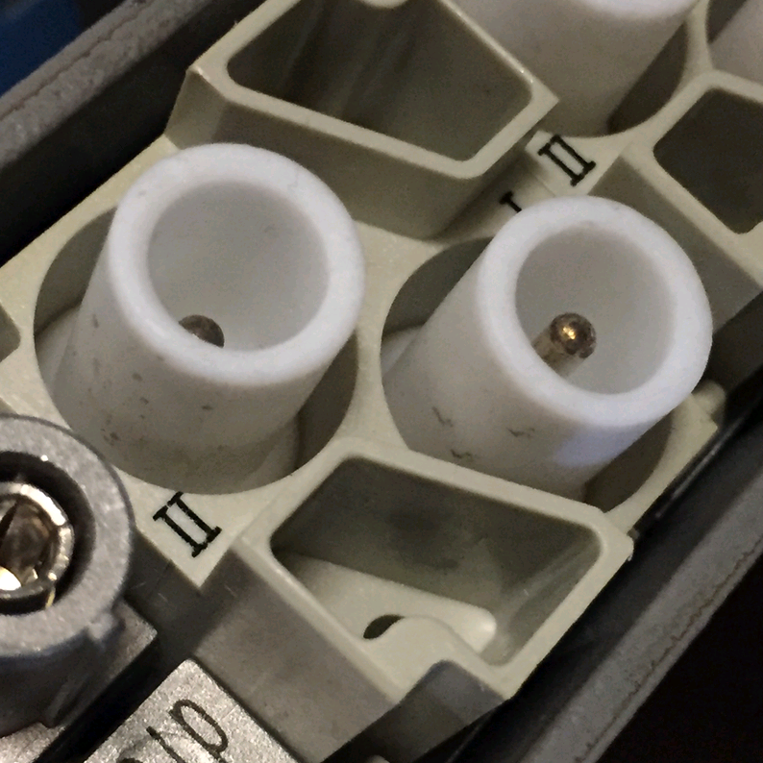
LS2: HV Generator Controls Maintenance
Motivation:
Problems of bad contacts in controls connectors identified during RUN2
Problem of metallic dust deposited on HV stack due to ROSS relay vibrations & heating
Problems of various HV-Divider voltage measurement cards failures, weak FASTON connectors soldering (breaking during intervention)
Upgraded hardware:
New DC ROSS relay controller (low power dissipation, no vibrations)
New HV-Divider voltage measurement cards
Replace some pins in HARTING connectors by more adapted ones
Add guides to help insert HARTING connectors properly
Status: Ongoing OK
New DC ROSS relay controller: Production ongoing.
New HV-Divider voltage measurement cards : Production ongoing.
MKD Generator series upgrade started, first units under test soon.
Budget: OK
LHC-OPE / HL-LHC-CONS
New HV divider voltage measurement card
Harting HV connector: Bad contact problems

Slide 13
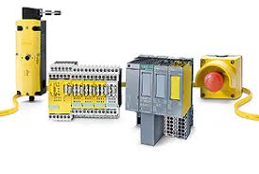
LS2: PLC Systems Maintenance
Motivation:
Most of PLC upgrade was foreseen for LS3, but we will have to advance some in LS2 because:
Obsolete hardware, not available anymore / no repair or replacement
Following external audit of LBDS PLC system, few recommendations for improvement
Problems of PROFI-Bus communication with BETS
Problems with ASi-Bus power supplies
Upgraded hardware:
Improve PROFI-Bus structure (Add RS-485 repeaters / Add Terminations)
Improve ASi-Bus structure (Remove second master / Replace safety cards)
Remove unused hardware from operation
Software corrections and adaptations to above changes
Status: Ongoing
External audit performed in 2018
Hardware procurement in preparation
Budget:
LHC-OPE / HL-LHC-CONS (LS3) to be anticipated
Siemens - Safety Asi-Bus hardware

Slide 14
LS3 Upgrades (In baseline)

Slide 15
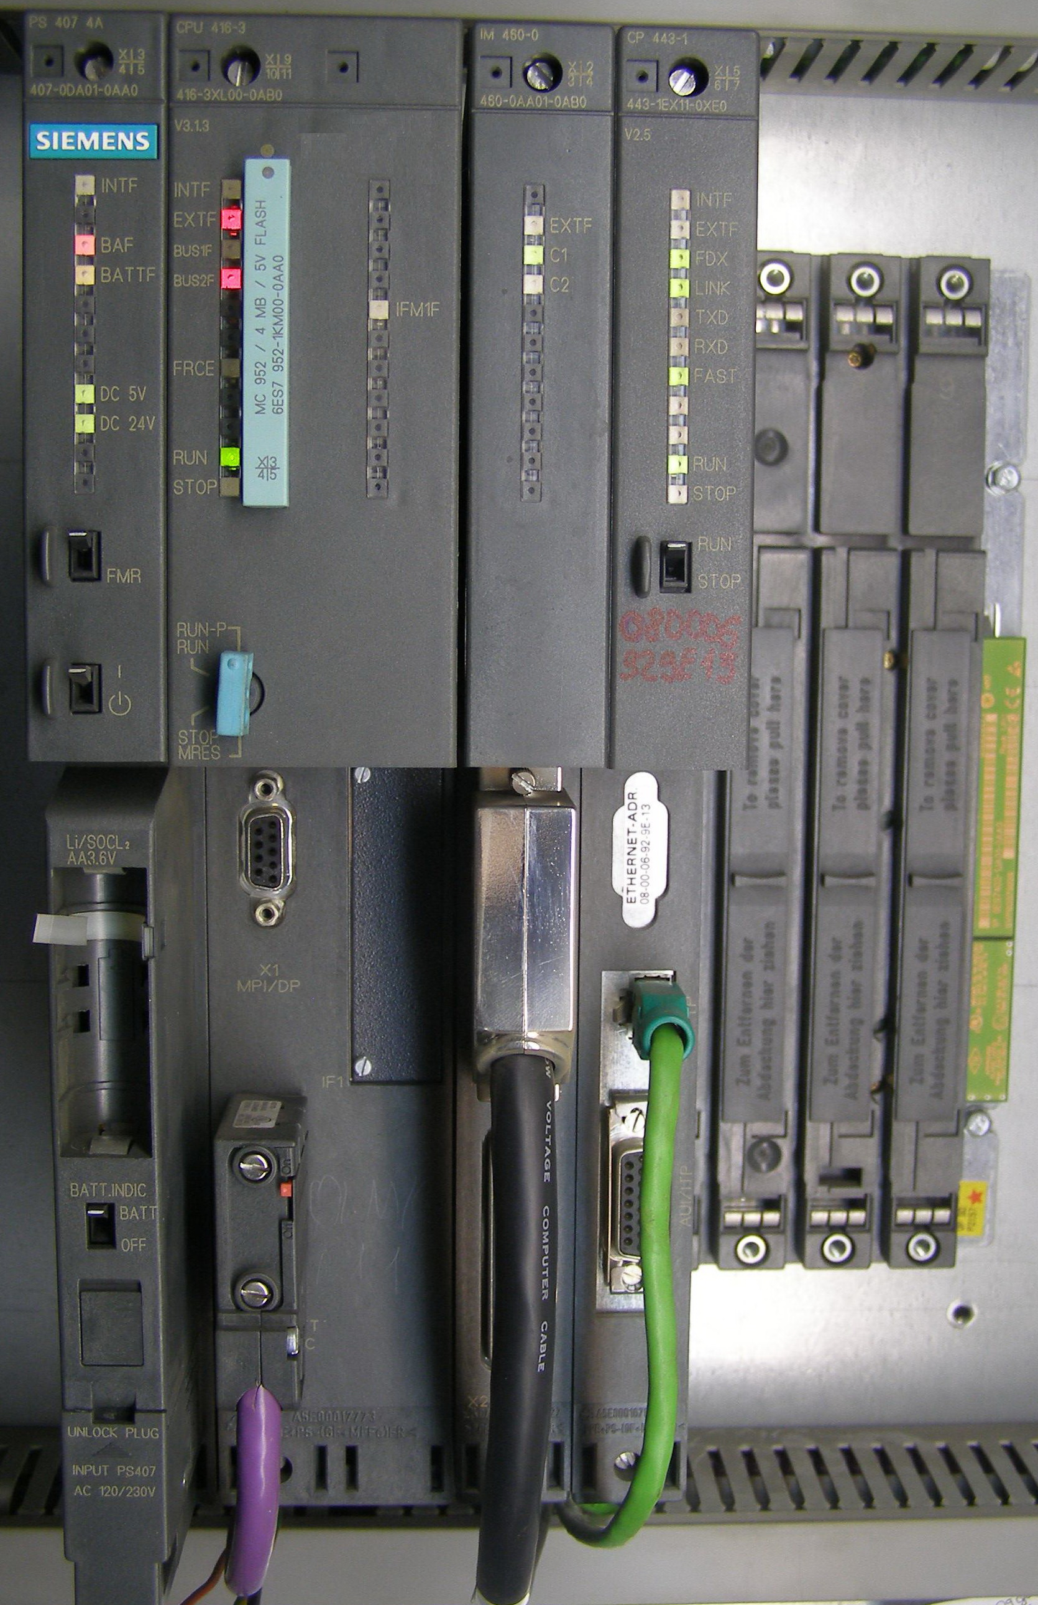
LS3: PLC Systems Upgrade
Motivation:
Bandwidth limitation at fieldbuses level
Ageing hardware (In operation since 2006)
Obsolete hardware, not available anymore / no repair or replacement
Needed to upgrade to newer software development versions
More powerfull CPU for faster beam energy feed-back loop
Upgraded hardware:
Replace all HV generators CPUs (50 units)
Replace safety controllers (54 units)
Replace safety I/O modules (84 units)
Replace PROFI-Bus by PROFI-Net (probably) (~200 connections)
Upgrade local control panels (4 units + Mobile test controller + 3 in lab)
Status: Not started
Budget:
HL-LHC-CONS (LS3)
Siemens – Type of old S7-400 CPU to upgrade

Slide 16
LS3 Upgrades (Not in baseline)

Slide 17
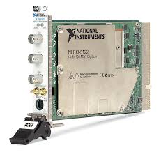
LS3: Upgrade of IPOC digitisers
Motivation:
Aging hardware (In operation since 2006 or 2010)
Hardware not available anymore / no repair nor one to one replacement available
Possible problem of software compatibility with future Linux versions.
Hardware to upgrade:
All NI-51xx cards (80 units) → IPOC / XPOC
All Spectrum M2i-3013 cards (100 units) → IPOC
All ACQIRIS DC-265/DC-270 cards (20 units) → OASIS (BE/CO)
Status: Not Started
Merge IPOC and SAM under same hardware under consideration
Strategy to upgrade hardware until LS3 under study
Budget:
350 kCHF
(Budget profile
to be confirmed)
NI PXI5122: Obsolescence announced for End-2019 !
Planned Expenditure [kCHF] | 2021 | 2022 | 2023 | 2024 | 2025 | 2026
Material / FSU |  |  | 20 | 300 | 30
FELL / TECH / VIA

Slide 18
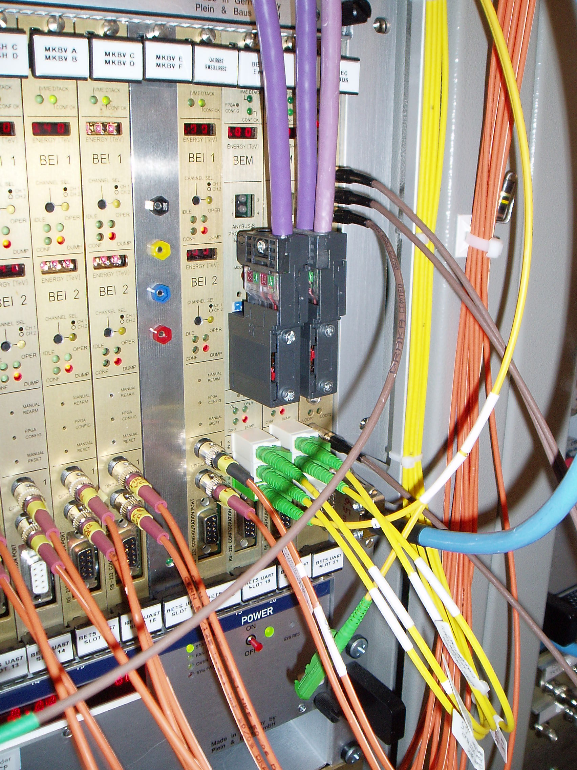
LS3: Upgrade of BETS
Motivation:
Upgrade BETS system in order to handle TCDQ steering during squeeze
(Beta* tracking).
Pending requests for new functionalities (Remote management of transfer functions, asymmetric limits, warning levels, etc…)
Upgrade BEA-6U hardware for integration within EPC FGC3.
Consolidate hardware in order to anticipate obsolescence of key components
Aging hardware (In operation since 2006)
Status: Not Started
Existing hardware OK up to LS3.
Hardware now used in others accelerators
Missing hardware for additional systems
Review to be organised to define scope and objective
Budget:
300 kCHF
BETS system in LHC:
- 1x BEC card on far right (lemo cables)
- 2x BEM cards on right (Yellow fibers / Purple PROFI-Bus)
- 14x BEI cards on left… (Orange fibers)
Planned Expenditure [kCHF] | 2021 | 2022 | 2023 | 2024 | 2025 | 2026
Material / FSU |  |  | 50 | 100 | 50
FELL / TECH / VIA |  |  | 50 | 50

Slide 19
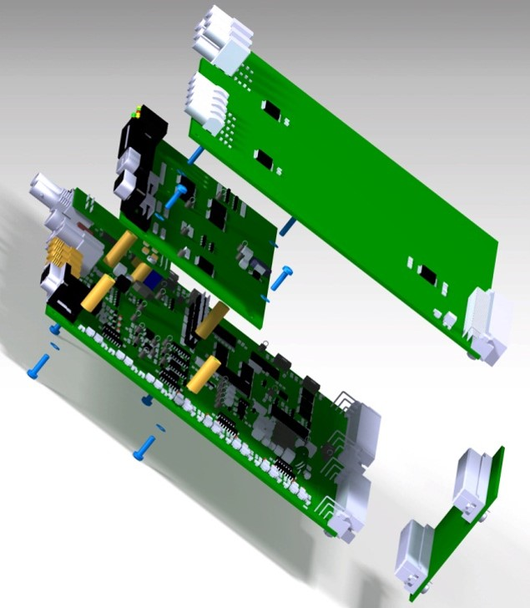
LS3: Upgrade of TSU hardware
Motivation:
Upgrade for compatibility with BIS V2
Architecture of Trigger Synchronisation Unit (TSU) to be reviewed
Deliverables:
New TSU boards design
Status: Not Started
Specification for BIS V2 must be frozen
Budget:
200 kCHF
TSU3 (LHC) - 3D view:
A composition of 4 cards
Planned Expenditure [kCHF] | 2021 | 2022 | 2023 | 2024 | 2025 | 2026
Material / FSU |  |  | 50 | 50 | 50
FELL / TECH / VIA |  |  | 50

Slide 20
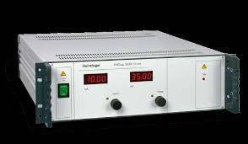
LS3: Upgrade Capacitor Charging Power Supplies
Motivation:
Replace capacitor charging power supply due to ageing effect
(20 year old in 2025).
Ageing effect visible during Run-II (instabilities at injection energy)
Higher output current required for operation at 7.5 TeV for principal power supply, due to increase of capacitor value in HV generators and faster ramp (Faster dE/dt at beginning of ramp)
Deliverables:
Purchase new power supplies / refurbishment of existing ones
Status: Not Started
Budget:
400 kCHF
Type of Heinzinger HVPS to upgrade
Planned Expenditure [kCHF] | 2021 | 2022 | 2023 | 2024 | 2025 | 2026
Material / FSU |  |  | 50 | 300 | 50
FELL / TECH / VIA

Slide 21
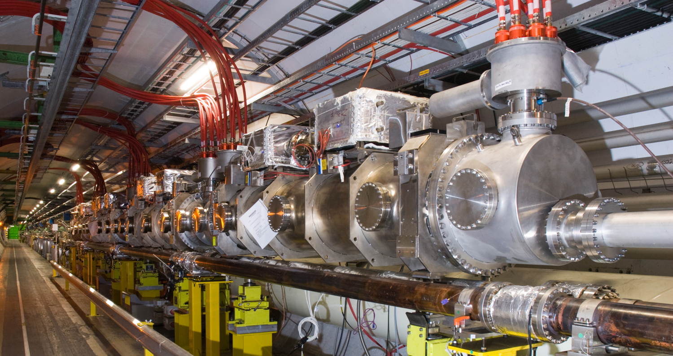
LS3: Provide Controls for Additional MKBH tanks
Motivation:
Provide electronics and controls for 4 additional MKBH generators
Deliverables:
UA63 & UA67 Infrastructure(Electrical distribution, Ethernet, Timing, controls cables, etc…)
New generator hardware (High voltage power supply, slow control, power trigger, re-trigger, IPOC/SAM…)
Upgrade of LBDS general subsystem
(SCSS, TSDS, BETS, IPOC, SAM, etc…)
Status: Not Started
Pending approval
Budget:
350 kCHF
MKBH tank in LHC tunnel
Planned Expenditure [kCHF] | 2021 | 2022 | 2023 | 2024 | 2025 | 2026
Material / FSU |  |  | 50 | 200 | 50
FELL / TECH / VIA |  |  |  | 50

Slide 22
Summary
Various controls problems were encountered during Run I & II operation
Actions are taken during LS2 to overcome most of these issues
Budget shared over LHC-OPE / LHC-CONS / HL-LHC-CONS
All upgrades planned for LS2 are ongoing and on track
Some upgrades planned for LS3 will be advanced to LS2
Many upgrades required for LS3 are not yet in the baseline (Hardware obsolescence)

