Slide 1
TDE upgrade needs and future prospects for HL-LHC
LHC Beam Dump System Review and its readiness for the Run3 and HL-LHC operation
5th February 2019
M. Calviani, S. Gilardoni (EN-STI)

Slide 2
Outline
Summary and limitations of LS2 interventions on LHC TDE block
Learning possibilities during Run3
What could happen in the HL-LHC era without LS3 upgrades
ALARA considerations
Ideas on the new LHC TDE block
Budget and manpower outlook
Conclusions

Slide 3
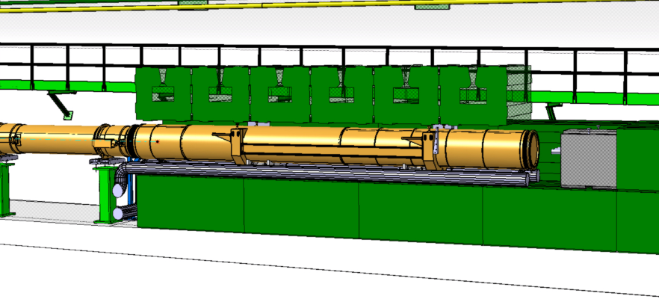
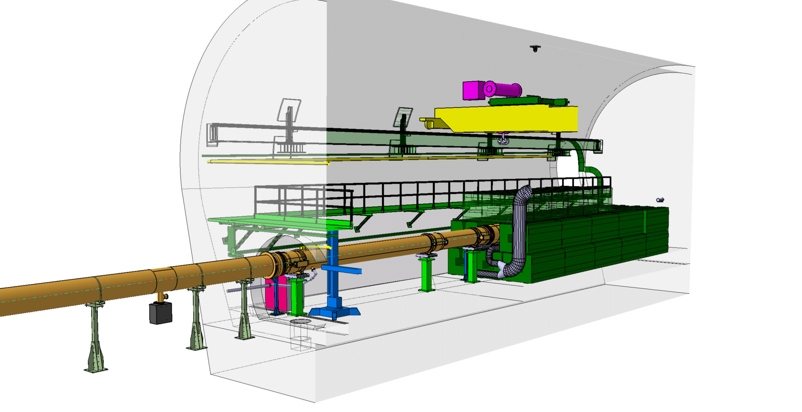
Run2 situation
Downstream window (TiGr2 plate)
Dump core
UHV LHC vac
N₂ dump sector
beam
Upstream window (CfC + SS316L foil)

Slide 4
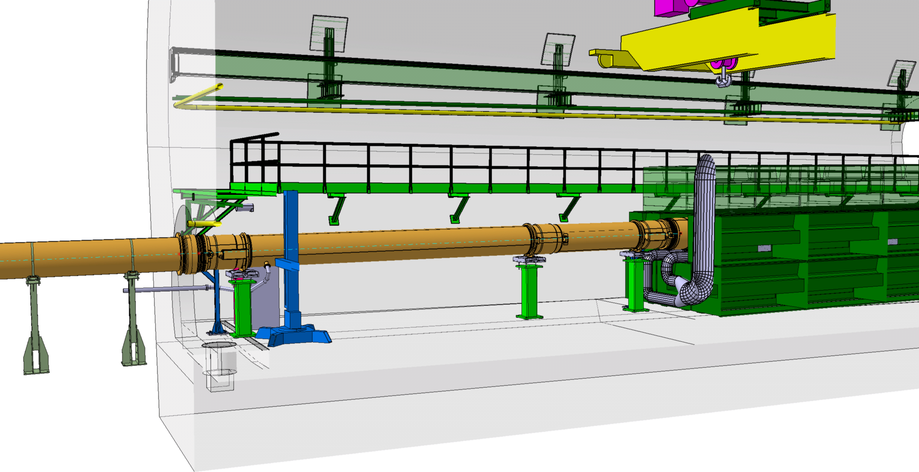
Run2 situation
Upstream window (CfC + SS316L foil)
+ 2x gaskets
No window
1x gasket

Slide 5
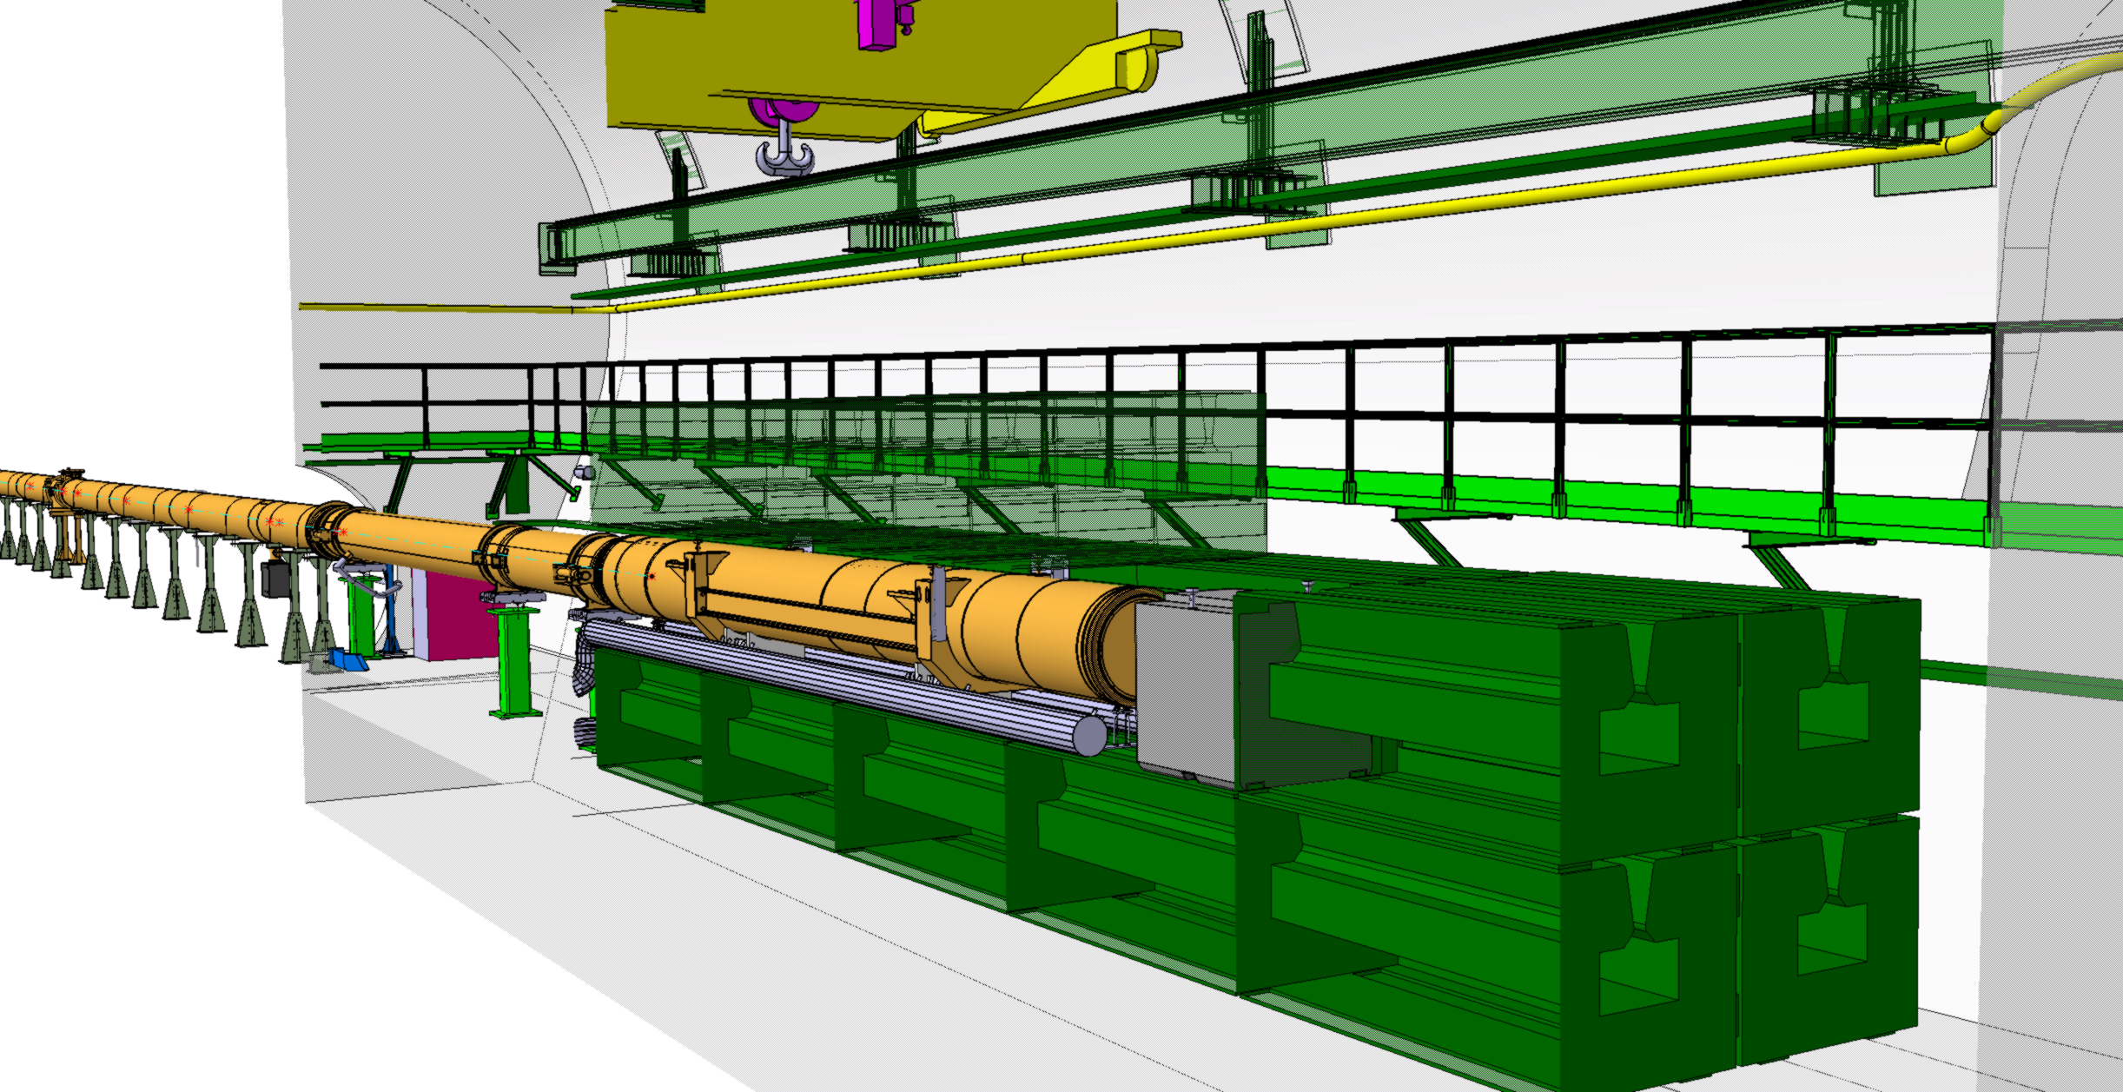
Run2 situation
Downstream window (TiGr2 plate)

Slide 6
Summary of foreseen LS2 interventions
Few interventions have been planned already to be executed during LS2 (→ A. Perillo-Marcone)
  Main objectives: a) reduce unavailability during Run3 and be compatible with the ALARA principle; b) compatible with LIU beam intensities
LMC369 has endorsed the following activities:
  Exchange of US nitrogen sector gaskets to cope with dump vibrations and plastic deformations and reduce nitrogen leak probability
  Exchange the DS dump window with the new design in TiGr5 with a CF flange
  Dump core modifications to be executed on spare cores only, which will be swapped with the operational ones, which will NOT be upgraded
LS2C, Coordination and related teams agreed for intervention in February 2020
BCR prepared and submitted to cover these activities
Detailed calculations in LHC-TDE-ER-0001

Slide 7
Limitations – what cannot be done in LS2
Modifications in LS2 should allow
  Mitigate of N₂ leaks through gaskets (US and DS)
  Increasing robustness of DS window (inaccessible and in a highly radioactive zone) in case of dilution failures
Remaining weak points in existing dumps
  Dump block vibrations → directly proportional to the total intensity of the dumped beam – will increase in Run3 and even more with HL-LHC
  Potential limitations in low density graphite sector and its behavior at high temperature (>1500 °C) – reaction to thermal stress unknown
  Reduced robustness of US window (316L) in case of dilution failures – no resources to study and build the system during LS2
    US window upgrade could be executed during YETS21-22 (BCR prepared and submitted)
The dump was NOT conceived to cope with nitrogen inside the core (but only vacuum) and with the presence of huge vibrations

Slide 8
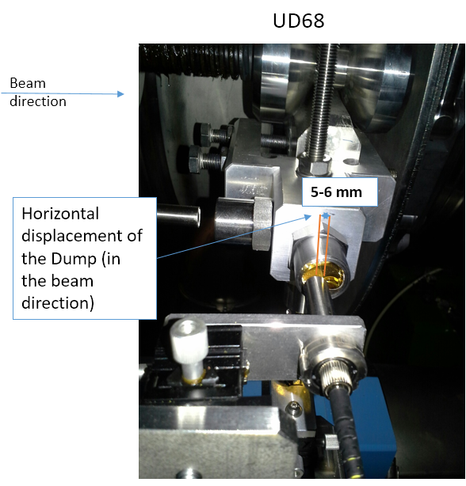
Learning possibility during Run3 (OP related)
Information on dump block behavior still quite limited despite installation of interferometers during 2017 & 2018
  Failures of the retroreflectors
    Shattered mirrors during 2017, exchanged with metallic ones during 2018
    Loss of alignment of interferometers heads due to significant plastic deformation of sector
  ➔ More robust system being developed with EN/SMM
During LS2, foreseen installation of additional instrumentation on modified spare core
  Strain gauges, temperature sensors, upgraded interferometers heads

Slide 9
What could happen without upgrades in LS3?
Dump is not restrained in the any direction
  Could lead to elevated stresses on bellows (N₂ leaks), possible damages on the DS window, despite the LS2 upgrades
Increased vibrations (linked in intensity/energy) could lead to increased leaks and need for intervening in the tunnel to repair the entire dump nitrogen sector (18 meters)
  Potential radioactive graphite dust (Be7) contamination in the UDs
Dump core integrity loss
  Graphite powder was already found in the nitrogen sector during 2016-2017 inspections (EDMS 2031855)
  Studies shall continue to validate the performances of Sigraflex in the HL-LHC era or studies for new materials (lower density graphite, foams, etc.)
Need to launch the study for a new dump sector design in order to cope with the limitations observed during 2015-2018
& study the complete dynamic response of the core

Slide 10
ALARA considerations
Interventions in the tunnel to repair leaks and exchange/fix gaskets are heavy from a radiation protection point of view
  ~3 mSv collective have been cumulated taking into account all operational during 2015-2018 by all intervening teams
  Current design not remote-handling friendly
Dose rate in the dump area will (only) increase over the years
  With the same reliability as in Run2, rough evaluations predict ~10-20 mSv collective until LS3, which is unacceptable from ALARA point of view
  These values will be proportionally higher in the HL-LHC era
New design could be made remote-handling friendly to reduce human interventions
  Already today optimizing interventions with robots when possible (EN/SMM)
  Coupled FLUKA with Radiation Survey with Virtual Reality environments

Slide 11
Low density graphite characterization (I/II)
Low density graphite (Sigraflex F03510 E) is very complex to characterize
  Employed usually for sealing applications in chemical and petrochemical industry
  Not typical used to sustain dynamic & thermal loads
  Systematic lack of data, not used for construction of operational ones
Oxidation behavior at high T summarized during HL-LHC TCC #50 with details in EDMS 1848986 – studies at CERN and at SGL
  “[..] Inert atmosphere recommended to guarantee safe operation over long-term”
  However interaction between C and N₂ >1500 °C is to be studied (cyanogen & hydrogen cyanide formation, mass reduction, etc.)
Can Sigraflex survive (cycle performances) at 1900 °C for regular dumps?

Slide 12
Low density graphite characterization (II/II)
Fundamental to be able to predict the behavior of Sigraflex → requires detailed measurement of thermo-physical and mechanical properties
  An effort has been made by the EN/MME MML (→ M. Guinchard presentation)
  We are however missing:
    The complete stress/strain behavior as a function of T and strain rate
    An EOS and a constitutive law in order to properly model the behavior of the material under dynamic load with LS-DYNA
    Fatigue and damage behavior
  Potential HiRadMat test of representative material in 2021 or 2022 (T_{max}?)
A possibility for complete characterization is being discussed with NTNU
First milestone set by end of 2020 for first results

Slide 14
Reasons for new core design
Must constrain dump movement mainly in longitudinal direction
Avoid plastic deformation of assembly/failures
  Vibration, permanent displacements, etc.
Concerns for thermo-mechanical stresses on the 318L housing (including welding)
  Detailed study still to be done (not exhaustively done in the past)
  Existing air cooling might not be sufficient (water-cooling suggested in past)
  Failure of housing could lead to contamination in the cavern due to dispersion of graphite powder
Behavior of graphite in N₂ likely put in question at extremely high operational temperatures
  To be clarified by end of 2020
For installation during LS3, remaining studies/assessment to be completed by 2020-21, new design in 2021-2022, construction 2023-2024

Slide 15
Conceptual ideas for new dump
Conceptual design not available yet, since resources have focused in
  Understanding currently installed TDE behavior and fix operational issues
  Developing Run3 enabling solutions to be implemented during LS2
Decouple core from external housing, to avoid the transmission of vibrations towards the outside vessel and to the N₂ sector
Decouple dump assembly from UHV sector
“Block” the entire core on the ground with the help of longitudinal restrainers (probably with dampers)
Review the configuration of the core to reduce peak temperature, employing an ever lower graphite density (~0.7-0.8 g/cm³) – if studies show that behavior at >2000 °C cannot be accepted
All options to be studied post 2020

Slide 16
Budget and manpower plans
Preliminary estimations have been discussed at the HL-LHC Consolidation Day (09/2017) and detailed in EDMS 2031855
Plans starting from 2021 until 2026
  EN-STI personnel will not be able to start before the end of LS2
Total project cost estimated at ~3.8 MCHF, including 2x dump sectors and 4x cores (3 MCHF material costs and 0.8 MCHF personnel)
  In-kind contributions to be investigated, mainly for dump assembly (318L or TiGr5) and related supporting structures

Slide 17
Conclusions
Upgrades to be executed during LS2 on the LHC TDE block are foreseen to mitigate the failures and observations of Run2, and therefore increase reliability during Run3
US window upgrade foreseen during YETS21/22, provided budget is available
For the HL-LHC era (post LS3) a major upgrade of the dump blocks is proposed in order to mitigate the issue of dump vibration and core material integrity, which will still be present during Run3

Slide 18
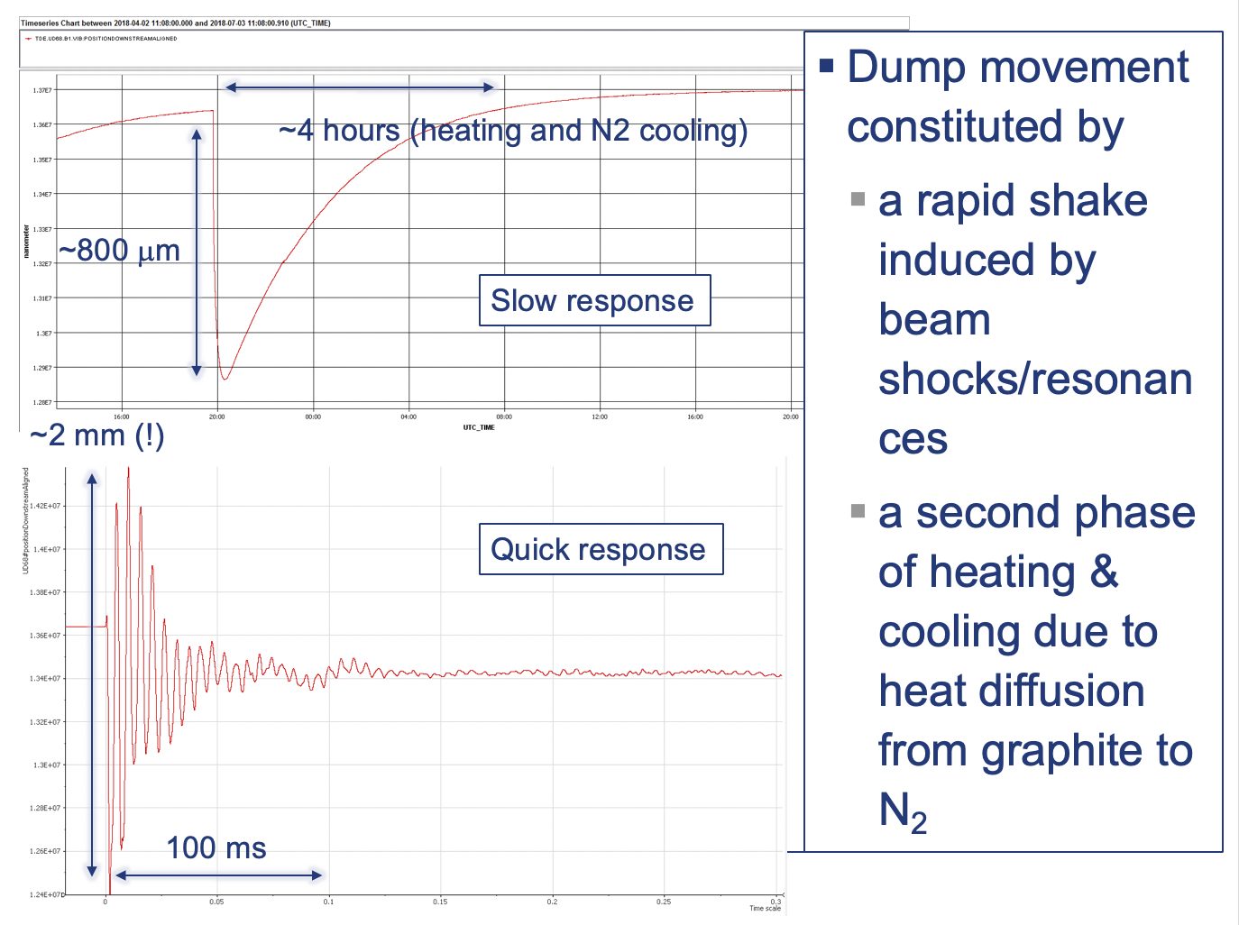

Slide 19
Region of interventions during LS3

