Slide 1
ECFA Activities
CHIPP Plenary Meeting 2019
Mike Seidel, Lenny Rivkin
Paul Scherrer Institut
material: J.D´Hondt, M.Benedikt, E.Jensen, L.Rossi, D.Schulte, A.Yamamoto, F.Zimmermann

Slide 2

  Schedule of ECFA meetings
      country visits: presentations on particle physics / accelerator developments
      RECFA closed meeting to work out comments, recommendations
      compilation of letter
    visits 2019:
    Spain (Madrid), March 1-2, 2019
    Slovenia (Ljubljana), April 5-6, 2019
    Poland (Warsaw), May 24-25, 2019
    Joint ECFA and EPS-HEPP session (Ghent), July 13, 2019 (including RECFA meeting)
    Cyprus, October 25-26, 2019 (confirmed)
    CERN, November 14-15, 2019 (including RECFA on 14 Nov and PECFA on 14-15 Nov)
    tentative visits in 2020:
    March: Serbia
    April: Ukraine/France??
    May: France/Ukraine??
    October: Denmark

Slide 3
  ECFA Working Groups
  Detector R&D Panel: next slides
  ApPEC-ECFA-NuPECC Joint Seminar: next slides
  ECFA working group on Recognition of Individual Achievements in Large Collaborations: next slides
  Working group on Higgs@FutureColliders: next slides

Slide 4
  ECFA Working Group on Detector R&D
  “A committee to review detector development efforts for future projects”
  https://cds.cern.ch/record/2235340/files/Statement%20R&D298.pdf
  https://ecfa.web.cern.ch/sites/ecfa.web.cern.ch/files/ECFA_detector_panel_ESPPU_input_Dec2018.pdf
  The mandate of the Detector R&D panel (ECFA/16/298, June 2016), some extracts:
  The ECFA Detector Panel is aimed at providing advice on detector development efforts for projects in their preliminary and preparatory phases. It receives R&D proposals on request by research communities, laboratories, institutions, individual authors and bodies such as science funding agencies. It appoints experts charged to evaluate them and make recommendations.
  It helps to create coherence of global detector R&D efforts by encouraging synergies between different activities and advising funding agencies on request.

Slide 5
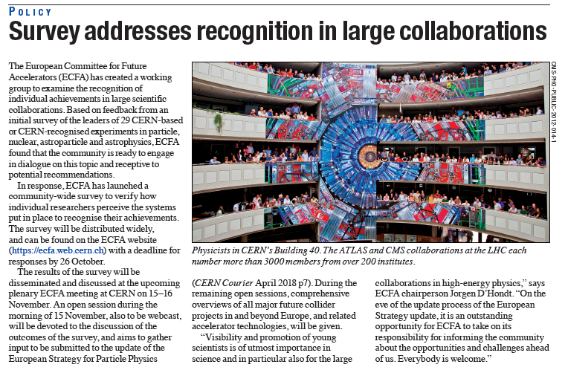
CERN Courier
October 2018
https://cerncourier.com/survey-addresses-recognition-in-large-collaborations/
Also in CERN Bulletin
https://home.cern/cern-people/updates/2018/10/addressing-recognition-large-collaborations?utm_source=Bulletin&utm_medium=Email&utm_content=2018-10-04E&utm_campaign=BulletinEmail
Survey outcome:
https://indico.cern.ch/event/759130/contributions/3148323/attachments/1753311/2874608/ECFA-Survey-Recognition-Results.pdf

Slide 6
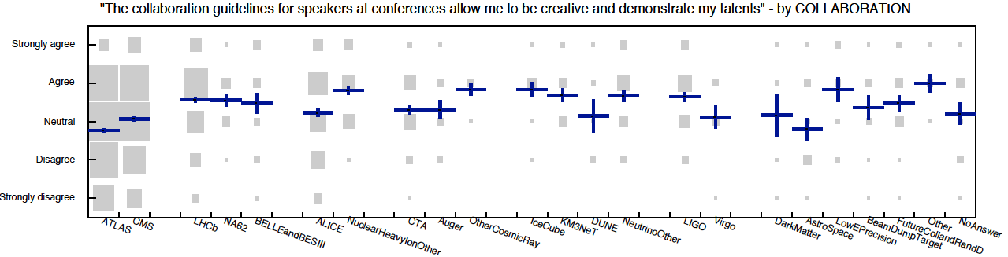
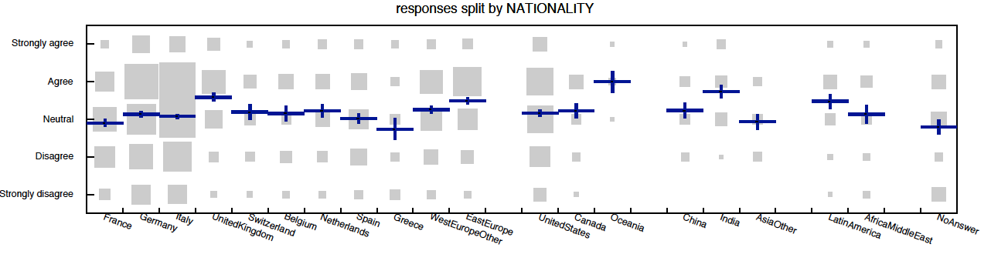
illustration

Slide 7
  Recognition theme – next steps agreed in ECFA
  In a next step ECFA will create a new working group with representatives from all interested scientific collaborations in particle physics (and to reach out to astroparticle and nuclear physics)
  Key objectives within an advisory and exploratory mandate of the working group:
    exchange and discuss best practices, and reflect on alternative or additional procedures
    potentially perform a second survey in 2020-2021 to monitor the progress on the topic
    however, the group will not be an ombudscommittee for individual problems
  The working group should openly communicate about its activities to the community at large
  The collaborations remain themselves responsible for the actions of the working group and to implement (or not) recommendations; ApPEC-ECFA-NuPECC will be there for example to facilitate, to invite the collaborations, to draft the initial mandate and potentially to assign (co-)chair(s)

Slide 8
  Working group on Higgs@FutureColliders
  In the context of exploring the Higgs sector, provide a coherent comparison of the reach with all future collider programmes proposed for the European Strategy, and to project the information on a timeline.
  For the benefit of the comparison, motivate the choice for an adequate interpretation framework (e.g. EFT, κ, …) and apply it, and map the potential prerequisites related to the validity and use of such framework(s).
  Members: Aleandro Nisati (Rome, chair), Christoph Grojean (DESY), Fabio Maltoni (Louvain/Bologna), Jorge de Blas (University of Padova), Maria Cepeda (CIEMAT), Riccardo Rattazzi (EPFL), Wouter Verkerke (NIKHEF), and ex-officio Keith Ellis and Beate Heinemann (PPG conveners for the EW sector), and ex-officio the ECFA Chair; Elisabeth Petit (CPPM) joined in March as speaker of the H³ talk in Granada.
  Preliminary report available at: http://inspirehep.net/record/1733996 (arXiv:1905.03764)
  The working group will now take into account comments received during he Open Symposium, and work towards a final report with an opportunity to present the final report during the ECFA-EPS sessions (July 13, 2019).

Slide 9
next: selected accelerator aspects of HEP strategy discussion
Higgs factories & timelines
magnet low field option
energy efficiency

Slide 10
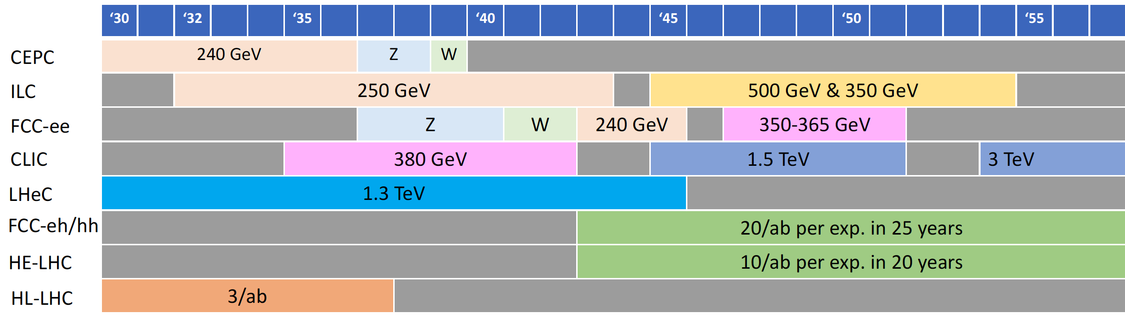
Proposed Schedules
Project | Start construction | Start Physics (higgs)
CEPC | 2022 | 2030
ILC | 2024 | 2033
CLIC | 2026 | 2035
FCC-ee | 2029 | 2039 (2044)
LHeC
Proposed dates from projects
Would expect that technically required time to start construction is O(5-10 years) for prototyping etc.
https://indico.cern.ch/event/808335/contributions/3365144/

Slide 11
Comparisons [Daniel Schulte]
Project | Type | Energy [TeV] | Int. Lumi. [a⁻¹] | Oper. Time [y] | Power [MW] | Cost
ILC | ee | 0.25 | 2 | 11 | 129 (upgr. 150-200) | 4.8-5.3 GILCU + upgrade
 |  | 0.5 | 4 | 10 | 163 (204) | 7.8 GILCU
 |  | 1.0 |  |  | 300 | ?
CLIC | ee | 0.38 | 1 | 8 | 168 | 5.9 GCHF
 |  | 1.5 | 2.5 | 7 | (370) | +5.1 GCHF
 |  | 3 | 5 | 8 | (590) | +7.3 GCHF
CEPC | ee | 0.091+0.16 | 16+2.6 |  | 149 | 5 G$
 |  | 0.24 | 5.6 | 7 | 266
FCC-ee | ee | 0.091+0.16 | 150+10 | 4+1 | 259 | 10.5 GCHF
 |  | 0.24 | 5 | 3 | 282
 |  | 0.365 (+0.35) | 1.5 (+0.2) | 4 (+1) | 340 | +1.1 GCHF
LHeC | ep | 60 / 7000 | 1 | 12 | (+100) | 1.75 GCHF
FCC-hh | pp | 100 | 30 | 25 | 580 (550) | 17 GCHF (+7 GCHF)
HE-LHC | pp | 27 | 20 | 20 |  | 7.2 GCHF

Slide 12
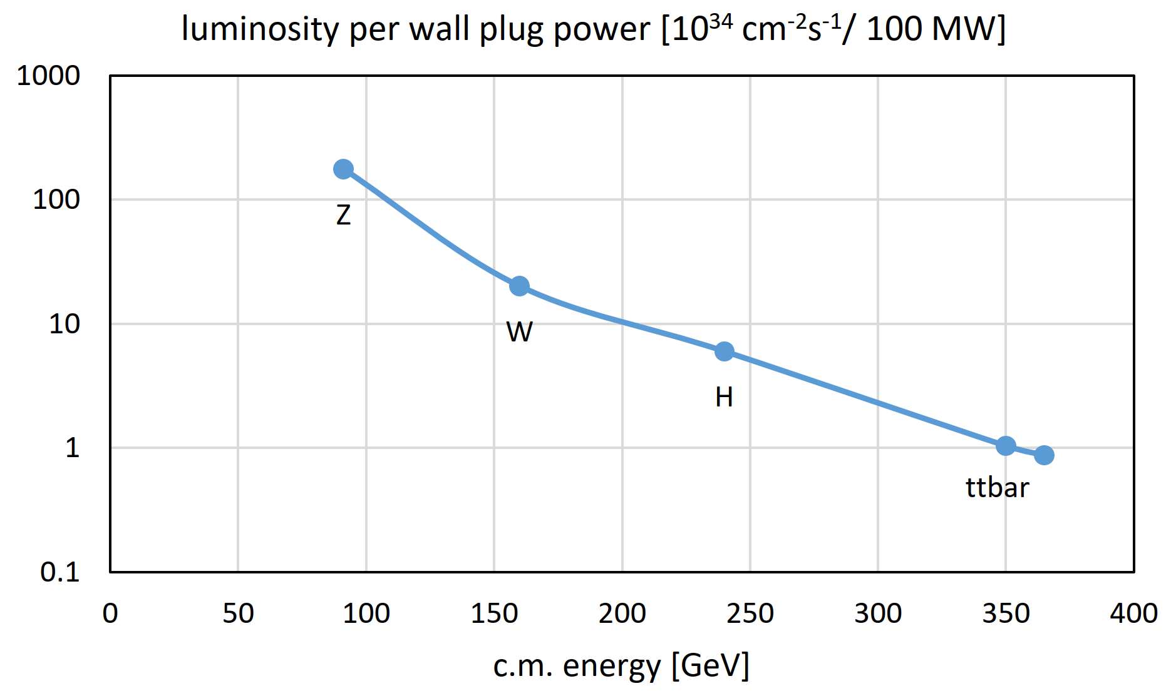
FCC-ee: a sustainable accelerator
twin-aperture arc magnets,
thin-film SRF, efficient RF power
sources, top-up injection
Frank Zimmermann
FCC-week
electricity cost ~200 euro per Higgs boson

Slide 13
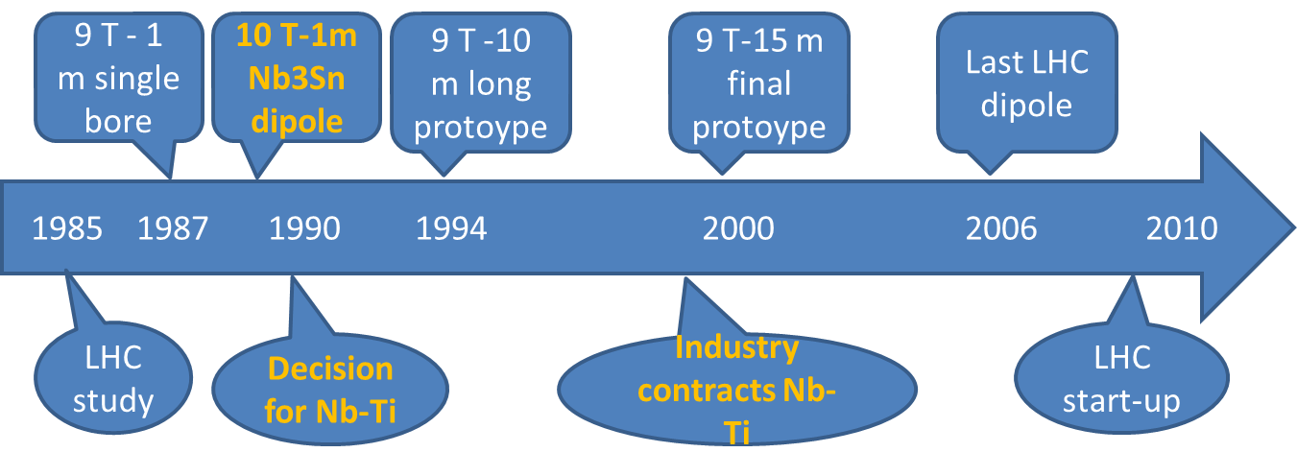
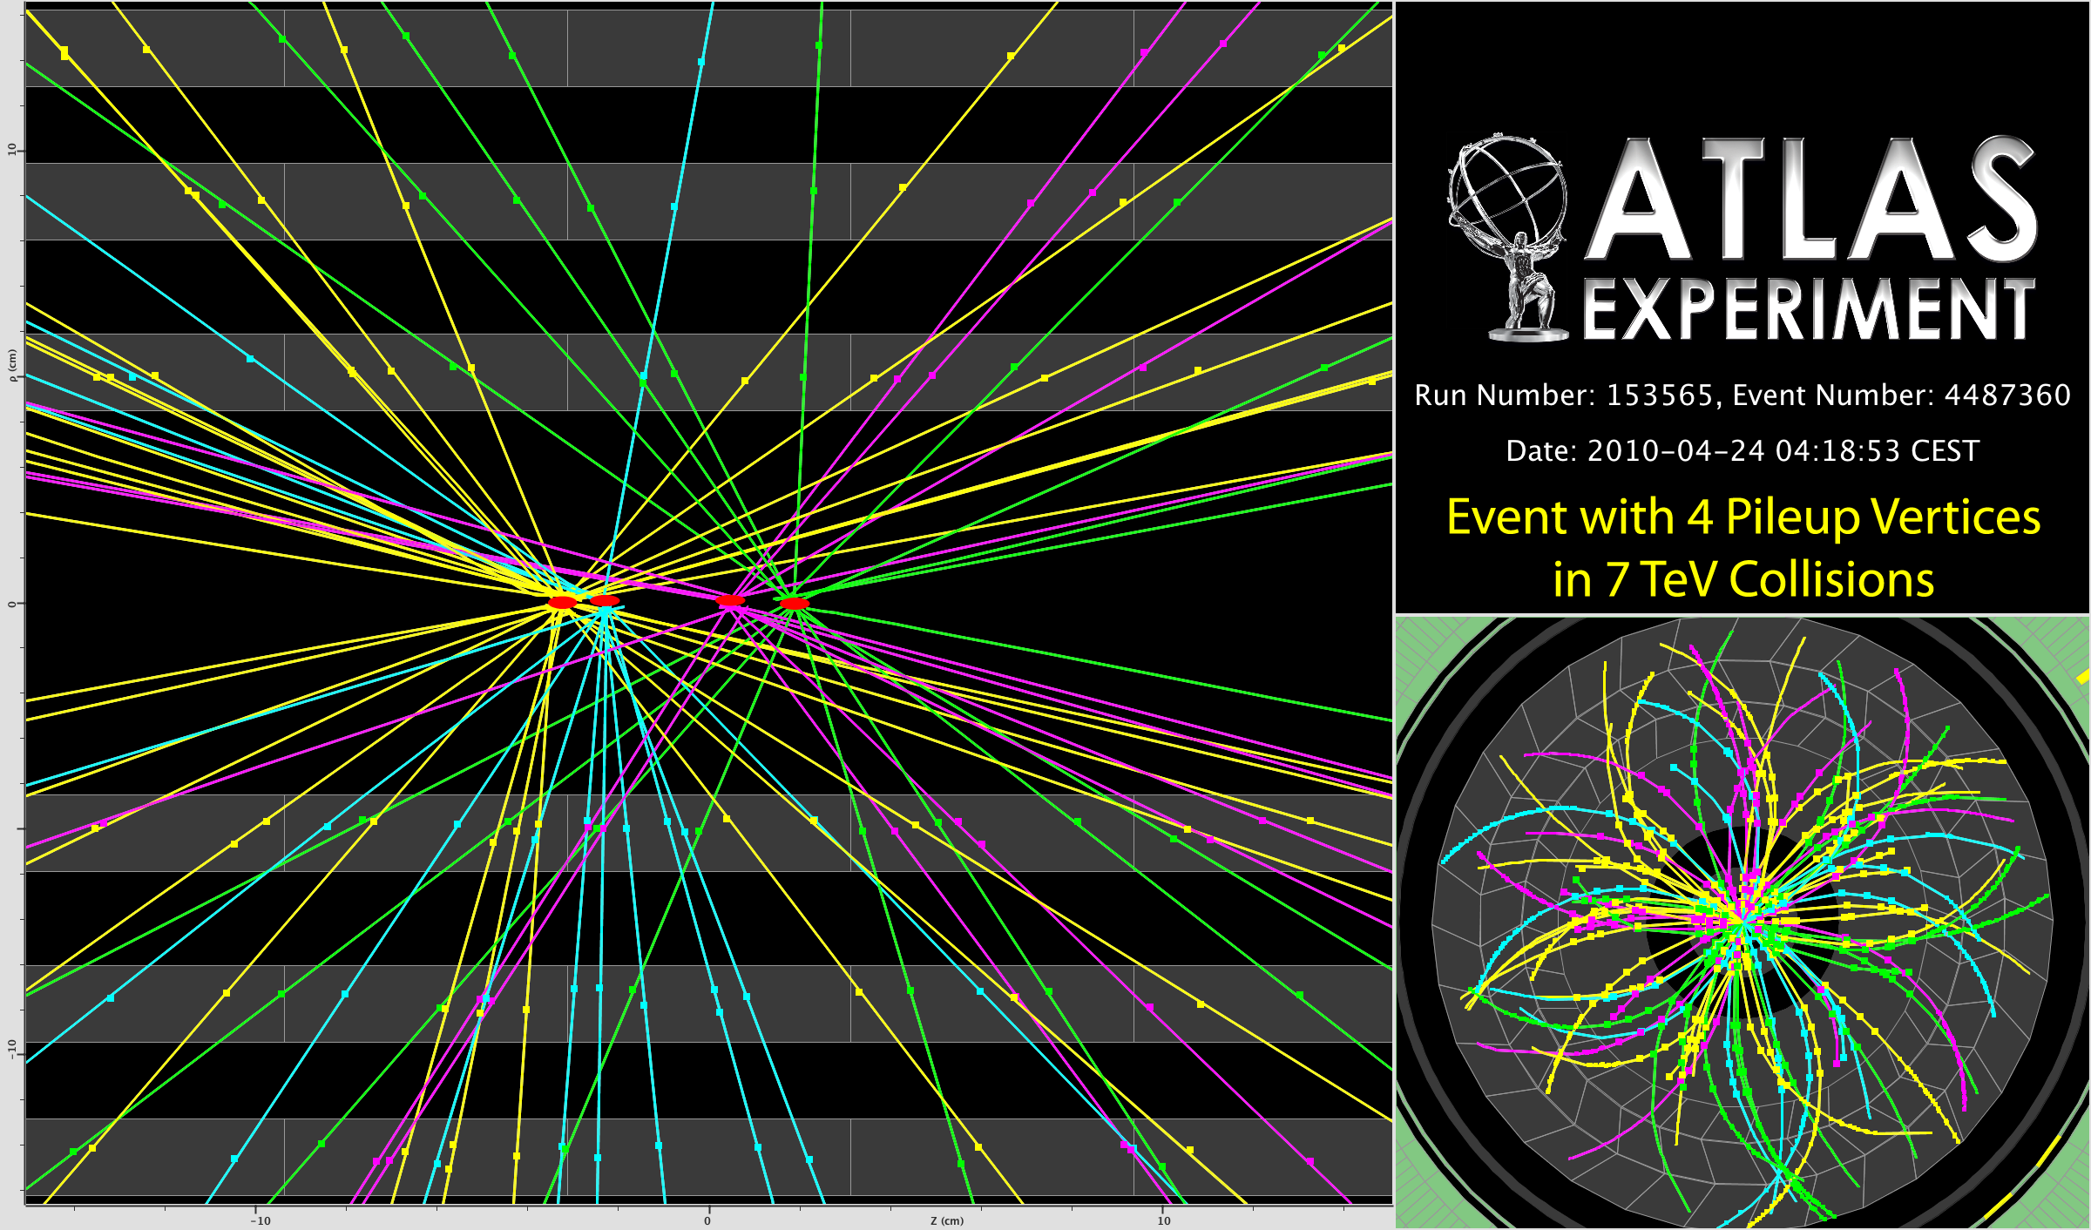
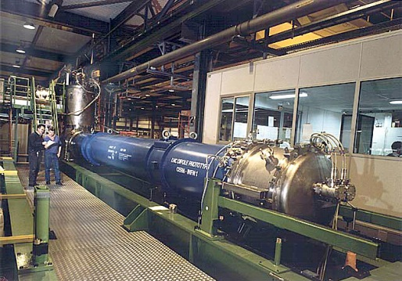
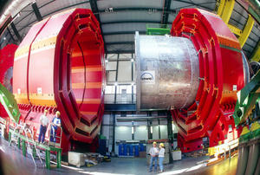
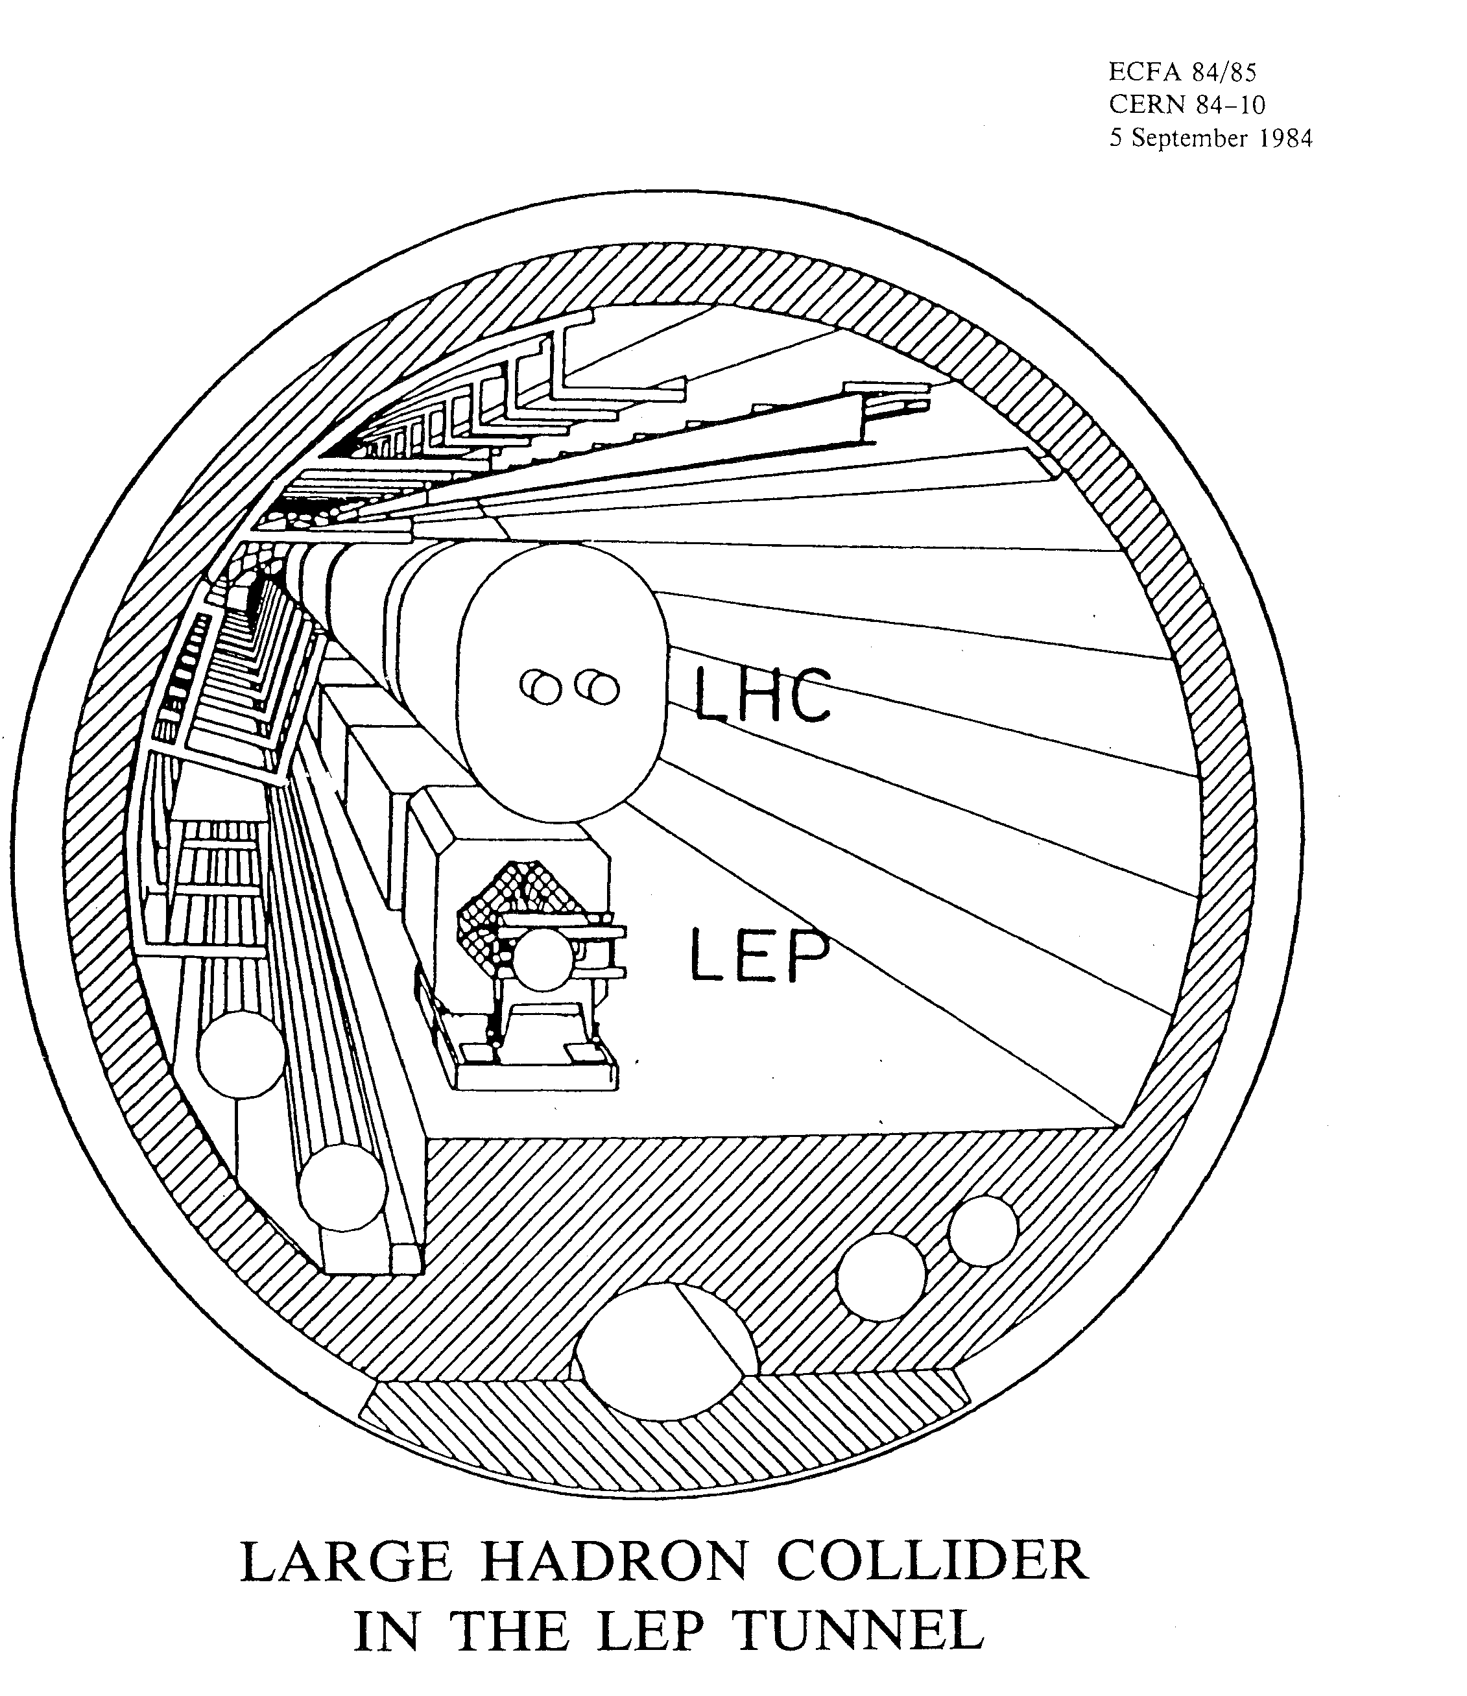
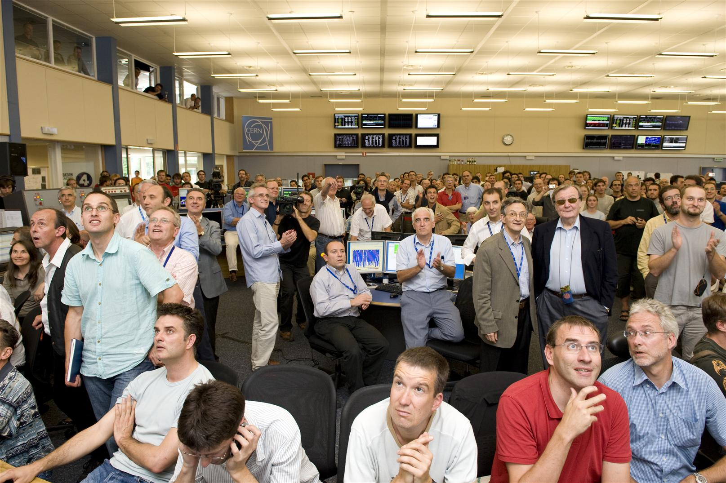
The 25 y LHC construction time line possible only because SSC developed the superconductor…
Only 2 y to make a short magnet «near to final». Conductor available(SSC)
7 years from start R&D to 1st Industry proto
12 y from first working prototype to last magnet

Slide 14

ESG request for parameters of a
lower-energy hadron collider
https://indico.cern.ch/event/727555/contributions/3447469/attachments/1867359/3071163/190624_Overview_of_the_FCC_Study_ap.pdf
parameter | FCC-hh |  | FCC-hh-6T | HE-LHC | HL-LHC | LHC
collision energy cms [TeV] | 100 |  | 37.5 | 27 | 14 | 14
dipole field [T] | 16 |  | 6 | 16 | 8.33 | 8.33
beam current [A] | 0.5 |  | 0.6 | 1.1 | 1.1 | 0.58
synchr. rad. power/ring [kW] | 2400 |  | 57 | 101 | 7.3 | 3.6
peak luminosity [10³⁴ cm⁻²s⁻¹] | 5 | 30 | 10 (lev.) | 16 | 5 (lev.) | 1
events/bunch crossing | 170 | 1000 | ~300 | 460 | 132 | 27
stored energy/beam [GJ] | 8.4 |  | 3.75 | 1.4 | 0.7 | 0.36
NbTi technology from LHC, magnet with single-layer coil providing 6 T at 1.9 K:
  Corresponding beam energy 18.75 TeV or 37.5 TeV c.m.
  Significant reduction of synchrotron radiation wrt FCC-hh (factor 50) and corresponding cryogenic system requirements.
Luminosity goal 10 ab⁻¹ over 20 years or 0.5 ab⁻¹ annual luminosity:
  Beam current 0.6 A or 20% higher than for FCC-hh, 1.2E11 ppb (FCC-hh: 1.0 ppb).
  Stored beam energy 3.75 GJ vs 8.4 GJ for FCC-hh.
Analysis of physics potential, technology requirements and cost ongoing.

Slide 15

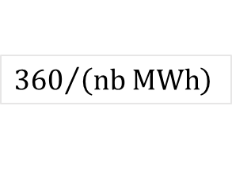


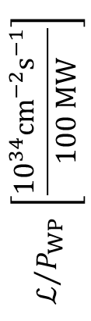
Luminosity per Grid Power
$$∝{\sqrt{s}}^{−4}$$
(2 IPs)
$$ℒ/{P_{WP}} \left[\frac{{10}^{34}cm^{−2}s^{−1}}{100 MW}\right]$$
${360}/{\left(nb MWh\right)}$
$$∝{\sqrt{s}}^{2}$$
[E.Jensen, Granada]
$$\sqrt{s} \left[TeV\right]$$
Numbers for baseline proposals

Slide 16



Proposed HEP Projects and Grid Power Consumption
 | ECM [TeV] | L / IP [10³⁴cm⁻²s⁻¹] | P_{Grid} [MW] | power driving effects
FCC-ee (Z) | 0.091 | 230 | 259 | SR Power: 50MW/beam
FCC-ee (t) | 0.365 | 1.5 | 359 | SR power: 50MW/beam
FCC-hh | 100 | 30 | 580 | SR power: 2.4MW/beam @ 50K, cryogenics
ILC | 1 | 4.9 | 300 | beam power: 13.6 MW/beam, cryogenics
CLIC | 3 | 5.9 | 582 | beam power: 14 MW/beam
muon coll. | 6 | 12 | 270 | mu decay, 1.6MW/drive beam, cycling magnets, but scaling advantages, least developed
→ need more R&D towards efficient concepts & technology, and energy management
Notes:
Here is a number of collider proposals. They are all optimized for fantastic luminosity, but they consume enormous amounts of power as well. Unfortunately all have good physics reasons why the consumption is so high to achieve the required luminosity.
Mitigating the large power consumption is a topic that is in my interest for a long time, and this be quite important for a public acceptance of such a project.

Slide 17
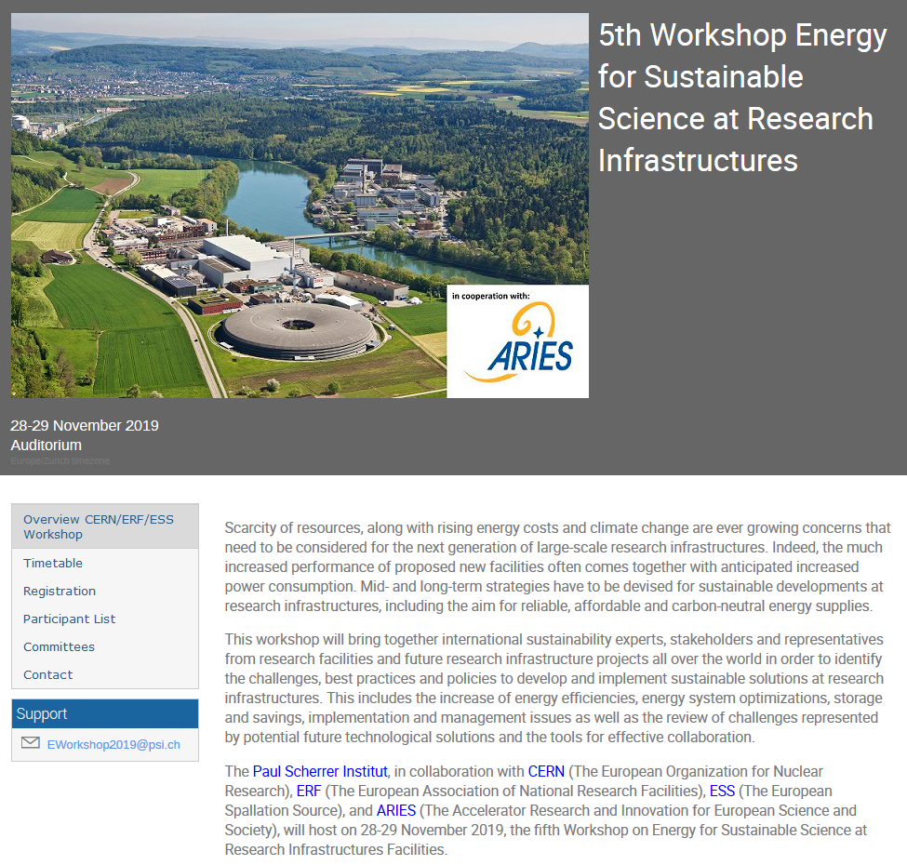
Upcoming Workshop on sustainable RIs
Program
General sustainability aspects (6)
Energy management at Research Infrastructures (8)
Energy efficient technologies (8)
Research on Sustainable Technologies using RI’s (4)
Cryogenic Systems and Conventional Cooling (4)
Organizing Committee
Carlo Bocchetta, ESS
Frederick Bordry, CERN
Florian Gliksohn, ERF
Joachim Grillenberger, PSI
Frank Lehner, DESY
Thomas Schmidt, PSI
Carlo Rizzuto, ELI
Mike Seidel, PSI
reserve the date: Paul Scherrer Institut, CH, November 28-29, 2019
https://indico.psi.ch/event/6754/

