Slide 1
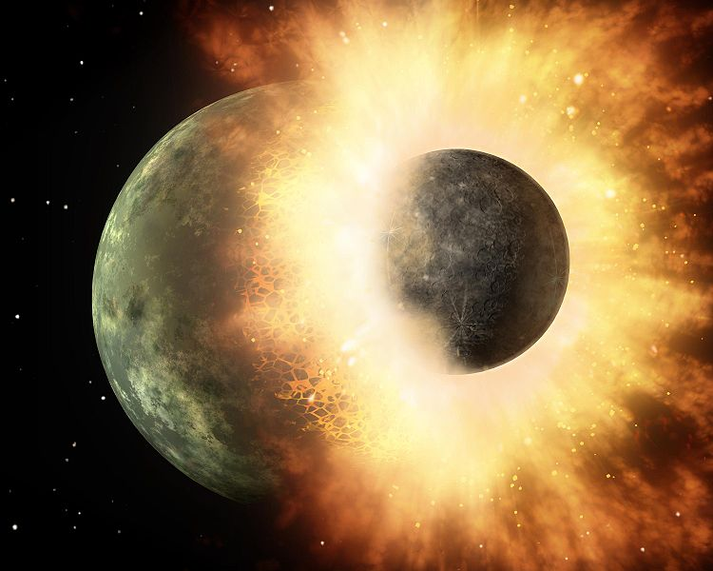
HEAVY IONS COLLISIONS EXPERIMENTS
Valérie Ramillien-Barret
Laboratoire de Physique Corpusculaire
Université Blaise Pascal – Clermont-Ferrand - FRANCE

Slide 2
HEAVY IONS COLLISIONS (HIC) EXPERIMENTS
Introduction
  Nuclear Matter constituents
  QCD – quarks confinement – asymptotic freedom – quarks deconfinement - QGP
  Where can we find nuclear matter at high density and high temperature?
  Nuclear matter phase diagram
Heavy Ions Collisions
  Collision time evolution
  Analysis method : comparison of models prediction with experimental results for pp – pA – AA collisions
  Collision geometry – Centrality – Glauber Model
  Some experimental observables and QGP signatures
Experiments : description and main results
  SPS (1986- 2003 Pb-Pb √s_{NN} < 20 GeV )
  RHIC (2000- … Au-Au √s_{NN} < 200 GeV )
  LHC : ALICE (2009- … Pb –Pb √s_{NN} < 5500 GeV) First results
Why study HIC ?
How study HIC ?
Results of the HIC experiments

Slide 3
HEAVY IONS COLLISIONS (HIC) EXPERIMENTS
Introduction
  Nuclear Matter constituents
  QCD – quarks confinement – asymptotic freedom – quarks deconfinement - QGP
Why study HIC ?

Slide 4
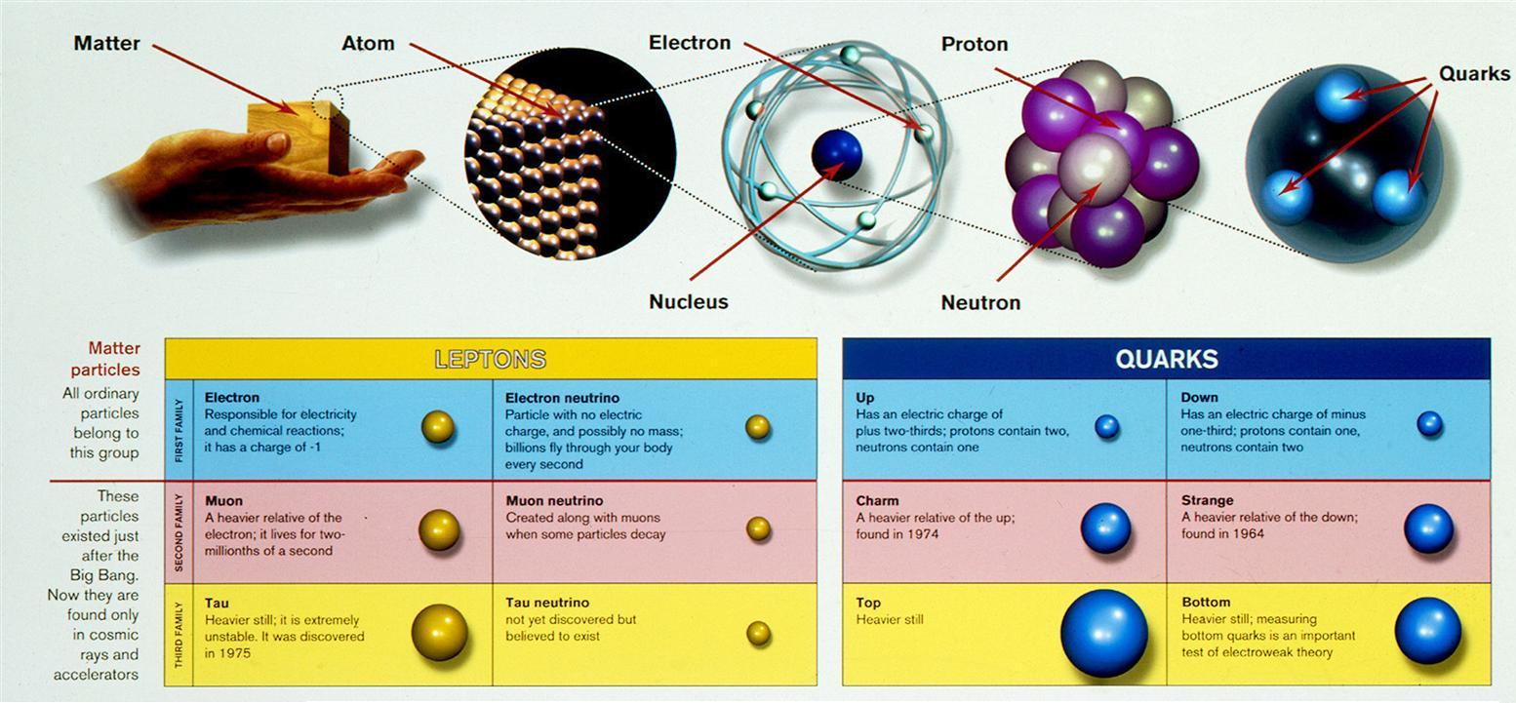
Nuclear Matter constituents
Elementary particles:
Autre figure !!!
(6 flavors)
Electro-Weak interaction
Quantum Electro Dynamic (QED)
Strong interaction
Quantum Chromo Dynamic (QCD)

Slide 5
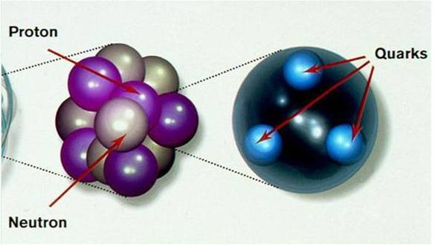
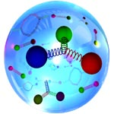
Nuclear Matter constituants
QCD vacuum
  Most part of the mass is composed by the energy of interacting quarks-antiquarks and gluons of the QCD vacuum
  Proton = uud Neutron = udd
  m_{p} = 938 MeV m_{n}= 939 MeV
  m_{u} ~ 3 MeV
  m_{d} ~ 6 MeV
only ~ 1.3 – 1.5 % of the mass
Heavy ions (=heavy nucleus) are composed by quarks confined in hadrons (protons and neutrons) surround by quarks-antiquarks and gluons of the QCD vacuum.
Heavy ions behavior describe by QCD

Slide 6
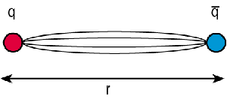
QCD
The quantum chromodynamics (QCD) is the theory of the strong interaction which describe the interactions between quarks by exchange of gluons which carry color charge (It is a part of Standard Model)
  The quarks are colored (R,G,B)
  The quarks interact among themselves via the
  exchange of colored gluons
Comparison between QED and QCD
gluon (color charge) exchange
 | QED | QCD
Fermions | e⁻, e⁺, μ … | quarks
Gauge bosons | photon (γ) | gluons (g)
Charge | electric charge (e) | color charge (g)
Coupling constant

Slide 7
QCD : coupling constant
Comparison between QED and QCD coupling constant (strenght of interaction)
α_{s} (QCD)
  Color attraction increase strongly with the distance
Coupling constant
α (QED)
  Electric force decrease slowly when the distance increase
long distance
low energy
low temperature
short distance
high energy
high temperature

Slide 8


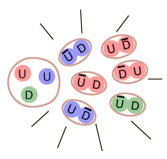
QCD : coupling constant
  The energy required to separate a quark is higher than the energy required to create a new pair quark-anti quark
QCD coupling constant
  Confinement :
  At long distance : strenght between quarks become stronger.
  quarks cannot be separate and they are bound into hadrons
α_{s} (QCD)
Coupling constant
long distance
low energy
low temperature
short distance
high energy
high temperature
Fragmentation process
No possibility to observe free quarks

Slide 9
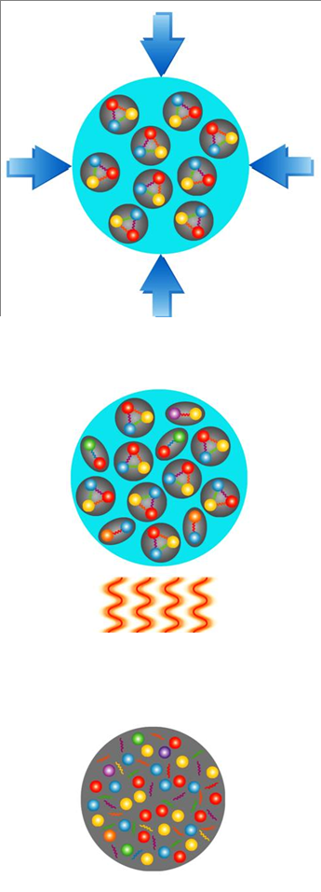
QCD : coupling constant
If we can compress and/or increase the temperature of heavy ions, quarks can be deconfined
QCD coupling constant
  Asymptotic freedom :
  At short distance : interactions become weak
  quarks can be considered as free in hadrons
α_{s} (QCD)
α_{s} (QCD)
Coupling constant
long distance
low energy
low temperature
short distance
high energy
high temperature
QCD predict the creation of a deconfined state of the matter called : Quark Gluon Plasma (QGP)

Slide 10
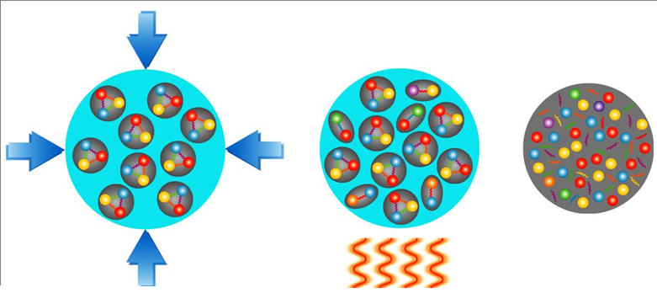
QCD – quarks deconfinement - QGP
Quark Gluon Plasma
QGP
  Compression :
  Nucleons will overlap themselves and lose their identity
  Heating:
  QCD vacuum is thermally excited, and above a critical temperature quarks are deconfined

Slide 11
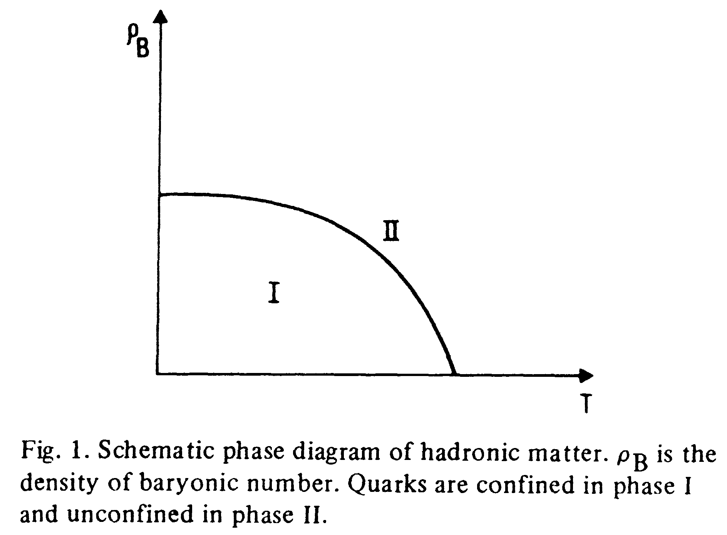
Phase diagram for nuclear matter
N. Cabibbo and G. Parisi: Phys. Lett. 59B (1975)
Deconfined phase
ρ_{Β} = [baryons/fm³]
Phase transition
Confined phase

Slide 12
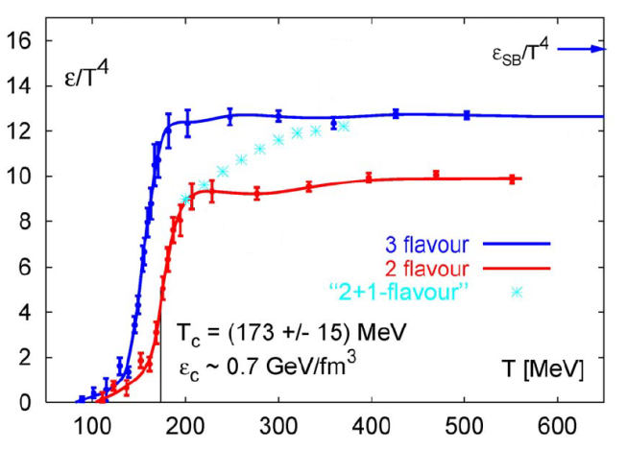
QCD prediction : estimation of the temperature of the phase transition
  ε : Energy density related to the degree of freedom of the system
  Hadron gaz : degree of freedom of pions (n_{f} = 3 isospin )
  QGP : degree of freedom of quarks (3 colors for each flavour)
  + gluons (8 colors)
  Sharp increase of energy density
  Phase transition from Hadron gas to QGP at T=Tc ~ 170 MeV (for μ_{B}=0)
Karsch et al. N.P. B605 (2001) 579
Stefan-Boltzmann limit for a gas of free particles
m_{u} = m_{d} = m_{s}
m_{u} = m_{d}
m_{u} = m_{d} ; m_{s} > m_{u,d}

Slide 13
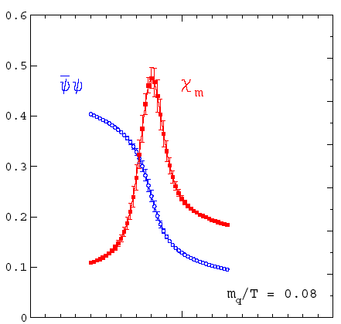
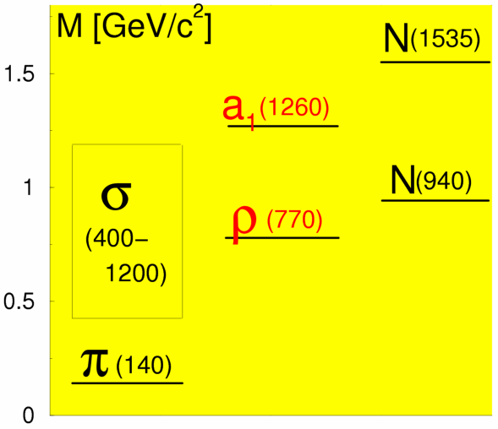
QCD : Chiral symmetry
For massive particles, chiral symmetry is broken.
chiral symmetry
chiral symmetry broken
At low temperature (normal nuclear matter):
  Quarks condensate provide to the quark an effective mass :
  Chiral partner doesn’t have the same mass:
At high temperature : QCD predict the chiral symmetry restoration
  Dissolution of quark condensate
  Chiral partner are mixed (expect to observe some modification in the mass distribution of these particles)
Phase transition
at T=T_{c} (170 MeV)
1.0 T/T_{c}
J^{P}=0± 1± 1/2±

Slide 14
HEAVY IONS COLLISIONS (HIC) EXPERIMENTS
Introduction
  Nuclear Matter constituents
  QCD – quarks confinement – asymptotic freedom – quarks deconfinement - QGP
  Where can we find nuclear matter at high density and high temperature?
  Nuclear matter phase diagram
Why study HIC ?

Slide 15
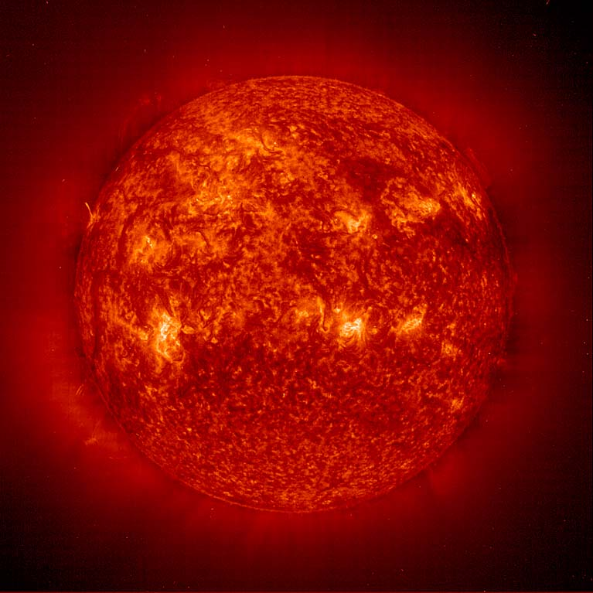
Where can we find nuclear matter at high temperature and high density ?
T center of sun ~ 15 000 000 K << T_{c} (170 MeV ~ 10¹³ K)

Slide 16
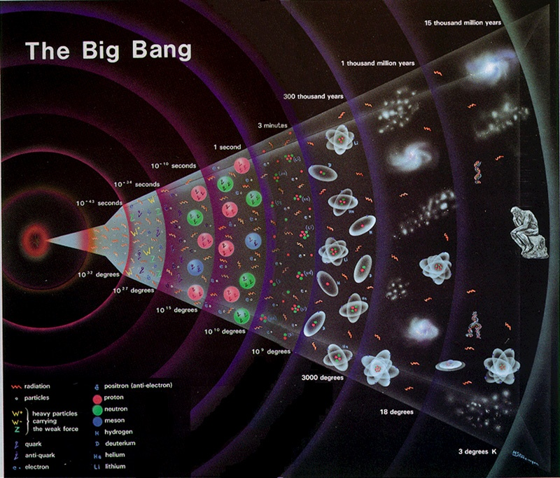
History of universe theory : Big Bang
10⁻³² to 10⁻¹⁰ s , temperature decrease from 10 ²⁷ to 10 ¹⁵ °C > Tc
universe could be composed of a « soup » of quark and anti-quark = QGP

Slide 17
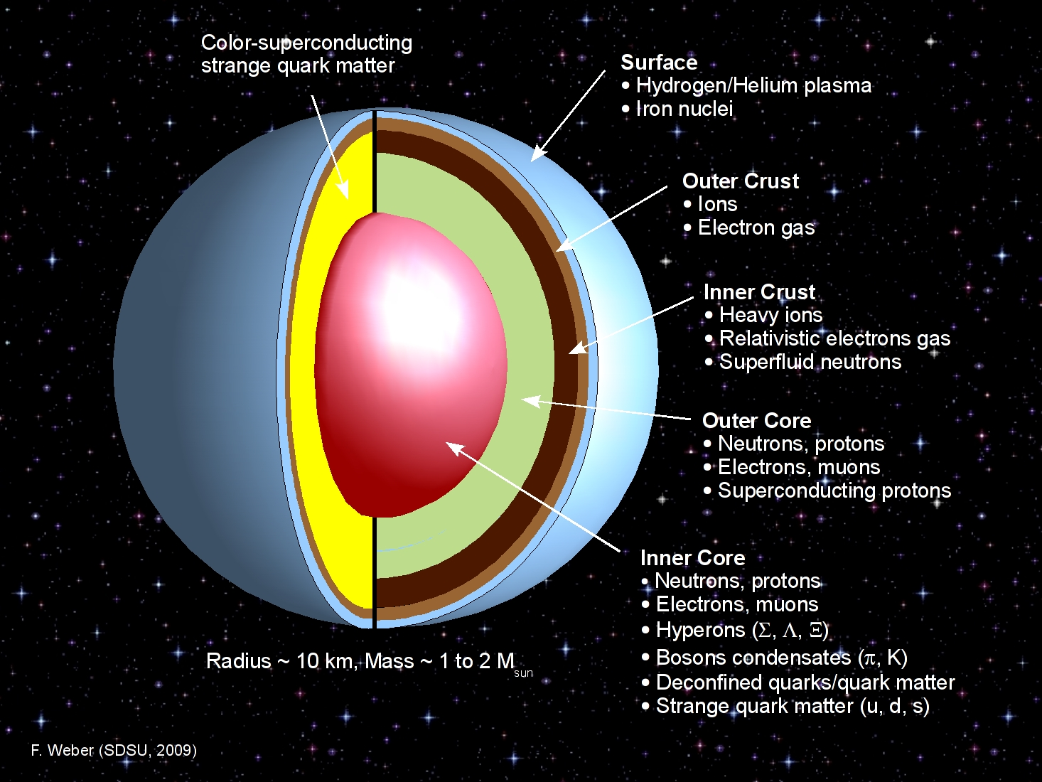
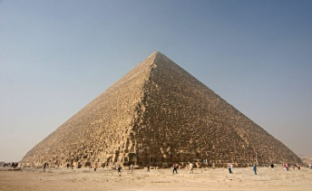
Neutron Star
A neuton star is the result of a supernova (collapse of a massive star) :
mass ~ 1 to 2 time the solar mass for a radius of ~ 10 km
mean density ~ 10 ¹⁴ g/cm³
kheops pyramid
(6 millions tonnes) in a pinhead
The inner core of a neutron star can be composed of deconfined quarks at very high density.

Slide 18
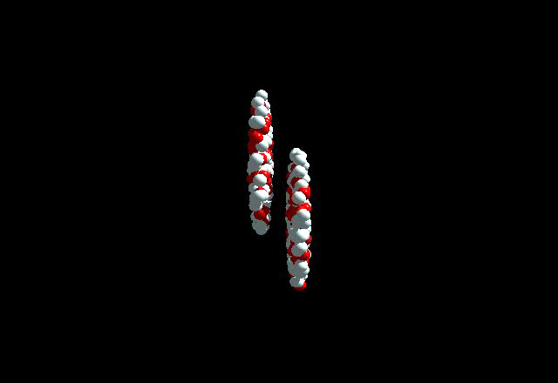
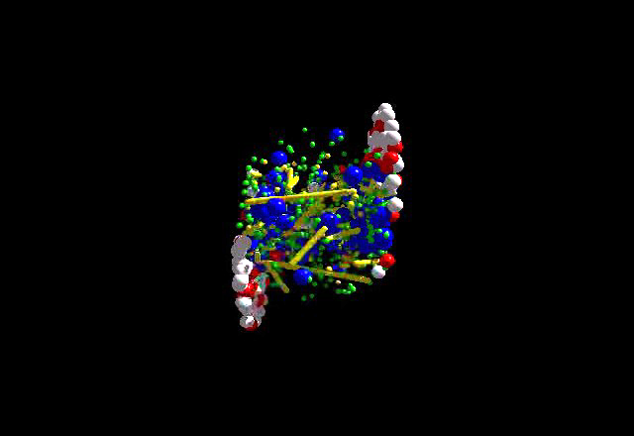
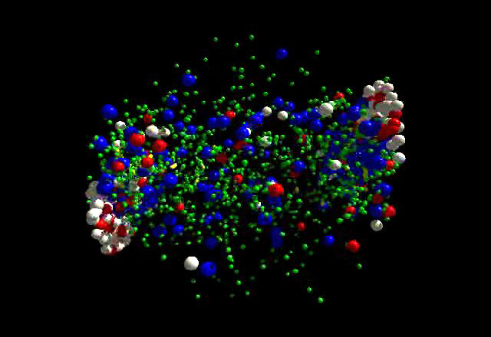
Heavy ions collisions
Pb
Pb
π⁺
p
π⁻
Create, during a short time, in the overlap, a region at high density and high temperature.
Possibility to study the nuclear behavior and to test the QCD predictions for the phase transition

Slide 19
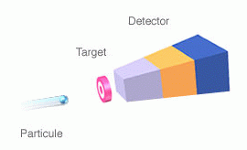
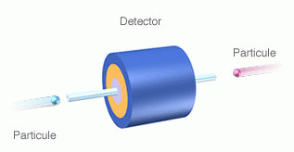
Heavy ions collisions experiments: 1971 - 2010
Saturne II (Saclay)
fixed target
1978-1997
√s_{NN} < 2.4 GeV
1 experiment
~ 30 physicists
SIS (GSI) fixed target
1989-
√s_{NN} < 2.7 GeV
4 experiments
~ 200 physicists
FAIR (GSI)
fixed target
2014-
√s_{NN} < 9 GeV
1 experiment
~ 500 physicists
BEVALAC (LBL)
fixed target
1975-1986
√s_{NN} < 2.4 GeV
2 experiments
~ 100 physicists
Synchro… (JINR)
fixed target
1971-1999
√s_{NN} < 3 GeV
x experiments
~ xxx physicists
AGS (BNL)
fixed target
1986-1998
√s_{NN} < 5 GeV
4 experiments
~ 400 physicists
NICA (JINR)
collider
2013-
√s_{NN} < 9 GeV
1 experiment
~ xxx physicists
RHIC (BNL)
collider
2000-
√s_{NN} < 200 GeV
4 experiments
~ 1000 physicists
LHC (CERN)
collider
2009-
√s_{NN} < 5500 GeV
4 experiments
~ 1000 physicists
SPS (CERN)
fixed target
1986- 2003
√s_{NN} < 20 GeV
7 experiments
~ 600 physicists
√s from ~2 GeV in 1975 to 5500 GeV in 2010

Slide 20
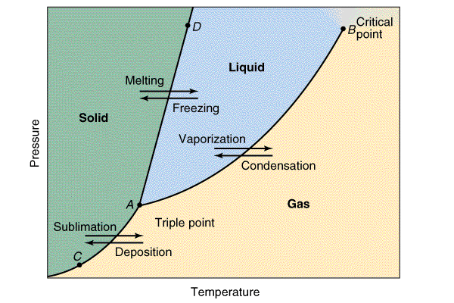
Phase diagram : exemple of water
Phase transition = modification of some properties (deformablility, compressibility) of the medium under external conditions (density, temperature)
 | Actual classification
First order transition | Existence of a mixed phase (liquid – gas transition)
Second order transition | Continuous phase transition ( liquid-super fluid transition)
Triple point | Point of the phase diagram diagram where three phases coexist in thermodymanic equilibrium
Critical point | Point of the phase diagram diagram where a first order transition becomes a second order transition
Super-fluid

Slide 21
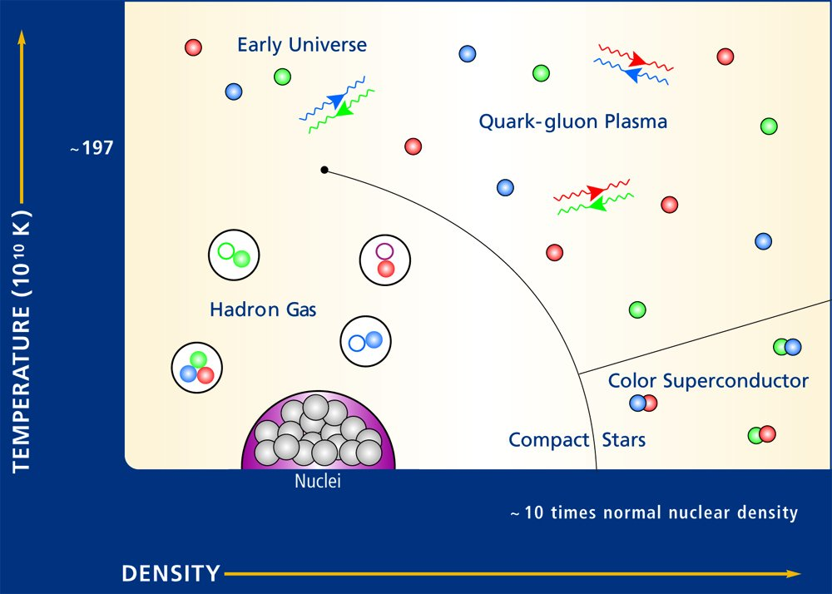
Phase diagram for nuclear mater
Plasma = ionized matter ; free ions and electrons
1975
gas
2010
solid
liquid

Slide 22
Phase diagram for nuclear mater
Critical point
Position ?
great evolution of knowledge
There are still many questions
Second order
Transition
(Cross over)
1975
First Order transition
Order of transition ?
gas
2010
solid
liquid

Slide 23
Phase diagram for nuclear mater
SPS :
GSI :
RHIC :
AGS :
LHC :
Transparency
important
LHC
Stopping power
important
SPS
Increase of the temperature at low density
RHIC
Increase of the density
AGS
GSI

Slide 24
HEAVY IONS COLLISIONS (HIC) EXPERIMENTS
Introduction
  Nuclear Matter constituents
  QCD – quarks confinement – asymptotic freedom – quarks deconfinement - QGP
  Where can we find nuclear matter at high density and high temperature?
  Nuclear matter phase diagram
Heavy Ions Collisions
  Collision time evolution
  Analysis method : comparison of models prediction with experimental results for pp – pA – AA collisions
Why study HIC ?
How study HIC ?

Slide 25
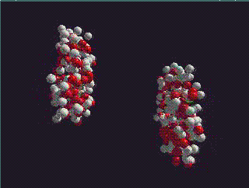
Heavy Ions Collisions : time evolution
Before the collision : heavy ions are flat because of Lorentz length contraction

Slide 26
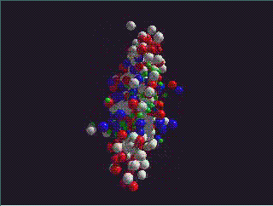
Heavy Ions Collisions : evolution
inelastic NN colisions : partons (q – g) creation – thermalisation

Slide 27
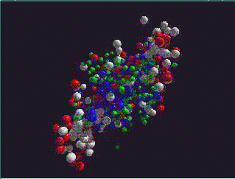
Heavy Ions Collisions : evolution
Hadronisation of the system - chemical freeze-out

Slide 28
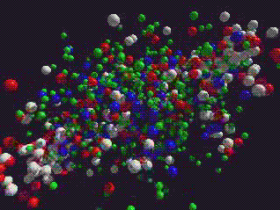
Heavy Ions Collisions : evolution
Thermal freeze-out

Slide 29
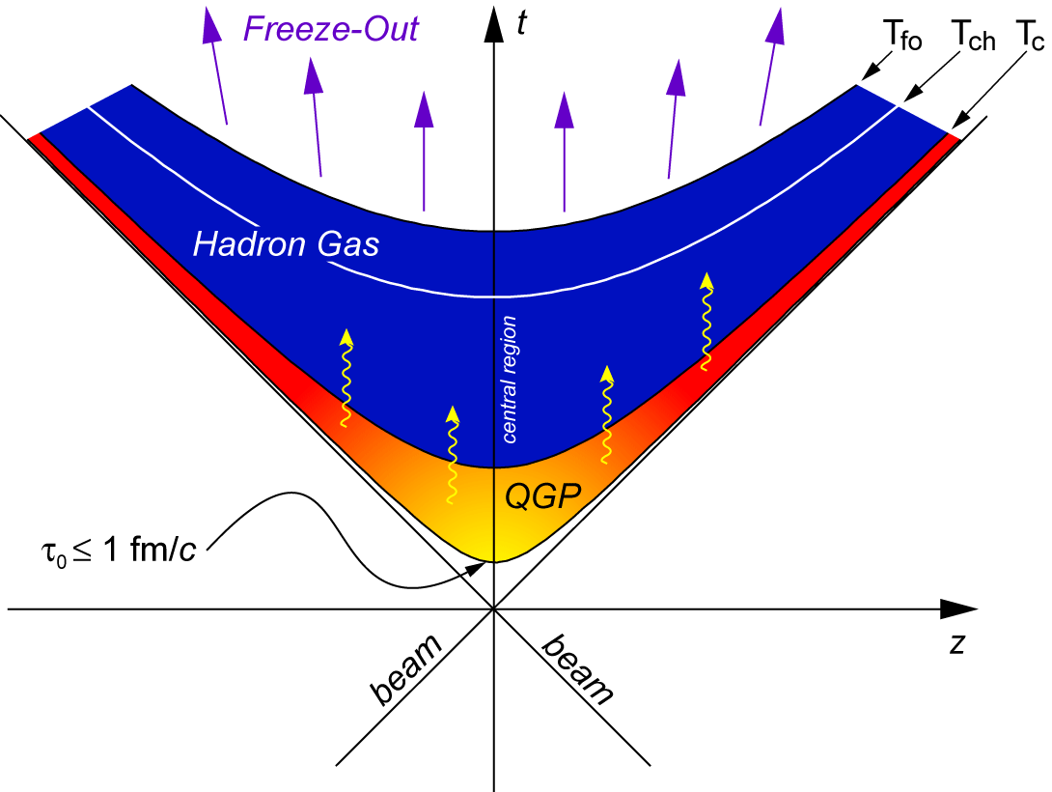
Heavy Ions Collisions : evolution
Thermal freeze-out : kinematics distributions are fixes
chemical freeze-out : constituants of particles (quarks) are fixed
Hadronisation: q – g combines to create Hadrons
thermalisation of q – g : QGP (if T > T_{c})
q – g created by inelastic NN colisions

Slide 30
Heavy Ions Collisions : experiments
Deduced from experimental results
Estimations
Central collisions | SPS | RHIC | LHC
 | 17 | 200 | 5500
 | 500 | 850 | 2000-4000
 | 1 | 0.2-0.3 | 0.1
 | 1.1 | 1.9 | 3 – 4
 | 3 | ~5 | 10-60
 | < 2 | 2-4 | > 10
 | ~10 | 20-30 | 30-40
 | ~10³ | ~10⁴ | ~10⁵

Slide 31
Heavy Ions Collisions
Central collisions | SPS | RHIC | LHC
 | 17 | 200 | 5500
 | 500 | 850 | 2000-4000
π⁺
e⁻
μ⁻
K
γ
π
μ⁺
K
p
Detected particles
Hadrons creation + desintegration + interaction
D
c-cbar
resonnances
Open flavours
photons
c
Deduce the nuclear properties and test the QCD predictions
Jet (high p_{t} quark) production

Slide 32
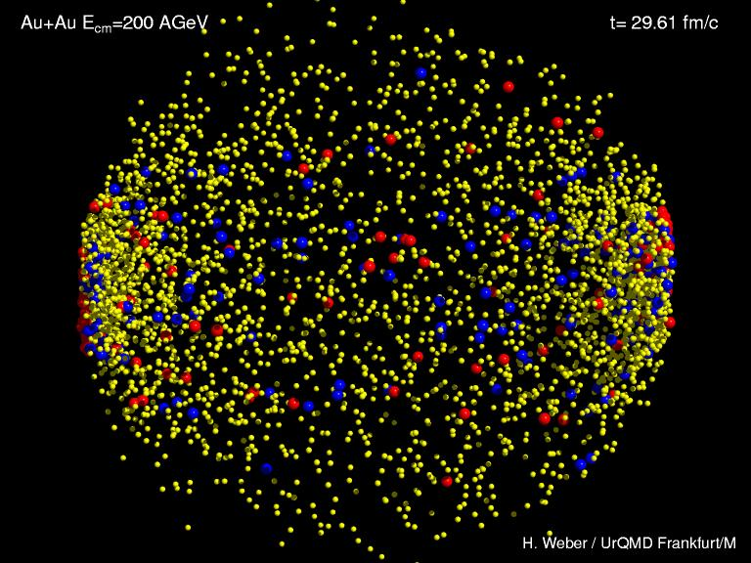
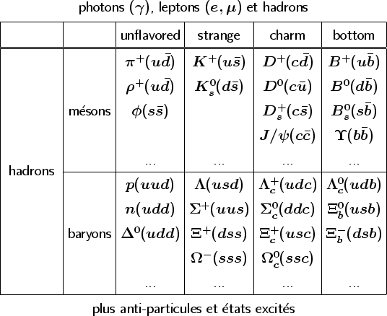
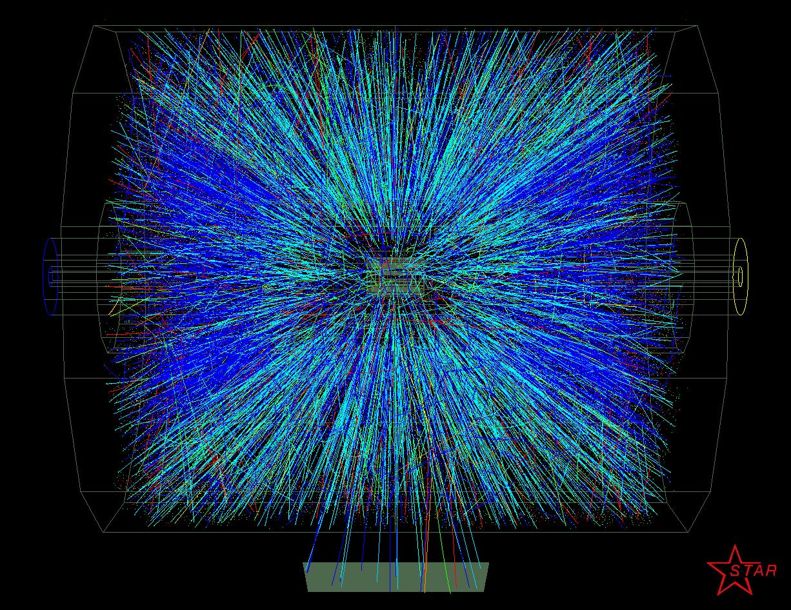
Heavy Ions Collisions
Heavy ion simulation for Au + Au at
= 200 GeV
Same collision view by detectors
+ anti-paticles and excited states
detect and identify the maximum of emited particles, directly or from their decay product

Slide 33
Heavy Ions Collisions analysis method
From the detected particles, how can we answer these questions?
What is the thermodynamic state of the matter?
Have we observed a transition phase signal ?
Have we create QGP ?
Model predictions
With QGP
Without QGP
Experimental observables
p-p
Central A-A
p-A or peripheral A-A
Test QCD
Vaccuum
comparison
Hadronic matter
QGP

Slide 34
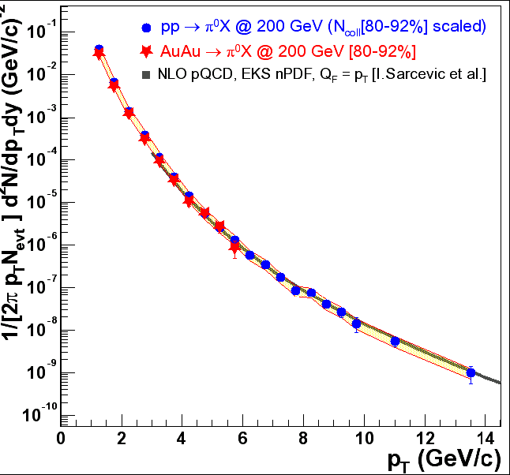
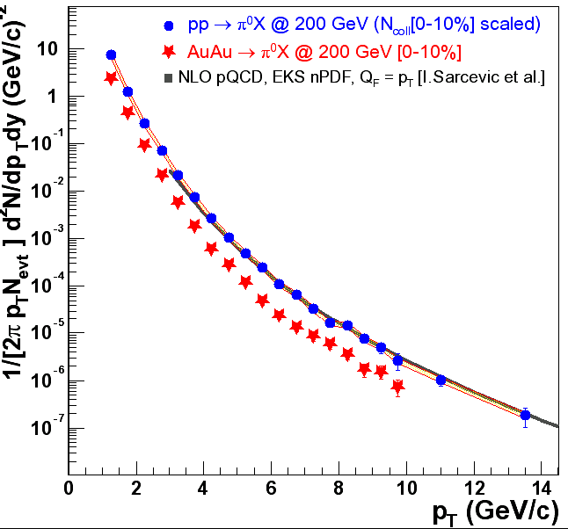

Heavy Ions Collisions analysis: example
Peripheral events
Central events
Differential cross section of production of π⁰ in p+p collisions at 200 GeV
reproduce pQCD NLO calculation.
➔ good agreement for peripheral collisions
➔ suppression for central collisions
Deviation observed from peripheral to central events

Slide 35
HEAVY IONS COLLISIONS (HIC) EXPERIMENTS
Introduction
  Nuclear Matter constituents
  QCD – quarks confinement – asymptotic freedom – quarks deconfinement - QGP
  Where can we find nuclear matter at high density and high temperature?
  Nuclear matter phase diagram
Heavy Ions Collisions
  Collision evolution
  Analysis method : comparison of models prediction with experimental results for pp – pA – AA collisions
  Collision geometry – Centrality – Glauber Model
  Some experimental observables and QGP signatures
Why study HIC ?
How study HIC ?

Slide 36
Heavy Ions Collisions : centrality
Centrality of the collision :
    b : impact parameter [0 ; b_{max}] (b_{max} = 2. R)
Spectator nucleons
Intermediate collision
R
b
Participating nucleons
Central collision
R
b~0
all nucleons participate

Slide 37
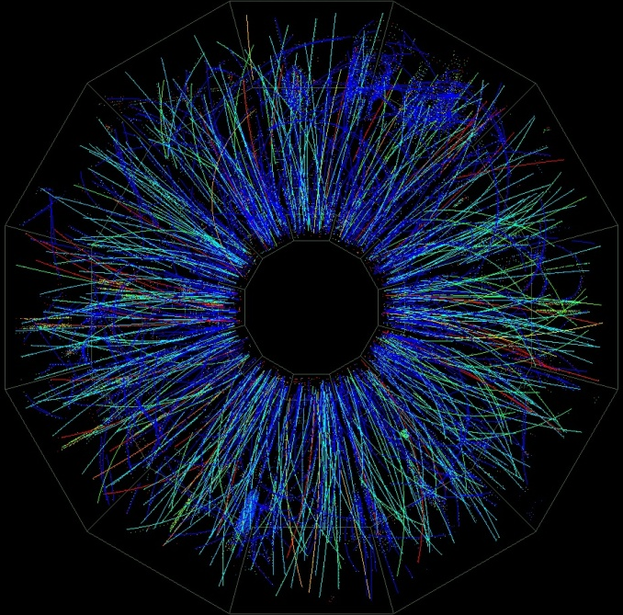
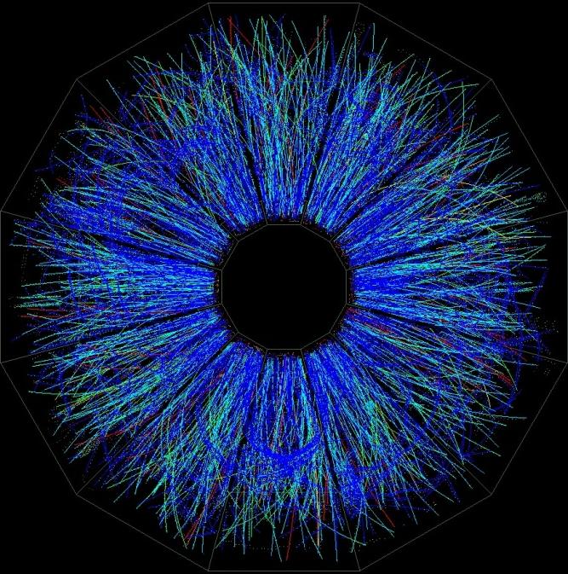
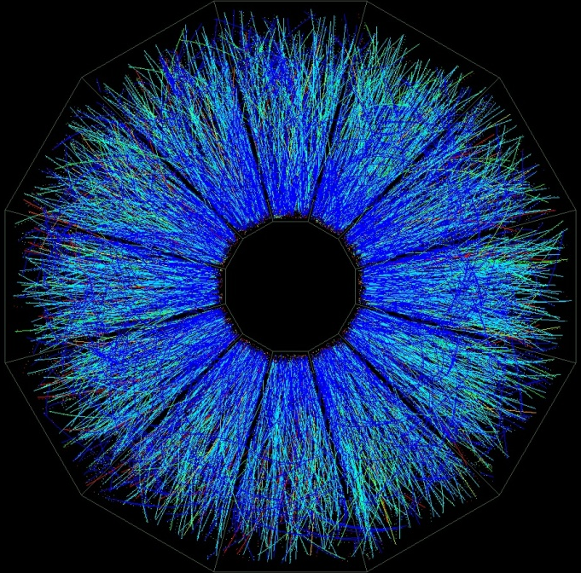
Heavy Ions Collisions : centrality
Peripheral collision
intermediate collision
central collision
STAR
b
b~0
b
Participating nucleons
Spectator nucleons

Slide 38
Heavy Ions Collisions : Glauber Model
Glauber Model: Estimation of the number of participant nucleons and binary NN collisions as a function of the impact parameter b.
Nucleus density distribution (Wood-Saxon) :
Density probalility :
Nuclear overlap function (probability of overlap of nucleons):
= r
s
b-s
b

Slide 39
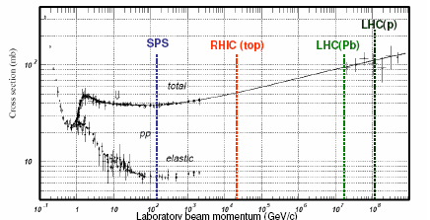
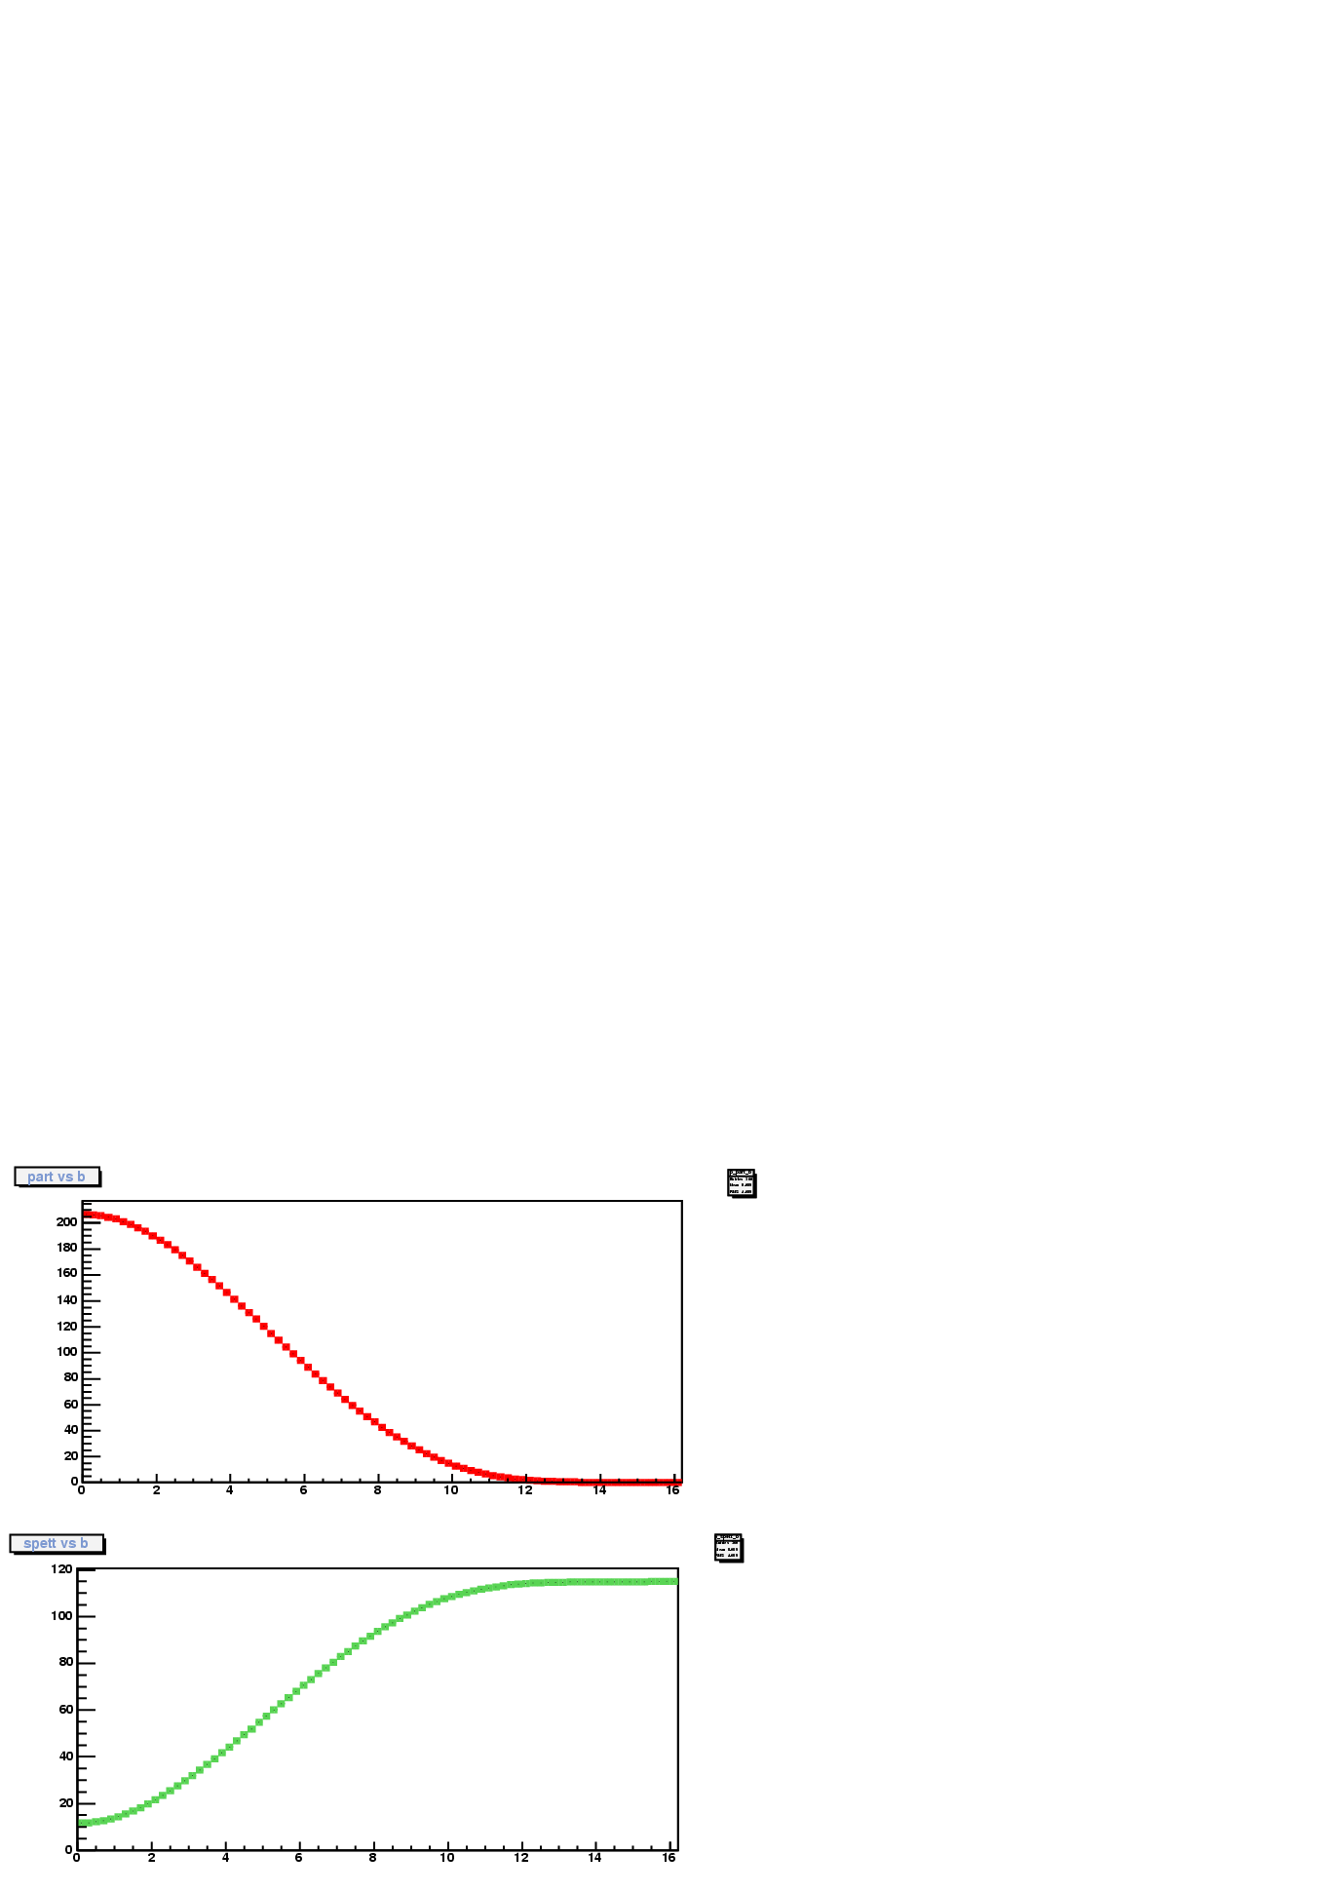
Heavy Ions Collisions : Glauber Model
Particle Data Book: W.-M. Yao et al., J. Phys. G 33,1 (2006) Fig 40.11
Glauber Model:
Total number of NN collisions :
Total number of participants and spectators:
N. Participants
Peripheral events
Central events
b(fm)

Slide 40
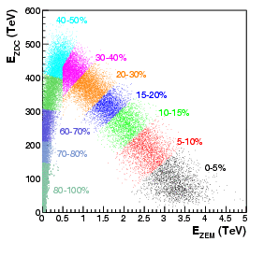
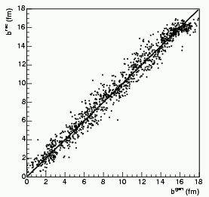
Heavy Ions Collisions : centrality
measurement
To avoid correlation between studied signal and centrality selection, we mesured spectator to select centrality: detector close to the beam pipe
ALICE - LHC - CERN
QUADRUPOLES
VACUUM
CHAMBER
EM ZDCs
NEUTRON ZDC
peripheral
central
PROTON ZDC
INTERACTION POINT
7 m
116 m
E_{ZDC} , E_{ZEM} N_{spec} Impact parameter (b)
Glauber model

Slide 41
Heavy Ions Collisions : observables
Questions:
What is the thermodynamic state of the matter?
What are the T, ε, μ_{B} ?
Have we create QGP ?
Have we observed a transition phase signal ?
Different classes of observables :
Observables sensitive to thermodynamic state
Observables sensitive to chiral symmetry restoration
Observables sensitive to the nuclear medium
(QGP or Hadron gas)
Particle Flow
Low mass resonnances
Jets
High mass resonnances
Transverse distributions
Ratio of particles
Thermal photons
…
Strangeness

Slide 42
Heavy Ions Collisions : observables
An other way to classify observables :
Signal from the early stage of the collision:
’’ hard probes ’’ ~ high p_{T}
Signal from the late stage of the collision:
’’ soft probes ’’ ~ low p_{T}
  Jets
  High mass resonnances
  Thermal
  photons
  …
  Strangeness
  Low mass resonnances
  Particle flow
  …

Slide 43
Observables sensitive to thermodynamic state
Particles Flow = collective motion of particles
  Particle Flow
  Transverse distributions
  Ratio of particles
  Thermal photons
Z
At the beginning of the collision: the nuclear overlap region is an ellipsoid.
Reaction plane (b,z)
  The gradient of pressure is largest in the shortest direction of the ellipsoid
  The initial spatial anisotropy evolves
  → Momentum-space anisotropy
Y
X
P_{y}
P_{z}
  symmetric radial flow (central collision)
  anisotropic transverse flow (non central collision)
P_{x}

Slide 44
Observables sensitive to thermodynamic state
Particle Flow
Y : out of plane
  Particle Flow
  Transverse distributions
  Ratio of particles
  Thermal photons
φ
X : in plane
Fourier
expansion
Directed flow coefficient
Elliptic flow coefficient
Y
Y
X
X
: in plane
: out of plane
Depend on :
centrality
pressure gradient : equation of state : p=f(ε)

Slide 45
Observables sensitive to thermodynamic state
Transverse mass distribution
  Particle Flow
  Transverse distributions
  Ratio of particles
  Thermal photons
When thermal equilibrium (=uniform temperature) is achieved, the transverse momentum or transverse mass distribution of the particles can be described by a Maxwell-Boltzmann distribution.
Thermal motion + radial flow model:
T : apparent temperature reflecting both the
transverse collective flow and thermal motion.
Kinematic distributions are fixed at the thermal freeze-out
: transverse collective flow velocity
T_{F} : thermal freeze-out temperature

Slide 46
Observables sensitive to thermodynamic state
Transverse energy
  Particle Flow
  Transverse distributions
  Ratio of particles
  Thermal photons
Estimation of the initial energy density :
Bjorken formula
τ₀ : formation time of QGP ( )
S_{z} : lateral surface of overlap region ;

Slide 47
Observables sensitive to thermodynamic state
Ratio between yield of particles
  Particle Flow
  Transverse distributions
  Ratio of particles
  Thermal photons
For particles produced by a thermal source at temperature T and baryon chemical potential μ_{B}. The number of particles of mass m produced per volume unit is (cf: J. Cleymans lecture) :
Ratio between yield of different particle species (ratio to cancel other effects)
Chemical composition is fixed at the chemical freeze-out
T : Chemical freeze-out temperature
μ_{B} : Baryon chemical potential

Slide 48
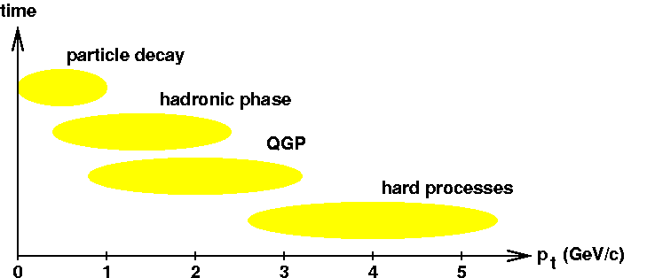
Observables sensitive to thermodynamic state
Thermal photons
  Particle Flow
  Transverse distributions
  Ratio of particles
  Thermal photons
Photons produced during QGP step :
not sensitive to strong interaction:
not affected by hadronisation step
Sensitive to the temperature of
medium (QGP = radiate light) α T⁴
important background :
  photons produced during initial stage
  photons produces during hadronic phase
  photons from particle decay (π⁰→γγ)
Thermal photons

Slide 49
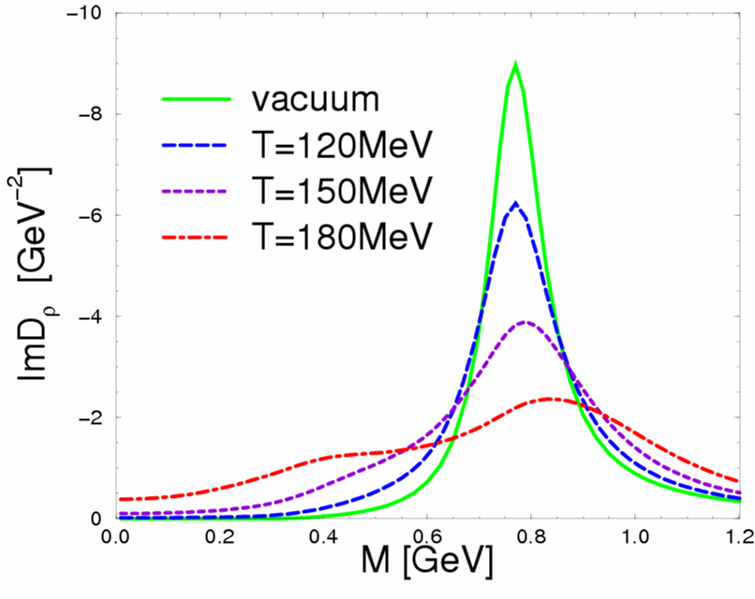
Observable sensitive to chiral symmetry restoration
Low mass resonnances
Low mass resonnances
Chiral symmetry restoration :
Chiral partner are mixed:
1.0 T/T_{c}
J^{P}=0± 1± 1/2±
Modification of the shape for low mass resonnances and mass shift
Signal for phase transition

Slide 50
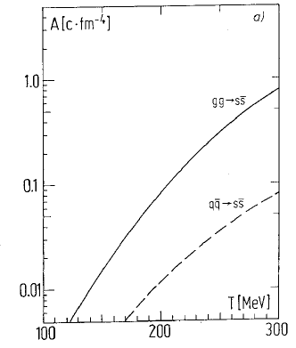
Observables sensitive to the nuclear medium
Strangeness : strange particle study
strangeness
Jets
High mass resonnances
Strange quarks pair are produced (g+g→s+s and q+q→s+s ) during and before QGP phase.
At T>T_{c} s-quark production increases
Hadronisation : production of strange hadrons and mesons
We expect an enhancement in the yields of strange and multi-strange particles in nucleus-nucleus reactions
T_{c}
→ indication for a phase transition

Slide 51
Observables sensitive to the nuclear medium
Jets
strangeness
Jets
High mass resonnances
Jets = cone of particles produced during hadronisation of high p_{T} quarks
(q+q→q+q q+g→q+γ and q+q→g+γ)
radiative energy loss when quarks travel through nuclear medium (jets or hadrons p_{T} decrease)
= Jet Quenching
high p_{T} hadron distributions
di-jets and γ-jet correlations
sensitive to the energy density
Expect difference between QGP and HG
p-p
A-A
q
q
q
q
γ

Slide 52
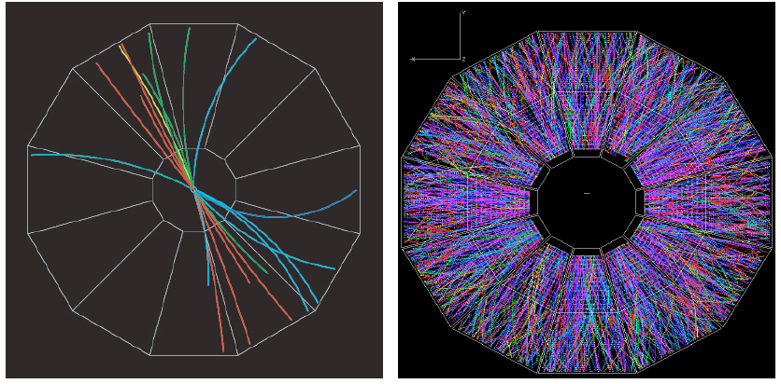
Observables sensitive to the nuclear medium
Jets
strangeness
Jets
High mass resonnances
  difficulties to reconstruct jets in central heavy ions collision
p-p → 2 jets
Au-Au → how many jets ?
Jet finder algorithms

Slide 53
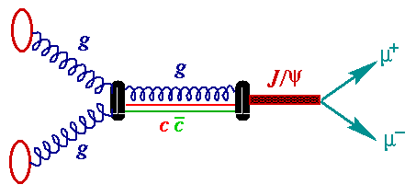
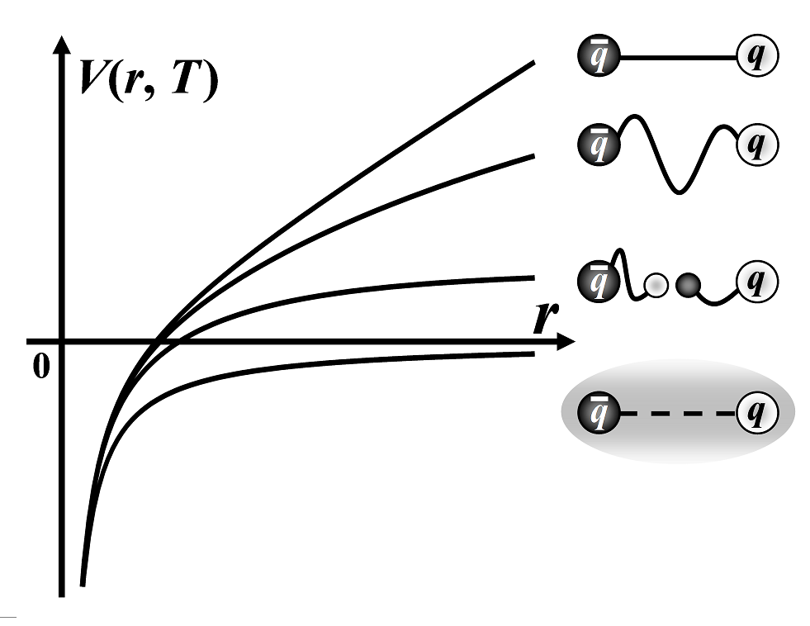
Observables sensitive to the nuclear medium
High Mass Resonnances :
Quarkonia suppression
strangeness
Jets
High mass resonnances
Matsui and Satz (1986)
J/ψ : the bound state cc
Υ : the bound state bb
production dominated
by gluon fusion
Color screening ( ~ Debye screening for electric fields)
T ↗
T < T_{d}
Screening radius :
r_{D} = 1 / µ(T) decreases with temperature
when r_{D} < r_{i} radius of a qq state i, q and q cannot bind and the quakonium cannot be create.
At T > T_{d}
screening effect in QGP

Slide 54
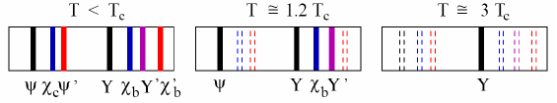
Observables sensitive to the nuclear medium
High Mass Resonnances :
Quarkonia suppression
strangeness
Jets
High mass resonnances
state | J/ψ | χ_{c} | ψ’ | Υ | χ_{b} | Υ’ | Υ’’
Mass (Gev) | 3.10 | 3.53 | 3.68 | 9.46 | 9.99 | 10.02 | 10.36
Radius (fm) | 0.25 | 0.36 | 0.45 | 0.14 | 0.22 | 0.28 | 0.39
T_{d}/T_{c} _{Depend on models} | 1.2-2 | ~1 | ~1 | 2-4 | 1.3-1.8 | 1.2-1.6 | ~1
T ↗
Sequential suppression :
= thermometer of the dense phase of the collision

Slide 55
Observables sensitive to the nuclear medium
Quarkonia measurement
strangeness
Jets
High mass resonnances
(J/ψ, ψ’, ϒ, ϒ’, ϒ’’) → µ⁺ µ⁻ or e⁺ e⁻
Leptons are not sensitive to strong interaction
not affected by hadronisation step
ALICE
simulation
X →e⁺ e⁻
Important background :
Open heavy flavor
D⁰ ( ) → e⁺ + …
X →μ⁺ μ⁻

Slide 56
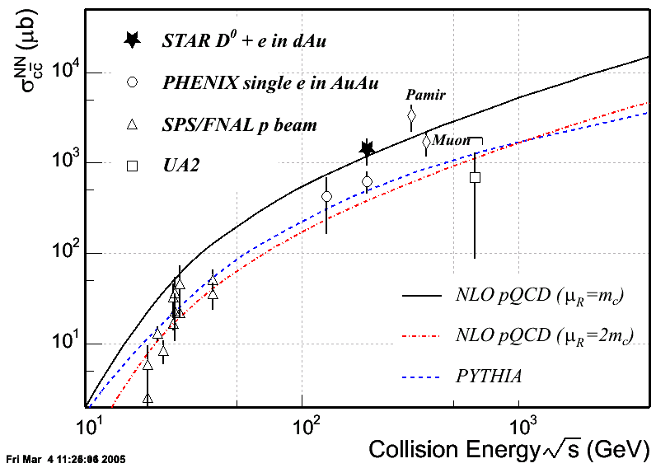
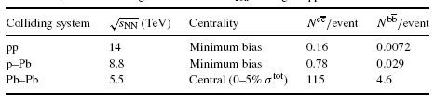
Open heavy flavors
Measurement of c and b cross section :
  large theoretical uncertainties even in p-p collisions
  important for quarkonia study
  study in medium effects on open heavy flavor production
LHC
Expected in ALICE (from NLO pQCD)

Slide 57
HEAVY IONS COLLISIONS EXPERIMENTS
How study HIC ?
Comparison
Model predictions
Experiments
pp- pA - AA
Observables sensitive to thermodynamic state
Observables sensitive to chiral symmetry restoration
Observables sensitive to nuclear medium
Tune models
Repeat until we can extract QGP properties

Slide 58
HEAVY IONS COLLISIONS (HIC) EXPERIMENTS
Introduction
  Nuclear Matter constituents
  QCD – quarks confinement – asymptotic freedom – quarks deconfinement - QGP
  Where can we find nuclear matter at high density and high temperature?
  Nuclear matter phase diagram
Heavy Ions Collisions
  Collision evolution
  Analysis method : comparison of models prediction with experimental results for pp – pA – AA collisions
  Collision geometry – Centrality – Glauber Model
  Some experimental observables and QGP signatures
Experiments : description and main results
  SPS (1986 - 2003 Pb-Pb √s_{NN} < 20 GeV )
  RHIC (2000 - … Au-Au √s_{NN} < 200 GeV )
  LHC : ALICE (2009 - … Pb –Pb √s_{NN} < 5500 GeV) First results
Why study HIC ?
How study HIC ?
Results of the HIC experiments

Slide 59
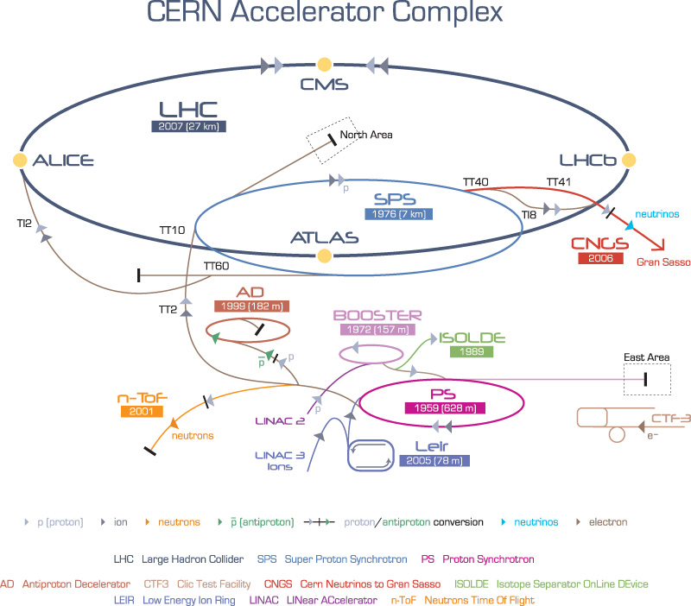
Super Proton Synchrotron (CERN)
NA
SPS (CERN)
fixed target
1986- 2003
√s_{NN} < 20 GeV
7 experiments
~ 600 physicists
SPS
WA
circumference ~7 km
Pb up to 17.3 GeV
2 experimental areas
7 heavy ion experiments : (NA44, NA45, NA49, NA50/60, NA52, WA97/NA57 et WA98)
LHC injector (E_{p} = 450 GeV)

Slide 60

SPS : heavy ions experiments
Fixed target
these experiments are all now finished

Slide 61





SPS : heavy ions experiments
Large acceptance Photons and Hadrons spectrometer
Measurement of charged particle spectra at mid rapidity
NA44
NA49
WA98
Reconstruction of strange and multi-strange hadrons from their decay particles at mid rapidity
Search for strangelet (strange massive particles)
NA52
NA57

Slide 62


SPS : heavy ions experiments
Measurement of low mass resonnances from e⁺e⁻ pairs
NA45/CERES
Measurement of low and high mass resonnances from μ⁺μ⁻ pairs
NA50/60/61

Slide 63




SPS : main results
Observables sensitive to thermodynamic state
NA49
Transverse energy spectra :
ε =3 GeV/fm³
High p_{T} photons = thermal photons produced in QGP : (Sensitive to the temperature of medium )
WA98
Τ =200 MeV
Phys. ReV. C,2001
excess ~ 10 % in central collisions

Slide 64




SPS : main results
Observables sensitive to thermodynamic state
NA44, NA49, NA50,WA97,WA98
Particle ratio
T_{ch freeze_out} = 170 MeV
~ T_{c}
J. Phys. G: Nucl.Part.Phys, 30 (2004) 823
P. Braun-Munzinger et al.
NA49
PRL 94 192301 (2005)
T_{th freeze_out} = 170 MeV
β_{T} = 0.2
T_{th freeze_out} = 144 MeV
β_{T} = 0.38

Slide 65




SPS : main results
Observables sensitive to the nuclear medium
WA97,NA57
Enhancement in the yields of strange and multi-strange particles :
Indication for a QGP formation
NA50
High Mass Resonnances - Quarkonia suppression:
J/ψ(cc) suppression
Indication for a QGP formation
Observables sensitive to chiral symmetry restoration
Low Mass Resonnances :
Excess of signal in low mass region
Enlargement of the ρ signal
NA60
Indication for chiral symmetry restoration
CERES/NA45
65

Slide 66

CERN Announcement on 10th febrary 2000

Slide 67
HEAVY IONS COLLISIONS (HIC) EXPERIMENTS
Introduction
  Nuclear Matter constituents
  QCD – quarks confinement – asymptotic freedom – quarks deconfinement - QGP
  Where can we find nuclear matter at high density and high temperature?
  Nuclear matter phase diagram
Heavy Ions Collisions
  Collision evolution
  Analysis method : comparison of models prediction with experimental results for pp – pA – AA collisions
  Collision geometry – Centrality – Glauber Model
  Some experimental observables and QGP signatures
Experiments : description and main results
  SPS (1986- 2003 Pb-Pb √s_{NN} < 20 GeV )
  RHIC (2000- … Au-Au √s_{NN}< 200 GeV )
  LHC : ALICE (2009- … Pb –Pb √s_{NN} < 5500 GeV) First results
Why study HIC ?
How study HIC ?
Results of the HIC experiments

Slide 68

Relativistic Heavy Ion Collider(RHIC)
First heavy ion collider
RHIC (BNL)
collider
2000-
√s_{NN} = 200 GeV
4 experiments
~ 1000 physicists
BRAHMS
PHOBOS
PHENIX
STAR
circumference ~3.9 km
protons up to 500 GeV
Au up to 200 GeV
4 heavy ion experiments : (STAR, PHENIX,PHOBOS,BRAHMS)

Slide 69

RHIC
Event rate :
collision | √s_{NN} (GeV)
p - p | 60 up to 500
d – Au | 100
Au – Au | 10 up to 200
Cu - Cu | 20 up to 200
L_{NN} = A₁A₂L

Slide 70


BRAHMS
Hadron distributions measurement
~ 50 physicists – 11 laboratories – USA, France, Romania, Poland, Denmark, Norway
(stopped in 2006)
PHOBOS
~ 110 physicists – 8 laboratories – USA, Taiwan, Poland
(stopped in 2005)
High data rate capability
(compared to large acceptance )

Slide 71



STAR
Hadron distributions
measurement
with a large acceptance ~ in 4π
~ 600 physicists – 54 laboratories – 12 countries

Slide 72


PHENIX
dileptons distributions measurement
e⁺e⁻, charged hadrons, γ
|η|<.35
µ⁺µ⁻
1.2>|η|>2.2
~ 450 physicists – 57 laboratories – 12 countries

Slide 73


RHIC : main results
Charged particle multiplicy density at mid-rapidity for central collisions (~ SPS*2)
STAR
99.5%
→ hard probes
The majority of produced particles are low p_{T}.
→ soft probes

Slide 74


RHIC : main results
Observables sensitive to thermodynamic state
<dE_{T}/dη> ~ 650 GeV (top 5% central)
Transverse energy spectra :
ε = 15 GeV/fm³ > ε_{SPS}
for τ₀ = 0.3 fm/c
PHENIX
High pt photons = thermal photons produced in QGP : (Sensitive to the temperature of medium )
EPJC46, 451 (2006)
Initial temperatures and times from theoretical models
‒ T=590MeV, τ₀=0.15fm/c (D.d’Enterria et al.)
‒ T=580MeV, τ₀=0.17fm/c (S.Rasanen et al.)
‒ T=450-600MeV, τ₀=0.2fm/c (D.K.Srivastava)
‒ T=370MeV, τ₀=0.33fm/c (S.Turbide et al.)
‒ T=300MeV, τ₀=0.5fm/c (J.Alam et al.)
‒ T=370MeV, τ₀=0.6fm/c (F.Liu et al.)
>Τ_{c} (> Τ_{SPS} = 200 MeV)

Slide 75



RHIC : main results
Observables sensitive to thermodynamic state
Particle ratio
T_{ch freeze_out} = 177 MeV
(~ same result at SPS)
μ_{B} = 29 MeV < μ_{B_SPS}
(low baryonic density)
Z Xu :JPG: Nucl.Part.30(2004)927
T_{c}
T_{th freeze_out} = 100 -150 MeV
β_{T} = 0.4 – 0.55
75

Slide 76


RHIC : main results
Observables sensitive to thermodynamic state and nuclear medium
Elliptic flow
Baryons scale together
all scale together
Mesons scale together
Phys. Rev. Lett. 98, 162301 (2007)
SPS region
→ quark number scaling observed
→ elliptic flow created during a phase where the degree of freedom correspond to the number of quarks
Indication for a QGP formation

Slide 77


RHIC : main results
Observables sensitive to thermodynamic state
Elliptic flow
flow measurements are well described by ideal hydrodynamic with low viscosity
For p_{T} up to 2 GeV,
η/s = 0.03 << 340 = (η/s)_{water}
(s: entropy density)
→ QGP = seems to be a perfect fluid with a very small viscosity (uncertainties on η/s value)
Perfect fluid = small viscosity – strong interaction between constituants
Ideal gas = infinite viscosity – no interaction
1/4π< η/s < 2-3 (1/4π)

Slide 78

RHIC : main results
: strongly coupled quark-gluon plasma
http://www.bnl.gov/rhic/news/

Slide 79
RHIC : main results
Observables sensitive to the nuclear medium
High p_{T} study
Peripheral events
Central events
Differential cross section of production of π⁰ in p+p collisions at 200 GeV
reproduce pQCD NLO calculation.
➔ good agreement for peripheral collisions
➔ suppression of π⁰ for central collisions
Different behavior between normal and dense matter
→ in medium effect : different possible effets

Slide 80

RHIC : main results
In medium effects
Shadowing = correspond to a modification of the parton distribution functions in the nucleus, relative to the nucleon.
cold nuclear effect
(present in p-A and A-A)
Color glass condensate (CGC) = gluon density saturation reach in nucleus (due to Lorentz contraction the gluon density increase before the collision)
Cronin effect = broadening of p_{T} spectra due to NN interaction in nucleus by gluon exchange
Jet Quenching = parton energy loss in dense matter (QGP)
= bremstrahlung of partons
hot nuclear effect
(only in A-A)

Slide 81

RHIC : main results
In medium effects study
Definition of nuclear modification factor :
nuclear modification ratio :
→ Estimation of the in medium effects :
R = 1 : binary scaling , no medium effect
R > 1 : excess of particles
R < 1 : absorbtion or suppression
Suppression of π⁰ only in central collisions
cannot be reproduced by shadowing in initial state of collison
Reproduced by
Jet quenching in final state of collision

Slide 82


RHIC : main results
Observables sensitive to the nuclear medium
High p_{T} study
No suppression in d-Au collision:
→ high p_{T} hadrons suppression du to Jet quenching
Photons : no suppression
hadrons (quarks) : suppression

Slide 83


RHIC : main results
Observables sensitive to the nuclear medium
High p_{T} jet
→ high p_{T} jet suppression
Di-jet correlation :
Δφ
q
q
→ evidence of strong jet quenching in QGP

Slide 84

RHIC : main results
Observables sensitive to the nuclear medium
High Mass Resonnances :
J/ψ( ) suppression
more J/ψ suppression in peripheral events
than in central events (higher density)
central
→ nuclear effects (shadowing + nuclear absorption)
peripheral
OR
PHENIX, PRL98 (2007) 232301
charm cross section is higher than at SPS energy : the number of created pairs is higher. And statistically, more J/ψ are produced
→ J/ψ regeneration
Pairs produced | SPS | RHIC | LHC
c | 0.2 | 10 | 120
b | - | 0.05 | 5
OR
→ mixing of nuclear effect and J/ψ regeneration

Slide 85

RHIC : main results
RHIC
SPS
ε = 5 -15 GeV/fm³ > ε_{SPS}
T_{QGP} = 300-600 MeV
T_{ch freeze_out} = 177 MeV
μ_{B} = 29 MeV < μ_{B_SPS}
J.Stachel (Trento 2004)
Flow at parton level
Jet quenching is observed = new QGP signature
Possibility for J/ψ regeneration
QGP is formed at RHIC: it is like a perfect fluid with low viscosity and strong interactions : sQGP

Slide 86
HEAVY IONS COLLISIONS (HIC) EXPERIMENTS
Introduction
  Nuclear Matter constituents
  QCD – quarks confinement – asymptotic freedom – quarks deconfinement - QGP
  Where can we find nuclear matter at high density and high temperature?
  Nuclear matter phase diagram
Heavy Ions Collisions
  Collision evolution
  Analysis method : comparison of models prediction with experimental results for pp – pA – AA collisions
  Collision geometry – Centrality – Glauber Model
  Some experimental observables and QGP signatures
Experiments : description and main results
  SPS (1986- 2003 Pb-Pb √s_{NN} < 20 GeV )
  RHIC (2000- … Au-Au √s_{NN} < 200 GeV )
  LHC : ALICE (2009- … Pb –Pb √s_{NN} < 5500 GeV) First results
Why study HIC ?
How study HIC ?
Results of the HIC experiments

Slide 87
Large Hadron collider(LHC)
LHC (CERN)
collider
2009-
√s_{NN} < 5.5 TeV
4 experiments
~ 1000 physicists(HIC)
circumference ~27 km
protons up to 14 TeV
Pb up to 5.5 TeV
4 experiments : 3 dedicated to p-p (ATLAS, CMS,LHCb) and one for heavy ion collisions ALICE

Slide 88
Large Hadron collider(LHC)
Central collisions | SPS | RHIC | LHC
 | 17 | 200 | 5500
 | 500 | 850 | 2000-4000
 | 1 | 0.2-0.3 | 0.1
 | 1.1 | 1.9 | 3 – 4
 | 3 | ~5-15 | 10-60
 | < 2 | 2-4 | > 10
 | ~10 | 20-30 | 30-40
 | ~10³ | ~10⁴ | ~10⁵
LO p+p y=0
√s
5500 GeV
(h⁺+h⁻)/2
=
π⁰
200 GeV
17 GeV
Faster formation
LHC
Higher temperature
RHIC
Higher density
SPS
Longer life time
  hard probes are abundantly produced
Bigger size
Jet, γ
quarkonia
Pairs produced | SPS | RHIC | LHC
c | 0.2 | 10 | 120
b | - | 0.05 | 5
better conditions to study QGP properties
88

Slide 89

Large Hadron collider(LHC)
Particle flow : viscosity measurement
Medium effects
γ, mesons, hadrons, jets
LHC
LHC
Heavy quarkonia : measurement of J/Ψ and Υ - study J/ψ regeneration
quarkonium dissociation temperatures
A. Mocsy & P. Petreczky, Phys. Rev. Lett. 99 (2007) 211602
J/Ψ and Υ’ : are suppress at the same temperature
Pairs produced | SPS | RHIC | LHC
c | 0.2 | 10 | 120
b | - | 0.05 | 5
J/Ψ can be regenerated
Υ’ cannot
open charm, open beauty

Slide 90



Large Hadron collider(LHC)
1994 : CERN council approves the construction of the LHC
1996 : the experiments CMS and ATLAS are officially approved.
15 m – 35 ton
1997 : the experiment ALICE is officially approved.
1998 : the experiment LHCb is officially approved.
2000 : LEP is stopped to allow the LHC construction
2005 : the first (of the 1232 ) LHC superconducting magnet is lowered into the accelerator tunnel.
2007 : the last LHC superconducting magnet is lowered into the accelerator tunnel.
23 km of super conducting magnets
10 sept 2008 : first beam in LHC
19 sept 2008 : incident in LHC (faulty electrical connection between two of the accelerator's magnets)
20 nov 2009 : restart of LHC

Slide 91





Large Hadron collider(LHC)
LHCb
ATLAS
100 m
27 km
ALICE
CMS

Slide 92


LHC experiments
Designed for :
also study :
ATLAS
barrel plus end caps detector
(46 m long, 22 m high and 25 m wide, 7000 tons)
2000 scientists, 35 countries
The ATLAS detector is the largest volume particle detector ever constructed.
particle physics
(p-p collisions)
Heavy ions physics
A-A and p-A
Search Higgs Boson
Test the Standard Model
New physical theories.
CMS
barrel plus end caps detector
(21 m long, 15 m wide and 15 m high, 12 500 tons)
2000 scientists, 37 countries
LHCb
forward spectrometer
(21m long, 10m high and 13m wide, 5600 tons)
650 scientists, 13 countries
Rare proccesses involving B meson
CP violation
ALICE
Heavy ions physics
A-A and p-A
p-p physics
barrel + forward muon spectrometer
(26 m long, 16 m high, 16 m wide,10 000 tons)
1000 scientists, 30 countries

Slide 93

LHC experiments
Designed for :
Can also study :
ATLAS
particle physics
(p-p collisions)
Heavy ions physics
A-A and p-A
CMS
LHCb
ALICE
p-p physics
Heavy ions physics
A-A and p-A

Slide 94

ALICE collaboration
1000 scientists, 30 countries, 100 institutes
2010

Slide 95
ALICE experiment
ALICE experiment is dedicated to study heavy ion physics
Trigger, centrality detectors
Not shown here
Tracking detectors |η|<0.9
FMD, V0, T0,ZDC
TPC
ITS
TRD
TOF
Smaller acceptance detectors
EMCAL
Muon spectrometer2<η<4
HMPID
PMD
Dipole magnet
PHOS
absorber
Tracking chambers
Not shown here
Trigger chambers
L3 magnet

Slide 96




ALICE experiment
Central collisions | SPS | RHIC | LHC
 | 17 | 200 | 5500
 | 500 | 850 | 2000-4000
LHC ALICE
SPS NA49
Need high granularity detector to separate tracks
RHIC STAR

Slide 97

ALICE experiment: requirements
Good tracking resolution even with very high multiplicities
Cover a large p_{T} range ( ~ 100 MeV/c up to ~100 GeV/c)
Good particle identification (PID)
Measure rare probes (Heavy flavours, quarkonia, photons , jets)
For central part of ALICE
separation @ 3σ
separation @ 2σ

Slide 98


ALICE: ITS (Inner Tracking System)
ITS : reconstruction of primary vertex and tracking of decay product of short-lived secondary particles
The ITS consists of six layers of high-precision silicon detectors:
  silicon pixels in the two inner layers. (SPD)
  silicon drift detectors in the two middle layers (SDD)
  double-sided silicon strips in the two outer layers (SSD)
Spatial resolution rφ ~ 12-35 μm z ~25 – 800 μm

Slide 99



ALICE: TPC (Time Projection Chamber)
TPC : determine the charged particle trajectories curving in the magnetic field, allowing particle identification.
The ALICE's time projection chamber (TPC), is the largest TPC ever built with 5m long and 5m diameter.
E
E
Reconstruct 15000 tracks per central Pb Pb event
Spatial resolution ~ 800-1200 μm
570 k channels
B=0.5T
Readout chambers
arXiv:1006.5432 (hep-ex) ;
Tracking efficiency >95% and stable up to dN/dy~8000

Slide 100



ALICE: TRD-TOF
TRD (Transition Radiation Detector) : e/π identification for p_{T}> 1 GeV.
Hit resolution < 400 mm
Angular resolution < 1 deg
TRD
Pulse height
TOF supermodule
TRD Supermodule
TOF (Time Of Flight: MRPC strips detector) : particle identification for p_{T} = 0.5-3 GeV/c (π,K,p separation)
time resolution < 100 ps
TOF

Slide 101

ALICE: HMPID (High Momentum Particle Identification)
HMPID: Ring Imaging Cherenkov (RICH) detector
covering about 5% of the central barrel
identification of π/K up to 3 GeV/c and K/p up 5 GeV/c
HMPID
TOF
e,p,K,π
TRD
TPC
ITS

Slide 102



ALICE: PHOS-EMCAL
EMCAL
PHOS (Photon Spectrometer) : high resolution electromagnetic calorimeter, optimised to measure γ (0.5-10 GeV/c ) and π⁰→γγ (1-10 GeV/c )
PHOS
High energy resolution ΔE_{γ}/E_{γ}~ 1-5 %
PbWO4 (lead tungstate)
crystals
Lead–scintillator.
EMCAL (ElectroMagnetic Calorimeter )
11 SuperModules(installation end in 2011)
provide partial back- to-back coverage with the PHOS calorimeter
trigger gamma
Higher acceptance /PHOS (when it is complete)
Δφ = 110º
|Δη| = 0.7

Slide 103




ALICE: MUON Spectrometer
MUON Spectrometer : detection of muon in forward region
Designed to study heavy quarkonia production ( J/ψ, ϒ) through their decay in μ⁺-μ⁻ pairs
(-4 < η < -2.5)
Tracking chambers
Front absorber composite material
Trigger chambers
Dipole magnet B=0.7 T
Muon filter
(iron wall)
  Tracking (MWPC) : Spatial resolution below 100 μm in the bending plane
  Trigger(RPC) : Spatial resolution ~1 cm , muon efficiency ≥ 95%

Slide 104


ALICE: data
central PbPb event in the central part : 80 MB
data taking rate (PbPb): 1.2 GB/s
data storage per year (10 months) : 12⋅10⁶ GB
data analysis & storage is world distributed

Slide 105



ALICE: history
1990-1996 :
Design
1992-2002 :
R&D
2000-2010 :
Construction
2002-2007 :
Installation
2002-2009 :
Commissioning
2009→ :
Data taking
2002
1993
july 2008
end 2001

Slide 106

ALICE detector status
Central detector :
ITS, TPC, TOF, HMPID : 100 %
TRD* : 7/18 modules
PHOS : 3/5 modules
EMCAL*: 4/12 modules
MUON spectrometer : 100 %
Trigger and centrality detectors:
(V0,T0,FMD,PMD,ZDC) : 100%
* : upgrade to the original setup

Slide 107

ALICE: first pp events at 900 GeV
2009-11-23 : for safety reason only ITS with B = 0 (+VO, FMD, ZDC,EMCAL)
1 hour of data taking :
284 events recorded

Slide 108

ALICE: first pp events at 900 GeV
1 hour of data taking :
284 events recorded
sufficient to measure dN_{ch}/dη
→ first LHC physics paper
submitted on Nov. 28 2009
ALICE Collaboration
Eur.Phys.J.C65:111-125,2010

Slide 109

ALICE: pp events at 900 GeV
Dec. 6 2009 switch on all ALICE detectors :
Detector validation
First physics analysis
400k pp events at 900 GeV recorded with B=0.5 T

Slide 110




ALICE: pp events at 900 GeV
Charged hadrons momentum distribution
Good agreement between the 3
detectors ITS, TPC,TOF
→good calibration and understanding of the detectors
K₀^{S} → ππ
→ p π
Also :
Ξ → Λ π
φ → K K
Σ∗ → Λ π
Κ∗ → Κ π
→ Λ Κ
And charmed :
D⁰→ Κ π
D⁰→ Κ π π π
D⁺→ Κ π π
D*→ D⁰ π
Particle reconstruction (invariant mass spectra)
→π⁺π⁻
→pπ⁻

Slide 111



ALICE: pp events at 900 GeV
Comparison with ATLAS and CMS results
Comparison with models

Slide 112



ALICE: pp events at 2.36 and 7 TeV
14/12/09: pp collisions at 2.36 TeV
record in energy for hadron collisions (Tevatron 1.96 TeV)
30/03/10: pp collisions at 7 TeV
New record
good agreement with CMS
arXiv:1004.3514[hep-ph]
above predictions (~ 20 %)
arXiv:1004.3034[hep-ph]

Slide 113

ALICE: pp events at 7 TeV
arXiv:1006.5432, accepted by PRL
no dependence on p_{T}
small excess of baryons over antibaryons (asymmetry of ~1.9%) at 900 GeV
ratio consistent with 1 at 7 TeV
standard Pythia describe the data
(correct baryon number transport model)

Slide 114



ALICE: J/ψ candidate
J/Ψ →e⁺ e⁻ (|η| < 0.9)
J/Ψ →μ⁺ μ⁻ (-4 < η < -2.5)

Slide 115



ALICE: pp events
pp collisions | LHC design | July 2010
Energy | 14 TeV | 7 TeV
Luminosity | 10³⁴ | 2.6 10³⁰
~400 Million MB interactions
~17 Million single muon events
Data taking efficiency
Data volume recorded
7 TeV
115

Slide 116


LHC running plan for heavy ion
LHC nominal conditions :
Collision system | √s_{NN} (TeV) | L₀ (cm⁻²s⁻¹) | Run time (s/year)
pp | 14.0 | 10³⁴ | 10⁷
Pb-Pb | 5.5 | 10²⁷ | 10⁶
p-Pb | 8.8 | 10²⁹ | 10⁶
Ar-Ar | 6.3 | 10²⁹ | 10⁶
Planning for heavy ion (1 month per year):
First 5 years :
1 month Pb-Pb at low luminosity
2 month Pb-Pb at nominal luminosity
1 month p-Pb
1 month with lighter ions
Next 5 years (depend on results)
Lower energy other ions …
Ion (Pb-Pb) run

Slide 117
ALICE first results summary
→ ALICE works with very good performances
→ Lots of p-p collisions collected and continue at 7 TeV
→ Lots of analysis are in progress (open charm, J/Ψ, jets, photons)
→ Already some important conclusions from p-p collisions:
  multiplicity higher than expected (~ 20%)
  p_{T} distributions not described by MC models
Now wait for :
More statistics in p-p collisions
Heavy ion collisions ( Nov/Dec 2010)

Slide 118
Summary
QCD prédiction
«Evidence for the existence of a new state of matter in which quarks … are liberated to roam freely. »
…
« … instead of behaving like a gas of free quarks and gluons, as expected, the matter created in RHIC’s collisions appears to be more like a liquid. »

Slide 119
More details
« Introduction to High-Energy Heavy-Ion Collisions » – Cheuk-Yin Wong
« Quark-Gluon Pasma » - Kohsuke Yagi, Tetsuo Hatsuda and Yasuo Miake
« Ultrarelativistic Heavy Ion Collision » - Romana Vogt
Experiment informations :
  http://www.bnl.gov/rhic/
  http://public.web.cern.ch/public/en/lhc/LHC-en.html
  http://aliceinfo.cern.ch/Collaboration/index.html

