Slide 1
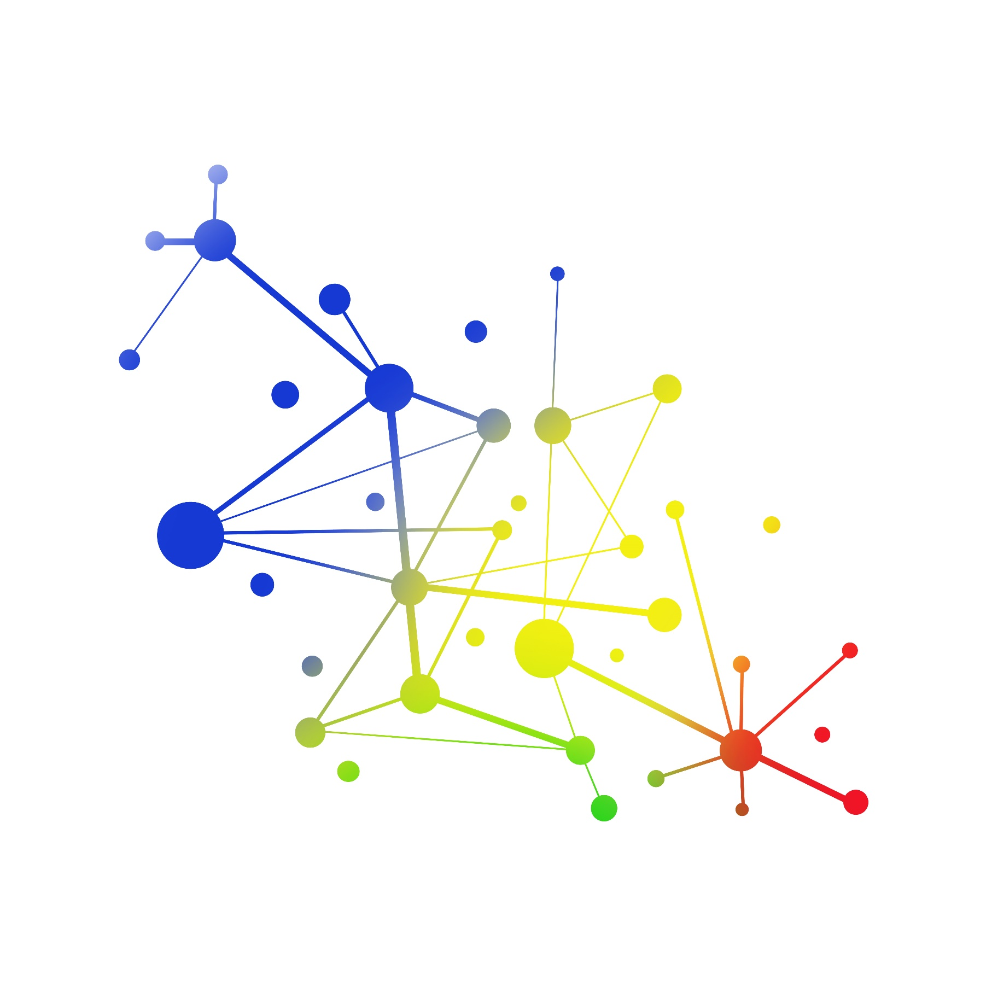

ORIGIN summary 2018 a scientific network to support cross-disciplinary science education engagement & networking
Tokyo / Japan
michael.hoch@cern.ch phone: + 41754115720
ORIGIN summary 2018 outlook 2019
Michael.Hoch@cern.ch for the ORIGIN network 10/01/2019

Slide 2

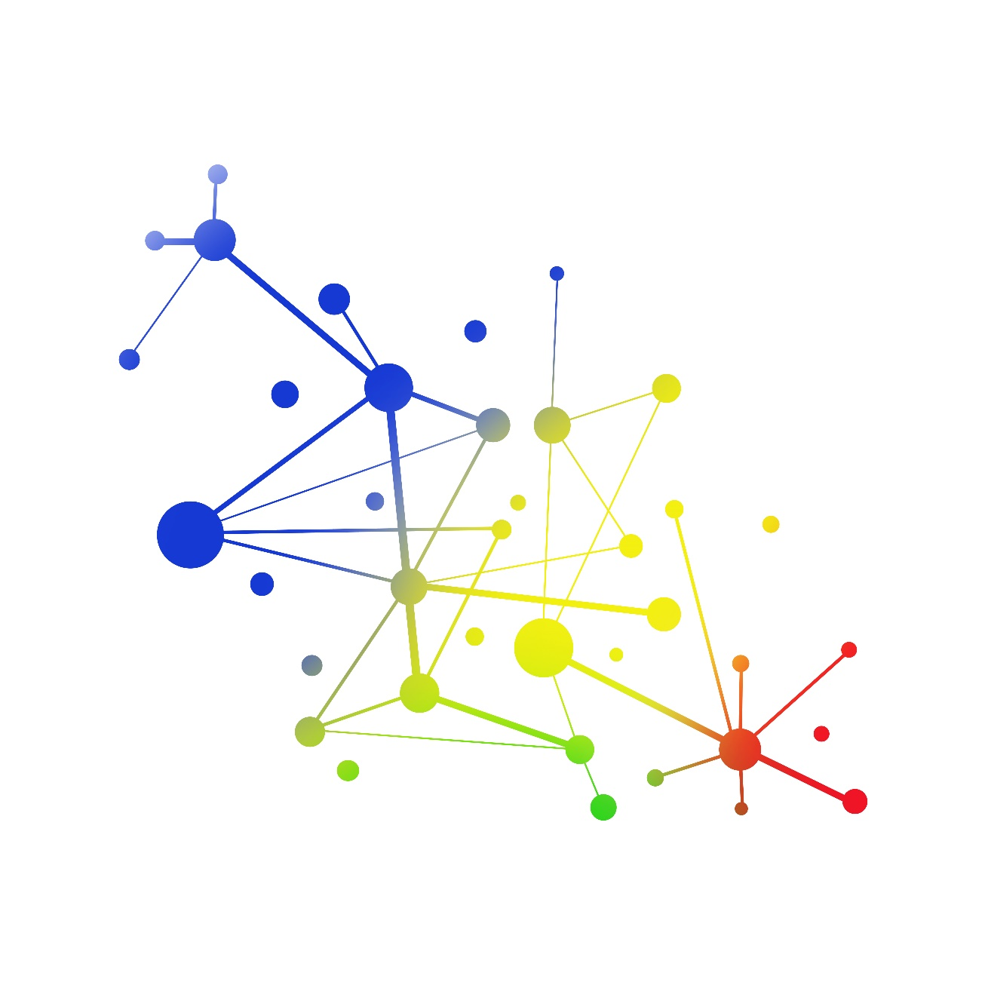
Who is ORIGIN
Scientific collaborations:
ALICE, ATLAS, CMS, ICEcube, LIGO, Muography VIRGO
Under Discussion DUNE, T2K/SuperK
Scientific Institutions:
Perimeter Institute, Canadian Light Source,
Scientific Topics:
Particle Physics, Astrophysics, Gravitational Waves, Neutrino-Physics Muography, Cosmology, Accelerator -Technology
http://originnetwork.web.cern.ch

Slide 3
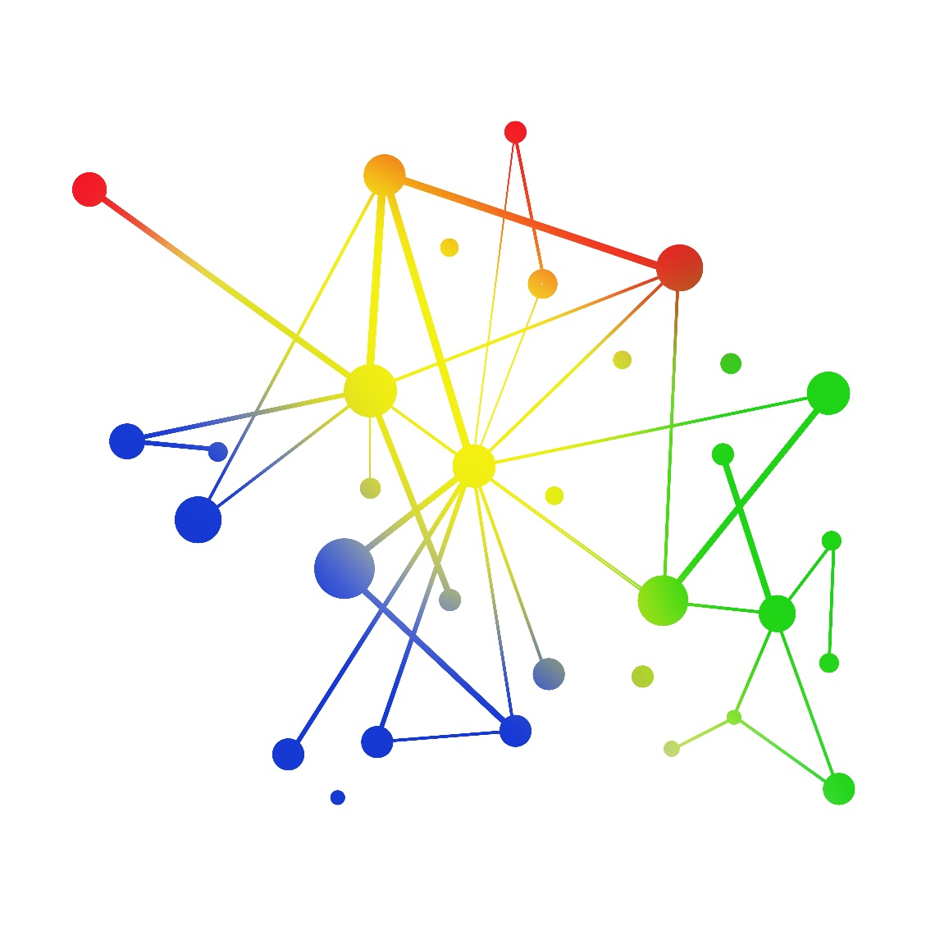
ORIGIN scientific collaboration coordinators:
ALICE - Despina Hatzifotiadou despina.hatzifotiadou@cern.ch
ATLAS - James Beacham j.beacham@cern.ch Claire Adam Bourdarios claire.bourdarios@cern.ch
CMS - Michael Hoch Michael.Hoch@cern.ch Chiara Mariotti chiara.mariotti@cern.ch
ICEcube - James Madsen james.madsen@uwrf.edu
LHCb - Bolek Pietrzyk Bolek.Pietrzyk@cern.ch
LIGO - Martin Hendry <martin.hendry@glasgow.ac.uk Heather Fong hfong@resceu.s.u-tokyo.ac.jp
Muographers - Sara Steigerwald steigerwald@virtual-muography-institute.org Hiroyuki Tanaka ht@eri.u-tokyo.ac.jp
VIRGO - Livia Conti livia.conti@pd.infn.it
ORIGIN regional scientific institutes collaborating:
Perimeter Institute Canada – Greg Dick gdick@perimeterinstitute.ca Marie Strickland mstrickland@perimeterinstitute.ca
Canadian Light Source Canada - Sandra Ribeiro Sandra.Ribeiro@lightsource.ca 'Mark Boland' Mark.Boland@lightsource.ca
University of Split Croatia – Ivica Puljak puljak@fesb.hr Nikola Godinovic ngod@fesb.hr
SEENET-MTP Centre Serbia- Goran Dordevic gorandj@junis.ni.ac.rs office@seenet-mtp.info
University of Montenegro - Edin Jasarovic edinjasarovic1982@gmail.com
HEPHY Vienna Austria - Brigitte DeMonte brigitte.de.monte@oeaw.ac.at
University of Toronto Canada - Peter Krieger krieger@physics.utoronto.ca Karola Dette karola.dette@cern.ch
University Ghent Belgium - Michael Tytgat michael.tytgat@cern.ch
Collaborators in the Arts:
Robin Kingsburgh robin.kingsburgh@gmail.com Mark-David Hosale markdavid@mdhosale.com Griffin, David dgriffin@faculty.ocadu.ca Antoine Gitten-Jackson - Consensus avr.truth@gmail.com Virgil Widrich virgil.widrich@uni-ak.ac.at andrew charalambous ucapach@ucl.ac.uk Heather Barnett h.barnett@csm.arts.ac.uk Chris Henschke chris.henschke@rmit.edu.au Katrien Vuylsteke Vanfleteren katrien.vuylstekevanfleteren@hogent.be Laura Mené menelaura@yahoo.fr Nathalie Stefanov nathalie.stefanov@esa-n.info
Regional partners:
Ontario Ministry of Education - Cole, Lisa S. (EDU) Lisa.S.Cole@ontario.ca Science Ministry Montenegro - Sanja Damjanovic sanja.damjanovic@mna.gov.me Djurdjina Bulatovic djurdjina.bulatovic@mna.gov.me Ontario Science Centre OSC Canada - 'Lorrie Ann Smith' LorrieAnn.Smith@osc.on.ca Natural History Museum Vienna Austria - 'Mair Agnes' Agnes.Mair@NHM-WIEN.AC.AT
http://originnetwork.web.cern.ch

Slide 4
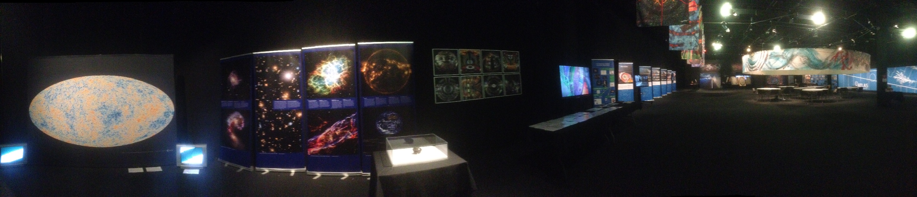
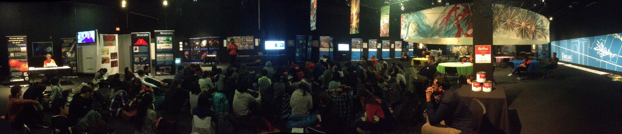

Science: from Astrophysics to Particle Physics
Art: International art@CMS collaborative artists and local artists
Cultural Collisions
by ORIGIN - Canada
Venue: Ontario Science Centre, OSC
First exhibition April 9th – 15th 2018 student research and inspiration
Second exhibition: May 29th – June 3rd at OSC : students art-works presentation
A formal evaluation by the Ministry of Education
Organization: creation of ORIGIN
Toronto Ministry of Education: general and education organization, evaluation
art@CMS: Exhibition curation ORIGIN: Scientific curation
art@CMS, ATLAS, CLS, CMS, LIGO/VIRGO, Muography, Perimeter Institute
More institutions are interested to join: TRIUMF, Snowlab
ORIGIN

Slide 5
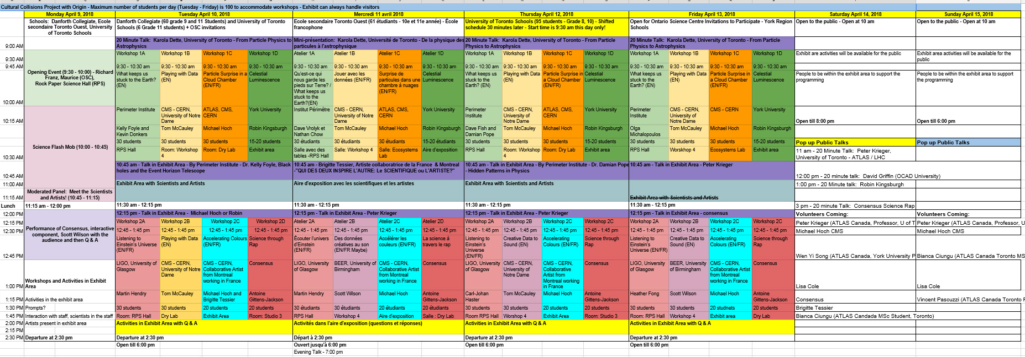
Cultural Collisions Canada – week schedule

Slide 6
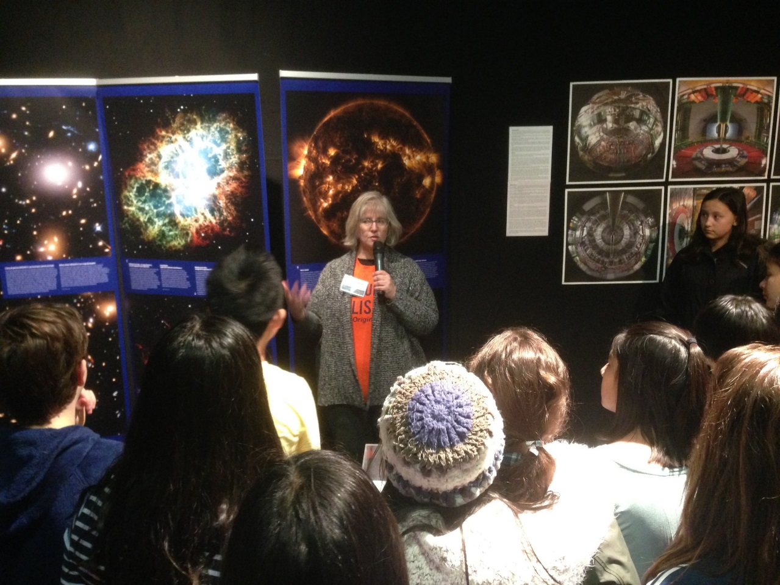
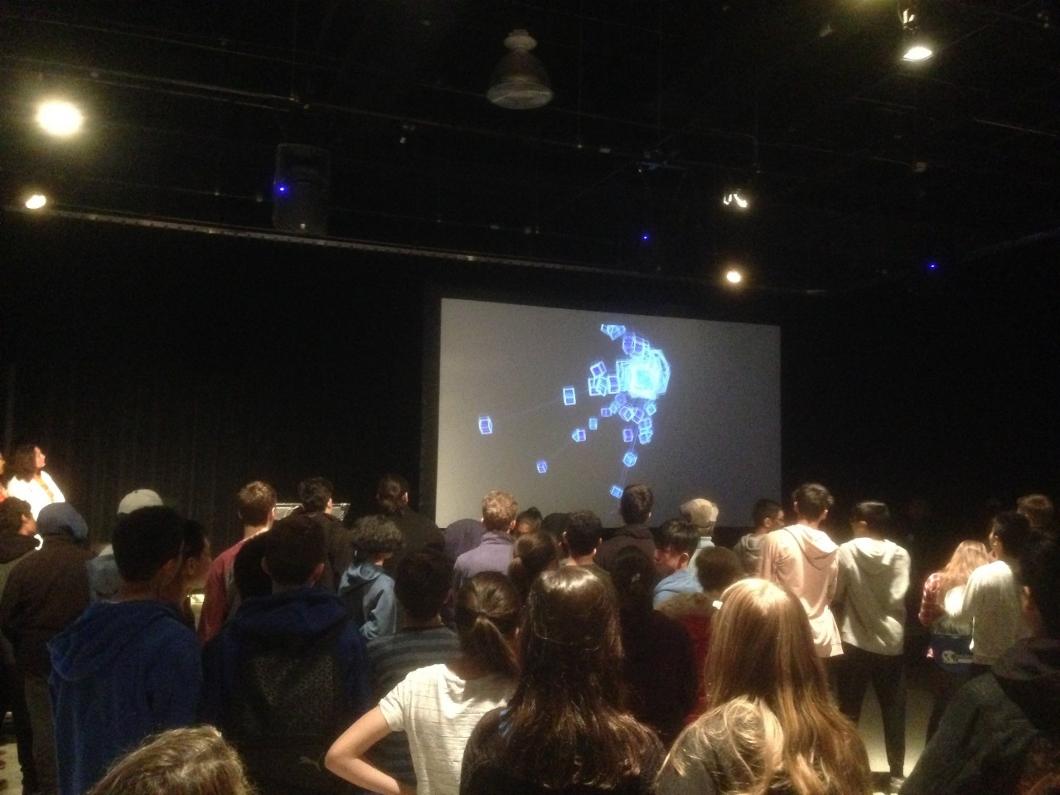
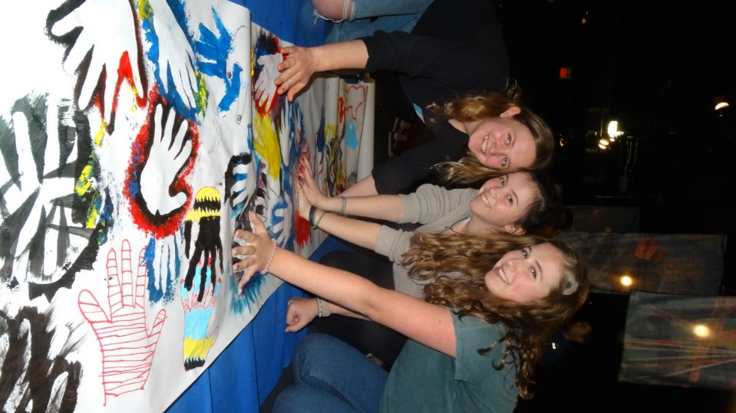

Creative
workshops
Science & Creative demonstrations
Science personal dialogues
Specialized topic talks
General science talks

Slide 7
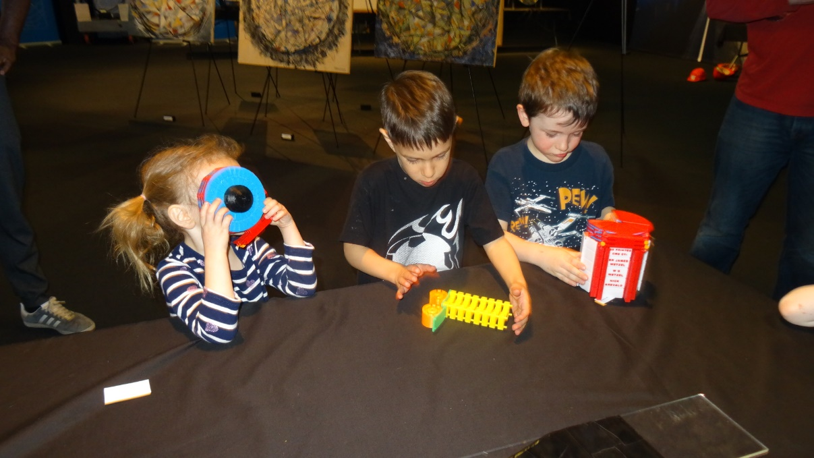
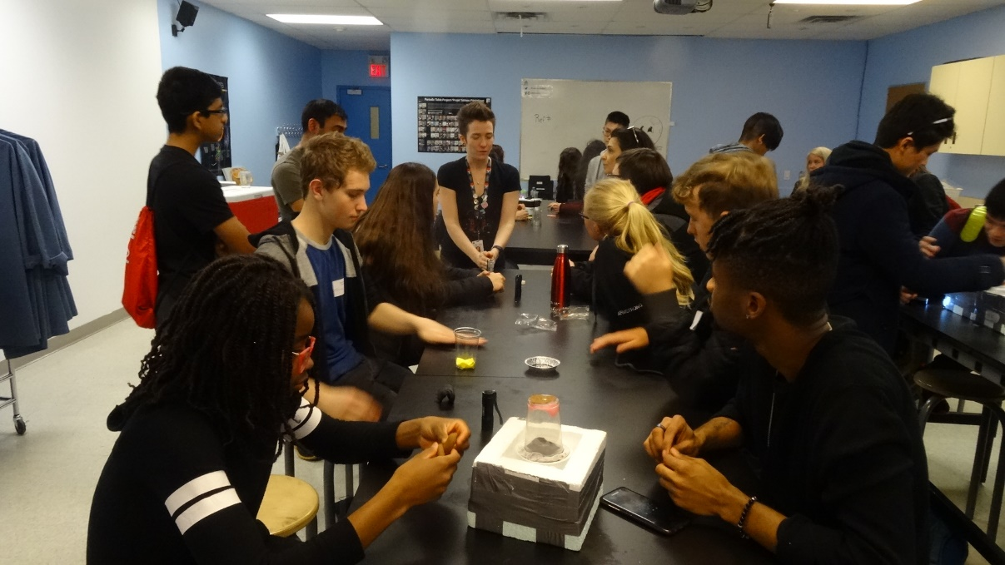
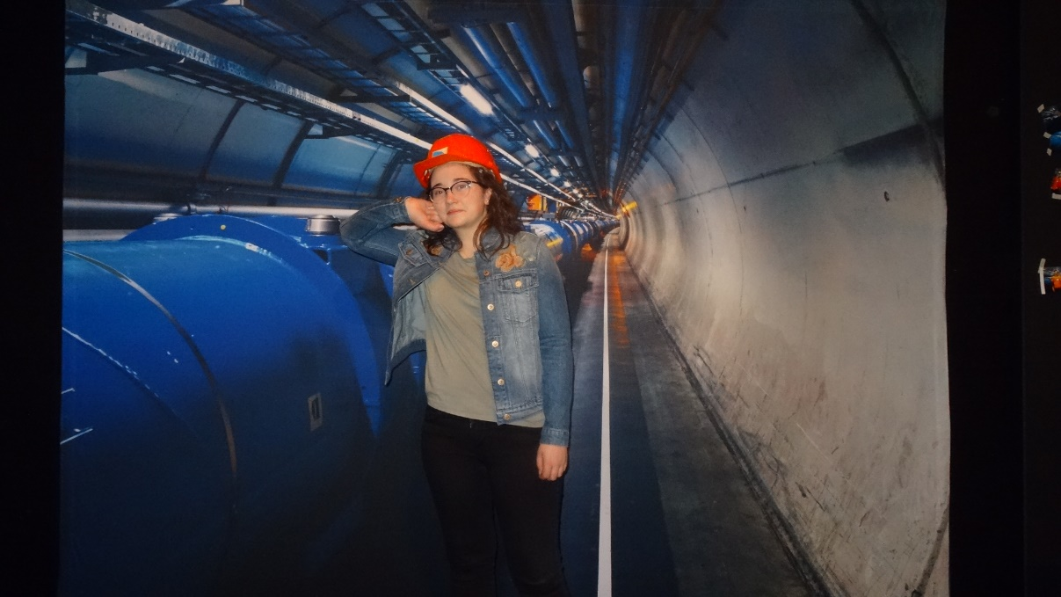
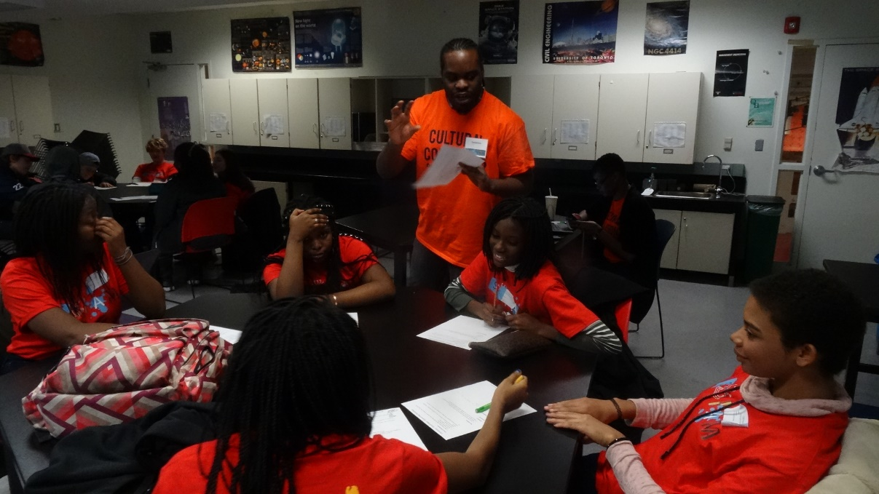
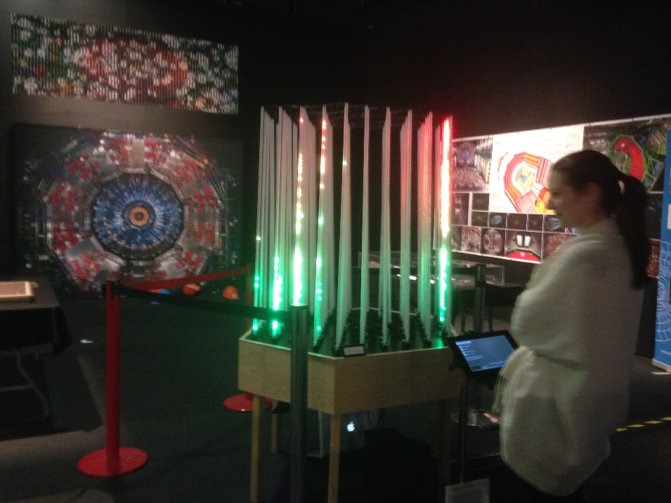
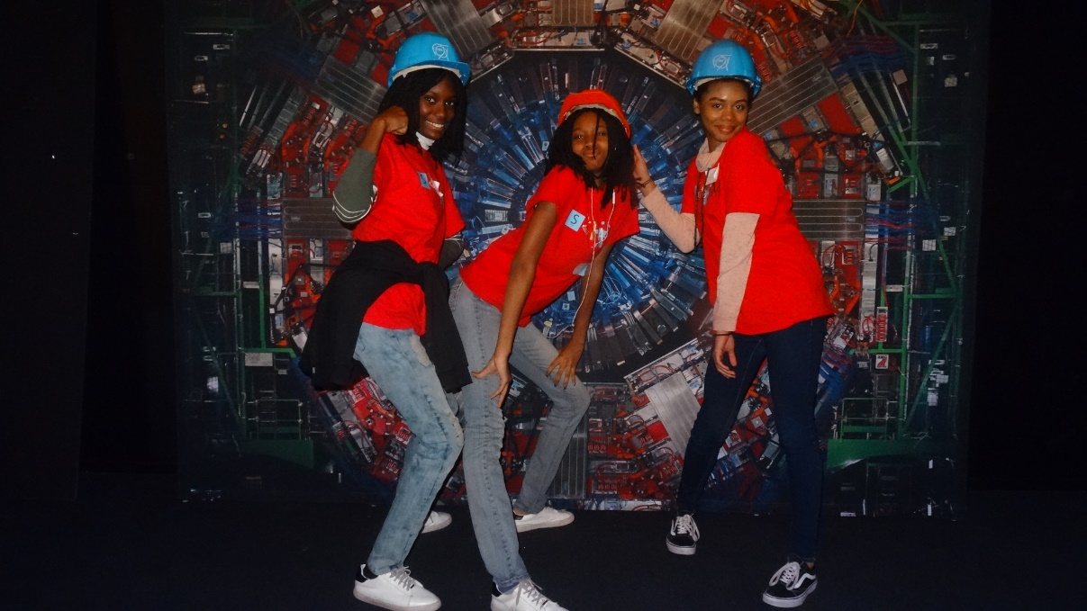
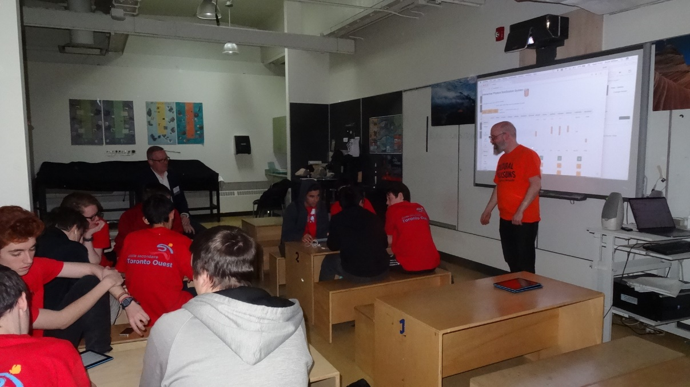
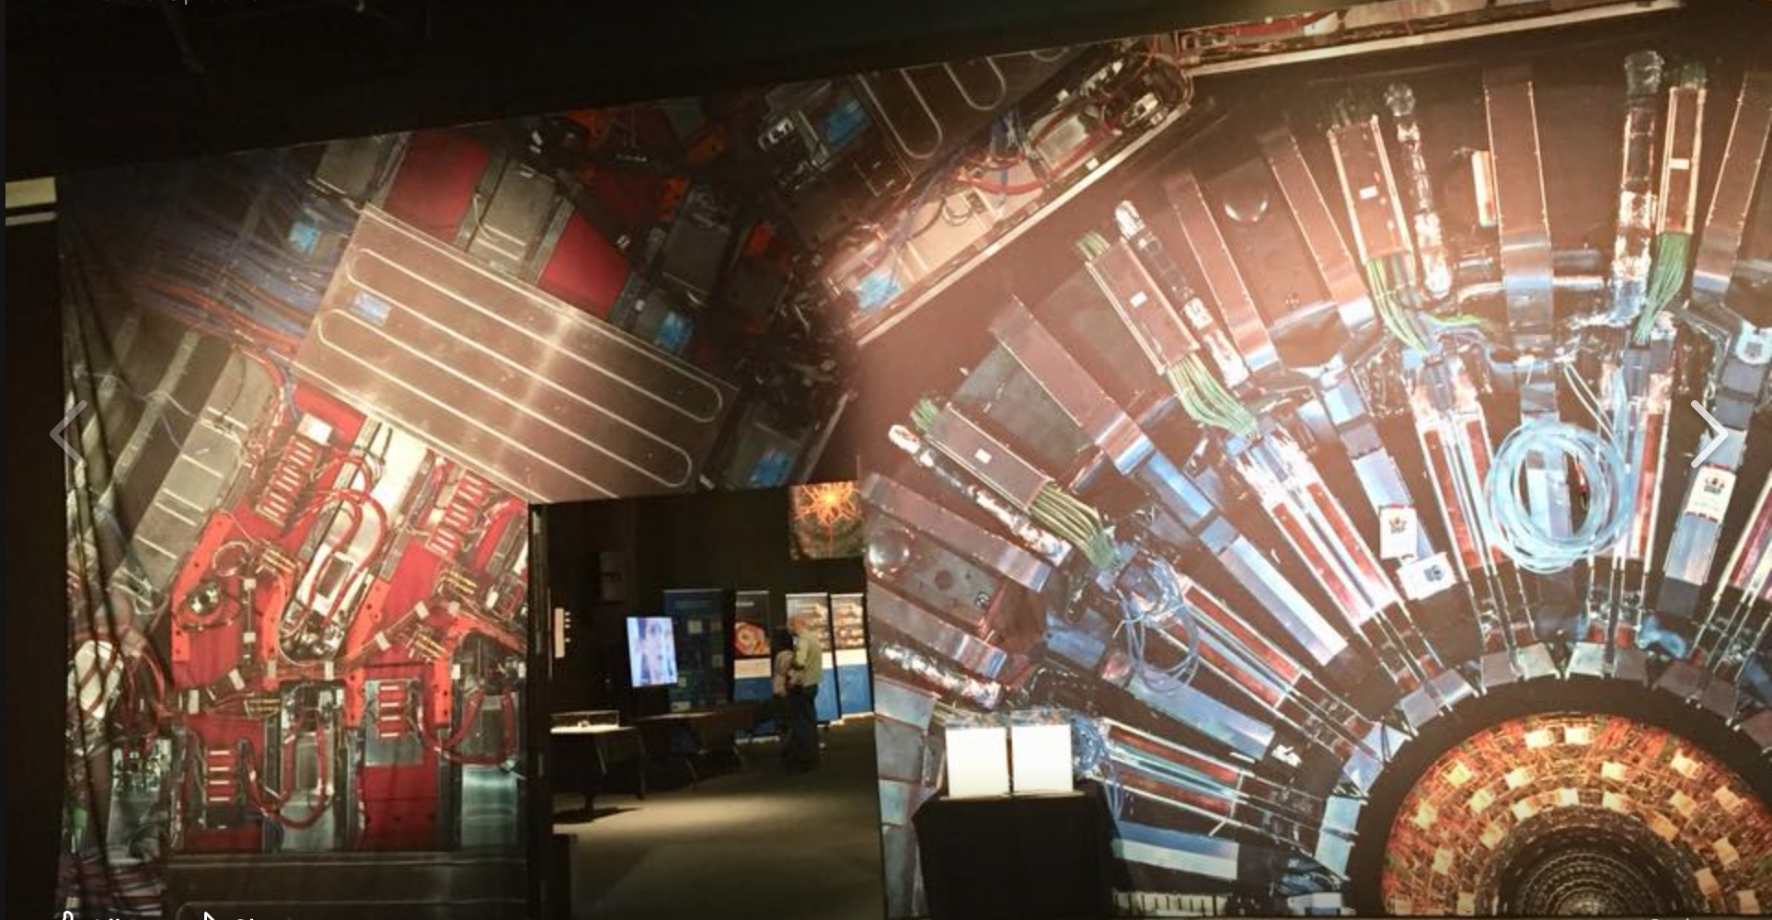
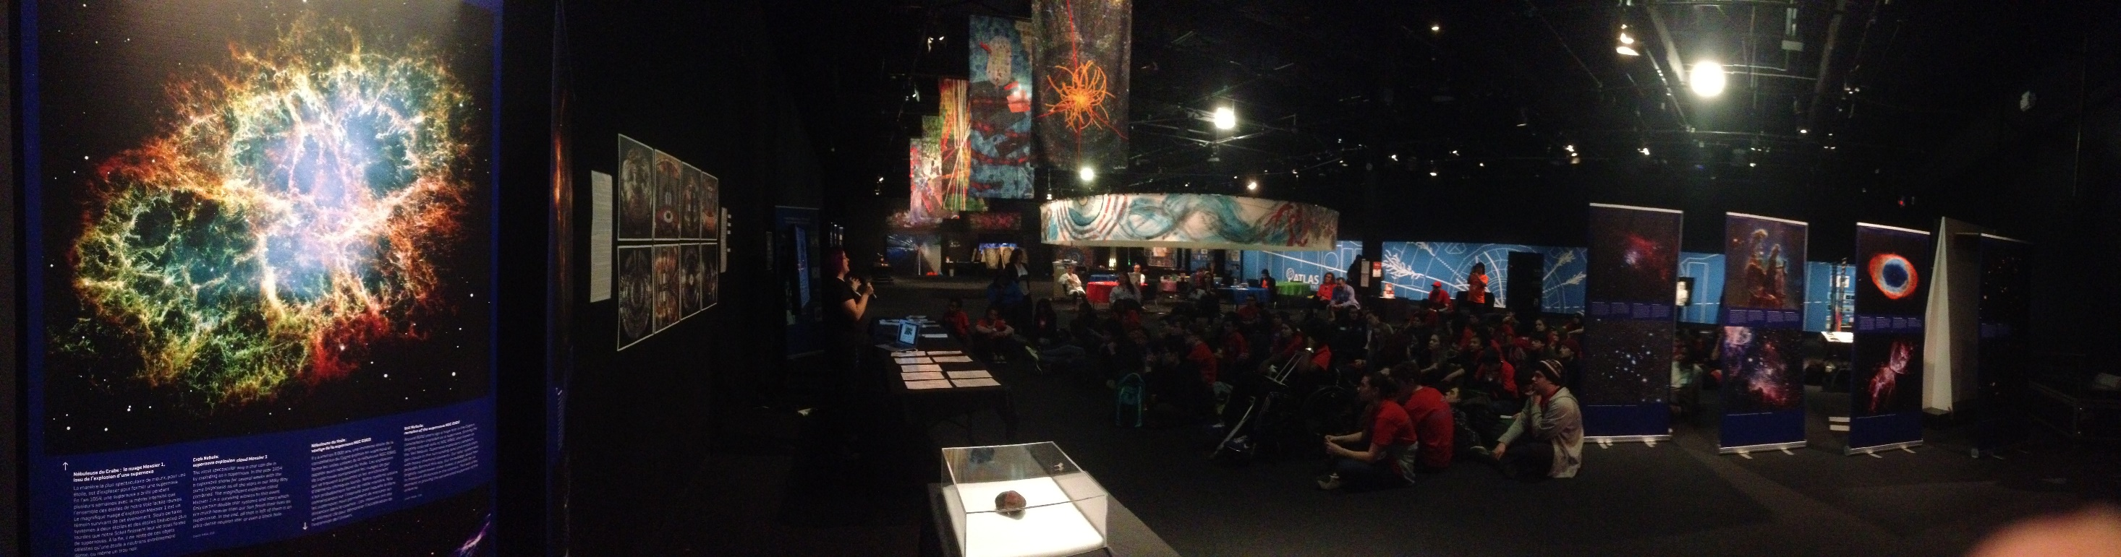
Young audience
Cloud Chamber Workshop
Life Size Photo Wall
Creative Photo Wall
Rap Workshop
ICEcube data art work &
Educational App
General Science Morning Introduction Talk

Slide 8
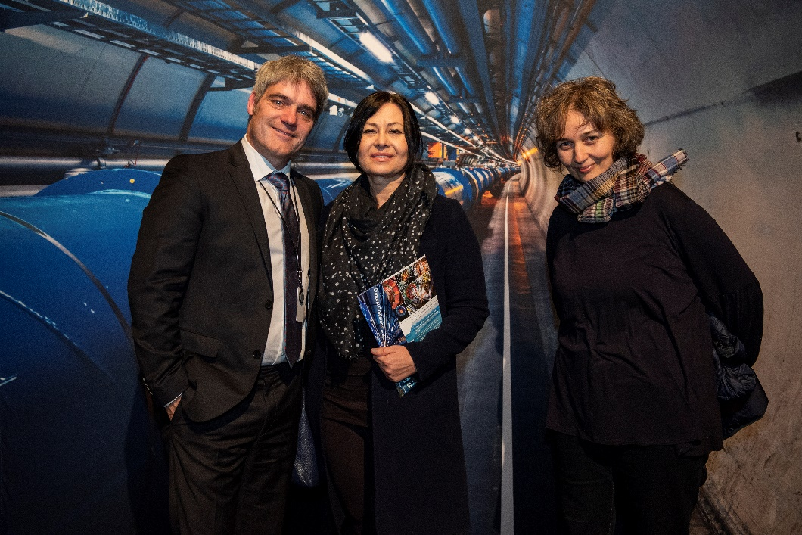
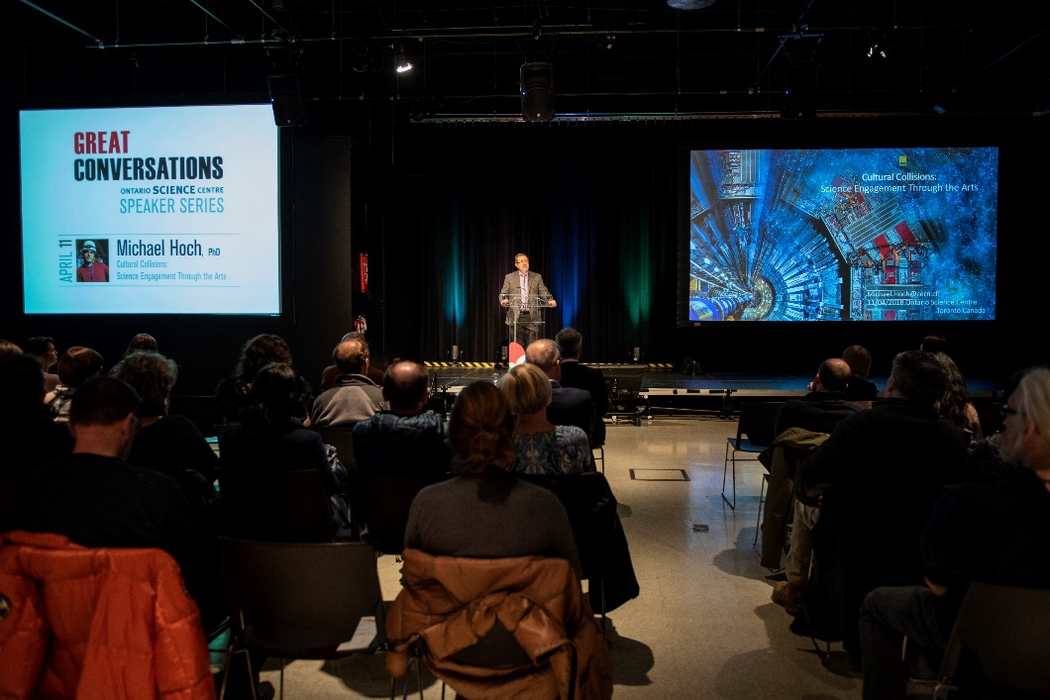
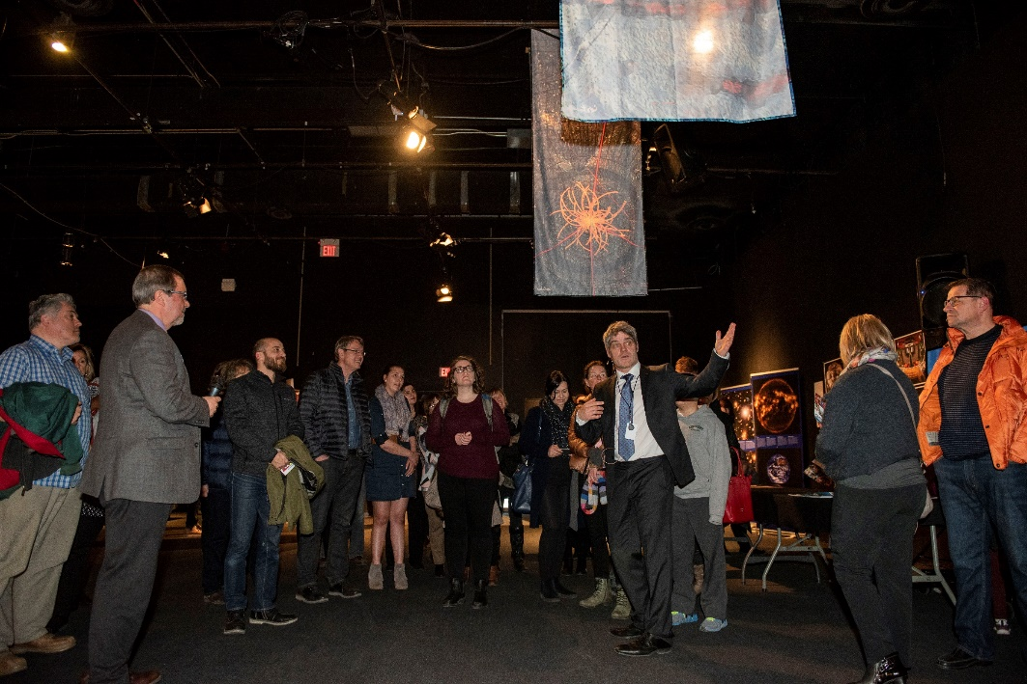
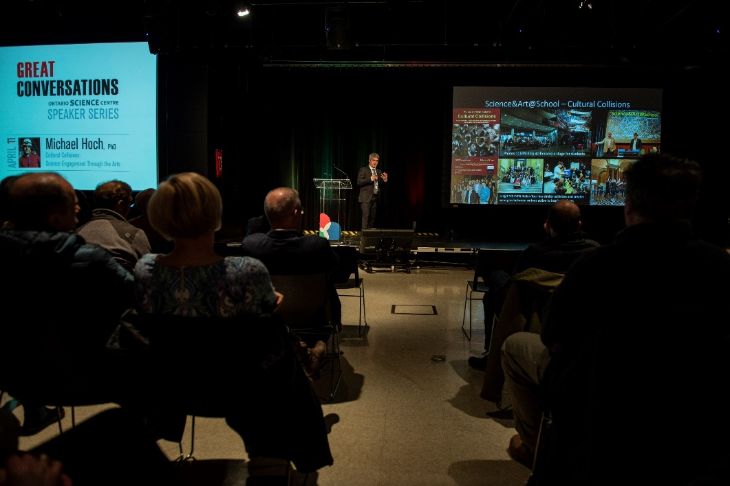
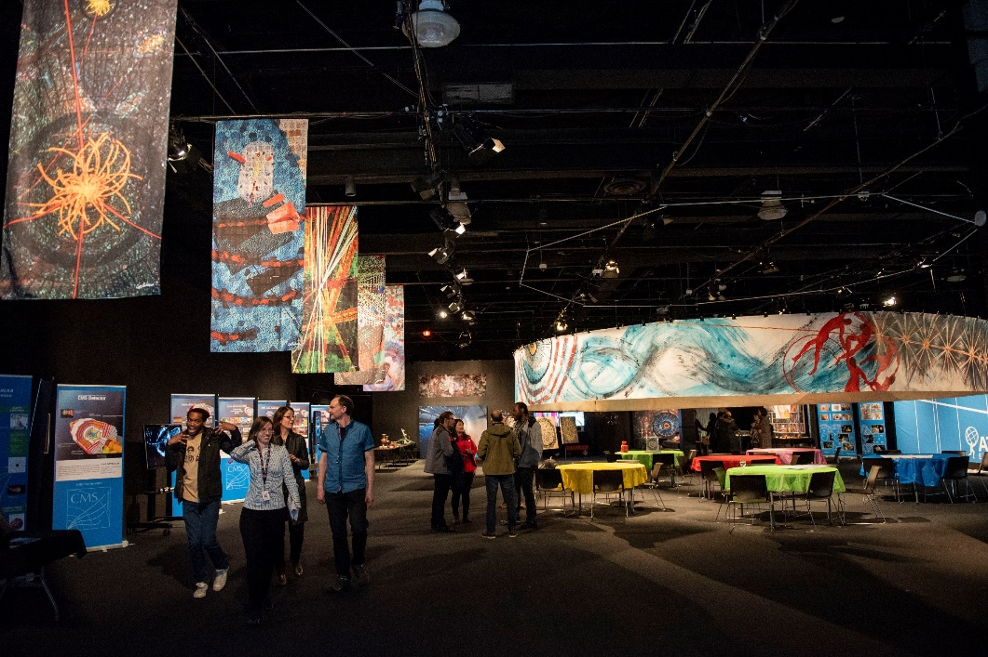
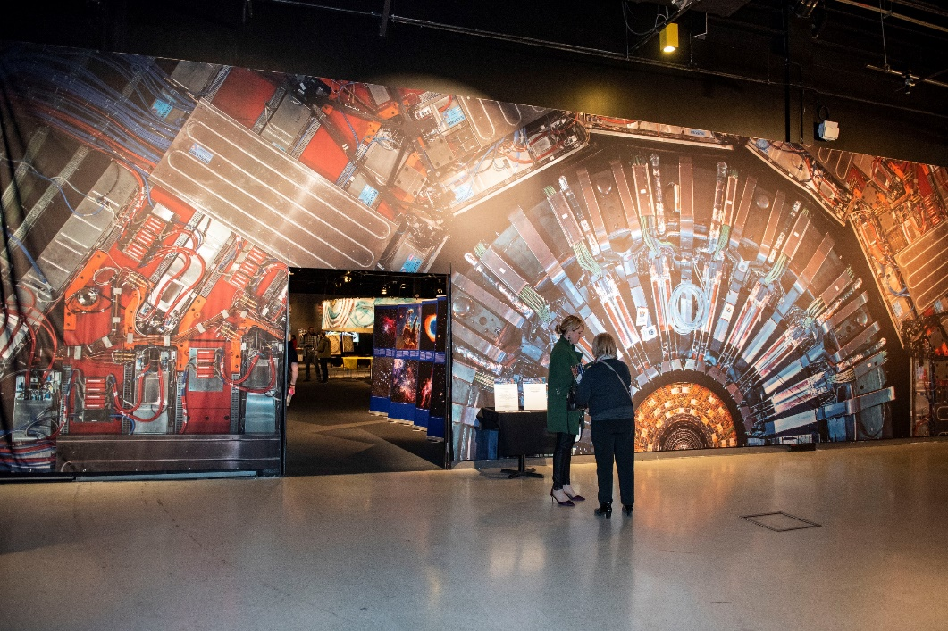
Exhibition & Great Conversation Evening “Science engagement through the Arts”
LHC tunnel Photo wall
Science Centre CEO Maurice Bitrain
Direct dialogue
presentation
Guided tour through the exhibition
Entrance CMS life size photo

Slide 9
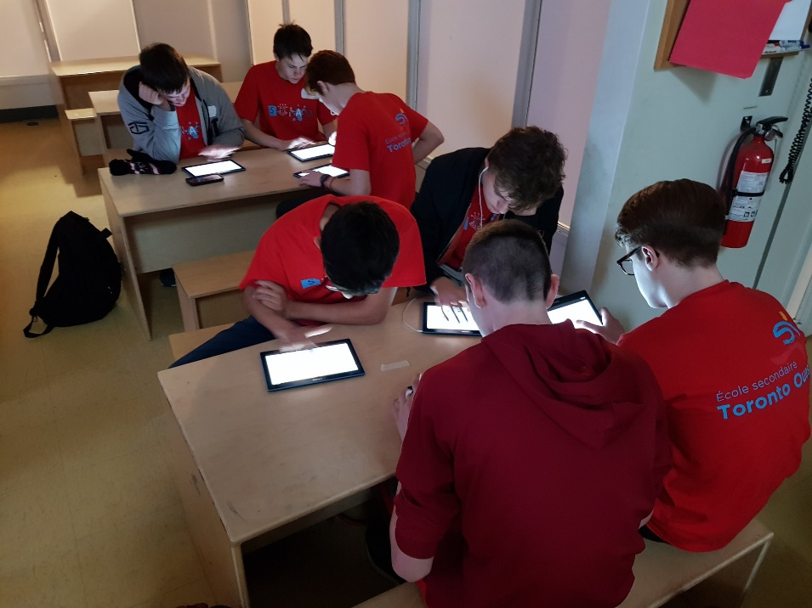
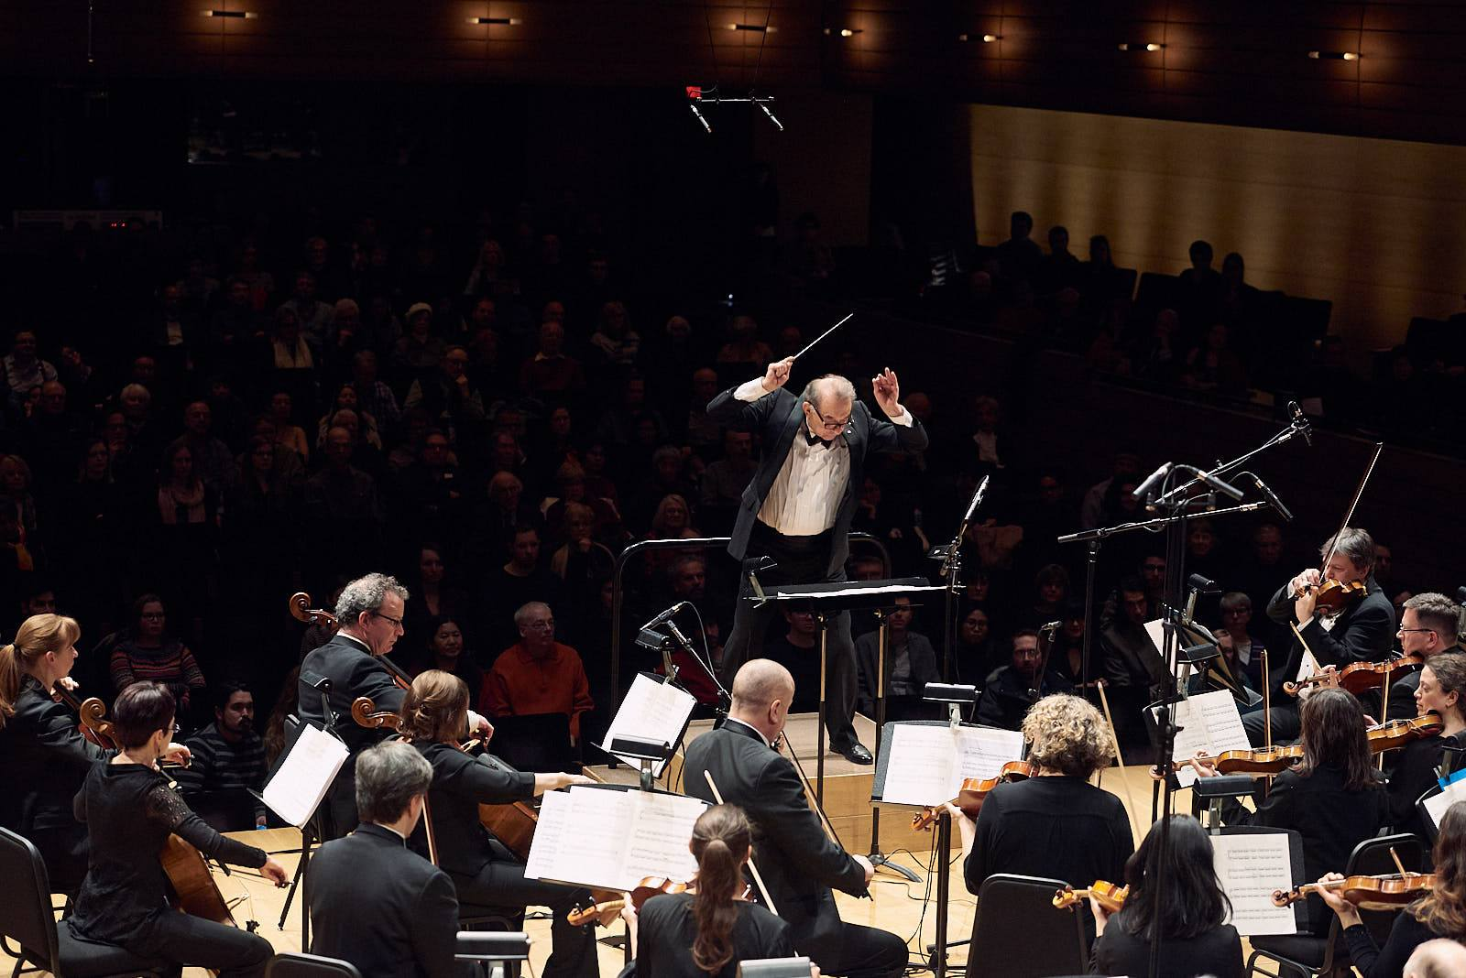
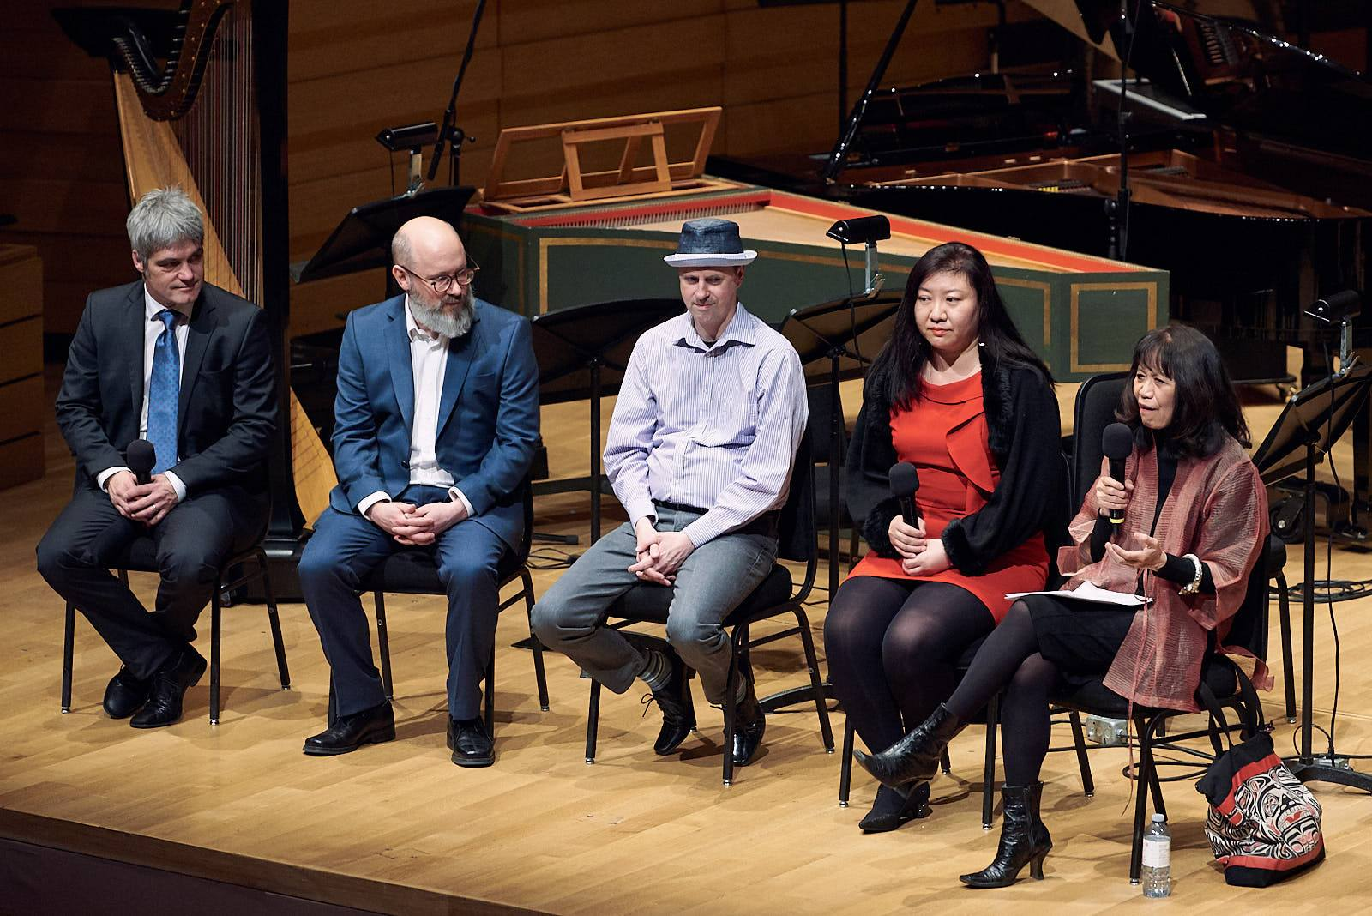

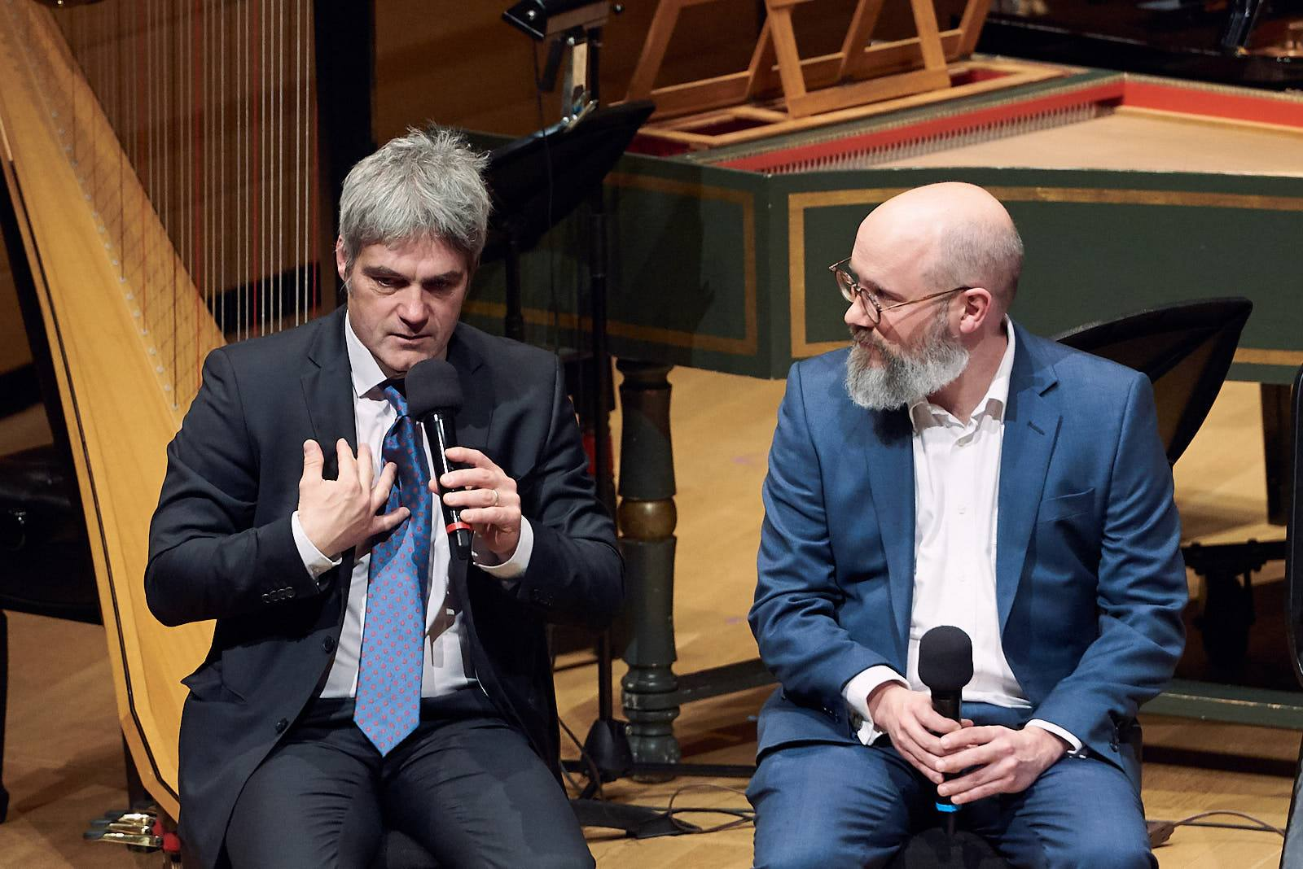
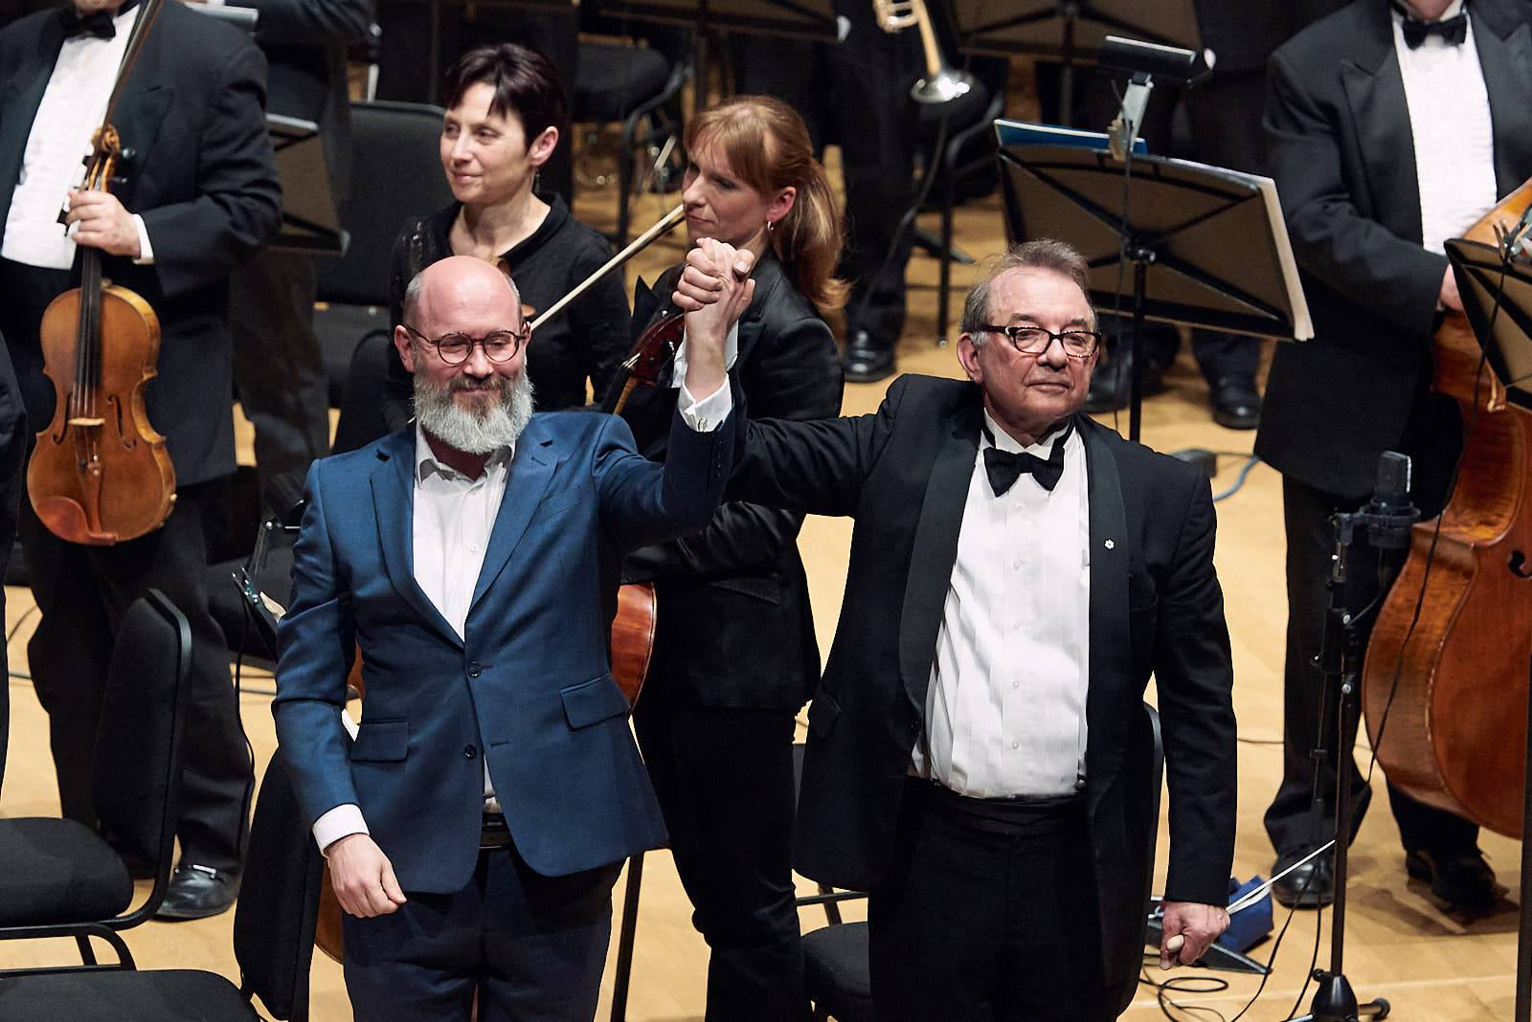
Concert at the Royal Music Conservatory Scott Wilson (BEER) world premier “Dark Matter”
World Premier “Dark Matter”
Pre Concert Conversation
Data Sonification Workshop
OSC data sonification
Life demonstration
Pre Concert Conversation

Slide 10

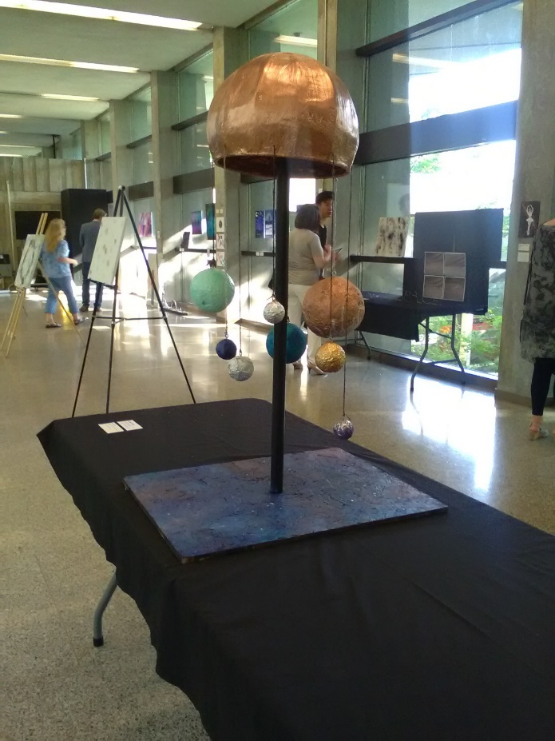
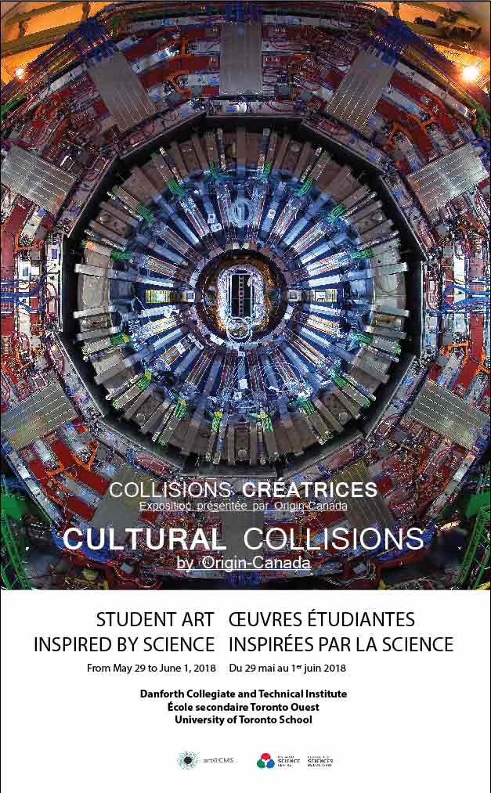
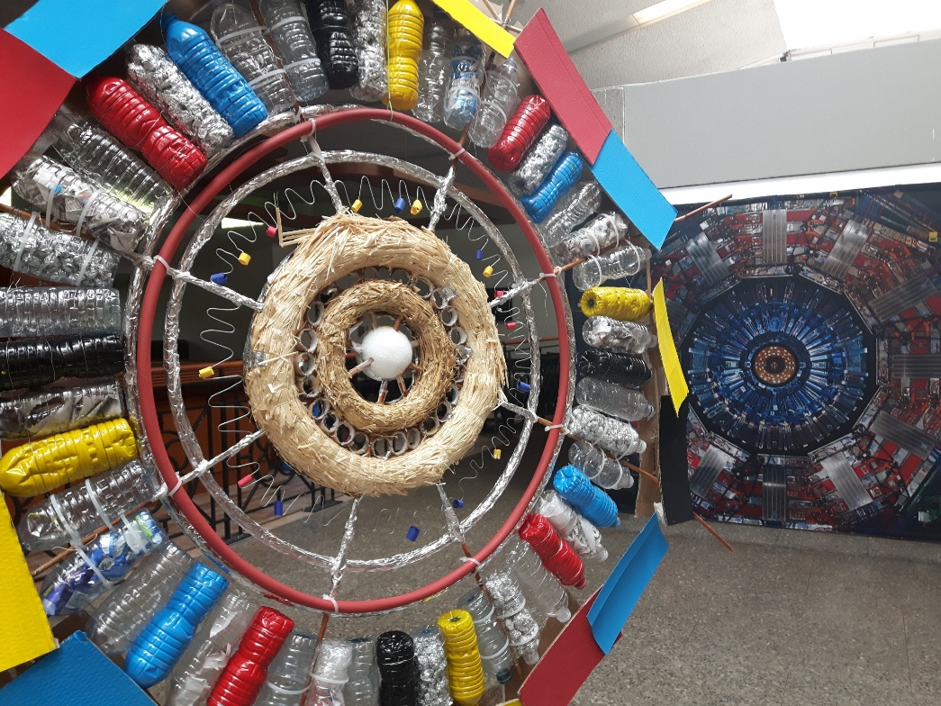
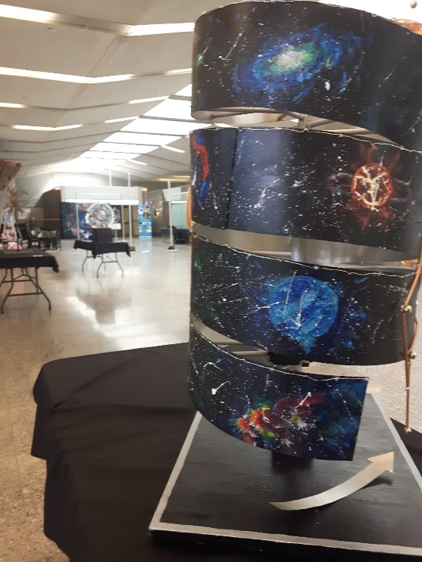
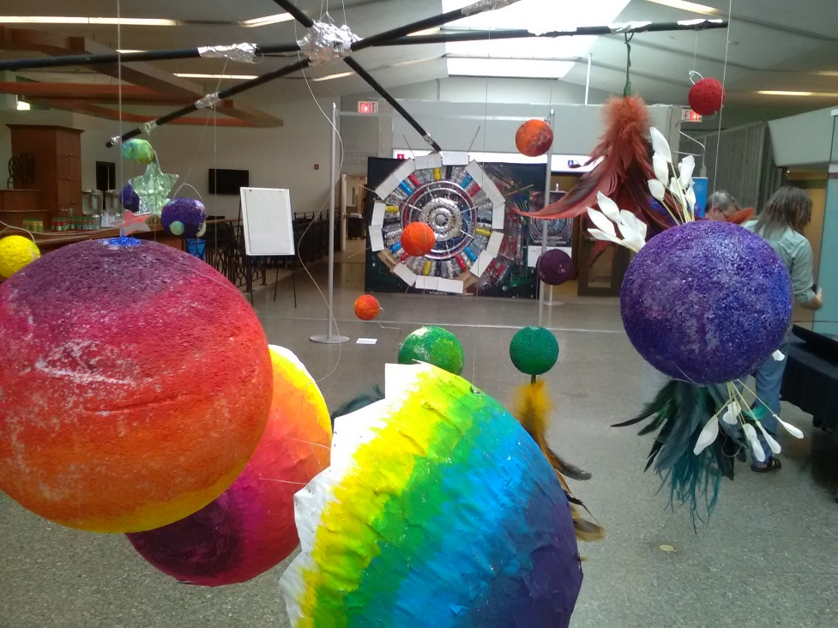
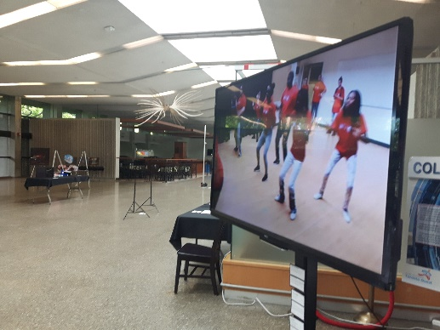
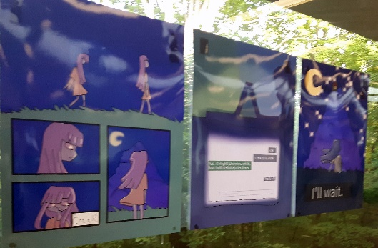
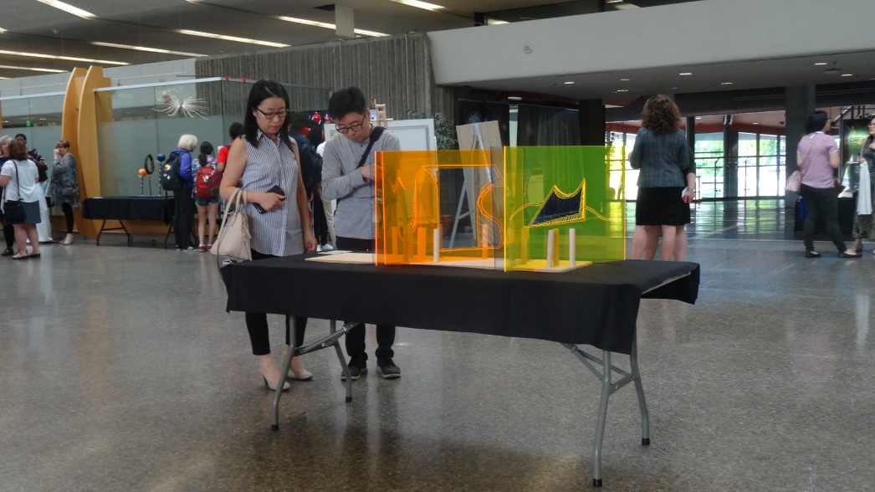
Second Exhibition - Student Results - artWorks

Slide 11
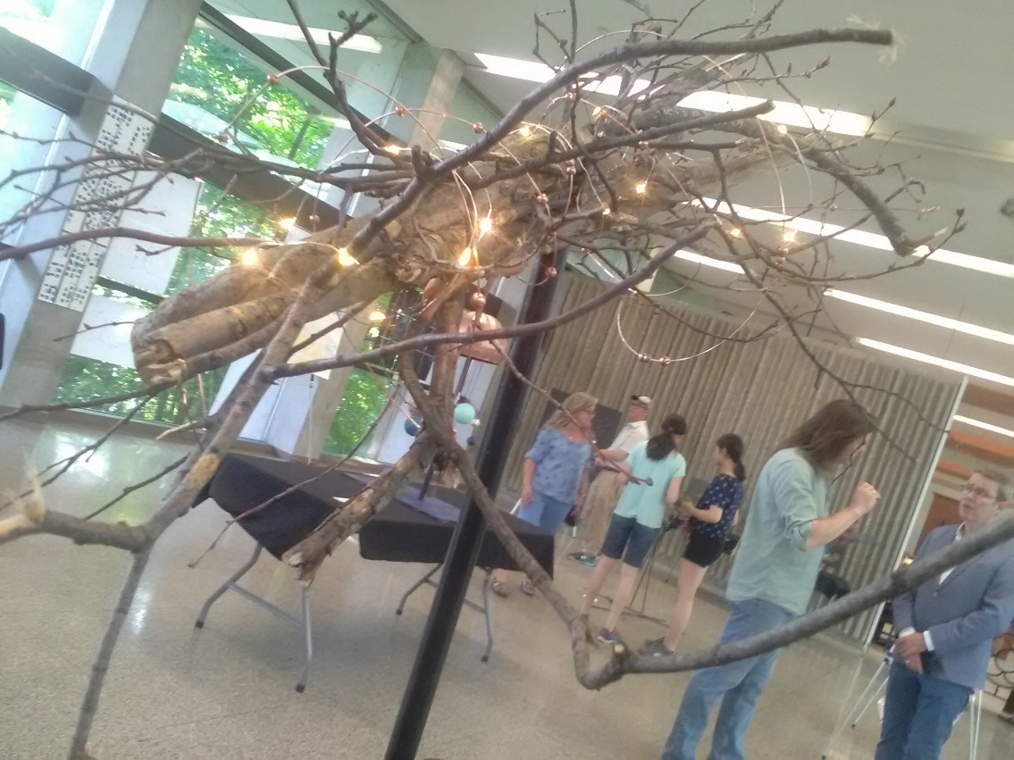
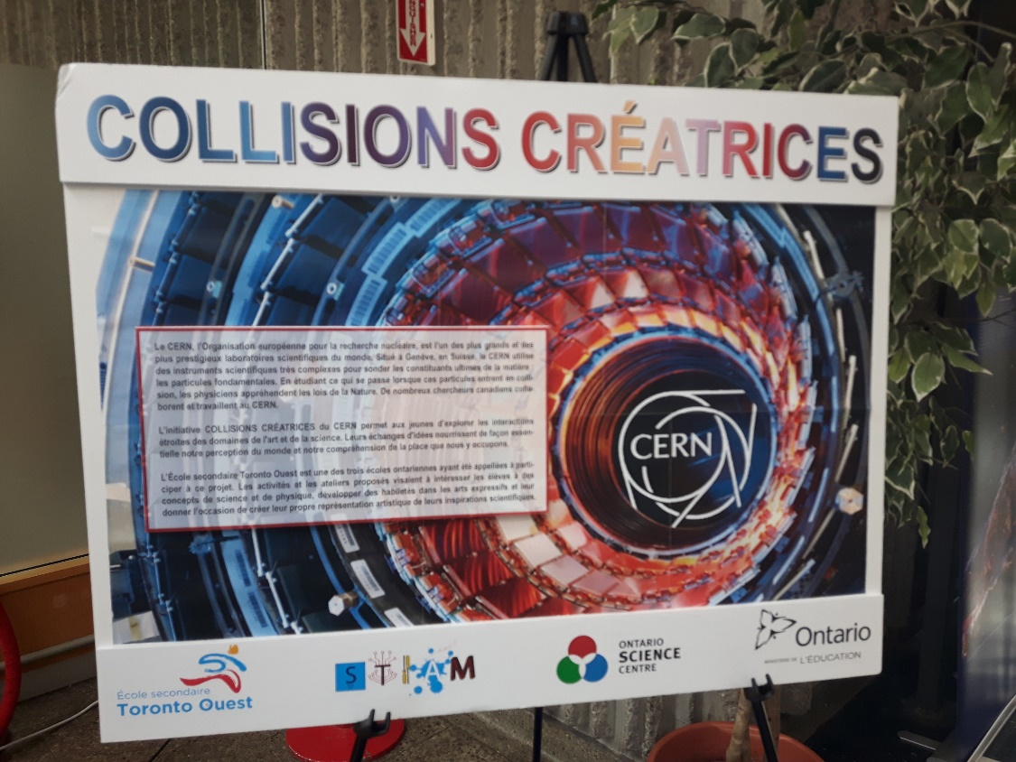
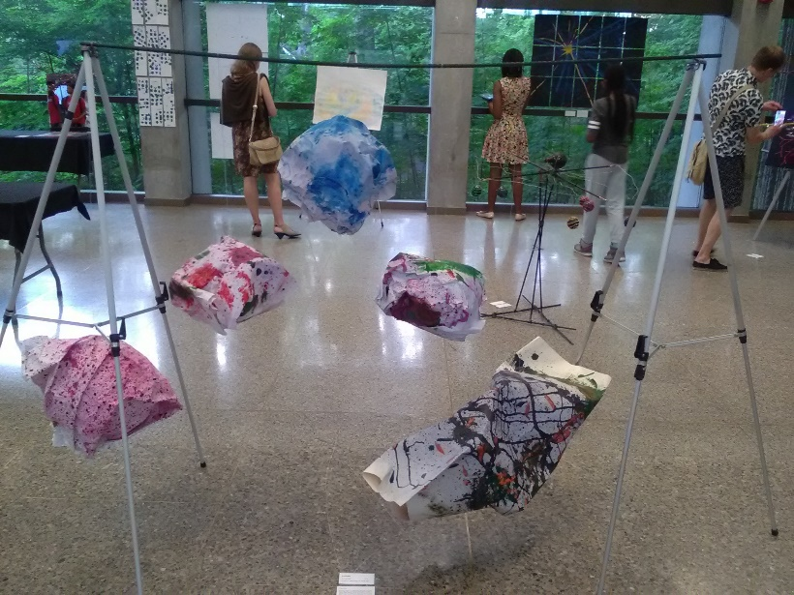
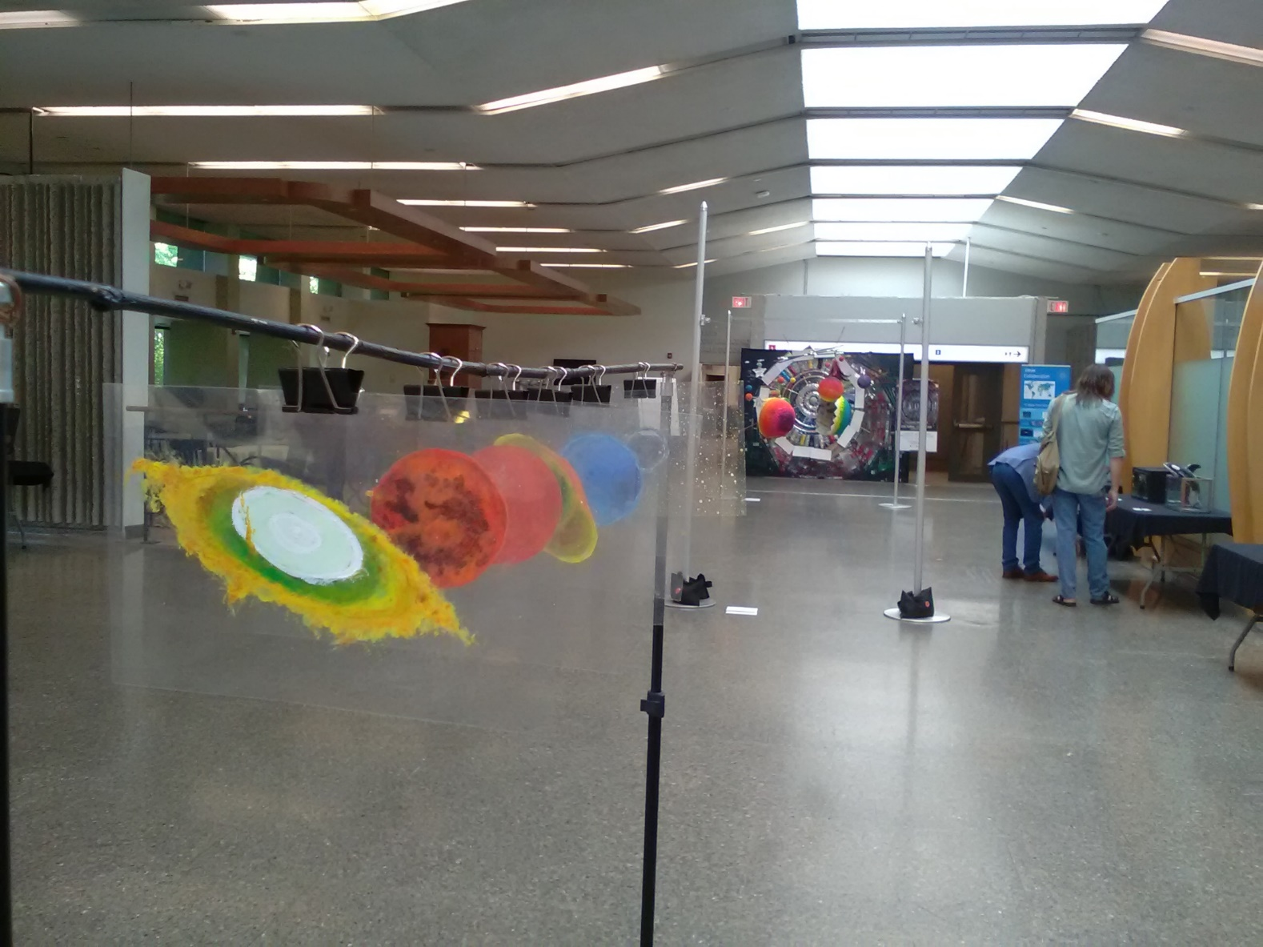
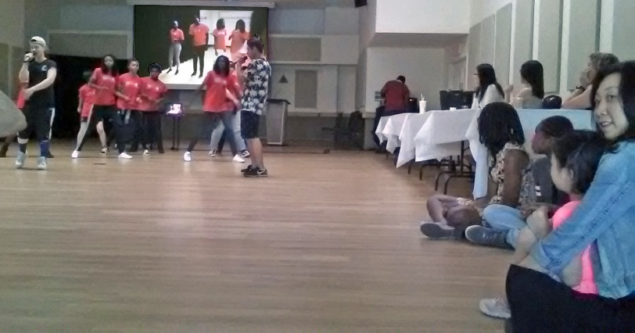
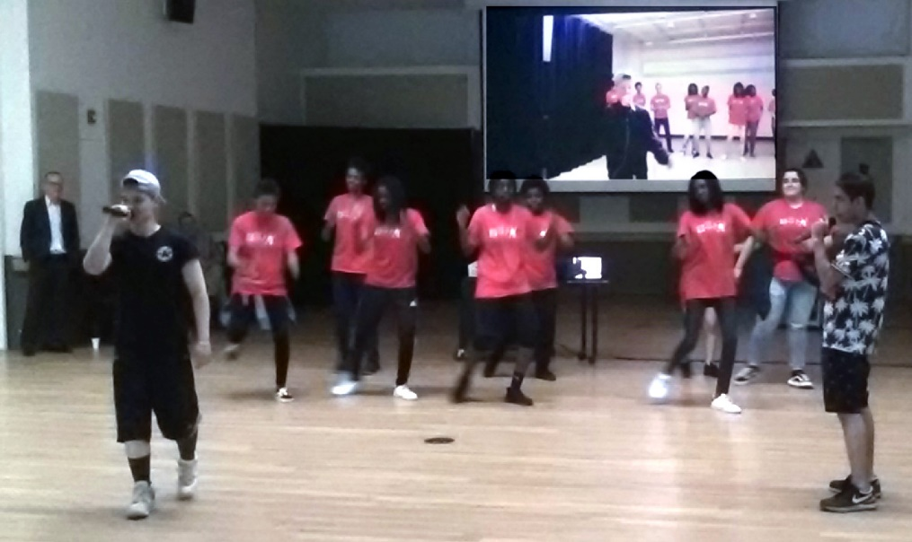
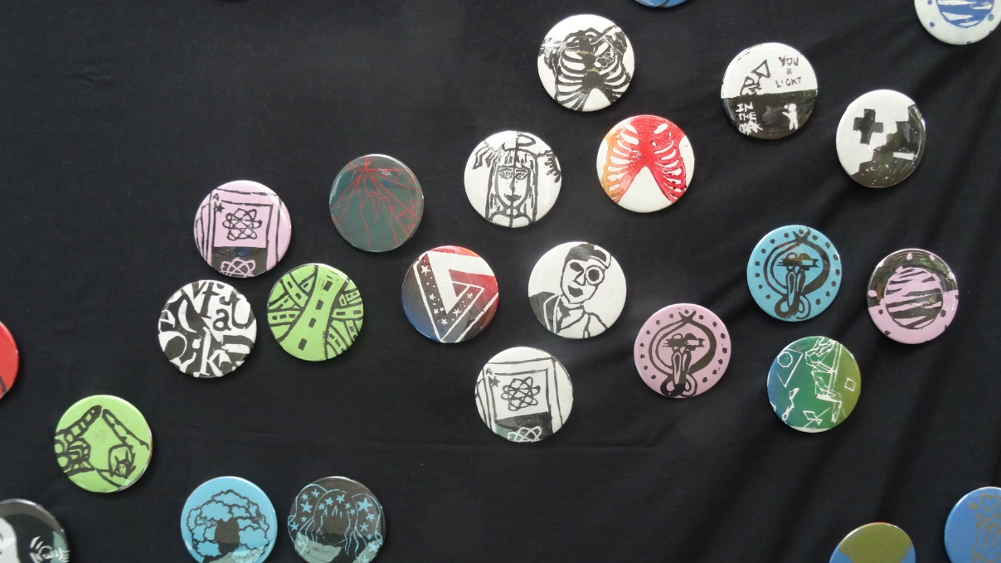
Student Exhibition Opening – Rap & Dance Performances
Direct dialogue
Guided tour through the exhibition
LHC tunnel Photo wall
Rap performance & HipHop

Slide 12
Ontario Ministry of Education Final Evaluation & report
Some links to documents on the CCC project and the evaluation;
with courtesy of the Ontario Ministry of Education and Ontario Science Centre;
Final evaluation report of the Cultural Collisions Canada
- Exploring the Nexus for Student Learning when the Arts and Science Collide
https://originnetwork.web.cern.ch/sites/originnetwork.web.cern.ch/files/CC%20Public%20Report%20Final.pdf
Final presentation Cultural Collisions Canada
– by Toronto Science Centre & Co
https://originnetwork.web.cern.ch/sites/originnetwork.web.cern.ch/files/OriginCanadaSlides.pdf
video walk through the exhibition
-- Ontario Science Centre
https://www.youtube.com/watch?v=4Hkrr1mCz7o&t=184s
http://originnetwork.web.cern.ch

Slide 13
“South East European cross disciplinary science education, engagement and networking Initiative”
Time scale to initiate 3-4 years: 2018 – 2022 (once program disseminated -> self-sustained by local community)
Midterm or long-term aim: Create sustainable network who may run interdisciplinary activities on science with art.
http://mhoch.web.cern.ch/mhoch/Art@CMS/Science4Peace_interdisciplinaryScienceEducationEngagementNetworkingTour_art@CMS.pdf
Kick off events delivered 2018:
Split/ Croatia (17th – 23th September)
Cetinje/ Montenegro (October 9th – 11th)
Tirana/ Albania (October 10th -12th)
Sarajevo/ Bosnia (October 15th – 19th)
Imotski/ Croatia (October 27th)
Possible scenario and cities 2019, 2020 and 2021:
Ljubljana (Slovenia), Zagreb [Osijek#, Rijeka#] (Croatia), Belgrade [Novi Sad#, Niš#] (Serbia), Sarajevo [Banja Luka#, Mostar#] (Bosnia and Herzegovina), Podgorica (Montenegro), Tirana (Albania), Pristina (Kosovo *), Skopje (FYR Macedonia)
This project will mutually Create dialogue, cross boarder networking and exchange, as well as engagement on common topics based on scientific methodology and culture. The nature of this program supports to work with mixed teams of different regions for mutual presentations and common engagement.

Slide 14
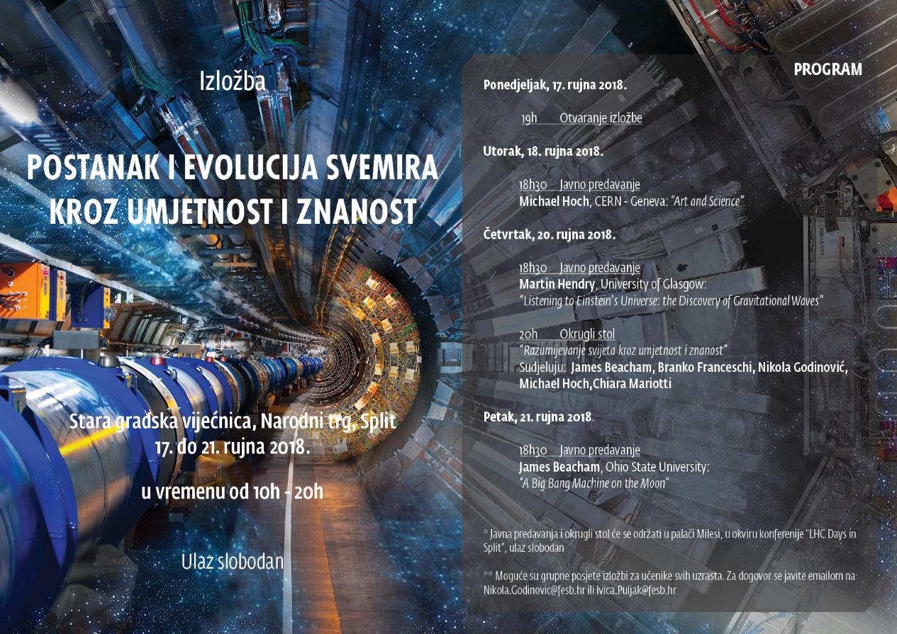
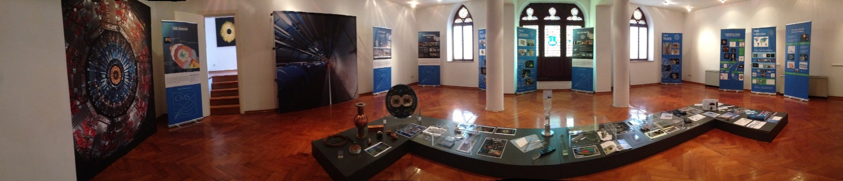
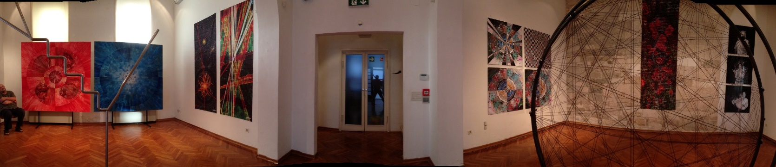
Cultural Collisions – Split /Croatia by ORIGIN Old City Hall – Sept. 17th -22nd 2018
Exhibition, lectures, round table discussion, workshops;
Workshops: Physics and Music (Arduino Explora), Gravitational waves (Torino interferometer), Playing with data (CMS tool developed for Canada)
Next years event :
walk through exhibition Split - > https://youtu.be/XYlDehGg4Xs

Slide 15
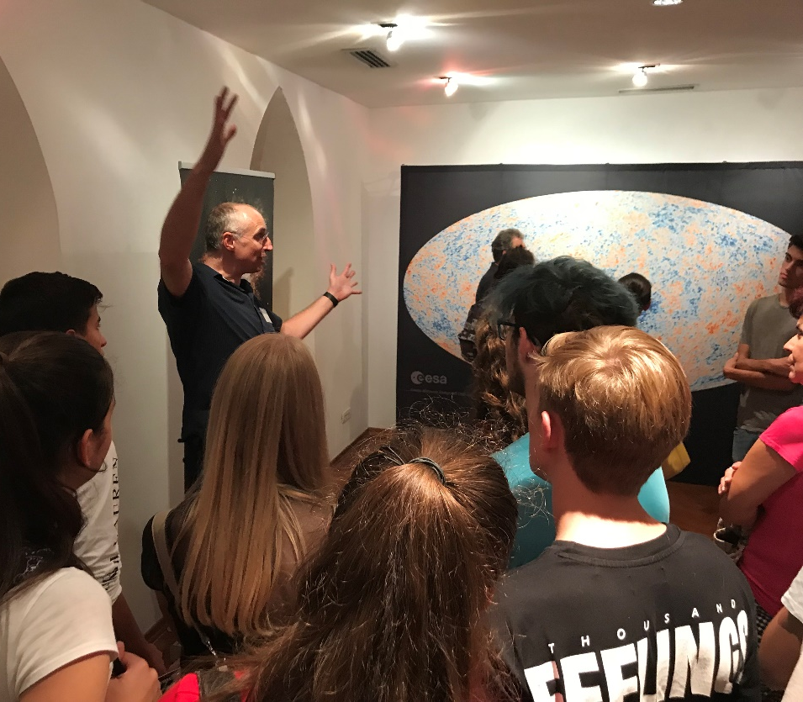
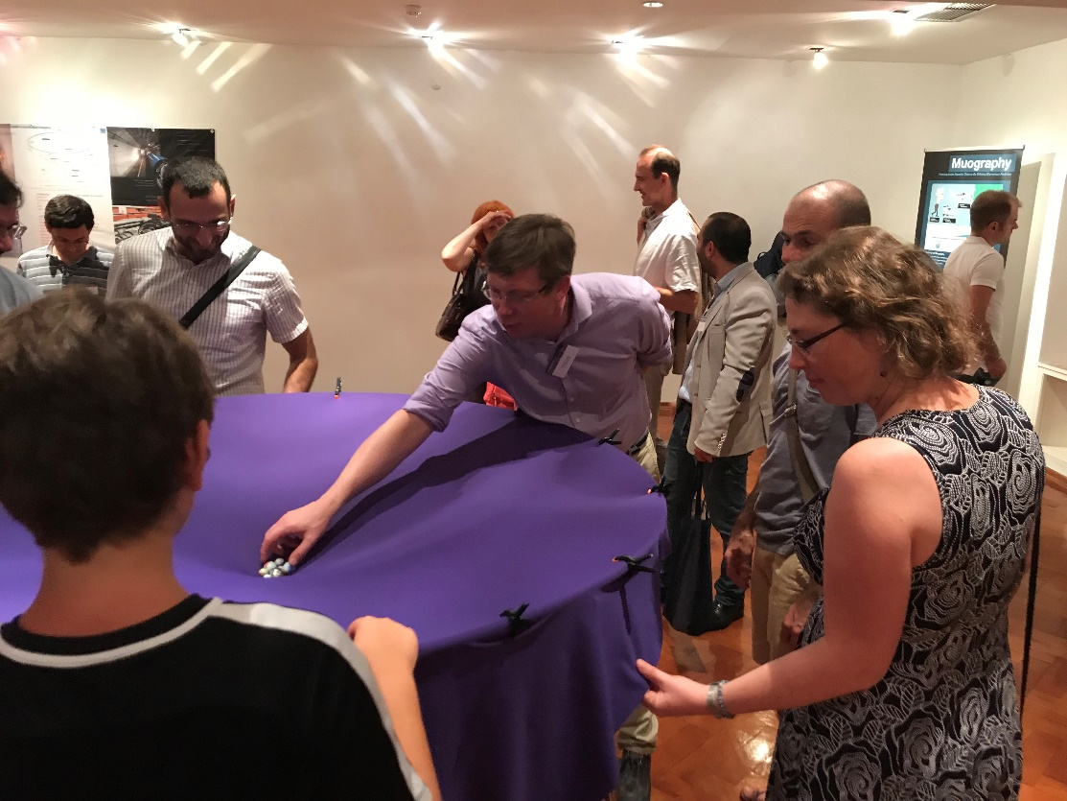
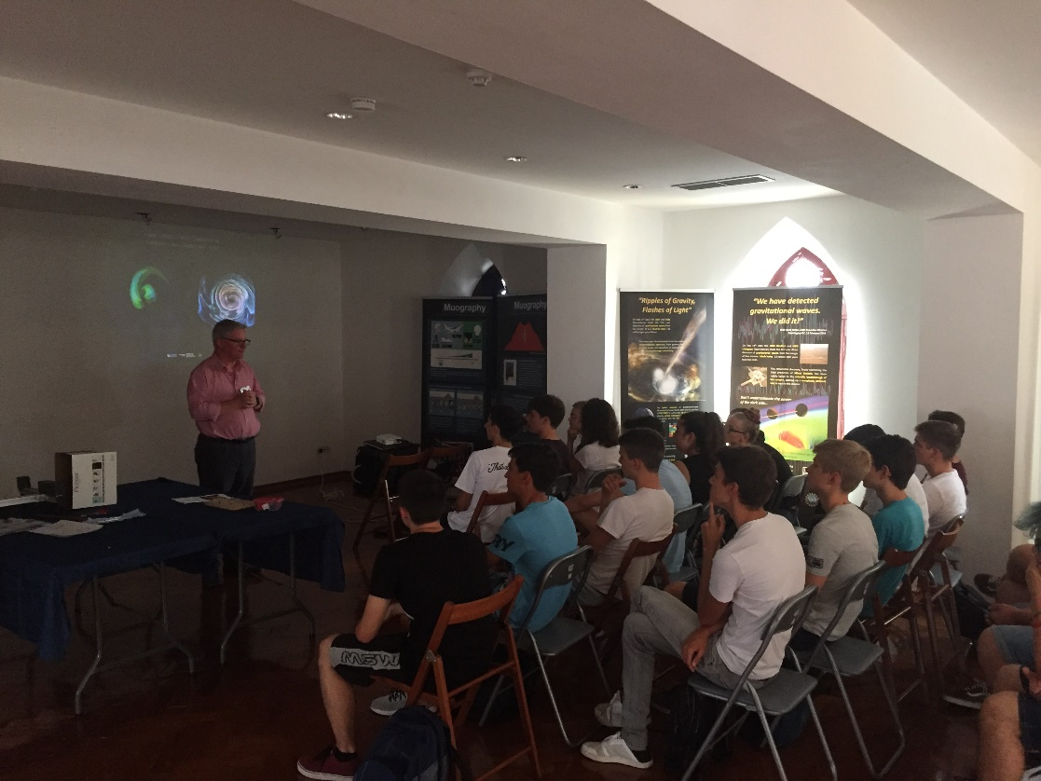
Cultural Collisions – Split /Croatia by ORIGIN train the trainers
During the main exhibition we trained students from primary and secondary schools to act as lectures for following (see next slides).

Slide 16




Cultural Collisions – Split /Croatia by ORIGIN Researchers night – September 28th
Format: students we trained become lecturer to general public and traning other students.
Audience during the researchers night: few thousands citizens

Slide 17



Cultural Collisions – Split /Croatia Visiting primary school – October 2nd
Format: exhibition & lectures, one day
Audience: about 100 primary school students

Slide 18




Cultural Collisions – Split /Croatia by ORIGIN Four secondary schools – October 3rd
Format: exhibition and lectures, one day
Exhibition presented by trained students
Lectures given by CMS scientists
Audience: about 500 secondary school students

Slide 19




Cultural Collisions – Split /Croatia by ORIGIN Primary school visit – October 29th
Format: lectures with trained student, training & participation

Slide 20




art@CMS – Art University Collaboration Gallery National Museum, Cetinje/ Montenegro October 2018
Format: art exhibition lectures and Cultural Collisions workshop start 3 schools 85 students
Event is the final show of our 2 semester course “art@CMS – Art University Collaboration, 2017/ 2018”
Presentation: Final presentation of 5 university art students + art@CMS collaborative artists
Video walk through the exhibition : https://youtu.be/UUnBDYhiSlk

Slide 21





LHC workshop & cross disciplinary exhibition - October 2018 Akademia Shkencave Tirana / Albania
Format: 2 day science workshop enhances by “light art exhibition”, aim: inspire students and general public and build up interest in our science community
Audience: 3 guided tours with High School students + general public conference

Slide 22






Science & Art, Sarajevo /Bosnia by ORIGIN - Fine Art Academy, 15th -22nd October 2018
Format: cross disciplinary exhibition ORIGIN, public lectures in the exhibition
Audience: general public and about high school students 400 attending lectures
Further remark: Art university Sarajevo requests of art university collaboration

Slide 23





Cultural Collisions, Imotski / Croatia by ORIGIN Exhibition and Concert, October 27th 2018
Format: Exhibition, masterclass, lectures, concert with French and local orchestra
-2 workshops in parallel with 2 teams:
Physics & Music, Gravitational Waves, Playing with data
Audience: 400 students of 4 school attending lectures and 70 students workshops participants

Slide 24



Cultural Collisions, Imotski / Croatia by ORIGIN City Hall, October 27th 2018
Format: ORIGIN exhibition, masterclass, lectures, music concert
Concert of the French youth orchestra and the local orchestra paying together.
general public audience in exhibition and concert: ~ 500
Video of the joint concert performance “Beethoven Ode to Joy”
https://youtu.be/H6y8ziRyEaw

Slide 25
Fundraising : “South East European cross disciplinary science education, engagement and networking Initiative”
Organizations who raised interest and possible funding or collaboration opportunities:
UNESCO -> in discussion /CERN meeting schedule under discussion
Austrian Cultural Forum Sarajevo -> will participate in our Project in October/November 2019
Western Balkan Funds -> funding proposal submitted
Regional UN department Montenegro -> in contact to follow up
JRC-ISPRA -> in discussion /CERN visit is planned in Spring 2019
COST European Cooperation of Science & Technology -> funding proposal submitted
RYCO (Regional Youth Cooperation Office)
RCC – Regional Cooperation Council
Council of Europe
OSZE
Our local partners in the region:
Ministry of Science Montenegro
Embassy France Sarajevo
Embassy Austria Sarajevo

Slide 26
recent / ongoing / past events and methods
Following slides:
Tbilisi/ Georgia Science & art events at TSU and GSU Sept/ Oct 2018
International start of next artUniversity collaboration semester 2018/2019
Japan Art & Science collaboration upcoming event and outlook 2020
Science Rapper ConSensus US tour November 2018
general introduction to Format:
“Science&Art@School” and “Cultural Collisions”
Cultural Collisions Canada 2018

Slide 27



Science & Innovation Festival 2018 by ORIGIN September 22nd – 31st Tbilisi / Georgia
Format: ORIGIN exhibition, lectures
Audience: festival visitors, general public, University students, and organized school students
Lectures by CMS and ATLAS colleagues to about 400 students organized by the Teachers House collaborator
art@CMS collaborative artists presented: Xavier Cortada, Michael Hoch, Anastasia, Chris Henschke, Peter Bellamy, Paul Schuster,
Walk through the exhibition https://youtu.be/wAYkB5fgyVo

Slide 28





Science & Innovation Festival 2018 by ORIGIN Tbilisi State University TSU - September 22nd – 31st Tbilisi / Georgia
ATLAS and CMS were represented at Tbilisi State University (TSU) at the request of, and sponsored by, the Georgian Ministry of Science and Education.
The occasion was a Science and Innovation Festival organised in the context of the 100th anniversary of the university attended by general public, university and school students with their teachers.
ATLAS and CMS combined forces to present an exhibition based on the recently developed ORIGINS format in a large central hall that would have just accommodated CMS (but not ATLAS).
Small displays of Muongrapher and LIGO were included, alongside ATLAS, CMS, and art@CMS posters and hardware.
Georgian ATLAS and CMS colleagues supported the exhibition acting as guides and interpreters.
Special presentations on CERN, particle physics, ATLAS and CMS were organized each afternoon for school students and teachers. In total about 400 students ranging in age from 9 to 18 years from 15 schools attended.
The Deputy Minister for Science and Education and the Rector of the TSU University thanked everyone involved and expressed the desire to continue this very successful educational and outreach collaboration.

Slide 29





CERN Cognitive Festival in Georgia, 22-25 October, 2018
IPPOG Masterclasses – 3 Days; 96 schoolkids from 9 schools; ~70 guests
Junior Scientist Diary awarded to each participant
by Alexander Sharmazanashvili lasha.sharmazanashvili@cern.ch

Slide 30





CERN Cognitive Festival in Georgia, 22-25 October, 2018
Format: Art & Science exhibition, masterclass workshops, public lectures
Settings: 20 art works (80x80cm); 40 science art photos (50x50cm); 18 art prints (80x80cm); 3 photo walls; 3 video screens
Festival open ceremony with participation of Georgian minister of education and science, culture and sport
by Alexander Sharmazanashvili lasha.sharmazanashvili@cern.ch

Slide 31





Cultural Collisions-Natural History Museum September 2018-April 2019, Vienna /Austria by ORIGIN
Format: Cultural Collisions, lectures, workshops exhibition “Code of Universe”
80 students of 3 different schools
Venue: NHM - Natural History Museum Vienna
Used existing temporary exhibition: “Code of Universe”
http://mhoch.web.cern.ch/mhoch/Art@CMS/Science_and_Art_Workshop_2018.pdf

Slide 32


New start of artUniversities Collaboraiton Semester 2018 - 2019
Central Saint Martins CERN visit Jan.14th 18th 2019
Applied Arts Vienna CERN visit Jan.14th 18th 2019
KASK CERN visit February March 2019
ORPHEUS and ESA Lille
Possible Shows of final art works to be discussed for:
EPS2019 July ,
CERN open Day, 14th 15th September 2019
Vienna ORIGIN exhibition, first two weeks in September 2019

Slide 33




Muographer collaboration with ORIGIN November 28th – December 1st 2018
Invitation of our ORIGIN partners ‘Muographer’ for their annual conference and workshop in foster cross disciplinary international collaboration. -> brainstorming session for ORIGIN events 2019 and 2020 (parallel to Olympic games in Tokyo)
http://muographers2018.muographers.org/attend/program-schedule-at-a-glance/origin/
Possible exhibition opportunities Autumn 2019 and 2020
Note ! 2020 Tokyo Olympics

Slide 34

Consensus ConCERNed US tour November 2019
Financial Times article; Oct 2018
https://www.ft.com/content/b4ecf4d8-d940-11e8-aa22-36538487e3d0
Interview BBC, Nov 2018
https://www.bbc.co.uk/sounds/play/p06qfhr5
released Videos of his 9 track album “ConCERNed”:
“Dark Matter” https://www.youtube.com/watch?v=OkeA2ePJGK8
“Method to the Madness“ https://www.youtube.com/watch?v=tJl8-ArzkBg&feature=youtu.be
“CMS [Grime Music in CERN]” ttps://www.youtube.com/watch?v=1ju3fo37yLE&feature=youtu.be
“Antimatter” https://www.youtube.com/watch?v=2UupDCfq-LA
FERMILAB talk:
http://events.fnal.gov/arts-lecture-series/events/event/rapper-consensus-free-lecture-demonstration/

Slide 35

Swiss Cultural Festival – and Swiss outlook October November 2018
Format: participation with lectures, workshops and performances
Participation of Guenther Dissertori ETH Zuerich, Hans-Peter Beck UniBern, Michael Hoch art@CMS
Launch of study to bring the Natural History Museum Vienna exhibition to Switzerland (after Hamburg / Germany)
Future exhibition project:
Funding launched to get the exhibition to Switzerland

Slide 36


Topics to discuss
List of upcoming opportunities and events 2019, 2020, …
South East Europe Tour ongoing Croatia, Montenegro, Serbia, Bosnia, …
Cultural Collisions Vienna ongoing Austria
Art in Science Institute for Basic Science (IBS) in Korea
LHCP 2019 Mexico
EPS2019 Belgium
Muography Art Japan (2019, 2020)
Thyssen Museum Spain (request for 2020)
List of topics to create to improve:
Poster design
Hardware collection
Art Work and Network in the Art Community

