Slide 1


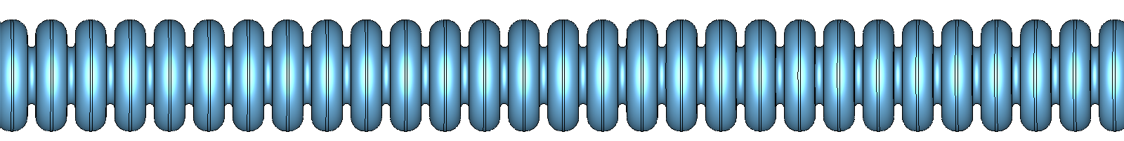


K-Band Low Gradient Design
Funded by the
European Union
A. Castilla*, G. Burt, W.L. Millar - Lancaster University
* a.castilla@cern.ch
CompactLight - Internal Meeting, 8th January 2019

Slide 2
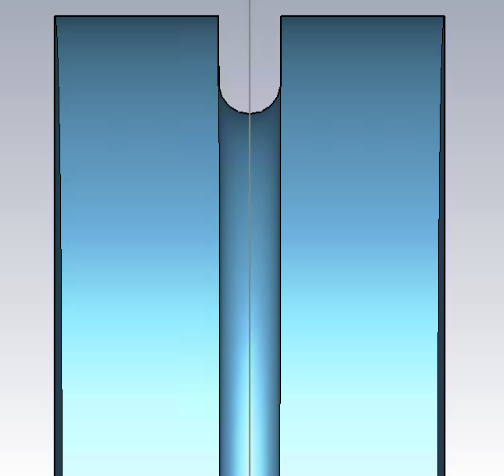
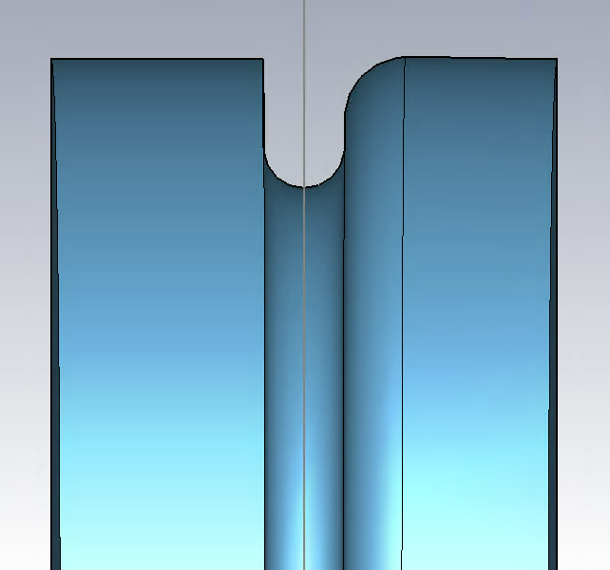
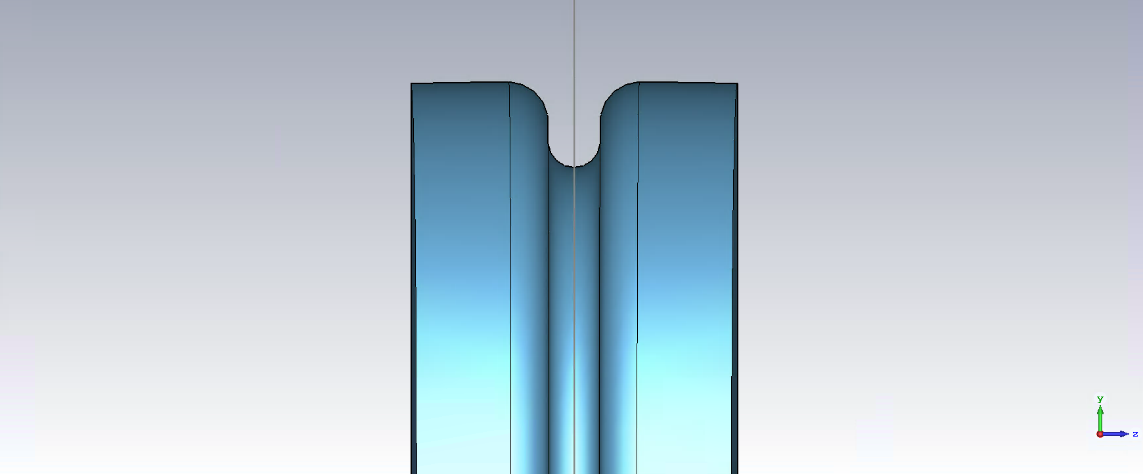
3 Variations of the Simple Cell
No- Blend
1- Blend
2- Blends

Slide 3
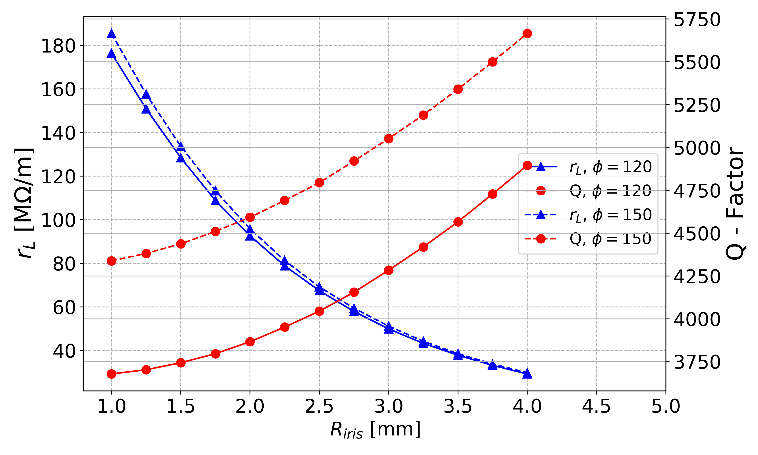
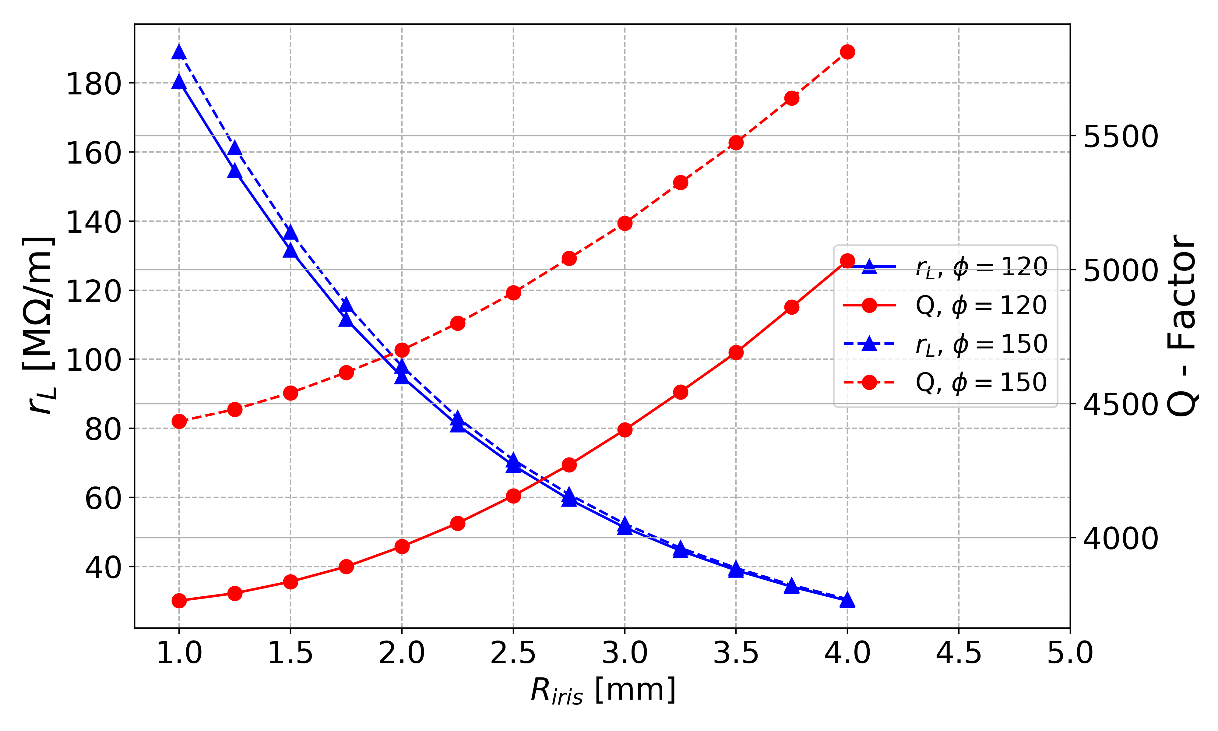
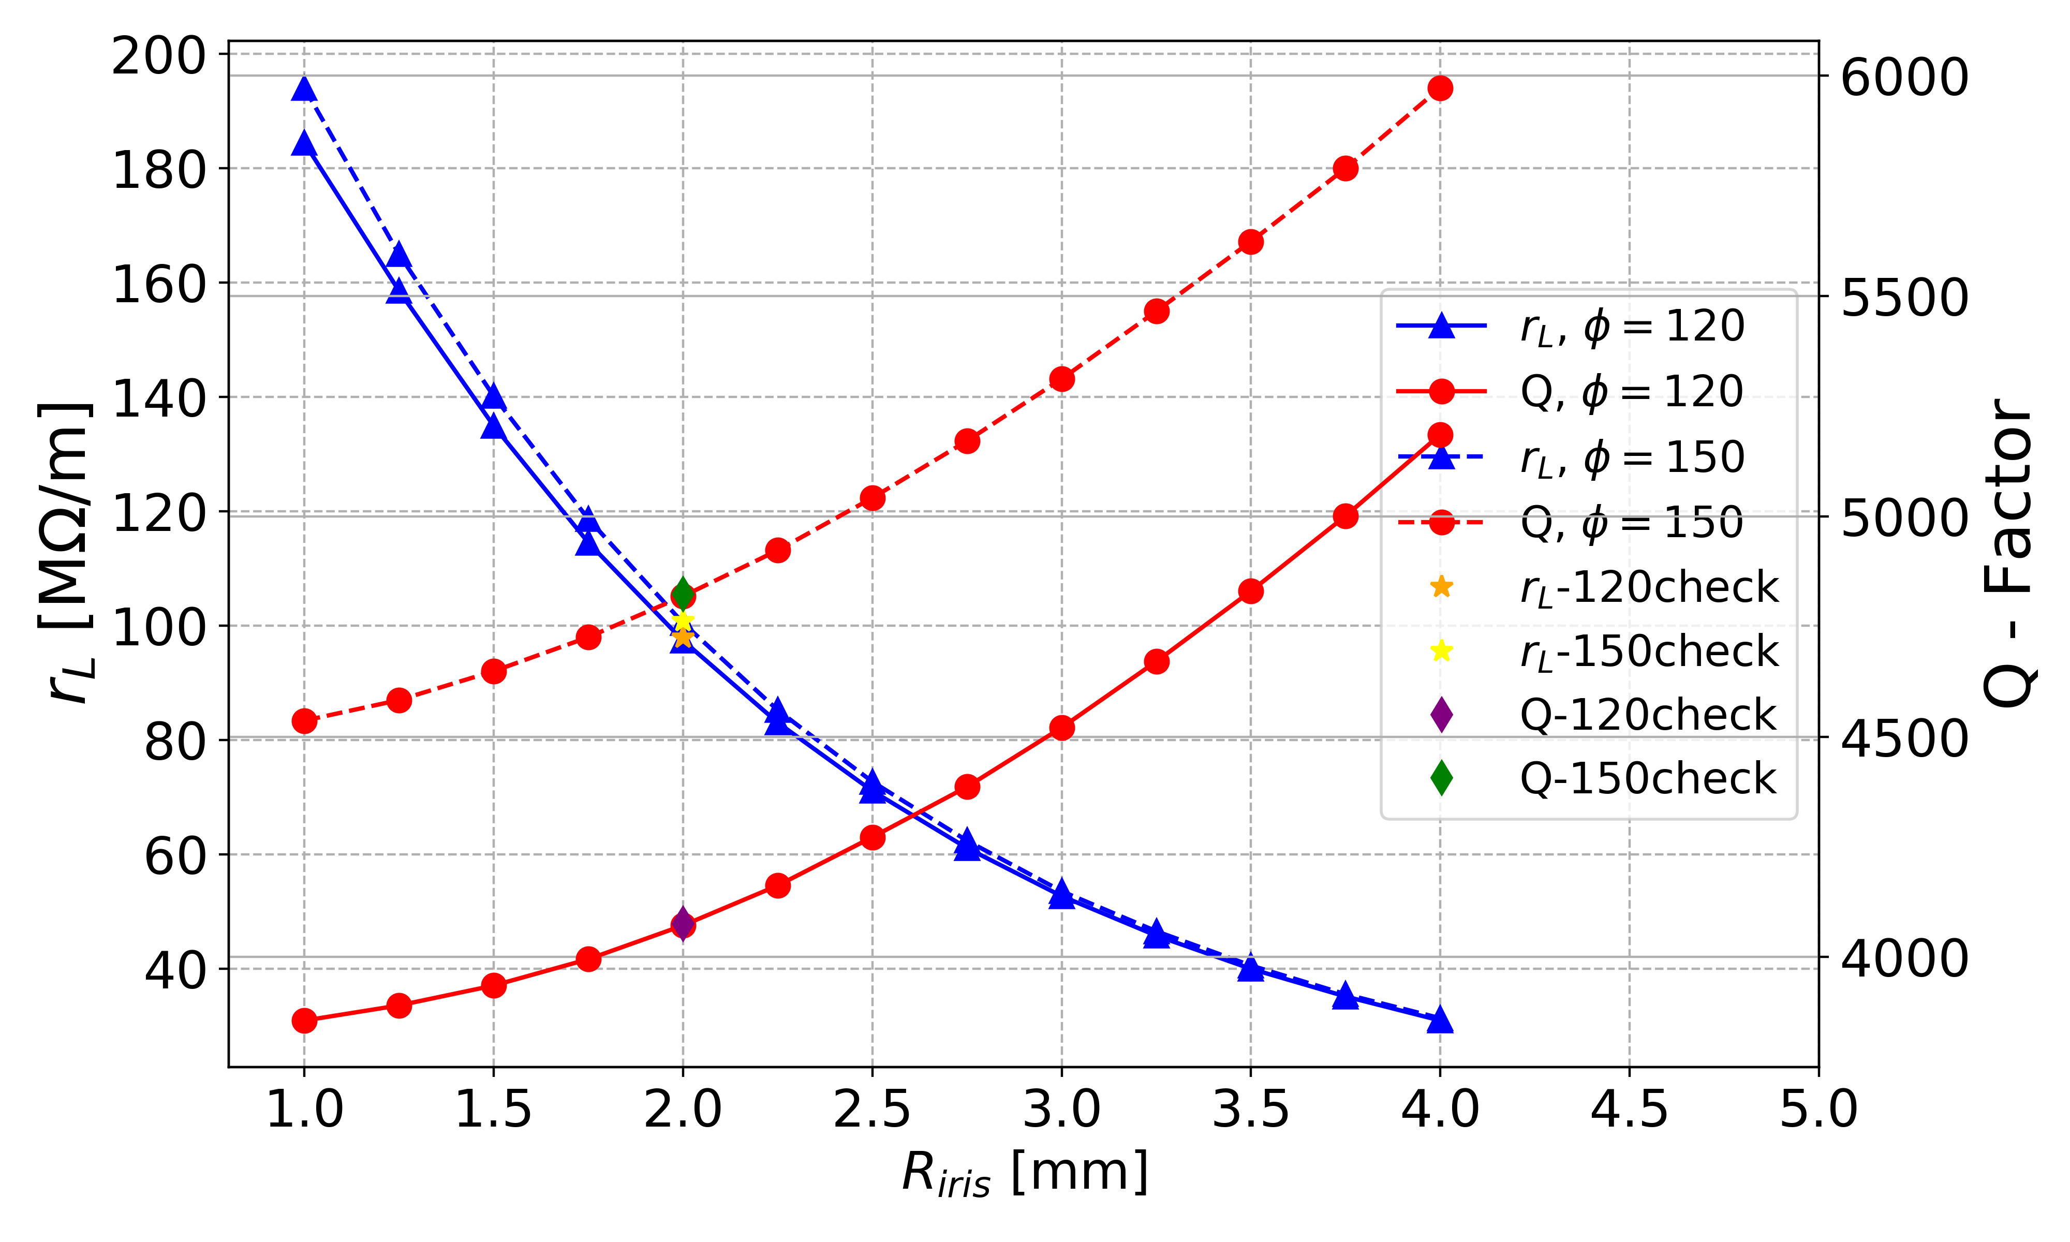
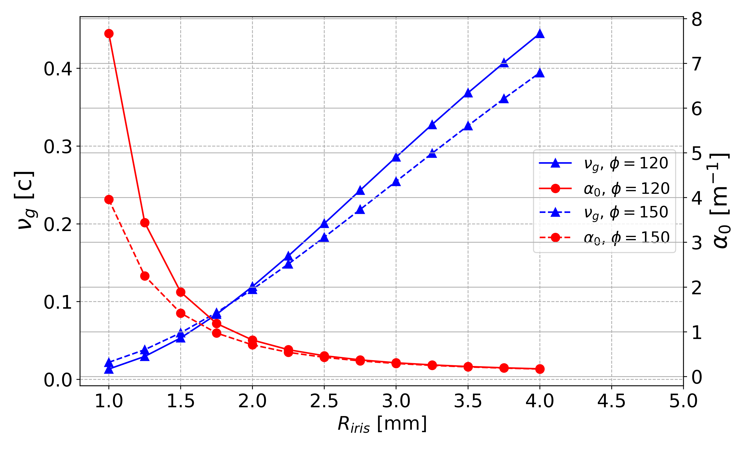
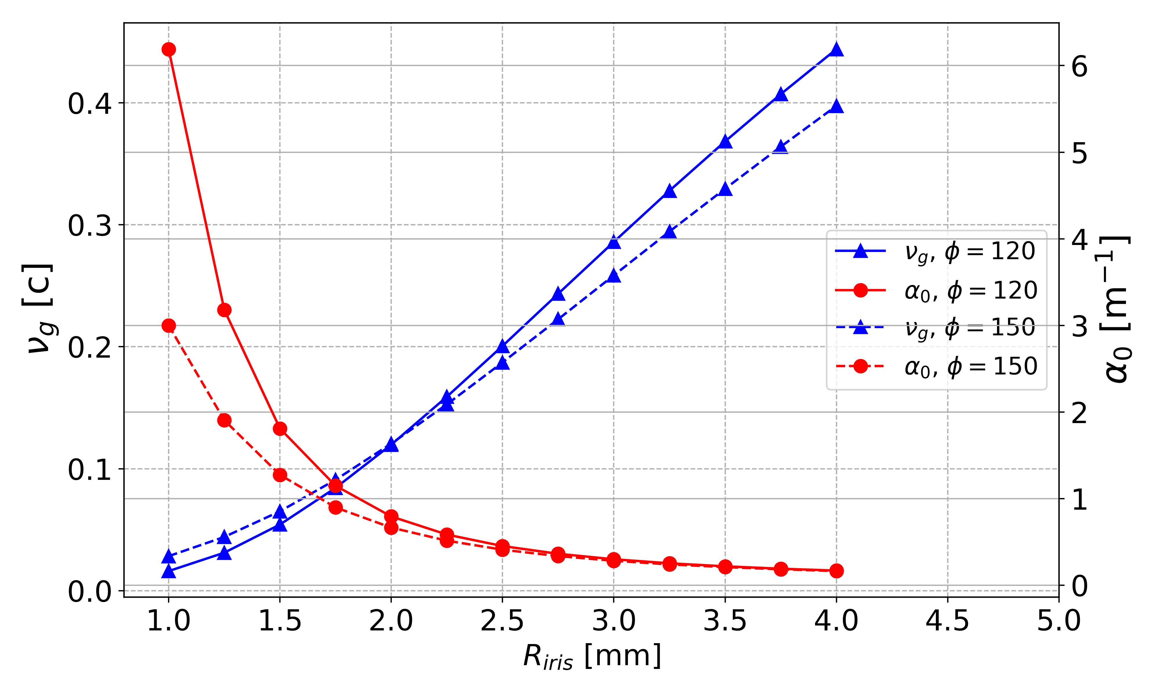
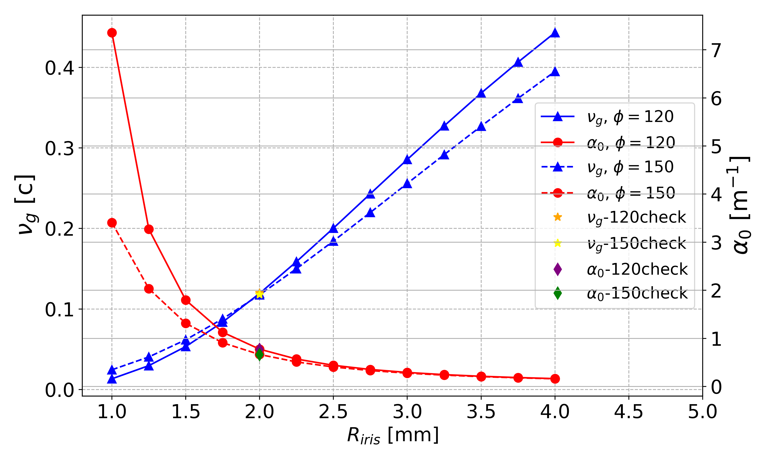
Simple Cell
No- Blend
1- Blend
2- Blends
Notes:
For the three cases can be noted that the shunt impedance slowly decays with the aperture, while the intrinsic Q increases with it. However, the differences are not dramatic from case to case.

Slide 4
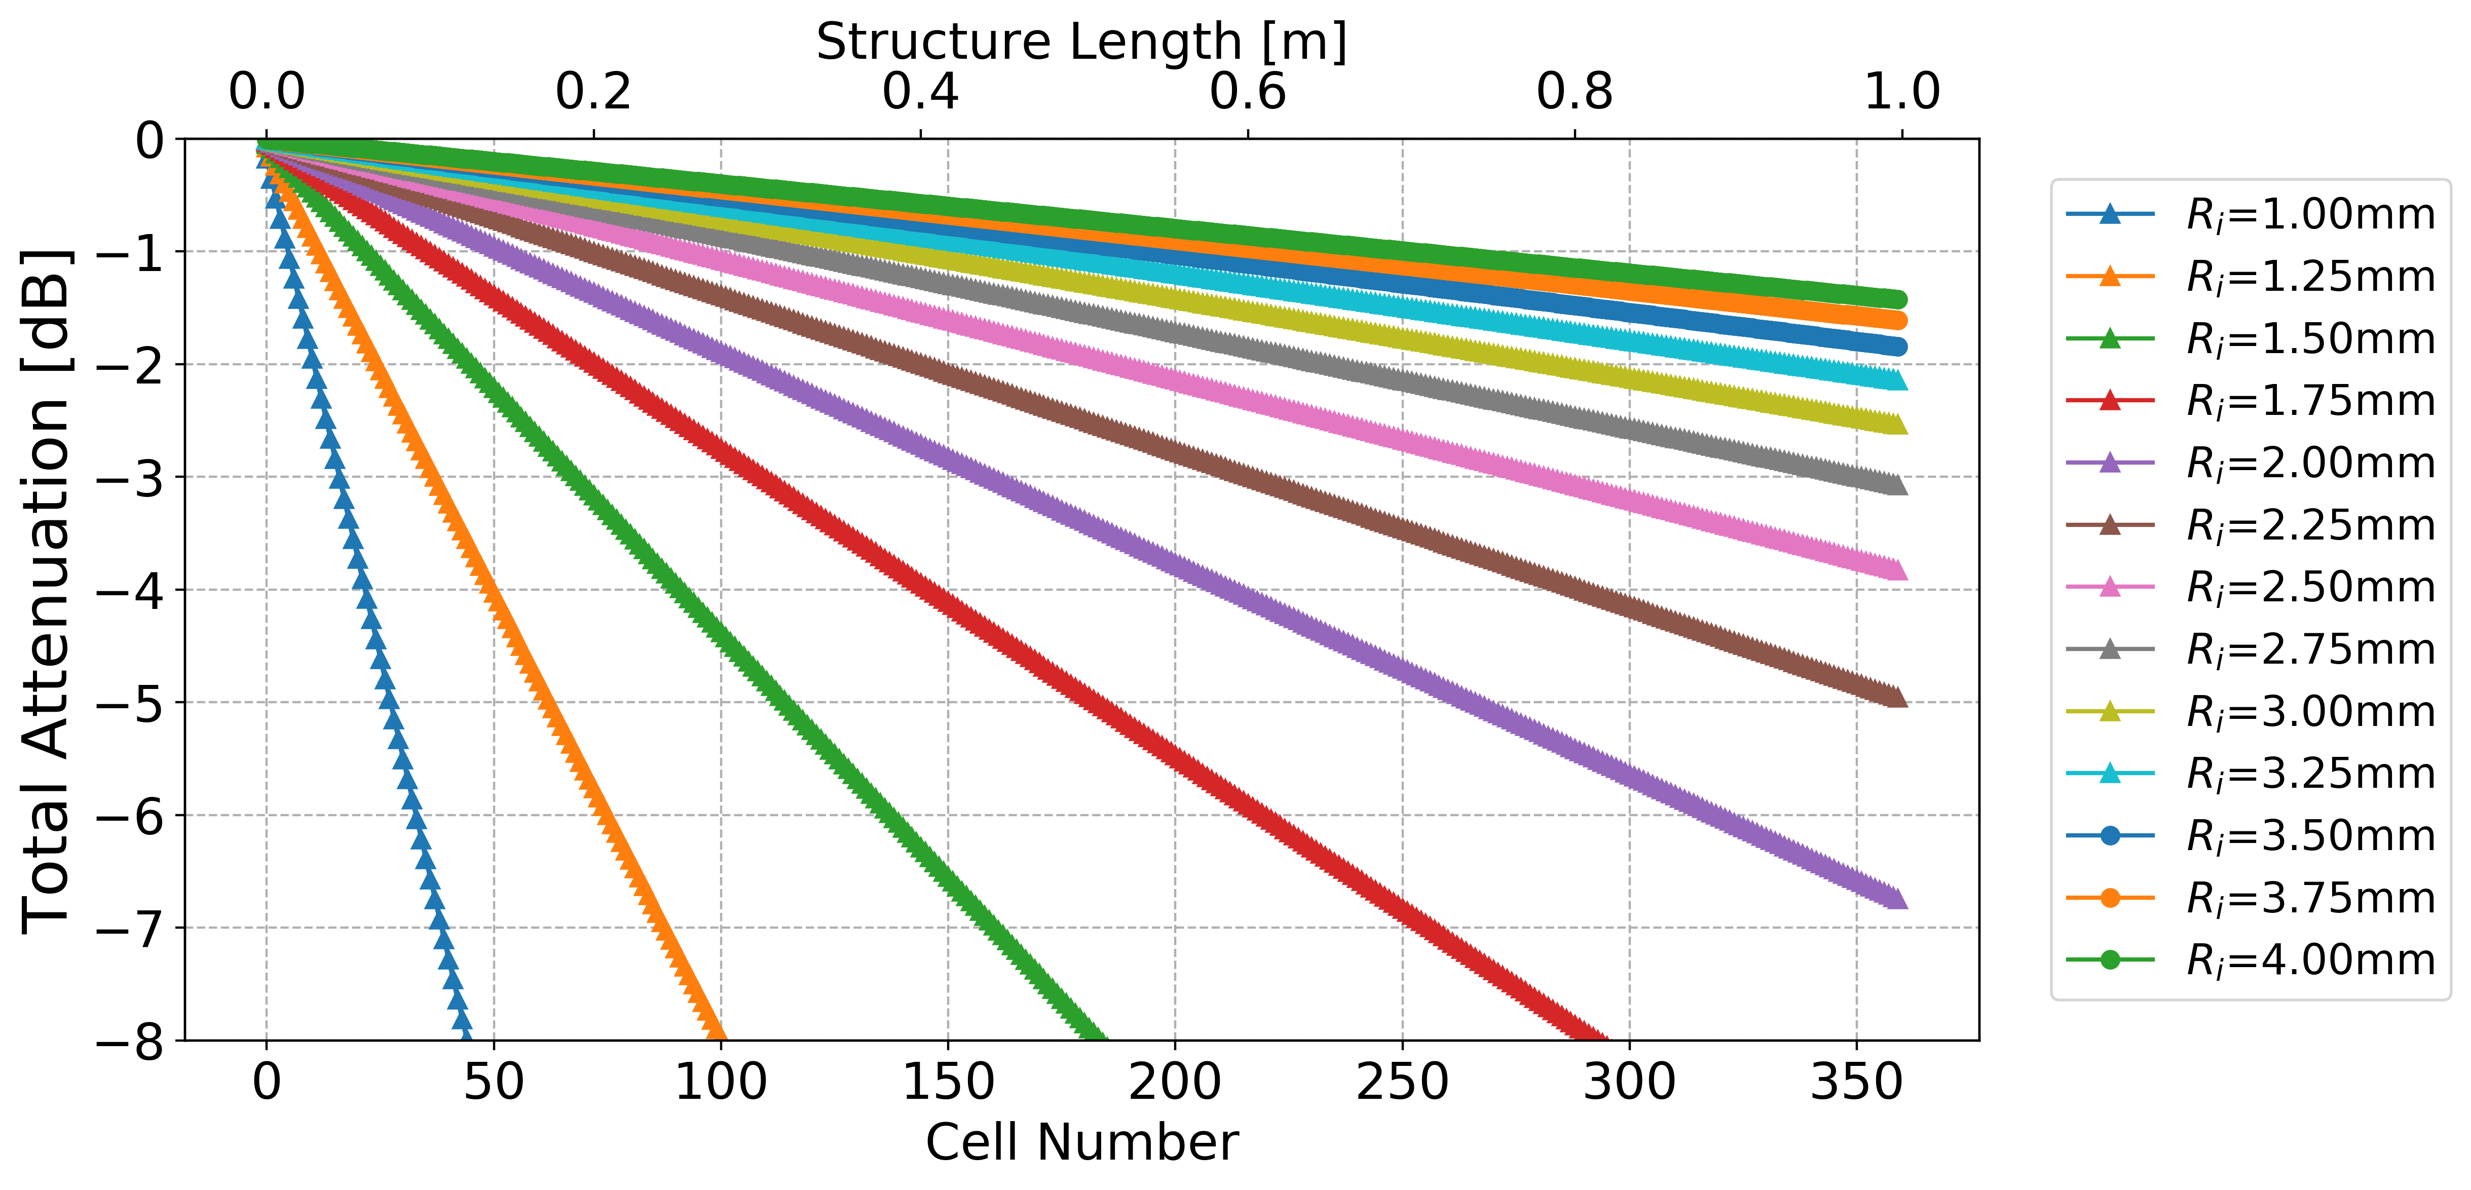
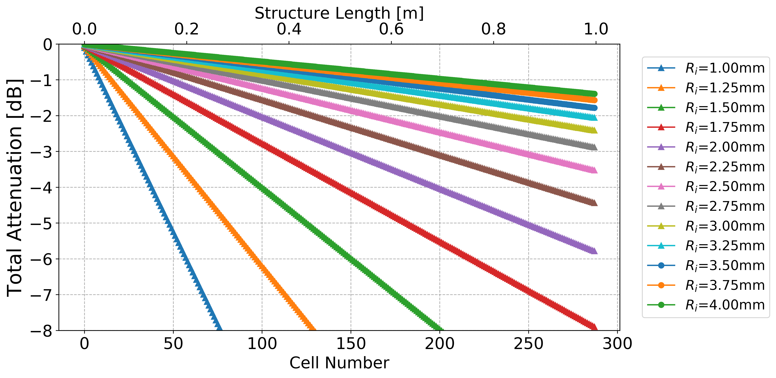
Simple Cell: 2- Blends
120deg
150deg

Slide 5
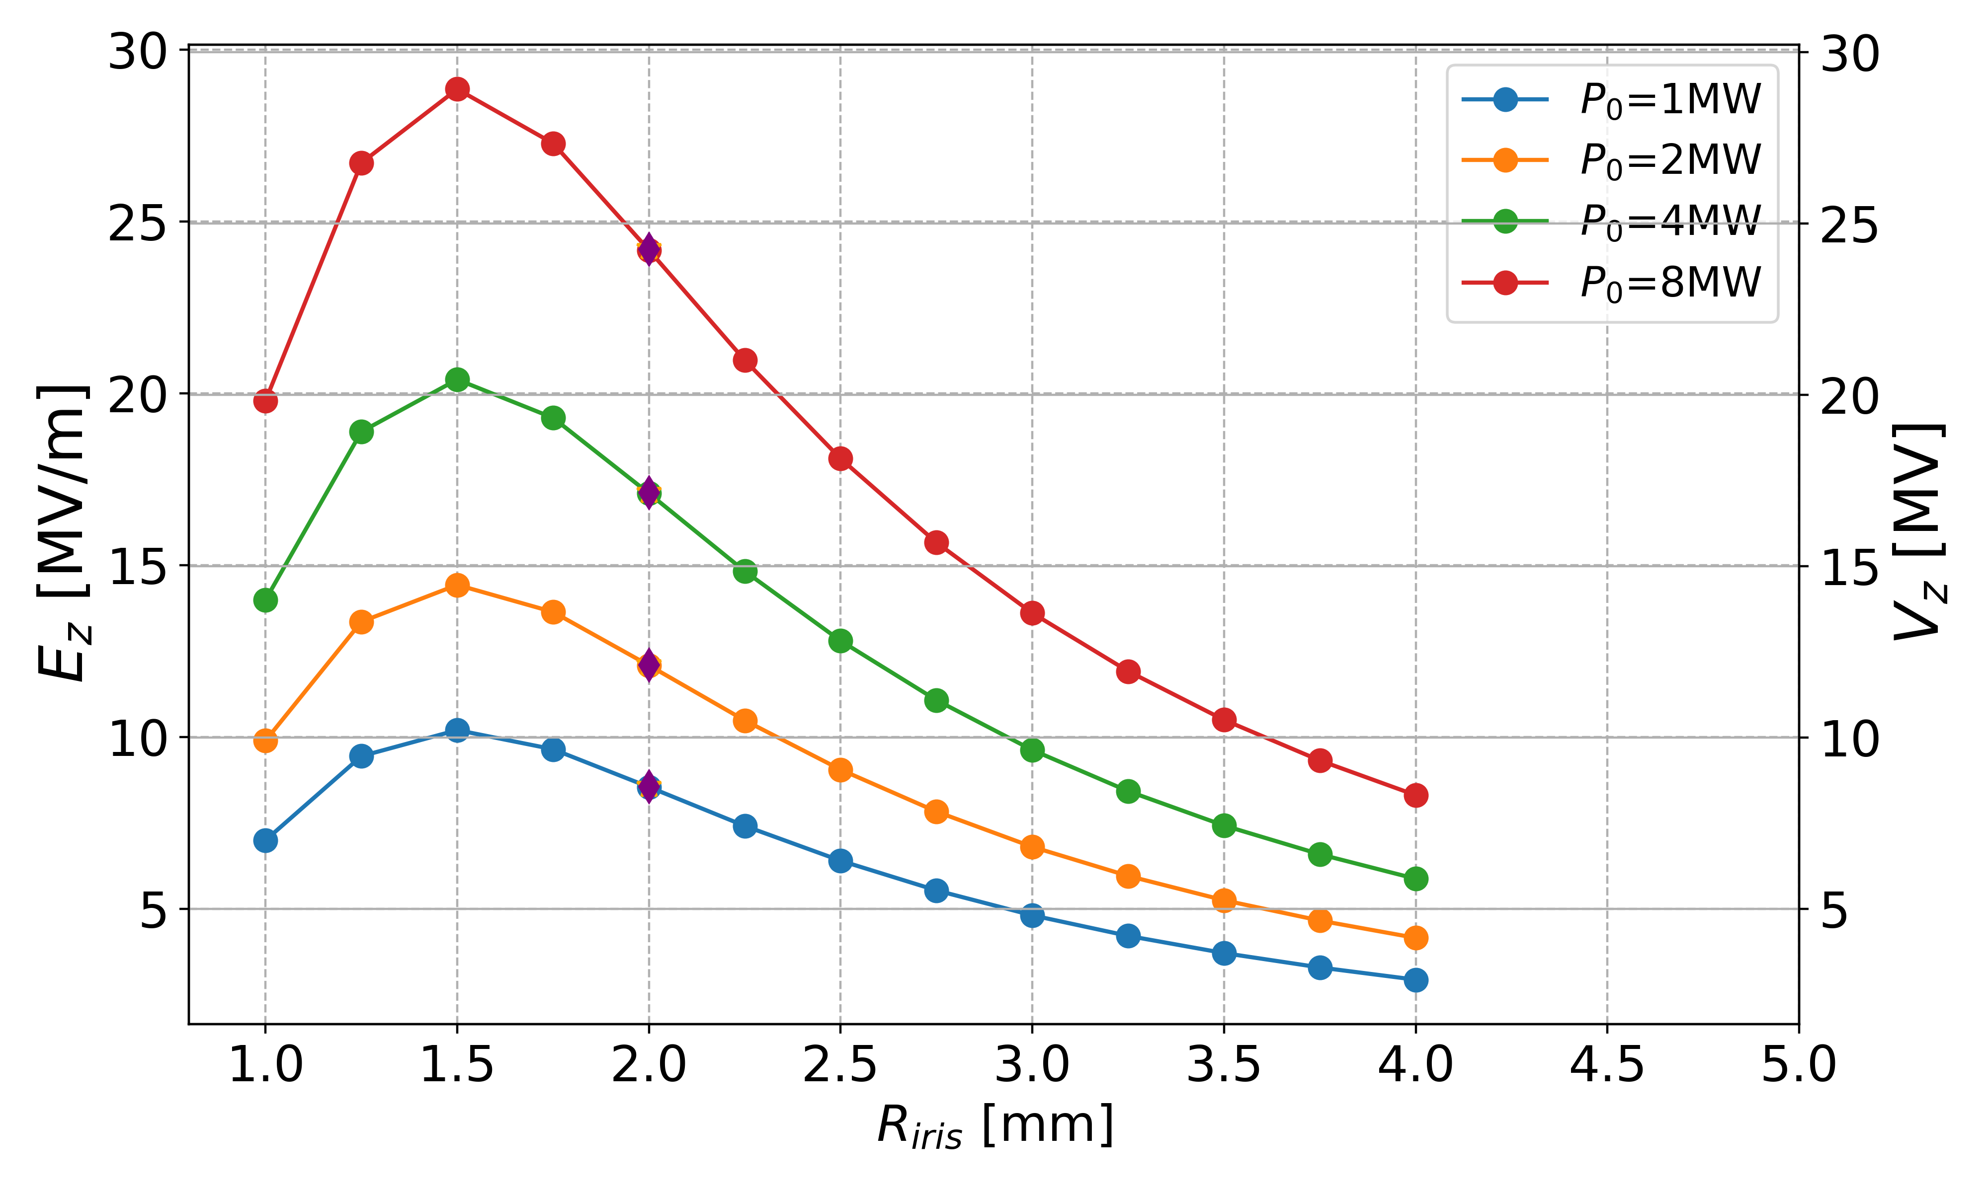
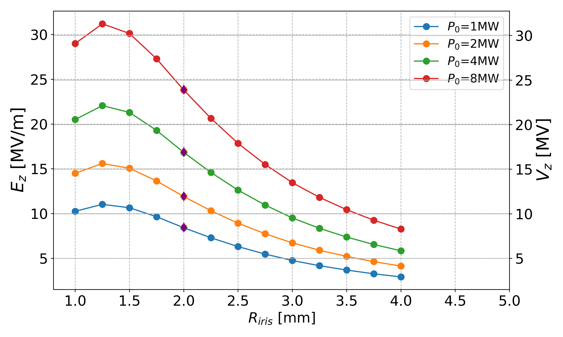
Simple Cell: 2- Blends
120deg
150deg

Slide 6

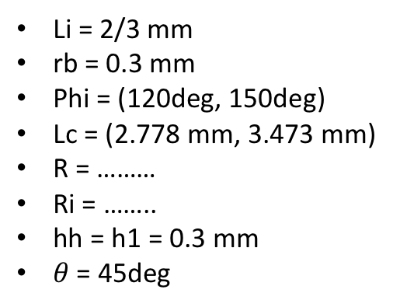
Reentrant Cell
Li
rb
Li = 2/3 mm
rb = 0.3 mm
Phi = (120deg, 150deg)
Lc = (2.778 mm, 3.473 mm)
R = ………
Ri = ……..
hh = h1 = 0.3 mm
$θ$ = 45deg
$$θ$$
hh
Li/2
h1
R
Li/2
Ri
Lc

Slide 7
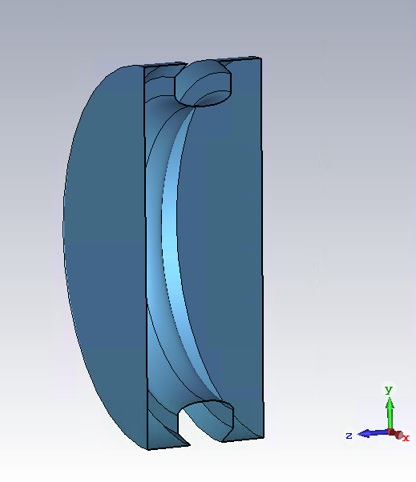
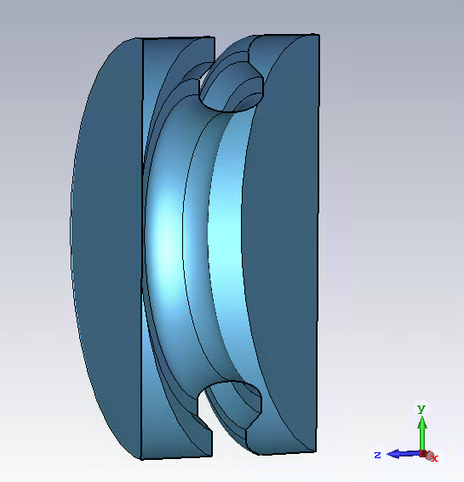
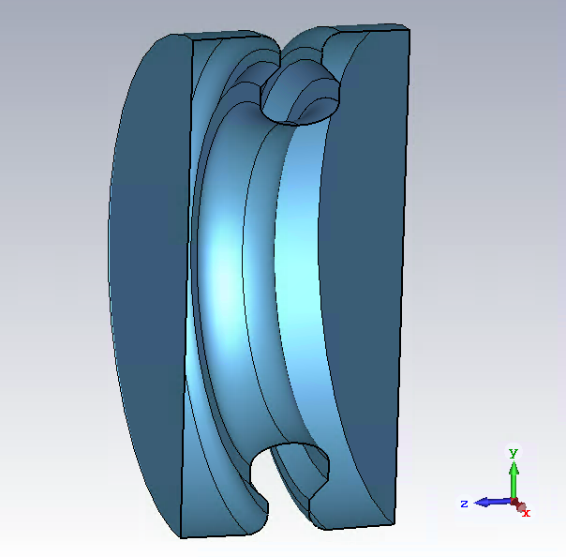
3 Variations of a Reentrant Cell
No- Blend
1- Blend
2- Blends

Slide 8
Reentrant (No Blend)
hh
First, we will do a small study on the cavity with no blends, to determine the influence of the reentrant cone depth (hh) and width (h1), compared to other parameters.
For these studies, the slope of the cone is kept at 45deg:
  Its parameterization allows, if required, to study its effect independently from the other parameters.
h1

Slide 9
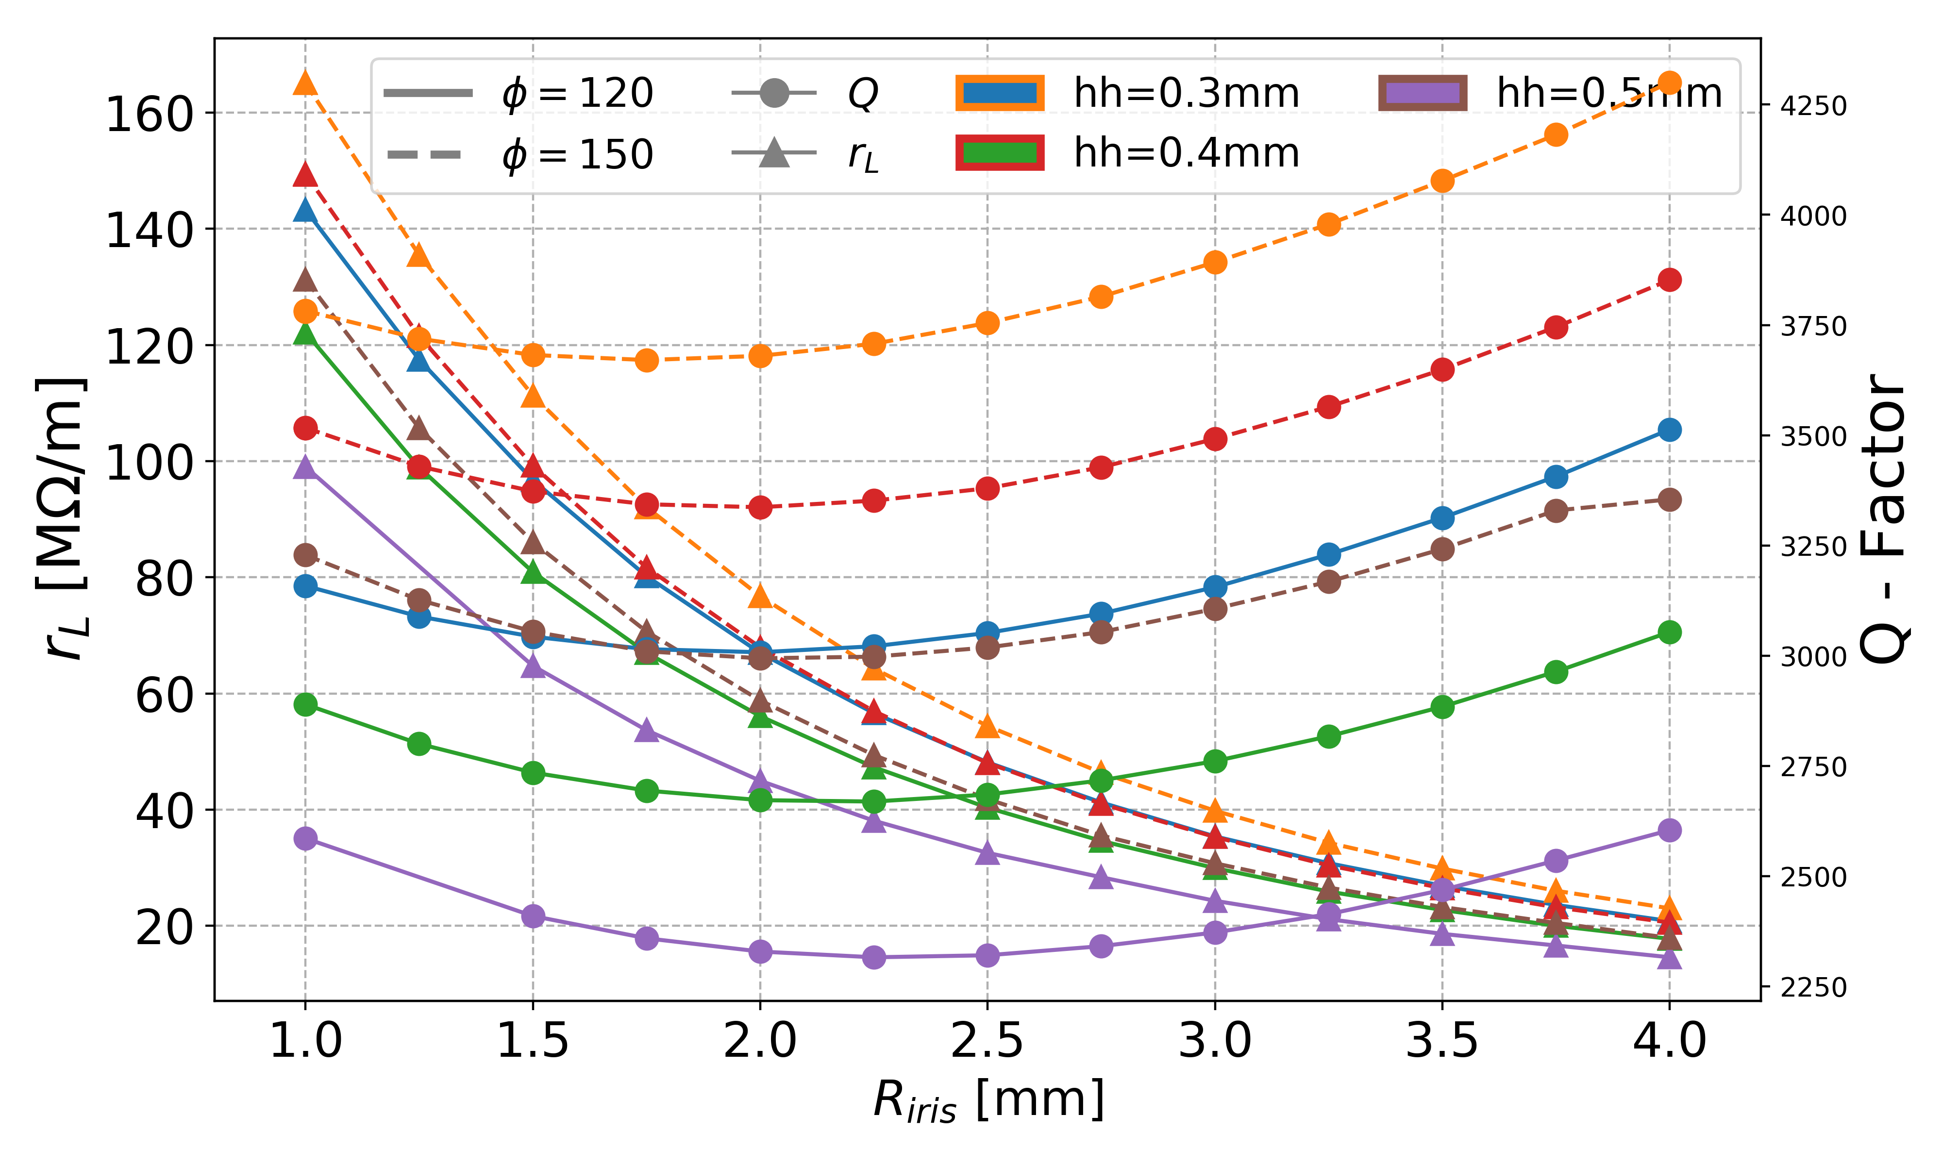


No Blends: Shunt Impedance
h1 = 0.3mm
h1 = 0.4mm
h1 = 0.5mm
Since the plots are very busy, it is difficult to appreciate very well. However, it can be seen that the variation of ‘h1’ does not affect the values in a significative way, while we can see that varying ‘hh’ represents a bigger impact on the results. Being ‘hh=h1=0.3mm’ the chosen combination.
Here can already be appreciated that the values for 150deg seem higher than for 120deg in a higher degree compared to the simple single cell case, this will be discussed later on.

Slide 10
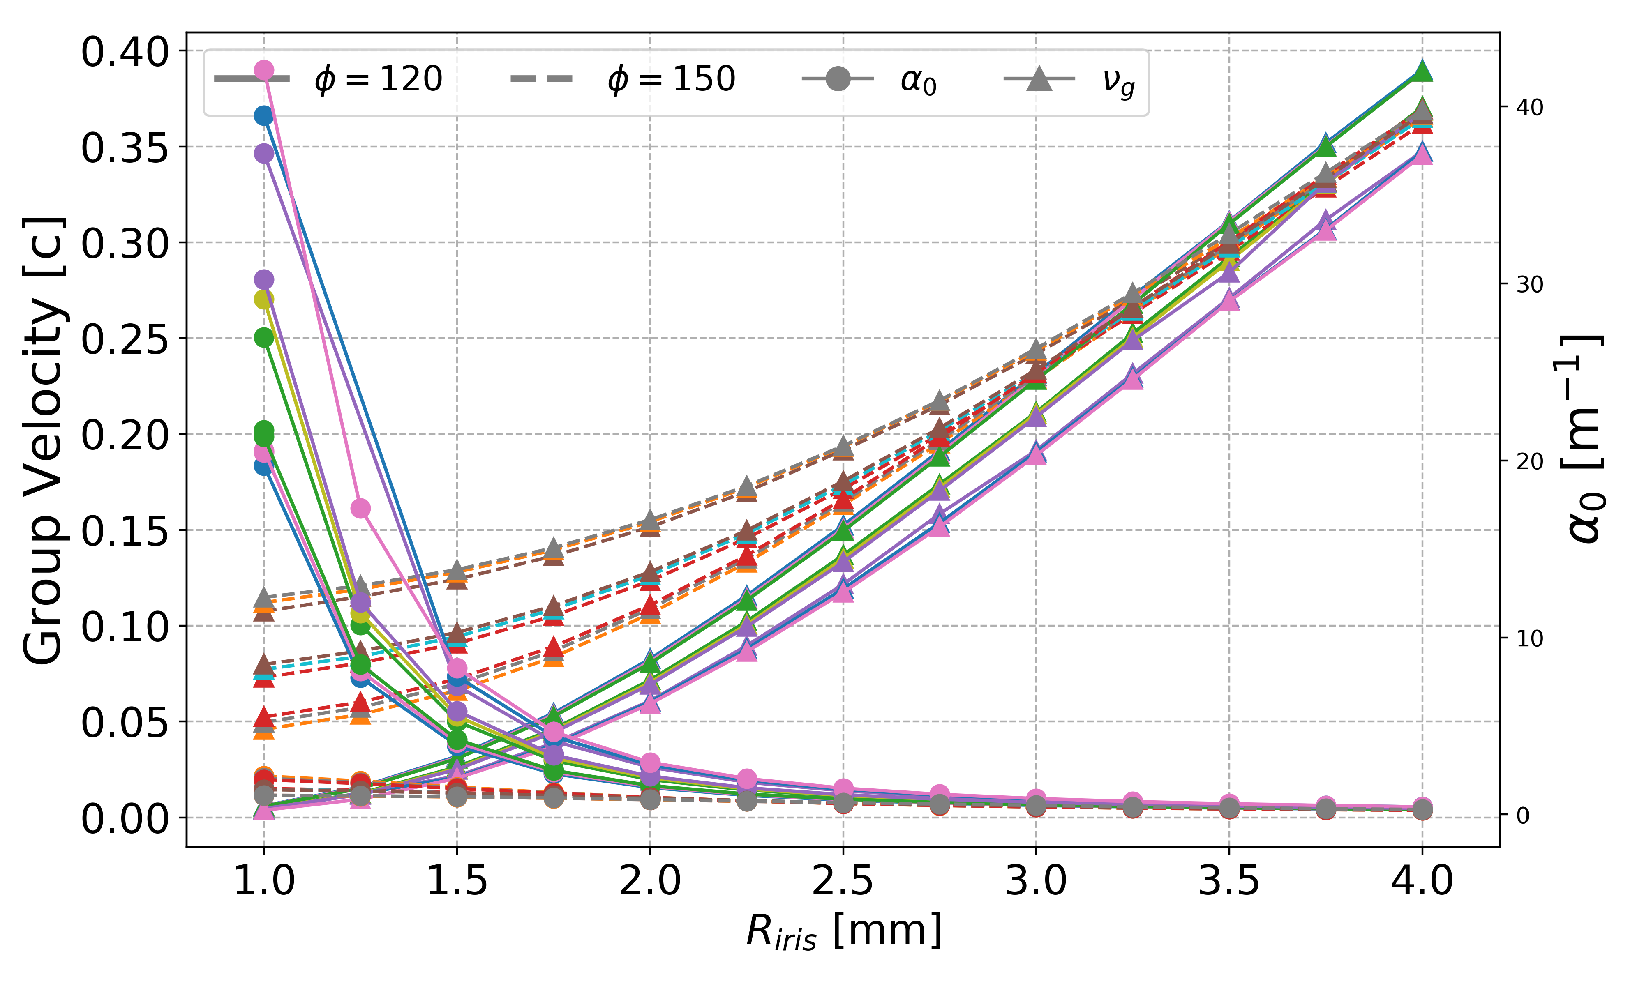
No Blends: Group Velocity
For completeness, we show other significant figures for the parameter space studied for the no-blend reentrant cell. The labels have been omitted due to space restrictions on the plot.
This is perhaps the most important point to highlight, the attenuation per unit length, for the 150deg case is considerably lower for low apertures, but at around 2mm radius and above, this difference is less important.
Having chosen the point ‘hh=h1=0.3mm’ we can proceed with a comparison of the 3-models
Attenuation for 150deg
Attenuation for 150deg

Slide 11
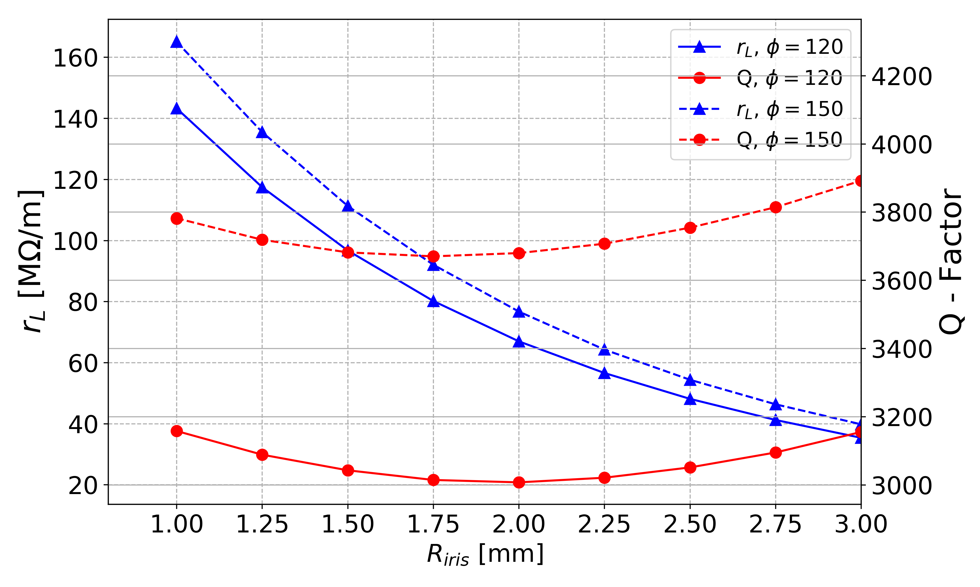
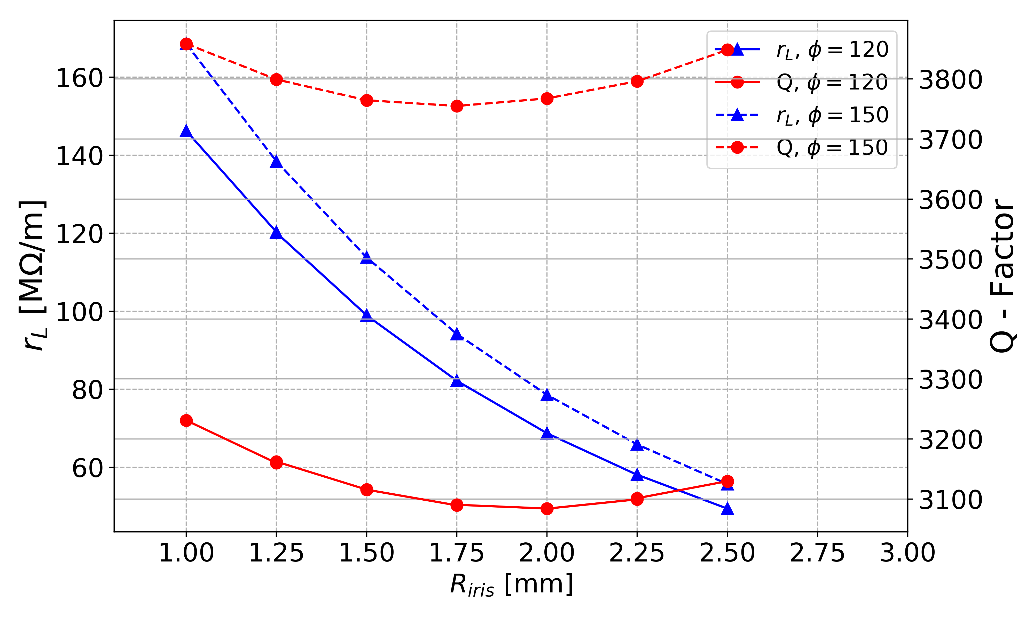
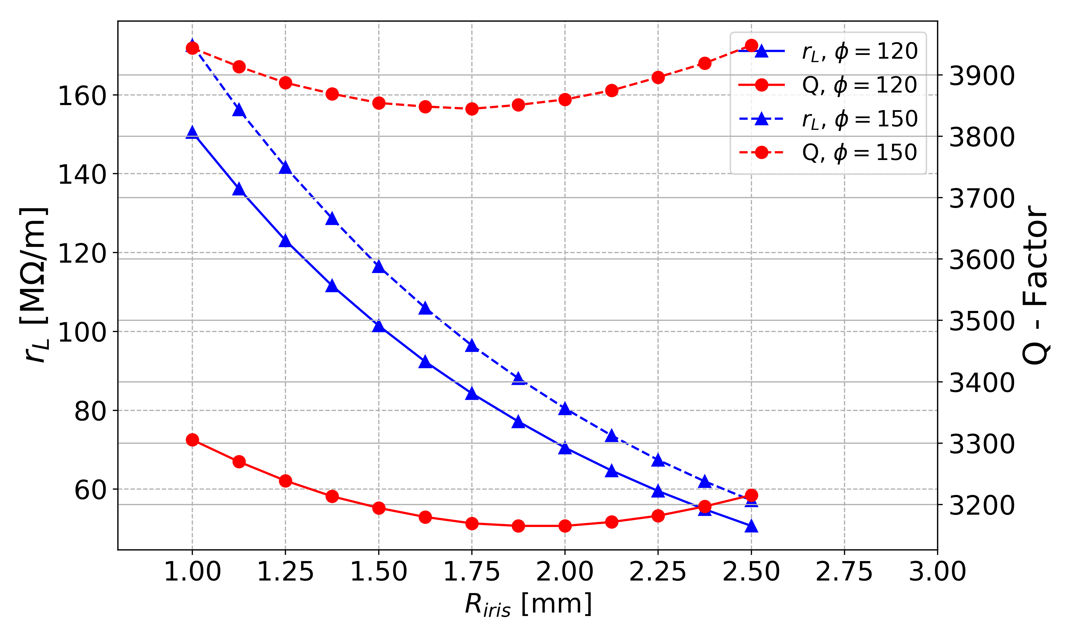
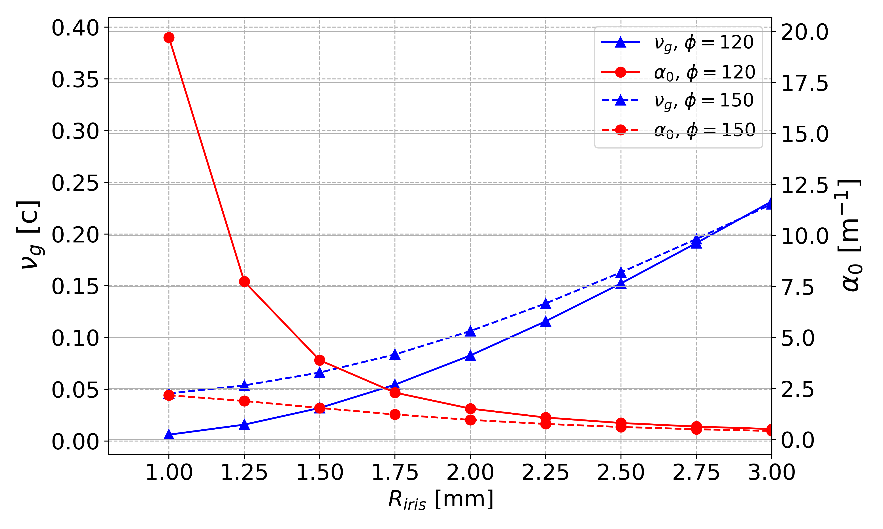
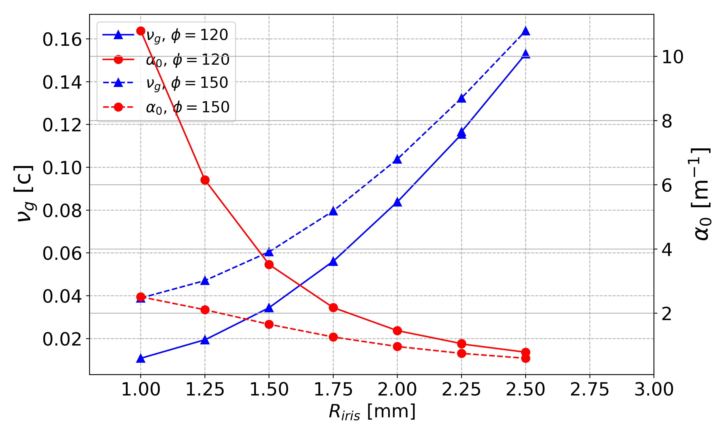
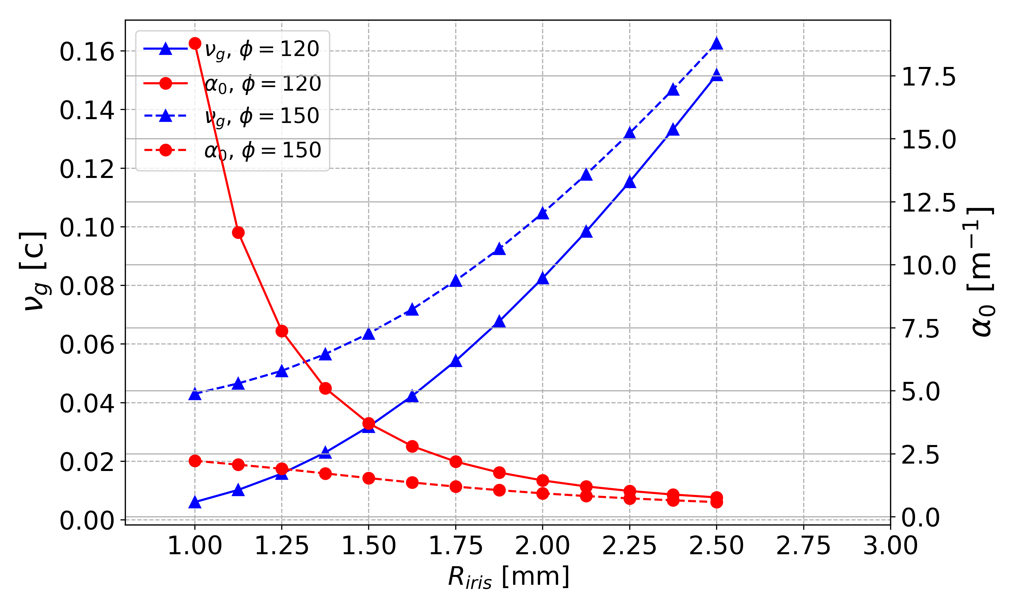
Reentrant Cell
No- Blend
1- Blend
2- Blends
Notes:
Similar to the simple cell design, for the three cases can be noted that the shunt impedance slowly decays with the aperture, while the intrinsic Q seems to have a local minima near a 3.5mm aperture. However, the differences are not dramatic from case to case.
These plots show what perhaps is the most relevant result from this study and is related to the fact that for 150deg phase advance, both the group velocity and the intrinsic Q are higher compared to the 120deg case. Thus the attenuation per unit length seems to be considerably lower than the attenuation for 120deg, at low apertures, reaching similar values around a 4mm aperture (radius of 2mm).

Slide 12
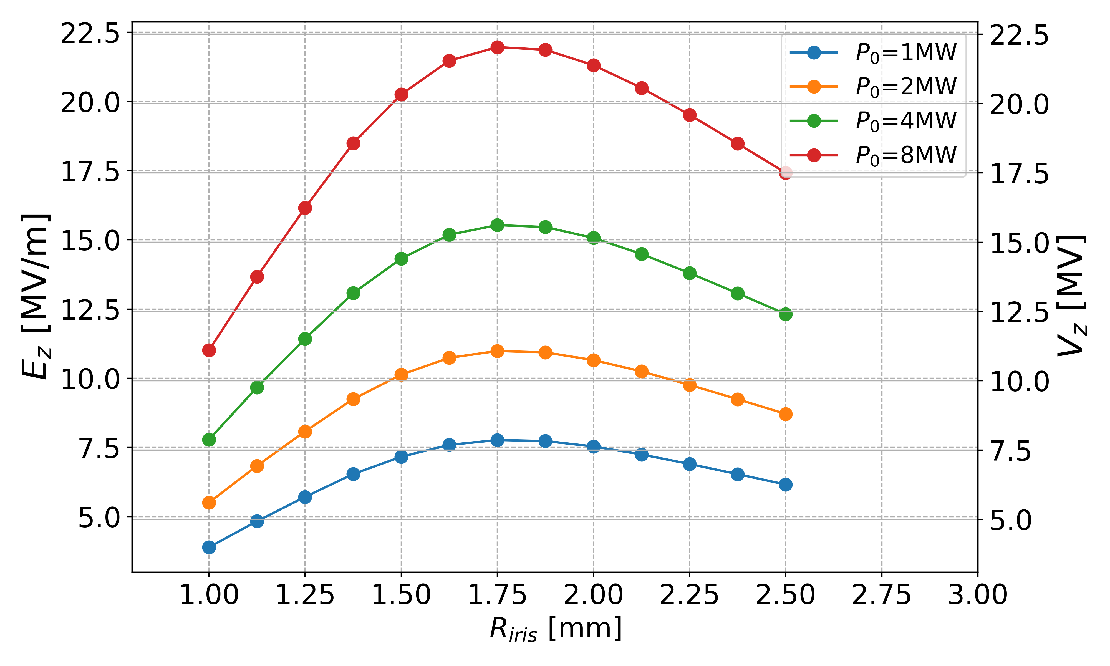
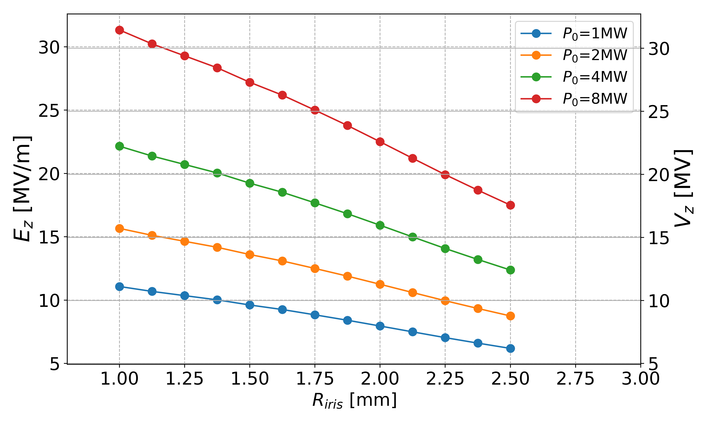
Reentrant 2- Blends
120deg
150deg
The numbers suggest that still at an aperture of 4mm diameter, the simple single cell with 120deg gives better voltage values.
If we are willing to go to lower apertures, the 150deg case can reach higher gradients for a given initial power.

Slide 13
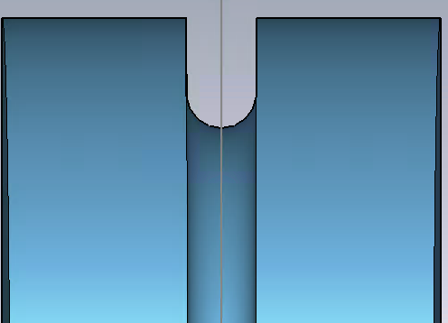
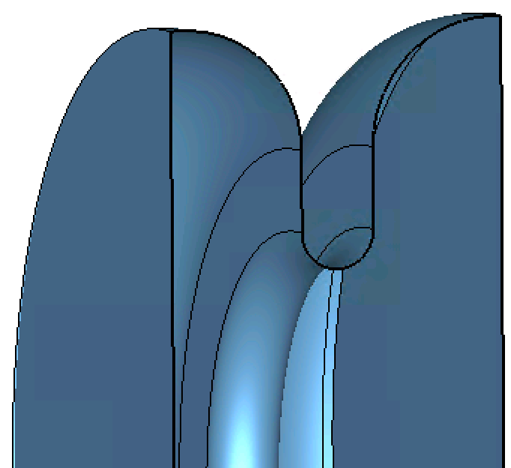
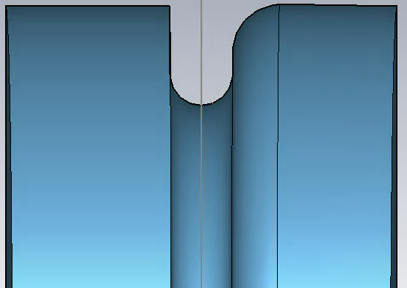
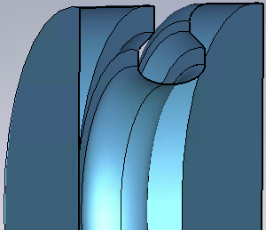
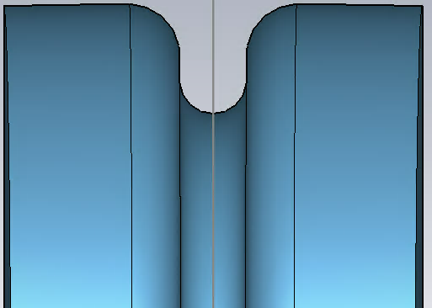
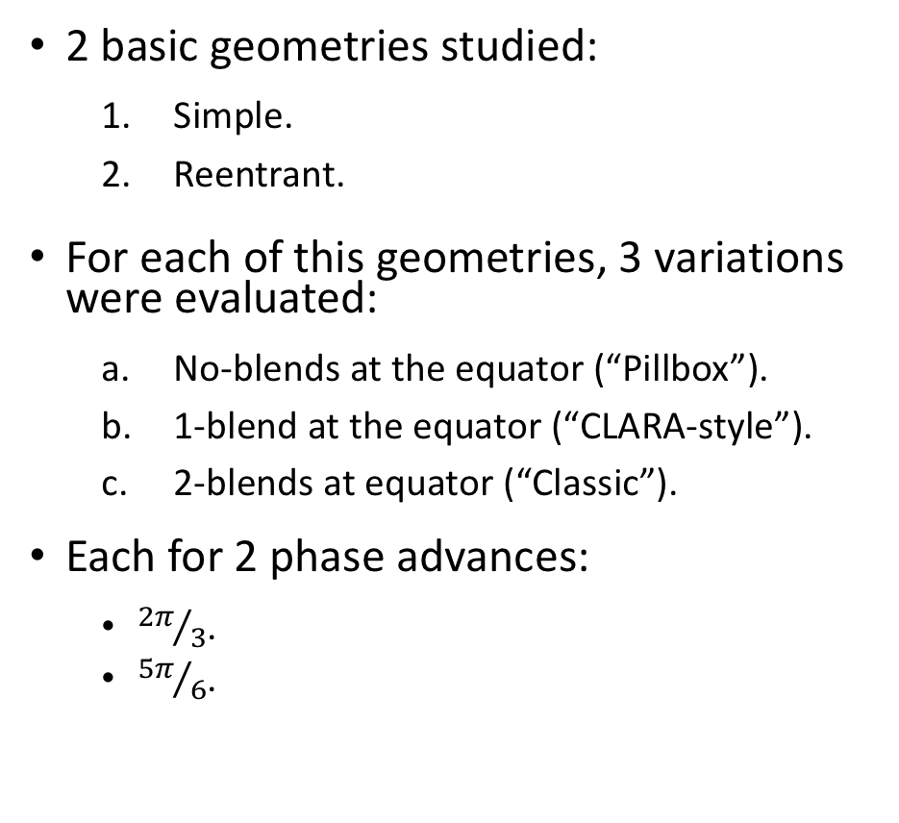
Single Cell Revisited: Candidates
2 basic geometries studied:
  Simple.
  Reentrant.
For each of this geometries, 3 variations were evaluated:
  No-blends at the equator (“Pillbox”).
  1-blend at the equator (“CLARA-style”).
  2-blends at equator (“Classic”).
Each for 2 phase advances:
  ${2π}/3$.
  ${5π}/6$.
a
1
b
c
2

Slide 14
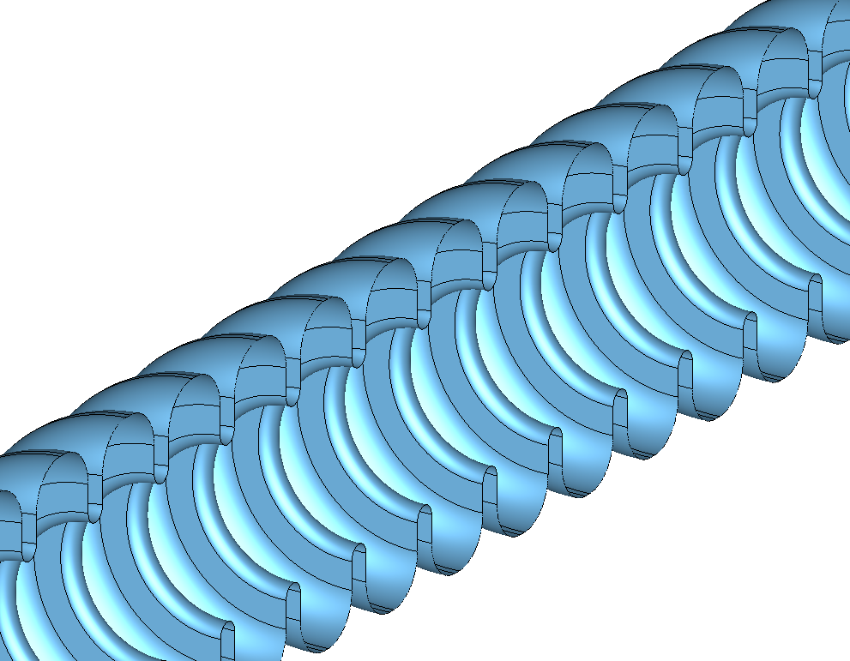





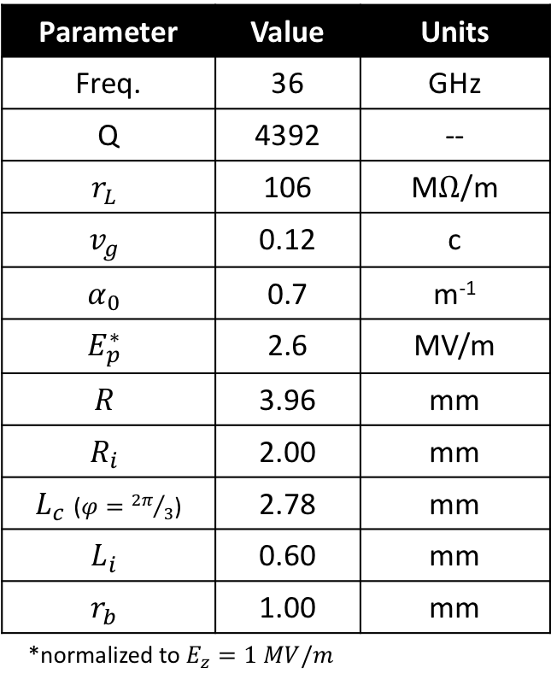

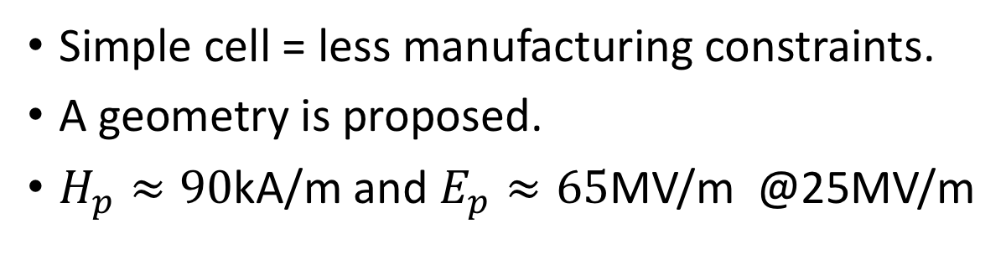
Cell Design
Simple cell = less manufacturing constraints.
A geometry is proposed.
$H_{p}≈90$kA/m and $E_{p}≈65$MV/m @25MV/m
Parameter | Value | Units
Freq. | 36 | GHz
Q | 4392 | --
$$r_{L}$$ | 106 | M$Ω$/m
$$v_{g}$$ | 0.12 | c
$$α_{0}$$ | 0.7 | m⁻¹
$$E_{p}^{∗}$$ | 2.6 | MV/m
$$R$$ | 3.96 | mm
$$R_{i}$$ | 2.00 | mm
$L_{c}$ ($φ={2π}/3$) | 2.78 | mm
$$L_{i}$$ | 0.60 | mm
$$r_{b}$$ | 1.00 | mm
*normalized to $E_{z}=1 MV/m$
$$r_{b}$$
$$L_{i}$$
$$R$$
$L_{i}$/2
$$R_{i}$$
$$L_{c}$$

Slide 15
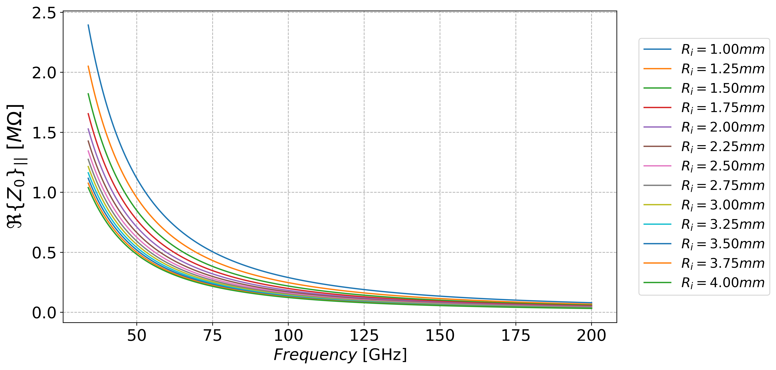
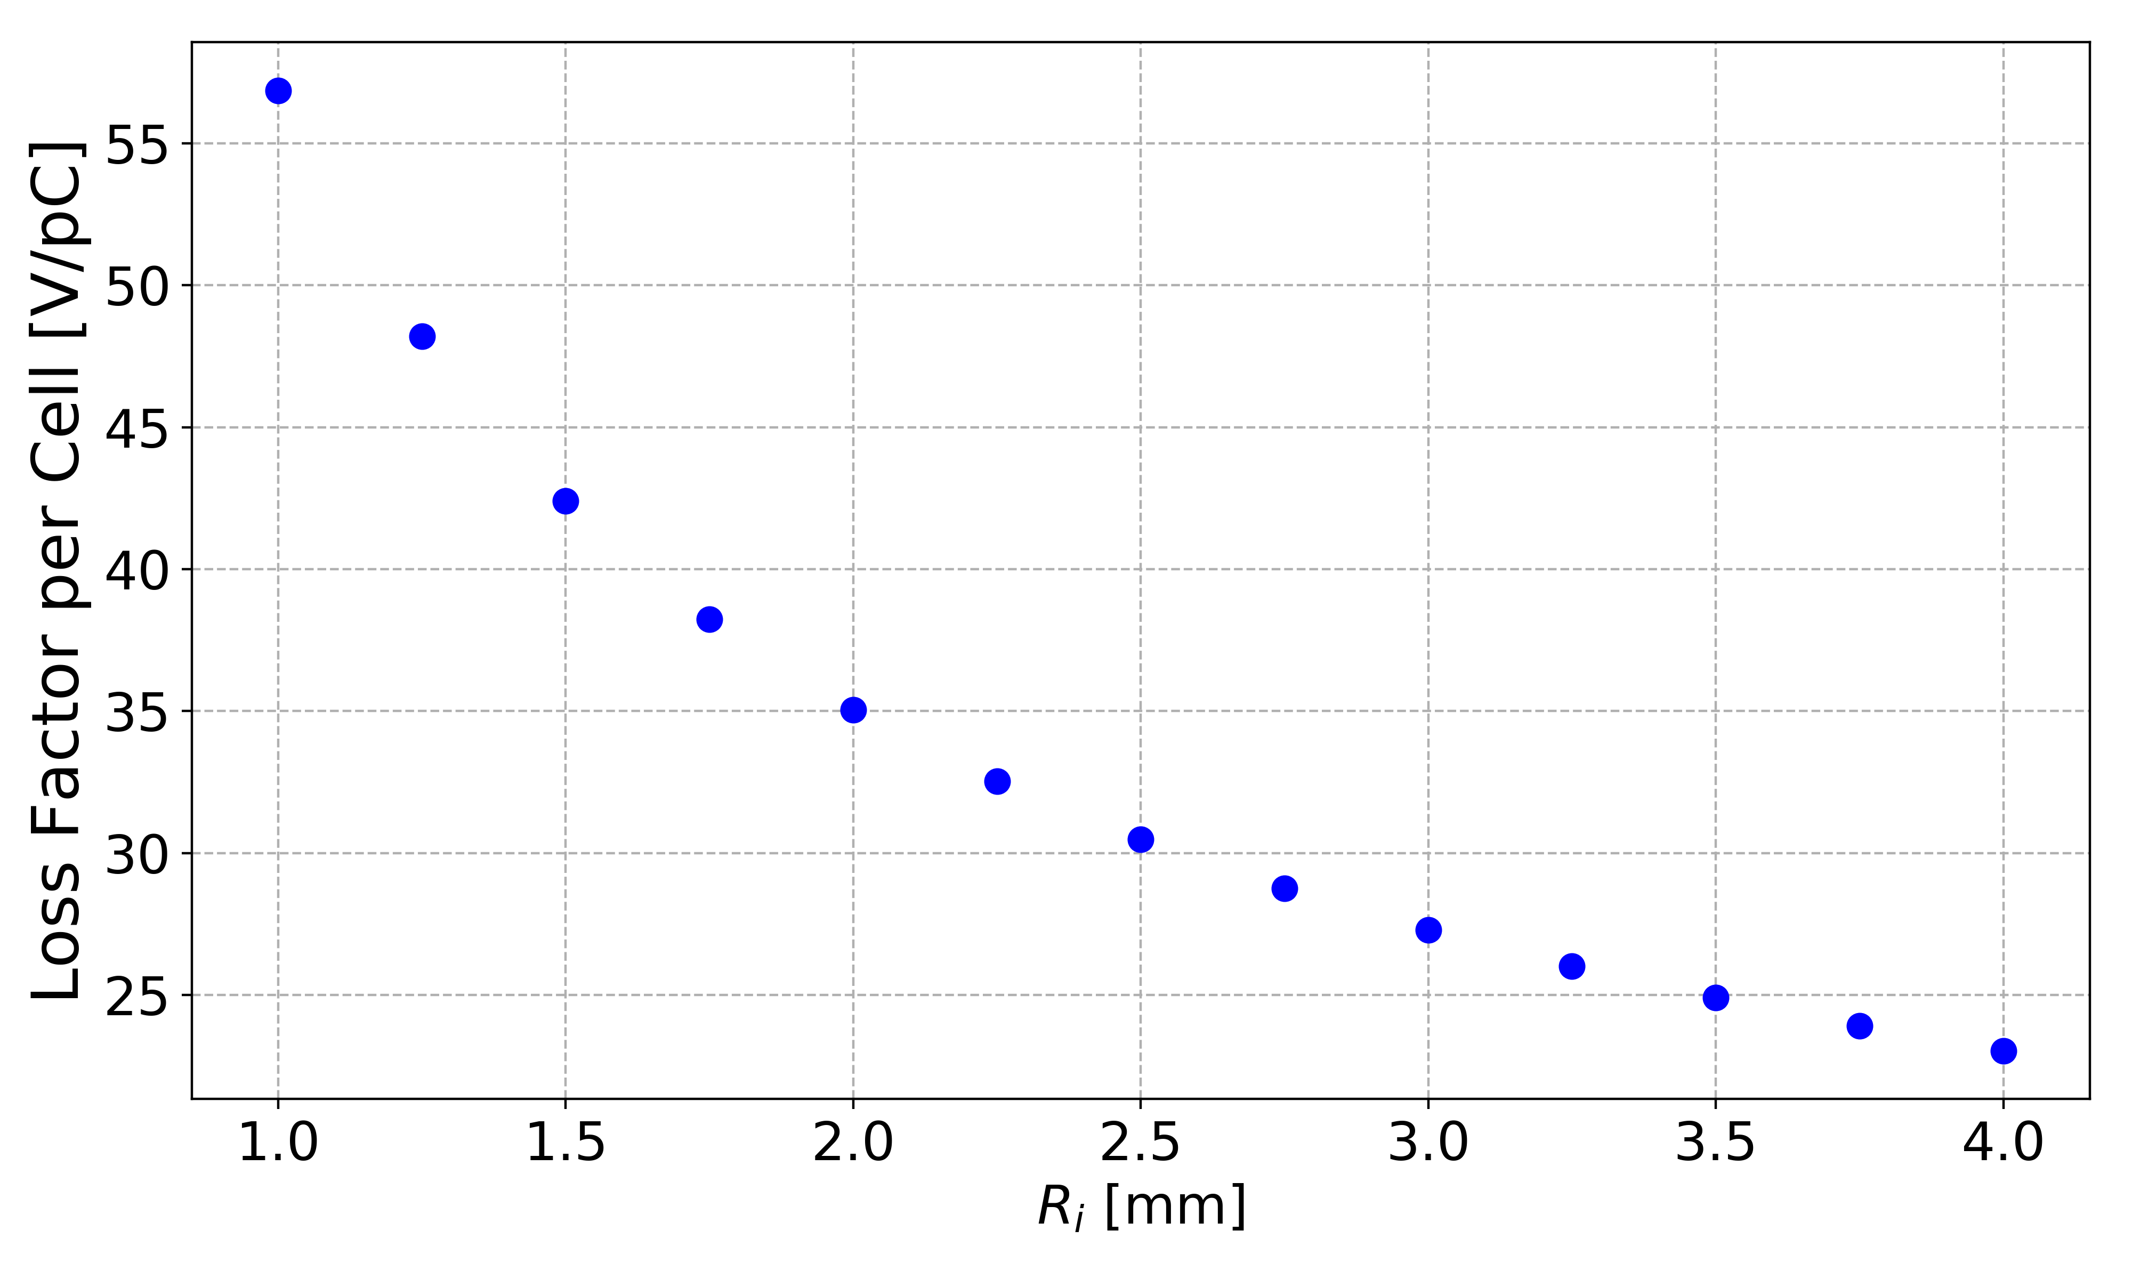
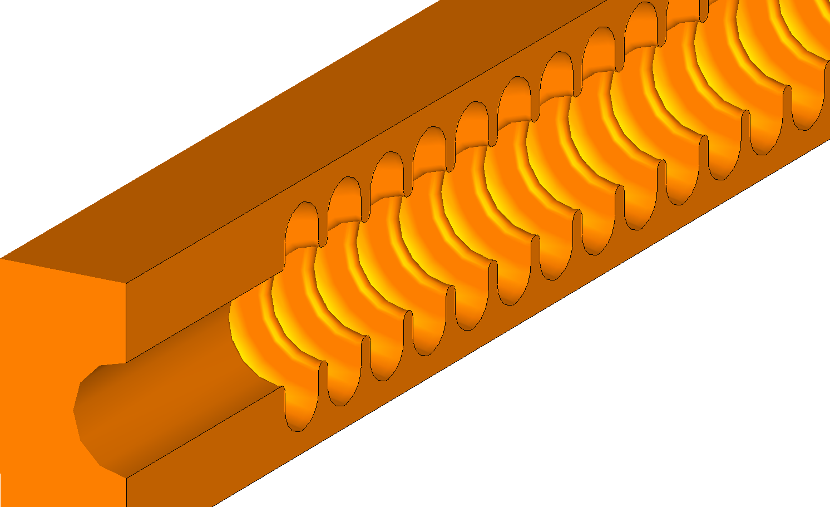
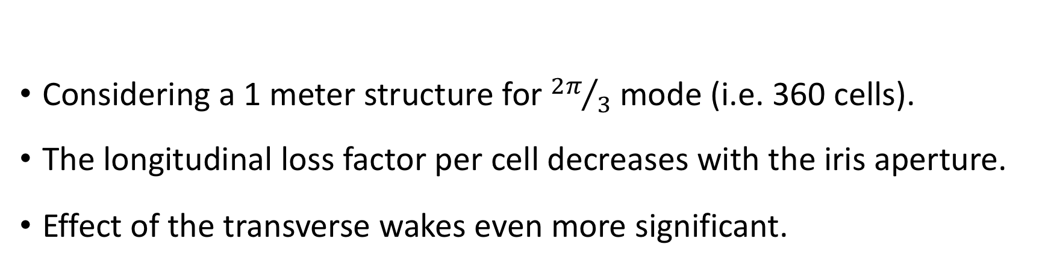
A Quick Look Into The Wakes
Considering a 1 meter structure for ${2π}/3$ mode (i.e. 360 cells).
The longitudinal loss factor per cell decreases with the iris aperture.
Effect of the transverse wakes even more significant.

Slide 16
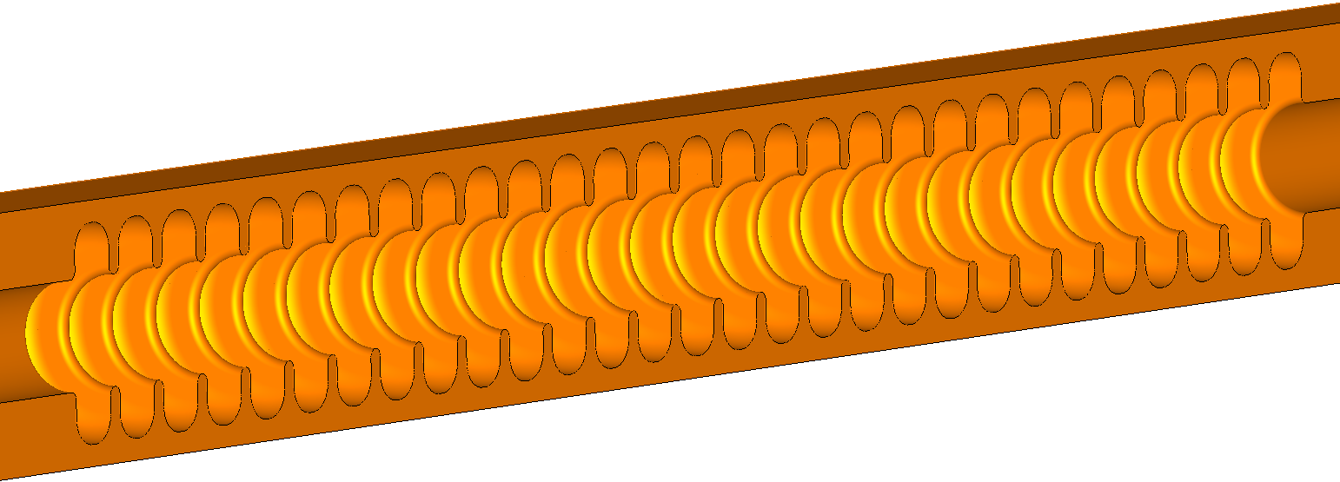
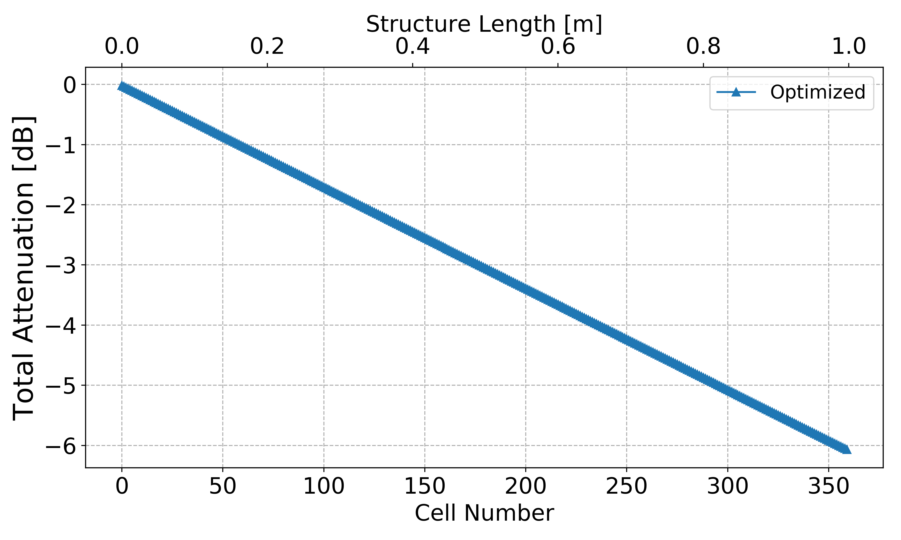
Other Options
Power recirculation advantages bounded by the total structure attenuation:
  It may be challenging for this aperture.

Slide 17
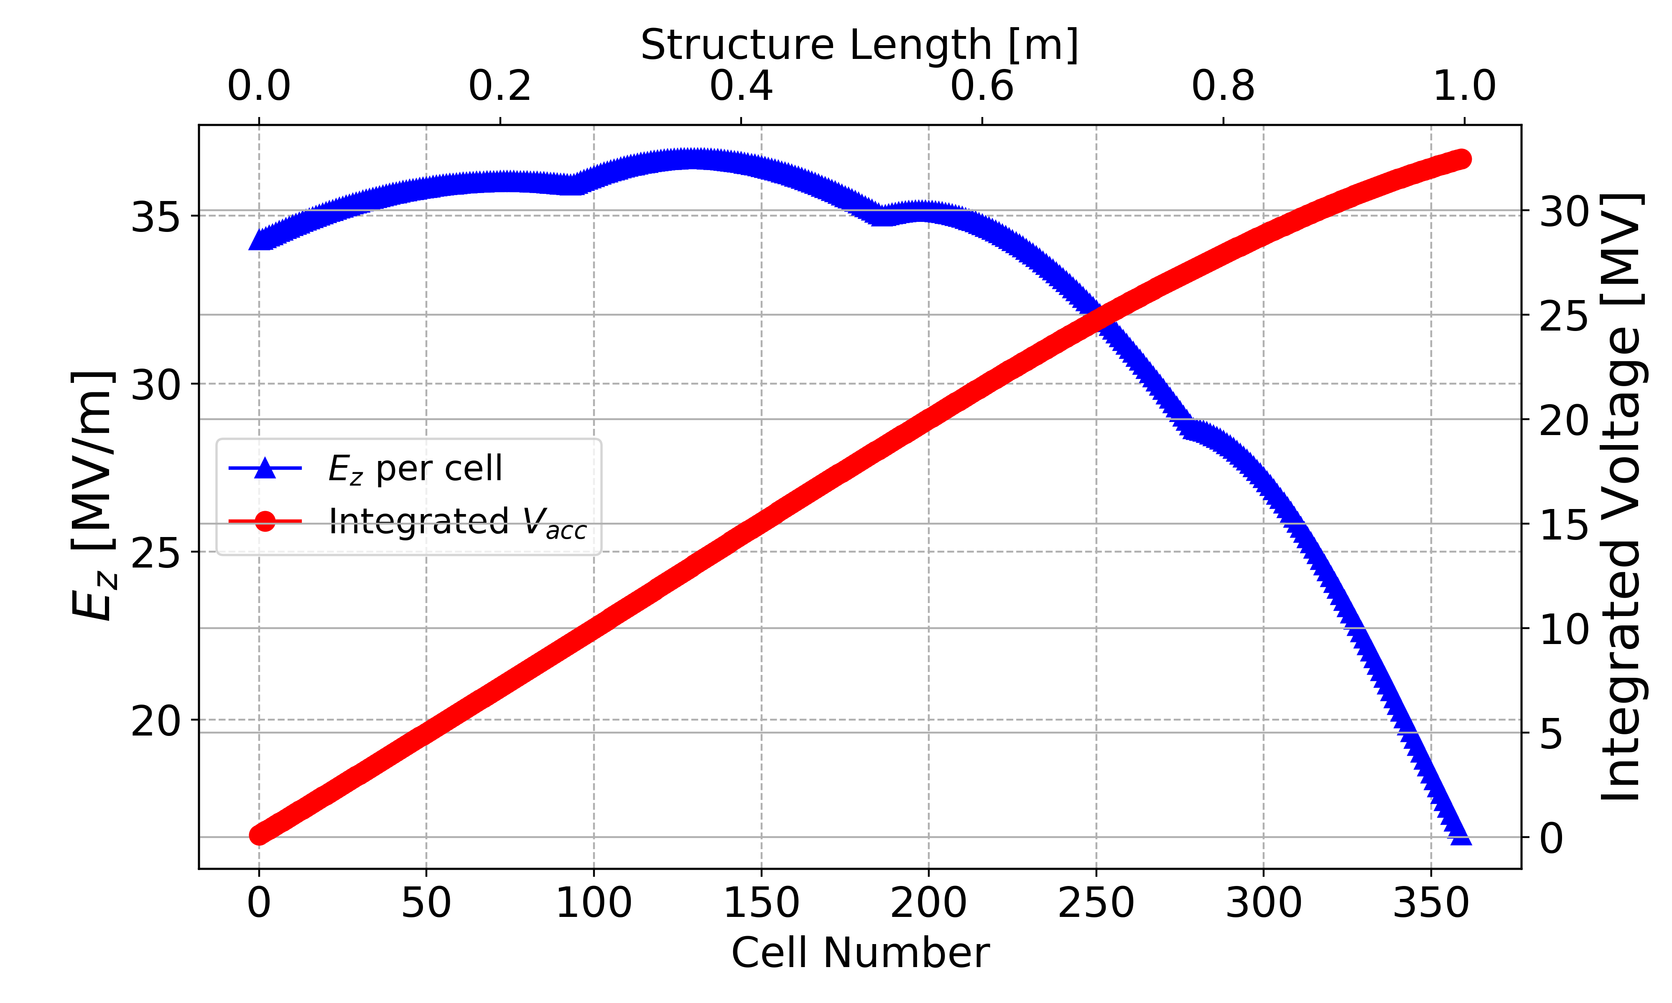
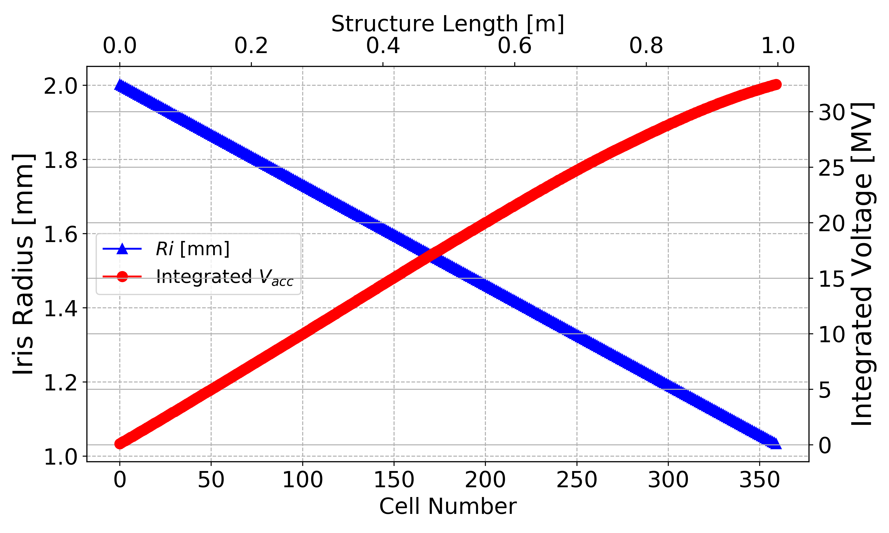
Simple Cell: ‘Constant Gradient’ (@8MW)
Improved gains at the expense of tapering the iris:
  Higher loss factor.
  ~32MV integrated voltage.
Constant Impedance
A. Castilla CompactLight - Internal Meeting, 8th January 2019

Slide 18
Simple Cell: ‘Constant Gradient’ (@8MW)
Improved gains at the expense of tapering the iris:
  Higher loss factor: Sweeping between 2 and 1mm.
  Slightly higher integrated voltage (~32MV).
A. Castilla CompactLight - Internal Meeting, 8th January 2019

Slide 19
Summary
Detailed exploration of the parameter space revisited:
  Wakes constrain the minimum iris aperture.
  RF performance constrains the maximum iris aperture.
  A simple cell geometry is proposed with 2mm iris radius.
Performance of a 1m structure:
  ~25MV achievable with reasonable power considerations.
Power recirculation option:
  More efficient for higher iris apertures (i.e. lower attenuation factors).
Constant gradient structure option:
  Higher integrated voltages than the constant impedance option.
  Higher loss factors from wakes due to reduction on the iris aperture.

Slide 21
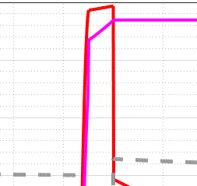
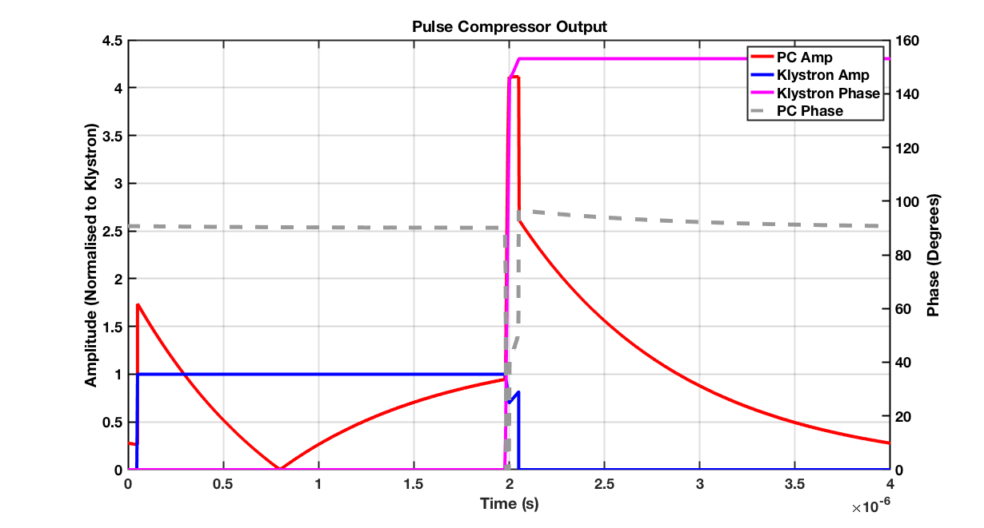
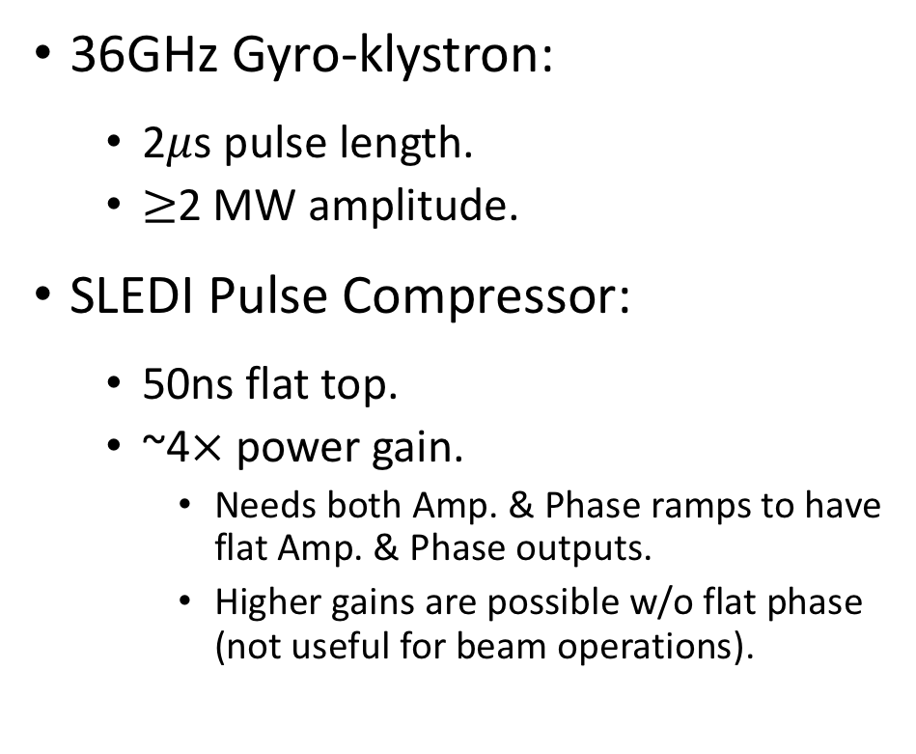
Power Considerations
36GHz Gyro-klystron:
  2$μ$s pulse length.
  $≥$2 MW amplitude.
SLEDI Pulse Compressor:
  50ns flat top.
  ~4$×$ power gain.
    Needs both Amp. & Phase ramps to have flat Amp. & Phase outputs.
    Higher gains are possible w/o flat phase (not useful for beam operations).
W.L. Millar - ULANC

