Slide 1
Open Science policies 2015-2019
What has been done so far in EU policy and what is left
OA Conference
CERN - UNIGE
Open Science – its impact and potential as a driver for radical change
19-21 June
Geneva
JC Burgelman
& Unit G4
European Commission, DG RTD

Slide 2
Structure
1. Why this policy
2. What where the main priorities
3. What was realized
4. What is still missing or incomplete

Slide 3


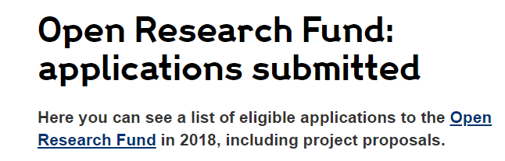





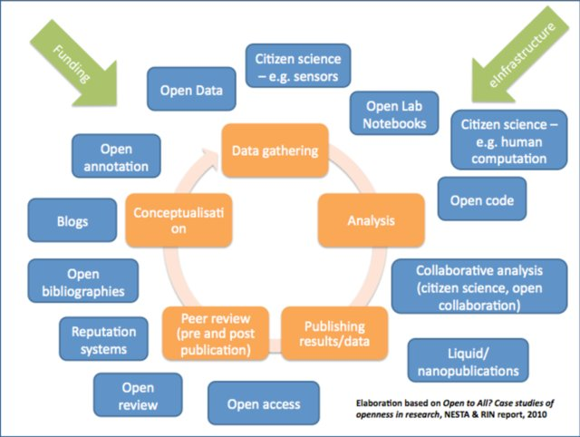

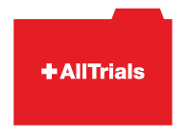













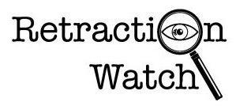



Opening up the full research cycle
Why? The nature of science (modus operandi) is changing from a closed system to an open and sharing one

Slide 4
Why?
Multiple benefits
Better ROI of the R&I investments: self evident: if all the results of our public research are made reusable, it will follow that better use is made. (Norori: Eco impact Human Gnoom sequencing: 1 billion eco output, 4 million jobs, 30% more genetic testing, innovative new methods, cures etc )
Faster circulation of new ideas: we have 22 million EU SME's that will have access to top notch research without having to significantly pay for it!
More transparency of the science system: the public taxpayer has this right & and it helps the self correcting of the system
Fit for 21st century science purpose: all grand societal challenges NEED cross disciplinary research

Slide 5
Which priorities
2016, -
Use and management of research results
1. FAIR data: FAIR data sharing is the default for funding scientific research
2. European Open Science Cloud: all EU researchers are able to deposit, access and analyse European scientific data through EOSC, without leaving their desk
3. Indicators: alternative metrics (next generation metrics) complement conventional indicators for research quality and impact (e.g. JIF and citations)
4. Future of scholarly communication: all peer reviewed scientific publications are freely accessible and early sharing of different kinds of research outputs is encouraged
Alignment of research partners
5. Rewards and incentives: the European research career evaluation system fully acknowledges Open Science activities
6. Research Integrity: all publicly funded research in the EU adheres to commonly agreed Open Science standards of research integrity
7. Skills and education: all scientists in Europe have the necessary skills and support to apply Open Science research routines and practices
8. Citizen Science: citizens significantly contribute and are recognised as valid knowledge producers of science
Pointer: Amsterdam Call for Action on OS (policy priorities identified from 12 action items)

Slide 6
What was achieved
Open access
Key objective
  Work with all stakeholders and EU Member States for the alignment of OA policies and support implementation in H2020
Main achievements
  Revision of the Recommendation on Scientific Information, Public Sector Initiative Directive and EU Copyright Directive (2018)
  EC Expert Group on the future of scholarly communication report (January 2019)
Next
  Follow-up on legal and regulatory aspects (incl. Plan S)
  Second tender on open access publishing platform (spring 2019)
  Procurements (monitoring of and support to H2020) and reports
Pointer: Open Access web page

Slide 7
What was achieved
FAIR (open) data
Key objective
  Implement FAIR data in EOSC, and beyond
Main achievements
  FAIR embedded in several ‘EOSC documents’: Communication (2016), Declaration (2017), Council Conclusions (2018)
  Study (June 2018) with cost-benefit analysis
  EC FAIR data Expert Group report (November 2018)
Next
  Collaboration with EOSC Working Groups
  FAIR-compliant certification scheme for data infrastructures and policy on Persistent Unique Identifiers in EOSC (end 2019)
  Horizon 2020 project-funding

Slide 8
Directive on open data and the re-use of public sector information (adopted 6-2019)
FAIR (open) data
•(Article 1) Research data falls now within the scope of the Public Sector Information Directive
●(Article 10) MS shall adopt national policies & relevant actions to make publicly funded research data openly available by default, in line with FAIR principles & “as open as possible, as closed as necessary”
●(Article 10 + Recital 28) Research data which are already publicly available through repositories shall be re-usable (but no extra cost for the retrieval of the datasets should be imposed, no additional curation of data should be required to comply with this obligation )
●(Recital 28) MS may extend the application of this Directive to research data made publicly available through other data infrastructures than repositories, through OA publications.

Slide 9
What was achieved
European Open Science Cloud
Key objective
  Adapt research infrastructures for Open Science and develop a common, federated, European framework (ecosystem) for publicly-funded research data
Main achievements
  Implementation roadmap and launch (March & November 2018)
  Two Expert Group reports (FAIR & EOSC in practice)
Next
  Implementation including FAIR certification schemes for repositories, FAIRsFAIR project etc.
  Mapping of EOSC-relevant national initiatives (end 2019)
  Evaluation by EC and EU Member States (end 2020)
Pointer: EOSC web page

Slide 10
What was achieved
Indicators
Key objective
  Develop and employ, for the development of Open Science, non-traditional metrics that cover not just citation of articles (i.e. what was initially named ‘Altmetrics’)
Main achievements
  Report from the first Expert Group on Altmetrics (2017)
  Second Expert Group on indicators for researcher’s engagement with Open science and its impacts (2019)
Next
  Report on concrete and implementable indicators to be released in June 2019 and discussed with OSPP in October 2019
Pointer: Expert Group on Indicators web page

Slide 11
What was achieved
Open Science Monitor
Key objective
  Get some quantitative and qualitative insights on the ongoing development of open science practices (this is not an assessment tool)
Main achievement
  Two public procurement contracts launched and implemented in a sequential way, with a web-based demonstration in place
Next
  Monthly updates till the end of 2019
  Improvement of the Monitor once the EU has a more open and transparent data infrastructure for publicly funded research (notably with a full implementation of the EOSC)
Pointer: Open Science Monitor web page

Slide 12
What was achieved
Citizen Science
Key objective
  Citizens significantly contribute and are recognised as valid knowledge producers of European science (part of dimensions supported by Responsible Research and Innovation)
Main achievement
  OSPP report on citizen science (incl. recommendations)
  Horizon 2020 project-funding
Next
  Reports on good practices in citizen science to be produced in 2019 to inform development of two citizen science toolkits
  Conference on citizen science towards the sustainable development goals (Berlin, second half of 2019)
  Systemic approach in Horizon Europe

Slide 13
What was achieved
Research integrity
Key objectives
  Set European standards to foster research integrity in the development of Open Science, in particular having in mind the relation between science and society
Main achievement
  Mutual learning exercise on research integrity (led by EU MS)
  Support to the European Network on Ethics and Research Integrity, and European Network of Research Integrity Officers
  Horizon 2020 project-funding
Next
  Fully address Open Science in the European Code of Conduct with the aim of a full implementation in the Framework Programmes

Slide 14
What was achieved
Rewards and skills
Key objectives
  Encourage, support and incentivise researchers to practice Open Science, with a focus on both research performing and research funding organisations
Main achievement
  Final reports of Expert Groups on Rewards and Skills
  OSPP makes rewards for Open Science a priority
Next
  Follow-up, in particular embed rewards for Open Science in the modernisation of European universities

Slide 15
OS in the evolution R&I funding programmes
2021
FP7
OA Pilot
Deposit and open access
Horizon 2020
OA Mandatory
Deposit and open access
& ORD/DMP Pilot
Horizon 2020
OA Mandatory
Deposit and open access
& ORD/DMP by default
(opt-out)
2017
Horizon Europe
OA Mandatory
Deposit and open access
DMP in line with FAIR Mandatory
ORD by default (exceptions)
& Open Science embedded
2014
2008

Slide 16
Open Science in Horizon Europe
Horizon Europe goes beyond open access (publications & data) to embrace and incentivize open science as modus operandi
1. Clarifies and strengthens the open access obligations while empowering authors of scientific publications
2. Sets obligations towards FAIR and open data sharing, and data management, while complying with IPR rules and exploitation obligations
3. Promotes compliance with open science principles through a combination of obligations and incentives
4. Implements sanctions for those beneficiaries that repeatedly and consistently fail to provide the required open access, requiring institutions to assume responsibility for their intellectual output
5. Introduces the use of new generation metrics for better assessing the impact of research output and the engagement in open science

Slide 17
Possible scenario for incorporation of Plan S principles in Horizon Europe
Open access via repositories kept but made immediate
  Embargoes not accepted any longer
Copyright retention and open license asked for
  Copyright retention already in the HE Regulation
  Open license to be required (in line with new standard licence adopted by the EC for its own information production)
Publication in hybrid journals allowed
  However, costs not to be eligible

Slide 18
Research data in Horizon Europe
Mandatory Data Management Plan
  When there is research data generated, collected, re-used…
Open by default
  Unless it cannot be (exceptions will apply- we will not use the term ‘opt-out’ any more)
Open access/data management disambiguated
  Different from current situation
Use of European Open Science Cloud required
  In some Work Programmes

Slide 19
The system change is not over
Still a long way to go
By 2030 the science system will be characterised by
Open research data as a renewable resource for research and innovation (via EOSC)
Full & immediate open access to the whole life cycle of a research process
A system of peer reviewed open access research workflows
Multiple ways to measure and reward scientific productivity
‘’liquid’’ science (like in SW development)
19

Slide 20
What’s left?
We know that Europe leads this OS movement…for the moment
We have a history of leading with ICT, but losing out in the end
The powers that be are astonishingly strong ... even in the good world of science
Scientists like intellectual disruptions, not institutional ones…. need a big cultural change (Leru 2018 paper)

Slide 21
I wish I could start my research career now
To wind up… and to put open
science into perpective
1. Never were the exogenous factors so good for science (budgets, trajectories, support, etc)
2. Never was there so much need for good science (see Harari 21 lessons if you don’t know where to start research on)
3. AND: Never were the endogenous factors so favourable to do good science (open science is making your scientific life easier & richer)
    Just do it!

Slide 22
Thank you http://ec.europa.eu/research/openscience/index.cfm

