Slide 1



Towards a European Network for Open Access Books
Pierre Mounier (EHESS)
Coordinator of OPERAS
Deputy Director of OpenEdition

Slide 2



The OA book landscape: highly distributed and diverse

Slide 3
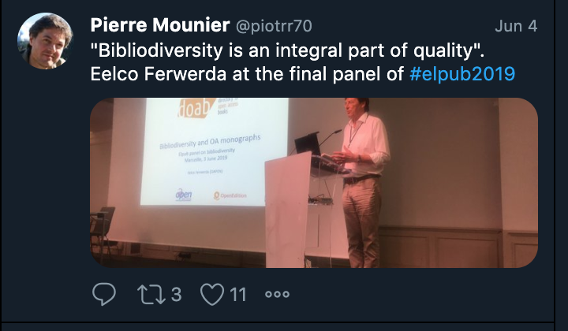
Why the sector needs coordination not centralization

Slide 4


Examples

Slide 5
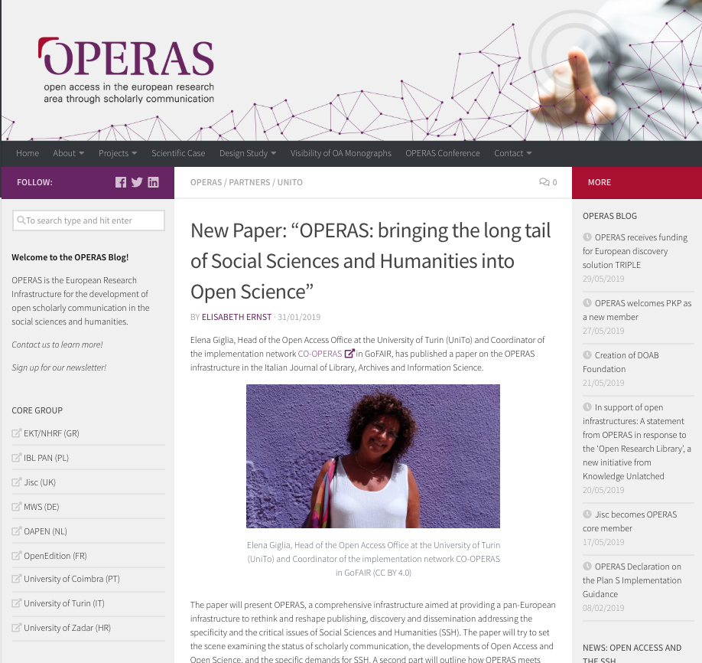

Slide 6
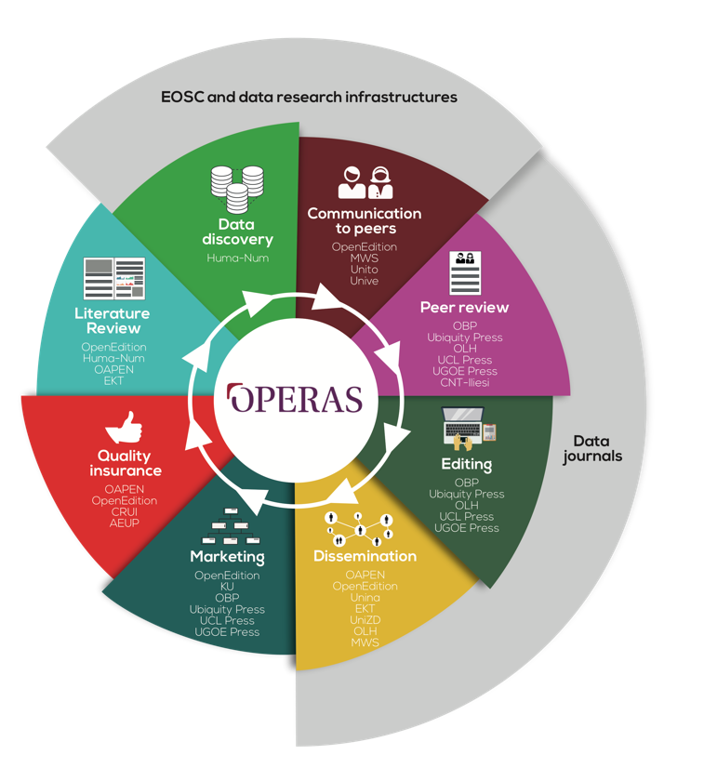

Slide 7
HIRMEOS project as a proof of concept for OPERAS
Upgrade 5 open access books publishing platforms to 5 added value services :
  Identification services : DOI, ORCID, Fundref
  Entities recognition services : persons, places, periods
  Certification Service : connection with DOAB
  Open Annotation Service : Hypothes.is
  Metrics : Open Access metrics, alternative metrics

Slide 8
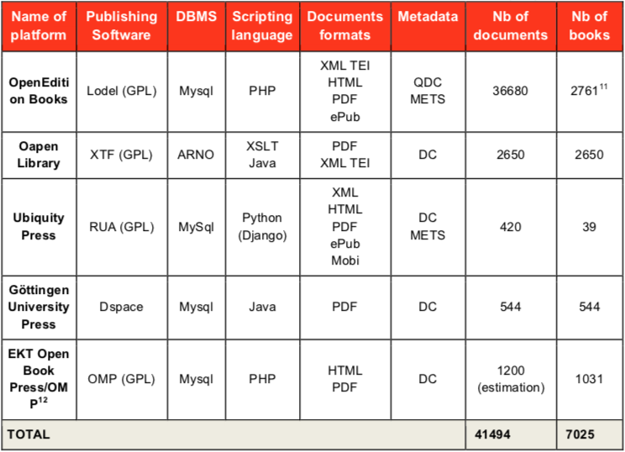
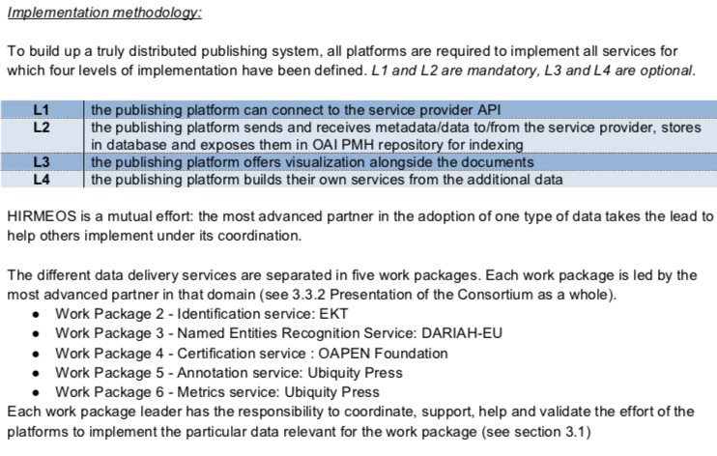
HIRMEOS coordination methodology

Slide 9
The need for a network to support bibliodiversity and enable coordinated projects

Slide 10
The Amsterdam meeting
Challenges :
Lack of knowledge across Europe (usage, business models and policies particularly)
Lack of coordination among the many specific projects and initiatives
Gap between available technologies and tools and current usages in the academic community
Potential lines of action :
Creation of an OA book watch that will collect all available information on usage, business models and policies, and elaborate standardized indicators to enable benchmarking.
Support to the technical infrastructure needed for efficient dissemination of OA books
Support to collective funding initiatives that enable small-scale projects to be funded through lowering of transaction costs
Preparation of a EU funded project to increase OA books usage across different platforms (HIRMEOS 2)
Title :
The Open Access Books Network (OABN)
Definition :
A multistakeholder network to support the development of open access books in Europe and address in a coordinated way the challenges oa books initiatives have to face
Participants :
Eelco Ferwerda (Oapen), Margo Bagheer (Göttingen University Press, AEUP), Vanessa Proudman (SPARC Europe), Rupert Gatti (OBP), Jeroen Sondervan (UU), Pierre Mounier (OpenEdition)

Slide 11
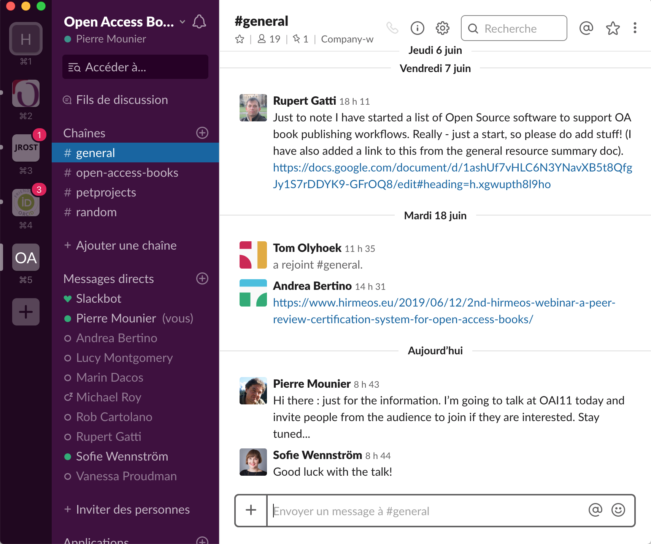
From the Elpub panel to the Slack channel

Slide 12
Join us (and let’s talk)!

Slide 13
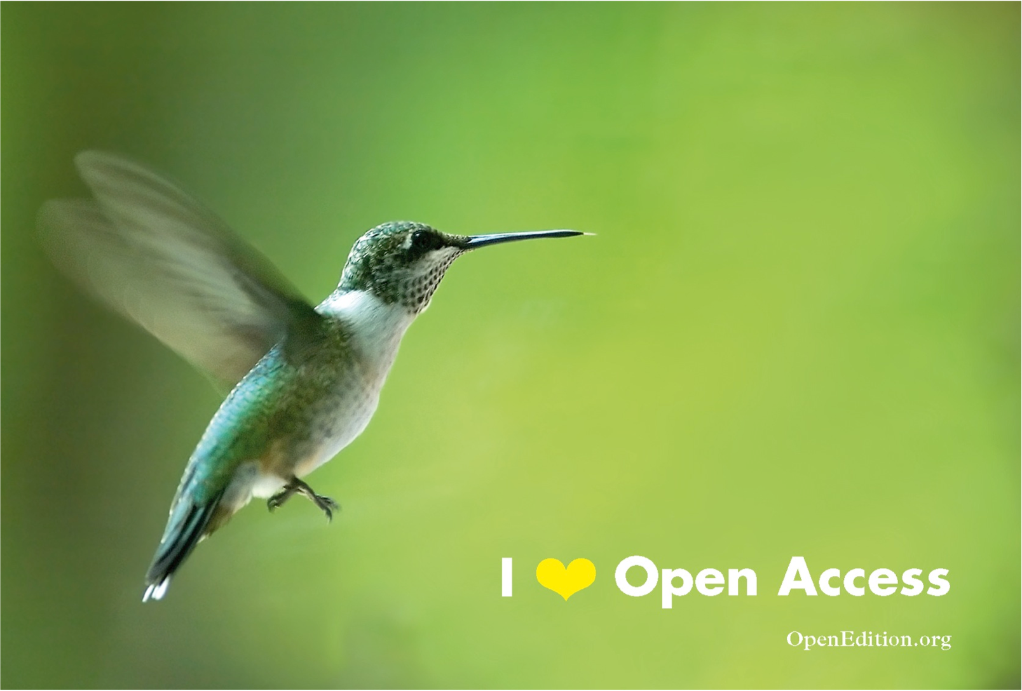
Thank you!
pierre.mounier@openedition.org
@piotrr70
http://operas-eu.org

