Slide 1








DFH : Individual Vs parallel hydraulic circuits
2 principles:
  Individual : Splices, HTS & Current Leads cooled in series
  Parallel : Splices cooled in parallel hydraulic circuits
Many assumptions…
➔ figures & concrete applications…
  Ratio $\frac{Mass flow for splice \& HTS}{Mass flow for current leads}$ ?
  Compare the consequences of increasing the mass flow locally around one splice
Functions: | Individual | Parallel
Control principle: | Current lead valve controls T_{splice} & T_{CL} Bypass valve adjusts DFH inlet temperature | Current lead valve controls T_{CL} Bypass valve controls highest of T_{splice}
Transient phases: Cool down / Warm up Ramp up / down | Mass flow through bypass main flowing section Change of mass flow distribution bypass-CL | Mass flow around splices Identical pressure for all CL circuits inlets
 | Apparent Advantages: 1 splice = 1 Valve (easy to target one splice) Easy control if CL needs >> splice or HTS needs Big bypass diameter for transients and control of $T_{DFH inlet}$ | Apparent Advantages: Independent control of $T_{splice}$ and $T_{CL}$ CL mass flows only adjusted to CL needs Splices needs covered by bypass (if > to CL needs)
 | Apparent Drawbacks: CL mass flow dependent from splice needs Bypass mass flow can not increase heat extraction Mass flow distribution evolves during Ramp up | Apparent Drawbacks: Difficulties to ensure equal flows in parallel circuits from design Increasing mass flow around one splice ➔ high total mass flow increase
P1, T1
$${\dot{m}}_{CLc}$$
P1, T1
P2, T2
$${\dot{m}}_{CLc}$$
Pc, Tc
$${\dot{m}}_{bypass}$$
$${\dot{m}}_{bypass}$$
P2, T2
$${\dot{m}}_{CLa}$$
$${\dot{m}}_{CLa}$$
Pa, Ta

Slide 2
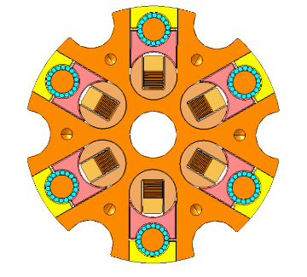


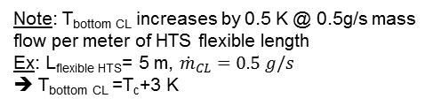



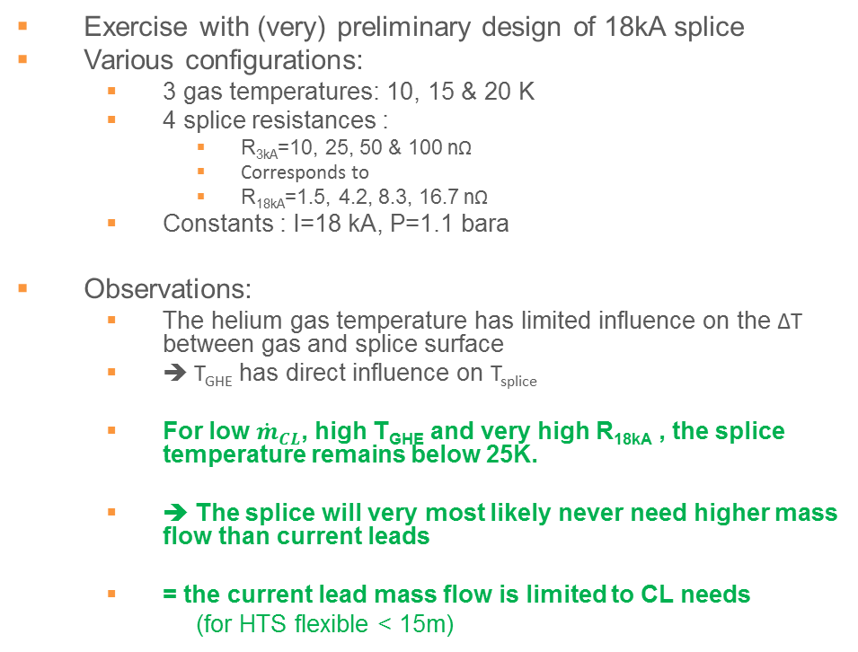
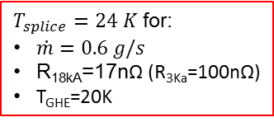
Needs to cool/maintain a 18kA-splice temperature within spec.
$${\dot{m}}_{CLc}$$
Pc, Tc
Note: T_{bottom CL} increases by 0.5 K @ 0.5g/s mass flow per meter of HTS flexible length
Ex: L_{flexible HTS}= 5 m, ${\dot{m}}_{CL}=0.5 g/s$
➔ T_{bottom} _{CL} =T_{c}+3 K
Exercise with (very) preliminary design of 18kA splice
Various configurations:
  3 gas temperatures: 10, 15 & 20 K
  4 splice resistances :
    R_{3kA}=10, 25, 50 & 100 nΩ
    Corresponds to
    R_{18kA}=1.5, 4.2, 8.3, 16.7 nΩ
  Constants : I=18 kA, P=1.1 bara
Observations:
  The helium gas temperature has limited influence on the ∆T between gas and splice surface
  ➔ T_{GHE} has direct influence on T_{splice}
  For low ${\dot{m}}_{CL}$, high T_{GHE} and very high R_{18kA} , the splice temperature remains below 25K.
  ➔ The splice will very most likely never need higher mass flow than current leads
  = the current lead mass flow is limited to CL needs
  (for HTS flexible < 15m)
Current leads requirement range
$T_{splice}=24 K$ for:
$\dot{m}=0.6 g/s$
R_{18kA}=17nΩ (R_{3Ka}=100nΩ)
T_{GHE}=20K
$$T_{GHE}=20K$$
$$T_{GHE}=15K$$
$$T_{GHE}=10K$$
Flowing areas
SPLICE PROPERTIES | Unit | Value
Splice length | [mm] | 220
Flowing area Equivalent diameter | [-] [mm] | 6 x ½ DN10 + central DN10 DN20
Deq | [mm] | 20
Heat transfer area | [mm²] | 27600
Dissipated power Current 3kA Resistance | [W] [kA] [nΩ] | From 0 to 5 W 6 X 3 From 10 to 100
LHC 13kA current leads mass flow
3kA splices
Preliminary early design MgB2-HTS

Slide 3
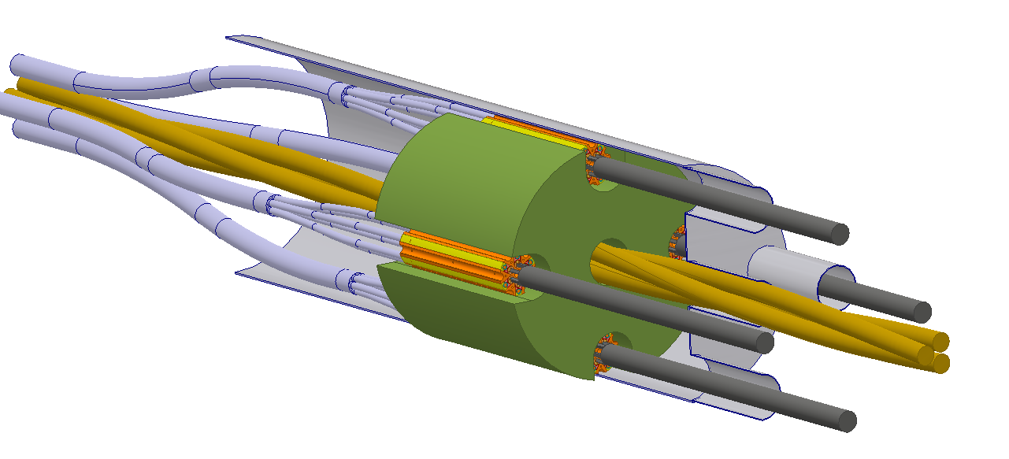
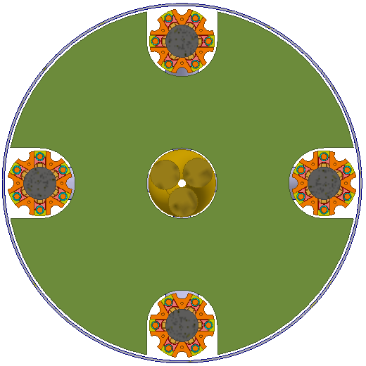
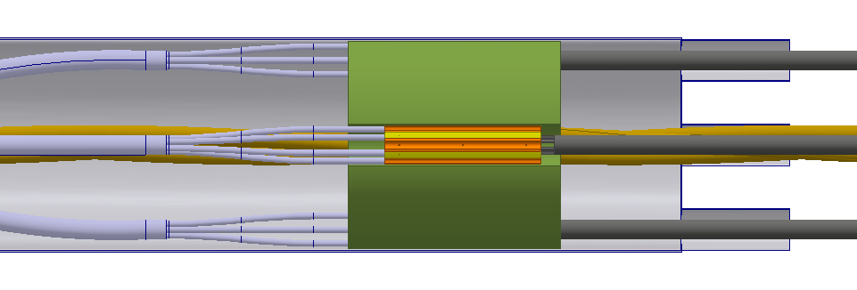




Hydraulic studies for parallel flow options
Exercise with DFHx1 and 18kA splice preliminary design: 4 x 18kA splice + 1 path for DFHx2 leads
Observations:
  Most of the flow goes to the biggest Deq circuit
      ≈20% to the 4 splices (5% each) , ≈80% to central outer circuits
  ➔ Install upstream orifices for similar parallel mass flows (common practice)
      Order of magnitude : Ø10 mm ➔ Integration of upstream orifices unreliable around MgB2 cables (various Ø, Kapton, solder geometry)
What if:
  ➔ A limited diffirence between parallel circuits implies high mass flows unbalance (higher R, Kapton, solder)
      One splice sub-hole is blocked ➔ Atr reduced by 15% ➔ Q reduced by 15%: Non critical
      One splice is warmer ➔ ∆P increase ➔ local mass flow decreases further
      One splice needs twice more heat extraction ➔ total mass flow +150%
      Support and flowing areas obstructions not perfect ➔ mis balance between hydraulic parallel circuits
18kA flowing area :
DN20 5% total flow
$${\dot{m}}_{splice}$$
$${\dot{m}}_{total}$$
$${\dot{m}}_{DN40}$$
central flowing area :
DN40 38% of total flow
To CL
To CL
$${\dot{m}}_{splice}$$
Ext flowing area :
DN40, 38% of total flow
To CL
To DFHx2
To CL
$${\dot{m}}_{DN40}$$
$${\dot{m}}_{splice}$$
0.5 g/s around one splice ➔ total 7 g/s
1.0 g/s around one splice ➔ total 17 g/s

Slide 4
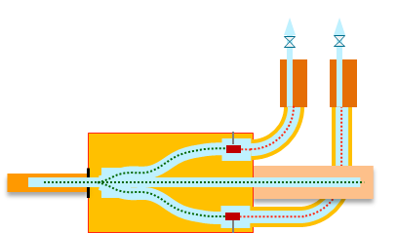
Comparison of individual Vs parallel flows for DFH application
For properly designed splices:
  Required mass flow for splices << Required mass flow for CL
Control of mass flows in parallel circuits:
  Difficult for various circuit geometries
Individual | Parallel
Apparent Advantages: 1 splice = 1 Valve (easy to target one splice) Easy control if CL needs >> splice or HTS needs Indeed Big bypass diameter for transients and control of 𝑇_(𝐷𝐹𝐻 𝑖𝑛𝑙𝑒𝑡) Present for DFHx2 leads | Apparent Advantages: Independent control of 𝑇_𝑠𝑝𝑙𝑖𝑐𝑒 and 𝑇_𝐶𝐿 CL mass flows only adjusted to CL needs Splice needs in the shadow Splices needs covered by bypass (if > to CL needs) +150% ➔ +20%
Apparent Drawbacks: CL mass flow dependent from splice needs CL needs >> splice needs Bypass mass flow can not increase heat extraction Only feasible if all splices in series Mass flow distribution evolves during Ramp up | Apparent Drawbacks: Difficulties to ensure equal flows in parallel circuits from design Very unreliable Increasing mass flow around one splice ➔ high total mass flow increase upper limit 10 g/s
Note: independent study, from installation, tooling, transport dimensions arguments.

Slide 5
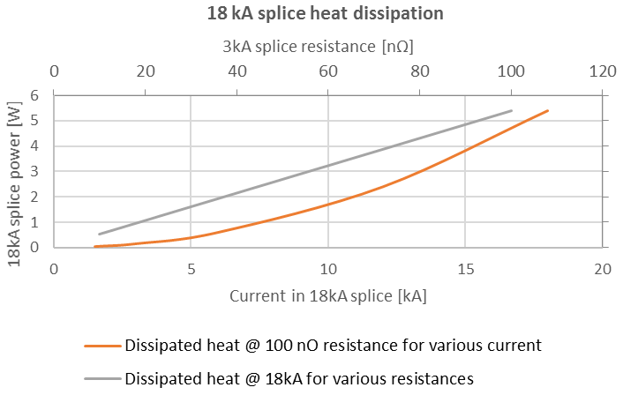
Spare info
For 1 kA = 0.05g/s mass flow in CL & T_{He} = 15 K
  @ 18 kA mCL=0.90 g/s ➔ Tsplice = 15.7 K
  @ 13 kA mCL=0.65 g/s ➔ Tsplice = 15.5 K
  @ 2 kA mCL=2x0.10 g/s ➔ Tsplice = 15.5 K
For splices cooled in series by current leads required mass flow:
Tsplice increases with current
= The higher the current, the higher Tsplice
= At 2 kA, low mass flows do not lead to higher Tsplice

Slide 6
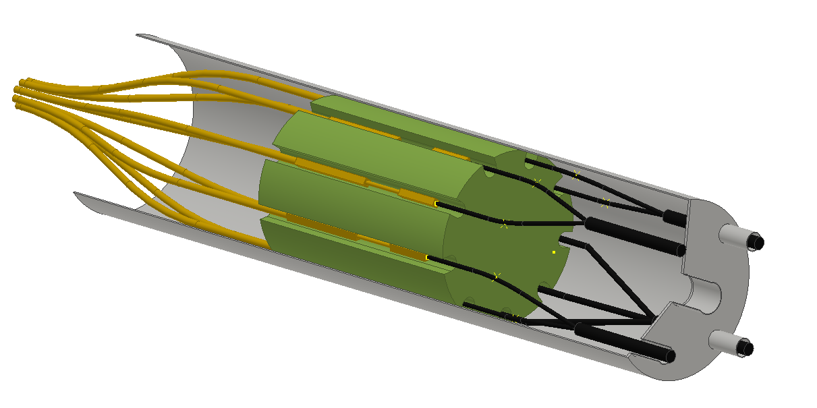
DFHx2 illustration of possible parallel circuits

