Slide 1
A Highly Sensitive Radon Emanation Measurement System at SNOLAB
Dimpal Chauhan,
Staff Scientist, SNOLAB
AAPCOS 2023
Saha Institute of Nuclear Physics, January 24, 2023

Slide 2
Overview
Motivation
Radon-222 Emanation Measurement System
Efficiency and Sensitivity
Services
Summary

Slide 3
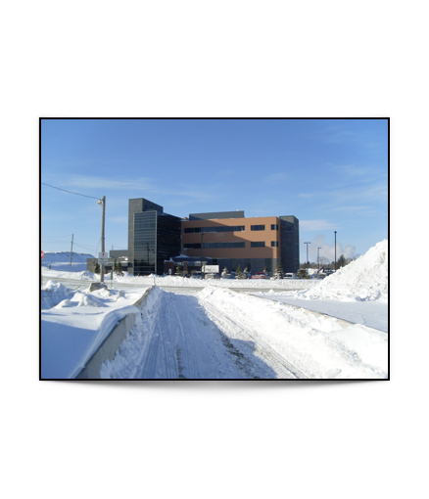
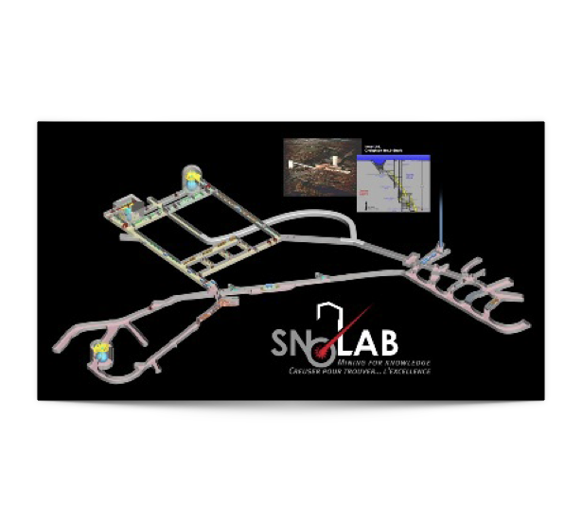
The SNOLAB Facility
Hosted at the Vale Creighton Nickel Mine in Sudbury, Ontario, Canada
Operated as a joint venture of 5 Canadian Universities (Carleton, Queen’s, Montreal, Alberta, and Laurentian)
Operations funded by the Canada Foundation for Innovation and the Province of Ontario

Slide 4
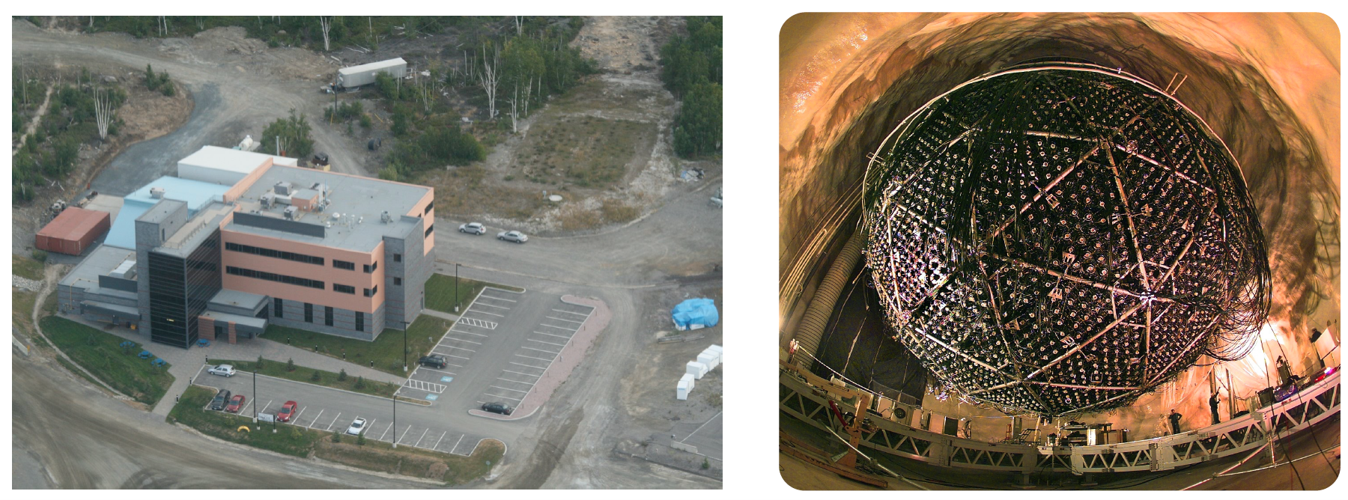
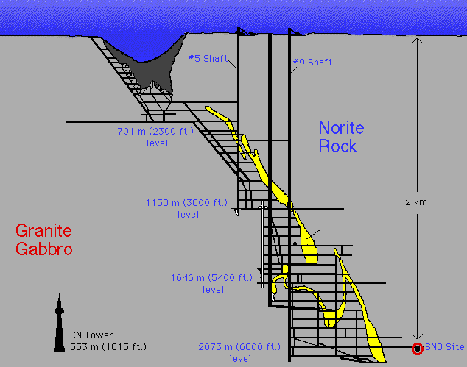
SNOLAB includes a campus 2km underground
Developed from original SNO detector as
part of a competition to develop international
facilities within Canada

Slide 5
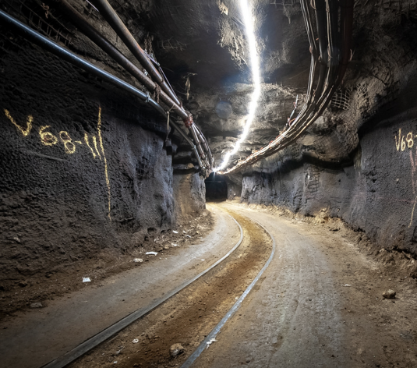
Why go Deep Underground?
High energy muons travel deep
Deep UG facilities provide significant rock overburden-> reduction in cosmic ray flux.
~2km walk from cage to SNOLAB

Slide 6
There is ~50 million times reduction in cosmic rays 2km underground at SNOLAB!
/5900 m.w.e

Slide 7
Cleanliness is critical to SNOLAB operations and science
Notes:
Strict cleanliness protocols is in place to meet the class 2000 cleanliness requirement.

Slide 8
Why do we care about cleanliness?
Radioactive backgrounds from the environment dominate
underground

Slide 9
Why do we care about
Radioactivity ?
Many experiments require ultra low level of radioactive backgrounds to achieve required sensitivities for their searches.
Main backgrounds: Naturally occurring radioactivity (238U and 232Th decay chains).
These backgrounds (alphas, betas, gammas) may mimic the expected detector signal.
GOAL: To measure these backgrounds and apply techniques to reduce them as low as possible.

Slide 10
How to measure Radioactivity Related Backgrounds
SNOLAB has several facilities which are used to directly measure these radioactive backgrounds
Suppress radon in your experiment’s environment (low radon rooms/lab)
Build a big shield (water as radioactive shield)
Performing regular assays of detector shield- Water Assay
Choose radiopure materials for the detector. Different techniques exist (choose the one that works best for material in question)
  Gamma counting using HPGe counters (identify radionuclides using their gamma energies)
  Rn emanation

Slide 11
Motivation
Rn-222 is chemically inert and has a half-life of 3.8 days.
Rn-222 can be emitted from the surface of materials (containing trace
amount of U/Th) & can propagate throughout detector contaminating expt.
Rn decays via alpha decay with MeV scale Q values & can result in
decay products embedding themselves in the surface of materials.
  Rn and its progeny are one of the dominant backgrounds to low
background and rare event searches
  Ultra low radioactive materials are needed in order to build
  experiments.
Disequilibrium may occur between U-238 and Rn-222 (due to emanation
of Rn from materials into the detector)
Knowing U-238 concentration is not enough for material selection.
Equilibrium often broken here
Equilibrium often broken here
Measuring Rn-222 emanation rate has become important to enable
construction of low background environments.

Slide 12
Radon Emanation Measurement System
We require low background, high efficiency radon detectors (near 100%) to determine background caused by Rn and its progeny.
All detector components and construction materials are tested for their radon emanation levels.
A technique was developed by SNO collaboration and later adapted by SNOLAB to fulfill these conditions.
SNOLAB Radon emanation measurement system is made of low-radioactivity acrylic emanation chamber, a Rn transferring board and detection device.

Slide 13
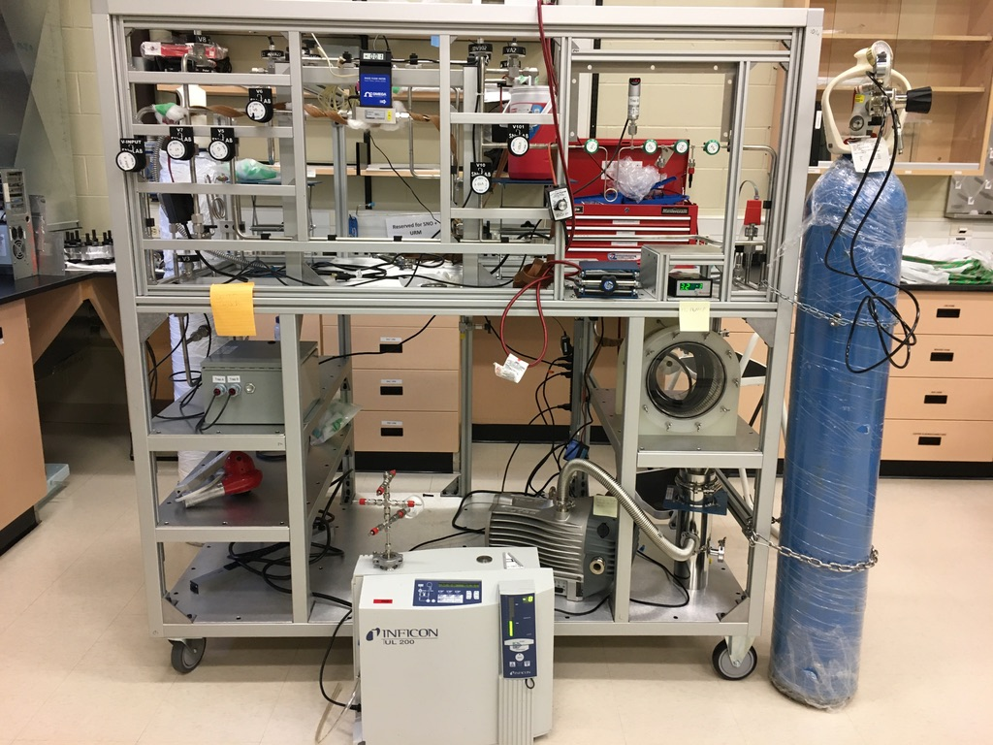
New Portable Rn Emanation Measurement Panel
Lucas cell
Secondary Trap
Acrylic
Emanation
Chamber

Slide 14
Portable Rn Emanation Measurement Panel
Orbital welded to avoid ingress of outside air
Acrylic chamber 20cm dia. x 20cm height. More
chambers to be added
Built on a moving cart
Two primary traps (bronze wool/Chromosorb)
Attachment port to connect sources or samples

Slide 15
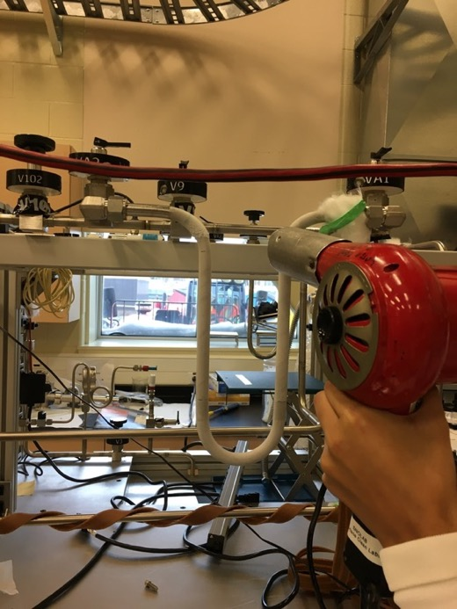
Primary/Secondary Traps
Primary traps are U-shaped ½ inch SS tubing.
Primary trap efficiency is increased by inserting bronze wool/chromosorb
Bronze wool generates an increased surface area in the trap
Chromosorb also has high effective surface area (300-400 m^2/g).
Secondary trap custom designed by Swagelok.
Coiled SS 1/8-inch diameter tube and has steel wire inserted to reduce volume.
1/8-inch selected to improve the Rn transfer efficiency by minimizing the dead volumes.

Slide 16
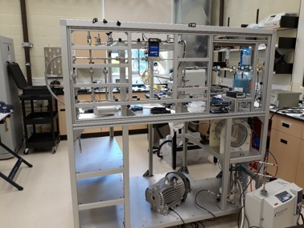

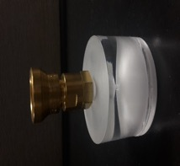
Radon Emanation/Extraction Process
Radon emanation is the process of removing all existing radon from a sample and letting new radon to be produced.
Once sample has been refilled with radon intrinsic to the sample, it is harvested.
Clean chamber , sample
Put sample in the vacuum chamber
Pump down chamber, whole system
Collected Rn is transferred into a
counter (Lucas cell)
Perform Rn extraction using Rn gas board
& allows most other residual gas to be
exhausted from the system
Wait ~2 weeks for Rn to be emanated from
the sample. Rn exists as residual gas inside chamber

Slide 17
Radon Extraction Process
Pump down Rn Board System
Primary trap (bronze wool/Chromosorb)
Secondary trap
The whole Board system (not the chamber).

Slide 18
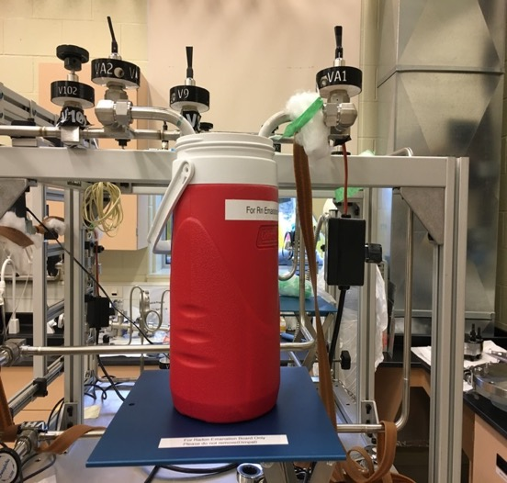
Radon Extraction Process
Extraction of Rn from Chamber (Rn pumped out to primary trap using LN2)
Radon freezes at ~61C, LN2 temperature is ~ -196 C
Primary trap immersed in LN2. Chamber to trap valve opened.
Rn freezes & sticks to bronze wool/chromosorb
(other gases like CO2, N2 exhausted from the system)
Extraction time: vacuum pull transfer for 1hour.

Slide 19
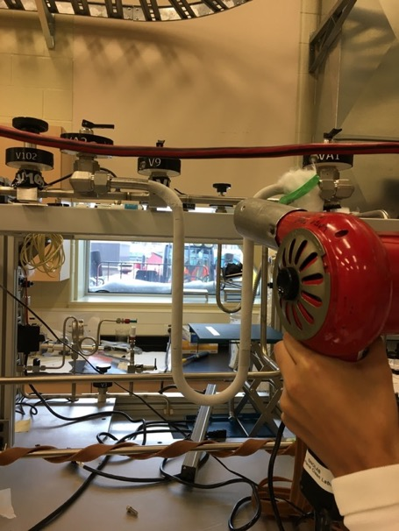
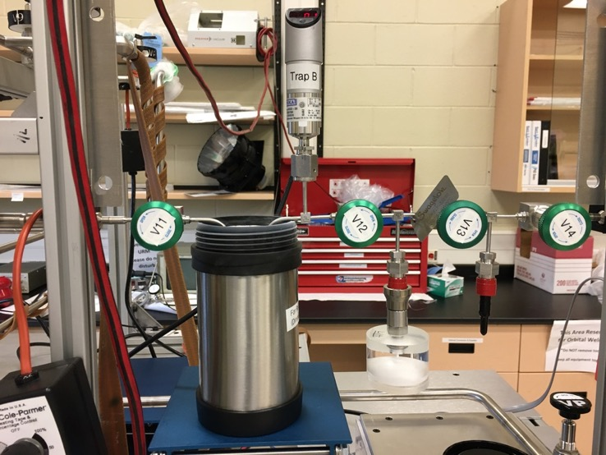
Radon Extraction Process
Transfer from Primary Trap to Secondary Trap
Secondary trap immersed in LN2
Primary trap warmed (~100C) restoring Rn to its gaseous state
Inlet of Primary trap closed & valve between Primary and secondary trap opened
Collected Rn transferred by cryo-pumping ~15 minutes.

Slide 20
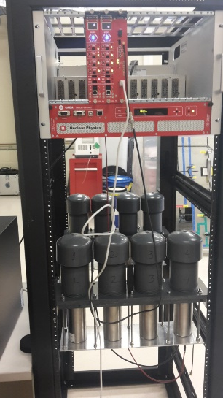
Radon Extraction Process
Transfer from Secondary Trap to Lucas cell
Attach LC to the system and evacuate
Secondary trap isolated and valve between LC and secondary
trap opened
Secondary trap heated using heat gun ~3-4 minutes
Collected Rn transferred by volume sharing (volume of LC > trap)
~15 minutes
Counting
LC coupled to PMT to count the number of alphas
Alpha particles produced in decay of 218Po, 214Po, 222Rn strike ZnS
producing flash of light detected by the PMT.
LC counted using CAEN DAQ system using 8 channels
More channels will be incorporated to increase counting capabilities

Slide 21
Efficiency of the System
Total efficiency= eff_{pumping}*eff_{trapping}*eff_{transfer} * eff_{detecting}
There are 3 alphas from Rn-222 daughters, this term causes the total efficiency to be more than 100%
Total efficiency: Ratio of measured Rn atoms in LC to the calculated Rn atoms in the initial Rn sample
Pump Rn from chamber to Primary trap
Absorb Rn in LN2 cooled Traps
Transfer Rn from trap to LC
Measure the source activity
Pumping Efficiency
Trapping Efficiency
Transfer Efficiency
Detection Efficiency

Slide 22
Total Efficiency of the System
Test # | Efficiency (%)
Run 1 | 215 .65 +/- 11.36
Run 2 | 192.76 +/- 10.34
Run 3 | 245.87 +/- 16.07
Run 4 | 223.31 +/- 11.59
Run 5 | 222.89 +/- 11.70
X Run 6 | 157.93 +/- 8.30
Weighted average | 199.23 +/- 4.46
Rn emanation is a multi-stage process.
Performed set of independent measurements to obtain the total efficiency of the system.
Systematic error expected to define uncertainty, since statistical error is small.
Systematic studies in progress.

Slide 23
Background Level of the System
Board background is usually negligible if the board is not contaminated.
Regular board background tests performed. Sensitivity of our system is 2 Rn/day
Lucas cell background varies over time. Initially background is ~ 3 counts/day, but it builds up after few years if the Lucas cell continuously used for radon emanation studies
  Pb-210 buildup (22 years half-life)
  Need to build new Lucas cells regularly

Slide 24
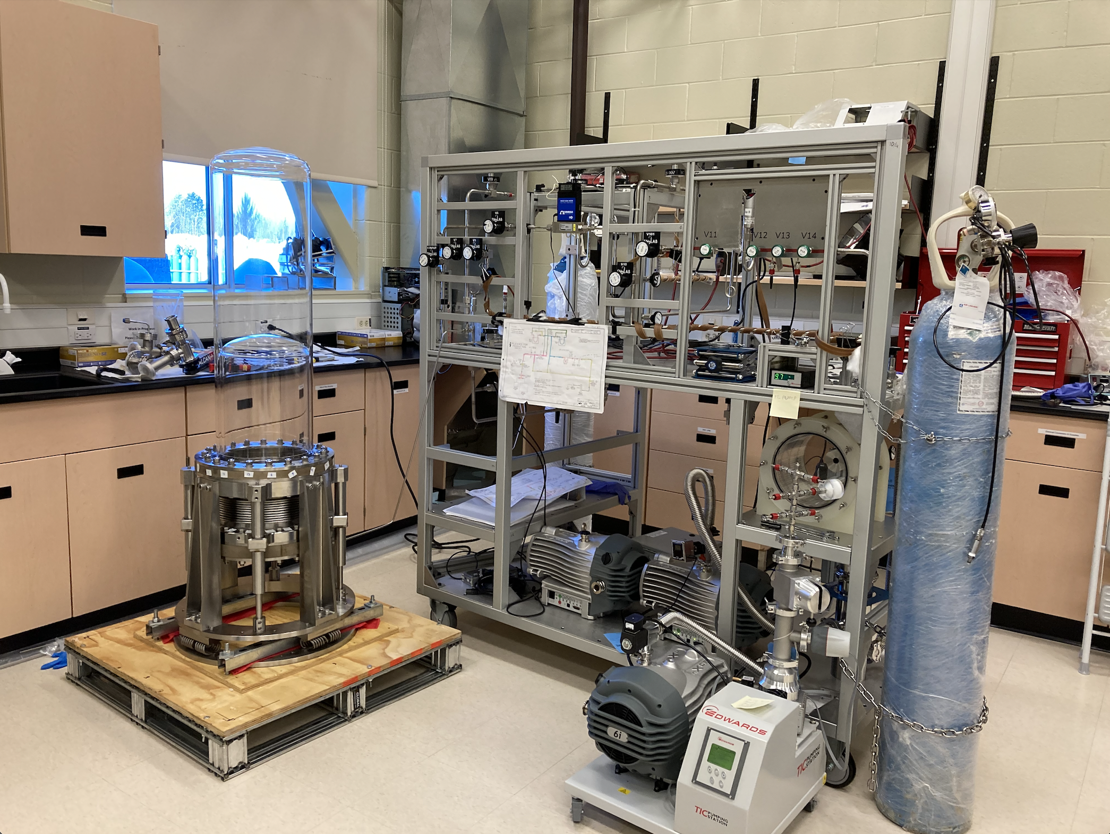
Services to the community so far…
Performed Rn emanation studies of DEAP filter – 3 tests, results sent to the collaboration.
Rn emanation studies of PICO-40L vessel – performed 3 tests, detailed report sent to PICO collaboration.

Slide 25
Services to the community so far…
Performed Rn emanation studies of SNO+ LAB assay components– Tests still ongoing.
Rn emanation studies of material from Health Canada – Campaign expected to start February 2023.
Other Rn emanation studies of samples performed.

Slide 26
Summary
New surface Rn emanation measurement facility for material selection studies with a sensitivity of 2 Rn/day.
We have a robust Rn-222 Emanation screening technique which can be used to study different detector construction materials.
Good handle on Rn-222 emanation studies in vacuum mode. Systematic studies in progress.
Carrier gas Rn-222 emanation studies in progress.
Rn-222 emanation request form exist:
https://www.snolab.ca/users/services/gamma-assay/assay_request_form.html
Please feel free to contact us if you want your samples to be counted : dchauhan@snolab.ca

Slide 27
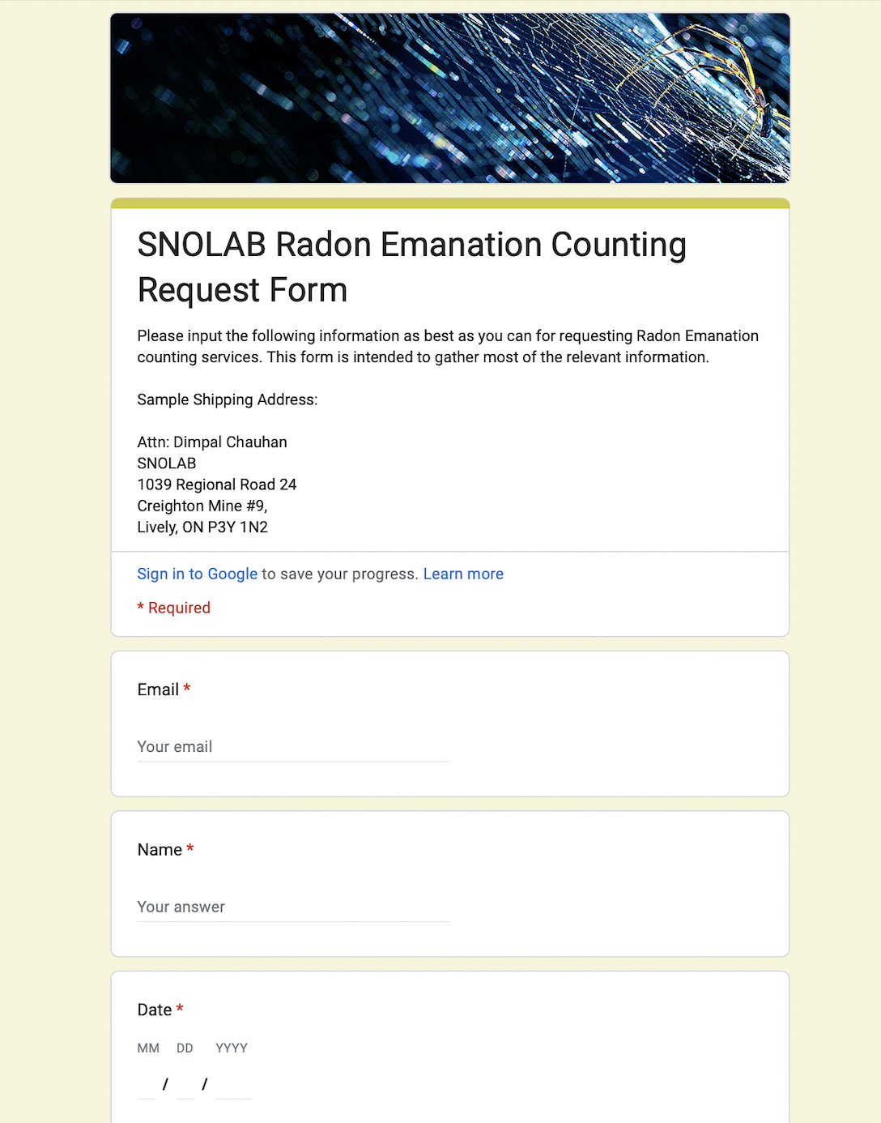
Summary
Please feel free to contact us if you want your samples to be counted : dchauhan@snolab.ca
3 minutes video of SNOLAB surface radon emanation
measurement system
https://youtu.be/cjo2RsvApPE

Slide 28
Thanks

Slide 29
Backup Slides

Slide 31
J
J
J
Chromosorb
J
J
J
J
J

