Slide 1

Particle Swarm Optimisation in GW signal Detection
Rajesh Kumble Nayak
IISER Kolkata
With Souradeep Pal
AAPCOS-2023 @SINP

Slide 2
Outline
GW Detection Problem
Optimisation Detection Statistics
Particle Swarm Optimisation(PSO)
Usefulness of PSO in GW detection problem
Applying PSO based application on real data
Results and Conclusions

Slide 3
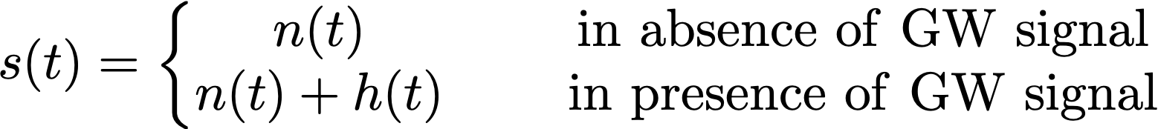
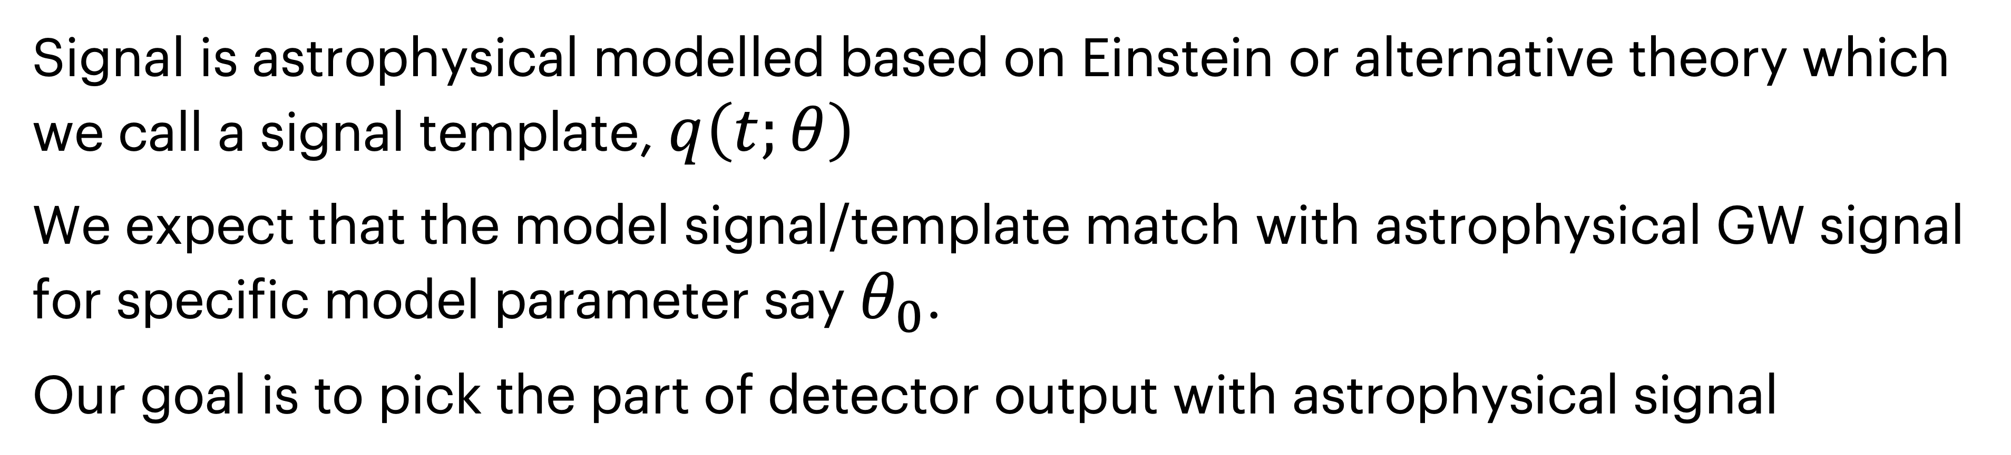
GW Detection Problem
The output from a GW detector, a time series $s(t)$ can be written as:
Here, n(t) is detector noise and h(t) is GW signal from astrophysical sources.
Signal is astrophysical modelled based on Einstein or alternative theory which we call a signal template, $q\left(t;θ\right)$
We expect that the model signal/template match with astrophysical GW signal for specific model parameter say $θ_{0}$.
Our goal is to pick the part of detector output with astrophysical signal

Slide 4
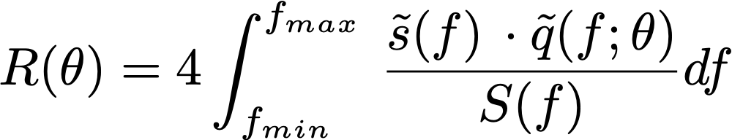
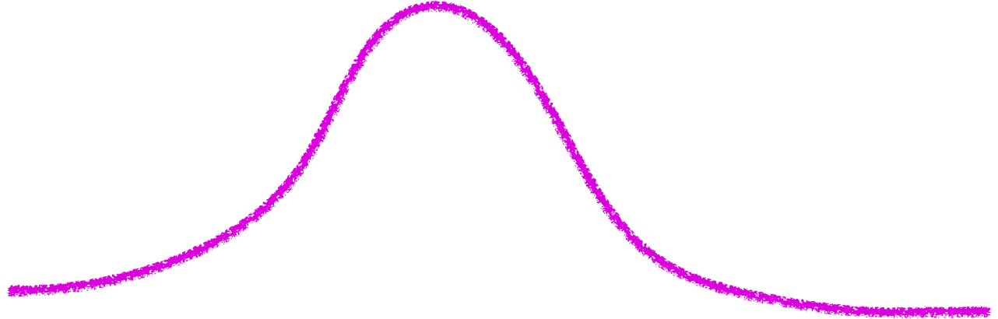
Neyman−Pearson criterion
The detection probability is given by the match or weighted correlation with noise PSD, $S(f)$, is given by,
It can be shown that $R(θ)$ is optimal statistic for Guassian noise.
Threshold
Noise statistics
This is prob. that noise behave like a signal
False Alram Prob

Slide 5
Neyman−Pearson criterion
The detection probability is given by the match or weighted correlation with noise PSD, $S(f)$, is given by,
It can be shown that $R(θ)$ is optimal statistic for Guassian noise.
Threshold
Detection prob
Noise statistics
Signal Statistics

Slide 6
Neyman−Pearson criterion
Threshold
Detection prob
Noise statistics
Signal Statistics
Neyman−Pearson criterion: Maximise the detection statistic over model parameters $θ$ using a threshold provided by a given false-alarm probability.

Slide 7
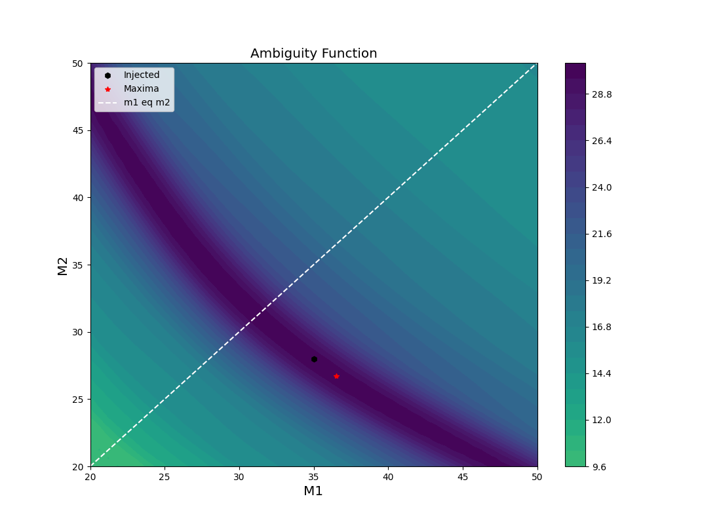
Some interesting points!
Match-making is expensive!
Even for the simple waveforms.
Complex waveforms contribute additional difficulty
Noise brings in local peaks and maximisation scheme can get trapped

Slide 8
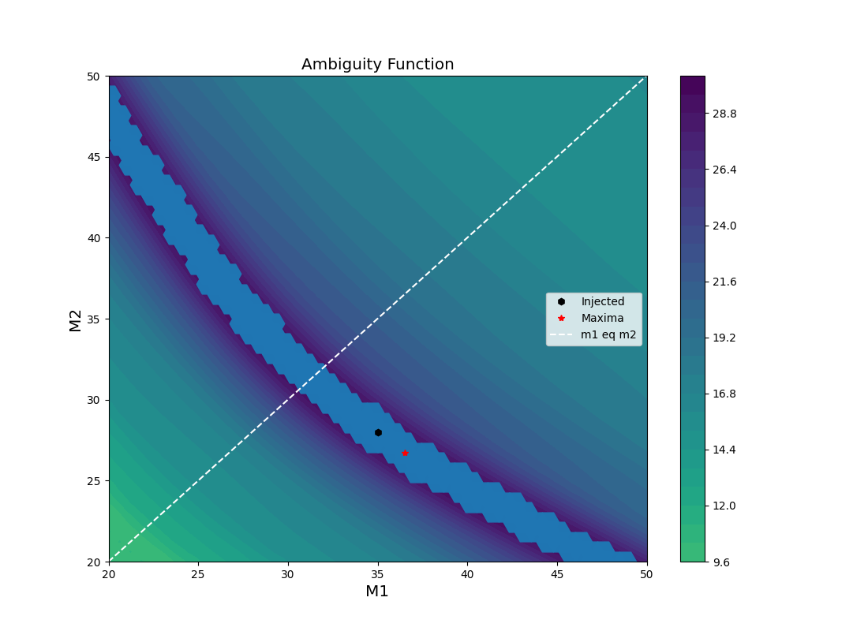
Some interesting points!
A Template

Slide 9
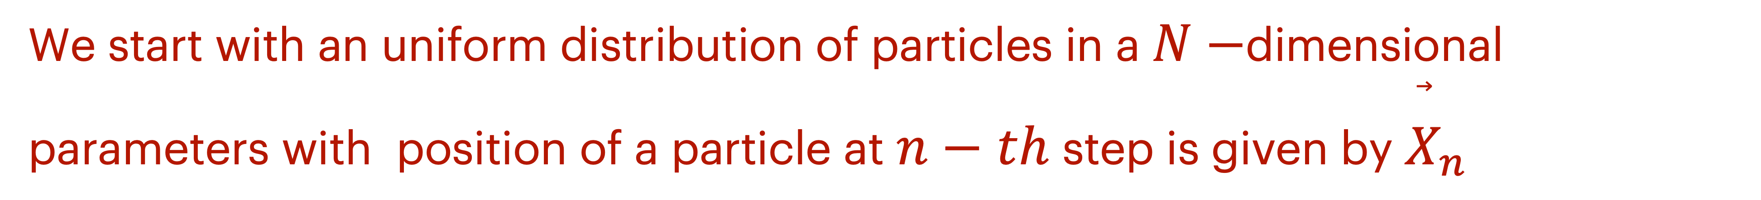
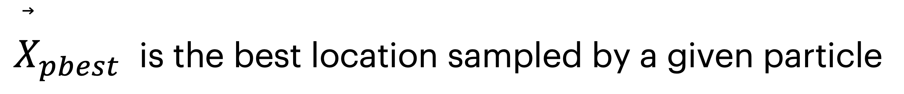

Particle Swarm optimisation!
In this method, a set of particles makes a “controlled” random walk in given parameter space to optimise a given function. Members share helpful information with the entire swarm and converge to an optimal point in the parameter space.
We start with an uniform distribution of particles in a $N−$dimensional parameters with position of a particle at $n−th$ step is given by ${\overset{⃗}{X}}_{n}$
The velocity of ${\overset{⃗}{V}}_{n}$ at $n−th$ step evolves as per rule
$α,βandγ$ are parameters of the algorithm, $\left(r_{0},r_{1},r_{2}\right)$ are set of random number between $(0,1)$.
${\overset{⃗}{X}}_{pbest}$ is the best location sampled by a given particle

Slide 10
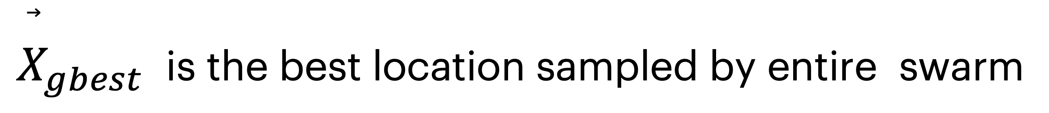

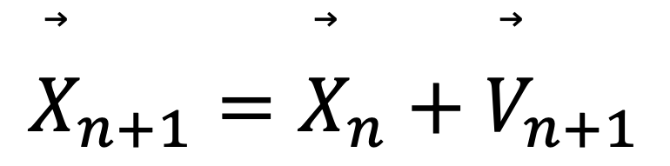
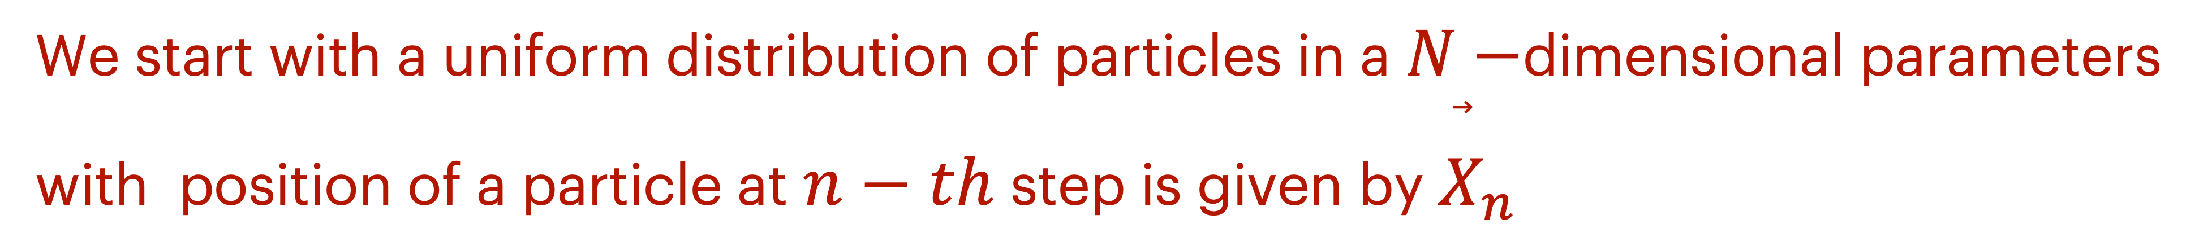
In this method, a set of particles make a “controlled” random walk in a given parameter space for optimising a given function. Members share useful information with entire swarm and converge to an optimal point in the parameter space.
Particle Swarm optimisation!
We start with a uniform distribution of particles in a $N−$dimensional parameters with position of a particle at $n−th$ step is given by ${\overset{⃗}{X}}_{n}$
The velocity of ${\overset{⃗}{V}}_{n}$ at $n−th$ step evolves as per rule
$α,βandγ$ are parameters of the algorithm, $\left(r_{0},r_{1},r_{2}\right)$ are set of random number between $(0,1)$.
${\overset{⃗}{X}}_{pbest}$ is the best location sampled by a given particle till current step
${\overset{⃗}{X}}_{gbest}$ is the best location sampled by entire swarm
The position evolution at $n−th$ step is given by
$${\overset{⃗}{X}}_{n+1}={\overset{⃗}{X}}_{n}+{\overset{⃗}{V}}_{n+1}$$

Slide 11






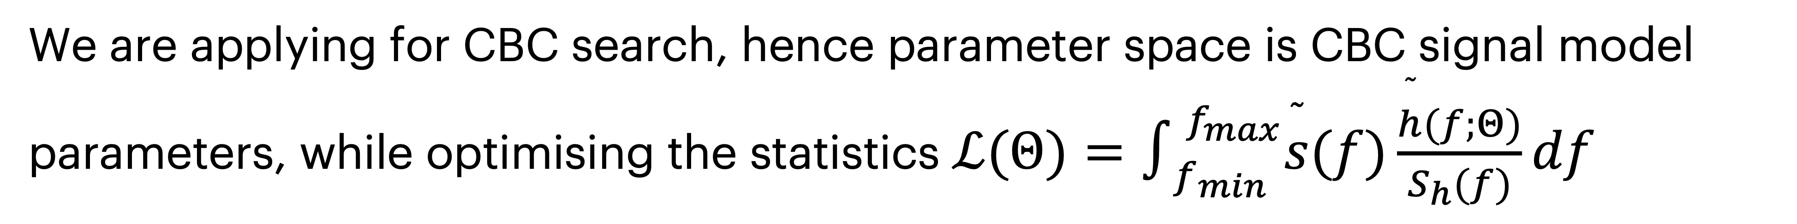
Particle Swarm optimisation!
$i−th$ Particle
Particle
P-best
G-best
Next-step
We are applying for CBC search, hence parameter space is CBC signal model parameters, while optimising the statistics $ℒ(Θ)=∫_{f_{min}}^{f_{max}}\overset{˜}{s}(f)\frac{\overset{˜}{h}(f;Θ)}{S_{h}(f)}df$

Slide 12
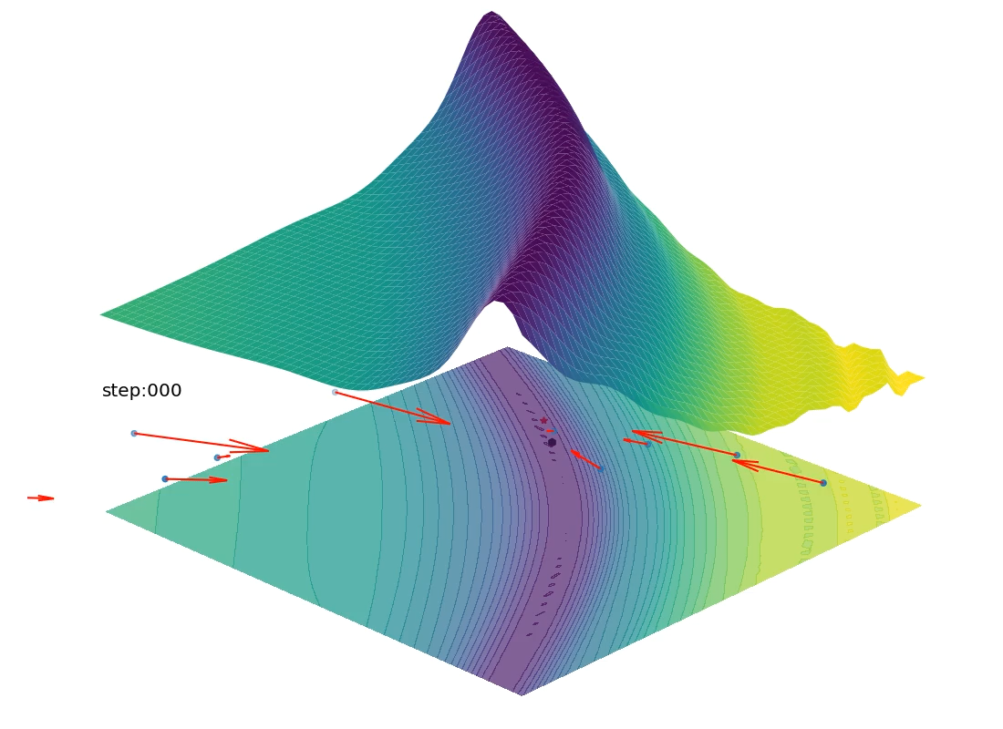
10 Particle in 20 steps

Slide 13
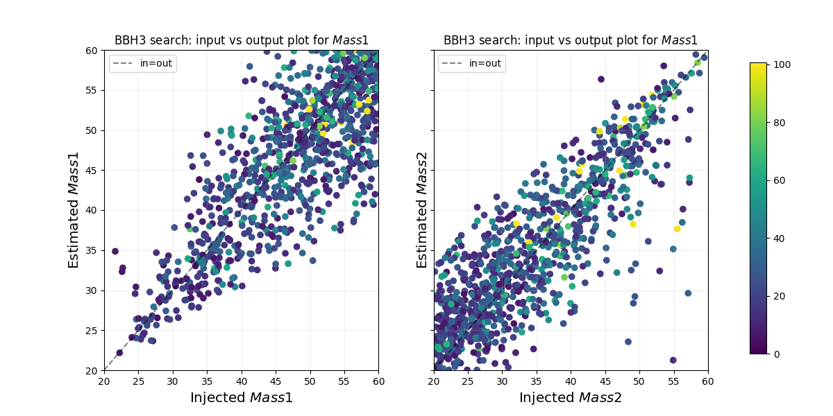
Injected Vs Estimated $M_{1}andM_{2}$ Non-spinning

Slide 14
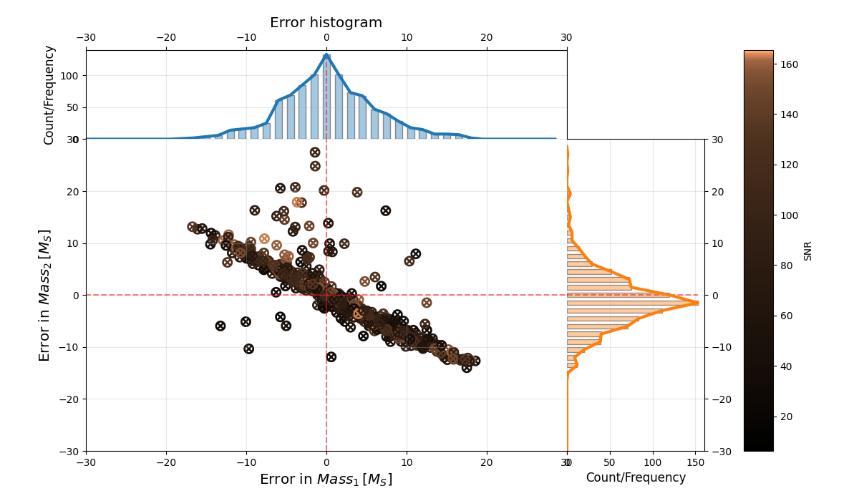
Error Estimated $M_{1}andM_{2}$ aligned-spin

Slide 15
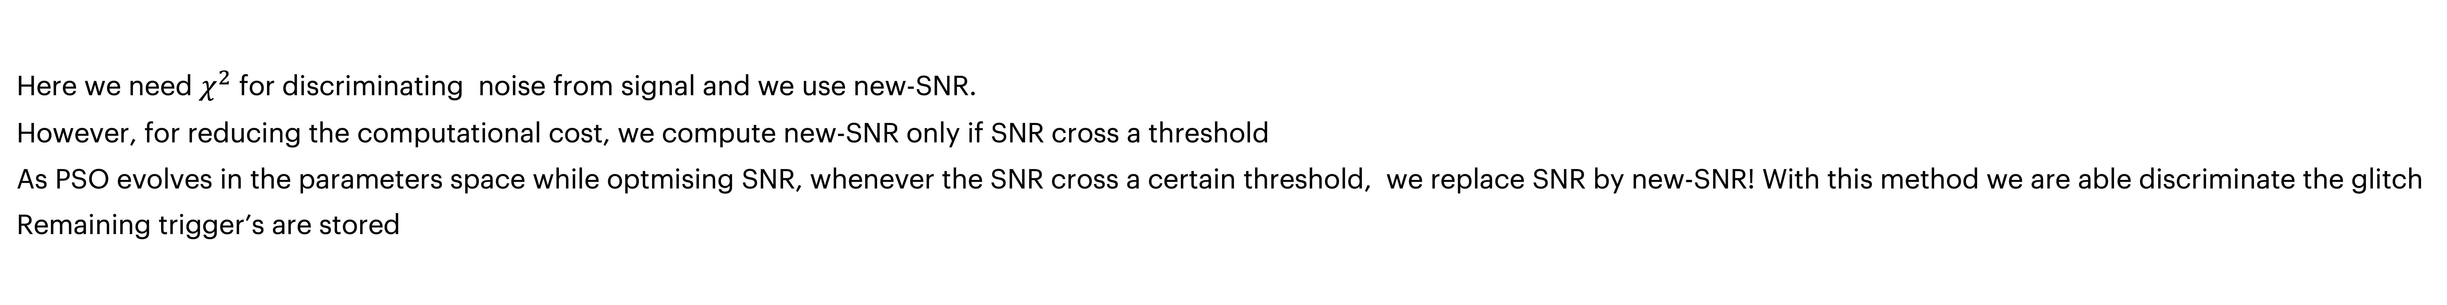
Real Detector data
Real detector data is far more complex.
Noise glitch
Unlike simulated noise, real noise generated lots of high SNR triggers
Here we need $χ^{2}$ for discriminating noise from signal and we use new-SNR.
However, for reducing the computational cost, we compute new-SNR only if SNR cross a threshold
As PSO evolves in the parameters space while optmising SNR, whenever the SNR cross a certain threshold, we replace SNR by new-SNR! With this method we are able discriminate the glitch
Remaining trigger’s are stored

Slide 17
Significance estimation - Coincidence mode!
We use standard time-sliding mechanism to compute the false alarm.
All the trigger (with new-SNR) are collected from each IFO
Trigger are grouped (with arrival time) to generate a event. Simple time-clustering and averaging is currently employed. This may be developed further in future.
Triggers forming a coincidence give foreground candidates that may be further constrained by network SNR (somewhere 8-9).
Triggers shifted in time by more than time-of-flight ( ~ 10 ms for HL) plus a timing error (some 5ms) between two detectors give rise to background events.

Slide 18
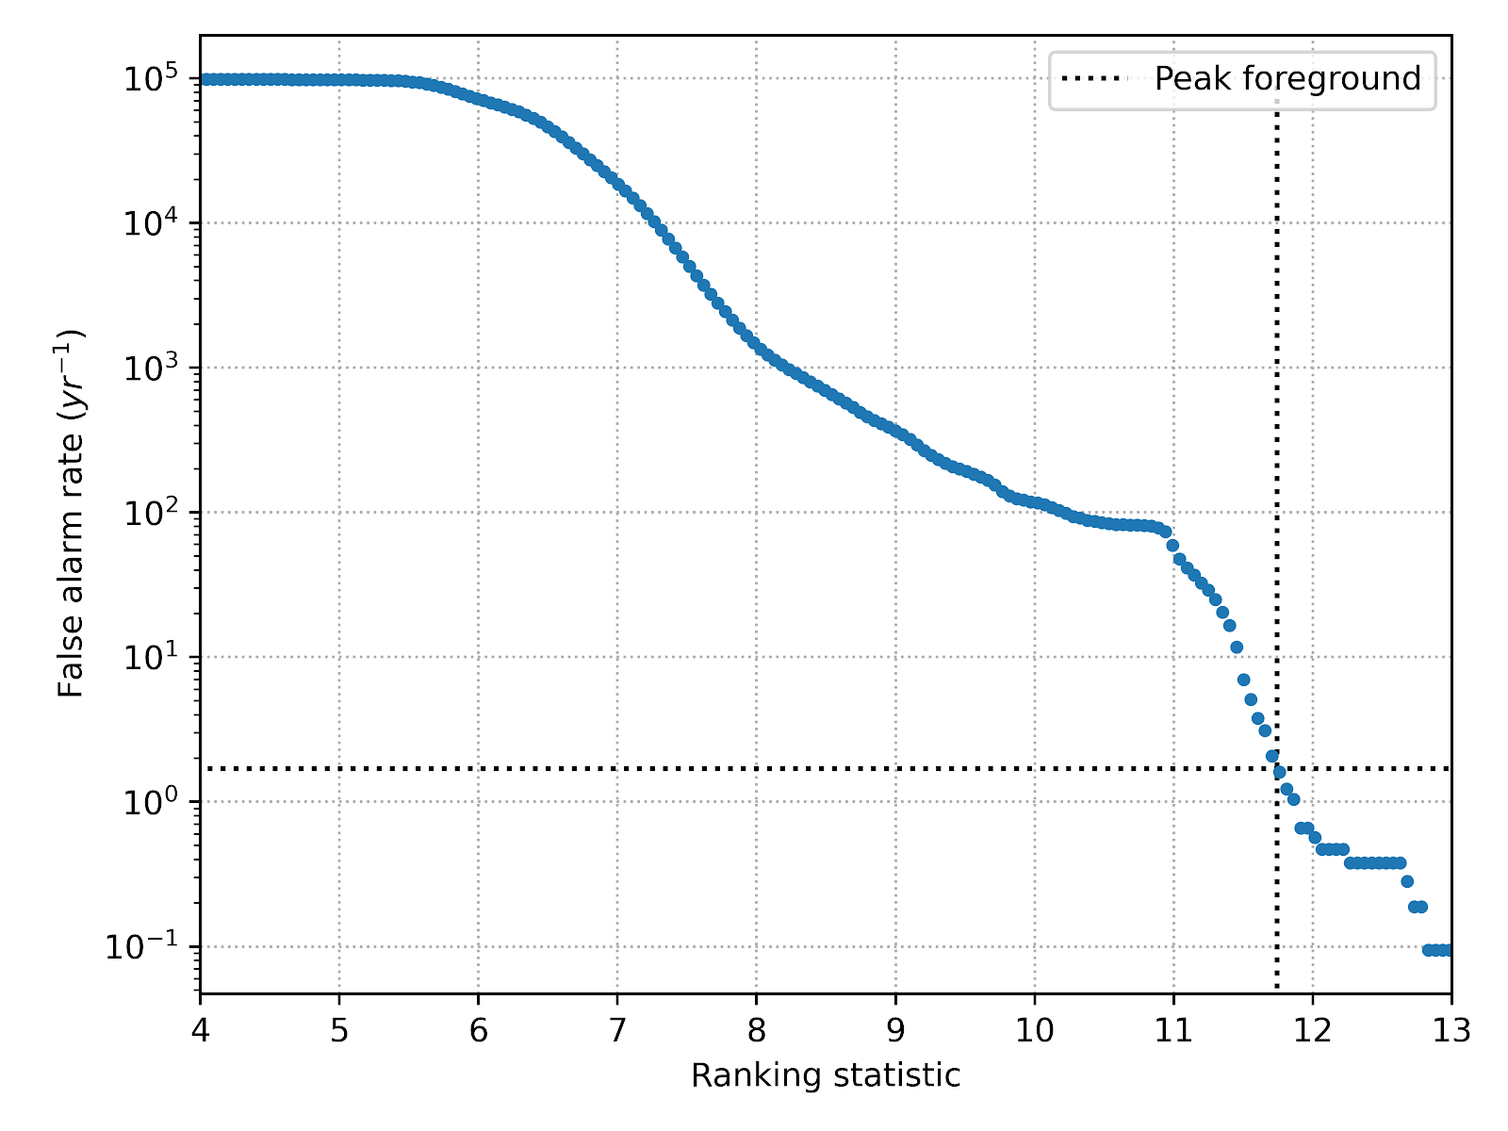
Example: GW190503_185404
We use only H1, L1 data (no trigger in V1).
Analysis duration ~ 4096 sec around each event.
Time-shift interval ~ 50 ms.
Background time generated ~ 10 yr [ = 4096 sec x 4096 sec) / (50 ms)]
FAR (of a foreground event) = (No. of background events louder than the given foreground event) / (Total background time generated).
If the (no. of background events louder than the given foreground event) < 1, then assign a FAR: < 1 / (Total background time generated).

Slide 19
Concluding remarks
PSO based search pipe-line is implemented and successfully applied on real data. Not need for a prior template bank.
Useful when when it becomes hard or impossible to compute template bank.
Better source parameter are by-product of search pipe-line, no need for additional rapid PE
Extremely useful if search parameter have to extended.
    Fully precessing search [Varun Srivastava, K Rajesh Nayak, Sukanta Bose: arXiv:1811.02401]
    Eccentric search [LIGO-G2200981]

Slide 20
Acknowledgements
We have extensively used the various tools provided by the PyCBC package
We have used O3 data provided by the GWOSC.
We acknowledge Sarathi cluster @ IUCAA
We acknowledge funding by MHRD under FAST scheme for CESSI

