Slide 1
R-ECFA Meeting:
CONNECTION TO INDUSTRY
Manuel Moreno Ballesteros
CDTI (Centre for the Development of Industrial Technology)
Spanish Industrial Liaison Officer: CERN, ESS, ESRF, XFEL and ILL
Madrid, 1 March 2019

Slide 2
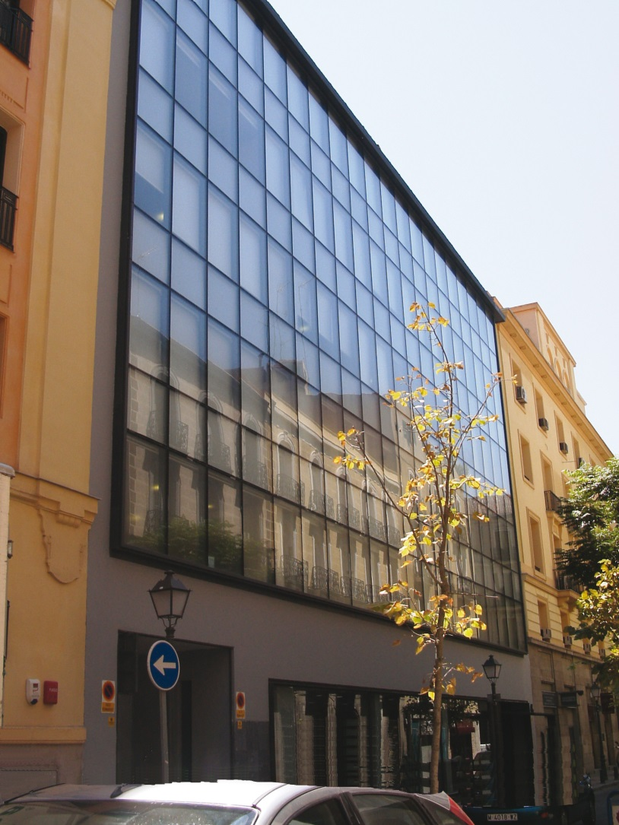
CDTI-Centre for the Development of Industrial Technology-
CDTI is a Public Business Entity, answering to the Ministry of Science, Innovation and Universities.
The CDTI seeks to contribute to improving spanish companies´ competitiveness and internationalization through innovation.
Main activities:
Financial and economic-technical assessment of R&D projects implemented by companies.
Managing and fostering Spanish participation in international technological cooperation programmes.
Supporting the setting up and consolidating technological companies.

Slide 3

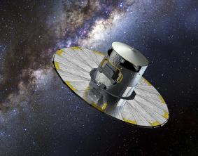
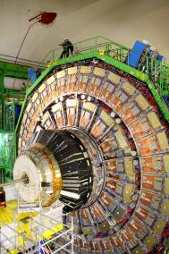
CDTI Business Innovation Financing Agency - 2018
990 M€ In direct financing
  730 M€ for R+D
  160 M€ for Innovation
  100 M€ For venture capital
460 M€ Industrial return H2020
250 M€ Industrial return: Big Science and Space

Slide 4
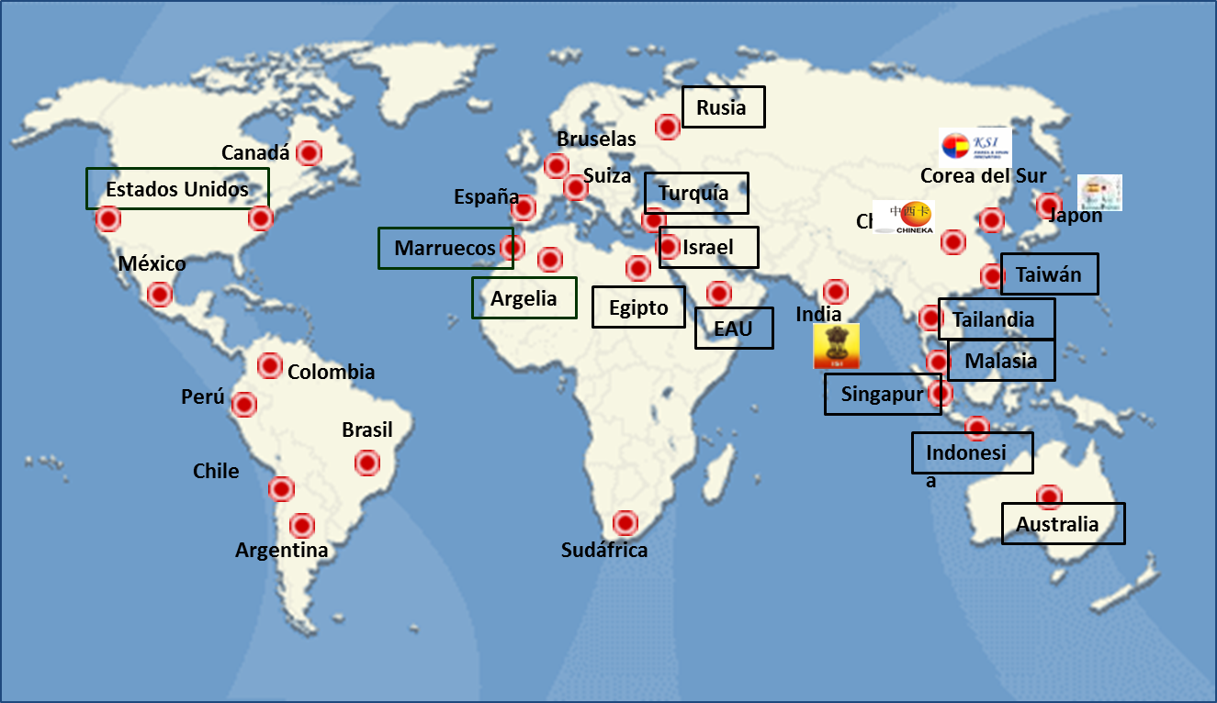
CDTI International R&D collaboration

Slide 5
CDTI ECOSYSTEM
RTDI funding
Support to the creation and consolidation of new technology based companies
Evaluation and funding
Reports towards tax exemption
INNVIERTE
Neotec grants
RTDI internationalization
Technological Returns
Technological Cooperation: Eureka, Iberoeka, Eurostars, H2020
Support to technological transfer: Foreign network
  Space: ESA, Hispasat, Eumetsat, ..
  Big Science - Technological supplies: CERN, ESRF, ILL, ESS, XFEL, ITER, ESO,
*RTDI - Research, Technology, Development & Innovation -

Slide 6

CDTI: Our role in Big Science
Big Science -
CDTI host the ILO's (Industrial Liaison Officers) Spanish network and has accumulated experience for over 25 years as ILO's for Big Science
Full-time professional managers
Management independence. No conflicts of interest arising from participation in projects.
Open management and networking: Service is provided to all types of participating entities. Support to all departments of the Spanish Government.
Great experience in international and domestic environments: multidisciplinary team with a good knowledge of the national RTD&I system
CDTI Tools: CDTI has a common database of more than 250 companies active in Big Science market
Big Experience hosting international events organization: Eureka Innovation week (2018), Spain at ESO(2015), Spain at CERN (2018), focused on B2B meetings.

Slide 7








CDTI: Spanish ILO functions in Big Science
ILO RESEARCH INFRASTRUCTURE (RI)
  Nominated ILO for the Spanish Delegation (MICIU).
  Regular meetings between ILO´s and Procurement Office.
  Facilitate the flow of communication between RI and companies
  Advising Research Infrastructures on the national industrial capacities
ILO NATIONAL INDUSTRY
  Main point of contact for tenders & medium term plans
  Organization of Industry Days, visits to the RI, etc.
  Supporting R&D projects
  Assisting companies in their understanding of the technical, contractual and financial requirements to become a supplier and helping them to form consortium
  Following up of awarding contracts
  ILO SPANISH ADMINISTRATION (MICIU)
    Advise the Spanish Delegation on industry-related matters
    Participation at the RI Finance Committees
    Advising national funding agencies in the definition of in-kind contributions

Slide 8

CDTI: Spanish companies in Big Science
More than 250 spanish companies working for the Big Science Market
More than 1.350 Million € in contracts over the last 15 years, the last 5 years of which account for 65% of the total return.

Slide 9
CERN: Spanish situation regarding tendering

Slide 10
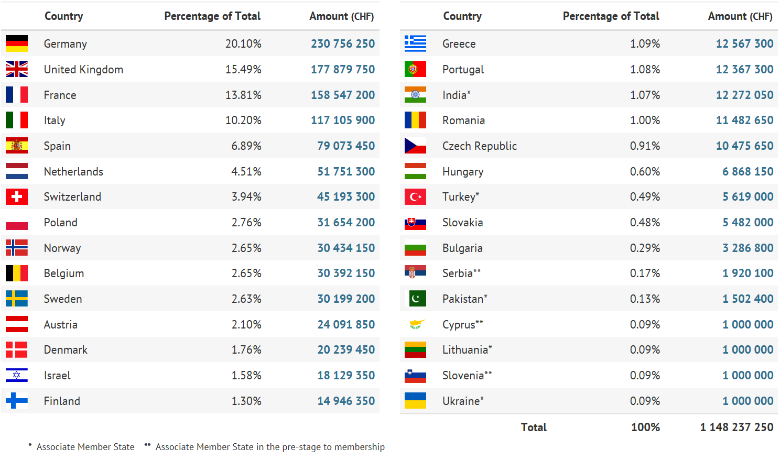
CERN: Yearly Budget (contributions 2018)*
* Source: CERN

Slide 11
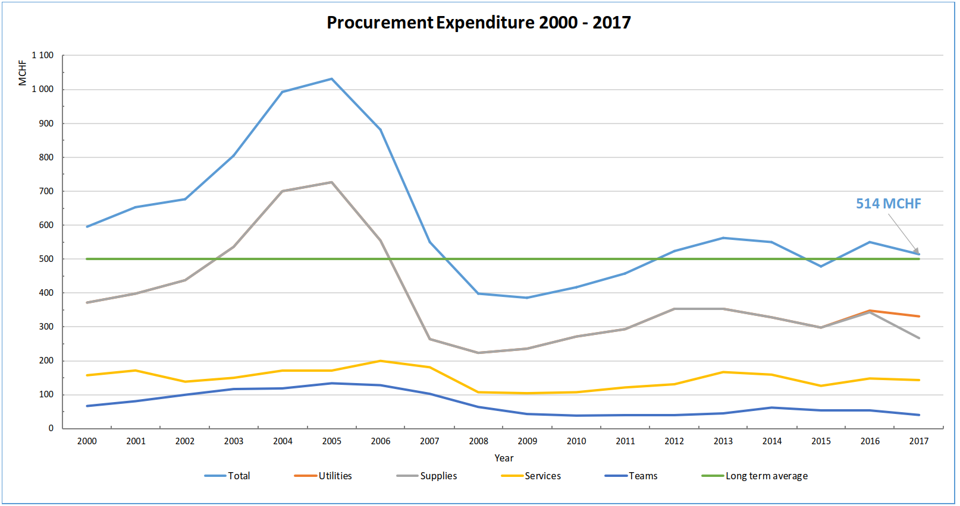
CERN: Procurement Expenditure*
* Source: CERN

Slide 12
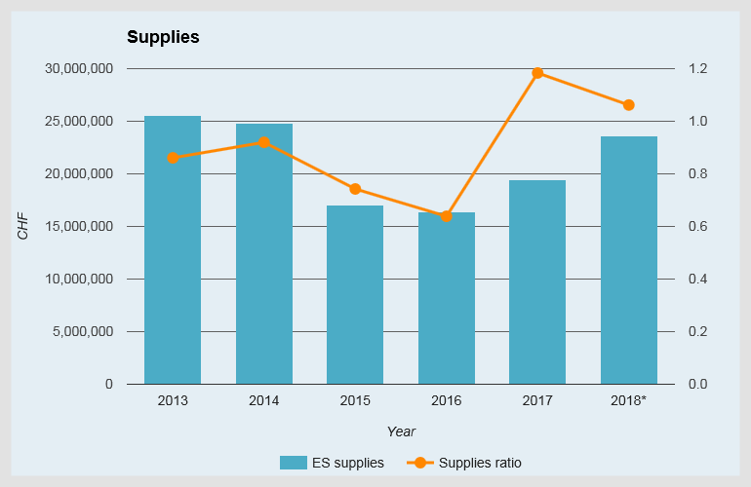
Spain: Industrial Return in supplies*
well balanced
Provisional data
* Source: CERN

Slide 13
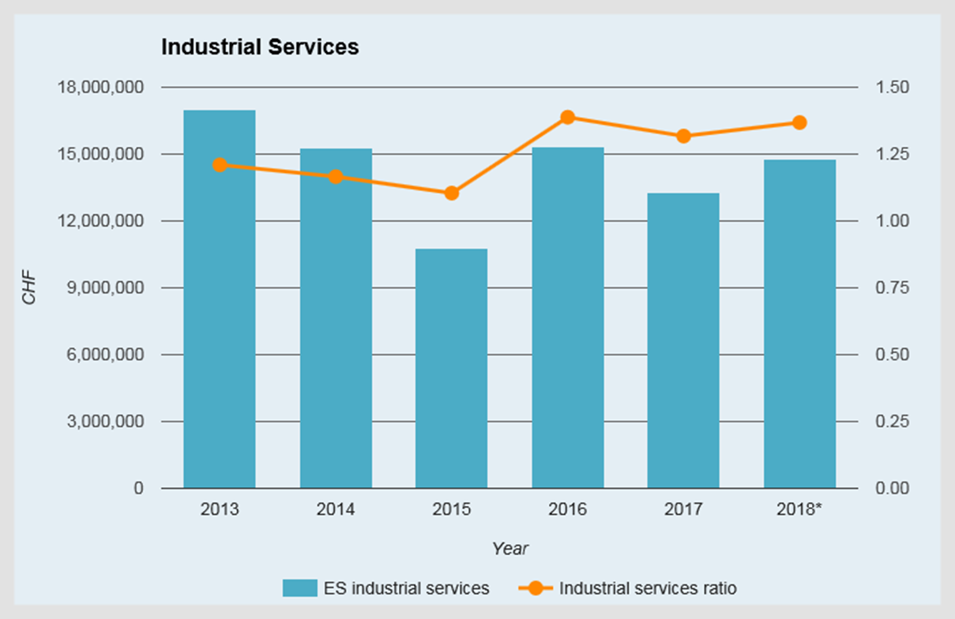
SPAIN: Industrial Return in services*
Spain has a well balanced
* Source: CERN

Slide 14
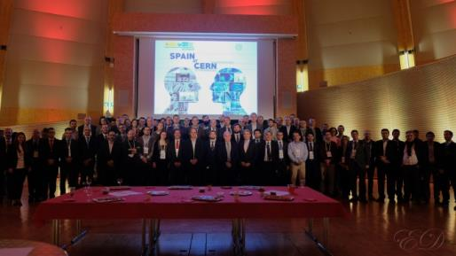

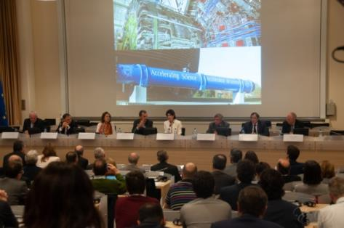
CERN: Promotion activity - Spain@CERN-
13th and 14th of November
57 companies participated in the event.
Agenda:
Opening Session (Pedro Duque Minister for Science, Innovation and Universities, Director-General F. Gianotti,…)
Plenary session – Purcharsing plans from Departments
B2B meetings Companies and CERN technical staff (number of the meetings 278)
Visits to workshops and experiments
Special social events (UN Dome Miquel Barceló,..)
Web: https://spain-at-cern.web.cern.ch

Slide 15
Key success factors at CERN
Profile of successful Companies at the CERN
Small – medium sized and flexible companies
Ensure full understanding of specifications – exceeded specifications may be too expensive
Communicate efficiently with CERN and ask questions when in doubt (issues, alternatives, etc.)
Take into account test requirements and documentation;
Follow-up closely on the performance of sub-contractors;
* Source: CERN

Slide 16
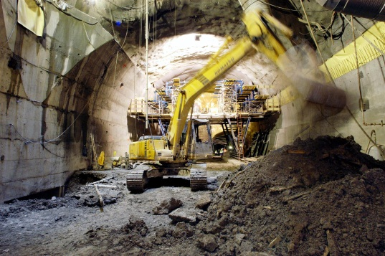
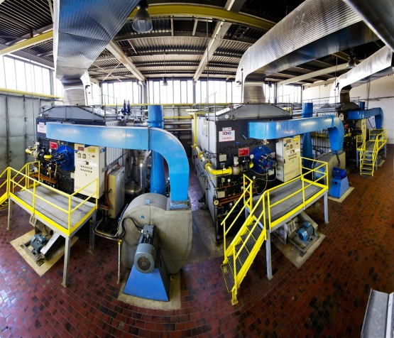
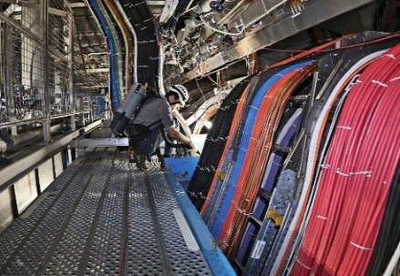
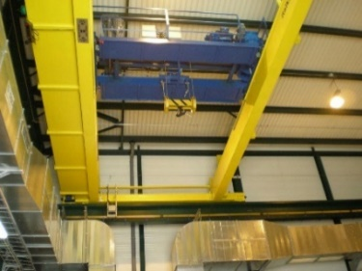
CERN: Opportunities*
Civil engineering:
  Construction, renovation of buildings
  Metallic structures, etc.
Infrastructure & services:
  Cooling & Ventilation
  Cables, electrical installations
  Mechanical engineering
  Security & access control, etc.
Installation, operation & maintenance
Data acquisition, IT systems, etc.
* Source: CERN

Slide 17
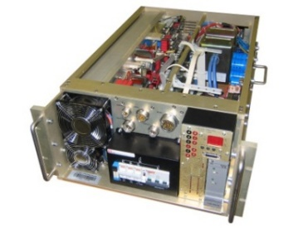
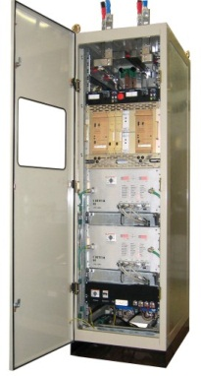
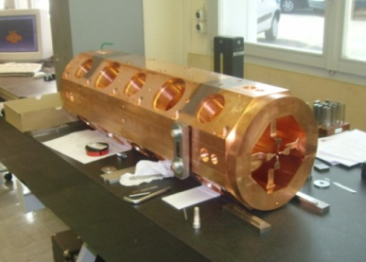
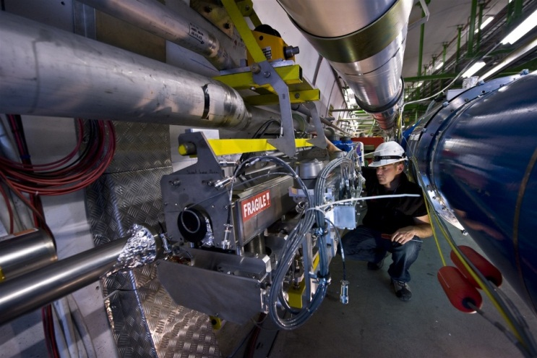
CERN – Oportunities in Technology for accelerators*
Industrial controls & field buses;
Timing & “fast” real-time controls;
Power converters;
Magnets;
Beams : instrumentation, collimation, injection, ejection & dump;
Other specific equipment : cryogenics, vacuum, radiofrequency.
New projects:
High Luminosity LHC (HL-LHC)
LHC Injectors Upgrade (LIU)+
Linear Collider studies (CLIC)
Future Circular Collider studies (FCC)
* Source: CERN

Slide 18
Spain: Industrial Challenges in Big Science
Increase Big Science industrial return
Release Big Science opportunities to more companies with a special focus on SMEs
Improve industry collaboration with laboratories, universities and scientific facilities at national and international level.
Foster collaboration in innovation, training and exchange programmes in Big Science Market and strengthen the relationship with ILOs of other countries (best practices exchange)
Plan to host international events: ESA Ministerial(2019) and next edition of Big Science Business Forum (2020) in Granada.

Slide 19
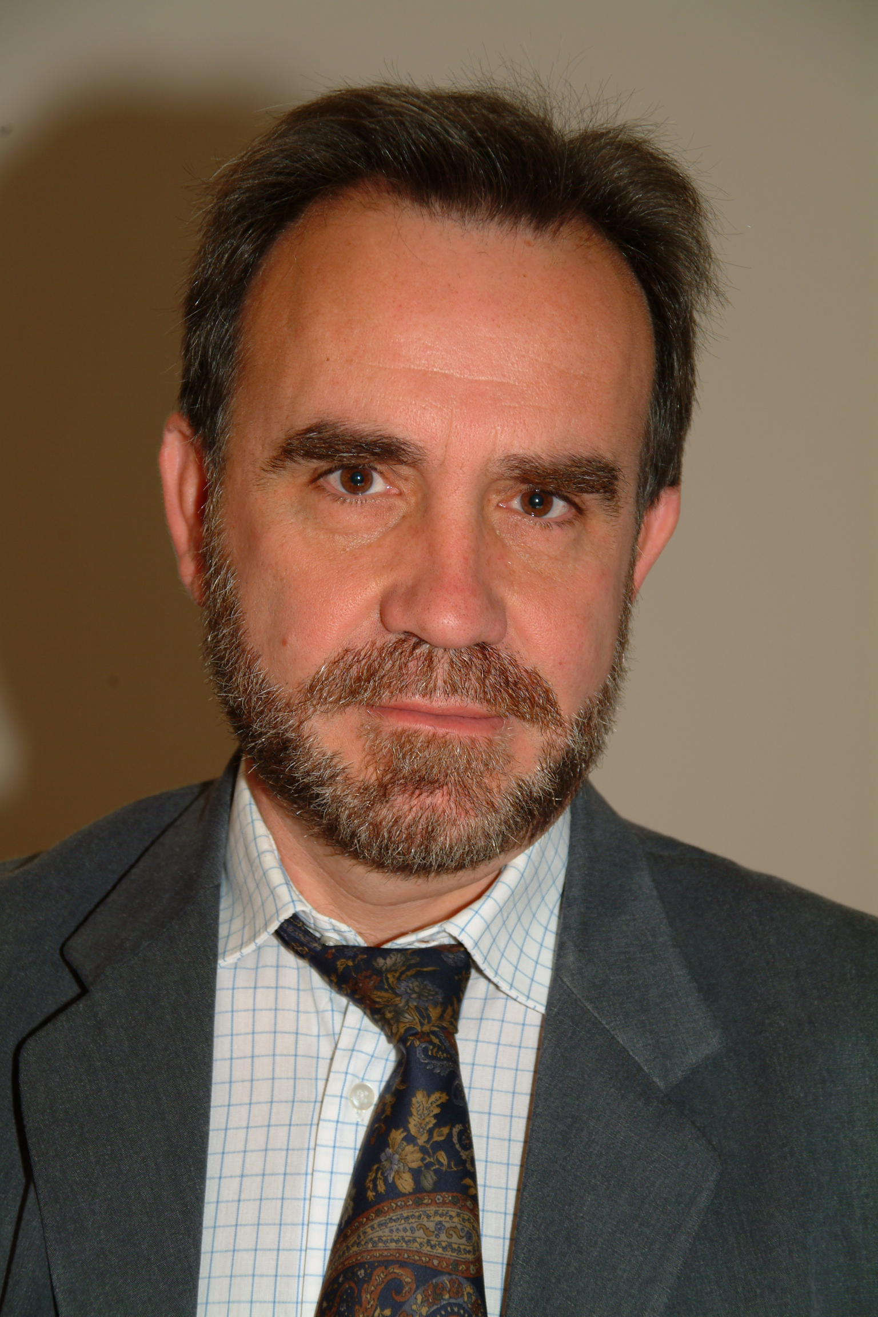
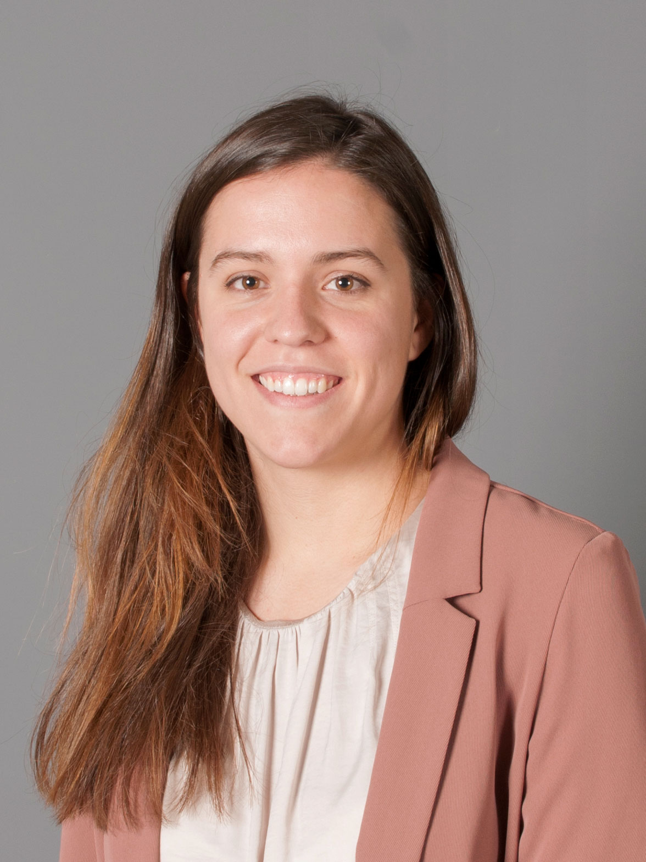
THANKS!
CERN: Industry Liaison Officers of Spain
Mr Manuel MORENO BALLESTEROS
Madrid
manuel.moreno@cdti.es
Tel: +34 91 581 55 43
Ms Ana Cristina SUJA LUCIA
CERN – Ginebra
ana.cristina.lucia@cern.ch
Tel.: Tel.: +41 22 767 4147 / +41 77 927 78 74

