Slide 1
Response to Reviewer Questions
O. Brüning, R. Calaga, O. Capatina, L. Rossi
HL-LHC Annual Meeting – Collaboration Board – Madrid – 13 November 2017

Slide 2
















IN-KIND CONTRIBUTIONS
Q1: HL-LHC & Collaborations: the long route
Personnel!
DOE Nb3Sn R&D
2000
Each in-kind is regulated by a formal collaboration agreement monitored by a Steering Committee composed by the Director for Accelerator and Project Leader for both Parties
LARP
generic
FP6
CARE
Nb3Sn
2005
CERN-KEK R&D
LARP
HiField quads
FP7
sLHC PP
(INJ)
FP7
EuCARD
HiField Dip
Project DS started
2010
KEK D1 design and construction
LARP
Demo
sLHC INJ implem.
EU collaborations
FP7 DS
Hi-Lumi LHC
Project approval
2015
BINP+...
Absorbers CC ampli. e-lens?...
TRIUMF CC cryostat
IHEP
CCT corrector
M
Today
Injector
upgrade
HL-LHC Construction
HL-LHC
install.& comm.
2024

Slide 3
Q1: HL-LHC Project Governance:
CERN Directorate and Accelerator & Technology Sector
ATSMB and EATSMB
ca. 1 / month
CMAC
Cost & Schedule
HL-LHC Experiments
HL-LHC and LIU Executive Committee
ca. 4 / year
HL-LHC Collaboration Board
once per year
HL-LHC Project Management
Every week
LIU Project
LMC
IEFC
HL-LHC Coordination Group
ca. 4 / year
HL-LHC Technical Coordination Committee
Every other week
ATS
DH & GL
HL-LHC Collaboration Steering Board
ca. once per year
PSM
1-2 / year
HL-LHC Work Packages
Depending on WP: every week

Slide 4
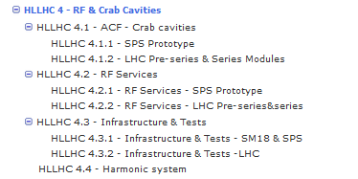
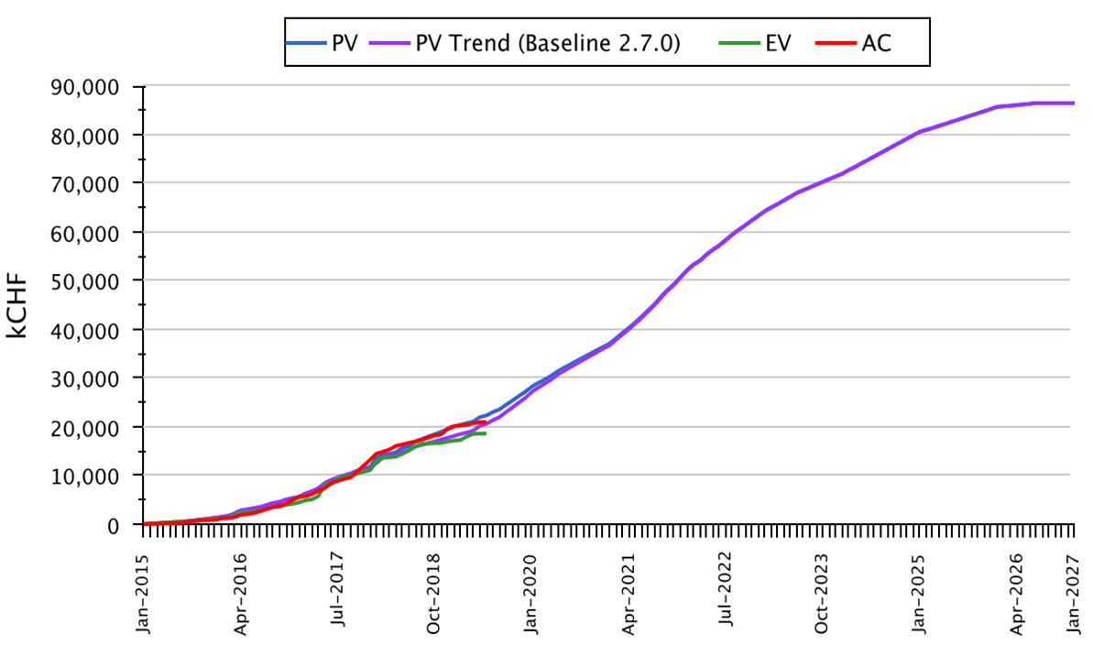
Q1: WBS Structure in EVM
Reviewed at project steering meetings
Every 3-months
Cost & Schedule Review – 18 months

Slide 5
Q1: Workpackage Structure
RF systems and
crab cavities (WP4)
LHC Cavities
(ACF)
Cryomodule
(ACFGA)
Bare cavities (ACFCA)
Helium vessel
(ACFHT)
Instrumentation
(ACFIS)
RF superconducting crab cavities
Tuning system
(ACFTU)
HOM couplers
(ACFHC)
Beam Axis
(XYZ)
LHC
RF services
(ACFSV)
LLRF & Fast Controls
(ALL)
RF racks
(AY)
Transmission lines
(ACFWG)
Slow controls
(AS)
Dressed cavities
(ACFDC)
Thermal shield & MLI
(ACFTS)
Cryogenic circuits
(ACFQC)
Cold magnetic shield
(ACFCM)
Harmonic system
800 MHz
Wide-band feedback system
Main coupler - FPC
(ACFMC)
External supports
(HACF)
Vacuum valves (VVG)
Cold –Warm Transitions (ACFVW)
Vacuum Vessel (ACFVT)
Warm Magnetic shield
(ACFWM)
Alignment Monitoring System
(ACFAM)
Support and Alignment System (ACFAH)
Cryomodule components
(ACFCC)
RF internal lines (ACFRL)
Pick-up antenna
(ACFPU)
RF Pick-ups (APW)
Inter Cavity Chamber (ACFVC)
Amplifiers
(ACFA)
Cryomodule Assembly
(ACF_A)
Beam Screen (ACFVS)
200 MHz
General Tooling
(ACF_T)
Forming Tooling
(ACFFT)
Machining Tooling
(ACFMT)
Welding Tooling
(ACFWT)
Clean Room Tooling
(ACFCT)
Amplifier Tetrode
(ACFAA)
Amplifier IOT
(ACFAB)
Amplifier Solid State
(ACFAC)
Amplifier 2nd Generation IOT
(ACFAD)
Amplifier 2nd Generation SSPA
(ACFAE)

Slide 6
Q1: Organization & Communication
CERN Internal WP4-Coordination
  General coordination – 1/month
  Cavities/Cryomodule (EN-MME, BE-RF-SRF, in-kind)
  RF couplers (BE-RF-PM + in-kind)
  High Power RF (BE-RF-PM)
  LLRF & Controls (BE-RF-FB)
  Integration (WP15/17, WP4) – two weekly meetings
  Cryogenics (WP9/TE-CRG), Vacuum (WP12/TE-VSC), Alignment (WP15.4/EN-SMM-SU)
CERN WP4-External Coordination
  General coordination meetings – 1/month
  Cavities/CM (in-kind) – Bi-weekly +Adhoc meetings
  RF Couplers (in-kind) – Weekly meetings or as needed

Slide 7
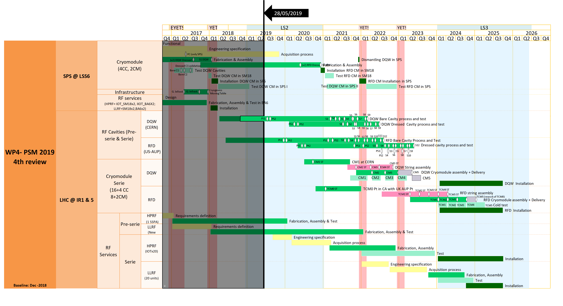
Q2: Masterplan WP4-CC
SPS-test CMs
HL-LHC CMs
RF Services

Slide 8
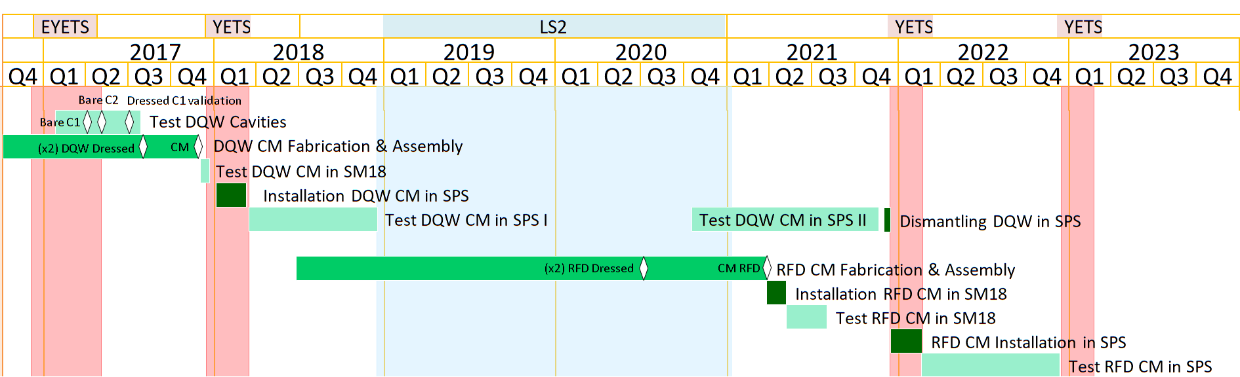
Q2: Strategic Plan for DQW/RFD-SPS

Slide 9
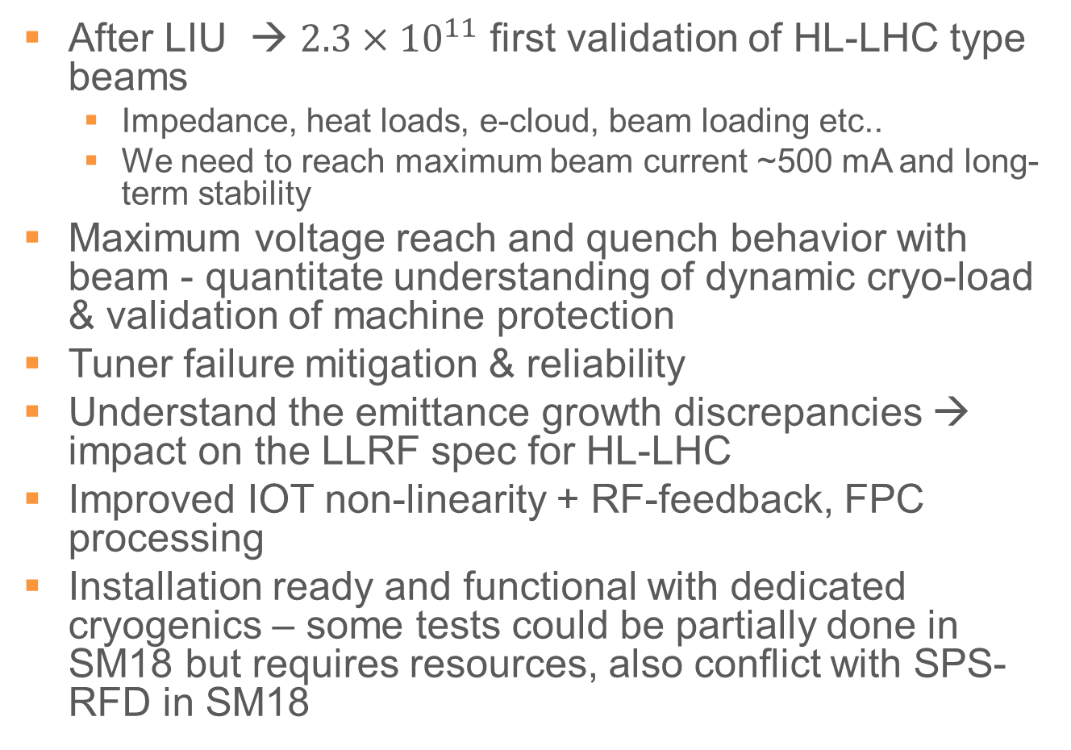
Q3: Gain for SPS-DQW Test2
After LIU → $2.3×{10}^{11}$ first validation of HL-LHC type beams
  Impedance, heat loads, e-cloud, beam loading etc..
  We need to reach maximum beam current ~500 mA and long-term stability
Maximum voltage reach and quench behavior with beam - quantitate understanding of dynamic cryo-load & validation of machine protection
Tuner failure mitigation & reliability
Understand the emittance growth discrepancies → impact on the LLRF spec for HL-LHC
Improved IOT non-linearity + RF-feedback, FPC processing
Installation ready and functional with dedicated cryogenics – some tests could be partially done in SM18 but requires resources, also conflict with SPS-RFD in SM18

Slide 10
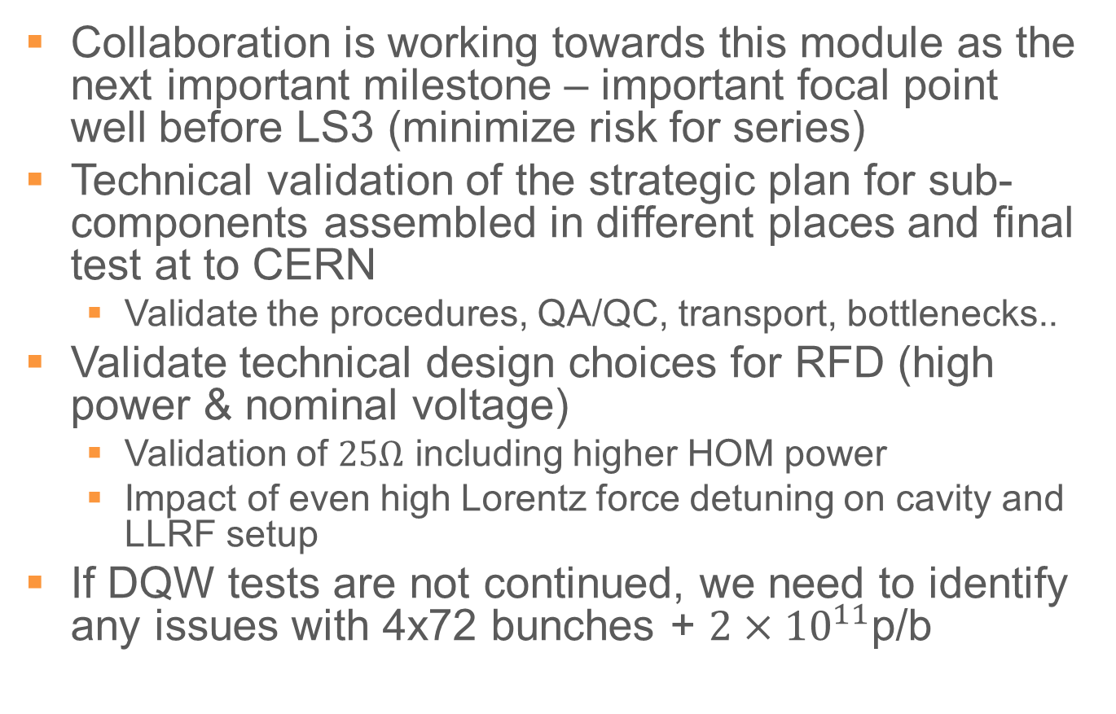
Q4: Impact of SPS-RFD (even late)
Collaboration is working towards this module as the next important milestone – important focal point well before LS3 (minimize risk for series)
Technical validation of the strategic plan for sub-components assembled in different places and final test at to CERN
  Validate the procedures, QA/QC, transport, bottlenecks..
Validate technical design choices for RFD (high power & nominal voltage)
  Validation of $25Ω$ including higher HOM power
  Impact of even high Lorentz force detuning on cavity and LLRF setup
If DQW tests are not continued, we need to identify any issues with 4x72 bunches + $2×{10}^{11}$p/b

Slide 11
Q6-7: Reviews before Procurement
RFD-SPS test (HL-LHC type)
  In agreement with between HL-project & UK, CM components will be finalized sequentially as they are ready between UK-STFC and WP4. Regular intermediate check point meetings already ongoing.
  A summing meeting with the main WPs involved at CERN and UK partners will take place end of year
DQW Series Cavities
  Specification committee for series (cavities+material) Apr 2019
  According to HL-LHC quality plan (N. Valverde’s talk). PRR meeting in Jul at RI by HL-project
DQW Series Cryomodules
  CM review (+ PRR, MR) after SPS-Proto assembly (not planned yet, ~2021)
RFD Series Cavities*
  US-AUP at CD2, CD3b (end 2019), CD3c (end of 2020) & PRR
    CD3c is preceded by independent Final Design Review (US) to obtain DOE approval
    Once ready for Procurement/Production, AUP will run Production Readiness Review with CERN involvement
    Execution after MIP approvals/MTF agreements per HL-LHC Quality Plan
RFD Series Cryomodules
  In the MOU, the HL-LHC QA plan (eng. Spec + acceptance criteria + safety) will be pre-requiste. Respective procurement “reviews” to be discussed with TRIUMF
*Input from US-AUP

Slide 12
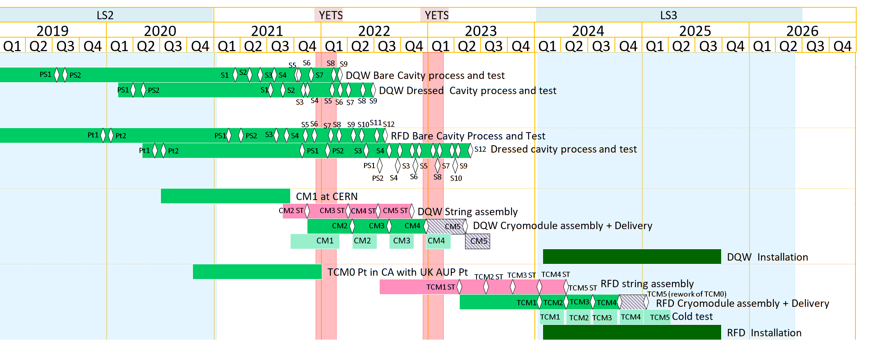
CM Series Schedule
HL-LHC quality plan Production readiness reviews &
manufacturing reviews for each relevant equipment
Installation readiness reviews before/during LS3

Slide 13
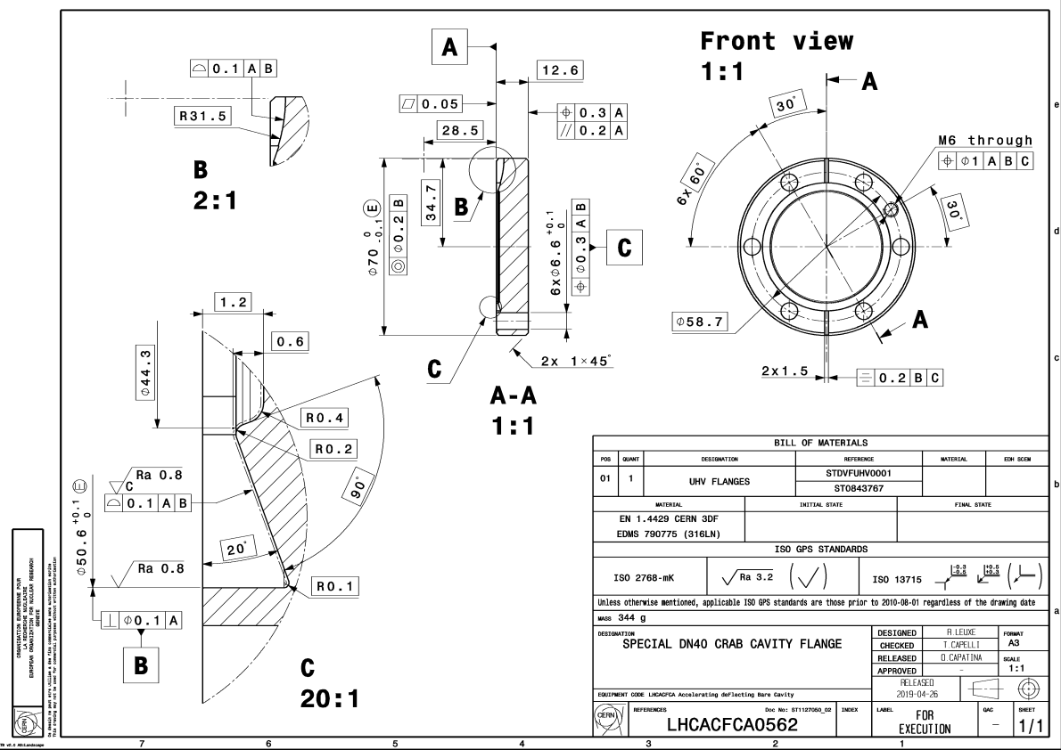

Q8: Doc for Knife Edge Modification
EDMS 2133865 – Special DN40 flange to accommodate $25 Ω$ feedthrough for field ANT

Slide 14
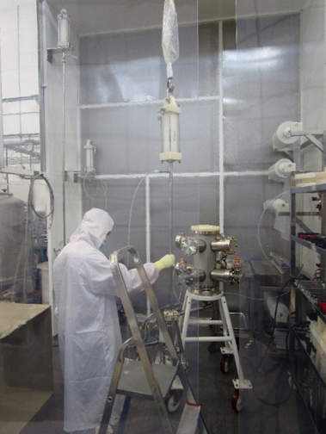
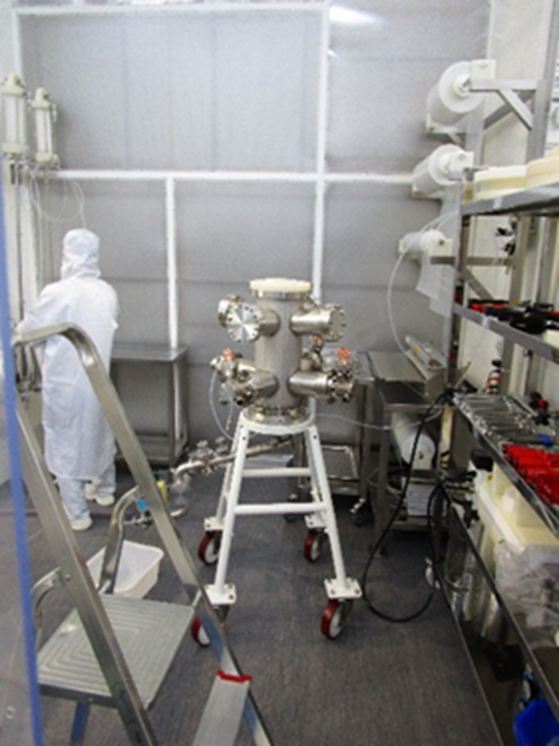
HPR of HOMs
filter
Water analysis, resistivity, particle counting and TOC
Cane tube
nozzle

Slide 15
US-AUP Upcoming Design Reviews
PRR (Bare Cavity Raw Materials) – Oct 2019
  Necessary for placing orders for long-lead materials for series bare cavities
Final Design Review (Dressed Cavities) – Feb 2020
  Necessary for successful CD-3c review
PRR (Bare Cavities) – Feb 2020
  Necessary for launching 2 bare cavity pre-series in April 2020
CD-3c – June 2020
  Approval for construction of series hardware
PRR (HOM Dampers) – Sep 2020
PRR (Mag Shields + He Tank) – Nov 2020
For all PRRs CERN will be reviewer
AUP Reference Documents:
Design Review Plan HiLumi-Docdb-170
Design Completion Definition HiLumi-Docdb-1738

