Slide 1
Strategy for Integration & Services
G.Vandoni
International review of the Crab cavity system design and production plan for the HL-LHC, 19-21 June 2019

Slide 2
SPS crab-cavity test stand as a
scaled-down
complete
integrated in machine
crab-cavity system with all related services
SPS learned view of integration of crab system
Interfaces to other systems identified
Sequencing of installation
Ensure no
deliverable
service
spec
is orphan in crab-cavity system
HL-LHC WP4 = “Crab-cavity system”

Slide 3
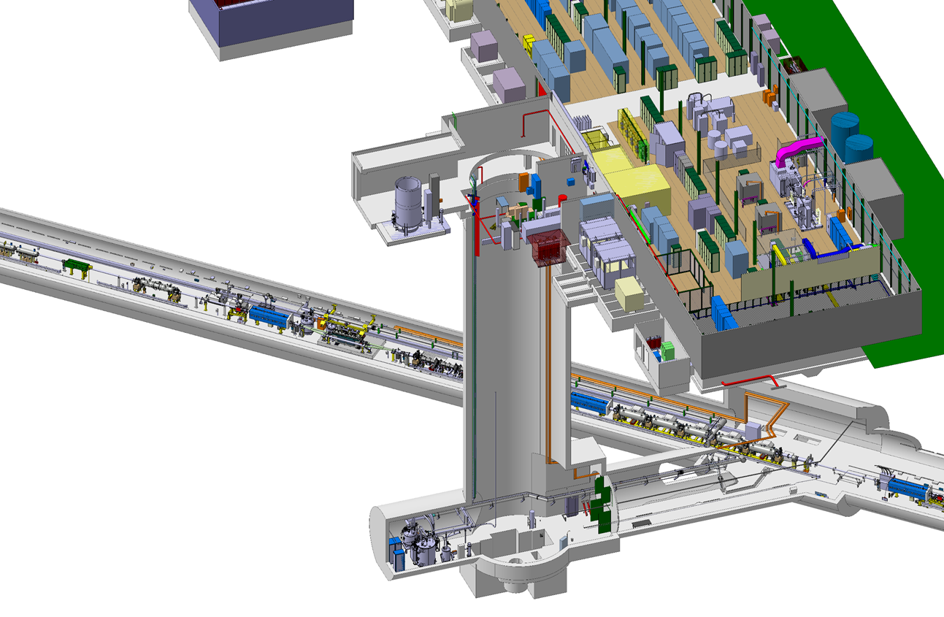
SPS crab-cavity test stand & infrastructure

Slide 4
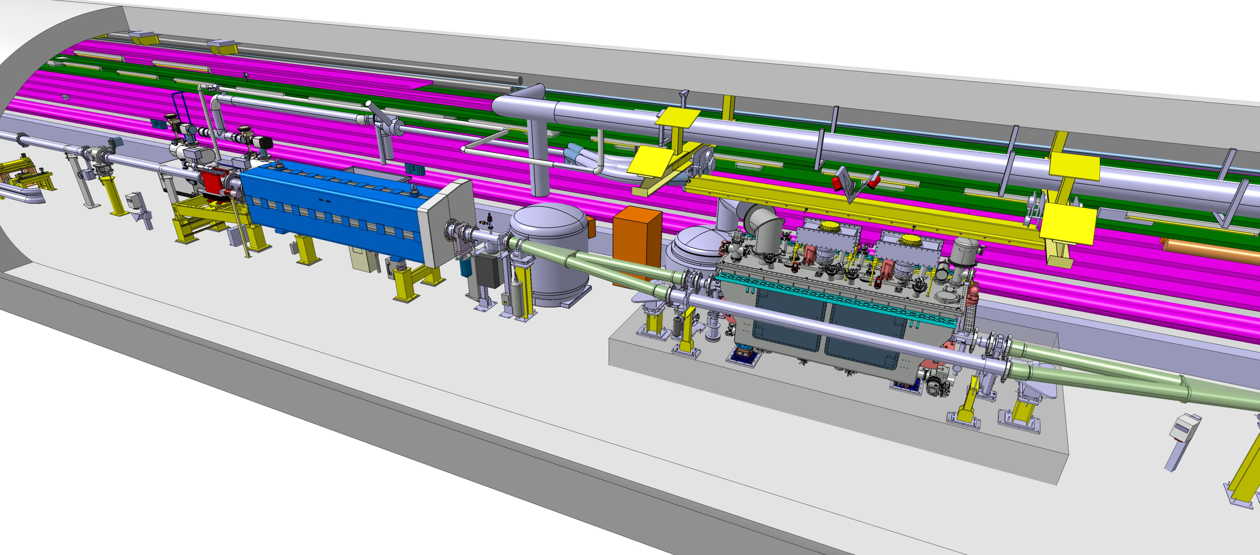

Slide 5
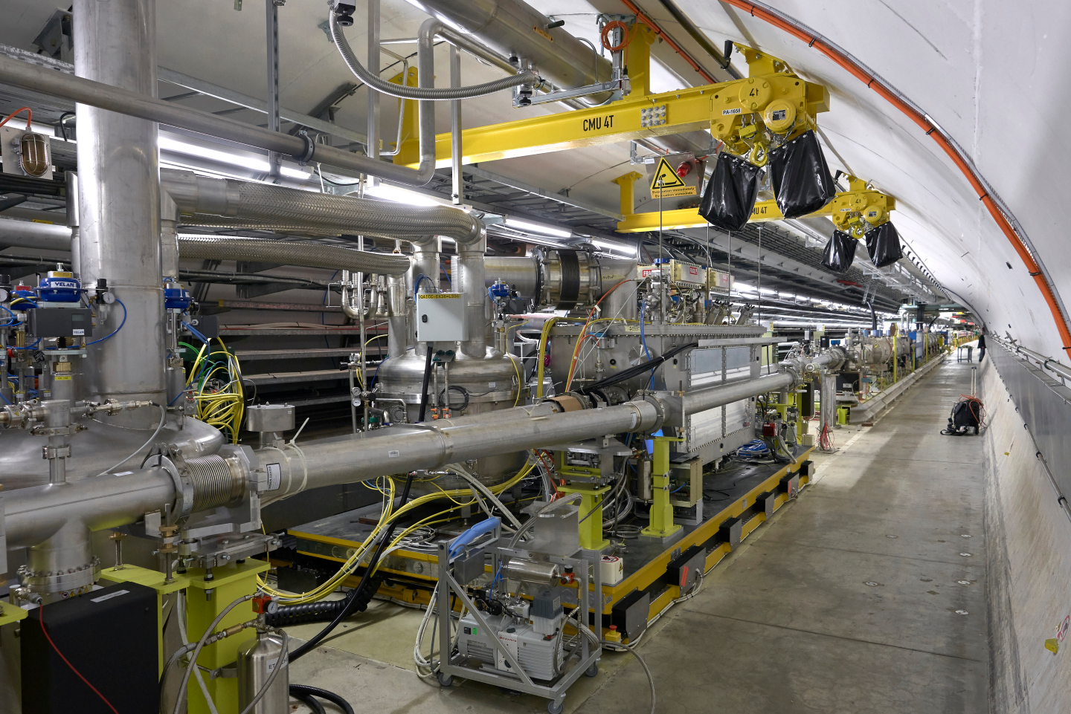
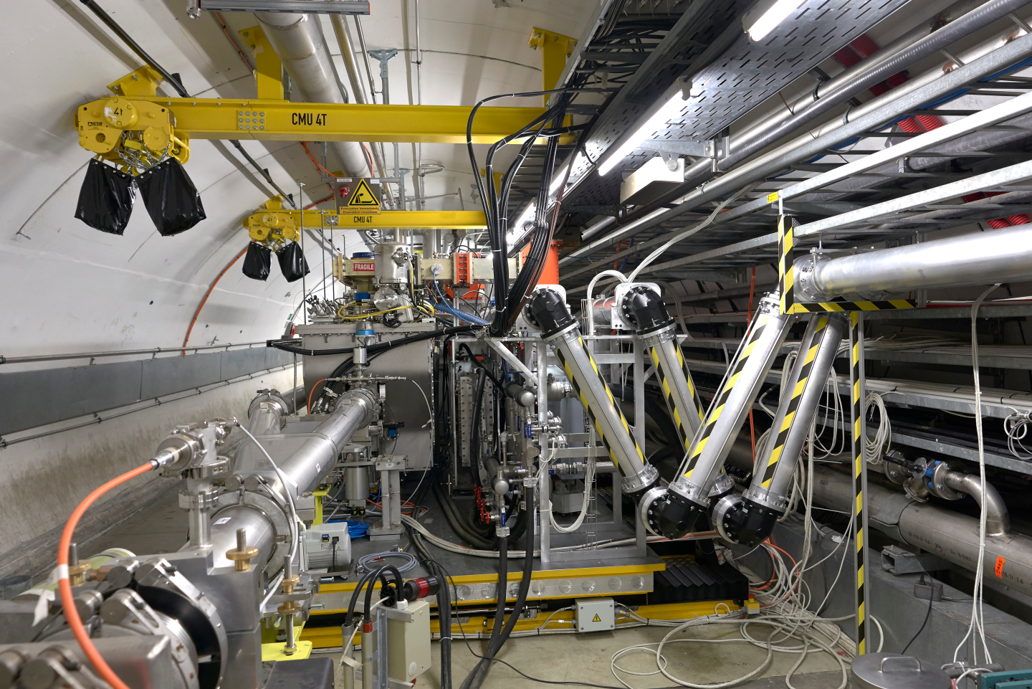

Slide 6
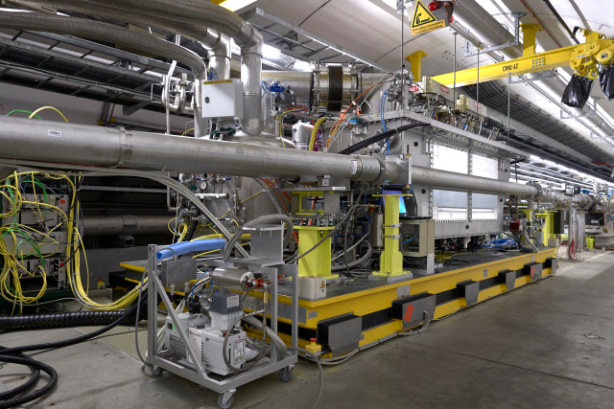
Integration of crab-system in SPS
RF power amplifiers Control racks
Cryogenics | Refrigeration Distribution/ Buffer/ storage
Vacuum | Vacuum sectorization, Y-chambers
Electrical distribution | Transformer Switchboards, UPS
Controls | Racks, cryo control room
Ventilation | Forced ventilation unit for Faraday Cage (FC)
Infrastructure | Cables, supporting structures
Safety | ODH detectors /beacons Interlocks: access, table movmnt
CM support | Motorized transfer table
RF Power
proximity equipment
Comparison with LHC in slide 9 and in P.Fessia’s presentation Friday
FC-LLRF
RF Transmission lines

Slide 7
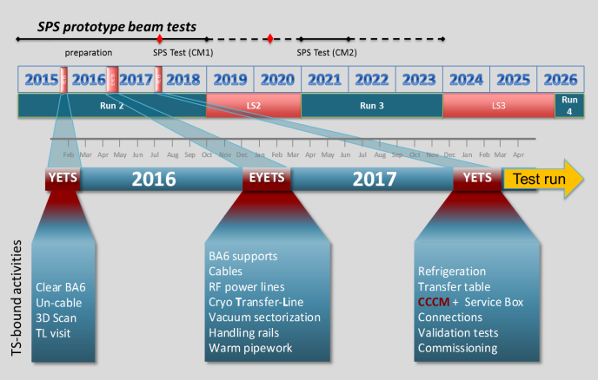
Installation in Technical stops – overview

Slide 8
Installation in 2018 Technical stop – overview
BA6 – surface area
El. power transformer & switchboards
IOT amplifiers commissioning
Cryogenic compressor skid
Oil removal skid
Faraday cage and LLRF commissioning
~20 teams in 4 locations
(+distributed cabling / ODH)
Storage tanks
LN2 and GHe
Helium pump zone
Cryogenic ancillaries and pipework
ODH and Alarms
From TS6- to TS6+
On crab-zone, at least 9 teams relay each other
10 large transport items
RF transm. lines
Cryogenic lines
Crab zone
ValveBox#2 connection to cryogenic line
Transfer Table
SB + CRYOMODULE
RF equipment and waveguides
Vacuum beamline
TA6 - alcove
Cryogenic Cold-Box
ValveBox#1 connection to cryogenic line
LN₂ flex line & phase separator
Connecting flexibles and pipework

Slide 9
Installation in 2017-2018 Technical stop – plan
Distribution
Refrigeration
Connections
Staged cabling by system, F-to-F

Slide 10
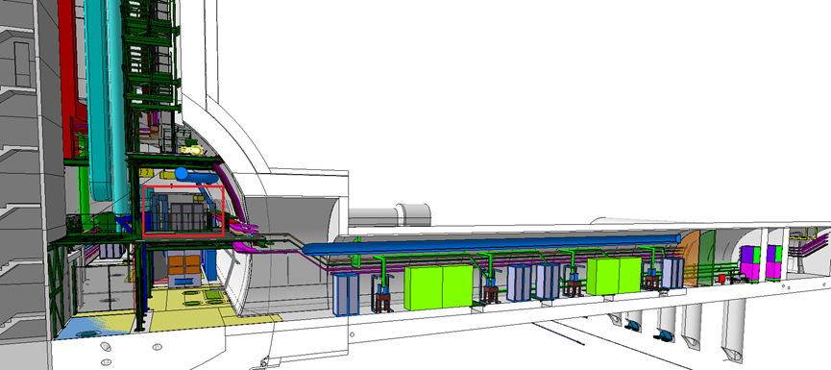
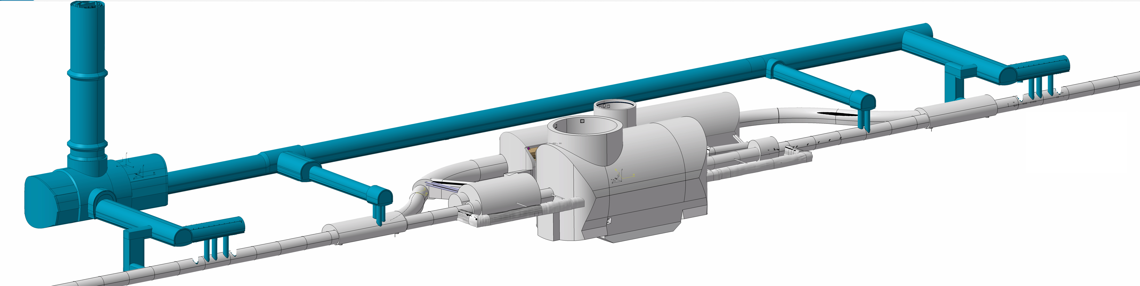

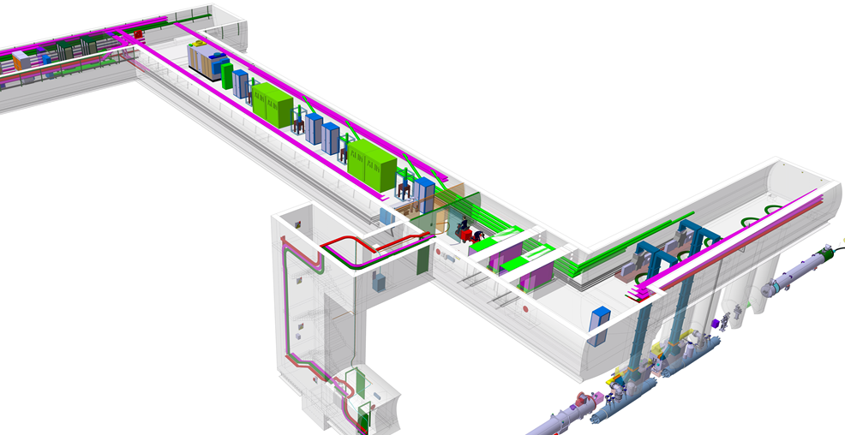

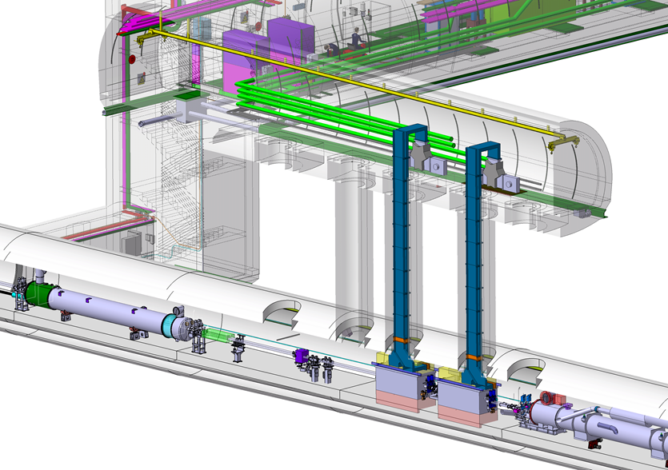
Crab-cavity system integration in HLLHC
→ P.Fessia, Friday morning
UA
UR
US
UA
CMS
Point 5
P5, for illustration only, courtesy M.Gonzalez

Slide 11
Crab-cavity system integration in HLLHC
→ P.Fessia, Friday morning
FC-LLRF
FC-LLRF
RF power amplifiers Control racks
RF Power passive proximity equipment
Transmission lines
CM
CM
P5, for illustration only, courtesy M.Gonzalez

Slide 12
Overall interfaces of Crab-cavity system
Crab cavity system
Integration & Installation
Survey
Civil engineering
Electricity: el. power distribution
Electricity: signal cables, racks, fibres
IT
Cooling & ventilation
Access & Alarms
Technical Monitoring
Logistics & storage
Operational Safety
Controls technologies
LLRF
High-Power RF
Project office/ Integrated safety
Accel Physics & Performance
Machine Protection
Cryogenics
Energy Deposition & R2E
Vacuum (& Beam screen)
Beam Instrumentation
Cavities & Cryomodules
LHC
SPS Test stand
SPS
Interfaces specific to each sub-system of crab system detailed slides 14-17

Slide 13
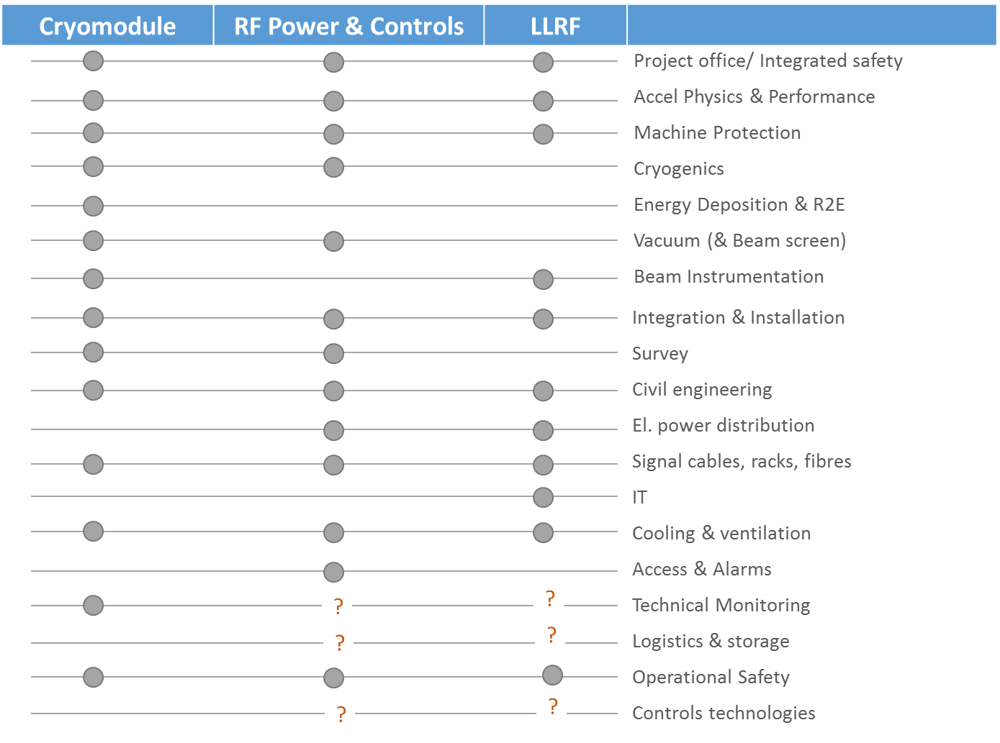
INTERFACES

Slide 14
Overall interfaces of Crab-cavity system – CM –
Electricity
Signal & Control cables
Cooling & Vent
Coupler’s cooling
RF Power
Power lines/ Local signal coax
CRYOMODULE WP4 | RF Power |  | Power & HOM couplers
 | Cryogenics | spec | cryogenic lines
 |  | deliv | cryo instrum
 | Vacuum | spec | beam/ insul vacuum
 |  | deliv | beam screen & transitions
 |  | serv | acceptance tests
 | Survey | deliv | FSI
 |  | serv | Knowledge transfer
Vacuum
Beam/ Insul vacuum Intermodules
Energy Dep & R2E
Dose estimates
Cryogenics
Refrig. & distribution
Beam Instr
BI for HL-LHC/ crabs: head-tail, streak camera…
Wide-band longitudinal pick-ups for LLRF
Survey
Jacks
Remote alignment
Civil Eng
Tunnel surfacing
WP4 : activity & budget
HL-WPs: activity & budget
Services: activity in unit, budget in WP4
To define

Slide 15
Overall interfaces of Crab-cavity system – CM –
Electricity
Signal & Control cables
Cooling & Vent
Coupler’s cooling
RF Power
Power lines/ Local signal coax
CRYOMODULE WP4 | RF Power |  | Power & HOM couplers
 | Cryogenics | spec | cryogenic lines
 |  | deliv | cryo instrum
 | Vacuum | spec | beam/ insul vacuum
 |  | deliv | beam screen & transitions
 |  | serv | acceptance tests
 | Survey | deliv | FSI
 |  | serv | Knowledge transfer
Vacuum
Beam/ Insul vacuum Intermodules
Energy Dep & R2E
Dose estimates
Cryogenics
Refrig. & distribution
Beam Instr
BI for HL-LHC/ crabs: head-tail, streak camera…
Wide-band longitudinal pick-ups for LLRF
SERVICES | Integration
 | Installation transport
 | Connection of systems
 | Validation tests
 | Technical monitoring
 | Alarms & Access
Survey
Jacks
Remote alignment
Civil Eng
Tunnel surfacing
WP4 : activity & budget
HL-WPs: activity & budget
Services: activity in unit, budget in WP4
To define

Slide 16
Overall interfaces of Crab-cavity system
– RF Power/Controls –
Coaxial RF lines
Electrical power
& power cabling
Signal & control cables
High Power RF system
Vacuum interlocks
Cooling
Cryogenics interlocks
Loads& Circulators
RF Amplifiers
Control racks
Access & Alarms:
EIS
Beam interlocks
RF Power lines
WP4 : activity & budget
HL-WPs: activity & budget
Services: activity in unit, budget in WP4
To define

Slide 17
Overall interfaces of Crab-cavity system
– LLRF Infrastructure –
Controlled ventilation
Signals & controls
ElectricPower
LowLevel RF WP4 | LLRF | Electronics
 |  | Faraday cage
 |  | Internal cabling
 | Electricity | El. power
 |  | Racks
 | IT | FC Network & telecom
 | Civil Eng | FC Internal structures
 | Fire safety | FC Detection & alarms
Civil engineering
WP4 : activity & budget
HL-WPs: activity & budget
Services: activity in unit, budget in WP4
To define

Slide 18
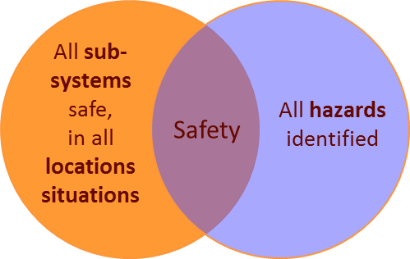
Integrated safety – SPS lesson & methodology
Mechanical | Pressure, Vacuum, Lifting, Mech. energy, hot works, hot surfaces
Cryogenic | Cryogenic fluids
Structural | Bearing structures
Electrical | Electrical equipment, HV equipment, UPS
Non-ionizing rad | RF, Laser
Workplace | Noise, Temperature, work at height
Environment | Potentially polluting substances
Worksite | Construction, dismantling, co-activity
Fire | Non-standard layout, combustible material
SAFETY DOMAINS
All sub-systems registered
All locations registered
All hazards identified
PRELIMINARY Risk analysis
set of actions
FINAL Risk analysis
SPS test stand Safety file:
Descriptive part
Demonstrative part
Operational part

Slide 19
Status of Interface definition
System | Status | Needed
PO Integrated safety | SPS Safety file checked, to approve | In progress for LHC
Accel Physics & Performance | Work in progress ECR integration modification | Beam based cavity alignment Cavity field quality requirements
Machine Protection | Failure modes under study in SPS | In progress
Cryogenics | Specifications defined | Proposal for cryo sectorization CM cryo instrumentation Integration QXL to jumper Definition of work share at interfaces
Energy Deposition & R2E | In progress | Specific simulation scores asked
Vacuum (& Beam screen) | Summary document in approval | NTH
Beam Instrumentation | In progress | Wide-band longitudinal pick-ups to simplify
G.Riddone, Friday

Slide 20
Status of Interface definition
System | Status | Needed
Integration & Installation | ECR integration modification Transport share defined | Transport specifications to be worked out as design progresses
Survey | Summary document in review | Jacks choice
Civil engineering |  | Cores position Tunnel surfacing Internal supports in FC
Electricity: el. power distribution | Requested | Approval of spec for FC load
Electricity: signal cables, racks, fibres | Requested, in check | Fibres for LLRF
IT | Summary document in approval | NTH
Cooling & ventilation | Mostly requested | Approval of spec for FC ventilation Cooling for RF power couplers
Access & Alarms | Spec in work | FC Fire safety
Technical Monitoring | No request done | To define
Logistics & storage | No request done | To define
Operational Safety (at installation) | No request done | To define
Controls technologies | No request done | To define
P.Fessia, Friday

Slide 21
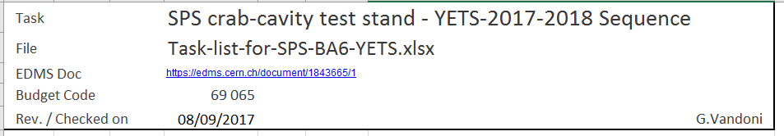
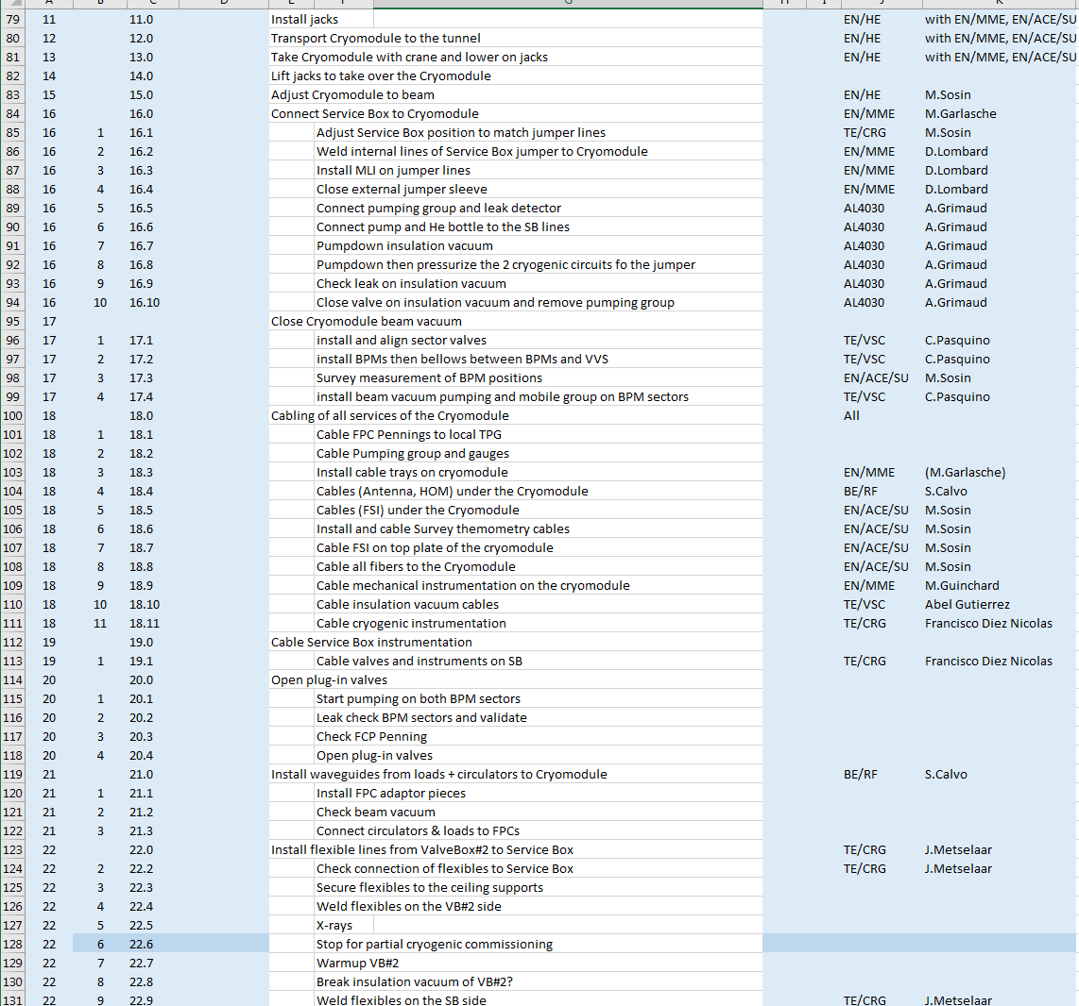
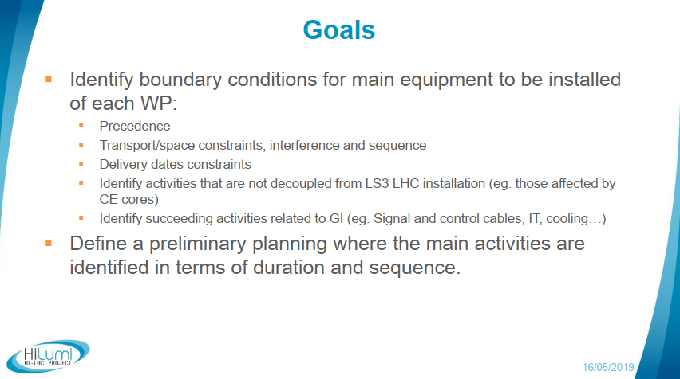
WP4 installation/ test sequence
Meeting
HL-LHC Installation Planning
P.Fessia/ L.Tavian
First baseline for C&S review 2019

Slide 22
CONCLUSIONS
SPS exercice LESSONS learnt ✓
Implementation of all systems interfacing crab cavity system
  → Analysis of system for LHC made easy
  Main interfaces identified and being detailed
  Mitigation of risk of orphan deliverables / activities
  Collaboration with all CERN partners for completion
Integration in existing machine environment
Installation sequence was performed successfully in very reduced time
  → Ready to work out sequence for HiLUMI

Slide 23
Thank you
Contribution by the whole SPS crab test stand team is gratefully acknowledged

Slide 24
Spare slides

Slide 25
Crabs integration in LHC, versus SPS
SPS
LHC
One beam, vacuum by-pass
Two beams, two beam pipes
Manual alignment, transfer table
Remote alignment
SPS specific, beam extraction interlock
Beam interlocks for machine protection
beam
Surface integration of RF ampli, controls, LLRF
New underground tunnels for integration of RF equipment
alignment
Dedicated cryoplant & distribution, new ODH
Connect to new QXL, upgraded plants
interlocks
SPS-specific DQW CM design
LHC-specific CM design
integration
cryogenics
cryomodule

Slide 26
WP4 categories of interfaces
Scope/ Budget in WP4
Interface to CERN-Unit
Specification :
WP4 for compliance with scope (performance…)
CERN unit for operational responsibility
Scope/ Budget in WPx
Interface to HL-LHC WP
Specification :
WP4 as requestor
WPx as responsible of scope
WP4 needs vacuum components
TE/VSC
Unit-a
Unit-b
Unit-c
WP4 needs installation of crab CM
WP15 executes transport from surface to tunnel for all WPs
WP4 : activity & budget
HL-WPs: activity & budget
Services: activity in unit, budget in WP4
To define

Slide 27
WP4 interface to Vacuum
TE/VSC operates beam vacuum:
SPECIFICATION of beam & insulation vacuum / Beam screen
defines general layout, acceptance criteria, control process
specifies operational vacuum conditions for optimal performance and integration
Defines and designs the beam screens
DELIVERABLES (cryomodule internal equipment and vacuum)
Cryomodule inner beam vacuum/ beam screen elements
Interconnections between 2 modules and related supports
Pumping & diagnostics equipment and controls, beam and insulation vacuum
SERVICES
Acceptance tests, beam & insulation vacuum
Installation, conditioning, tests and commissioning

Slide 28
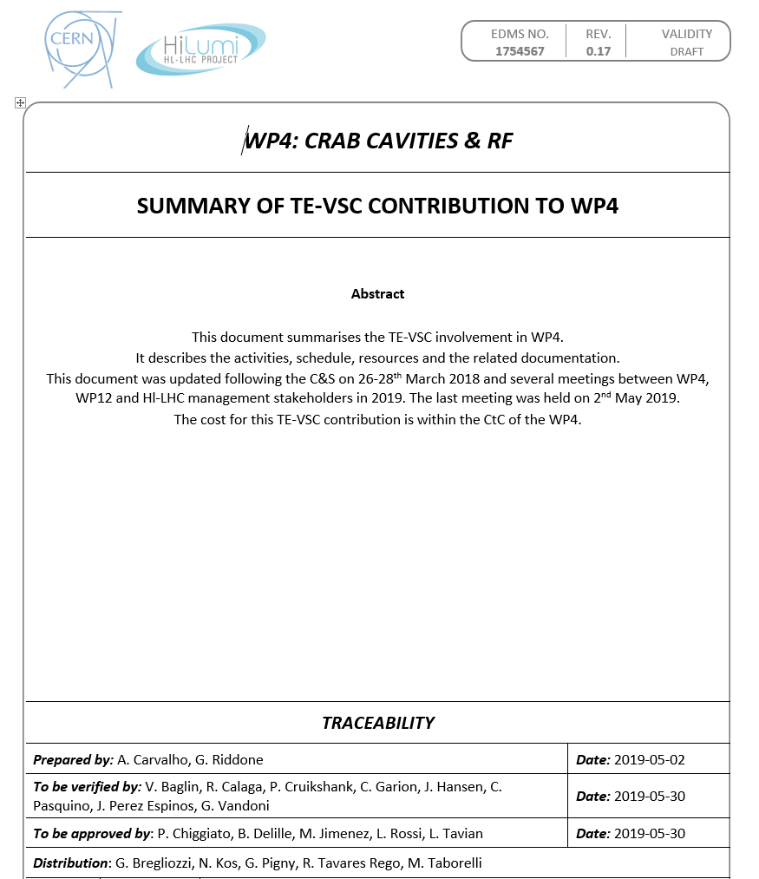
WP4 Interface to Vacuum
TE/VSC operates beam vacuum:
SPECIFICATION of beam & insulation vacuum / Beam screen
defines general layout, acceptance criteria, control process
specifies operational vacuum conditions for optimal performance and integration
Defines and designs the beam screens
DELIVERABLES (cryomodule internal equipment and vacuum)
Cryomodule inner beam vacuum/ beam screen elements
Interconnections between 2 modules and related supports
Pumping & diagnostics equipment and controls, beam and insulation vacuum
SERVICES
Acceptance tests, beam & insulation vacuum
Installation, conditioning, tests and commissioning

Slide 29
WP4 versus Transport & Installation
WP 17.7 All transport in new underground premises
WP 15 All transport/standard installation in existing premises
WP 4 All surface transport/ specific installation
WP15
Tunnel | Transport & installation of CMs to final position
UA, US, UR | Transport & installation of RF power amplifiers, ancillaries and waveguides, Control and LLRF racks, FC
 | Transport vehicles and tools
Surface | Surface transport related to fabrication/ test: cavities, CMs Surface transport, RF amplifiers & ancillaries, transmission lines, FC
WP4 : activity & budget
HL-WPs: activity & budget
Services: activity in unit, budget in WP4
To define

Slide 30
WP4 versus Signals & controls cables
UA, UR, US | RF amplifiers & ancillaries, Control racks, Faraday cage & LLRF
Cores | Supports and transmission lines / Signal & Control cables
Tunnel | Connection to CM of all interfaces (RF power, signals & controls, vacuum, cryo, FSI, cooling)
Electrical powering cabling
FC internal cabling
RF systems controls cabling
Vacuum, cryo instr, FSI system controls cabling
Interface/ interlock cabling
UA
UR
US
UA
Within HiLumi, the electricity service is collecting Cable Installation pre-Requests

Slide 31
WP4 versus Survey & Alignment
Included in WP4 from Survey
WP15.4, not included in WP4 scope
Cavity position monitoring by FSI:
  FSI targets/ supports
  FSI feedthroughs
  FSI DAQ, patch panels, cables, fibers, field bus
  1 laser per IP
Resources/ activities
  Procedures
  Purchase, validation, calibration of FSI
  Knowledge transfer to UK, Canada on FSI
  Knowledge transfer on conventional survey
  Support and FSI installation at crab production, CM assembly at CERN
  Survey & alignment for RFD-SPS
Remote cryomodule position monitoring:
  WPS sensors
  Inclinometers
  Wire protection
  Associated cables/ fibers and DAQ
Remote adjustment of the cryomodules
  Motorization of jacks
  Associated DAQ, controls/ commands
Survey & Alignment during installation

