Slide 1
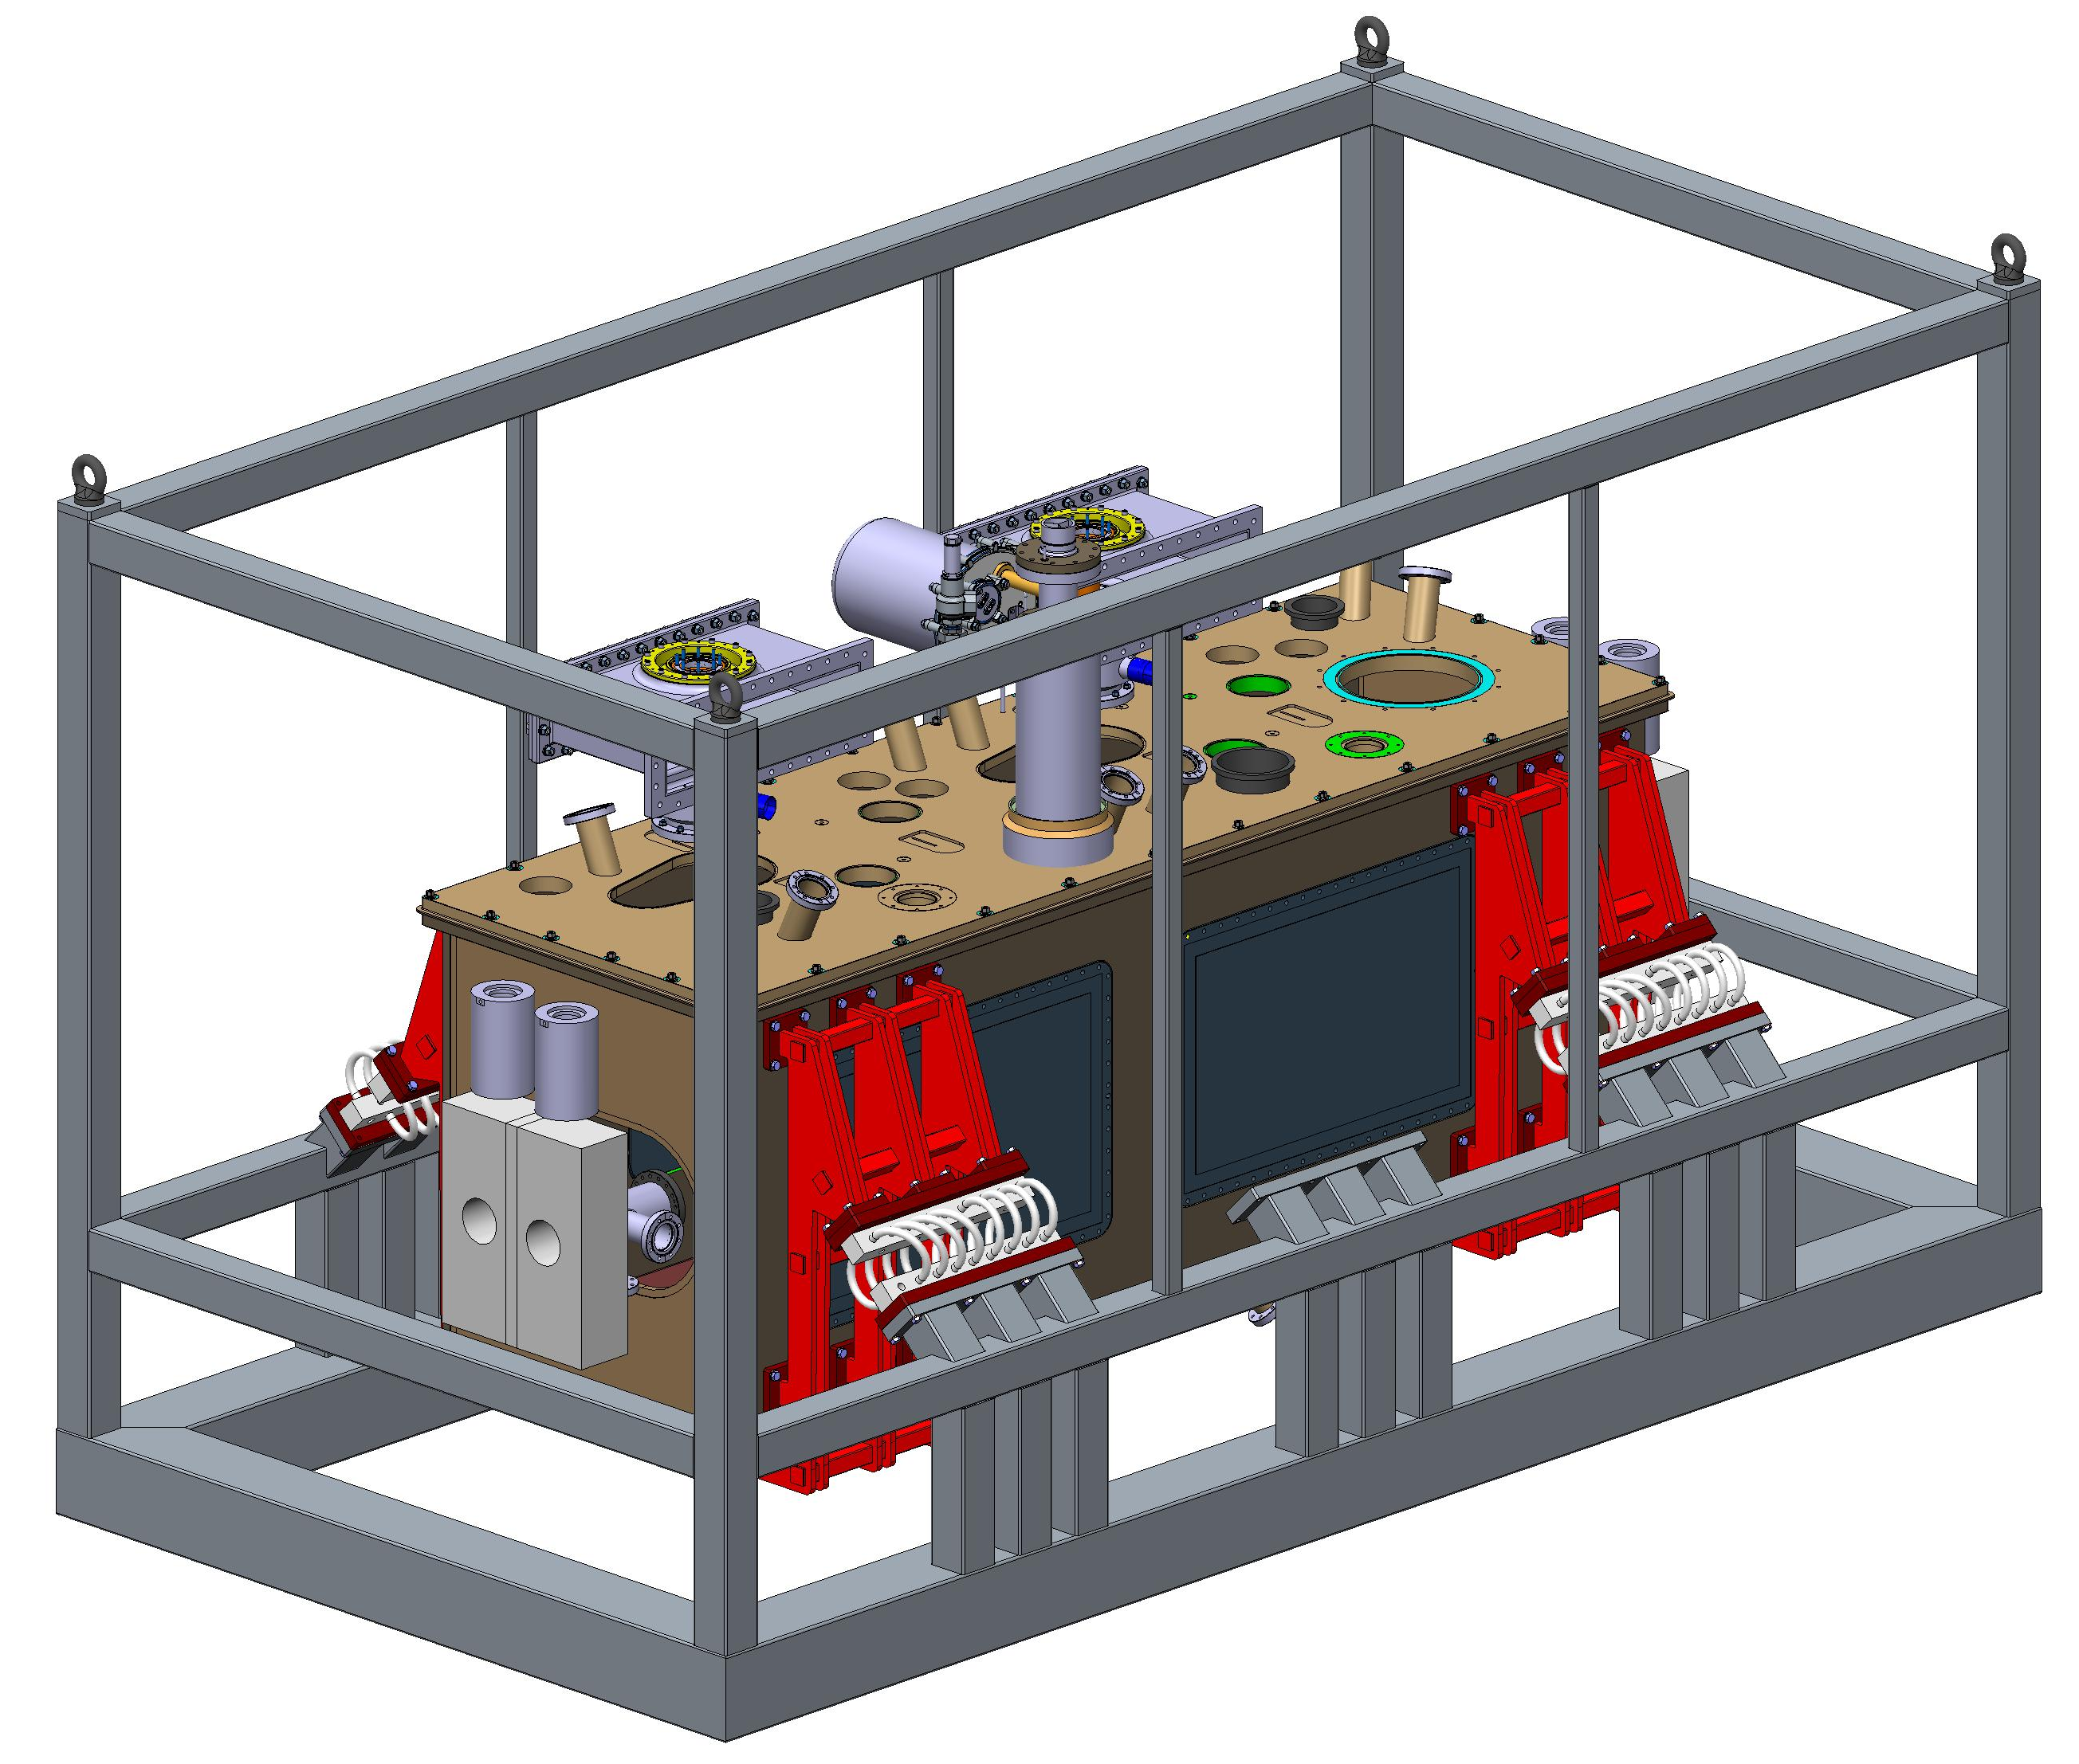
Transport Aspects
Edward Jordan
Crab Cavity International Review – CERN – 20th June

Slide 2
Background
Anti Shock Frame - Requirement:
  “A suitable support shall be designed to safely transport the Cryomodule from assembly premises to CERN where it will be tested and installed. The solution shall reduce all forms of vibration and shock loading to as low as reasonably practicable.”
This presentation will focus on mechanical solution to reduce shock loading.

Slide 3
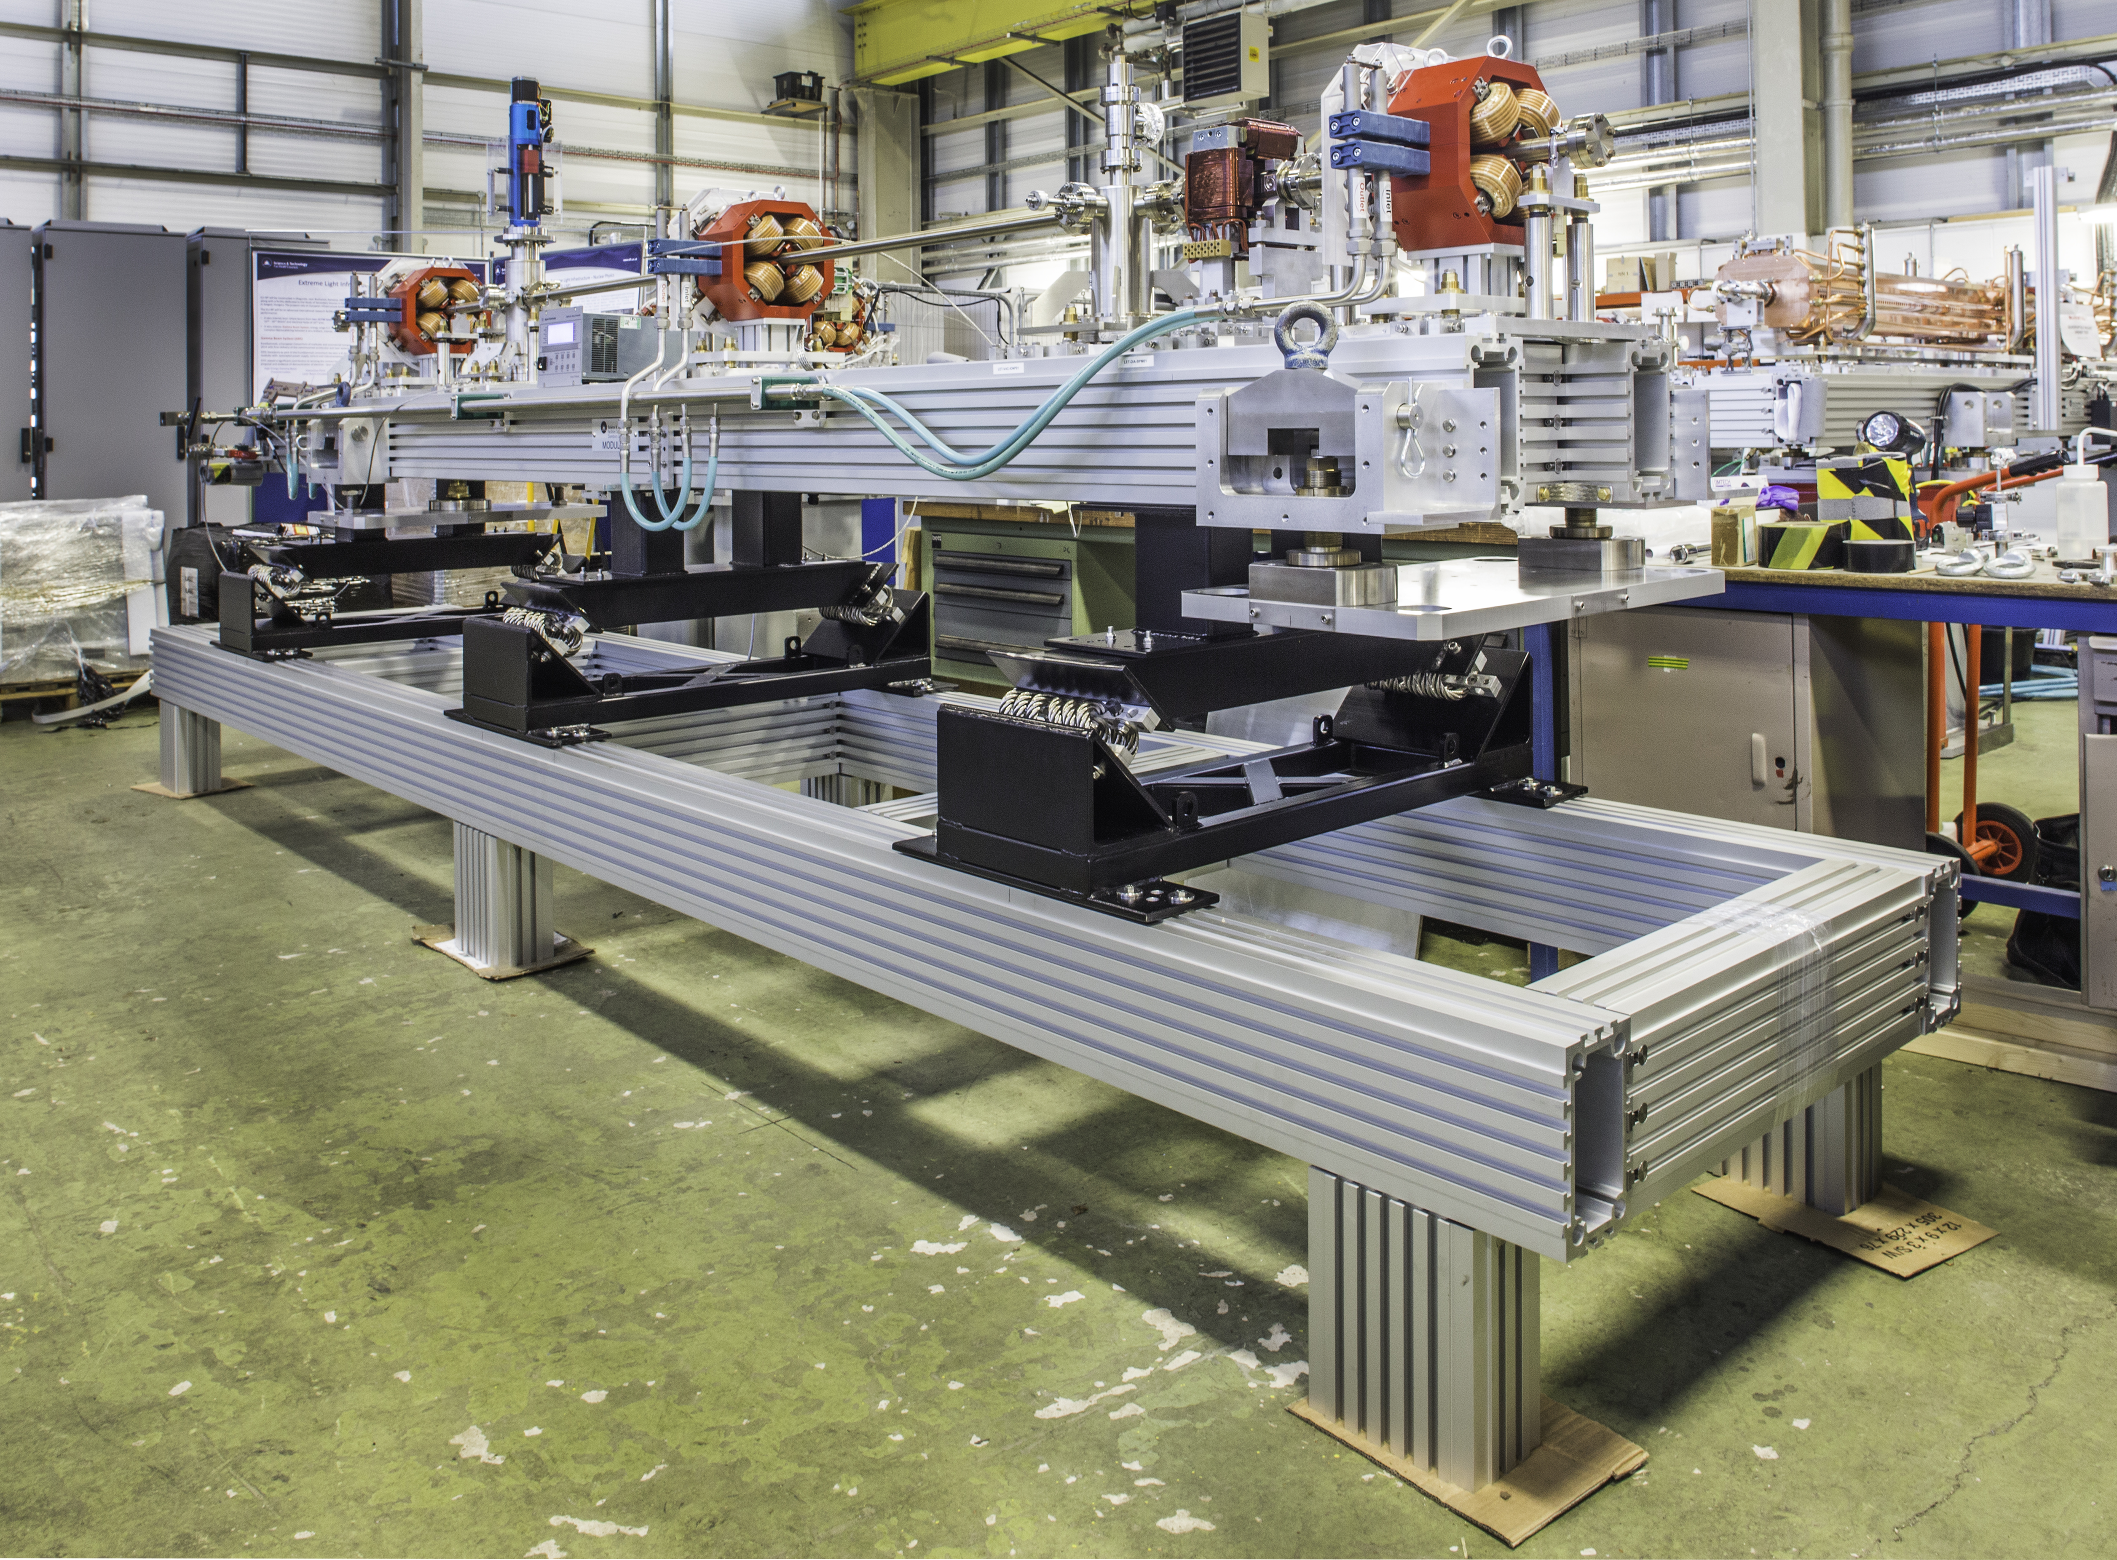
STFC Experience - Wire rope isolators
Proven to reduce shock and random vibration transmission
Experience (and Data) gained at Daresbury through shipment of 12 modules to ELI-NP in Romania
Note: isolators should be at COM height for optimum performance, this position was a compromise to maximise the number of module per transport (i.e. up to 4 modules per trailer)

Slide 4
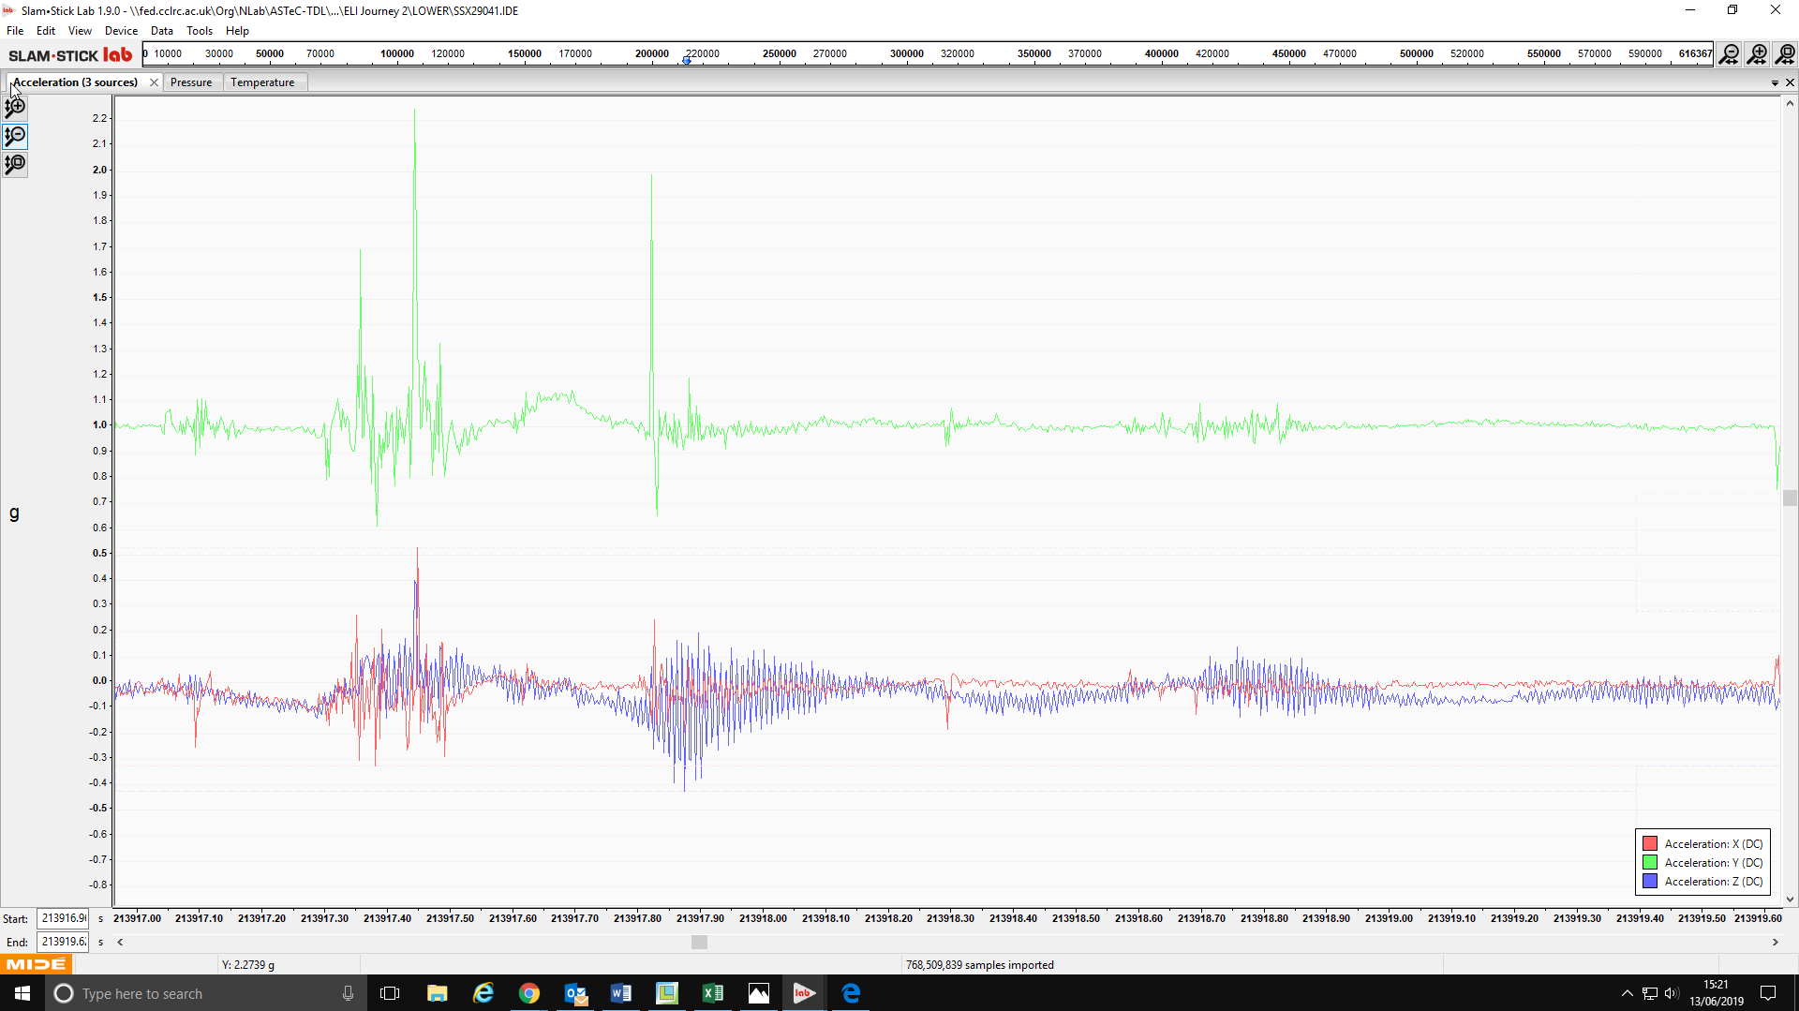
Vertical wire rope isolator performance
Vertical Shock – Y orientation - 1.2g (@ 36Hz)
Shock from highway event – Truck bed
Lateral Shock – high frequency and low frequency present

Slide 5
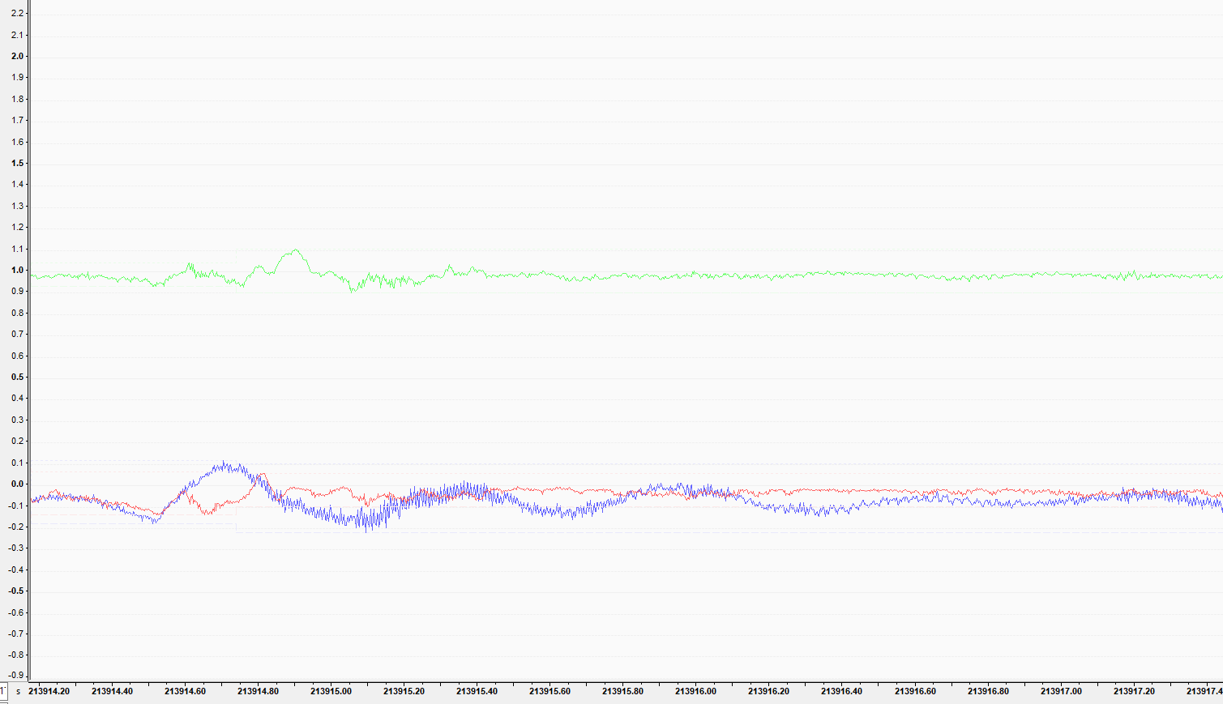
Vertical wire rope isolator performance
Response on sprung frame
Vertical Shock completely isolated
Lateral 0.1g Low Frequency (@1.7Hz) Shock remains
We concluded from this example that although the vertical excitation was isolated, it introduced harmonic motion into the transverse plane due to the offset centre of mass vs centre of friction.

Slide 6
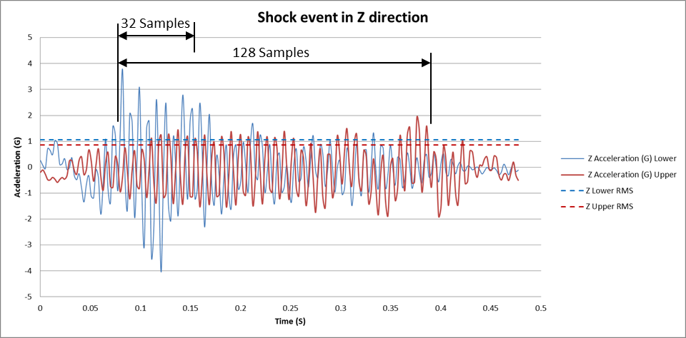
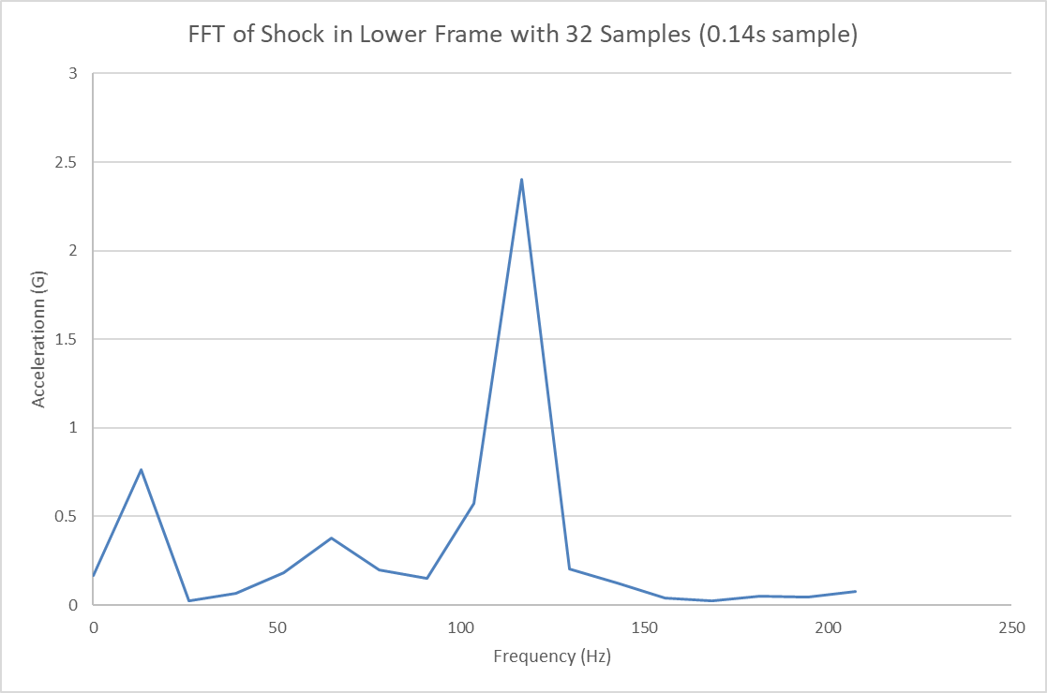
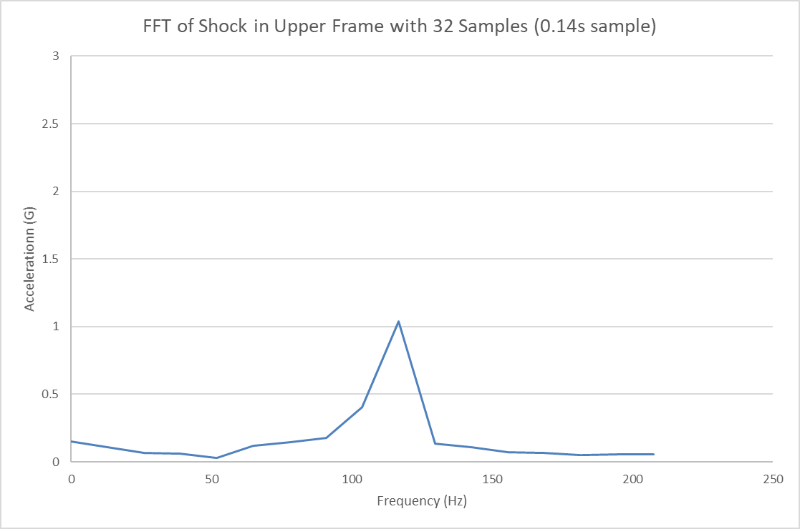
Lateral wire rope isolator performance
High Frequency component not completely isolated; attributed to non optimum position of springs about COM - vertical

Slide 7
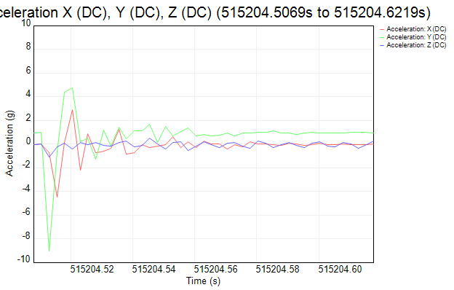
Shock from lowering equipment onto floor (in Romania)
Reviewing data acquired when shipping normal conducting accelerators from Daresbury Lab to Magurele, Romania, a 10g shock can be seen over a time period of 12.5 ms, corresponding to frequency of approximately 80 hz.
This shock was observed when the equipment was removed from its anti-shock frame and lowered onto the ground (i.e. with no wire-rope isolation).
≈ 12.5 ms
10g

Slide 8
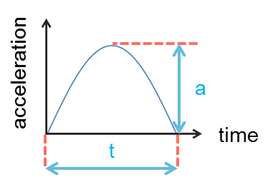
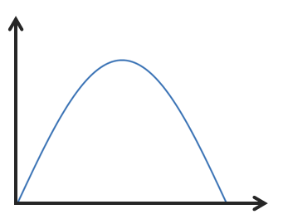
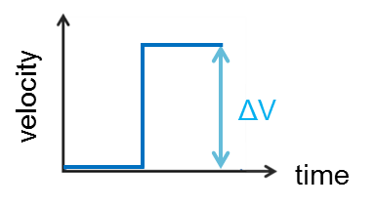
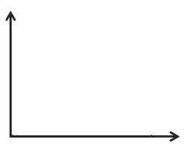
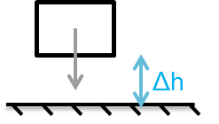
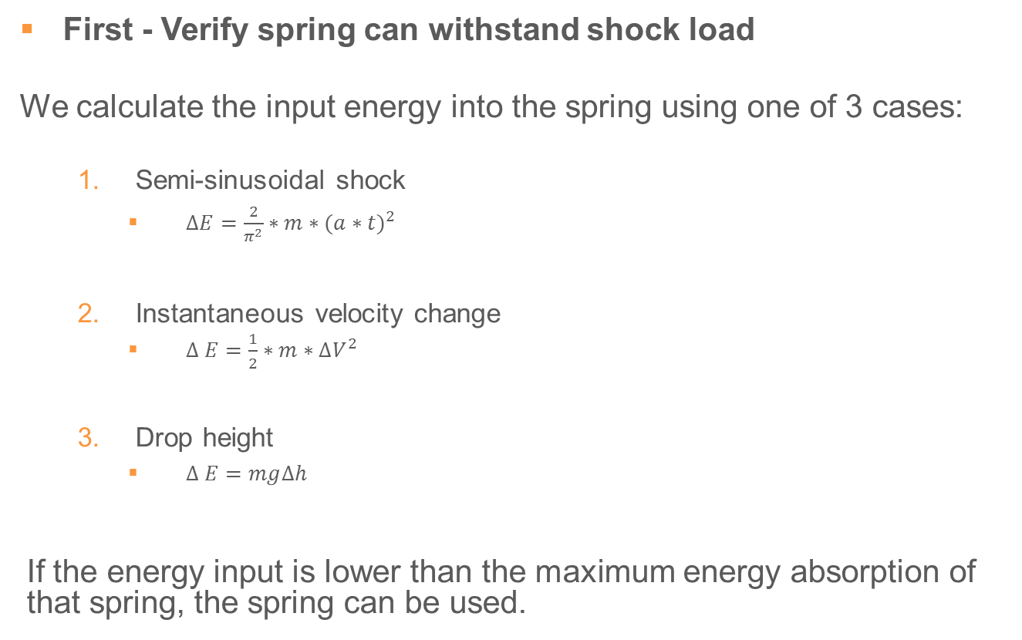
Mathematical Method for spring selection (1)
First - Verify spring can withstand shock load
We calculate the input energy into the spring using one of 3 cases:
  Semi-sinusoidal shock
    $∆E=\frac{2}{π^{2}}∗m∗{(a∗t)}^{2}$
  Instantaneous velocity change
    $∆ E=\frac{1}{2}∗m∗{∆V}^{2}$
  Drop height
    $∆ E=mg∆h$
If the energy input is lower than the maximum energy absorption of that spring, the spring can be used.
acceleration
t
time
velocity
ΔV
time
Δh

Slide 9
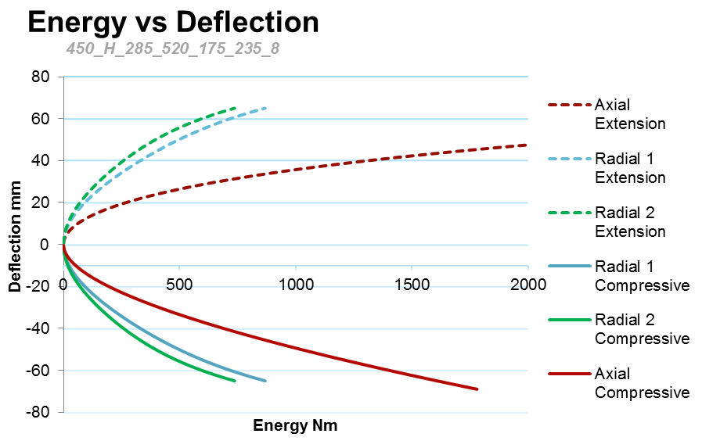
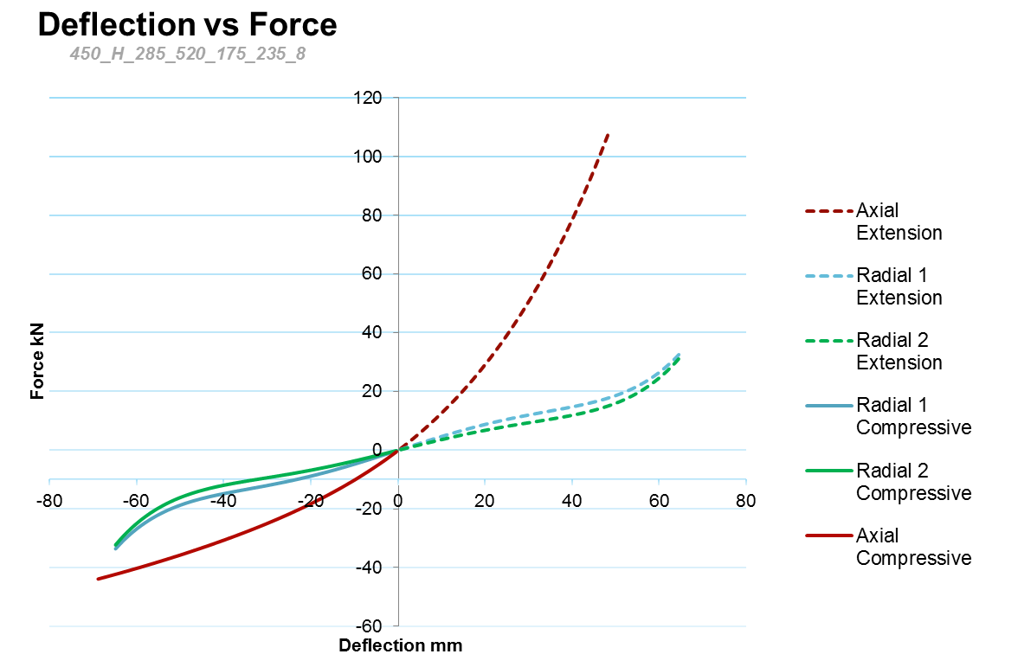
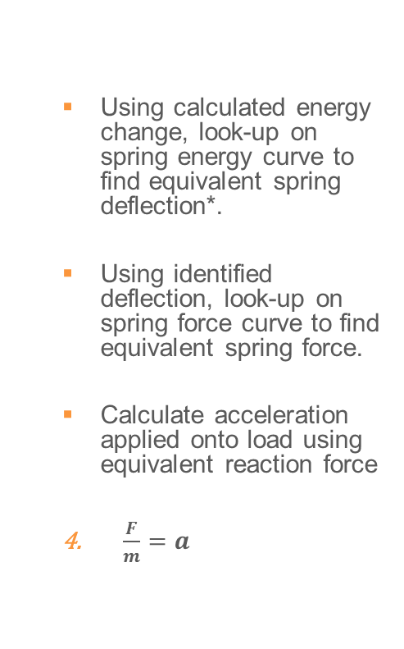

Mathematical Method for spring selection (2)
Second, derive transmitted force input onto Cryomodule from compressed spring by:
  Using calculated energy change, look-up on spring energy curve to find equivalent spring deflection*.
  Using identified deflection, look-up on spring force curve to find equivalent spring force.
  Calculate acceleration applied onto load using equivalent reaction force
  $\frac{F}{m}=a$
ΔE → Δx → ΔF
Δx
ΔE
ΔF
$$\frac{F}{m}=a$$
Δx
  *Spring data acquired from product reseller.

Slide 10
Mathematical Model - Example
Using shocks identified from data shown on pages 6,7,8:
  1.2 g (@ 36 Hz) Vertical
  10 g (@ 80 Hz) Vertical
Mass of Cryomodule is a primary variable!
Mass used = 3300kg
Case Load | Input Acceleration | Input Frequency | Output Acceleration | Acceleration Reduction | Stroke Utilised
 | g | Hz | g | % | %
1 | 1.2 | 36 | 0.43 | 64 | 0.18
2 | 10 | 80 | 1.08 | 89 | 2.53

Slide 11
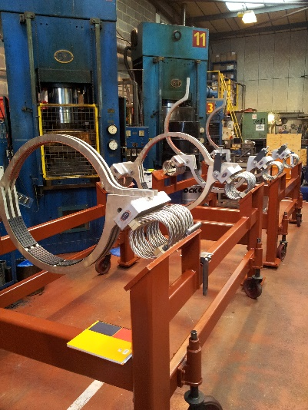
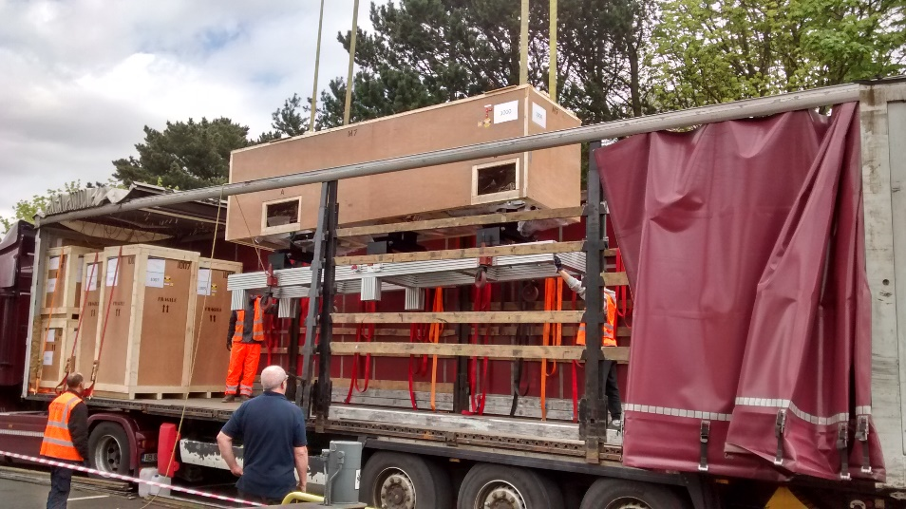
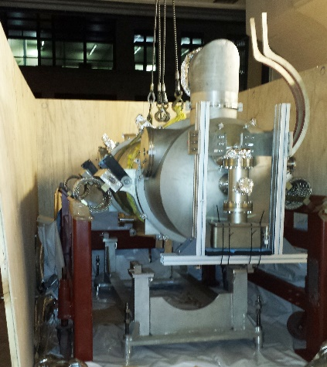
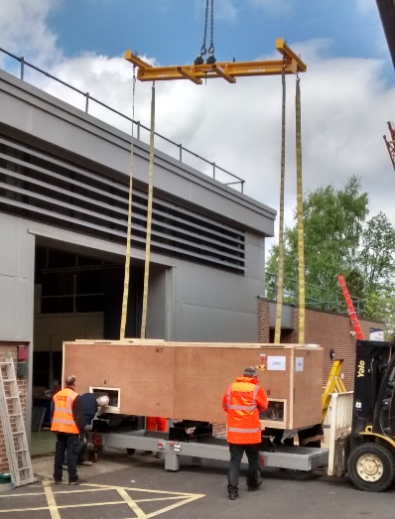
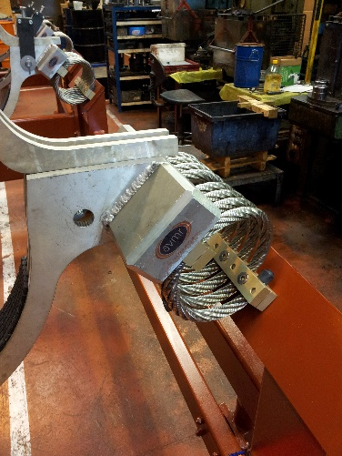
Reference Designs
SLAC CM transportation to DL
(2013)
ELI Accelerating Modules to Romania (2017)

Slide 12
Concept Design
Transportation Frame
≈ 1050kg
Transport interface arms ≈ 52kg
Wire Rope Isolators (CavoFlex) ≈ 25kg

Slide 13
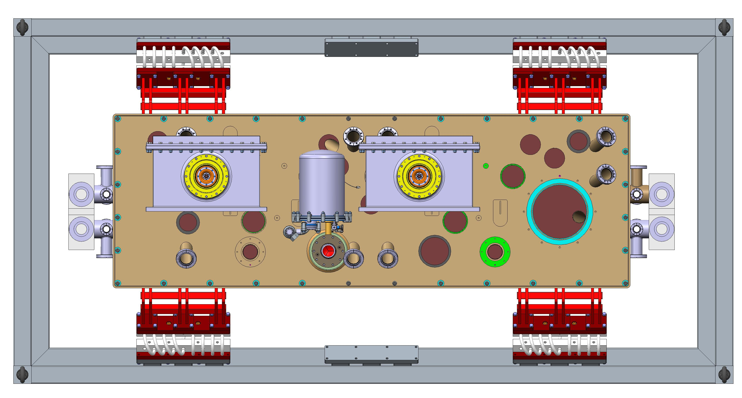
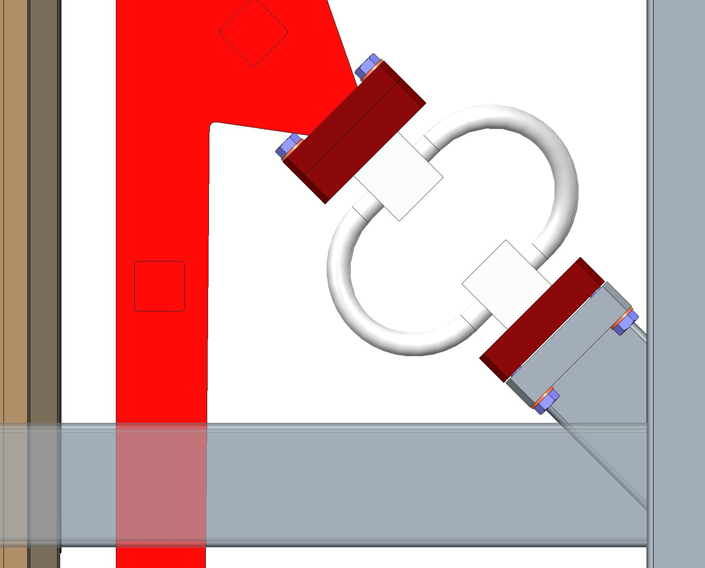
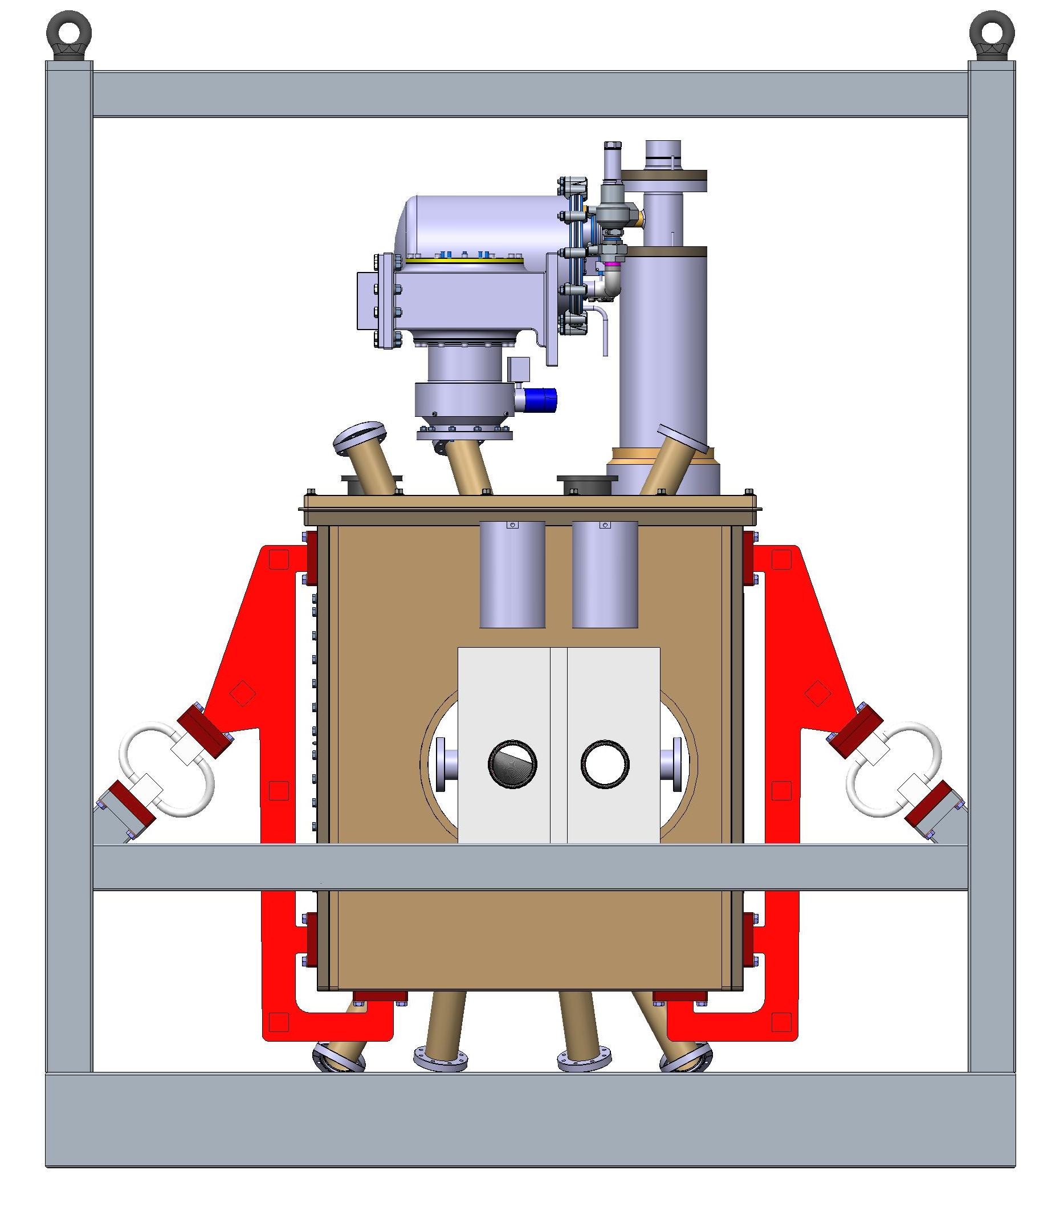
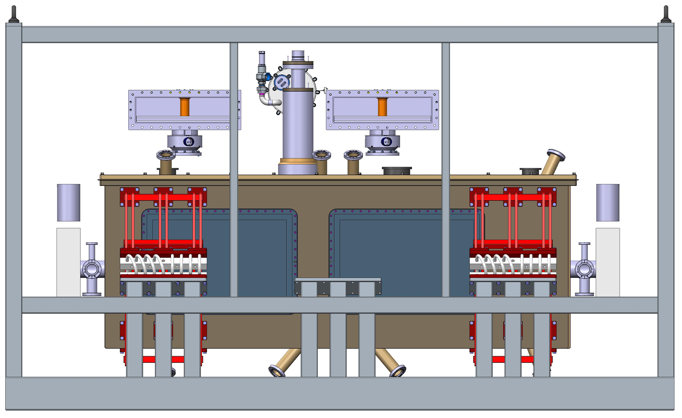
Critical Dimensions
95mm
Direction | Clearance
x | 95mm + 95mm
y | 193mm + 147mm
z | 306mm + 326mm
y
306 mm
326 mm
147mm
2320 mm
193 mm
2035 mm
4000 mm
x
z

Slide 14
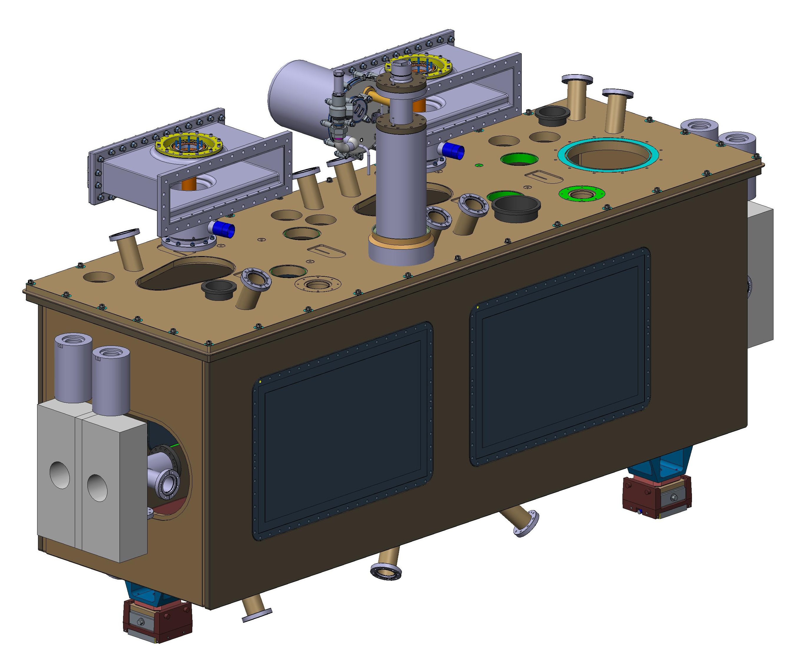
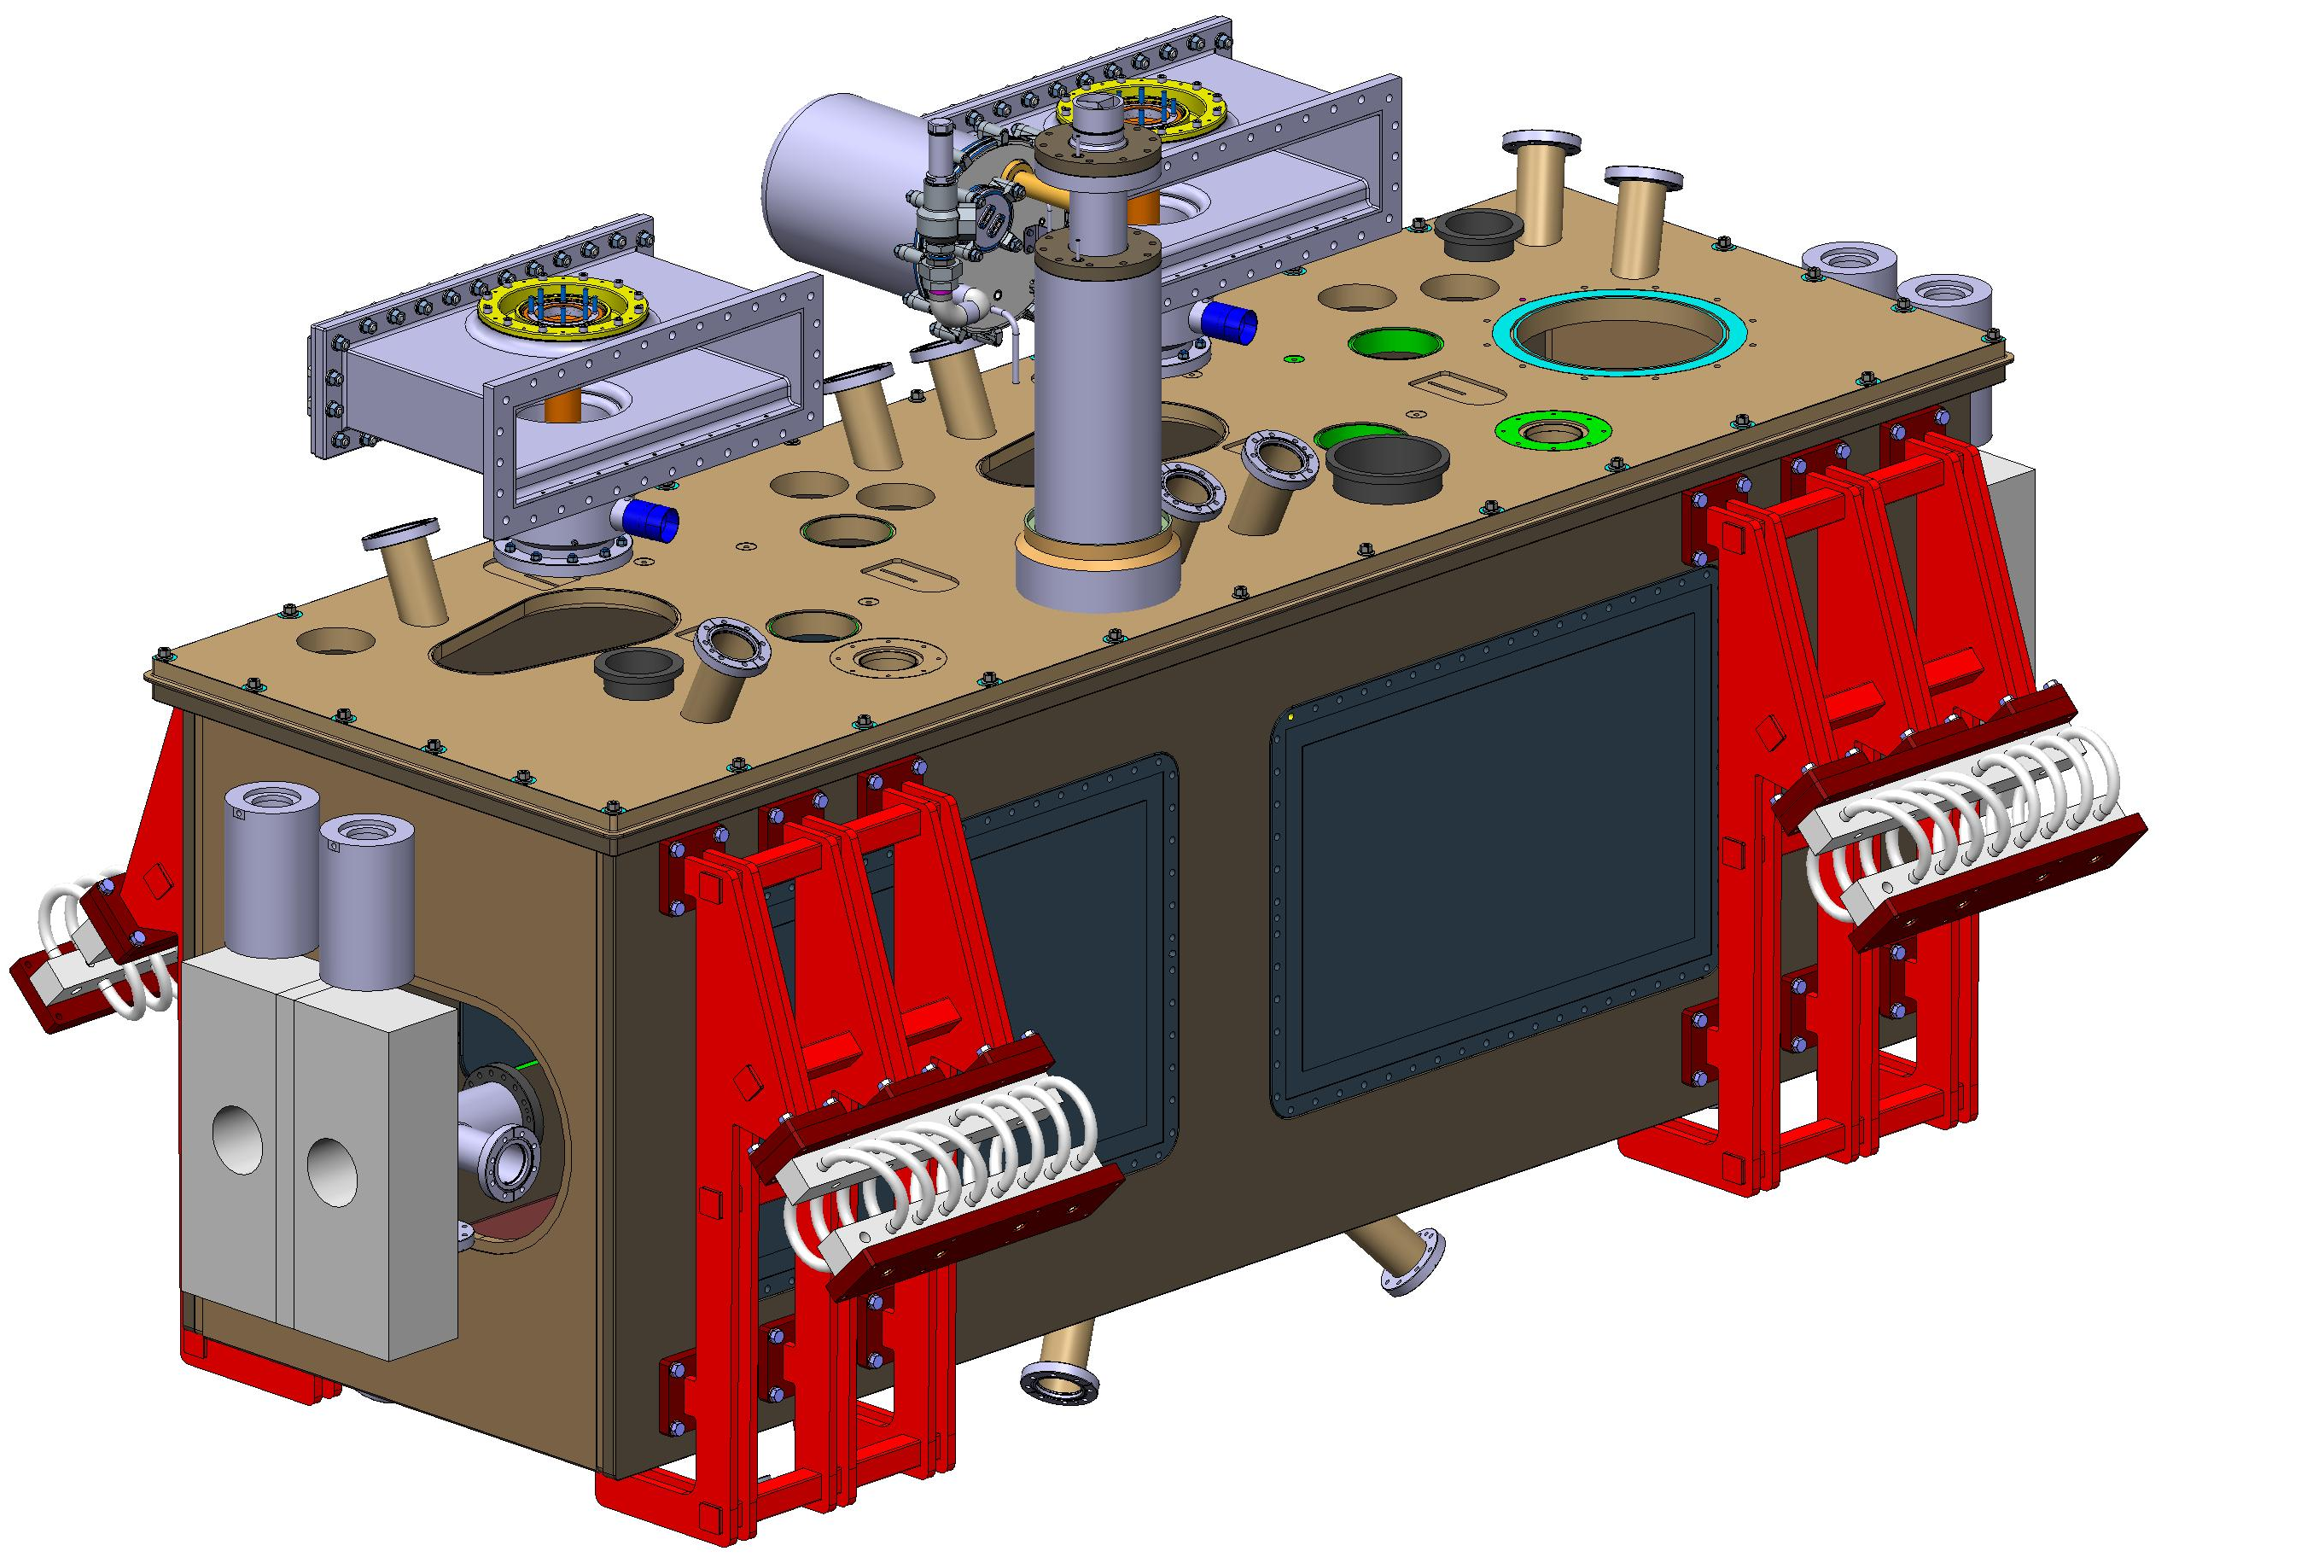
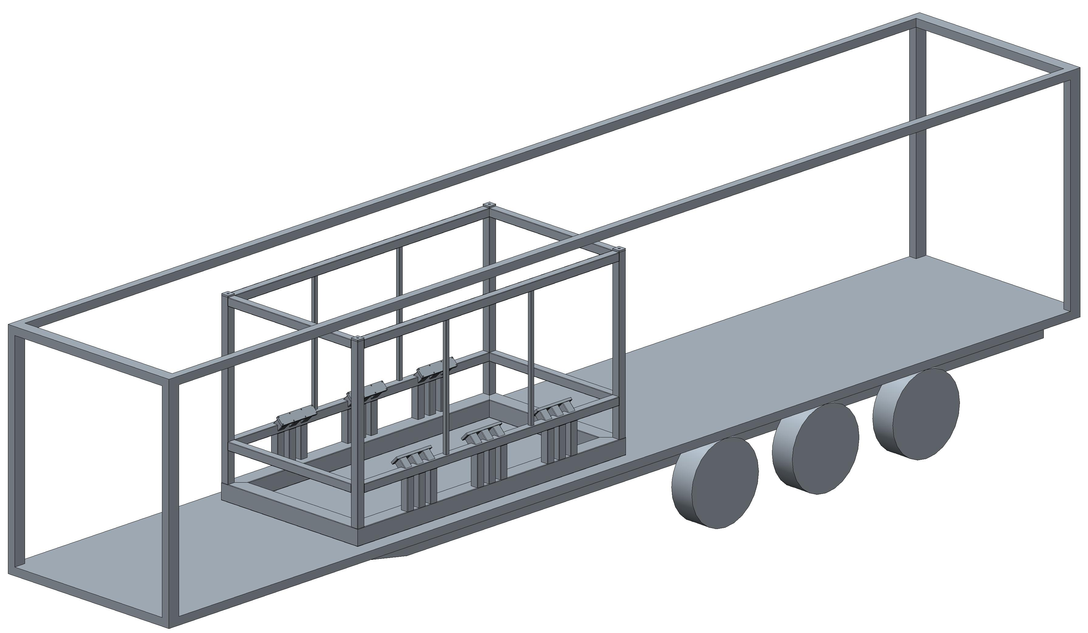
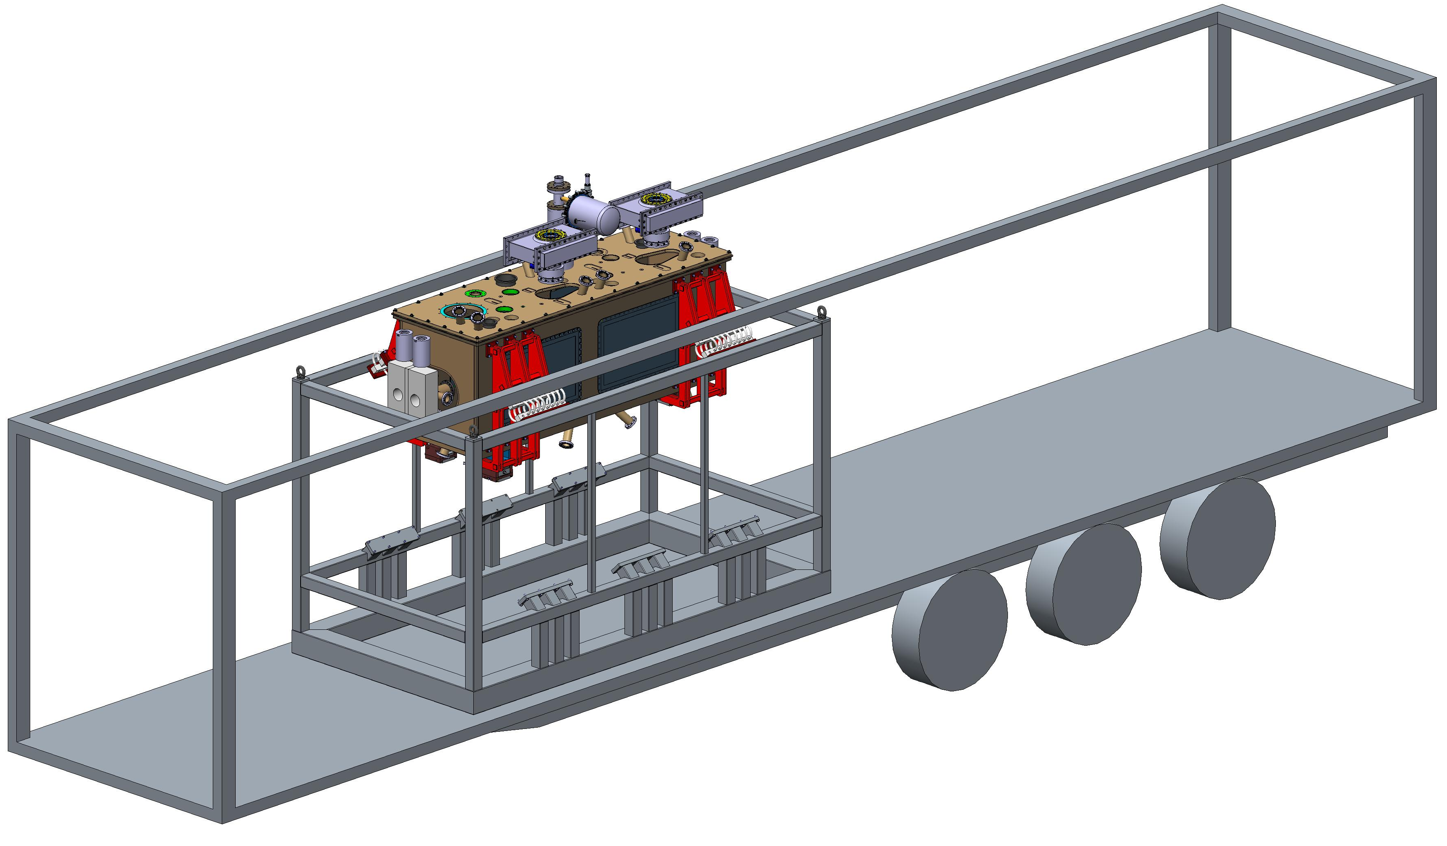
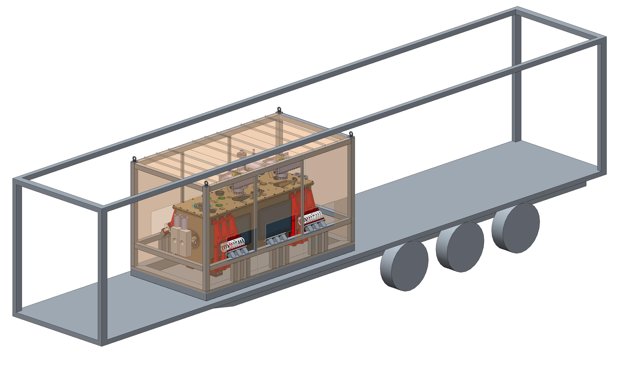
Assembly procedure – Cryomodule into transportation frame
Transport interface arms are attached to CM
Transport frame is lowered into truck trailer
CM lowered into (and fastened) to transport frame.
Wooden panels fixed to exterior

Slide 15
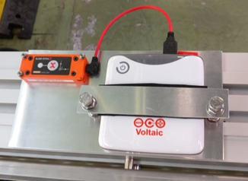
Instrumentation
The instrumentation will serve to verify the suitability of the frame design.
Mide Slam Stick X accelerometer
LOG-0002-100G-DC
Accelerometer – Slamstick with individual battery pack,
  Sampling frequency at 400hz,
  Aliasing effect at chosen sample rate to be investigated,
GPS tracking-
  TO be discussed with haulage company to allow location accuracy of events during journey,
Absolute distance measurement
  Device to be investigated,

Slide 16
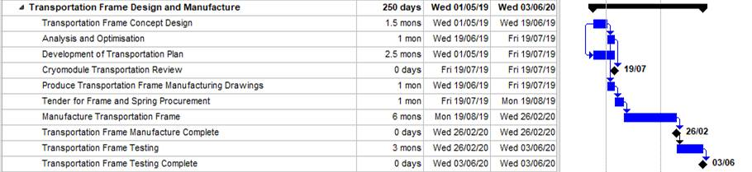
Transportation frame production planning
Today
Content of transport plan:
Transportation method
Cryomodule internal transportation tooling
Transportation frame
Loading procedure
Instrumentation and Visual Indicators
On departure: Cryomodule checks and evidence
On receipt: Cryomodule checks and evidence
Acceptance vs failure scenarios
Note on testing:
We plan to procure a concrete block with identical size, mass and mounting points as Cryomodule,
Conduct on road testing to validate transportation frame performance,

Slide 17
Thank you for your attention

Slide 18
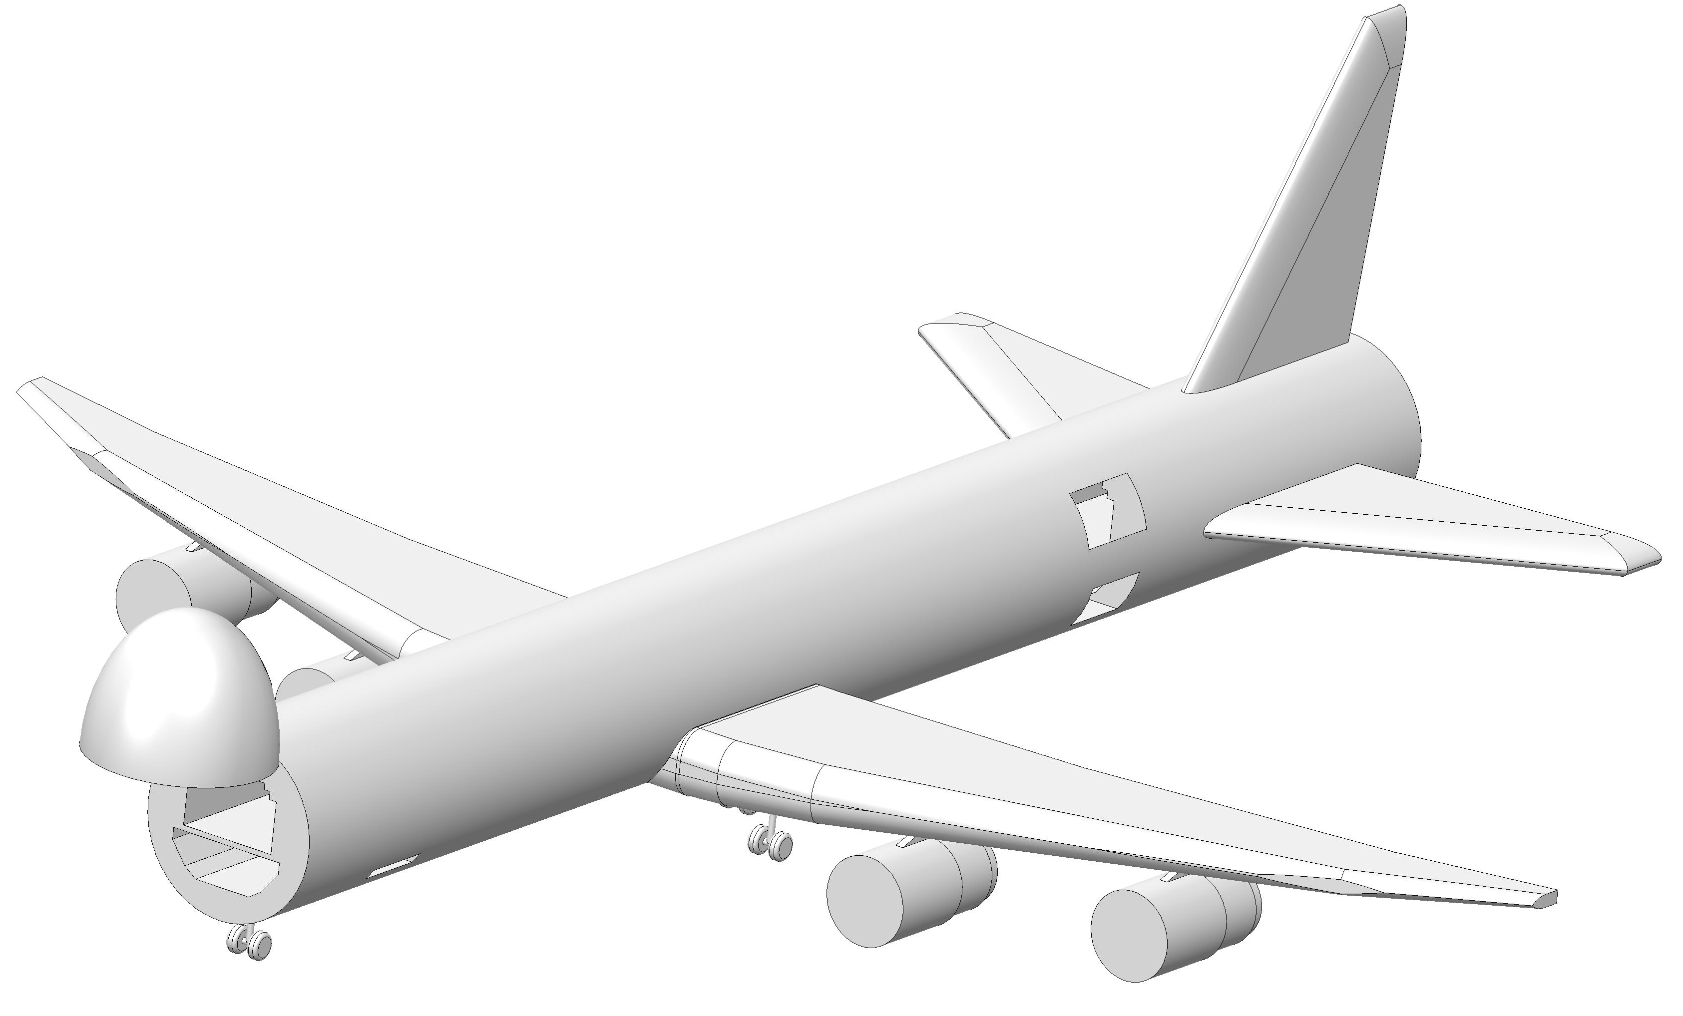
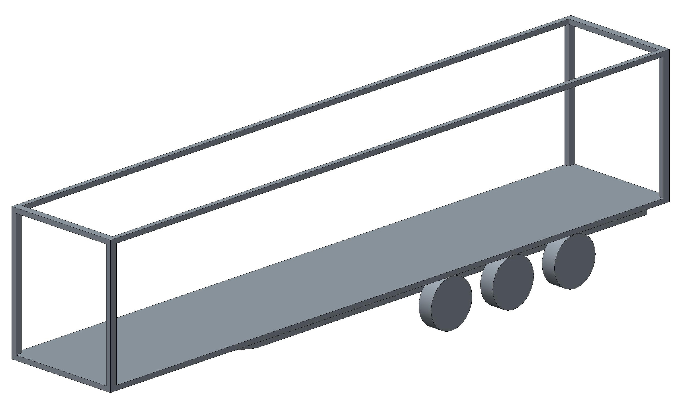
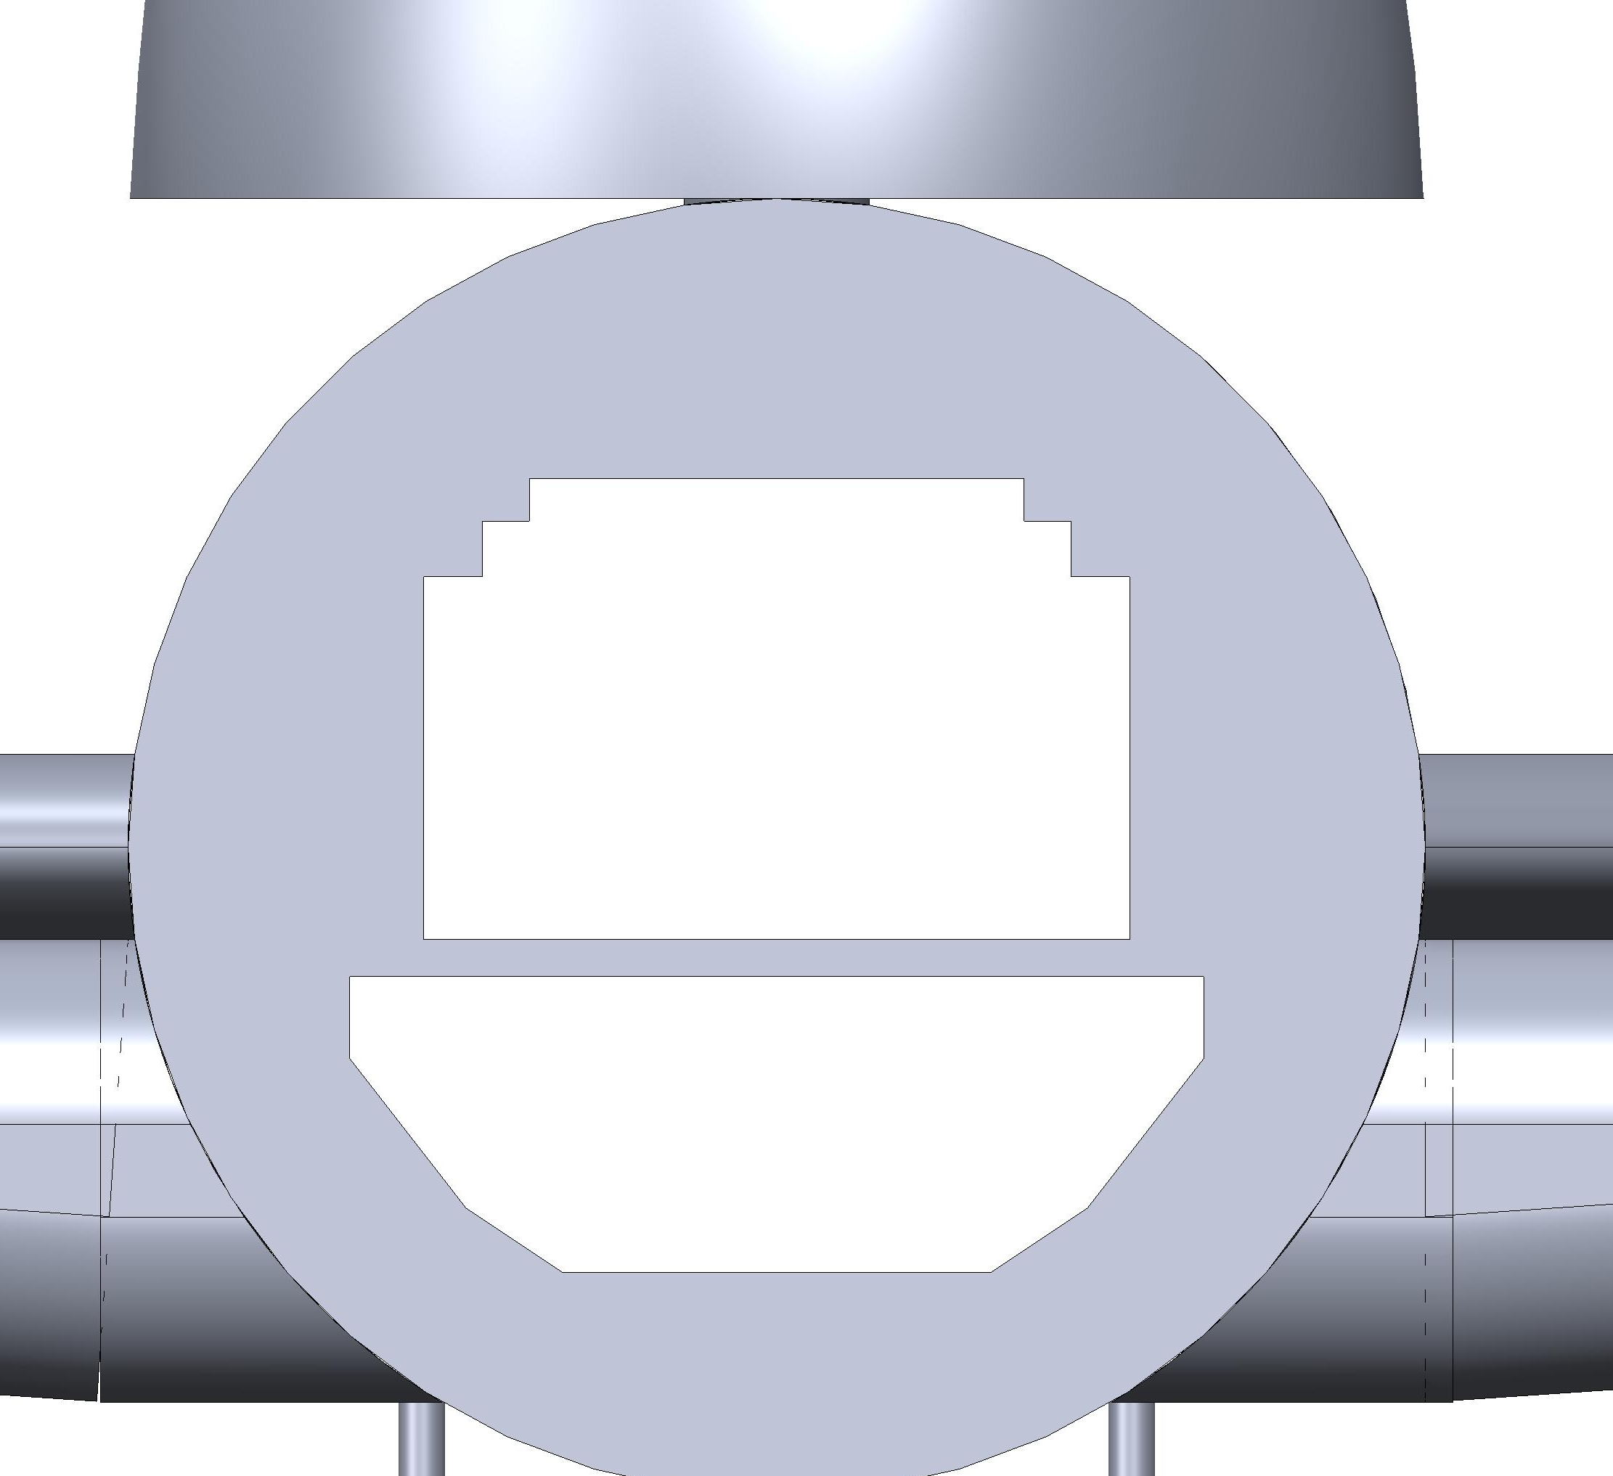
Reference slides
Design envelope truck: 2.6m x 2.2m x 13.3m (HWL)
Design envelope 747 400F: 2.4m x 2.6m x 61m (HWL)
2.6m
61m
2.6m
13.3m
2.4m
2.2m
Design envelope combined: 2.4m x 2.2m x 13.3m (HWL)

