Slide 1
Quench of Triplet quadrupole
(RQX.R1, 03.06.2018)
Observations
  Beam
  Triplet circuit
  Cryogenic system
Simulations
Summary
B. Lindstroem, E. Ravaioli, A. Verweij, D. Wollmann
More details:
Analysis of the sequence of events in RQX.R1 circuit on 3 June 2018, Internal note, TE-MPE, EDMS 2025613
168th and 169th MPP
A. Verweij: Analysis of IT quench, 351st LMC, 20.06.2018
138th HiLumi WP2 meeting, 15.01.2019

Slide 2
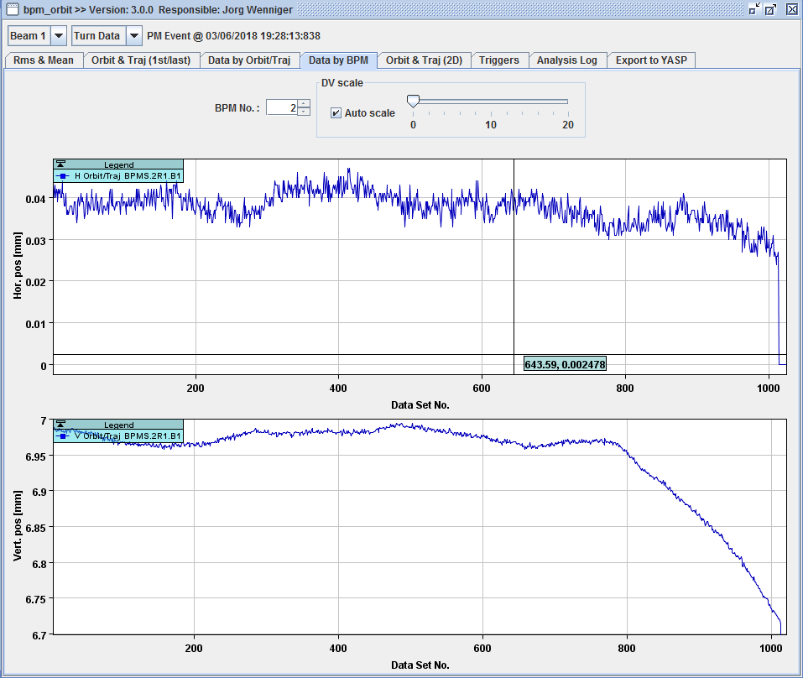
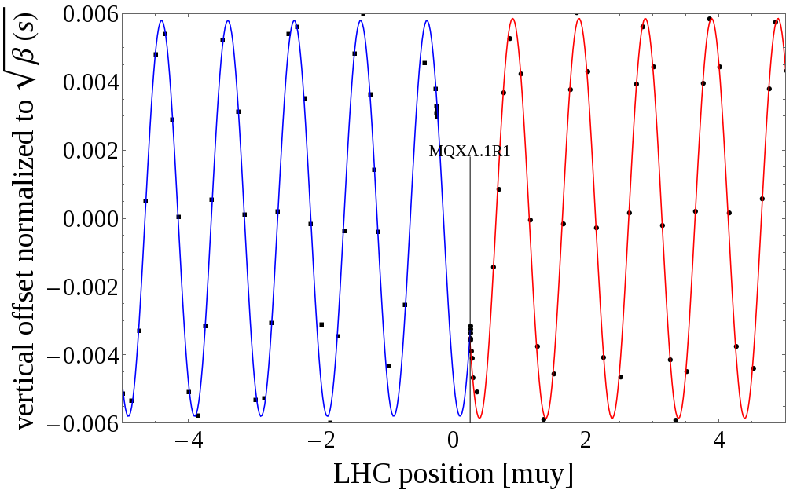
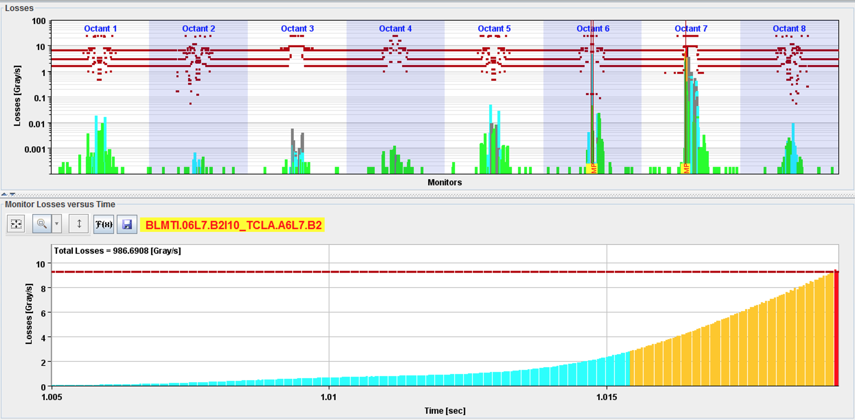
Beam observations during triplet event
Significant orbit movement in B1
No orbit change observed in B2
Beams dumped by losses in collimators
Max kick before beam dump: 0.2 urad
<10 um
18 ms
∼250 um
Offset=0.58 mm
Plotting two consecutive turns identifies the source of the orbit distortion in the triplet R1

Slide 3
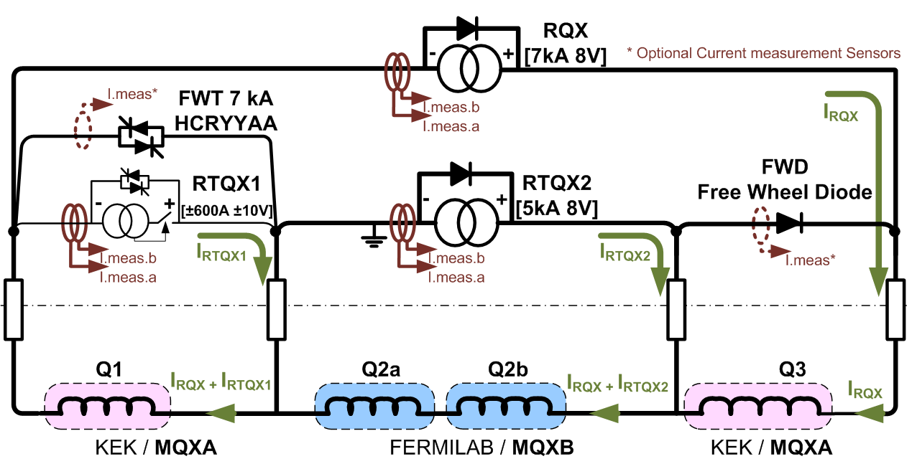
Re-cap nested triplet circuit
Nested circuit with two main power converters (RQX and RTQX2) and one trim converter (RTQX1). The event originates in Q1.

Slide 4
Re-cap geometry of triplet
z=31.5 m
z=22.9 m
z=29.3 m
z=32.1 m
z=44.1 m
z=47.0 m
z=53.3 m
Q1
BPMS.2R1.B1/2
Q2a/b
Q3
Average=
(3.67+5.42)/2=4.55 mm
B1
3.67 mm
5.42 mm
B1
B2
-3.67 mm
-4.00 mm
B2
Average=(-3.67-4.00)/2=-3.84 mm

Slide 5
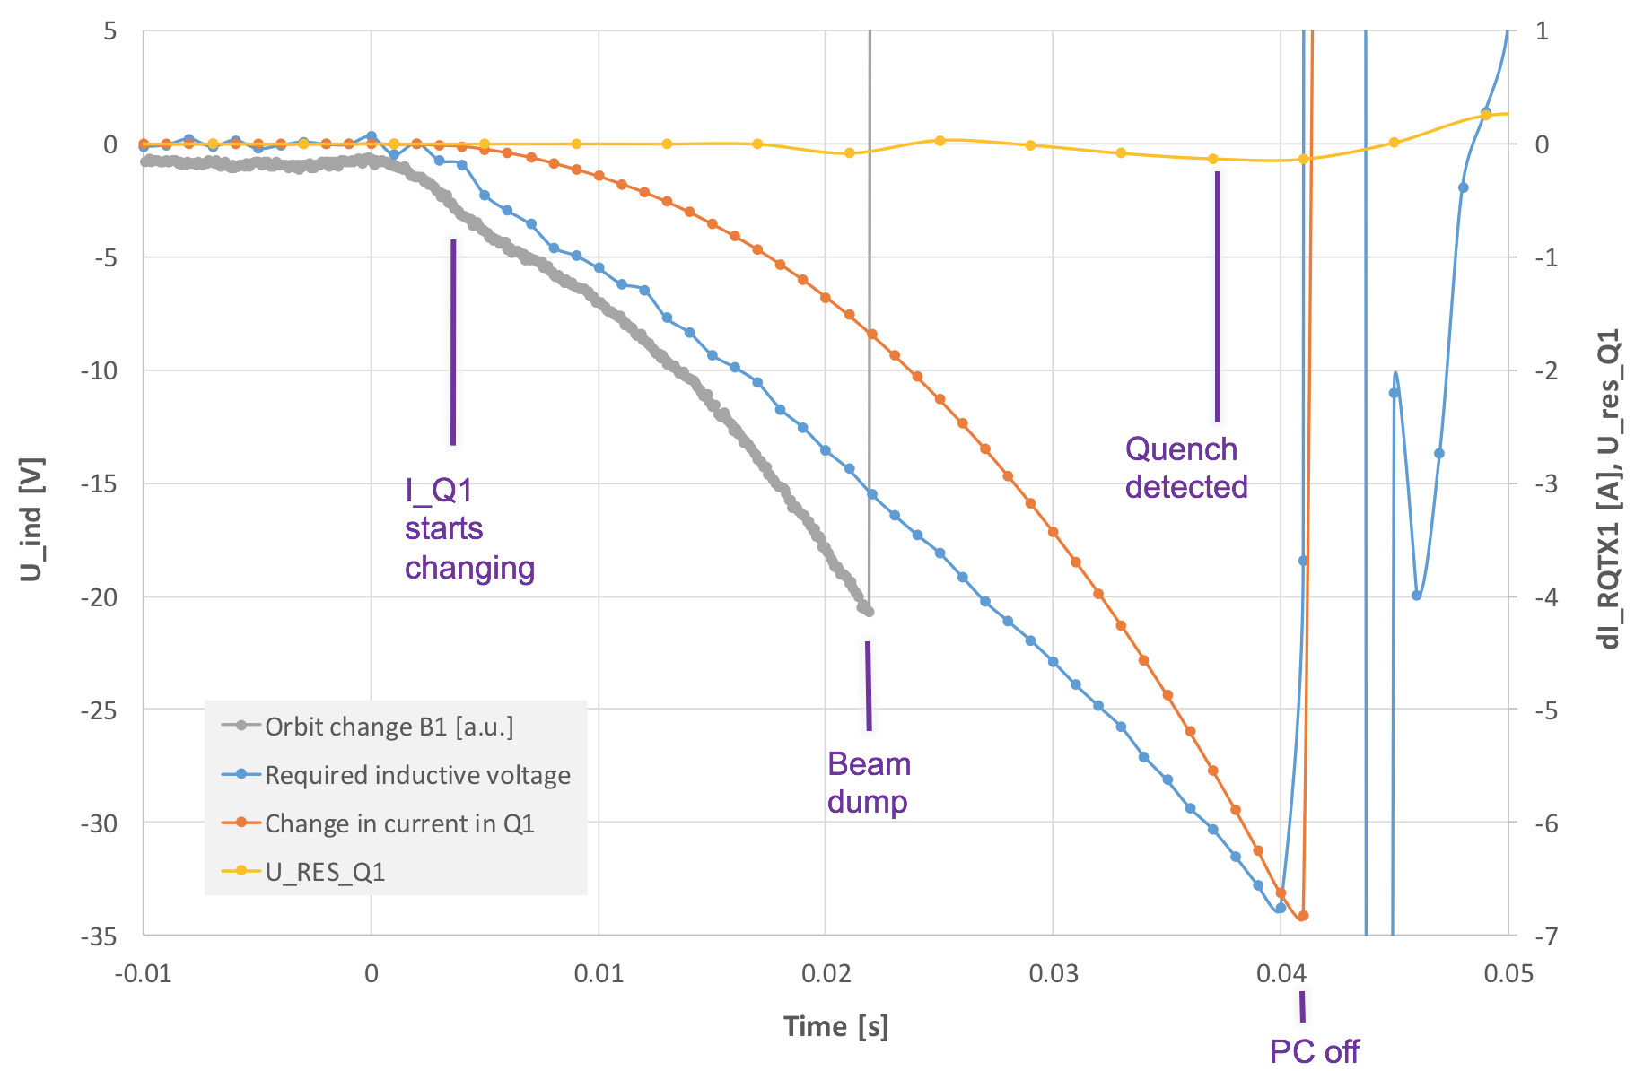
Circuit observations versus beam observations
Current change in RQTX1 at beam dump: - 1.7 A
Quench detected only 18ms after beam dump
Total current change in RQTX1 at moment of PC off: - 7 A
Usually quench: quench detected with U_{res} > 100 mV (current change tens of mA) → very fast developing quench, detected very late, due to missing symmetric quench detection in triplet quads

Slide 6
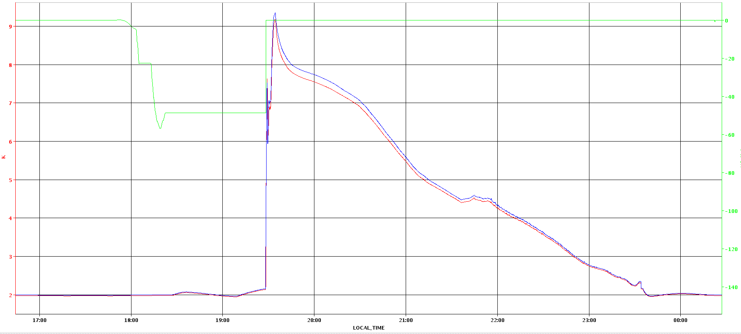
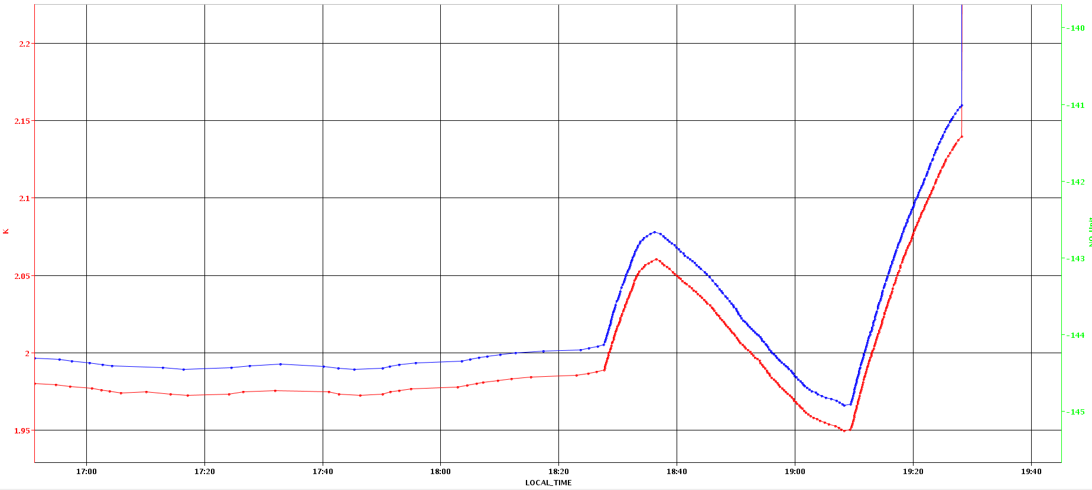
Observations in cryogenic system
9 K
0 A
20 min
2.15 K
-49 A
Current in RTQX1
1.95 K
2 K
Temperature oscillations in helium bath before event
Triplet R1 warms up from ~1.97 K to ~2.16 K
Helium temperature above lambda point means less cooling for magnet at energy deposition due to debris from IP

Slide 7

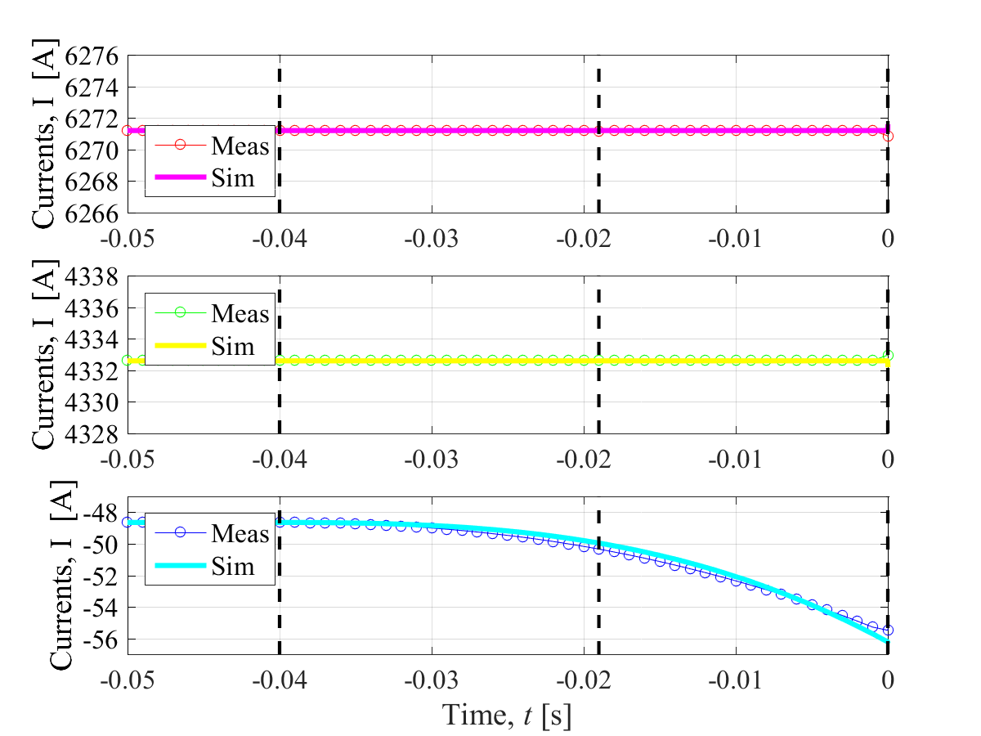
Observations in circuit versus simulations
RQX
Observed behaviour in circuit well reproduced by simulations
Very fast current decay was achieved in simulations by defining high normal zone propagation velocity
RTQX2
RQTX1
I_{Q1} = I_{RQX} + I_{RTQX1}
I_{Q2} = I_{RQX} + I_{RTQX2}
I_{Q3} = I_{RQX}

Slide 8
Expected kick strength & beam offsets from circuit measurements
Expected kick from measured current change at 6.2 kA (TF = 30.312 T/m/kA, and max ∆I 1.7 A)
  B1 kick: 6.7e-8 rad
  B2 kick: 6.0e-8 rad
Expected offset from calculated kick:
  82 µm offset at BPMS.2R1.B1
  39 µm offset at BPMS.2R1.B2
But, observed B1 offset: 250 µm, B2 offset: <10 µm
Factor 3 discrepancy
Correct orbit in triplet confirmed by Q1 k-modulation measurements on 16.06.2018
Detailed study of field distortions during quench due to:
  Inter-filament Coupling Currents (IFCC)
  Inter-strand Coupling Currents (ISCC)
  Current re-distribution in sc. Cables (CRC)

Slide 9
Inter-Filament Coupling Currents (IFCC)
Currents (only 1/4 magnet cross-section shown)
Magnetic field induced in the magnet aperture
Quenched turns
in [mT] | From BPM | From ΔI | IFCC | ISCC | CRC | All
B1, ΔB_{X} | +0.7 | +0.233 | +0.014
B1, ΔB_{Y} | <0.1 | +0.000 | +0.002
B2, ΔB_{X} | <0.1 | –0.197 | +0.022
B2, ΔB_{Y} | <0.1 | +0.000 | +0.003

Slide 10
Inter-Strand Coupling Currents (ISCC)
Currents (only 1/4 magnet cross-section shown)
Magnetic field induced in the magnet aperture
Quenched turns
in [mT] | From BPM | From ΔI | IFCC | ISCC | CRC | All
B1, ΔB_{X} | +0.7 | +0.233 | +0.014 | –0.026
B1, ΔB_{Y} | <0.1 | +0.000 | +0.002 | +0.000
B2, ΔB_{X} | <0.1 | –0.197 | +0.022 | +0.048
B2, ΔB_{Y} | <0.1 | +0.000 | +0.003 | +0.000

Slide 11
Current Redistribution in the Cable (CRC)
Currents (only 1/4 magnet cross-section shown)
Magnetic field induced in the magnet aperture
Quenched turns
The real cable redistribution currents are between two extreme cases
    Infinite contact resistance between strands: Effect is zero
    Zero contact resistance between strands: Effect is maximum (full redistribution)
in [mT] | From BPM | From ΔI | IFCC | ISCC | CRC | All
B1, ΔB_{X} | +0.7 | +0.233 | +0.014 | –0.026 | +0 / +0.967
B1, ΔB_{Y} | <0.1 | +0.000 | +0.002 | +0.000 | +0.000
B2, ΔB_{X} | <0.1 | –0.197 | +0.022 | +0.048 | +0 / +0.636
B2, ΔB_{Y} | <0.1 | +0.000 | +0.003 | +0.000 | +0.000

Slide 12
Kicks from IFCC, ISCC and CRC
Dipole kicks observed in beam can be explained by current redistribution in the sc. cables during the quench
The other effects studied are one order of magnitude too small
Note, that the exact values of many parameters used in the simulations are unknow: number of quenched turns, initial length normal zone, normal-zone propagation velocity, turn-to-turn quench propagation time, conductor properties, …
in [mT] | From BPM | From ΔI | IFCC | ISCC | CRC | All
B1, ΔB_{X} | +0.7 | +0.233 | +0.014 | –0.026 | +0 / +0.967 | +0.221 / +1.188
B1, ΔB_{Y} | <0.1 | +0.000 | +0.002 | +0.000 | +0.000 | +0.002
B2, ΔB_{X} | <0.1 | –0.197 | +0.022 | +0.048 | +0 / +0.636 | –0.127 / +0.509
B2, ΔB_{Y} | <0.1 | +0.000 | +0.003 | +0.000 | +0.000 | +0.003

Slide 13
Summary
Beam dump observed on 03.06.2018 due to losses in the collimation system has it’s origin in the triplet R1 (Q1)
Very fast (symmetric) quench leading to beam dump after 240 turns → QPS detection only ~40 ms after onset of quench
Origin of event most likely due to warm up of helium in combination with debris from the IP
Asymmetric response of B1 and B2 can be explained by current redistribution in sc. cables during the quench

Slide 15
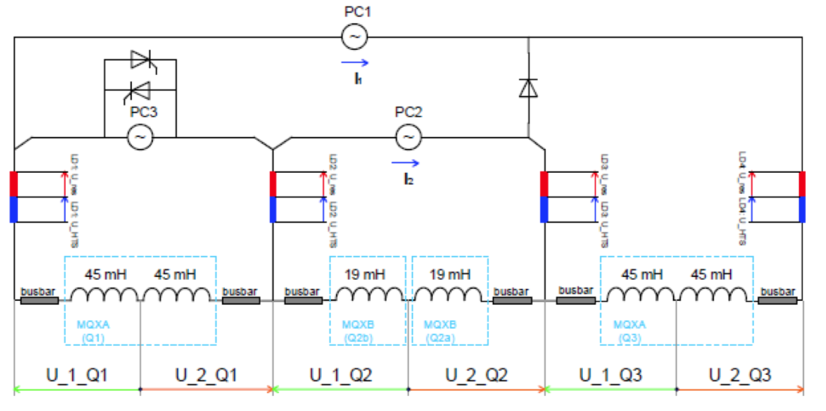
QPS signal names

