Slide 1
RRR measurements of beam screens samples from the dipole A31L2
M. Morrone, S. Calatroni, K. Brunner, S. Prunet, TE-VSC/CRG
with inputs from: N. Kos, V. Petit TE-VSC
138th WP2 Meeting
15/01/2019

Slide 2
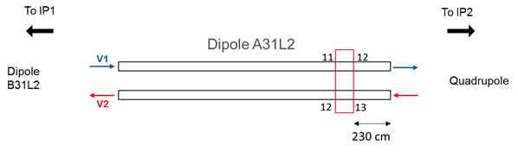
Beam screen location
Layout of the A31L2magnet
Dipole A31L2 replaced during the EYETS 2016-2017;
Two beam screens around 30 cm long, V1 and V2, used for the RRR measurements;
V1= beam going from direction 11 to 12;
V2= beam going from direction 13 to 12;
The portion of the V1 and V2 beam screens are close to IP2 (230 cm from the end of the magnet).

Slide 3
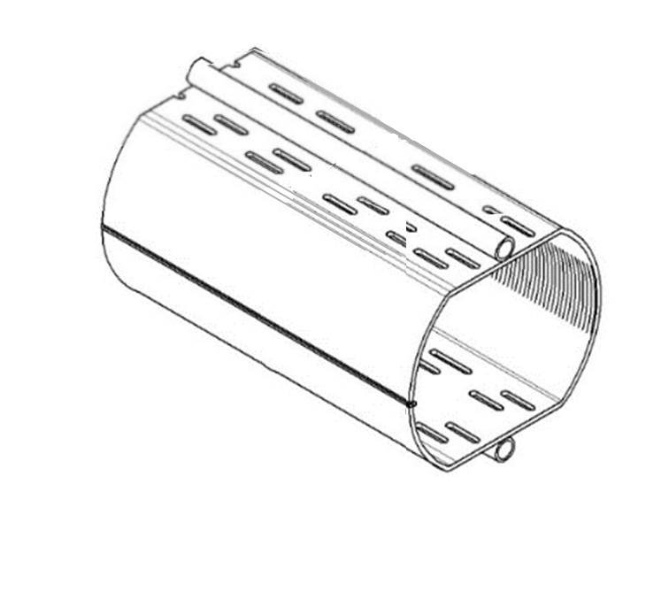
Beam screen samples
Top side
Left side
-sawtooth side-
100 mm
Cu 75 μm
P506 1 mm
1.75 mm
Dimension of the samples
Right side
-above the weld-
Bottom side
50 mm
Samples extracted from the beam screen
Distance of the electrodes to measure the voltage drop

Slide 4
Test campaign
Top side
Left side
-sawtooth side-
V1 beam screen:
P506+Cu
2 x top side;
2 x bottom side;
2 x left side;
2 x right side.
P506 (Cu stripped by etching)
1 x top side
V2 beam screen:
P506+Cu
2 x top side;
2 x bottom side;
2 x left side;
2 x right side.
P506 (Cu stripped by etching)
1 x top side
Right side
-above the weld-
Bottom side
List of the samples tested for the V1 and V2 beam screen
Samples extracted from the beam screen

Slide 5
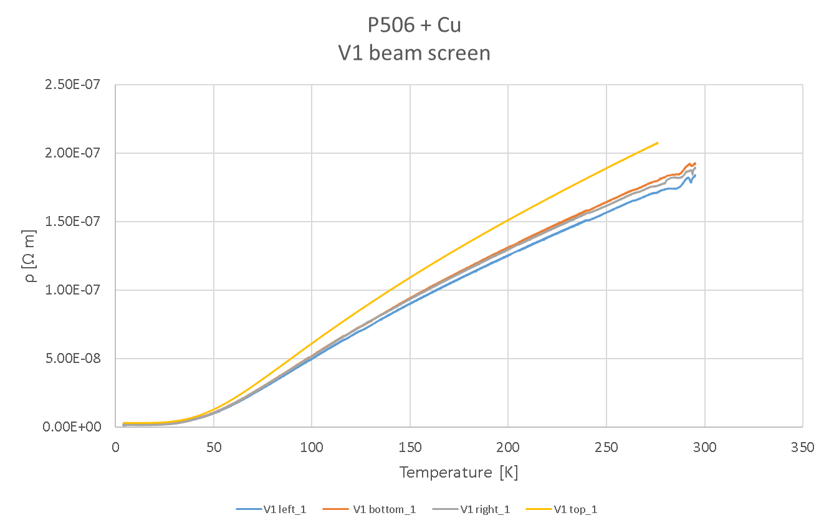
Results
Measurement current:
V1 left_1, V1 bottom_1, V1 right_1=0.1 A
V1 top_1=1 A

Slide 6
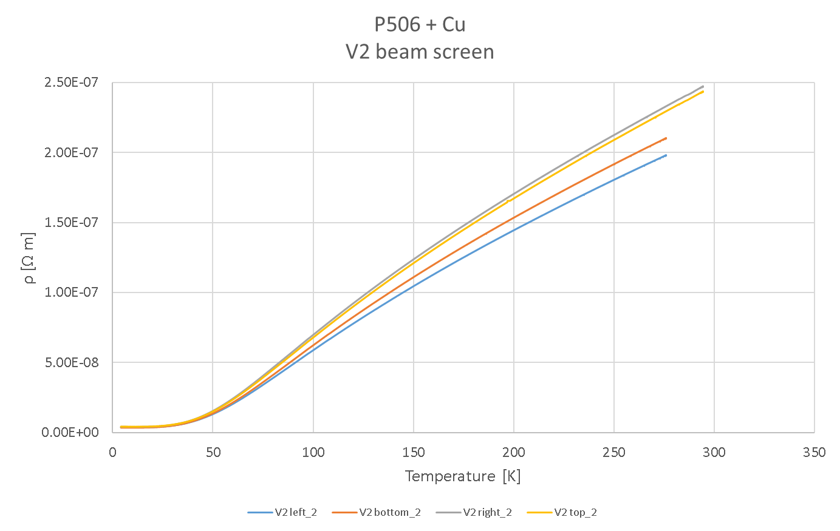
Results
Measurement current:
V1 left_2, V1 bottom_2, V1 right_2, V2_top_2 = 1 A

Slide 7
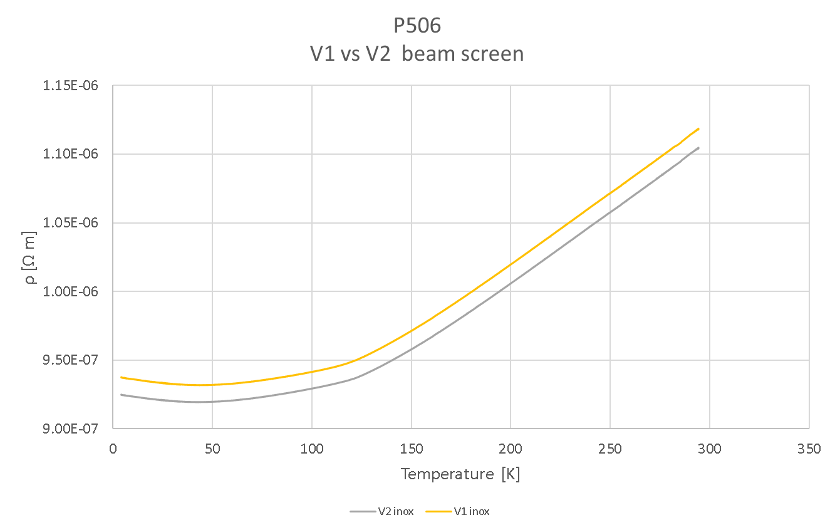
Results
Measurement current:
V1 inox, V2 inox = 1 A

Slide 8
Cu RRR and Rs results
V1 beam screen
Sample | ρ (4.2 K) [Ω m] | ρ (295 K) [Ω m] | RRR | Rs (4.2 K) = ρ /t [Ω]
V1 top_1 | 2.2E-10 | 1.8E-08 | 79 * | 3.0E-06
V1 top_2 | 2.1E-10 | 1.7E-08 | 81 * | 2.8E-06
V1 bottom_1 | 1.3E-10 | 1.6E-08 | 120 | 1.8E-06
V1 bottom_2 | 1.4E-10 | 1.6E-08 | 112 | 1.9E-06
V1 right_1 | 1.3E-10 | 1.6E-08 | 120 | 1.8E-06
V1 right_2 | 1.4E-10 | 1.6E-08 | 112 | 1.9E-06
V1 left_1 | 1.5E-10 | 1.5E-08 | 104 | 2.0E-06
V1 left_2 | - | - | -
V2 beam screen
Sample | ρ (4.2 K) [Ω m] | ρ (295 K) [Ω m] | RRR | Rs (4.2 K) = ρ /t [Ω]
V2 top_1 | 3.0E-10 | 2.2E-08 | 74 | 4.0E-06
V2 top_2 | 3.0E-10 | 2.2E-08 | 73 | 4.0E-06
V2 bottom_1 | 2.6E-10 | 1.8E-08 | 67 * | 3.5E-06
V2 bottom_2 | 2.5E-10 | 1.8E-08 | 72 * | 3.3E-06
V2 right_1 | 2.8E-10 | 2.2E-08 | 80 | 3.8E-06
V2 right_2 | 2.9E-10 | 2.2E-08 | 77 | 3.8E-06
V2 left_1 | 2.5E-10 | 1.6E-08 | 65 * | 3.4E-06
V2 left_2 | 2.6E-10 | 1.7E-08 | 64 * | 3.5E-06
RRR values of the V1 beam screen Cu layer
RRR values of the V2 beam screen Cu layer
The values of RRR marked with an asterisk should be slightly higher as the resistivity of these samples
has been measured up to 275 K.

Slide 9
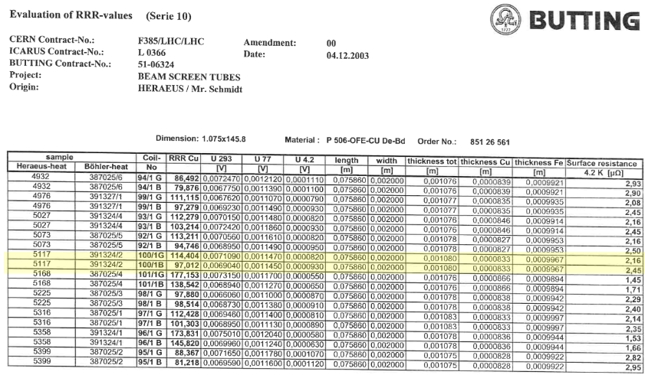
V1 beam screen
RRR values before installation
G= Flat side
B= Bent side

Slide 10
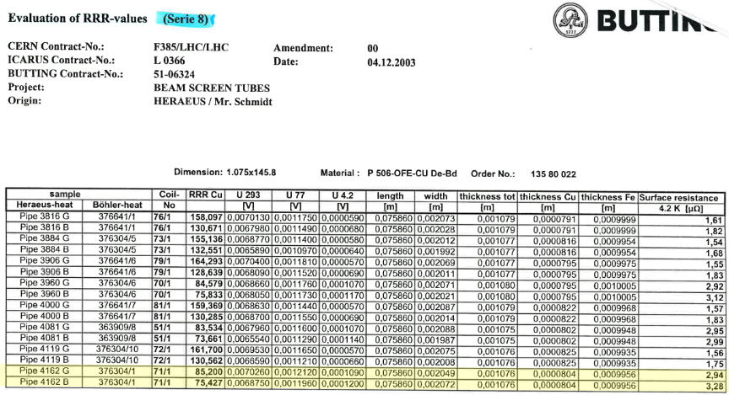
V2 beam screen
RRR values before installation
G= Flat side
B= Bent side

Slide 11
Conclusions
The RRR of the inner copper layer of two beam screen extracted from the A31L2
has been measured;
By comparison with electrical resistivity measurements performed by the beam screen supplier no degradation of the Cu RRR has been observed.

Slide 12
Thank you for your attention!

