Slide 1
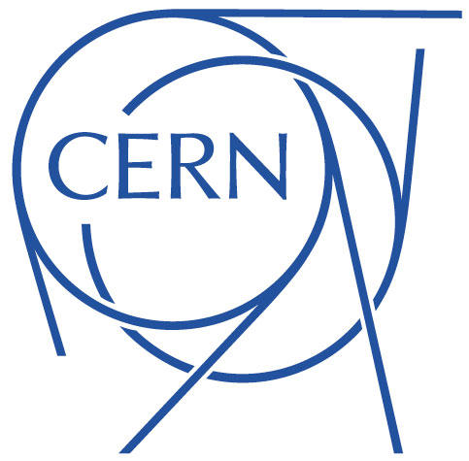
Implication on orbit correction and aperture of missing MCBY/MCBC
(preliminary)
R. De Maria, D. Gamba
139th HiLumi WP2 Meeting – 22/01/2019

Slide 2
Orbit corrector Budget
MCBY and MCBC are mostly used to correct alignment imperfections.
If one or more correctors have missing strength:
one can try to use nearby correctors (if strength is available) and at the cost of additional residual orbit (if aperture is available)
or
cure the alignment imperfection by manual alignment (remote alignment is already used to reduce the o.b. budget) at the cost of machine time)
In the following we study impact on strength/aperture when one or more corrector is missing.

Slide 3
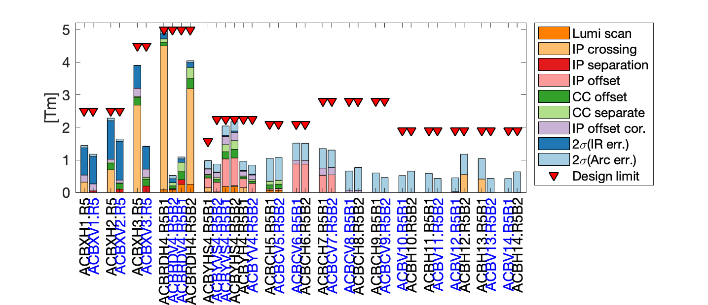
Orbit corrector budget: flat top energy
Case H crossing plane and right side (for V crossing and right side symmetries applies)
295 urad crossing angle in H plane
±0.75 mm separation in V plane
100 um IP movement independent for B1/B2 for lumiscan
2 mm IP offset with correctors + remote alignment
  Q1-Q4 displaced by 2 mm; Q5 displaced by 1 mm
± 200 um B1/B2 separation at CC
± 200 um B1 and B2 orbit offset at CC
± 500 um B1 and B2 IP offset with orbit corrector only

Slide 4
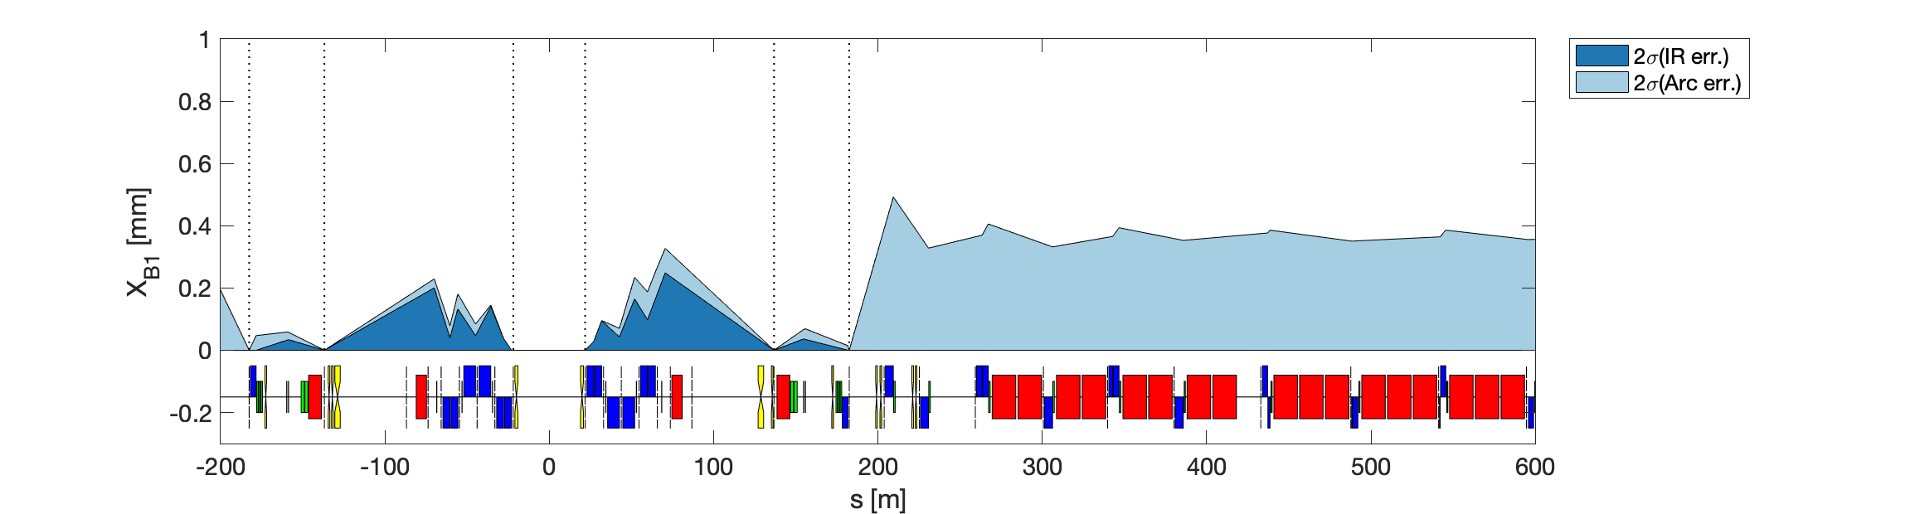
Residual orbit after correction
Alignment imperfections:
  All square distributions
    (i.e. if ±0.5 mm, then sigma = 0.5/sqrt(3) = 0.2887 mm)
  Quadrupoles
    ±0.5mm DX/DY, ±10mm DS, ±0.002 DKR1, ±1 mrad DPSI.
      Presently considering only DX/DY on quadrupoles. Normally DS/DKR1/DPSI has minor impact.
  Dipoles
    ±10mm DS, ±0.002 DKR0, ±0.5 mrad DPSI.

Slide 5
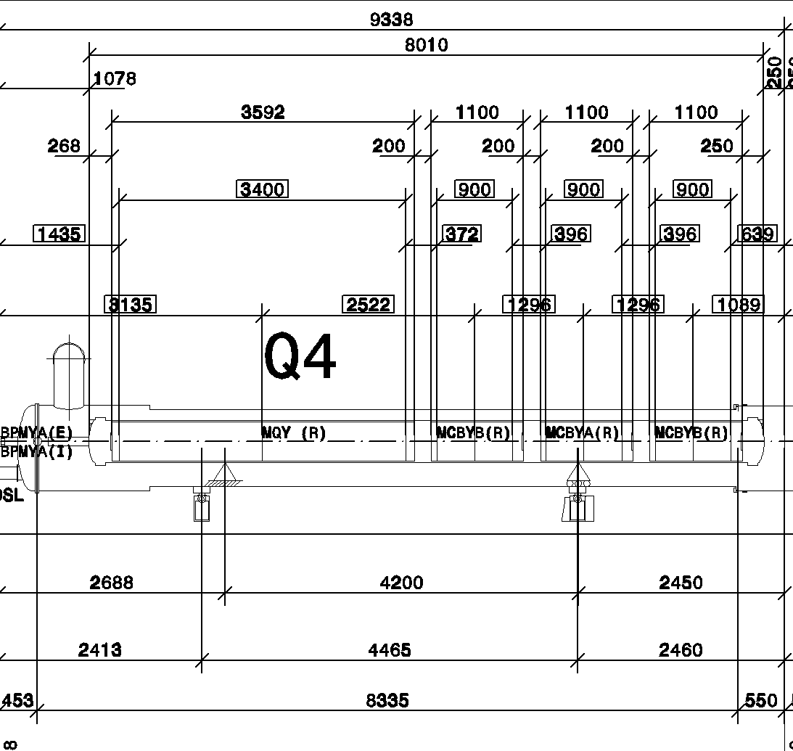
Expected radiation load MCBY
Gamma irradiation foreseen doses
Around 5 MGy after 3300 fb⁻¹
4 MCBY are currently operated with limited current:
Q4R8 (RCHYH4.R8B1),
Q5R8 (RCBYHS5.B8B1),
Q4L5 (RCBYS4.L5B1),
Q5L4 (RCBYS.L5B1).

Slide 6
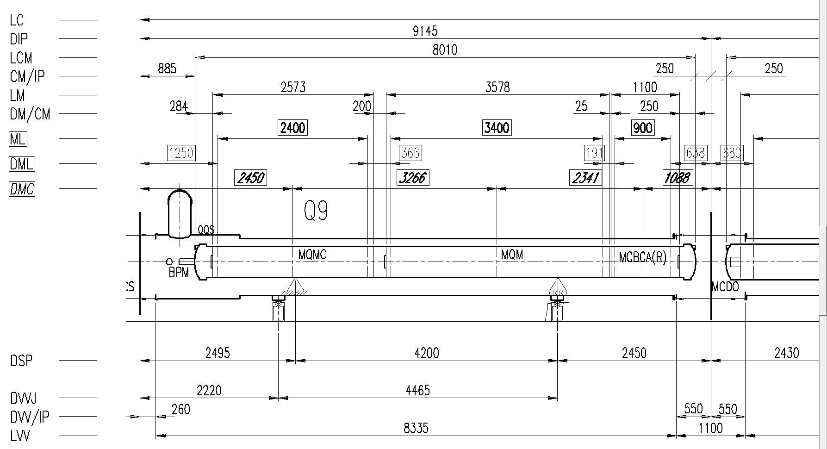
Expected radiation load MCBC

Slide 7
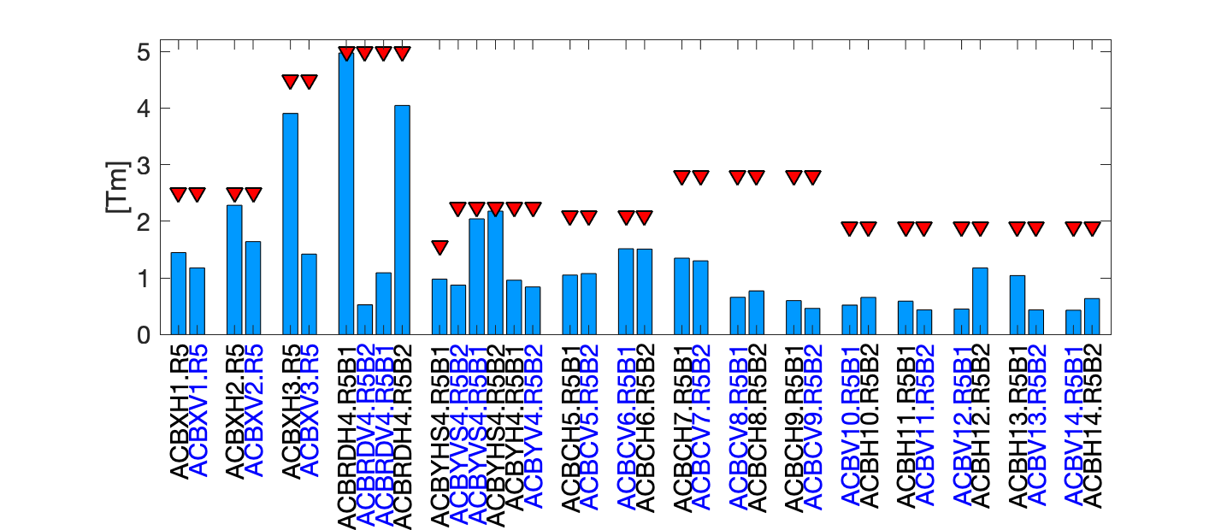
Where we are
(no distinction between contributions)

Slide 8
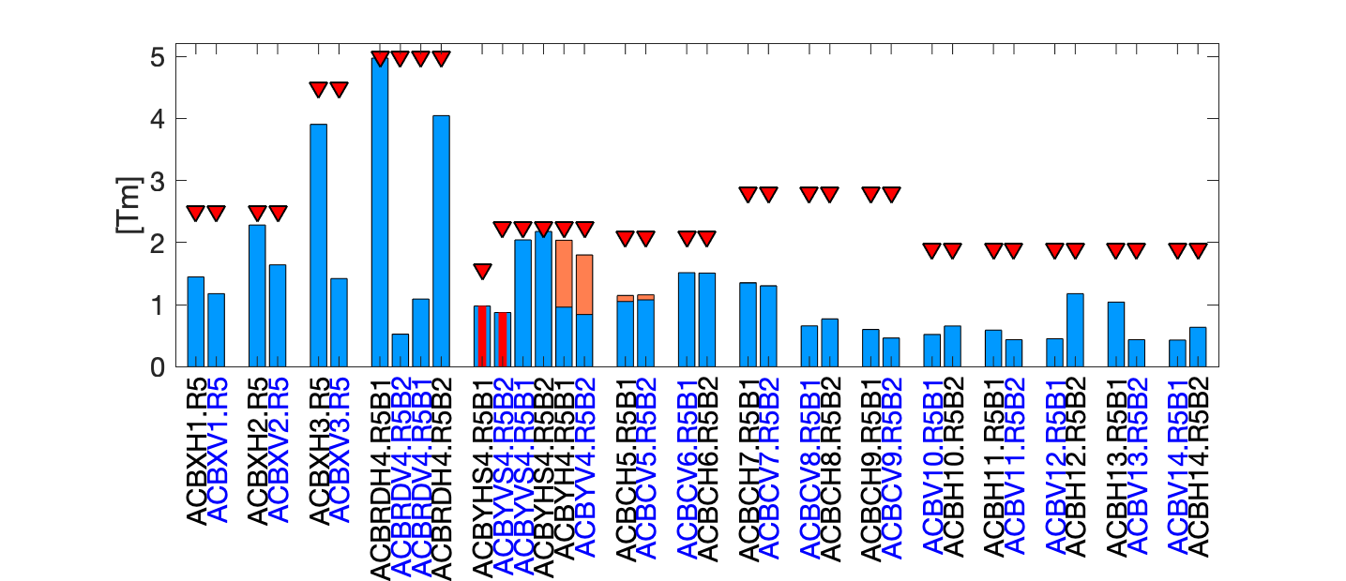

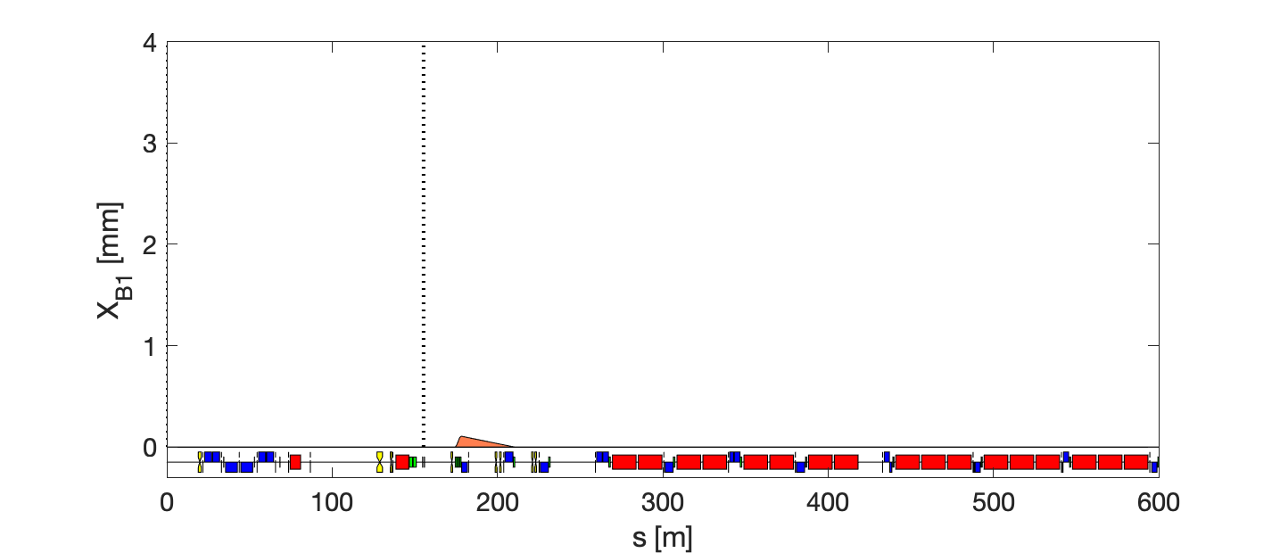


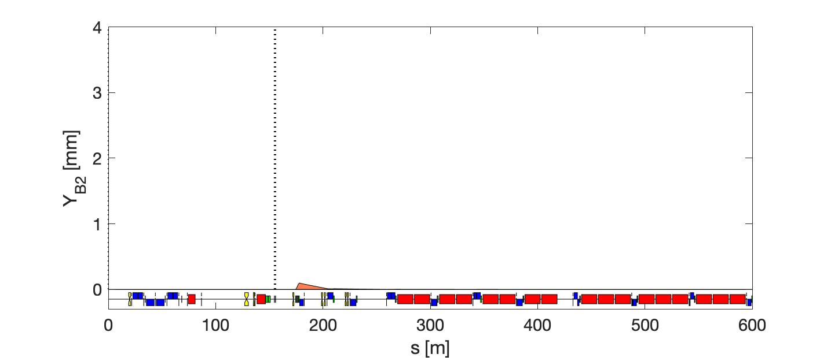
Failure scenario – Q4 (first corrector)
within available strength
minimum local orbit
No perturbation @<Q4 & @>Q25
Using only 2 nearby correctors (before/after)
Q4 Q5 Q6 Q7 Q8 Q9 Q10 Q11 Q12 Q13 Q14

Slide 9
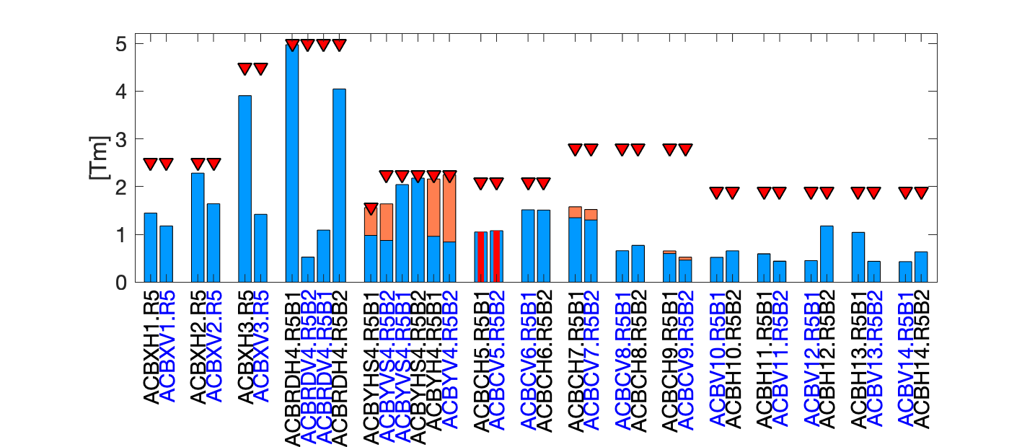
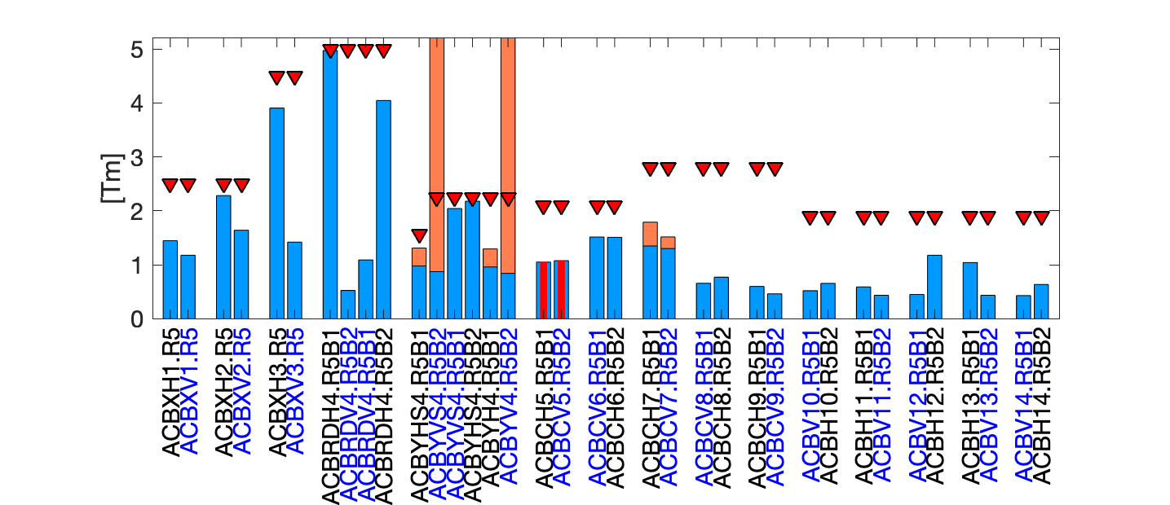
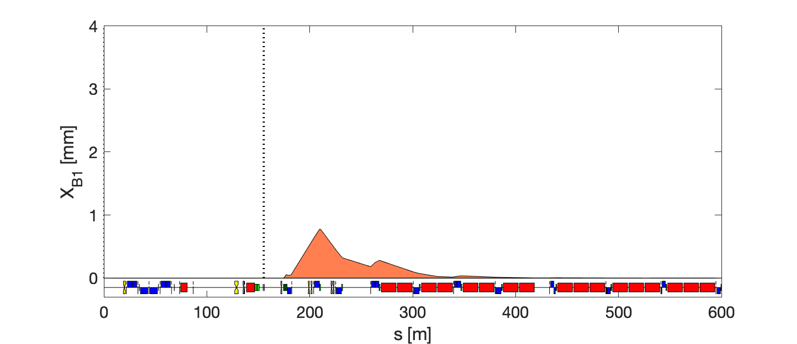
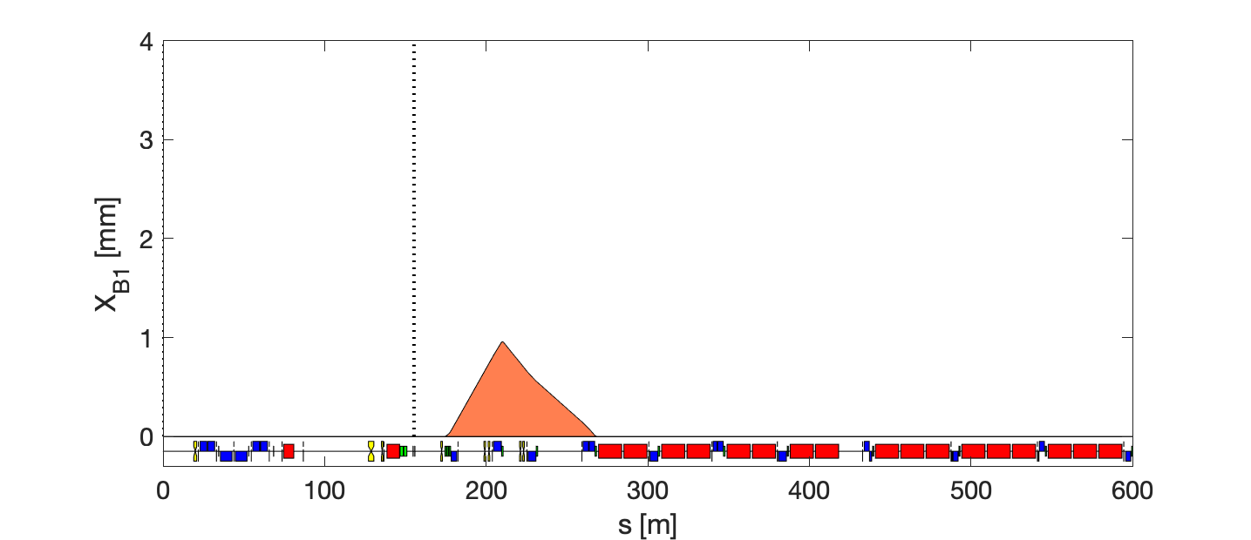

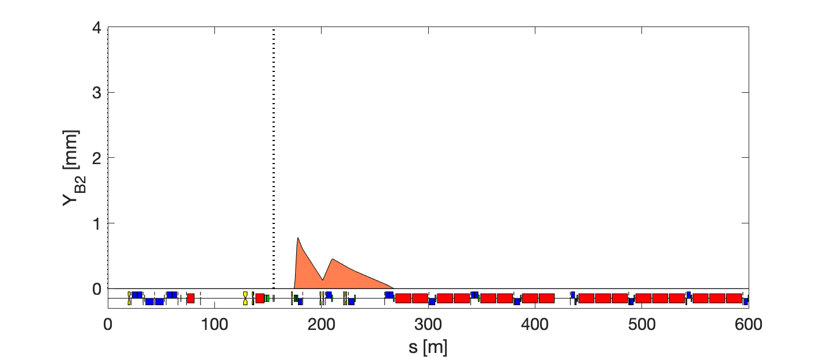
Failure scenario – Q5
within available strength
minimum local orbit
No perturbation @<Q4 & @>Q25
Using only 2 nearby correctors (before/after)
Q4 Q5 Q6 Q7 Q8 Q9 Q10 Q11 Q12 Q13 Q14

Slide 10

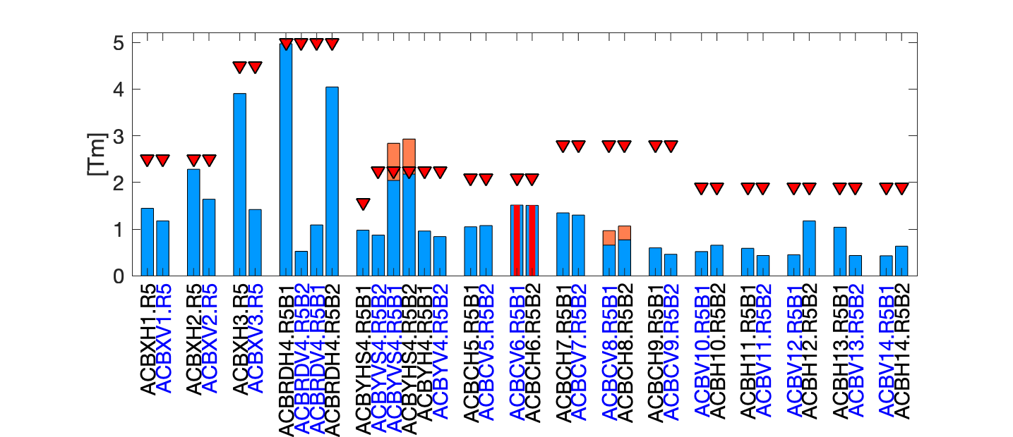
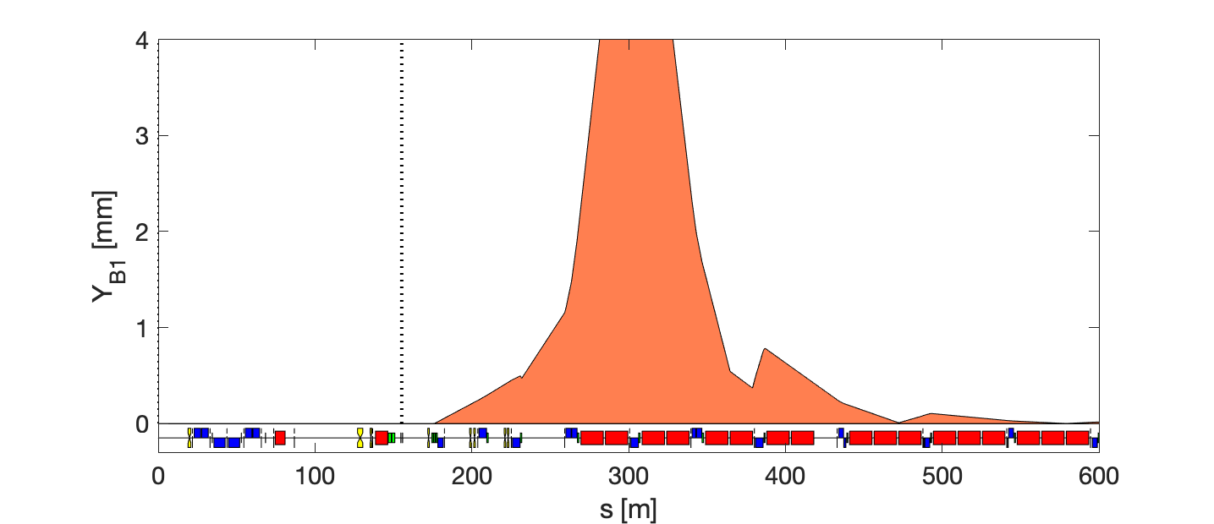
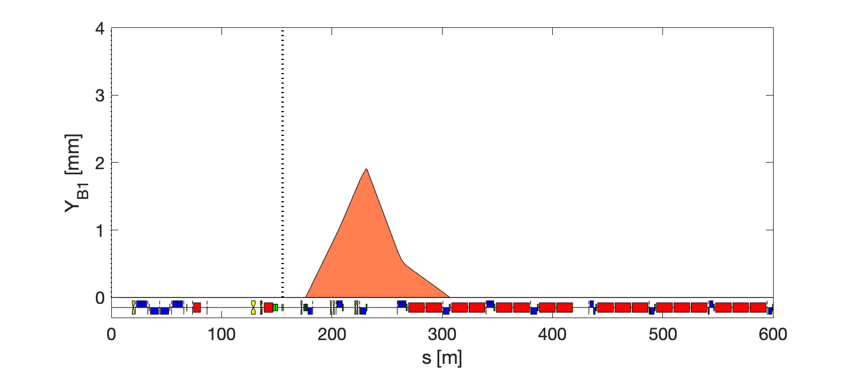
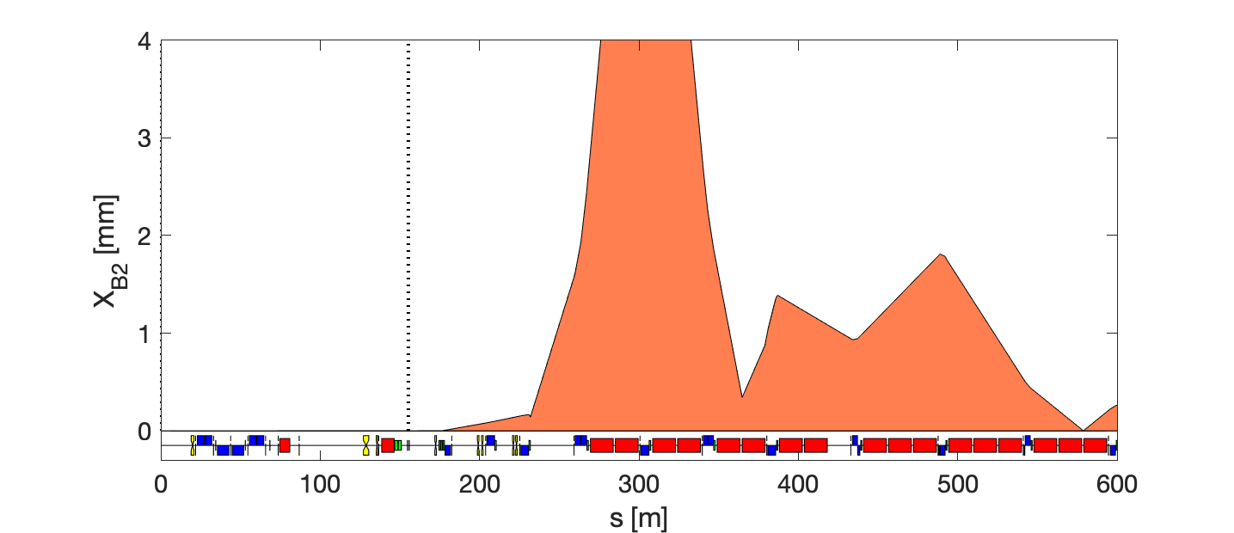

Failure scenario – Q6
within available strength
minimum local orbit
No perturbation @<Q4 & @>Q25
Using only 2 nearby correctors (before/after)
Up to 7 mm @Q8
Q4 Q5 Q6 Q7 Q8 Q9 Q10 Q11 Q12 Q13 Q14
Up to 8.5 mm @Q8

Slide 11
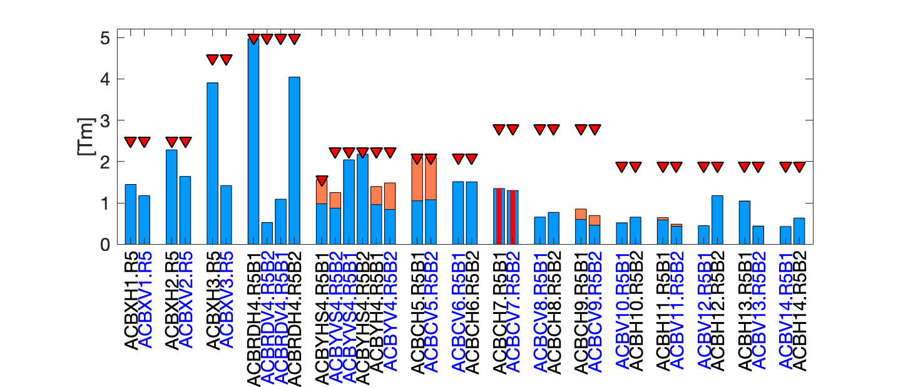
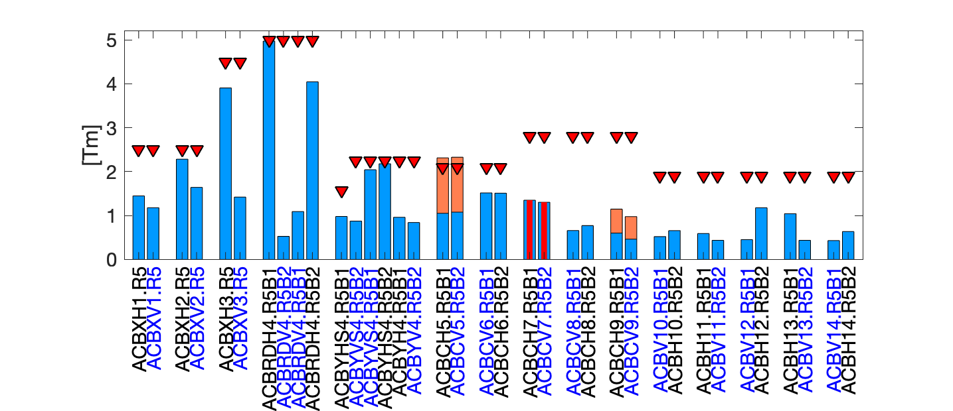
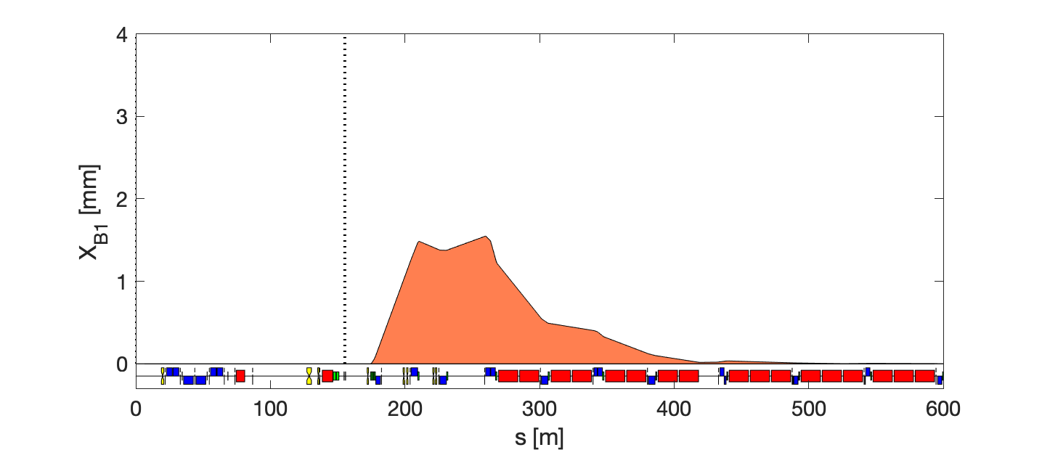
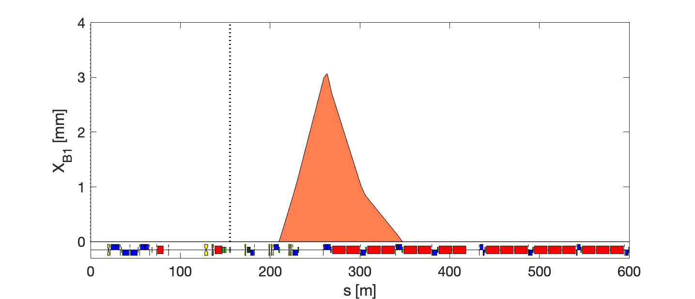


Failure scenario – Q7
within available strength
minimum local orbit
No perturbation @<Q4 & @>Q25
Using only 2 nearby correctors (before/after)
Q4 Q5 Q6 Q7 Q8 Q9 Q10 Q11 Q12 Q13 Q14

Slide 12

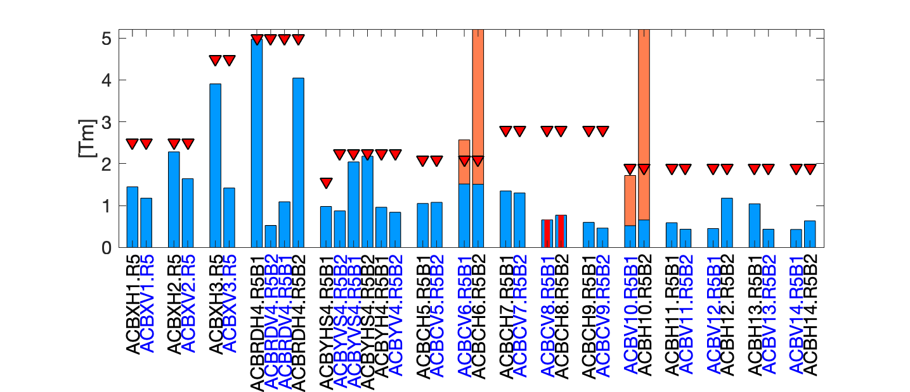
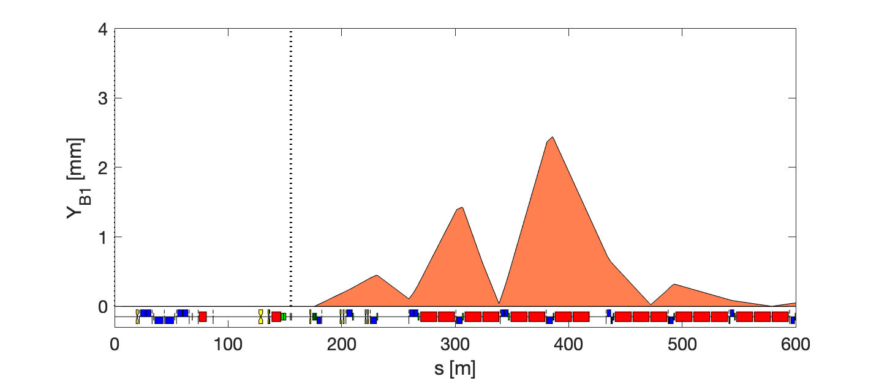
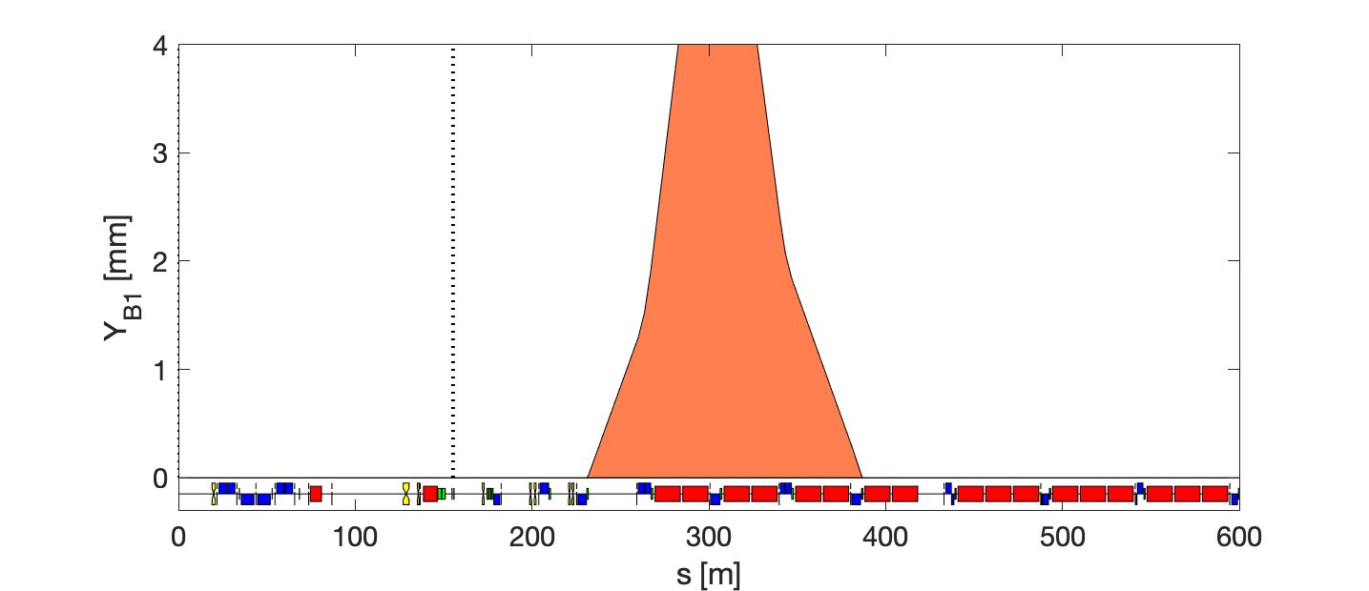
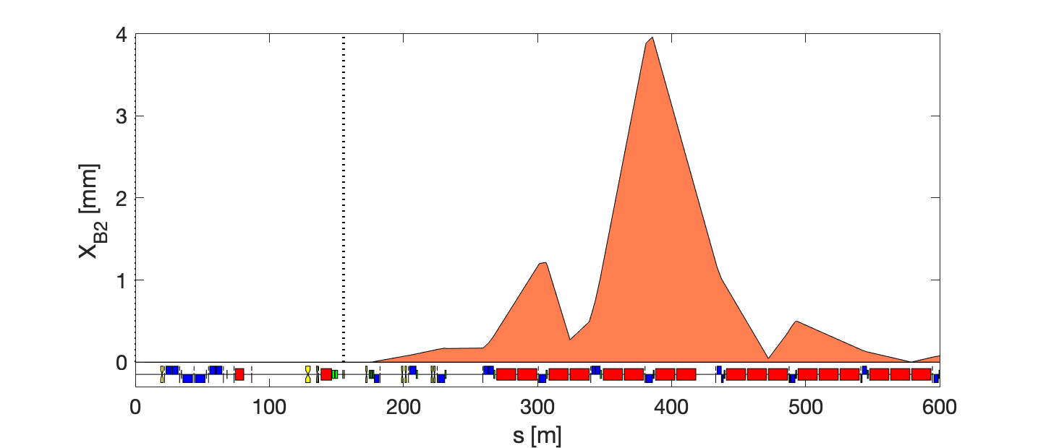
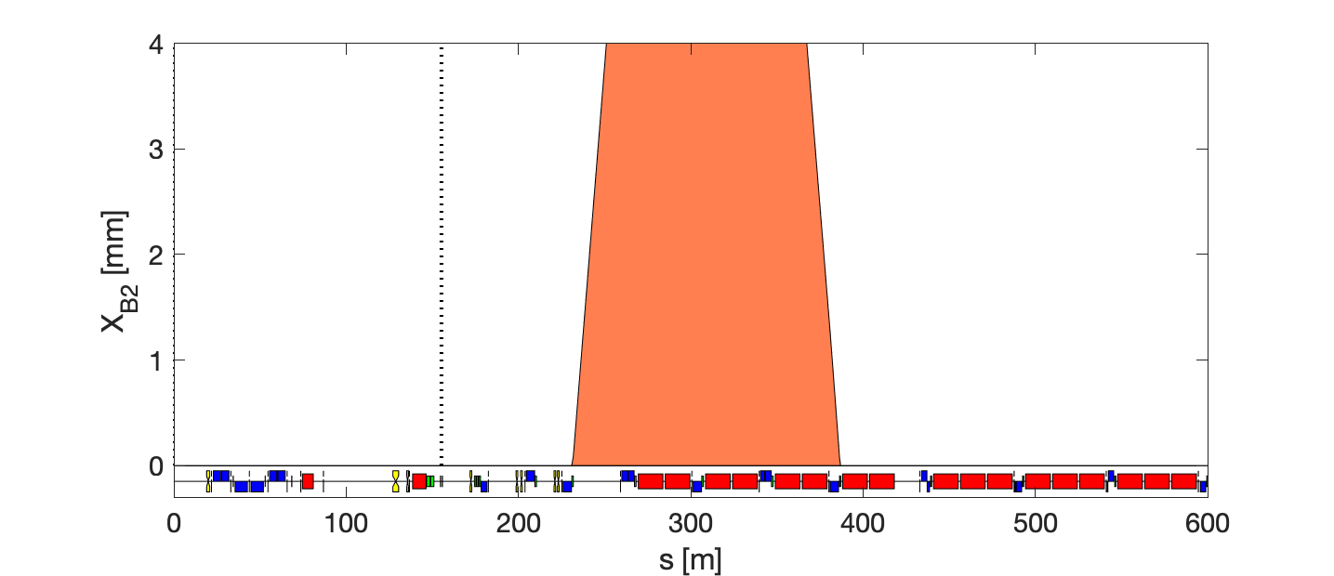
Failure scenario – Q8
within available strength
minimum local orbit
No perturbation @<Q4 & @>Q25
Using only 2 nearby correctors (before/after)
Up to 6.5 mm @Q8
Q4 Q5 Q6 Q7 Q8 Q9 Q10 Q11 Q12 Q13 Q14
Up to 30 mm @Q8

Slide 13
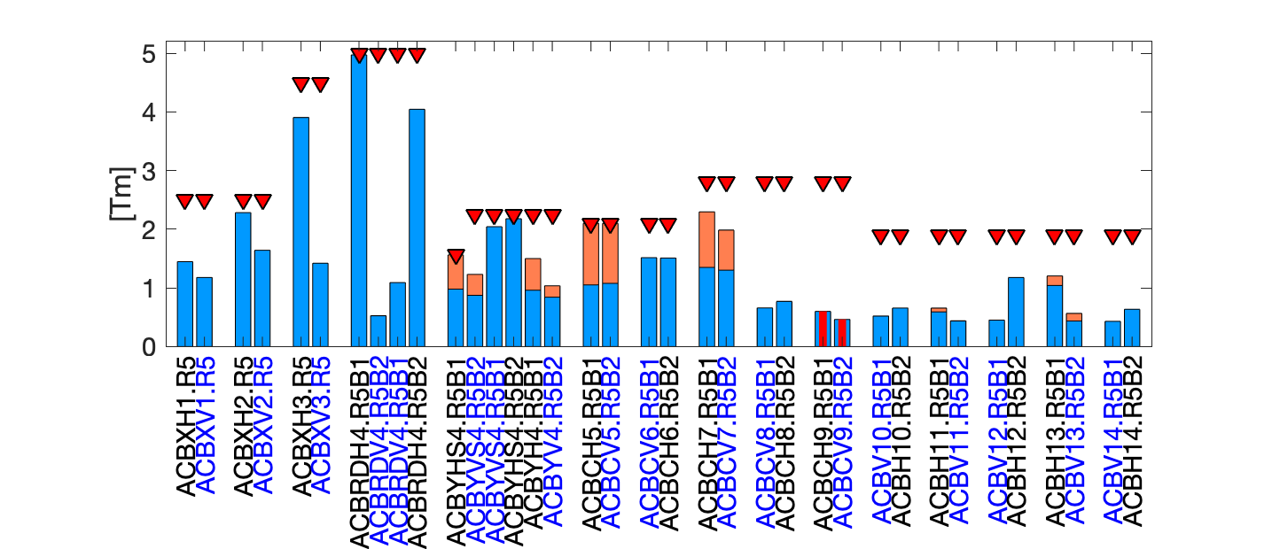
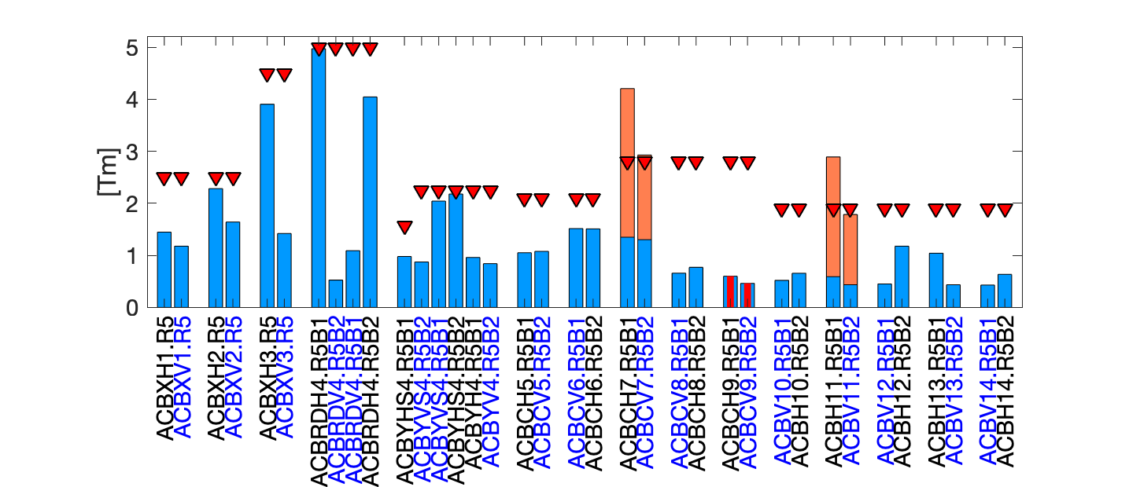
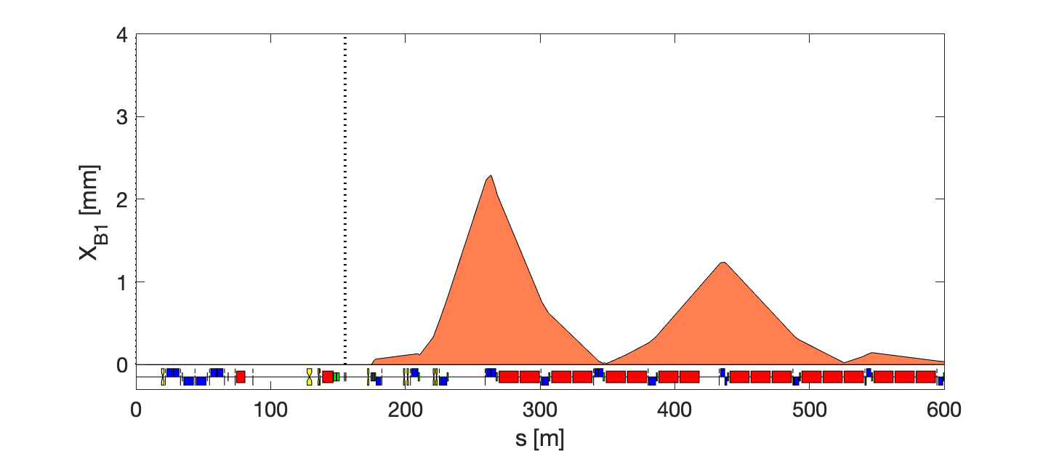
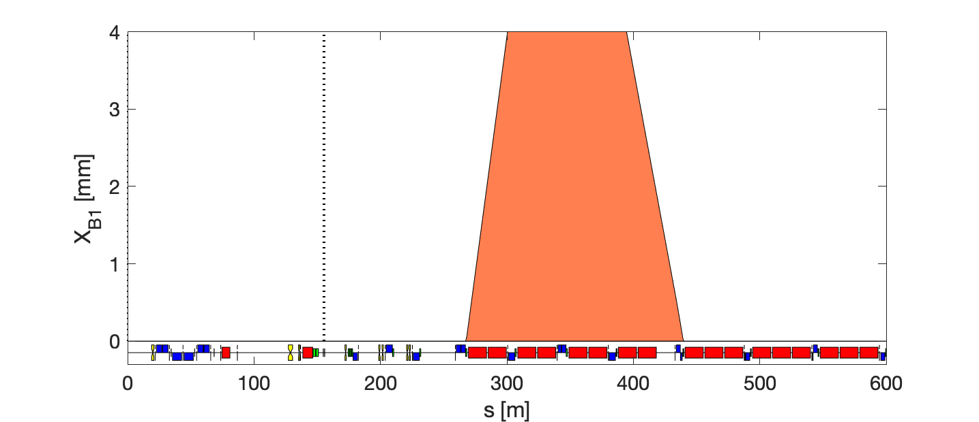
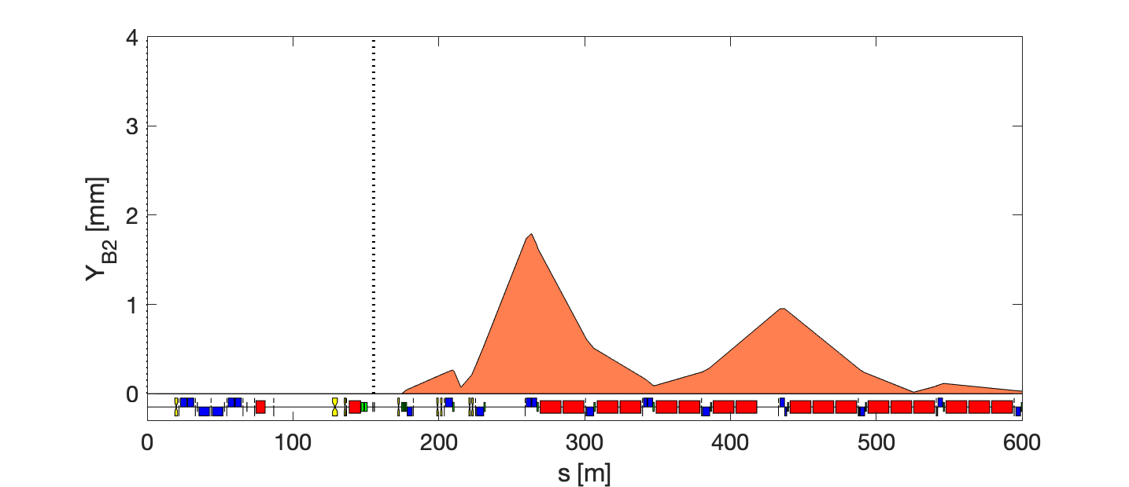
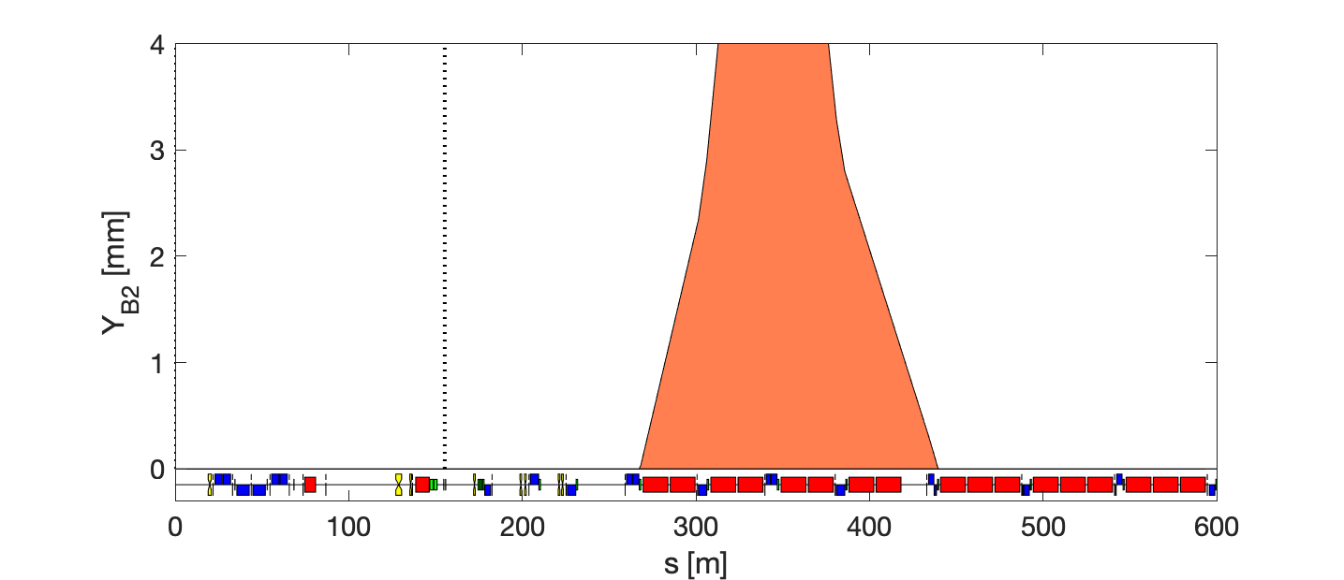
Failure scenario – Q9
within available strength
minimum local orbit
No perturbation @<Q4 & @>Q25
Using only 2 nearby correctors (before/after)
Up to 15 mm @Q9
Q4 Q5 Q6 Q7 Q8 Q9 Q10 Q11 Q12 Q13 Q14
Up to 9 mm @Q9

Slide 14
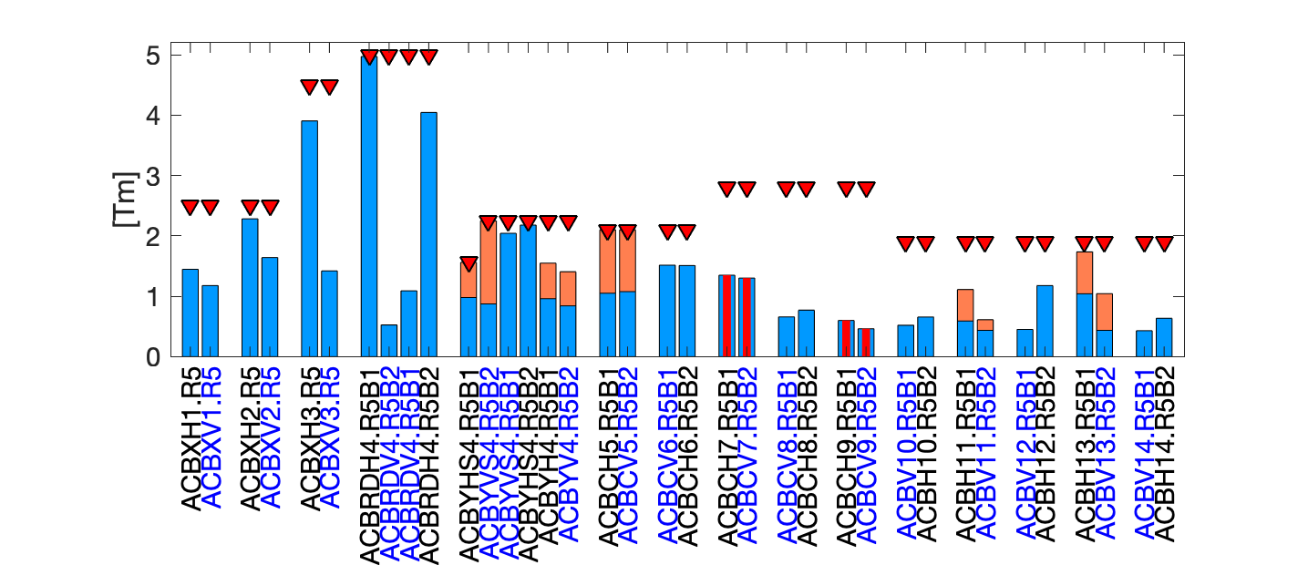
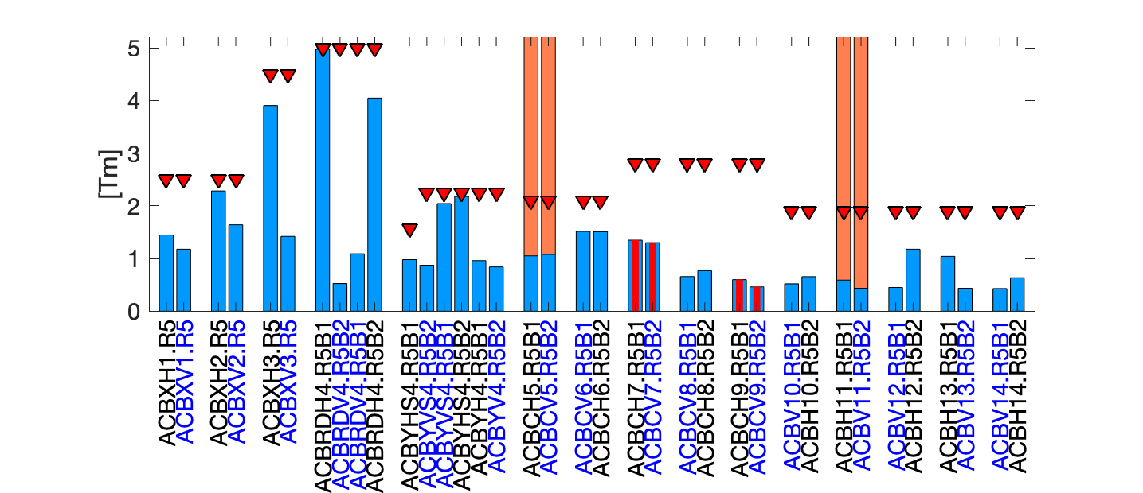
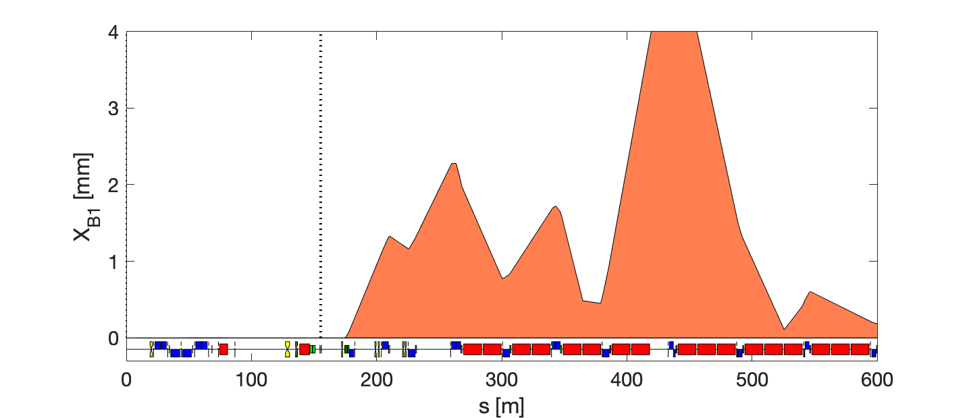
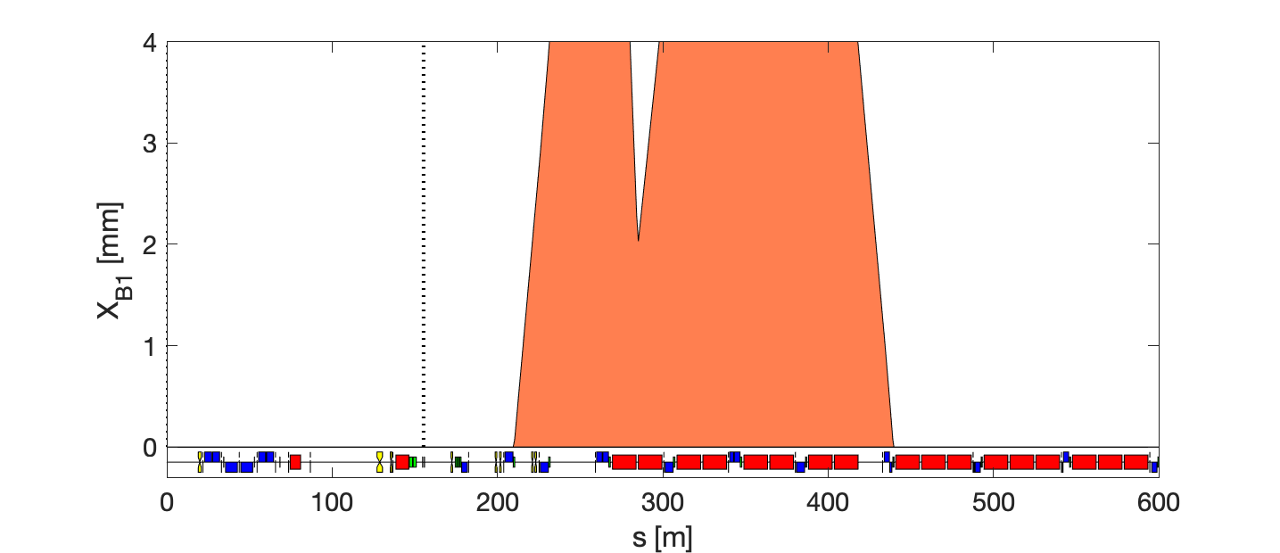
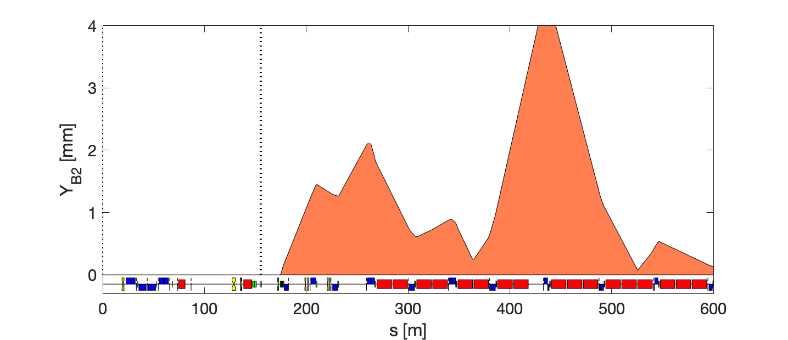
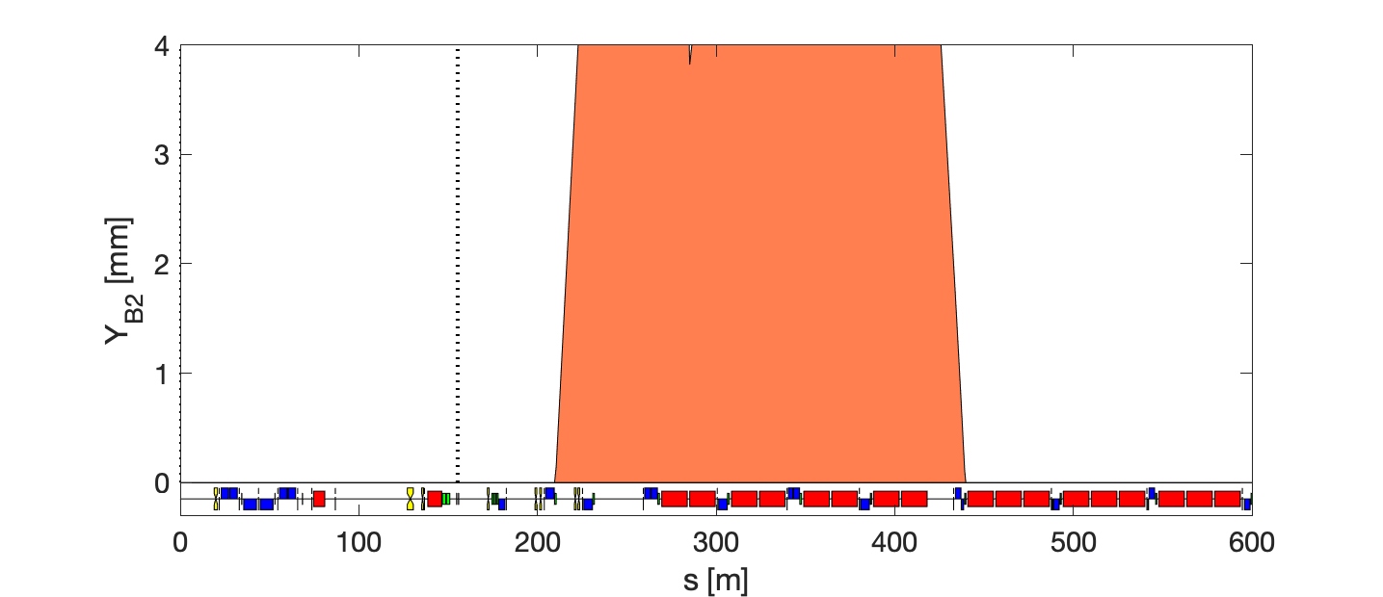
Failure scenario – Q7 + Q9
within available strength
minimum local orbit
No perturbation @<Q4 & @>Q25
Using only 2 nearby correctors (before/after)
Up to 5.5 mm @Q11
Up to 30 mm @Q9
Q4 Q5 Q6 Q7 Q8 Q9 Q10 Q11 Q12 Q13 Q14
Up to 48 mm
Up to 4.5 mm @Q11

Slide 15
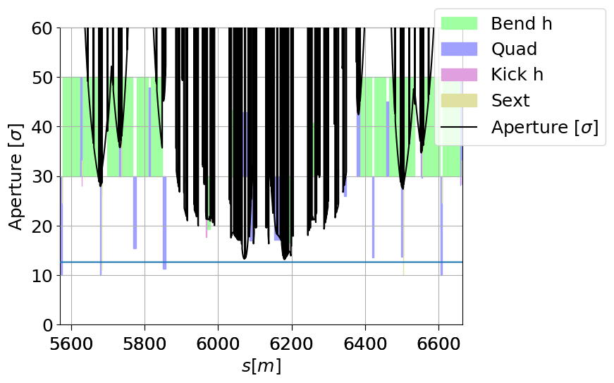
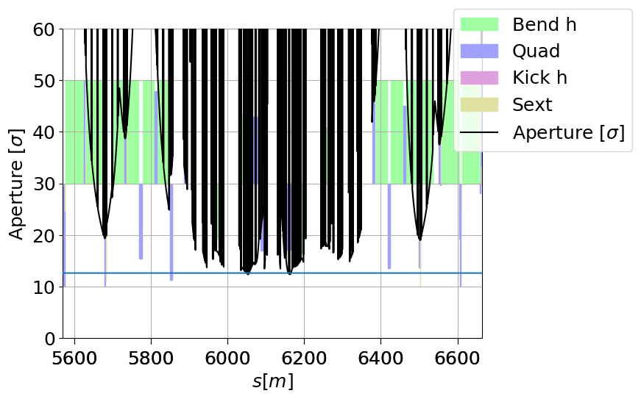
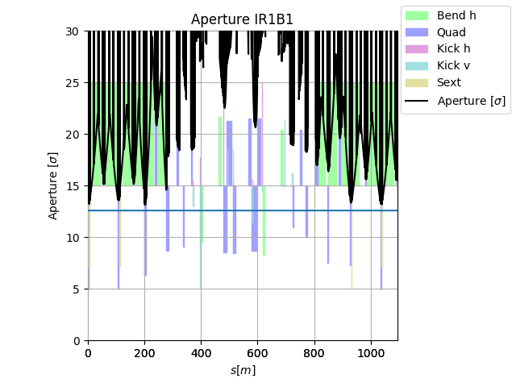
Aperture margins
Example: β*=15 cm
Example: β*=18/7.5 cm
Detailed analysis needed for each case.
General features:
Q4: no/little margin for flat optics, more margin for round optics, plenty at injection
Q5-Q9: some margin at injection and round optics, limited margin for flat
Q10-Q13: ~1mm margin at injection, similar for round optics, no margin on flat
Example: injection

Slide 16
Conclusion
Failure of one orbit corrector:
MCBY in Q4 can be absorbed by other MCBY in Q4
MCBC in Q5 can be absorbed by MCBY in Q4 with β* reach issues at flat top
MCBC in Q6 cannot be absorbed by MCBY in Q4 due to strength limitation nor other correctors due to large orbit excursion
MCBC in Q7 can be absorbed by correctors in Q4, Q5
MCBC in Q8 can be absorbed by MCBC in Q6, Q10, Q12 with β* reach issues at flat top due to aperture loss in Q10
MCBC in Q9 can be absorbed by MCBC in Q4, Q5, Q7 with β* reach issues at flat top due to aperture loss in Q11
Failure of two orbit corrector:
If different planes e.g. Q8, Q7 same as above
If same plane, e.g. Q7 and Q9, no solution possible
Failure of three orbit correctors or more: no solution

Slide 17
Back-up

Slide 18
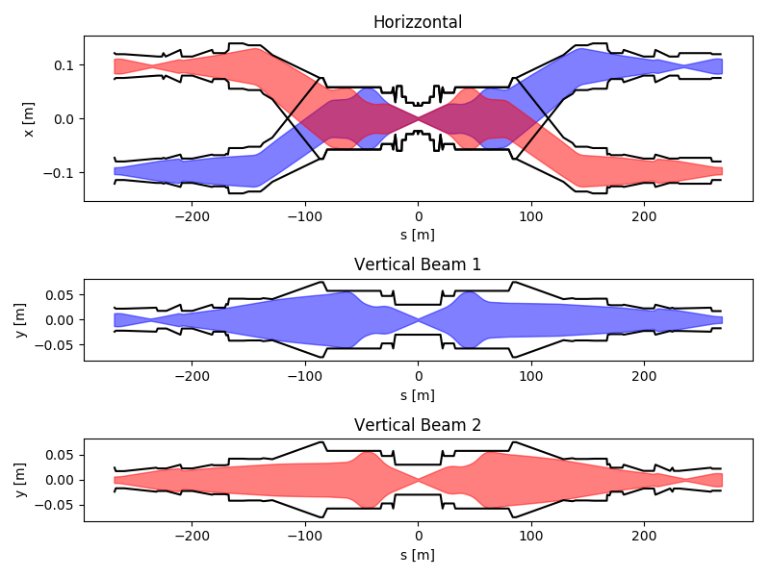
Old plot from Riccardo (to be re-done!)
Q8
Q5

Slide 19

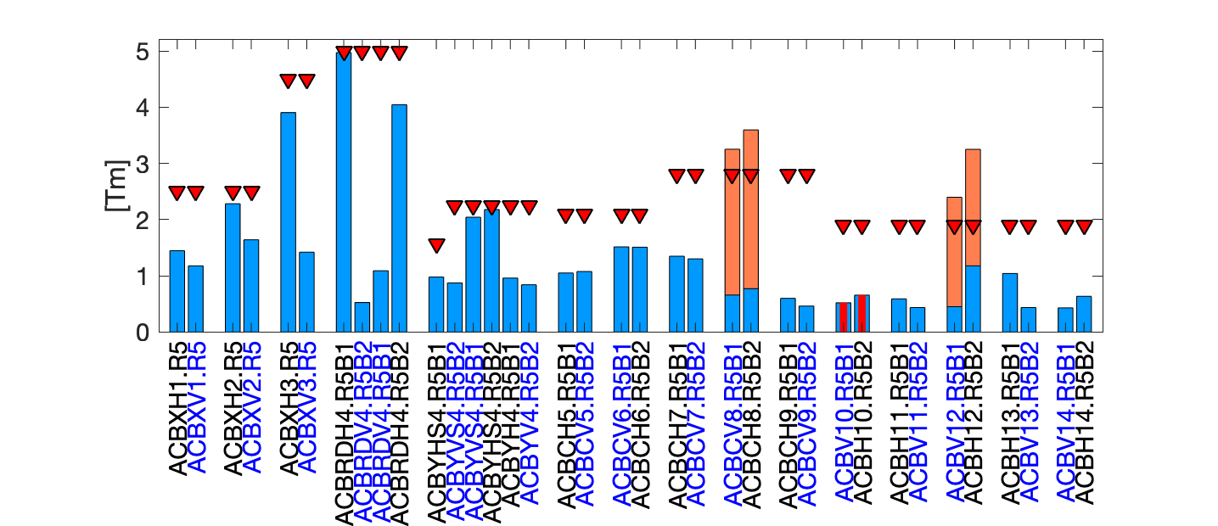
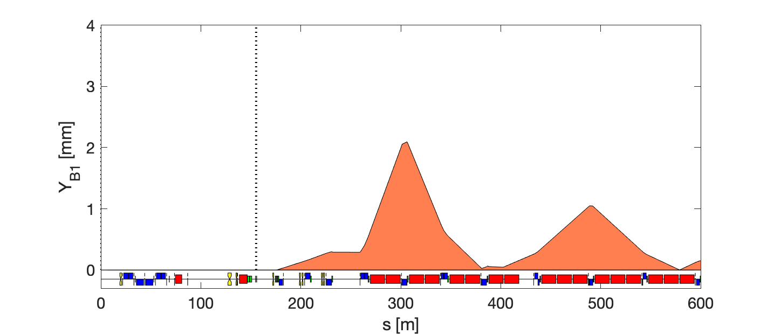
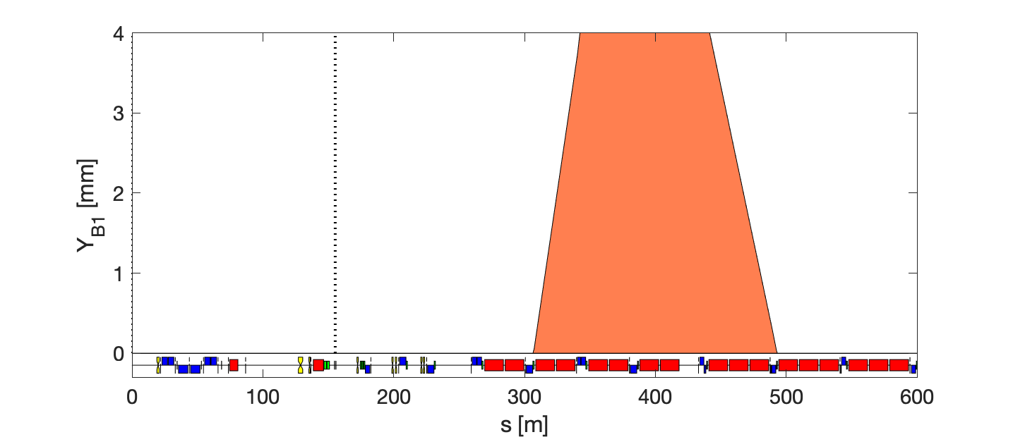
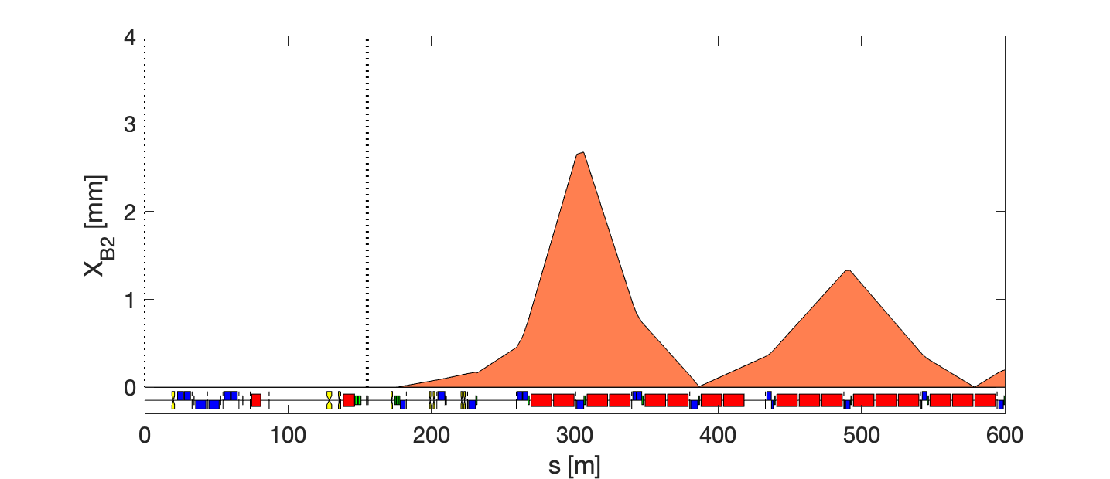

Failure scenario – Q10
within available strength
minimum local orbit
No perturbation @<Q4 & @>Q25
Using only 2 nearby correctors (before/after)
Q4 Q5 Q6 Q7 Q8 Q9 Q10 Q11 Q12 Q13 Q14

