Slide 1
The MCBC and MCBY LHC magnet consolidation
Daniel Schoerling
Thanks to Luca Bottura, Francesco Cerutti, Alexandre Louzguiti, and Jean-Philippe Tock
22th of January 2019

Slide 2
Content
Magnets discussed in this presentation and expected radiation load
Radiation testing
Actions to be taken during LS3
Procurement strategy
Design of MCBC/MCBY
Items to be delivered by CERN to contractor
Impact on the different sections of TE-MSC, expected work load
Conclusion

Slide 3
MCBC and MCBY corrector magnets
MCBC
MCBY

Slide 4

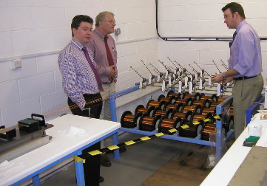
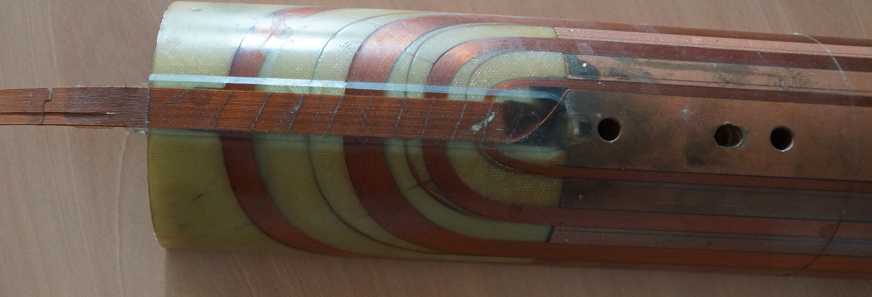
Some words on how they were produced
Round wire was insulated and rolled down to a rectangular wire
Ribbon cable, made with a custom-made machine and epoxy: CY1300 (95 pbw) and DY026 (5 pbw) supplied by Ciba-Geigy Polymers
Coil winding with ribbon cable (cos-theta coils, one layer)
Coil impregnation with Araldite GY 285 (Bisphenol F, 100 pbw) supplied by Ciba-Ceigy, mixed with hardener Texaco D400 (57 pbw)
Assembly of the coil and wrapping with ISOPREG 2704 sheet from Isovolta, curing time 15 h at 120°C. and squeezing out the epoxy to increase the glass fraction within the bandage to approximately 60 % by volume.
Assembly of scissor laminations and Al shrinking cylinder

Slide 5
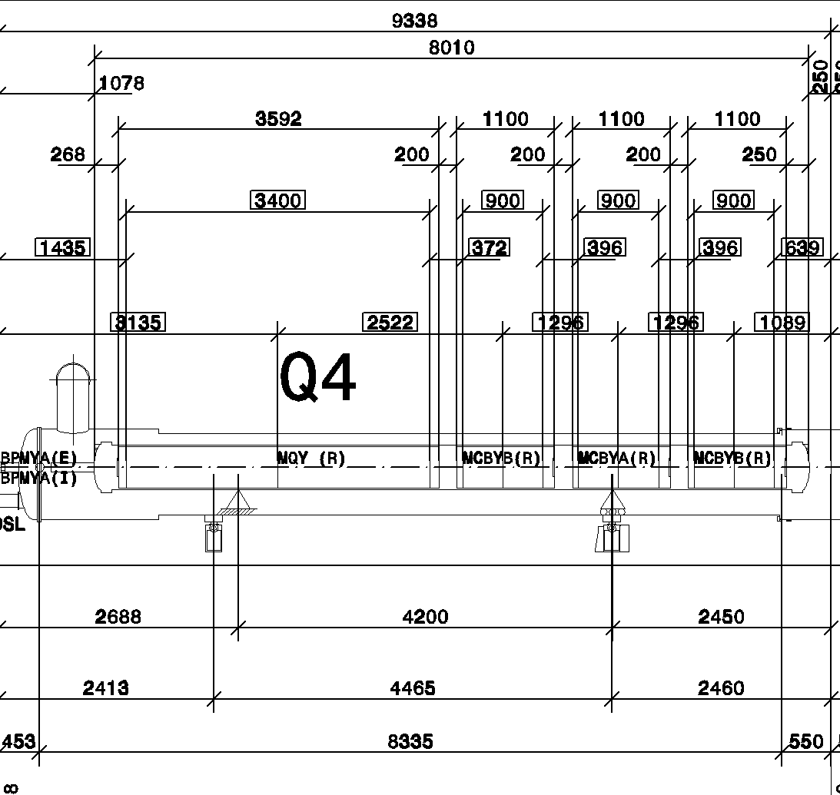
Expected radiation load MCBY
Gamma irradiation foreseen doses
Around 5 MGy after 3300 fb⁻¹
4 MCBY are currently operated with limited current:
Q4R8 (RCHYH4.R8B1),
Q5R8 (RCBYHS5.B8B1),
Q4L5 (RCBYS4.L5B1),
Q5L4 (RCBYS.L5B1).

Slide 6
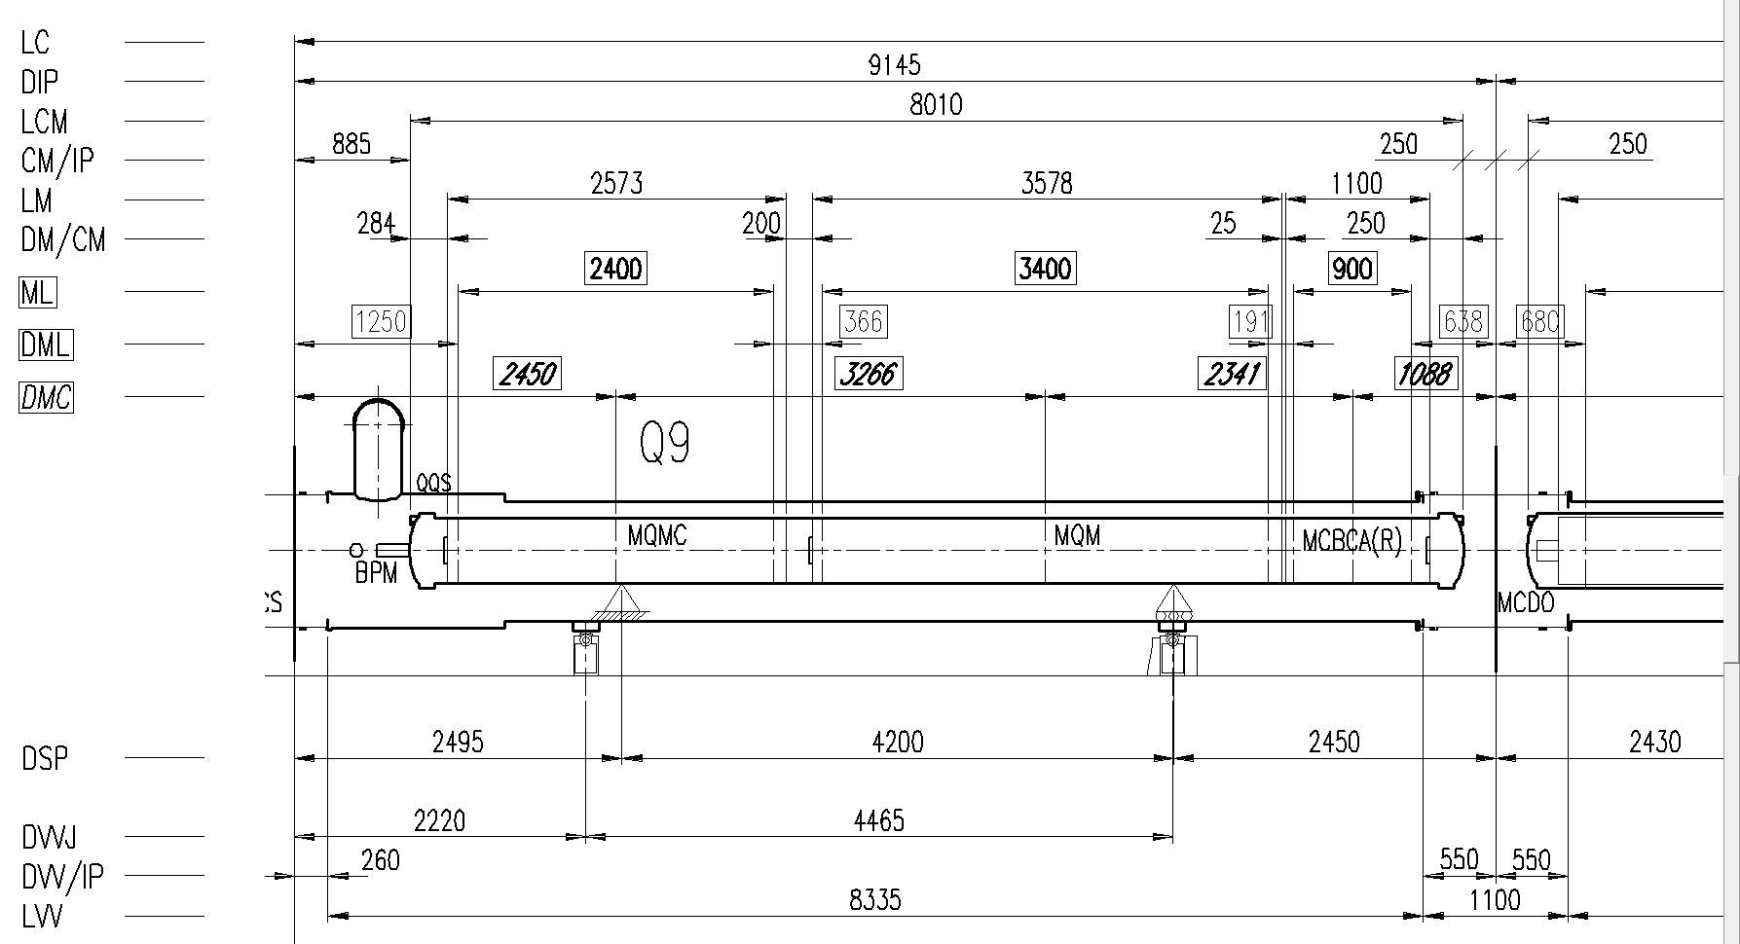
Expected radiation load MCBC

Slide 7
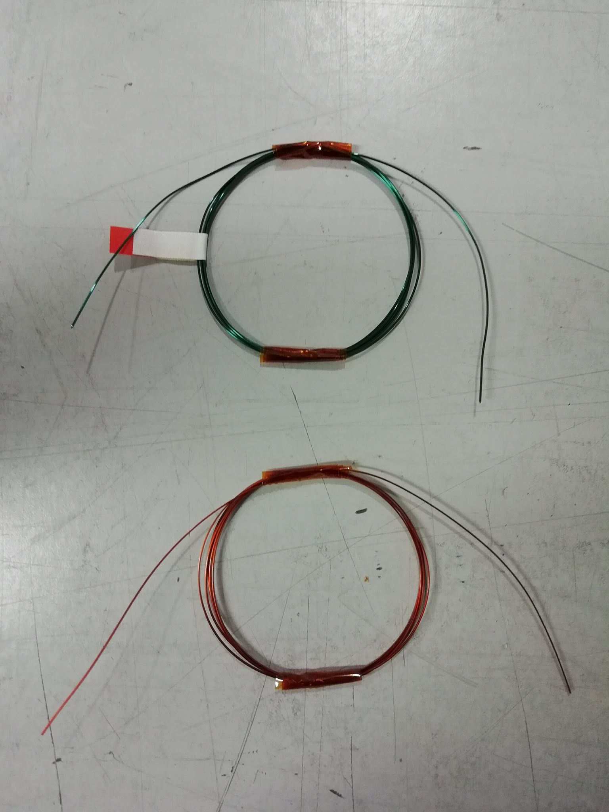
Breakdown voltage of gamma irradiated strands
Strands have been irradiated with gamma rays up to 5 MGy at BGS / Fraunhofer INT facility (DE)
Samples = 1m of strand spooled in several turns of 5 cm-diameter
Samples gamma irradiated in several steps (0, 1, 2.5 and 5 MGy), 3 samples per step
Breakdown voltage of the samples measured in water (all samples withstood 1 kV before irradiation)
Strand used in LHC corrector magnets (type 2)
Cu strand to test another insulating material
Insulating material : PVA enamel
Insulating material : super-PI enamel
Result : does withstand more than 1 MGy [air]
Result : does withstand more than 2.5 MGy [air]
Courtesy of Alexandre Louzguiti

Slide 8
How radiation resistant are these magnets?
Albert Ijspeert remembered that at the time of LHC construction one magnet with the same technology was irradiated, but never tested.
Araldite GY 285 (Bisphenol F) + Tecaxo D400 is not included in this test campaign
Araldite GY 285 + DETD (an aromatic amine) + Vf=45% glass fiber was shown to be radiation resistant up to 10MGy [Z. Wu et al. / Fusion Engineering and Design 88 (2013) 3078–3083]
No radiation resistance data was found so far for Bisphenol F + Polyoxypropylenediamine. Araldite GY 285 + Jeffamine D400 has been included in the radiation campaign of the polymer lab (timeline for results 10MGy-20MGy: 6 months)

Slide 9
New spare magnets, requirements
Spare magnets to be procured should be radiation resistant up to ~30 MGy
  Polyimide enamel insulation
  Same epoxy for ribbon making (small amount and not considered relevant after winding)
  Cyanate ester/epoxy mixture for impregnation (radiation hard) or other radiation hard epoxy (to be tested?)

Slide 10
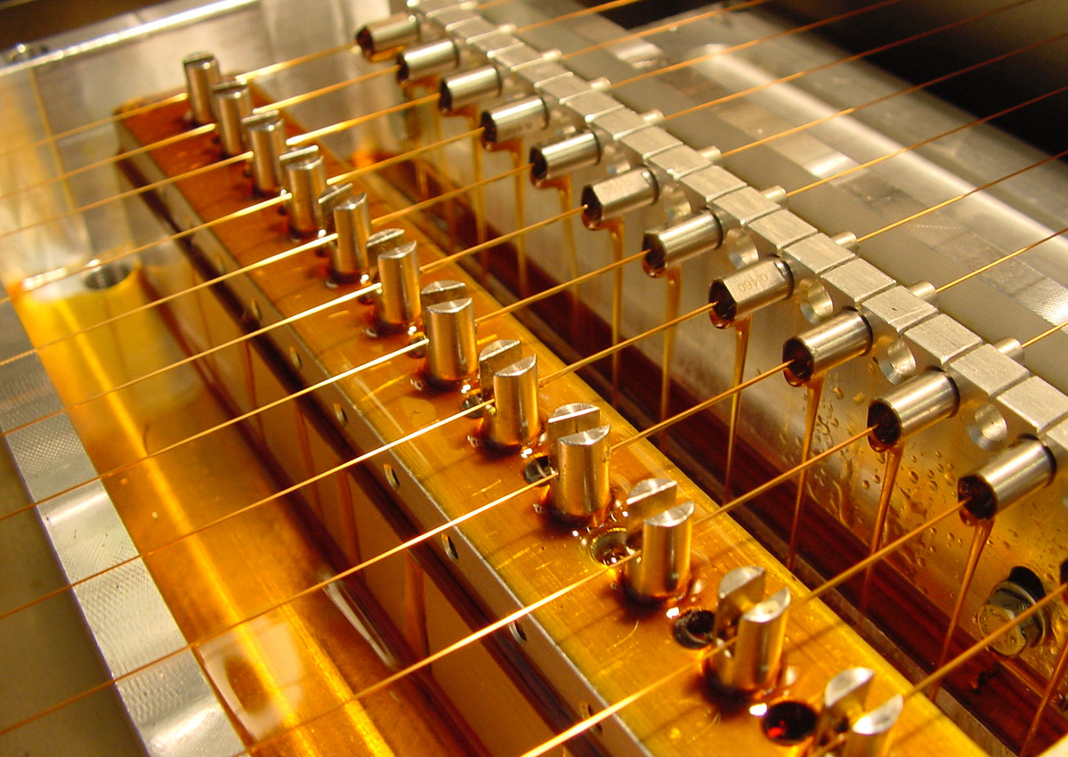
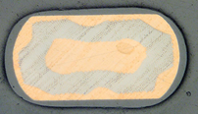
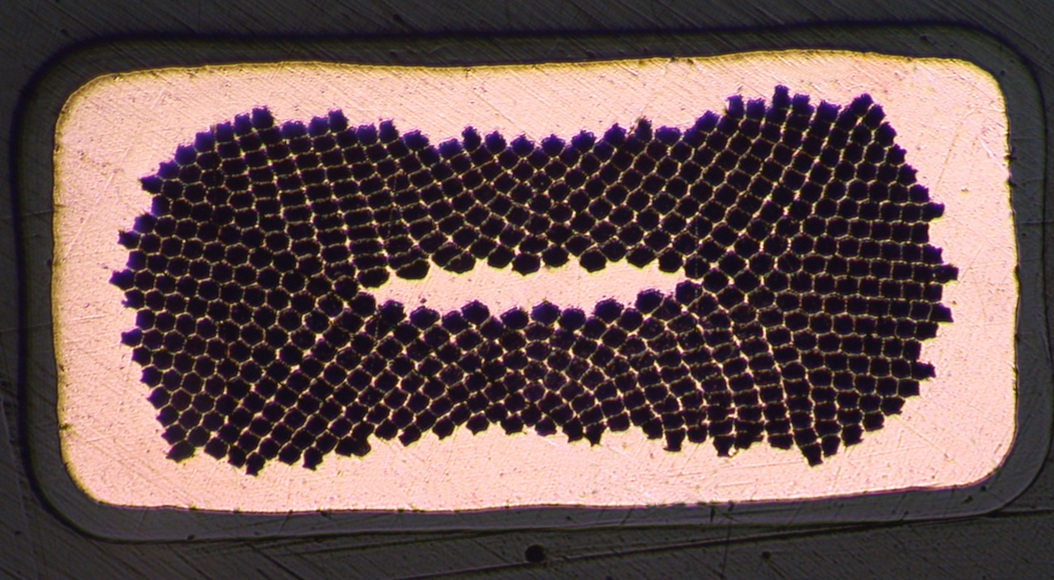
Status of MCBC – Wire insulation
Issues are expected with rolling down the insulated wire (not optimal for glue between Cu and insulation)
Nb-Ti is sensitive to temperature (curing temperature are typically higher than degradation limit)
Supercon (and Luvata) offer small rectangular wires with enamel insulation (Formvar and polyimide enamel)
Other solutions explored:
  Enamel insulation on the rectangular wire (20 companies contacted, all but one refused)
  Round to rectangular deformation: Two companies identified, which are capable of rolling down with 4 rollers to ensure a rectangular shape
  Foil wrapping was tried with two companies but failed: Conductor dimension to irregular and out of tolerance for Ribbon manufacture
  Other polyimide variants are also being investigated

Slide 11
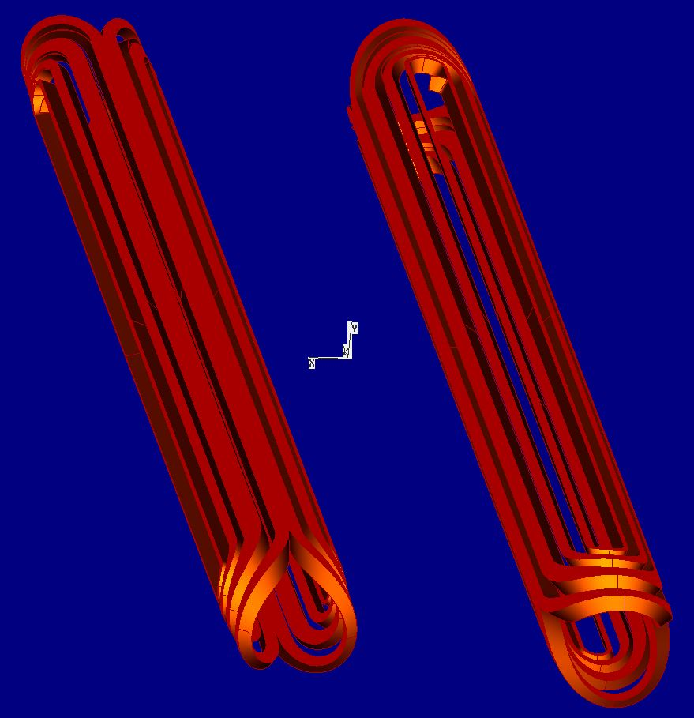
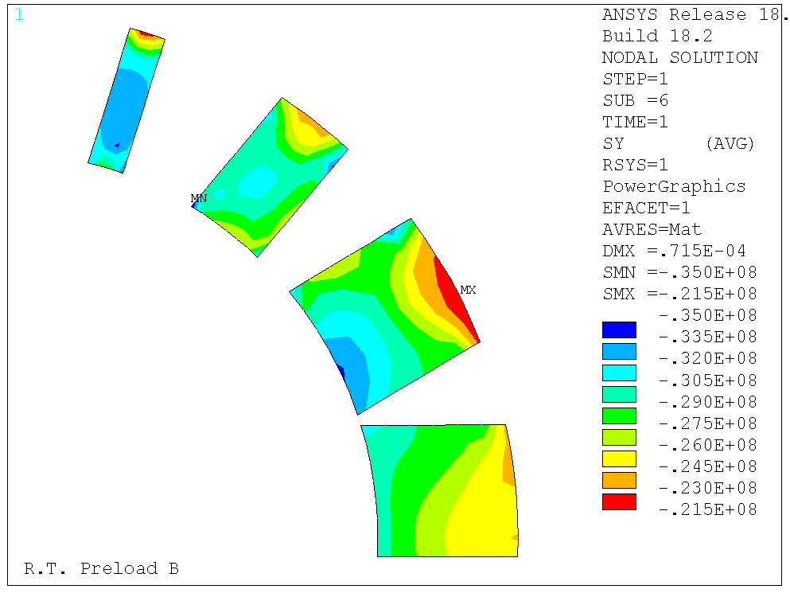
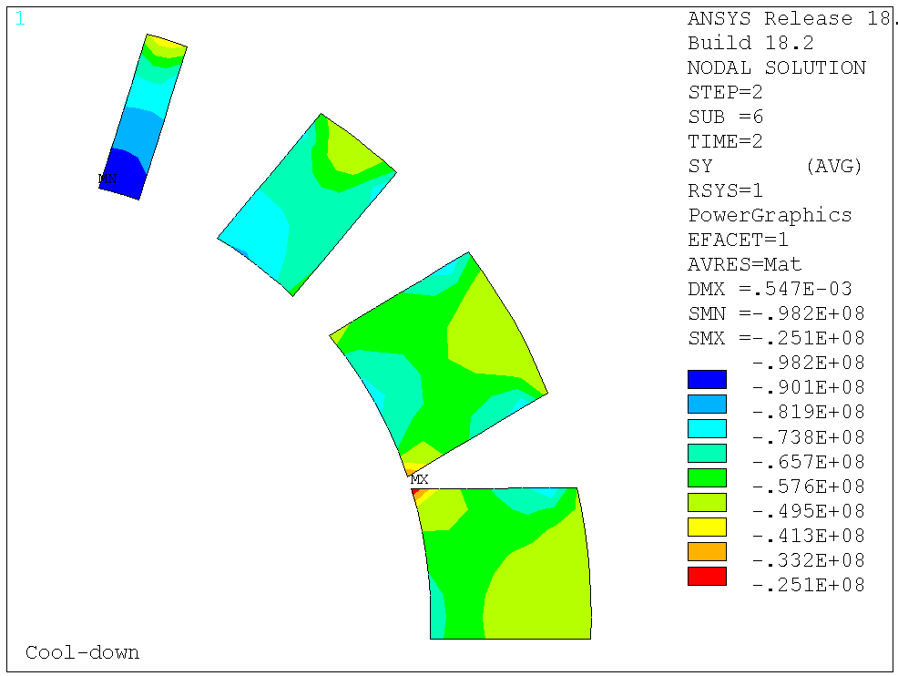
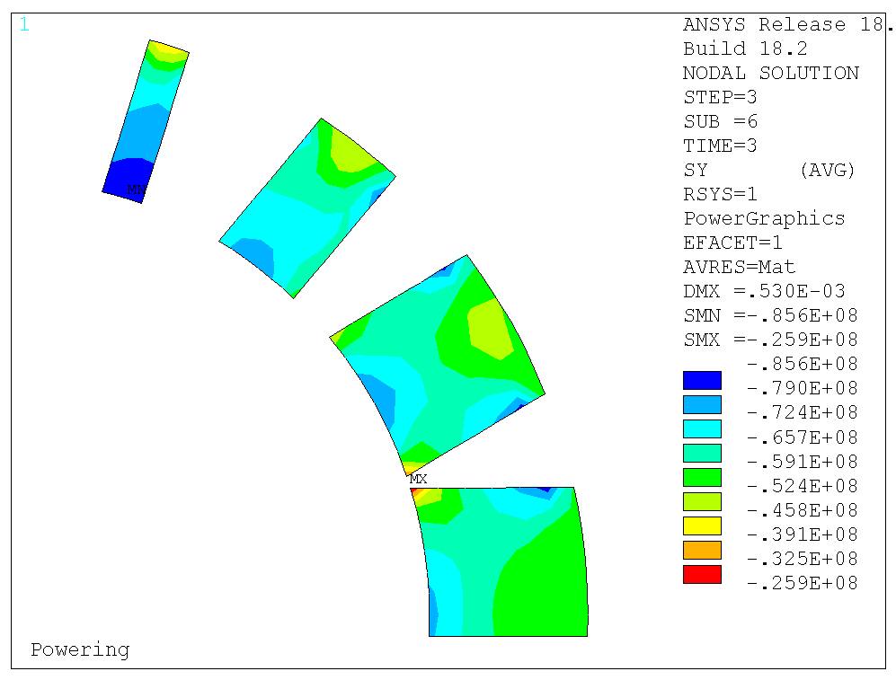
Status of MCBC/Y design
Original drawings do not follow new ISO standard: Therefore it was decided to re-do the drawings, ongoing
Different versions of end spacer designs have been found -> not clear which one is the file used for the construction of the magnets
  3D Roxie re-done (now with differential geometry)
  Mechanical 2D ANSYS model redone
Technical specification is available (update for radiation hardness
required)

Slide 12
Open questions
We recommend to use MCBY coil modules for the MCBCA-D and MCBYA-B spare magnets (to be confirmed)
Which magnets shall be changed during LS3? If we change magnets, which see in the remaining lifetime more than 1 MGy integrated dose, we should either plan to change them again in LSx or procure more radiation hard magnets (tight schedule)
What are possible mitigation scenarios? What will be done if one of these magnets fails?
What shall we do with the 4 limited MCBYs?

