Slide 1
Third Barcelona Techno Week
Course on semiconductor detectors
ICCUB, 2nd-6th July 2018
Hybrid Pixel Detectors for Spectroscopic X-ray Imaging: System Aspects and Review of Readout ASICs
Rafael Ballabriga Suñé
EP-ESE-ME
CERN
Notes:
The talk has 2 parts:
Practical aspects in the design of HPDs (from the point of view of the front-end electronics designer)
Definitions
Limitations mainly to energy resolution and count rate behaviour
2. Review of readout ASICs (How available ASICs address these limitations)
Some slides left for reference/completeness but I may skip them depending on the timing.
HPDs can be used to detect different types of particles (here emphasis on photon detection)
Let’s start with the definitions:
Hybrid pixel detectors
Spectroscopic X-ray imaging

Slide 2
Outline
Hybrid pixel detectors and the Medipix Collaborations
Spectroscopic X-ray imaging
The ideal detector system
Limiting factors
  Sensor
  Electronics
ASICs for spectroscopic X-ray imaging
  Digitization methods
  Count-rate
  Charge summing and hit allocation architectures
  Detector tiling
Summary and conclusions

Slide 3
Hybrid Pixel Detectors and the Medipix Collaborations
Notes:
Architectures that have been implemented in hybrid pixel detectors

Slide 4
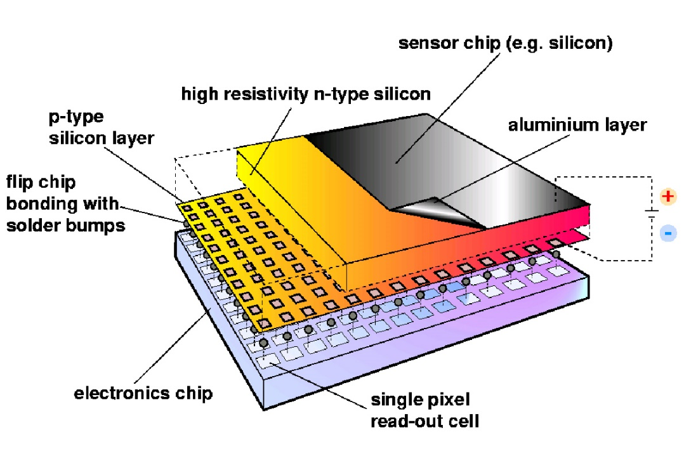
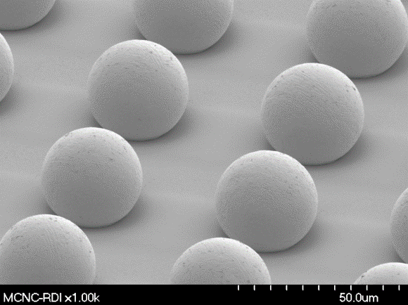
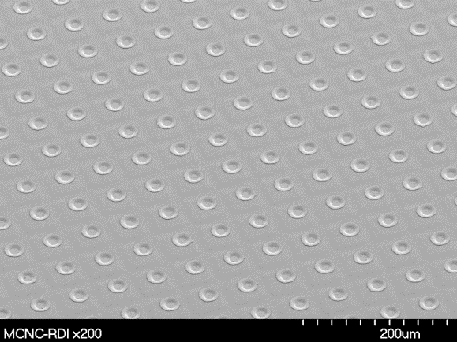
A hybrid pixel detector is a 2-dimensional matrix of microscopic radiation-sensitive elements each of which is connected to its own pulse processing electronics.
The sensor element and the readout electronics are implemented in different substrates i.e. can be optimized separately
Notes:
Conversion of radiation to electrical signal occurs in the semiconductor detector volume (direct detection)
The intimate connection allows to minimize the parasitics (capacitance and inductance) and this optimizes the SNR.

Slide 5
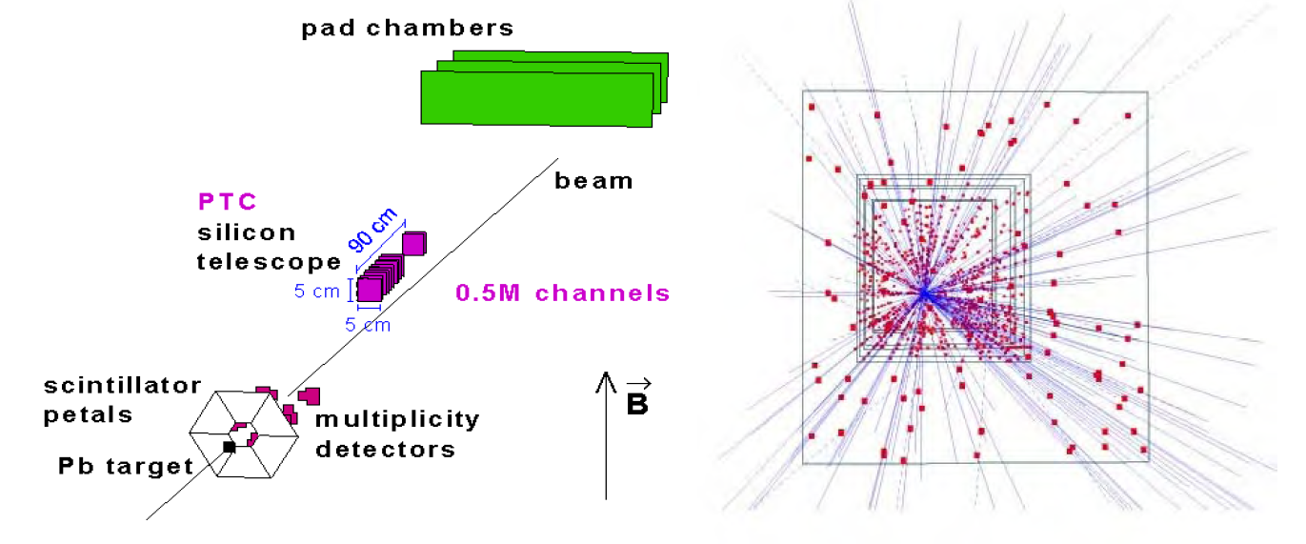
Origins in HEP
In High Energy Physics the “objects” to be imaged are the interactions between incoming particles, which result in other outgoing particles.
Layout of the lead beam experiment WA97 (1995). First time hybrid pixel detectors are used in a HEP experiment.
Event reconstruction with 153 tracks (no magnetic field)
7 detector planes
5x5cm² /plane
0.5M pixels
Pixel dimensions: 75 x 500μm² (OmegaD)
1KHz trigger rate
The dots represent hits in the Silicon detectors from which tracks are reconstructed.
Every dot is associated with one track
Clean and fast images
Notes:
http://link.springer.com/content/pdf/10.1023/A%3A1021200315694
1. First published in 1984 by Gaalema IEEE NSS (showed the possibility and potential of hybrid pixel detectors)
(an integrated circuit for focal plane imaging sensors could be connected to a diode array to detect X-rays).
2. Designs of pixel readout started in Europe and in the States in early 1990s by groups developing vertex detectors for LHC and SSC.
3. After the stop of the SSC (Superconducting Super Collider) in the States in 1994 R&D continued exclusively and for a few years at CERN

Slide 6
Origins in High Energy Physics
During LHC Runs 1 and 2, there were in operation in 3 vertex detectors of the Large Hadron Collider experiments
  ATLAS (~100M channels)
  CMS (~100M channels)
  ALICE (~10M channels)
All making important contributions to LHC physics programme
Notes:
In High Energy Physics the “objects” to be imaged are the interactions (events) between incoming particles, which result in other outgoing particles.
The dots represent hits in the Silicon detectors from wich tracks are reconstructed.
The tracking detectors are the detector elements which are closest to the interaction point. Their purpose is to disentangle the various particle tracks and to assign them to primary or secondary vertices.
http://link.springer.com/content/pdf/10.1023/A%3A1021200315694
1. First published in 1984 by Gaalema IEEE NSS (showed the possibility and potential of hybrid pixel detectors)
(an integrated circuit for focal plane imaging sensors could be connected to a diode array to detect X-rays).
2. Designs of pixel readout started in Europe and in the States in early 1990s by groups developing vertex detectors for LHC and SSC.
3. After the stop of the SSC (Superconducting Super Collider) in the States in 1994 R&D continued exclusively and for a few years at CERN

Slide 7
Medipix Collaborations
Created to develop state-of-the-art hybrid pixel detectors and their applications
  Medipix3 contained the 1st implementation of an algorithm to address charge sharing
  Timepix4 contains the novel architecture for 4 sides buttability
Readout chips are designed at CERN based on
  Feedback from the collaboration members
  Know how developed (1) for HEP and (2) together with HEP
Examples:
  Medipix3 was the first large scale chip in the HEP community in 130nm CMOS
  Velopix is a successor of Timepix3 for LHCb velo (same size, pitch, common features, design team ☺)
  LHCb sensor characterization done with Timepix3
  CLICpix and ClicTD developed in the team
Collaboration members develop readout systems and install chips in their applications
Notes:
In High Energy Physics the “objects” to be imaged are the interactions (events) between incoming particles, which result in other outgoing particles.
The dots represent hits in the Silicon detectors from wich tracks are reconstructed.
The tracking detectors are the detector elements which are closest to the interaction point. Their purpose is to disentangle the various particle tracks and to assign them to primary or secondary vertices.
http://link.springer.com/content/pdf/10.1023/A%3A1021200315694
1. First published in 1984 by Gaalema IEEE NSS (showed the possibility and potential of hybrid pixel detectors)
(an integrated circuit for focal plane imaging sensors could be connected to a diode array to detect X-rays).
2. Designs of pixel readout started in Europe and in the States in early 1990s by groups developing vertex detectors for LHC and SSC.
3. After the stop of the SSC (Superconducting Super Collider) in the States in 1994 R&D continued exclusively and for a few years at CERN

Slide 8
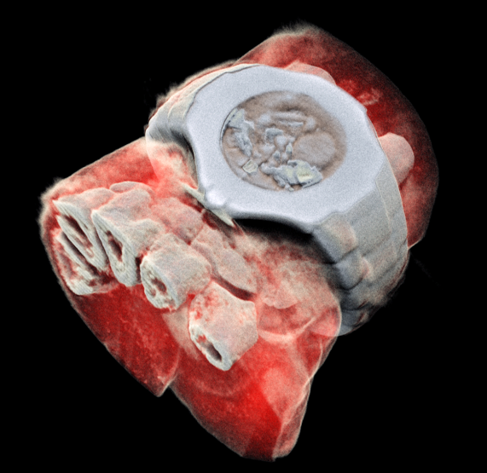
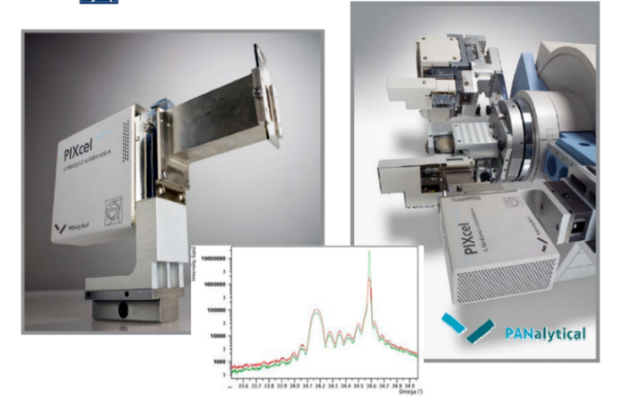
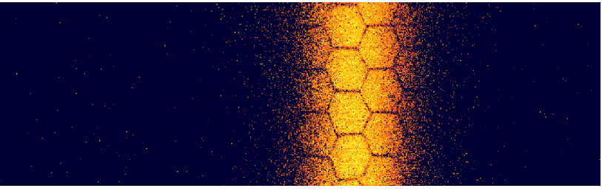
Medipix Collaborations
Science driven development! (no companies in the collaboration PMC)
Licenses have been granted to commercial partners
  With the objective of disseminating the technology
Example of spin-off (and spin-back) from (to) High Energy Physics
PS Beam Profile Monitor
(J. Storey)
Material analysis
(R. De Vries)
CT scan
(A. Butler)
Notes:
In High Energy Physics the “objects” to be imaged are the interactions (events) between incoming particles, which result in other outgoing particles.
The dots represent hits in the Silicon detectors from wich tracks are reconstructed.
The tracking detectors are the detector elements which are closest to the interaction point. Their purpose is to disentangle the various particle tracks and to assign them to primary or secondary vertices.
http://link.springer.com/content/pdf/10.1023/A%3A1021200315694
1. First published in 1984 by Gaalema IEEE NSS (showed the possibility and potential of hybrid pixel detectors)
(an integrated circuit for focal plane imaging sensors could be connected to a diode array to detect X-rays).
2. Designs of pixel readout started in Europe and in the States in early 1990s by groups developing vertex detectors for LHC and SSC.
3. After the stop of the SSC (Superconducting Super Collider) in the States in 1994 R&D continued exclusively and for a few years at CERN

Slide 9
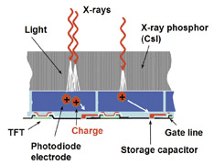
X-ray imaging technologies classification: conversion of X-rays
Indirect conversion Direct Conversion
100-1000 e- generated in the diode (Interaction depth dependent)
Degraded energy and spatial resolution
Cheaper
4000-25000 e- induced (Medical radiography range) (reproducible)
Notes:
An important characteristic of an X-ray imaging system is the way the radiation quantum is transformed into an electrical signal before it is processed by the readout electronics. Systems are classified from this point of view into indirect and direct detection systems.
In indirect detection systems the conversion of the photon into an electrical signal is done in two steps: first the conversion is done from X-rays to visible light by means of a scintillator material and second, the visible light is detected in a pixelated sensor with photodiodes. Spatial resolution and the efficiency of the overall detection process are degraded due to this two-step process. The approach of indirect detection combined with on-pixel photon counting signal processing has been implemented by Dierickx ([4], [5]).
In direct detection systems the X-ray photons deposit their energy in the detector material directly creating electron-hole pairs that drift to collection electrodes creating an electrical current. For the X-ray energies used in medical applications, each impinging photon releases a charge from 4000 to 25000 electrons in a CdTe semiconductor detector. In an indirect conversion system the detected electrical signal is in the range from 100 to 1000 electrons depending on the scintillator characteristics. Scintillator materials used in indirect conversion technology are nowadays more economical to manufacture than high-Z materials. The cost of bump bonding is currently an important fraction of the total cost of an assembly.
Indirect detection: i.e., detection of the X-ray photon indirectly by first absorbing it in a high-Z scintillator and then detecting the secondary, visible light radiation by a visible light image sensor.
Direct detection: the X-ray detection happens by absorption of the photon in a high-Z semiconductor
Most, if not all of today’s successful photon counting X-ray imagers are based on “direct detection” [4–13], i.e., the X-ray detection happens by absorption of the photon in a high-Z semiconductor photo diode or photo resistor. From a pure detection performance standpoint, this approach is ideal: the photo-electric conversion happens in a very limited volume, and the energy quantum is deposited in a narrow trace or cloud of secondary electron-hole pairs, which are quickly and with little sideward dispersion collected by the electric drift field. As the collection time is in the order of nanoseconds, the direct detector can be operated at very high count rates. As the secondary charges remain confined, the modulation transfer function (MTF), and hence the DQE, is excellent, and the reproducibility of the collected charge packet size is nearly perfect, allowing, if required, an accurate photon energy measurement.
The limiting factor for the widespread use of direct detection in photon counting imaging is the cost and manipulation of the material.
The alternative route, indirect detection, i.e., detection of the X-ray photon indirectly by ﬁrst absorbing it in a high-Z scintillator and then detecting the secondary, visible light radiation by a visible light image sensor, is economically viable [14]. Many scintillators are inexpensive and easy to co-integrate, and CMOS visible-light event counting is an easily scalable and mature technology.
However, indirect detection has disadvantages as compared to detect detection: the overall indirect process has a signiﬁcantly lower photon to electron conversion, suffers from slow decay times, may suffer light dispersion and poor MTF, and has poor reproducibility of charge packet sizes, making photon energy measurements unreliable.
Definitions
A thin-film transistor (TFT) is a special kind of field-effect transistor made by depositing thin films of an active semiconductor layer as well as the dielectric layer and metallic contacts over a supporting (but non-conducting) substrate. A common substrate is glass, because the primary application of TFTs is in liquid-crystal displays. This differs from the conventional transistor, where the semiconductor material typically is the substrate, such as a silicon wafer.
Manufacture
TFTs can be made using a wide variety of semiconductor materials. A common material is silicon. The characteristics of a silicon-based TFT depend on the silicon's crystalline state; that is, the semiconductor layer can be either amorphous silicon,^{[1]} microcrystalline silicon,^{[1]} or it can be annealed into polysilicon.
Other materials which have been used as semiconductors in TFTs include compound semiconductors such as cadmium selenide,^{[2][3]} or metal oxides such as zinc oxide.^{[4]} TFTs have also been made using organic materials, referred to as organic field-effect transistors or OTFTs.
By using transparent semiconductors and transparent electrodes, such as indium tin oxide (ITO), some TFT devices can be made completely transparent. Such transparent TFTs (TTFTs) can be used for construction of video display panels.
Because conventional substrates cannot withstand high annealing temperatures, the deposition process must be completed under relatively low temperatures. Chemical vapor deposition and physical vapor deposition (usually sputtering) are applied. The first solution-processed TTFTs, based on zinc oxide, were reported in 2003 by researchers at Oregon State University.^{[4]} The Portuguese laboratory CENIMAT at the Universidade Nova de Lisboa has produced the world’s first completely transparent TFT at room temperature.^{[citation needed]} CENIMAT also developed the first paper transistor,^{[citation needed]} which may lead to applications such as magazines and journal pages with moving images.
Flat panels with poly-Si TFT (e.g. A. K. Liang “Performance of in-pixel circuits for photon counting arrays (PCAs) based on polycrystalline silicon TFTs” Phys. Med. Biol. 61 (2016) 1968-1985)

Slide 10
X-ray imaging technologies classification: Signal processing
Integrating
Single Quantum Processing
Notes:
Integrating
Single Quantum Processing
Signal from each individual photon is treated on an event-by-event basis
Signal attributed to a particle only when it exceeds a threshold
E.g. Photon Counting, Spectroscopic Imaging
X-ray imaging in spatially segmented detectors containing multiple thresholds is referred to as spectroscopic X-ray imaging. Spectroscopic X-ray imaging has been shown to improve the overall image quality for a given X-ray dose or lead to a reduction in the required dose necessary to obtain a given image quality.
Spectroscopic X-ray detectors can enable the identification of the material composition of the object under study by exploiting the property that the attenuation of X-rays is energy and material dependent. If the information of the energy spectrum transmitted through the object is measured and accounted for in the identification algorithm, different materials can be distinguished. Spectroscopic X-ray imaging can also be used in medical imaging to suppress beam-hardening artifacts or to discriminate to some extent between calcium or iodine and lighter elements (Z < 20), which form body tissues [1]. K-edge Computed Tomography (CT) has been proposed as a potential method for functional CT wherein heavy metal nanoparticles are used as targeted imaging agents. K-edge CT imaging combined with targeted biomarkers could provide simultaneous functional and anatomical tomographic images in a single scan thus providing a new quantitative molecular imaging platform [2]. K-edge imaging relies on the developments of spectroscopic detectors since the cost and complexity of developments for multiple kVp systems can be prohibitive. Moreover, multiple kVp with energy integrating detectors does not provide optimal results because there is cross-talk between the different energy images [3].

Slide 11
Detected photons
Principle of operation of an integrating detector
Integrating systems:
  Most X-ray medical imaging systems deployed today
  Noise is integrated together with the signal (limits SNR)
  The weight of each photon is proportional to its energy
  Does not suffer from pile-up
Notes:
In the plot, we can see:
Photon time of arrival and their energy
Illustration of how the integrating detector works: when the shutter closes we get a number i.e. the total amount of integrated charge during the shutter time
The weight of each photon is proportional to its energy: High energy photons mask the information of the low energy ones
Dead-time free system

Slide 12
Detected photons
Principle of operation of a photon counting detector
threshold
Photon counting systems:
  A signal is attributed to a photon and subsequently processed when it exceeds a threshold (above the system noise)
  Suppression of random electronics noise due to the fact that threshold can be set above it
  Perfect linear behavior (as long as the counter depth is sufficient)
  The weight of each photon is one
  A minimum time is required between two consecutive events in order for them to be recorded as separate pulses
Notes:
Photon time of arrival and their energy
Illustration of how the photon counting detector works: when the shutter closes we get a number i.e. the total number of photons detected during the shutter time

Slide 13
Detected photons
Principle of operation of a spectroscopic X-ray detector
Threshold 1
Threshold 0
Spectroscopic systems:
  A signal is attributed to a photon and subsequently processed when it exceeds a threshold (above the system noise)
  Suppression of random electronics noise due to the fact that threshold can be set above it
  Perfect linear behavior (as long as the counter depth is sufficient)
  Energy weighting can be applied off-detector for contrast enhancement (no need for multiple exposures)
  A minimum time is required between two consecutive events in order for them to be recorded as separate pulses
Notes:
Energy weighting can be applied off detector for enhancing contrast.

Slide 14
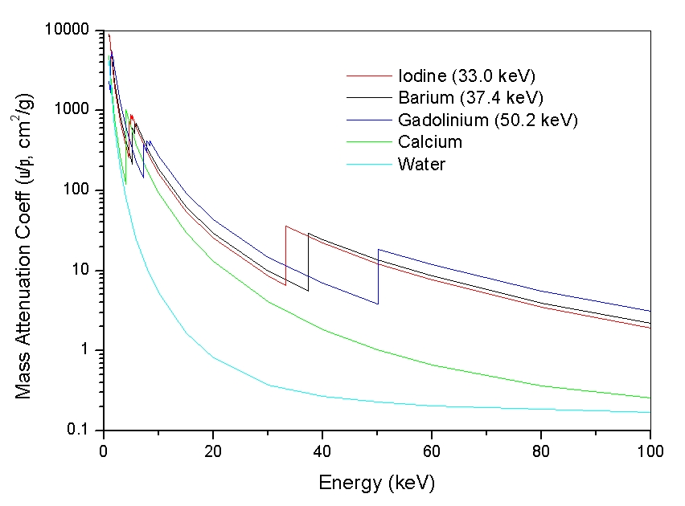
Spectroscopic X-ray imaging
Spectroscopic X-ray imaging consists on the acquisition of X-ray images whereby different sections of the incoming spectrum are sampled simultaneously
  Lower energy photons provide more contrast (Radiology 2003)
  Enables material identification in the object under study e.g. Fibrous tissue and tumour have different attenuation characteristics (Phys.Med.Biol. 1987, JDI 1995, Radiology 2003)
  K-edge identification (better use of contrast agents, e.g. tumors retain iodine contrast (Dahnet 2003.))
Notes:
Implications
Signal to Noise Ratio improvement
Allows to exploit the energy-dependence of the attenuation coefficients of different materials
Enables identification of materials using their K-edge
X-ray imaging in spatially segmented detectors containing multiple thresholds is referred to as spectroscopic X-ray imaging. Spectroscopic X-ray imaging has been shown to improve the overall image quality for a given X-ray dose or lead to a reduction in the required dose necessary to obtain a given image quality. Spectroscopic X-ray detectors can enable the identification of the material composition of the object under study by exploiting the property that the attenuation of X-rays is energy and material dependent. If the information of the energy spectrum transmitted through the object is measured and accounted for in the identification algorithm, different materials can be distinguished. Spectroscopic X-ray imaging can also be used in medical imaging to suppress beam-hardening artifacts or to discriminate to some extent between calcium or iodine and lighter elements (Z < 20), which form body tissues [1]. K-edge Computed Tomography (CT) has been proposed as a potential method for functional CT wherein heavy metal nanoparticles are used as targeted imaging agents. K-edge CT imaging combined with targeted biomarkers could provide simultaneous functional and anatomical tomographic images in a single scan thus providing a new quantitative molecular imaging platform [2]. K-edge imaging relies on the developments of spectroscopic detectors since the cost and complexity of developments for multiple kVp systems can be prohibitive. Moreover, multiple kVp with energy integrating detectors does not provide optimal results because there is cross-talk between the different energy images [3].
Lower energy photons
The information that the photon arriving at the detector carries is directly proportional to its probability to be attenuated in the object under study.
Charge deposit-

Slide 15
Notes:
This is the attenuation of different materials (metals) as a function of the energy.
The energy dependent attenuation are a signature of the material.
Matlab routine to generate plot:
F:\CERNBOX\WORK\Measurements\180109_MaterialAttenuation
Matlab function (MaterialAttenuation\analysis)
A narrow beam of monoenergetic photons with an incident intensity I₀, penetrating a layer of material with thickness x and density ρ, emerges with intensity I given by the exponential attenuation law
$$\frac{I}{I_{0}}={ e}^{−\left(μ/ρ\right)ρx}$$
mu is the linear attenuation coefficient (units: distance⁻¹) (inverse of the mean free path)
rho is the density of the material
In physics, the mean free path is the average distance travelled by a moving particle (such as an atom, a molecule, a photon) between successive impacts (collisions),^{[1]} which modify its direction or energy or other particle properties.
In gamma-ray radiography the mean free path of a pencil beam of mono-energetic photons is the average distance a photon travels between collisions with atoms of the target material. It depends on the material and the energy of the photons:
l=1/m
where μ is the linear attenuation coefficient, μ/ρ is the mass attenuation coefficient and ρ is the density of the material. The mass attenuation coefficient can be looked up or calculated for any material and energy combination using the National Institute of Standards and Technology (NIST) databases^{[4][5]}
Sometimes one measures the thickness of a material in the number of mean free paths. Material with the thickness of one mean free path will attenuate 37% (1/e) of photons.

Slide 16
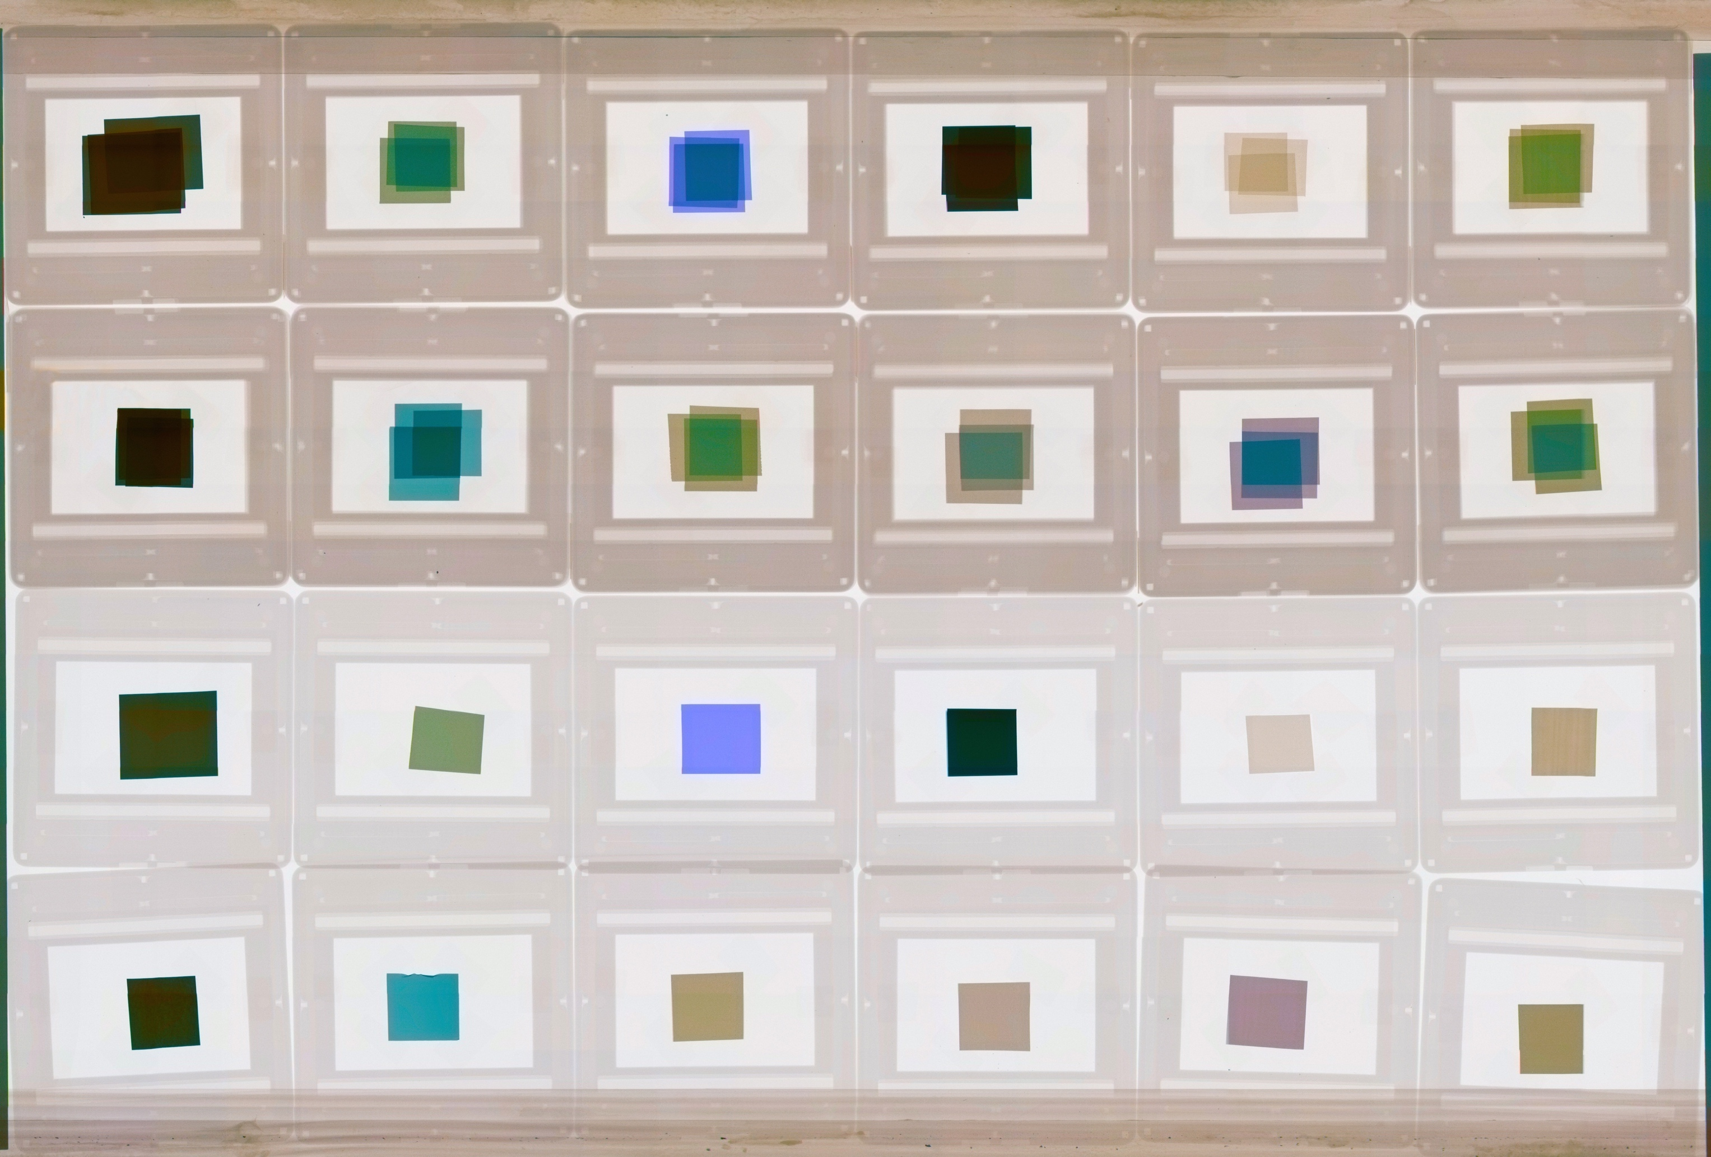
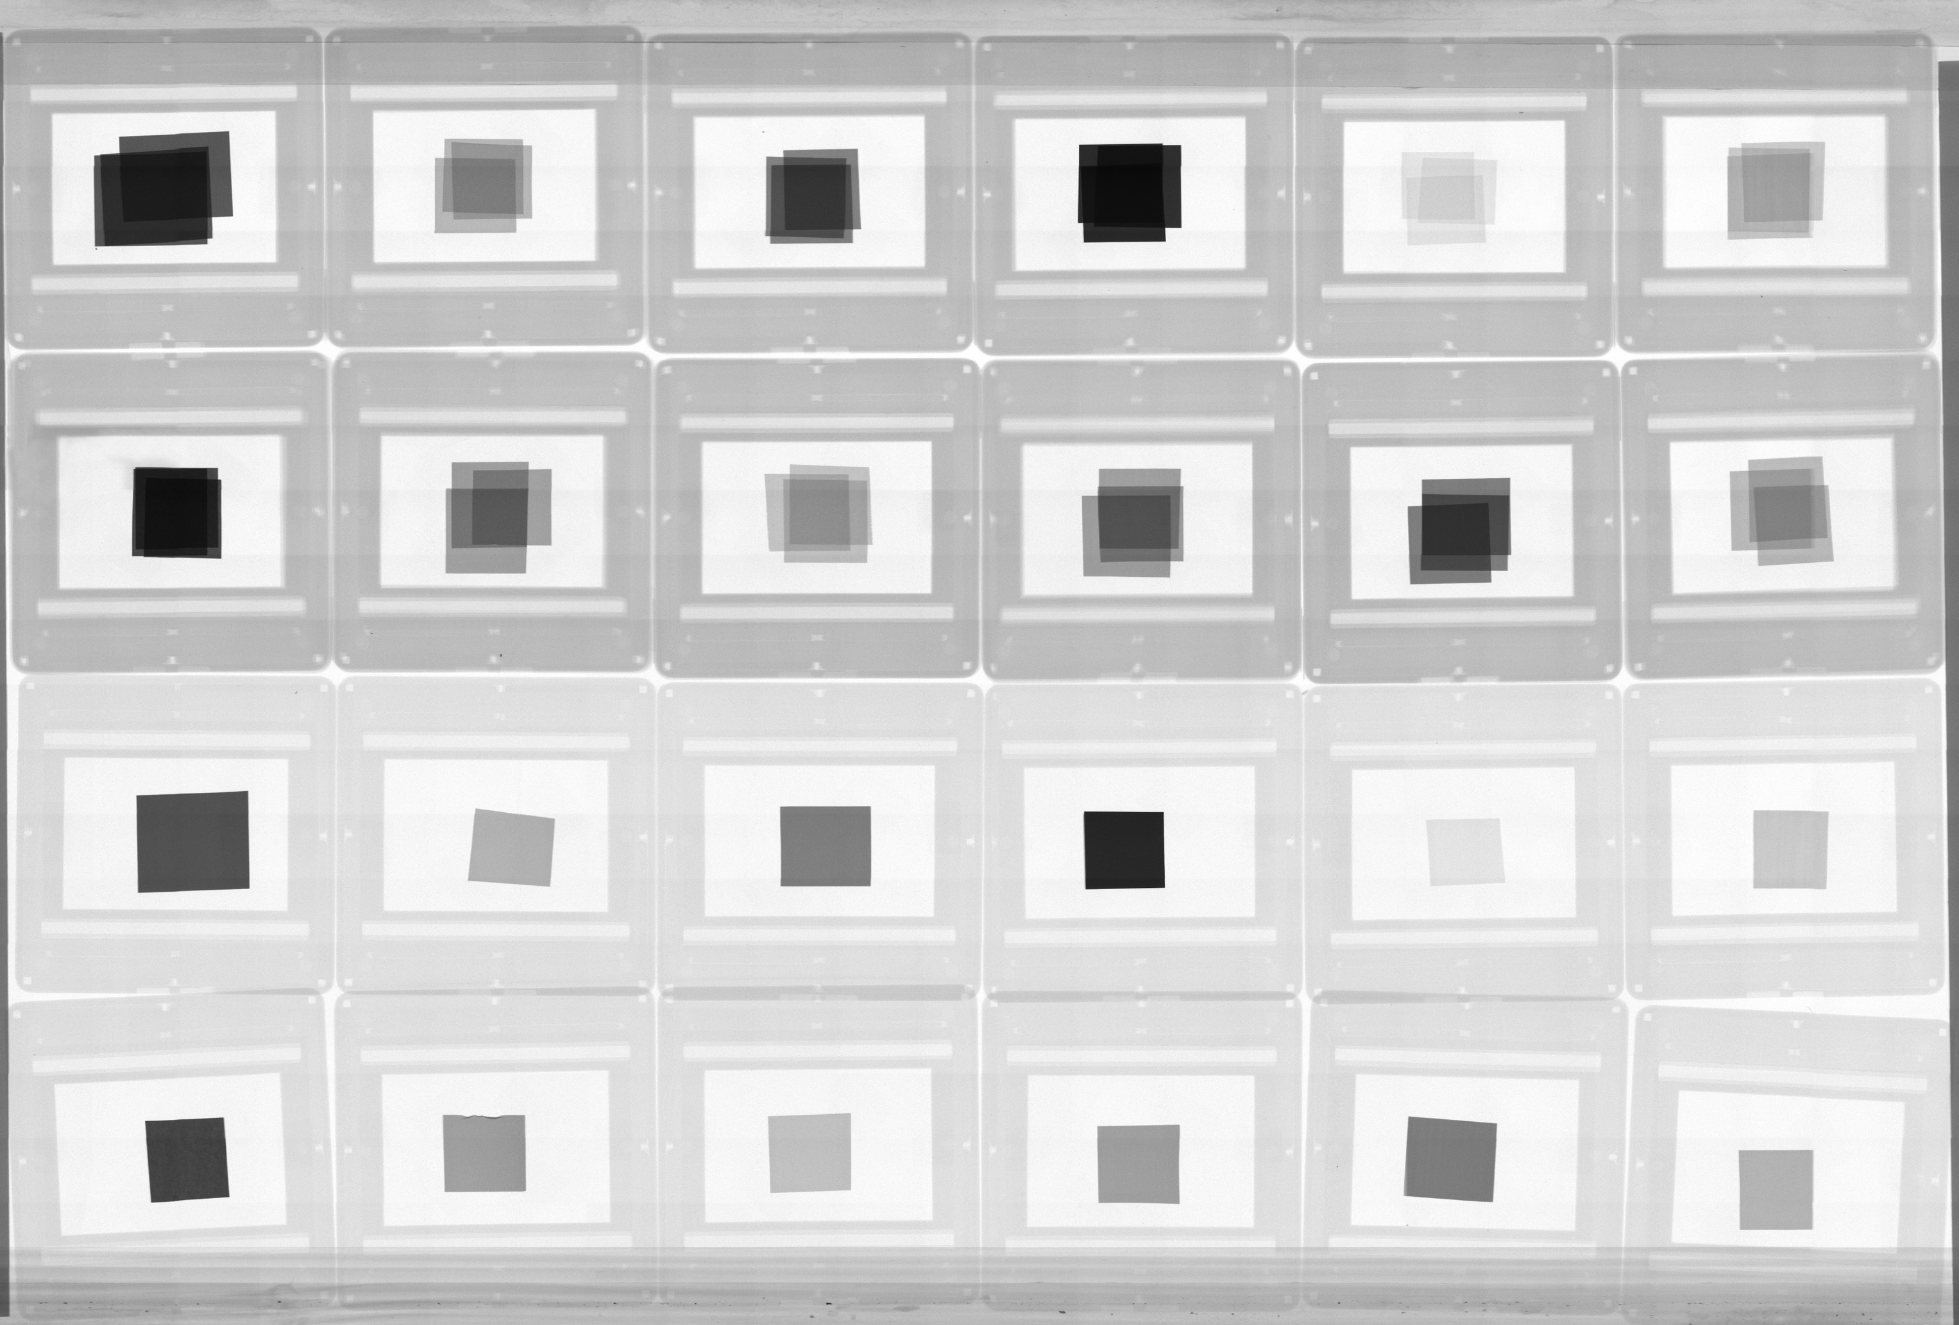
The regular vs “colour” X-ray imaging of test samples
Ta 75µm
Cu75µm
Mo 75µm
W 150µm
Ti 75µm
Fe 75µm
Pt 75µm
Pt 30µm
Co 75µm
Sn 75µm
Ag 75µm
Ni 75µm
Ta 25µm
Cu 25µm
Mo 25µm
W 50µm
Ti 25µm
Fe 25µm
Pt 25µm
Pt 10µm
Co 25µm
Sn 25µm
Ag 25µm
Ni 25µm
J. Jakubek
Notes:
We can use this in order to identify materials using a polychromatic beam of X-rays. (and identify them with colours)

Slide 17
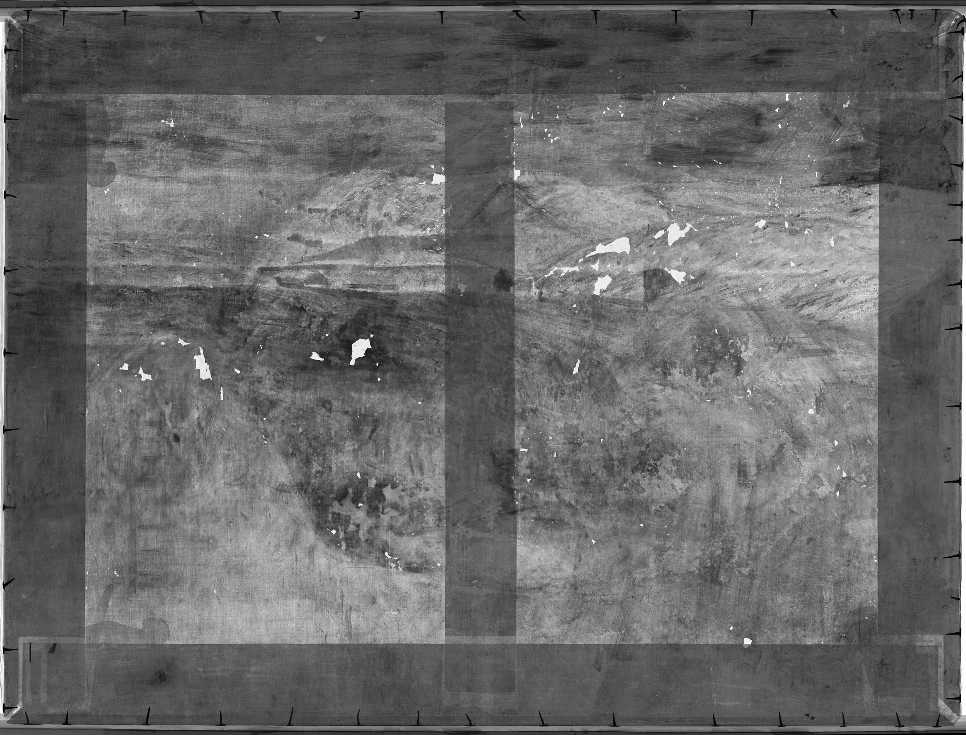

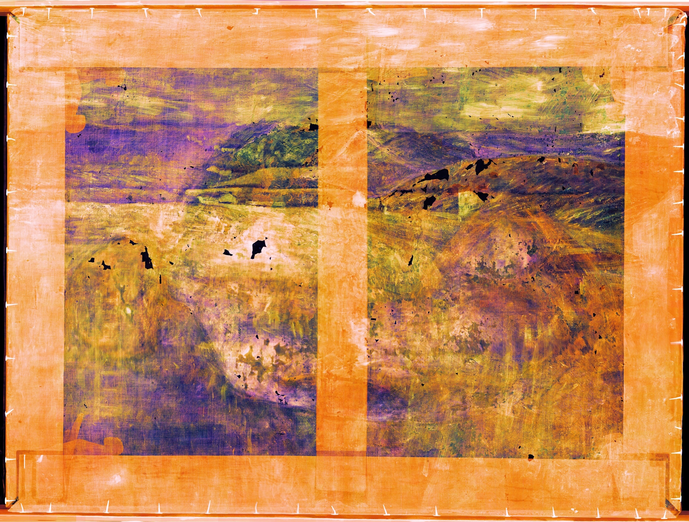

BBC Click on Fake Art – InsightART's X-ray colour imaging of art!
https://youtu.be/1xUD0BUzgtQ
Signed
Vincent van Gogh
La Crau with Montmajour in the backgroud
~1888
J. Jakubek
Notes:
Quadre que el propietari va comprar en uns subasta com un Van Gogh (mai s’havia fet cap analisis d’autenticitat del quadre i no hi havia historia documentada sobre el mateix)
2015-2018 analisi del quadre
La clau:
The material-sensitive X-ray images show the exact distribution of individual pigments across the image area, as well as the way they are applied in individual parts of the work. Using the separation of individual energy channels, we can get an accurate survey of the author’s work with individual layers and materials (Fig. 12 and Fig. 13). In the subsequent post-production process, it is also possible to show materials that are only related to the layer of paint that we want to visualize (Fig. 14).
El llenç o tela és un suport fet de teixit que normalment porta un bastidor per a poder tensar-lo i es fa servir per pintar-hi a sobre. Acostumen a ser de cotó o de lli: el cotó té un color més clar, una trama menys compacta i és més econòmic; el de lli és més rígid, de color gris ocre una mica fosc i es considera la millor tela per a pintar a l'oli. També es pot dir tela al quadre sobre tela ja pintat.
Transmission radiography: changes in the beam intensity caused by specific attenuation of different components in the sample.
The changes in the intensity of the beam transmitted by the sample are caused by differences in the inner composition of the object.
XRF (X-ray Fluorescence) based on the detection of radiation induced by the X-ray photons. (surface technique).
The knowledge of the painting and composition of the pigments helps dating te work and even trace back the author. (One can study the under painting, brush strokes and canvas fabric from the X-ray radiogram).
The sensor noise is suppressed by the ability to set the individual threshold for each pixel. These features lead to practically unlimited contrast in the resulting transmission images and spatial resolution of hundreds of nanometers (after magnification with microfocus beam).
XRF can give quantitative information of concentrations of materials (e.g. Concentrations of Cadmium red mixed in Titanium white). i.e. Pigment composition and identification is possible using energy based methods.
https://insightart.eu/2018/07/11/new-possibilities-of-exploring-artworks-with-x-ray-transmission-radiography-using-the-latest-generation-of-pixel-detectors/
La Crau with a View of Montmajour
The painting of La Crau with a View of Montmajour (Fig. 9) is a unique example of the use of material-sensitive X-ray radiography using RToo imaging equipment with Widepix detector. It is an oil painting on canvas, showing a view of the landscape near the French Arles with the ruins of Montmajour Abbey in the background. In the lower left corner is the signature Vincent. The image was purchased by the current owner in an auction, where it was listed as a copy by van Gogh. With its visual style and thematic focus this work fits the style of Vincent van Gogh’s work in 1888.
Fig. 9 La Crau with a View of Montmajour, signed Vincent.However, there is only a minimal amount of information about the origin of this work and, in the past, there has never been a thorough restoration or technological and historical research into the painting. For these reasons, in 2015-2018 the work was subject to a full range of available analyses including material-sensitive X-ray radiography.
Fig. 10 La Crau with a View of Montmajour, X-ray radiography in high resolution. Fig. 11 La Crau with a View of Montmajour, material-sensitive X-ray radiography with a drawing of a female nude in the lower layers of the painting shows the distribution of individual pigments in the image.Fig. 12 La Crau with a View of Montmajour, material-sensitive X-ray radiography – display of pigments dominated by zinc, chromium and cadmium.Fig. 13 La Crau with a View of Montmajour, material-sensitive X-ray radiography – display of lead-dominated pigments.During the radiographic survey of the work, it was found that there is another image under the painting of the La Crau landscape, namely the figure of a female nude shown from behind (Fig. 11). This figure was commenced only with brown tones in the shadow parts and white pastes in the illuminated parts of the figure. The style of underpainting and the position of the model show that it is an incomplete study painting of the nude, similar to the models van Gogh drew and painted in classes of the local academy in 1886-88, during his Parisian visit. The paste layers of the underpainting were partially scraped before painting the new image, and thus on the surface of the current painting a small relief is visible.
The material-sensitive X-ray images show the exact distribution of individual pigments across the image area, as well as the way they are applied in individual parts of the work. Using the separation of individual energy channels, we can get an accurate survey of the author’s work with individual layers and materials (Fig. 12 and Fig. 13). In the subsequent post-production process, it is also possible to show materials that are only related to the layer of paint that we want to visualize (Fig. 14).
Only the original figure of the female nude is shown in the picture; all the paint layers from the top landscape painting of La Crau with a View of Montmajour were suppressed here by filtering the signal in the individual energy channels. Thus, it is evident that this method allows a completely new way of working with X-ray radiography using the most advanced pixel detectors. The post-production image processing options are enormous and bring with them many ways to process the resulting X-ray image so that they have the greatest possible value for the studied work. For example, the exact representation of a figure in lower layer of La Crau with a View of Montmajour allows a precise comparison to be made of the presumed author’s painting style with his/her other works (Fig. 15 and Fig. 16).
Fig. 14 La Crau with a View of Montmajour, a black-and-white photograph of material sensitive X-ray radiography showing only the materials (pigments) associated with the original painting of a female nude.
Fig. 15 a) b) c)
Van Gogh’s studies of a female nude of 1886-7.
Fig. 16 Vincent van Gogh, Standing Female Nude, 1886-7; this figure shows a striking similarity to the modelling of the figure with the female nude displayed by RToo equipment under La Crau with a View of Montmajour.Conclusion
It is clear that X-ray transmission radiography using the latest pixel detectors has a great future in the field of artwork research. By engaging other technological processes, such as artificial intelligence for precise determination of detected pigments in paints, or virtual reality for more thorough analysis of radiographs, this method is becoming an important tool for accurate identification of artworks in the authentication process. In terms of extensive application and utilization capabilities, it is evident that these methods will soon appear in the everyday practice of restorers, conservators, technologists and historians, who will significantly benefit from them in their profession. Obviously, the development of these technologies continues; however, at present we already have a new functional tool that significantly shifts the field of X-ray radiography.

Slide 18
J. Jakubek

Slide 19
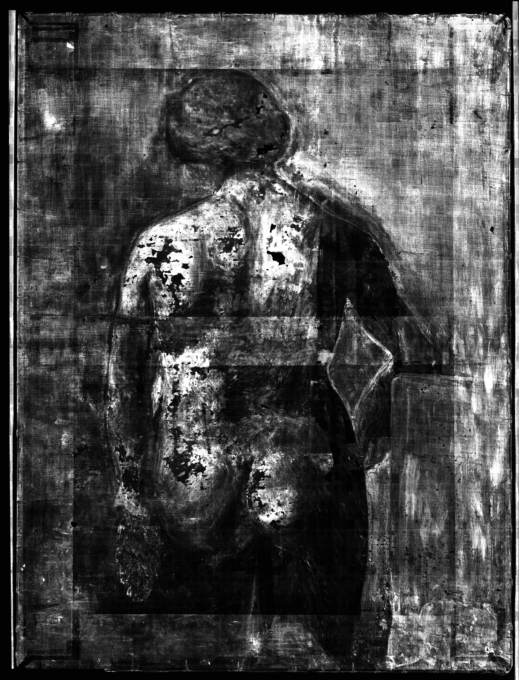

Possible thanks to the pixel recording of the spectroscopic information
J. Jakubek

Slide 20
The ideal detector system

Slide 21
The ideal X-ray detector
Direct detection
  Increased signal, improved spatial resolution
Single quantum processing
  Energy weighting (optimal SNR), noise rejection, perfect linear behaviour
Zero dead time (τ)
  Limitation of single quantum processing
  For a given application τ<<1/r (τ is the dead time, r is the count rate and 1/r is the mean time between consecutive photons)
Notes:
Direct detection
Increased signal, improved spatial resolution
Single quantum processing
Energy weighting (optimal SNR), noise rejection, perfect linear behaviour
Zero dead time
Dead time is defined as the minimum time that must separate two events in order for them to be recorded as separate/different pulses.
In a given application, the dead time (tau) has to be much smaller than 1/r where r is the detector count rate in counts per second.
An important characteristic of an X-ray imaging system is the way the radiation quantum is transformed into an electrical signal before it is processed by the readout electronics. Systems are classified from this point of view into indirect and direct detection systems.
In indirect detection systems the conversion of the photon into an electrical signal is done in two steps: first the conversion is done from X-rays to visible light by means of a scintillator material and second, the visible light is detected in a pixelated sensor with photodiodes. Spatial resolution and the efficiency of the overall detection process are degraded due to this two-step process. The approach of indirect detection combined with on-pixel photon counting signal processing has been implemented by Dierickx ([4], [5]).
In direct detection systems the X-ray photons deposit their energy in the detector material directly creating electron-hole pairs that drift to collection electrodes creating an electrical current. For the X-ray energies used in medical applications, each impinging photon releases a charge from 4000 to 25000 electrons in a CdTe semiconductor detector. In an indirect conversion system the detected electrical signal is in the range from 100 to 1000 electrons depending on the scintillator characteristics. Scintillator materials used in indirect conversion technology are nowadays more economical to manufacture than high-Z materials. The cost of bump bonding is currently an important fraction of the total cost of an assembly.
Indirect detection: i.e., detection of the X-ray photon indirectly by first absorbing it in a high-Z scintillator and then detecting the secondary, visible light radiation by a visible light image sensor.
Direct detection: the X-ray detection happens by absorption of the photon in a high-Z semiconductor
Most, if not all of today’s successful photon counting X-ray imagers are based on “direct detection” [4–13], i.e., the X-ray detection happens by absorption of the photon in a high-Z semiconductor photo diode or photo resistor. From a pure detection performance standpoint, this approach is ideal: the photo-electric conversion happens in a very limited volume, and the energy quantum is deposited in a narrow trace or cloud of secondary electron-hole pairs, which are quickly and with little sideward dispersion collected by the electric drift field. As the collection time is in the order of nanoseconds, the direct detector can be operated at very high count rates. As the secondary charges remain confined, the modulation transfer function (MTF), and hence the DQE, is excellent, and the reproducibility of the collected charge packet size is nearly perfect, allowing, if required, an accurate photon energy measurement.
The limiting factor for the widespread use of direct detection in photon counting imaging is the cost and manipulation of the material.
Definitions
A thin-film transistor (TFT) is a special kind of field-effect transistor made by depositing thin films of an active semiconductor layer as well as the dielectric layer and metallic contacts over a supporting (but non-conducting) substrate. A common substrate is glass, because the primary application of TFTs is in liquid-crystal displays. This differs from the conventional transistor, where the semiconductor material typically is the substrate, such as a silicon wafer.
Manufacture
TFTs can be made using a wide variety of semiconductor materials. A common material is silicon. The characteristics of a silicon-based TFT depend on the silicon's crystalline state; that is, the semiconductor layer can be either amorphous silicon,^{[1]} microcrystalline silicon,^{[1]} or it can be annealed into polysilicon.
Other materials which have been used as semiconductors in TFTs include compound semiconductors such as cadmium selenide,^{[2][3]} or metal oxides such as zinc oxide.^{[4]} TFTs have also been made using organic materials, referred to as organic field-effect transistors or OTFTs.
By using transparent semiconductors and transparent electrodes, such as indium tin oxide (ITO), some TFT devices can be made completely transparent. Such transparent TFTs (TTFTs) can be used for construction of video display panels.
Because conventional substrates cannot withstand high annealing temperatures, the deposition process must be completed under relatively low temperatures. Chemical vapor deposition and physical vapor deposition (usually sputtering) are applied. The first solution-processed TTFTs, based on zinc oxide, were reported in 2003 by researchers at Oregon State University.^{[4]} The Portuguese laboratory CENIMAT at the Universidade Nova de Lisboa has produced the world’s first completely transparent TFT at room temperature.^{[citation needed]} CENIMAT also developed the first paper transistor,^{[citation needed]} which may lead to applications such as magazines and journal pages with moving images.
Flat panels with poly-Si TFT (e.g. A. K. Liang “Performance of in-pixel circuits for photon counting arrays (PCAs) based on polycrystalline silicon TFTs” Phys. Med. Biol. 61 (2016) 1968-1985)

Slide 22
Limiting factors in real systems degrading energy resolution and count rate
Notes:
Say: These factors affect the mainly energy resolution and the count rate

Slide 23
1. Absorption efficiency
4. Fluorescence
5. Compton scattering
6. Charge trapping
7. Polarization
2. Fluctuations in the number of generated carriers
3. Charge diffusion
Notes:
Limiting factors in the sensor (Thesis folder / HybridPixelDetectorScheme2)
Thesis folder / HybridPixelDetectorScheme2
SENSOR
Absorption efficiency (probability that the X-ray photon will be removed from the beam in the absorber of a given thickness)
Fluctuations in the number of generated charge carriers
Photoelectron interacts with electrons in material
Energy losses occur both to ionizing processes (result in charge) and non-ionizing processes (multiple mechanisms reduce statistical spread)
Fluctuations represent a lower limit for the achievable energy resolution
Charge diffusion (the created electrons and holes drift under the influence of the electric field and also diffuse to the pixel electrodes)
Partial charge deposition due to Fluorescence and Compton Scattering
Charge trapping in the semiconductor material:
reduction of the signal in the electrodes
The mobility lifetime product of the carrier determines the trapping length (usually higher for electrons than holes)
If a detector has small pixels the carriers drifting to the readout electrodes will induce most of the total signal
Other defects in the crystal (like grain boundaries) can also lead to trapping and charge carrier loss
Sensor polarization
Time-dependent decrease of the count-rate and charge collection eﬃciency due to trapping and detrapping of the carriers within the crystal that aﬀect the electric ﬁeld proﬁle in the detector.
It is possible to minimize the polarization eﬀects by using high bias voltages and low temperature operation.
Good reliability of CdZnTe has been recently reported and systems with such detectors are commercially available.
INTERFACE
Ballistic deficit
Ballistic deficit refers to the loss of signal amplitude at the shaper output due to an incomplete integration of the sensor signal by the readout electronics.
READOUT
Electronics noise
Noise is a random process inherent to the conduction of current in devices that limits the minimum signal level that a circuit can process with acceptable quality
Cross talk
Threshold offset and gain dispersion between pixels
Pulse pile-up leads to a reduction of the event counts and an incorrect/distorted measurement of the energy
Polarization: causes a change in the detector’s performance after biasing the sensor, and leads to a reduction in the count rate over time and loss of charge collection efficiency.
Polarization arises from trapping and de-trapping of ionized deep level acceptors within the crystal which affects the space-charge and the electric field distribution.
Time-dependent decrease in the counting rate and charge collection efficiency due to electron capture in the material.
Polarization is a phenomenon occuring in semiconductor detectors that leads to a time-dependent decrease of the count-rate and charge collection efficiency [9]. It happens due to trapping and detrapping [23] of the carriers within the crystal that affect the electric field profile in the detector. The sensor design must be such that the charge generated by the X-ray photon is removed from the device at sufficiently high rate through both drift and recombination. It is possible to minimize the polarization effects by using high bias voltages and low temperature operation [31]. Good reliability of CdZnTe has been recently reported and systems with such detectors are commercially available [23].
Discussion with CdTe Ohmic vs Schottky
Ohmic:
Higher leakage current (but can be compensated with a proper leakage current compensation network in the pixel)
Less defects for imaging (i.e. better for imaging with photon counting detectors).
A bit more noise (due to increased leakage current)
Schottky
Lower leakage current (i.e. this type is required for integrating front-ends)
More defects for imaging (dead pixels / anomalously high leakage current / grain boundaries)

Slide 24
8. Ballistic deficit
11. Cross-talk
-A
-A
Channel i
9. Offset mismatch, Gain mismatch and random noise
10. Pulse pile-up
Pile-up
Notes:
Limiting factors in the sensor-electronics interface and in the electronics
Thesis folder
HybridPixelDetectorScheme2
INTERFACE
Ballistic deficit
Ballistic deficit refers to the loss of signal amplitude at the shaper output due to an incomplete integration of the sensor signal by the readout electronics.
READOUT
Electronics noise
Noise is a random process inherent to the conduction of current in devices that limits the minimum signal level that a circuit can process with acceptable quality
Cross talk
Threshold offset and gain dispersion between pixels
Pulse pile-up leads to a reduction of the event counts and an incorrect/distorted measurement of the energy
Polarization: causes a change in the detector’s performance after biasing the sensor, and leads to a reduction in the count rate over time and loss of charge collection efficiency.
Polarization arises from trapping and de-trapping of ionized deep level acceptors within the crystal which affects the space-charge and the electric field distribution.
Time-dependent decrease in the counting rate and charge collection efficiency due to electron capture in the material.
Polarization is a phenomenon occuring in semiconductor detectors that leads to a time-dependent decrease of the count-rate and charge collection efficiency [9]. It happens due to trapping and detrapping [23] of the carriers within the crystal that affect the electric field profile in the detector. The sensor design must be such that the charge generated by the X-ray photon is removed from the device at sufficiently high rate through both drift and recombination. It is possible to minimize the polarization effects by using high bias voltages and low temperature operation [31]. Good reliability of CdZnTe has been recently reported and systems with such detectors are commercially available [23].
Discussion with CdTe Ohmic vs Schottky
Ohmic:
Higher leakage current (but can be compensated with a proper leakage current compensation network in the pixel)
Less defects for imaging (i.e. better for imaging with photon counting detectors).
A bit more noise (due to increased leakage current)
Schottky
Lower leakage current (i.e. this type is required for integrating front-ends)
More defects for imaging (dead pixels / anomalously high leakage current / grain boundaries)

Slide 25
1. Absorption efficiency
Notes:
Thesis folder / HybridPixelDetectorScheme2
SENSOR
Absorption efficiency (probability that the X-ray photon will be removed from the beam in the absorber of a given thickness)
Fluctuations in the number of generated charge carriers
Charge diffusion
Partial charge deposition due to Fluorescence and Compton Scattering
Charge trapping in the semiconductor material:
reduction of the signal in the electrodes
Other defects in the crystal can also lead to trapping and charge carrier loss
Sensor polarization
INTERFACE
Ballistic deficit
READOUT
Electronics noise
Cross talk
Threshold offset and gain dispersion between pixels
Pulse pile-up
Polarization: causes a change in the detector’s performance after biasing the sensor, and leads to a reduction in the count rate over time and loss of charge collection efficiency.
Polarization arises from trapping and de-trapping of ionized deep level acceptors within the crystal which affects the space-charge and the electric field distribution.
Time-dependent decrease in the counting rate and charge collection efficiency due to electron capture in the material.
Polarization is a phenomenon occuring in semiconductor detectors that leads to a time-dependent decrease of the count-rate and charge collection efficiency [9]. It happens due to trapping and detrapping [23] of the carriers within the crystal that affect the electric field profile in the detector. The sensor design must be such that the charge generated by the X-ray photon is removed from the device at sufficiently high rate through both drift and recombination. It is possible to minimize the polarization effects by using high bias voltages and low temperature operation [31]. Good reliability of CdZnTe has been recently reported and systems with such detectors are commercially available [23].

Slide 26
Absorption efficiency
Silicon (Z=14) ideal for HEP applications
Higher Z required above 20keV
Ge, GaAs, CdTe, CdZnTe
Notes:
Si: low mass, very homogeneous, low price

Slide 27
3. Charge diffusion
Notes:
Thesis folder / HybridPixelDetectorScheme2
SENSOR
Absorption efficiency (probability that the X-ray photon will be removed from the beam in the absorber of a given thickness)
Fluctuations in the number of generated charge carriers
Charge diffusion
Partial charge deposition due to Fluorescence and Compton Scattering
Charge trapping in the semiconductor material:
reduction of the signal in the electrodes
Other defects in the crystal can also lead to trapping and charge carrier loss
Sensor polarization
INTERFACE
Ballistic deficit
READOUT
Electronics noise
Cross talk
Threshold offset and gain dispersion between pixels
Pulse pile-up
Polarization: causes a change in the detector’s performance after biasing the sensor, and leads to a reduction in the count rate over time and loss of charge collection efficiency.
Polarization arises from trapping and de-trapping of ionized deep level acceptors within the crystal which affects the space-charge and the electric field distribution.
Time-dependent decrease in the counting rate and charge collection efficiency due to electron capture in the material.
Polarization is a phenomenon occuring in semiconductor detectors that leads to a time-dependent decrease of the count-rate and charge collection efficiency [9]. It happens due to trapping and detrapping [23] of the carriers within the crystal that affect the electric field profile in the detector. The sensor design must be such that the charge generated by the X-ray photon is removed from the device at sufficiently high rate through both drift and recombination. It is possible to minimize the polarization effects by using high bias voltages and low temperature operation [31]. Good reliability of CdZnTe has been recently reported and systems with such detectors are commercially available [23].

Slide 28
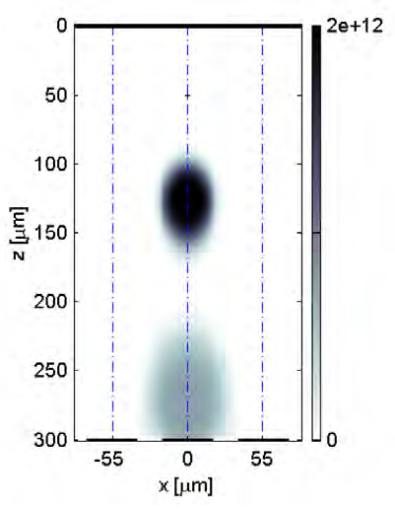
Charge diffusion
Diffusion occurs when there are local differences of carrier concentrations in the semiconductor
Gaussian cross section of the distribution with standard deviation:
D: Diffusion coefficient
t: time
Charge density distribution (hole component) (Charges/cm³), Si sensor, deposition at 50um, 4ns and 14ns after conversion (Thesis L. Tlustos)
Notes:
Diffusion occurs when there are local differences of carrier concentrations in the semiconductor. In this case a current is observed from the region of high carrier concentration to the region of low carrier concentration. The density of current is proportional to the gradient of the carrier density and the diffusivity D. In the case of a diffusion current of electrons:

Slide 29
Charge diffusion
Simulated Data
Si 300μm, 55μm pixel
100e⁻ r.m.s. noise
10keV monochromatic photon beam
Distortion in the energy spectrum increases as the pixel pitch decreases with the detector thickness
Simulation: L. Tlustos
Notes:
This is one of the first simulations to validate the new architecture.
It simulates a hybrid pixel detector architecture with a three hundred micrometer thick silicon sensor and fifty five micron pixel pitch.
The simulation was done with a 10keV photon beam.
In blue the spectrum seen by one pixel working independently of its neighbours is shown. Because some of the charge deposited in the sensor is “shared” between pixels, the spectrum seen by one pixel has a low energy tail. The electronic noise of the pixel front end is simulated to be 100e-.
The influence of this effect on the spectrum increases as the pixel pitch is decreased with respect to the thickness of the sensor material.
This charge sharing tail means that any residual threshold variation between pixels produces a fixed pattern which varies with the incoming energy spectrum.
In red the new architecture in which 4 pixels contribute to the total charge sum and the hit is allocated to the circuit with the largest energy deposition. The electronics noise is 200 e- in this case.

Slide 30
4. Fluorescence
Notes:
Thesis folder / HybridPixelDetectorScheme2
SENSOR
Absorption efficiency (probability that the X-ray photon will be removed from the beam in the absorber of a given thickness)
Fluctuations in the number of generated charge carriers
Charge diffusion
Partial charge deposition due to Fluorescence and Compton Scattering
Charge trapping in the semiconductor material:
reduction of the signal in the electrodes
Other defects in the crystal can also lead to trapping and charge carrier loss
Sensor polarization
INTERFACE
Ballistic deficit
READOUT
Electronics noise
Cross talk
Threshold offset and gain dispersion between pixels
Pulse pile-up
Polarization: causes a change in the detector’s performance after biasing the sensor, and leads to a reduction in the count rate over time and loss of charge collection efficiency.
Polarization arises from trapping and de-trapping of ionized deep level acceptors within the crystal which affects the space-charge and the electric field distribution.
Time-dependent decrease in the counting rate and charge collection efficiency due to electron capture in the material.
Polarization is a phenomenon occuring in semiconductor detectors that leads to a time-dependent decrease of the count-rate and charge collection efficiency [9]. It happens due to trapping and detrapping [23] of the carriers within the crystal that affect the electric field profile in the detector. The sensor design must be such that the charge generated by the X-ray photon is removed from the device at sufficiently high rate through both drift and recombination. It is possible to minimize the polarization effects by using high bias voltages and low temperature operation [31]. Good reliability of CdZnTe has been recently reported and systems with such detectors are commercially available [23].

Slide 31
Fluorescence
γ
γ_{f}
1.
2.
Primary photon releases photoelectron that loses its energy generating electron-hole pairs
De-excitation of the first atom releases a characteristic photon that will deposit its energy some distance away from the first interaction
Multiple hits can be detected for a single incoming photon
3.

Slide 32
Fluorescence
Mean free path of fluorescence photon [μm]
Fluorescence yield [%]
Energy fluorescence photons [keV]
Z
The fluorescence yield increases with the atomic number
The mean free path of the fluorescence photons is in the same order of magnitude as the pixel pitch
Implications: degradation of the energy measurement, blur the image
Table: L. Tlustos, PhD thesis
Notes:
Fluorescence yield is the probability of producing a fluorescence photon after a K-shell electron absorbs an incoming photon.
K_alpha1=K1-L3
K_alpha2=K1-L2
Another important effect in some high-Z materials is charge trapping. Some semiconductor
defects can temporarily trap electrons and holes. So, when a photon hits the detector, some of the
electrons and holes generated by the photon may be trapped as they drift towards the electrodes,
reducing the signal induced on the electrodes.
The effects of trapping are influenced by various factors. The rates at which electrons and
holes are trapped are dependent on the material properties and can be characterised by the electron
and hole trapping lifetimes. If the carriers can be collected more quickly then fewer carriers will
be trapped. So, reducing the sensor thickness, increasing the field strength and using material with
higher carrier mobilities will reduce the effects of trapping. The pixel geometry will also affect the
induced signals; in particular, if a detector has small pixels, then the carriers drifting to the readout
electrodes will induce most of the total signal [12]. If a material has much lower electron trapping
than hole trapping, or vice versa, then this “small pixel effect” can be exploited to improve the
charge collection, by putting the pixel contacts on the appropriate side.
Since germanium is available in wafers of extremely high purity, trapping effects in a finelypixellated
germanium detector will be negligible. While CdTe is affected by charge trapping, the
material quality has improved to the point where lifetime-mobility product is over 110􀀀3cm2=V
for electrons and around 110􀀀4cm2=V for holes [13]. With a typical detector thickness of 1000
m and a bias voltage of 500V, the mean drift distance before trapping would then be at least 5 cm
for electrons and 5 mm for holes, which would result in 2% of the electrons and 18% of the holes
being trapped if they have to drift across the full detector thickness. In a photon counting pixel
detector with electron readout, where holes only make a small contribution to the total signal, the
signal loss from trapping will be small compared to other effects and can be ignored.
GaAs has a relatively high concentration of defects, and one major challenge for developing
GaAs detectors is to produce material with both high resistivity and low trapping. The trapping
parameters of GaAs may vary a great deal depending on how the material is produced. As discussed
in subsection 3.4, this paper focuses on simulating chromium-compensated GaAs [6], which has
shown promising results when bonded to Medipix2 readout chips [14].

Slide 33
10. Pulse pile-up
Channel i
Pile-up
Notes:
Thesis folder
HybridPixelDetectorScheme2

Slide 34
Pulse pile-up
μ=15μs
Gaussian shaper (σ=100ns), τ~300ns (@Threshold=2.5keV)
τ/μ=0.02
Pile-up is the overlap in the processing chain, of the signals due to two consecutive photons
Plot: signal Gaussian shape (sigma~100ns), the mean time between consecutive photons (μ) follows exponential probability density function
Notes:
Exponential probability density function (pdf) with mean time between photons equal to mu.

Slide 35
Pulse pile-up
μ=3μs
Gaussian shaper (σ=100ns), τ~300ns (@Threshold=2.5keV)
τ/μ=0.1
Notes:
as we decrease the mean time between consecutive photons we start seeing events piling up.

Slide 36
Pulse pile-up
μ=1.5μs
Gaussian shaper (σ=100ns), τ~300ns (@Threshold=2.5keV)
τ/μ=0.2

Slide 37
Pulse pile-up
μ=0.3μs
Gaussian shaper (σ=100ns), τ~300ns (@Threshold=2.5keV)
τ/μ=1

Slide 38
Pulse pile-up
Probability of having an event piling-up on the previous one
τ is the dead time
μ is the mean time between events
τ/μ ~0.1-0.2 is a good compromise between speed and energy resolution
Notes:
Calculation is based on the fact that the time between consecutive photons follows an exponential probability density function (pdf) with mean time between photons equal to mu.
The amplifier output must return to the baseline before a new pulse can be processed otherwise the two signals will pile up. The time of arrivals of the events in a radiation detector usually falls a Poisson distribution.
Straight forward way to reduce the event loss is to speed up the system. Ex Ploss=1-P(0)=0.01 . This is fulfilled for mu=0.01.
Suppose instead that a memory is added so that the data can be stored locally while waiting for the readout, making the channel sensitive to another hit.

Slide 39
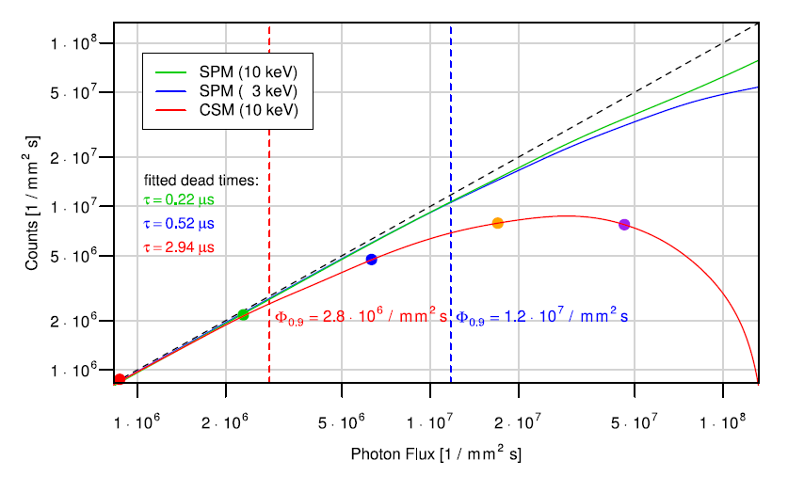
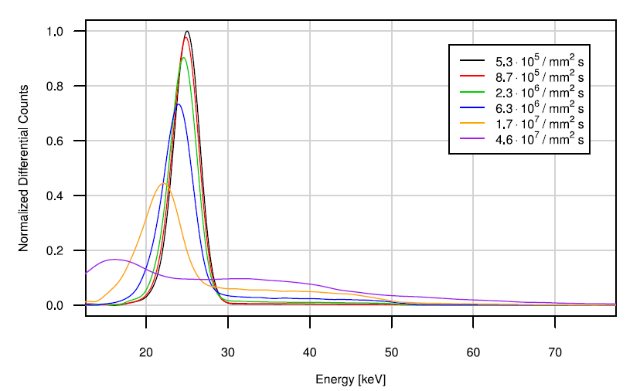
Measurement Medipix3 (25keV, 110μm pitch, 2mm CdTe)
τ/μ=0.22
τ/μ=0.08
τ/μ=0.08
τ/μ=0.22
τ/μ=0.6
Measurements: T. Koenig, KIT

Slide 40
ASICs for spectroscopic X-ray imaging

Slide 41
Tables
  Updated
  Reported measurement values not taken as absolute values for comparison but should be used to identify trends and performance envelopes
Count-rate
Charge summing and hit allocation architectures
Power consumption
Detector tiling
Notes:
The work I am going to present is based on: “Review of Hybrid Pixel Detector Readout ASICs for spectroscopic X-ray imaging”. Published in 2016. It has been updated.
Tables: for completeness!
For example: count rate measurement results depends on many parameters: e.g. Input spectrum/ threshold (No standardized measurement conditions)

Slide 42
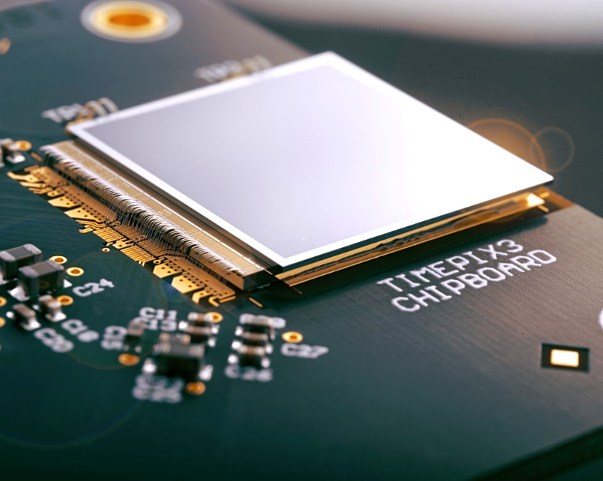
Table 1: Design parameters for Hybrid Pixel Detectors
Readout channels are laid out in a 2-dimensional matrix connected to the sensor elements at the same pitch
Notes:
1st table: Design parameters for Hybrid Pixel Detectors
ASICs whereby the readout channels are laid out in a 2d matrix

Slide 43
Notes:
Table
ASICS sorted depending on their pixel size
F:\CERNBOX\WORK\PhotonCountingChips\tables.ppt
Hybrid pixel detector photon counting chips. The indexes (in italics and inside curly brackets) in
the table identify the chips in the following plots (they should not be confused with the references). (NS
means that the data was not speciﬁed in the reference).

Slide 44
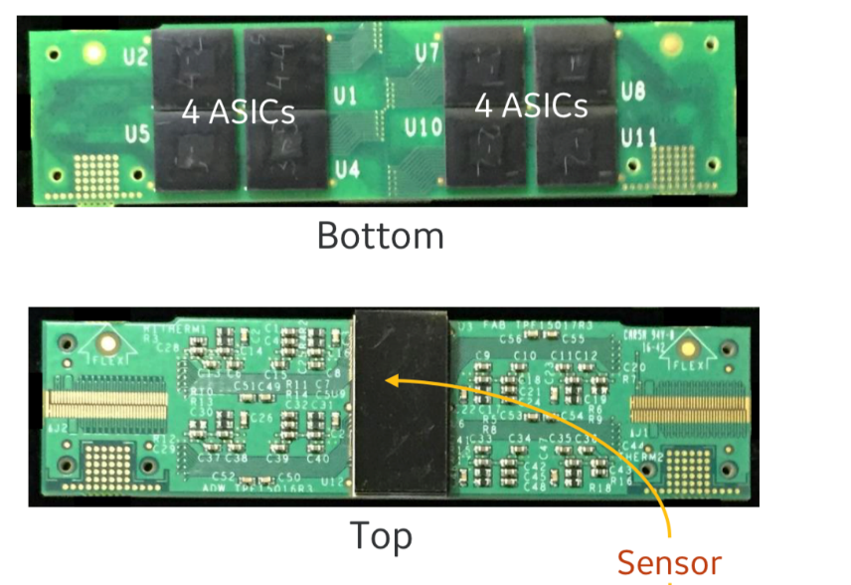
Table 2: Design parameters for readout chips non-hybridized to the sensor
Readout channels are connected to the sensor through interposers
Notes:
ASICs in which the readout channels are connected to the sensor

Slide 45
Notes:
F:\CERNBOX\WORK\PhotonCountingChips\tables.ppt
Design parameters
Table 3. Photon counting ASICs not hybridized to the sensor.
Table 3 presents photon counting semiconductor readout ASICs that are not hybridized to the sensor and, as a consequence, cannot be bump-bonded to a 2D sensor. In these chips the size of the sensor pixel does not necessarily match the size of the readout channel.

Slide 46
Table 3: Measured parameters for Hybrid Pixel Detectors
Readout channels are laid out in a 2-dimensional matrix connected to the sensor elements at the same pitch

Slide 47
Notes:
Siemens ASIC refers to the ACTINA presented by Loick Verger F:\CERNBOX\WORK\PhotonCountingChips\tables.ppt
Electrical parameters
Table 4. Electrical parameters for hybrid pixel detector photon counting chips.
The measured electrical parameters for all these chips are shown in Table 4 and Table 5. The maximum count-rates correspond to the input flux at which the output count-rate saturates which corresponds, for the particular case of the paralyzable model, to the inverse of the dead time. Beyond this value it is no longer possible to linearize the count-rate, resulting in ambiguous and therefore inconsistent datasets.
The electronics noise or ENC and the energy resolution are also reported. Note that the ENC corresponds to an electrical parameter related to a single detection channel whereas the energy resolution is usually specified for the full detector system. As a consequence, pixel-to-pixel threshold and gain mismatch are accounted for in the energy resolution.
Please note that the reported values for the maximum count-rates and the energy resolution have a strong dependency on the measurement conditions (for example, the maximum count-rate depends strongly on the energy of the incoming radiation and on the threshold level programmed on the ASIC). The measurements presented in the following tables were not taken under the same measurement conditions. As a consequence, those numbers should not be taken as absolute values to compare the different designs but should be rather used to identify trends and performance envelopes.
New chips:
IBEX from Dectris, which achieves a very high maximum count-rate and which implements the instant retrigger technology as we saw in the workshop.
PXF40: a prototype chip from AGH in 40nm CMOS technology and that achieves a very high input count rate (measured in this case with 8keV photons).
The HEPS-BPIX chip: High Energy Photon Source-BPIX Beijing Pixel (design for synchrotrons)
The Philips ChromAIX2 (which increases the pixel size with respect to its predecessor).
The CEA-Multix

Slide 48
Table 4: Measured parameters for readout chips non-hybridized to the sensor
Readout channels are connected to the sensor through interposers
48

Slide 49
Notes:
Electrical parameters
Table 5. Electrical parameters for photon counting ASICs not hybridized to the sensor.

Slide 50
Digitization methods
Notes:
Now let’s discuss the methods to digitize the energy measurement.

Slide 51
Digitization methods
On-pixel
  Flash ADC (e.g. ChromAIX chips)
  SAR ADC (e.g. CEA-Multix)
  Ramp-compare ADC (e.g. Ajat-0.35)
  Time-Over-Threshold (e.g. Timepix3)
Other
  Digitization off-pixel (e.g. Hexitec)
Notes:
Different methods have been implemented:
Most of the chips digitize using a “flash” or “parallel” Analog to digital converter (one comparator per energy level).
There are a couple of chips (Samsung and CEA-Multix) in which a Successive Approximation Register is implemented
Ramp and compare (this approach is slower and the chip is used for spectroscopy applications).
Other chips like the Timepix chips or the Dosepix chip digitize the energy using the Time over threshold approach
And finally other chips (specially those for spectrometry (at a relatively low fluxes)) digitize the signal with many bits (13-14) with ADCs physically located outside the chips.

Slide 52
Flash ADC example: Philips ChromAIX1 chip
ChromAIX1
  8x16 pixels (300μm pitch), 0.18μm CMOS
  4 energy thresholds, 20ns peaking time
  Flash (parallel) ADC, applications for large bandwidth, high power consumption
R. Steadman, “ChromAIX: A high-rate energy resolving photon-counting ASIC for Spectral Computed Tomography” Proc. SPIE 7622, 762220–762228 (2010).
Notes:
Designed by Philips for their CT prototype scanners using photon counting technology
Chip specs
For every threshold level there is a discriminator/comparator and the counters associated to it.
Flash analog-to-digital converters, also known as parallel ADCs, are the fastest way to convert an analog signal to a digital signal. Flash ADCs are ideal for applications requiring very large bandwidth, but they consume more power than other ADC architectures and are generally limited to 8-bit resolution.

Slide 53
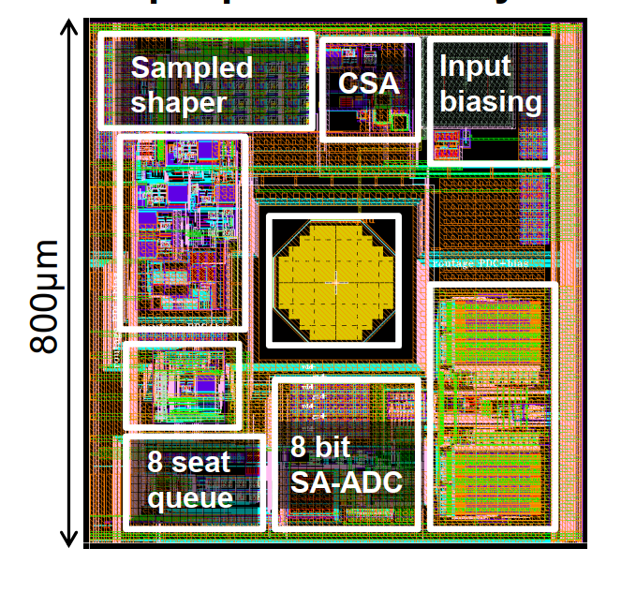
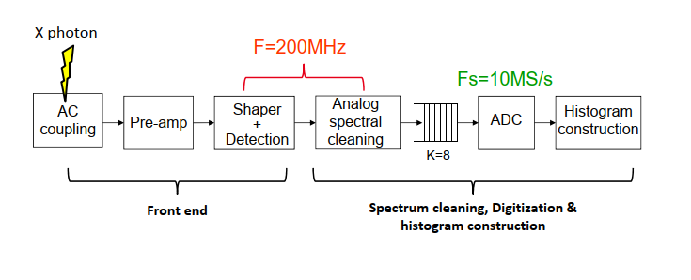
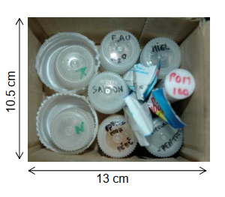
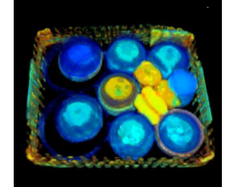
SAR ADC example: CEA-Multix
4x8 pixels (800μm pitch), 0.13μm CMOS
On chip charge sharing, charge induction and pile-up corrections
SAR ADC (8 bits) fed by a queuing block to derandomize the detected photon flux
256 bins, 6 bit depth
Output count rate: 8M counts/s/pixel
10mW/pixel
A. Peizerat et al. "A 256 energy bin spectrum X-Ray photon-counting Image Sensor providing 8 Mcounts/s/pixel and on-chip charge sharing, charge induction and pile-up corrections " 2017 Symposium on VLSI Circuits Digest of Technical Papers.
Notes:
SAR ADC (8 bits) fed by an innovative queuing block to derandomize the detected photon flux and in this way to relax the specifications for the ADC sampling frequency.

Slide 54
Time-over-Threshold (ToT) digitization
Notes:
Another way of digitizing is the Time Over Threshold method.
If we take a look at the signal at the preamplifier output, when it is discharged at constant current, we realize that the time the signal is above threshold is proportional to the energy. This can be used to combine the signal with a clock and obtain a linear energy measurement. This is known as time over threshold approach.
Applications: Particle tracking by time stamping and measurement of the total deposited charge (e.g. Radiation and beam monitors, dosimetry, gas detectors, HEP TPC readout, HEP prototype for vertex detector)
Developed in the framework of the Medipix3 collaboration (design effort between CERN, Bonn university and Nikhef)
256x256 pixel matrix, 55x55μm² pixels
CMOS 0.13μm technology
Simultaneous measurement of ToA and ToT per event (48bits/event)
Packet-based data-driven readout (small readout associated dead time of 375ns)
Maximum dead time free hit rate of 40 10⁶ hits/s/cm²
Programmable shutdown/wake-up feature for the front-end (analog domain) and/or general clock gating (digital domain)
Maximum output data bandwidth of 5.12Gbps
Schematic:
Preamplifier.
Discriminator.
Synchronization logic to synchronize the asynchronous hits to the on-pixel clock.
Clock gating to reduce dynamic power consumption of inactive pixels.
14-bit time stamp register.
10-bit LFSR counter for Time-over-Threshold
Logic.
The SP (super-pixel-logic) is shared by 8 pixels.
Intra –SP token ring
Data are shifted from a selected pixel into a deserializer in the superpixel and written into a buffer for readout.
Each SP accesses the column by using token-ring arbitration.
Data driven

Slide 55
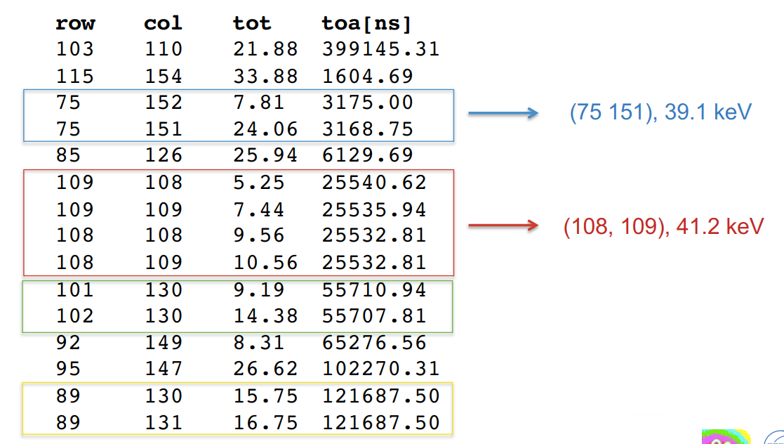
ToT digitization: Timepix3 chip
Developed in the framework of the Medipix3 collaboration
256x256 pixel matrix, 55x55μm² pixels
CMOS 0.13μm technology
Simultaneous measurement of Time and Energy per event with a data driven readout
No frames but continuous data stream. Every event consists of
  16 bits address
  18 bits Time (1.56ns resolution)
  10 bits Energy
Maximum hit rate of 0.4 10⁶ hits/s/mm²
Impact of charge diffusion/fluorescence can
be compensated by offline processing, sub-pixel
resolution possible
T. Poikela et al. "Timepix3: a 65K channel hybrid pixel readout chip with simultaneous ToA/ToT and sparse readout" JINST 9 C05013, 2014.
Notes:
Applications: Particle tracking by time stamping and measurement of the total deposited charge (e.g. Radiation and beam monitors, dosimetry, gas detectors, HEP TPC readout, HEP prototype for vertex detector)
Developed in the framework of the Medipix3 collaboration (design effort between CERN, Bonn university and Nikhef)
256x256 pixel matrix, 55x55μm² pixels
CMOS 0.13μm technology
Simultaneous measurement of ToA and ToT per event (48bits/event)
Packet-based data-driven readout (small readout associated dead time of 375ns)
Maximum dead time free hit rate of 40 10⁶ hits/s/cm²
Programmable shutdown/wake-up feature for the front-end (analog domain) and/or general clock gating (digital domain)
Maximum output data bandwidth of 5.12Gbps
Schematic:
Preamplifier.
Discriminator.
Synchronization logic to synchronize the asynchronous hits to the on-pixel clock.
Clock gating to reduce dynamic power consumption of inactive pixels.
14-bit time stamp register.
10-bit LFSR counter for Time-over-Threshold
Logic.
The SP (super-pixel-logic) is shared by 8 pixels.
Intra –SP token ring
Data are shifted from a selected pixel into a deserializer in the superpixel and written into a buffer for readout.
Each SP accesses the column by using token-ring arbitration.
Data driven

Slide 56
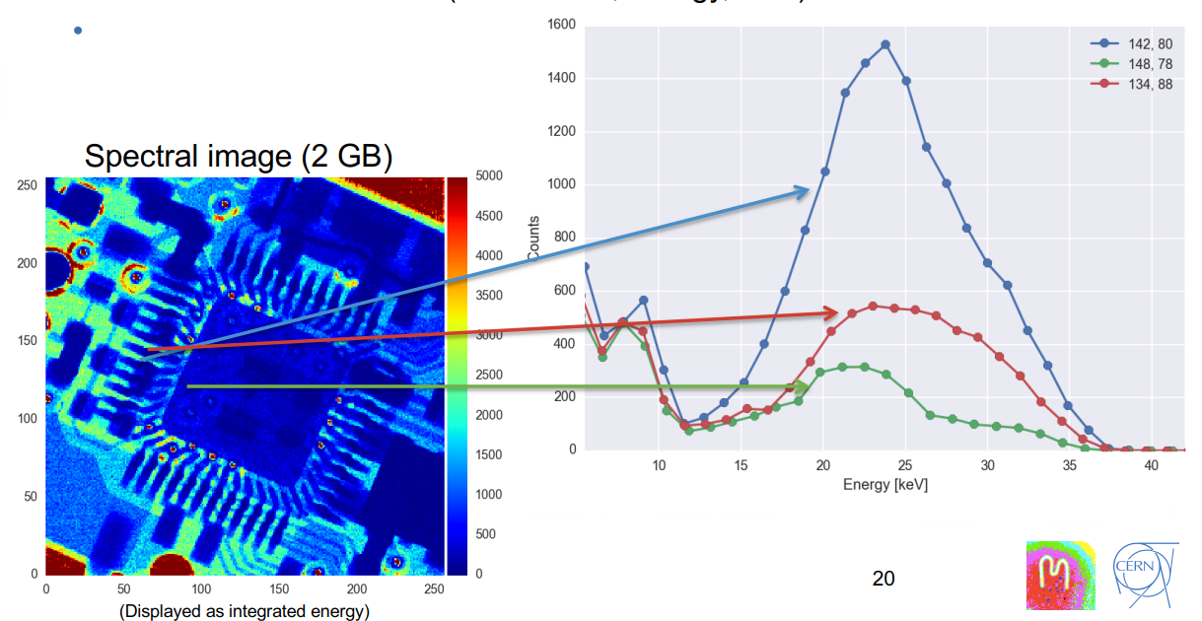
ToT digitization: Timepix3 chip
T. Poikela et al. "Timepix3: a 65K channel hybrid pixel readout chip with simultaneous ToA/ToT and sparse readout" JINST 9 C05013, 2014.
Notes:
The amount of data to create an image is very big because we have the information of every photon and we can build histograms per pixel.
Applications: Particle tracking by time stamping and measurement of the total deposited charge (e.g. Radiation and beam monitors, dosimetry, gas detectors, HEP TPC readout, HEP prototype for vertex detector)
Developed in the framework of the Medipix3 collaboration (design effort between CERN, Bonn university and Nikhef)
256x256 pixel matrix, 55x55μm² pixels
CMOS 0.13μm technology
Simultaneous measurement of ToA and ToT per event (48bits/event)
Packet-based data-driven readout (small readout associated dead time of 375ns)
Maximum dead time free hit rate of 40 10⁶ hits/s/cm²
Programmable shutdown/wake-up feature for the front-end (analog domain) and/or general clock gating (digital domain)
Maximum output data bandwidth of 5.12Gbps
Schematic:
Preamplifier.
Discriminator.
Synchronization logic to synchronize the asynchronous hits to the on-pixel clock.
Clock gating to reduce dynamic power consumption of inactive pixels.
14-bit time stamp register.
10-bit LFSR counter for Time-over-Threshold
Logic.
The SP (super-pixel-logic) is shared by 8 pixels.
Intra –SP token ring
Data are shifted from a selected pixel into a deserializer in the superpixel and written into a buffer for readout.
Each SP accesses the column by using token-ring arbitration.
Data driven

Slide 57
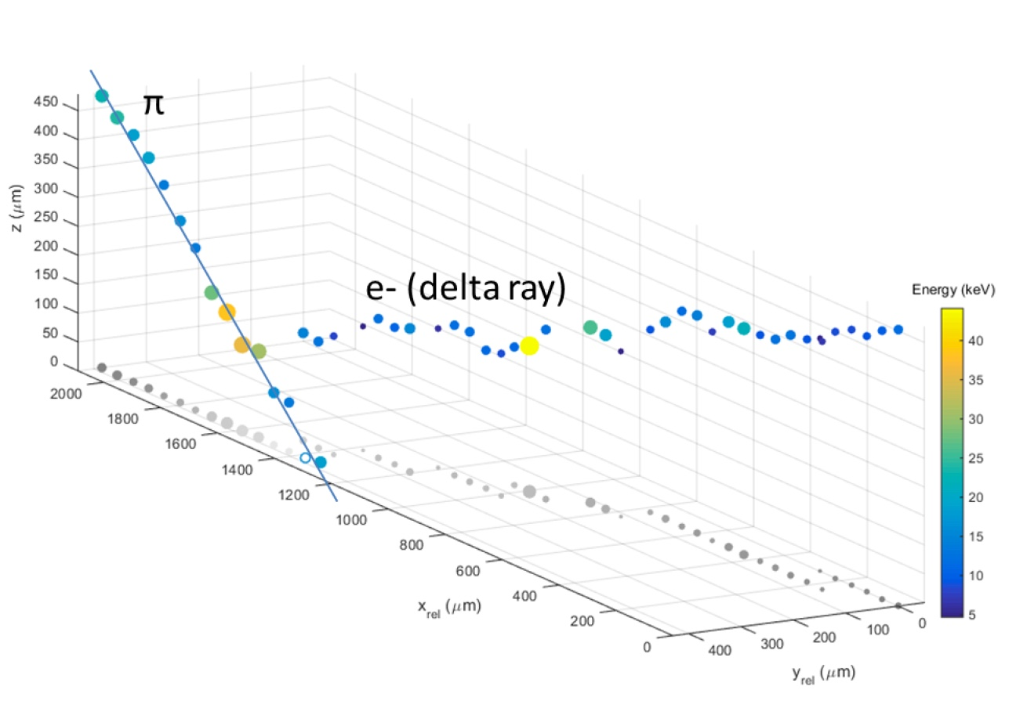
Test with 120GeV/c Pion Track
p+ in n Si sensor
500μm thick
V_{bias} = 130V
Sensor volume
Time information used to determine interaction depth
Colour (and diameter) indicate energy deposited
Measured z resolution ~50μm
Slide courtesy of B. Bergmann, S. Pospisil, IEAP, CTU, Prague
Notes:
This represents the volume of the detector
Based on the energy and time of arrival we can reconstruct the 3d track of a particle (pion) passing through the detector and generating a delta electron.
(based on the drift time)
3D track reconstructed based on the time information recorded on the pixel (because the charge cloud, once it is generated in the sensor volume, it takes some time to drift to the collection electrodes in the pixels).

Slide 58
Digitization off-pixel: The Hexitec ASIC
Developed in the framework of the HEXITEC collaboration by RAL (STFC)
80x80 pixel matrix, 250x250μm² pixels, 0.35μm CMOS
Peak detector on pixel, digitization off-chip
L. Jones et al., “HEXITEC ASIC- a pixelated readout chip for CZT detectors” Nuclear Instruments and Methods in Physics Research A 604(2009)34–37.
Acknowledgements: M. Wilson
Notes:
80x80 pixels
4 groups of 20 columns each
Multiplexed and read out in parallel by a 20MHz 12 bit ADC
Readout time in rolling shutter is 20 columns x 80 rows x 50ns
10K frames/s

Slide 59
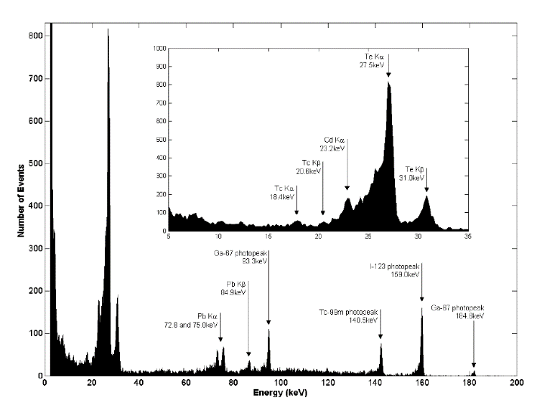
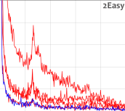
Digitization off-pixel: The Hexitec ASIC
Measure the energy and position of every photon
3-200keV, no thresholds, no counting.
10kHz Frame Rate (rolling shutter)
~25k photons/s/mm² and correct for charge sharing
800eV FWHM @ 60keV, 1.1keV FWHM @ 141keV
L. Jones et al., “HEXITEC ASIC- a pixelated readout chip for CZT detectors” Nuclear Instruments and Methods in Physics Research A 604(2009)34–37.
Acknowledgements: M. Wilson
Notes:
Rolling shutter is a method of image capture in which a still picture (in a still camera) or each frame of a video (in a video camera) is captured not by taking a snapshot of the entire scene at single instant in time but rather by scanning across the scene rapidly, either vertically or horizontally. In other words, not all parts of the image of the scene are recorded at exactly the same instant. (Though, during playback, the entire image of the scene is displayed at once, as if it represents a single instant in time.) This produces predictable distortions of fast-moving objects or rapid flashes of light. This is in contrast with "global shutter" in which the entire frame is captured at the same instant.

Slide 60
Count-rate

Slide 61
Maximum count rates (Mcps/mm²) vs pixel size (μm)
PXF40 (AGH) 18x24 pixel matrix @100μm pitch
(measurement @8keV monochromatic)
IBEX (Dectris) 256x256 pixel matrix @75μm pitch
Instant Retrigger technology
Timepix3 (CERN)
(In data driven mode: coordinates, 10 bits energy, 18 bits time of interaction per event)
Hexitec (STFC)
12
Notes:
Maximum count rates in Million counts per second per millimeter square as a function of the pixel size.
The maximum count-rates correspond to the input flux at which the output count-rate saturates which corresponds, for the particular case of the paralyzable model, to the inverse of the dead time. Beyond this value it is no longer possible to linearize the count-rate, resulting in ambiguous and therefore inconsistent datasets.
Red dots: Hybrid pixel detectors.
Blue dots: non-hybridized systems.
Dashed line is a guide for the eye that corresponds to a count rate=10Mcps/mm^2
We can observe that increasing segmentation helps to deal with increased fluxes.
Please note that:
Reported measurement values not taken as absolute values for comparison but should be used to identify trends and performance envelopes
For example, count rate depends on measurement conditions (energy of the incoming radiation (monochromatic-polychromatic) and on the threshold level programmed on the ASIC) (Not all the chips where measured in the same conditions)
New chips in the table (wrt 2016)
We also discussed about the Timepix3 and the Hexitec whereby the digitization is done in 10-14 bits for spectroscopy or tracking applications.

Slide 62
Maximum count rates (Mcps/mm²) vs pixel size (μm)
KTH_Lin_SPD (Edge-on Si strip)
Royal Institute of technology Stockholm
Electrical engineering Linkoping
SP Devices AB
z
γ
y
x
Segmentation x16 in z direction
M. Gustavsson et al. "A high-rate Resolving Photon Counting ASIC for Spectral Computed Tomography" , IEEE Trans Nucl. Sci, Vol. 59, No. 1, Feb 2012.
15
Notes:
Another Outlier: 38 Implementation by the group from Matts Danielsson
All systems, the segmentation is in the plane perpendicular to the beam.
In this approach segmentation is also done in the z direction.

Slide 63
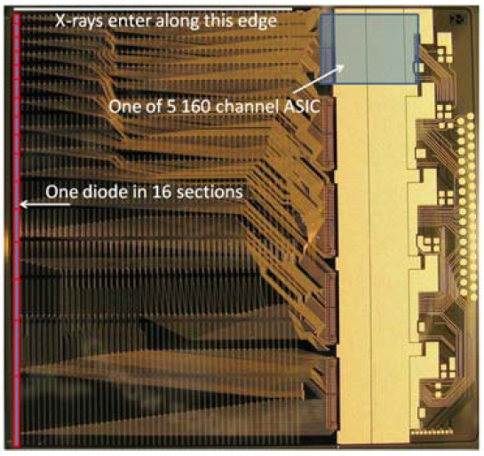
KTH_Lin_SPD ASIC
X-rays
0.4x0.5mm detector element size
1 detector module has 50 Si strips (edge-on-geometry)
1 strip is divided into 16 segments
800 channels per module (8 thresholds)
1500 modules in a full system
Segmentation in the direction of the X-rays increases the maximum flux the system can deal with
Longer segments (~4.8mm) together with complicated wiring increase the input capacitance of the readout channel (~3pF)
M. Gustavsson et al. "A high-rate Resolving Photon Counting ASIC for Spectral Computed Tomography" , IEEE Trans Nucl. Sci, Vol. 59, No. 1, Feb 2012.
Notes:
The detector is built up from stacked silicon wafers with a depth of 32 mm and thickness of 500 μm separated by 20 μm sheaths of tungsten. The pixel size is 0.4 × 0.5 mm2. Figure 1 shows the basic layout of the detector. Part of the lower level strips will be obscured by the tungsten shielding of the upper level, resulting in a geometric detection efficiency of 0.98 (figure B1). No scatter grid is applied; instead the intrinsic scatter rejection from the sheaths is used.
To mitigate the flux rate problem, the detector is divided into 16 segments along the x-ray direction with an individual charge sensing channel with N = 8 energy thresholds connected to each segment. Such segmentation has been proposed by others before to overcome the issue of high count rates, for instance by Tkaczyk et al (2007). The height of the segments are exponentially increasing, ensuring uniform count rates.

Slide 64
KTH_Lin_SPD ASIC
M. Danielsson “A Silicon Strip Detector for Photon Counting Spectral Computed Tomography” Presentation at the 3rd Workshop on Medical Applications of Spectroscopic X-ray detectors

Slide 65
Power consumption versus channel density
Above 1W/cm² active cooling has to be implemented
(38) An effective sensor channel is read out by 16 readout channels (moreover high input capacitance due to interconnects)
Notes:
0.1W/cm2 corresponds roughly to the limiting heat flux that can be removed by natural air convection with 10oC temperature rise.
La convecció és una de les tres formes de transferència de calor i es caracteritza pel fet que aquesta es produeix a través del desplaçament de matèria entre regions amb diferents temperatures. La convecció es produeix únicament en materials fluids. Quan s'escalfen disminueix la seva densitat i ascendeixen al ser desplaçats per les porcions a menor temperatura que, al mateix temps, descendeixen i s'escalfen repetint el cicle. El resultat és el transport de calor per mitjà de les parcel·les de fluid ascendent i descendent. La transferència de calor implica el transport de calor en un volum i la barreja d'elements macroscòpics de porcions calentes i fredes d'un gas o un líquid. S'inclou també l'intercanvi d'energia entre una superfície sòlida i un fluid.
En la transferència de calor per convecció forçada es provoca el flux d'un fluid sobre una superfície sòlida per mitjà d'una força externa com per exemple una bomba, un ventilador o altre dispositiu mecànic.
En la transferència de calor per convecció lliure o natural en la qual un fluid és més calent o més fred i en contacte amb una superfície sòlida causa una circulació a causa de les diferències de densitat que resulten del gradient de temperatures en el fluid.
Els mecanismes de transferència d'energia tèrmica són:
Conducció
Convecció
Radiació
It is likely that front-end electronics power dissipation will limit the achievable pixel density of proposed fine-grain detectors. To realize the low noise possibilities of pixel detectors with low-capacitance electrodes, the electronics must be located in close proximity to the detector. Detector temperature usually has to be controlled and kept at or below room temperature to prevent undesirable leakage currents or thermally induced gain inhomogeneity. Therefore, available cooling technology must be considered when high density pixel electronics is designed.
Fig. 2 shows the allowed power dissipation per pixel versus pixel density, for three overall power density levels. The lowest level, 0.1Wcm2, corresponds roughly to the limiting heat flux that can be removed by natural air convection with 10°C temperature rise [16]. At the highest level, 10W/cm2, forced liquid cooling is required to limit the temperature rise to less than 10°C. It can be seen that as pixel densities exceed 10^4, the electronics power budget will have to be at the microwatt per channel level to avoid exotic cooling schemes.

Slide 66
The trend shows that reducing the pixel size helps dealing with higher fluxes
(28) ChromAIX1 (2010)
(33) ChromAIX2 (2017)
Simulation 80keV photons, 2mm CdTe, -800V, 100e- r.m.s. noise (no threshold dispersion, no charge trapping)
In order to do spectroscopy at fine pitches a charge reconstruction and hit allocation architecture is required.
Acknowledgements for simulations on sensor physics: D. Pennicard (DESY), L. Tlustos (CERN)
Notes:
When decreasing the pixel pitch, the distortion in the energy spectrum due to charge sharing and fluorescence photons in high-Z materials increases.
When the pixel pitch is decreased from 1mm to 500um the amplitude of the main peak (at 80keV) is decreased. At the same time the peak from the fluorescence photons and escape peaks increase in magnitude.
When decreasing the pixel pitch further to 100um, the charge sharing tail is clearly visible.
For pixel pitches below 100um the energy information contained in the incoming beam is lost.
The larger pixels in the ChromAIX2 ensure better energy response as it is less affected by charge sharing and fluorescence

Slide 67
What is the upper limit (in 2D laid out) detectors?
The lower limit on τ depends on the time required by the analog front-end to integrate the charge
Notes:
1/tau (dead time) is the maximum count rate that the electronics channel can deal with (counts/hits per second).
Then we normalize to the pixel area
This corresponds to the incoming photon rate at which the output count-rate shows a maximum.
The lower limit on ταυ depends on the time required by the analog front-end to integrate the charge delivered by the sensor. If the integration time is too small we might end up having ballistic deficit (which corresponds to the loss of signal amplitude at the shaper output due to an incomplete integration of the sensor signal by the readout electronics).
The ultimate limit for tau (the dead time) depends on the sensor collection time which at the same time depends on the detector geometry (in particular on the sensor thickness and on the pixel pitch).
Ballistic deficit refers to the loss of signal amplitude at the shaper output due to an incomplete integration of the sensor signal by the readout electronics

Slide 68
Signal induction in the pixel electrodes
γ
Signal shape depends on detector geometry
Time to integrate a given percentage of the charge
Pixel pitch
1mm
 | t_{90%} | t_{97.5%}
50μm | 2.4ns | 13.5ns
300μm | 14.7ns | 38.2ns
1mm CdTe
60keV photon
600V sensor bias
Energy deposition at z=240μm
(No charge trapping, charge sharing or fluorescence included in simulation)
We assume t_{X%}=t_{p} and τ=2τ_{p}
Notes:
We can see in the
z=240υm equals the mean free path of the photon.
First order calculation (dead time =2x peaking time (symmetric pulse)

Slide 69
(2) Medipix3 110u (SPM)
(24) Siemens PC
(1) Medipix3 55u (SPM)
(28) Philips Chromaix1
(33) Philips Chromaix2
(2) Medipix3 55u (CSM)
(2) Medipix3 110u (CSM)
(3) Timepix3
Notes:
Industry (for CT): trade off between count rate and spectrum fidelity.
We are in the region with spectroscopy at fine pixel pitch.

Slide 70
Timepix4 in Data-driven
Medipix4 CSM, Spectroscopic
Timepix4 in Data-driven

Slide 71
Charge reconstruction and hit allocation architectures

Slide 72
The trend shows that reducing the pixel size helps dealing with higher fluxes
Simulation 80keV photons, 2mm CdTe, -800V, 100e- r.m.s. noise (no threshold dispersion, no charge trapping)
In order to do spectroscopy at fine pitches a charge reconstruction and hit allocation architecture is required.
Acknowledgements for simulations on sensor physics: D. Pennicard (DESY), L. Tlustos (CERN)
Notes:
When decreasing the pixel pitch, the distortion in the energy spectrum due to charge sharing and fluorescence photons in high-Z materials increases.
When the pixel pitch is decreased from 1mm to 500um the amplitude of the main peak (at 80keV) is decreased. At the same time the peak from the fluorescence photons and escape peaks increase in magnitude.
When decreasing the pixel pitch further to 100um, the charge sharing tail is clearly visible.
For pixel pitches below 100um the energy information contained in the incoming beam is lost.

Slide 73
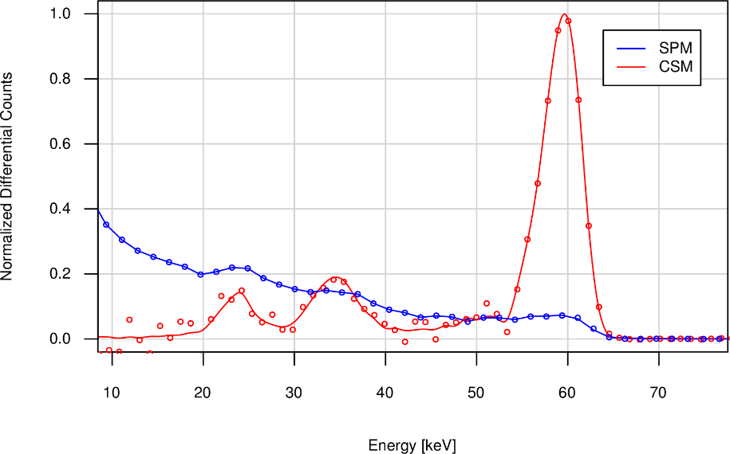
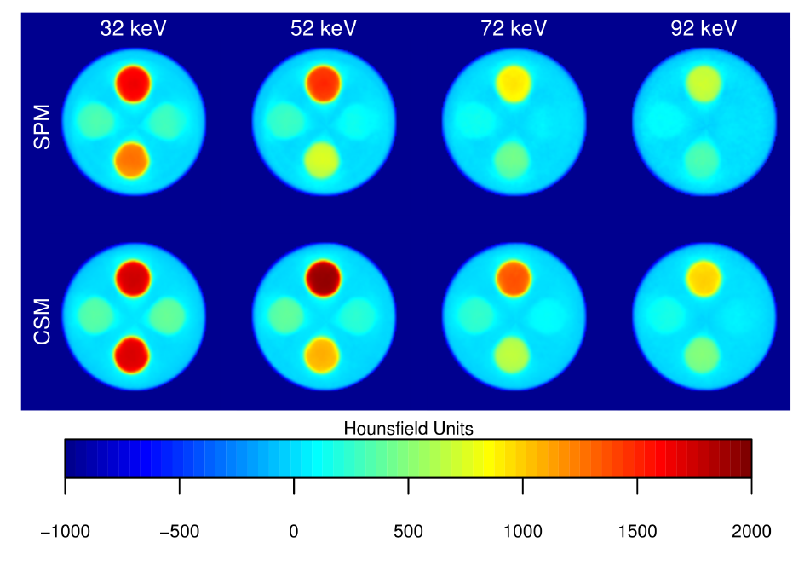
Measurement (60keV, 110μm pitch, 2mm CdTe)
Measured energy spectrum in Single Pixel Mode and in Charge Summing Mode
60keV, 2mm CdTe, 110μm pitch
Fluorescence photons are included in charge sum if their deposition takes place within the volume of the pixels neighbouring the initial deposition
~4.4KeV FWHM
Ga K-edge can be identified in CSM images
SNR higher in CSM for the higher energy thresholds
Gd
Other chips have applied architectures for addressing the impact of charge sharing and fluorescence: Pixie III by Pixirad, X-Counter PC (PDT25-DE), AGH-Fermilab and MultiX-CEA.
I
Measurements: T. Koenig
Notes:
CT of a phantom
0.15s acquisition
720 projections
Reduced SNR can be observed for the high threshold in SPM which is related to the reduced DQE (less reduction in CSM)
Different contrast in SPM and CSM.
The K-edge of gadolinium (50.2KeV) can be discovered in the CSM images (this is not the case for the SPM images)
The gain in CSM amounts to 45% for the iodine and 30% for gadolinium solutions compared to pmma.

Slide 74
Detector tiling

Slide 75
Detector tiling on traditional designs
periphery
periphery
periphery
periphery
matrix
matrix
matrix
matrix
y
matrix
matrix
matrix
matrix
x
periphery
periphery
periphery
periphery
sensor
Readout chips are organized in Pixel Matrix and Chip Periphery
2 chips can be tiled seamlessly in the y direction
N chips can be tiled seamlessly in the x direction (yield and wafer size limits N)
In Medipix 3 we designed the chip “TSV ready”
See S. Vahanen presentation
Notes:
However the chip size is limited by the reticle size (the reticle contains the pattern to be transferred to the silicon).
Usually Hybrid Pixel Detectors contain 2 regions: 1 the sensitive matrix and the periphery where there are the I/O pads, bias references (Bandgaps, DACs) and I/O logic.
In the slide we can see an arrangement in which chips can be tiled seamlessly on 3 sides but to build larger modules one would have “insensitive regions”. To minimize that we have been exploring TSVs. (Through Silicon Via Technology).
A reticle is usually used in the front-end process of semiconductor fabrication. A pattern to be transferred to silicon wafers is produced by chrome etching on a glass plate. The pattern is transferred to wafers through an exposure device.

Slide 76
Through Silicon Vias on the Medipix3RX ASIC
In Timepix4 and Medipix4 the periphery dead area will be suppressed by integrating its circuitry underneath the pads.

Slide 77
TSVs diameter 1.2um
VIPIC1 (Vertically Integrated Photon Imaging Chip)
Signal processing on 2 ASICs
80μm pixel pitch, 64x64 pixels, bonding interface ~50 pads/pixel (4μm pitch for the interconnections)
Notes:
Cu-Cu thermocompression
Cu DBI (direct bonding interconnect) method

Slide 78
Summary and conclusions

Slide 79
Summary and conclusions
We presented hybrid pixel detectors, classification and limitations
A review of ASICs was presented
Segmenting in x, y (and z!) helps dealing with higher fluxes but the measured energy spectrum is degraded due to charge sharing and fluorescence
Charge reconstruction and hit allocation algorithms are needed to do spectroscopic measurements at fine pitches
A trade off between segmentation, count rate and ballistic deficit (which has an impact energy resolution) exists for the more demanding applications
After positive results with TSV technology we started designing chip architectures to allow detectors to be tiled seamlessly on 4 sides
The Medipix collaborations are science-driven and the essence of our chips is:
  “To obtain spectroscopic information at fine pixel pitches”

Slide 80
References
Medipix3RX
[BAL05] R. Ballabriga et al. IEEE Trans. Nucl. Sci. 54, No 5, pp.1824-1829 (2005).
[BAL13] R. Ballabriga et al. "The Medipix3RX: a high resolution, zero dead-time pixel detector readout chip allowing spectroscopic imaging" JINST 8 C02016 (2013).
[CAM05] M. Campbell et al. “Method for determining a particle and sensor device therefor”. Patent granted in the US (US7667205).
E. Frojdh et al. “Count rate linearity and spectral response of the Medipix3RX chip coupled to a 300µm silicon sensor under high flux conditions”, JINST 9 C04028, April 2014.
Timepix3
[POI14] T. Poikela et al. "Timepix3: a 65K channel hybrid pixel readout chip with simultaneous ToA/ToT and sparse readout" JINST 9 C05013, 2014.
Pixirad Pixie II
R Bellazzini et al., "Chromatic X-ray imaging with a fine pitch CdTe sensor coupled to a large area photon counting pixel ASIC" JINST 8 C02028 (2013).
Samsung
H. S. Kim et al. Solid-State Circuits Conference Digest of Technical Papers (ISSCC), 2012 IEEE International pp. 110-112 (2012).
Pixirad Pixie III
R Bellazzini et al., "PIXIE III: a very large area photon-counting CMOS pixel ASIC for sharp X-ray spectral imaging" JINST 10 C01032 (2015).
Eiger chip
V. Radicci et al. "EIGER a new single photon counting detector for X-ray applications: performance of the chip" 2012 JINST 7 C02019.
PXD23K
P. Maj et al. "23552-channel IC for single photon counting pixel detectors with 75 um pitch, ENC of 89e- rms, 19 e- rms offset spread and 3% rms gain spread" IEEE Trans. Nucl. Sci. 2014 IEEE.

Slide 81
References
X-Counter PC (PDT25-DE)
C. Ullberg et al. Physics of Medical Imaging, Proc. of SPIE Vol. 8668 86680P-1.
PXD18K
R. Szczygiel et al. "PXD18k Fast Single Photon Counting Chip with Energy Window for Hybrid Pixel Detector" 2011 IEEE NSS conf. record.
FPDR90
R. Szcygiel et al. "FPDR90- A Low Noise, Fast Pixel Readout Chip in 90nm CMOS Technology" IEEE Trans. Nucl. Sci., Vol. 58, No. 3, June 2011.
AGH-Fermilab
P. Maj et al. "Measurements of Matching and Noise Performance of a Prototype Readout Chip in 40nm CMOS process for Hybrid Pixel Detectors" IEEE transactions on Nucl. Sci., Vol. 62, No. 1, February 2015.
XPAD3
P. Pangaud et al. Nuclear Instruments and Methods in Physics Research A 571 (2007) 321–324.
P Delpierre "A history of hybrid pixel detectors, from high energy physics to medical imaging" JINST 9 C05059 (2014).
Pilatus2
P. Kraft, "Characterization of the Readout Chip for the PILATUS 6M Detector", ETHZ-IPP Internal Report 2005-03 (March 2003).
P. Kraft "Characterization and Calibration of PILATUS Detectors" IEEE Trans. Nucl. Sci., Vol. 56, No. 3, 2009.
Pilatus 3
T. Loeliger et al. Nuclear Science Symposium and Medical Imaging Conference (NSS/MIC), 2012 IEEE Conf. Record. pp. 610-615 (2012).
Telesystems
K. Ogawa et al. Development of an energy binned photon counting detector for X-ray and gamma-ray imaging, NIM A 664 (2012) 29-37.

Slide 82
References
Dosepix (CERN)
W. Wong "A Hybrid Pixel Detector ASIC with Energy Binning for Real-Time, Spectroscopic Dose Measurement" Doctoral thesis, Mid Sweden University, 2012.
Siemens PC
S. Kappler et al. “A research prototype system for quantum-counting clinical CT,” in Medical Imaging 2010: Physics of Medical Imaging (SPIE, San Diego, CA, 2010), Vol. 7622, pp. 76221Z-6 (2010).
S. Kappler et al. "Quantum-counting CT in the regime of count-rate paralysis: introduction of the pile-up trigger method" Proc. SPIE 7961 Physics of Medical Imaging, 79610T (2011).
E. Kraft et al. "Experimental evaluation of the pile-up trigger method in a revised quantum-counting CT detector" Proc. SPIE 8313, Medical Imaging 2012: Physics of Medical Imaging, 83134A (2012).
S. Kappler et al., “First results from a hybrid prototype CT scanner for exploring benefits of quantum-counting in clinical CT,” Proc. SPIE 8313, 83130X (2012).
Hexitec
L. Jones et al., “HEXITEC ASIC- a pixelated readout chip for CZT detectors” Nuclear Instruments and Methods in Physics Research A 604(2009)34–37.
Philips ChromAIX
R. Steadman, “ChromAIX: A high-rate energy resolving photon-counting ASIC for Spectral Computed Tomography” Proc. SPIE 7622, 762220–762228 (2010).
Ajat 0.35
L. J. Meng et al. "Preliminary evaluation of a novel energy-resolved photon-counting gamma ray detector" NIM A 604 (2009) 548-554.
H. M. Cho et al. "The effects of photon flux on energy spectra and imaging characteristics in a photon-counting X-ray detector" Phys. Med. Biol. 58 (2013) 4865-4879.
CIX 0.2
E. Kraft IEEE Trans. Nucl. Sci. 54, 383–390 (2007).

Slide 83
References
KTH_LIN_SP Devices
C. Xu et al. "Evaluation of a Second-Generation Ultra-Fast Energy-Resolved ASIC for Photon-Counting Spectral CT IEEE Trans. Nucl. Sci, Vol. 60, No. 1, Feb. 2013.
M. Gustavsson et al. "A high-rate Resolving Photon Counting ASIC for Spectral Computed Tomography" , IEEE Trans Nucl. Sci, Vol. 59, No. 1, Feb 2012.
DxRay-Interon
W. C. Barber et al. "High Flux Energy-Resolved Photon-Counting X-Ray Imaging Arrays with CdTe and CdZnTe for Clinical CT"
W. C. Barber et al. "Photon Counting energy resolving CdTe detectors for high-flux X-ray imaging" Nuclear Science Symposium Conference Record (NSS/MIC), 2010 IEEE.
Ajat-0.5
K. Spartiotis et al. “A photon counting CdTe gamma- and X-ray camera” NIM A 550 (2005) 267-277.
Hamamatsu
Y. Tomita et al. "X-ray Color Scanner with Multiple Energy Differentiate Capability" Nuclear Science Symposium Conference Record, 2004 IEEE. Page(s): 3733 - 3737 Vol. 6 .
IDEAS
S. Mikkelsen et al. "An ASIC for Multi-Energy X-ray Counting" 2008 IEEE Nucl. Sci. Symp. Conference record.
GE-DxRay
J. S. Iwanczyk et al. "Photon Counting Energy Dispersive Detector Arrays for X-ray Imaging", IEEE Trans Nucl Sci. 2009 ; 56(3): 535–542. doi:10.1109/TNS.2009.2013709.
BNL
G. De Geronimo et al. "ASIC with multiple Energy discrimination for High-Rate Photon Counting Applications" IEEE Trans on Nucl. Sci. Vol. 54, No. 2, April 2007.

Slide 84
References (since July 2016)
IBEX
M. Bochenek et al. "IBEX: Versatile Readout ASIC With Spectral Imaging Capability and High Count Rate Capability" IEEE Transactions on Nuclear Science ( Volume: 65, Issue: 6, June 2018 ).
UFXC32K
Grybos P., et al., “32k Channels readout IC for single photon counting detectors with 75 µm pitch, ENC of 123 e− rms, 9 e− rms offset spread and 2% rms gain spread”, IEEE Trans. Nucl. Sci., vol. 63, no. 2, April 2016, pp. 1155-1161.
PXF40
Kleczek R., et al., “Ultrafast signal processing readout front-end electronics in CMOS 40 nm technology for hybrid pixel detectors operating in Single Photon Counting mode”, Proc. of 2017 International Image Sensor Workshop, Hiroshima, 30 May – 2 June, 2017.
HEPS-BPIX
W. Wei et al. "HEPS-BPIX, a single photon counting pixel detector with a high frame rate for the HEPS project", Nuclear Instruments and Methods in Physics Research A 835 (2016) 169–176.
D2R1
D. Baudin et al. "D²R1: A 2-Dimensional X-Ray Detector for CdTe Based Fine Pitch and High Energy Resolution Imaging Spectroscopy" TNS-00227-2018
Philips ChromAIX2
R. Steadman et al. ChromAIX2: A large area, high count-rate energy-resolving photon counting ASIC for a Spectral CT Prototype. NIMA Volume 862, 1 August 2017, Pages 18-24.
CEA-Multix
A. Peizerat et al. "A 256 energy bin spectrum X-Ray photon-counting Image Sensor providing 8 Mcounts/s/pixel and on-chip charge sharing, charge induction and pile-up corrections " 2017 Symposium on VLSI Circuits Digest of Technical Papers.
J. P. Rostaing, et al, Electronics Letters, vol. 52, no. 6, pp. 428-430, 2016.

Slide 85
Additional slides

Slide 86
M. Hoheisel
Notes:
Many applications (like medical imaging or synchrotron applications) require large detection areas
http://www.esrf.eu/files/live/sites/www/files/events/conferences/2005/IWORID7/FinalProgramme/hoheisel_1.pdf

Slide 87
Limiting factors in real systems degrading energy resolution and count rate
Notes:
Say: These factors affect the mainly energy resolution and the count rate

Slide 88
1. Absorption efficiency
4. Fluorescence
5. Compton scattering
6. Charge trapping
7. Polarization
2. Fluctuations in the number of generated carriers
3. Charge diffusion
Notes:
Limiting factors in the sensor (Thesis folder / HybridPixelDetectorScheme2)
Thesis folder / HybridPixelDetectorScheme2
SENSOR
Absorption efficiency (probability that the X-ray photon will be removed from the beam in the absorber of a given thickness)
Fluctuations in the number of generated charge carriers
Photoelectron interacts with electrons in material
Energy losses occur both to ionizing processes (result in charge) and non-ionizing processes (multiple mechanisms reduce statistical spread)
Fluctuations represent a lower limit for the achievable energy resolution
Charge diffusion
Partial charge deposition due to Fluorescence and Compton Scattering
Charge trapping in the semiconductor material:
reduction of the signal in the electrodes
The mobility lifetime product of the carrier determines the trapping length (usually higher for electrons than holes)
If a detector has small pixels the carriers drifting to the readout electrodes will induce most of the total signal
Other defects in the crystal (like grain boundaries) can also lead to trapping and charge carrier loss
Sensor polarization
Time-dependent decrease of the count-rate and charge collection eﬃciency due to trapping and detrapping of the carriers within the crystal that aﬀect the electric ﬁeld proﬁle in the detector.
It is possible to minimize the polarization eﬀects by using high bias voltages and low temperature operation.
Good reliability of CdZnTe has been recently reported and systems with such detectors are commercially available.
INTERFACE
Ballistic deficit
Ballistic deficit refers to the loss of signal amplitude at the shaper output due to an incomplete integration of the sensor signal by the readout electronics.
READOUT
Electronics noise
Noise is a random process inherent to the conduction of current in devices that limits the minimum signal level that a circuit can process with acceptable quality
Cross talk
Threshold offset and gain dispersion between pixels
Pulse pile-up leads to a reduction of the event counts and an incorrect/distorted measurement of the energy
Polarization: causes a change in the detector’s performance after biasing the sensor, and leads to a reduction in the count rate over time and loss of charge collection efficiency.
Polarization arises from trapping and de-trapping of ionized deep level acceptors within the crystal which affects the space-charge and the electric field distribution.
Time-dependent decrease in the counting rate and charge collection efficiency due to electron capture in the material.
Polarization is a phenomenon occuring in semiconductor detectors that leads to a time-dependent decrease of the count-rate and charge collection efficiency [9]. It happens due to trapping and detrapping [23] of the carriers within the crystal that affect the electric field profile in the detector. The sensor design must be such that the charge generated by the X-ray photon is removed from the device at sufficiently high rate through both drift and recombination. It is possible to minimize the polarization effects by using high bias voltages and low temperature operation [31]. Good reliability of CdZnTe has been recently reported and systems with such detectors are commercially available [23].
Discussion with CdTe Ohmic vs Schottky
Ohmic:
Higher leakage current (but can be compensated with a proper leakage current compensation network in the pixel)
Less defects for imaging (i.e. better for imaging with photon counting detectors).
A bit more noise (due to increased leakage current)
Schottky
Lower leakage current (i.e. this type is required for integrating front-ends)
More defects for imaging (dead pixels / anomalously high leakage current / grain boundaries)

Slide 89
8. Ballistic deficit
11. Cross-talk
-A
-A
Channel i
9. Offset mismatch, Gain mismatch and random noise
10. Pulse pile-up
Pile-up
Notes:
Limiting factors in the sensor-electronics interface and in the electronics
Thesis folder
HybridPixelDetectorScheme2

Slide 90
1. Absorption efficiency
Notes:
Thesis folder / HybridPixelDetectorScheme2
SENSOR
Absorption efficiency (probability that the X-ray photon will be removed from the beam in the absorber of a given thickness)
Fluctuations in the number of generated charge carriers
Charge diffusion
Partial charge deposition due to Fluorescence and Compton Scattering
Charge trapping in the semiconductor material:
reduction of the signal in the electrodes
Other defects in the crystal can also lead to trapping and charge carrier loss
Sensor polarization
INTERFACE
Ballistic deficit
READOUT
Electronics noise
Cross talk
Threshold offset and gain dispersion between pixels
Pulse pile-up
Polarization: causes a change in the detector’s performance after biasing the sensor, and leads to a reduction in the count rate over time and loss of charge collection efficiency.
Polarization arises from trapping and de-trapping of ionized deep level acceptors within the crystal which affects the space-charge and the electric field distribution.
Time-dependent decrease in the counting rate and charge collection efficiency due to electron capture in the material.
Polarization is a phenomenon occuring in semiconductor detectors that leads to a time-dependent decrease of the count-rate and charge collection efficiency [9]. It happens due to trapping and detrapping [23] of the carriers within the crystal that affect the electric field profile in the detector. The sensor design must be such that the charge generated by the X-ray photon is removed from the device at sufficiently high rate through both drift and recombination. It is possible to minimize the polarization effects by using high bias voltages and low temperature operation [31]. Good reliability of CdZnTe has been recently reported and systems with such detectors are commercially available [23].

Slide 91
Absorption efficiency
Silicon (Z=14) ideal for HEP applications
Higher Z required above 20keV
Ge, GaAs, CdTe, CdZnTe
Notes:
Si: low mass, very homogeneous, low price

Slide 92
Absorption efficiency
Silicon (Z=14) ideal for HEP applications
Higher Z required above 20keV
Ge, GaAs, CdTe, CdZnTe

Slide 93
2. Fluctuations in the number of generated carriers
Notes:
Thesis folder / HybridPixelDetectorScheme2
SENSOR
Absorption efficiency (probability that the X-ray photon will be removed from the beam in the absorber of a given thickness)
Fluctuations in the number of generated charge carriers
Charge diffusion
Partial charge deposition due to Fluorescence and Compton Scattering
Charge trapping in the semiconductor material:
reduction of the signal in the electrodes
Other defects in the crystal can also lead to trapping and charge carrier loss
Sensor polarization
INTERFACE
Ballistic deficit
READOUT
Electronics noise
Cross talk
Threshold offset and gain dispersion between pixels
Pulse pile-up
Polarization: causes a change in the detector’s performance after biasing the sensor, and leads to a reduction in the count rate over time and loss of charge collection efficiency.
Polarization arises from trapping and de-trapping of ionized deep level acceptors within the crystal which affects the space-charge and the electric field distribution.
Time-dependent decrease in the counting rate and charge collection efficiency due to electron capture in the material.
Polarization is a phenomenon occuring in semiconductor detectors that leads to a time-dependent decrease of the count-rate and charge collection efficiency [9]. It happens due to trapping and detrapping [23] of the carriers within the crystal that affect the electric field profile in the detector. The sensor design must be such that the charge generated by the X-ray photon is removed from the device at sufficiently high rate through both drift and recombination. It is possible to minimize the polarization effects by using high bias voltages and low temperature operation [31]. Good reliability of CdZnTe has been recently reported and systems with such detectors are commercially available [23].

Slide 94

Fluctuations in the number of generated charge carriers
Photoelectron ionizes atoms creating on average, N electron-hole pairs. The standard deviation of created pairs is
Fluctuations represent a lower limit for the achievable energy resolution. Energy resolution degradation (eV FWHM/e⁻ r.m.s.):
$$σ=\sqrt{NF}$$
E₀ is the absorbed energy, N is the number of generated carriers, F is the Fano Factor (~0.12 Si)
Notes:
Fano Factor CdTe= 0.15
Multiple excitation mechanisms come into play and reduce the overall statistical spread.
For example in semiconductors, absorbed energy forms electron-hole pairs but also excites lattice vibrations (quantized as phonons). Thus, many more excitations are involved than apparent from the charge signal alone and this reduces the statistical fluctuations of the charge signal.

Slide 95
3. Charge diffusion
Notes:
Thesis folder / HybridPixelDetectorScheme2
SENSOR
Absorption efficiency (probability that the X-ray photon will be removed from the beam in the absorber of a given thickness)
Fluctuations in the number of generated charge carriers
Charge diffusion
Partial charge deposition due to Fluorescence and Compton Scattering
Charge trapping in the semiconductor material:
reduction of the signal in the electrodes
Other defects in the crystal can also lead to trapping and charge carrier loss
Sensor polarization
INTERFACE
Ballistic deficit
READOUT
Electronics noise
Cross talk
Threshold offset and gain dispersion between pixels
Pulse pile-up
Polarization: causes a change in the detector’s performance after biasing the sensor, and leads to a reduction in the count rate over time and loss of charge collection efficiency.
Polarization arises from trapping and de-trapping of ionized deep level acceptors within the crystal which affects the space-charge and the electric field distribution.
Time-dependent decrease in the counting rate and charge collection efficiency due to electron capture in the material.
Polarization is a phenomenon occuring in semiconductor detectors that leads to a time-dependent decrease of the count-rate and charge collection efficiency [9]. It happens due to trapping and detrapping [23] of the carriers within the crystal that affect the electric field profile in the detector. The sensor design must be such that the charge generated by the X-ray photon is removed from the device at sufficiently high rate through both drift and recombination. It is possible to minimize the polarization effects by using high bias voltages and low temperature operation [31]. Good reliability of CdZnTe has been recently reported and systems with such detectors are commercially available [23].

Slide 96
Charge diffusion
Diffusion occurs when there are local differences of carrier concentrations in the semiconductor
Gaussian cross section of the distribution with standard deviation:
D: Diffusion coefficient
t: time
Charge density distribution (hole component) (Charges/cm³), Si sensor, deposition at 50um, 4ns and 14ns after conversion (Thesis L. Tlustos)
Notes:
Diffusion occurs when there are local differences of carrier concentrations in the semiconductor. In this case a current is observed from the region of high carrier concentration to the region of low carrier concentration. The density of current is proportional to the gradient of the carrier density and the diffusivity D. In the case of a diffusion current of electrons:

Slide 97
Charge diffusion
Simulated Data
Si 300μm, 55μm pixel
100e⁻ r.m.s. noise
10keV monochromatic photon beam
Distortion in the energy spectrum increases as the pixel pitch decreases with the detector thickness
Simulation: L. Tlustos
Notes:
This is one of the first simulations to validate the new architecture.
It simulates a hybrid pixel detector architecture with a three hundred micrometer thick silicon sensor and fifty five micron pixel pitch.
The simulation was done with a 10keV photon beam.
In blue the spectrum seen by one pixel working independently of its neighbours is shown. Because some of the charge deposited in the sensor is “shared” between pixels, the spectrum seen by one pixel has a low energy tail. The electronic noise of the pixel front end is simulated to be 100e-.
The influence of this effect on the spectrum increases as the pixel pitch is decreased with respect to the thickness of the sensor material.
This charge sharing tail means that any residual threshold variation between pixels produces a fixed pattern which varies with the incoming energy spectrum.
In red the new architecture in which 4 pixels contribute to the total charge sum and the hit is allocated to the circuit with the largest energy deposition. The electronics noise is 200 e- in this case.

Slide 98
Charge diffusion
T=300K
d=2mm
E=500V/mm
E=250V/mm
Notes:
Diffusion occurs when there are local differences of carrier concentrations in the
semiconductor. In this case a current is observed from the region of high carrier
concentration to the region of low carrier concentration. The density of current is
proportional to the gradient of the carrier density and the diffusivity D. In the case of a
diffusion current of electrons:
Percentage of charge within Radius

Slide 99
4. Fluorescence
Notes:
Thesis folder / HybridPixelDetectorScheme2
SENSOR
Absorption efficiency (probability that the X-ray photon will be removed from the beam in the absorber of a given thickness)
Fluctuations in the number of generated charge carriers
Charge diffusion
Partial charge deposition due to Fluorescence and Compton Scattering
Charge trapping in the semiconductor material:
reduction of the signal in the electrodes
Other defects in the crystal can also lead to trapping and charge carrier loss
Sensor polarization
INTERFACE
Ballistic deficit
READOUT
Electronics noise
Cross talk
Threshold offset and gain dispersion between pixels
Pulse pile-up
Polarization: causes a change in the detector’s performance after biasing the sensor, and leads to a reduction in the count rate over time and loss of charge collection efficiency.
Polarization arises from trapping and de-trapping of ionized deep level acceptors within the crystal which affects the space-charge and the electric field distribution.
Time-dependent decrease in the counting rate and charge collection efficiency due to electron capture in the material.
Polarization is a phenomenon occuring in semiconductor detectors that leads to a time-dependent decrease of the count-rate and charge collection efficiency [9]. It happens due to trapping and detrapping [23] of the carriers within the crystal that affect the electric field profile in the detector. The sensor design must be such that the charge generated by the X-ray photon is removed from the device at sufficiently high rate through both drift and recombination. It is possible to minimize the polarization effects by using high bias voltages and low temperature operation [31]. Good reliability of CdZnTe has been recently reported and systems with such detectors are commercially available [23].

Slide 100
Fluorescence
γ
γ_{f}
1.
2.
Primary photon releases photoelectron that loses its energy generating electron-hole pairs
De-excitation of the first atom releases a characteristic photon that will deposit its energy some distance away from the first interaction
Multiple hits can be detected for a single incoming photon
3.
See presentation F. Salvat

Slide 101
Fluorescence
Mean free path of fluorescence photon [μm]
Fluorescence yield [%]
Energy fluorescence photons [keV]
Z
The fluorescence yield increases with the atomic number
The mean free path of the fluorescence photons is in the same order of magnitude as the pixel pitch
Implications: degradation of the energy measurement, blur the image
Table: L. Tlustos, PhD thesis
Notes:
Fluorescence yield is the probability of producing a fluorescence photon after a K-shell electron absorbs an incoming photon.
K_alpha1=K1-L3
K_alpha2=K1-L2
Another important effect in some high-Z materials is charge trapping. Some semiconductor
defects can temporarily trap electrons and holes. So, when a photon hits the detector, some of the
electrons and holes generated by the photon may be trapped as they drift towards the electrodes,
reducing the signal induced on the electrodes.
The effects of trapping are influenced by various factors. The rates at which electrons and
holes are trapped are dependent on the material properties and can be characterised by the electron
and hole trapping lifetimes. If the carriers can be collected more quickly then fewer carriers will
be trapped. So, reducing the sensor thickness, increasing the field strength and using material with
higher carrier mobilities will reduce the effects of trapping. The pixel geometry will also affect the
induced signals; in particular, if a detector has small pixels, then the carriers drifting to the readout
electrodes will induce most of the total signal [12]. If a material has much lower electron trapping
than hole trapping, or vice versa, then this “small pixel effect” can be exploited to improve the
charge collection, by putting the pixel contacts on the appropriate side.
Since germanium is available in wafers of extremely high purity, trapping effects in a finelypixellated
germanium detector will be negligible. While CdTe is affected by charge trapping, the
material quality has improved to the point where lifetime-mobility product is over 110􀀀3cm2=V
for electrons and around 110􀀀4cm2=V for holes [13]. With a typical detector thickness of 1000
m and a bias voltage of 500V, the mean drift distance before trapping would then be at least 5 cm
for electrons and 5 mm for holes, which would result in 2% of the electrons and 18% of the holes
being trapped if they have to drift across the full detector thickness. In a photon counting pixel
detector with electron readout, where holes only make a small contribution to the total signal, the
signal loss from trapping will be small compared to other effects and can be ignored.
GaAs has a relatively high concentration of defects, and one major challenge for developing
GaAs detectors is to produce material with both high resistivity and low trapping. The trapping
parameters of GaAs may vary a great deal depending on how the material is produced. As discussed
in subsection 3.4, this paper focuses on simulating chromium-compensated GaAs [6], which has
shown promising results when bonded to Medipix2 readout chips [14].

Slide 102
5. Compton scattering
Notes:
Thesis folder / HybridPixelDetectorScheme2
SENSOR
Absorption efficiency (probability that the X-ray photon will be removed from the beam in the absorber of a given thickness)
Fluctuations in the number of generated charge carriers
Charge diffusion
Partial charge deposition due to Fluorescence and Compton Scattering
Charge trapping in the semiconductor material:
reduction of the signal in the electrodes
Other defects in the crystal can also lead to trapping and charge carrier loss
Sensor polarization
INTERFACE
Ballistic deficit
READOUT
Electronics noise
Cross talk
Threshold offset and gain dispersion between pixels
Pulse pile-up
Polarization: causes a change in the detector’s performance after biasing the sensor, and leads to a reduction in the count rate over time and loss of charge collection efficiency.
Polarization arises from trapping and de-trapping of ionized deep level acceptors within the crystal which affects the space-charge and the electric field distribution.
Time-dependent decrease in the counting rate and charge collection efficiency due to electron capture in the material.
Polarization is a phenomenon occuring in semiconductor detectors that leads to a time-dependent decrease of the count-rate and charge collection efficiency [9]. It happens due to trapping and detrapping [23] of the carriers within the crystal that affect the electric field profile in the detector. The sensor design must be such that the charge generated by the X-ray photon is removed from the device at sufficiently high rate through both drift and recombination. It is possible to minimize the polarization effects by using high bias voltages and low temperature operation [31]. Good reliability of CdZnTe has been recently reported and systems with such detectors are commercially available [23].

Slide 103
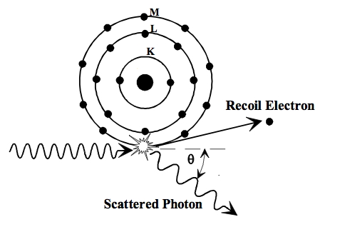
Partial charge deposition due to Compton Scattering
Variable amount of energy transferred to the detector
The scattered photon may be absorbed in another pixel (blurring the image)
Assuming one Compton interaction in the detector
Compton Edge (E_{KMAX})
See presentation F. Salvat
Notes:
Compton Scattering (Inelastic)
Interaction between photon and electron in the absorbing material.
Incoming photon is deflected through an angle with respect to its original direction. (all scattering angles are possible).
Photon transfers a portion of its energy to electron (recoil).
Compton scattering is an example of inelastic scattering because the wavelength of the scattered light is different from the incident radiation.
Inelastic scattering is a fundamental scattering process in which the kinetic energy of an incident particle is not conserved (in contrast to elastic scattering).
In the case of elastic scattering the kinetic energy of a particle is conserved but its direction of propagation is modified.
Conservation of energy and momentum->Relation between energy transfer and the scattering angle.
M0c^2 is the mass rest of the electron (511keV)
The angular distribution is predicted by the Klein Nishina formula
Because the Compton scattering process doesn't occur with equal probability at all scattering angles, the Compton scattering region will usually have a small amount of curvature depending on the energy of the incoming gamma ray.
There is also a finite probability for the scattered gamma ray to undergo additional Compton scattering events before leaving the detector. Since additional energy is left in the detector by these multiple scattering events, this produces a small continuum of counts between the Compton edge and the full energy peak.

Slide 104
Partial charge deposition due to Compton Scattering
Compton Edge (E_{KMAX})
Notes:
Compton Scattering
Interaction between photon and electron in the absorbing material.
Incoming photon is deflected through an angle with respect to its original direction. (all scattering angles are possible).
Photon transfers a portion of its energy to electron (recoil).
Conservation of energy and momentum->Relation between energy transfer and the scattering angle.
M0c^2 is the mass rest of the electron (511keV)
The angular distribution is predicted by the Klein Nishina formula
Because the Compton scattering process doesn't occur with equal probability at all scattering angles, the Compton scattering region will usually have a small amount of curvature depending on the energy of the incoming gamma ray.
There is also a finite probability for the scattered gamma ray to undergo additional Compton scattering events before leaving the detector. Since additional energy is left in the detector by these multiple scattering events, this produces a small continuum of counts between the Compton edge and the full energy peak.

Slide 105
Partial charge deposition due to Compton Scattering
Compton predominant above 57keV
150keV
150keV
265keV

Slide 106
6. Charge trapping
Notes:
Thesis folder / HybridPixelDetectorScheme2
SENSOR
Absorption efficiency (probability that the X-ray photon will be removed from the beam in the absorber of a given thickness)
Fluctuations in the number of generated charge carriers
Charge diffusion
Partial charge deposition due to Fluorescence and Compton Scattering
Charge trapping in the semiconductor material:
reduction of the signal in the electrodes
Other defects in the crystal can also lead to trapping and charge carrier loss
Sensor polarization
INTERFACE
Ballistic deficit
READOUT
Electronics noise
Cross talk
Threshold offset and gain dispersion between pixels
Pulse pile-up
Polarization: causes a change in the detector’s performance after biasing the sensor, and leads to a reduction in the count rate over time and loss of charge collection efficiency.
Polarization arises from trapping and de-trapping of ionized deep level acceptors within the crystal which affects the space-charge and the electric field distribution.
Time-dependent decrease in the counting rate and charge collection efficiency due to electron capture in the material.
Polarization is a phenomenon occuring in semiconductor detectors that leads to a time-dependent decrease of the count-rate and charge collection efficiency [9]. It happens due to trapping and detrapping [23] of the carriers within the crystal that affect the electric field profile in the detector. The sensor design must be such that the charge generated by the X-ray photon is removed from the device at sufficiently high rate through both drift and recombination. It is possible to minimize the polarization effects by using high bias voltages and low temperature operation [31]. Good reliability of CdZnTe has been recently reported and systems with such detectors are commercially available [23].

Slide 107
(
Notes:
Say: These factors affect the mainly energy resolution and the count rate

Slide 108
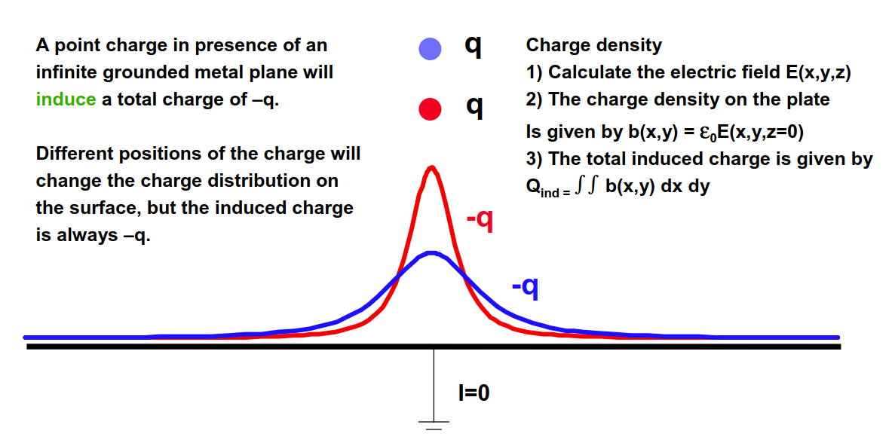
Induced charge on detector electrodes
Signals on detector electrodes arise from motion of charge carriers
Induced current is derived from laws of electrostatics
W. Riegler, CERN
Notes:
MOTION and not COLLECTION of carriers on the electrodes
If a negative charge (-q) “floats” on top of an ideal grounded conductor, this alters the charge distribution at the conductor surface, inducing on it a charge +q of equal magnitude and opposite sign.
If the charge –q is now put closer to the conductor, the total induced charge is always the same but its distribution changes.
By dynamically changing the position of the charge, we change the charge distribution at the conductor surface causing a motion of charges and thus, an electrical current.
This signal is due by induction and it vanishes if the charge –q stops moving or if it lands on the electrode.
Drift field is the electric field that is generated (determined) by the actual potentials in the sensor and it is the responsible for the movement of charge.
The weighting field determines how a moving charge couples to a specific terminal (this is calculated as the electric field in a region in which the electrode of interest is biased at 1V while all other electrodes are grounded).

Slide 109
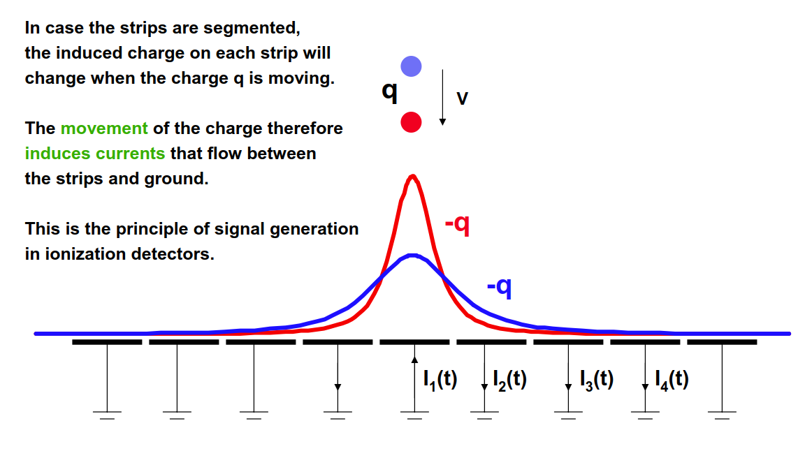
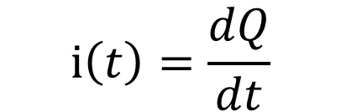
Induced charge on detector electrodes
Signals on detector electrodes arise from motion of charge carriers
Induced current is derived from laws of electrostatics
$$i\left(t\right)=\frac{dQ}{dt}$$
W. Riegler, CERN
Notes:
MOTION and not COLLECTION of carriers on the electrodes
If a negative charge (-q) “floats” on top of an ideal grounded conductor, this alters the charge distribution at the conductor surface, inducing on it a charge +q of equal magnitude and opposite sign.
If the charge –q is now put closer to the conductor, the total induced charge is always the same but its distribution changes.
By dynamically changing the position of the charge, we change the charge distribution at the conductor surface causing a motion of charges and thus, an electrical current.
This signal is due by induction and it vanishes if the charge –q stops moving or if it lands on the electrode.
Drift field is the electric field that is generated (determined) by the actual potentials in the sensor and it is the responsible for the movement of charge.
The weighting field determines how a moving charge couples to a specific terminal (this is calculated as the electric field in a region in which the electrode of interest is biased at 1V while all other electrodes are grounded).

Slide 110



Induced charge on detector electrodes
Method: Shockley-Ramo theorem: the instantaneous current induced on a given electrode is equal to
where q is the charge of the carrier, v is its velocity, E_{w} is the weighting field and E_{d} is the drift field
The induced charge (Q) on the electrode is given by
where Δϕ₀ is the weighting potential from the beginning to the end of the carrier path
$$i\left(t\right)=q\vec{v}∙\vec{E_{w}}$$
$$\vec{v}=μ\vec{E_{d}}$$
$$Q=q∆φ_{0}$$
S.Ramo, Proc. IRE, 27 (1939) p.584
W.Shockley, J. Appl. Phys. 9, 635 (1938)
V. Radeka Ann. Rev. Nucl. Part. Sci. 1988 38: 217-277
Gatti et al., NIMA 193 (1982) 651
Notes:
MOTION and not COLLECTION of carriers on the electrodes
If a negative charge (-q) “floats” on top of an ideal grounded conductor, this alters the charge distribution at the conductor surface, inducing on it a charge +q of equal magnitude and opposite sign.
If the charge –q is now put closer to the conductor, the total induced charge is always the same but its distribution changes.
By dynamically changing the position of the charge, we change the charge distribution at the conductor surface causing a motion of charges and thus, an electrical current.
This signal is due by induction and it vanishes if the charge –q stops moving or if it lands on the electrode.
Drift field is the electric field that is generated (determined) by the actual potentials in the sensor and it is the responsible for the movement of charge.
The weighting field determines how a moving charge couples to a specific terminal (this is calculated as the electric field in a region in which the electrode of interest is biased at 1V while all other electrodes are grounded).

Slide 111


Induced signal on detector electrodes
Example of calculation of the weighting potential in pixelated system
γ
Full planar electrode
e⁻
e⁻
h⁺
Segmented electrode
$$i\left(t\right)=q\vec{v}∙\vec{E_{w}}$$
e⁻
h⁺
β
h⁺
$$Q=q∆φ_{0}$$
interaction
The current signal develops when the “collected” carriers are close to the detector electrodes.
Electron motion contribution: –n₀q(1-β)
Hole motion contribution: n₀q(0-β)
Total induced charge: –n₀q
The carriers drifting to the readout electronics will induce most of the total signal
M. E. Myronakis, D. G. Darambara, Med. Phys. 38, 455 (2011);
Notes:
Here we can see a simulation of the weighting potential in a segmented detector
The weighting field is the gradient of the weighting potential
After charge deposition charge carriers drift to the electrodes
The current signal develops when the “collected” carriers are close to the detector electrodes BECAUSE the gradient of the weighting potential is higher in that region
The total induced charge is independent on the depth of deposition
The system can be designed to be sensitive to only a single charge carrier type

Slide 112





$$i\left(t\right)=q\vec{v}∙\vec{E_{w}}$$
$$0<q\vec{v}∙\vec{E_{w}}$$
$$\vec{v}$$
$$\vec{E_{w}}$$
$$0>q\vec{v}∙\vec{E_{w}}$$
Notes:
E:\Measurements\180820_AnalysisWeightingPotentialAnalitically

Slide 115
110μm pixel, 2mm CdTe
500μm pixel, 2mm CdTe

Slide 116
)
Notes:
Say: These factors affect the mainly energy resolution and the count rate

Slide 117
Charge trapping in the semiconductor material
Generated e⁻h⁺ migrate until collected in electrode, recombine or are trapped
Charge trapping reduces the signal at the electrodes
The μτ-product is an important characteristic for a material to be suitable as sensor material
  Mobility (μ)
  Lifetime (τ) is dominated by low levels of impurities in the material
 | Si | GaAs [1] | CdTe [1] | CZT [2,3]
e⁻h⁺ creation energy | 3.62 | 4.2 | 4.43 | 4.43
μ_{e-} (cm²/Vs) | 1400 | 8000 | 1100 | 1000
μ_{h+}(cm²/Vs) | 480 | 4000 | 100 | 50
μτ_{e-}(cm²/V) | 1.0 | 8x10⁻⁵ | 3.3x10⁻³ | 2.2x10⁻²
μτ_{h+}(cm²/V) | 1.0 | 4x10⁻⁶ | 2x10⁻⁴ | 1x10⁻⁵
Differences μτ for electrons and holes
[1] E. Hamann "Characterization of High Resistivity GaAs Material for Photon Counting Semiconductor Pixel Detectors" Doctoral Thesis, 2013.
[2] M. Amman et al. “Evaluation of THM-Grown CdZnTe Material for Large-Volume Gamma-Ray Detector Applications” IEEE Trans. Nucl. Sci. Vol. 56, No. 3, June 2009.
[3] T. Takahashi et al. "Recent progress in CdTe and CdZnTe detectors", IEEE Tr. Nucl. Sci. 48 (2001) 950.
Notes:
Lifetime: average time of charge carriers before trapping or recombination
Since pixelated detectors are single-polarity devices, it suffices that the mu tau product of only one charge carrier type in the sensor material is high.
For most high-Z materials, the mu tau product of electrons is higher than the one of holes. Another important effect in some high-Z materials is charge trapping. Some semiconductor defects can temporarily trap electrons and holes. So, when a photon hits the detector, some of the electrons and holes generated by the photon may be trapped as they drift towards the electrodes, reducing the signal induced on the electrodes.
The effects of trapping are influenced by various factors. The rates at which electrons and holes are trapped are dependent on the material properties and can be characterised by the electron and hole trapping lifetimes. If the carriers can be collected more quickly then fewer carriers will be trapped. So, reducing the sensor thickness, increasing the field strength and using material with higher carrier mobilities will reduce the effects of trapping. The pixel geometry will also affect the induced signals; in particular, if a detector has small pixels, then the carriers drifting to the readout electrodes will induce most of the total signal [12].
If a material has much lower electron trapping than hole trapping, or vice versa, then this “small pixel effect” can be exploited to improve the
charge collection, by putting the pixel contacts on the appropriate side.
Since germanium is available in wafers of extremely high purity, trapping effects in a finely pixelated germanium detector will be negligible. While CdTe is affected by charge trapping, the material quality has improved to the point where lifetime-mobility product is over 1x10^-3cm2/V.
for electrons and around 1x10^-4cm2/V for holes [13].
With a typical detector thickness of 1mm and a bias voltage of 500V, the mean drift distance before trapping would then be at least 5 cm
for electrons and 5 mm for holes, which would result in 2% of the electrons and 18% of the holes being trapped if they have to drift across the full detector thickness. In a photon counting pixel detector with electron readout, where holes only make a small contribution to the total signal, the signal loss from trapping will be small compared to other effects and can be ignored.
GaAs has a relatively high concentration of defects, and one major challenge for developing GaAs detectors is to produce material with both high resistivity and low trapping.

Slide 118
Charge trapping in the semiconductor material
 | CZT
e⁻h⁺ creation energy | 4.43
μ e⁻ (cm²/Vs) | 1000
μ h⁺(cm²/Vs) | 50
μτ e⁻(cm²/V) | 2.2x10⁻²
μτ h⁺(cm²/V) | 1x10⁻⁵
Calculation of the Trapping Length (D): mean distance travelled by the carrier before trapping or recombination
Sensor bias voltage
(1)
Sensor thickness
i.e. for an electric field of 300V/mm the trapping length for electrons is 660mm and for holes 0.3mm
The probability that the charge carrier recombines or is trapped:
distance travelled to the electrodes
D/thickness (carrier extraction factor [Knoll])>50)
For electrons travelling 1mm under the electric field, 0.15% will be lost due to trapping or recombination
For holes 96% will be lost in the same distance
Notes:
The cumulative distribution function of the probability density function (pdf) of an exponential distribution is given by 1-exp(-d/D).
Since pixelated detectors are single-polarity devices, it suffices that the mu tau product of only one charge carrier type in the sensor material is high.
For most high-Z materials, the mu tau product or electrons is higher than the one of holes.
In probability theory and statistics, the exponential distribution (a.k.a. negative exponential distribution) is the probability distribution that describes the time between events in a Poisson process, i.e. a process in which events occur continuously and independently at a constant average rate.

Slide 119
Minimising charge trapping
Collecting carriers more quickly
  Reducing sensor thickness
  Increasing field strength
  Using material with higher mobility
Small pixel effect
  Sensor geometry with fine pixels (w.r.t. sensor thickness)
  Collecting electrons
  -> minimize the contribution of holes in the induced signal
Notes:
Making use of the small pixel effect by collecting those carriers less susceptible to being trapped.

Slide 120
8. Ballistic deficit
Notes:
Thesis folder
HybridPixelDetectorScheme2

Slide 121
Ballistic deficit
Ballistic deficit refers to the loss of signal amplitude at the shaper output due to an incomplete integration of the sensor signal by the readout electronics
τ_{sensor}=1ns
τ_{sensor}=10ns
τ_{sensor}=25ns
τ_{SH}=50ns
Mathematical model (other effects like charge sharing are not included).
Notes:
E:\Measurements\160614_SimulationBallisticDeficit
This effect is related to a signal peaking time shorter than the sensor induced signal time.

Slide 122
9. Offset mismatch, gain mismatch and random noise
Channel i
Notes:
Thesis folder
HybridPixelDetectorScheme2

Slide 123
Noise, offset and gain dispersion between pixels
Offset mismatch
Photon energy
Detected photon energy
Random noise
Gain mismatch
Notes:
Origins of the dispersion are systematic and stochastic effects during the manufacturing of the transistors of the readout ASIC.
Threshold (offset) and gain dispersion between detection channels generate an energy-dependent degradation in the energy resolution. The origins of the dispersion are systematic (e.g. dimensional errors, mechanical stresses, temperature differences, etc.) and stochastic effects (e.g. ion implantation in the transistor channel, dopant diffusion, etc.) during the manufacturing of the transistors of the readout ASIC.
Digital calibration of the offset and gain dispersion are usually implemented to equalize the energy thresholds in the detector channels.
C:\rafa_documents\WORK\FRONT-ENDS\CalculationNoiseGainOffsetMismatchinSpectrum.m

Slide 124
Noise
Noise is inherent to the conduction of current in devices
Noise sources in the front-end can be categorized into series and parallel
ENC (Equivalent Noise Charge) is defined as the ratio of the total integrated r.m.s. noise at the output of the pulse shaper to the signal amplitude due to one electron charge q
See presentation P. O’Connor
Notes:
Noise or undesired random fluctuations superimposed on the signal
The noise sources can be categorized into those that are effectively in parallel with the input and those which are in series with the signal source.
Sources of parallel noise include the fluctuations in the leakage current within the sensor itself, in the reset network, in the leakage current compensation network and in the gate-source current of the FET in the input stage of the amplifier.
Sources of series noise include the thermal noise of the input FET.

Slide 125
Series thermal Series flicker Parallel
Detector capacitance
Shaping time (ts) Shaper parameters
Input transistor capacitance

Slide 126
Offset and gain dispersion between pixels
In systems with multiple channels, mismatch between transistors degrades the detector parameters (e.g. energy resolution)
Matching is the statistical study of the differences between identically designed components placed at a small distance and used with the same bias conditions
Stochastic effects:
  • Ion implantation
  • Dopant diffusion
  • Dopant clustering
  • Interface states
  • Edge roughness
  • Polysilicon grain effects
Systematic effects:
  • Dimensional errors
  • Device orientation
  • Mechanical stress
  • Temperature differences
  • Different DC bias
  • Parasitic components
Timepix3 layout, X. Llopart
Notes:
When talking about mismatch, one talks about stochastic or random mismatch (the sigma of your distribution, random part) and systematic effects (the mean of your distribution, the offset)

Slide 127
Matching
Mismatch in Na, Tox, μ, W, L
Mismatch in VT and β
I_{D1}
I_{D1}±ΔI_{D}
V_{G}
V_{G}
Mismatch in electrical properties
0.25μm/0.25μm transistor ~1000 doping atoms σ~3%
0.1μm/0.065μm transistor ~60-80 doping atoms σ~11% ¹
¹Source: M. Pelgrom, IDESA training 2007
Notes:
VT is the threshold voltage
Beta is the transconductance factor or the transfer parameter (beta=mu Cox W/L)
By watching this picture we can understand that matching is a charge effect. The charge is converted into voltage through the gate capacitance.

Slide 128
11. Cross-talk
-A
-A
Notes:
Thesis folder
HybridPixelDetectorScheme2

Slide 129
Cross-talk
C_{D}
C_{D}
i_{d}
C_{D}
C_{IP}
C_{IP}
-A
-A
-A
C_{FB}
C_{FB}
C_{FB}
A signal is coupled from a channel to its neighbour through the parasitic capacitance between pixels

Slide 130
Z_{fb}
C_{ip}
First order calculation (amplifier with finite gain, infinite bandwidth):
V_{in_main}
i_{main}
A(s)
i_{det}
Z_{in}
V_{out_main}
C_{D}
General expression:
C_{ip}
C_{ip}
V_{in_xtk}
i_{xtk}
A(s)
Z_{in}
V_{out_xtk}
C_{D}
C_{ip}
C_{ip}
Notes:
The general expression is the expression of a voltage divider between the impedance of the interpixel capacitance and the

Slide 131
Electronics: cross-talk
Differentiation by the inter-pixel capacitance is clearly seen at the shaper output

Slide 132
Interpixel capacitance
The inter-pixel capacitance dominates the total capacitance
Approximations for hand calculations C_{INTERPIXEL} 1pF/cm (0.1fF/μm)
Analytical expressions:
Approximations for hand calculations C_{BACKPLANE}=(ε/Detector Thickness) x Area pixel (ε=1.05x10-10F/m)
A. Cerdeira, M. Estrada “Analytical Expressions for the Calculation of Pixel Detector Capacitances” IEEE Trans. Nucl. Sci, Vol. 44, No. 1, 1997
Other publications on sensor capacitances:
G. Gorfine et al. “Silicon pixel capacitance” NIMA 456 (2001) 70-76.
M. Havranek et al. “Measurement of pixel sensor capacitances with sub-femtofarad precision” NIMA 714 (2013) 83-89
Notes:
Interpixel capacitance has an impact on noise and on Cross talk
From fitting the three dimensional numerical solution of the Laplace equation
i.e. for a 55um pixel we have a 5.5fF capacitance for each of the adjacent neighbours

Slide 133
10. Pulse pile-up
Channel i
Pile-up
Notes:
Thesis folder
HybridPixelDetectorScheme2

Slide 134
Pulse pile-up
μ=15μs
Gaussian shaper (σ=100ns), τ~300ns (@Threshold=2.5keV)
τ/μ=0.02
Pile-up is the overlap in the processing chain, of the signals due to two consecutive photons
The mean time between consecutive photons (μ) follows exponential probability density function
Notes:
Exponential probability density function (pdf) with mean time between photons equal to mu.

Slide 135
Pulse pile-up
μ=3μs
Gaussian shaper (σ=100ns), τ~300ns (@Threshold=2.5keV)
τ/μ=0.1

Slide 136
Pulse pile-up
μ=1.5μs
Gaussian shaper (σ=100ns), τ~300ns (@Threshold=2.5keV)
τ/μ=0.2

Slide 137
Pulse pile-up
μ=0.3μs
Gaussian shaper (σ=100ns), τ~300ns (@Threshold=2.5keV)
τ/μ=1

Slide 138
Pulse pile-up
Probability of having an event piling-up on the previous one
τ is the dead time
μ is the mean time between events
τ/μ ~0.1-0.2 is a good compromise between speed and energy resolution
Notes:
Calculation is based on the fact that the time between consecutive photons follows an exponential probability density function (pdf) with mean time between photons equal to mu.
The amplifier output must return to the baseline before a new pulse can be processed otherwise the two signals will pile up. The time of arrivals of the events in a radiation detector usually falls a Poisson distribution.
Straight forward way to reduce the event loss is to speed up the system. Ex Ploss=1-P(0)=0.01 . This is fulfilled for mu=0.01.
Suppose instead that a memory is added so that the data can be stored locally while waiting for the readout, making the channel sensitive to another hit.

Slide 139
Measurement Medipix3 (25keV, 110μm pitch, 2mm CdTe)
τ/μ=0.22
τ/μ=0.08
τ/μ=0.08
τ/μ=0.22
τ/μ=0.6
Measurements: T. Koenig, KIT

Slide 140
X-ray imaging technologies
Indirect detection
  100-1000e⁻ generated in the diode
  Degraded energy and spatial resolution
  Cheaper
  Signal processing:
    Integrating
      e.g. Flat panels (Scintillator+Light sensitive photodiode))
    Spectroscopic processing
      e.g. Scintillator+CMOS visible light sensor (e.g. B. Dierickx, “X-ray Photon Counting and Two Color X-ray Imaging Using Indirect Detection”)
Direct detection
  4000-25000 e⁻/h⁺ generated (medical radiographic range)
  Signal processing:
    Integrating
      e.g. Flat panels (a-Se+TFT array)
      Hybrid pixels: Monch (PSI), F. Serra’s presentation)
    Spectroscopic processing
      hybrid pixel detectors (CMOS), non hybridized solutions (CMOS)
Notes:
An important characteristic of an X-ray imaging system is the way the radiation quantum is transformed into an electrical signal before it is processed by the readout electronics. Systems are classified from this point of view into indirect and direct detection systems.
In indirect detection systems the conversion of the photon into an electrical signal is done in two steps: first the conversion is done from X-rays to visible light by means of a scintillator material and second, the visible light is detected in a pixelated sensor with photodiodes. Spatial resolution and the efficiency of the overall detection process are degraded due to this two-step process. The approach of indirect detection combined with on-pixel photon counting signal processing has been implemented by Dierickx ([4], [5]).
In direct detection systems the X-ray photons deposit their energy in the detector material directly creating electron-hole pairs that drift to collection electrodes creating an electrical current. For the X-ray energies used in medical applications, each impinging photon releases a charge from 4000 to 25000 electrons in a CdTe semiconductor detector. In an indirect conversion system the detected electrical signal is in the range from 100 to 1000 electrons depending on the scintillator characteristics. Scintillator materials used in indirect conversion technology are nowadays more economical to manufacture than high-Z materials. The cost of bump bonding is currently an important fraction of the total cost of an assembly.
Indirect detection: i.e., detection of the X-ray photon indirectly by first absorbing it in a high-Z scintillator and then detecting the secondary, visible light radiation by a visible light image sensor.
Direct detection: the X-ray detection happens by absorption of the photon in a high-Z semiconductor
Most, if not all of today’s successful photon counting X-ray imagers are based on “direct detection” [4–13], i.e., the X-ray detection happens by absorption of the photon in a high-Z semiconductor photo diode or photo resistor. From a pure detection performance standpoint, this approach is ideal: the photo-electric conversion happens in a very limited volume, and the energy quantum is deposited in a narrow trace or cloud of secondary electron-hole pairs, which are quickly and with little sideward dispersion collected by the electric drift field. As the collection time is in the order of nanoseconds, the direct detector can be operated at very high count rates. As the secondary charges remain confined, the modulation transfer function (MTF), and hence the DQE, is excellent, and the reproducibility of the collected charge packet size is nearly perfect, allowing, if required, an accurate photon energy measurement.
The limiting factor for the widespread use of direct detection in photon counting imaging is the cost and manipulation of the material.
The alternative route, indirect detection, i.e., detection of the X-ray photon indirectly by ﬁrst absorbing it in a high-Z scintillator and then detecting the secondary, visible light radiation by a visible light image sensor, is economically viable [14]. Many scintillators are inexpensive and easy to co-integrate, and CMOS visible-light event counting is an easily scalable and mature technology.
However, indirect detection has disadvantages as compared to detect detection: the overall indirect process has a signiﬁcantly lower photon to electron conversion, suffers from slow decay times, may suffer light dispersion and poor MTF, and has poor reproducibility of charge packet sizes, making photon energy measurements unreliable.
Definition
A thin-film transistor (TFT) is a special kind of field-effect transistor made by depositing thin films of an active semiconductor layer as well as the dielectric layer and metallic contacts over a supporting (but non-conducting) substrate. A common substrate is glass, because the primary application of TFTs is in liquid-crystal displays. This differs from the conventional transistor, where the semiconductor material typically is the substrate, such as a silicon wafer.
Manufacture[edit]
TFTs can be made using a wide variety of semiconductor materials. A common material is silicon. The characteristics of a silicon-based TFT depend on the silicon's crystalline state; that is, the semiconductor layer can be either amorphous silicon,^{[1]} microcrystalline silicon,^{[1]} or it can be annealed into polysilicon.
Other materials which have been used as semiconductors in TFTs include compound semiconductors such as cadmium selenide,^{[2][3]} or metal oxides such as zinc oxide.^{[4]} TFTs have also been made using organic materials, referred to as organic field-effect transistors or OTFTs.
By using transparent semiconductors and transparent electrodes, such as indium tin oxide (ITO), some TFT devices can be made completely transparent. Such transparent TFTs (TTFTs) can be used for construction of video display panels.
Because conventional substrates cannot withstand high annealing temperatures, the deposition process must be completed under relatively low temperatures. Chemical vapor deposition and physical vapor deposition (usually sputtering) are applied. The first solution-processed TTFTs, based on zinc oxide, were reported in 2003 by researchers at Oregon State University.^{[4]} The Portuguese laboratory CENIMAT at the Universidade Nova de Lisboa has produced the world’s first completely transparent TFT at room temperature.^{[citation needed]} CENIMAT also developed the first paper transistor,^{[citation needed]} which may lead to applications such as magazines and journal pages with moving images.
Flat panels with poly-Si TFT (e.g. A. K. Liang “Performance of in-pixel circuits for photon counting arrays (PCAs) based on polycrystalline silicon TFTs” Phys. Med. Biol. 61 (2016) 1968-1985)

Slide 141
Absorption efficiency
Silicon (Z=14) ideal for HEP applications
Higher Z required above 20keV
Ge, GaAs, CdTe, CdZnTe

Slide 142
Charge diffusion
Increasing E
T=300K
d=2mm
E=500V/mm
E=250V/mm
d
R
Notes:
Diffusion occurs when there are local differences of carrier concentrations in the
semiconductor. In this case a current is observed from the region of high carrier
concentration to the region of low carrier concentration. The density of current is
proportional to the gradient of the carrier density and the diffusivity D. In the case of a
diffusion current of electrons:
Percentage of charge within Radius

Slide 143
(
Notes:
Say: These factors affect the mainly energy resolution and the count rate

Slide 144



Induced charge on detector electrodes
Signals on detector electrodes arise from motion of charge carriers
Induced current is derived from laws of electrostatics
Method: Shockley-Ramo theorem: the instantaneous current induced on a given electrode is equal to
where q is the charge of the carrier, v is its velocity, E_{w} is the weighting field and E_{d} is the drift field
The induced charge (Q) on the electrode is given by
where Δϕ₀ is the weighting potential from the beginning to the end of the carrier path
$$i\left(t\right)=q\vec{v}∙\vec{E_{w}}$$
$$\vec{v}=μ\vec{E_{d}}$$
$$Q=q∆φ_{0}$$
S.Ramo, Proc. IRE, 27 (1939) p.584
W.Shockley, J. Appl. Phys. 9, 635 (1938)
V. Radeka Ann. Rev. Nucl. Part. Sci. 1988 38: 217-277
Gatti et al., NIMA 193 (1982) 651
Notes:
MOTION and not COLLECTION of carriers on the electrodes
If a negative charge (-q) “floats” on top of an ideal grounded conductor, this alters the charge distribution at the conductor surface, inducing on it a charge +q of equal magnitude and opposite sign.
If the charge –q is now put closer to the conductor, the total induced charge is always the same but its distribution changes.
By dynamically changing the position of the charge, we change the charge distribution at the conductor surface causing a motion of charges and thus, an electrical current.
This signal is due by induction and it vanishes if the charge –q stops moving or if it lands on the electrode.
Drift field is the electric field that is generated (determined) by the actual potentials in the sensor and it is the responsible for the movement of charge.
The weighting field determines how a moving charge couples to a specific terminal (this is calculated as the electric field in a region in which the electrode of interest is biased at 1V while all other electrodes are grounded).

Slide 145


Induced signal on detector electrodes
γ
e⁻
h⁺
decreasing pixel pitch wrt sensor thickness
e⁻
h⁺
$$i\left(t\right)=q\vec{v}∙\vec{E_{w}}$$
β
$$\vec{E_{w}}=−grad\left(φ_{0}\right)$$
interaction
Electron motion contribution: –n₀q(1-β)
Hole motion contribution: n₀q(0-β)
Total induced charge: –n₀q
The current signal develops when the “collected” carriers are close to the detector electrodes.
The carriers drifting to the readout electronics will induce most of the total signal
M. E. Myronakis, D. G. Darambara, Med. Phys. 38, 455 (2011);
Notes:
Here we can see a simulation of the weighting potential in a segmented detector
The weighting field is the gradient of the weighting potential
After charge deposition charge carriers drift to the electrodes
The current signal develops when the “collected” carriers are close to the detector electrodes BECAUSE the gradient of the weighting potential is higher in that region
The total induced charge is independent on the depth of deposition
The system can be designed to be sensitive to only a single charge carrier type

Slide 146
)
Notes:
Say: These factors affect the mainly energy resolution and the count rate

Slide 147
Charge trapping in the semiconductor material
Generated e⁻h⁺ migrate until collected in electrode, recombine or are trapped
Trapping reduces the signal at the electrodes
Lifetime (τ) is dominated by low levels of impurities in the material
The μτ-product is an important characteristic for a material to be suitable as sensor material
 | Si | GaAs [1] | CdTe [1] | CZT [2,3]
e⁻h⁺ creation energy | 3.62 | 4.2 | 4.43 | 4.43
μ_{e-} (cm²/Vs) | 1400 | 8000 | 1100 | 1000
μ_{h+}(cm²/Vs) | 480 | 4000 | 100 | 50
μτ_{e-}(cm²/V) | 1.0 | 8x10⁻⁵ | 3.3x10⁻³ | 2.2x10⁻²
μτ_{h+}(cm²/V) | 1.0 | 4x10⁻⁶ | 2x10⁻⁴ | 1x10⁻⁵
[1] E. Hamann "Characterization of High Resistivity GaAs Material for Photon Counting Semiconductor Pixel Detectors" Doctoral Thesis, 2013.
[2] M. Amman et al. “Evaluation of THM-Grown CdZnTe Material for Large-Volume Gamma-Ray Detector Applications” IEEE Trans. Nucl. Sci. Vol. 56, No. 3, June 2009.
[3] T. Takahashi et al. "Recent progress in CdTe and CdZnTe detectors", IEEE Tr. Nucl. Sci. 48 (2001) 950.
Notes:
Since pixelated detectors are single-polarity devices, it suffices that the mu tau product of only one charge carrier type in the sensor material is high.
For most high-Z materials, the mu tau product of electrons is higher than the one of holes. Another important effect in some high-Z materials is charge trapping. Some semiconductor defects can temporarily trap electrons and holes. So, when a photon hits the detector, some of the electrons and holes generated by the photon may be trapped as they drift towards the electrodes, reducing the signal induced on the electrodes.
The effects of trapping are influenced by various factors. The rates at which electrons and holes are trapped are dependent on the material properties and can be characterised by the electron and hole trapping lifetimes. If the carriers can be collected more quickly then fewer carriers will be trapped. So, reducing the sensor thickness, increasing the field strength and using material with higher carrier mobilities will reduce the effects of trapping. The pixel geometry will also affect the induced signals; in particular, if a detector has small pixels, then the carriers drifting to the readout electrodes will induce most of the total signal [12].
If a material has much lower electron trapping than hole trapping, or vice versa, then this “small pixel effect” can be exploited to improve the
charge collection, by putting the pixel contacts on the appropriate side.
Since germanium is available in wafers of extremely high purity, trapping effects in a finely pixelated germanium detector will be negligible. While CdTe is affected by charge trapping, the material quality has improved to the point where lifetime-mobility product is over 1x10^-3cm2/V.
for electrons and around 1x10^-4cm2/V for holes [13].
With a typical detector thickness of 1mm and a bias voltage of 500V, the mean drift distance before trapping would then be at least 5 cm
for electrons and 5 mm for holes, which would result in 2% of the electrons and 18% of the holes being trapped if they have to drift across the full detector thickness. In a photon counting pixel detector with electron readout, where holes only make a small contribution to the total signal, the signal loss from trapping will be small compared to other effects and can be ignored.
GaAs has a relatively high concentration of defects, and one major challenge for developing GaAs detectors is to produce material with both high resistivity and low trapping.

Slide 148
Charge trapping in the semiconductor material
 | CZT
e⁻h⁺ creation energy | 4.43
μ e⁻ (cm²/Vs) | 1000
μ h⁺(cm²/Vs) | 50
μτ e⁻(cm²/V) | 2.2x10⁻²
μτ h⁺(cm²/V) | 1x10⁻⁵
Calculation of the Trapping Length (D): mean distance travelled by the carrier before trapping or recombination
Sensor bias voltage
(1)
Sensor thickness
i.e. for an electric field of 300V/mm the trapping length for electrons is 660mm and for holes 0.3mm
The probability that the charge carrier recombines or is trapped:
distance travelled to the electrodes
For electrons travelling 1mm under the electric field, 0.15% will be lost due to trapping or recombination
For holes 96% will be lost in the same distance
Notes:
The cumulative distribution function of the probability density function (pdf) of an exponential distribution is given by 1-exp(-d/D).
Since pixelated detectors are single-polarity devices, it suffices that the mu tau product of only one charge carrier type in the sensor material is high.
For most high-Z materials, the mu tau product or electrons is higher than the one of holes.
In probability theory and statistics, the exponential distribution (a.k.a. negative exponential distribution) is the probability distribution that describes the time between events in a Poisson process, i.e. a process in which events occur continuously and independently at a constant average rate.

Slide 149
Minimising charge trapping
Collecting carriers more quickly
  Reducing sensor thickness
  Increasing field strength
  Using material with higher mobility
Small pixel effect
  Sensor geometry with fine pixels (w.r.t. sensor thickness)
  Collecting electrons
  -> minimize the contribution of holes in the induced signal
Notes:
Making use of the small pixel effect by collecting those carriers less susceptible to being trapped.

Slide 150
ToT digitization: Timepix3 chip
Developed in the framework of the Medipix3 collaboration
256x256 pixel matrix, 55x55μm² pixels
CMOS 0.13μm technology
Simultaneous measurement of Time and Energy per event with a data driven readout
Every event consists of
  16 bits address
  18 bits Time (1.56ns resolution)
  10bits Energy
Maximum hit rate of 0.4 10⁶ hits/s/mm²
Impact of charge diffusion/fluorescence can be compensated by offline processing, sub-pixel resolution possible
T. Poikela et al. "Timepix3: a 65K channel hybrid pixel readout chip with simultaneous ToA/ToT and sparse readout" JINST 9 C05013, 2014.
Notes:
Applications: Particle tracking by time stamping and measurement of the total deposited charge (e.g. Radiation and beam monitors, dosimetry, gas detectors, HEP TPC readout, HEP prototype for vertex detector)
Developed in the framework of the Medipix3 collaboration (design effort between CERN, Bonn university and Nikhef)
256x256 pixel matrix, 55x55μm² pixels
CMOS 0.13μm technology
Simultaneous measurement of ToA and ToT per event (48bits/event)
Packet-based data-driven readout (small readout associated dead time of 375ns)
Maximum dead time free hit rate of 40 10⁶ hits/s/cm²
Programmable shutdown/wake-up feature for the front-end (analog domain) and/or general clock gating (digital domain)
Maximum output data bandwidth of 5.12Gbps
Schematic:
Preamplifier.
Discriminator.
Synchronization logic to synchronize the asynchronous hits to the on-pixel clock.
Clock gating to reduce dynamic power consumption of inactive pixels.
14-bit time stamp register.
10-bit LFSR counter for Time-over-Threshold
Logic.
The SP (super-pixel-logic) is shared by 8 pixels.
Intra –SP token ring
Data are shifted from a selected pixel into a deserializer in the superpixel and written into a buffer for readout.
Each SP accesses the column by using token-ring arbitration.
Data driven

Slide 151
Timepix3 Pixel Schematic
1 pixel
Common for 8 pixels
Front-end (Analog)
Front-end (Digital)
Super pixel (Digital)
Leakage
Current
compensation
Token
arbitration
Deserializer
[1x31]
TOA & TOT
TOA (14-bit)
TOT (10-bit)
FTOA (4-bit)
Input
pad
3fF
TOA
TOA (14-bit)
FTOA (4-bit)
PC & iTOT
iTOT (14-bit)
PC (10-bit)
31-bits
Preamp
Synchronizer
&
Clock gating
Counters
&
Latches
Super pixel FIFO
[2x31]
TestBit
~50mV/ke⁻
MaskBit
VCO
@640MHz
3fF
4-bit Local
Threshold
14-bits
640MHz
37-bits
handshake
TpA
TpB
Global threshold
(LSB= ~10e⁻)
clock
(40MHz)
Time stamp
OP Mode
Control
voltage
Data out
to EOC
clock
(40MHz)
T. Poikela et al. "Timepix3: a 65K channel hybrid pixel readout chip with simultaneous ToA/ToT and sparse readout" JINST 9 C05013, 2014.
Notes:
Applications: Particle tracking by time stamping and measurement of the total deposited charge (e.g. Radiation and beam monitors, dosimetry, gas detectors, HEP TPC readout, HEP prototype for vertex detector)
Developed in the framework of the Medipix3 collaboration (design effort between CERN, Bonn university and Nikhef)
256x256 pixel matrix, 55x55μm² pixels
CMOS 0.13μm technology
Simultaneous measurement of ToA and ToT per event (48bits/event)
Packet-based data-driven readout (small readout associated dead time of 375ns)
Maximum dead time free hit rate of 40 10⁶ hits/s/cm²
Programmable shutdown/wake-up feature for the front-end (analog domain) and/or general clock gating (digital domain)
Maximum output data bandwidth of 5.12Gbps
Schematic:
Preamplifier.
Discriminator.
Synchronization logic to synchronize the asynchronous hits to the on-pixel clock.
Clock gating to reduce dynamic power consumption of inactive pixels.
14-bit time stamp register.
10-bit LFSR counter for Time-over-Threshold
Logic.
The SP (super-pixel-logic) is shared by 8 pixels and can be accessed by only one pixel at a time.
Intra –SP token ring
Data are shifted from a selected pixel into a deserializer in the superpixel and written into a buffer for readout.
Each SP accesses the column by using token-ring arbitration.
Data driven
Token ring local area network (LAN) technology is a communications protocol for local area networks. It uses a special three-byte frame called a "token" that travels around a logical "ring" of workstations or servers. This token passing is a channel access method providing fair access for all stations, and eliminating the collisions of contention-based access methods.
Introduced by IBM in 1984, it was then standardized with protocol IEEE 802.5 and was fairly successful, particularly in corporate environments, but gradually eclipsed by the later versions of Ethernet.

Slide 152
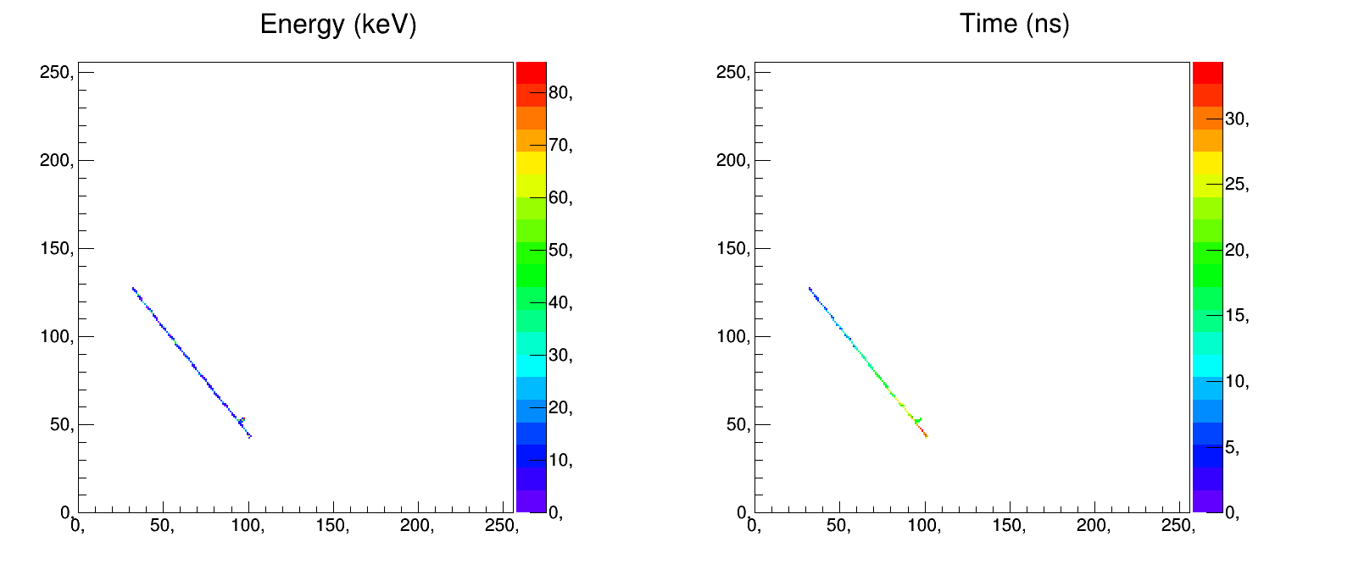
Timepix3 measurement
Bias 100V, Ikrum 5, with time walk correction

Slide 153
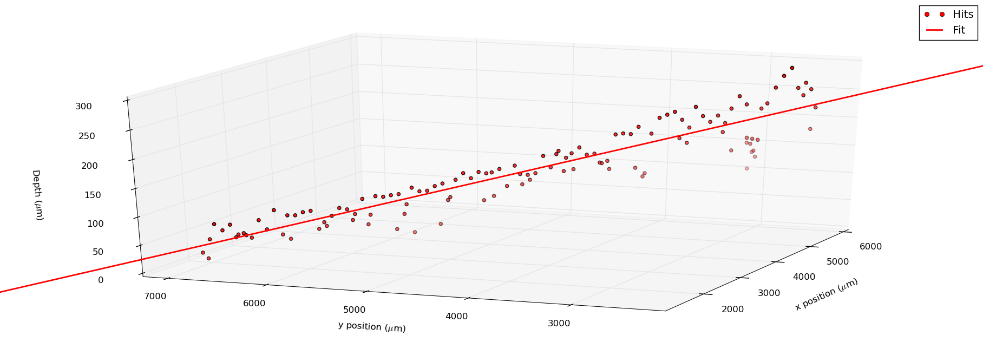
Timepix3 measurement
Note: Not to scale!
Bias 100V, Ikrum 5, with time walk correction

Slide 154
ToT digitization: Dosepix chip
40keV photons
3.18keV FWHM
W. Wong
Notes:
This was measured at ANKA with 40keV synchrotron radiation. The green line shows the energy bin output directly from the chip (i.e. one "frame" of data), the blue line shows binning done offline with ToT counts read from the chip, and the read line shows a simulation Erik did using Geant4 and a model of the frontend. Reference is Frojdh et al, NIMA, 2015.
Underestimation of charge sharing in the simulation.
E 3.18KeV FWHM

Slide 155
Medipix3RX Pixel Diagram: Charge Summing Mode
If(LocalCharge>ChargeNeighbours)
Then Counter0++
C_{F}
Local charge to adjacent pixels
DataIn0
DataIn1
DiscOutNeighbours
ToNeighbours
3
Local charge
8
8
1
-A_{v}
g_{m}
DiscOutLocal
Arbitration logic
Counter0
1
1
TH_{spm}
1
C_{TEST}
Single Pixel Mode Arbitrated
1
1
TestBit
TestPulse
Reconstructed charge
Charge from adjacent pixels
1
3
DiscOutSum
synchronization
1
Counter1
TH_{csm}
1
3
Charge Summing Mode
If((LocalCharge>ChargeNeighbours) and (Reconstructed charge in one of the adjacent summing circuits > TH_{CSM}))
Then Counter1++
DiscOutSumNeighbours
1
1
DataOut0
DataOut1

Slide 156
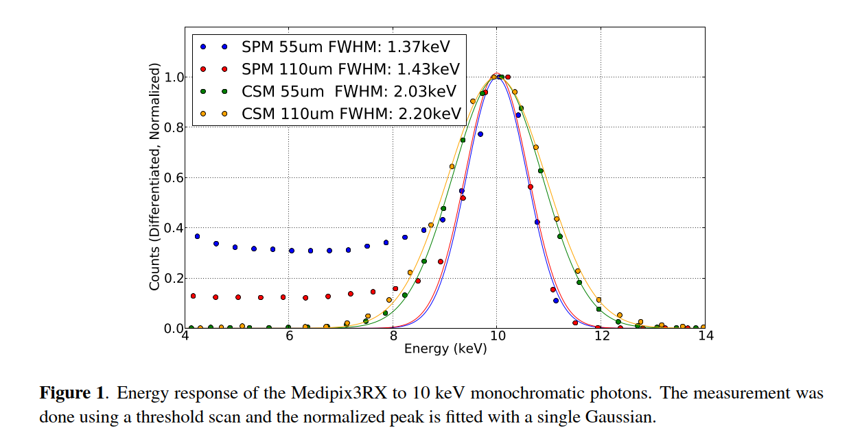
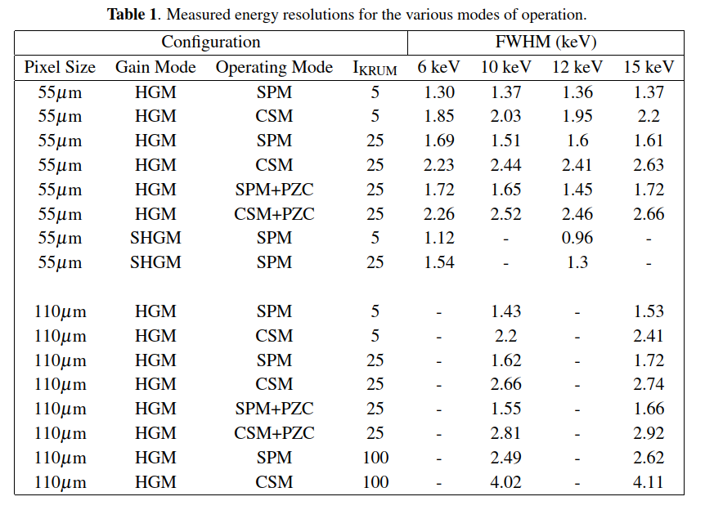
E. Frojdh, “Count rate linearity and spectral response of the Medipix3RX chip coupled to a 300µm silicon sensor under high ﬂux conditions”

Slide 157
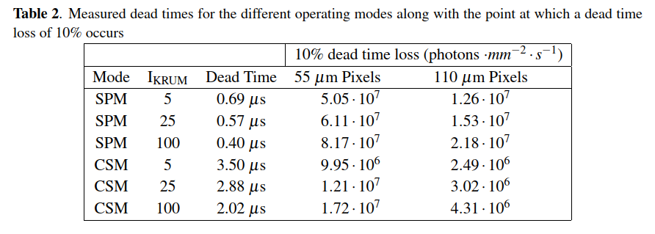
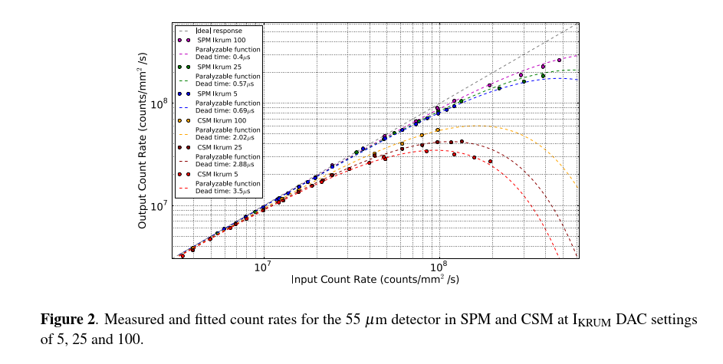
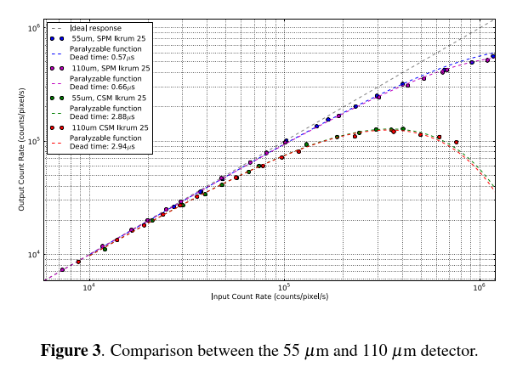
x5
/5
/5
E. Frojdh, “Count rate linearity and spectral response of the Medipix3RX chip coupled to a 300µm silicon sensor under high ﬂux conditions”

Slide 158
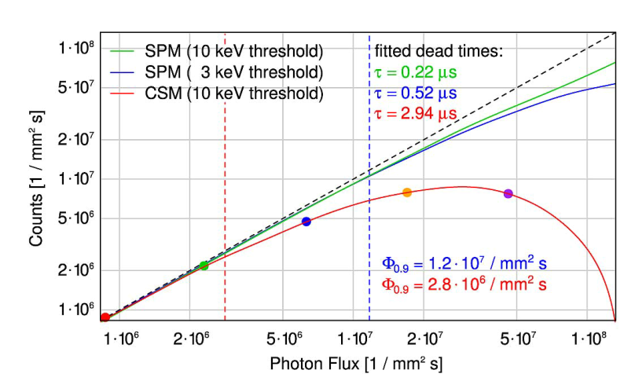
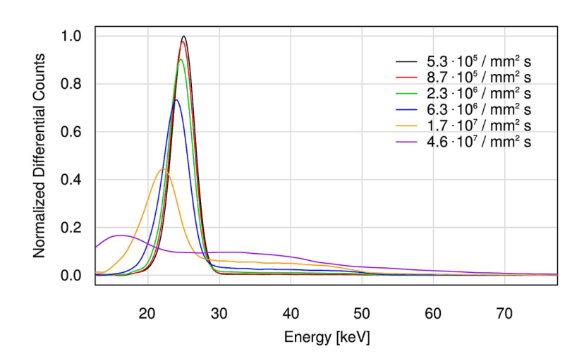
Counts measured with the 110um detector as a function of the photon ﬂux (25 keV). All the lines represent spline interpolants to the measurements, and the single pixel mode data were corrected for double counts to allow a better comparison.
Energy response functions measured for 25 keV photons in charge summing mode and the ﬂuxes given in the legend, again obtained with the 110um detector. The curves were scaled to exhibit equal areas in the measurement range.
Flux 90% | SPM | 1.20E+07 | cps/mm2
 | CSM | 2.80E+06 | cps/mm2
Dead time | SPM | 2.20E-01 | us
 | CSM | 2.94E+00 | us
/4.3

Slide 159
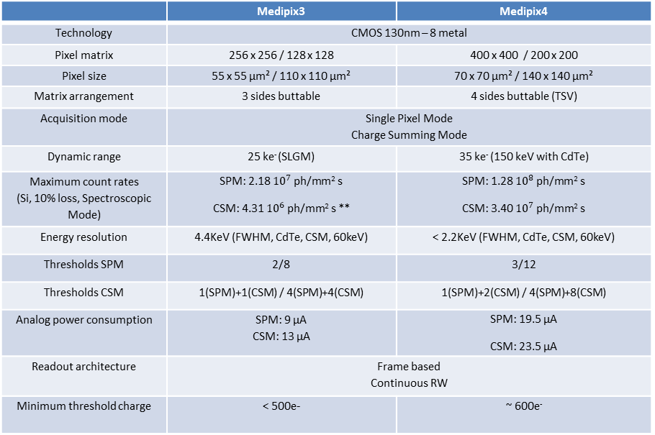
Towards Medipix4
 | Medipix3 | Medipix4
Technology | CMOS 130nm – 8 metal
Pixel matrix | 256 x 256 / 128 x 128 | 400 x 400 / 200 x 200
Pixel size | 55 x 55 µm² / 110 x 110 µm² | 70 x 70 µm² / 140 x 140 µm²
Matrix arrangement | 3 sides buttable | 4 sides buttable (TSV)
Acquisition mode | Single Pixel Mode Charge Summing Mode
Dynamic range | 25 ke⁻ (SLGM) | 35 ke⁻ (150 keV with CdTe)
Maximum count rates (Si, 10% loss, Spectroscopic Mode) | SPM: 2.18 ${10}^{7}$ ph/mm² s CSM: 4.31 ${10}^{6}$ ph/mm² s ** | SPM: 1.28 ${10}^{8}$ ph/mm² s CSM: 3.40 ${10}^{7}$ ph/mm² s
Energy resolution | 4.4KeV (FWHM, CdTe, CSM, 60keV) | < 2.2KeV (FWHM, CdTe, CSM, 60keV)
Thresholds SPM | 2/8 | 3/12
Thresholds CSM | 1(SPM)+1(CSM) / 4(SPM)+4(CSM) | 1(SPM)+2(CSM) / 4(SPM)+8(CSM)
Analog power consumption | SPM: 9 µA CSM: 13 µA | SPM: 19.5 µA CSM: 23.5 µA
Readout architecture | Frame based Continuous RW
Minimum threshold charge | < 500e- | ~ 600e⁻

Slide 160
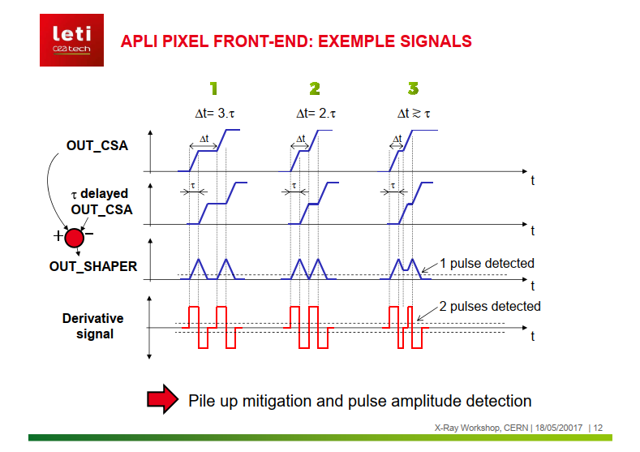
SAR(L) ADC example: CEA-Multix
Samsung PC
  4x8 pixels (800μm pitch), 0.13μm CMOS
  On chip charge sharing, charge induction and pile-up corrections
  SAR ADC (8 bits)
A. Peizerat et al. "A 256 energy bin spectrum X-Ray photon-counting Image Sensor providing 8 Mcounts/s/pixel and on-chip charge sharing, charge induction and pile-up corrections " 2017 Symposium on VLSI Circuits Digest of Technical Papers.
Notes:
The chip from Samsung (also designed for X-ray photon counting) is an example of pixel implementing the SAR type ADC. The output of the amplifier is frozen and the digitization is done in different steps/clock cycles. (The algorithm is not strictly speaking SAR (there is not a binary search) but they call it SAL (like)).
Sampling based CSA
After energy discrimination is finished, the ADC activates an asynchronous self reset signal that represents the END of conversion (EOC).
CFB (1.5fF) is reset.
Optimized switching level with dummy switch.
Correlated double sampling (to correct for charge injection and for offset voltage of OTA).
OTA VOS (offset voltage) is sampled by CCDS (SW1 and M1 ON)
M1 turns OFF, i.e. AVOUT from charge injection is also stored in CCDS
SW1 turns OFF
Successive approximation like ADC
Unlike traditional SAR (Successive Approximation Register) ADC, the proposed SAL ADC controls the internal DAC linearly rather than in a binary search way.
Clockless comparator, SAL control logic, Thermometer coded DAC
If VOUT>VTHPRE the start trigger runs the SAL ADC

Slide 161
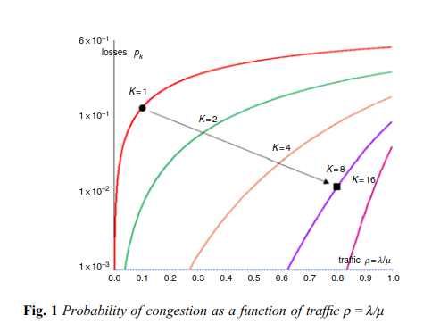
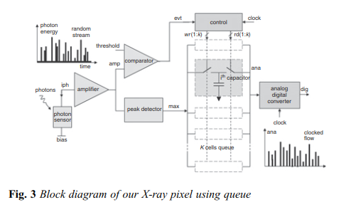
SAR(L) ADC example: CEA-Multix
Samsung PC
  4x8 pixels (800μm pitch), 0.13μm CMOS
  On chip charge sharing, charge induction and pile-up corrections
  SAR ADC (8 bits)
Considering Fig. 1, the set of parametric curves K shows the losses pk
versus trafﬁc ρ= λ/μ. It appears that a conventional approach (K = 1)
shows basically losses around 9% for a trafﬁc ρ= 0.1 (µ = 100 M
samples/s for λ= 10 M photons/s). If we need losses ten times lower,
the corresponding ADC should present a sampling frequency ten
times higher (µ = 1 G samples/s for λ= 10 M photons/s). With an eight-
seat queue (K = 8), it appears that the sampling frequency (=μ) is
reduced by a factor of 8 while pk is decreased by a factor of 9.
λ is the average photon ﬂux
µ (is the ADC sampling frequency)
A. Peizerat et al. "A 256 energy bin spectrum X-Ray photon-counting Image Sensor providing 8 Mcounts/s/pixel and on-chip charge sharing, charge induction and pile-up corrections " 2017 Symposium on VLSI Circuits Digest of Technical Papers.
Notes:
The chip from Samsung (also designed for X-ray photon counting) is an example of pixel implementing the SAR type ADC. The output of the amplifier is frozen and the digitization is done in different steps/clock cycles. (The algorithm is not strictly speaking SAR (there is not a binary search) but they call it SAL (like)).
Sampling based CSA
After energy discrimination is finished, the ADC activates an asynchronous self reset signal that represents the END of conversion (EOC).
CFB (1.5fF) is reset.
Optimized switching level with dummy switch.
Correlated double sampling (to correct for charge injection and for offset voltage of OTA).
OTA VOS (offset voltage) is sampled by CCDS (SW1 and M1 ON)
M1 turns OFF, i.e. AVOUT from charge injection is also stored in CCDS
SW1 turns OFF
Successive approximation like ADC
Unlike traditional SAR (Successive Approximation Register) ADC, the proposed SAL ADC controls the internal DAC linearly rather than in a binary search way.
Clockless comparator, SAL control logic, Thermometer coded DAC
If VOUT>VTHPRE the start trigger runs the SAL ADC

Slide 162
SAR(L) ADC example: Samsung PC
Samsung PC
  128x128 pixels (60μm pitch), 0.13μm CMOS
  3 energy thresholds, 4.6μW/pixel
  SAR ADC (3 energy thresholds, 1 comparator)
H. S. Kim et al. Solid-State Circuits Conference Digest of Technical Papers (ISSCC), 2012 IEEE International pp. 110-112 (2012).
Notes:
The chip from Samsung (also designed for X-ray photon counting) is an example of pixel implementing the SAR type ADC. The output of the amplifier is frozen and the digitization is done in different steps/clock cycles. (The algorithm is not strictly speaking SAR (there is not a binary search) but they call it SAL (like)).
Sampling based CSA
After energy discrimination is finished, the ADC activates an asynchronous self reset signal that represents the END of conversion (EOC).
CFB (1.5fF) is reset.
Optimized switching level with dummy switch.
Correlated double sampling (to correct for charge injection and for offset voltage of OTA).
OTA VOS (offset voltage) is sampled by CCDS (SW1 and M1 ON)
M1 turns OFF, i.e. AVOUT from charge injection is also stored in CCDS
SW1 turns OFF
Successive approximation like ADC
Unlike traditional SAR (Successive Approximation Register) ADC, the proposed SAL ADC controls the internal DAC linearly rather than in a binary search way.
Clockless comparator, SAL control logic, Thermometer coded DAC
If VOUT>VTHPRE the start trigger runs the SAL ADC

Slide 163
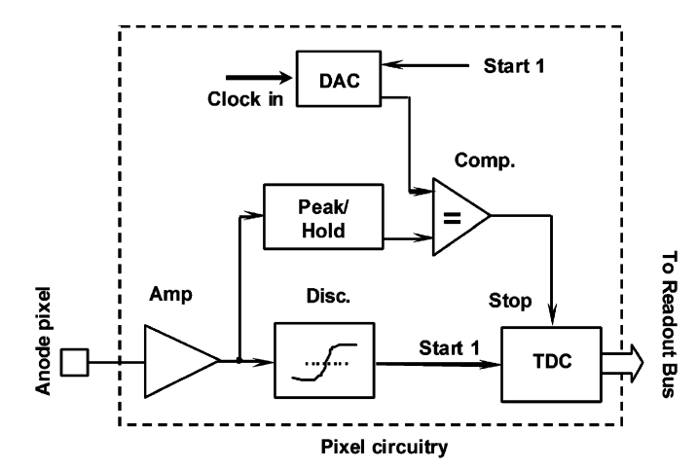
Ramp and compare principle
L.-J. Meng et al. / Nuclear Instruments and Methods in Physics Research A 604 (2009) 548–554.
Notes:
(ADDITIONAL SLIDE)

Slide 164
Strategies for dealing with high fluxes

Slide 165
  Pilatus3 (Dectris)
  60x97 pixel matrix, 172μm pixel pitch
  1 Threshold level
  0.25μm CMOS technology
  Radiation hardness by design
  (IBEX includes also the instant retrigger
  functionality)

Slide 166
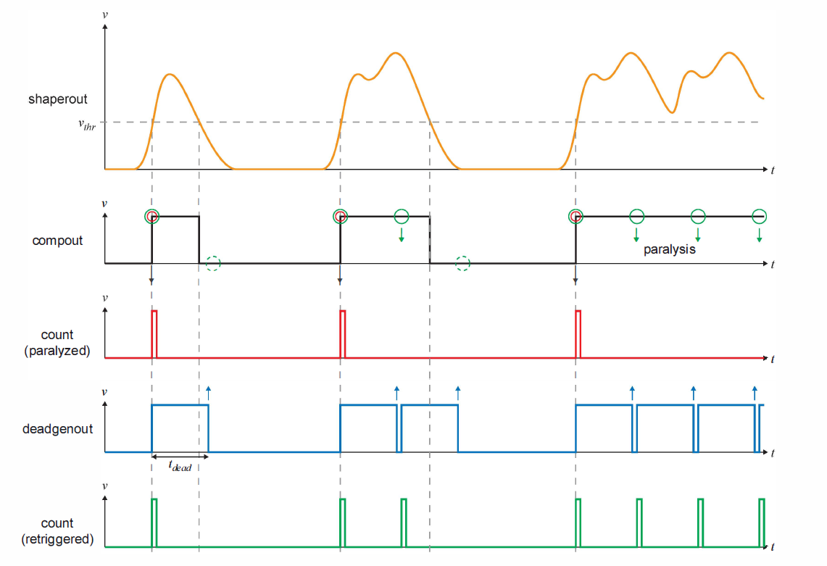

Pilatus3 ASIC (Instant retrigger)
Measurement 8keV photons, Threshold @4keV
T. Loeliger et al. Nuclear Science Symposium and Medical Imaging Conference (NSS/MIC), 2012 IEEE Conf. Record. pp. 610-615 (2012).
Re-evaluation of the pulse after a pre-determined time interval
Notes:
Instant retrigger technology re-evaluates the pulse signal after a predetermined dead time interval after each count and potentially retriggers the counting circuit in case of pulse pile-up.
Counting becomes non-parallizable.
XRD X-ray Diffraction experiments in synchrotrons
Macromolecular crystallography (MX), Small Molecule Crystallography (SMX) require high photon fluxes and count-rates.
Compout shows the corresponding digital discriminator output signal that triggers the counter.
Count shows the corresponding counts being registered by a conventional single counting X-ray detector. Counts are lost in case of pulse pile up. (paralysis)
Deadgenout dead time generator output signal with instant retrigger technology.
A predefined dead time interval is started whenever a count has been registered.
Corresponding counts. The counting becomes non-paralyzable.
In order to achieve high counting accuracy, the dead time interval has to account for the width of a single photon pulse corresponding to the specific photon energy, which in fact is only viable with high precision for a monochromatic x-ray source.
Nominal retrigger dead time 100ns

Slide 167
The Counting Detector
Basic Geometry:
CdTe sensor, 1.6mm thick
225µm sub-pixel pitch
Macro-pixel mode (4x4) fits to
geometry of anti-scatter grid
24 modules → 22cm FOV
z-coverage up to 32x0.5mm
ASIC:
Fast pulse shaping < 20ns
Counter thresholds 20keV ... 160keV
Two counters per sub-pixel

Slide 168


Siemens Photon Counting ASIC (pileup trigger method)
  64x64 pixel matrix, 225μm pixel pitch
  Pile-up trigger method
  Observation: higher thresholds paralyze at higher count rates
  Combine spectral counter signal with pile-up counter signal
  Advantages
    Unambiguous up to the highest fluxes
    Full spectral sensitivity in the low-flux regime inside the patient (N_{p}<<N_{S})
140 kVp
E. Kraft et al. "Experimental evaluation of the pile-up trigger method in a revised quantum-counting CT detector" Proc. SPIE 8313, Medical Imaging 2012: Physics of Medical Imaging, 83134A (2012).
Notes:
Ns: Number of counts in the spectral counter
Np: Number of counts in the pile up counter
CT->Extreme X-ray fluxes->Pulse pile up->detector paralysis and ambiguity
Pile up trigger-> a novel method that provides unambiguous detector signals in the rate regimes where classical rising-edge counters run into paralysis.
CT 10^9 hits/s x cm^2
Pixel pitch is chosen 225um (Kappler) (Philips 300um). This size is a trade off between segmentation (small pixels) for speed and large pixels to minimize the negative influence of k-escape and charge sharing in the energy spectrum measured by the individual pixel.
Calculation:
Pixel pitch 250um, max count rate in CT scan with 140kV and 800mA may reach 125 Mcps (central projection, no attenuation). In these conditions the average time between photons amounts to 8ns.
Note that beyond the peak for the 20keV threshold it is not longer possible to linearize this signal, resulting in ambiguous and therefore inconsistent data sets not suited for CT image reconstruction.
The same is true for the 65keV threshold. But its peak occurs at higher X-ray tube currents (475mA)
Definition: A pile up counter is a rising-edge counter with a threshold beyond the maximum energy of the incoming X-ray spectrum. The signal of a 160keV counter, for instance is zero at low tube currents but it provides a reasonable signal at rates where pulse pile up occurs (this corresponds to the diagnostically irrelevant regions in CT with lowest or no attenuation.
By combining the counts of NS (from a spectral threshold) with the counts of Np (from a pile up threshold) in a weighted manner:
N=Ns+wxNp
Then the signal is (1) unambiguous up to the highest fluxes and (2) full spectral sensitivity in the low flux regime. (w=~1.25)

Slide 169
Spin-off (applications)
X-ray materials analysis
X-ray non-destructive testing
Dosepix chip development
Gamma camera
Compton camera
Low Energy Electron Microscopy
Transmission electron microscopy
Dose deposition tracking in hadron therapy
High resolution neutron imaging
Single (visible) photon imaging
Time-of-Flight mass spectrometry
combined with MCP

Slide 170
Spin-off (Industrial licensing of Medipix/Timepix chips)
2 Medium Sized Enterprises
  PANalytical (The Netherlands)
  Kromek (UK)
6 start-ups from Collaboration members:
  Advacam s.r.o. (from IEAP, Czech Republic)
  Amsterdam Scientific Instruments (from NIKHEF, The Netherlands)
  MARS Bio-imaging (from University of Canterbury, New Zealand)
  Quantum Detectors (from Diamond, UK)
  X-ray Imaging Europe (from FMF, Germany)
  X-Spectrum (from DESY, Germany)

Slide 171
Spin-back (applications @ CERN/Physics)
  LHCb VELOpix chip is directly derived from Timepix3
  LHCb Timepix3 telescope – 80 Mhits/sec
  Sensor studies for CLIC/LHCb
  Background radiation monitoring at ATLAS and CMS
  Beam monitoring in UA9
  Beam Gas Interaction monitor is operating at CERN PS
  ASACUSA experiment
  Beta particle channeling in ISOLDE
  Forward physics using Timepix3?
  Axion search at CAST (with InGrid)
  Large area TPC (with InGrid)
  Transition radiation measurements for ATLAS
  GEMPIX development for radiation therapy beam monitoring
  GEMPIX for ⁵⁵Fe waste management
  Developments for CLIC: CLICpix, CLICpix2, C3PD

Slide 172


ToT digitization: Dosepix chip
Developed in a partnership between CERN, University of Erlangen and IBA dosimetry
Main applications: dosimetry, X-ray tube diagnostics tool
16x16 pixel matrix, 220x220μm² pixels
CMOS 0.13μm technology
1 global analog threshold
Operation Modes:
  Energy binning mode
    12 bit ToT measurement @100MHz
    16 digital thresholds (on each pixel) for event-by-event energy binning
    16x 16bit energy bins
  Photon counting mode (8 bits)
  Integral ToT (24 bits)
W.S.Wong et al., Electrical measurements of a multi-mode hybrid pixel detector ASIC for radiation detection, JINST 7, 2012. doi:10.1088/1748-0221/7/01/C01056

Slide 173
ToT digitization: Dosepix chip
W. Wong
Notes:
This was measured at ANKA with 40keV synchrotron radiation. The green line shows the energy bin output directly from the chip (i.e. one "frame" of data), the blue line shows binning done offline with ToT counts read from the chip, and the read line shows a simulation Erik did using Geant4 and a model of the frontend. Reference is Frojdh et al, NIMA, 2015.
Underestimation of charge sharing in the simulation.
E 3.18KeV FWHM

Slide 174
Power consumption

Slide 175
Power consumption versus channel density
Above 1W/cm² active cooling has to be implemented
(38) An effective sensor channel is read out by 16 readout channels (moreover high input capacitance due to interconnects)
Notes:
0.1W/cm2 corresponds roughly to the limiting heat flux that can be removed by natural air convection with 10oC temperature rise.
La convecció és una de les tres formes de transferència de calor i es caracteritza pel fet que aquesta es produeix a través del desplaçament de matèria entre regions amb diferents temperatures. La convecció es produeix únicament en materials fluids. Quan s'escalfen disminueix la seva densitat i ascendeixen al ser desplaçats per les porcions a menor temperatura que, al mateix temps, descendeixen i s'escalfen repetint el cicle. El resultat és el transport de calor per mitjà de les parcel·les de fluid ascendent i descendent. La transferència de calor implica el transport de calor en un volum i la barreja d'elements macroscòpics de porcions calentes i fredes d'un gas o un líquid. S'inclou també l'intercanvi d'energia entre una superfície sòlida i un fluid.
En la transferència de calor per convecció forçada es provoca el flux d'un fluid sobre una superfície sòlida per mitjà d'una força externa com per exemple una bomba, un ventilador o altre dispositiu mecànic.
En la transferència de calor per convecció lliure o natural en la qual un fluid és més calent o més fred i en contacte amb una superfície sòlida causa una circulació a causa de les diferències de densitat que resulten del gradient de temperatures en el fluid.
Els mecanismes de transferència d'energia tèrmica són:
Conducció
Convecció
Radiació
It is likely that front-end electronics power dissipation will limit the achievable pixel density of proposed fine-grain detectors. To realize the low noise possibilities of pixel detectors with low-capacitance electrodes, the electronics must be located in close proximity to the detector. Detector temperature usually has to be controlled and kept at or below room temperature to prevent undesirable leakage currents or thermally induced gain inhomogeneity. Therefore, available cooling technology must be considered when high density pixel electronics is designed.
Fig. 2 shows the allowed power dissipation per pixel versus pixel density, for three overall power density levels. The lowest level, 0.1Wcm2, corresponds roughly to the limiting heat flux that can be removed by natural air convection with 10°C temperature rise [16]. At the highest level, 10W/cm2, forced liquid cooling is required to limit the temperature rise to less than 10°C. It can be seen that as pixel densities exceed 10^4, the electronics power budget will have to be at the microwatt per channel level to avoid exotic cooling schemes.

Slide 176
 | Medipix2 | Medipix3 | Timepix | Timepix3
Pixel side (μm) | 55 | 55/110 | 55 | 55
Technology (nm) | 250 | 130 | 250 | 130
# pixels in x and y | 256 | 256/128 | 256 | 256
Readout architecture | Frame based Sequential RW | Frame based Continuous RW | Frame based Sequential RW | Data driven/ frame based
Charge summing and allocation mode (CSM) | No | Yes | No | No
# thresholds | 2 (window discriminator) | 2/4/8 Seq RW 1/4 Cont RW | 1 | 1
ToT/ToA | No | No | ToT (14 bit) OR ToA (14 bit, 10ns precision) | ToT (10 bit) AND ToA (18 bit, 1.56ns precision)
Front end noise (e⁻ rms) | 110 | 80(SPM) 174(CSM) | 100 | 62
Minimum Threshold (e⁻) | 900 | 500 (SPM) 1000 (CSM) | 650 | 500
Peaking time (ns) | 150 | 120 | 100 | 30
Max count rate (Mc/mm²/s)* *very sensitive to exact test conditions | 826 | 614 (SPM 55μm) 114 (CSM 55μm) 130 (SPM 110μm) 29 (CSM 110μm) | - | 0.43 (data driven)

