Slide 1
Inventory of present situation
J. Tan, I. Ortega, S. Deschamps, W. Devauchelle, P. Carriere, J. Cenede, G. Tranquille
F. Roncarolo, M. Duraffourg, S. Burger
February 1st 2019
EA-BI-WG

Slide 2
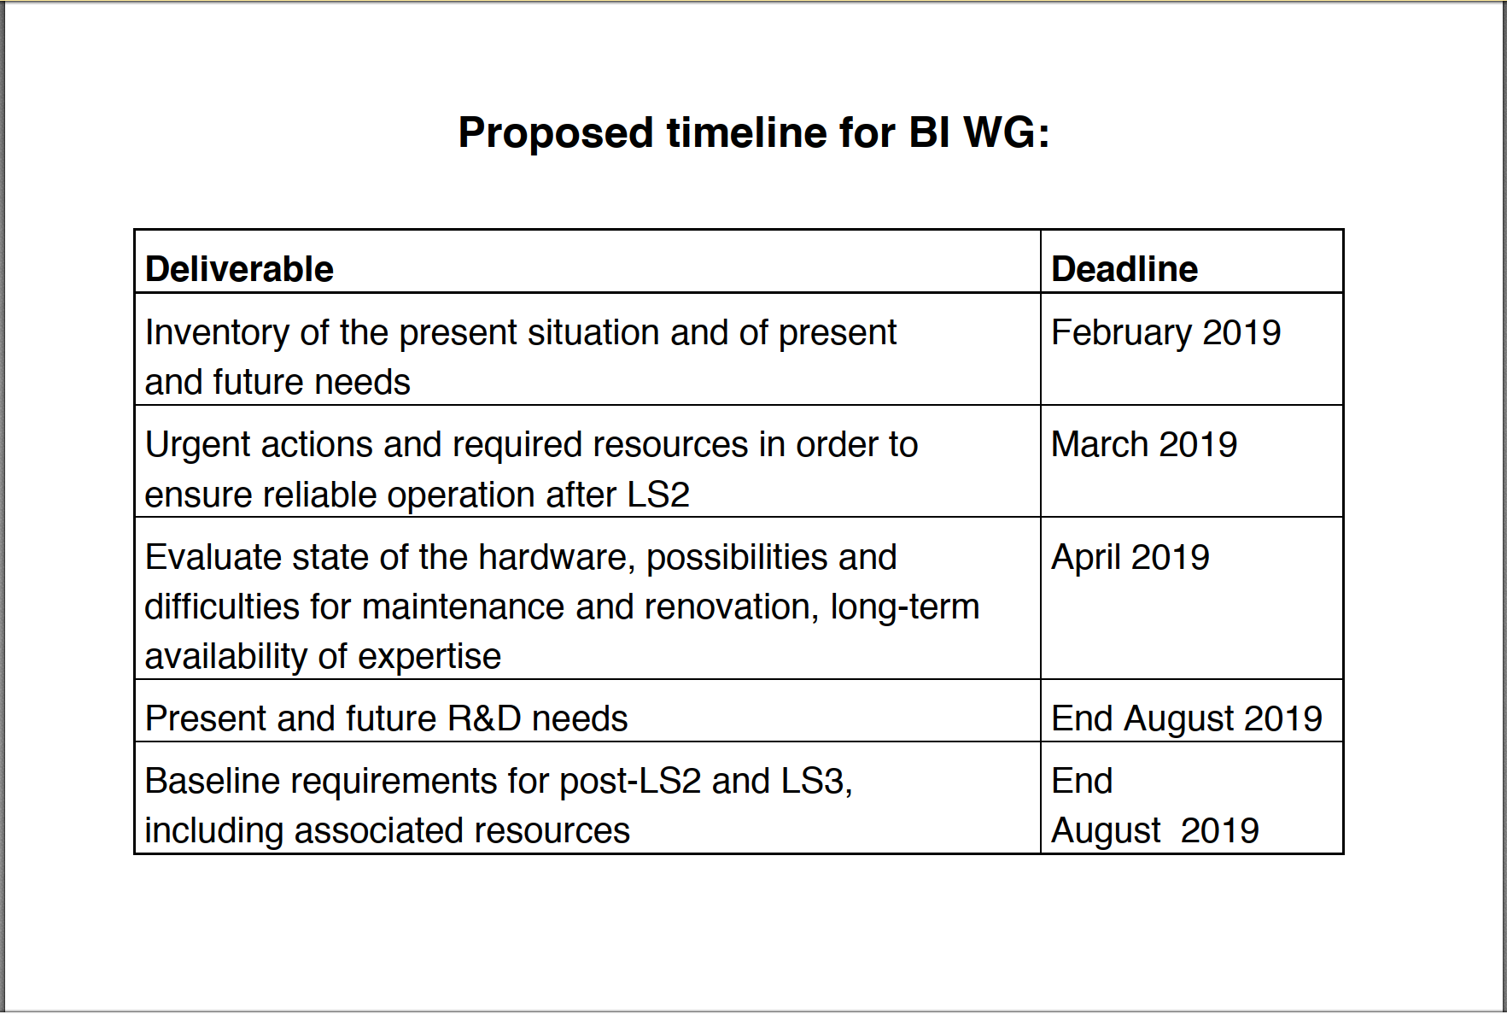
Courtesy L. Gatignon

Slide 3
Outline
From F61 to East Area: status by observable
From TT20 to North Area : status by observable
Transfer lines of AD and ELENA : profile monitors
Summary

Slide 4
F61 line and East Area: Intensity measurement
Primary lines after LS2
Instrument | Location | Status | Qty Installed | Spares Monitors + Aqn chain | Remarks
BCGAA (ex. LSD) | F61 | operational | 1 | 0 + HV power supply + PMT | Ionization photons
BCTF | F61 | operational | 1 | 0 + TRIC cards | Very old monitor - Bunched beam
XSEC | F61 – F62 – F63 – T08 | operational | 5 | 1 + 10 scaler boards | SEM
XION | T08 | operational | 1 | 3 + 10 scaler boards | SEM+Ar From 10⁶ to 10¹⁰/spill
XTEL | F61 | operational | 2 | 1 + 5 scint. boards | Scintillators
Secondary lines after LS2
Instrument | Location | Status | Qty Installed | Spares Monitors + Aqn chain | Remarks
XSCI | T09-T10-T11 | operational | 4 | 10 assembled. 5 new paddles. 5 scint. boards | From 1 to 10⁷/spill. In common with NA.

Slide 5
F61 line and East Area: Profile measurement
Primary lines after LS2
Instrument | Location | Status | Qty Installed | Spares Monitors + Aqn chain | Remarks
BTV | F61- F61D-F62 – T08 | operational | 5 | Rad. Hard cameras, push-pull actuator, Al2O3 screens | Upgrade done after LS1 – One BTV w/ bellow in T8
Target TV | F62 – F63 – T08 | operational | 3 | Rad. Hard cameras
XWCM | CHARM | operational | 1 | 8 + Aqn boards | Large screen size Common module for XWCA, XWCM and GEM
Secondary lines after LS2
Instrument | Location | Status | Qty Installed | Spares Monitors + Aqn chain | Remarks
XBPF | T09 - T10 - T11 | In production | 4 | 3 fibre planes + Aqn board, as EHN1 | Upgrade, replace old XDWC

Slide 6
East Area – secondary: Particle identification
Secondary lines after LS2
Instrument | Location | Status | Qty Installed | Spares Monitors + Aqn chain | Remarks
XCET | T09 – T10 | Being upgraded by EN | 4 | ?? + 9 boards | EN: Upgrade of monitor + gas valve mechanics BI: Aqn. Boards as NA + gas valve control

Slide 7
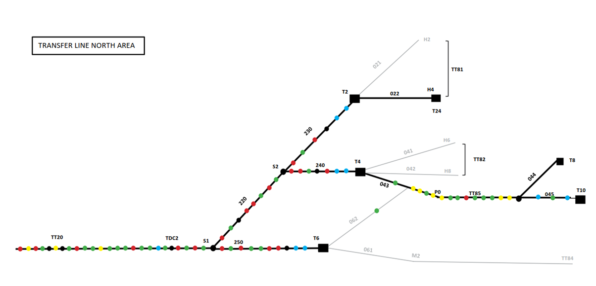
N.A. Primary beam diagnostics
Each dot is an instrument or a diagnostics box with more than 1 instrument…
Courtesy F. Roncarolo

Slide 8
N.A. Primary beam diagnostics: SEM-based monitors
TT20, TDC2, TCC2
Instrument | Location | Status | Qty | Spares | Remarks
BSI | lines + target lines | operational | 6 + 3 |  | Intensity. Large systematic errors (~ 20%) LS2: partial electronics consolidation (spill sampling)
BSPH-BSMH | lines | operational | 13 + 2 |  | H position, steering
BSPV-BSMV | lines | operational | 8 + 3 |  | V position, steering
BSGH-V | lines | operational | 5 + 13 |  | Profile w/ grids
BBSH-V | lines | operational | 3 + 3 |  | Profile w/ movable strip
BSG | T2 and T4 | operational | 1+1 |  | Dual profile
Target boxes
Instrument | Location | Status | Qty | Spares | Remarks
TBIU | T2, T4 and T6 | operational | 3 |  | Renovated in 2014
TBID | T2, T4 and T6 | operational | 3 |  | Renovated in 2014

Slide 9
N.A. Primary beam diagnostics: BTVs and BLMs
BTV
Instrument | Location | Status | Qty | Spares | Remarks
BTV | TT20 | operational | 2 | A few tube-based cameras, screens | LS2:Mech. Consolidation (Malta Cross)
Screen for long. spill | TT20 | operational | 1 | A few tube-based cameras, screens
BTV | BA80 | operational | 7 | A few tube-based cameras, 0 screens (40yo) | Very old, yet robust. Information on a couple of screens is lost. LS2: Upgrade to standard BTV device (VME) & application New cables Mech. Consolidation (Malta Cross)
BTV 240119 | Downstream T4 |  |  |  | not used anymore, to be removed during LS2 in agreement with EA
BLM
Instrument | Location | Status | Qty Installed | Spares | Remarks
BLM | TT20 | operational | 6 |  | SPS type
BLM | TDC2 | Failure in 2018 | ?? |  | LS2: Will install new cables and have old and new in parallel

Slide 10
N.A. Secondary beam diagnostics
NA61
H2
T2
NA64
H4
T2 wobbling
H6
T4
H8
T4 wobbling
P42
K12
T10
NA62
T6
P6
COMPASS
M2
Courtesy Alexander Gerbershagen

Slide 11
North Area- secondary: Intensity measurement
Instrument | Location | Status | Qty | Spares | Remarks
XION | M2, K12 | Operational | 3 | 3 , IFC and Scaler modules | Old aqn. chain
XSCINT | H2, H4, H6, H8, P42-62, M2, K12 | Operational | 32 | 10 sets (Scint+PMT) assembled. 5 new paddles. 5 boards
XBTF | Neutrino Platform | Operational | 5 | 0 +0 | Produced in 2018 No spares in agreement with users

Slide 12
North Area – secondary : Profile measurement
Instrument | Location | Status | Qty Installed | Spares Monitors + Aqn chain | Remarks
XWCA | H2, H4, H6, H8 | Operational | 18 | 10 + 35 boards | From 10⁵/spill. Common module for XWCA, XWCM and GEM Some present degraded performance. Unknown status of spare monitors.
XWCM | H4, M2, K12 | Operational | 11 | 8 | Large XWCA (20cm x 20cm). Some present degraded performance. Unknown status of spare monitors.
XDWC | H2, H4, H6, H8 | Operational | 16 | 19 + 6 boards | Up to 10⁴/spill. Unknown status of spare monitors.
XFISC | K12, H2, H4, H6, H8, P41-61, P42-62, M2 | Operational | 56 tanks | 5 + 24 | Mechanics by EN-EA. Spare filaments – OK. Spare PMT – OK.
XBPF | Neutrino Platform | Operational | 10 planes | 0 +0 | Produced in 2018 No spares in agreement with users
XGEM | H6 | Operational | 1 | 5 | removed in 2018, to be replaced by XWCA during LS2

Slide 13
North Area – secondary : Particle identification
Instrument | Location | Status | Qty Installed | Spares Monitors + Aqn chain | Remarks
XCET | H2, H4, H6, H8, Neutrino Platform | Operational | 10 | ?? + 9 boards + PMT | Mechanics by EN-EA. LS2 : a couple of XCET to be installed in Neutrino Platform (H2)
XCED | H2, H6, M2, K12 | 2 Operational 3 Need Therm. housing + new gas control | 4 | ?? + boards + PMT | Mechanics by EN-EA. Unknown status of spare monitors.
XEMC | H4, H6, H8 | Operational | 3 | 2 + 1 [FISC+PHA] | Lead scintillator calorimeter.

Slide 14
AD & ELENA : Profile measurement
Instrument | Location | Status | Qty Installed | Spares Monitors + Aqn chain | Remarks
BTV | AD Transfer line 7000 | Operational | 1 | Camera and screen | CCD camera
XGEM | AD Transfer line 7000 and DEM | Operational | 6 | 15 | Destructive – Produced in ~2012 Common module for XWCA, XWCM and GEM
SEM (Hori detector) | AD and ELENA Transfer lines | In production | 8 |  | 95% transparent 3 assembled monitors ready for VSC acceptance tests 5 to be assembled 28 yet to be assembled (missing grids) 1 set of FE boards available only. Missing 43 !!
A total of 44 SEMs to be installed in the AD and ELENA transfer lines

Slide 15
Summary of the present status
East Area Consolidation is in good shape
  upgrade : XBPF and XCET
  keep the rest
  Complete cable renovation cables
North Area and transfer lines
  40 yo monitors : loss of documentation and expertise
  Splitters and targets areas are very activated.
  Most monitors: obsolete, miss
  TT20 line: Partial consolidation undertaken before and during LS2
Is ELENA (new machine) within the scope of this Working Group ?
Inventory
  Very difficult to make; few written documentation.
  Some monitors have been lent to users and lost track.
  Spare parts dispersed: centralised storage is needed.
  The status of some spares is unknown: control campaign needed.
  Obsolete boards

