Slide 1
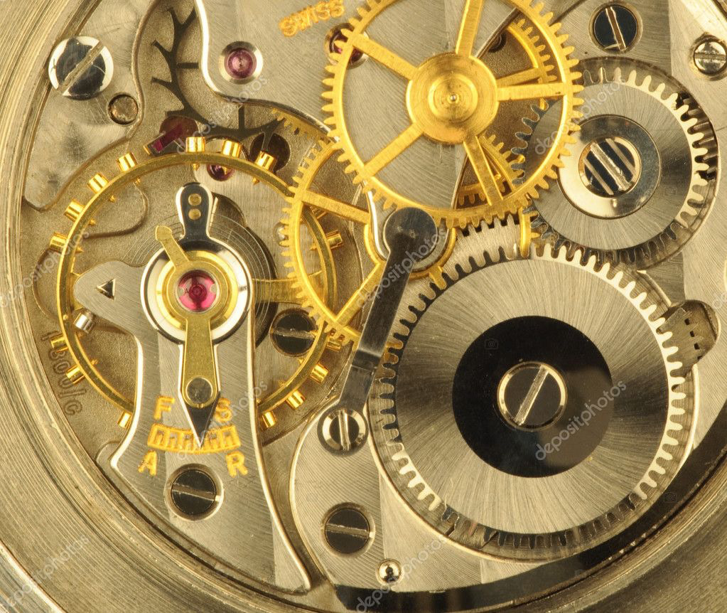
The Standard-Model
Ulla Blumenschein, Queen Mary University of London
Introduction Standard model
Precision tests of electroweak physics
Electroweak physics with several bosons

Slide 2
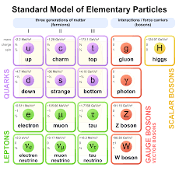
The Standard Model

Slide 3


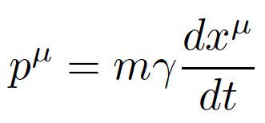
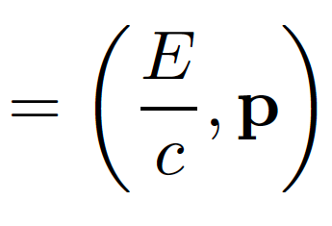

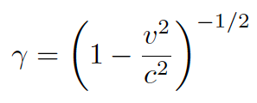

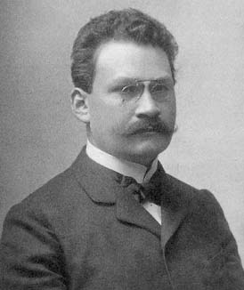




Relativistic kinematics
Space-time 4-vector:
Energy-momentum 4-vector:
Metric:
→
→
=
= m²
Herbert Minkowski,
Goettingen 1902-09

Slide 4
Towards QED

Slide 5

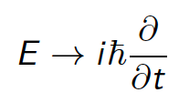
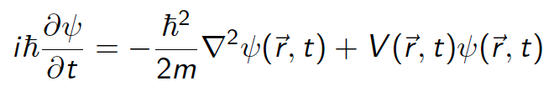

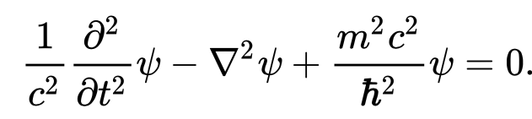
QM description of Fermions
Applying quantum substitution
to classic energy-momentum relation
Schroedinger equation:
Kinematics of relativistic particles:
Relativistic energy-momentum relation:
Applying quantum prescription:
→ Klein-Gordon equation:
Works for scalar particles but not for fermions: Need equation first order in t
E = p²/2m +V
E² = p²c² + m²c⁴
In the following slides:
natural units: h = c = 1

Slide 6
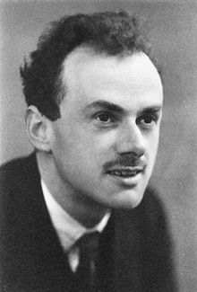
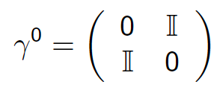
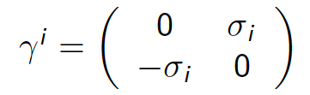










The Dirac equation
→ 4D matrices: γmatrices
Fermion becomes a Dirac spinor
Dirac equation:
Solutions of the Dirac equation, fermion at rest:
Electrons:
Positrons

Slide 7
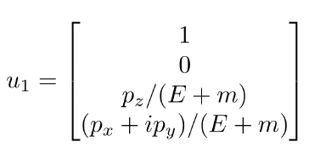
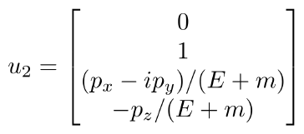
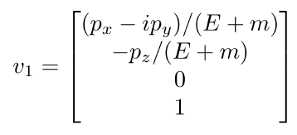
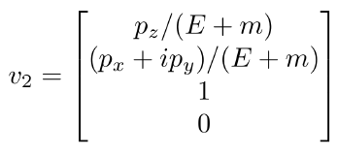
The Dirac equation
→ Solutions of the Dirac equation, fermion at in constant motion:
Electrons:
Positrons:
( Here: spin component in direction of motion )

Slide 8
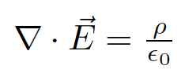







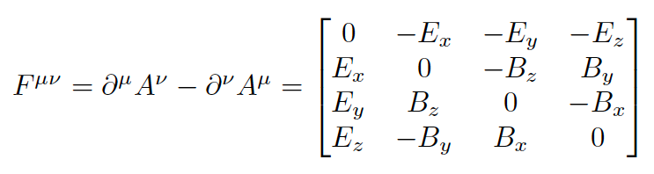
The EM force
Classic Maxwell equations:
Homogenuous MWE: B and E as as derivative of potentials
relativistic description: 4-potential
Field strength tensor:

Slide 9





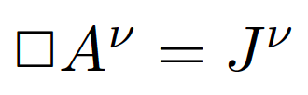
The EM force
Inhomogenuous Maxwell equations:
Conservation of EM current:
The MWE of the potential:
Solved by many potentials related by gauge transformation:
Lorentz gauge: →
A^{µ} → A^{µ} + Λ(x^{µ})

Slide 10

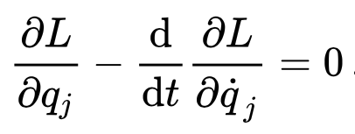

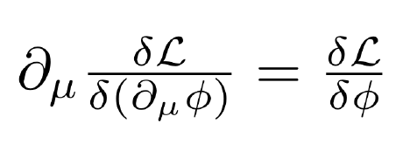
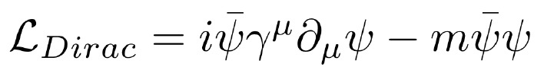


The Lagrangian density
Classical mechanics: Lagrangefunction:
Fundamental law of motion: Euler-Lagrange equation:
Field theory: Lagrangian is a function
of fields and their 4-derivatives
Euler-Lagrange equation:
Example Dirac Lagrangian:
Example: Lagrangian of free photon:

Slide 11
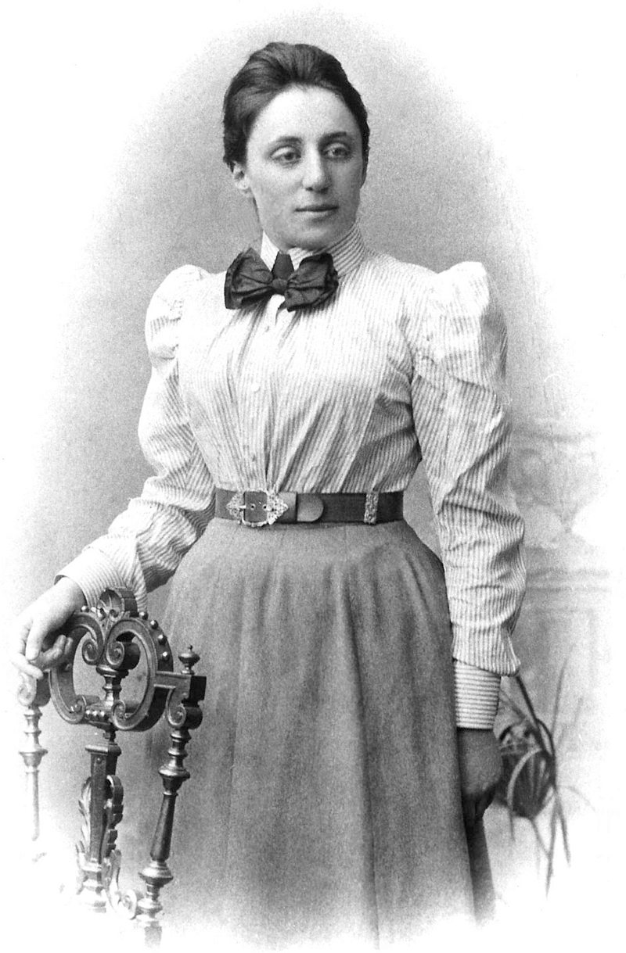
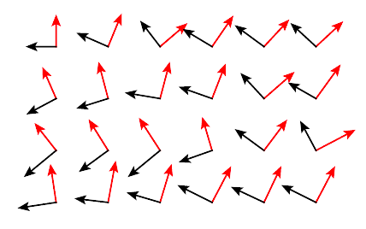
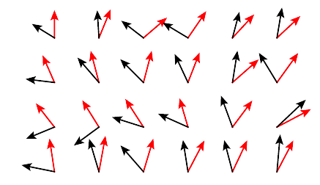
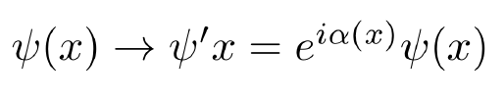

Gauge symmetries
Noether theorem:
Continuous symmetries → corresponding conserved quantities
Dirac Lagrangian Is invariant
under global phase translation
Emmy Noether,
Goettingen 1915-33
Now require also invariance under
Local phase transitions

Slide 12




Gauge invariance
In order to preserve the Lagrangian, the derivative has to transform
In the same way
…not trivial as we have to cancel the inner derivative of the phase:
→ extend to covariant derivative by adding interaction with photon field A_{µ}
With a photon field transforming as:
(using the gauge freedom
of the 4-potential)

Slide 13


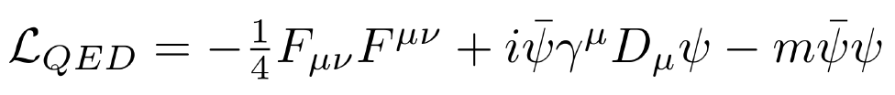
Gauge invariance
→ New Lagrangian:
Adding kinematic term for free photon:
.. Yields the Maxwell-equations for current density
Needed to introduce photon field by requiring local U(1) gauge
invariance of the Lagrangian
Charged particles are always
accompanied by EM field
J^{µ} = e (ψγ^{µ}ψ)
_

Slide 14

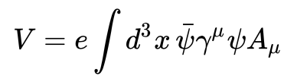

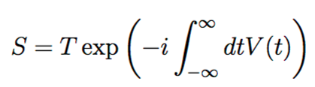
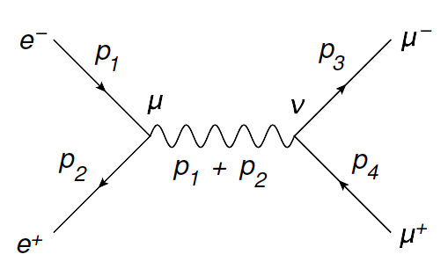
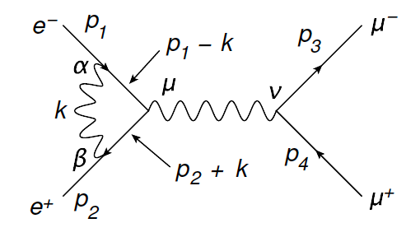
Perturbation theory
Scattering matrix
Perturbation Hamiltonian
in the Interaction picture
Perturbation expansion: terms can be graphically represented as
Feynman diagrams
example: ee → µµ
+
+ …....
LO
NLO

Slide 15
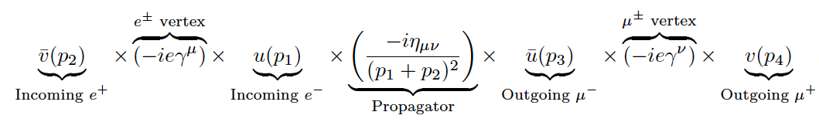
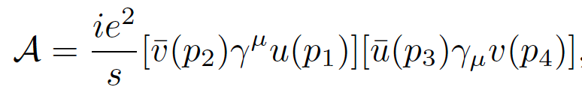
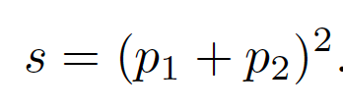

Feynman diagrams
Each line and each vertex represents a mathematical term:
Resulting matrix element:
A set of Feynman Rules allows to translate any diagram to an amplitude

Slide 16

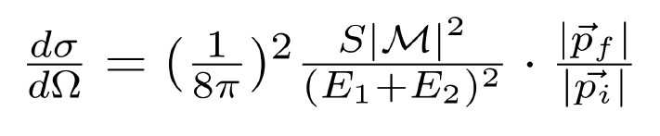
From amplitudes to cross sections
Particle Collider: Interaction rate depends on luminosity and cross section
Luminosity L depends on the number of particles
per punch, the bunch frequency and the beam profile
Differential cross section: depends on squared matrix element
Integration over phase space → total cross section

Slide 17
Weak interactions

Slide 18
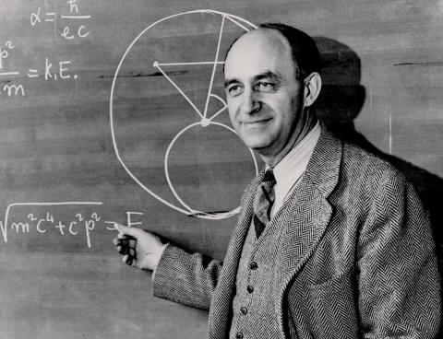
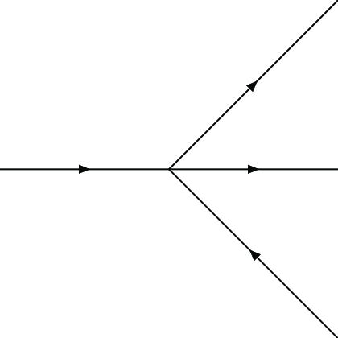




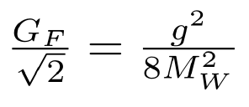
Fermi Theory
Fermi theory of weak interaction, 1933: Effective Field Theory
p
G_{F}
n
e
v
Effective coupling parameter G_{F},
related to new physics at a scale m_{W}
which was not accessible in 1933
Cross section diverges at high energies
and does not explain observed parity violation
Today’s relation at low energies:

Slide 19
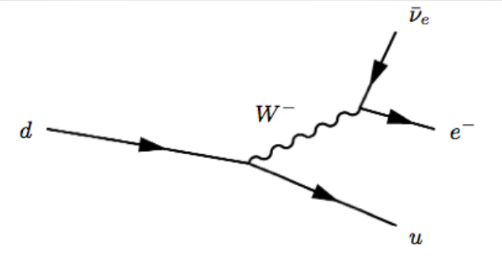

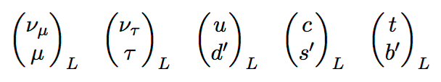
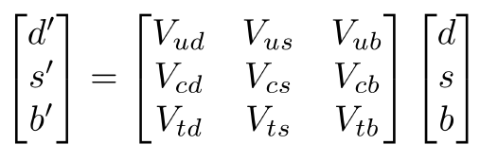
Contemporary theory
Contemporary Matrix element:
Projection to
left-handed fermions
4-momentum
transfer q
M_{W} ~80 GeV
The W couples with pairs of left-handed leptons
CKM matrix:
connection between
weak and mass states

Slide 20
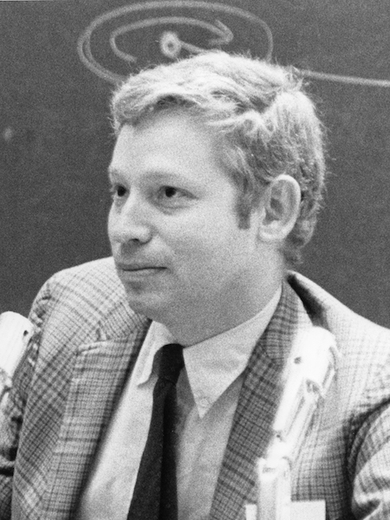
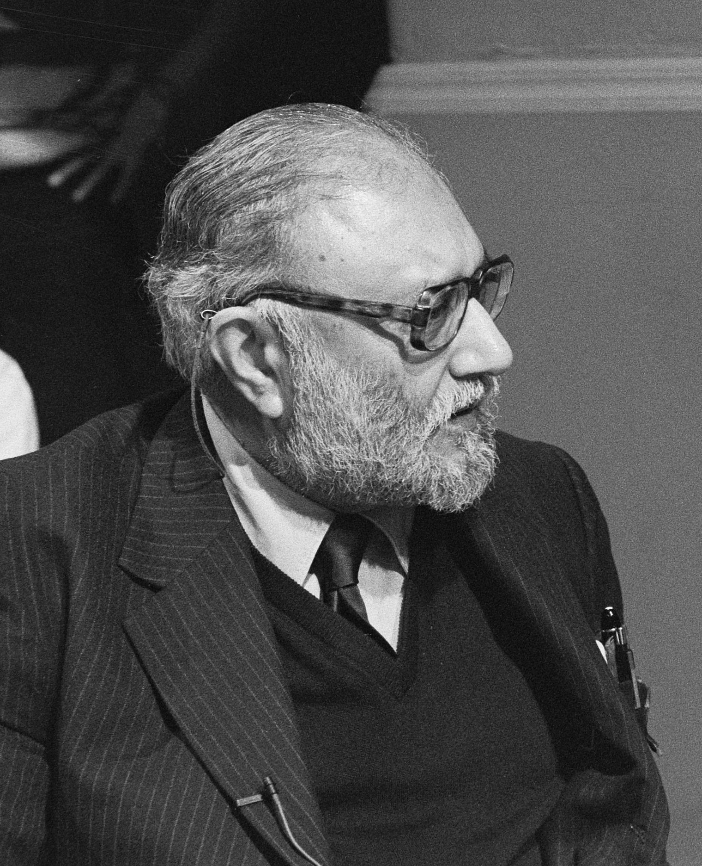
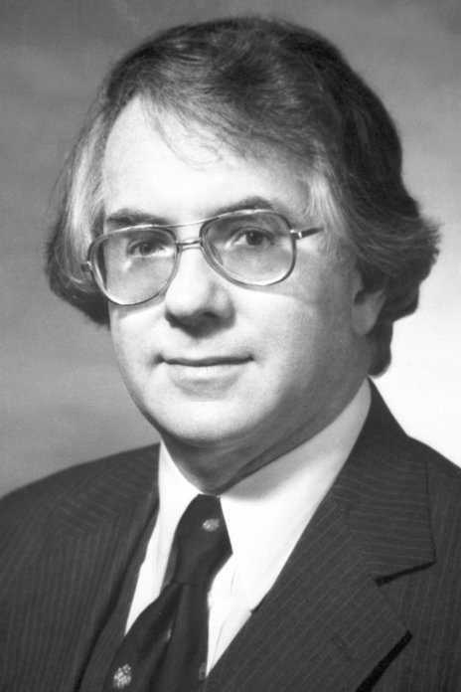




Electroweak unification
Require the Dirac Lagrangian to be invariant
under a local SU(2)_{L} x U(1)_{Y} transformation.
U(1)_{Y}: generator is the weak hypercharge Y = 2(Q −T₃), T₃ = ± ½ for
left-handed fermions, T₃ = 0 for right-handed fermions
SU(2)_{L}: only transforms left-handed fermion-doublets
generators of SU(2) are the Pauli matrices:
S. Weinberg
A. Salam
S.L.Glashow

Slide 21
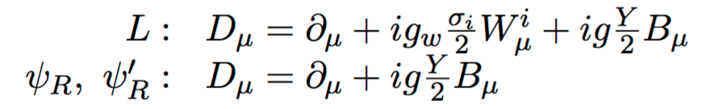
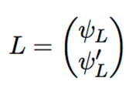



Electroweak unification
New covariant derivative: one gauge field per generator
Physical fields are linear combinations of the original gauge fields:
In order to obtain the QED current for A_{µ}, the Weinberg angle needs to be:

Slide 22
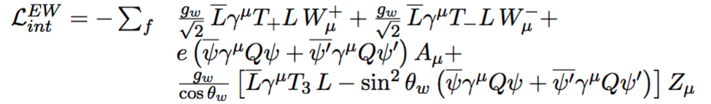
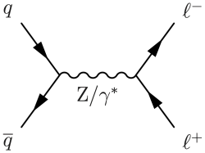
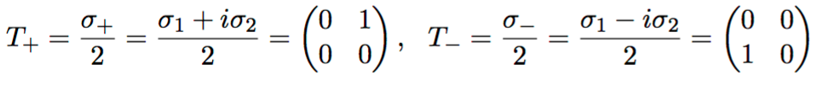

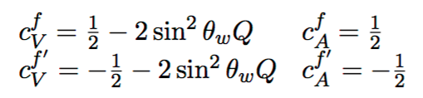
Electroweak unification
Interaction Lagrangian:
Rewriting the Z interaction in terms of axial and vector coupling:

Slide 23





Experimental milestones
⬥ 1972: Gargamelle: discovery of neutral currents
Neutral current
interaction
Bubble chamber in
Neutrino beam
*
-
The Neutral Current was not part of Gargamelle’s core program
… but they reacted fast to new challenge

Slide 24


Experimental milestones
⬥ 1972: Gargamelle: discovery of neutral currents
Neutral current
interaction
⬥ 1984: UA1/UA2: observation of W and Z bosons
UA1 Z production
1982-85
-
SPS pp collider
1981-1991, E=900 GeV

Slide 25









Electroweak gauge fields
Lagrangian of free gauge fields:
with:
Leads to triple and quartic gauge boson couplings:
W/Z bosons carry
EM and/or weak charges

Slide 26







Higgs mechanism
So far no mass terms for the gauge bosons W,Z as they
would destroy the local gauge invariance
Mass terms introduced by interaction with a scalar field
through the covariant derivative in he kinetic term
after assuming a non-zero vacuum expectation value
(electroweak symmetry breaking)
the interactions lead to mass terms for the W and Z
Peter Higgs

Slide 27



Summary Standard Model
⬥ Relativistic Quantum Field Theory
⬥ Symmetry requirements
⬥ Renormalizability
Symmetries and fields:
Lorentz boosts/rotations, translations
matter particles, spin1/2: ψ
described by Dirac formalism:
2x6 leptons: e, ν_{e}, µ, ν_{µ}, τ, ν_{τ}
2x6 quarks: u, d, c, s, b, t
Local gauge symmetries:
➔ force fields: spin 1: V
SU(2) x U(1) ➔ γ, Z, W±: EW force
SU(3) ➔ 8 gluons: strong force
⬥ Fermions and bosons masses
➔ scalar Higgs field ϕ
EW Symmetry breaking in
the ground state (vacuum)
Renormalizability
Effective parameters
can be adjusted in
all orders of
perturbation
expansion such
that theory keeps finite

Slide 28










SM: an international development
Yang Chen-Ning
(China) Gauge theories
Richard Feynman
(US), QED
Shinichiro Tomonaga
(Japan) QED
Abdus Salam
(Pakistan)
EW theory
Gerard ‘t Hooft
Netherlands,
renormalisation
Frank Wilczek
(US) QCD
Chien-Shiun Wu
(China/US)
Parity violation
Emmy Noether
(Germany):
Symmetries and
conservation
Peter Higgs
(UK) EWSB
Makoto Kobayashi
(Japan): Quark mixing
Murray Gell-Man
(US) Quarjks
Tsung-Dao Lee
(China) parity violation
Steven Weinberg
(US) EW theory

Slide 29




Parameters of the Model
13 masses: fermions, mH
4+4: quark and νmixing
1 QCD: strong coupling: α_{s}
3 EWK parameters, e.g.
- SU2 coupling g
- Weinberg angle θ_{W}
- Higgs vev ν
---------------------------------
25 free parameters (18 w/o ν)
EWK mixing
Other parameters can be derived:
Indirect constraints on other
SM parameters
→ Probe the SM

Slide 30





SM precision at LEP & SLC
1989-1998: e⁺e⁻ colliders LEP1 & SLC
Ecms ~90GeV
LEP: large data
sets
Z line shape
Numerous measurements:
Line width -> total decay rate
Forward/Backward, L/R asymmetry
Branching fractions
Heavy-Flavour quark production
Polarisation
SLC: small data set
polarised beam
3 light neutrino species
Good agreement with SM predictions
with order EWK corrections
Phys.Rept.427:257-454,2006

Slide 31

SM precision at LEP & SLC
1989-1998: e⁺e⁻ colliders LEP1 & SLC
Ecms ~90GeV
LEP: large data
sets
Z line shape
Numerous measurements:
Line width -> total decay rate
Forward/Backward, L/R asymmetry
Branching fractions
Heavy-Flavour quark production
Polarisation
SLC: small data set
polarised beam
3 light neutrino species
Good agreement with SM predictions
with order EWK corrections
Phys.Rept.427:257-454,2006

Slide 32



SM precision at LEPII
LEP2 (1996-2000): WW, ZZ, γγ
⬥ W leptonic and hadronic BF
⬥ W mass and width
⬥ Triple gauge couplings:WWZ, WWγ
& anomalous TGC: ZZZ, ZZγ*
WW cross section
Phys.Rept.532,119-224, 2013
→ Precise measurement of
W properties
TGC as predicted in SM

Slide 33





LHC: the Higgs boson
Production:
- gg fusion
- VBF
- bbH, ttH
- ZH,WH
2012: Higgs boson discovery:
ATLAS & CMS experiments, mH =125.1±0.2 GeV
LHC: Proton collider, 27km circumference,
6.5TeV beam energy
γγ
ZZ
WW
Phys. Lett. B 716 (2012)

Slide 34






The electro-weak fit
⬥ Since LEP/SLD, EWK precision data used together with accurate
SM calculations to predict parameters of the theory
2012: Higgs discovery, mH → EWK SM sector over constrained
→ Check consistency of SM by comparing fitted with measured values
Simple leading-order relation:
Example:
Higgs, W, Z, and top masses
are connected via radiative
corrections
include radiative corrections:

Slide 35

The electro-weak fit
⬥ Since LEP/SLD, EWK precision data used together with accurate
SM calculations to predict parameters of the theory
2012: Higgs discovery, mH → EWK SM sector over constrained
→ Check consistency of SM by comparing fitted with measured values
Example:
Higgs, W, Z, and top masses
are connected via radiative
corrections
GFitter: Eur. Phys. J. C78, 675 (2018)

Slide 36





The electro-weak fit
Example Z pole precision measurements:
Z Vector and Axial vector
Coupling structure:
..can be observed as
Fermion L/R asymmetries:
all related to θ_{W}

Slide 37



The electro-weak fit
Example Z pole precision measurements:
Z Vector and Axial vector
Coupling structure:
..can be observed as
Fermion L/R asymmetries:
all related to θ_{W}
.. or as Forward-Backward
Asymmetry
(forward = electron direction)
γ/Z interference
pure Z contribution
LO Z contribution
at the Z pole →

Slide 38





The electro-weak fit
Example Z pole precision measurements:
Z Vector and Axial vector
Coupling structure:
.. or as partial width,
ratio to the total
hadronic width
..can be observed as
Fermion L/R asymmetries:
all related to θ_{W}
.. or as Forward-Backward
Asymmetry
(forward = electron direction)
γ/Z interference
pure Z contribution
LO Z contribution
at the Z pole →

Slide 39

The electro-weak fit
LHC
LEP, Tevatron, LHC
LEP/
SLD
Tevatron
Direct measurements
in good agreement with
EW fit, except for A_{l} (SLD)
and A_{FB}^{(0,b)}
potential for new precision
measurements
Tevatron, LHC

Slide 40
Weinberg angle at the LHC

Slide 41


FB asymmetry
We want to measure the Weinberg angle with highest precison
Via the Forward-Backward asymmetry n Drell-Yan events
How is Forward and
Backward defined?
Ulla Blumenschein, DIS 2018, Kobe
41
19/07/19

Slide 42




FB asymmetry
Polar angle θ* of lepton
in dilepton centre-of-mass frame
z axis: bisection of quark
direction and negative anti-quark
Direction → Collins-Soper frame
In general, Z boson
not produced at rest
ATLAS measurement of cosθ*
B
F
JHEP 12 (2017) 059

Slide 43
FB asymmetry
Polar angle θ* of lepton
in dilepton centre-of-mass frame
z axis: bisection of quark
direction and negative anti-quark
Direction → Collins-Soper frame
At Tevatron the quark direction is known (= proton direction)
But what is the quark direction and the LHC?
Ulla Blumenschein, DIS 2018, Kobe
43
19/07/19

Slide 44


FB asymmetry
What is the quark direction and the LHC?
quark -> valence quark, anti-quark -> sea
Valence
quarks
Sea
quarks
Sea quarks in proton
Sea quarks usually carry a lower fraction of the
Quark momentum → define the hemisphere
which contains the Z boson as “Forward”
Not always correct → Dilution effect → dependence on modeling of the proton structure

Slide 45

Dilution in pp colliders
Guess quark direction
from Z direction
Quark direction from generator

Slide 46

Dilution in pp colliders
Best guess of quark direction in events
with a Z at large |η| (close to beam pipe)
Most sensitive: events with leptons at large |η|

Slide 47



Dilution in pp colliders
Larger FB asymmetry for events with one electron close to beam pipe
JHEP 12 (2017) 059

Slide 48

The Weinberg angle
PDFs Sensitivity
off-peak
sin²θ_{W}
Sensitivity at the peak and at large η

Slide 49

CMS: Template fit
Template-fit (Powheg+Pythia8 templates) -> PDF & sin²θ_{W}
arXiv:1806.00863

Slide 50

CMS results
Uncertainties comparable with Tevatron experiments.
Statistical uncertainties dominating

Slide 51

ATLAS measurement
ATLAS advantage: can identify electrons close to beam pipe
→ tap into region with large effective forward-backward asymmetry
LHC has precision
comparable to
Tevatron in spite
of dilution
Towards e+e- precision:
Reduce PDF uncertainty
Include more data
ATLAS-CONF-2018-037

Slide 52
Multi-Boson measurements

Slide 53




Multi-Boson production
Gauge boson kinematics and interaction:
Triple and Quartic Gauge Coupling
Higgs kinematics
and gauge boson coupling
New
Physics:
→ anomalous TGC
→ anomalous QGC
aTGC
aQGC

Slide 54
Multi-Boson production
WW
ZZ
WZ
Wγ
Zγ
γγ
γγγ
Wγγ
WWγ
WWW
WWZ
WZZ
VBF Z
VBF W
VBS WW
VBS WZ
VBS ZZ
Standard (“QCD”) production of Boson pairs:
Test of pQCD
Triple Gauge Coupling
Important background for H->VV
Electroweak production of single bosons
Contains Vector Boson Fusion (VBF)
→ Triple Gauge Coupling
Electroweak production of 2 bosons
Contains Vector Boson Scattering (VBS)
Triple/Quartic Gauge Couplings
Higgs contribution stabilizes cross section
Triboson production
→ Triple/Quartic Gauge Couplings

Slide 55


WW cross section
Selection: final states with e+µ,
Jets and b-jets veto to suppress top
m(eµ)> 55 to reduce Higgs component
Backgrounds: top, W+jets, Drell-Yan
Main systematic uncertainty
from jets and b-jets veto,
and backgrounds
pT(eµ)
top
arXiv:1905.04242

Slide 56


WW cross section
new physics
would show
here
pT(lead lep)
arXiv:1905.04242
WW cross section measured with
a precision of 7%, syst. dominated.
In agreement with NNLO calculations
and NLO MC generators

Slide 57



ZZ cross section
Advantage:
Clean selection of 4 leptons
→ no jet vetoes needed
Can even measure ZZ+jets
Disadvantage:
Smaller cross section
→ need more data
Triple gauge boson vertex
forbidden in SM
Not allowed in SM
Possible with new physics
JHEP 04 (2019) 048

Slide 58

ZZ cross section
Advantage:
Clean selection of 4 leptons
→ no jet vetoes needed
Can even measure ZZ+jets
Disadvantage:
Smaller cross section
→ need more data
Triple gauge boson vertex
forbidden in SM
On-shell ZZ
JHEP 04 (2019) 048

Slide 59


ZZ cross section
m(4l)
N(jets)
JHEP 04 (2019) 048
Phys. Rev. D 97 (2018) 032005
Good agreement with NNLO predictions
(if applicable) and MC generators
Good modeling of jet multiplicity
with multi-leg ME+PS generator

Slide 60



ZZ cross section
ZZ cross section measured with 3.5% precision
NNLO
NLO
NNLO is preferred over NLO
CMS SMP-19-001

Slide 61




Boson scattering
s = squared center-of-mass
energy of the interacting
bosons
Without the Higgs contribution the cross section
diverges for high energies
Higgs contribution cancels divergence
if Higgs couples proportional to W mass:
g_{HWW} = gM_{W} … as expected from SM Higgs
Similar for W+W- scattering, WZ scattering, etc

Slide 62



Electroweak ss WW production
Characteristic for EWK VV production:
presence of two forward jets
EWK VV events accumulate at large m(jj)
and large rapidity gaps between jets |Δη(jj)|
→ First observation of
EWK WW production

Slide 63





Electroweak WZ production
Main Background: Standard WZ with 2jets
BDT, using 15 discriminating variables:
→ First observation of EWK WZ production

Slide 64

Summary
The Standard-Model has been probed at high precision at e+e- colliders.
LHC has reached a high precision in EWK physics measurements and
Is probing important SM parameters at a competitive precision.
So far no hint for physics beyond the Standard Model.

