Slide 1
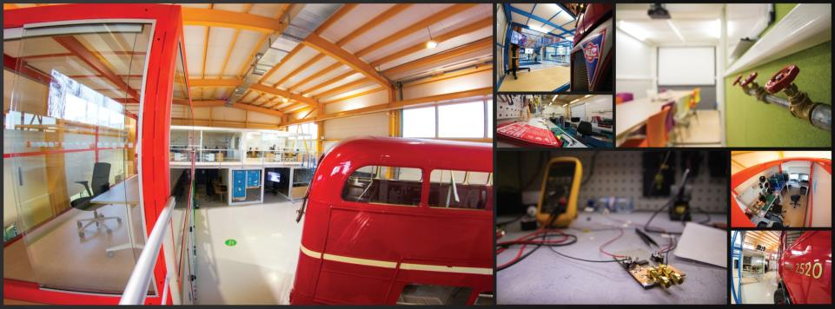

CERN Ideasquare
INTRODUCTION
EPS TIG Workshop, CERN October 4-6, 2019 Markus Nordberg (CERN)

Slide 2
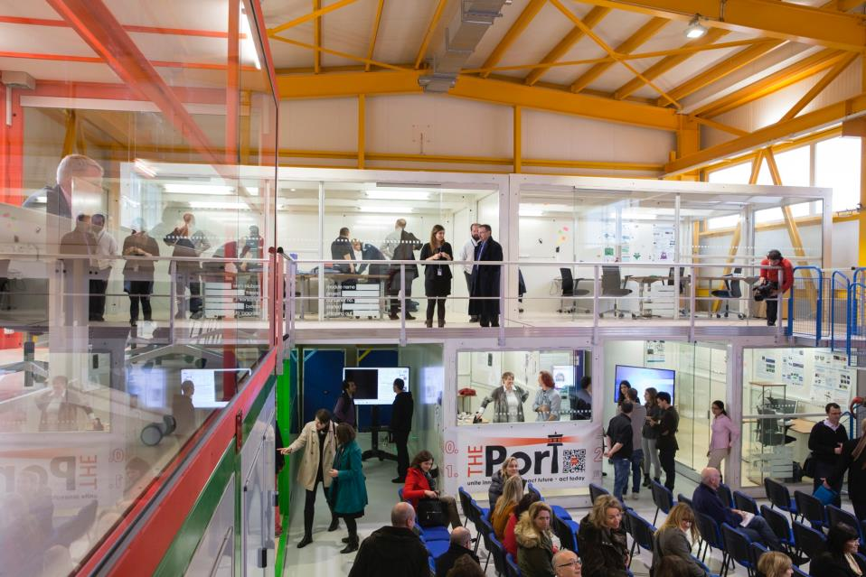
IDEASQUARE IN BRIEF
“Ideasquare is an experiment to bring together physicists, engineers, industrial partners, early-stage researchers and cross-disciplinary teams of students to work together on detector upgrade R&D and related technologies. The purpose is to co-develop new technologies for research purposes, and at the same time, create a fruitful environment for socially and globally relevant new product ideas and innovation.”

Slide 3
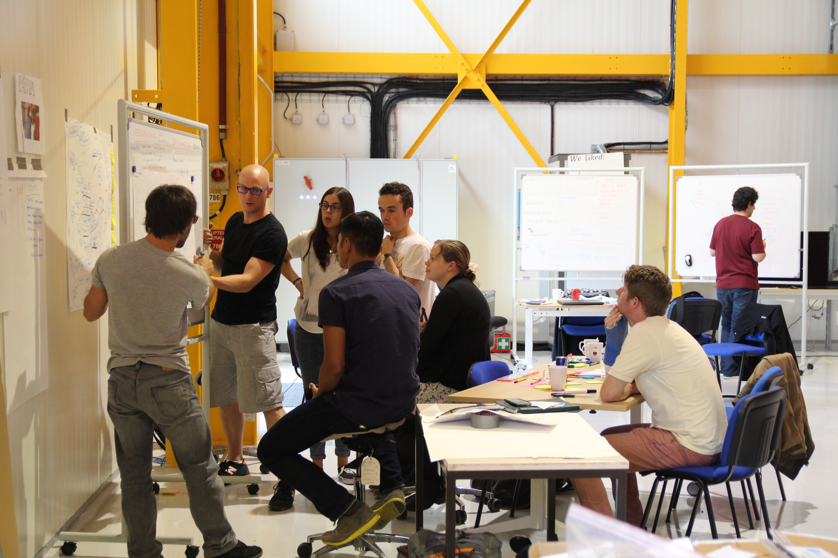

IDEASQUARE IS
Project with a dedicated building, hosting:
  EU-funded detector upgrade R&D projects
  Innovation events, workshops, hackathons
  Multidisciplinary master level student programs
...to prototype, test and iterate new forms of collaboration and co-creation in the areas or Research, Education and Technology – RET
Monitored by IS Advisory Board
Research
Education
Technology

Slide 4
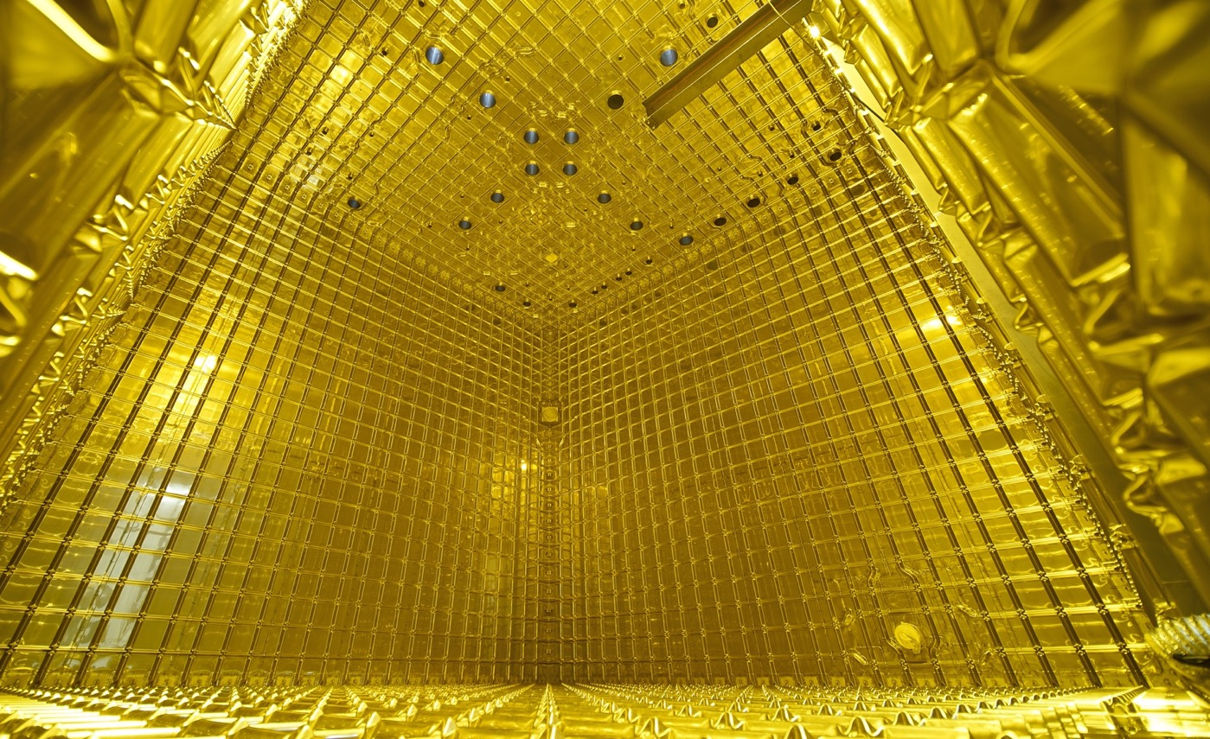

EXAMPLE: NEUTRINO PLATFORM PROJECTS
Neutrino Platform (CENF) fosters fundamental research in the field of Neutrino Accelerator Physics
CENF supports generic detector, neutrino beams R&D and large detector prototypes or demonstrators. It gives technical, financial and logistics support to approved projects
Currently includes seven projects, including significant involvement in (Proto)Dyne
CERN & IdeaSquare provides a facility for R&D on future technologies (HW and SW) and partner in several neutrino research programs
www.attract-eu.com

Slide 5
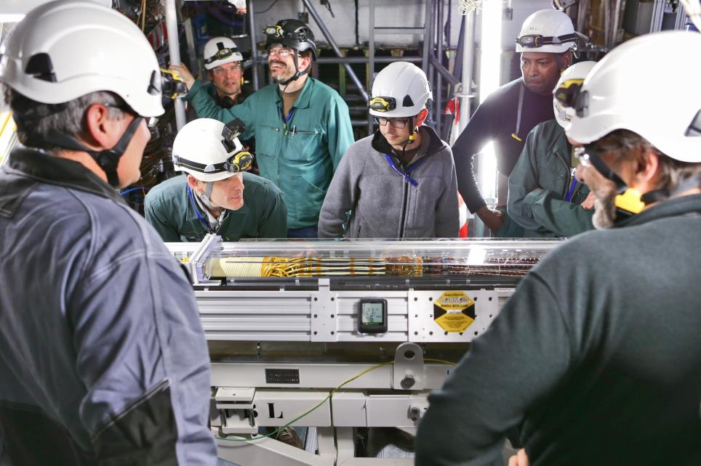

EXAMPLE: EU-FUNDED ATTRACT PROJECT(S)
ATTRACT funds 170 breakthrough projects in Detection & Imaging
  15 of them involving the NL universities, research labs, industry
Provides funding for developing early-stage ideas and prototypes
Focuses on high innovation with potential outside research
Engages with CBI-like student activities, seeking for unforeseen entrepreneurial opportunities for the young
Purpose is to create a new innovation ecosystem in Europe
ATTRACT is coordinated by CERN (IdeaSquare)
www.attract-eu.com

Slide 6
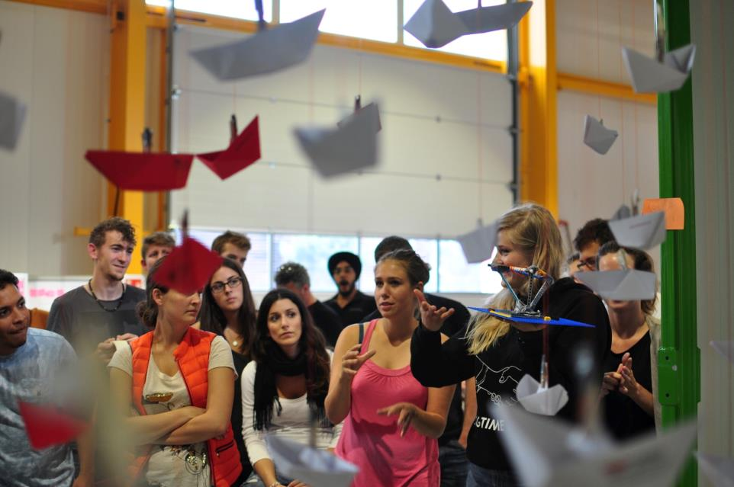

EXAMPLE: MASTER-LEVEL STUDENT COURSE
Challenge Based Innovation (CBI) is 5-6 month MSc-level specialization course for product and service development, run by participating universities from 8 countries around the world
Over 600 students have participated with more than100 conceptual prototypes produced, contributing to UN Sustainable Development Goals
In the course, multidisciplinary student teams learn how to apply Design Thinking – process for new product/service development; engaging with CERN researchers who act as technological coaches in the process
“Work extremely hard, learn and have fun!”
“Fail fast and often to succeed sooner”

Slide 7

EXAMPLE: STUDENT PROJECT PROTOTYPE

Slide 8
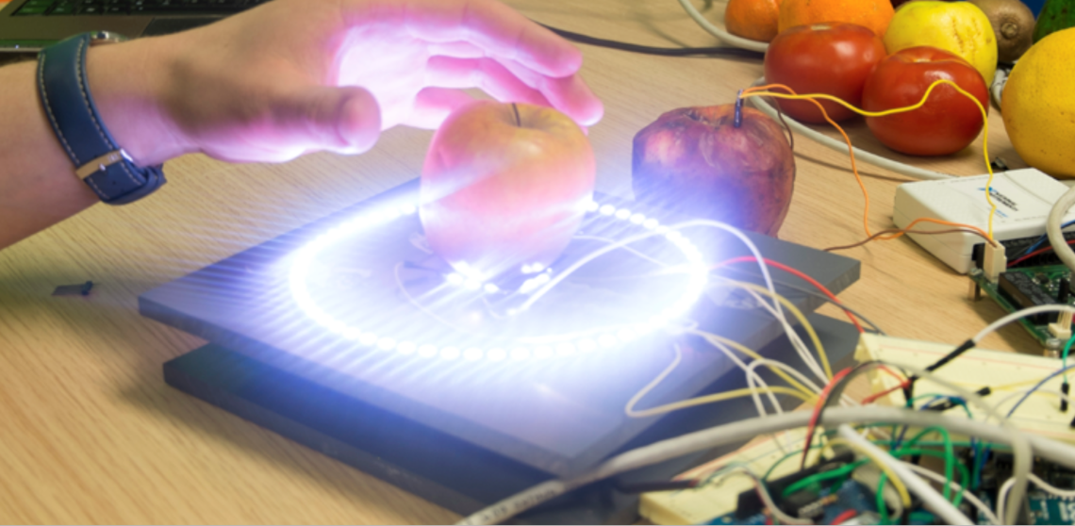
EXAMPLE: STUDENT PROJECT PROTOTYPE

Slide 9
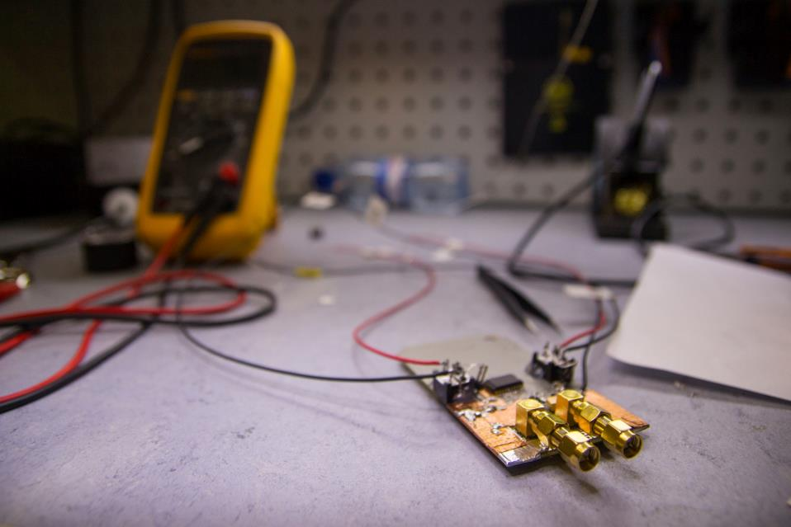
IDEASQUARE OUTPUT
Creating next-generation of young scientists and innovators
Accelerating flow of ideas and time from discovery to application
More effective sharing of ideas, spaces and resources across projects at CERN and outside
New results in socio-economic research about experimental innovation processes (IdeaSquare Journal of Experimental Innovation, http://cij-ei.web.cern.ch/cij-ei/)
Making societal value of basic research more visible and tangible
New insights for ATTRACT (www.attract-eu.com)

Slide 10

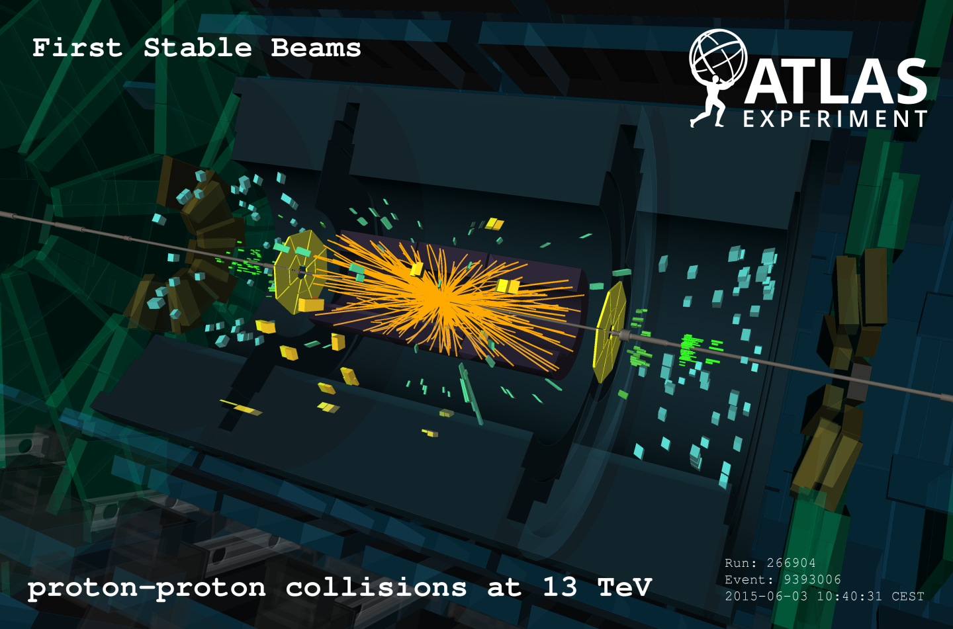


WHAT IS THE MOST INTERESTING LINK FOR NEW INNOVATION?
Detector R&D
Projects
Defined/closed
Technology
MSc-Level Student Programs (e.g. CBI)
Initially undefined/open
Product
Process
Focus

Slide 11


Questions? Comments?
Contact information:
Email
Skype
Let’s have a cup of coffee and make it happen!

