Slide 1
1st EPS TIG Hands-on Event for Science, Technology and Interfaces

Slide 2
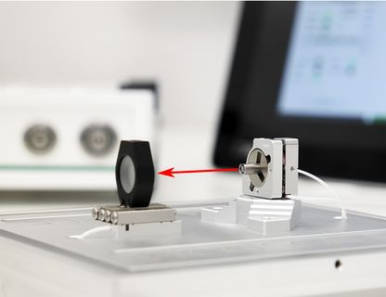
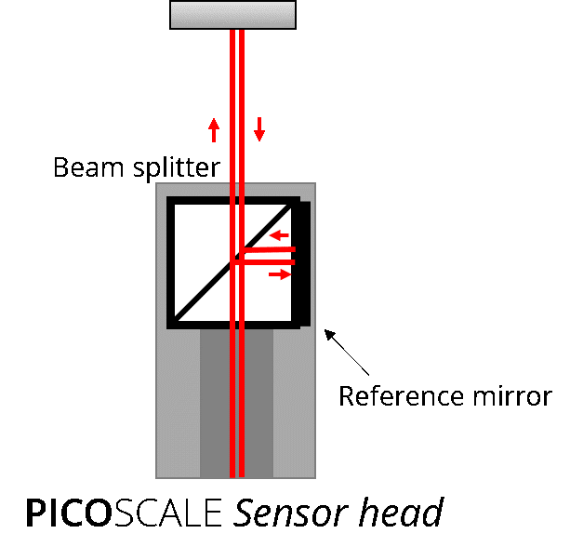
Session 2 Project
Build a modern interferometer to measure the shift along the X, Y and Z axis of a piezo stack.

Slide 3
Working groups
List of the groups:
A) Communication and coordination
B) Opto-mechanics hardware
C) Electrical hardware
D) Interferometer software
E) Data Analysis

Slide 4
Problems
Prism shape ⇒ two channels are highly correlated ⇒ difficult calibration
Drift compensation during acquisition
Alignment of the lasers and the faces of the piezo-stack

Slide 5
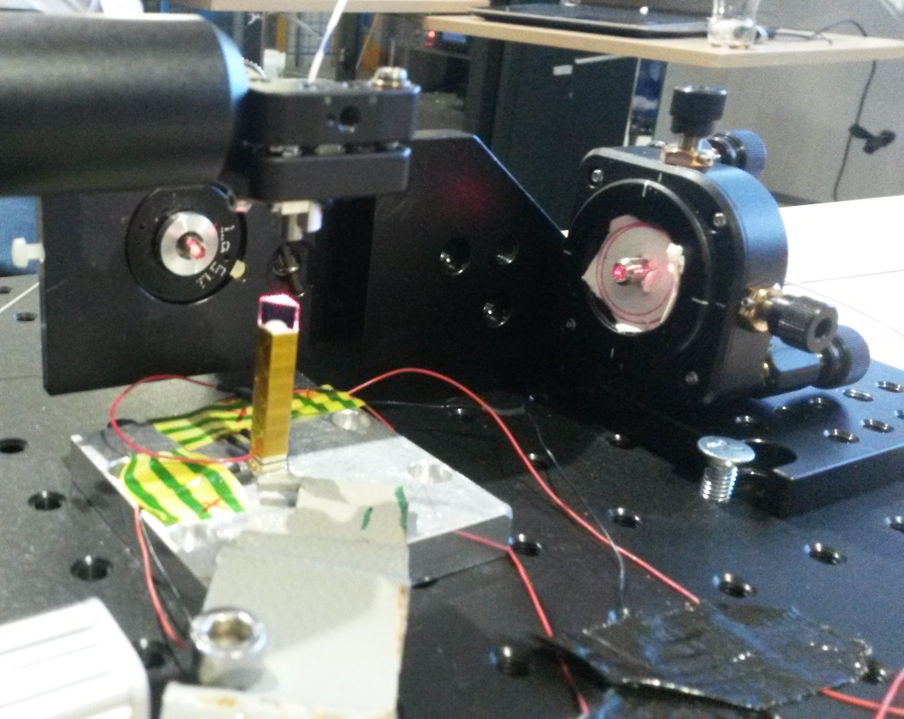
Final Acquisition
Acquisition only from one channel (Z axis)
Acquisitions:
Drift signal
Piezo displacement changing the tension

Slide 6
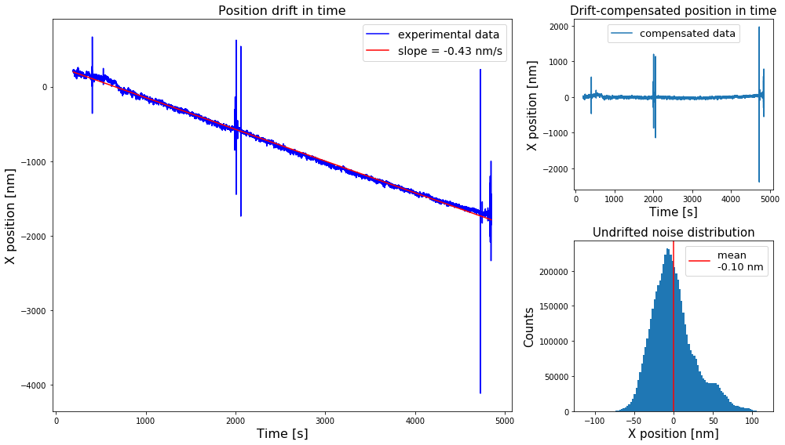
Results: Drift Measure

Slide 7
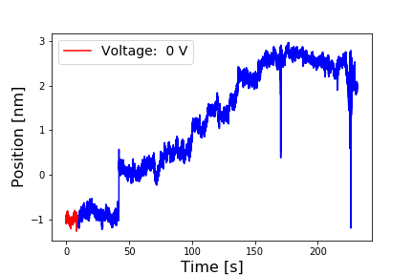
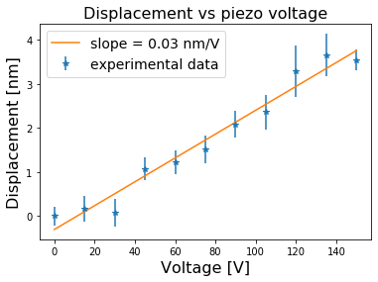
Results: Piezo-stack behaviour

