Slide 1
JIRA for LIU BWS
Overview and tips

Slide 2
Getting ready
Connect to https://issues.cern.ch
Create your own dashboard, or use a shared one. For starters, you can subscribe to BWS-LIU User Dashboard.
Have a look at BI-BWS-LIU board.

Slide 3
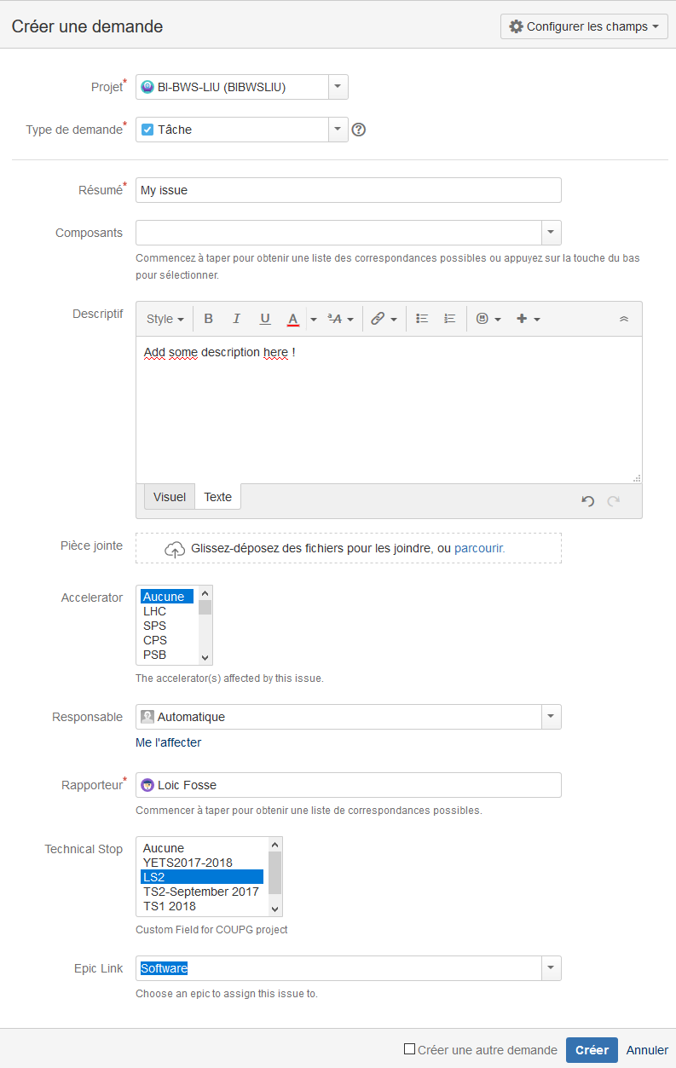
Create an issue
Check Project.
Set issue type.
Add a summary and a description.
Set accelerator / TS is relevant.
Set responsible. It can stay unassigned.
Don’t forget the Epic Link.
All fields can be corrected afterwards !

Slide 4
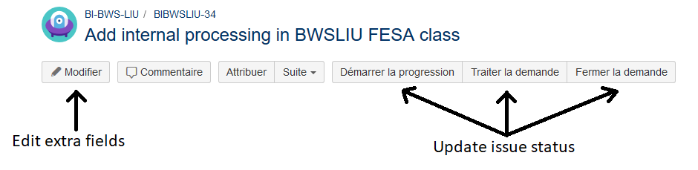
Update an issue
Some fields are only available once the issue is created:
Priority
Proper due date/time estimation*
Etc.
Current status can be changed with dedicated buttons. Don’t hesitate to start – stop – start again an issue.

Slide 5
Good practices and suggestions
Don’t hesitate to create your own tasks, and to split your issues in smaller ones. All tasks > 0.5 day are relevant in JIRA (imho).
Create and watch all issues you need. An issue can stay unassigned for a while.
Link issues when necessary.
Don’t forget to update status.
All relevant information to an issue should be attached to it.
Favor comments instead of emails to discuss an issue. Comments are sent by email to all watchers !

Slide 6
JIRA improvements
Add cross-section components
Ask for more visualization widgets

