Slide 2
Beam studies in 2018
H. Damerau for the Landau RF System Study Group
PS Landau RF system Checkpoint Meeting
24/01/2019
Many thanks to F. Bertin, R. Calaga, L. De Mallac, N. Esfahani, G. Favia,
A. Lasheen, M. Morvillo, M. Paoluzzi, C. Rossi, E. Shaposhnikova

Slide 3
Overview
Performance achieved in 2018
  Upgrades during YETS2017/2018
Existing 40 MHz cavities for Landau damping
Margin to reduce longitudinal emittance
What cannot be covered with existing cavities?

Slide 4
Intensity reach

Slide 5
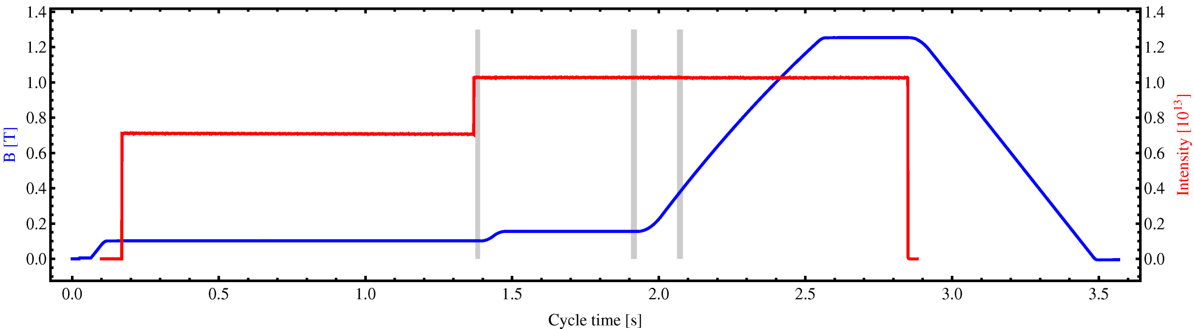
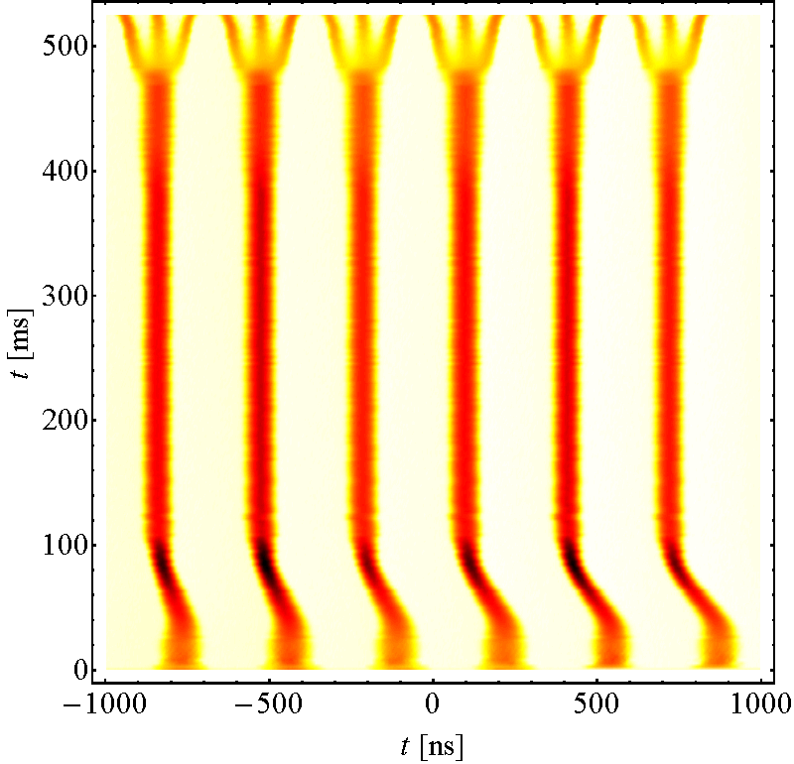
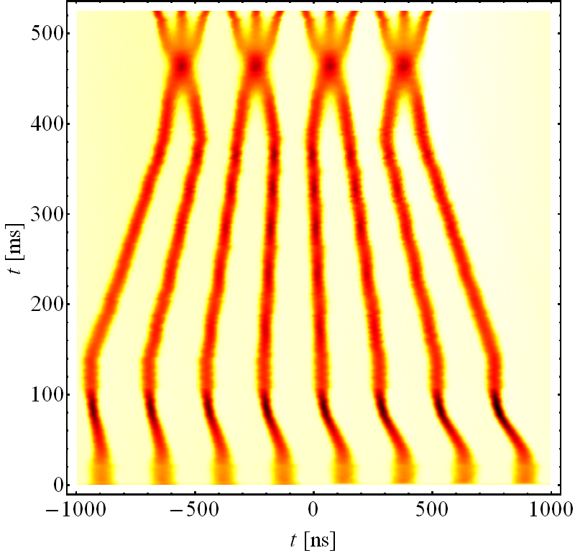
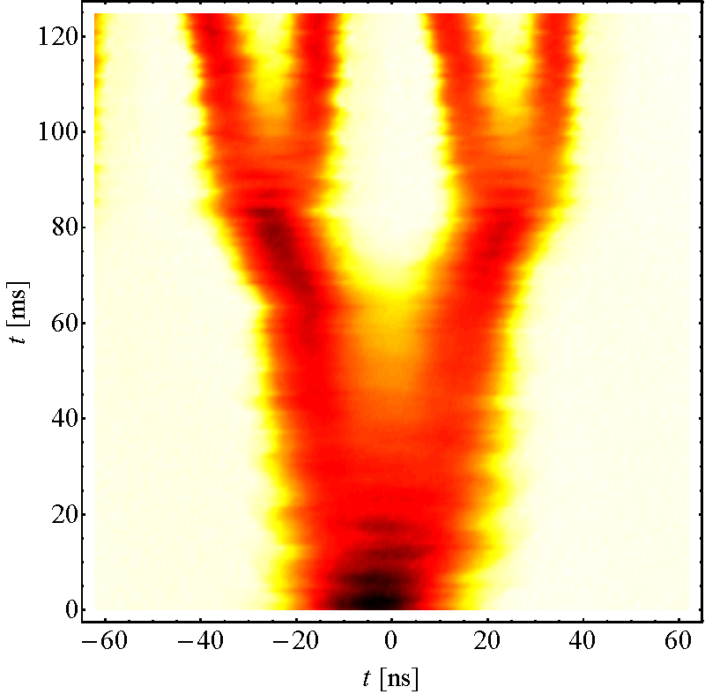
LHC-type beams with 25 ns spacing in the PS
Longitudinal emittance, bunch length meas.
Inject 4+2 or 4+4 bunches
Eject 72 bunches
Controlled blow-ups
h = 21
γ_{tr}
h = 7 or 9
h = 84
Instability,
blow-up
Standard, 3-split
BCMS
E_{kin} = 2.5 GeV
E_{kin} = 2.5 GeV
26 GeV/c

Slide 6
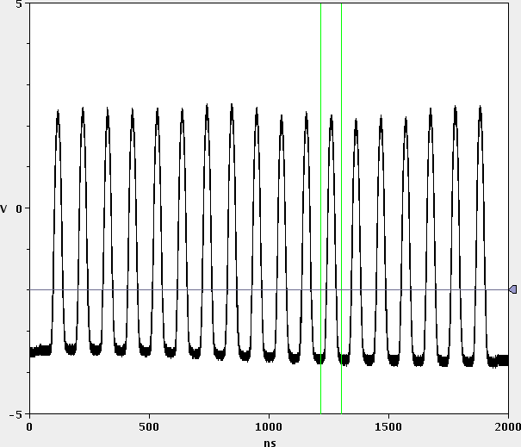
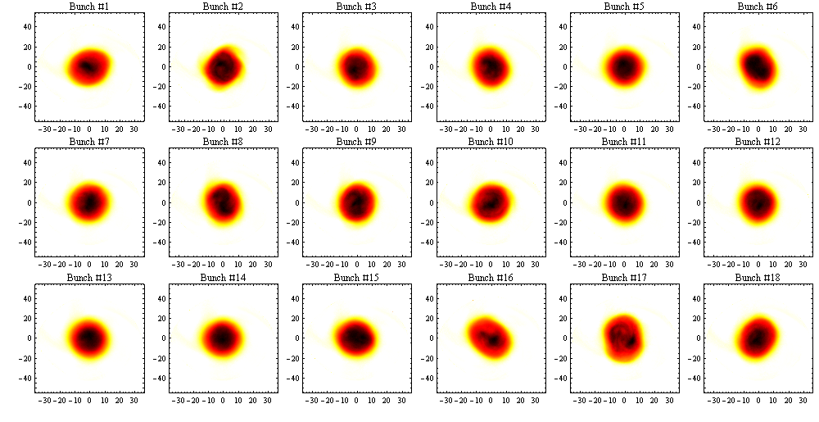
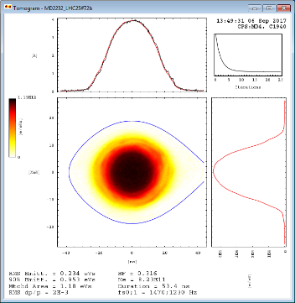
Multi-bunch tomography
Record almost full turns with 4 GS/s
Reconstruct longitudinal distribution of each bunch individually
Common foot-tangent fit definition (0.35 eVs/b) varies with bunch shape
Choice of analysing statistical emittances (90%), ε_{l,foot-tangent} ≈ 1.4 ε_{l,90%}
10 cycle average to reduce and evaluate cycle-to-cycle fluctuations
4 GS/s
ΔE [MeV]
Δt [ns]

Slide 7
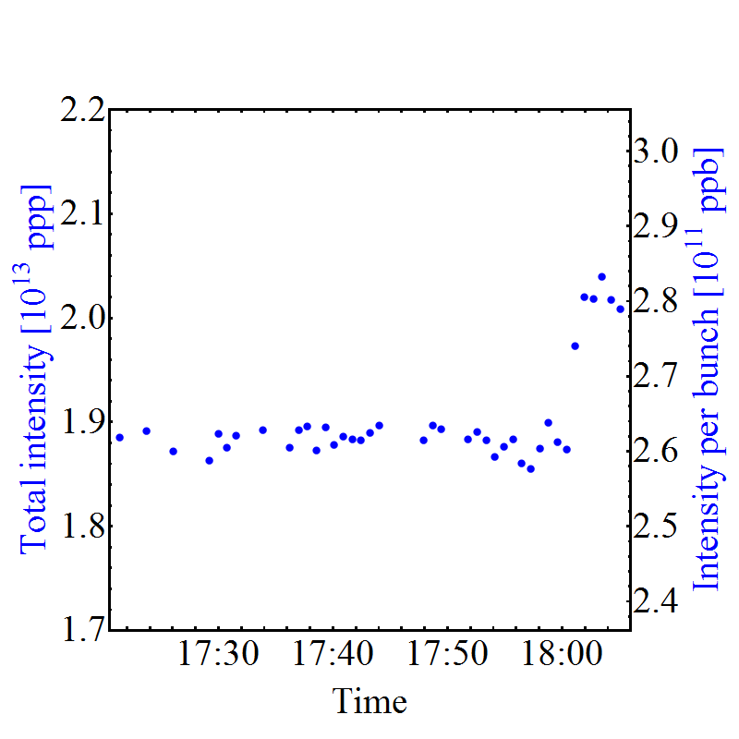
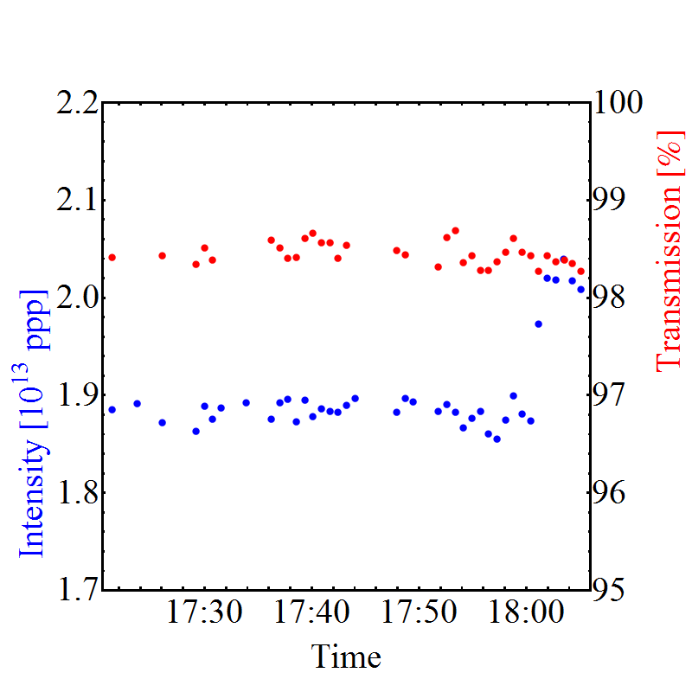
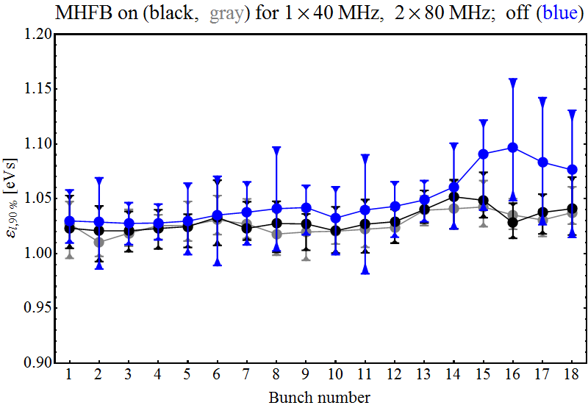
LHC25ns (72 bunches), maximum intensity
All presently available upgrades active:
  Finemet coupled-bunch feedback
  1×40 MHz, 2×80 MHz with multi-harmonic feedback (MHFB)
  1×40 MHz as Landau RF system starting ~170 ms after transition
Transmission at ~2.6 ∙ 10¹¹ ppb well within 5% budget
MHFB removes emittance growth towards end of batch
Intensity and transmission
e_{l}, arrival at flat-top, 2.6 ∙ 10¹¹ ppb
Intensity and transmission
~2.6×10¹¹ ppb

Slide 8
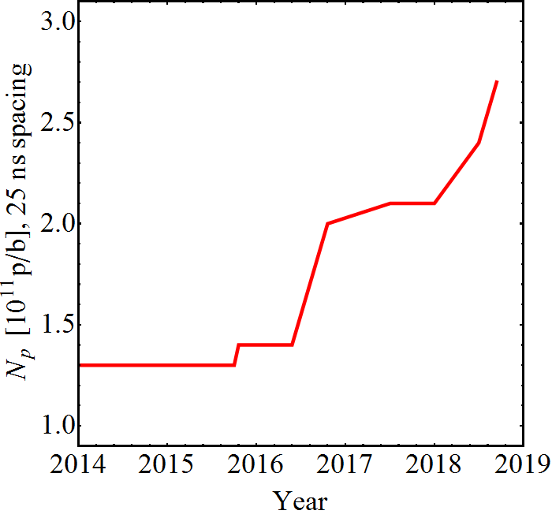
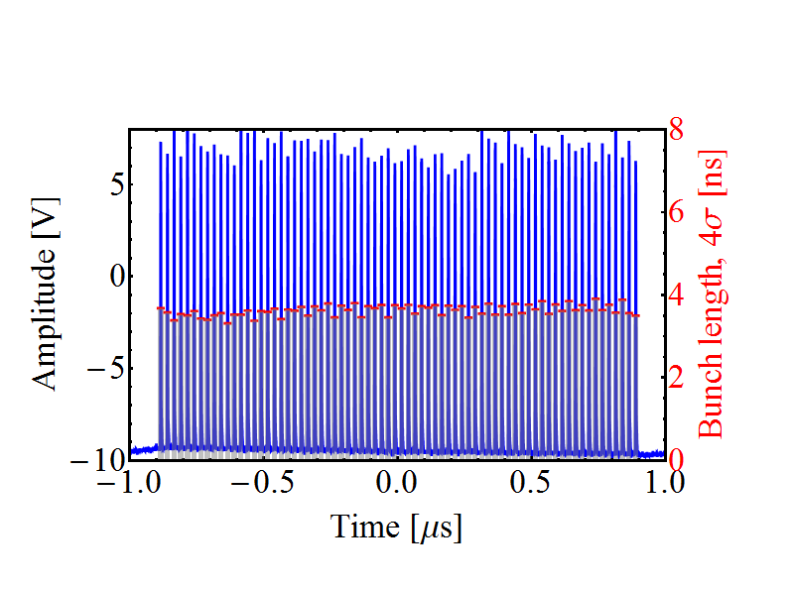
Intensity evolution (25 ns, 72 bunches)
Intensity per bunch at extraction
Multi-harmonic feedbacks
C40-78 as Landau RF system
LIU baseline
Suspected feedback saturation
Optimization 2017
Study WG started
Finemet dipole-mode
coupled-bunch feedback
Reach with C10-86/96 coupled-bunch feedback (2005)*
Bunch profile/length
*Intensities >1.3 ∙ 10¹¹ ppb were delivered <2016, but not with sufficient quality for LHC
Wealth of beam measurements at 2.6 ∙ 10¹¹ p/b (LIU intensity)
No more protons until end of 2020

Slide 9
Existing 40 MHz system

Slide 10
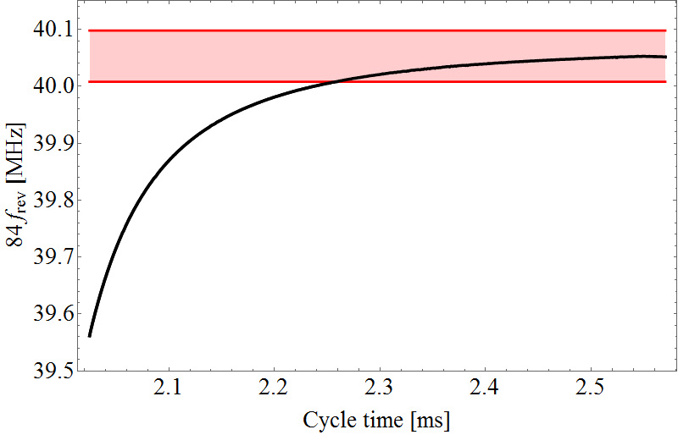
Frequency range of 40 MHz cavities
  Existing 40 MHz cavities optimized for large RF voltage (~300 kV) at fixed frequency (84f_{rev} at 26 GeV)
  Explore frequency range at low RF voltage
  Measured in 2017 with previous anode converters
  Important difference between both 40 MHz cavities
40 MHz frequency during cycle
Usable frequency range:
V_{RF} | C40-77 | C40-78
10 kV | 110 kHz | 170 kHz
20 kV | 50 kHz | 90 kHz
  Measured frequency range of C40-78 at 20 kV
84f_{rev} [MHz]
  84f_{rev} (protons) from transition to flat-top
Cycle time [s]

Slide 11
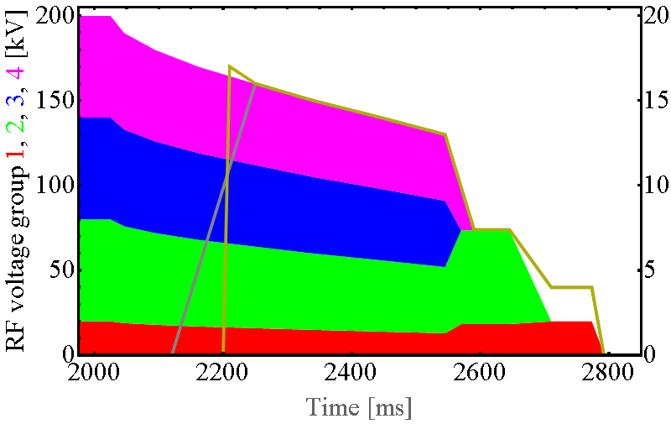
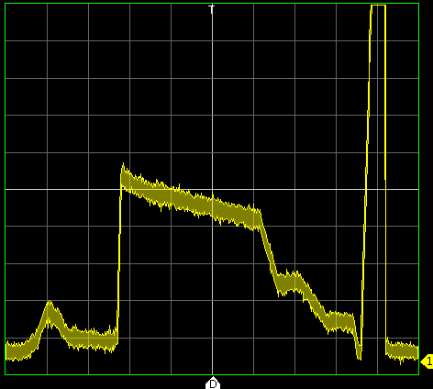
Operating 40 MHz cavities during acceleration
Drive cavities off resonance during acceleration
  Beam tests with new anode power converter
  Gap of ~150 ms between transition and start of 40 MHz voltage
  Evidence of stabilizing effect during acceleration
10 MHz and 40 MHz voltage programs
Detected voltage C40-78
100 ms/div
Voltage ratio 1/10
Transition
Voltage ratio 1/5
RF voltage 40 MHz [kV]
1 s
Time
Cycle time [ms]

Slide 12
Existing 40 MHz cavities as Landau RF system
Final tests to operate existing 40 MHz cavities as Landau RF systems
Signals from C40-77
Signals from C40-78
U_{DC,final}
U_{DC,final}
V_{prog}
V_{prog}
~12 kV_{p}
RF at gap
~16 kV_{p}
RF at gap
I_{DC,final}
I_{DC,final}
Transition
100 ms/div
Extraction
Transition
100 ms/div
Extraction
C40-77 much weaker off-frequency than C40-78
Confirms earlier bandwidth measurements
V_{RF} | C40-77 | C40-78
10 kV | 110 kHz | 170 kHz
20 kV | 50 kHz | 90 kHz
2017 data (no beam)
Beneficial effect on longitudinal beam stability proven

Slide 13
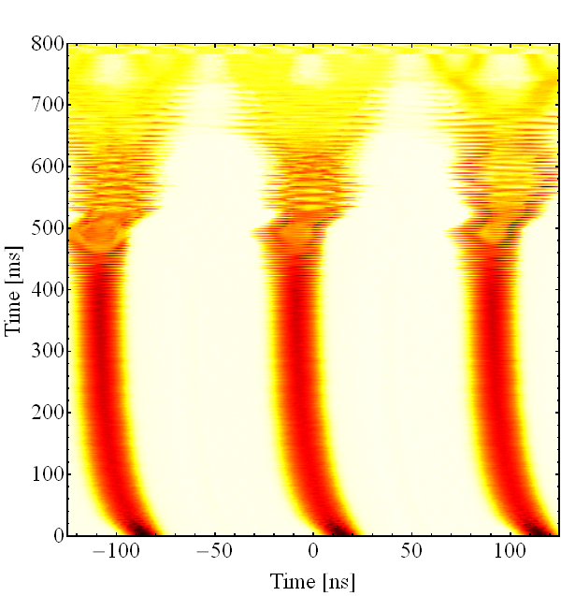
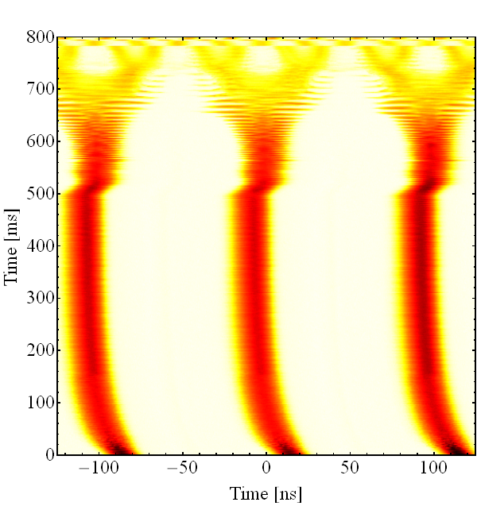
40 MHz cavity as Landau RF system
Evaluate benefit of on longitudinal stability during acceleration
  Disable coupled-bunch feedback ~225 ms after transition
  Significant stabilization due to higher-harmonic RF
  Stability margin beyond LIU baseline
  Further optimization: relative phase and voltage ratio
10 MHz only
10 and 40 MHz (in phase)
V_{h84}/V_{h21} ~0.1, 0.2 at flat-top
Feedback off
Feedback off

Slide 14
Margins?

Slide 15
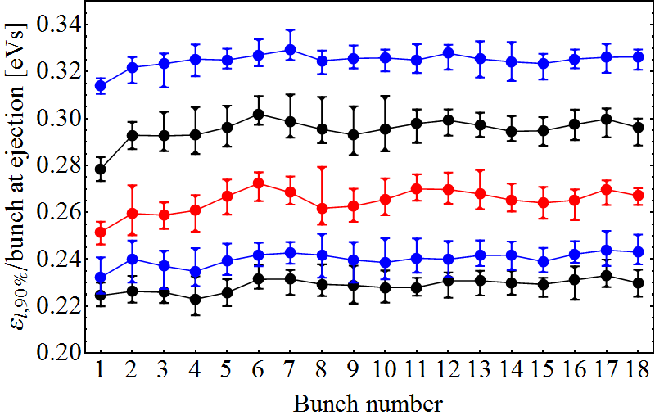
Longitudinal stability margin (25 ns, 72 bunches)
Explored minimum longitudinal emittance, ε_{l} with all upgrades together
  1-turn delay feedbacks (all 10 MHz cavities)
  Multi-harmonic feedbacks (1 × 40 MHz and both 80 MHz cavities)
  Coupled-bunch feedbacks (Finemet damper and C10-86/C10-96)
  40 MHz Landau RF system (C40-78 only, acceleration and flat-top)
ε_{l} (90%) at start of flat-top, per bunch at ejection
versus controller blow-up after transition, 2.6 ∙10¹¹ p/b
Blow-up 4 with 4×4.5kV
3×4.5kV
Nominal ε_{l}
2×4.5kV
1×4.5kV
Margin to deliver 10…15% smaller emittance
Limitations due to beam-loading (RF current) beyond
No blow-up after transition

Slide 16
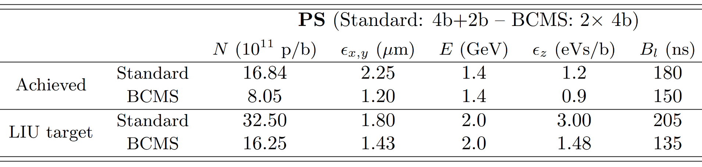
Minimum longitudinal emittance from PS?
LIU baseline at PS injection
Bunches split in PS by 12 (standard triple splitting) or 6 (BCMS)
  ~0.25 eVs/bunch at extraction already at injection
Assume ~20% (un-)controlled blow-up (RF manipulations, transition, synchronization)
Longitudinal emittance below 0.3 eVs_{FT}/bunch corresponding to ~0.21 eVs_{90%}/bunch difficult to achieve with present LIU baseline
ε_{l} in foot-tangent (FT) definition

Slide 17
Not covered by existing system

Slide 18
Additional benefits of dedicated Landau system
Dedicated versus existing RF system
 | Dedicated system at 40 MHz | Existing 40 MHz cavities | Comment
Voltage ratio, with respect to 200 kV | 20% | ~14 % max. | Main RF voltage decreases after transition
Operation below transition | ✓ | Excluded
Time for damping | Flat-bottom to flat-top | ~13.5 GeV to flat-top
Usage for other than LHC-type beams | Excluded | Excluded | 30 MHz option only or Fixed target beam at h = 21?
Voltage limitations with existing 40 MHz system during acceleration
Higher-harmonic below 13.5 GeV excluded without dedicated RF system

Slide 19
Existing 40 MHz cavities as Landau RF system
Total voltage of both cavities together up to 28 kV_{p} at ~175 ms after transition crossing, f_{RF} ≈ 39.98 MHz
  ~17 % of main RF voltage
  More voltage could be attained closer to the flat-top
Limitations due to bandwidth excludes advancing voltage program earlier
  Impossible to operate existing cavities closer to transition energy or even below
  Landau RF system effective for beam energies above E_{tot} ≈ 13.5 GeV

Slide 20
Voltage requirement for Landau RF system
Updated RF system parameters:
Reduced voltage requirement confirmed by parameter scans
  Optimum ratios: 0.15 (30 kV) for h₂/h₁ = 4 and 0.2 (40 kV) for h₂/h₁ = 3
 | Δf/f [%] | h₂/h₁ = 3, h = 63 | h₂/h₁ = 4, h = 84
2 GeV to 26 GeV | 5.3 | 28.49…30.04 MHz | 37.98…40.05 MHz
Transition to 26 GeV | 1.3 | 29.65…30.04 MHz | 39.53…40.05 MHz
Fixed target option | 6.8 | 28.49…30.51 MHz (h₂ = 63 and 64)
RF voltage |  | 60 kV (V₂/V₁ ≈ 0.3) | 40 kV (V₂/V₁ ≈ 0.2)

Slide 21
Reach of existing 40 MHz system
Updated RF system parameters:
Existing 40 MHz system short in voltage
  Just enough for Landau damping during acceleration?
Damping operation only above 13.5 GeV
  What is the impact on performance?
 | Δf/f [%] | h₂/h₁ = 3, h = 63 | h₂/h₁ = 4, h = 84 | h₂/h₁ = 4, h = 84 existing cavities
2 GeV to 26 GeV | 5.3 | 28.49…30.04 MHz | 37.98…40.05 MHz | 39.98…40.05 MHz (13.5…26 GeV)
Transition to 26 GeV | 1.3 | 29.65…30.04 MHz | 39.53…40.05 MHz
Fixed target option | 6.8 | 28.49…30.51 MHz (h₂ = 63 and 64) |  | excluded
RF voltage |  | 60 kV (V₂/V₁ ≈ 0.3) | 40 kV (V₂/V₁ ≈ 0.2) | < 28 kV (V₂/V₁ < 0.17)

Slide 22
Summary
Longitudinal LIU baseline parameters reached at PS extraction
Existing 40 MHz cavities with new anode power converters usable above ~13.5 GeV
  Beneficial effect on beam stability observed
Limitations with existing cavities
  Maximum RF voltage limited to ~28 kV (sum of both cavities)
  Higher-harmonic operation at lower energies excluded

