Slide 1
Strategy for measurements of Mo coating for collimators
Adnan, Nicolo and Benoit for the Impedance team and IWG

Slide 2
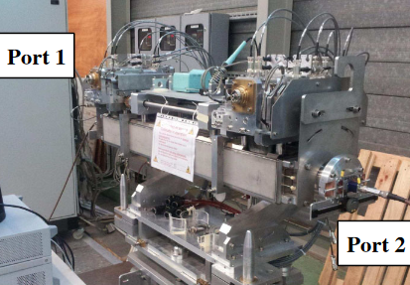
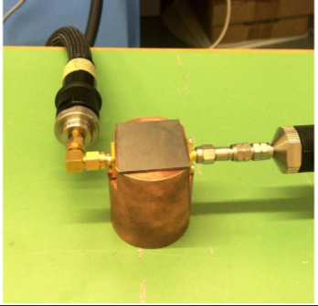
The life of a MoGr block
Production of MoGr blocks
Validation at CERN
Coating at DTI
Validation at CERN
Asssembly at CINEL
Validation at CERN
Possibility
to measure
uncoated blocks
and samples
Possibility
to measure
coated blocks
and samples
Possibility
to measure
collimator assembly

Slide 3
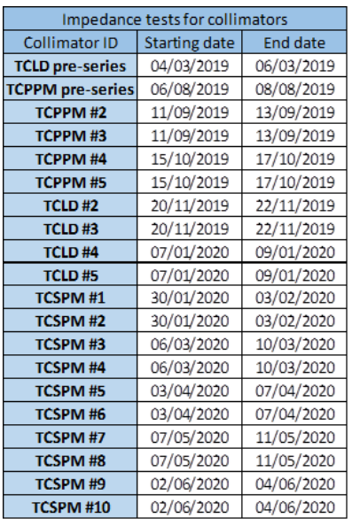
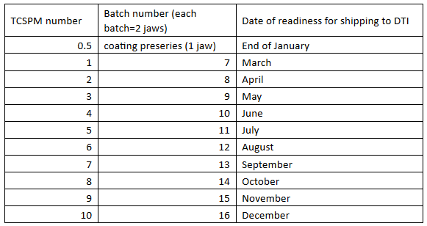
Main facts
1 batch: 20 MoGr blocks (2 jaws + spares) and 2 samples
10 batches in total (200 blocks including 20 spares)
1 uncoated batch sent to CERN per month from mid February 2019
Batch sent to DTI for coating 2 weeks after reception (see planning in table below)
Coating performed and batch sent back to CERN after 2 weeks
Assembly at CINEL
Final validation at CERN (see planning on the right)

Slide 4
The life of a MoGr block
2 collimators
per month
starting
January 2020
1 batch
per month
Production of MoGr blocks
Validation at CERN
Coating at DTI
Validation at CERN
Asssembly at CINEL
Validation at CERN
2 weeks
2 weeks
?
?
Possibility
to measure
uncoated blocks
and samples
Possibility
to measure
coated blocks
and samples
Possibility
to measure
collimator assembly

Slide 5
Baseline and questions concerning measurements
Proposed baseline:
  We measure the uncoated samples before coating → check of MoGr bulk
  We measure the coated samples → check of coated MoGr
  Probe measurements on the full assembly collimator → check of non conformities (RF fingers)
  (with stringent limits on insertion and collimator gap)
→ risk minimized: - no pollution or damage to blocks, only to samples
- less invasive check of collimator (probes only)
→ but: - no check of variability of production (MoGr and coated MoGr)
- no check of difference between coating of samples and blocks
- no check of resistive wall impedance of full assembly
Questions:
  Should we measure a sampling of the uncoated blocks?
  Should we measure a sampling of the coated blocks?
  Should we push for wire measurements of the full assembly

Slide 6
Questions/options
Should we measure a sampling of the uncoated blocks?
  Pros: too many losses to be very sensitive with the cavity measurement,
  Cons: pollution, damage of the blocks, the DC measurement could be enough
    Proposal: one should measure a subset of one batch with cavities (10), only if sample measurement prove useful. In case of issues, only a subset should be used to check that the impact was or not coming from impedance. Procedure should be checked by TE-VSC colleagues (done), and written up. TE-VSC colleague should be present.
Should we measure a sampling of the coated blocks?
  Pros: too many losses to be very sensitive with the cavity measurement, the DC measurement could be enough
  Cons: pollution, damage of the blocks
    Proposal: one should only measure a subset of one batch with cavities (10). In case of issues, only a subset should be used to check that the impact was or not coming from impedance. Procedure should be checked by TE-VSC colleagues (done), and written up. TE-VSC colleague should be present.
Should we push for wire measurements of the full assembly?
  Pros: clearer identification of modes → better understanding of non conformities; access to resistive wall if gap can be very small
  Cons: large risk of pollution and coating damage by manipulation or wire breakage
  Proposal: no wire measurement.

