Slide 1
HL-LHC BEAM STABILITY WITH
POSITIVE LANDAU OCTUPOLE POLARITY
E. Métral for HSC team
=> Recent analysis by XavierB presented at HSC meeting on 21/01/2019 (https://indico.cern.ch/event/783125/contributions/3279356/attachments/1781821/2899102/2019-01-14_HLLHCWithPositivePolarity-expanded.pdf)

Slide 2
HL-LHC BEAM STABILITY WITH
POSITIVE LANDAU OCTUPOLE POLARITY
E. Métral for HSC team
=> Recent analysis by XavierB presented at HSC meeting on 21/01/2019 (https://indico.cern.ch/event/783125/contributions/3279356/attachments/1781821/2899102/2019-01-14_HLLHCWithPositivePolarity-expanded.pdf)
Reminder on current LHC understanding

Slide 3
HL-LHC BEAM STABILITY WITH
POSITIVE LANDAU OCTUPOLE POLARITY
E. Métral for HSC team
=> Recent analysis by XavierB presented at HSC meeting on 21/01/2019 (https://indico.cern.ch/event/783125/contributions/3279356/attachments/1781821/2899102/2019-01-14_HLLHCWithPositivePolarity-expanded.pdf)
Reminder on current LHC understanding
Main outcomes of recent analysis by XavierB

Slide 4
HL-LHC BEAM STABILITY WITH
POSITIVE LANDAU OCTUPOLE POLARITY
E. Métral for HSC team
=> Recent analysis by XavierB presented at HSC meeting on 21/01/2019 (https://indico.cern.ch/event/783125/contributions/3279356/attachments/1781821/2899102/2019-01-14_HLLHCWithPositivePolarity-expanded.pdf)
Reminder on current LHC understanding
Main outcomes of recent analysis by XavierB
Conclusion

Slide 5
REMINDER ON CURRENT LHC UNDERSTANDING
Beam stability issues linked to impedance and beam-beam take place between end of ramp and collision

Slide 6
REMINDER ON CURRENT LHC UNDERSTANDING
Beam stability issues linked to impedance and beam-beam take place between end of ramp and collision
When machine is optimised, a factor ~ 2 more LO is still needed in operation (Q’ ~ 15 and ADT) compared to prediction with impedance model (as of 2018) => Possible contributors
  Destabilising effect of noise => Demonstrated in MD in 2018. Next: detailed analysis; quantification; scalings (e.g. BTF MD revealed highly nonlinear effect of impedance)
  Impedance larger than expected (would also explain past measurements with Q’ < 0) => Best estimate under investigation
  Etc.

Slide 7
REMINDER ON CURRENT LHC UNDERSTANDING
Beam stability issues linked to impedance and beam-beam take place between end of ramp and collision
When machine is optimised, a factor ~ 2 more LO is still needed in operation (Q’ ~ 15 and ADT) compared to prediction with impedance model (as of 2018) => Possible contributors
  Destabilising effect of noise => Demonstrated in MD in 2018. Next: detailed analysis; quantification; scalings (e.g. BTF MD revealed highly nonlinear effect of impedance)
  Impedance larger than expected (would also explain past measurements with Q’ < 0) => Best estimate under investigation
  Etc.
At low Q’, situation seems much more critical than predicted => Current investigations (https://indico.cern.ch/event/794757/)
  Destabilising effect of ADT with impedance larger than expected
  => Required tune spread nonlinear wrt to impedance / intensity
  Destabilising effect of Landau damping in absence of ADT
  Effect of noise, etc.

Slide 8
MAIN OUTCOMES OF RECENT ANALYSIS BY XAVIERB (1/4)
Reminder on strategy for HL-LHC => Keep factor 2!

Slide 9
MAIN OUTCOMES OF RECENT ANALYSIS BY XAVIERB (1/4)
Reminder on strategy for HL-LHC => Keep factor 2!
New finding: interaction at IP with (large) crossing angle compensates detuning with LOF > 0 for particles at large amplitude (as opposed to BBLR) => In this case, LOF > 0 is more critical than LOF < 0!

Slide 10
MAIN OUTCOMES OF RECENT ANALYSIS BY XAVIERB (1/4)
Reminder on strategy for HL-LHC => Keep factor 2!
New finding: interaction at IP with (large) crossing angle compensates detuning with LOF > 0 for particles at large amplitude (as opposed to BBLR) => In this case, LOF > 0 is more critical than LOF < 0!
Ultimate BCMS & full collimation upgrade: synchronous collapse

Slide 11
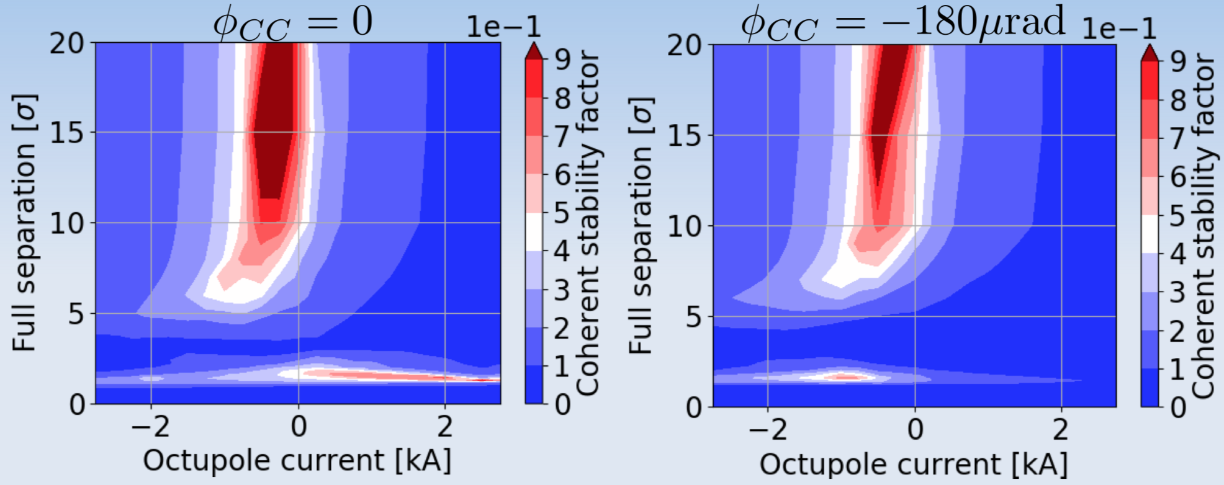
MAIN OUTCOMES OF RECENT ANALYSIS BY XAVIERB (1/4)
Reminder on strategy for HL-LHC => Keep factor 2!
New finding: interaction at IP with (large) crossing angle compensates detuning with LOF > 0 for particles at large amplitude (as opposed to BBLR) => In this case, LOF > 0 is more critical than LOF < 0!
Ultimate BCMS & full collimation upgrade: synchronous collapse
CC OFF
CC ON
For factor 2
X. Buffat

Slide 12
MAIN OUTCOMES OF RECENT ANALYSIS BY XAVIERB (2/4)
Ultimate BCMS & full collimation upgrade: Asynchronous collapse

Slide 13
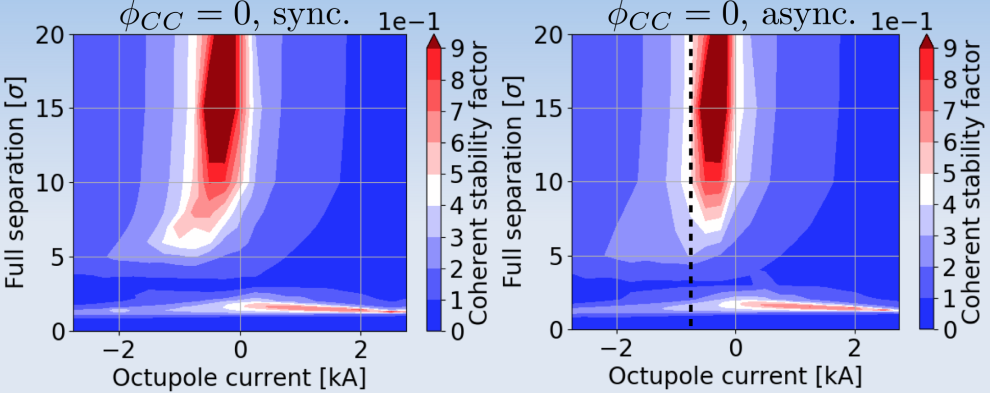
MAIN OUTCOMES OF RECENT ANALYSIS BY XAVIERB (2/4)
Ultimate BCMS & full collimation upgrade: Asynchronous collapse
X. Buffat
Improves a
bit the situation for LOF < 0

Slide 14
MAIN OUTCOMES OF RECENT ANALYSIS BY XAVIERB (3/4)
Ultimate BCMS & CC ON: synchronous collapse

Slide 15
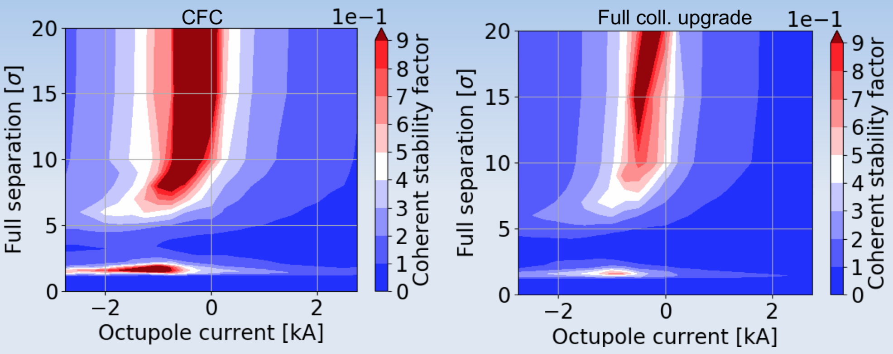
MAIN OUTCOMES OF RECENT ANALYSIS BY XAVIERB (3/4)
Ultimate BCMS & CC ON: synchronous collapse
  => With LOF > 0 and CC ON during collapse, minimum of stability (over the cycle) is at end of ramp
X. Buffat

Slide 16
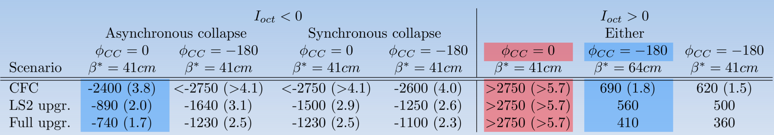
MAIN OUTCOMES OF RECENT ANALYSIS BY XAVIERB (4/4)
Summary
X. Buffat
Tele-index required
using the formula from StephaneF => To be confirmed once the optics are available

Slide 17
CONCLUSION
With reminder of the assumption of the same factor ~ 2 as for current LHC!
With LOF > 0 and CC OFF
  Fast collapse of separation bump is required (see https://cds.cern.ch/record/2301292/files/CERN-ACC-NOTE-2018-0002.pdf)

Slide 18
CONCLUSION
With reminder of the assumption of the same factor ~ 2 as for current LHC!
With LOF > 0 and CC OFF
  Fast collapse of separation bump is required (see https://cds.cern.ch/record/2301292/files/CERN-ACC-NOTE-2018-0002.pdf)
  => It will be fine to cross rapidly this region (as confirmed during ATS MD in 2018) but cannot be used in static (e.g. for levelling). Proposed future MD: determine the minimum speed to cross the region without triggering instabilities

Slide 19
CONCLUSION
With reminder of the assumption of the same factor ~ 2 as for current LHC!
With LOF > 0 and CC OFF
  Fast collapse of separation bump is required (see https://cds.cern.ch/record/2301292/files/CERN-ACC-NOTE-2018-0002.pdf)
  => It will be fine to cross rapidly this region (as confirmed during ATS MD in 2018) but cannot be used in static (e.g. for levelling). Proposed future MD: determine the minimum speed to cross the region without triggering instabilities
With LOF > 0 and CC ON
  Minimum of stability is at end of ramp
  No tele-squeeze required (but at limit for LS2 upgrade only)

Slide 20
CONCLUSION
With reminder of the assumption of the same factor ~ 2 as for current LHC!
With LOF > 0 and CC OFF
  Fast collapse of separation bump is required (see https://cds.cern.ch/record/2301292/files/CERN-ACC-NOTE-2018-0002.pdf)
  => It will be fine to cross rapidly this region (as confirmed during ATS MD in 2018) but cannot be used in static (e.g. for levelling). Proposed future MD: determine the minimum speed to cross the region without triggering instabilities
With LOF > 0 and CC ON
  Minimum of stability is at end of ramp
  No tele-squeeze required (but at limit for LS2 upgrade only)
With LOF < 0
  Best scenario is: Asynchronous collapse + CC ON only in collision
  Tele-squeeze required during the ramp

Slide 21
APPENDIX

Slide 22
MISSING IMPEDANCE AND NOISE EFFECT
Becomes unstable if
we wait for a longer time (confirmed in 2018) => Factor ~ 2 compared to prediction (MDs in agreement with physics)

Slide 23
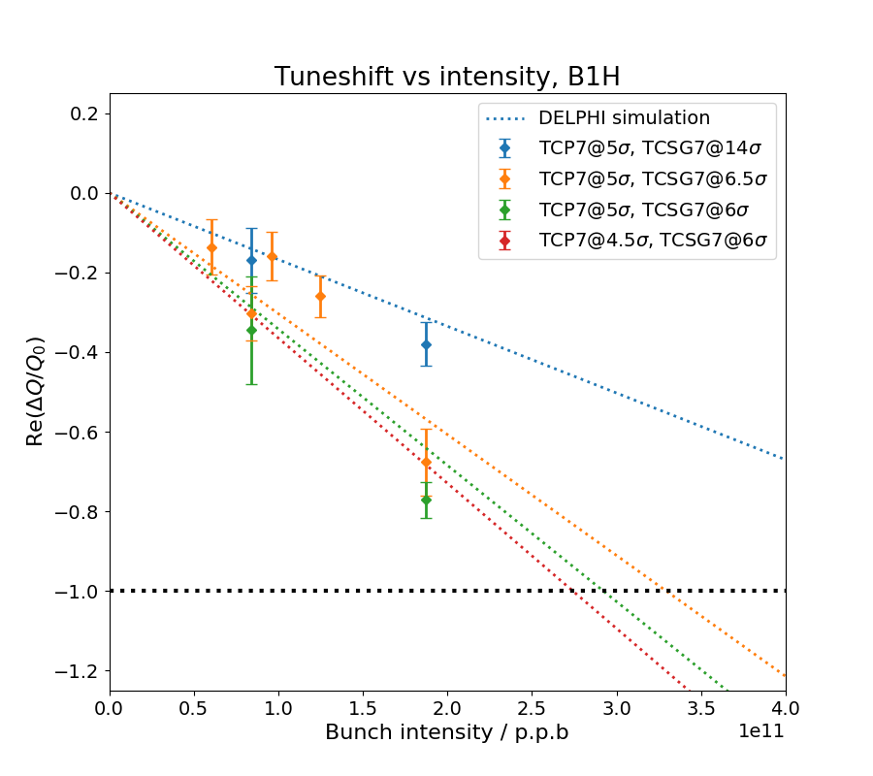
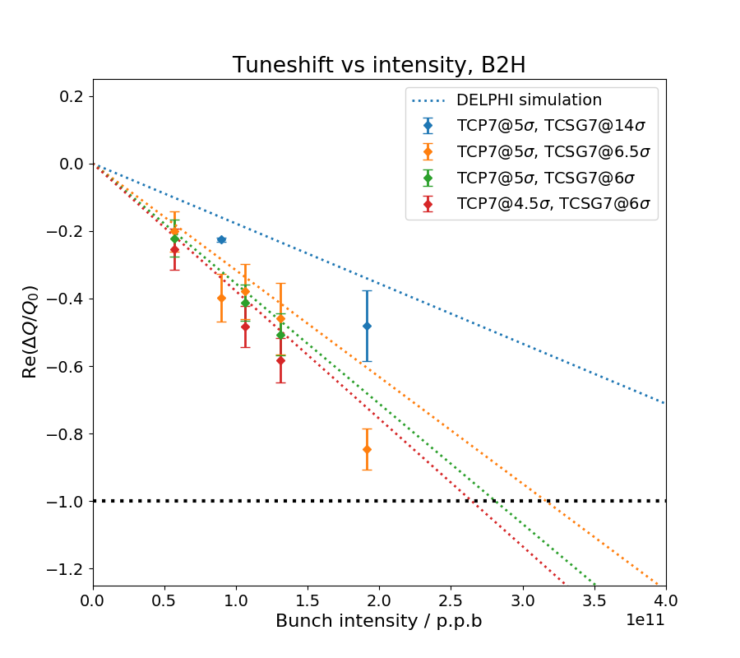
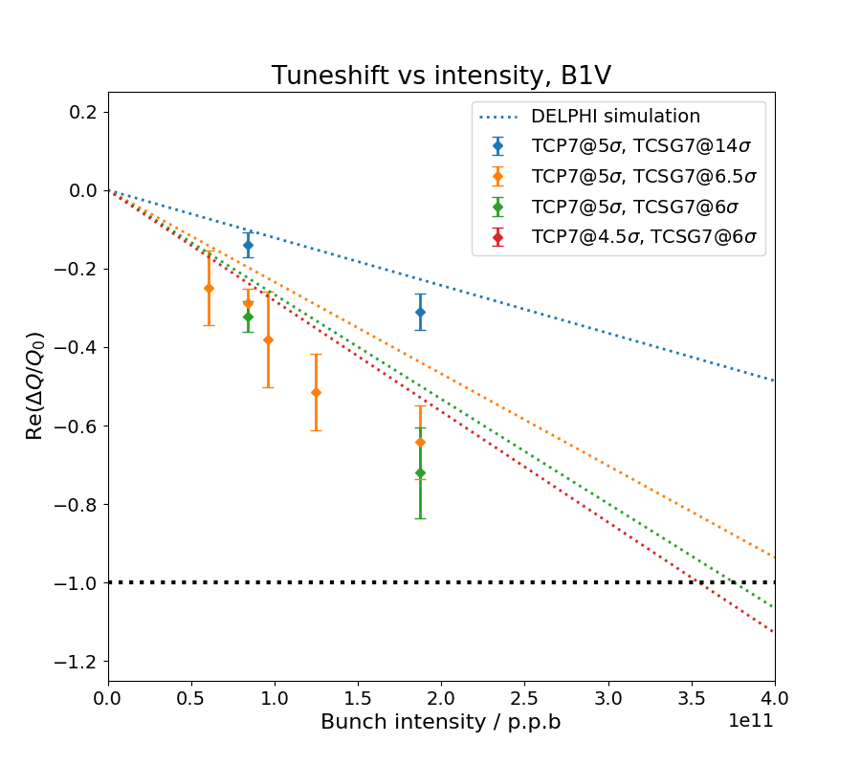
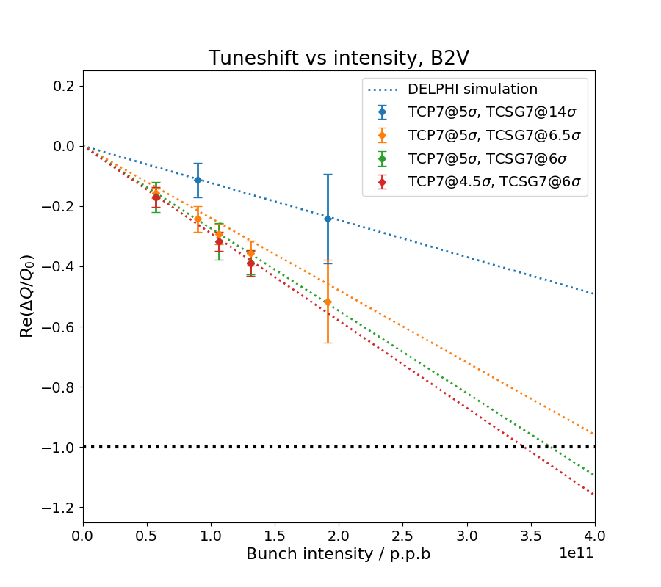
TMCI STUDIES (D. Amorim)

Slide 24
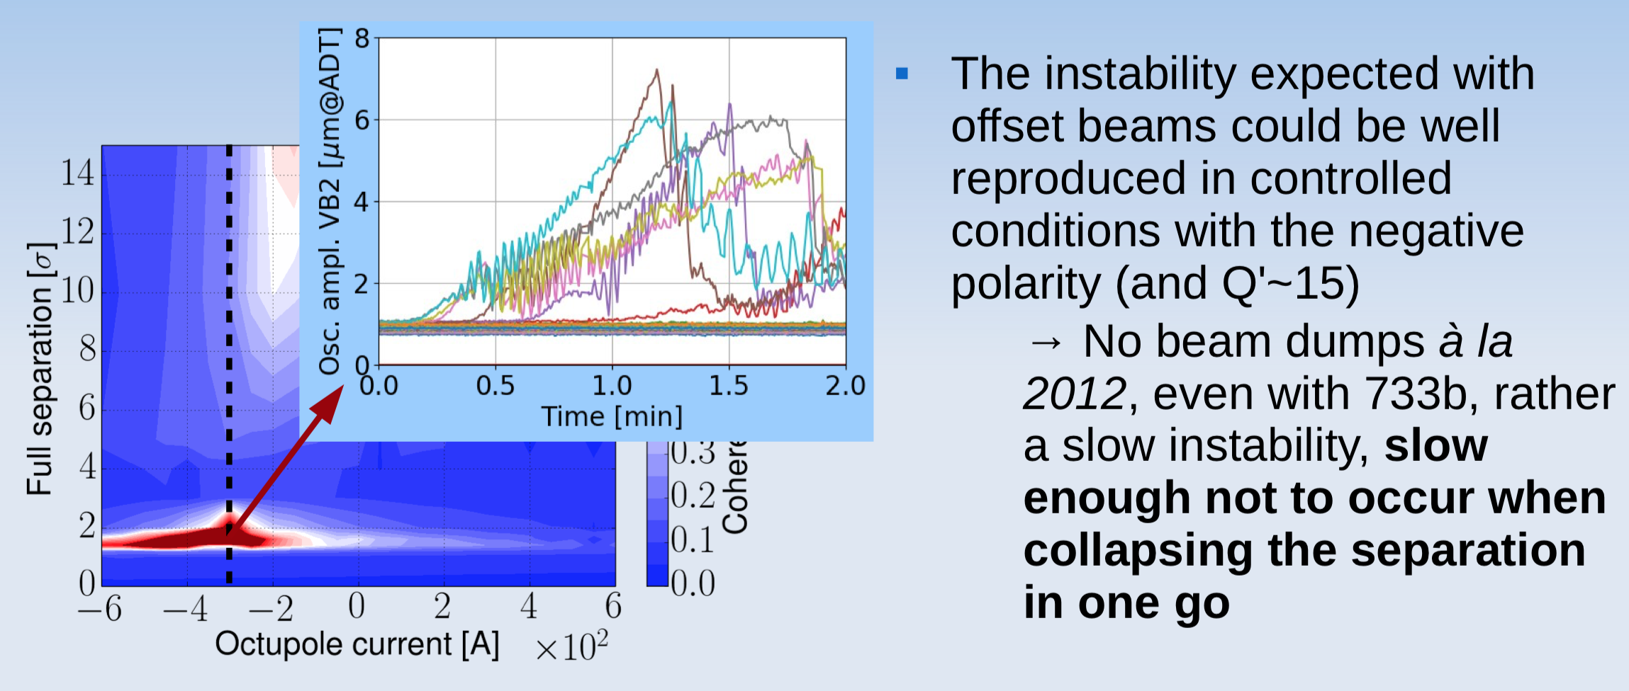
“FAST” CROSSING OF THE UNSTABLE REGION
X. Buffat and S. Fartoukh et al. (ATS MD, 2018)

Slide 25
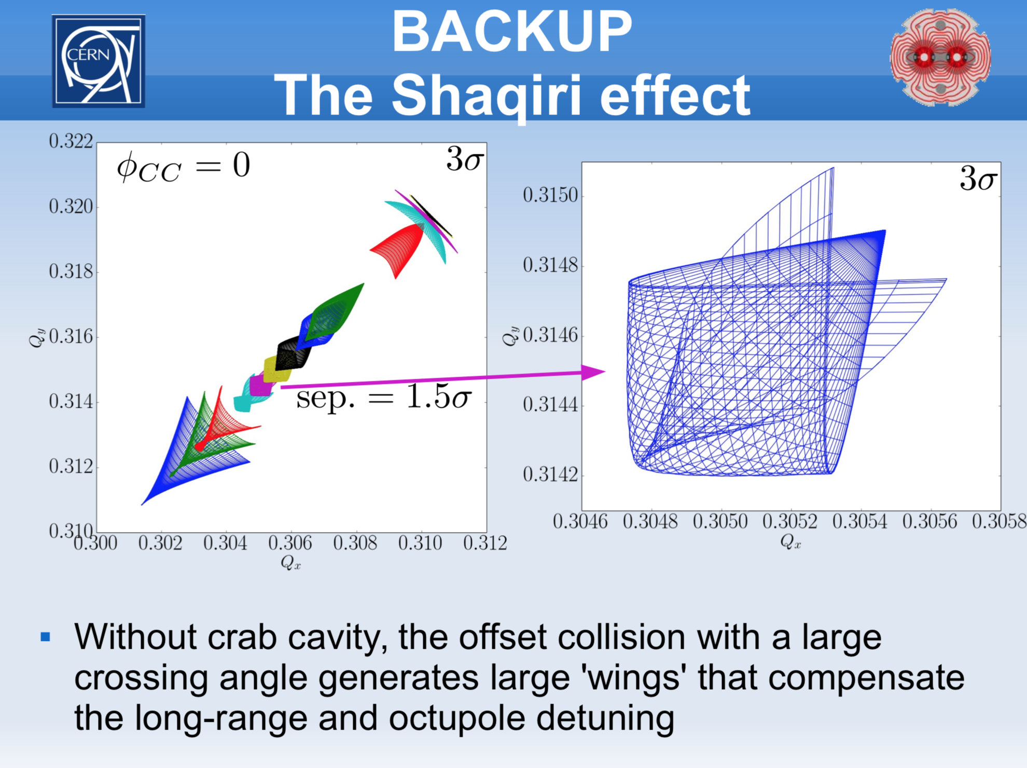
X. Buffat

Slide 26
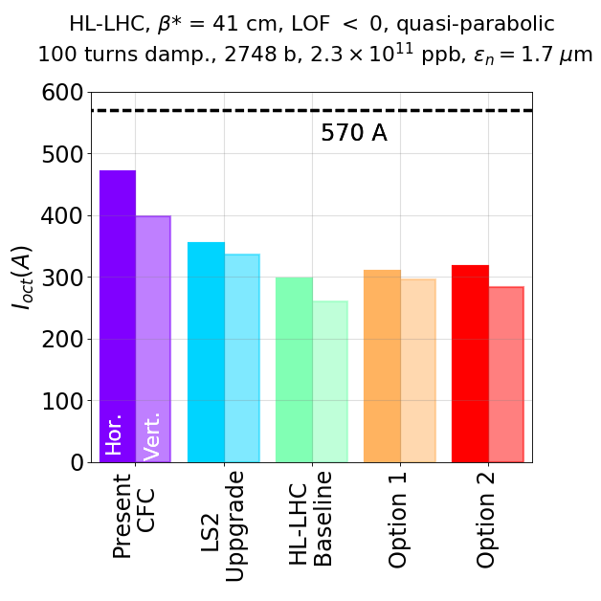
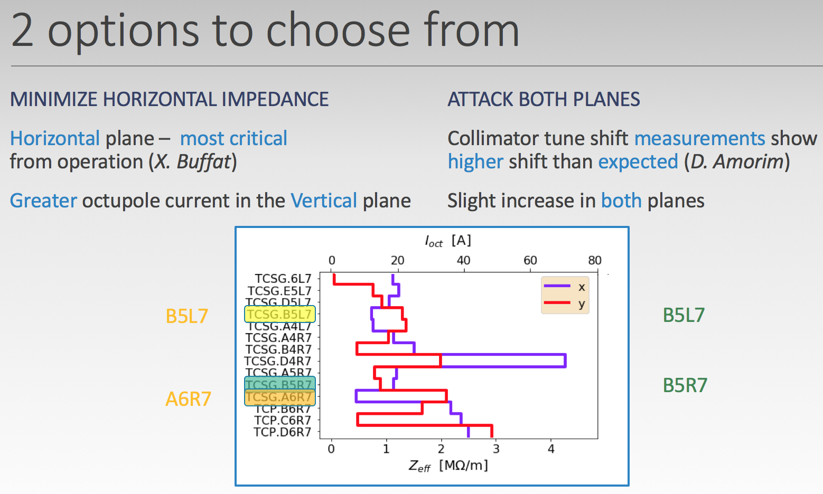
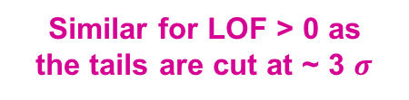
REQUIRED LO CURRENT TO REACH 1-BEAM STABILITY
(Ultimate BCMS)
2 new options (1 and 2) where only 5 out of 7 collimators are upgraded during Phase 2 => 2 collimators identified to remain in the machine (CFC)
S. Antipov
S. Antipov
Similar for LOF > 0 as
the tails are cut at ~ 3 $σ$

Slide 27
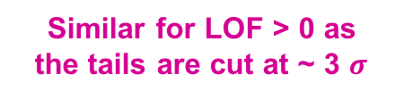
REQUIRED LO CURRENT TO REACH 1-BEAM STABILITY
(Ultimate BCMS) + Tighter collimator settings than baseline
=> See tighter settings discussed in:
https://indico.cern.ch/event/567839/contributions/2295334/attachments/1350209/2037939/elensreview_2016_06102016.pdf
https://indico.cern.ch/event/751331/contributions/3113704/attachments/1705707/2748308/Why_coat_the_collimators.pdf
Similar for LOF > 0 as
the tails are cut at ~ 3 $σ$
S. Antipov

