Slide 1

DA with positive octupole polarity:
Continuation of the discussion on the 8th HL-LHC collab. meeting
G. Arduini, X. Buffat, N. Karastathis, R.de Maria, Y. Papaphilippou
Outline:
Quick Recap from HL-LHC Meeting
High telescopic index with positive octupole polarity in:
Squeeze & Collisions
Nominal & Ultimate Scenarios
141st WP2 Meeting - 05.02.2019

Slide 2
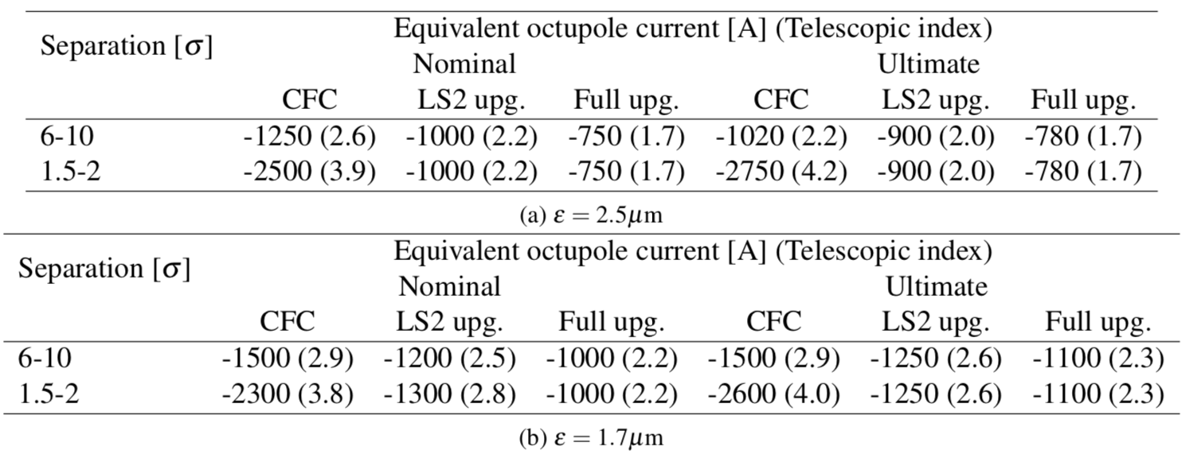
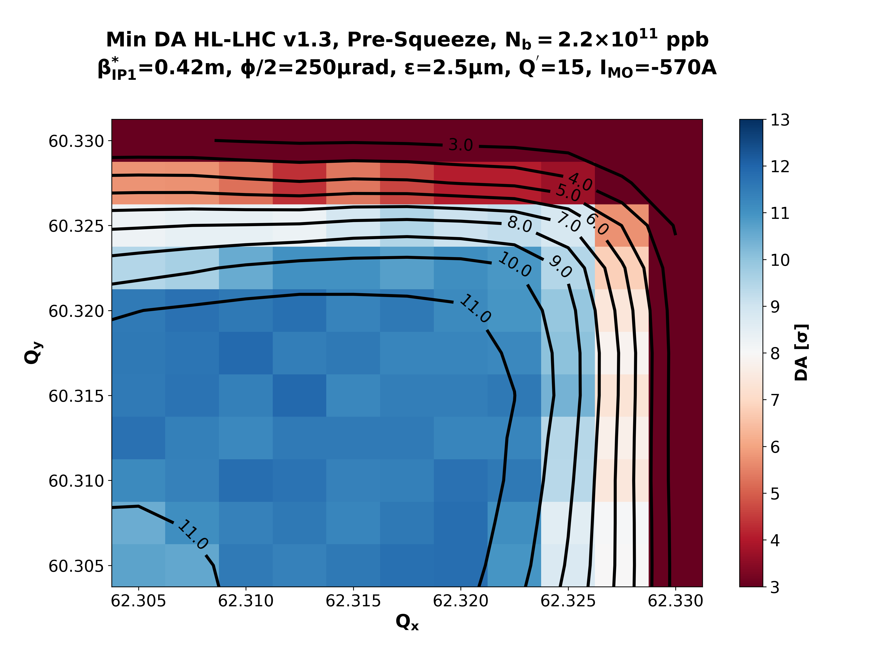
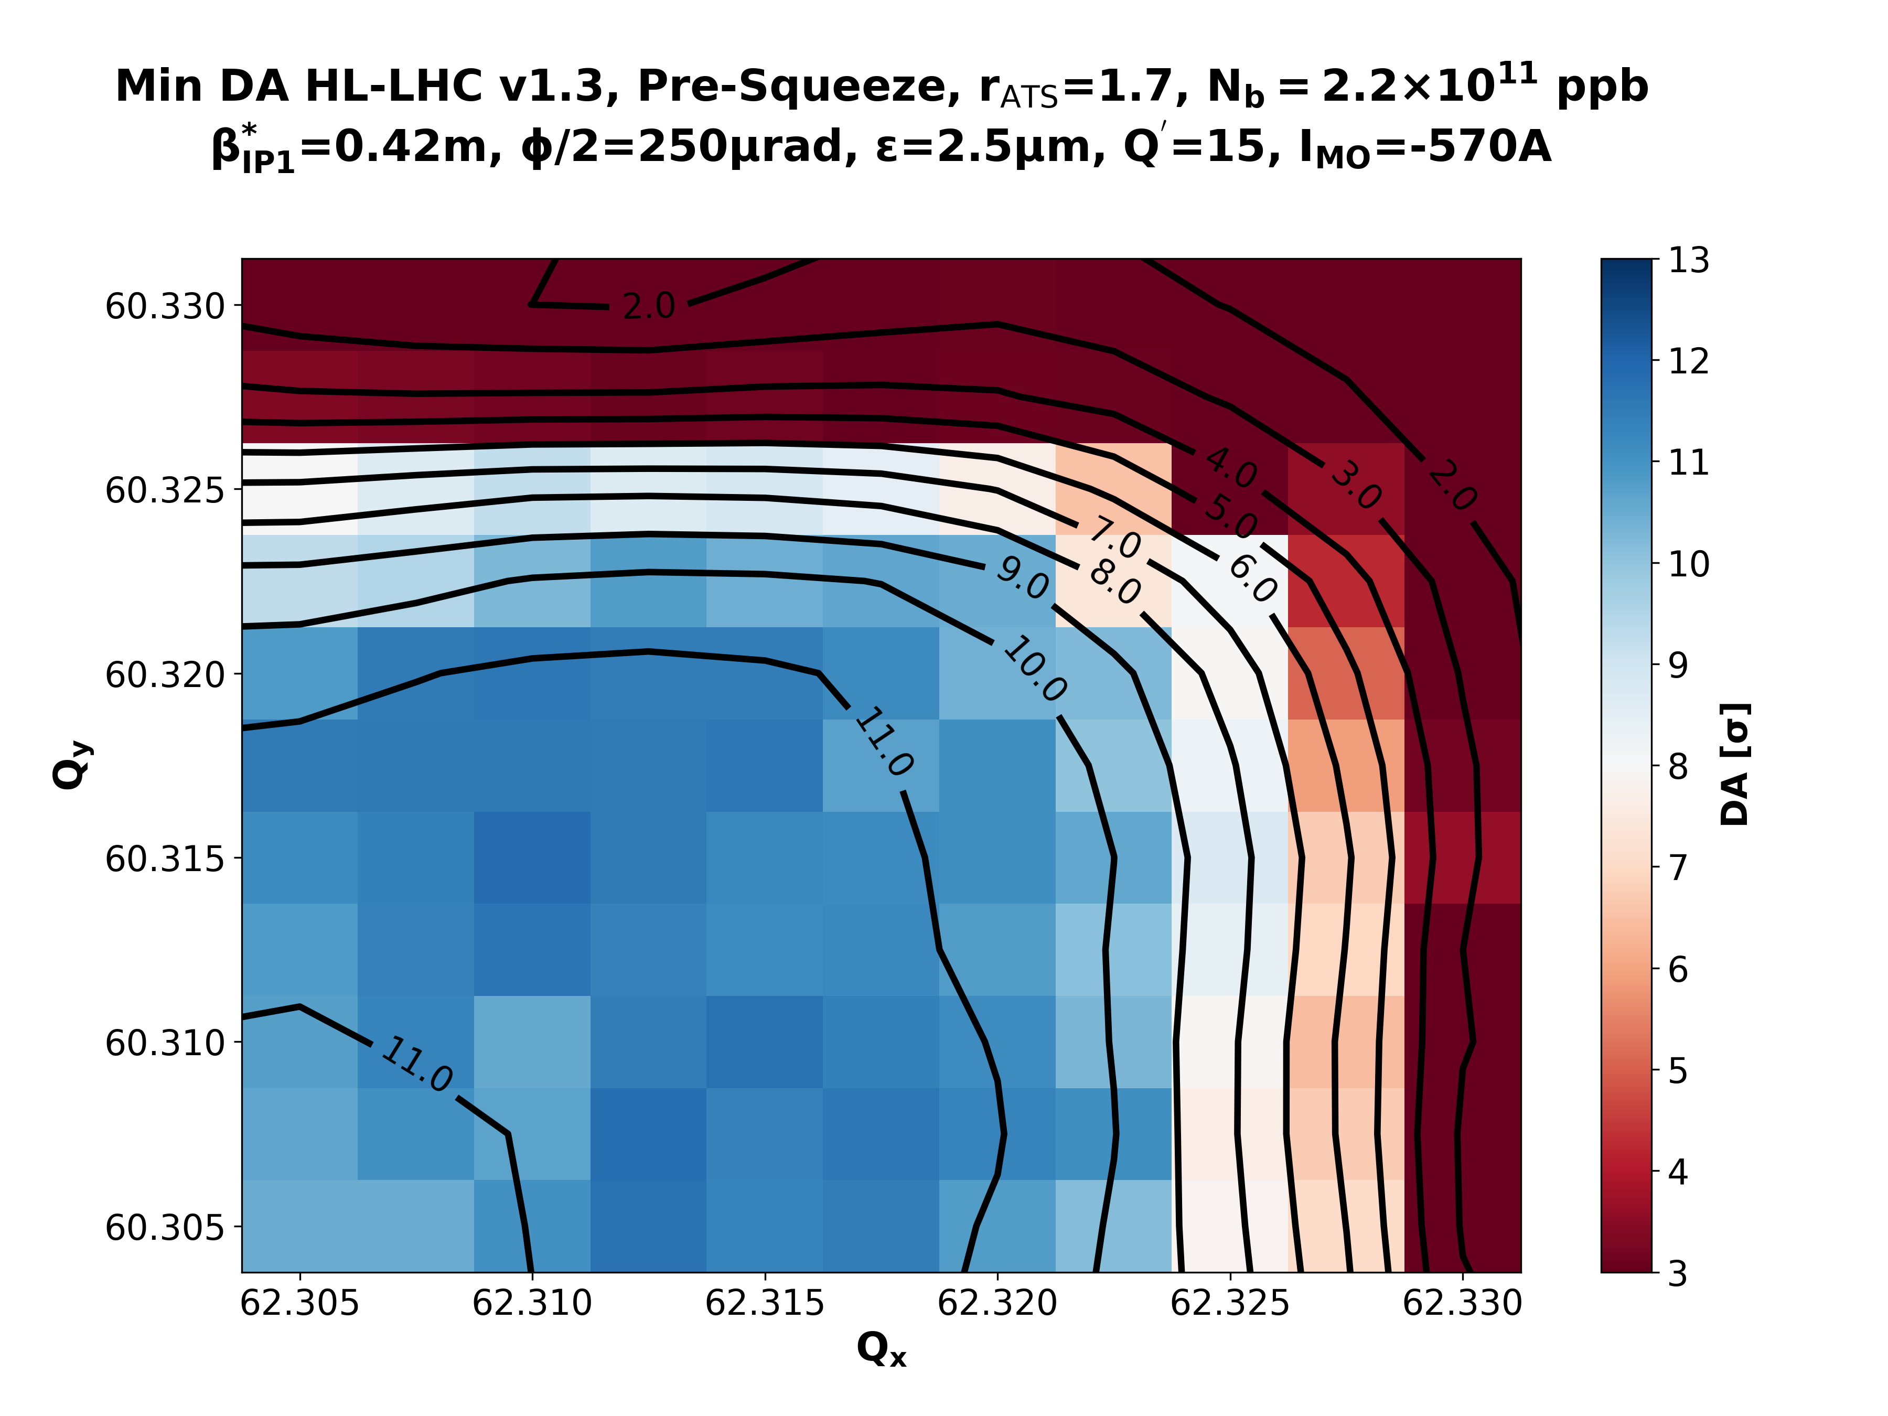
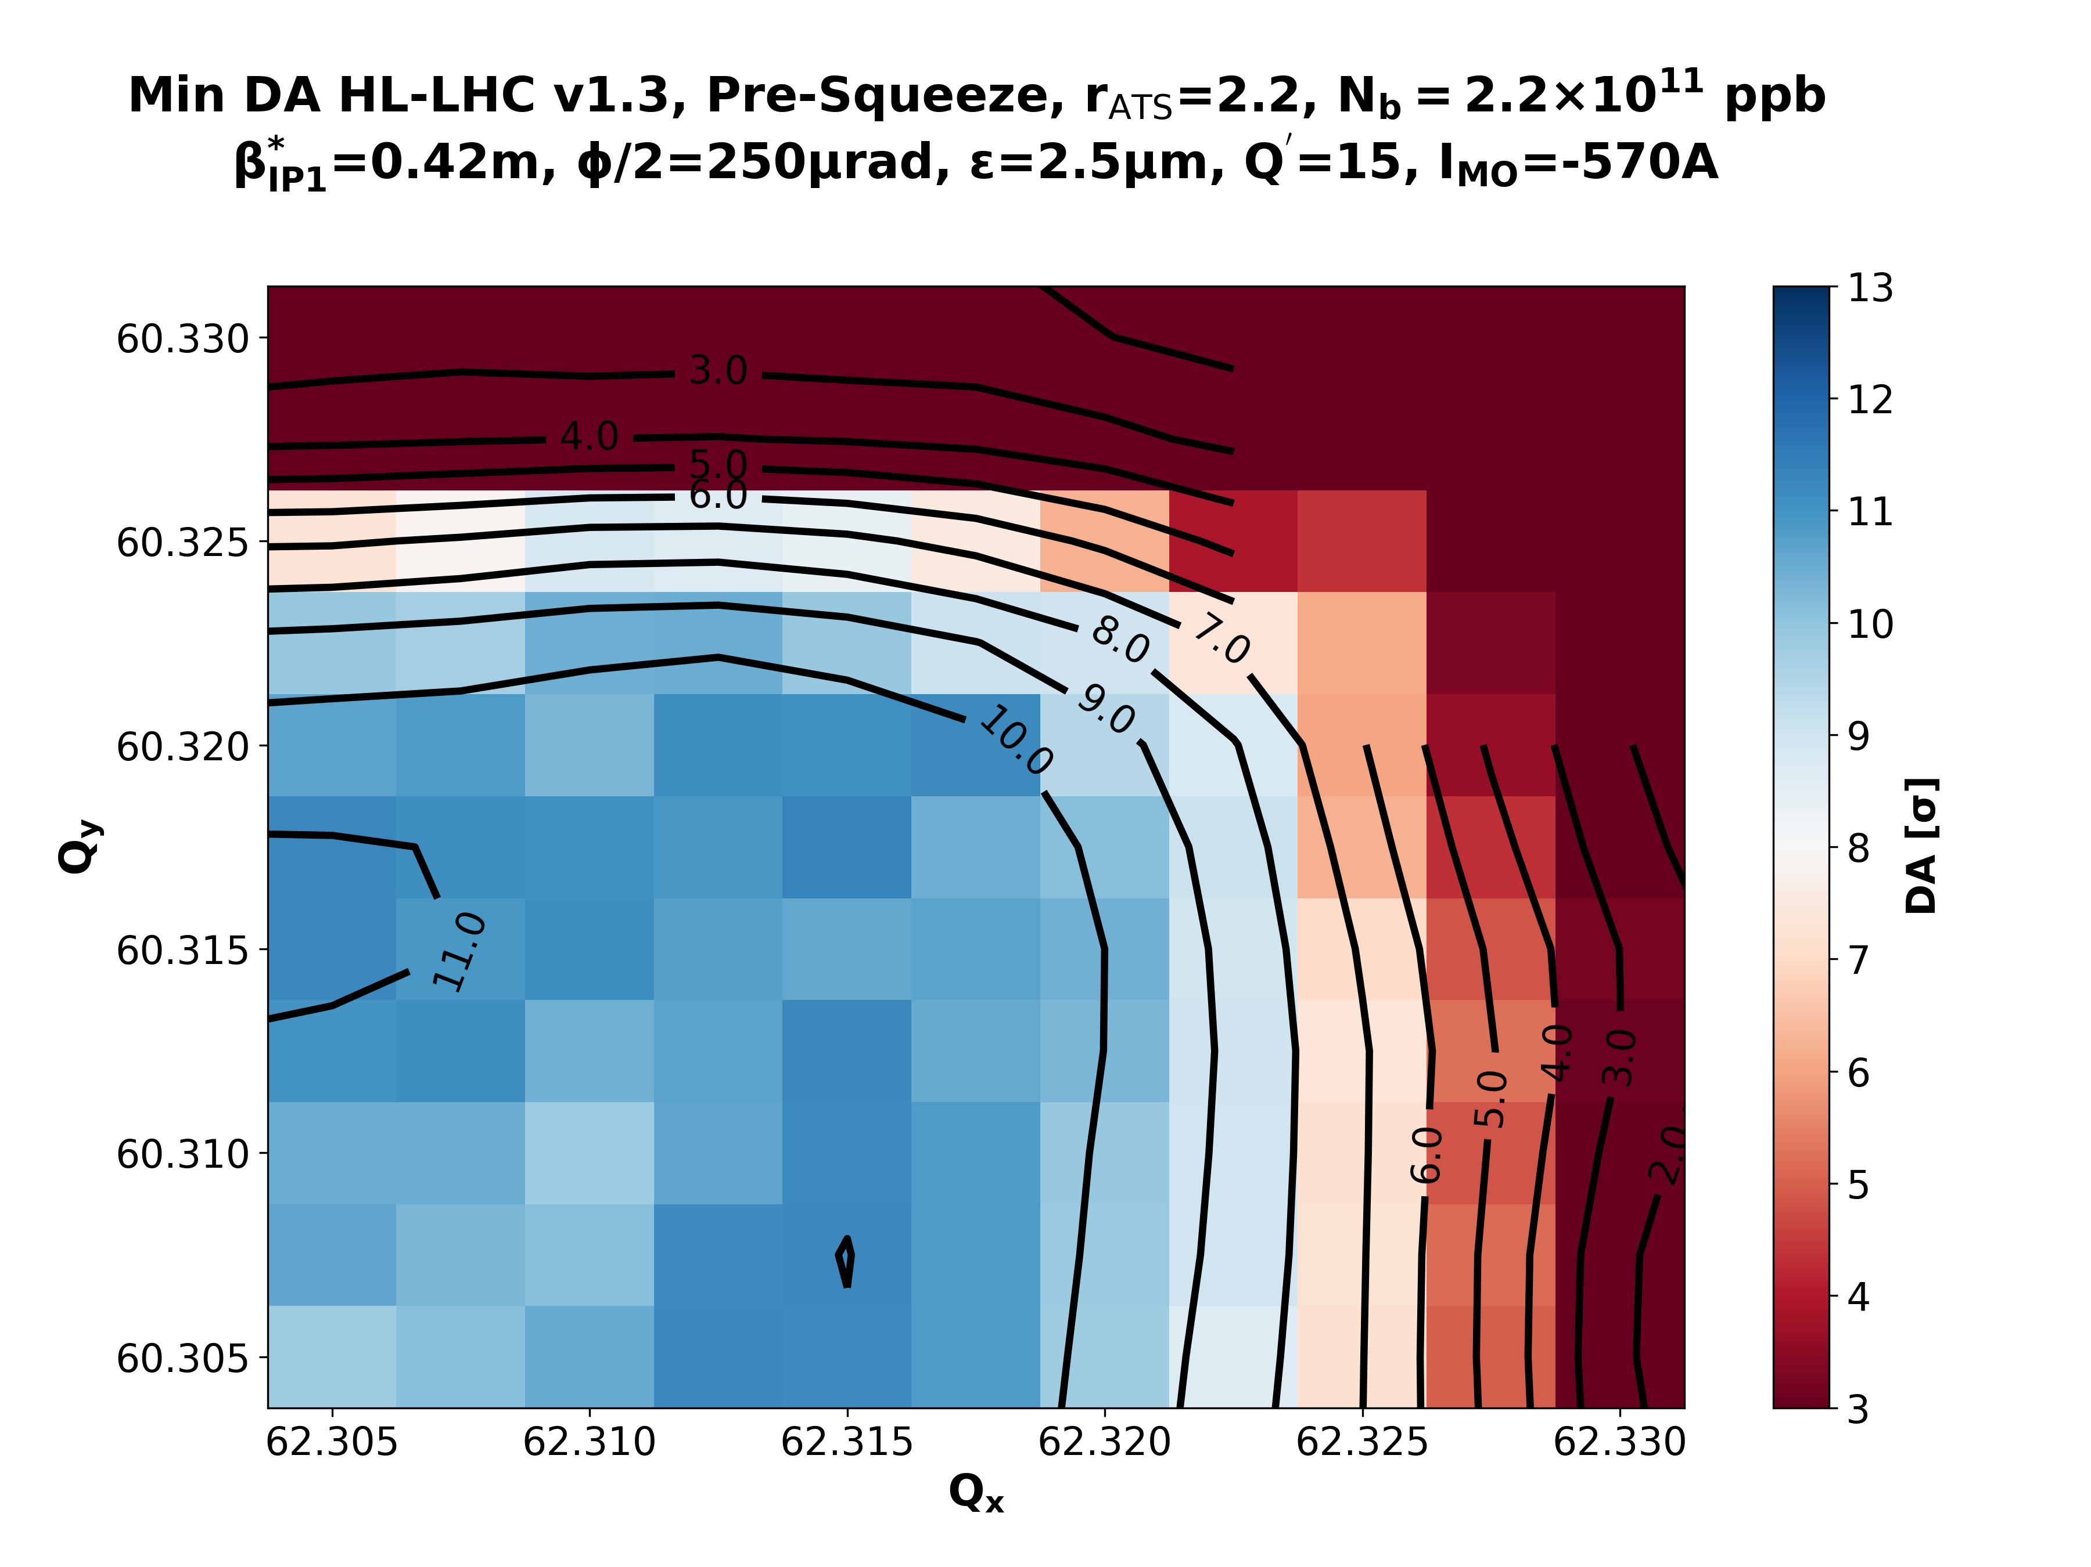
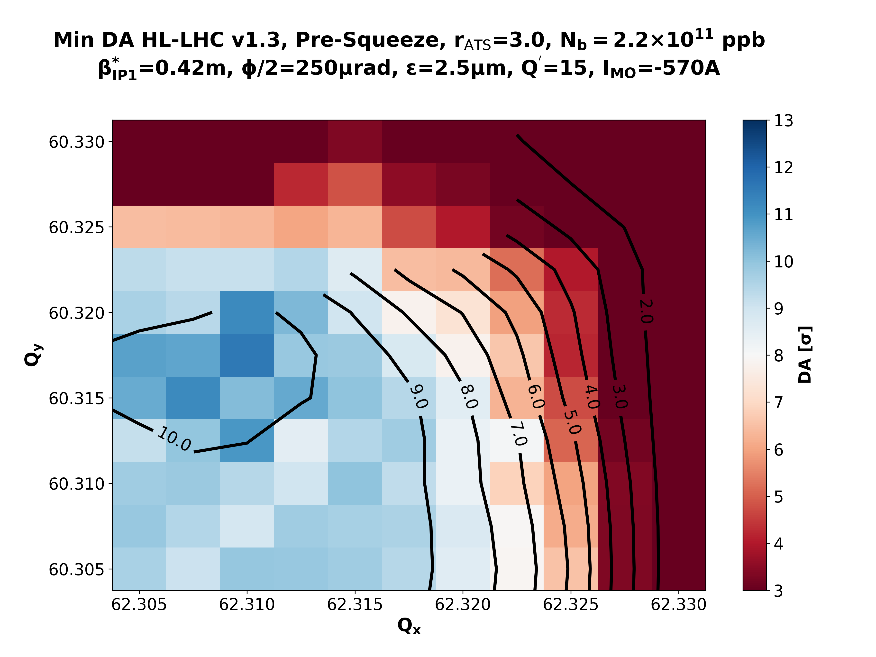
Recap
rATS = 1.0
Courtesy of X. Buffat
-1750 (3.0)
-1000 (2.2)
-750 (1.7)
Pre-Squeeze β*=42cm
rATS = 1.7
rATS = 2.2
rATS = 3.0
Enough DA in the pre-squeeze at full octupole polarity.(↑ rATS ⇒ ↓ DA)

Slide 3
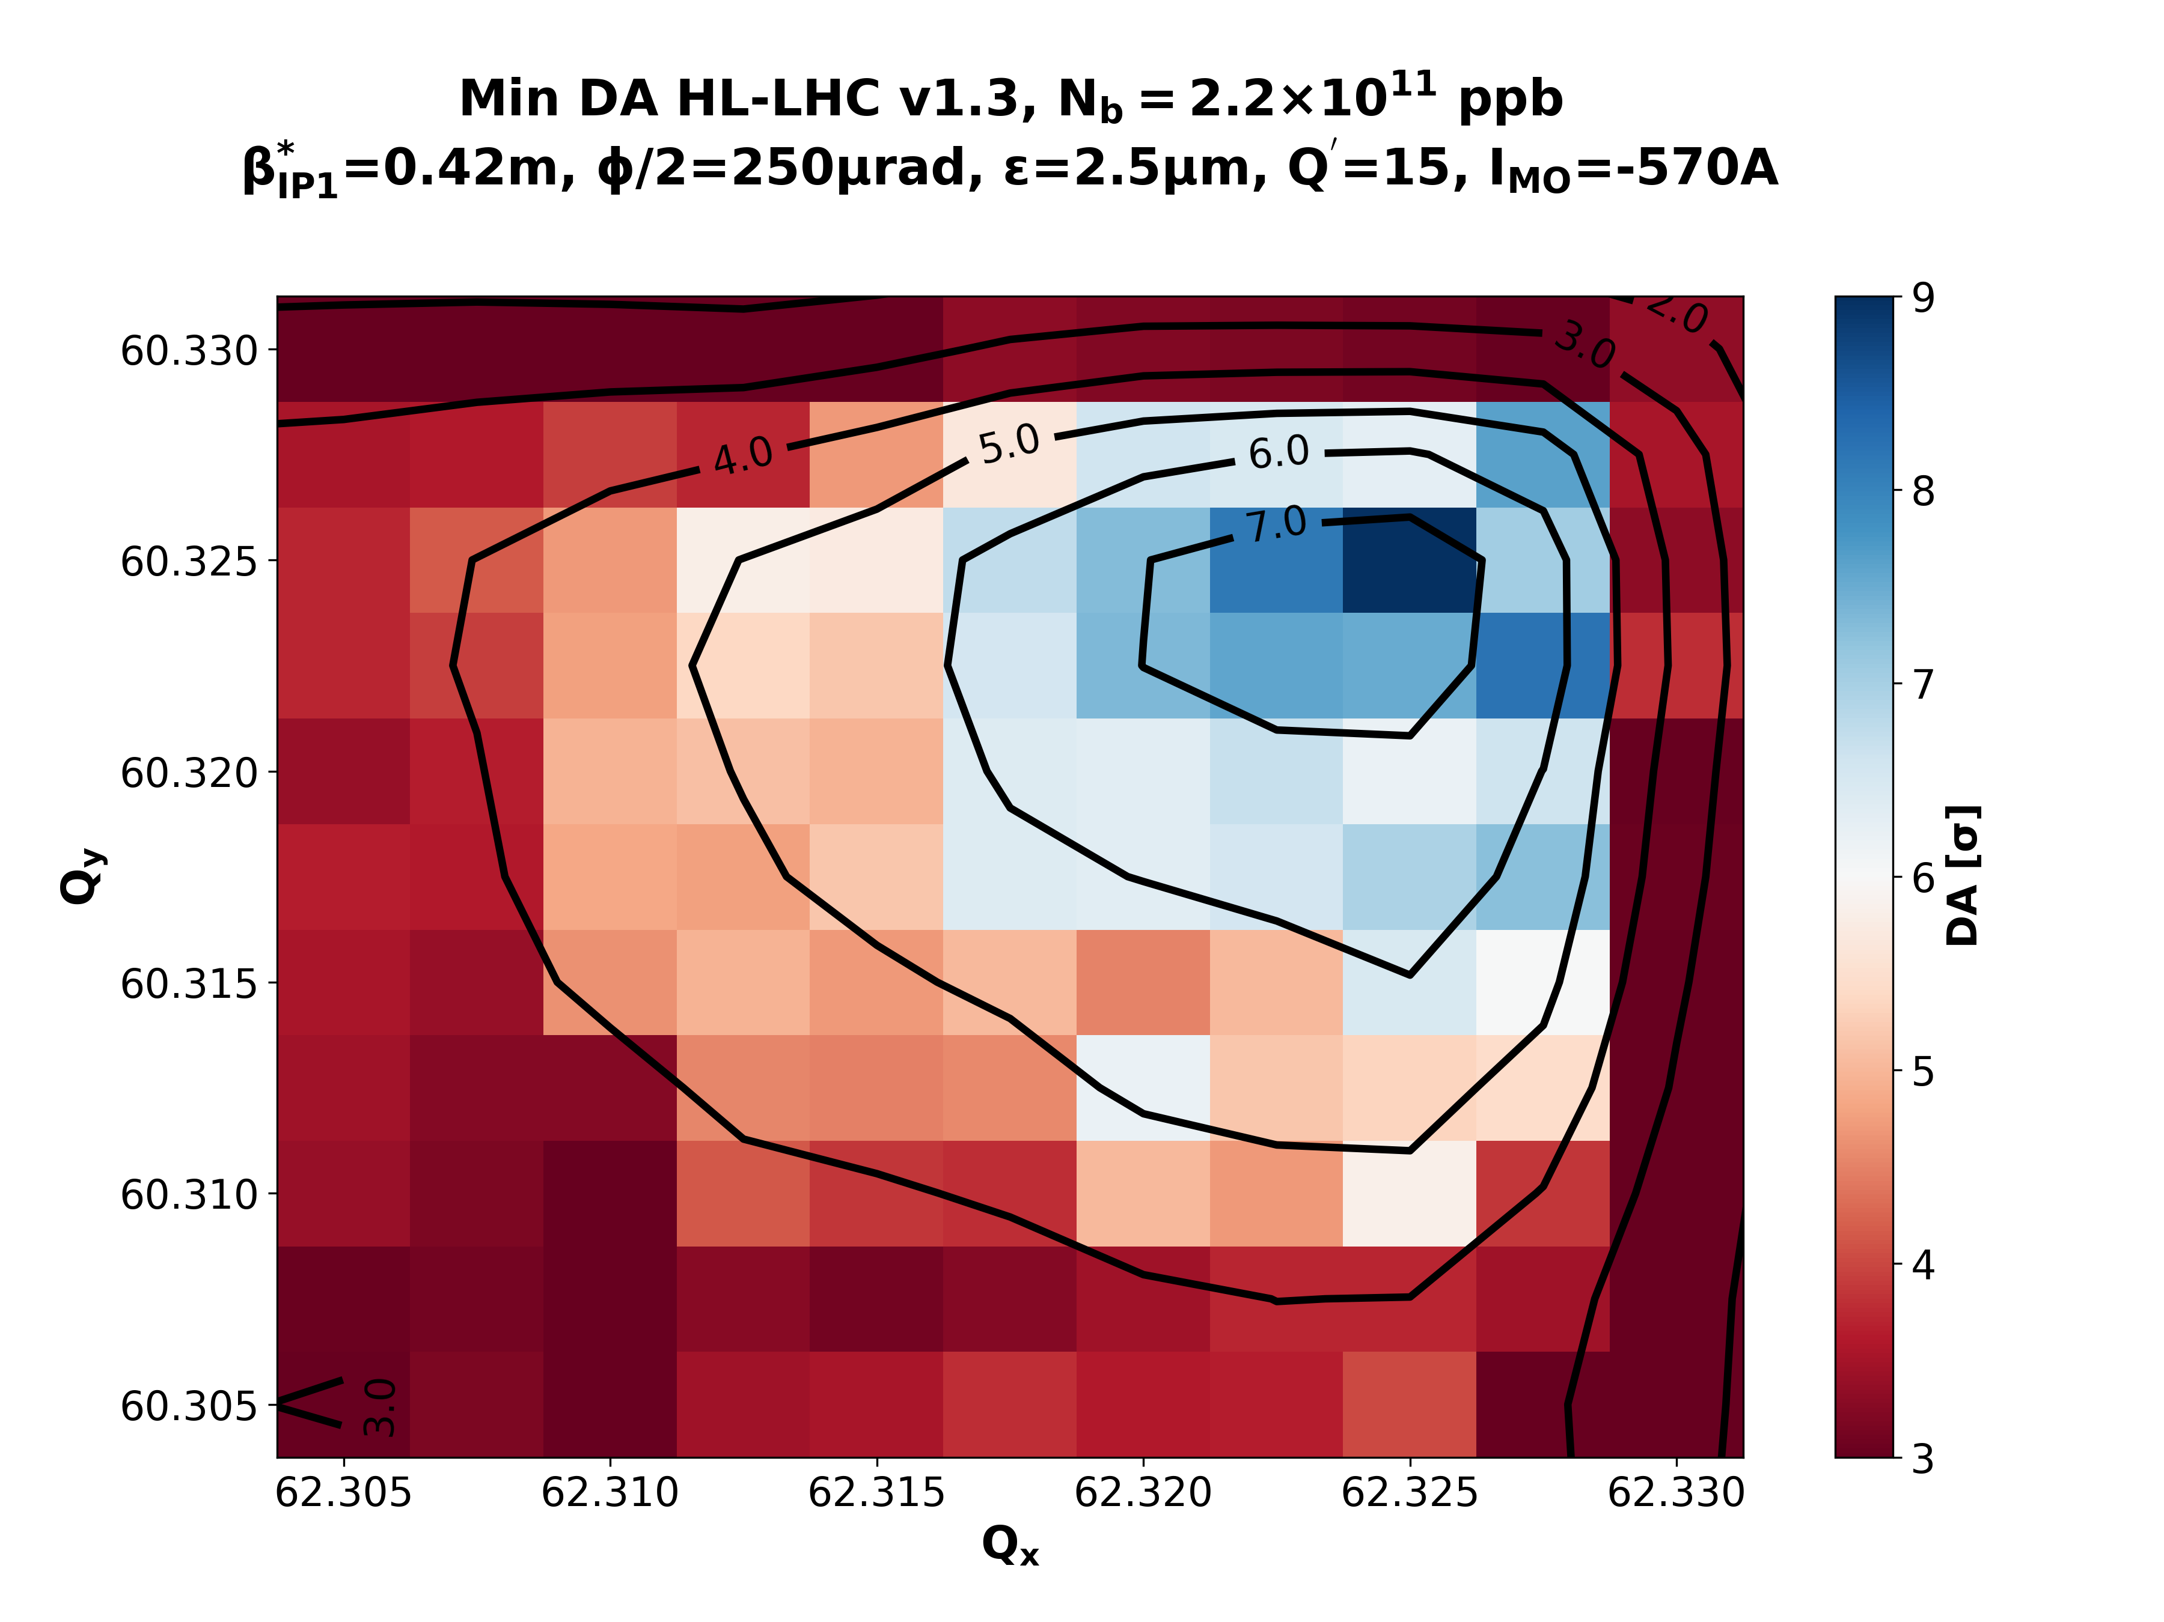
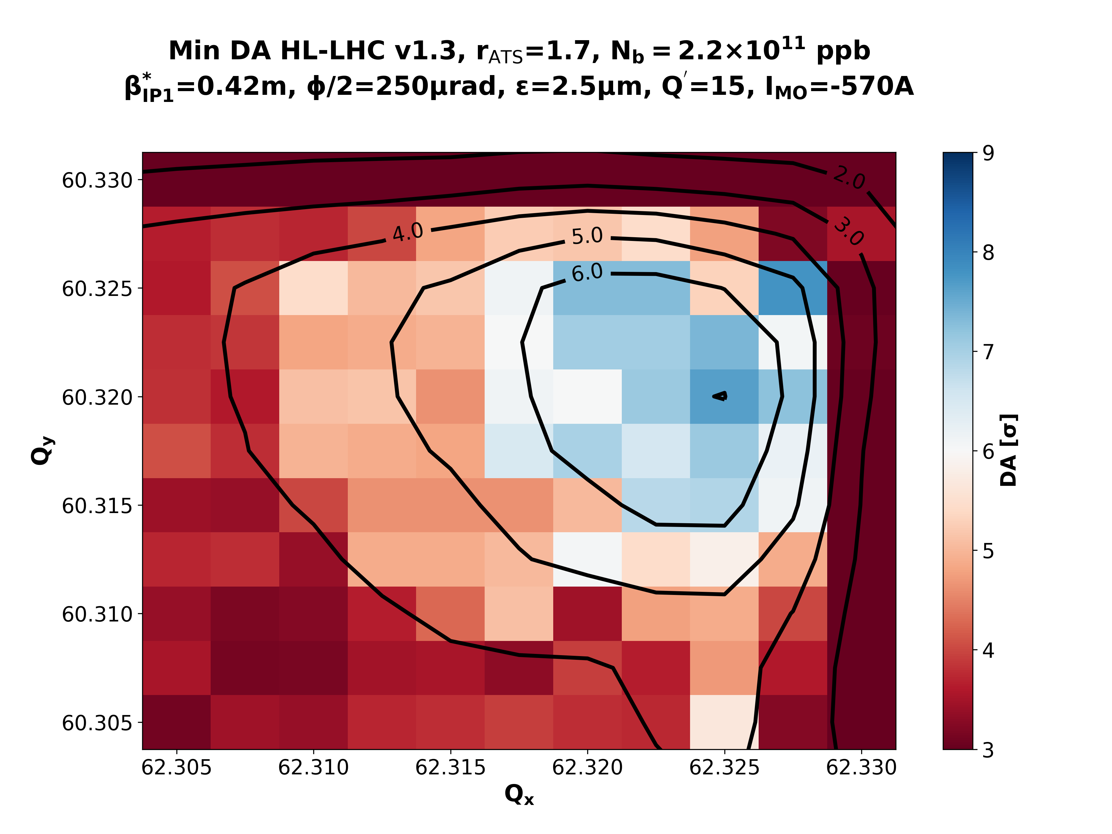
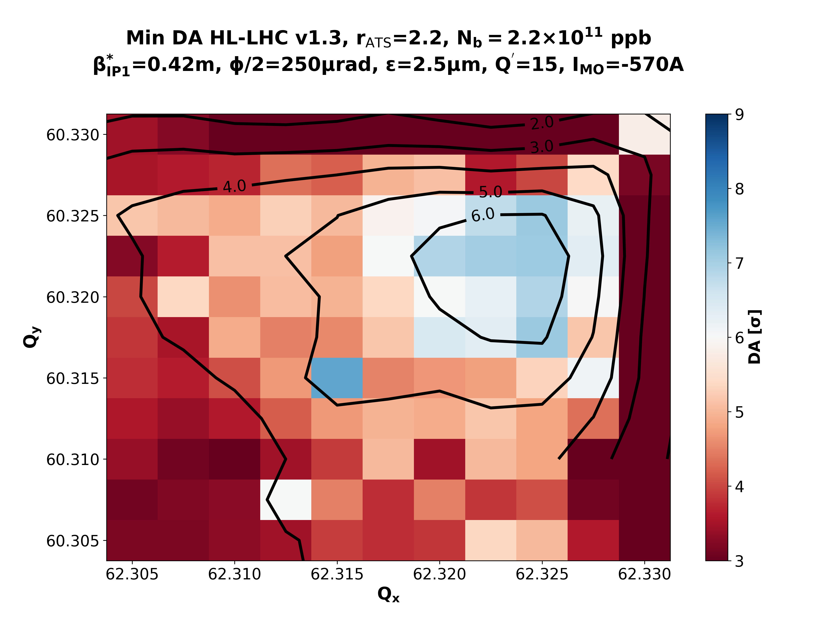
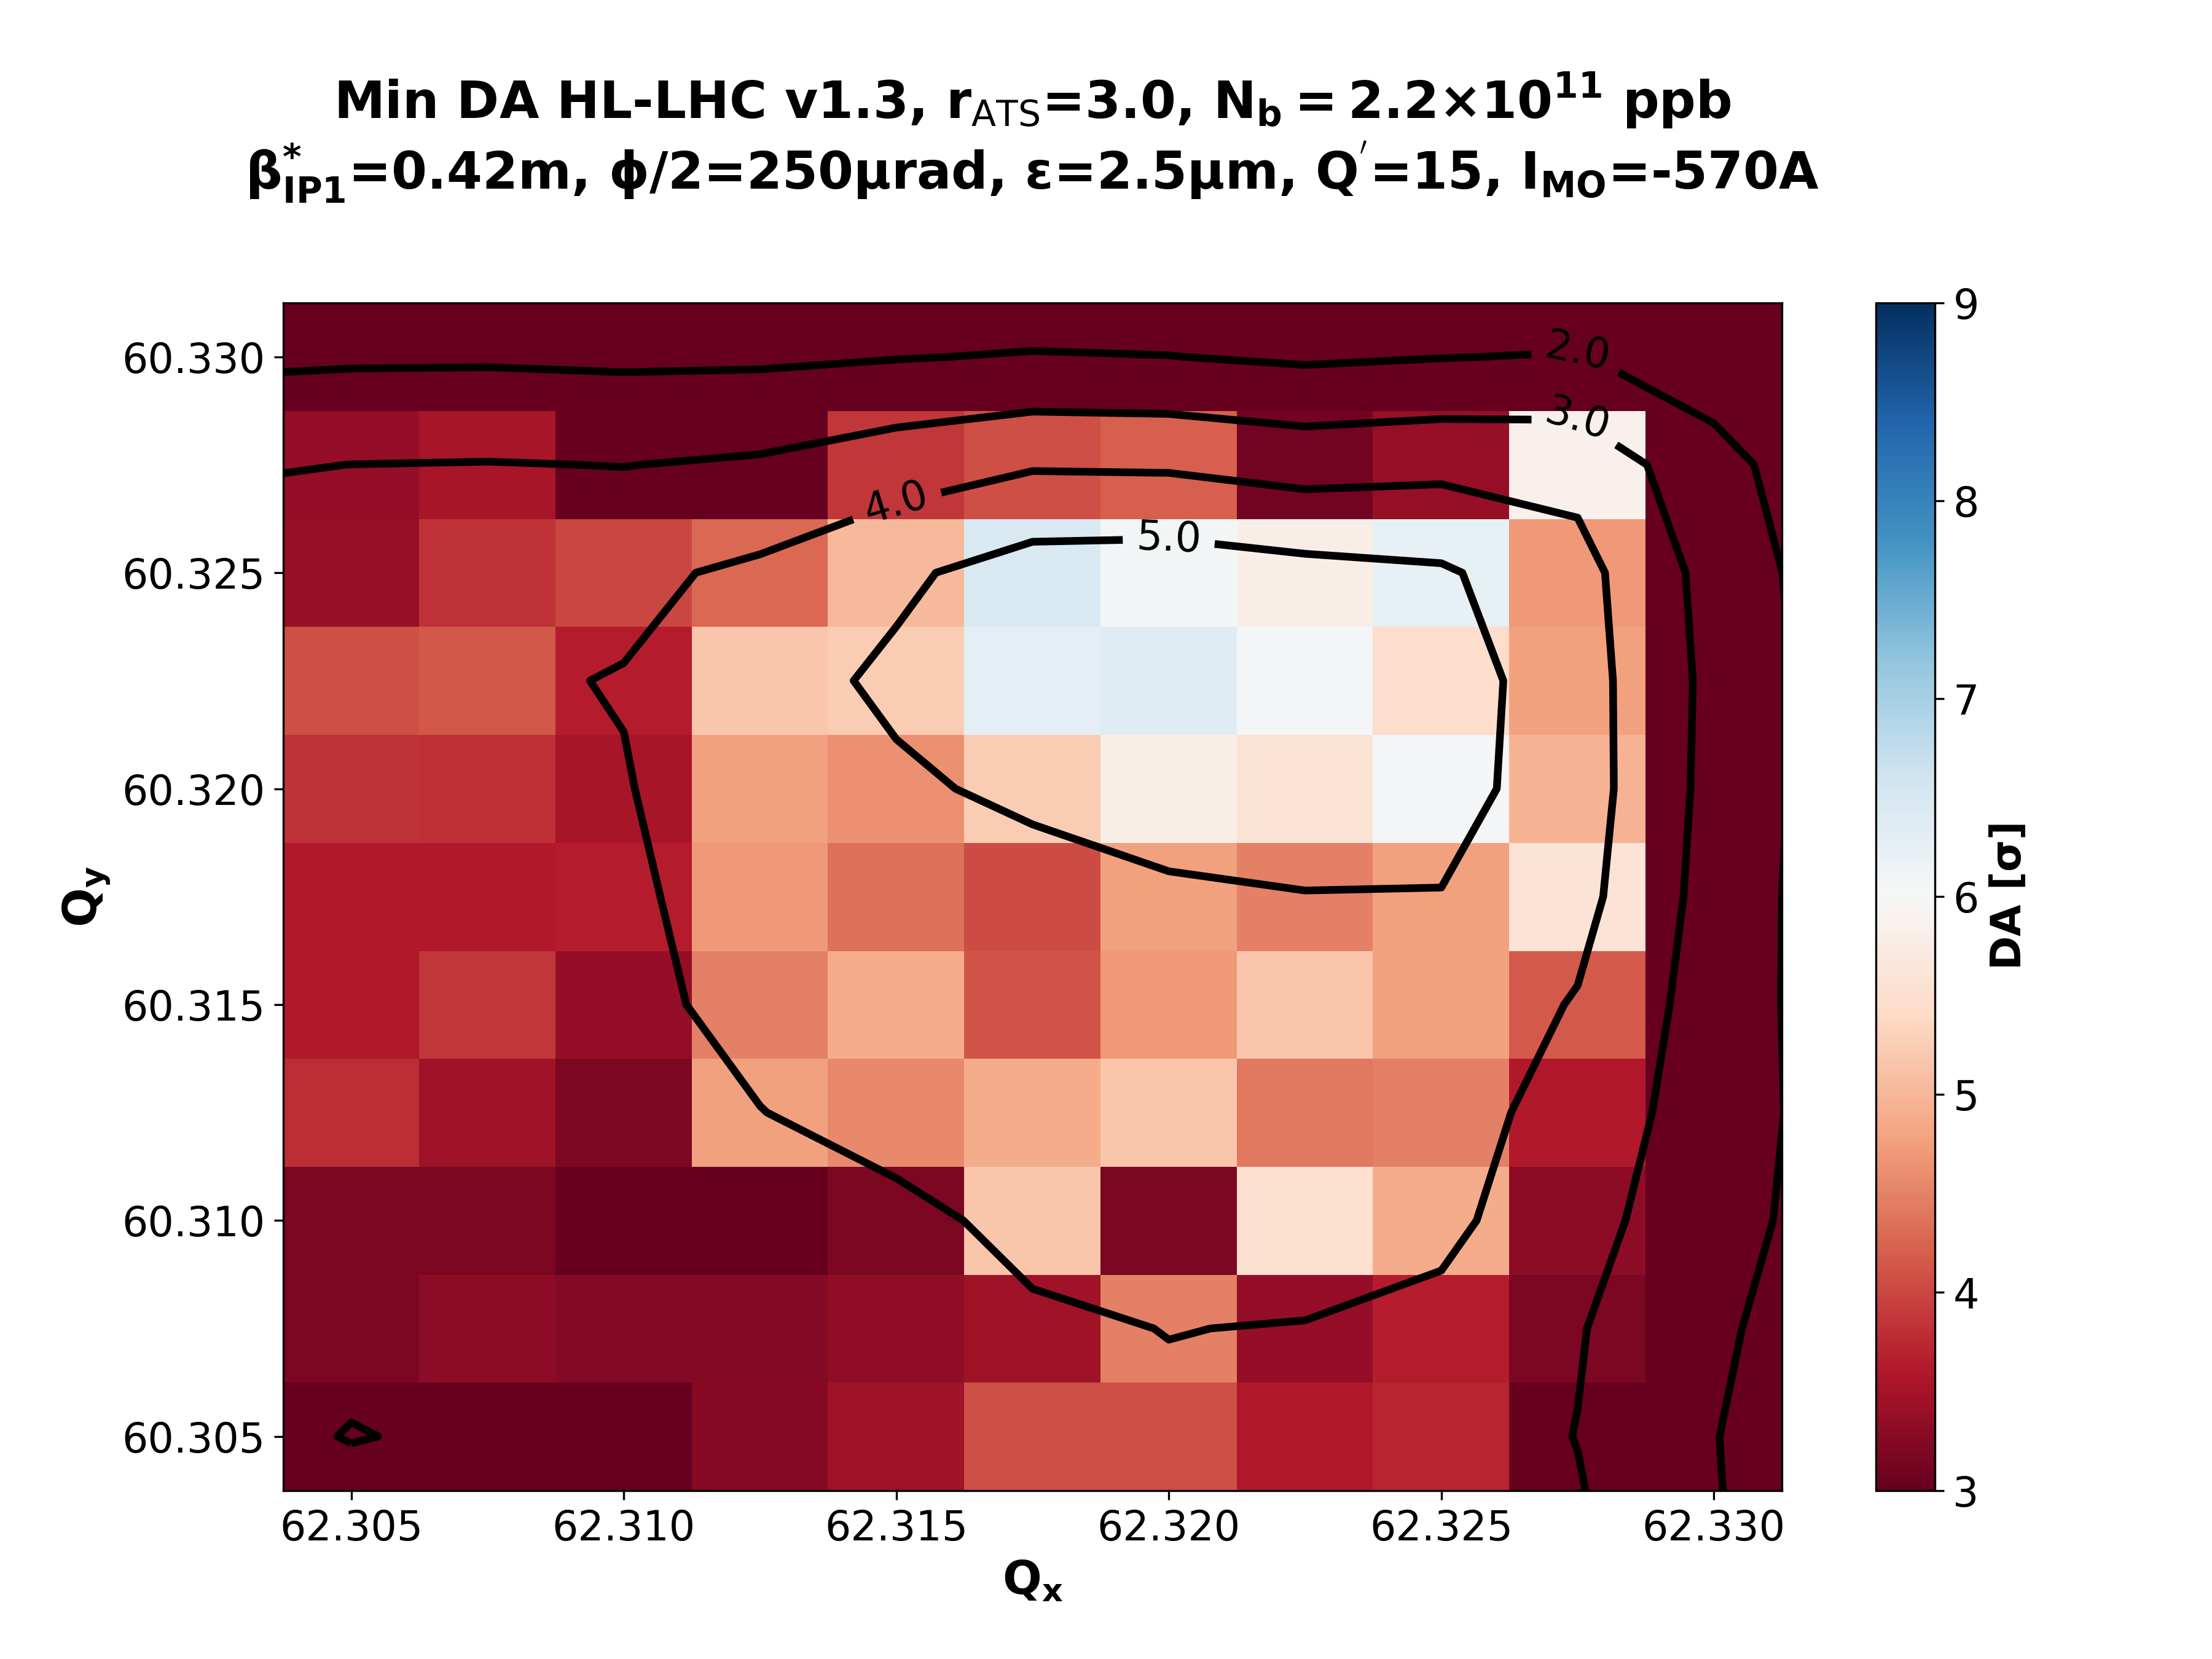
Recap (II)
Courtesy of X. Buffat
-1750 (3.0)
-1000 (2.2)
-750 (1.7)
rATS = 1.0
Collisions β*=42cm
rATS = 1.7
rATS = 2.2
rATS = 3.0
Transition from collapse to collisions with rATS = 2.2 results in DA>6σ.
Post-LS2 collimator upgrade + high rATS ➔ OK in terms of lifetime

Slide 4
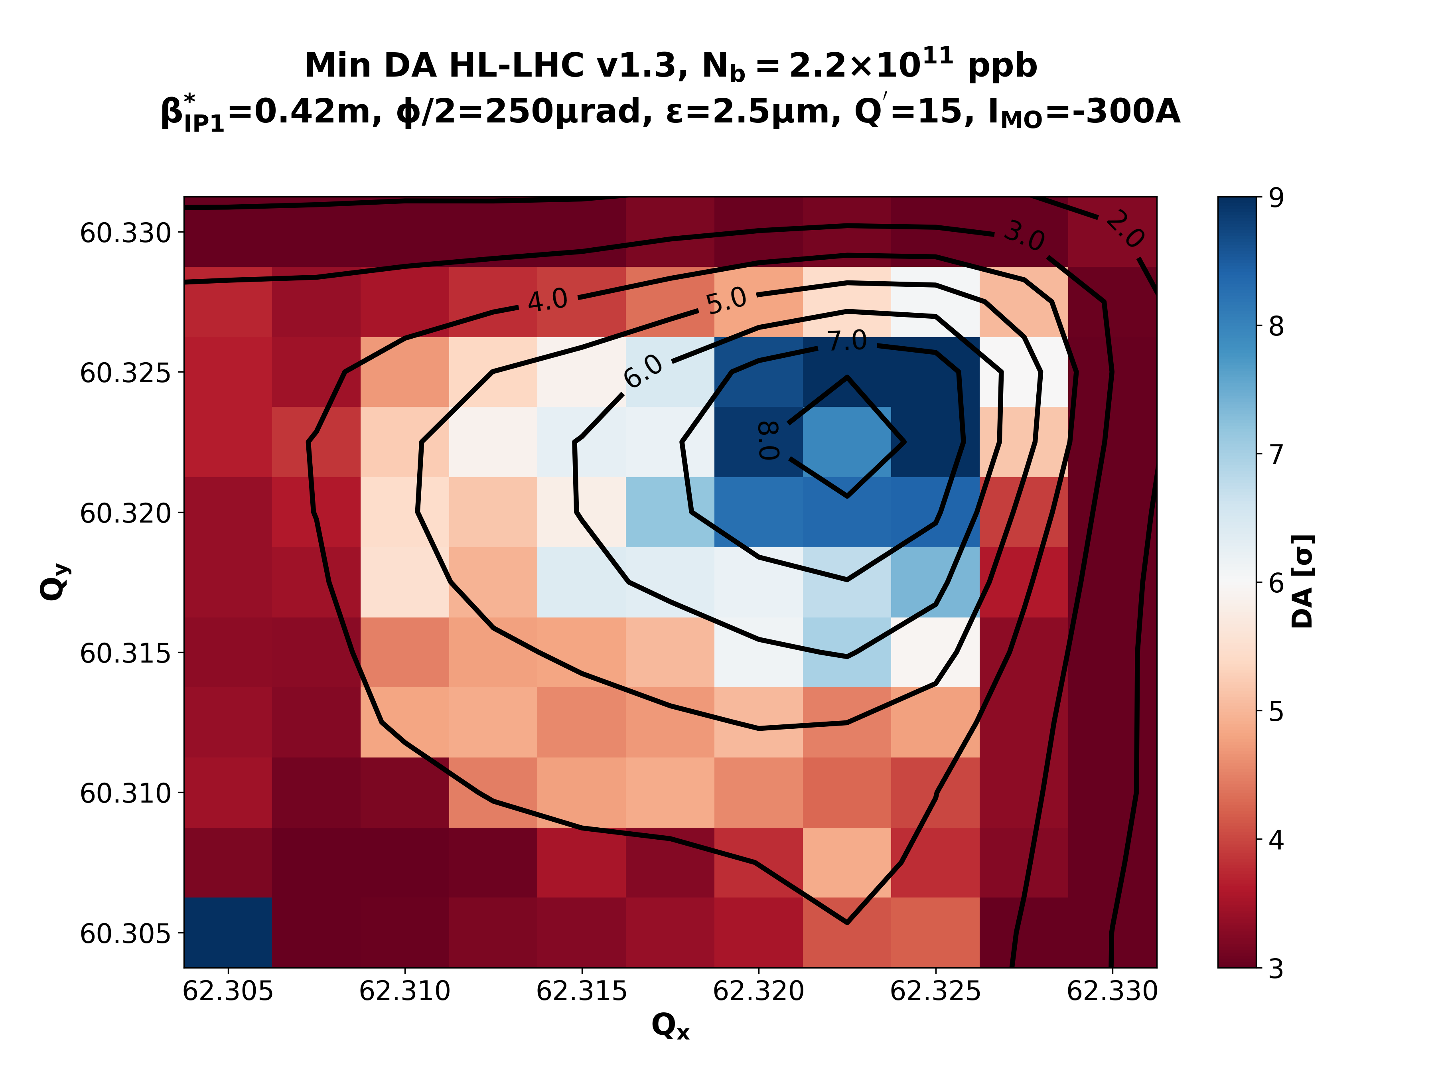
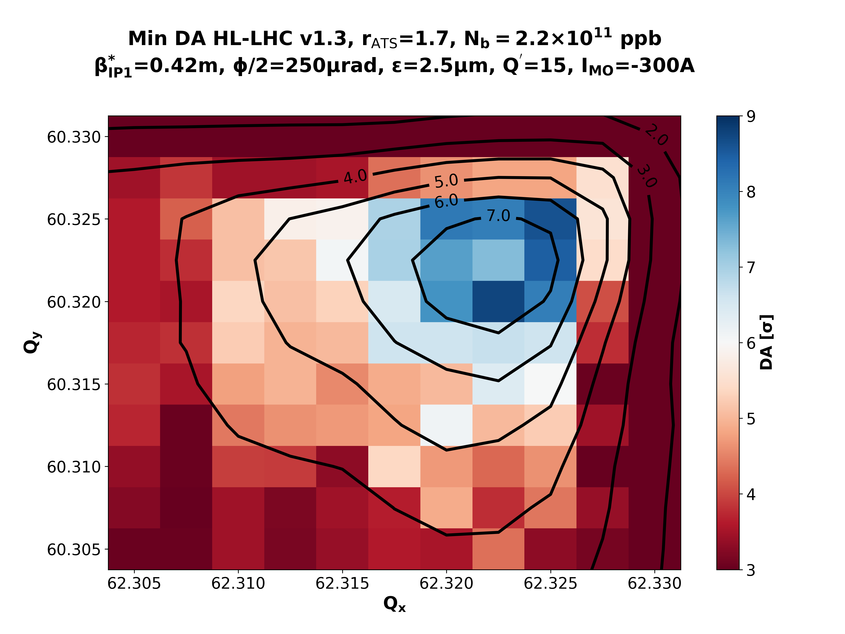
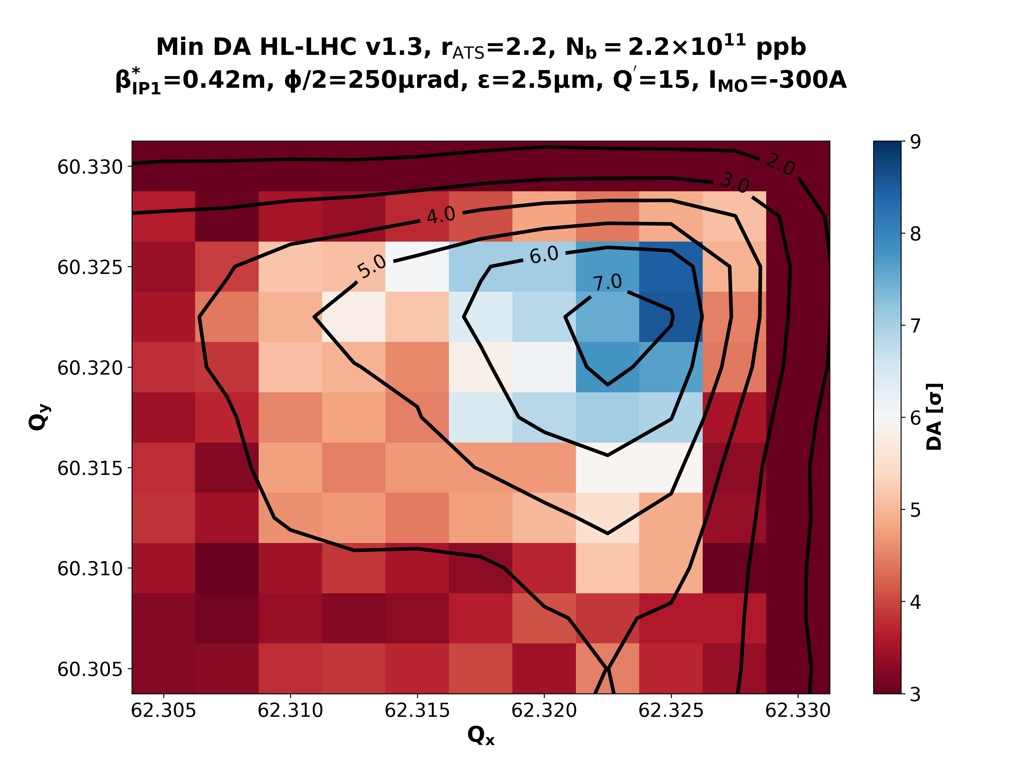
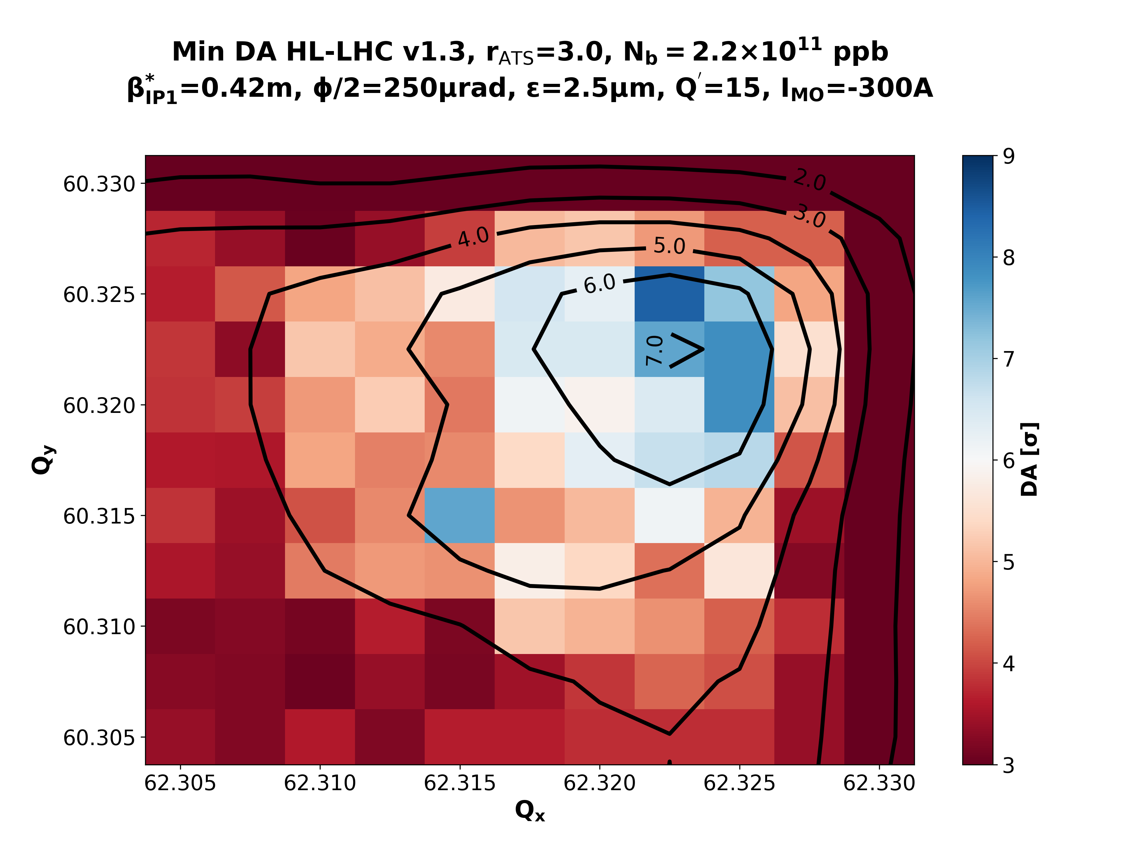
Recap (III)
Courtesy of X. Buffat
-1750 (3.0)
-1000 (2.2)
-750 (1.7)
Collisions β*=42cm
rATS = 1.0
rATS = 1.7
rATS = 2.2
rATS = 3.0
Reducing the octupoles at collisions (with the BB as stability guarantee) buys us back the DA.

Slide 5
Nominal Scenario

Slide 6
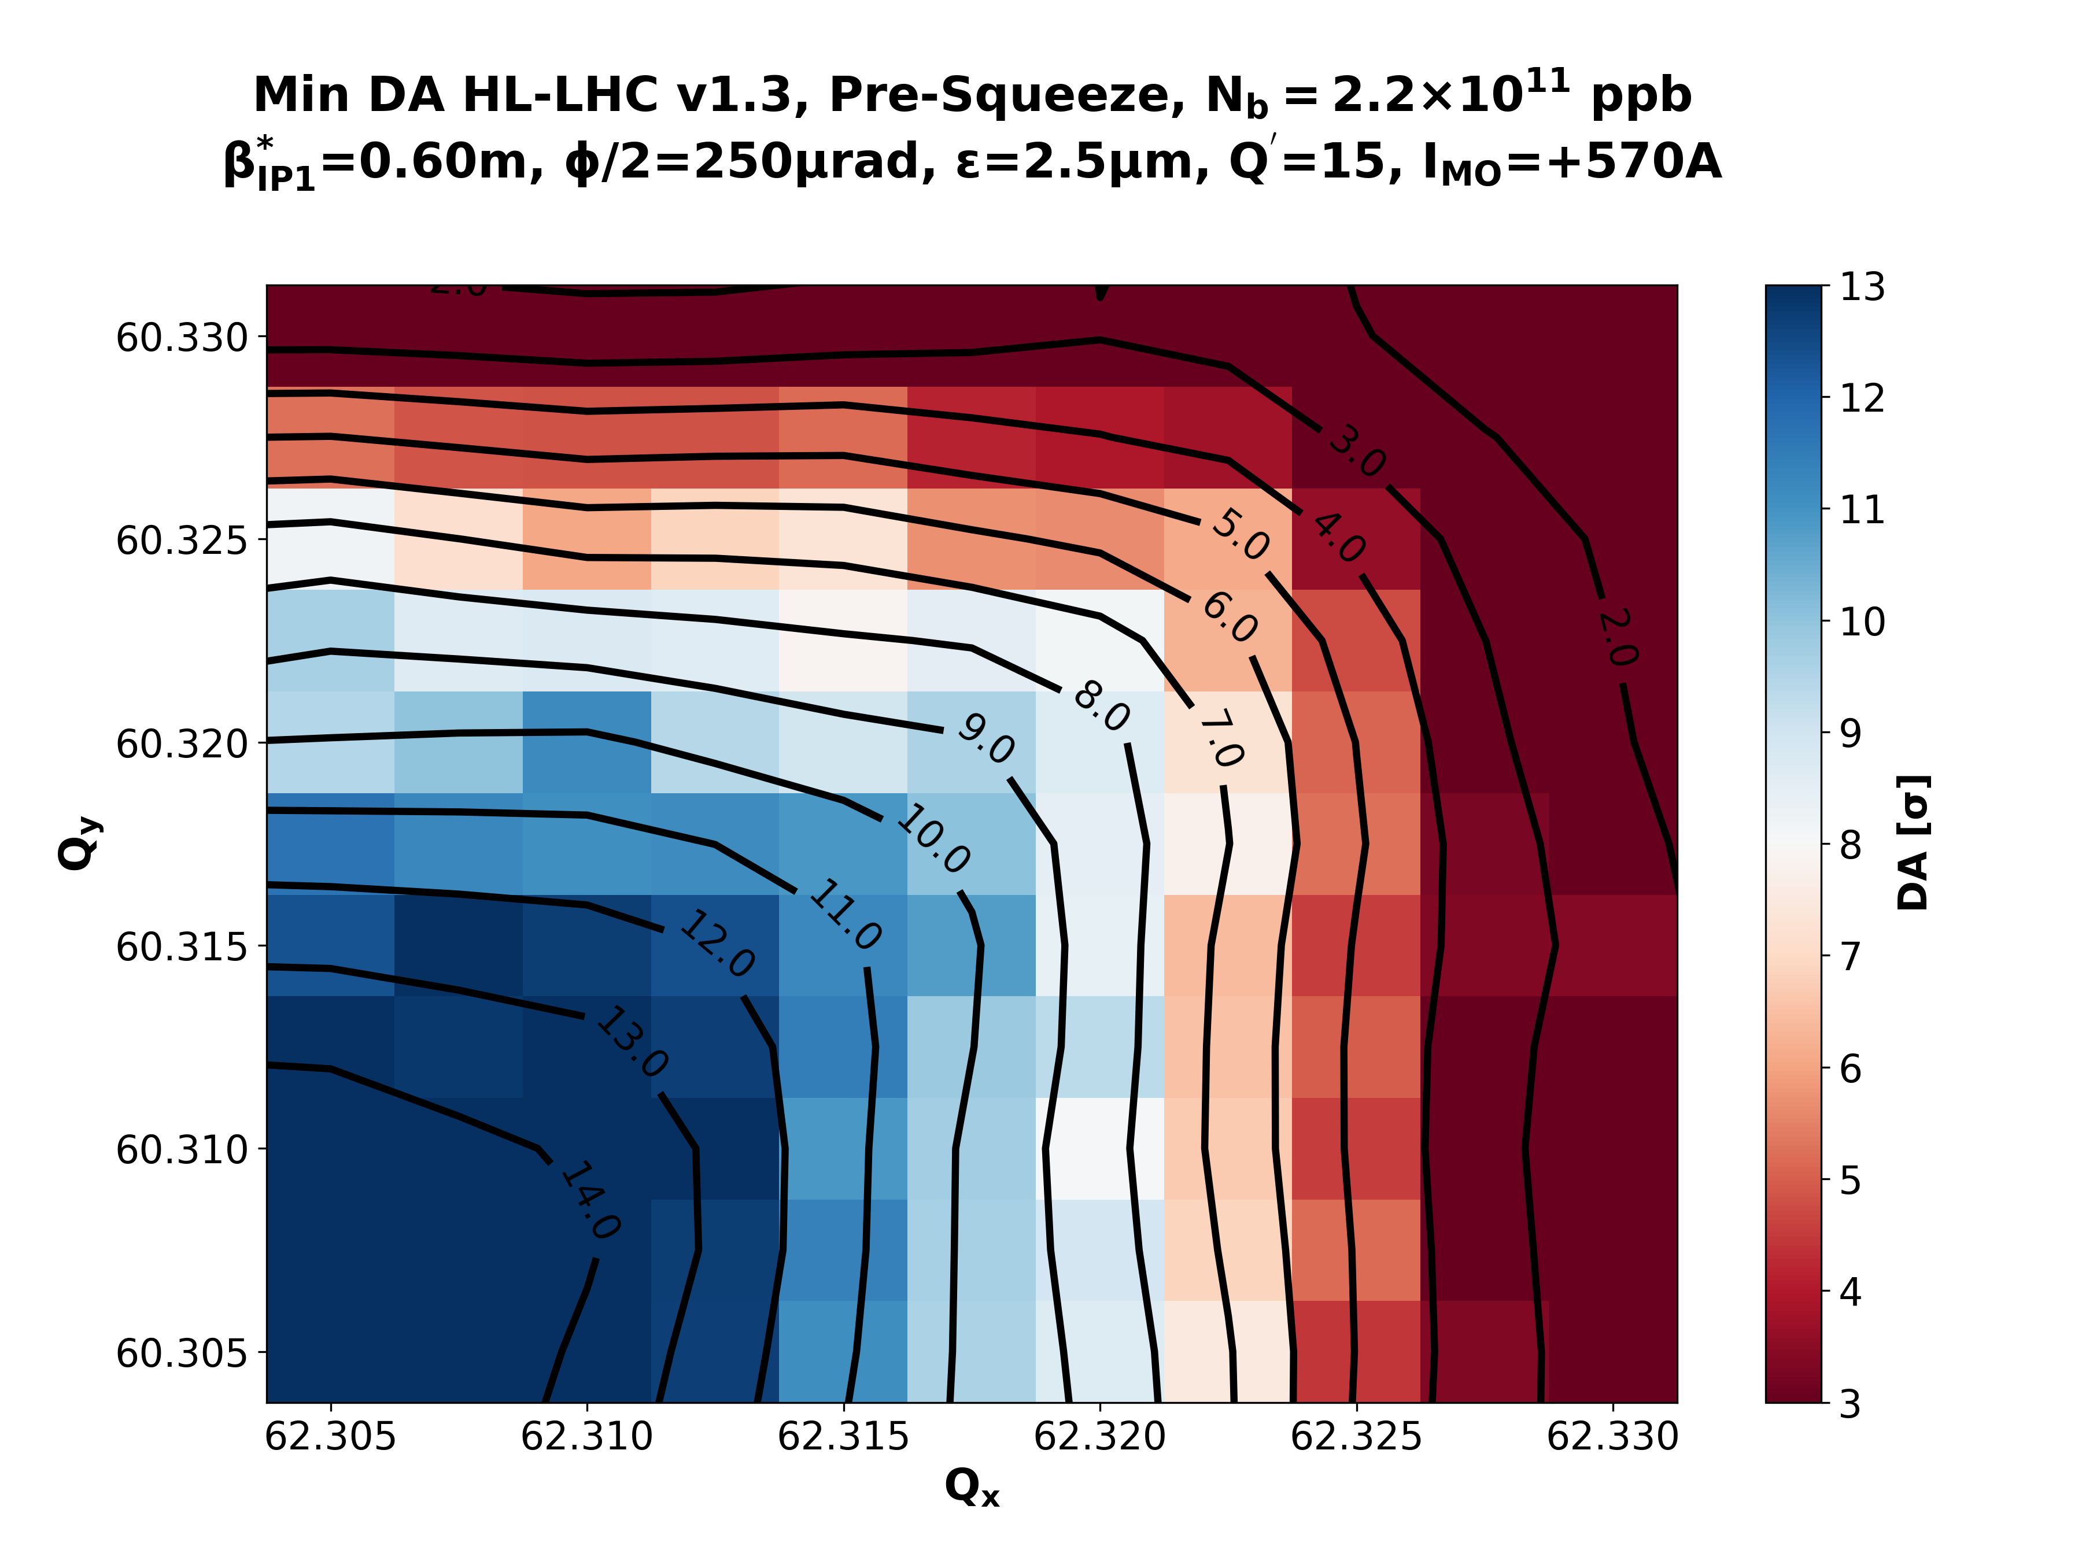
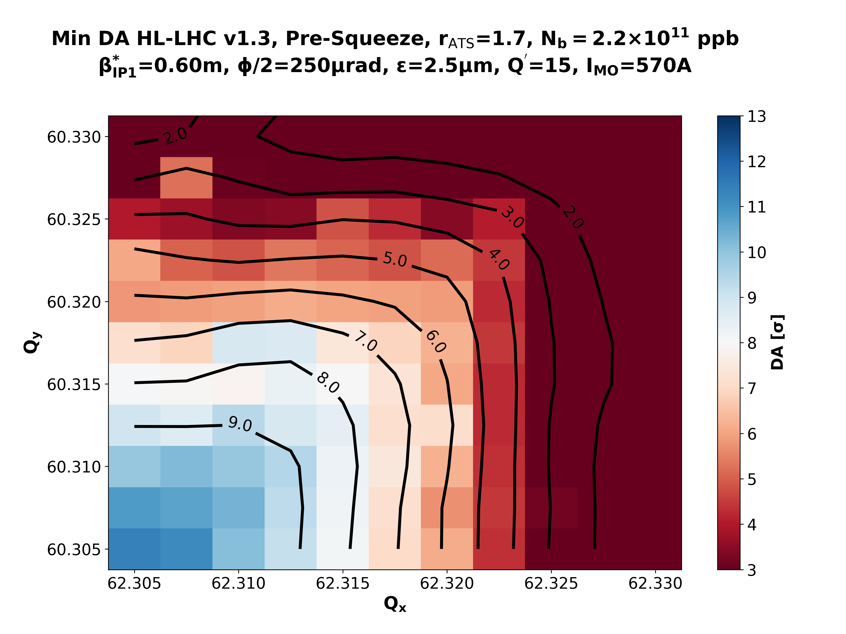
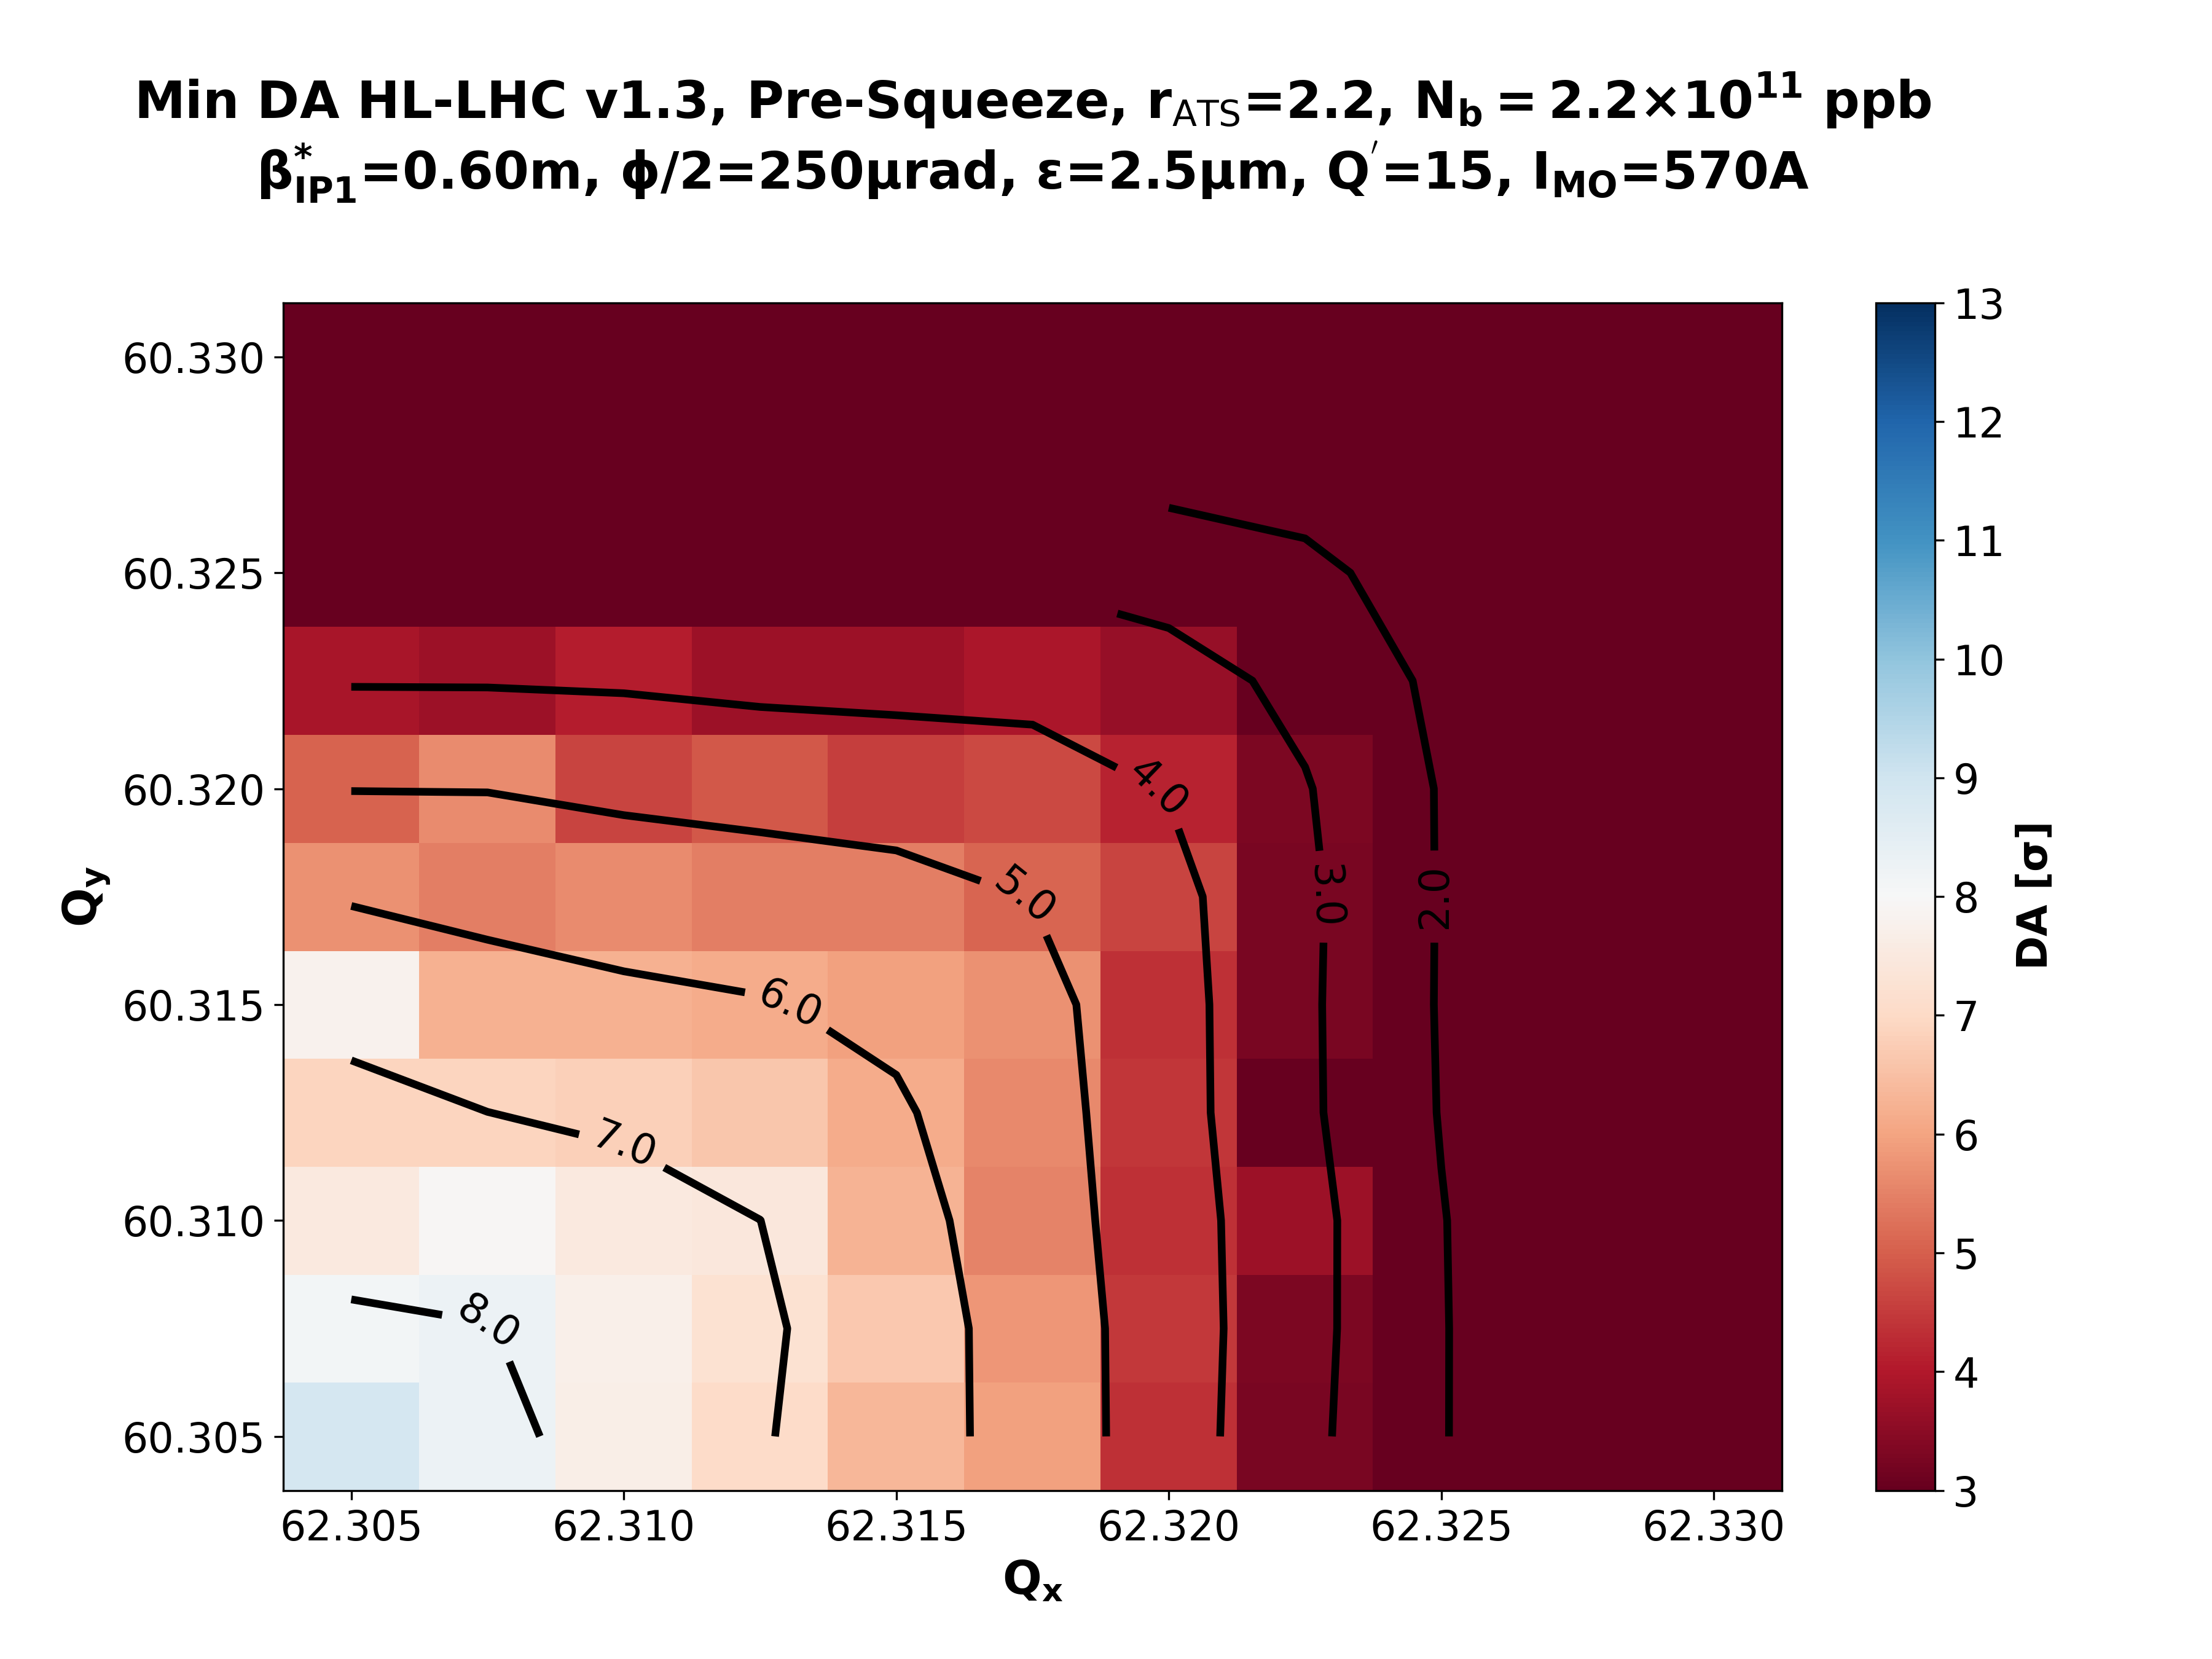
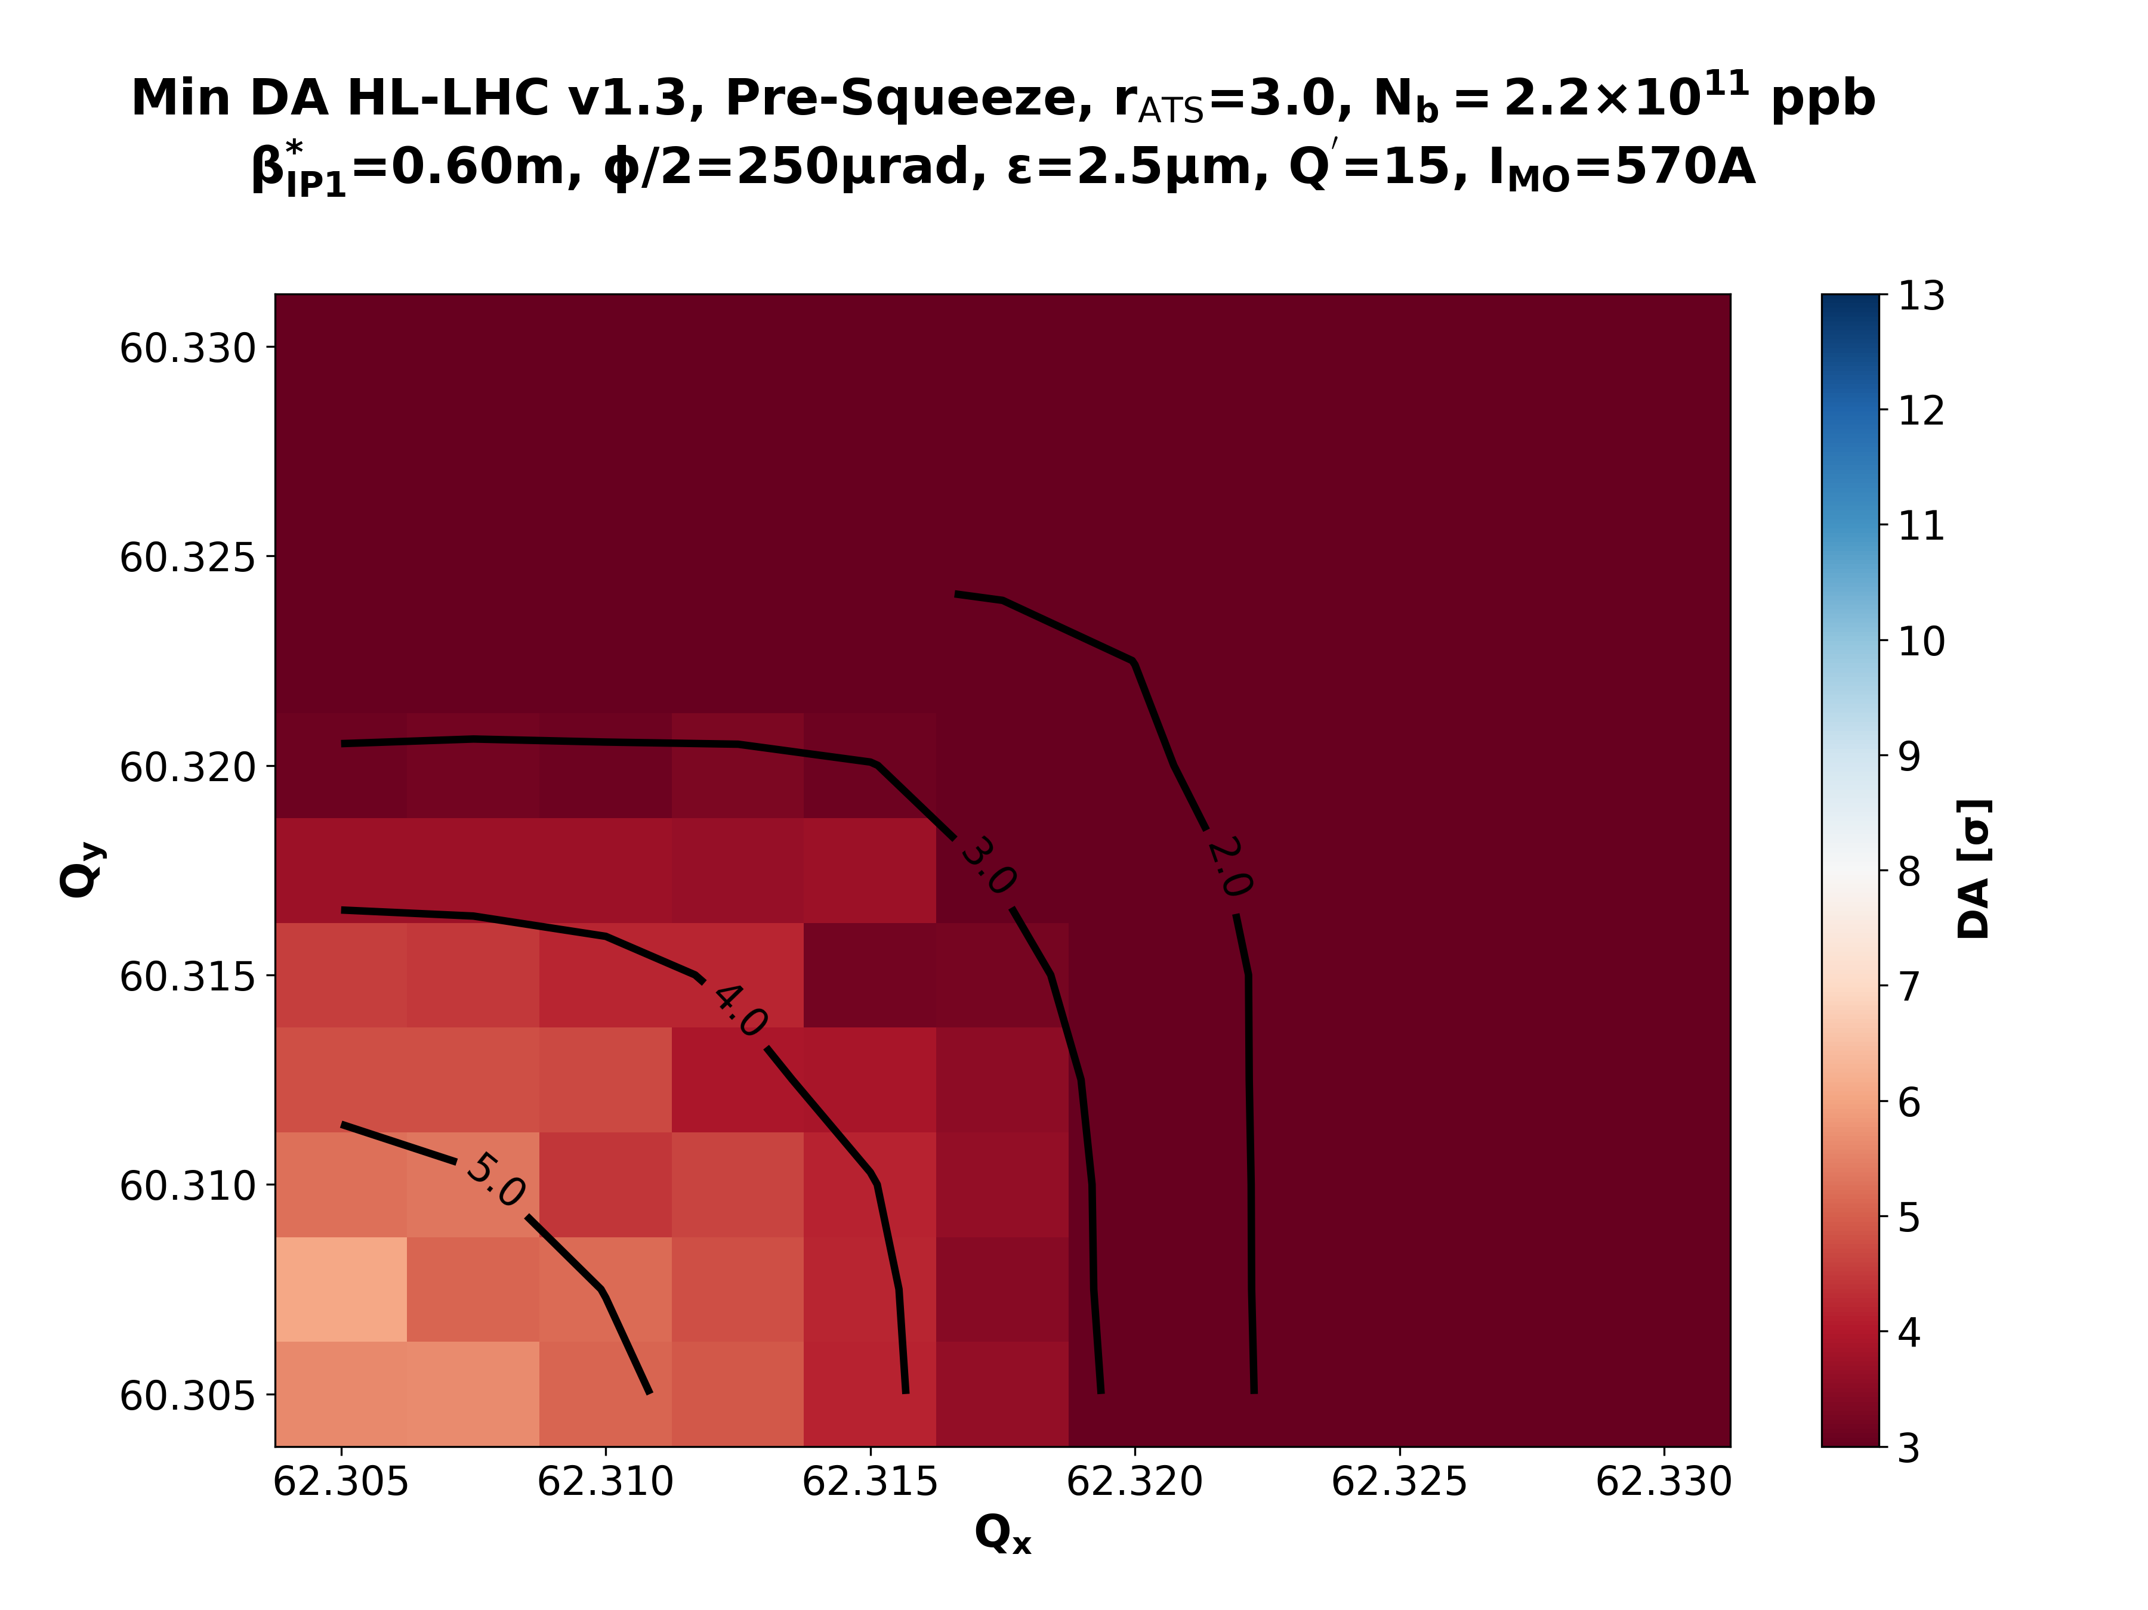
IMO>0: Pre-Squeeze & β*=60cm
rATS = 1.0
rATS = 1.7
rATS = 2.2
rATS = 3.0

Slide 7
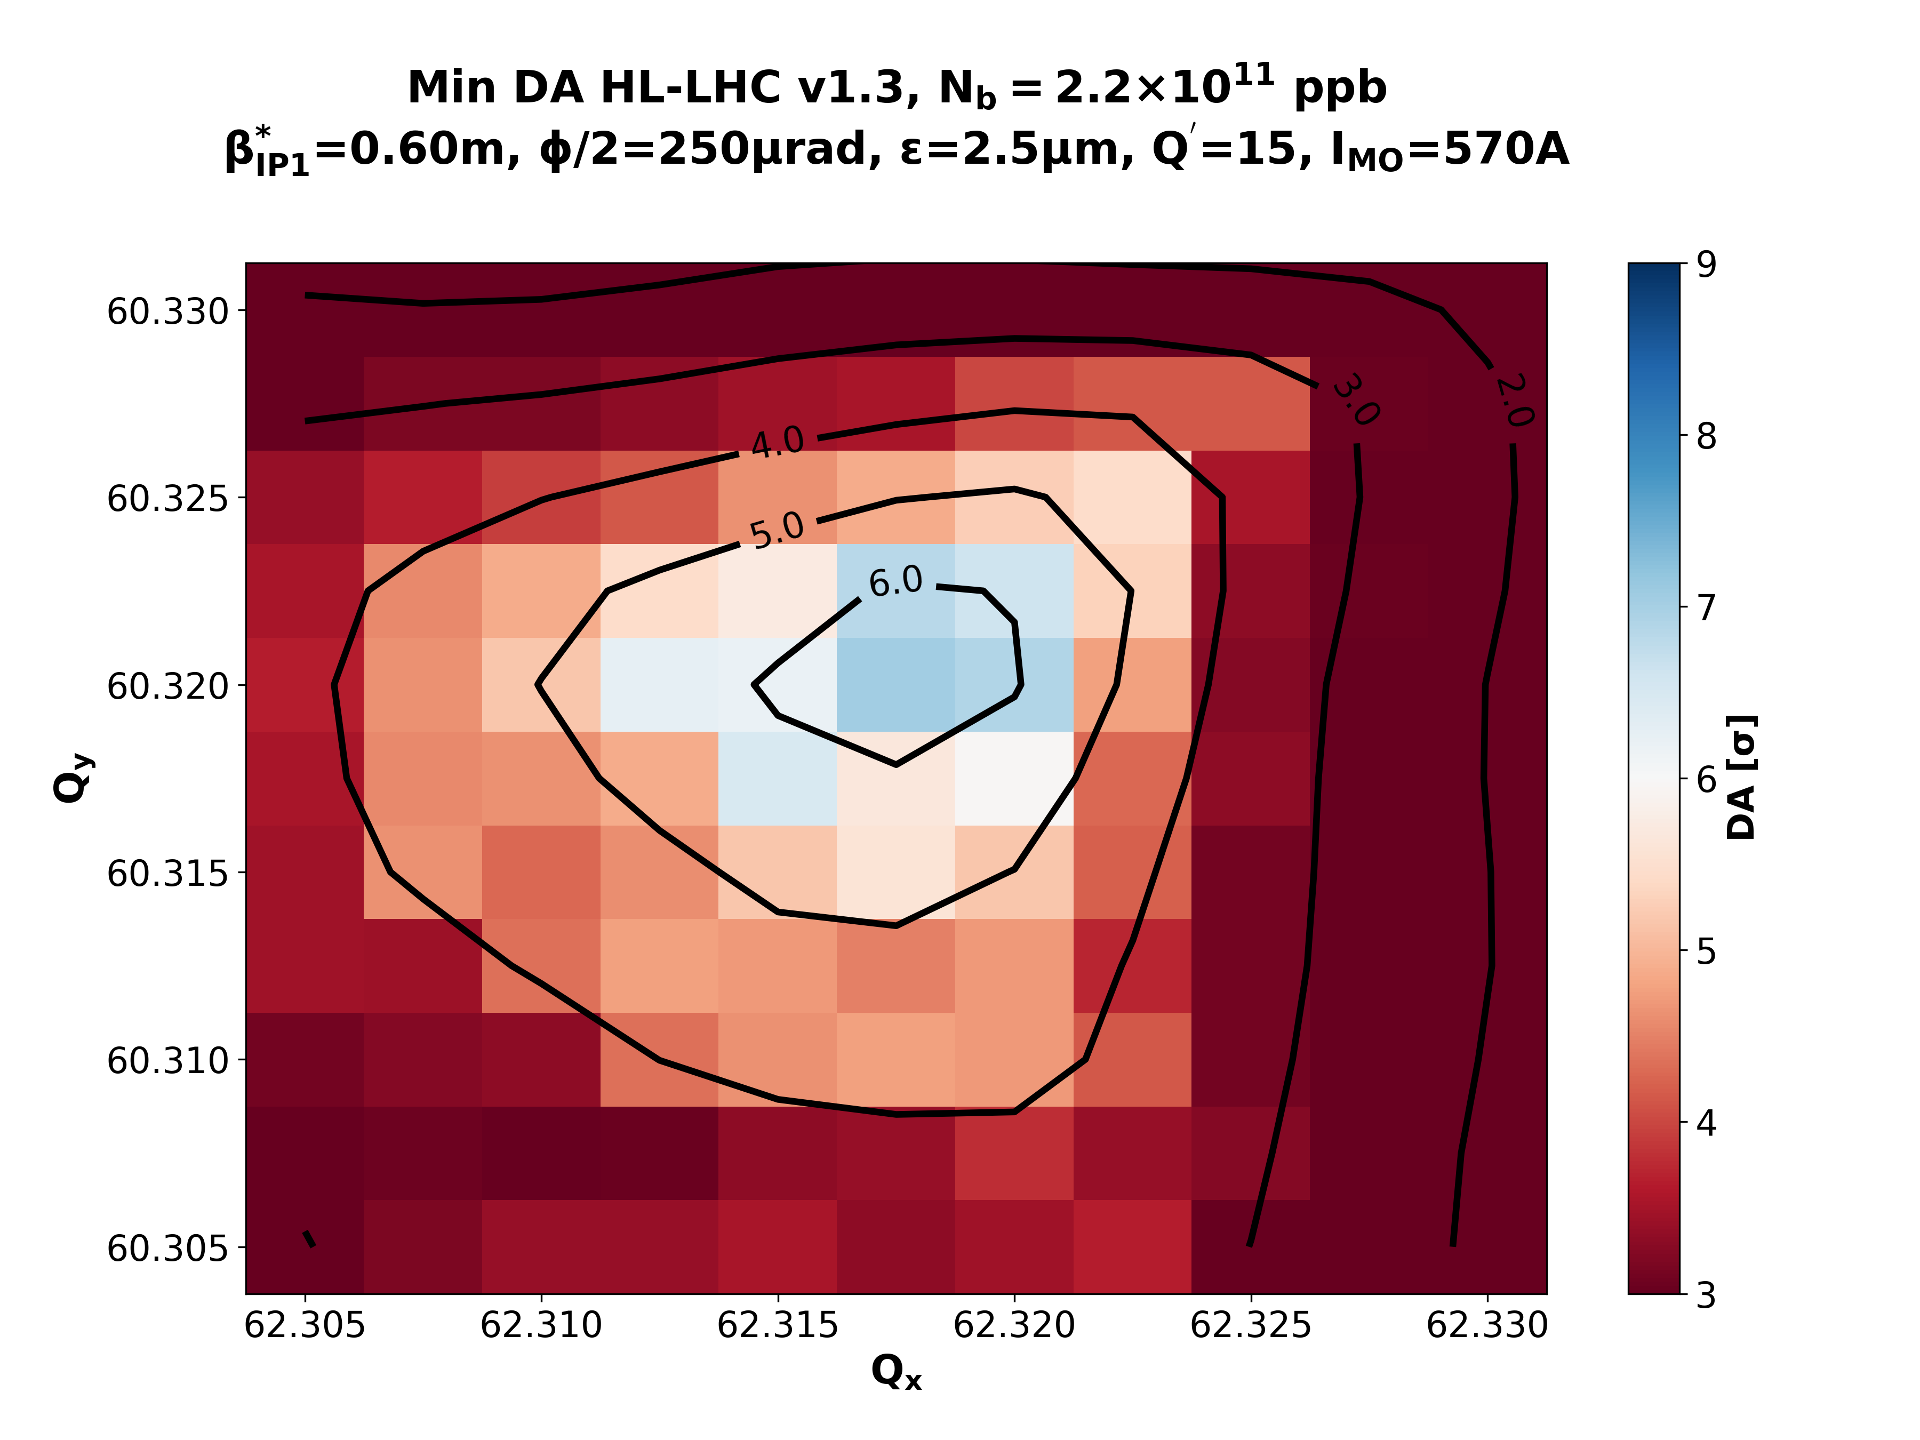
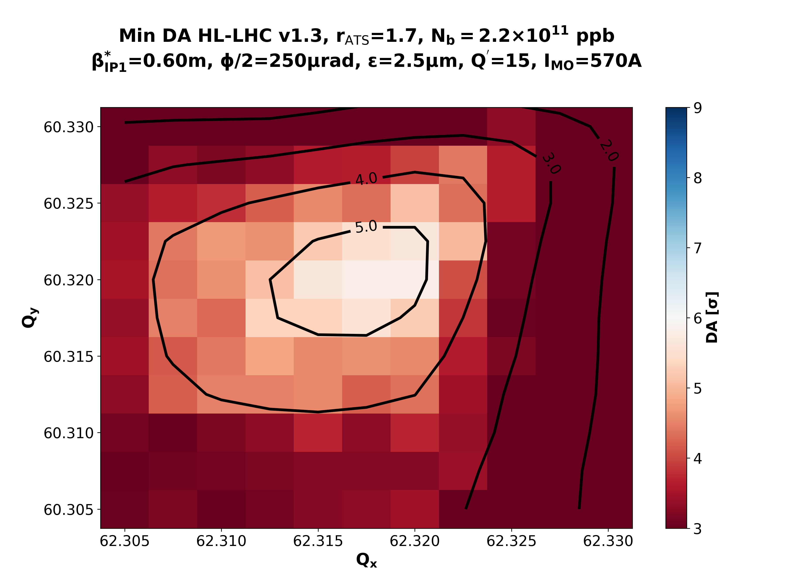
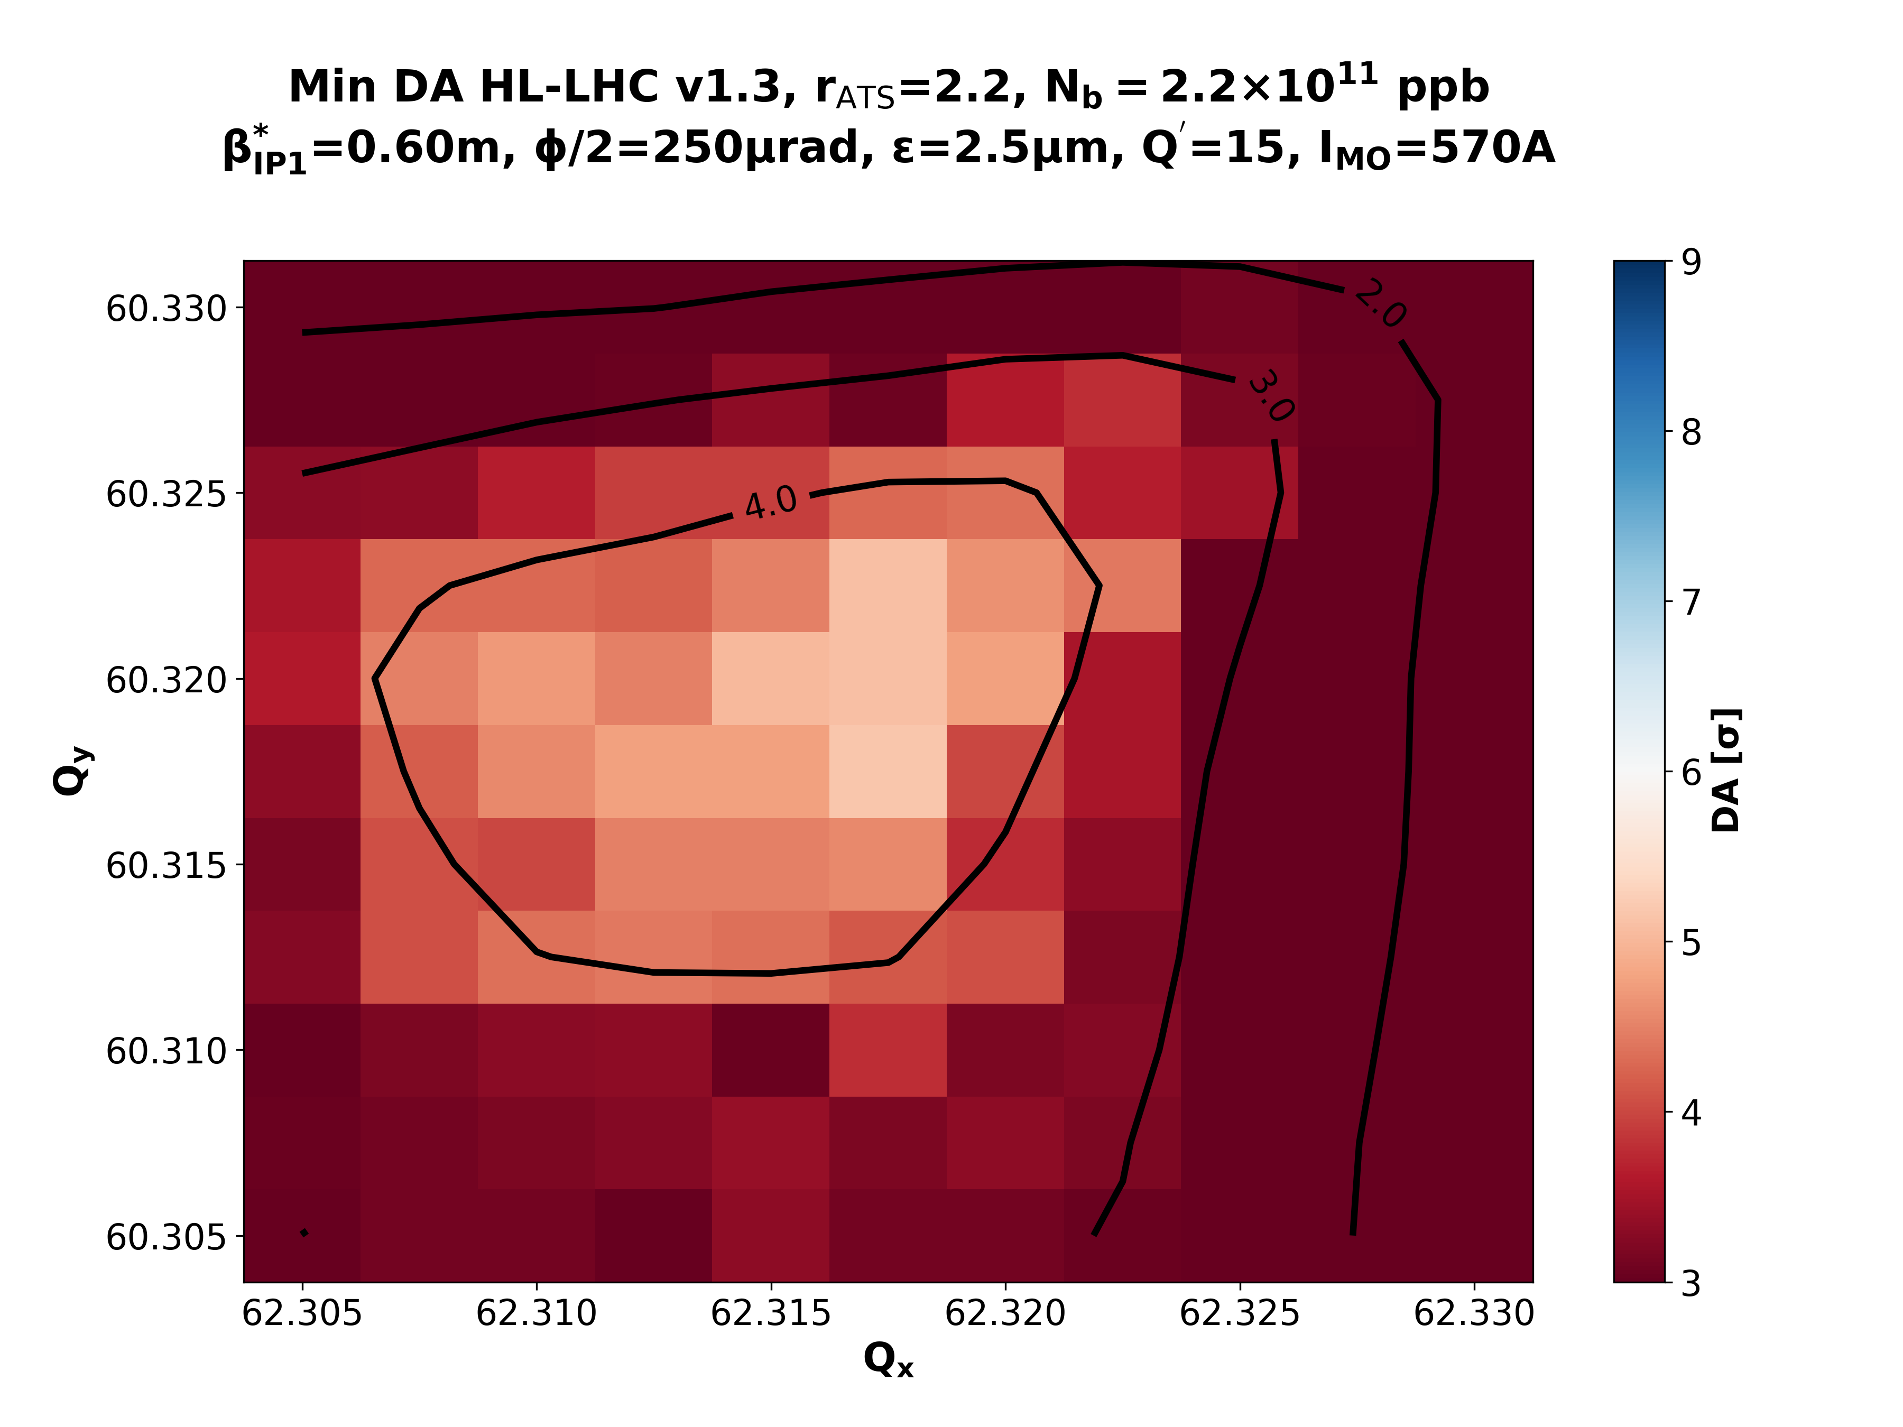
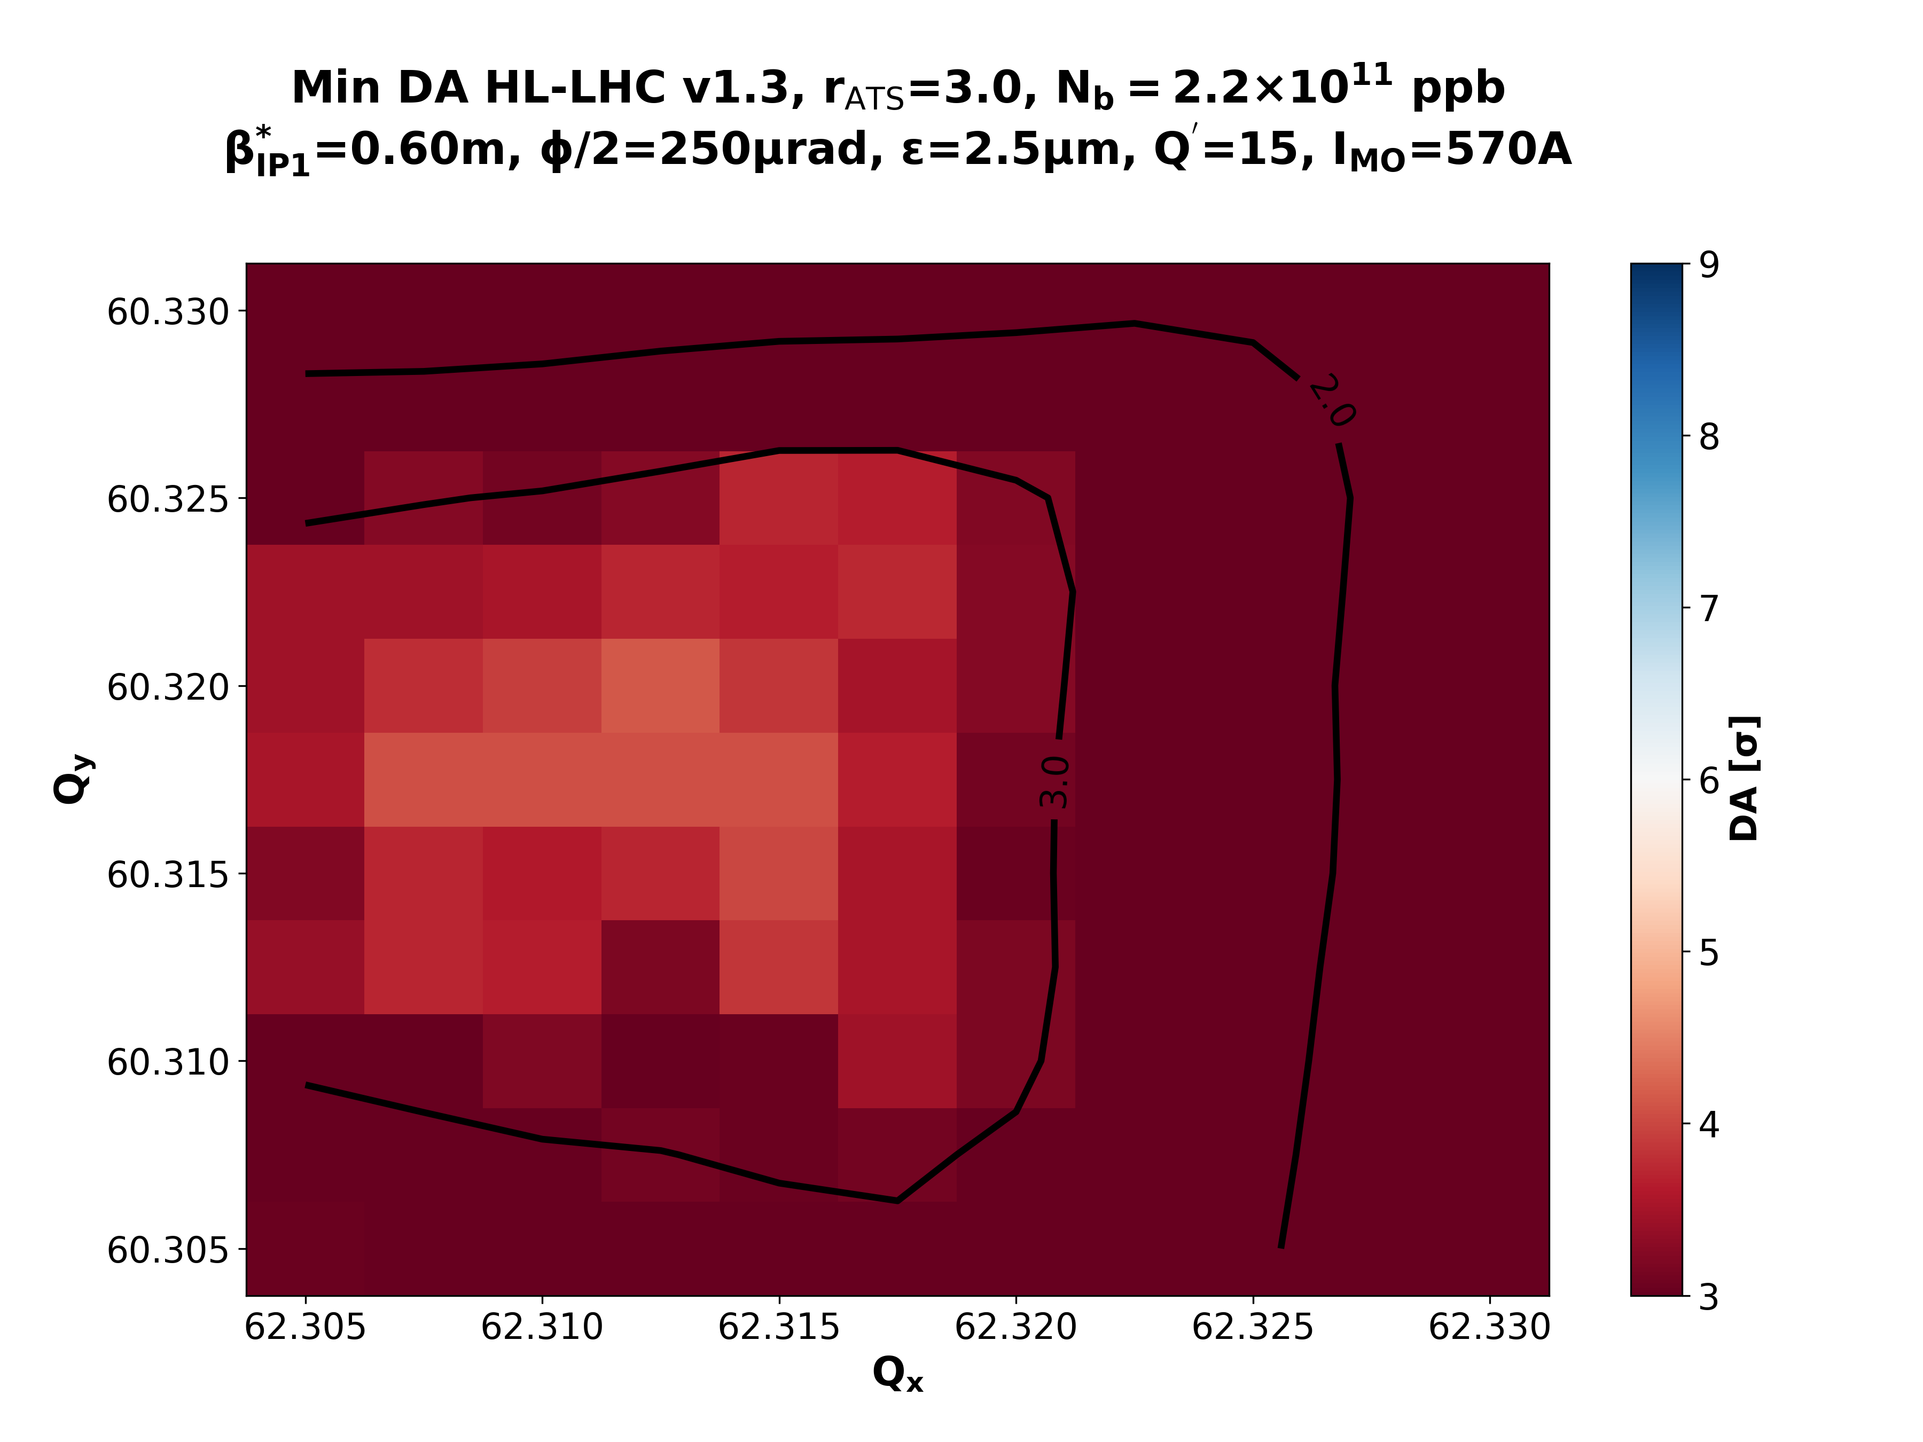
IMO>0: Collisions & β*=60cm
rATS = 1.0
rATS = 1.7
rATS = 2.2
rATS = 3.0

Slide 8
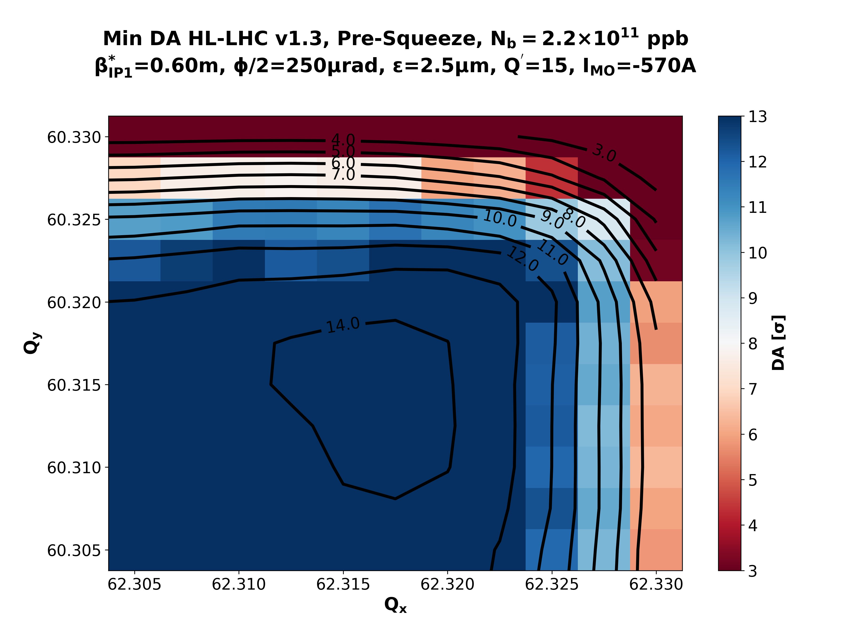
β*=60cm: IMO<0 vs IMO>0
~ -2σ of DA
IMO < 0
IMO > 0
rATS = 1.0
rATS = 1.0
rATS = 1.0
rATS = 1.0

Slide 9
Ultimate Scenario

Slide 10
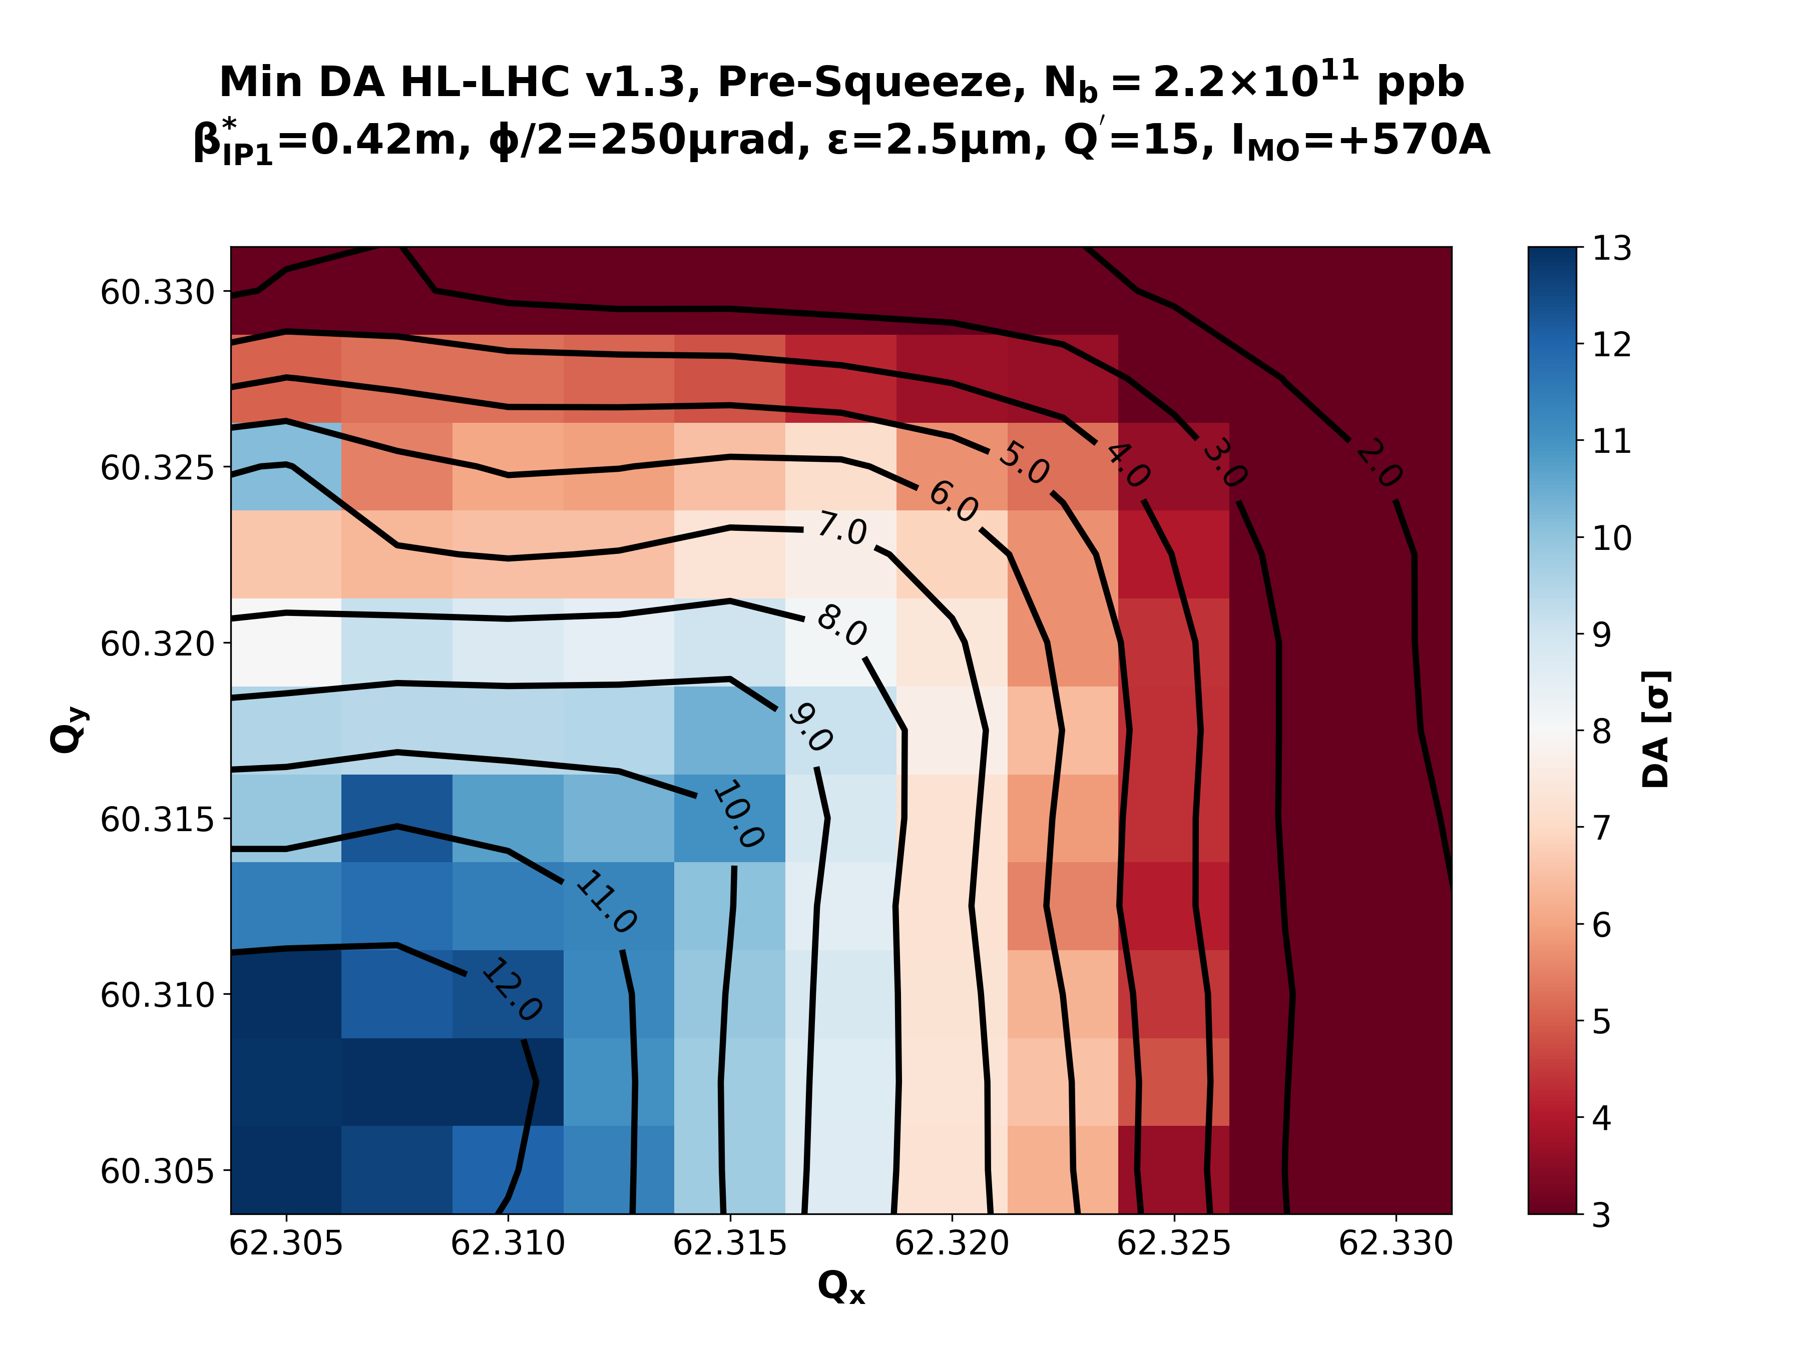
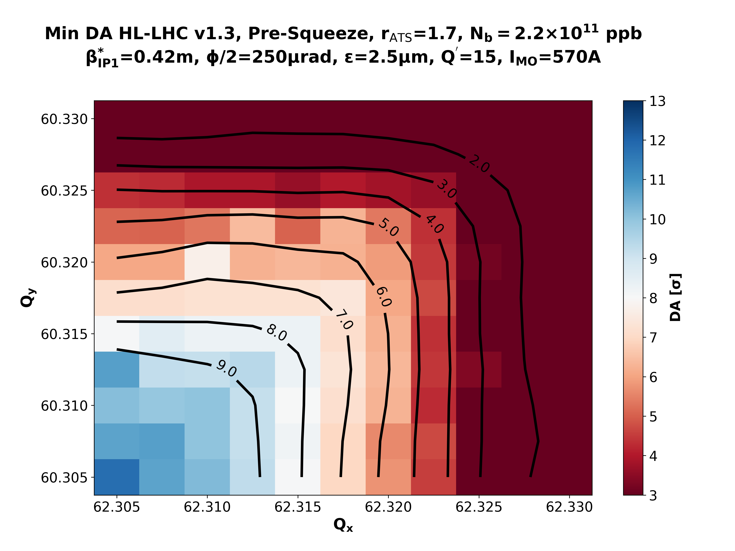
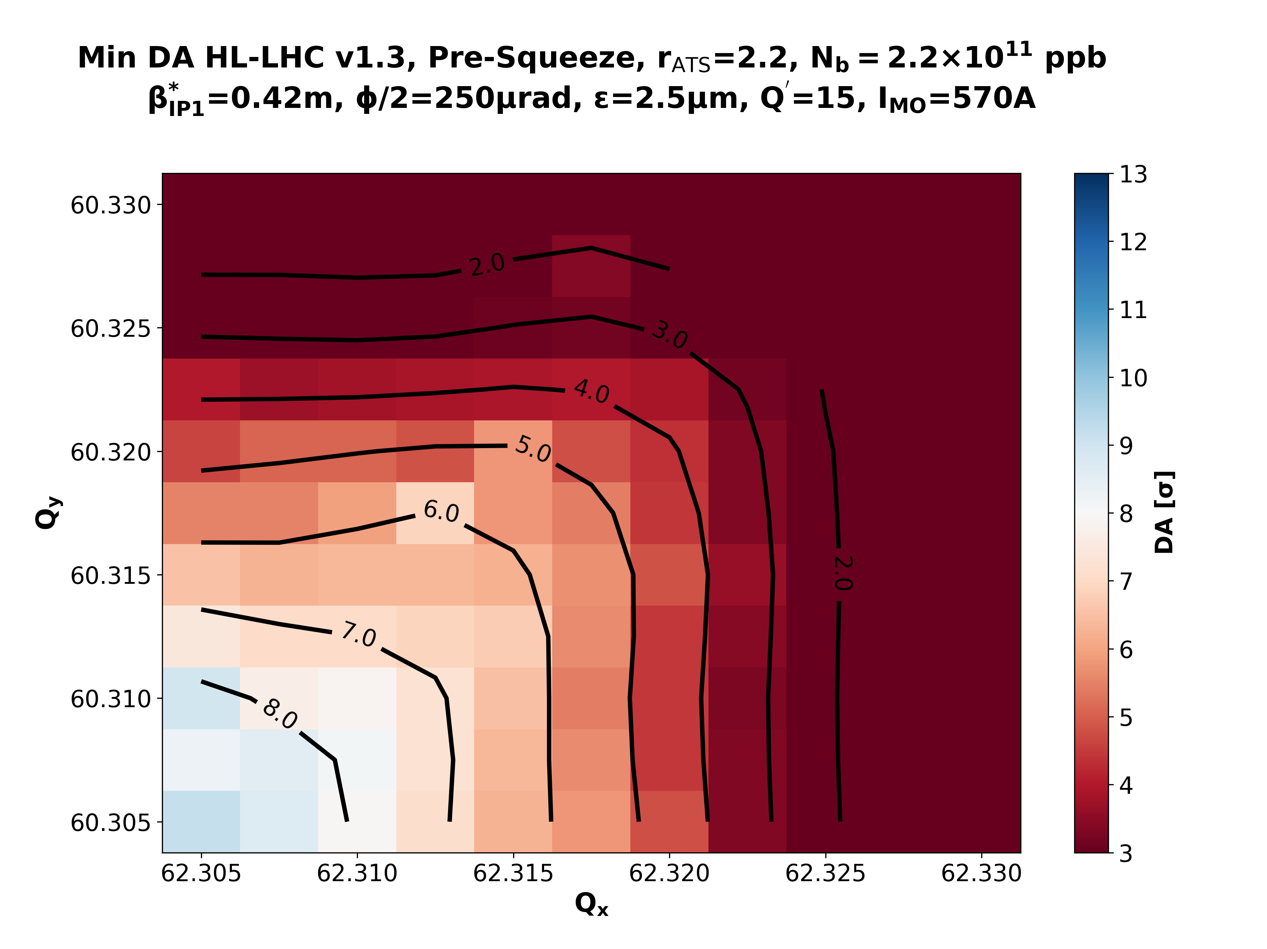
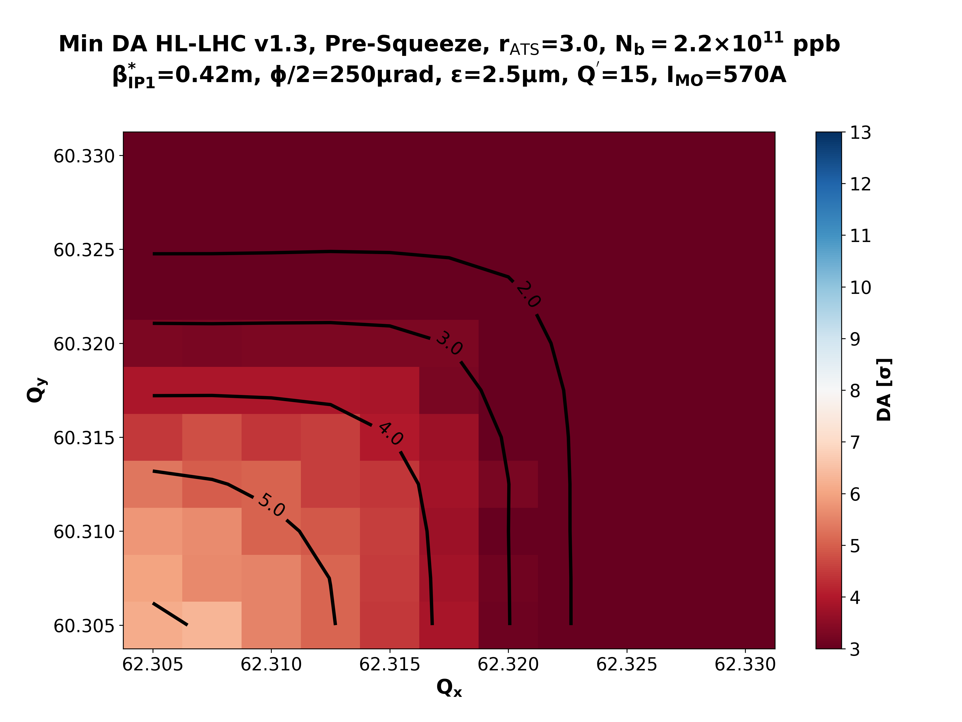
IMO>0: Pre-Squeeze & β*=42cm
~ -2σ of DA
wrt 60cm
rATS = 1.0
rATS = 1.7
rATS = 2.2
rATS = 3.0

Slide 11
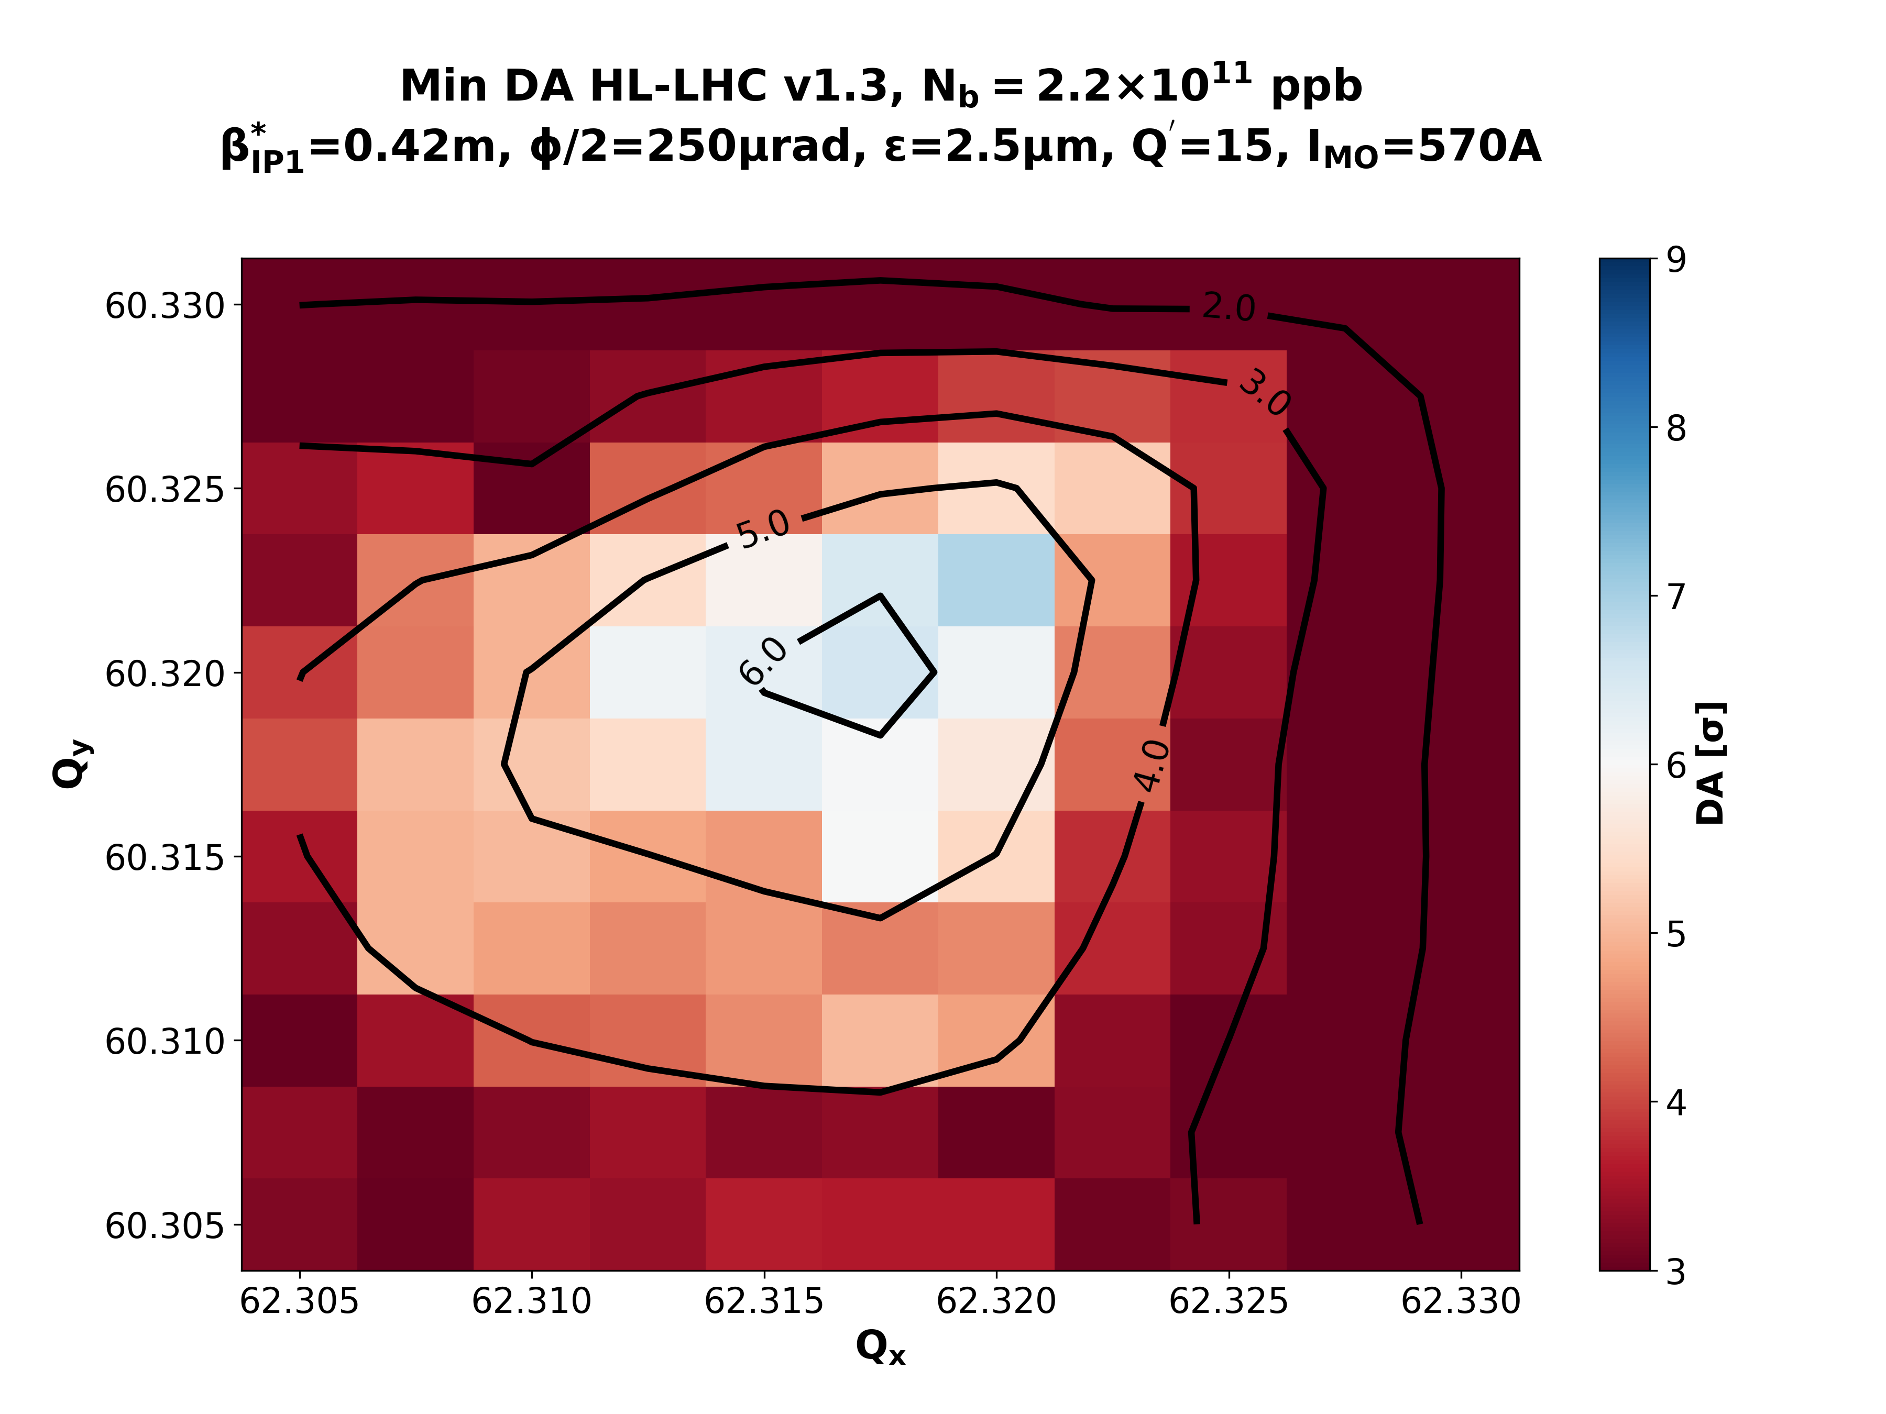
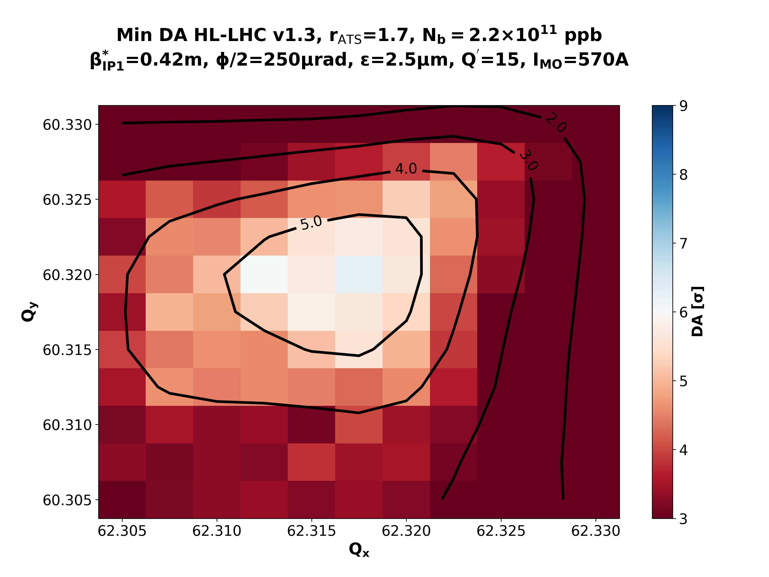
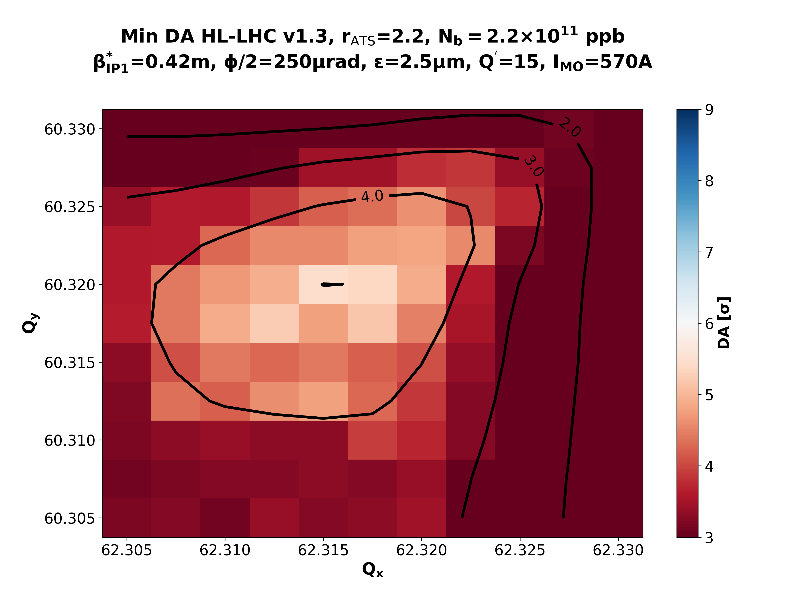
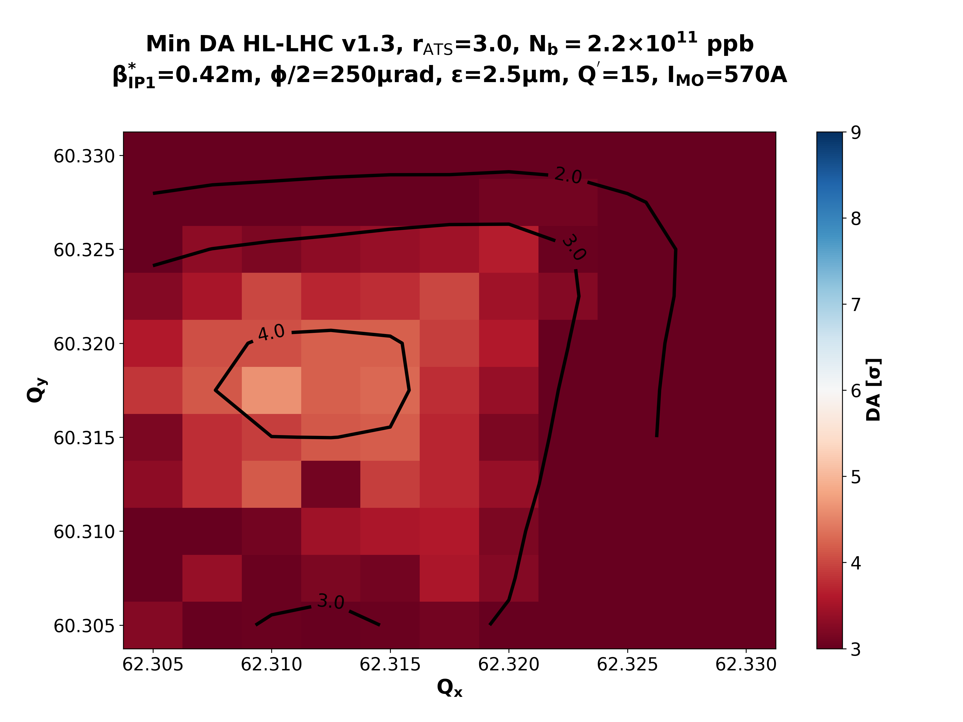
IMO>0: Collisions & β*=42cm
rATS = 1.0
rATS = 1.7
rATS = 2.2
rATS = 3.0

Slide 12
β*=42cm: IMO<0 vs IMO>0
~ -2σ of DA
IMO < 0
IMO > 0
rATS = 1.0
rATS = 1.0
rATS = 1.0
rATS = 1.0

Slide 13
Concerning Stability
In terms of stability, for the ultimate scenario we would need ~ 500 A for the “LS2 upgrade” case ➔ rATS = 1 is enough (vs 2.2 for the negative)
rATS = 1.0
rATS = 2.2
While a configuration of 6-6.5σ can be found with the positive polarity at the start of collisions, the shrinkage of the available tune space is not negligible.
A function for reducing the octupole current could be beneficial, however…

Slide 14
Concerning Stability
… with the positive polarity is significantly more difficult in achieving 6σ DA in the 15cm point.
At some point the function should cross the IMO=0 A ➔ could be challenging!
What about a wire (or e-lens) configuration?

Slide 15
Summary
Operating with the positive octupole polarity reduces (under the same optics conditions) the DA by ~ 2.0σ, due to the lack of BBLR compensation.
Concerning the collimation upgrade, the post-LS2 configuration is still within reach in terms of DA at the start of collisions, although the leveling process requires some interventions. The negative polarity with high tele-index seems more favorable.
For an rATS=1.0 & IMO>0 and the ultimate scenario:
  Optimal tune at pre-squeeze ≄ optimal tune collisions
  With full octupoles the DA region at the start of collisions shrinks significantly.
  Reduction of the octupole at collision can be a solution, but an inversion of the polarity should be implemented when the BBLR intensifies (i.e. 15cm).
Other (non-baseline) BBLR compensator solutions could be thought as implementations of mitigating the side-effects of the positive octupole polarity on DA.

Slide 16
BACKUP SLIDES

Slide 17
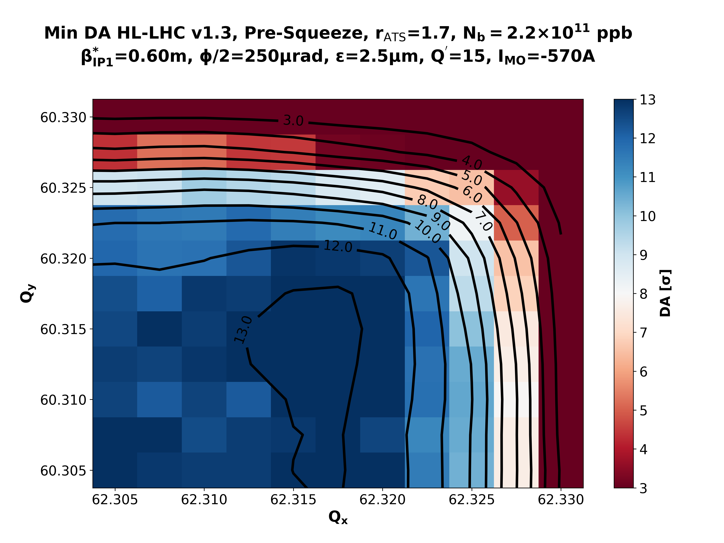
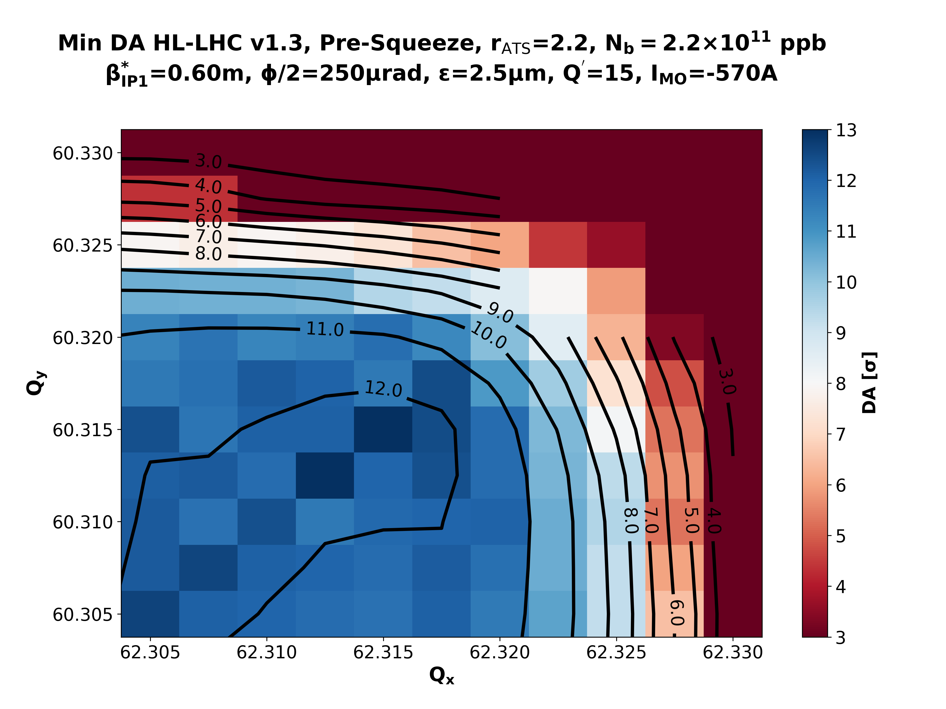
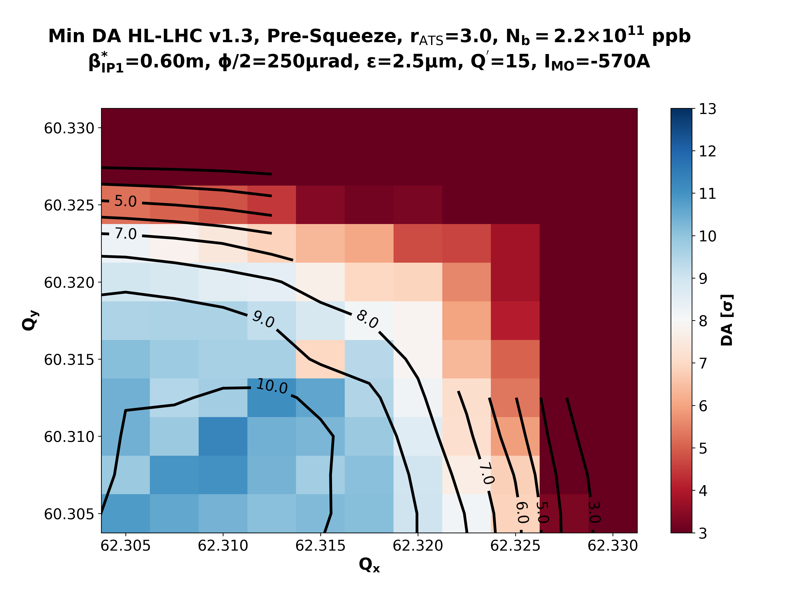
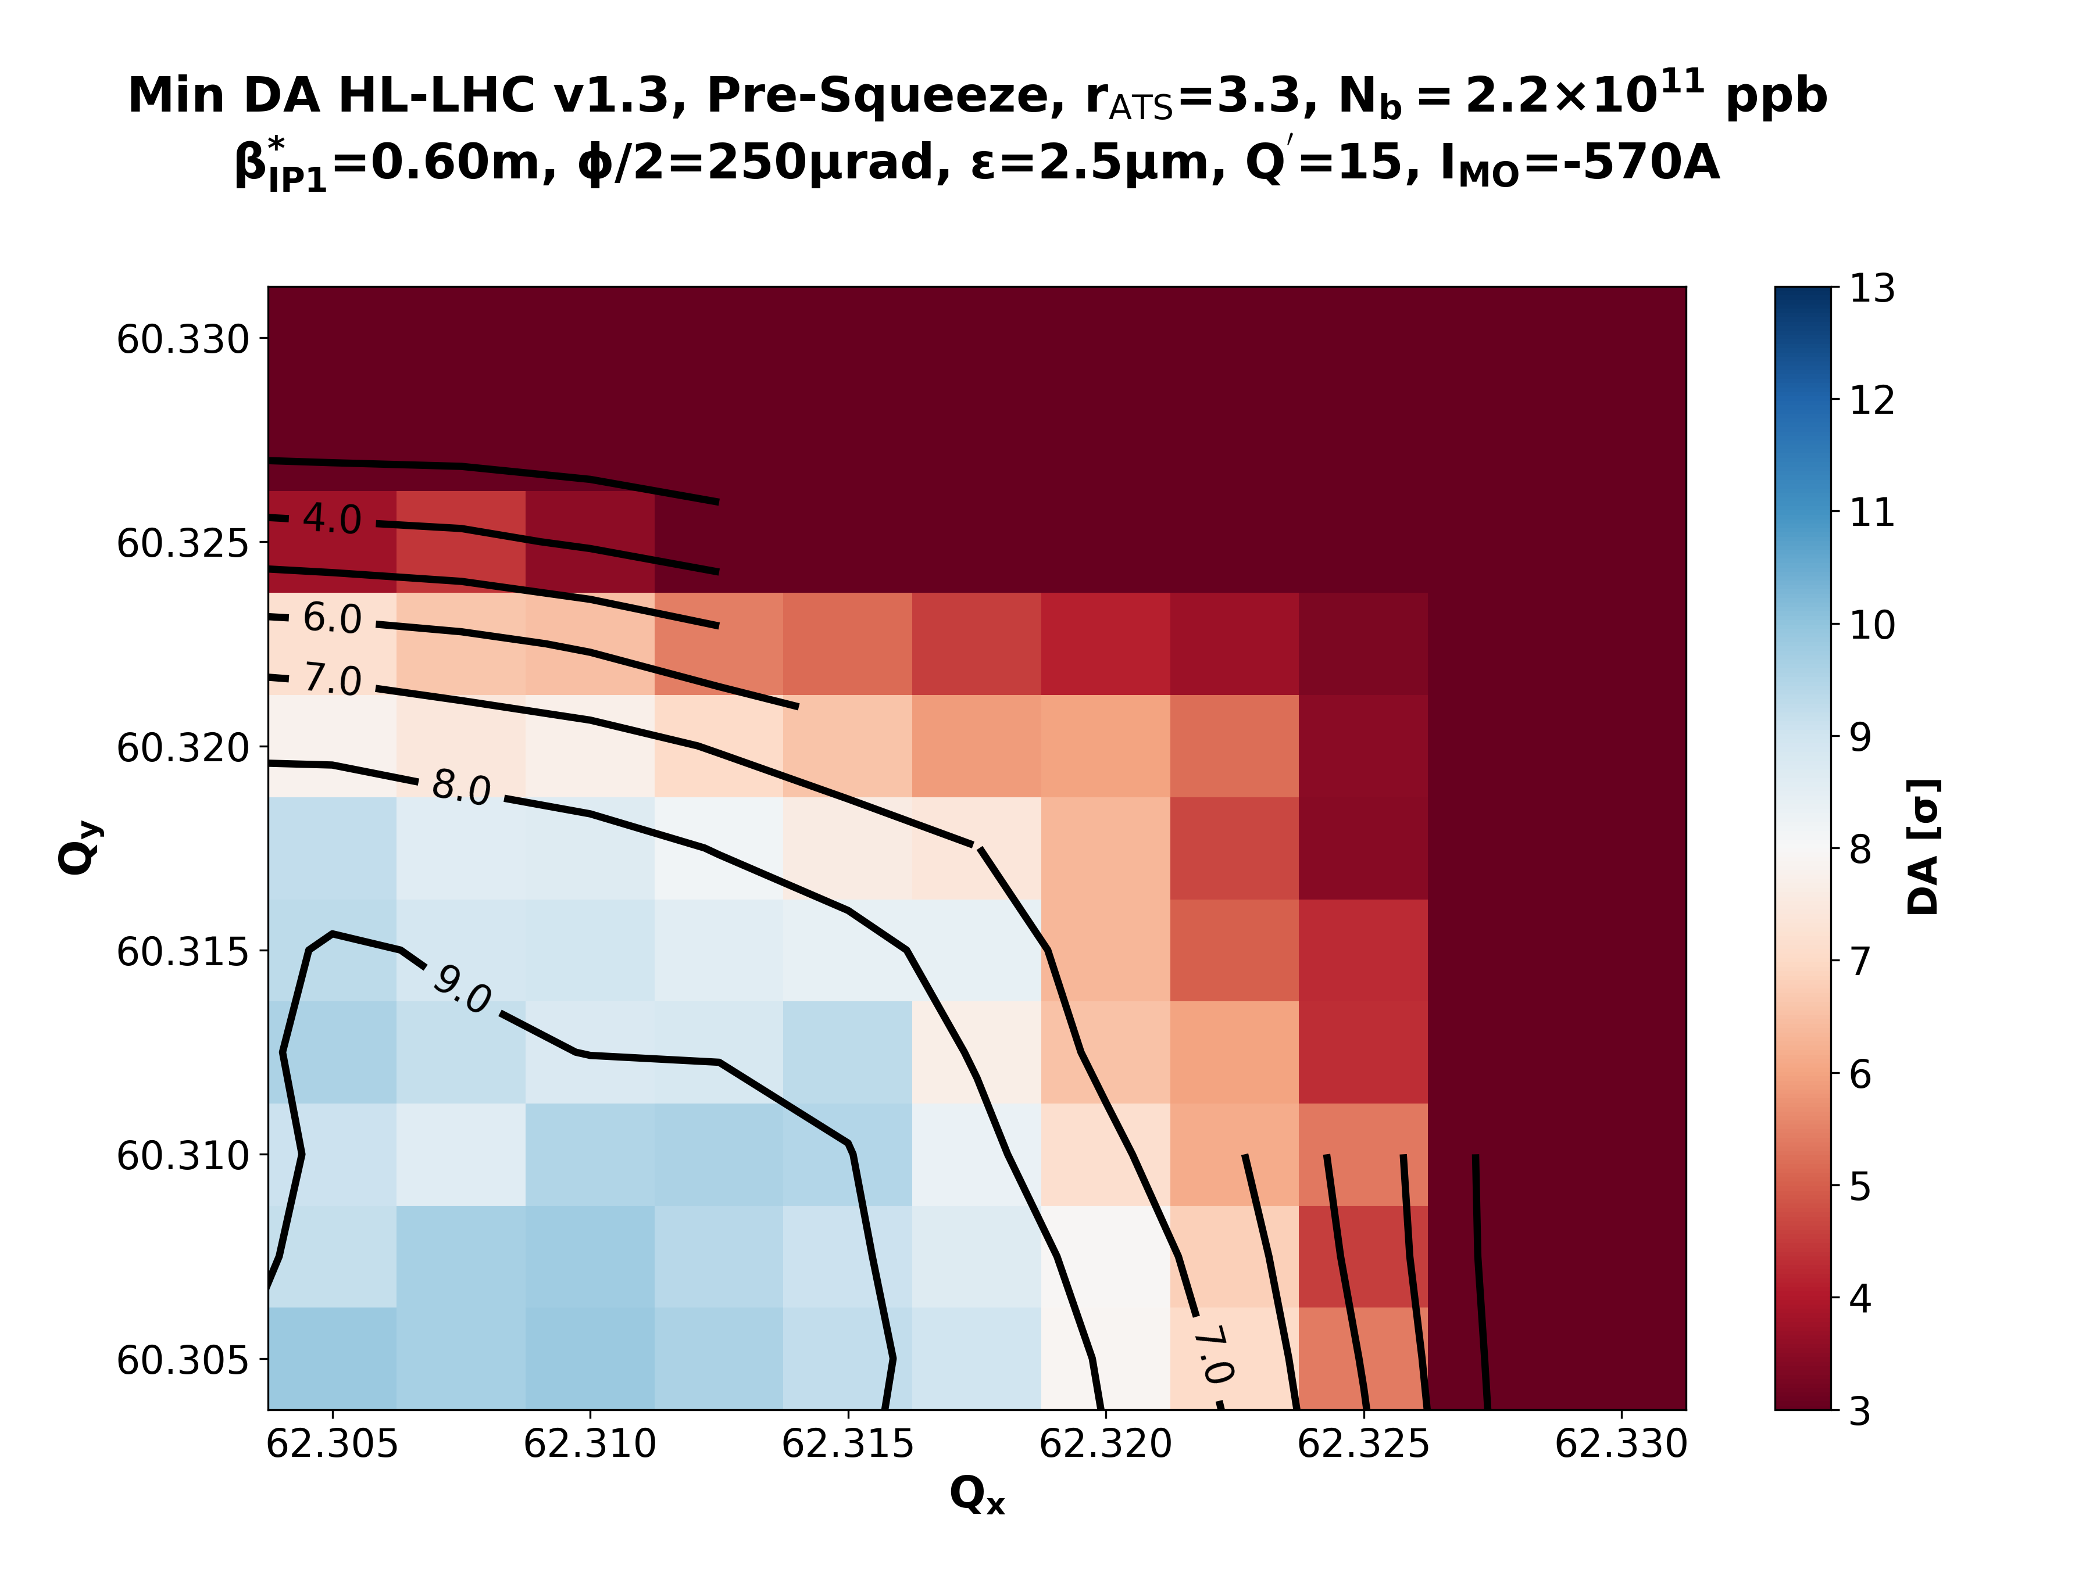
Nominal Presqueeze – β*=60cm - IMO=-570 A
rATS = 1.0
rATS = 1.7
rATS = 2.2
rATS = 3.0
rATS = 3.3

Slide 18
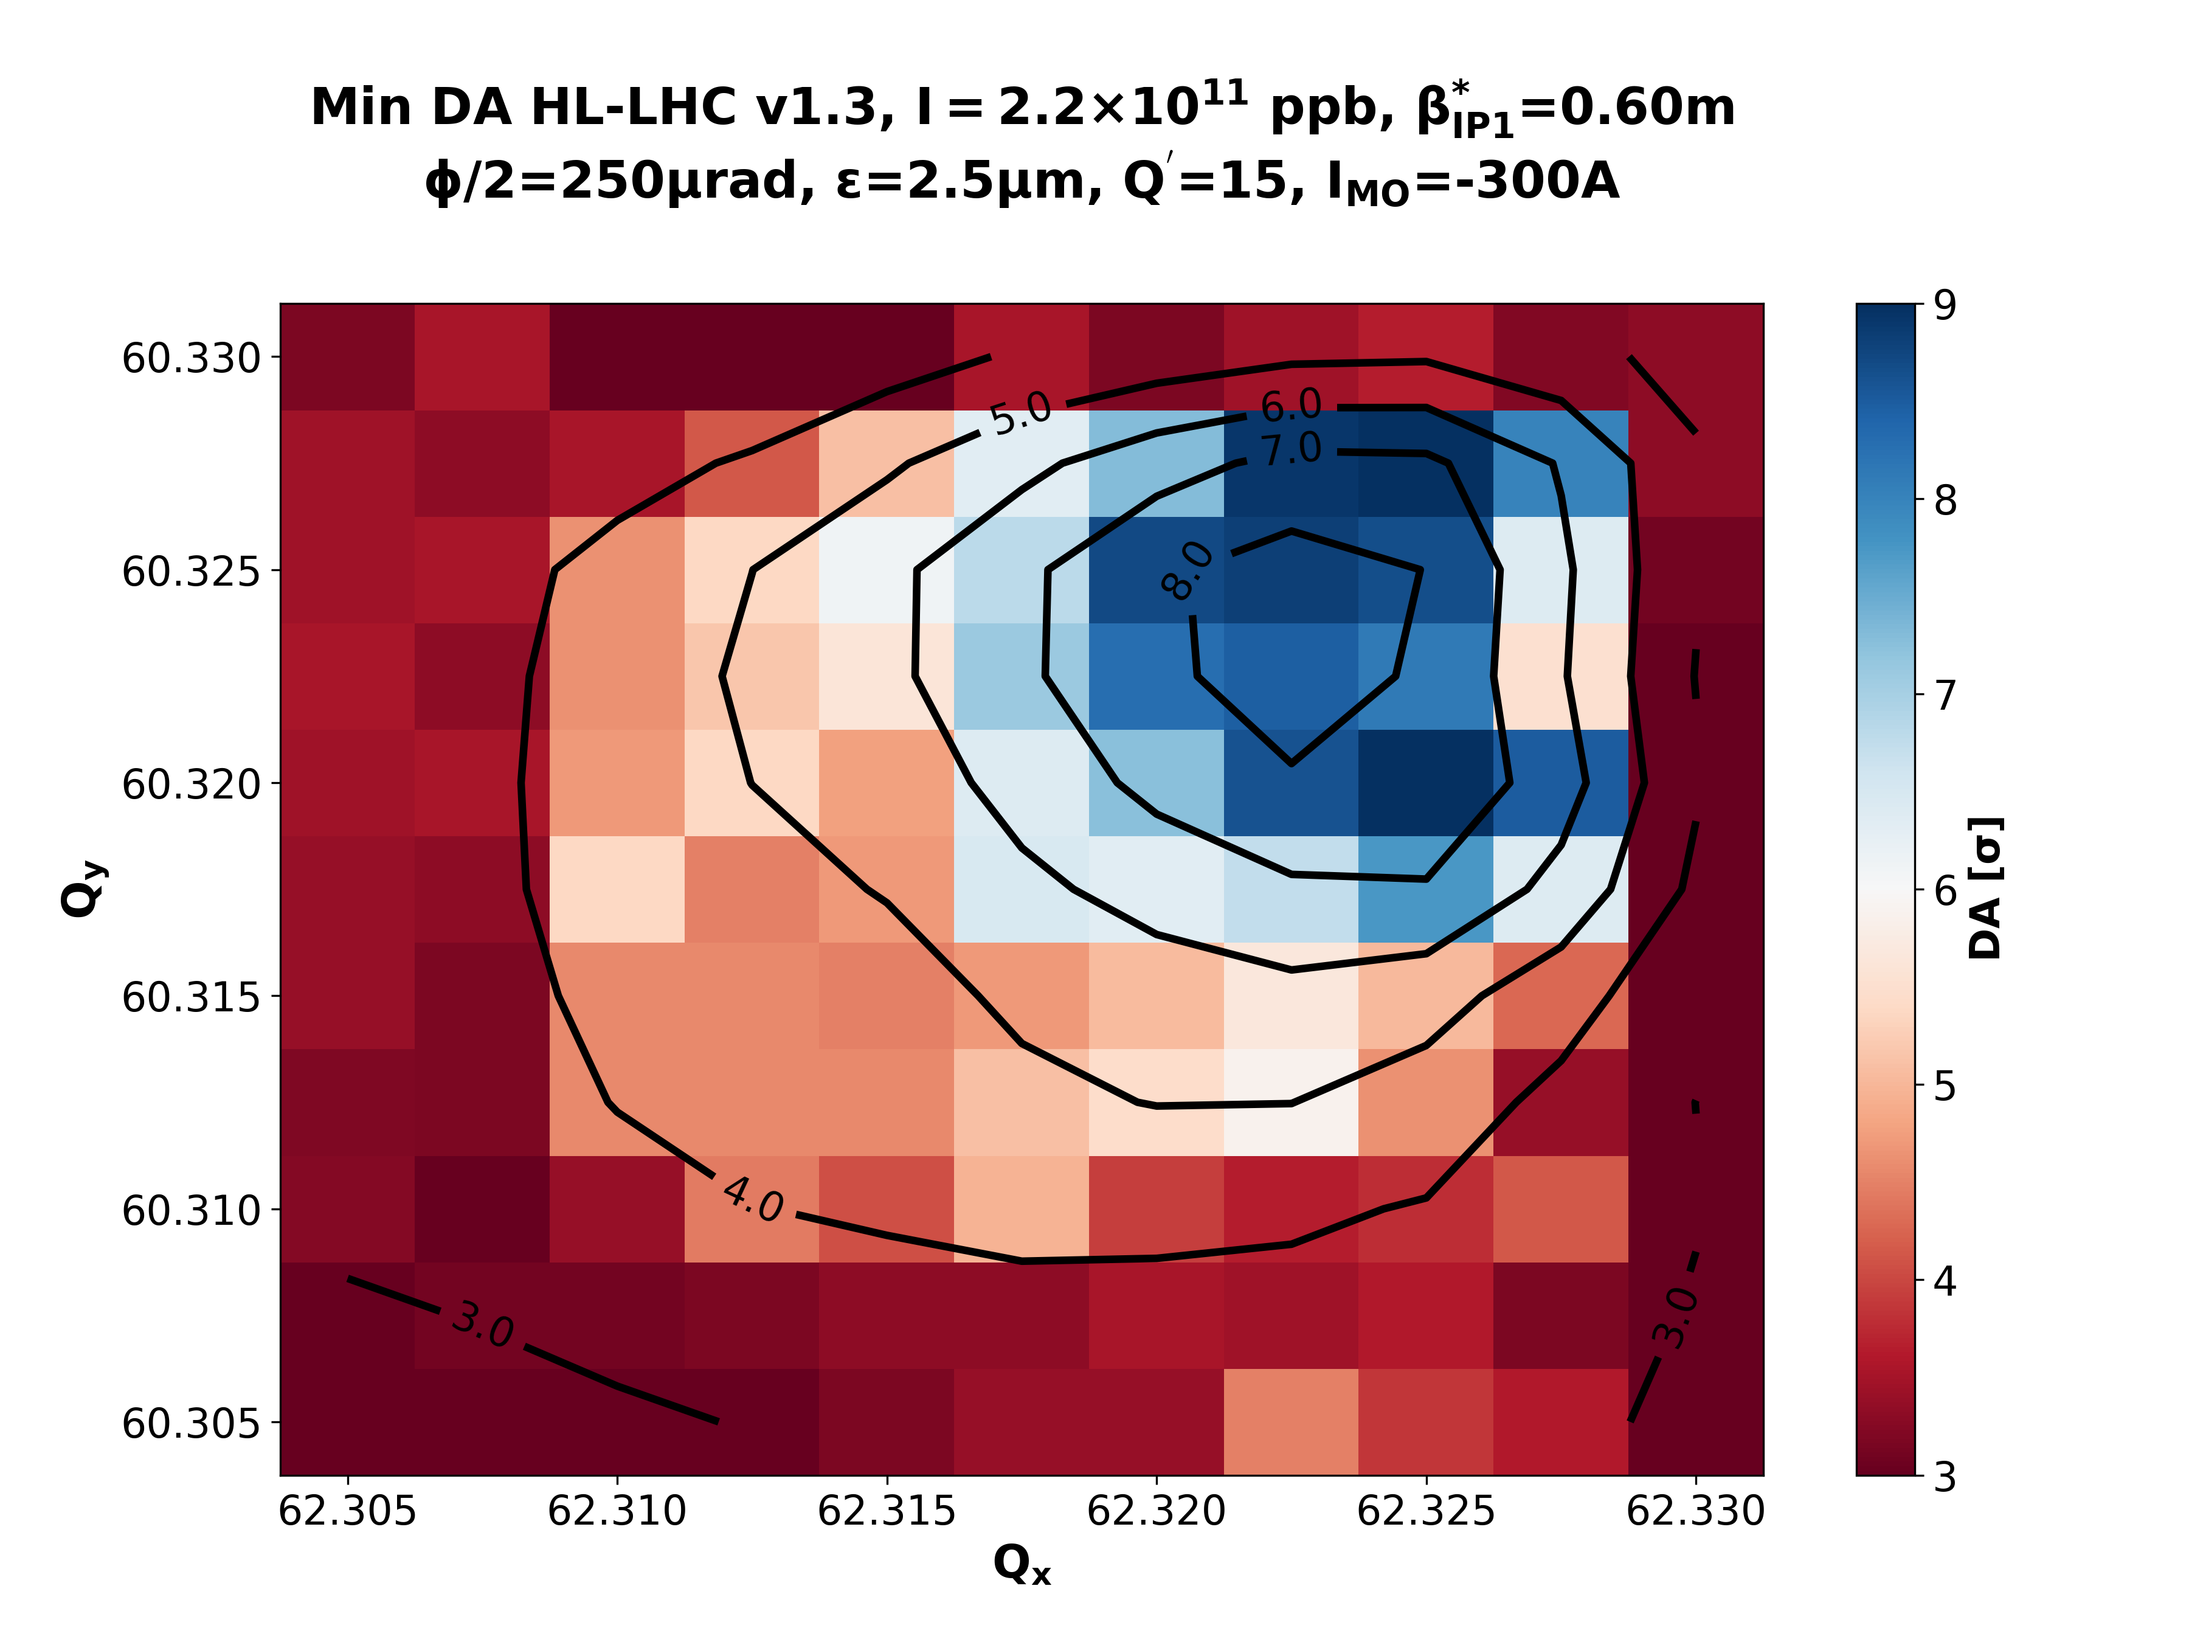
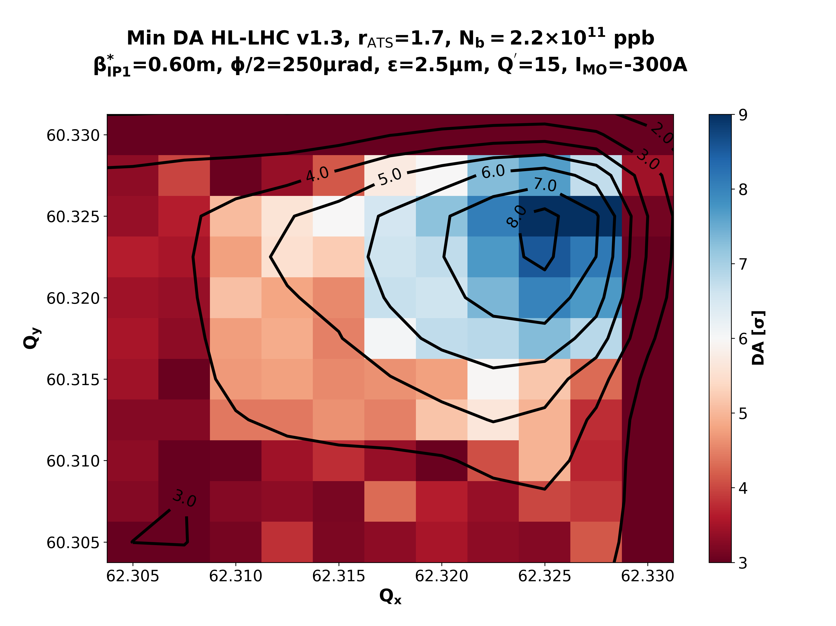
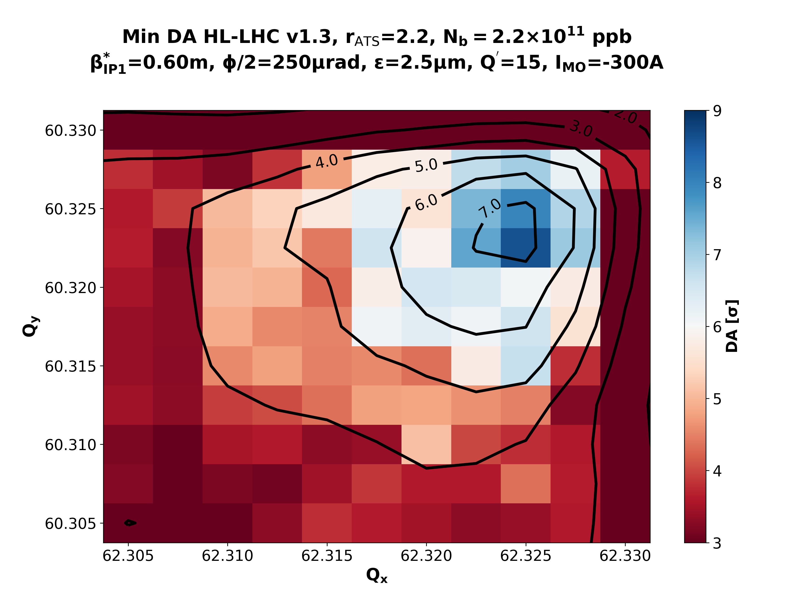
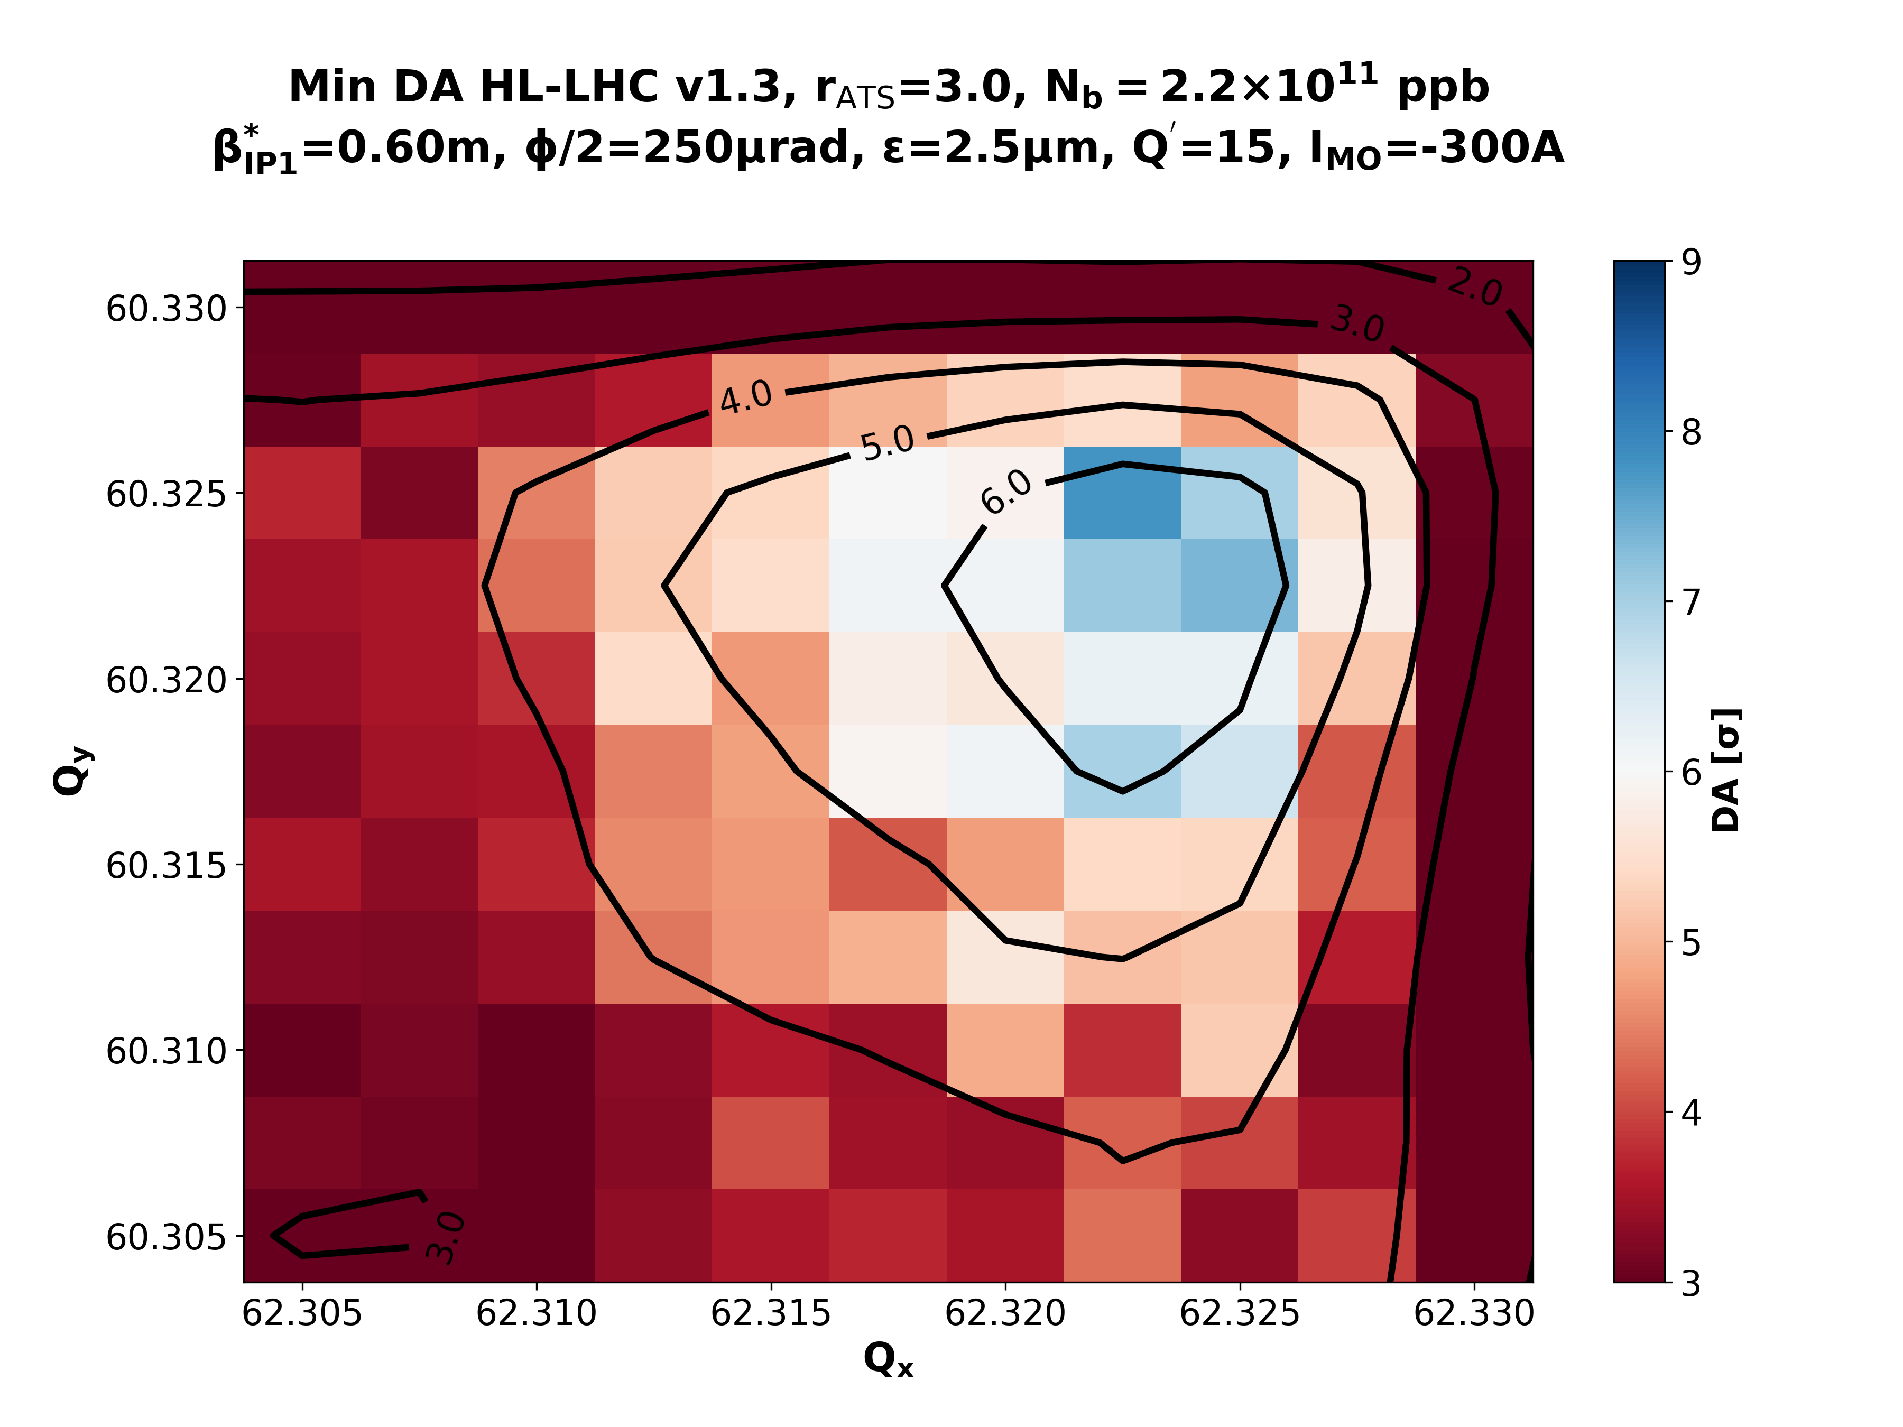
Nominal Collisions – β*=60cm - IMO=-300 A
rATS = 1.0
rATS = 1.7
rATS = 2.2
rATS = 3.0
rATS = 3.3

Slide 19
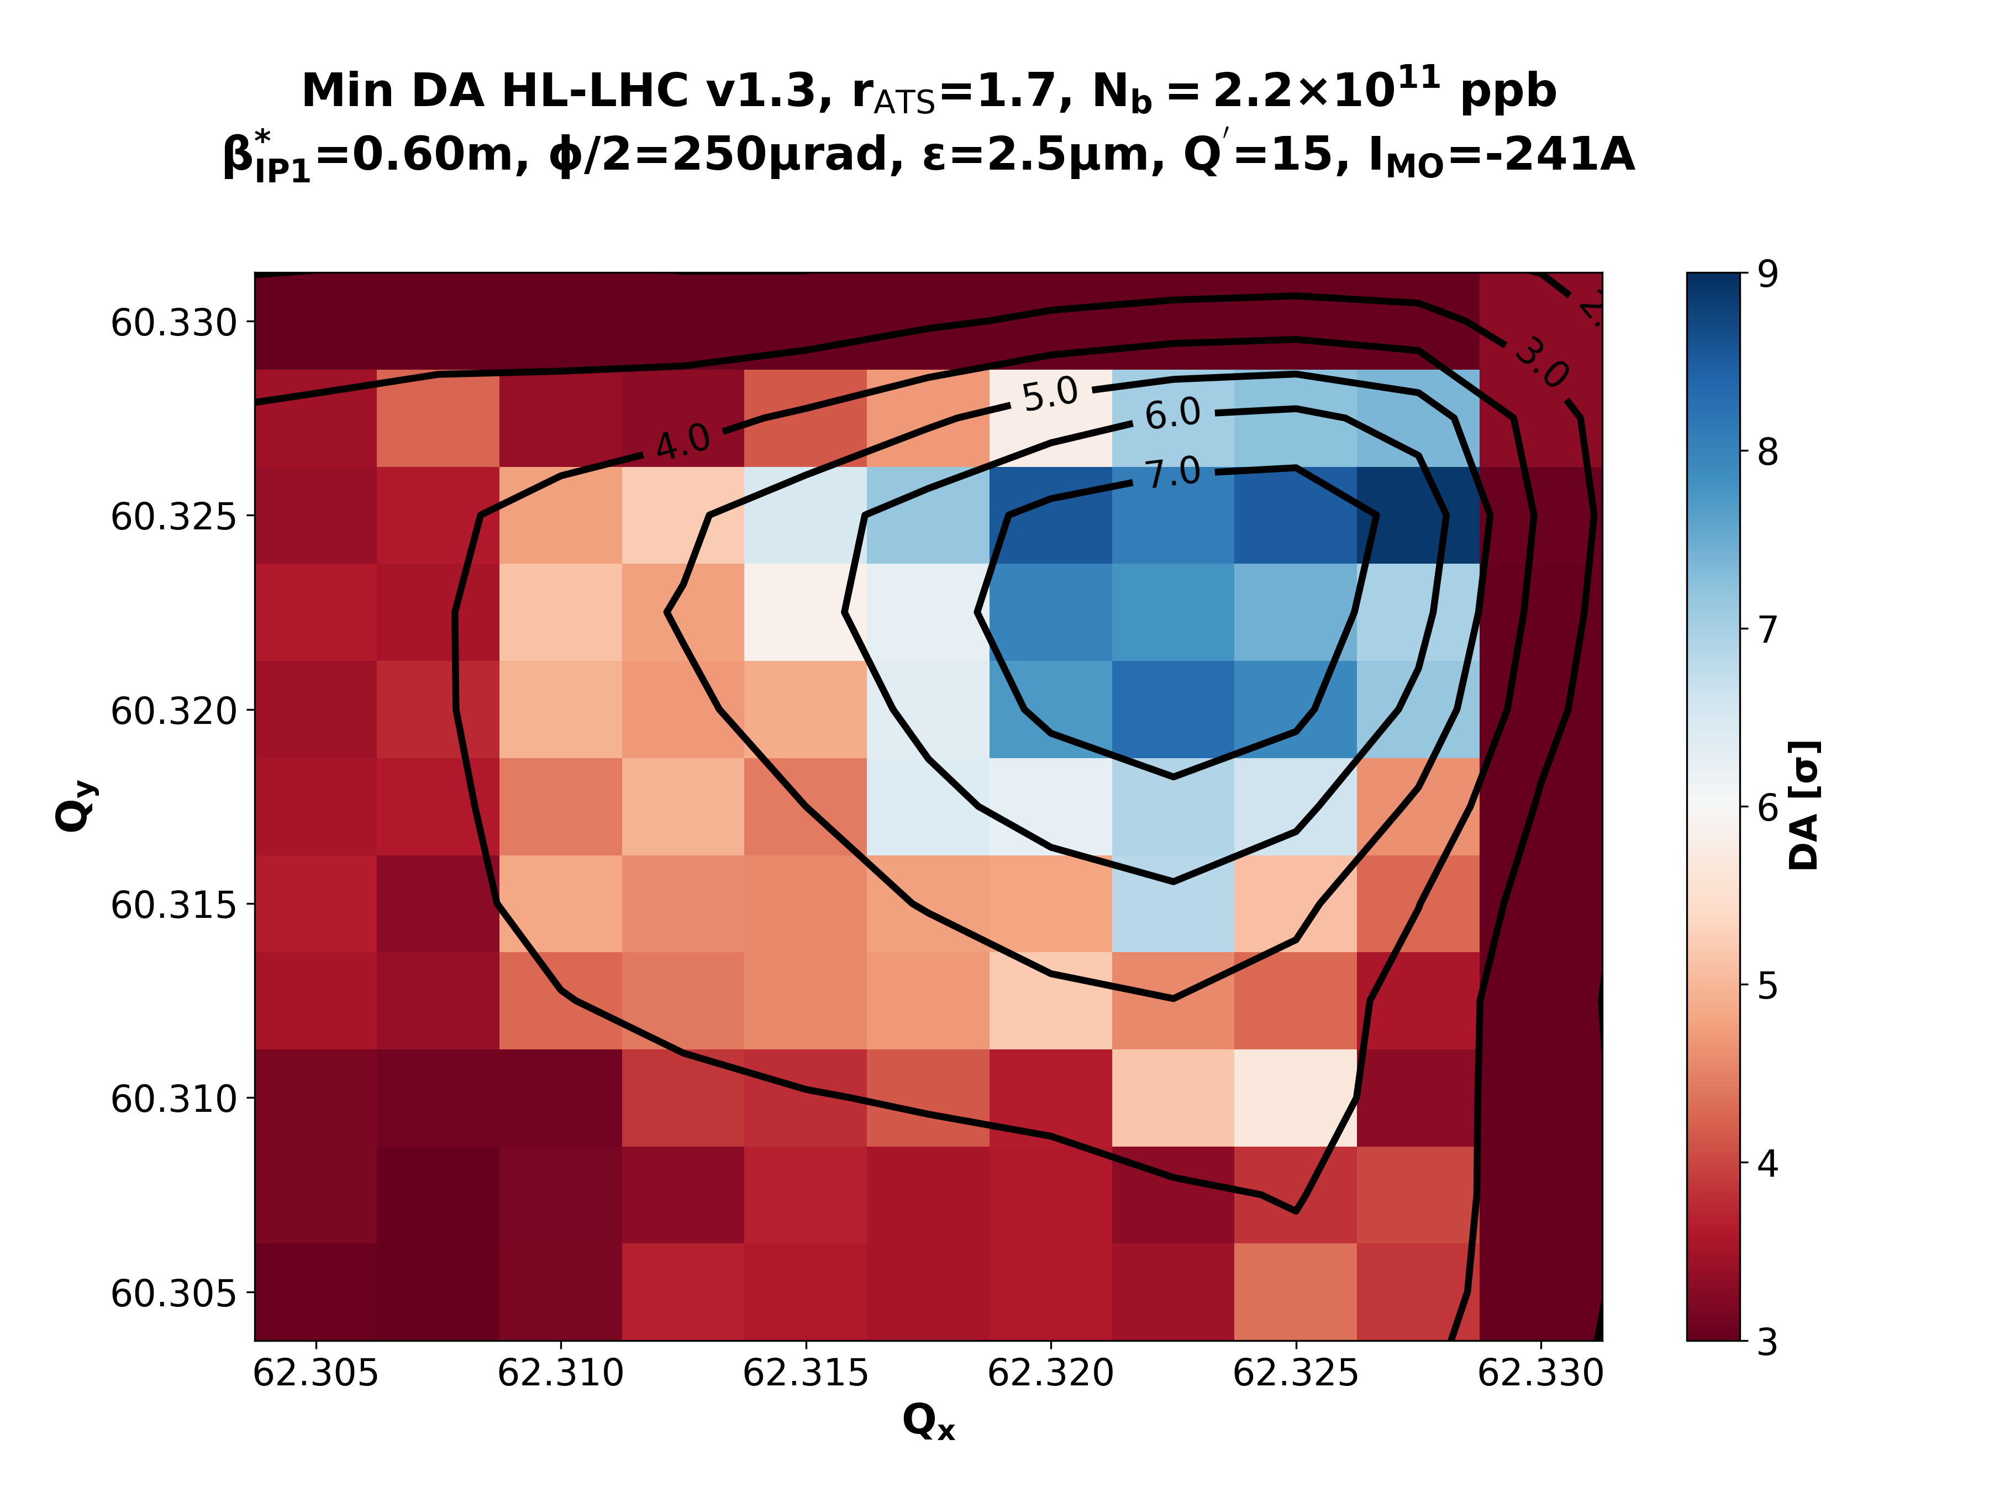
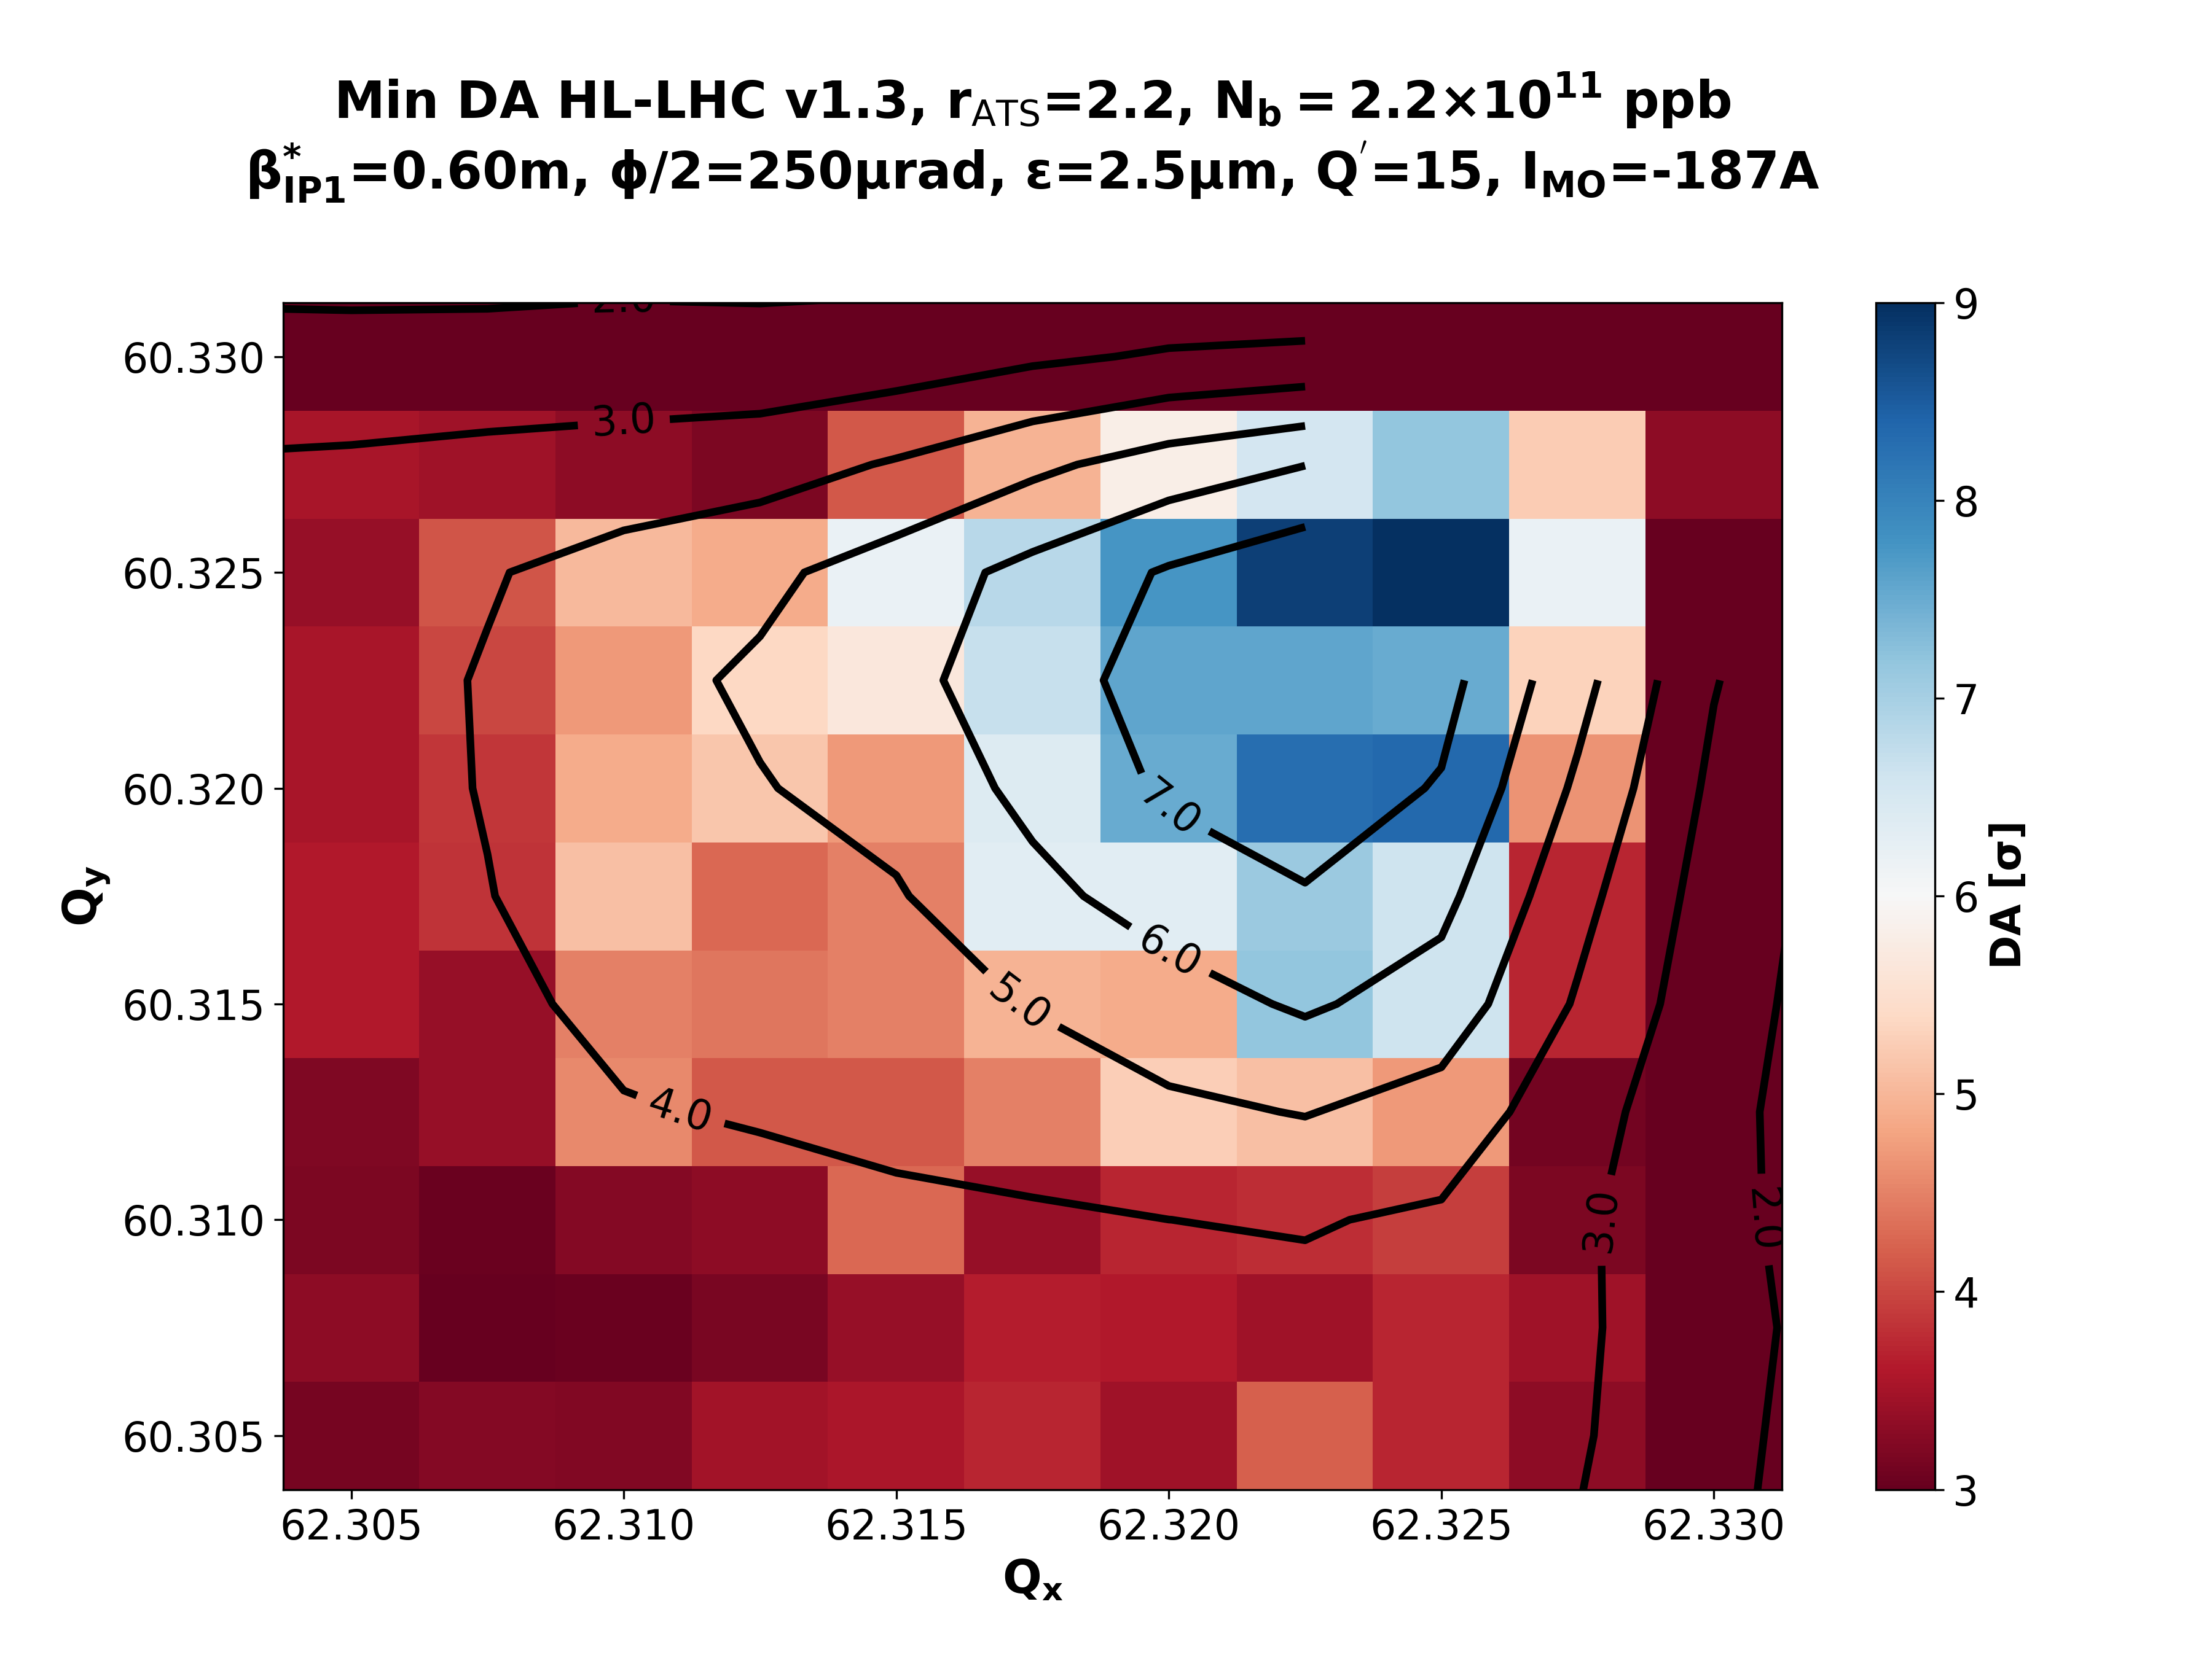
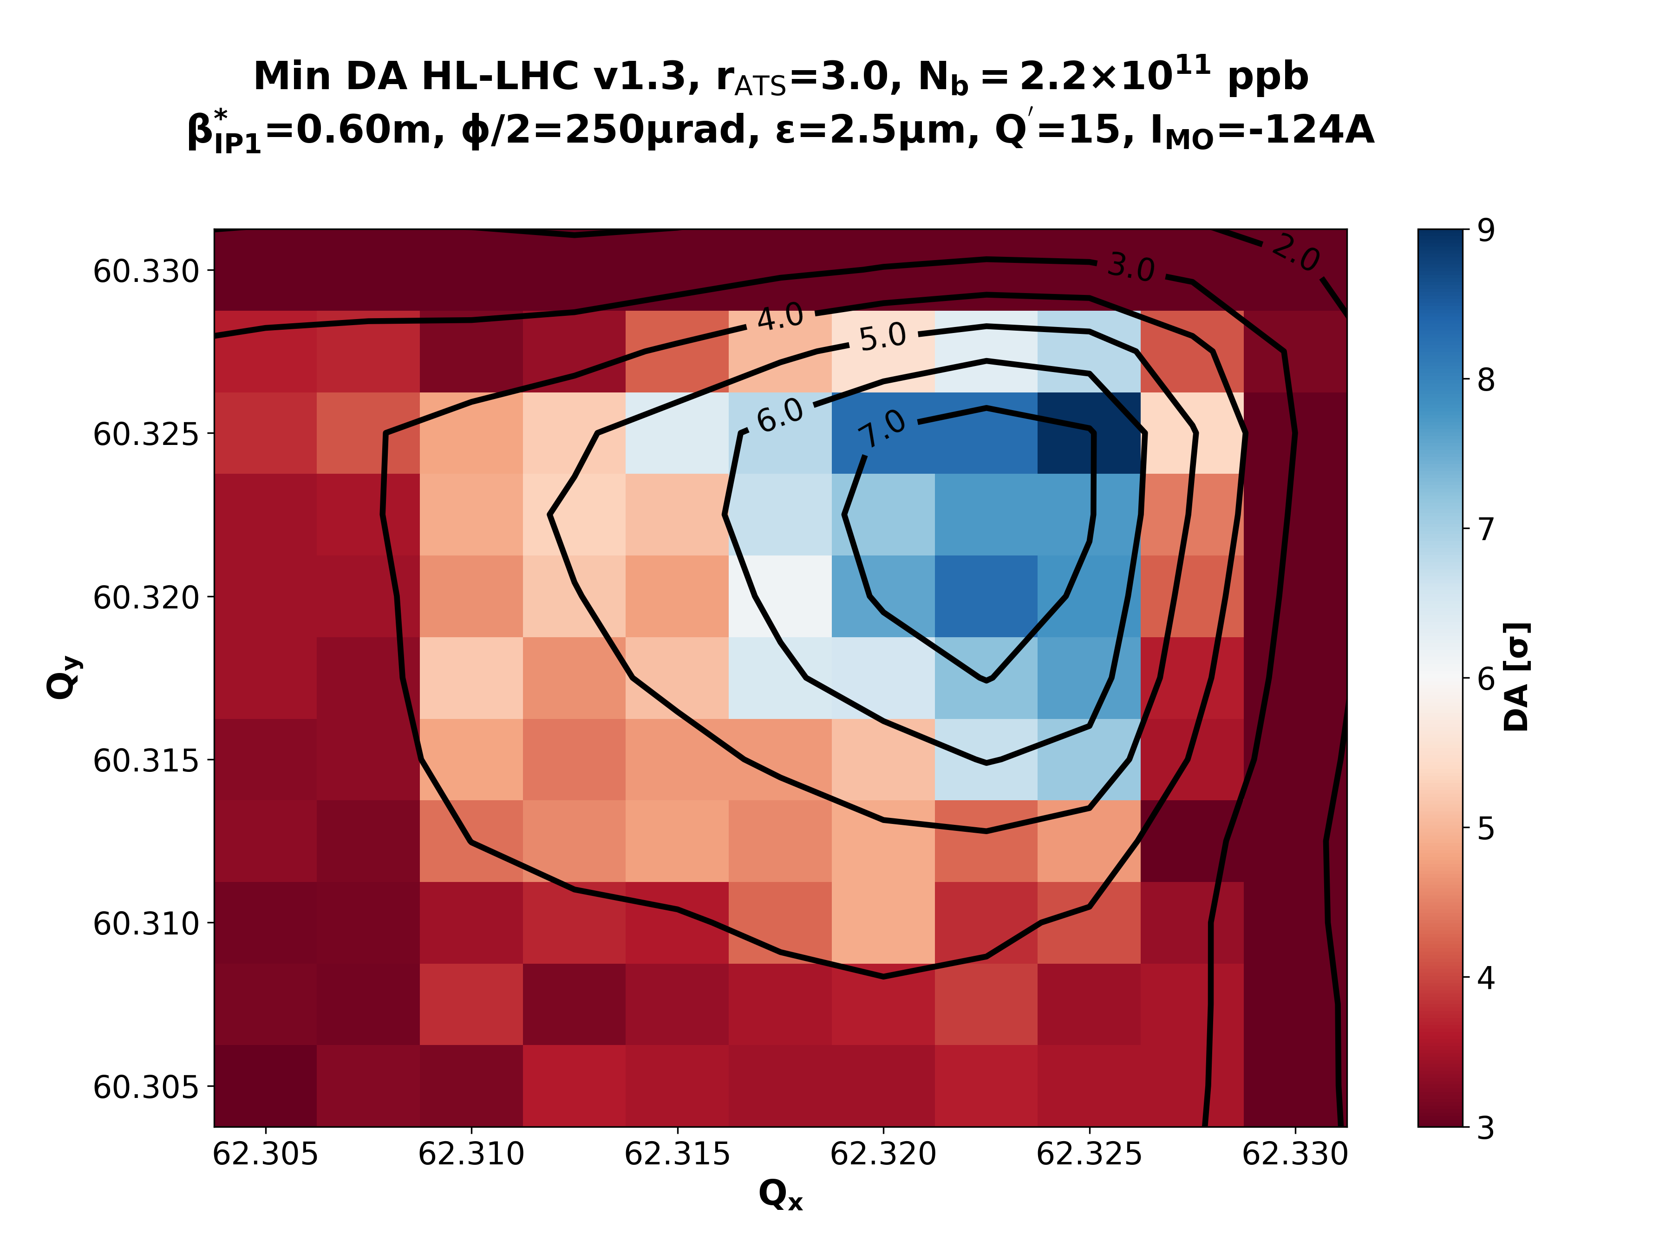
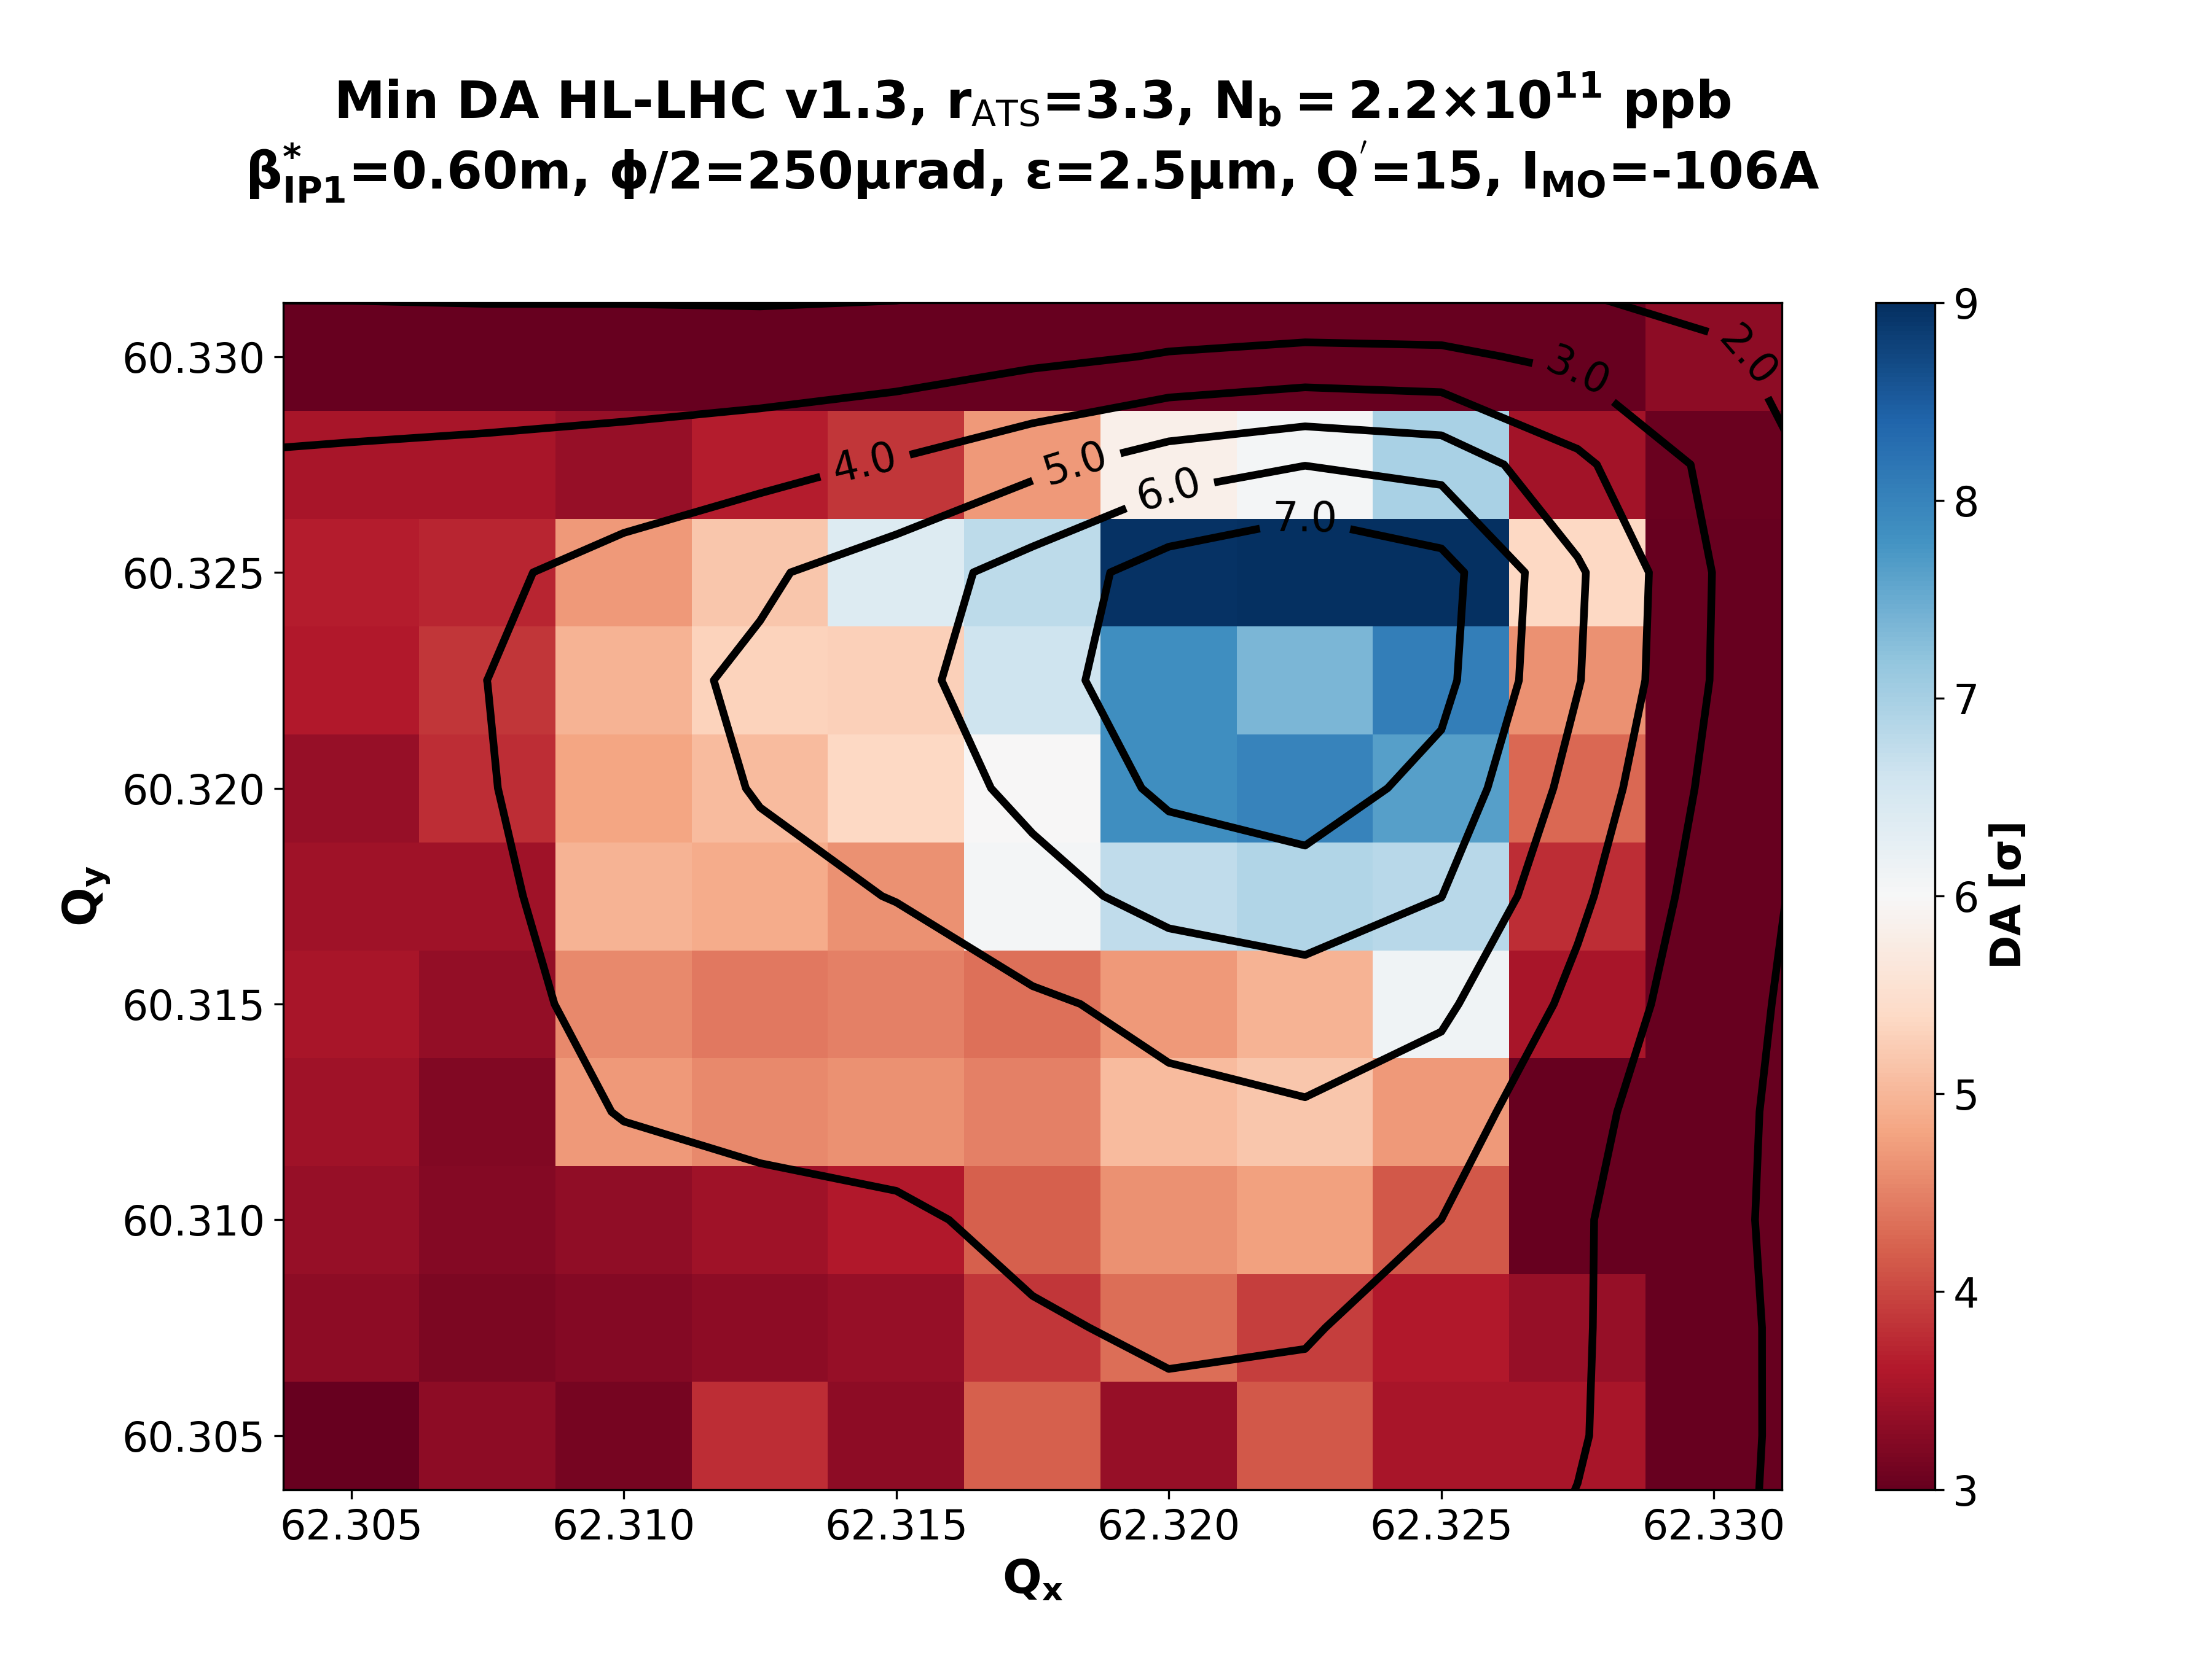
Nominal Collisions – β*=60cm – Varying IMO
rATS = 1.0
rATS = 1.7
rATS = 2.2
rATS = 3.0
rATS = 3.3

Slide 20
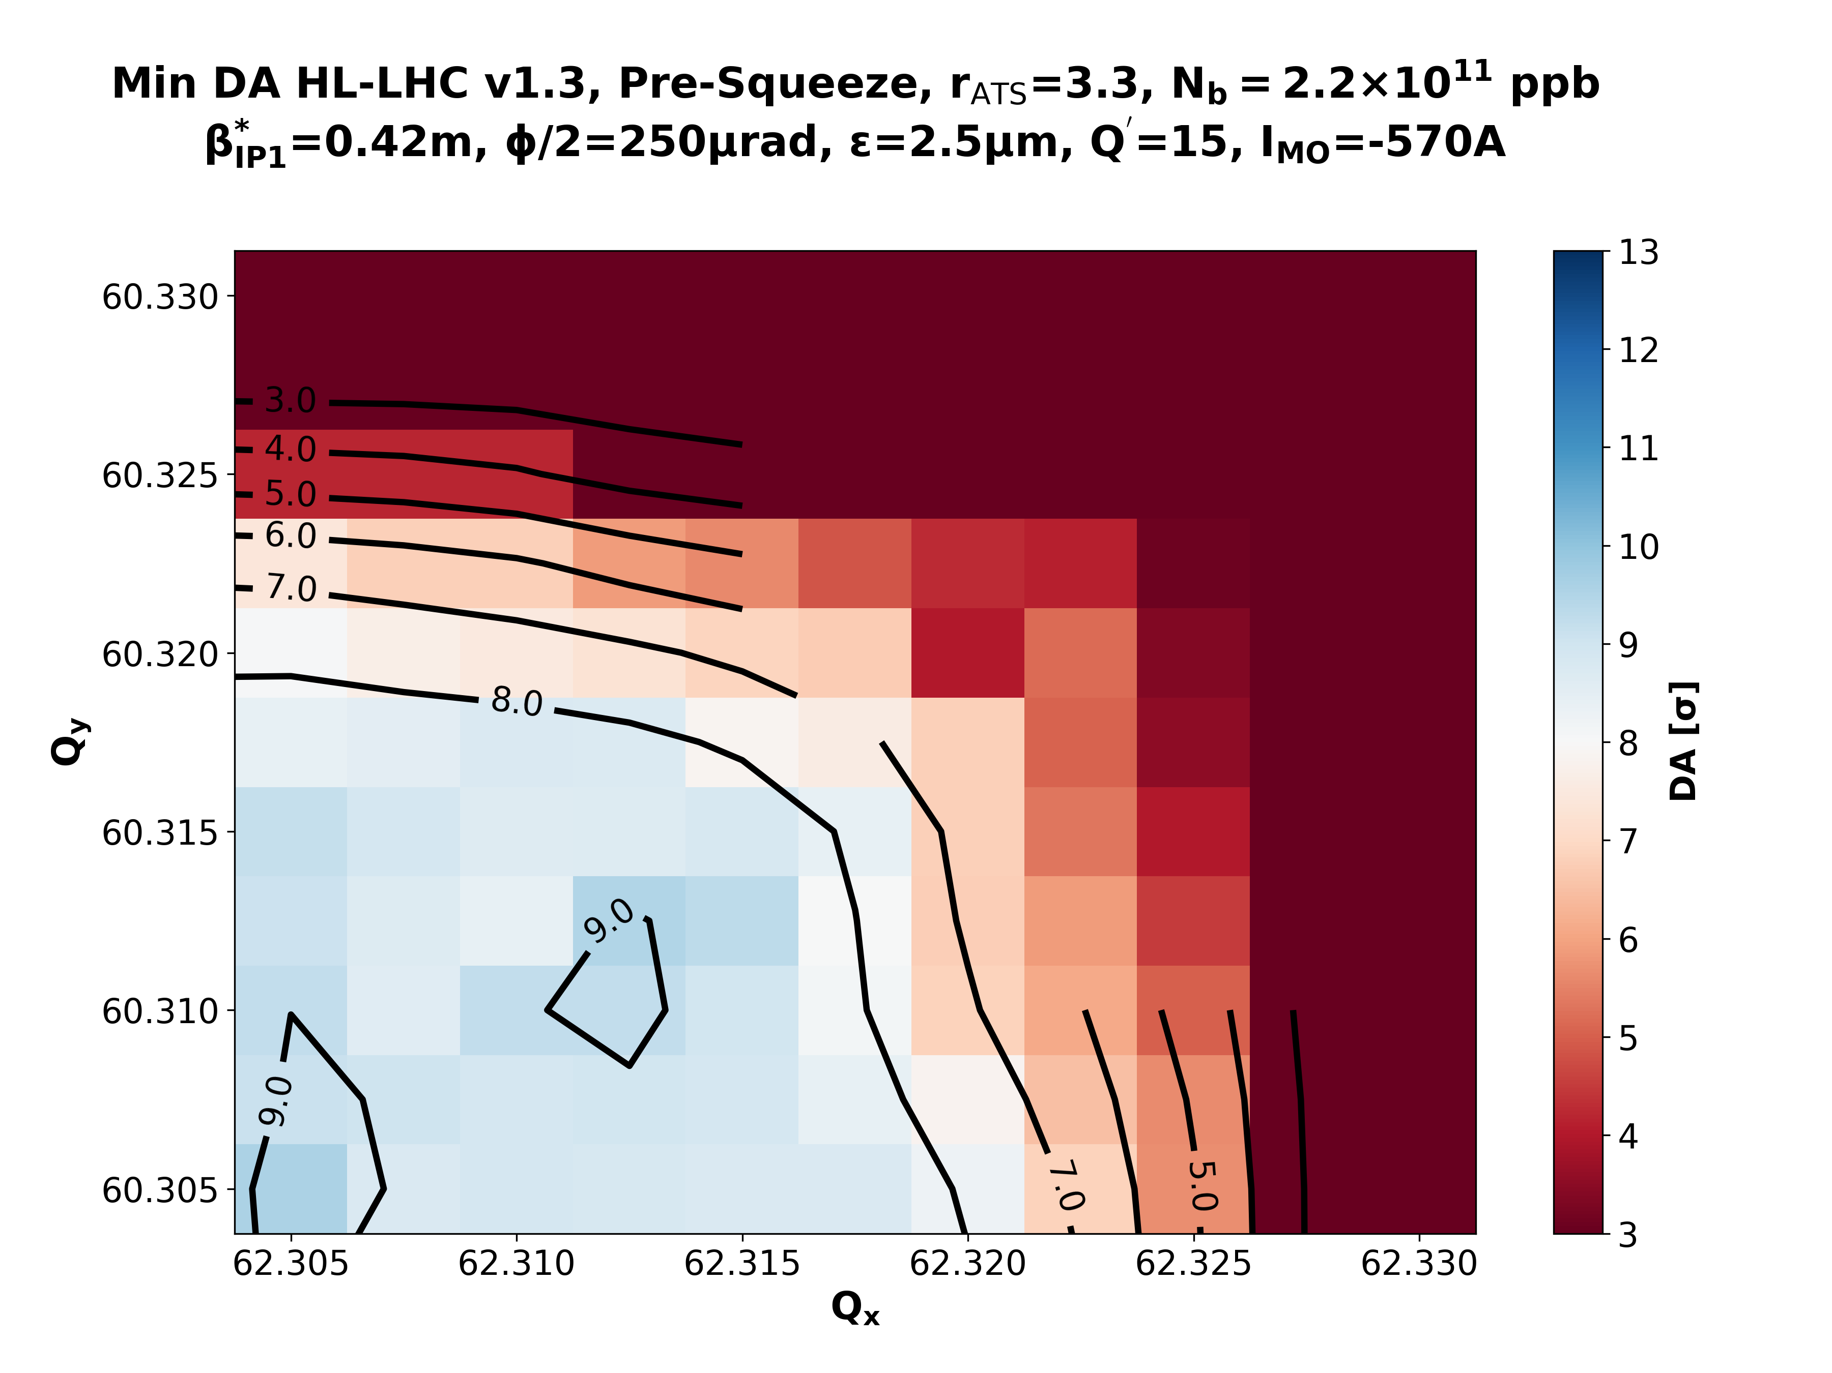
Ultimate Presqueeze – β*=42cm - IMO=-570 A
rATS = 1.0
rATS = 1.7
rATS = 2.2
rATS = 3.0
rATS = 3.3

Slide 21
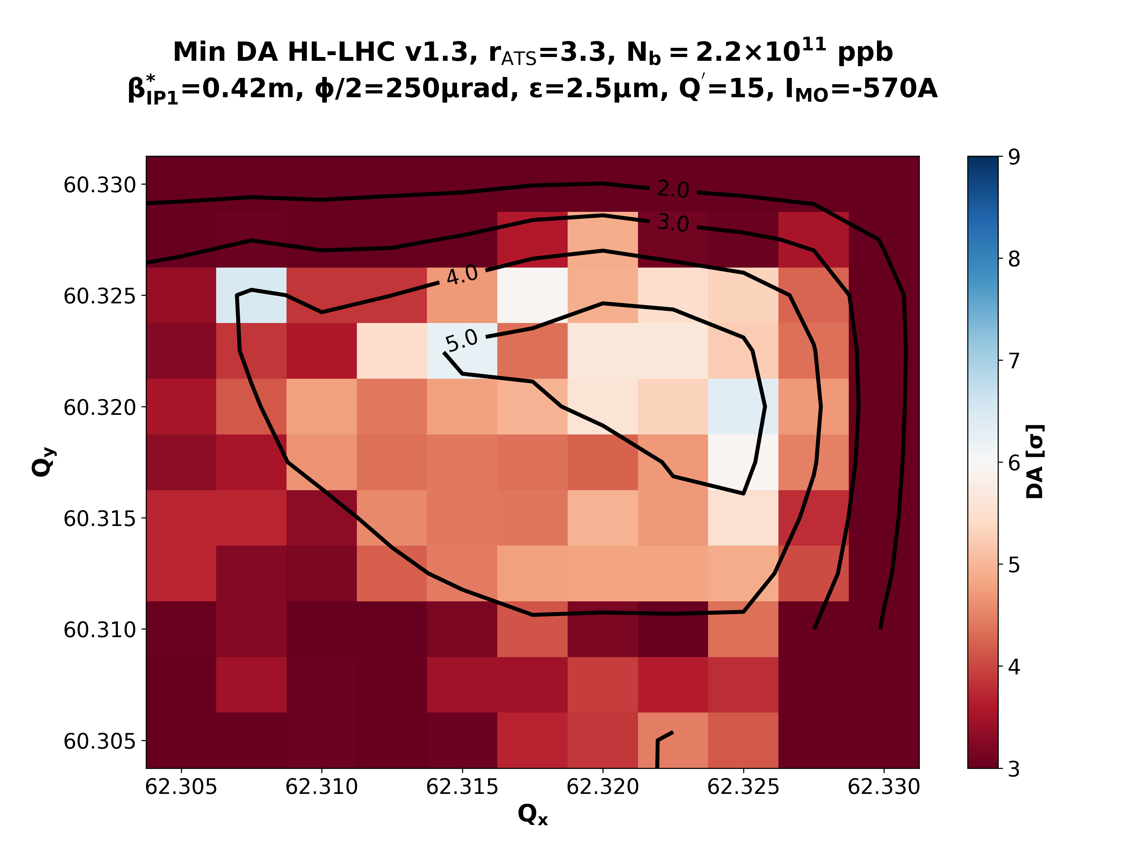
Ultimate Collisions – β*=42cm - IMO=-570 A
rATS = 1.0
rATS = 1.7
rATS = 2.2
rATS = 3.0
rATS = 3.3

Slide 22
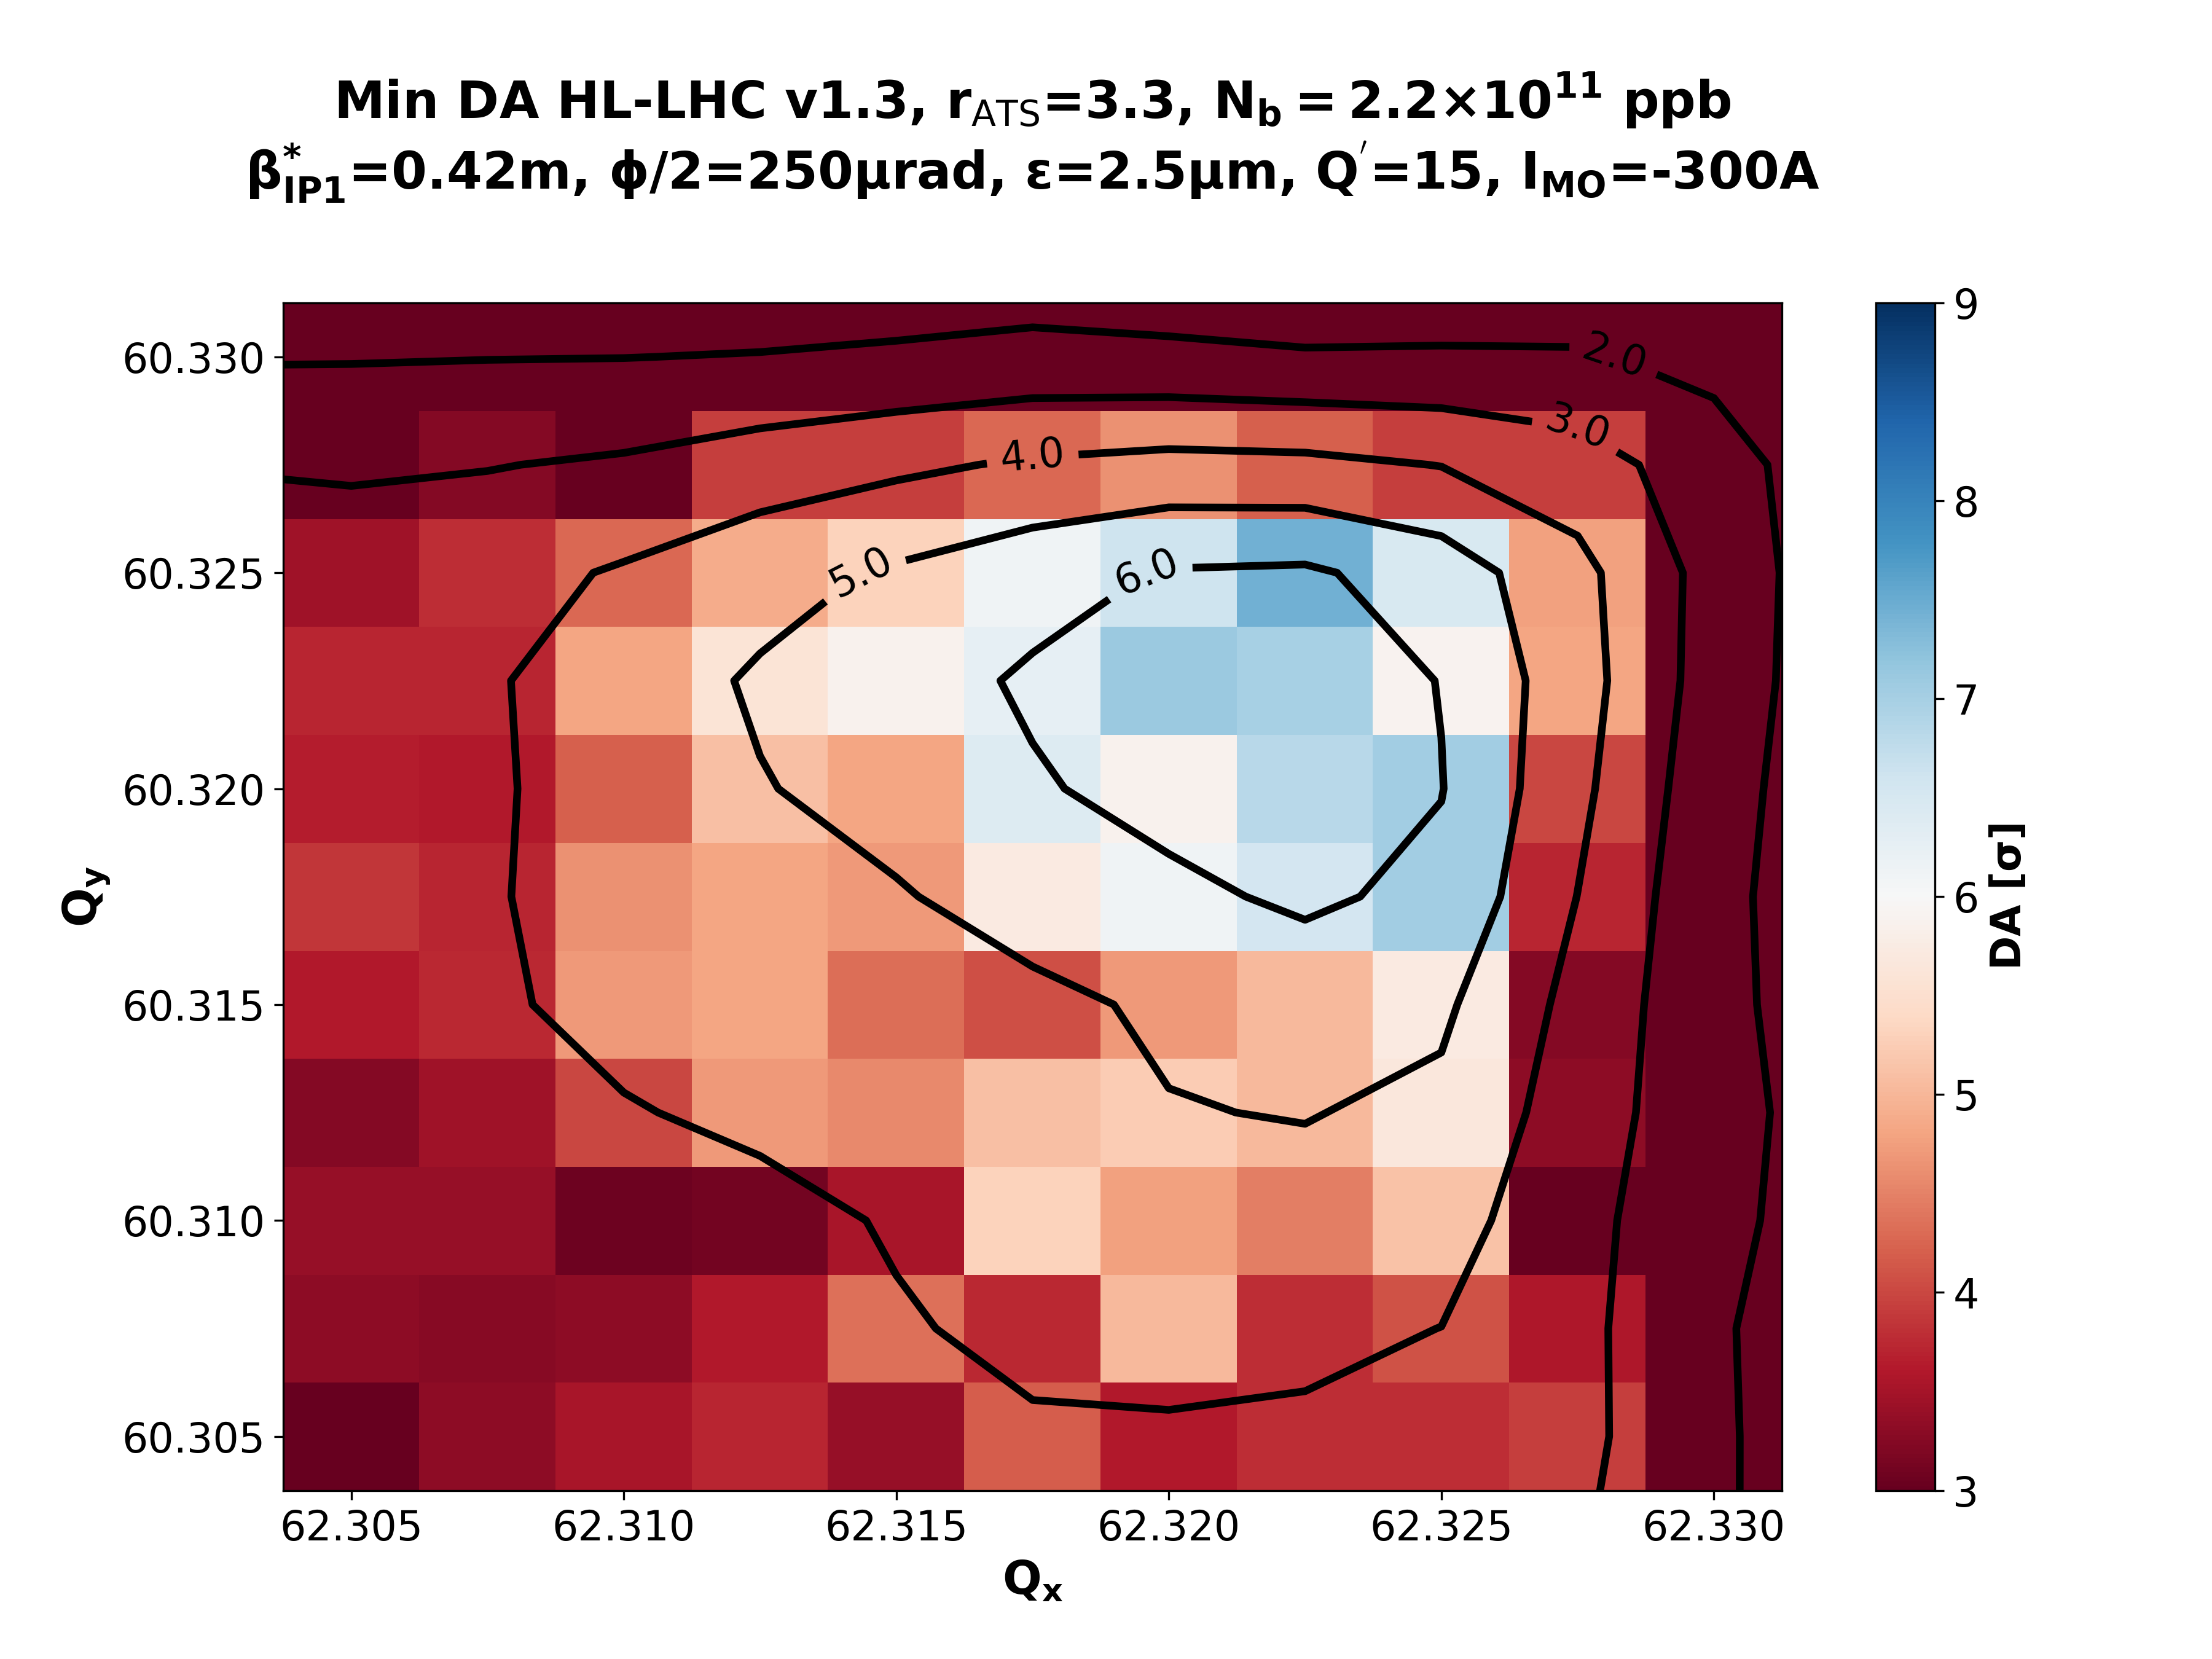
Ultimate Collisions – β*=42cm - IMO=-300 A
rATS = 1.0
rATS = 1.7
rATS = 2.2
rATS = 3.0
rATS = 3.3

Slide 23
Nominal PreSqueeze – β*=60cm - IMO=+570 A
rATS = 1.0
rATS = 1.7
rATS = 2.2
rATS = 3.0

