Slide 1

Additional Material on DA
G. Arduini, X. Buffat, N. Karastathis, R.de Maria, E. Metral, Y. Papaphilippou
141st WP2 Meeting - 05.02.2019

Slide 2
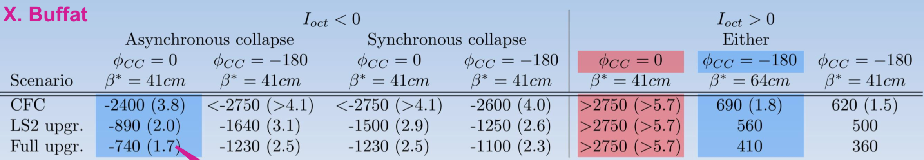
Stability

Slide 3
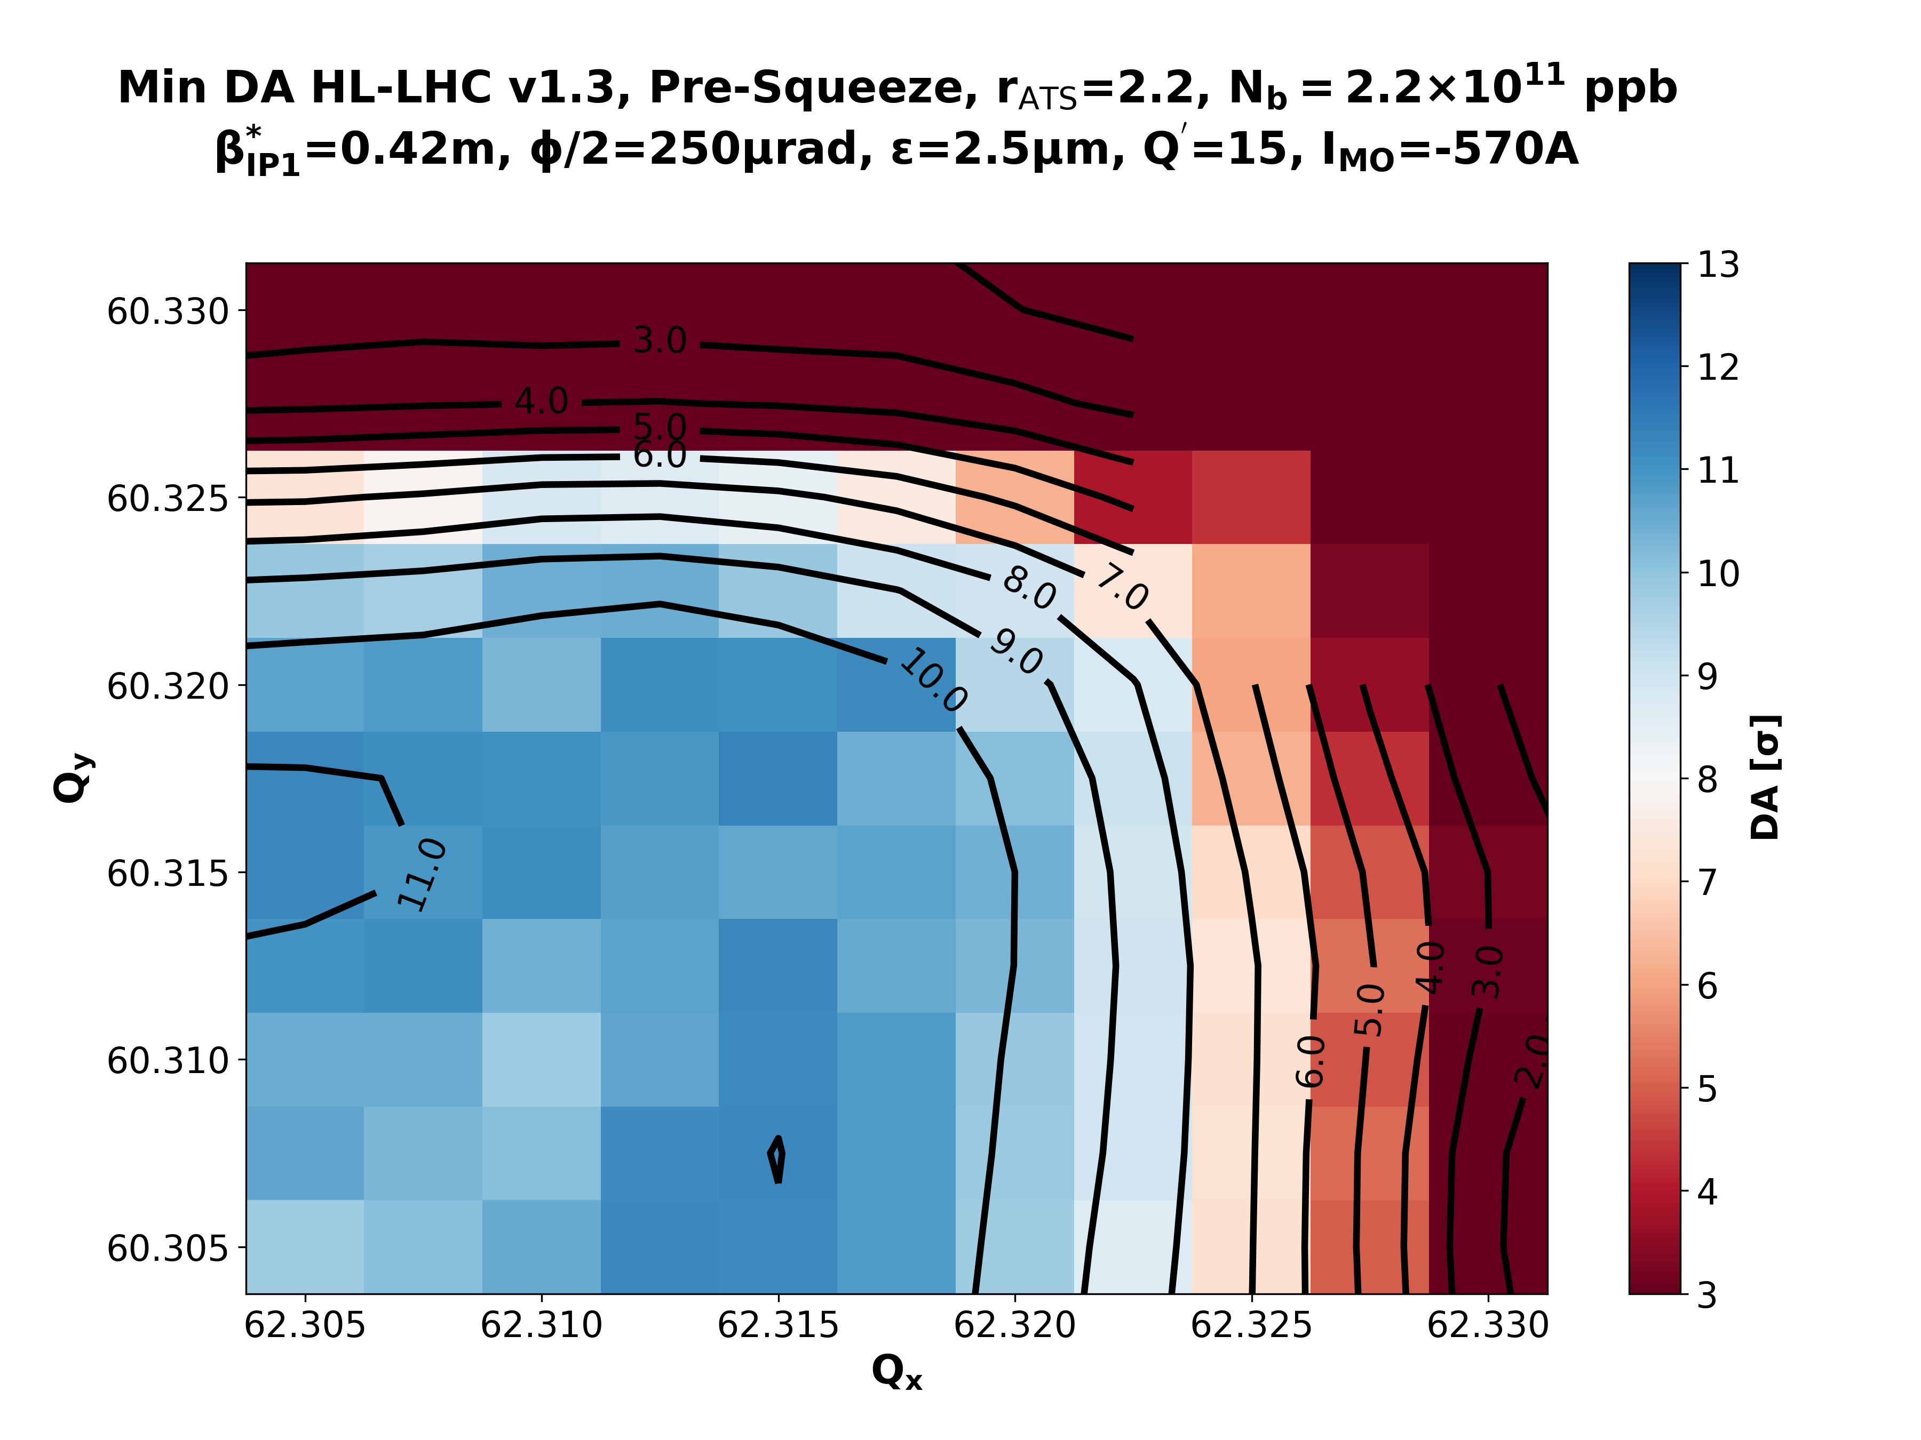
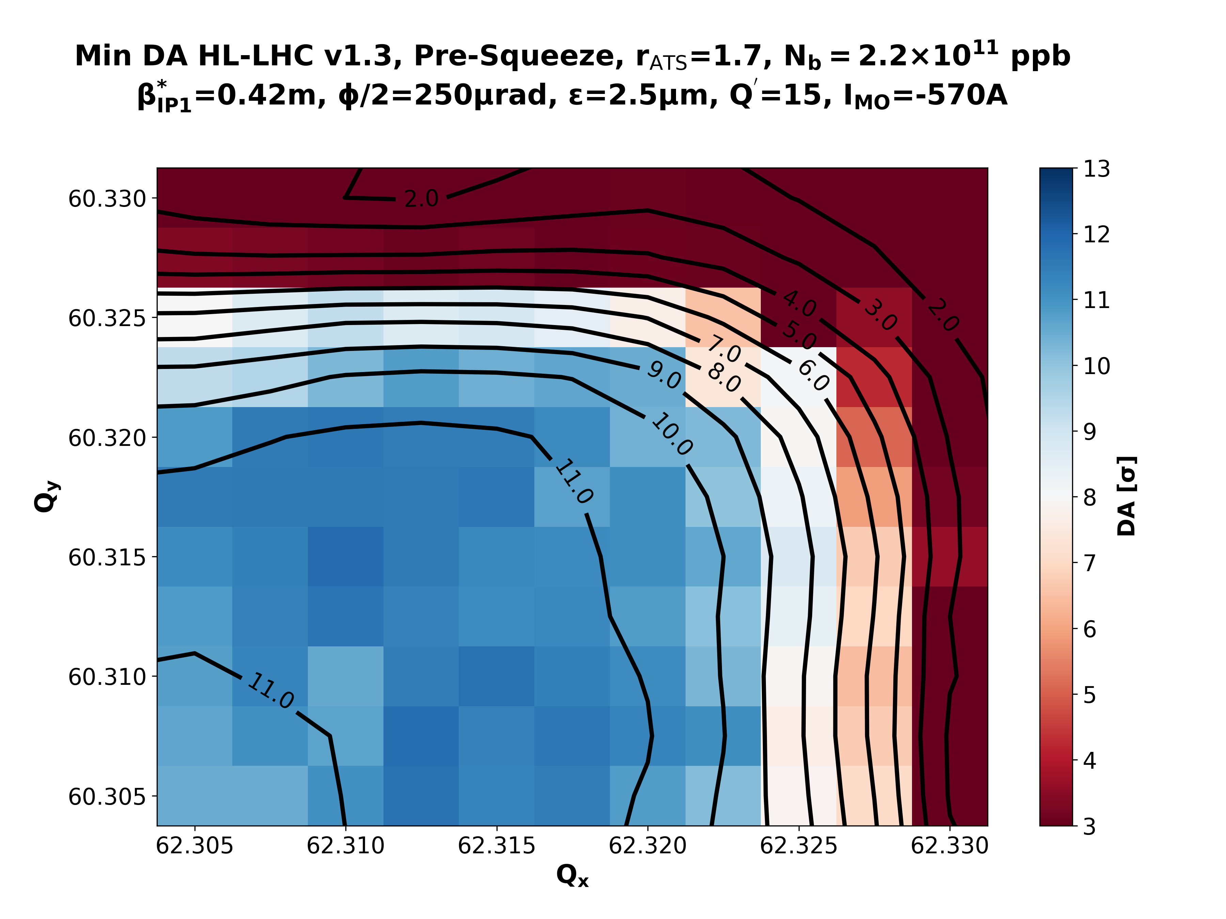
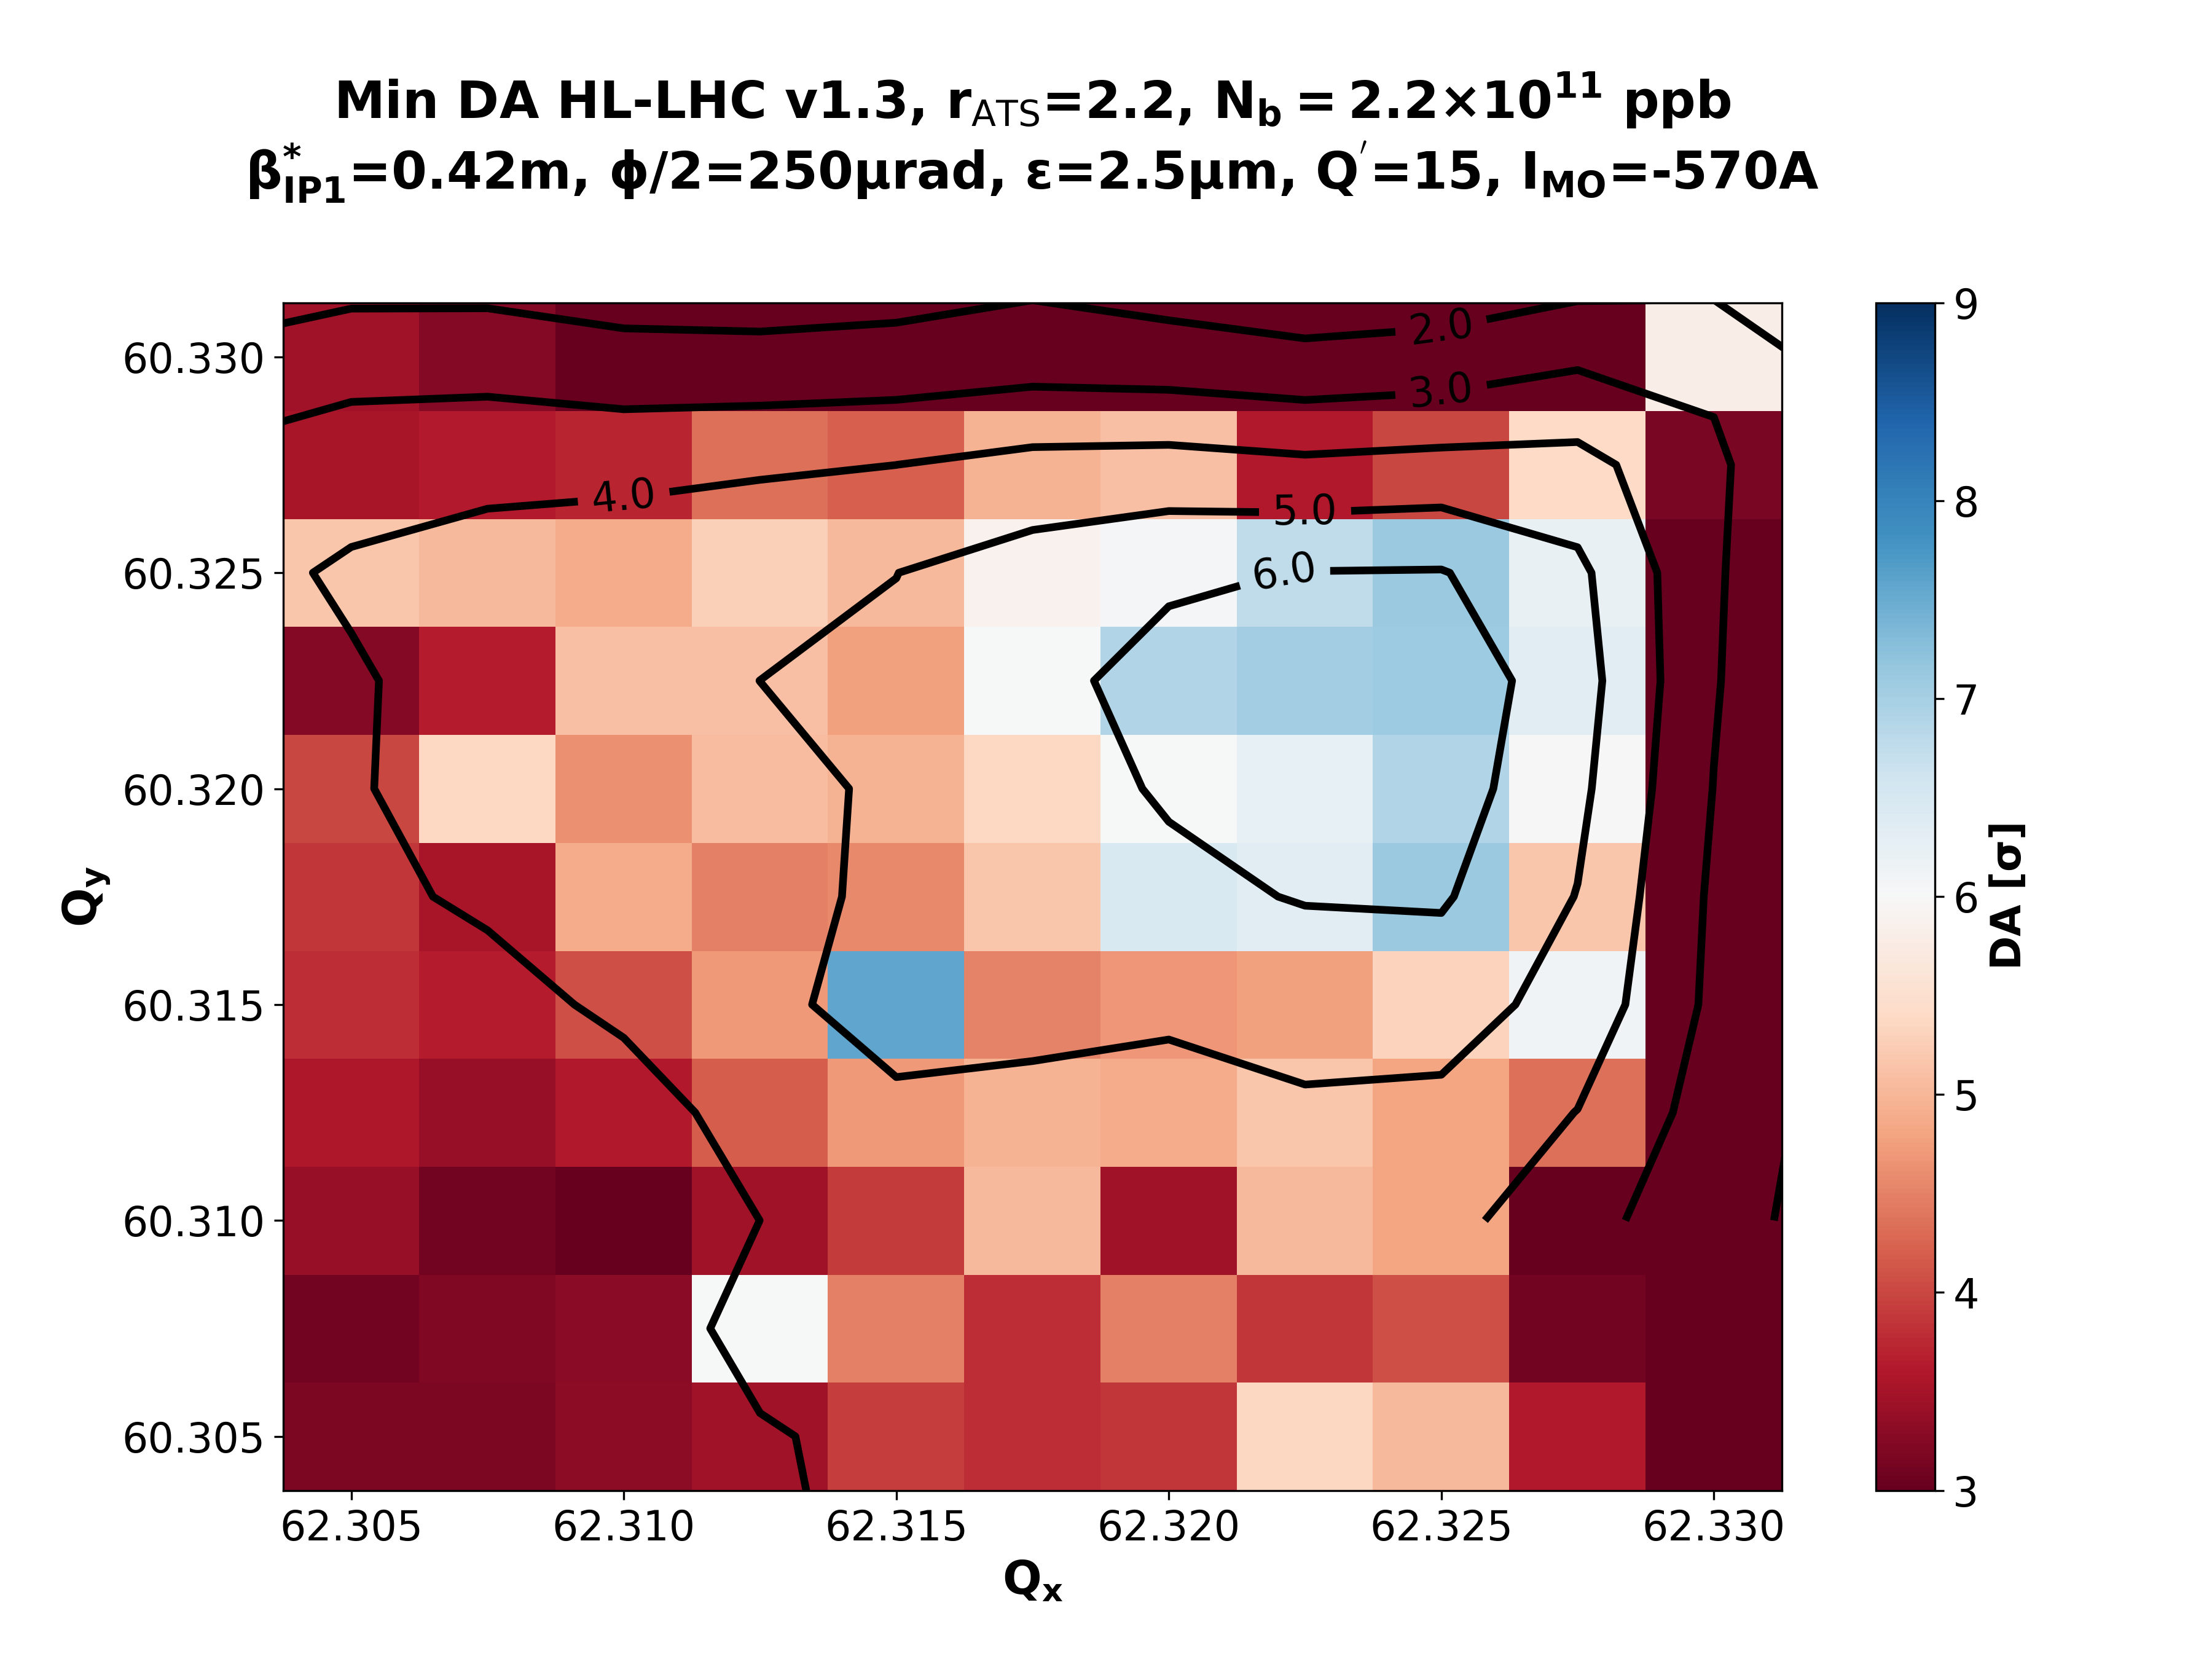
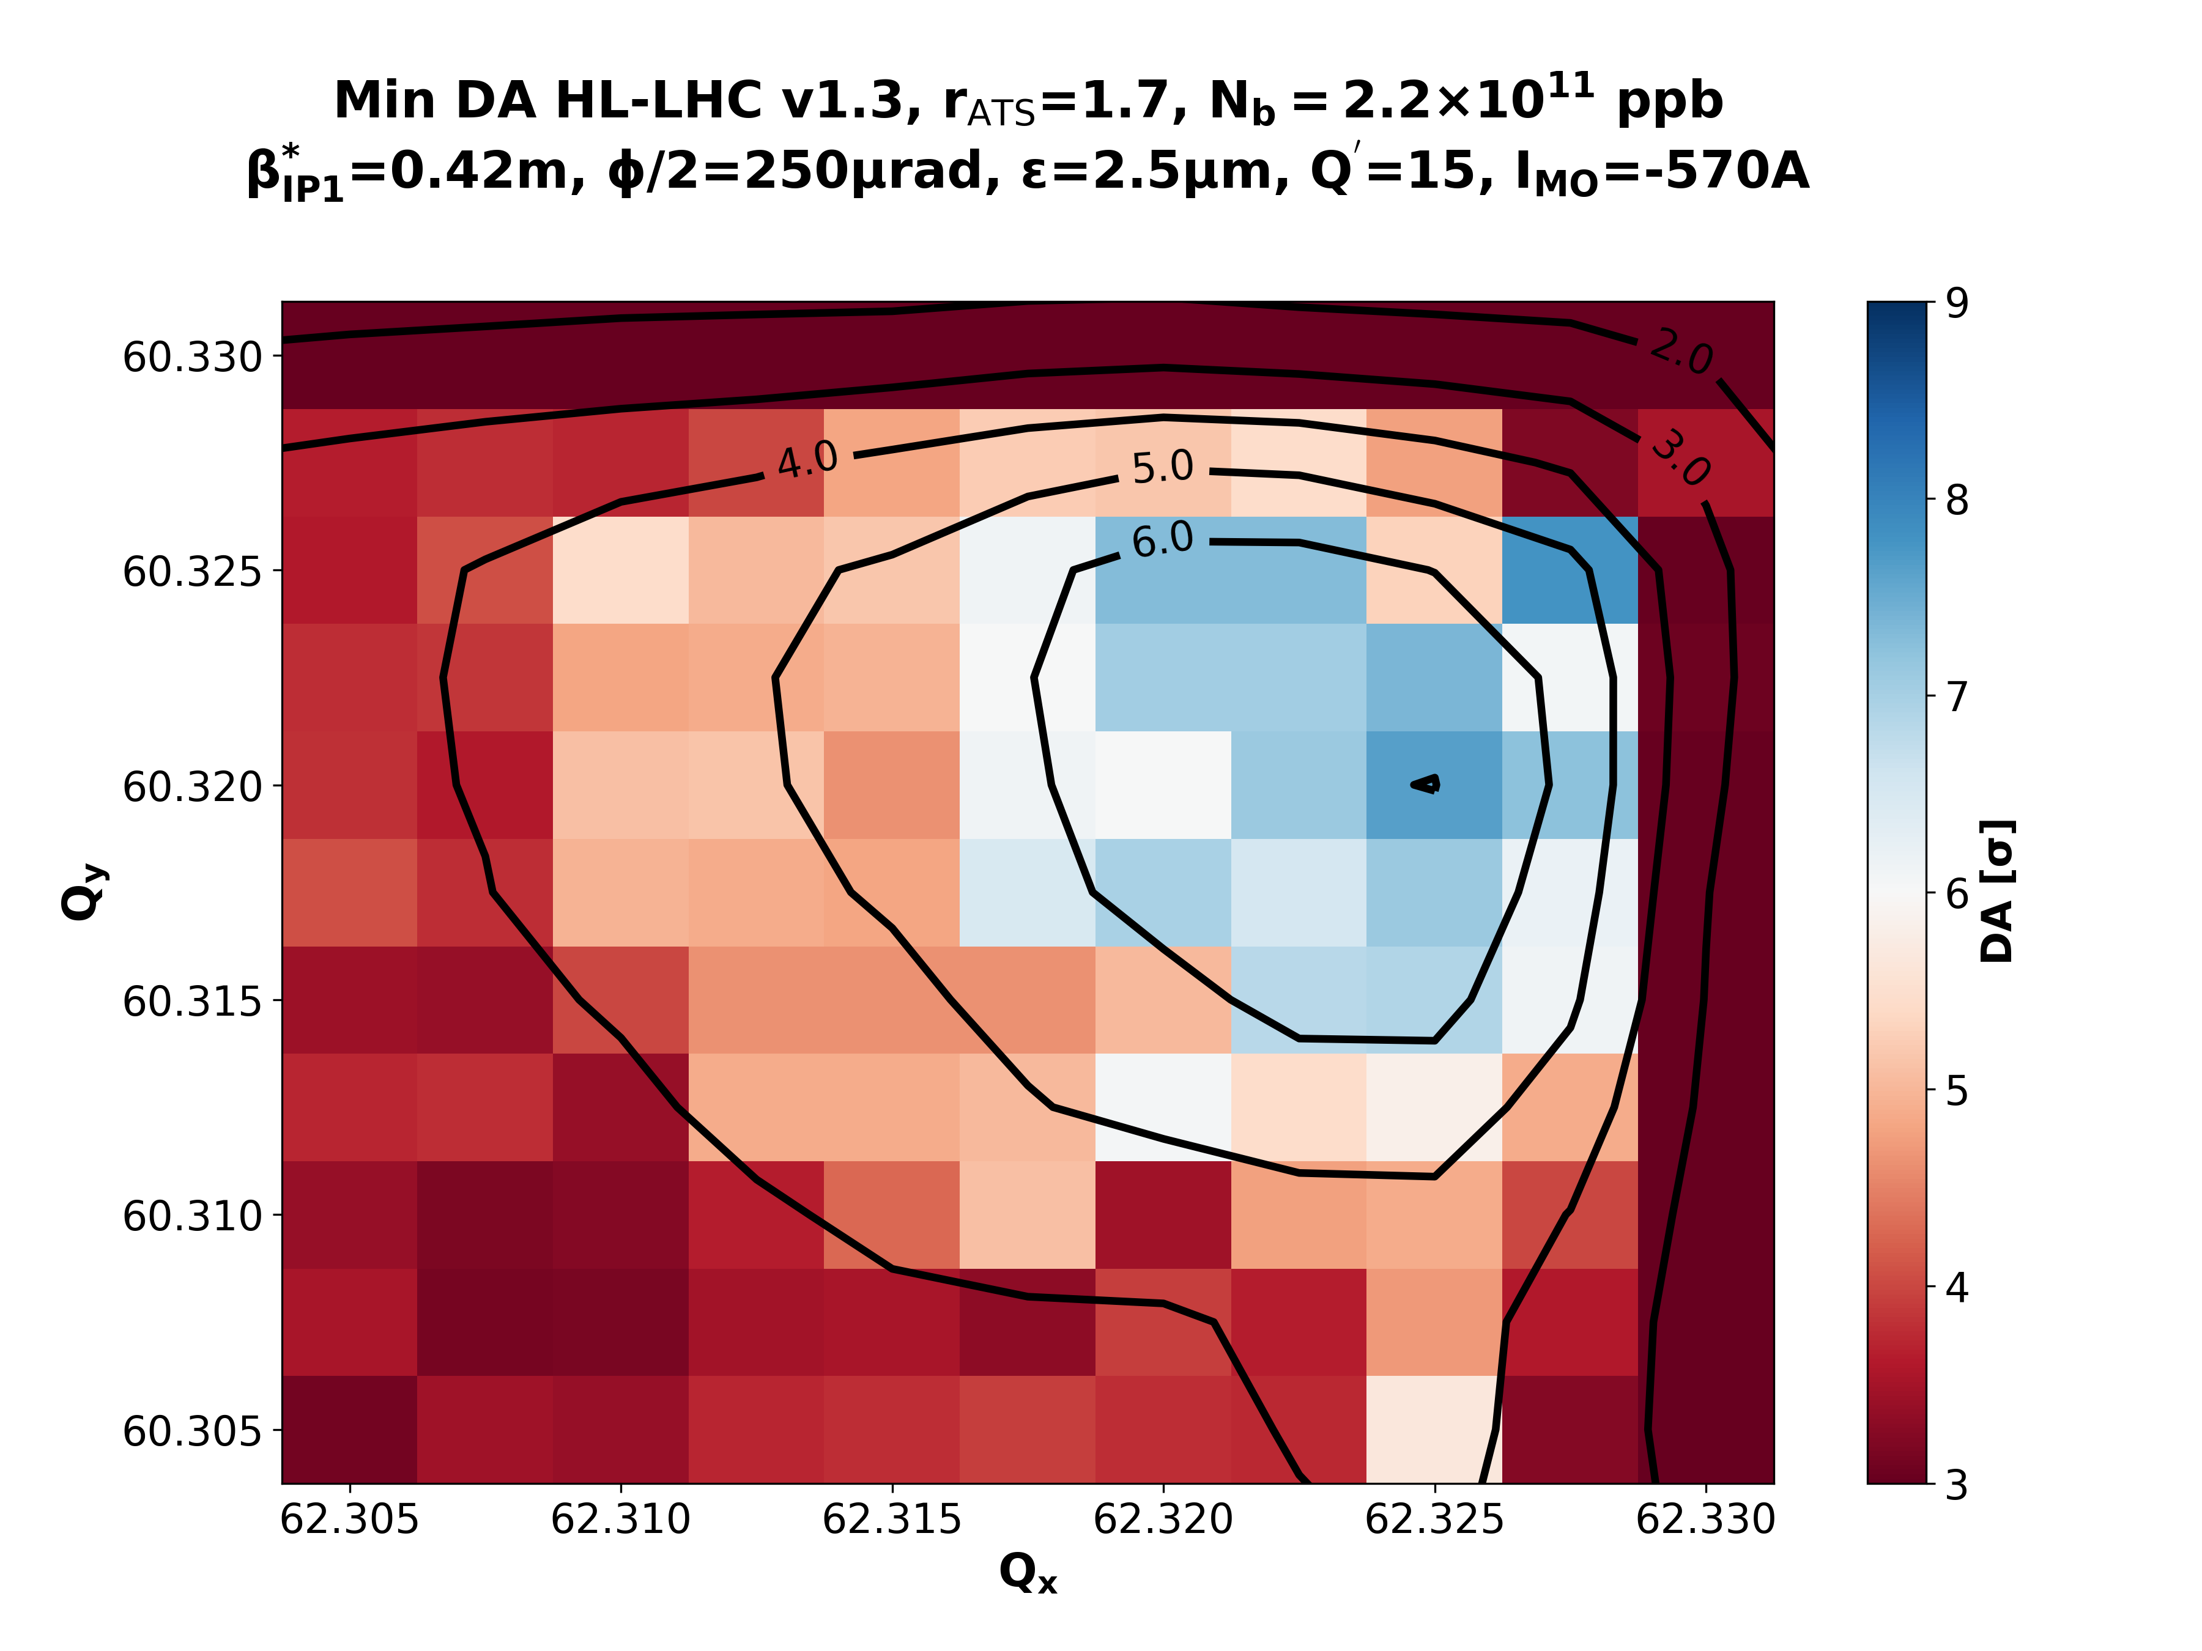
Negative Polarity
Post-LS2
Full Upgrade
rATS = 2.2
rATS = 1.7
Pre-Squeeze
Collisions
rATS = 2.2
rATS = 1.7

Slide 4
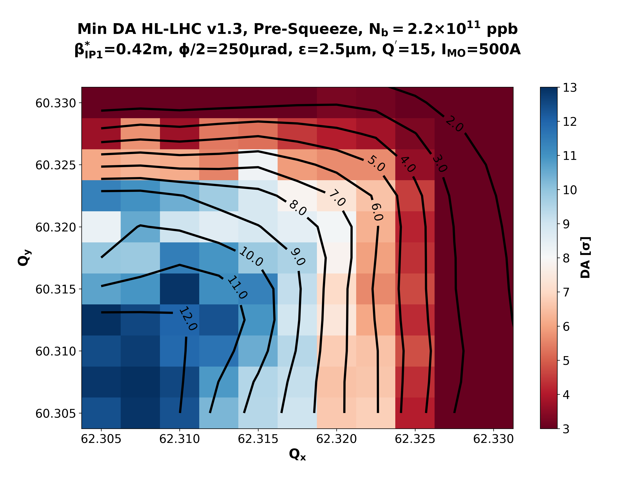
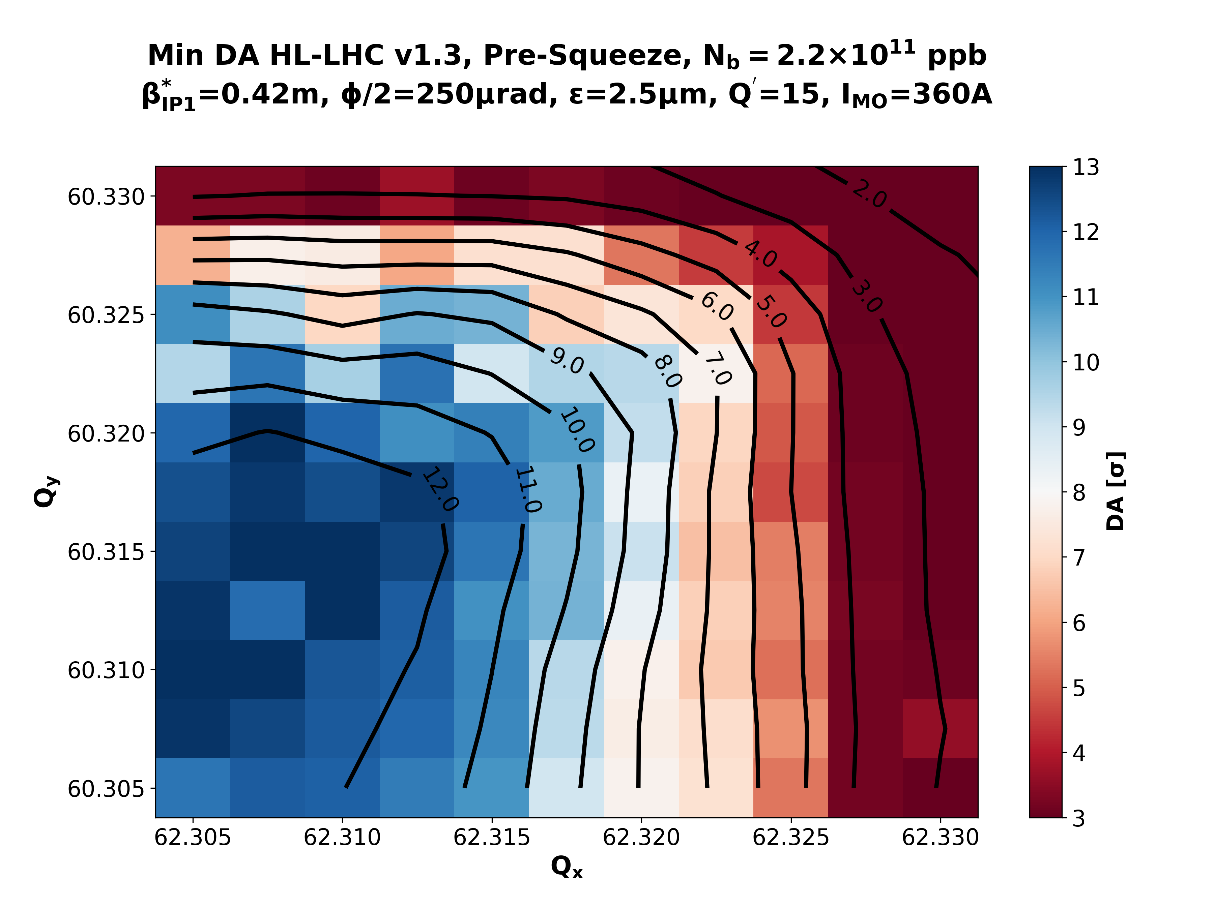
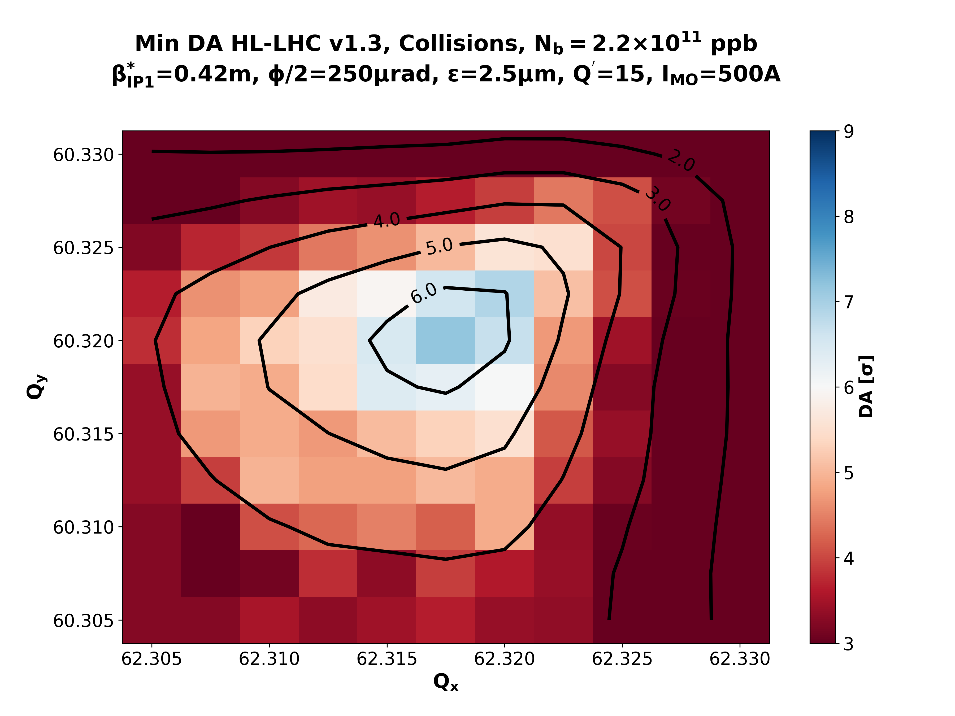
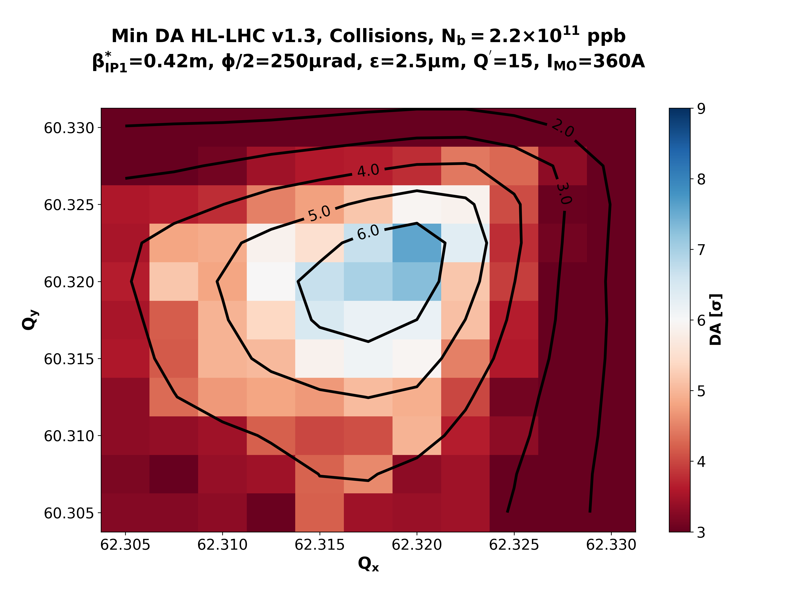
Positive Polarity
Post-LS2
Full Upgrade
rATS = 1.0
rATS = 1.0
Pre-Squeeze
rATS = 1.0
rATS = 1.0
Collisions

