Slide 1



Gentner Programme
Main Programme points
  special German Doctoral Student Programme
    in addition to the existing CERN Doctoral Student Programme
    funding (subsistence) by BMBF (German Federal Ministry of Education and Research)
    extra funds for Students’ travel to Germany and for Supervisors’ travel to CERN
  eligibility
    open to EU nationals
    students need to be enrolled at a university in Germany
  mid- and long term goals
    better usage of CERN resources by Germany
    better connection between German Universities and CERN
    long-term: more Germans at CERN (Doctoral Students, Fellows, Staff)
      presently only ~6.7% German staff (176/2633), but 20.6% contribution of DE to CERN budget
      IT: 12.0% (10.4% contribution), GB: 8.0% (16.1% contribution), ES: 6.1% (7.1% contribution)

Slide 2
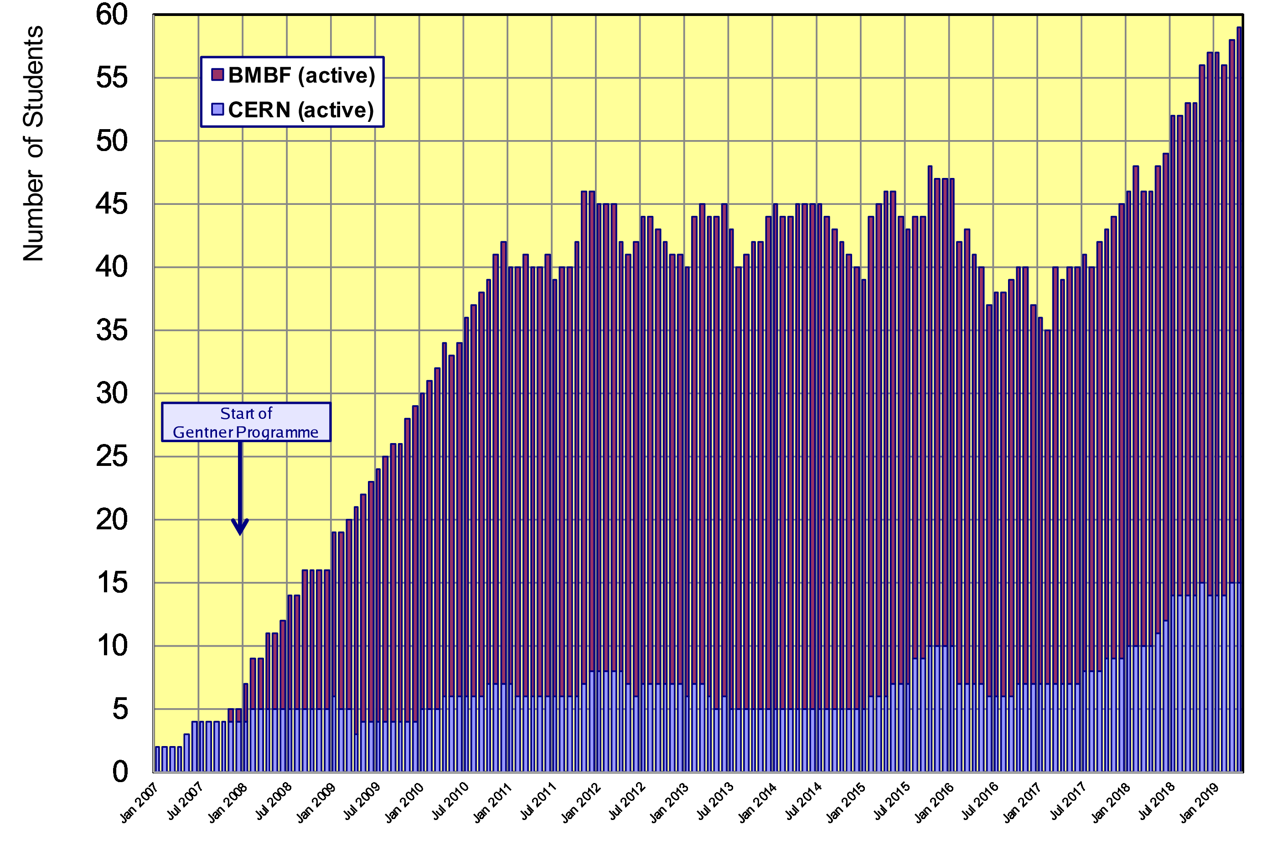
Status Gentner Programme
Presently 44 active Gentner Students (only 7 female = 16%!)
  further 15 Germans in regular CERN Programme
General trend: fewer number of applications by women over past 2-3 years!
Had ~30% women over many years
No obvious reason known

Slide 3
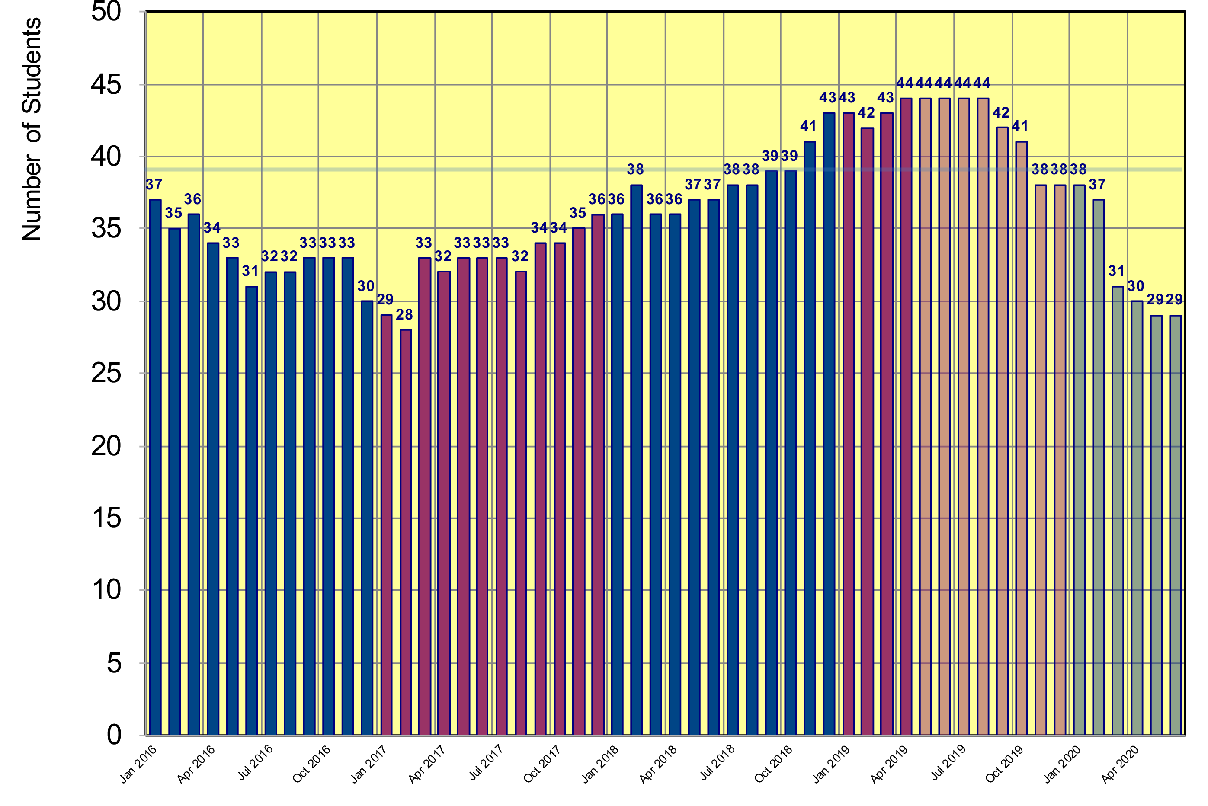
Status Gentner Programme
Projection until June 2020
  based on preferred starting date given by selected students
projection
Drop due to unfavorable EUR/CHF exchange rate
39 students foreseen in Gentner agreement
first students from 2019-1 selection
first students from 2019-2 selection
2019
2020

Slide 4
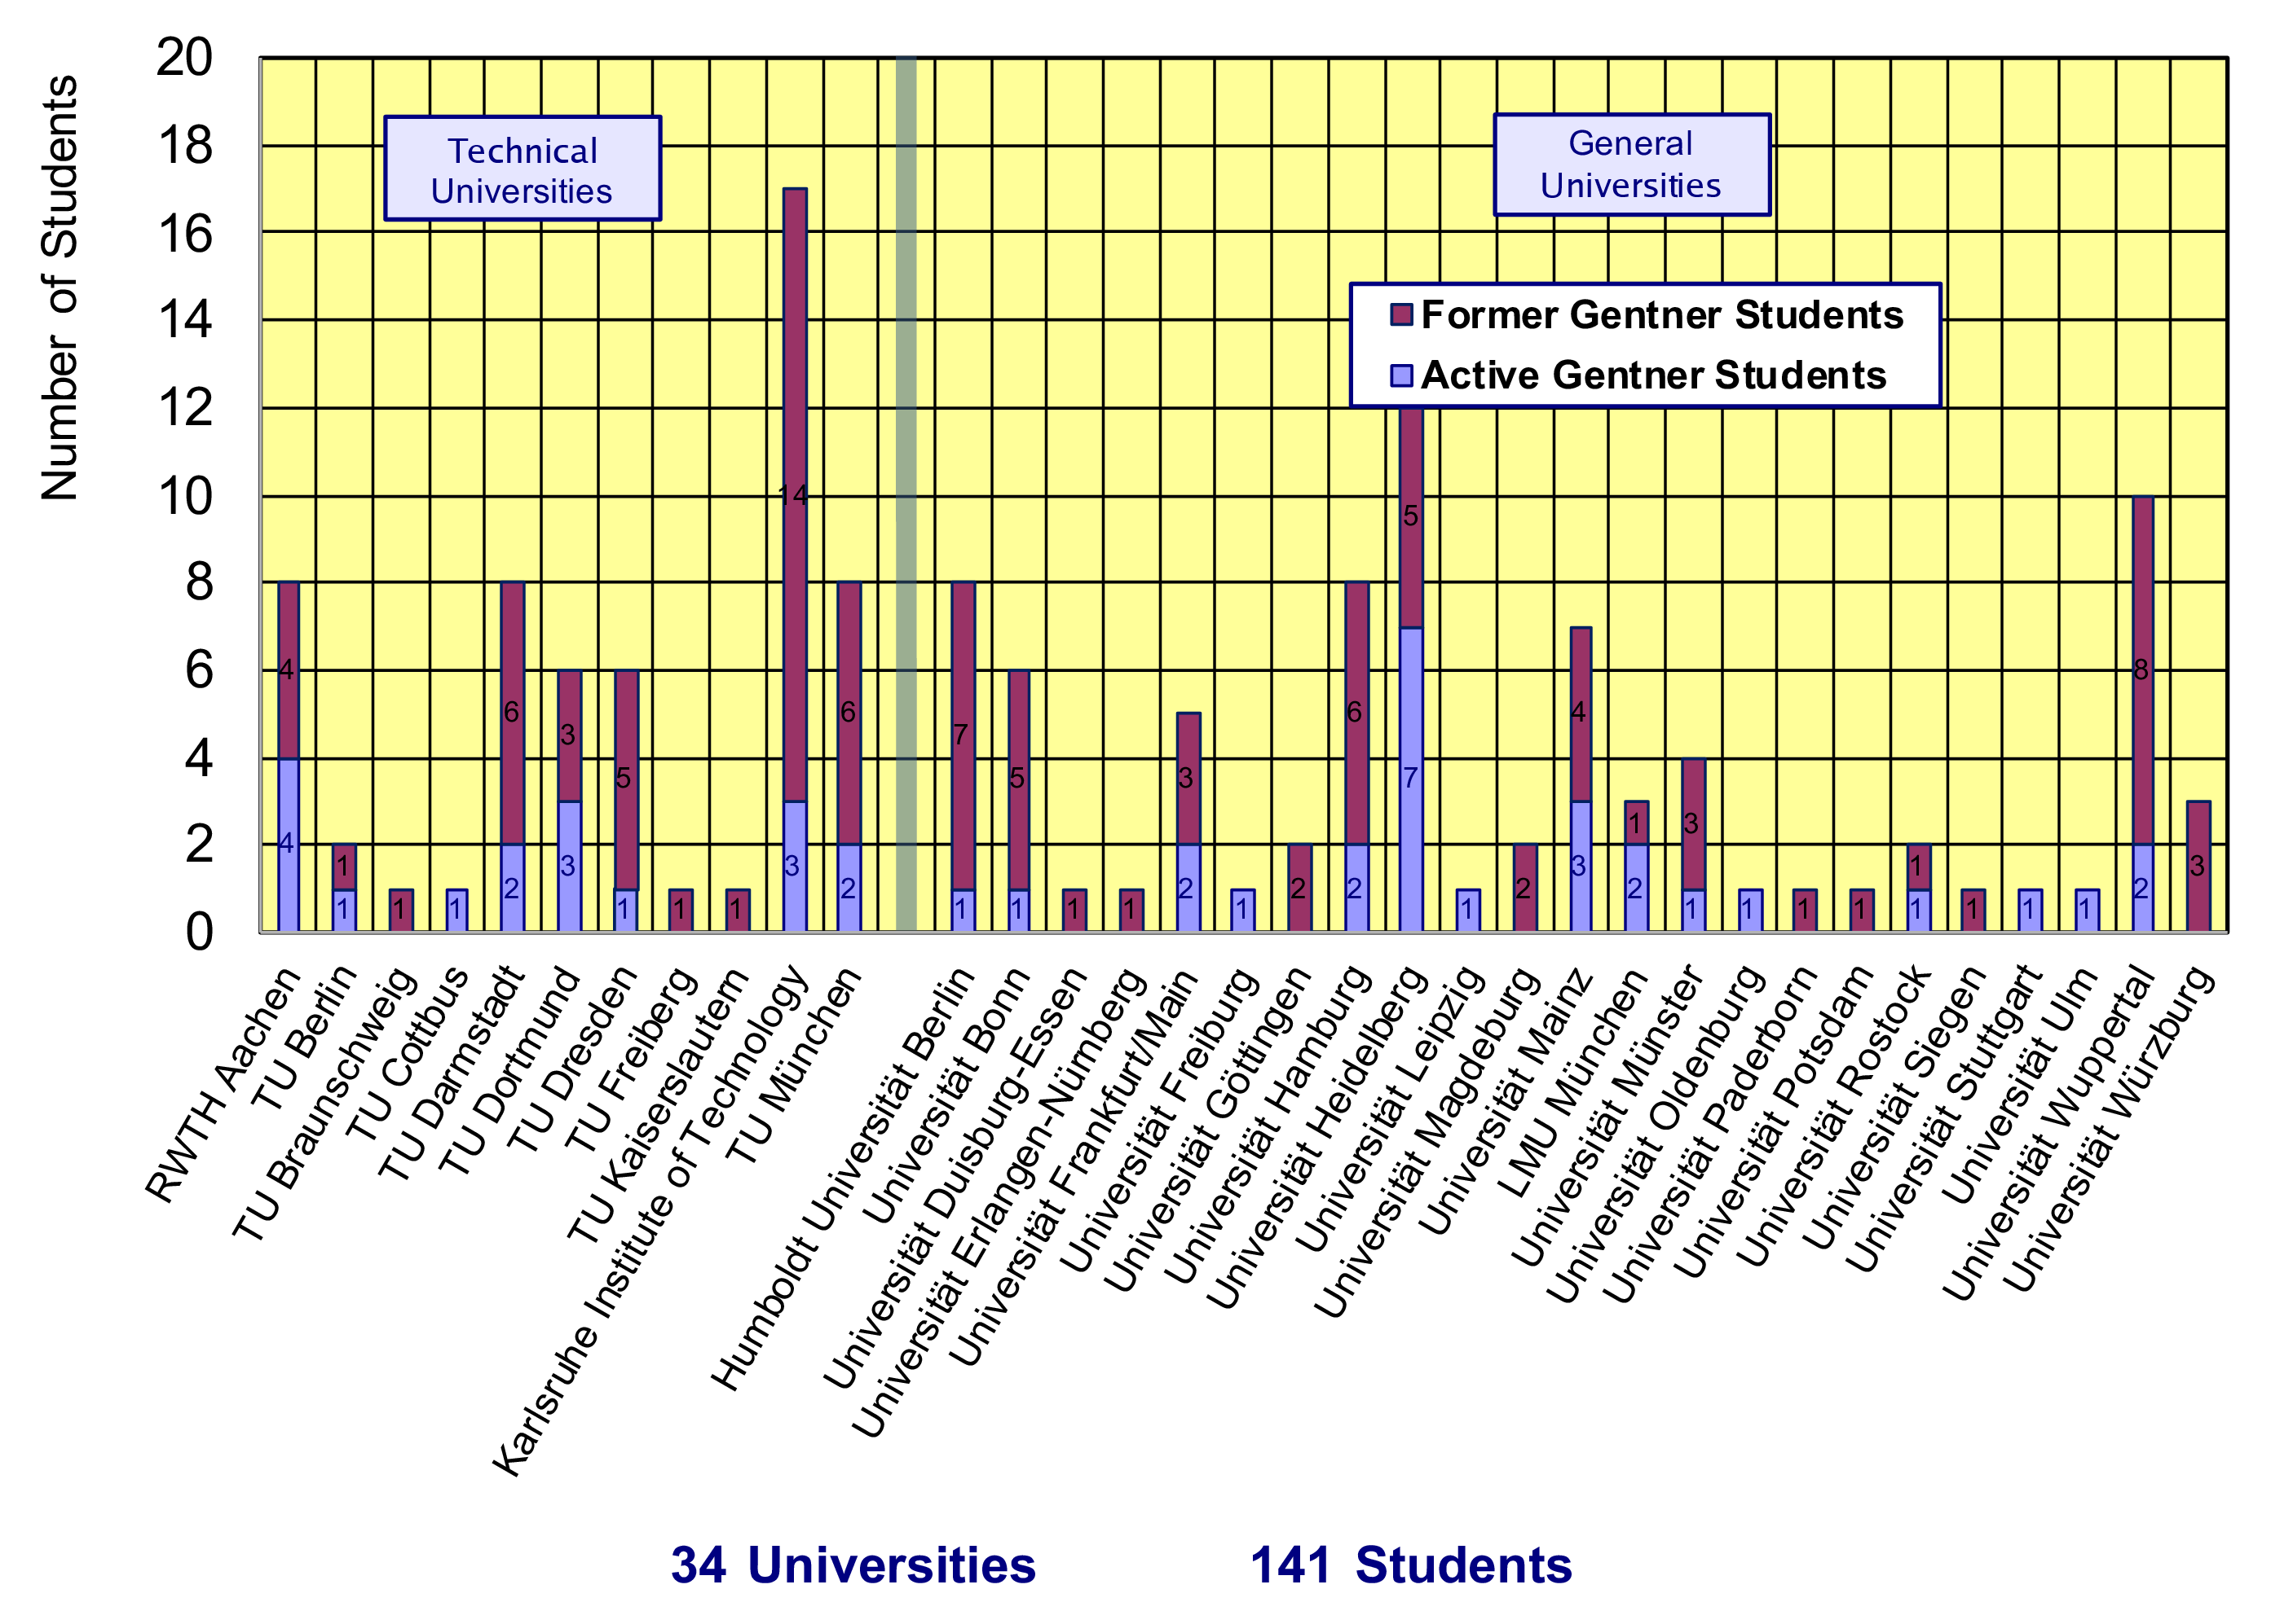
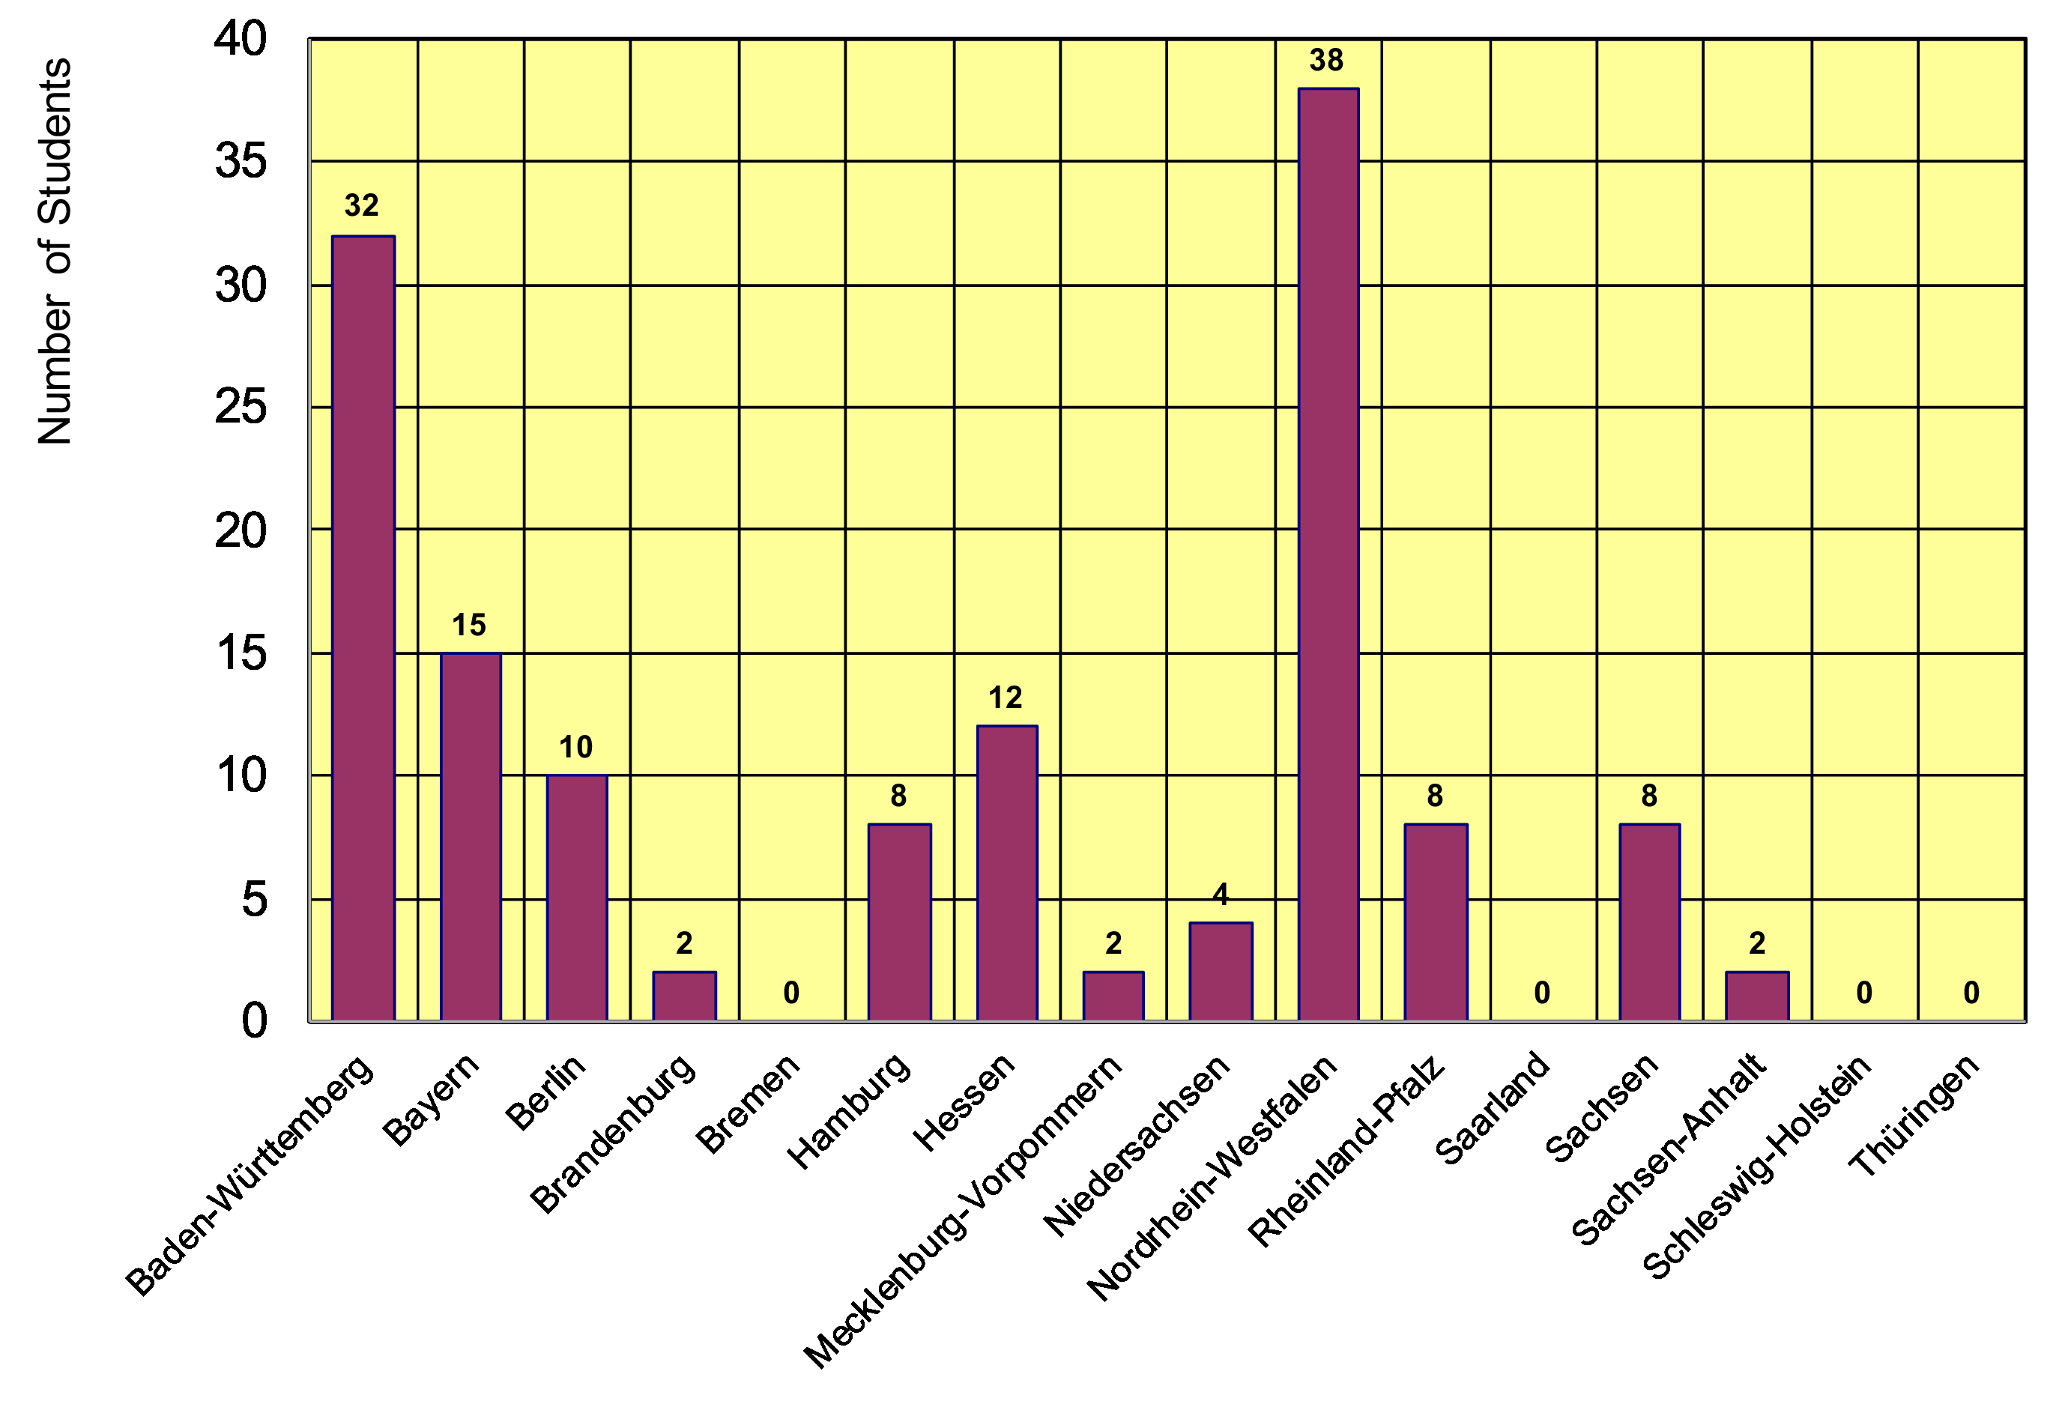
Gentner Students
  coming from 34 different Universities in Germany
    no new universities since October 2018
  12/16 German States
    NRW and BW are leading
    only a few small(er) States are missing

Slide 5
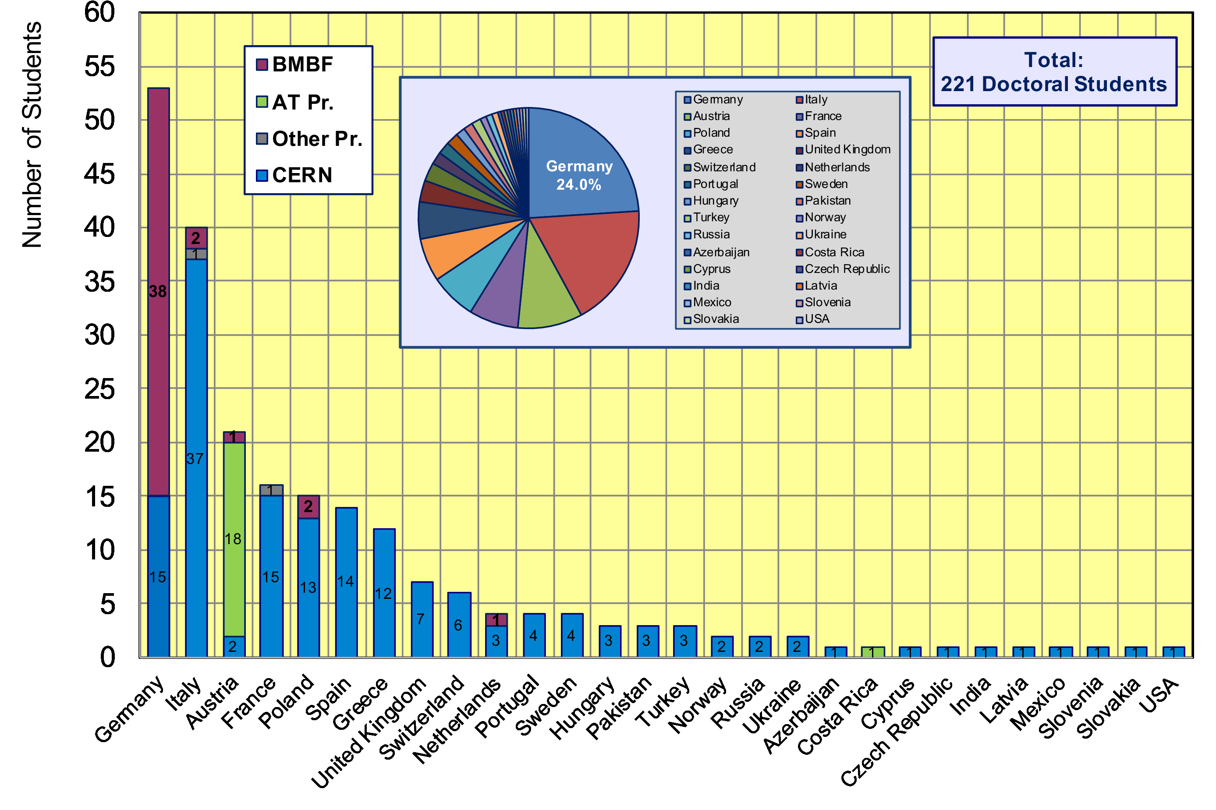
CERN Doctoral Students
Nationalities of all Doctoral Students at CERN
  Germans (53 Students, 24.0%) are leading (strong increase since last Gentner Day)

Slide 6
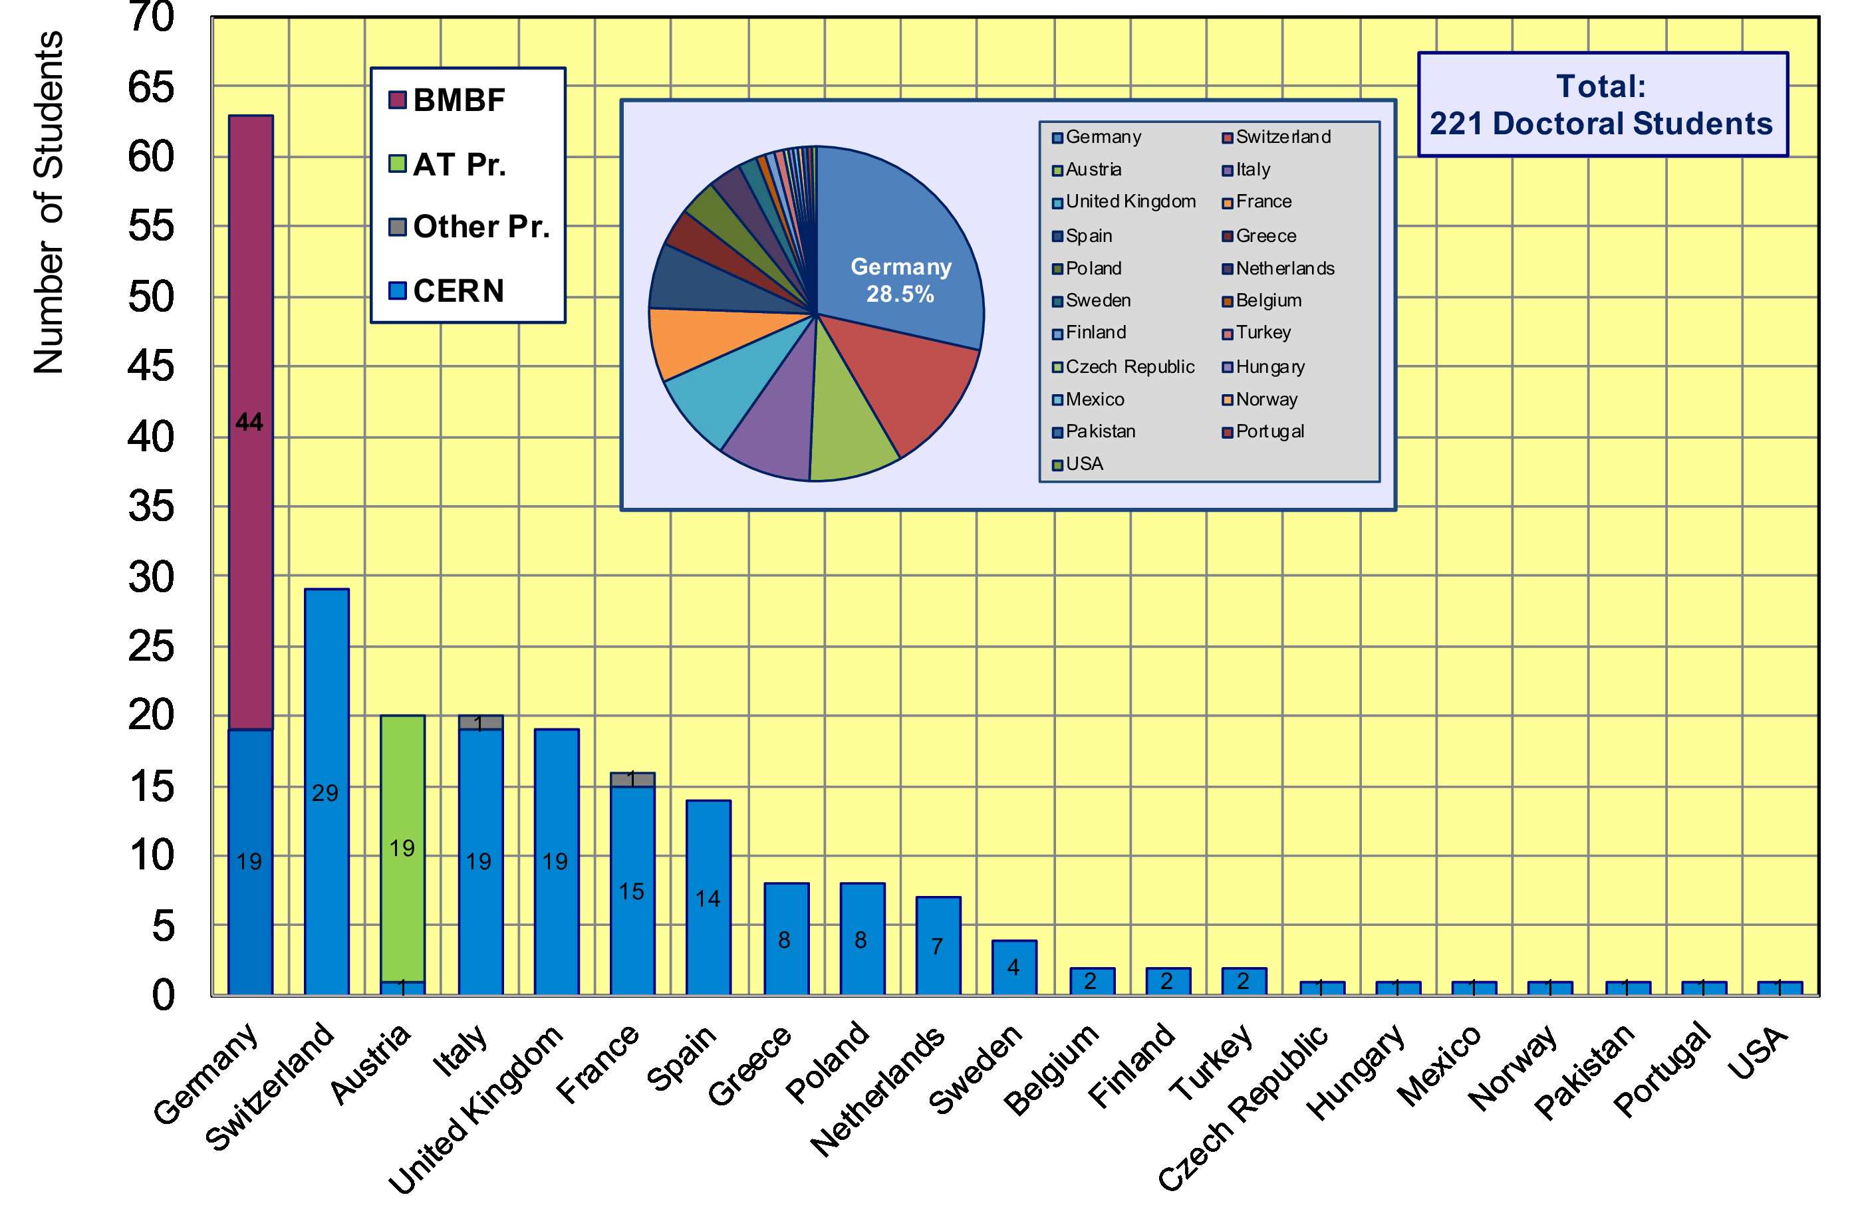
CERN Doctoral Students
Home University Country of all CERN Doctoral Students
  63/221 Students enrolled at German Universities (28.5%) (largest number ever)

Slide 7
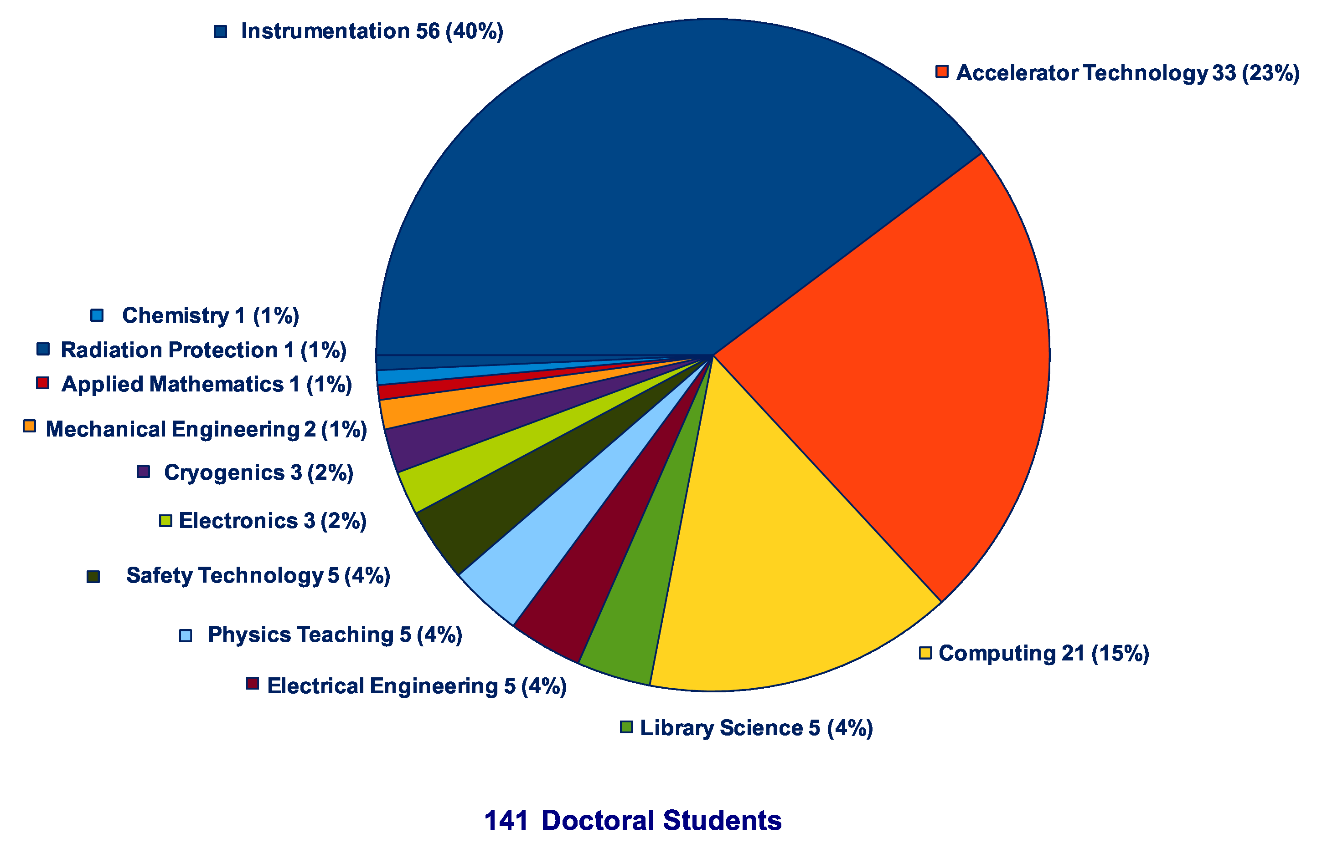
Thesis Topics of Gentner Students
(active + former)
Majority of topics in Instrumentation (40%), Accelerator Technology (23%), Computing (15%), all others = 22%

Slide 8
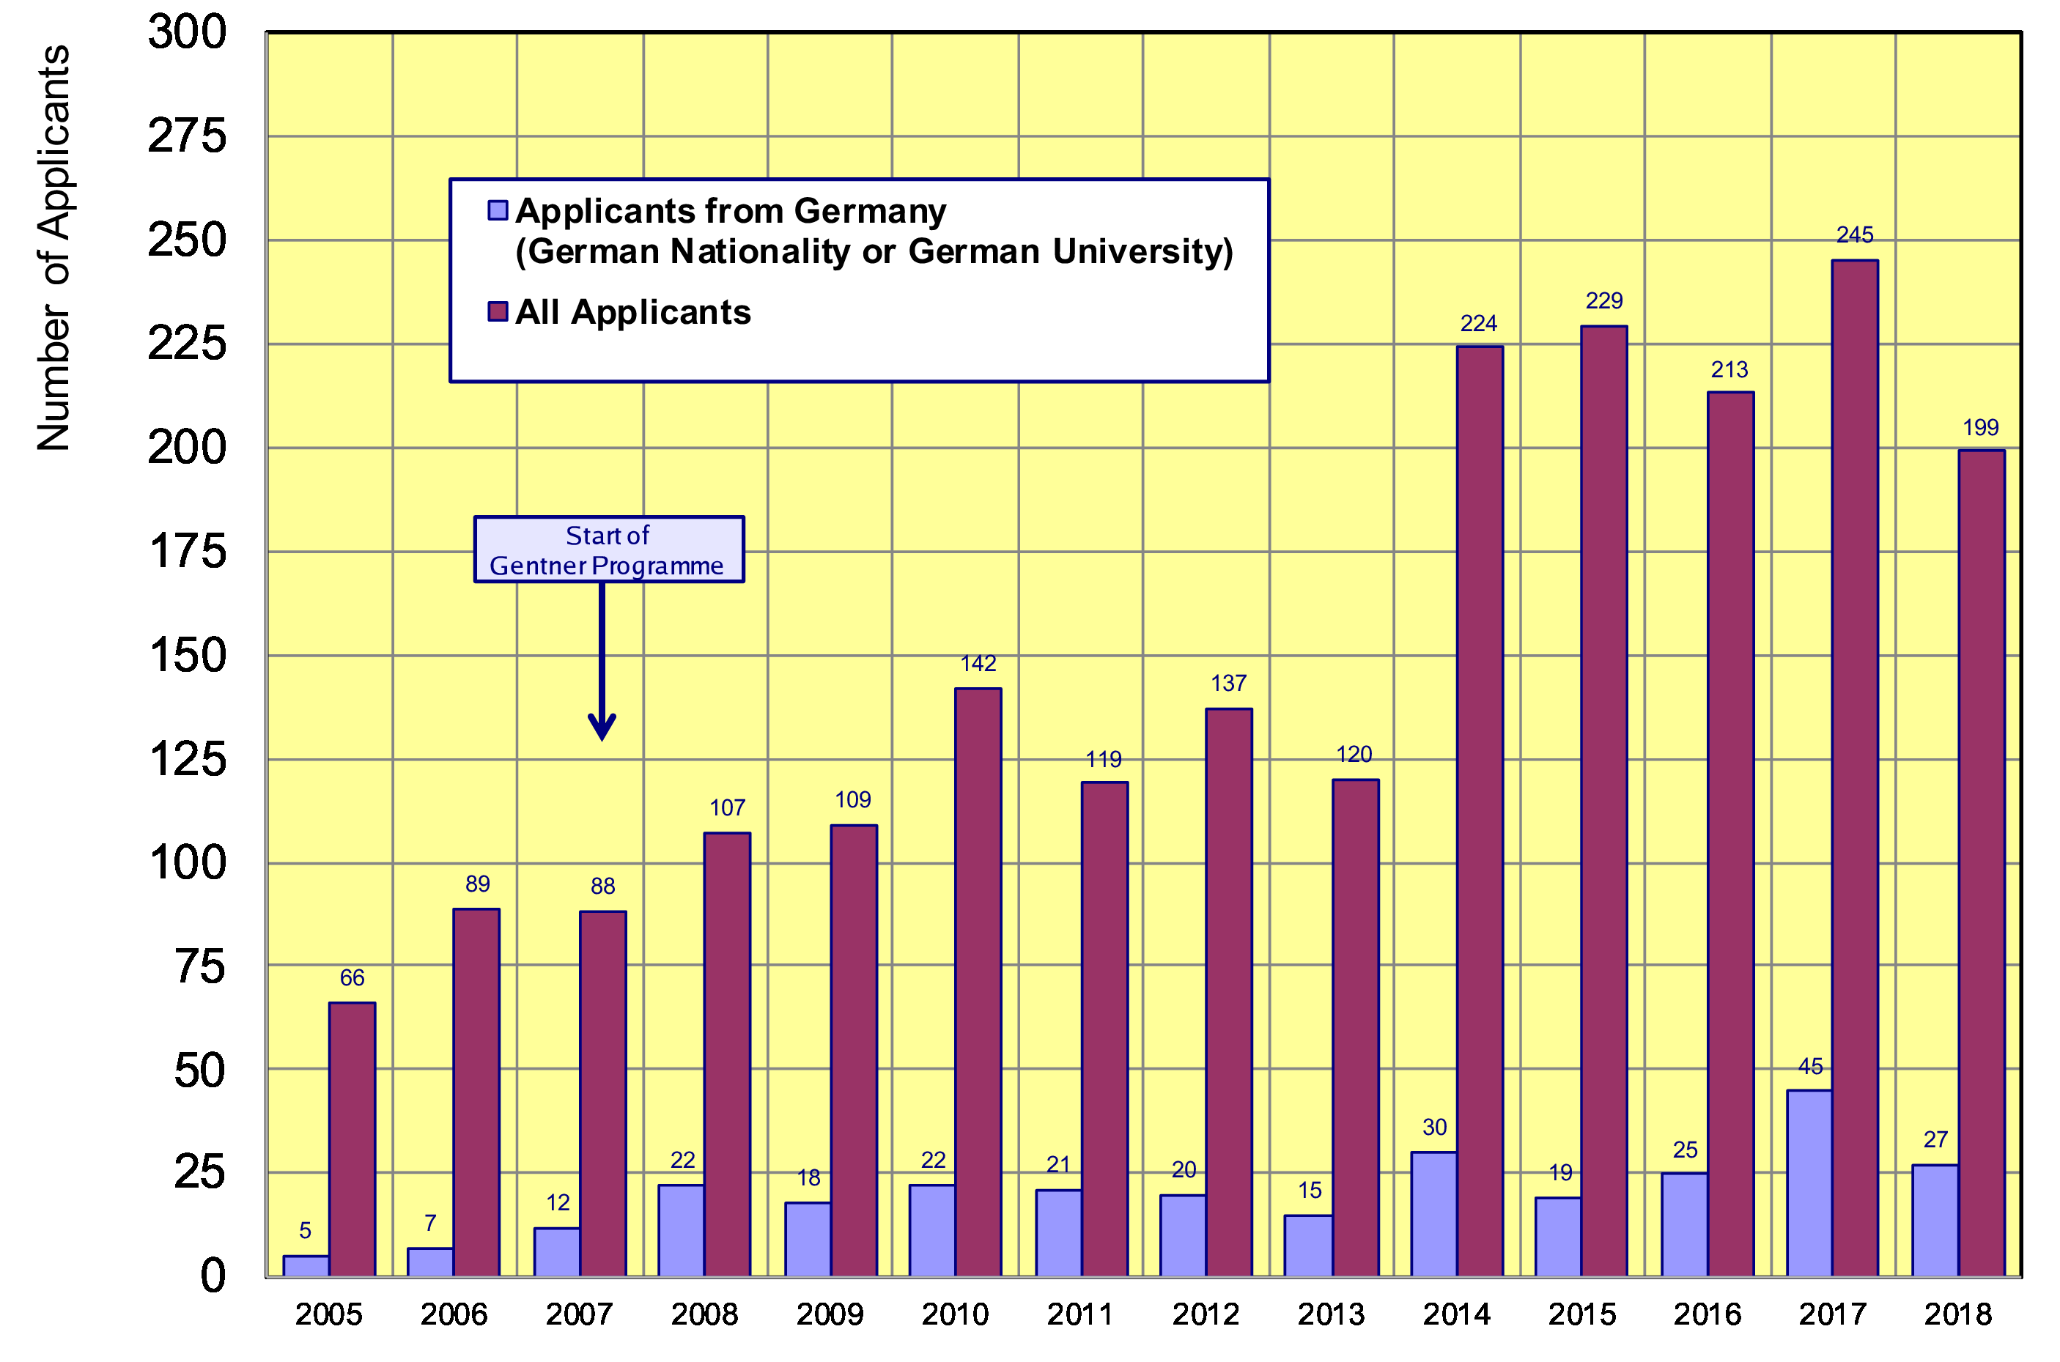
Doctoral Student Applications
Typically ~24 applicants/year from Germany (~stable since 2008)
    27 applications from DE in 2018 (11 selected for the Gentner Programme)
average: 24

Slide 9
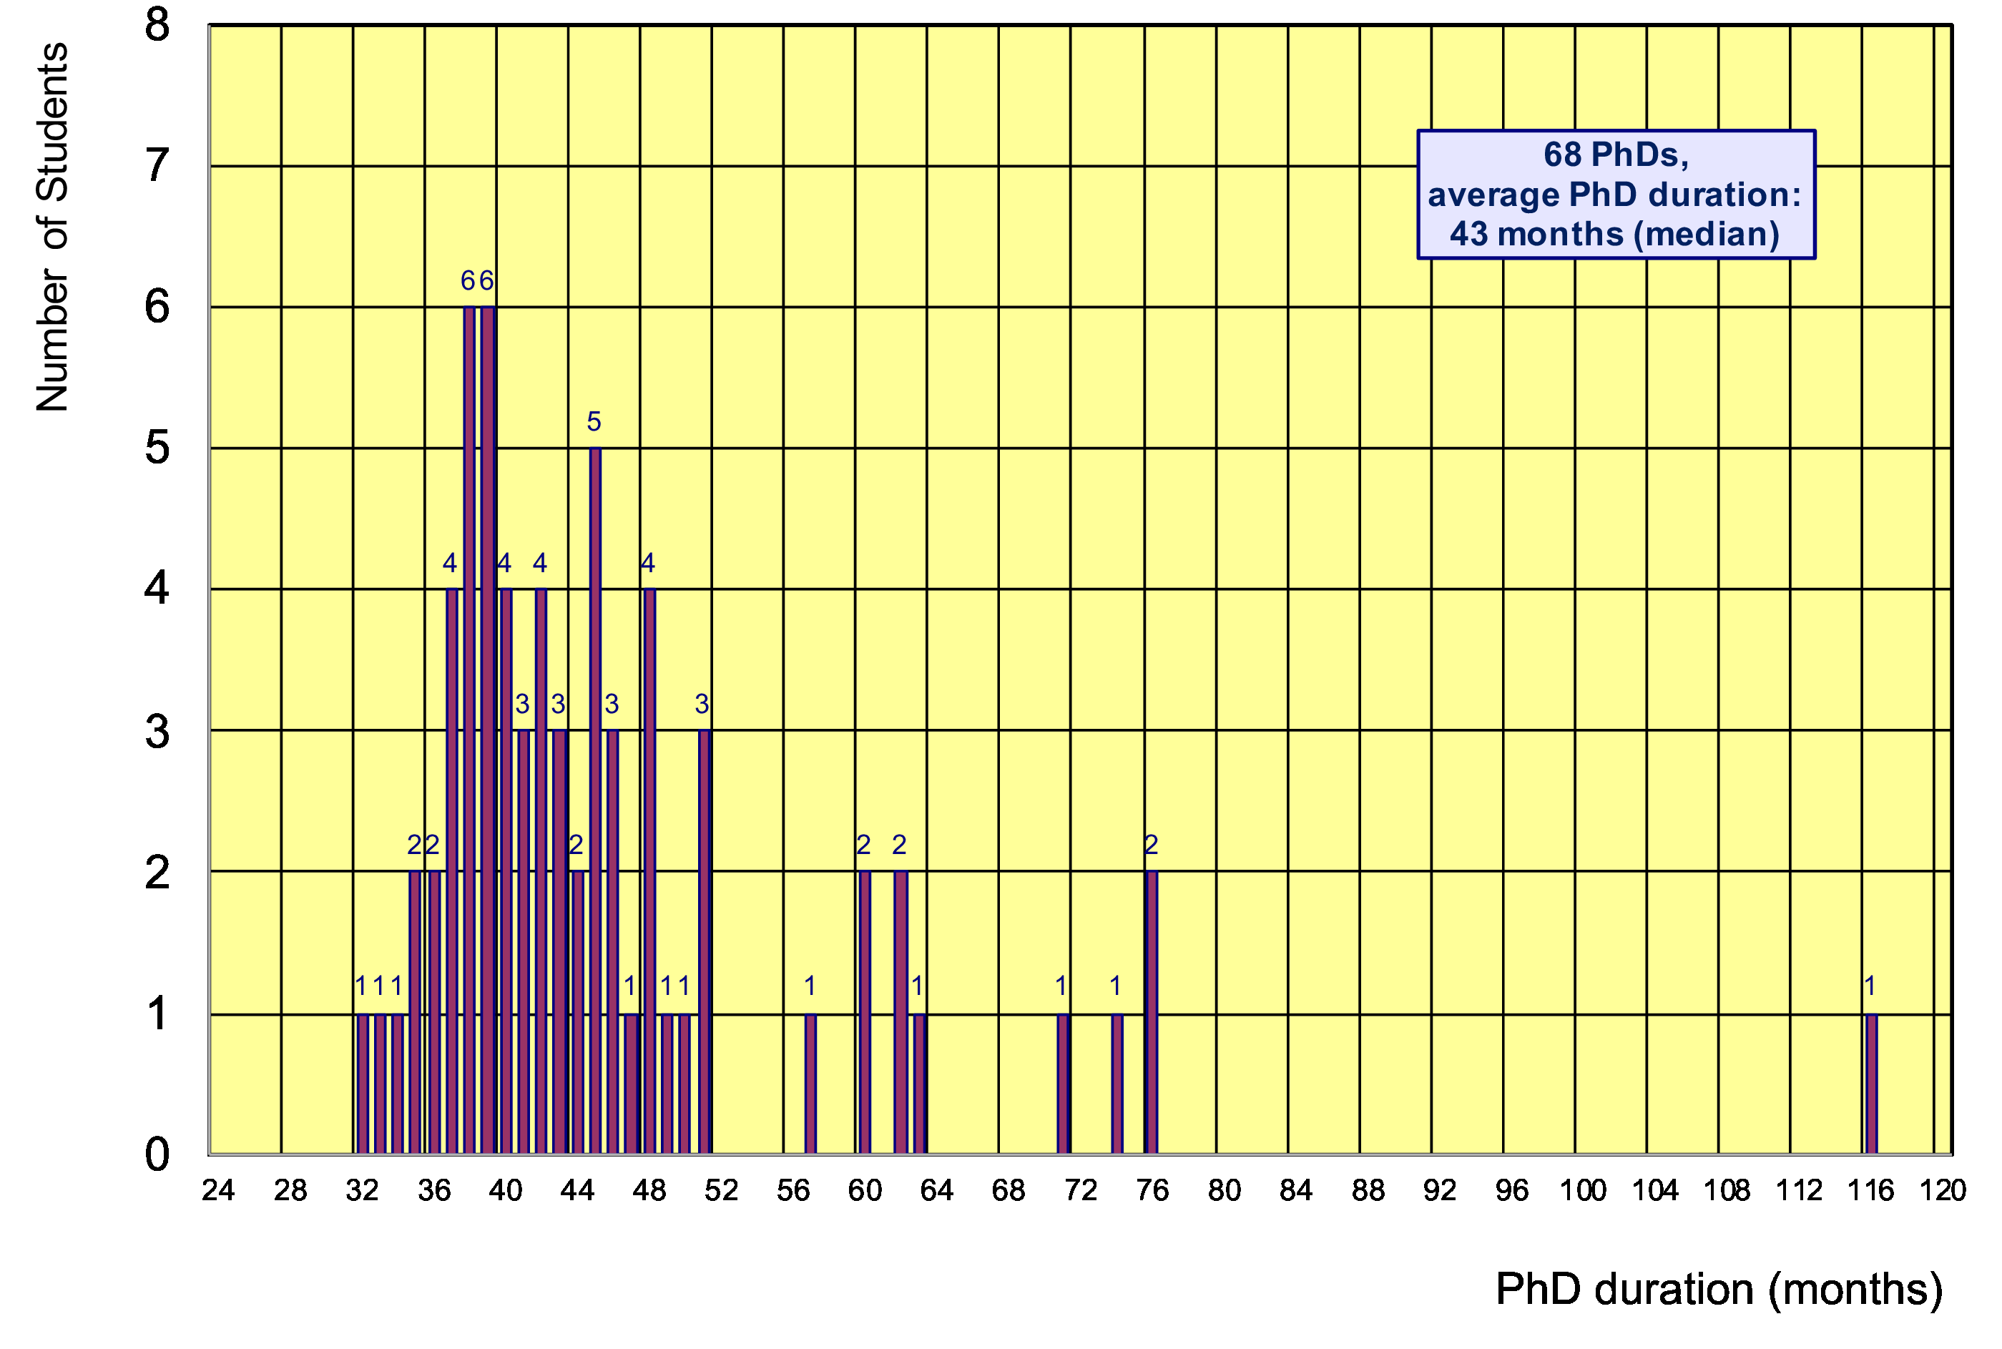
Former Gentner Students
68 PhDs so far (15 female = 22%), 8 Students have cancelled their PhD
    average age at PhD (defense): 30.9 years (median)
    average duration of PhD: 43 months (median) = 7 months after end of CERN 3-years contract
Physics PhDs in Germany (2017)
24% female PhDs students
30.9 years (median) at PhD
55.2 months (median) duration of PhD
7/68 students (10%)
needed ≤ 3 years

Slide 10
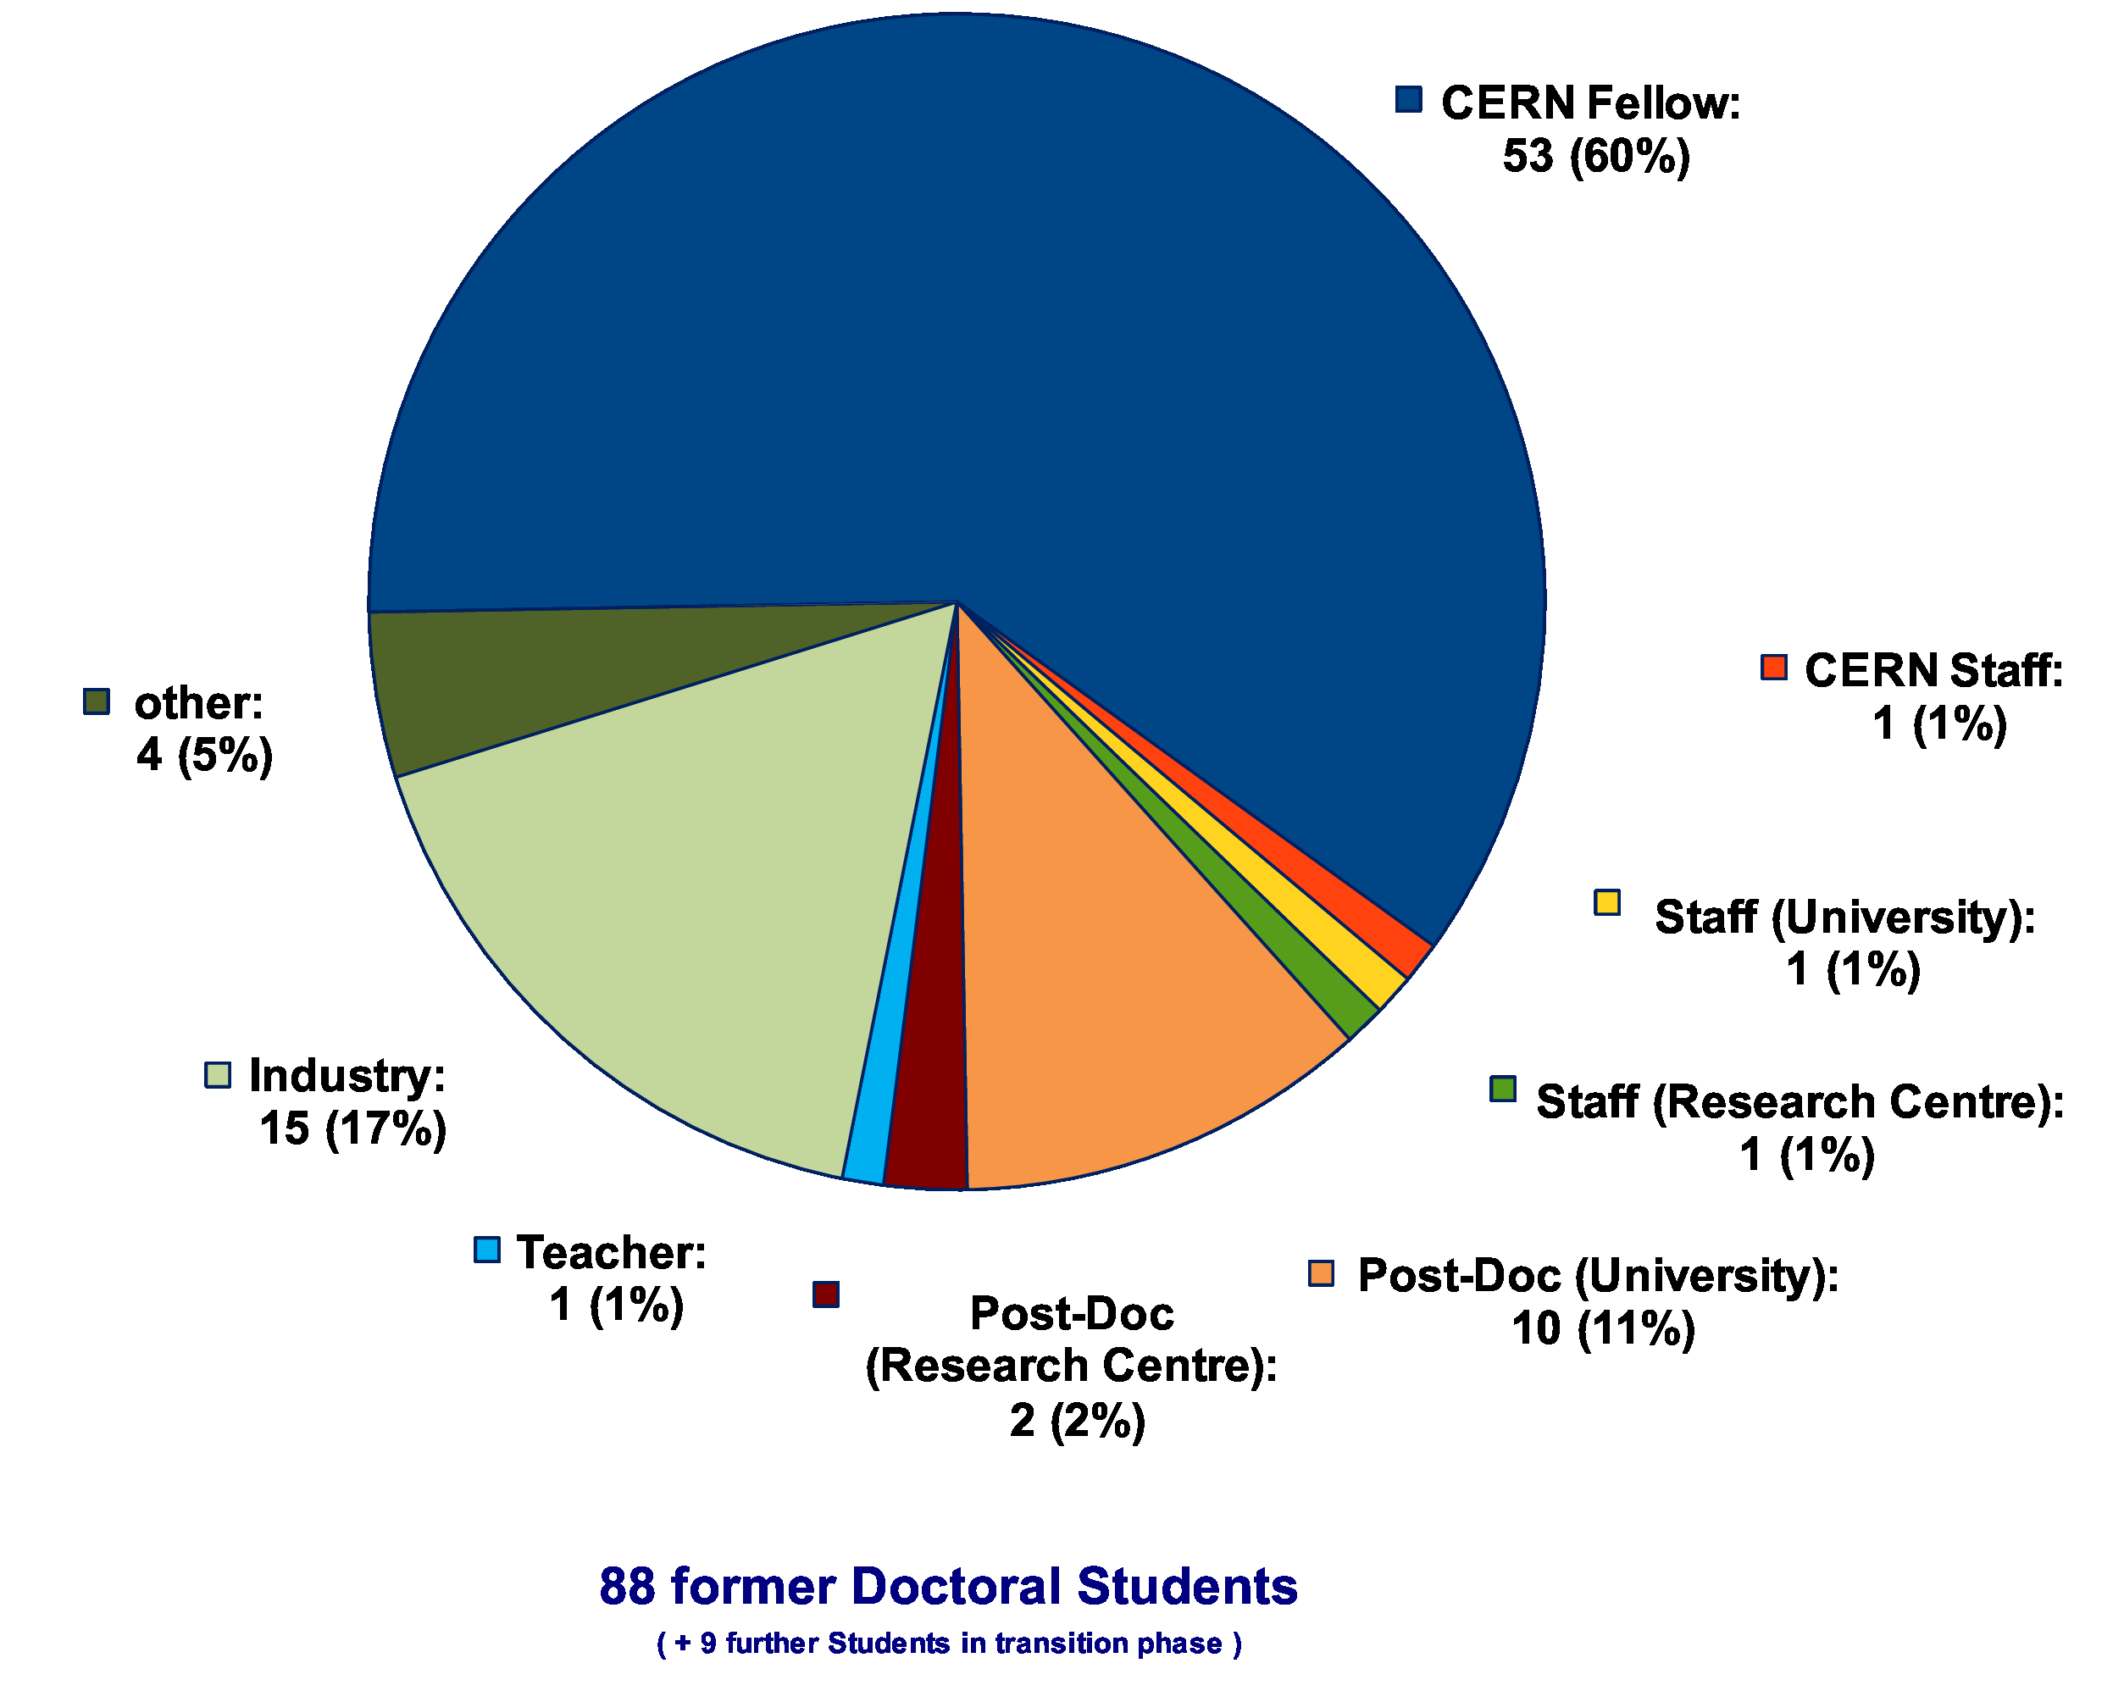
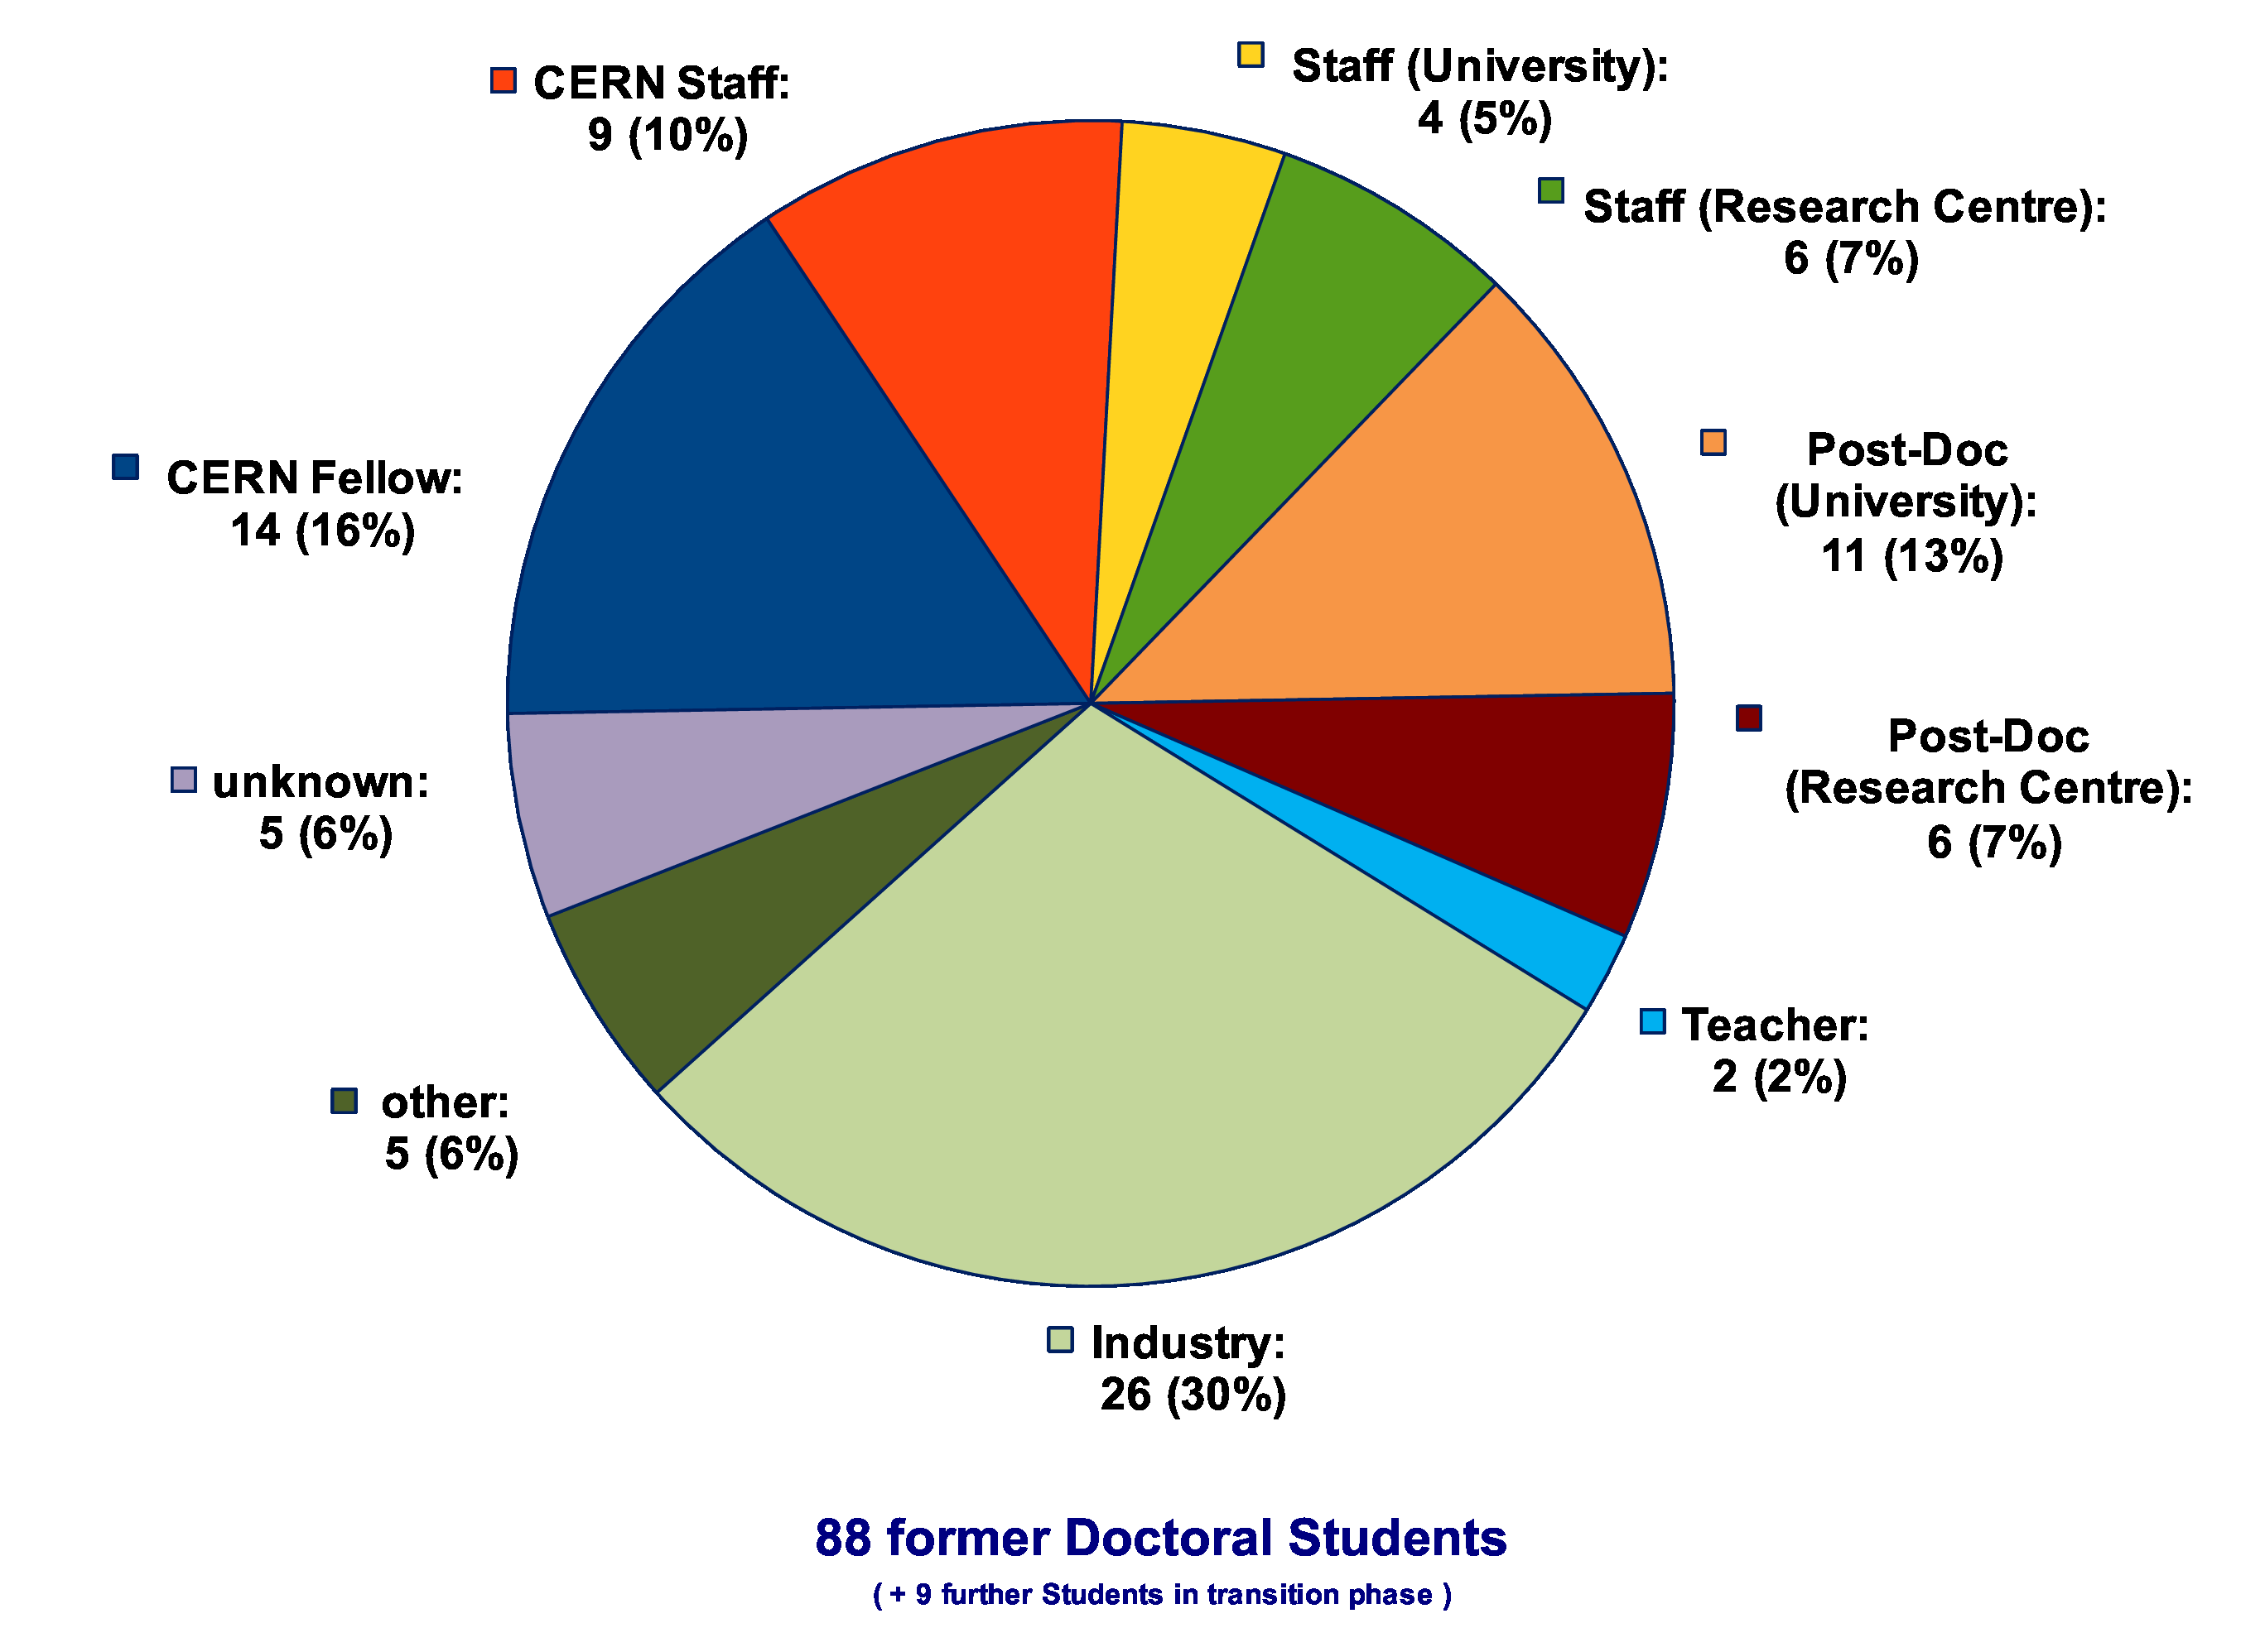
Whereabouts of Gentner Students
  first employment of 60% of the Gentner Students: CERN Fellow(!)
First Employment
Present Employment
presently 9 CERN Staff Members,
2 with indefinite contract
3 Staff are supervising Gentner students

Slide 11
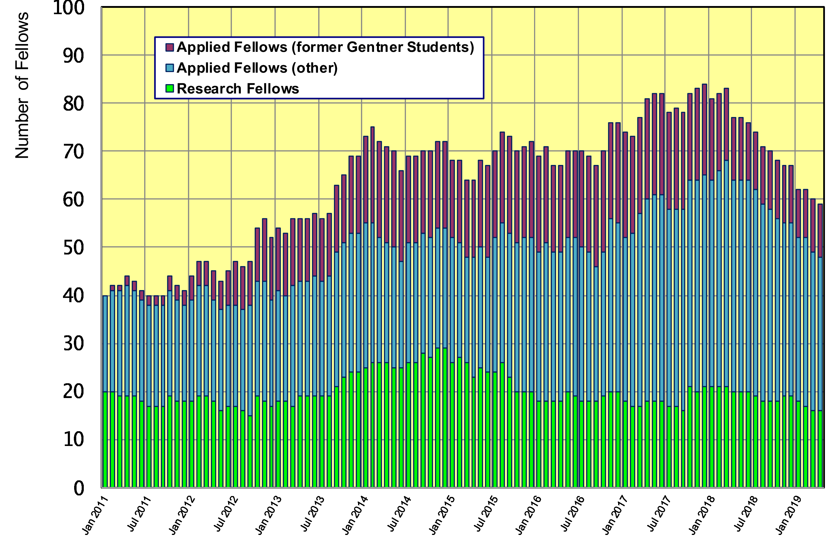
Gentner Students → Fellows
  significant increase of DE Fellows by former Gentner Students
    general trend: fewer former Gentner students become Applied Fellow, also generally fewer German Applied Fellows

Slide 12
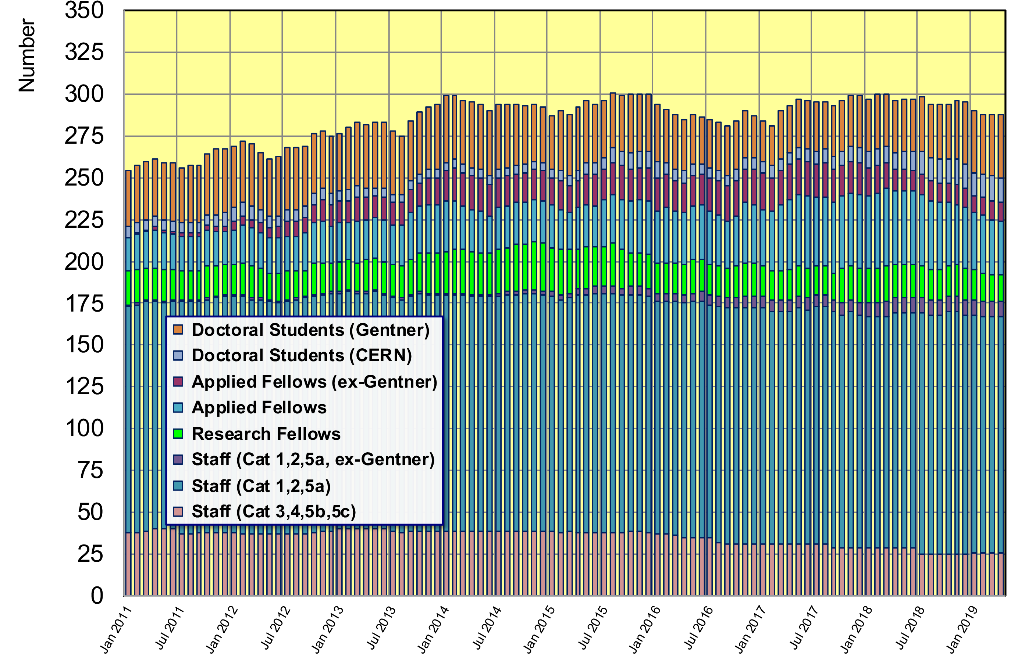
Gentner Students → Fellows, Staff
  288 German Doctoral Students, Fellows and Staff right now
    37 active + 20 former (German) Gentner Students at CERN (=19.8% of DE personnel)

Slide 13
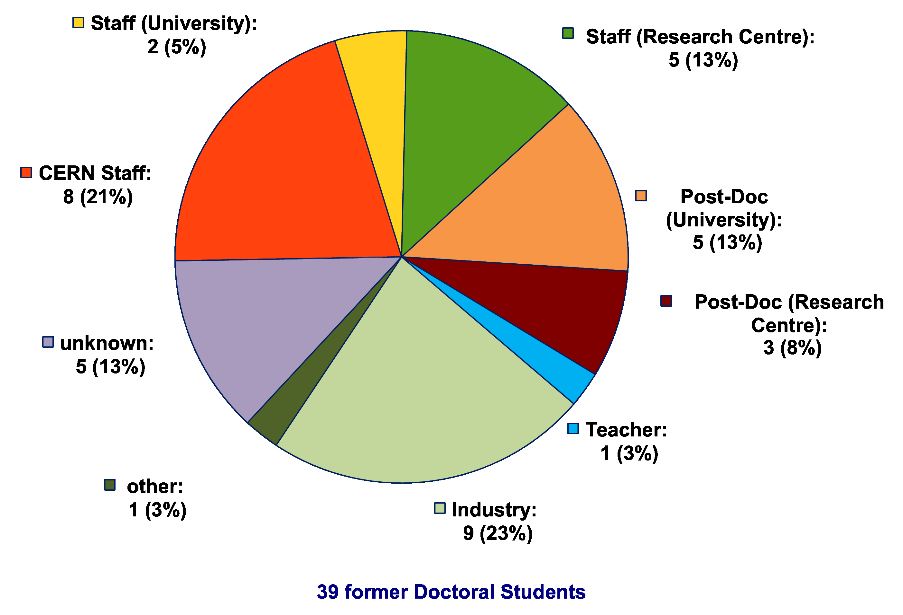
Whereabouts of Fellows
(former Gentner Students)
  many Fellows stay in academic research after their fellowship
    21% become CERN staff, 38% move to University or Research Centre

Slide 14
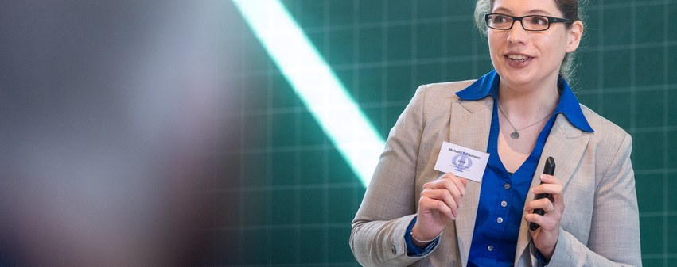
DPG Award to former Gentner Student
DPG (German Physical Society) Young Investigator Award for accelerator physics 2019 was given to Michaela Schaumann (former Gentner student)
    “…in recognition of her outstanding scientific achievements as part of her PhD studies and at the first research phase during the LHC heavy ion operation.”
    Michaela was Gentner student from January 2012 to December 2014 and received her PhD at the RWTH Aachen
    continued at CERN as fellow and became staff in 2018, responsible for the heavy ion operation of the LHC in the position of an “Engineer in Charge”

Slide 15
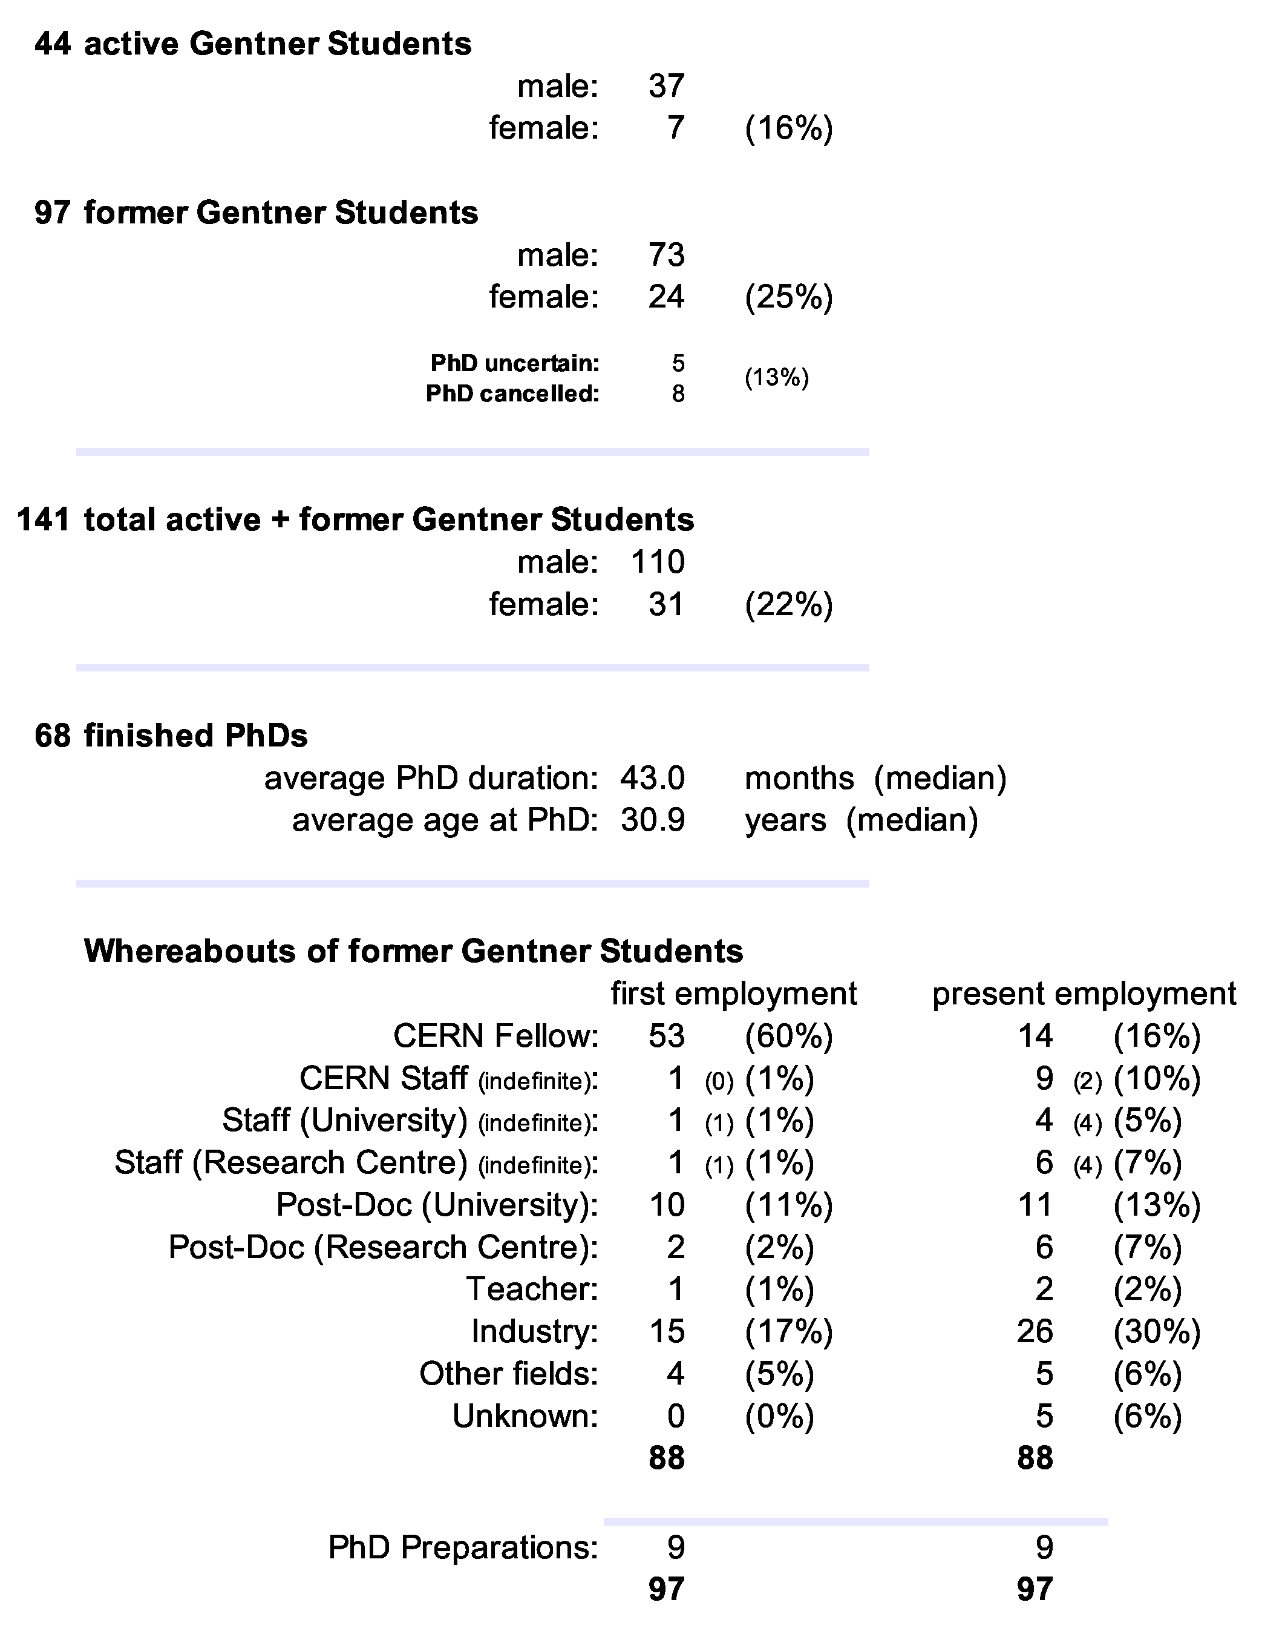
Summary Gentner Programme
  number of students increased to 44 over last months (nominal: 39 students)
  will continue to stay high in 2019
  also increasing number of Germans in regular Programme
  still low number of female applications and students
  number of former Gentner students becoming Fellow went down w.r.t. some years ago
Next Gentner Day:
30 October 2019

