Slide 1
Risk matrices for CERN Accelerator Chain
RASWG 12/02/2019
Jan Uythoven, Andrea Apollonio,
Miriam Blumenschein

Slide 2
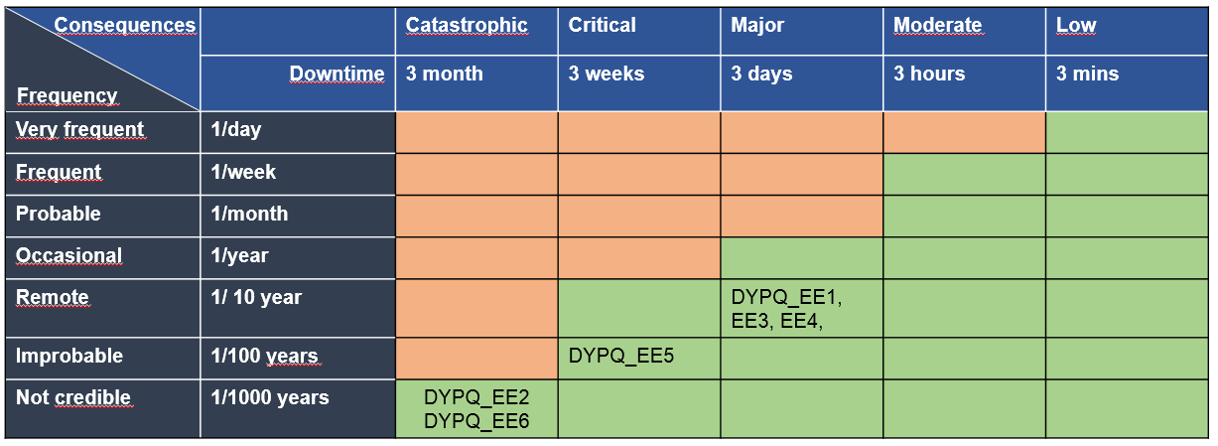
Risk Matrices
Used in RIRE method
  Reliability Requirements and Initial Risk Estimation (RIRE)
  Developed by Miriam Blumenschein (TE-MPE-MI)
  See RASWG 28/06/2018 (https://indico.cern.ch/event/738748/)
This method includes a ‘Risk Matrix’ for the system one level higher than the system under study. QPS → Risk Matrix of the LHC
  Green zone for acceptable failure rate of the LHC
  Failure modes of the QPS; acceptable frequency for design etc.

Slide 3
CERN Accelerators: LHC
LHC risk matrix |  | Recovery
 |  | ∞ | year | month | week | day | hours | minutes
Frequency | 1 / hour
 | 1 / day
 | 1 / week
 | 1 / month
 | 1 / year
 | 1 / 10 years
 | 1 / 100 years
 | 1 / 1000 years
60 seconds downtime, twice per day…. 360’000 seconds
….
1 week downtime, once per year….330’492 seconds
Multiplying this out gives, for 200 days of operation, all columns:
82.6 % machine availability

Slide 4
Details of LHC Calculations
→ adapted to experience
LHC Matrix |  |  |  | order | order | number | downtime/year seconds
 |  | # seconds | # occurrences | Recovery | seconds
 | 1/hour | 3600 | 4800
 | 1/day | 86400 | 400 | minutes | 60 | 15 | 360000
 | 1/week | 604800 | 200 | hours | 3600 | 2 | 1440000
 | 1/month | 2635200 | 7 | day | 86400 | 1 | 566557
 | 1/year | 31622400 | 1 | week | 604800 | 1 | 330492
 | 1/10 years | 316224000 | 0.0546 | month | 2635200 | 1 | 144000
 | 1/100 years | 3162240000 | 0.0055 | year | 31622400 | 1 | 172800
 | 1/1000 years | 31622400000 | 0.0005 | - |  | -
 | In seconds | 17280000 | seconds |  |  | Total | 3013849 | seconds
 | In seconds | 17280000
 |  | 200 | days in year |  |  | Availability | 82.56 | %
Example:
400 occurrences over 200 days of running = 2 x per day
Recovery is of the order of minutes (60 s) and takes 15 minutes
Downtime over a year = 400 x 60 x 15 = 360’000 seconds
Details for the other machines in the back

Slide 5
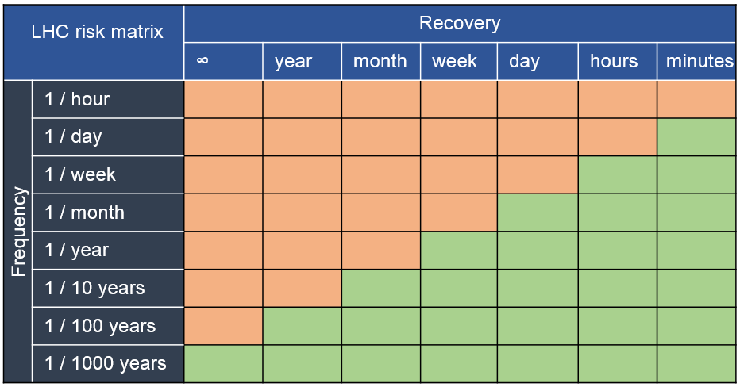
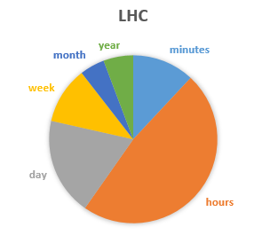
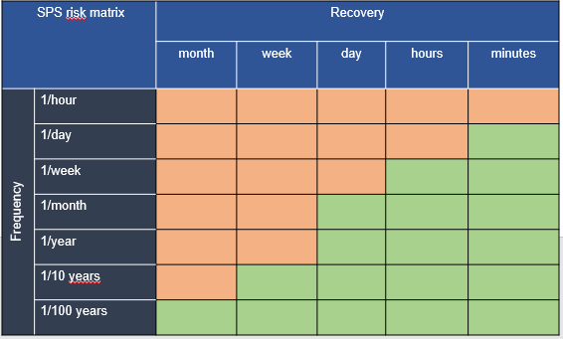
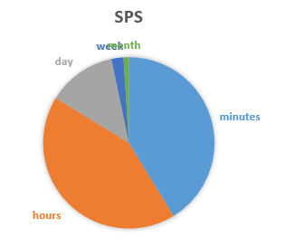
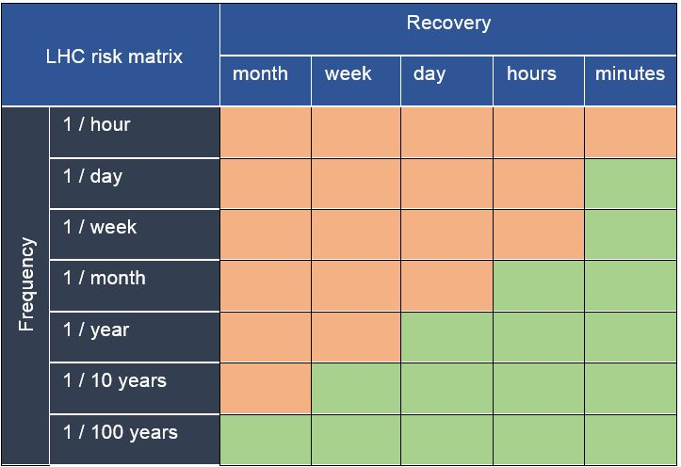
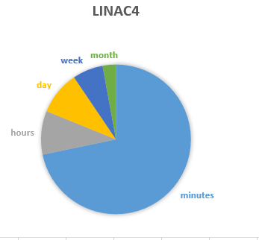
Different machines
Availability 82.56 %
Availability 91.59 %
PSB – PS: Availability: 94.79 %
LINAC4
Availability 97.1 %

Slide 6
How to use the Risk Matrices
Reliability Studies
  Identify the down time of the different failure modes and place them in the Matrix
  Gives system requirements
Engineering Change Request (ECR) implementation
  5.3 R2E Impact on performance and availability
  Linked to R2E Radiation Hardness Assurance (RHA) validation doc
  In RHA Project Validation (RHAPV) document section on CRITICALITY → Introduce Risk Matrix
  Provide quantitative requirements
In Engineering Specification …

Slide 7
Spare Slides
Detailed matrices

Slide 8
LHC
LHC Matrix |  |  |  | order | order | Recovery in seconds | downtime/year seconds
 |  | # seconds | # occurrences | Recovery | seconds
 | 1/hour | 3600 | 4800
 | 1/day | 86400 | 400 | minutes | 60 | 15 | 360000
 | 1/week | 604800 | 200 | hours | 3600 | 2 | 1440000
 | 1/month | 2635200 | 7 | day | 86400 | 1 | 566557
 | 1/year | 31622400 | 1 | week | 604800 | 1 | 330492
 | 1/10 years | 316224000 | 0.0546 | month | 2635200 | 1 | 144000
 | 1/100 years | 3162240000 | 0.0055 | year | 31622400 | 1 | 172800
 | 1/1000 years | 31622400000 | 0.0005 | - |  | -
 | In seconds | 17280000 | seconds |  |  | Total | 3013849 | seconds
 | In seconds | 17280000
 |  | 200 | days in year |  |  | Availability | 82.56 | %

Slide 9
SPS
SPS Matrix |  |  |  | order | order | number | downtime/year seconds
 |  | # seconds | # occurrences | Recovery | seconds | 5
 | 1/hour | 3600 | 4800
 | 1/day | 86400 | 2000 | minutes | 60 | 5 | 600000
 | 1/week | 604800 | 86 | hours | 3600 | 2 | 617143
 | 1/month | 2635200 | 2 | day | 86400 | 1 | 188852
 | 1/year | 31622400 | 1
 | 1/10 years | 316224000 | 0.0546 | week | 604800 | 1 | 33049
 | 1/100 years | 3162240000 | 0.0055 | month | 2635200 | 1 | 14400
 | 1/1000 years | 31622400000 | 0.0005
 | In seconds | 17280000 | seconds |  |  | Total | 1453444 | seconds
 | In seconds | 17280000
 |  | 200 | days in year |  |  | Availability | 91.59 | %

Slide 10
PSB and PS
PSB/PS |  |  |  | order | order | number | downtime/year seconds
 |  | # seconds | # occurrences | Recovery | seconds | 5
 | 1/hour | 3600
 | 1/day | 86400 | 2000 | minutes | 60 | 5 | 600000 |  | 5 minutes stop, 10 times per day
 | 1/week | 604800 | 29 | hours | 3600 | 2 | 205714 |  | Main difference with LINAC4
 | 1/month | 2635200
 | 1/year | 31622400 | 1 | day | 86400 | 1 | 47213
 | 1/10 years | 316224000 | 0.0546 | week | 604800 | 1 | 33049
 | 1/100 years | 3162240000 | 0.0055 | month | 2635200 | 1 | 14400
 | 1/1000 years | 31622400000 | 0.0005
 | In seconds | 17280000 | seconds |  |  | Total | 900377 | seconds
 | In seconds | 17280000
 |  | 200 | days in year |  |  | Availability | 94.79 | %

Slide 11
LINAC4
LINAC4 |  |  |  | order | order | number | downtime/year seconds
 |  | # seconds | # occurrences | Recovery | seconds | 5
 | 1/hour | 3600
 | 1/day | 86400 | 1200 | minutes | 60 | 5 | 360000 |  | 5 minutes stop, 6 times per day
 | 1/week | 604800
 | 1/month | 2635200 | 7 | hours | 3600 | 2 | 47213
 | 1/year | 31622400 | 1 | day | 86400 | 1 | 47213
 | 1/10 years | 316224000 | 0.0546 | week | 604800 | 1 | 33049
 | 1/100 years | 3162240000 | 0.0055 | month | 2635200 | 1 | 14400
 | 1/1000 years | 31622400000 | 0.0005
 | In seconds | 17280000 | seconds |  |  | Total | 501875 | seconds
 | In seconds | 17280000
 |  | 200 | days in year |  |  | Availability | 97.10 | %

