Slide 2
LHC Injectors Upgrade Workshop
Montreux, 13-15 February 2019

Slide 3
Timeline and Requirements for Beam Commissioning in the PSB
Gian Piero Di Giovanni on behalf of the PSB Beam Commissioning WG

Slide 4
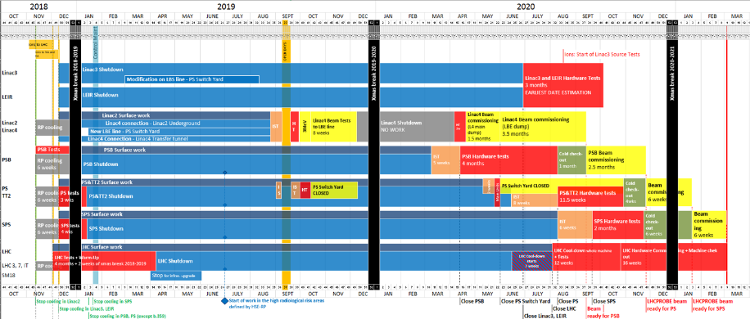
LS2 Master Schedule
Originally the time allocated for the production of the LHCPROBE beam was 2.5 months (PSB-OTH-NOT-0002).
Reviewed the process and timeline for the PSB beam commissioning to fit more steps in the allocated timeframe.
we are here
Notes:
Add from where the decision RLIUP 2013

Slide 5
PSB Layout
The PSB is composed by 4 superposed rings:
  CONS: Even though each ring is identical to the others in design, the commissioning of one ring does not
  necessarily result in the commissioning of the remaining rings. We still do have to work to iron out
  ring-specific issues.
  PROS: Flexibility which allows experts to work in parallel to sort out common or ring-specific issues without
  interfering with each other.
Beam paths in the distributor BI.DIS (left) and at BI.SMV10 and BI.BVT10 (right)

Slide 6
Initial Beam Commissioning
For the initial part of the commissioning we plan to use a low intensity beam with an intensity of 5E9-1E10 protons.
Assuming a current of 25 mA after the RFQ and a chopping factor of 65%, the beam intensity per PSB turn is
about 1E11 protons.
After discussing with BE-BI, the instrumentation should work with a bunch length as short as 150 ns, but the
intensity may still be too high for the initial phase.
A proposal is to also modify the LEBT-MEBT settings and reduce the current in the Linac4. While this is not a
solution which can be implemented in PPM (e.g. for the future PROBE/INDIV production), it would still be possible
to run with this configuration until the PSB is ready to increase the intensity.
After discussion with ABP experts, it may be possible to achieve a Linac4 current reduction factor for the future PROBE/INDIV production in ppm by tuning MEBT only → This still has to be shown during the LBE line run.

Slide 7
Pre-requisites
Linac4 beam fully characterized with the LBE run and conform to specifications at PSB injection (EDMS 1898179).
Full L4-to-PSB connection and hardware commissioning (e.g POPS-B, new RF system, …) performed.
The control infrastructure, CCC-OP and experts applications ready.
Machine checkout lists and logging ready.
New 160 MeV → 1.4 and 2.0 GeV magnetic cycle ready.
Optics models ready and available to the commissioning team.
Constant support by all the specialists involved.
Interlock systems ready and tested before first beam injection from Linac4:
  General for machine protection: Elements connected to the BIC can differ between operational state and “special” conditions (commissioning tasks, users not ready).
    We will have to handle exceptions, justifying any possible masking and documenting to avoid forgetting them.
    Plan to document inputs from all user. In any case users must be ready to provide inputs during this phase.

Slide 8
First Injection
Synchronise, steer and centre the beam on the H⁰/H⁻ dump monitor
2 weeks
Time: 1 week for ring 3 and 1 week to commission the other 3 rings
Activity | Related tasks | Tool requirements | Remarks | Groups
Interlock | Check functionalities | BIS, SIS, EC |  | OP
Steering L4T-LT-LTB-BI line | Synchronisation of equipment (e.g. distributor timings) with OASIS Kick response Check instrumentation (BTVs, SLITs, BPMs, BCTs, BLMs) | OASIS, Trajectory application, YASP, BI-related apps, L4 Cruise control | Critical task to ensure proper synchronisation of all equipment in the BI line and at PSB injection | ABT, BI, OP
Steering at PSB injection | No foil at PSB injection, using screens (BIS masked) Centre beam at BTV at the Stripping Foil position (BTV) and then H⁰/H⁻ dump, powering the BSW for injection chicane Calibrate H⁰/H⁻ monitor | OASIS, YASP 1st turn in PSB,BI-related apps | New Injection Schema in the PSB. Principle successfully tested with HST, but no painting, vertical beta-beating | ABP, ABT, BI, OP
Notes:
For H0/H- should we

Slide 9
First Turn and Closed Orbit (I)
Establish first turns and closed orbit, closure injection/painting bumps, capture beam
2 weeks | 4 weeks
Activity | Related tasks | Tool requirements | Remarks | Groups
Insert Stripping Foil | Continuous monitor of stripping efficiency + Injection watchdog | Stripping Foil, BCTs in PSB |  | ABT, OP
Injection oscillation minimisation | For RF setting up, the beam has to be able to circulate a few turns w/o losses (YASP+TbT BPMs) Commissioning IC and Diamond BLMs | OASIS, YASP, BI-related apps | RF will turn on as soon as beam present in the machine to start checking basic signals. | ABP, ABT, OP
Bunch-to-bucket capture | Working in H1 with nominal 2 GeV cycle Commission injection synchronisation. Energy matching Phasing of the cavities with beam. Close the phase loop and adjust azimuth delay between the phase BPM and the RF | Tomoscope, LLRF | New process in the PSB. Adiabatic capture as temporary backup. | OP, RF
Notes:
For H0/H- should we

Slide 10
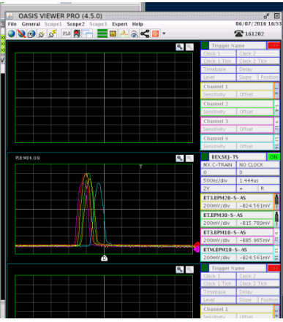
First Turn and Closed Orbit (II)
Establish first turns and closed orbit, closure injection/painting bumps, capture beam
2 weeks | 4 weeks
Activity | Related tasks | Tool requirements | Remarks | Groups
Chicane and painting bump closure | The beam has to be able to circulate for at least 5 ms (decay time BSW). Leakage targeted ± 0.5 mm | KSW functions for painting, OASIS for synchronization, BI-related apps, BCTs, YASP | First time the new injection schema in the PSB will be tested with all its complexity. | ABP, ABT, OP
Reference Orbit | Defined at the end of the chicane bump collapse, i.e. needed at least 6-7 ms | Same as above |  | ABP, ABT, OP
Optional: BT-BTM setting up | Advance extraction kicker time. Set up the recombination/extraction lines to the dump (check BPMs, BLMs, BCTs, KR, steering). Rescale by rigidity for 1.4/2.0 GeV. | Kicker FESA class, YASP, extr. traj. apps, equip. apps. |  | ABT, BI, OP
160 MeV extraction to beam dump–
V. Forte, G.P. Di Giovanni, B. Mikulec
MSWG 08/07/2016

Slide 11
First Turn and Closed Orbit: Optics Measurements
2 weeks | 4 weeks
Verify the beta beating at injection, correct it and optimise the injection
Because of the new PSB injection chicane, the beam will suffer a large vertical beta-beating of the order
of 20-40%, depending on the vertical tune.
Methodology for optics measurement (phase and/or amplitude methods) and performance of the new
Q-STRIP power converters tested in 2018.
At this point in time the tune measurement will be a crucial tool (tune BPM).
This will be the time to start commissioning the matching monitor (SEM grid) in ring3.
  New extraction kicker functionality to be able to reliably extract the beam after max 100 turns.
  Plan to follow as a guideline the work done in the PS in 2018.
Time: 1 week (included in the ‘first turn and closed orbit’ phase)

Slide 12
Accelerate and Extract
Accelerate to 2 GeV the captured beam and extract it to the PSB dump
2 weeks | 4 weeks | 3 weeks | 2 weeks
Activity | Related tasks | Remarks | Groups
RF commissioning Step 1 | Exploiting Finemet, MPS (POPS-B), B-Train full performance No Radial loop needed for small intensity beams Commissioning of synchronisation loop Longitudinal blow-up Intensity regulation with INDIV-like beam Cycle optimization | If the machine is properly set, we should be able to accelerate up to flat top a small intensity beam (LHCINDIV like) with all loops open. | OP, RF
Transverse optimisation | Kick response, initial orbit correction, alignment checks, loss minimization, TFB basic checks | Check alignment and propose correction. Limit dose radiation to survey team w/o blocking PS beam commissioning. | ABP, BI, OP, RF
BT-BTM, if not done before | Kick response, BI checks, etc, etc |  | ABT, BI, OP

Slide 13
Ramp up the Intensity
Beam with intermediate intensity and depending on beam priorities
2 weeks | 4 weeks | 3 weeks | 2 weeks
Activity | Related tasks | Tool requirements | Remarks | Groups
RF Commissioning Step 2 | Servo all un-used harmonics. Radial loop commissioning. Commissioning of H2. Same steps as for H1 to be repeated for H2. Check induced voltage in the cavities Cycle optimization, matching specs | Tomoscope, LLRF, OASIS | MTE beam produced as of today. In case of delays in commissioning H2, PS could still receive a medium intensity in H1 for PS/SPS initial commissioning. Positive tests carried out in 2018. | OP, RF
Transverse plane | Resonance compensation, tune optimization, transverse emittance, tune variation, TFB, minimise losses, etc, etc | WS, Q-Meter, TFB, TbT BPMs | This is the time when we start tightening up on the beam specifications, working to match the final specifications of the beams. | ABP, OP
Stripping Foil | Monitor heating, performance as the # of turns increases, tighten interlock. |  |  | ABT, OP

Slide 14
Beam Requests from Downstream Injectors
PS Current Requests:
  TOF ~5e12, and LHCINDIV for 1st checks, then 14 GeV MTE for alignment (at least 1E12 ppp).
  MTE higher intensity for 200 MHz blow-up (1E13 ppp).
  Later EAST, AD, nTOF and multi-bunch LHC beams.
SPS Current Requests:
  LHCINDIV with an intensity 1E11 ppb. The higher-than-expected bunch intensity from LHCPROBE is needed for setting the SPS RF system.
  Low intensity fixed target beam, SFTPRO, with an intensity of 5E11 ppp for aperture measurements.
  Low intensity fix target beam, SFTPRO, with an intensity of 2E12 ppp for beam-based alignment.
  Multi-bunch LHC-type beam. To be decided if LHC25 or BCMS25.

Slide 15
ISOLDE Beam Request
Information from J. Alberto and R. Catherall
“ISOLDE will work in stand-alone mode with stable beam as from summer 2020. This does not require protons.
We will just work with our own self-produced beams of stable isotopes.”
“For the start up in 2021, we are flexible. We have ear-marked April 2021 after having different conversations
with different people. However, we are flexible. If you say that protons are available earlier then let us know and
we will make ourselves ready (but not too early).”
Proposal to target ISOLDE beam for end March 2021.
Expected 1 week of commissioning of BTY line: Steering, KR, BI equipment, YASP/optics BTY commissioning, centring at the SEM grid (currently we allocate 3 days).

Slide 16
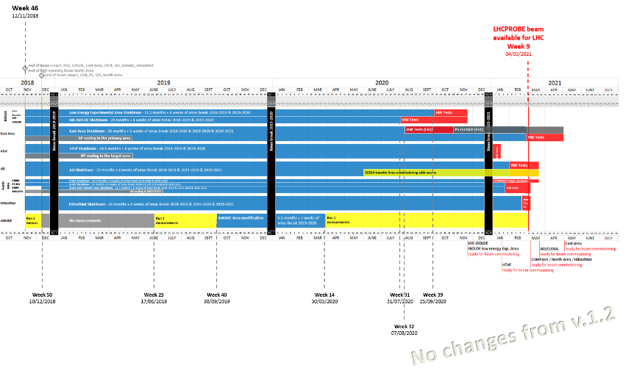
LS2 Master Schedule
Fixed-target physics schedule.
Keeping this in mind, here it is a first proposal for a PSB delivery schedule for the different beams.

Slide 17

PSB Beam Delivery Schedule
LHCPROBE/INDIV ready: ≥ 1 ring
TOF @ 200-400E10 ppb
TOF intensity increasing with time

Slide 18
PSB Beam Delivery Schedule
LHC Multi-bunch by end December

Slide 19
PSB Beam Delivery Schedule
AD ready

Slide 20
PSB Beam Delivery Schedule
MTE @ 1E12 ppp (H2 or H1)
for PS commissioning, BB align

Slide 21
PSB Beam Delivery Schedule
MTE @ 1E13 ppp (H2 or H1)
For PS commissioning, 200 MHz BU

Slide 22
PSB Beam Delivery Schedule
MTE @ 2E13 ppp (H2)

Slide 23
PSB Beam Delivery Schedule in a Glance
Date | Beams Milestone | Comment
End Nov. 2020 (Week 48) | LHCPROBE/INDIV, at least one ring TOF @ 200-400E10 ppb MTE @ 1E12 ppp. | TOF intensity increasing with time. MTE in H2 (H1 as a backup).
Beg. Dec. 2020 (Week 50) | MTE @ 1E13 ppp. | MTE in H2 (H1 as a backup)
Mid. Dec. 2020 (Week 51) | LHC Multi-bunch
End Jan. 2021 (Week 5) | AD
Mid. Feb. 2021 (Week 7) | MTE @ 2E13 ppp.
End Mar. 2021 (Week 13) | ISOLDE
The production of other beams will follow, for instance EAST is expected by beginning of May (week 18).
We should be able to match expectations for delivery.

Slide 24
Not Explicitly Discussed
BTP line commissioning:
  To start as soon as beam can be sent downstream to the PS.
  Assuming the BT line is commissioned, the BTP line should come quickly.
  Usual commissioning steps: Kick response, BI commissioning, steering.
  Need for new optics model for PSB-PS-1st-turn-PS in YASP.
Longitudinal painting:
  Not mandatory in the LIU baseline.
  Additional setting-up time needed for longitudinal painting, ~weeks.
  Application needed to master chopping pattern, debuncher phase, PIMS voltage at the same time.
  The maximum Linac4 energy modulation amplitude is ±0.8 MeV (from PIMS) and the energy spread (from
  Linac4 debuncher) is 120 keV rms
  Studies to be done to evaluate impact on high-intensity beams.
  Many details still to be defined. Much more will be learned thanks to the LBE run end 2019 and the
  2020 Linac4 commissioning to LBE.

Slide 25
Summary
Presented a first glance at the PSB beam commissioning.
Several details, including new requests, still to be defined and which could impact the commissioning time.
New equipment and instrumentation to be commissioned. LS2 will be crucial to prepare all tools and gather inputs from all experts.
Every beam must have a nominal production scheme prepared in advance
‘Hot restart’ of the PSB machine in 2020 after the winter break especially to support the PS commissioning.
Gathering all information and updating the EDMS document PSB-OTH-NOT-0002

Slide 27
Main OP Applications Needed for Operations
Applications | Tasks
Tomoscope and BSM | Longitudinal characterization
Wirescanner/SEM | Transverse characterization
OASIS | Raw signals and beam synchronization (timings)
Q-meter | Tune and chromaticity
BLMs | Interlock and aperture checks, diamond BLMs at injection
Injection/ejection trajectory monitor | Check the status of the BPMs in the injection/ejection lines
YASP/TbT Orbit | Fundamental for injection/ejection trajectory and oscillations optimization, orbit
Cruise Control | Substitutes the OP display integrating info about chopping patterns, injection timings, KSW functions for painting, monitor/reset injection BLMs, longitudinal painting
Equipment specific applications | H⁰/H⁻ monitor, BTV, Stripping foil current

Slide 28
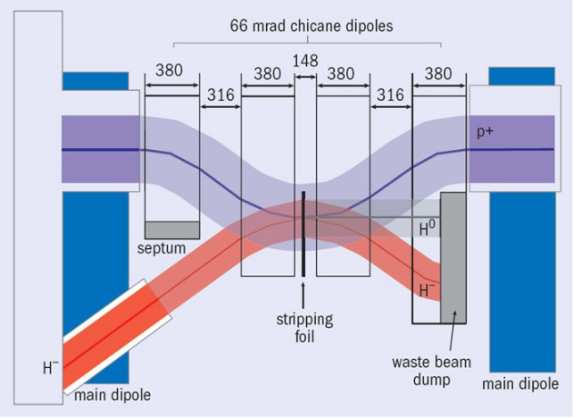
New PSB Injection Schema

Slide 29
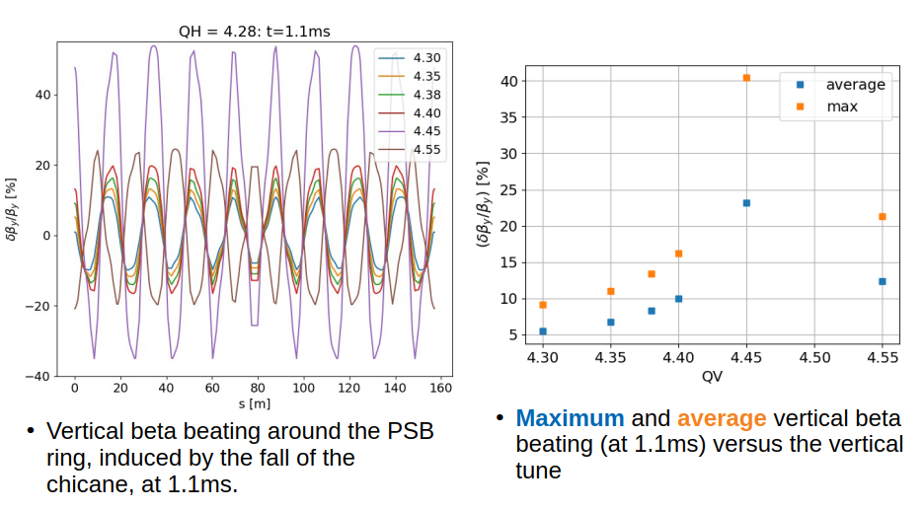
Expected Vertical Beta Beating
F. Antoniou, see https://indico.cern.ch/event/787707/

Slide 30
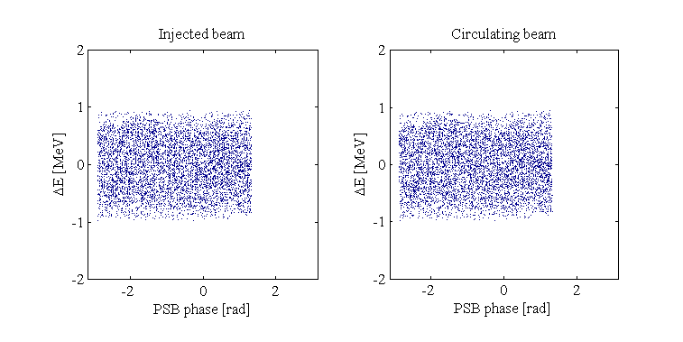
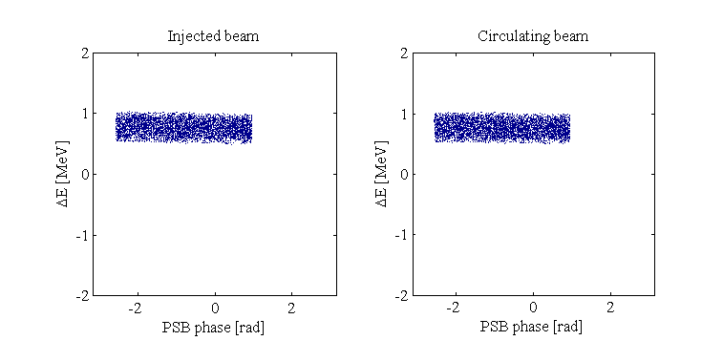
Longitudinal Painting (V. Forte’s Simulations)
Multi-turn un-modulated energy injection
  The L4 bunch trains arrive to the PSB with the same central energy E₀ = 160 MeV
  The rms energy spread δE is usually large (~400-450 keV) to compensate peaks of line density
  → bad for space charge
  The chopping factor is fixed (~60%)
Multi-turn longitudinal painting
  The L4 bunch trains arrive to the PSB with different (turn-by-turn) central energy around E₀ = 160 MeV
  The rms energy spread δE is fixed (120-250 keV)
  The chopping factor is varying to follow the longitudinal iso-Hamiltonian contours for a given longitudinal emittance.
Longitudinal painting requirements and optimization
Vincenzo Forte, Chiara Bracco - TE/ABT/BTP
Elena Benedetto – BE/ABP/HSI

Slide 31
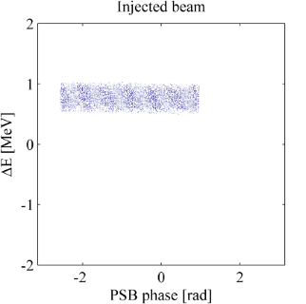
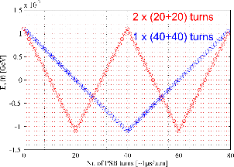
Longitudinal Painting (V. Forte’s Simulations)
The rms energy spread δE
  Imposed by the de-buncher
  Fixed during the injection process
The central energy E₀(t)
  Imposed by the last two PIMS
  Can be swept turn-by-turn at injection
The central energy sweeping rate dE₀(t)/dt
  Imposed by the last two PIMS → change of phase and, thus, power requested to the de-buncher
E₀(t)
δE
2π ⋅ chopping factor
The chopping factor (≤1)
  Imposed by the chopper
  Rations the effective current/turn at the PSB entrance
    I_{eff}(t) = chop. factor × unchopped current = chop. factor × 40 mA
  Can be modulated turn-by-turn at injection
  Determines the number of turns to be injected for any given target intensity
The number of injectable turns
  Is limited by the BI.DIS at <150 per PSB ring
A possible energy sweep through the PIMS
Longitudinal painting requirements and optimization
Vincenzo Forte, Chiara Bracco - TE/ABT/BTP
Elena Benedetto – BE/ABP/HSI

Slide 32
Slide title
First level
  Second level
    Third level
      Fourth level
        Fifth level

Slide 33
Beam commissioning time line I
Milestone 1
Milestone 2
2 weeks | 4 weeks | 1 week | 3 weeks | 2 weeks
Activity | Related tasks | Tool requirements | Risks | Remarks | Estimated duration

Slide 34
Beam commissioning time line I
Milestone 1
Milestone 2
Week 1 | Week 2 | Week 3 | Week 4 | Week 5 | Week 6
Activity | Related tasks | Tool requirements | Risks | Remarks | Estimated duration

Slide 35
Beam commissioning time line II
Milestone 3
Milestone 4
Week 1 | Week 2 | Week 3 | Week 4 | Week 5 | Week 6
Activity | Related tasks | Tool requirements | Risks | Remarks | Estimated duration
 | deded

