Slide 2
LHC Injectors Upgrade Workshop
Montreux, 13-15 February 2019

Slide 3
PS Beam Commissioning Schedule
Frank Tecker, BE-OP
Many thanks to
D.Cotte, H. Damerau, M.Delrieux, O.Hans, A.Huschauer

Slide 4
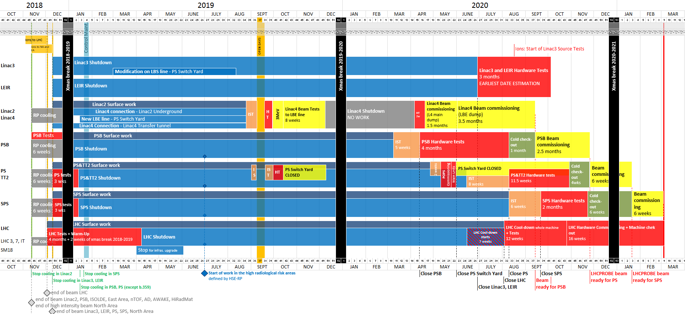
LS2 Master Schedule
6 weeks foreseen for standalone PS beam commissioning
Interrupted by 2 weeks Christmas shutdown !!!
  Keep services running (CO, water, etc.) => need piquet services
  No lock-out
  Access system by TI
  People’s holidays
=> effective 4.5-5 weeks!
Fast restart examples
  2010 AMS run
  2013 Jan restart

Slide 5
Beams required
SPS (from week 3/2021) (from K.Li’s presentation)
  LHCIndiv (1.2e11)
  MTE low intensity (core only, 5e11, 2µs) after 2 days
  MTE low int (5e12, 10µs) after 1 week
  LHCProbe after 2 weeks
  MTE full beam after 3 weeks
  Multi-bunch beams (12b, 24, 36, 48, 72) after 4 weeks
    Standard 25ns or BCMS (not big difference for the PS RF)
NTOF from week 3/2021 (new target, assume intensity ramp-up later)
AD from week 12/2021 (RF side should follow other beams)
EAST from week 18/2021

Slide 6
Assumptions / Prerequisites
Hardware tests/Cold checkout finished, all possible tests without beam done
  New injection equipment (polarity,…)
  BPM alignment offsets after main unit renovation
  new RF beam control validated without beam, existing one prepared for beam, 10 MHz cavity phasing
  Interlocks (new internal dump, interlock when in chamber to PSB extraction BIC + SIS interlock, interlock from BCT (TOF parasitic beam on EAST not extracted), BLM,…)
  External conditions (will have been renovated), some will have to be done when EIS are working
  Optics definitions, YASP configuration
  Magnetic checks of PFW circuits foreseen
Injection line PSB->PS commissioned up to BT dump
  known Twiss parameters
  BTP line magnets polarity checks, HW tests done
2 GeV injection cycles prepared (had a first check for RF already)
  Shorter ramp time needed (~30 ms less)
  POPS regulation should allow first ramp up modification
Plan in DSO tests for SPS, TOF, (AD, EAST later), …

Slide 7
Beam commissioning time line I - Injection
Circulating low intensity beam (TOF-like or LHCIndiv)
Week 1 | Week 2 | Week 3 | Week 4 | Week 5 | Week 6
Activity | Related tasks | Tool requirements | Risks | Remarks | Estimated duration
Safety chain tests |  |  |  |  | 1 day
Interlock tests | Ext. conditions, SIS |  | New equipment | Ext. conditions renovated | ½ day
BTP line | BPM setup Kick response | YASP |  | - 30m, 6 quadrupoles - BPM should be like BT line | 2 days
BPM commissioning | First turn, orbit |  |  |  | 1 day
Injection | Bump setup | YASP, bump closure (MatLab) | New equipment | - Delay and amplitude optimization - Synchronization studies - To be redone after main magnet alignment | 2 days

Slide 8
Beam commissioning time line I (cont.)
Circulating low intensity beam (TOF-like or LHCIndiv)
Week 1 | Week 2 | Week 3 | Week 4 | Week 5 | Week 6
Activity | Related tasks | Tool requirements | Risks | Remarks | Estimated duration
LE orbit, optics | kick response | YASP |  |  | 1 day
Multi-turn SEM grid | Ralentisseur verification with beam | Analysis tool (to be (re-) developed) | New equipment 1st prototype successfully tested, 2 more to be commissioned | - Dedicated time, circulating beam <~30 turns - Essential for injection matching - Time for analysis needed - Maybe several iterations | Interleaved with other tasks 2-3 days (+2 days)
BLM system | Interlock | VISTAR (new) |  | Works well in the PS ring, higher bandwidth, sensitivity, and no saturation | 1 day
MTV |  |  |  | According to progress of beam | In parallel

Slide 9
Beam commissioning time line I (cont.)
Circulating low intensity beam (TOF-like or LHCIndiv)
Week 1 | Week 2 | Week 3 | Week 4 | Week 5 | Week 6
Activity | Related tasks | Tool requirements | Risks | Remarks | Estimated duration
RF capture, radial loop | Phase loop lock before injection |  | New equipment | - New RF beam control from the start - Old system kept as much as possible as backup, PPM switch possible - with RF experts | 1-2 days
Transverse feedback setup | Optimize damping time of injection oscillations | Analysis scripts | New digital control (similar to PSB) and power amplifier | - Standard HW-check verification of knob, functions (gain, tune offset), BPM attenuation and gain procedure, kicker response - Commissioning with expert - Essential for MTE and LHC beams | 1-3 days per beam, in parallel with other activities

Slide 10
Beam commissioning time line II – 14 GeV orbit
Single bunch beam to 14/26 GeV
Week 1 | Week 2 | Week 3 | Week 4 | Week 5 | Week 6
Activity | Related tasks | Tool requirements | Risks | Remarks | Estimated duration
Transition crossing |  |  |  | RF experts | 1 day
Acceleration to 14/26 GeV |  |  |  | RF experts | 1 day
Orbit check at 14 GeV for main unit alignment |  | Analysis framework | 40 MU refurbished | - Most critical for MTE beam at dummy septum 15 / septum 16 - Consider local orbit when calculating correction - Could require another iteration of main magnet movements | 3 days (+2/3 days)
Internal dump | interlocks |  | New equipment |  | In parallel
K-modulation at low energy |  | Analysis script |  | Low energy quads polarity and optics check | 1 day in parallel

Slide 11
Beam commissioning time line II
Single bunch beam to 14/26 GeV
Week 1 | Week 2 | Week 3 | Week 4 | Week 5 | Week 6
Activity | Related tasks | Tool requirements | Risks | Remarks | Estimated duration
Wire scanners |  |  | New equipment | - Extensive cross-checks done for 54H - Commissioning with BI experts | 10 days in parallel
BGI | H/V BGI magnet effect on orbit | Application | New equipment | - with experts - Non-critical | ? in parallel
TT2 extraction | - Shadowing TPS15/SMH16 - Bumper optimization - QKE16 (except MTE) | Diamond BLMs | Bumper new equipment | - Final setup for all other beams after MTE shadowing | 2-3 days
TT2 setup | Kick response | YASP, BPMs |  |  | 1 day
 | Twiss parameters | SEM grids |  |  | 1 day
TOF -> D3 dump

Slide 12
Beam commissioning time line III
Christmas shutdown
Week 1 | Week 2 | Week 3 | Week 4 | Week 5 | Week 6
Activity | Related tasks | Tool requirements | Risks | Remarks | Estimated duration
200 MHz setup |  |  | New system (old as backup) | - Blowup for high-intensity beams - 8e12 needed - At least 2 days for cavity setup | 5 days
Start MTE core/islands | Synchronisation MTE kickers KFA4/9/13/21 | Q-meter Wire scanner |  | TFB excitation mode setup
Make machine safe for Xmas shutdown |  |  |  |  | 1 day

Slide 13
Beam commissioning time line IV
LHCIndiv/probe and TOF ready
Week 1 | Week 2 | Week 3 | Week 4 | Week 5 | Week 6
Activity | Related tasks | Tool requirements | Risks | Remarks | Estimated duration
Restart and recover previous commissioning state |  |  |  | - Piquet and equipment experts need to be available | 2-3 days
Finalize LHCIndiv, LHCprobe and TOF | Bunch rotation 40/80 MHz cavities |  | New controller | RF expert needed | 1 day
Continue MTE setup | TT2 trajectories by turns |  |  |  | 1 day
BLM thresholds |  |  |  | For higher intensity beam | In parallel

Slide 14
Beam commissioning time line V
MTE ready
Week 1 | Week 2 | Week 3 | Week 4 | Week 5 | Week 6
Activity | Related tasks | Tool requirements | Risks | Remarks | Estimated duration
Start multi-bunch LHC setup | 20 MHz 40/80 MHz cavities |  | New controller | RF expert needed | 2-3 days
 | 10 MHz 1-turn delay feed-back |  |  | For multi-bunch | 2 days

Slide 15
Non-standalone commissioning – beam for SPS/nToF
LHCIndiv
MTE low int.
LHCProbe
MTE full int.
LHC multi-bunch
Week 7 | Week 8 | Week 9 | Week 10 | Week 11 | Week 12
MTE core to SPS
Activity | Related tasks | Tool requirements | Risks | Remarks | Estimated duration
Finalize MTE setup | Loss optimization |  | - Intensity limit - Many systems | 2e13 higher than 2018 operation | ?
Finalize multi-bunch LHC beam | RF splitting |  |  | 12, 24, 36, 48, 56, 72 bunches 25ns, BCMS Priorities/order to be detailed

Slide 16
Remarks
Equipment groups work mainly during daytime, it would be essential to have the beam commissioning coordinators also on normal working hours (at least during the first 6 weeks of the start-up).
This would improve communication and would help everybody to keep up with planning changes according to the technical progress
Expert availability needs to be arranged shared with other machines
More time needed between TOF/EAST beam permits and physics start!
  Had delays on the experimental zone readiness this year -> delayed beam permit
Reference magnet
  measurement system dis-/reassembled
  Setup with eddy current compensation card in reference magnet (was not present this year)

Slide 17
Conclusion
Hardware commissioning progress very important
Christmas shutdown needs to be incorporated as well as possible
  Reduces effective time
A lot of new essential equipment / instrumentation needs to be commissioned
  RF beam control
  Transverse feedback
  bumpers
  Wire scanners, BGI
  Multi-turn SEM grids
  Internal dumps, ralentisseur, external conditions
Should be able to get the required beams ready in time for the SPS
if there are no major hiccups

