Slide 2
LHC Injectors Upgrade Workshop
Montreux, 13-15 February 2019

Slide 3
SPS Post-LS2 Beam Commissioning
Kevin Li,…

Slide 4
Overview with reference to other talks

Slide 5
SPS Post-LS2 recommissioning
During LS2 the SPS will have undergone a major upgrade to satisfy the LIU requirements – most of the new systems will have never seen beam before
Key systems upgrades
  New orbit system (ALPS)
  New internal beam dump in LSS1 (SBDS)
  New injection interlock system, beam dump in BIS loop + modified behavior
  RF power upgrade
    4 → 4 + 2 new cavities: re-partitioning of cavities (4 x 3 + 2 x 4 sections)
    Entirely re-engineered LLRF system based on state-of the-art technology (digital system, uTCA)
Recommissioning will be driven by these new systems (in particular RF) and needs to be modified from the classical OP way

Slide 6
SPS Post-LS2 recommissioning
During LS2 the SPS will have undergone a major upgrade to satisfy the LIU requirements – most of the new systems will have never seen beam before
Key systems upgrades
  New orbit system (ALPS)
  New internal beam dump in LSS1 (SBDS)
  New injection interlock system, beam dump in BIS loop + modified behavior
  RF power upgrade
    4 → 4 + 2 new cavities: re-partitioning of cavities (4 x 3 + 2 x 4 sections)
    Entirely re-engineered LLRF system based on state-of the-art technology (digital system, uTCA)
Recommissioning will be driven by these new systems (in particular RF) and needs to be modified from the classical OP way
But: many other upgrades in addition:
  New access system
  New wire scanners
  New BLM software – different
  BCTs at different locations
  Switch to FGC instead of MUGEF for corrector circuits and circuits powered from SR2 and SR8: plus new interlocking implementation
  ...

Slide 7
Commissioning – pre-requisites
Tight beam commissioning schedule (next slide) → all prerequisites have had to be identified and sorted out in time to guarantee readiness of all systems for beam commissioning
  Revised structure of LIU to cope with new requirements → LIU-SPS topics followed up in TC/BHC/BD Meetings
Some key prerequisites:
  Hardware readiness of all systems
  All systems fully integrated and tested in the controls environment
    FESA classes
    Settings: paramters, value generators, make rules
  Tools and applications ready and tested during dry-runs and checkout
  All systems successfully commissioned and tested without beam
  Operational scenarios tested during dry-runs and checkout
  Magnetic cycles prepared and ready in the SPS: LHCINDIV, MD26_Q26, MTE_APERTURE
  Pre-injectors ready to deliver LHCINDIV (~1.2e11 nominal ) and MTE @5e11 (2 – 8 us batch length)
See J. Ridewood’s talk

Slide 8
Commissioning – pre-requisites
Tight beam commissioning schedule (next slide) → all prerequisites have had to be identified and sorted out in time to guarantee readiness of all systems for beam commissioning
  Revised structure of LIU to cope with new requirements → LIU-SPS topics followed up in TC/BHC/BD Meetings
Some key prerequisites:
  Hardware readiness of all systems
  All systems fully integrated and tested in the controls environment
    FESA classes
    Settings: paramters, value generators, make rules
  Tools and applications ready and tested during dry-runs and checkout
  All systems successfully commissioned and tested without beam
  Operational scenarios tested during dry-runs and checkout
  Magnetic cycles prepared and ready in the SPS: LHCINDIV, MD26_Q26, MTE_APERTURE
  Pre-injectors ready to deliver LHCINDIV (~1.2e11 nominal ) and MTE @5e11 (2 – 8 us batch length)
  Crucial to have constant support by all the specialists involved!
See J. Ridewood’s talk

Slide 9
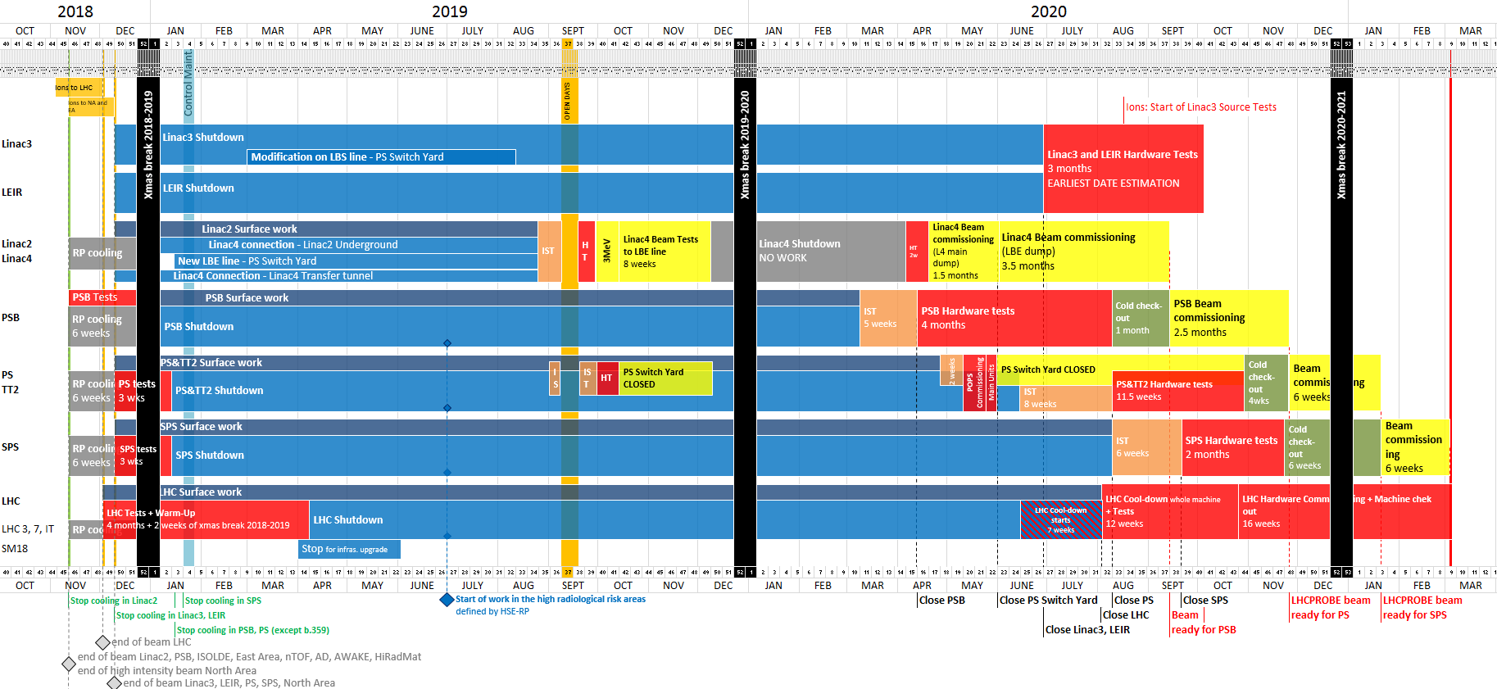
Schedule master plan to date
LHCPROBE beam
available for LHC
Week 9
04/03/2021
Allocated ~6 weeks for SPS beam commissioning: week 3 – week 9
we are here

Slide 10
Schedule master plan to date
LHCPROBE beam
available for LHC
Week 9
04/03/2021
Allocated ~6 weeks for SPS beam commissioning: week 3 – week 9
  Strongly recommend to start in week 3 – on Monday:
  2 fundamental systems to commission with beam:
    Orbit system ALPS → establish circulating beam
    LLRF system → establish first capture
  Establishing first capture could easily take 1 week
  → start commissioning on Friday ≡ no OP work in first weekend
we are here

Slide 11
Commissioning – considerations
We are in the process of aligning and synchronizing activities, resolving dependencies and adjusting procedures where necessary
Cross-injector coordination crucial
  For beam readiness
  For expert availability: e.g. several of SPS RF experts work for LINAC4, SPS and LHC
  Prioritization required - at least during hardware and beam commissioning period
Auxiliary tools: Improved ASM and commissioning check lists need to be ready middle of 2020 (for SPS case) to align with prerequisites from hardware commissioning

Slide 12
Commissioning – considerations
We are in the process of aligning and synchronizing activities, resolving dependencies and adjusting procedures where necessary
Cross-injector coordination crucial
  For beam readiness
  For expert availability: e.g. several of SPS RF experts work for LINAC4, SPS and LHC
  Prioritization required - at least during hardware and beam commissioning period
Auxiliary tools: Improved ASM and commissioning check lists need to be ready middle of 2020 (for SPS case) to align with prerequisites from hardware commissioning
Further develop useful algorithms, new concepts, tools and procedures –
examples from 2018 run:
  Deployment of COSE for SFTPRO
  LHC cycle setup entirely based on LHCINDIV (cannot measure tunes with multi-bunch)
    Pre-requisite was: injection tune measurement with damper pickups, automatic Laslett tune correction
  Establish golden trajectories (PS extraction + TT10) and golden injection orbit
  Use of automation techniques where tested and available (i.e. ZS alignment)
  these are game changers:
    LHC beam SPS injection no issue in 2018, despite the reduced MKP strength
    Zs alignment time requirement moved from 9 hours (manual) → 45 minutes (automatic)

Slide 13
Beam commissioning of LIU equipment
New instrumentation
  ALPS setup in FIFO mode
  ALPS setup for orbit
  ALPS setup with BST
  BTV setup for SBDS
  Wire scanner setup
  BGI, BSRT calibration
OP
  Cycle generation and makerule tests with beam
  Beam-based alignment
  Aperture checks
  Interlock tests
RF upgrade
  200 MHz and 800 MHz cavity control with beam (feedback, feedforward)
  Beam control: synchro loop, phase loop, radial loop, acceleration, transition crossing, RF gymnastics, sampling of 5ns (MTE) and 25ns (LHC)
  Longitudinal damper, CEBU
LSS5 beam dump
  MKD synchronization (w/o and with TSU)
  Check beam position on BTV for different energies
  Waveform checks
  Failure and interlock checks
  Beam energy tracking setup
  TIDVG conditioning

Slide 14
Commissioning – baseline plan in a nutshell
First beam type: LHC INDIV (Q26)
  To phase in cavities and establish capture (this will already be a big milestone for RF!)
Within first days: MTE aperture beam @ 14 GeV (~5e11 ppb) needed for aperture measurement
Beam based alignment (= double optics alignment) needs to be carried out early on
  To establish golden orbits at injection and extraction orbits
  Requires in addition MTE low intensity beam (~5e12 ppb) at 400 GeV; acceleration with transition crossing
After BBA – final setup and optimization of single bunch cycles; LHC extraction setting up
Then, move to multi-bunch beams
→ Compromise on having the beam-based alignment at half of the commissioning time → end of week 3

Slide 15
Beam commissioning – conceptual sketch
LHCPROBE beam
available for LHC
Week 9
04/03/2021
ALPS
FIFO
BTV checks
ALPS
ORBIT
BTV setup
BTV setup
BGI, BSRT calibr.
ALPS
TRAJ.
BLM checks
WS setup
Circulate beam
LHCINDIV cycle setup
MTE cycle setup
LHCINDIV extraction setup
MTE slow extraction setup
LHC25NS cycle setup
Ready for scrubbing
Aperture checks
Interlock tests
Kick response
LHCPILOT cycle + extraction setup
RF capture
RF LHCINDIV + acceleration
RF LHCPILOT + acceleration
RF injection synchronization
RF MTE + acceleration
RF MTE 2 inj. + acceleration
RF LHC25NS + acceleration
MKD synch.
(w/o, w/ TSU)
SBDS failure check
Zs align.
SBDS BETS check
TIDVG cond.
TIDVG cond.
3
4
5
6
7
8
9
Beam-based alignment
LHCPILOT
ready
SFTPRO ready
LHC25NS
trains ready

Slide 16
Beam commissioning timeline – overview
Week | 3 (1) | 4 (2) | 5 (3) | 6 (4) | 7 (5) | 8 (6) | 9 (7)
Milestones | Circulating beam and RF capture | LHCINDIV @450 GeV | Beam based alignment | LHCPILOT to TT40 / TT60 TEDs | Fixed Target beam to targets | LHC25NS 12+ bunch trains | LHC25NS scrubbing
Beams | MD26_Q26 (1.2e11) LHCINDIV (1.2e11) | LHCINDIV (1.2e11) MTE aperture (5e11, 8us) | LHCINDIV (1.2e11) MTE LOW INT (5e12, 8us) | LHCINDIV (1.2e11) MTE LOW INT (5e12, 8us) | LHCINDIV (1.2e11) MTE HI INT (1e13 in 2 batches) | LHC25NS (1.2e11) BCMS + variants MTE HI INT (int. ramp-up) | LHC25NS (1.2e11) BCMS + variants MTE HI INT
Key tasks | Establish circulating beam Phase in cavities Establish RF capture | OP and RF setup for LHCINDIV Acceleration of LHCINDIV Orbit system setup (first turn with BST, kick response) Aperture checks: capture MTE aperture | Kick response Acceleration of MTE (transition crossing) Beam based alignment + accesses | Establish goldens OP and RF setup of MTE for slow extraction OP and RF setup of LHCPILOT for extraction | Intensity ramp up for Fixed Target Ready to steer to targets ZS alignment | LHC 25NS 12 bunches trains setup Damper RF multi-bunch | Scrubbing
Delivery of first beam commissioning goal – (with a 2 weeks contingency)

Slide 17
Beam commissioning – remarks
Foresee to start up on Monday (despite tradition)
  Reason: RF will need at least a week before OP work can continue → Friday startup ≡ no work on the first weekend
Intensity step stocking fillers: TIDVG conditioning
Not priority in first 6 weeks:
  Longitudinal damper
  Longitudinal blow-up → plan to commission at the latest by mid April to ensure hardware and software readiness for LIU intensities
  BQM commissioning for high intensity: needs be done before LHC needs it
  BPM extraction interlock commissioning: needs to be done before LHCINDIV extraction
  COAST, HiRadMat and AWAKE: HiRadMat not before beginning of May; AWAKE: ??
Need to define slot for scrubbing (1 week): currently week 9
  Will have to be during LHC commissioning:
    → When to start FT physics (slow extraction not (necessarily) compatible with 25 ns beams – ready to steer to targets in week 7)

Slide 18
Beam commissioning timeline – week 1
Threading & capture
Week 1
Week 2
Week 3
Week 4
Week 5
Week 6
Activity | Related tasks | Tool requirements | Risks | Remarks | Estimated duration
Establish threading beam | Setup ALPS in FIFO | YASP with ALPS integration | Blocking delay: BI intervention or access | LHCINDIV Q26 LHCINDIV Q20 | 1 day
Establish RF capture Setup RF injection | Setup LHCINDIV cycle |  | Blocking delay: RF intervention | LHCINDIV Q26 LHCINDIV Q20 | 5 days
Test BLM HW / SW interlock |  | BLM update integration | Non-critical: BI intervention | LHCINDIV Q26 LHCINDIV Q20 | 1 shift
Synchronize MKD Check BTVs | RF capture ready |  |  | LHCINDIV Q26 LHCINDIV Q20
Kick response | RF capture ready | ALOHA | Medium: settings inconsistencies or configuration problem | LHCINDIV Q26 LHCINDIV Q20 | 1 shift

Slide 19
Beam commissioning timeline – week 2
LHCINDIV @450 GeV
Week 1
Week 2
Week 3
Week 4
Week 5
Week 6
Activity | Related tasks | Tool requirements | Risks | Remarks | Estimated duration
Access: fix BPMs, synchronization of TSUs |  |  | Medium: broken links or BPMs |  | 1 shift
Setup ALPS orbit system | RF BST ready |  | Low: BI intervention | LHCINDIV Q26 LHCINDIV Q20 | 1 shift
Setup MTE aperture beam | Setup RF for MTE (5ns structure) | Aperture measurement | Medium: appearance of aperture bottleneck | MTE (5e11) | 2 days
Acceleration of LHCINDIV | Setup RF acceleration for LHCINDIV to 450 GeV and re-phasing |  | Medium: problems with RF controls | LHCINDIV | 5 days
Synchronization of MKD with TSU | Setup BTV to follow beam energy | To be established |  |  | 2 days
Check SBDS energy tracking and waveform | Check BLM interlock time response(??)

Slide 20
Beam commissioning timeline – week 3
Beam-based alignment
Week 1
Week 2
Week 3
Week 4
Week 5
Week 6
Activity | Related tasks | Tool requirements | Risks | Remarks | Estimated duration
Setup & acceleration of MTE (5e12) to 400 GeV | Setup RF acceleration for MTE (5e12) to 400 GeV |  | Medium: problems with RF controls | MTE (5e12, 8us) | 3 days (?? To be checked with RF)
Check SBDS for MTE (5e12) | Setup BTV to follow beam energy
Commissioning of TIDVG for MTE (5e12)
Beam-based alignment |  | YASP | Non-critical: access for alignment | LHCINDIV MTE (5e11, 8us) | 1 shift
Access for beam-based alignment |  |  | Non-critical: might need second access, provisioned | Ideally by Thursday the latest | 1 shift

Slide 21
Beam commissioning timeline – week 4
LHCPILOT
Week 1
Week 2
Week 3
Week 4
Week 5
Week 6
Activity | Related tasks | Tool requirements | Risks | Remarks | Estimated duration
Establish goldens (trajectory & orbit) |  |  | Non-critical | LHCINDIV | 1 shift
Setup LHCINDIV extraction | RF re-phasing; extraction interlock tests (FEI, BPMs) | ALPS, FEIs, YASP | Medium: problems with RF rephasing | LHCINDIV | 5 days
Setup LHCPILOT up to extraction |  |  | Non-critical: LHCINDIV already done | LHCPILOT | 2 days
Setup slow extraction on TED |  |  | Non-critical: time for optimization | MTE (5e12, 8us) | 2 days

Slide 22
Beam commissioning timeline – week 5
Fixed Target beam ready
Week 1
Week 2
Week 3
Week 4
Week 5
Week 6
Activity | Related tasks | Tool requirements | Risks | Remarks | Estimated duration
Zs alignment |  | Further develop optimization tools | Non-critical | MTE (5e12, 8us) | 1 shift at least
Commissioning TIDVG for MTE |  |  |  | MTE two injections (5e13) | 3 shifts
Setup MTE two injections (5e13) | Setup RF for MTE two injections (5e13) |  | Non-critical | MTE two injections (5e13) | 1 day
Ready for steering MTE 2 inj. (1e13) to target | TT20 steering | YASP | Non-critical | MTE two injections (5e13) | 1 day

Slide 23
Beam commissioning timeline – week 6
LHC25NS multi-bunch beam
Week 1
Week 2
Week 3
Week 4
Week 5
Week 6
Activity | Related tasks | Tool requirements | Risks | Remarks | Estimated duration
Commissioning TIDVG for LHC25NS |  |  |  | LHC25NS | 3 shifts
Setup LHC25NS cycle | Setup RF for LHC25NS multi-bunch | Laslett tune correction | Non-critical: problems with settings | LHC25NS, BCMS + variants | 5 days
Setup transverse damper |  |  | Non-critical | LHC25NS, BCMS + variants | 1 day
Start scrubbing |  |  | Medium: delay due to slow/poor conditioning | Incompatible with FT physics | 1 week

Slide 24
Beam requirements and delivery dates – provisional
Beam requests | Beam delivery
18.01.2021: LHCINDIV 20.01.2021: MTE (5e11, 2-8 us) 25.01.2021: MTE (5e12, 8us) 01.02.2021: LHCPROBE 15.02.2021: LHC25NS trains (12, 36, 48, 56, 72) | 12.02.2021: LHCPILOT 16.02.2021: SFTPRO 24.02.2021: LHC25NS short trains Mid-May: HiRadMat ???: AWAKE

Slide 25
Summary
Outlined general scope of upgrade with key systems that impact commissioning strategy .
Specified pre-requisites to be met before start of beam commissioning.
Highlighted details on commissioning of LIU equipment
Defined overall beam commissioning milestones
  Established beam commissioning planning skeleton around these milestones
  Established detailed planning for pre-LS2 beam performance recovery according to the master schedule
  Identified potential critical items / unknowns that could impact the schedule – absorbed part of the risks in contingency
Implications of the CERN 2020 Christmas closure on BC activities (lock-out strategy, piquet planning, rapid start-up,...)

Slide 26
Summary
Key messages:
  LIU upgrades require a change of the traditional beam commissioning strategy
  Start of SPS post-LS2 beam commissioning strongly recommended by 18.01.2021
  First beam needed for SPS post-LS2 beam commissioning is LHCINDIV (1.2e11- at Q26 optics)
  Essential milestones accommodated in first week – contingency included to absorb part of the risk:
    Establish circulating beam
    Establish RF capture
  Highest risk item is the 200 MHz upgrade with the entirely newly engineered LLRF system; another essential system is the new orbit system ALPS; for the ALPS, a full vertical slice test (1BA) already took place in 2018
  Delivery of LHCPILOT by 04.04.2021 according to the present planning looks feasible!
Outlined general scope of upgrade with key systems that impact commissioning strategy .
Specified pre-requisites to be met before start of beam commissioning.
Highlighted details on commissioning of LIU equipment
Defined overall beam commissioning milestones
  Established beam commissioning planning skeleton around these milestones
  Established detailed planning for pre-LS2 beam performance recovery according to the master schedule
  Identified potential critical items / unknowns that could impact the schedule – absorbed part of the risks in contingency
Implications of the CERN 2020 Christmas closure on BC activities (lock-out strategy, piquet planning, rapid start-up,...)

Slide 28
First milestone
Beam type | Main tasks | Comments | Time estimation
LHC INDIV Q26 | RF commissioning; first capture Synchronization, phase loop, synchro loop LSS BLM HW interlocks BPM commissioning, first turn, orbit Kick response | Q26 optics, no acceleration, sort out cable delays | Week 1 (could take 2 weeks)
MTE LOW INT (5e11 p+, 2us batch length) | Phase and radial bbb measurement @5ns spacing; radial loop Aperture measurement (+orbit for aperture) | 2us batch length, using the cable delays from above | Week 2
LHC INDIV Q20 to 450 GeV | 200 MHz cavity control commissioning through ramp Long. blow-up commissioning Beam dump commissioning through ramp Golden trajectory and orbit 1 at injection Calibrate WS, BGI… | Q20 optics, acceleration to 450 GeV | Week 2
First Milestone: LHC INDIV Q20 to 450 GeV
Beams required: LHC INDIV, MTE low intensity

Slide 29
Second milestone
Beam type | Main tasks | Comments | Time estimation
MTE LOW INT (5e11 p+; 8us batch length) | 200 MHz cavity control commissioning through ramp @ 5e12 p+ Beam loading compensation RF gymnastics Beam based alignment BTV dump patterns (BETS) Slow extraction (RF off) TT20 TED | 8us batch length, acceleration with transition crossing on radial loop | Week 3
LHC PILOT | Revisit re-phasing Check BPM readings Finish interlock testing for LHC extraction (power converters,…) Set up LHC extraction on TT40/TT60 TED; test on LHC clock Establish golden trajectories and golden orbits | Ready for LHC – can from now on concentrate on the rest | Week 4
Second Milestone: PILOT to LHC
Beams required: MTE 5e+12 all islands, LHC probe

Slide 30
Third milestone
Beams required: LHC Multi-bunch
Beam type | Main tasks | Comments | Time estimation
LHC Multi-bunch Beam | RF 800 MHz cavity controller commissioning RF 200 MHz bbb phase measurement @ 25ns Long. damper commissioning Long. blow-up in batch mode BQM and LHC transfer inhibit Transverse damper commissioning Kicker fine delays for 200 ns Scrubbing cycle & scrubbing (~3 days) | 25ns – 12 bunches first, later increase to 24, 36, 48, 72 bunches | Weeks 3, 4, 5
Fixed Target Beam | Steering beams to target Intensity ramp up (2 injections) Revisit transition crossing, RF gymnastics Cycle optimization | Start FT Physics | Week 5
LHC intensity ramp-up | 200 MHz cavity control commissioning through ramp @ high intensity Test BPM extr. interlocks |  | Week 6
Third Milestone: Train to LHC

Slide 31
Commissioning – main chunks
Important to align and synchronized activities well, resolving dependencies and adjusting procedures where necessary
It is crucial that there is a cross-injector coordination and that all the resources are fully available for the schedules tasks
Auxiliary tools: Improved ASM and commissioning check lists!
Procedures established in 2018:
  Deployment of COSE for SFTPRO
  LHC cycle setup entirely based on LHCINDIV
  Establish golden trajectories and golden orbits along the injector chain
  Use of automation techniques where tested and available (i.e. Zs alignment)

Slide 32
Commissioning – boundary conditions
Beam requirements are driven by needs of RF → start with LHC INDIV (Q26) to establish first capture (this will already be a big milestone for RF!)
MTE aperture beam (~5e11 ppb) needed later in parallel for aperture cycle
MTE low intensity beam (~5e12 ppb) needed for beam based alignment
Beam based alignment
  Needed due to missing corrector strength on the SPS at flat top
  OP can not finalize the setup of any single cycle before not having completed the beam based alignment
  OP can not complete the beam based alignment before not having been able to accelerate LHCINDIV and MTE to flat top
  RF will need time for commission and set up of the system to be able to accelerate both beam types to flat-top
  Compromise on having the beam base alignment at half of the commissioning time → end of week 3 (normally, this is done in week 1); this defines the beam commissioning skeleton
After BBA – final setup and optimization of single bunch cycles; then, move to multi-bunch beams

Slide 33
Beam commissioning of LIU equipment
New instrumentation
  ALPS setup in FIFO mode
  ALPS setup for orbit
  ALPS setup with BST
  BTV setup for SBDS
  Wire scanner setup
  BGI, BSRT calibration
OP
  Establish circulating beam (dependency BI)
  Aperture checks
  Interlock tests
  Cycle generation, setup and optimization (dependency RF)
  Beam-based alignment
  Transfer line steering
  Establish goldens
  Extraction setup (LHC and slow extraction)
RF upgrade
  Establish first capture
  Synchronization
  200 MHz and 800 MHz cavity control with beam (feedback, feedforward)
  Beam control: synchro loop, phase loop, radial loop, acceleration, transition crossing
  Re-phasing
  Longitudinal damper, CEBU
LSS5 beam dump
  MKD synchronization (w/o and with TSU)
  Check beam position on BTV for different energies
  Waveform checks
  Failure and interlock checks
  Beam energy tracking setup
  TIDVG conditioning

Slide 34
Beam commissioning – conceptual sketch
ALPS
FIFO
BTV checks
ALPS
ORBIT
BTV setup
BTV setup
BGI, BSRT calibr.
ALPS
TRAJ.
BLM checks
WS setup
Circulate beam
LHCINDIV cycle setup
MTE cycle setup
LHCINDIV extraction setup
MTE slow extraction setup
LHC25NS cycle setup
Ready for scrubbing
Aperture checks
Interlock tests
Kick response
LHCPILOT cycle + extraction setup
RF capture
RF LHCINDIV + acceleration
RF LHCPILOT + acceleration
RF injection synchronization
RF MTE + acceleration
RF MTE 2 inj. + acceleration
RF LHC25NS + acceleration
MKD synch.
(w/o, w/ TSU)
SBDS failure check
Zs align.
SBDS BETS check
TIDVG cond.
TIDVG cond.
3
4
5
6
7
8
9
Beam-based alignment
LHCPILOT
ready
SFTPRO ready
LHC25NS
trains ready

Slide 35
Junk Yard

Slide 36
Beam commissioning conceptual sketch
ALPS
FIFO
ALPS
ORBIT
ALPS
TRAJECTORY
ALPS
TRAJECTORY
ALPS
TRAJECTORY

Slide 37
Pre-requisites
Linac4 beam fully characterized with the LBE run and conform to specifications at
PSB injection (EDMS 1898179).
Full L4-to-PSB connection and hardware commissioning performed.
The control infrastructure, CCC-OP and experts applications ready.
Machine checkout lists and logging ready.
New 160 MeV → 1.4 and 2.0 GeV magnetic cycle ready.
Optics models ready and available to the commissioning team.
Constant support by all the specialists involved.
Interlock systems ready and tested before first beam injection from Linac4:
  General for machine protection: Elements connected to the BIC can differ between operational state and “special” conditions (commissioning tasks, users not ready)
    We will have to handle exceptions, justifying any possible masking and documenting to avoid forgetting them.
    Plan to document inputs from all user. In any case users must be ready to provide inputs during this phase.

Slide 38
Initial Commissioning Beam
For the initial part of the commissioning we plan to use a low intensity
beam with an intensity of 5E9-1E10 protons.
Assuming a current of 25 mA after the RFQ and a chopping factor of
65%, the beam intensity per PSB turn is ~1E11 protons.
After discussing with BE-BI, the instrumentation should work with a
bunch length as short as 150 ns, but the intensity may still be
too high for the initial phase.
A proposal is to also modify the LEBT-MEBT settings and reduce
the current in the Linac4. While this is not a solution which can be
implemented in PPM (e.g. for the future PROBE/INDIV production), it
would still be possible to run with this configuration until the PSB is
ready to increase the intensity.
After discussion with ABP experts, it may be possible to achieve a Linac4 current reduction factor for the future PROBE/INDIV production in ppm by tuning MEBT only → This still has to be shown during the LBE line run.

Slide 39
Beam commissioning time line I
Milestone 1
Milestone 2
Week 1 | Week 2 | Week 3 | Week 4 | Week 5 | Week 6
Activity | Related tasks | Tool requirements | Risks | Remarks | Estimated duration

Slide 40
Beam commissioning time line II
Milestone 3
Milestone 4
Week 1 | Week 2 | Week 3 | Week 4 | Week 5 | Week 6
Activity | Related tasks | Tool requirements | Risks | Remarks | Estimated duration

Slide 41
Content
Pre-requisits,
Main chunks / WP (OP, RF, ABT, BI)
Rough draft overview
Fine planning week-by-week
Summary milestones
Summary beam readiness dates
Summary risks
Conclusion

Slide 42
Points to be addressed:
  Detailed planning for pre-LS2 beam performance recovery according to the master schedule
  Define milestones for the different beam commissioning phases for LHC and non-LHC beams
  Details on commissioning of LIU equipment
  Hardware and software prerequisites
  Identify potential critical items/unknowns that could impact the schedule
  Implications of the CERN 2020 Christmas closure on BC activities (lock-out strategy, piquet planning, rapid start-up,...)

Slide 43
Next meetings agendas
  Planning based on 2018 commissioning with new procedures
  “+” new systems that will see their first beam commissioning:
    SDBS
    200 MHz RF
    New interlocks
    BI ALPS, WS, etc.
    CO timing upgrade…?

Slide 44
SPS Post-LS2 Beam Commissioning
K. Li

Slide 45
General overview
Start 18.01.2021
Stop 04.03.2021
Duration: 46 days (~6 weeks)
Several new key systems crucial for commissioning and operation:
  RF 200 MHz
  ALPS BPM electronics
  SBDS internal beam dump
  Several new interlocks (dI/dt, BLM)
  CO timing system upgrade (still to be seen in detail what this means)
Commissioning steps
  Hardware commissioning (2 months)
  Dry-runs
  Cold checkout (6 weeks)
  Beam commissioning (6 weeks) ← performance monitoring

Slide 46
Telescope list of times
Milestones for phase 1 beam commissioning:
  First turn, capture and acceleration of LHCINDIV to 450 GeV
  Acceleration of MTE, readiness for BBA, setup of extraction LHC and NA
  Multi-bunch beam setup, scrubbing, transverse damper setup
  Acceleration of multi-bunch beams
Phase 2: LIU beam commissioning
Core commissioning tasks
  RF
  SBDS
  BI / APLS for trajectory and orbit
  OP beam commissioning and set-up + interlocks – sanity checks!
Dive into details of each

Slide 47
What needs to be done? – OP
Preamble – lessons learned
  Planning:
    Sanity checks.
    Make sure all system experts are available (RF, BI, ABT).
    RF settings generation has always been a challenge – this needs to be significantly improved for the future system; would like to include also automatic consistency checks where it makes sense!
  Machine checkout tool:
    Used for HW and beam commissioning
    What is the status? Requirements? What can we adopt from the past?
    Idem for ASM.
    Use the beam commissioning online check lists which should now also contain all procedures.
    Tools to serve as backbone for post-LS2 commissioning.
Tasks:
Main risks

Slide 48
OP beam commissioning – 2018 detailed breakdown
16.03. – FT core and LHCINDIV:
  Setting up of SFTPRO to 400 GeV, FT core for aperture measurements and LHC INDIV
  First iteration for aperture measurements, FT and INDIV setting up, kick response during the weekend → very important to have FT and INDIV before the weekend
20.03. – Quad alignment + PILOT:
  Setting up of SFTPRO to 400 GeV, FT core for aperture measurements and LHC INDIV
  Focus on BBA and preparation of PILOT and INDIV beams for LHC
21.03. – LHC extraction setup:
  First LHC extraction setting up only to TT40/60 TEDs
22.03. – PILOT to TI2 and TI8

Slide 49
OP beam commissioning – 2018 detailed breakdown
23.03. – LHC HI beams set up:
  Nominal LHC bunch on LHC1 cycle-type
  This will be done in parallel also on HiRadMat cycle
  Transverse damper setting up on SFTPRO cycle
  Optimisation of HI cycles over the weekend
26.03. – FT beam to TT20 TEDs and 12b on LHC cycle:
  SX setting up to TED
  Start of setting up of 12b on both LHC1 (standard) and HiRadMat
  Also, setting up of 200 MHz one-turn delay feedback
  Prepare to have more than 1 batch on LHC beams before Easter weekend ➔ Easter scrubbing!
    2 days for first part of 800 MHz and long feedforward commissioning
    Transverse damper setting up for high intensity LHC beams
    Very important to have trains of 25 ns beam at 26 GeV
  Easter scrubbing
Beam status:
LHC INDIV and PILOT ready
SFTPRO (2e12 p) ready
LHC1 and HiRadMat accelerated to FT
SPS status:
Aperture measured
Orbit at FT corrected with BBA (Q20/26)
PILOT extracted to TED
Beam status:
LHC INDIV and PILOT ready
SFTPRO 1 batch (>1e13 p) ready
LHC1 and HiRadMat 1+ batches
SPS status:
Transverse damper ready
Longitudinal FF ready
ZS aligned
- MOPOS setting up and preparation, gain adjustment
- BLM interlock test
- diamond BLM adjustment
- servo spill active filter calibration
- BBQ and chirp verification

Slide 50
OP beam commissioning – 2018 detailed breakdown
…very intense week!!!
Beam status:
LHC INDIV and PILOT
SFTPRO 2 batches
LHC Standard and HiRadMat multi-batch at FB
AWAKE prepared
SPS status:
800 MHz and long damper almost ready
TT20 steered (!!)
02.04. – PILOT to LHC
03.04. – Protons down to TT20 to NA targets
  2 batches on SFTPRO
  AWAKE start set-up (04.04.)
  AWAKE cycle with single bunch at 3e11 p ready
  Finishing 800 MHz setting up with more than 1 batch on LHC cycle
09.04. – Start AWAKE and NA physics
16.04. – Intensity ramp up in the LHC
COAST, IONs…
Beam status:
LHC INDIV and PILOT
SFTPRO 2 batches
LHC Standard and BCMS 1+ batches to FT
HiRadMat 1+ batches to FT
COAST single bunch
AWAKE
SPS status:
Machine scrubbed

Slide 51
OP – beam commissioning detailed items
2018 strategies:
  Set up all LHC beams with LHCINDIVs – trajectory, orbit, tunes, chromaticity
  LLRF for HI beams needs time
  PC – what will change? How will this need to be commissioned. Who needs to be there and when? Do we foreseen any major upgrades?
New tools needed
  Improved QC
  NXCALS logging
  RF centralized tool
  Chromaticity measurement
  HEADTAIL monitor exploitation
  What about the BGI and BSRT?
  Damper application and settings management

Slide 52
General notes
Strategy for scheduling:
  Devise best case scenarios
  Highlight risks and time estimates
  Present fall-back solutions is available
One chapter on beam deliverables

Slide 53
What needs to be done? – BI
Tasks
Major risks

Slide 54
What needs to be done? – RF
Tasks
Major risks

Slide 55
What needs to be done? – SBDS
Tasks
Major risks

Slide 56
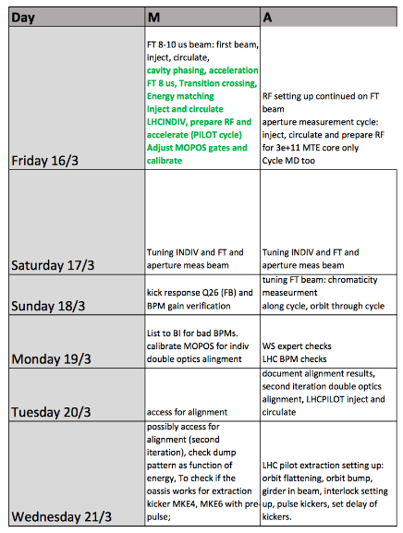
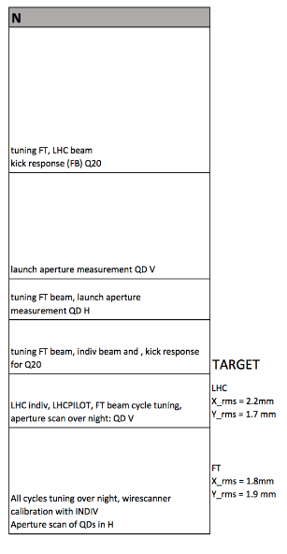

Slide 57
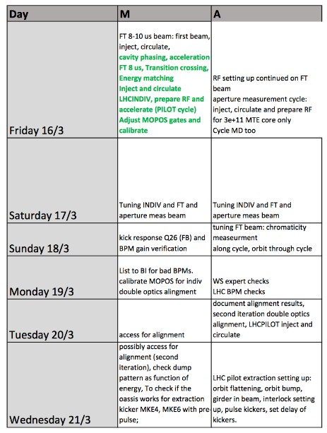
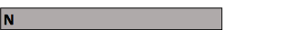
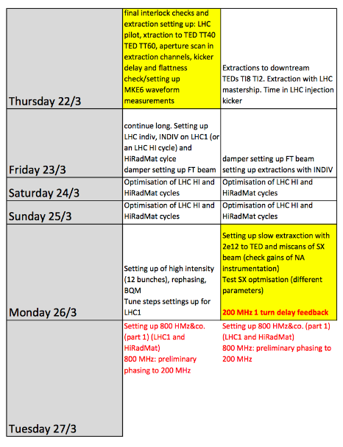
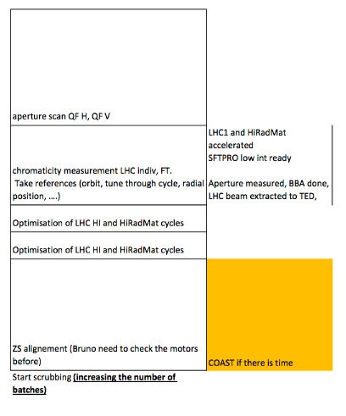

Slide 58
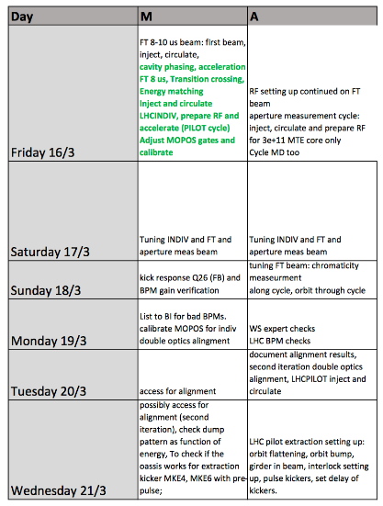
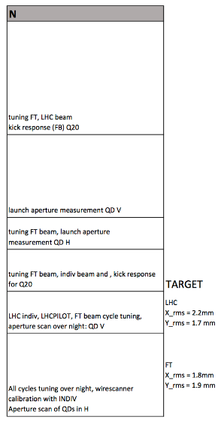
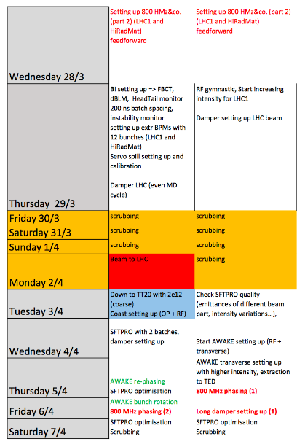
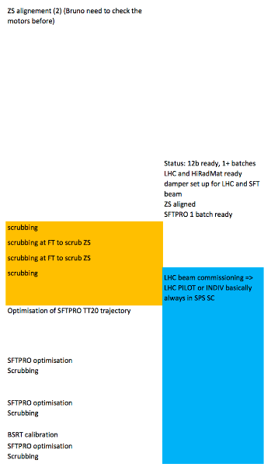

Slide 59
