Slide 1
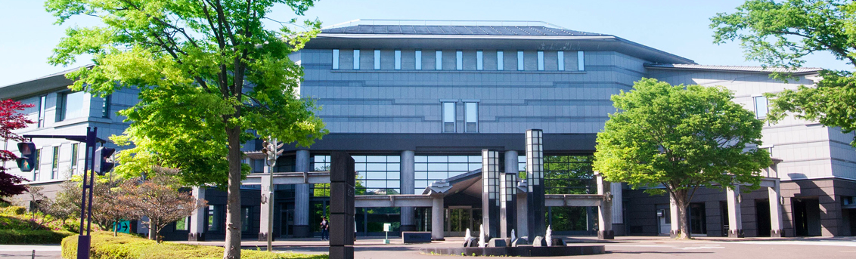
International Workshop for Future Linear Colliders 2019
Oct 28 – Nov 1, 2019, Sendai, Japan
Hosted by LCC
Timing:
Final phase of EPPSU
Short list of the ‘Master Plan’ of Science Council of Japan

Slide 2
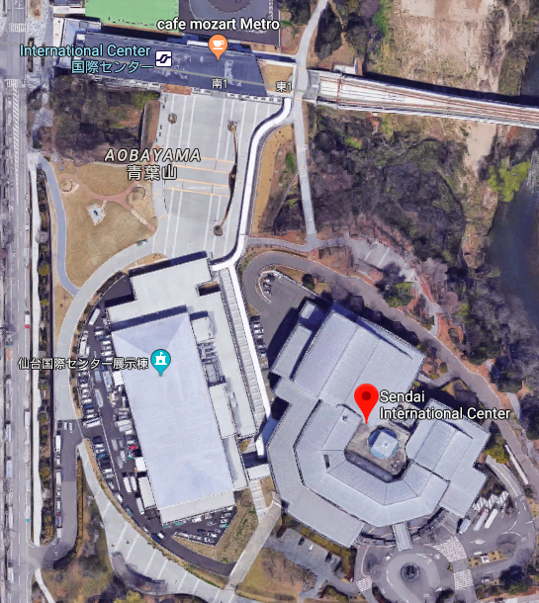
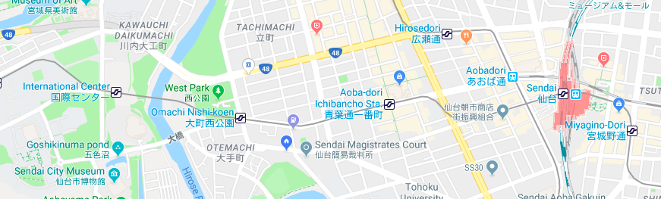
Sendai International Center is connected
directly to a subway station ‘International
Center’.
Many hotels along the subway line from
JR Sendai station (~10 min, 3rd stop).
Important to show our enthusiasm and
commitment for LC,
for the European Strategy discussions, and
for the Master Plan drafting by SCJ.
See you there!
JR Sendai Staton
International Center

