Slide 1
Magnet quench and thermal tests of the shielded HL-LHC beam screen
WP12 Meeting
M. Morrone, C. Garion
With contributions and materials from:
O. Sacristan, M. Guinchard, L. Fiscarelli, P. Borges de Sousa, T. Koettig
TE-VSC-DLM 05 - 02 - 2019

Slide 2
Magnet quench test - Outline
Magnet quench test
Physics of the problem
Instrumentation
Results and comparison with simulations
Conclusions and next steps

Slide 3
Outline
Magnet quench test
Physics of the problem
Instrumentation
Results and comparison with simulations
Conclusions and next steps

Slide 4
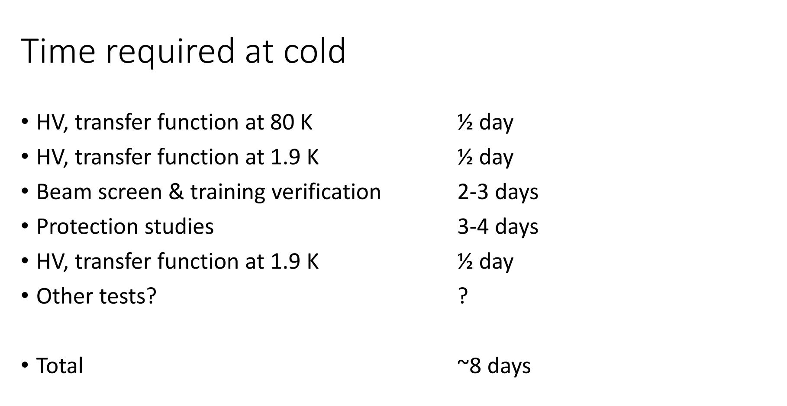
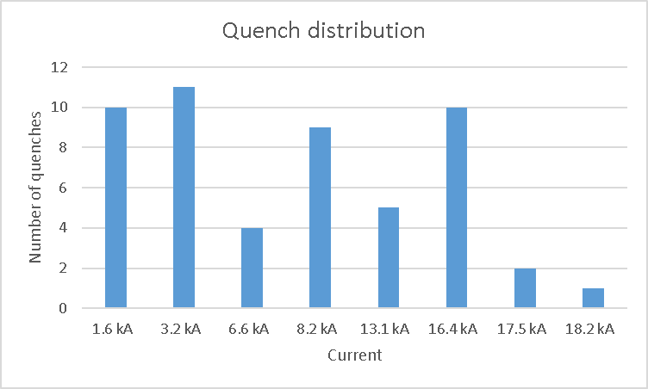
Test plan
Start date of the test in SM18: 10th October 2018
EDMS: 2024740
End date of the test in SM18: 18th October 2018
54 quenches
(CLIQ, quench heater, training, extraction, high quench integral, ramp rate)

Slide 5
Aim of the test
Training verification of the MQXFS4b at 1.9 K.
Flux jump effect on the current studies, both during other tests' ramps and during dedicated exponential cycles;
Magnet protection studies, including CLIQ discharges in different configurations, QH delay and performance and QH-only discharges;
Effect of CLIQ on the beam screen studied with over 20 runs dedicated to that measurement;
Measurement of the magnetic field during CLIQ and quench heater discharge by means of dedicated pickup coils in the beam screen;

Slide 6
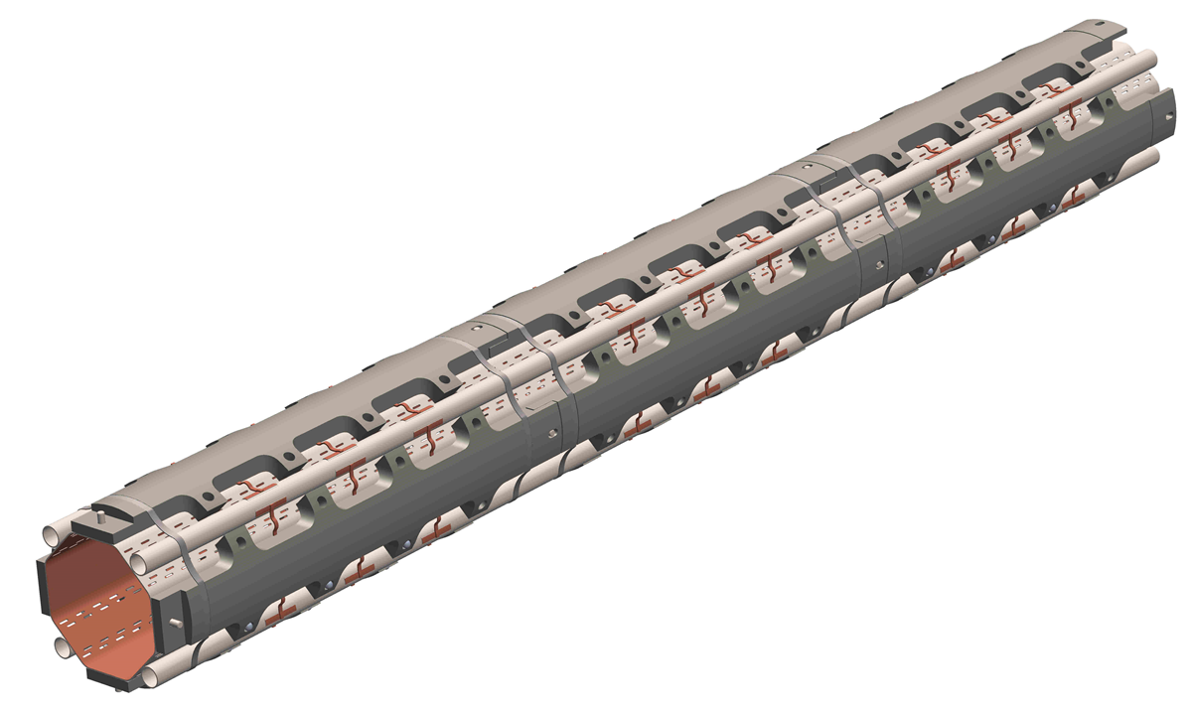
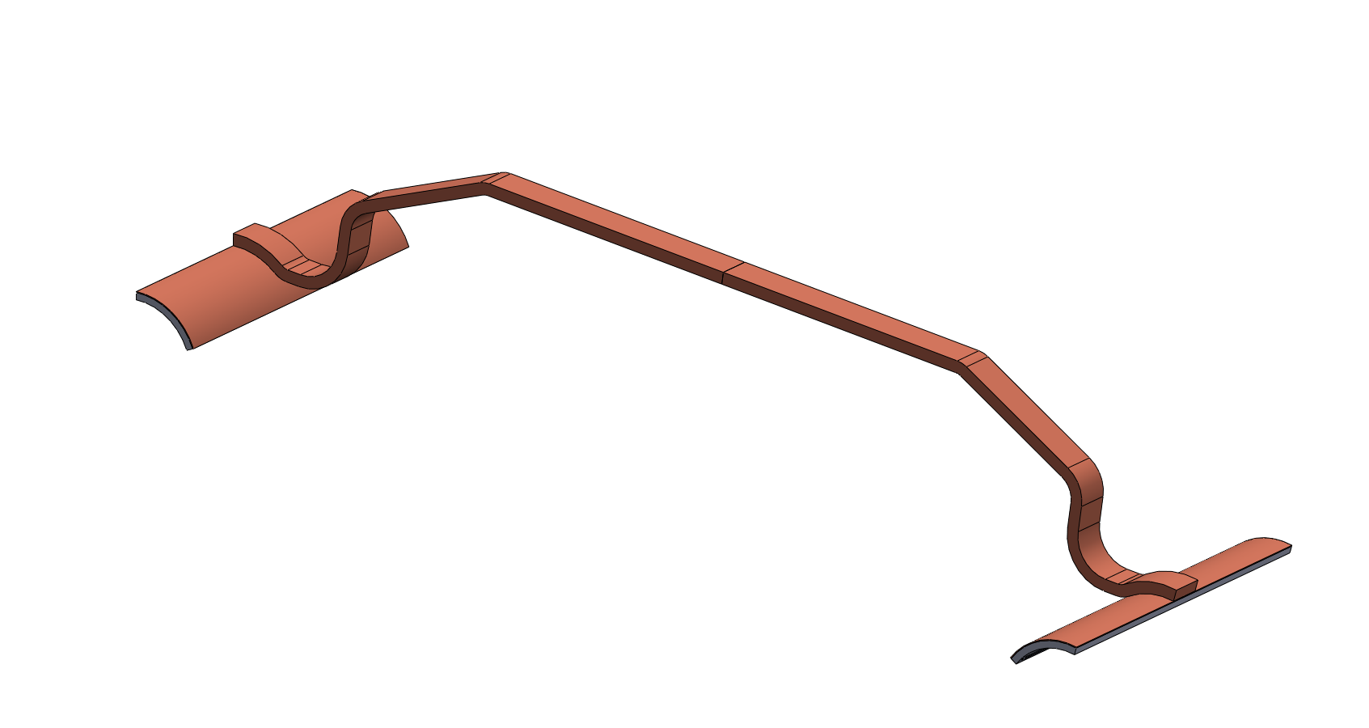
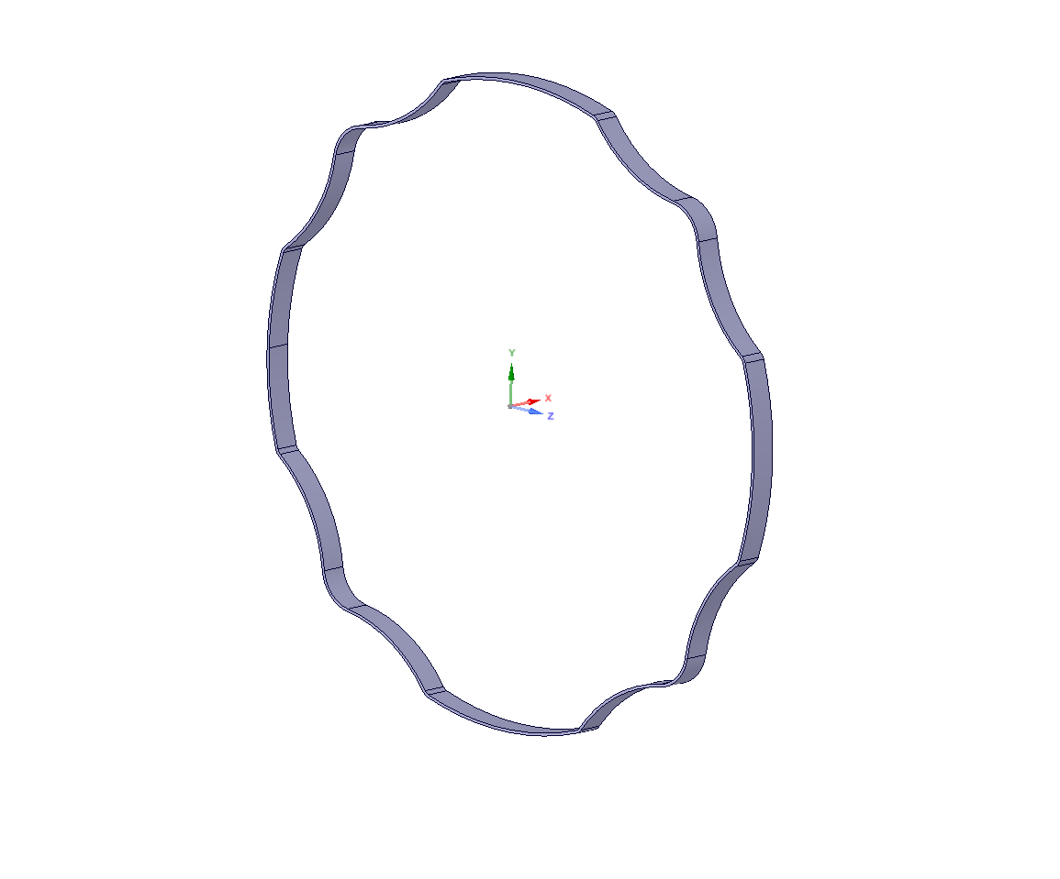
Test conditions
Q1 beam screen version compatible with the CLIQ discharge (pins and W block geometry modified);
Beam screen immersed in the 1.9 K helium bath;
Temperature: 1.9 K (significant change of the electrical resistivity of Cu due to temperature
and magneto-resistivity → reduced thickness of Cu inner layer for the prototype, from 75 μm to 25 μm);
Magnetic field decay representative of the HL-LHC conditions, including the CLIQ system;
Vertical position of the beam screen within the cryostat.
Inner copper layer
reduced from 75 to ~ 25 μm
2 versions of thermal link and elastic rings tested

Slide 7
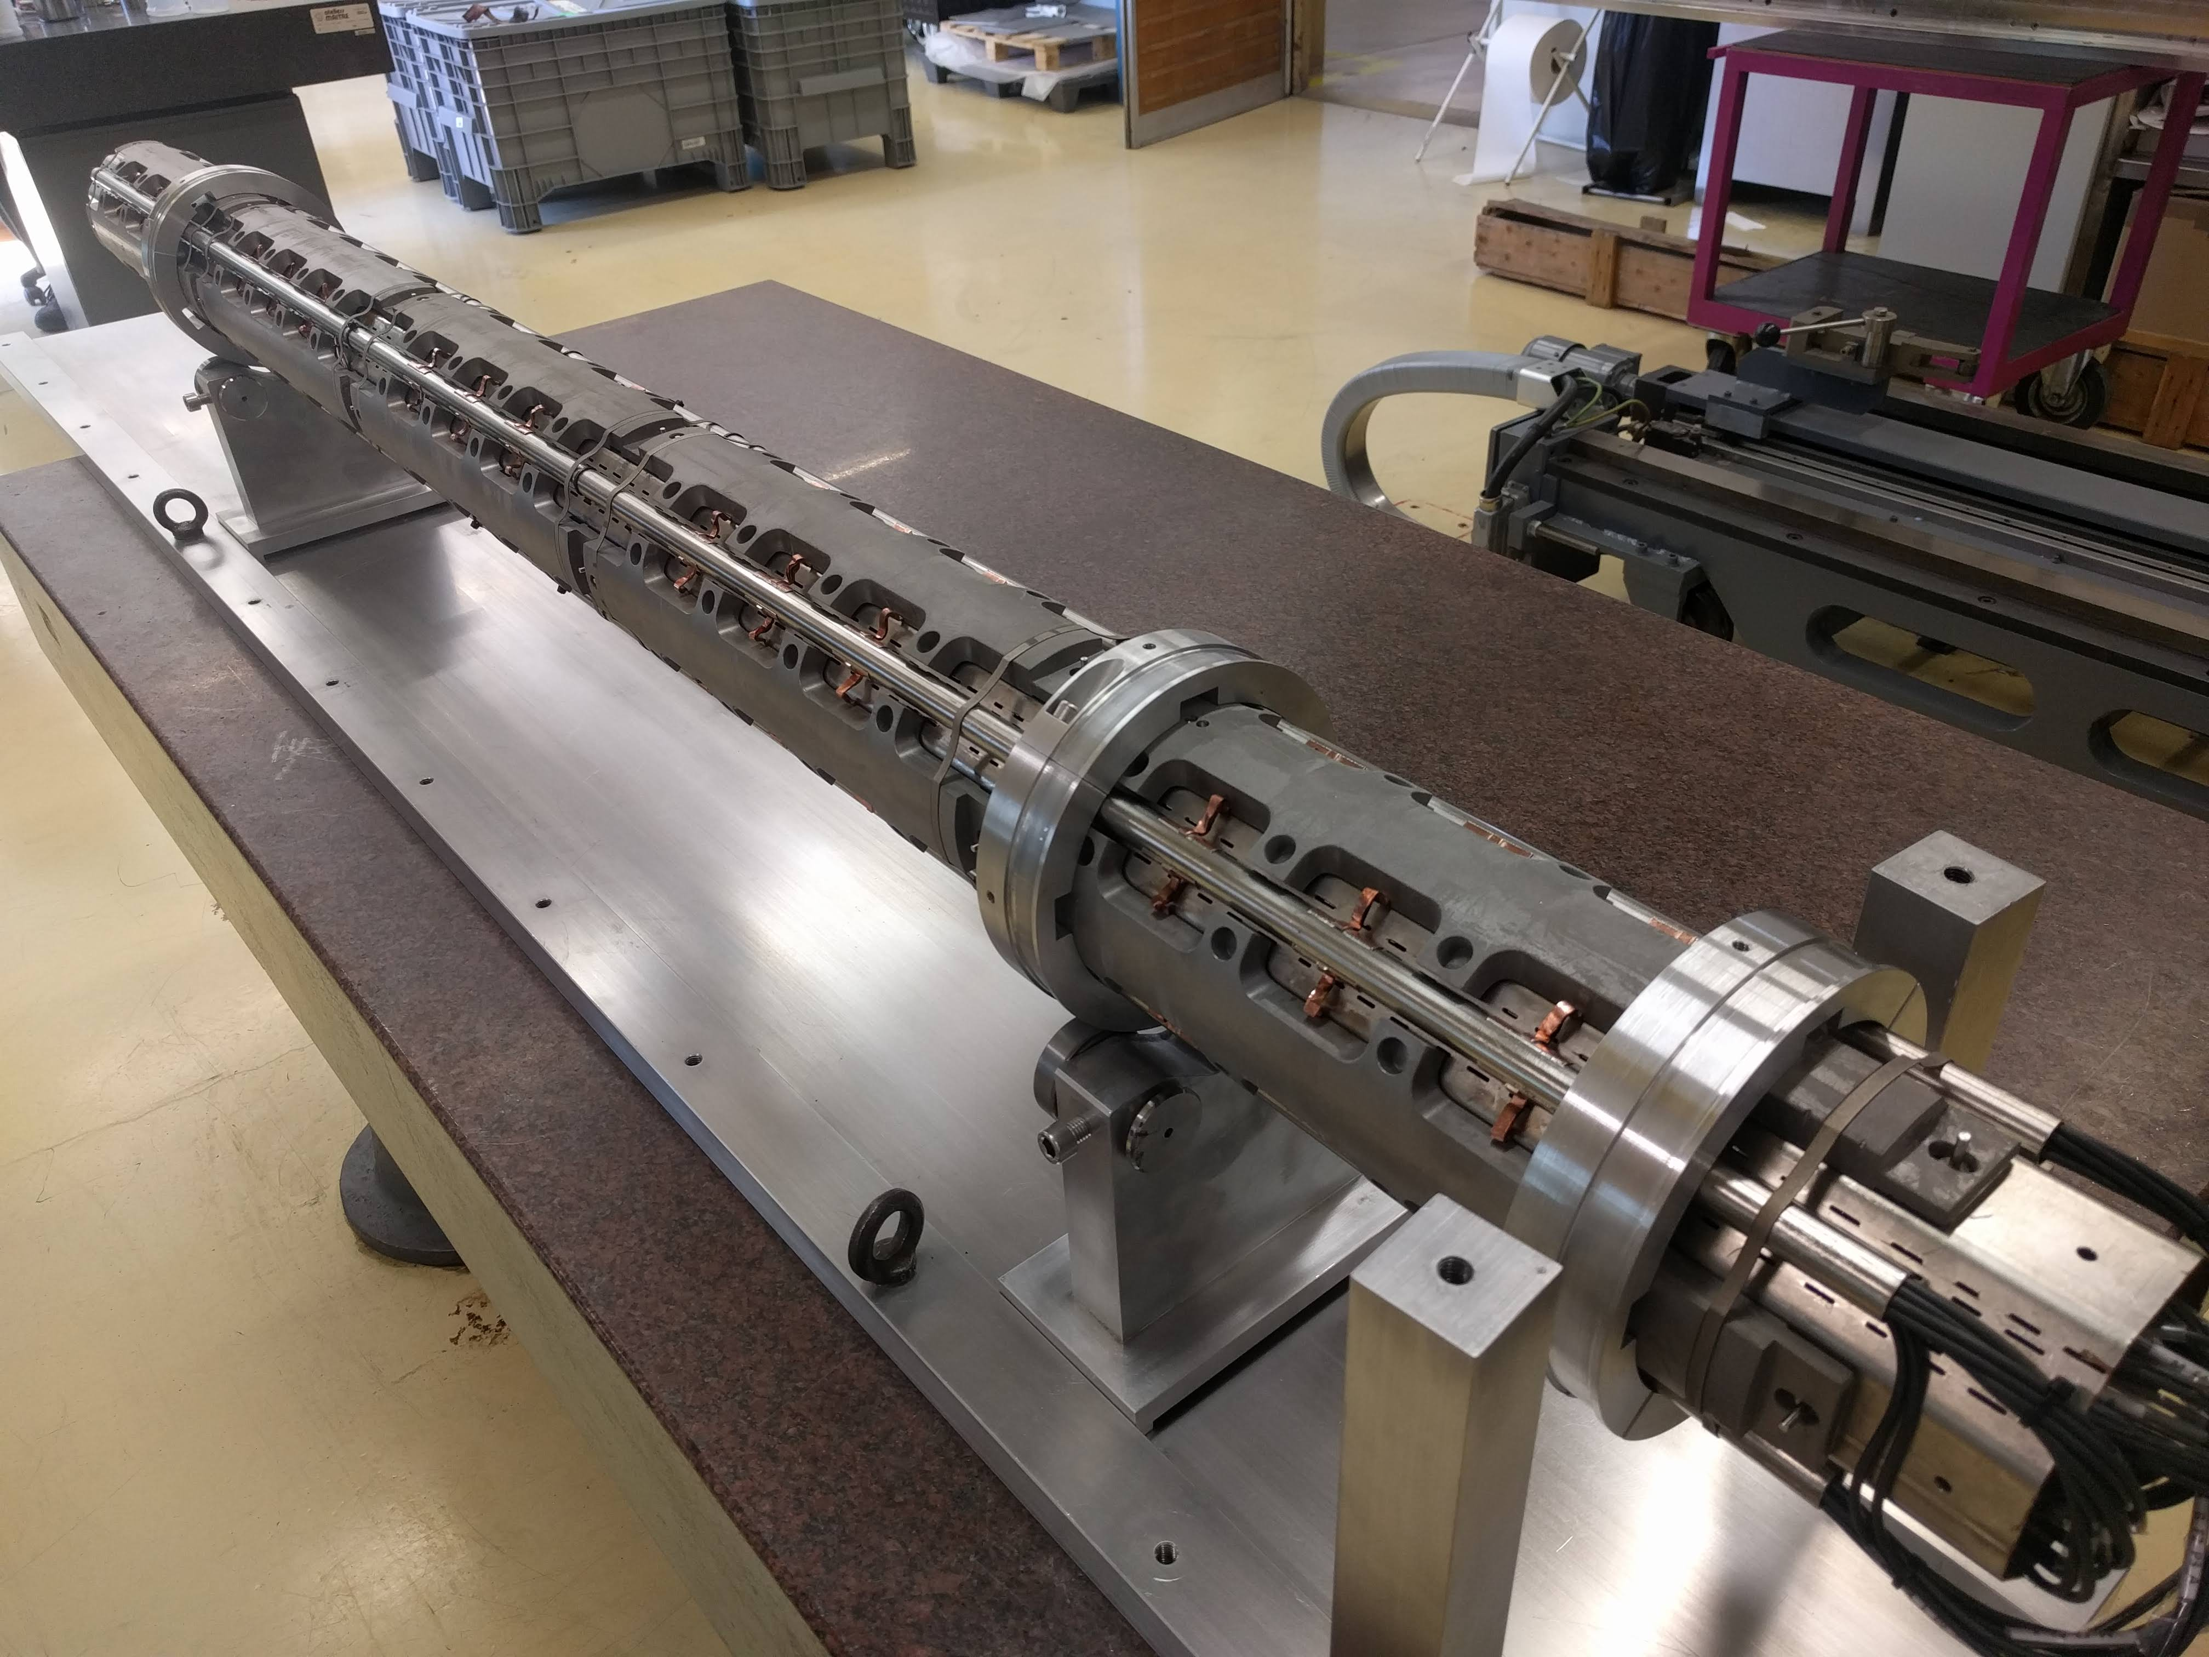
BS quench test prototype
-Q1 type-
2 m

Slide 8
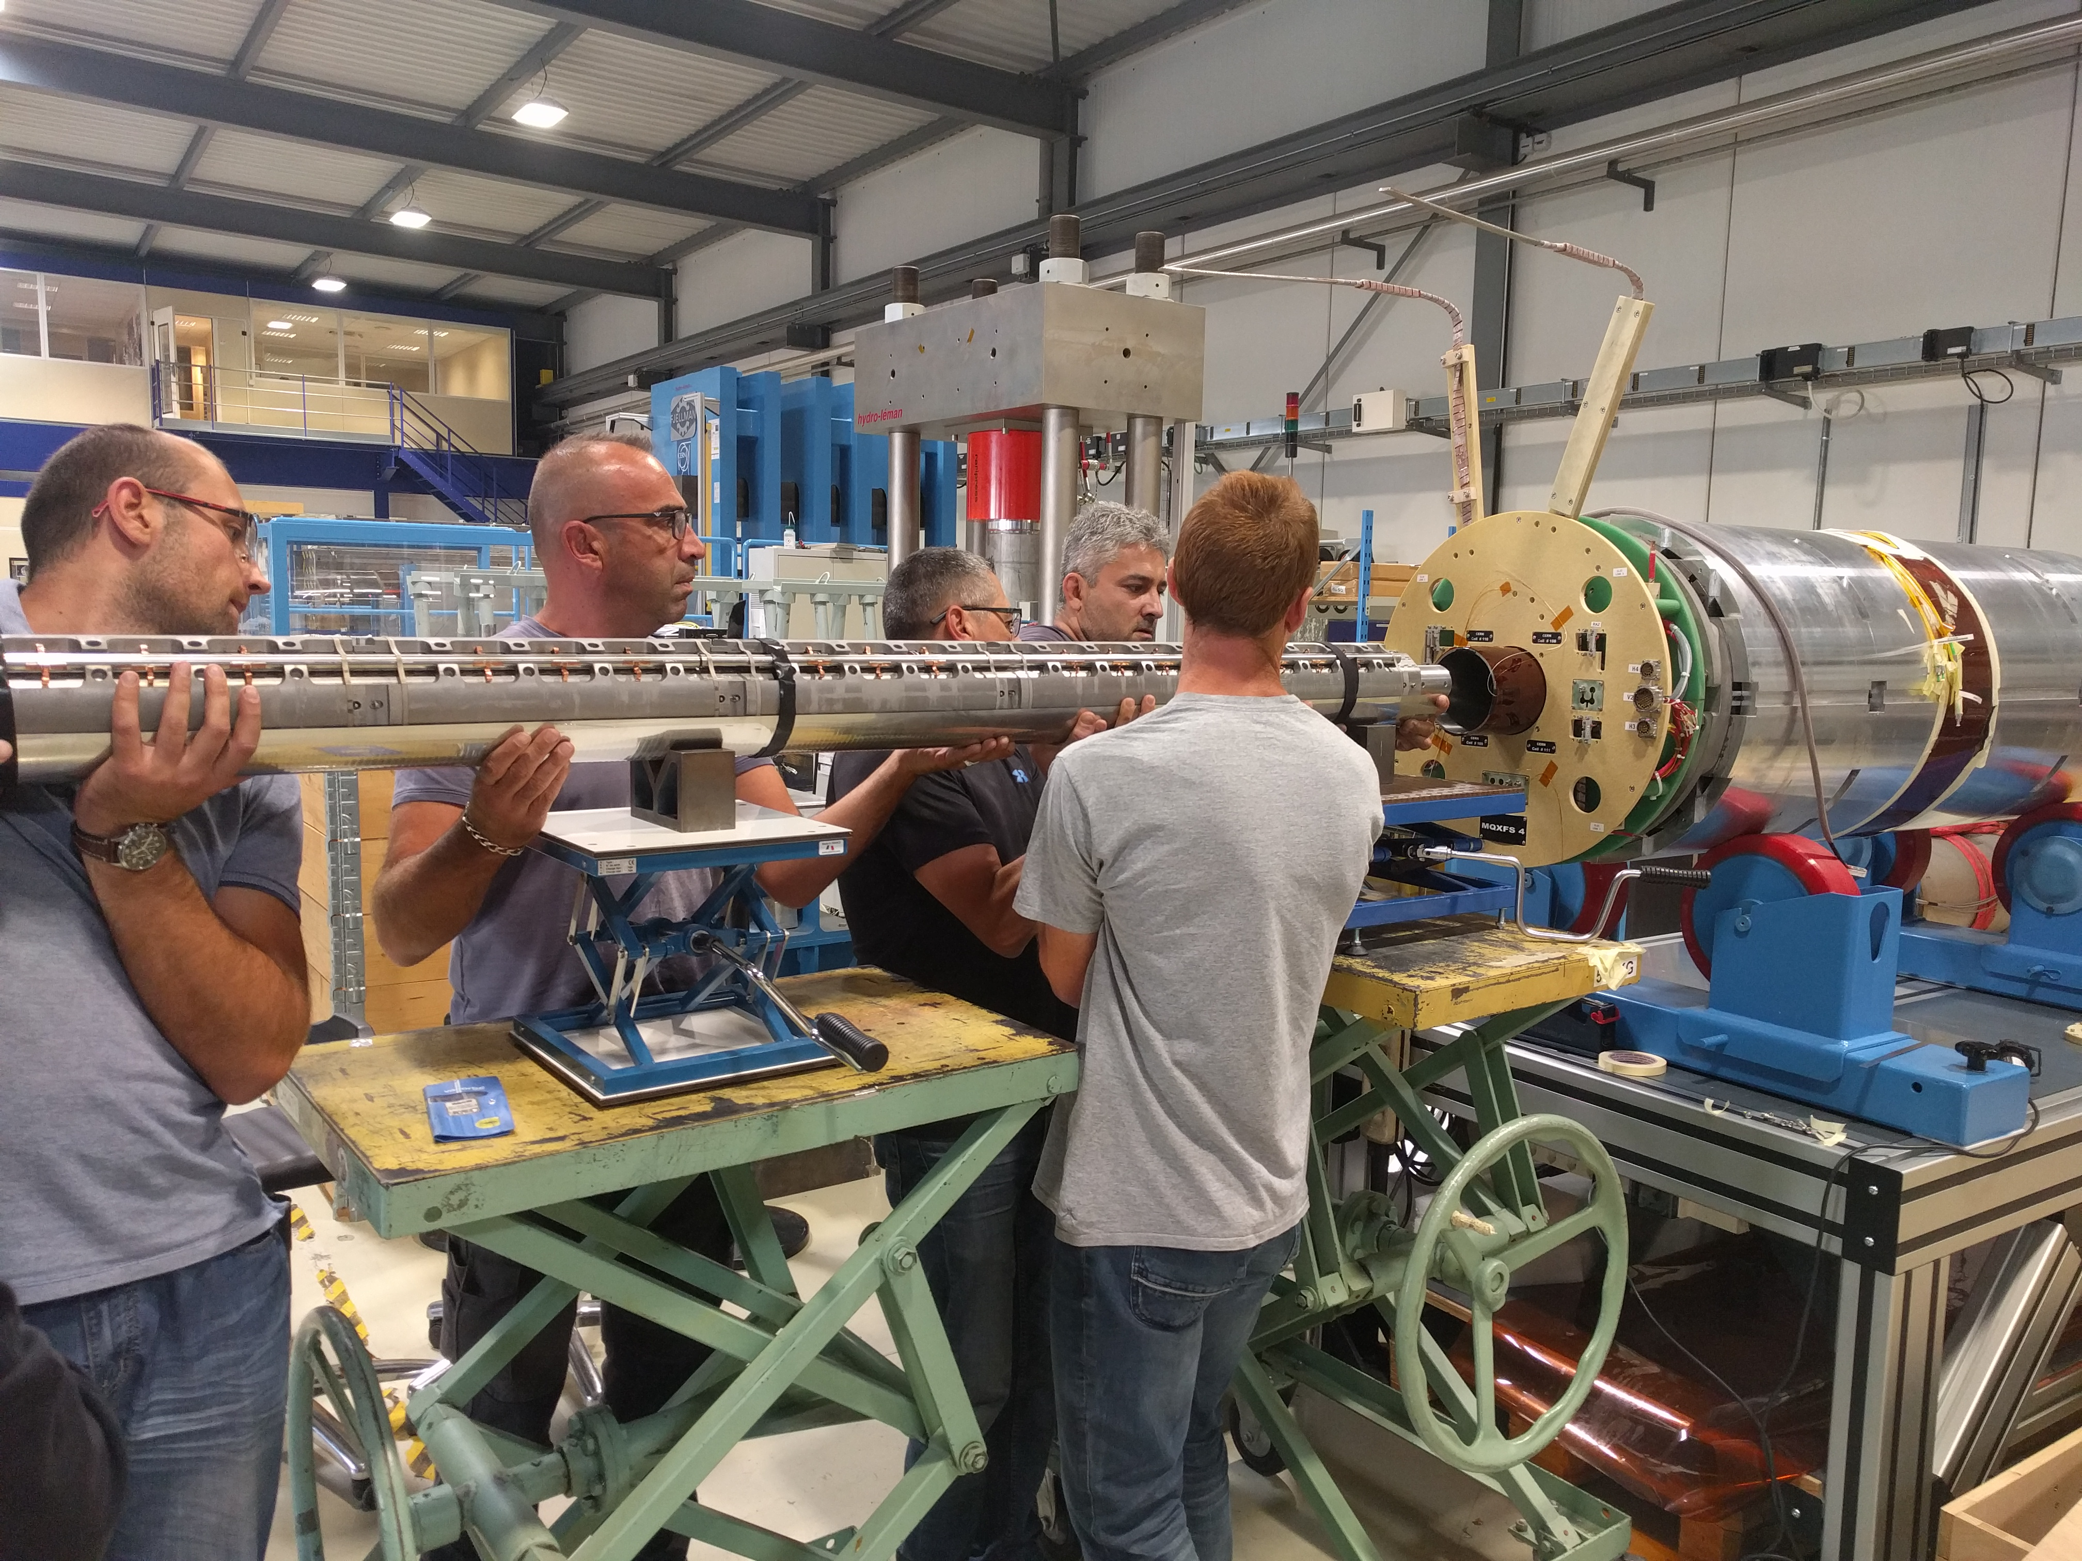
BS insertion in the MQXFs4b magnet

Slide 9
Outline
Magnet quench test
Physics of the problem
Instrumentation
Results and comparison with simulations
Conclusions and next steps

Slide 10
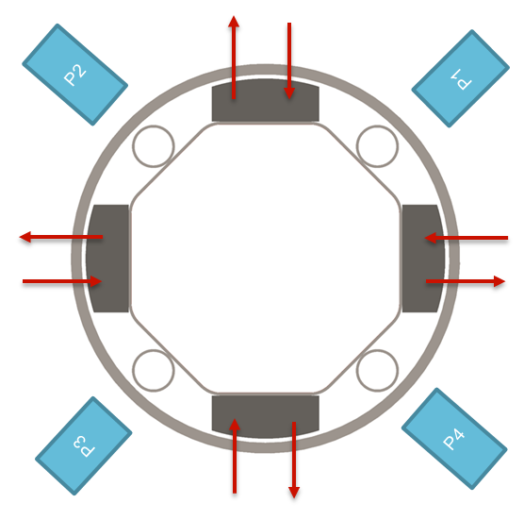
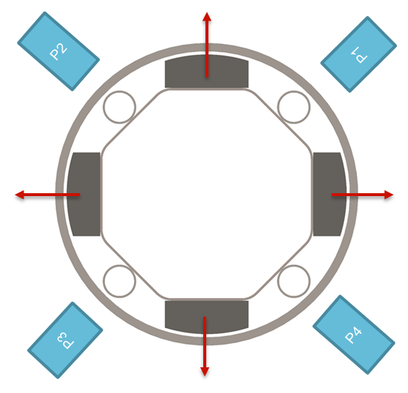

Physics of the problem
1
2
3
Non-monotonic phase (3 regions)
→ Torque
Non-monotonic phase
monotonic phase (1 region)
→ outward forces
$$\vec{f}∝\frac{B\dot{B}}{ρ}r$$
Courtesy of Emmanuele Ravaioli
monotonic
phase
$\dot{BB}$ ($\dot{B}$ has a change of sign) is not monotonic in the first phase of the CLIQ discharge!
Therefore, opposite forces are expected in the same component.

Slide 11
Outline
Magnet quench test
Physics of the problem
Instrumentation
Results and comparison with simulations
Conclusions and next steps

Slide 12
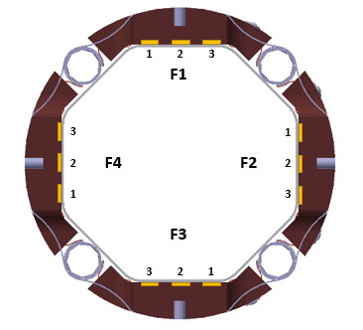
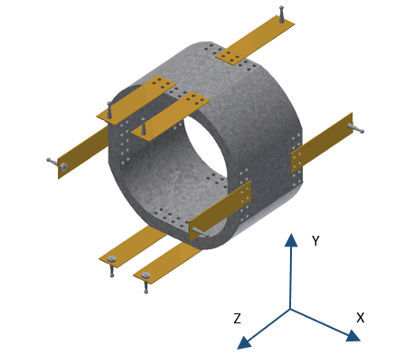
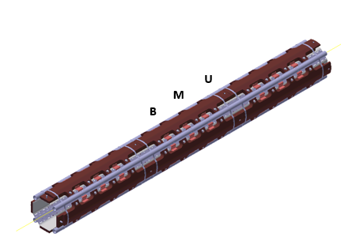
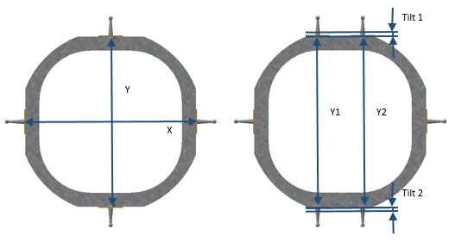
Instrumentation
42 Strain gauges distributed in 3 sections along 4 diametrally opposed faces of the beams screen in axial and transversal directions
3 custom made displacement measuring heads inside the beam screen to measure:
Beam screen expansion
W block tilt
Magnetic field
4 lines of fibers installed in 4 diametrally opposed generatrixes of the cold bore: 12 biaxial strain measurement points
expansion
tilt
M. Morrone, C. Garion

Slide 13
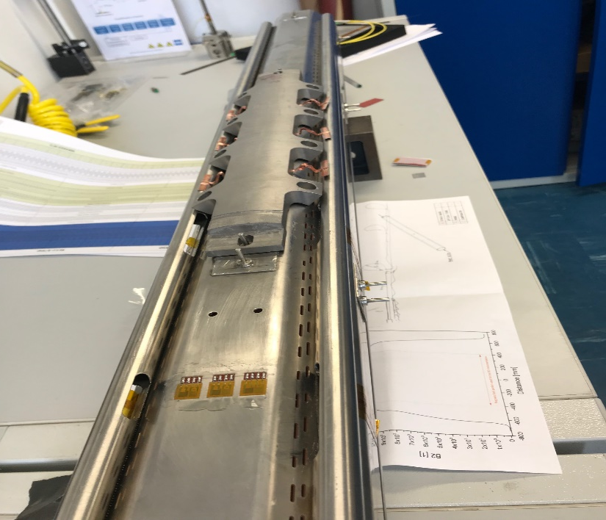
Strain gauges
EDMS 1762736
42 Strain gauges distributed in 3 sections along 4 diametrally opposed faces of the beam screen in axial and transversal directions.
S.G.
S.G.
S.G.
M. Morrone, C. Garion

Slide 14
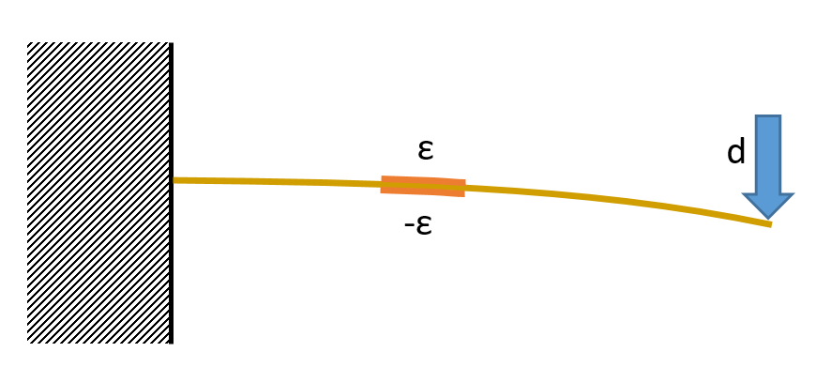
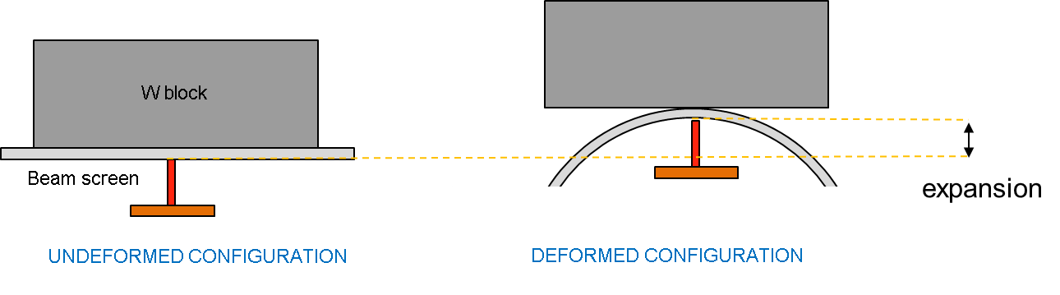
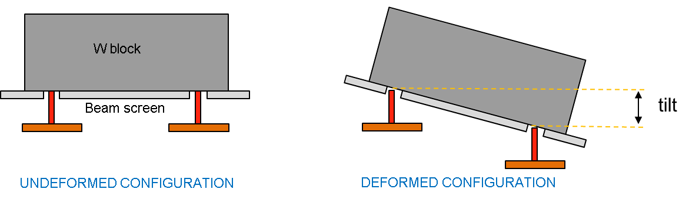
Measuring probe
3 custom made displacement measuring heads inside the beam screen to measure:
Beam screen expansion
W block tilt
Magnetic field
Expansion
Beam screen
Tilt
W bock
M. Morrone, C. Garion

Slide 15
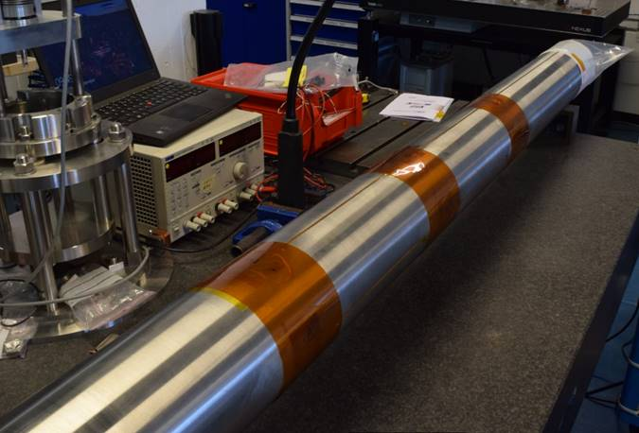
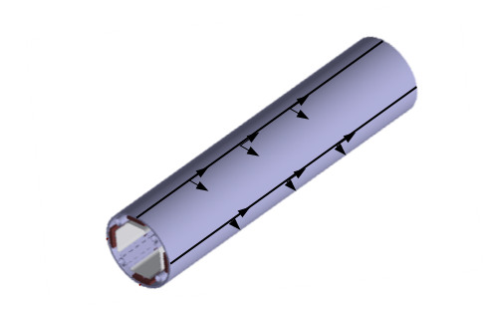
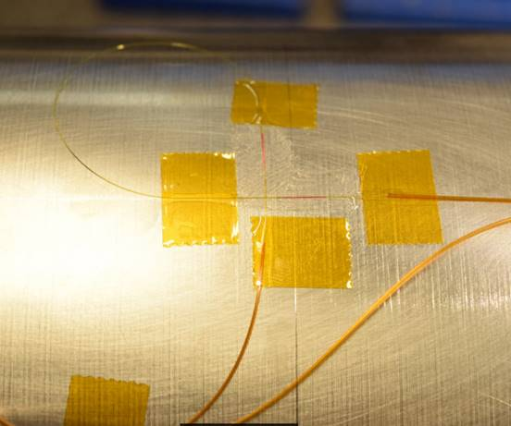
Cold bore fibers
4 lines of fibers installed in 4 diametrally opposed generatrixes of the cold bore: 12 biaxial strain measurement points.
M. Morrone, C. Garion

Slide 16
Outline
Magnet quench test
Physics of the problem
Instrumentation
Results and comparison with simulations
Conclusions and next steps

Slide 17
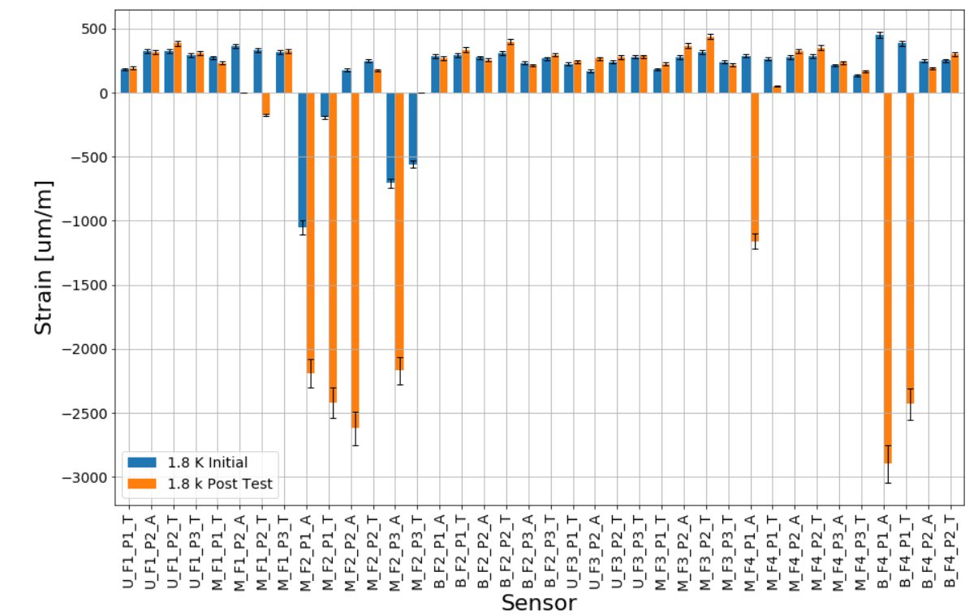
General overview of all the strain gauges
No plastic deformation.
Due to some artefacts.

Slide 18
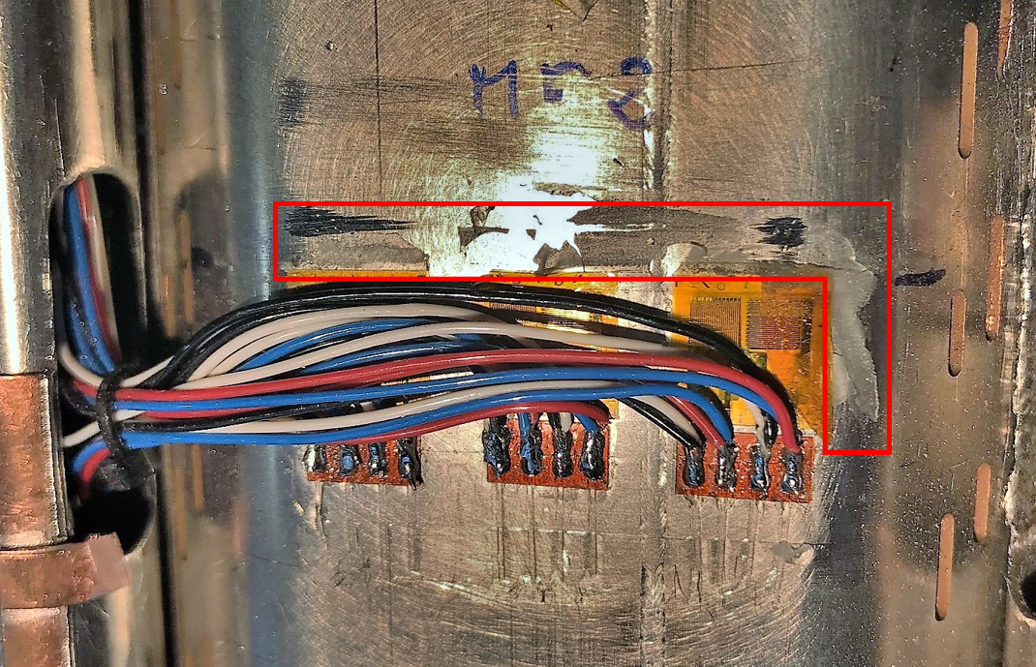
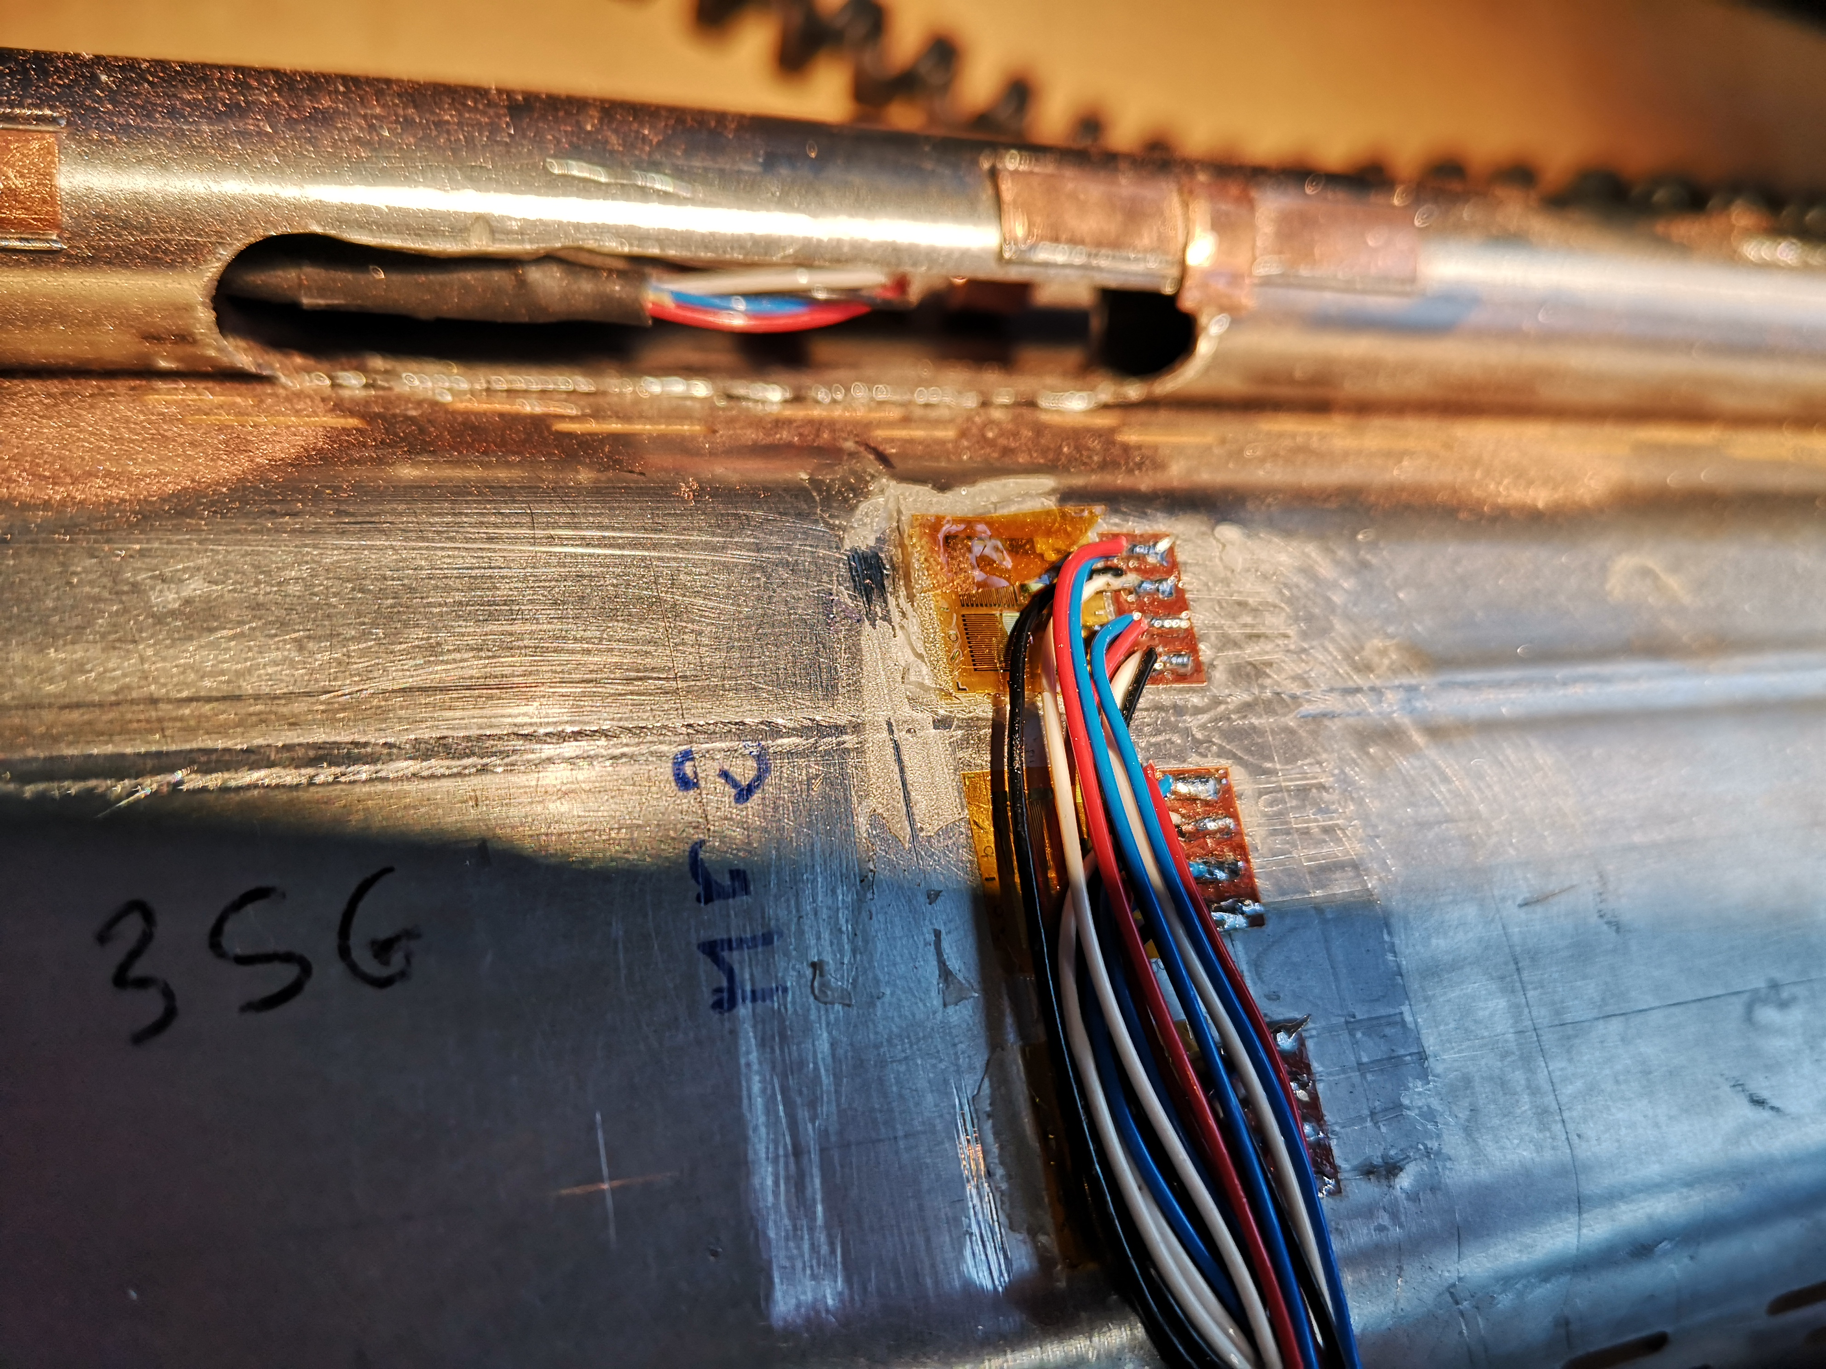
General overview of all the strain gauges
The behaviour observed at the points located at M_F2 can be explained by the extra thickness induced by a slight surplus of the adhesive used for the bonding of the strain gages which entered in contact with the tungsten block. It can be seen in the red frame on the picture above on the left. It is also noticeable that a strain gauge got detached (picture on the right).

Slide 19
Results at 8.2 kA
(Strain gauges, measuring probe)

Slide 20
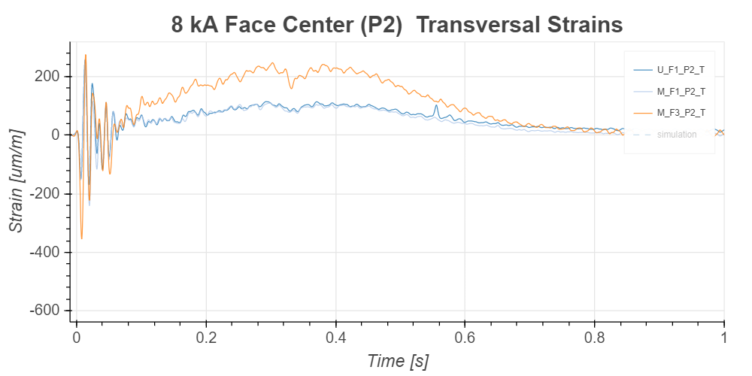
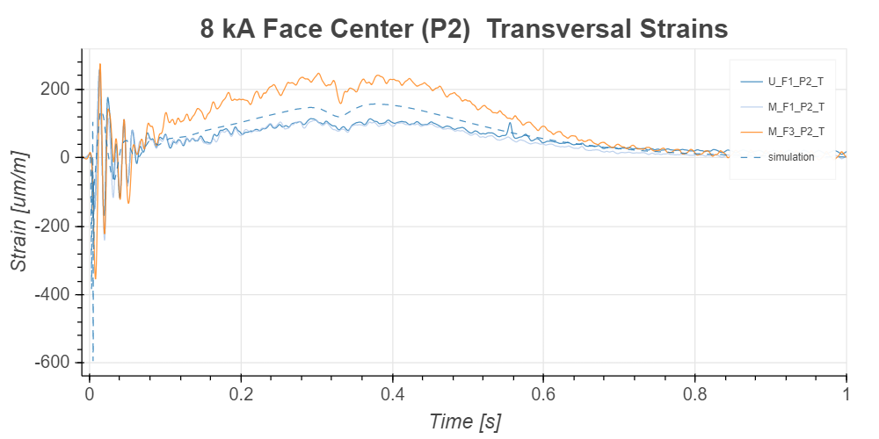
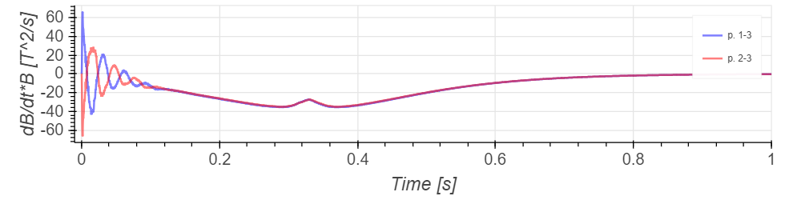
B measured at r =75 mm in front of each pole.

Slide 21
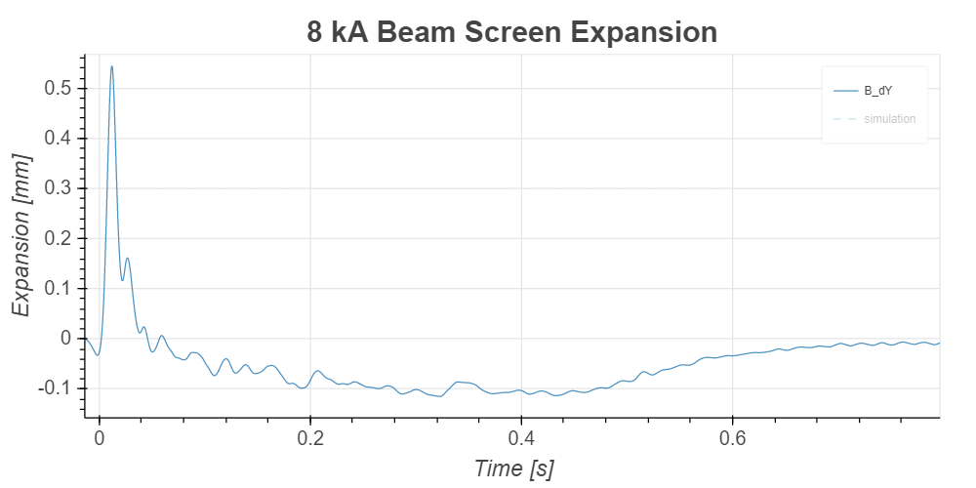
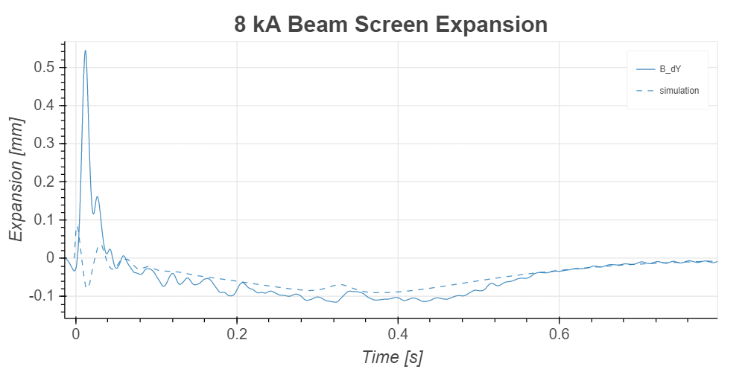
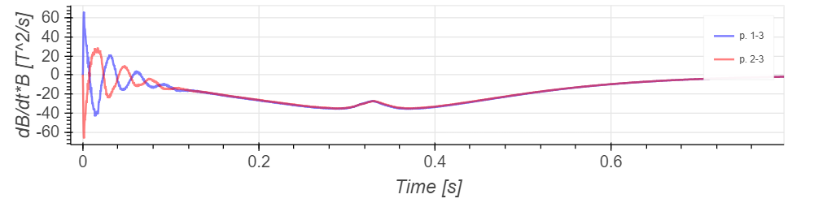
B measured at r =75 mm in front of each pole.

Slide 22
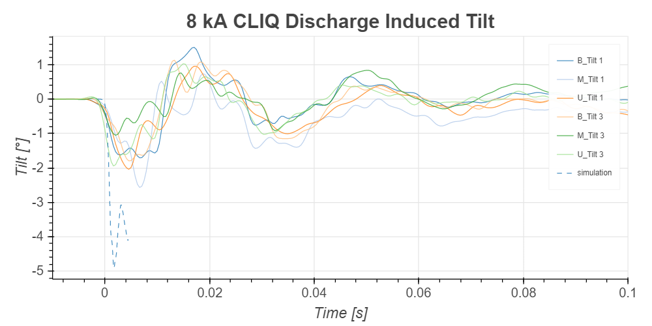
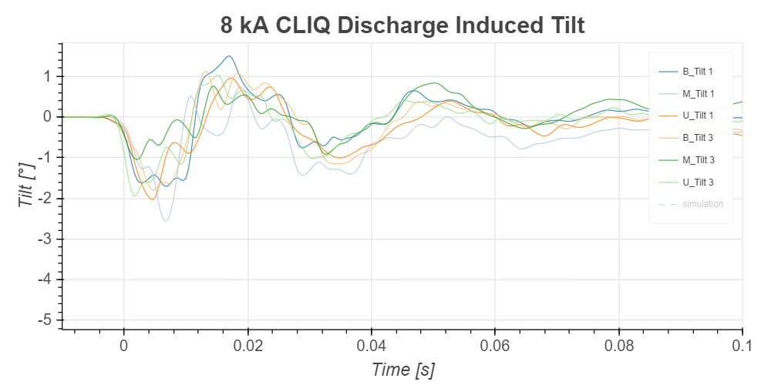
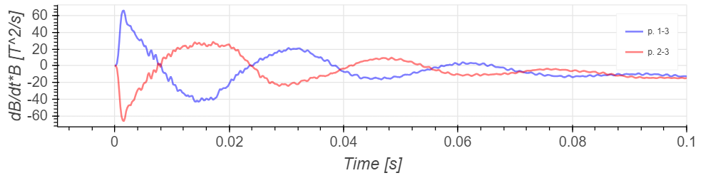
B measured at r =75 mm in front of each pole.

Slide 23
Results at 18.2 kA
(Strain gauges, measuring probe)

Slide 24
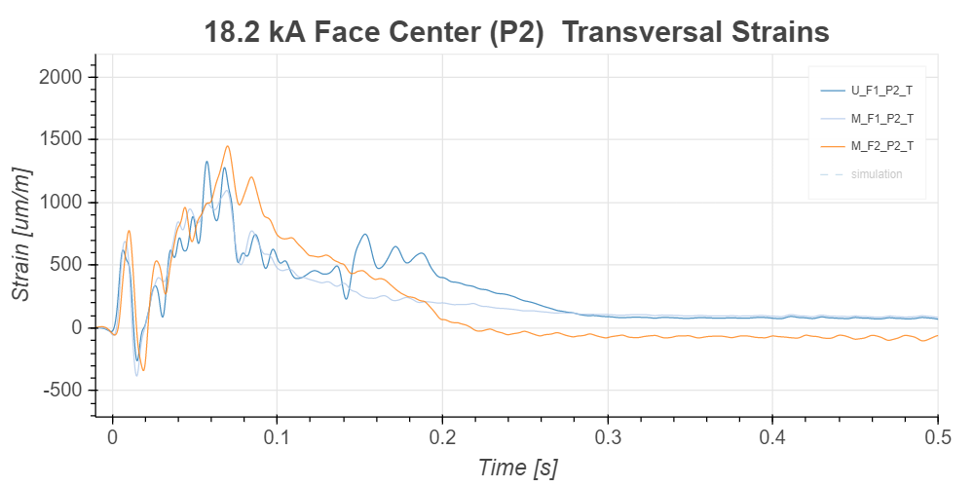
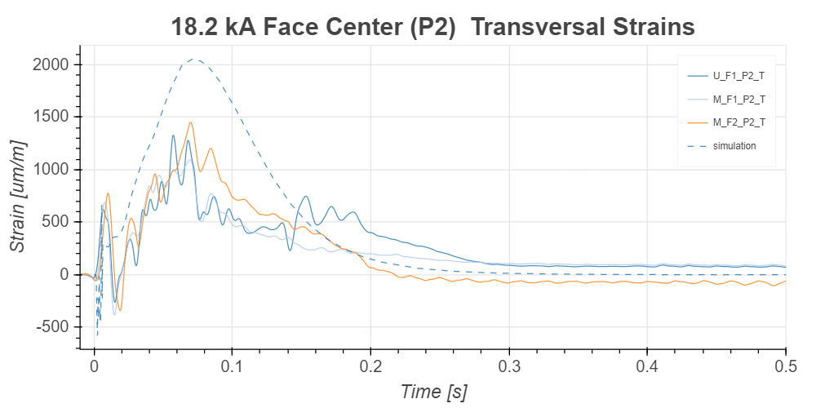
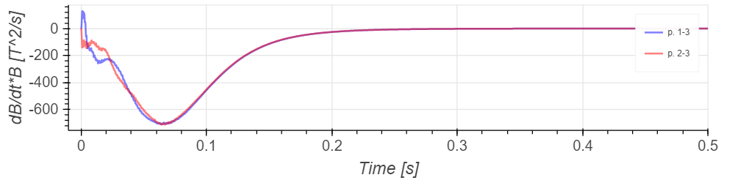
B measured at r =75 mm in front of each pole.

Slide 25
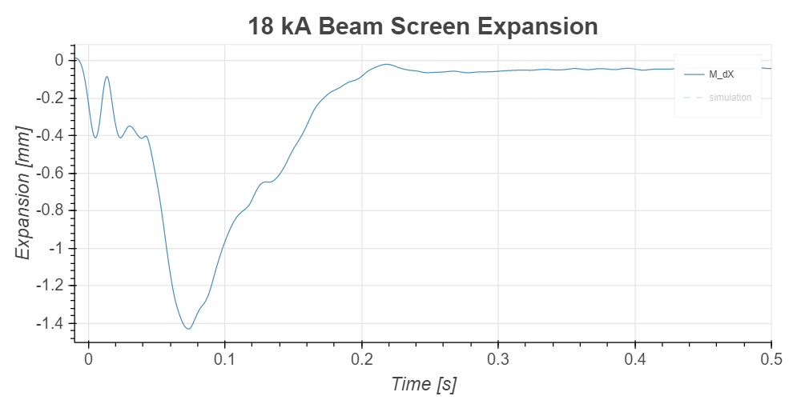
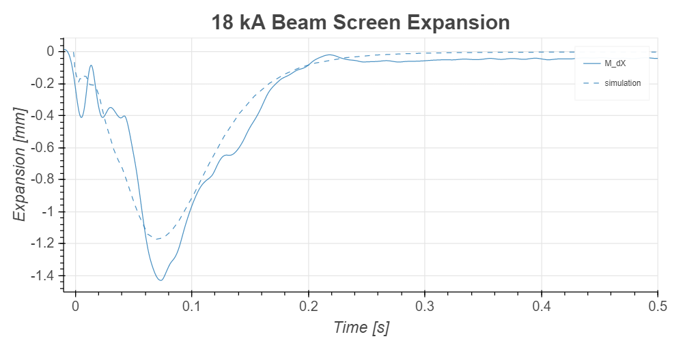
B measured at r =75 mm in front of each pole.

Slide 26
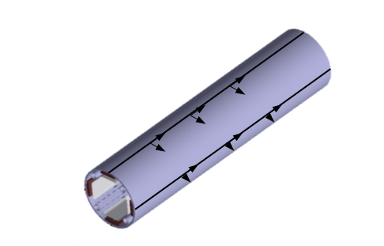
Cold bore
(optical fibers)
A3
A2
T3
A1
T2
T1

Slide 27
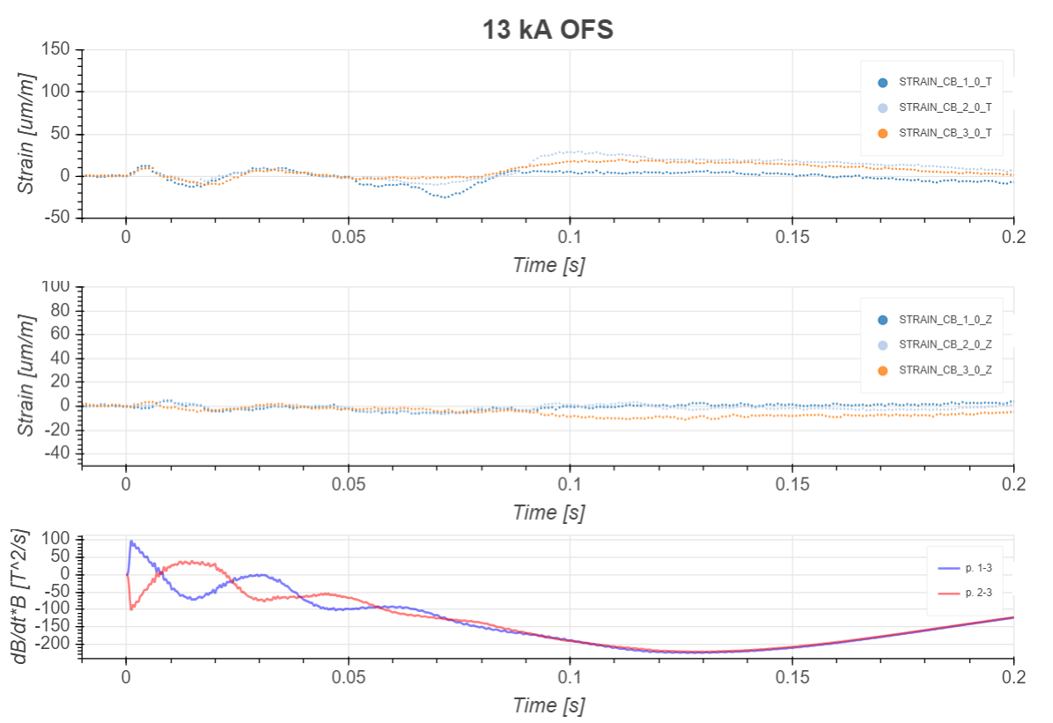
B measured at r =75 mm in front of each pole.

Slide 28
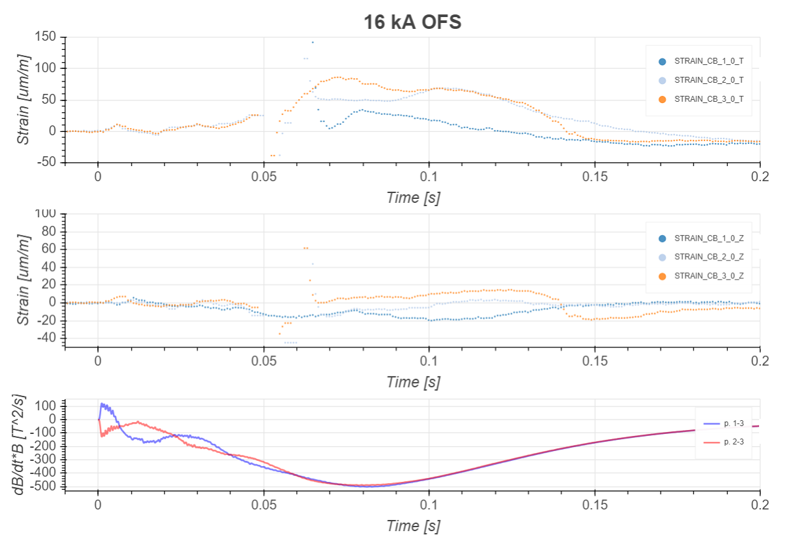
B measured at r =75 mm in front of each pole.

Slide 29
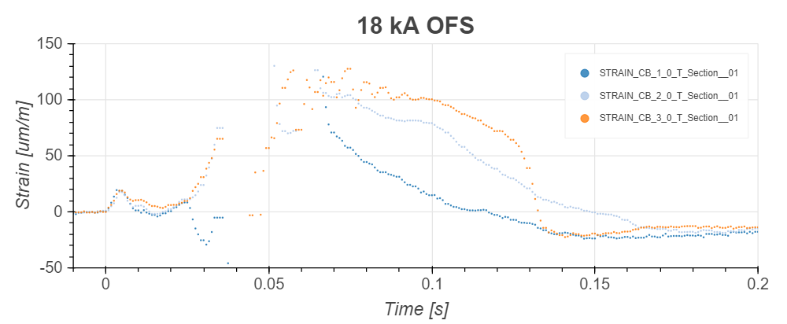
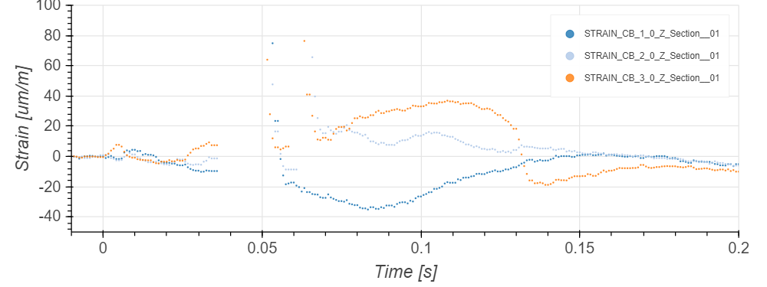
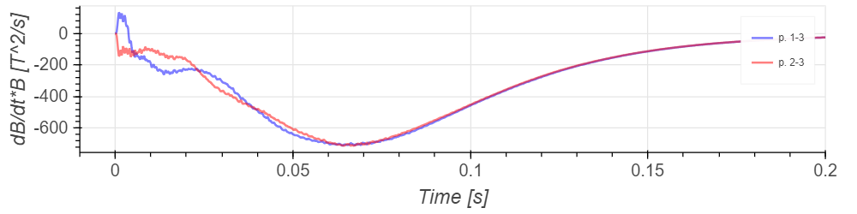
B measured at r =75 mm in front of each pole.

Slide 30
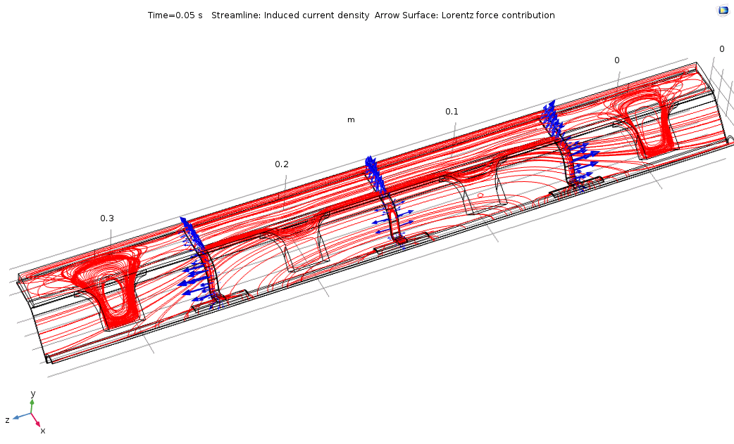
Thermal link (17.8 kA)
The forces induced in the external links are driven
by the current flow of the W block.

Slide 31
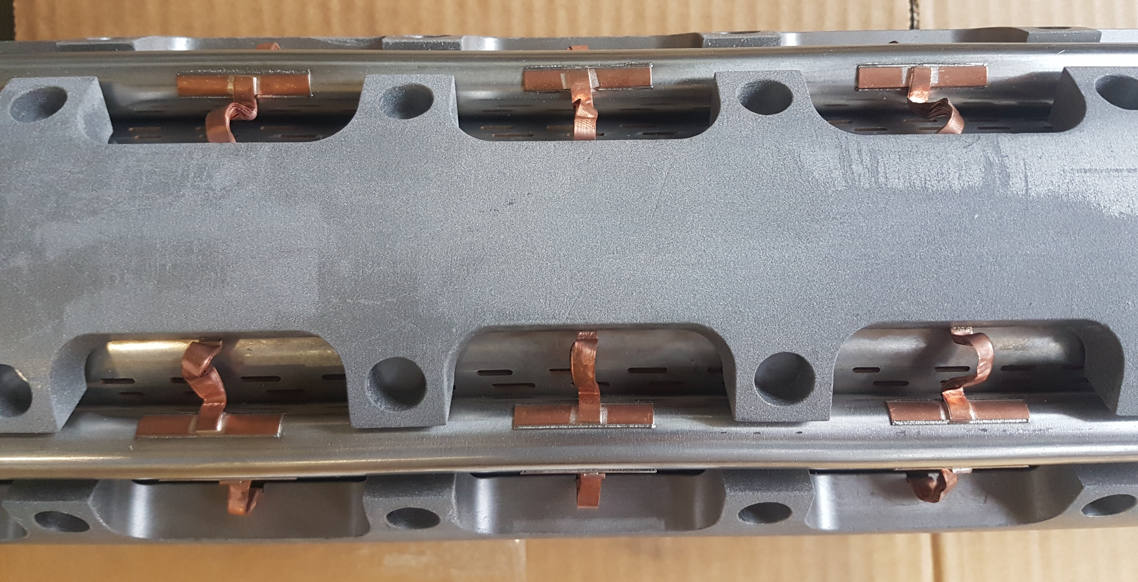
Thermal link
Deformation of the thermal link after the quench test.

Slide 32
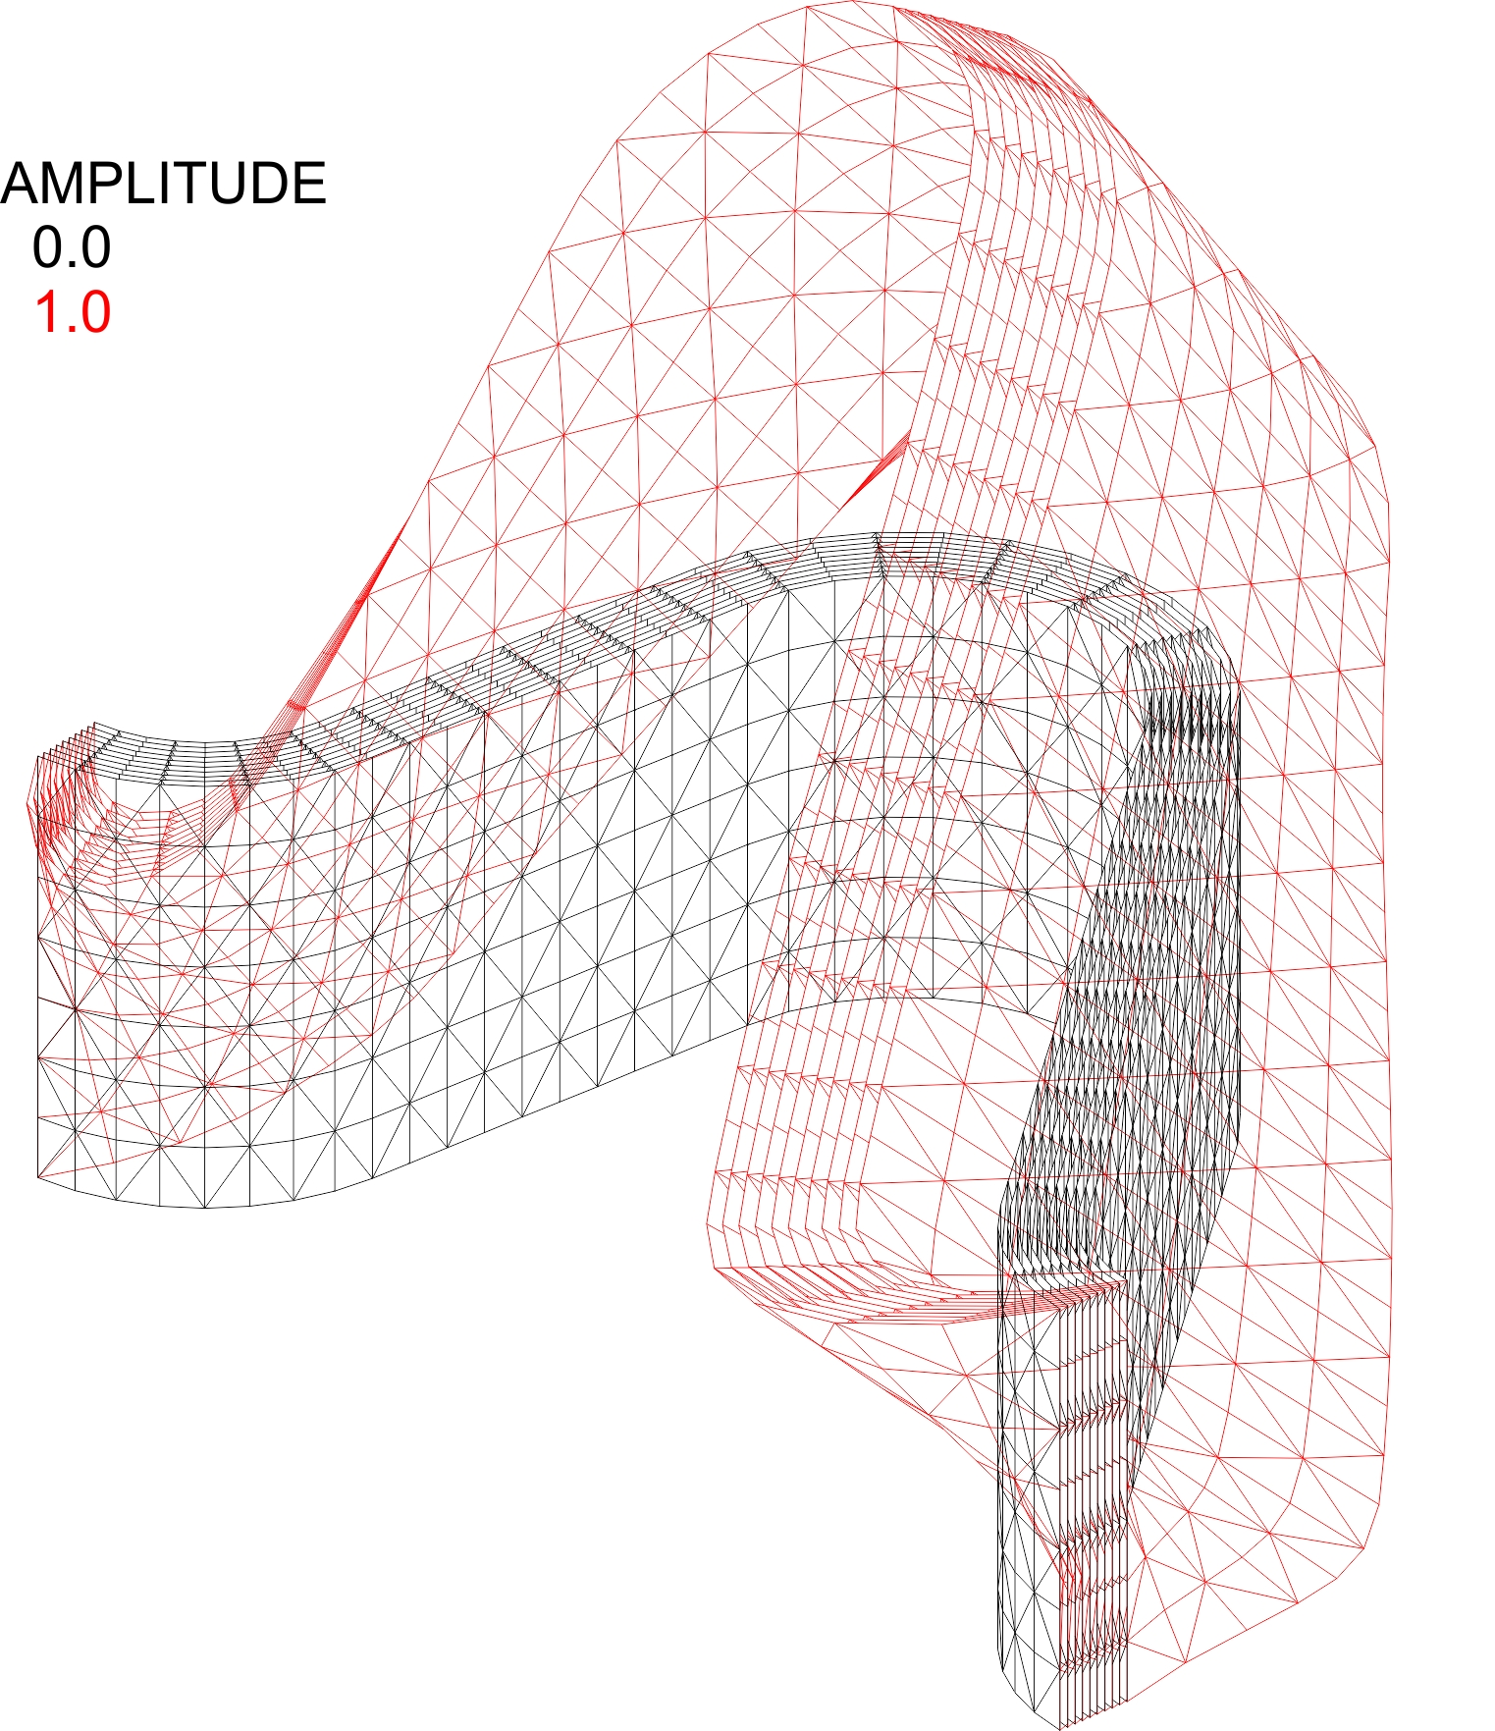
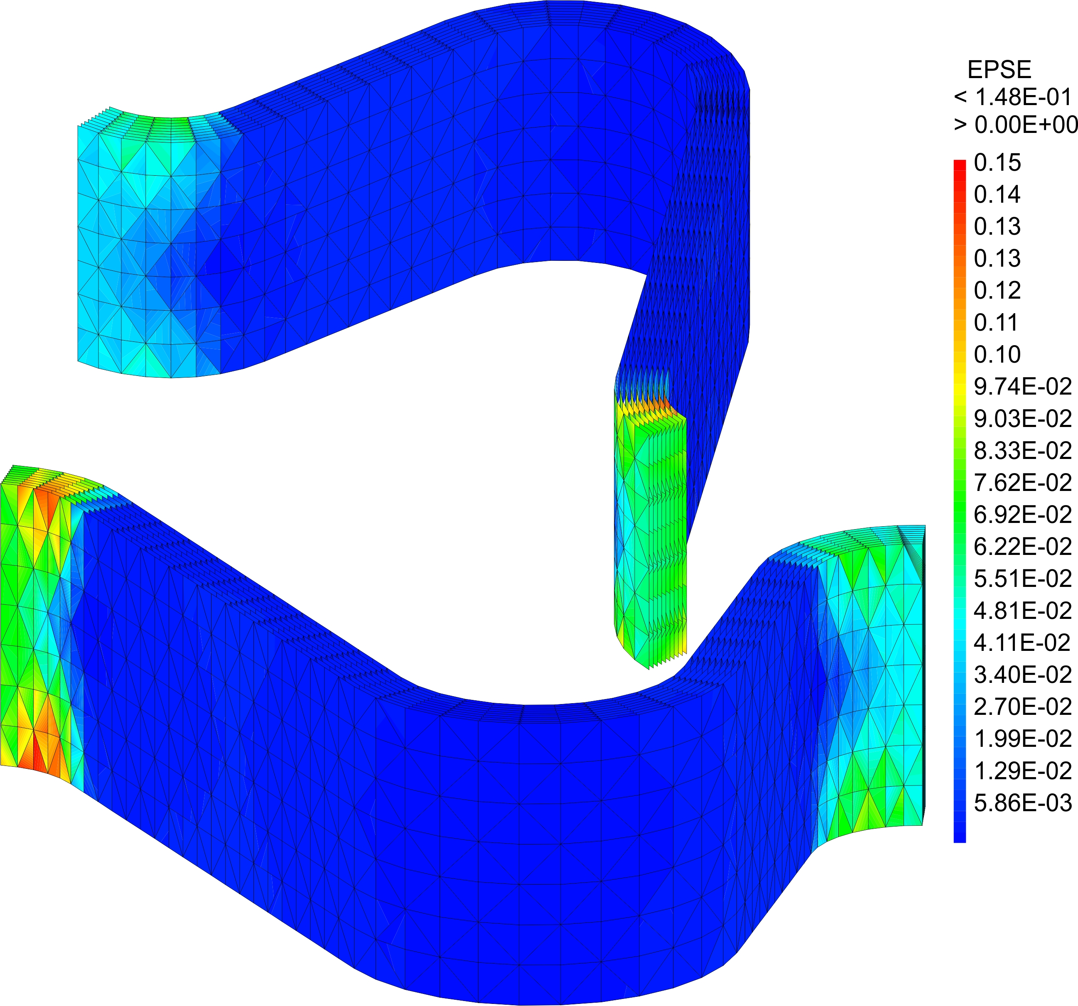
Thermal link (17.8 kA)
Deformation and eps of the original geometry of the thermal link (10 x 0.1 mm).

Slide 33
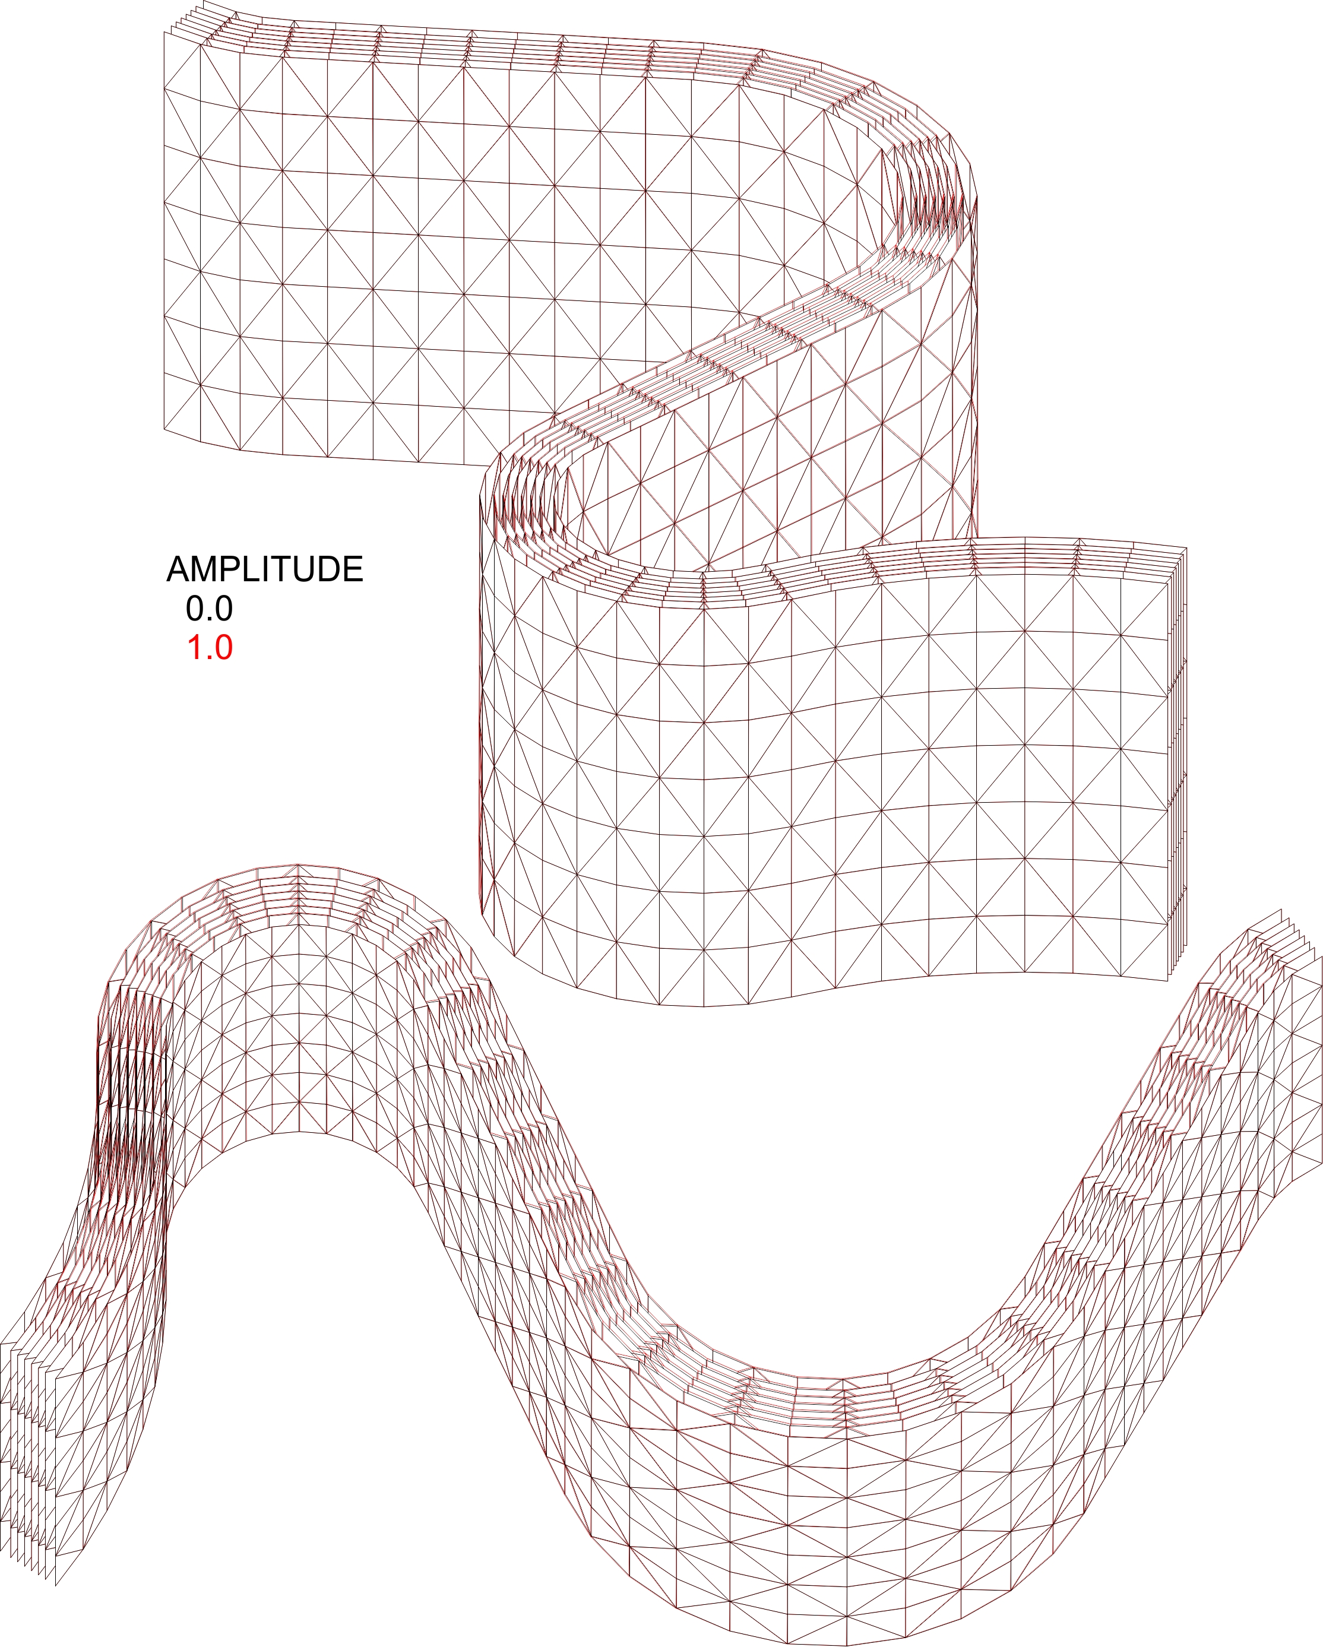
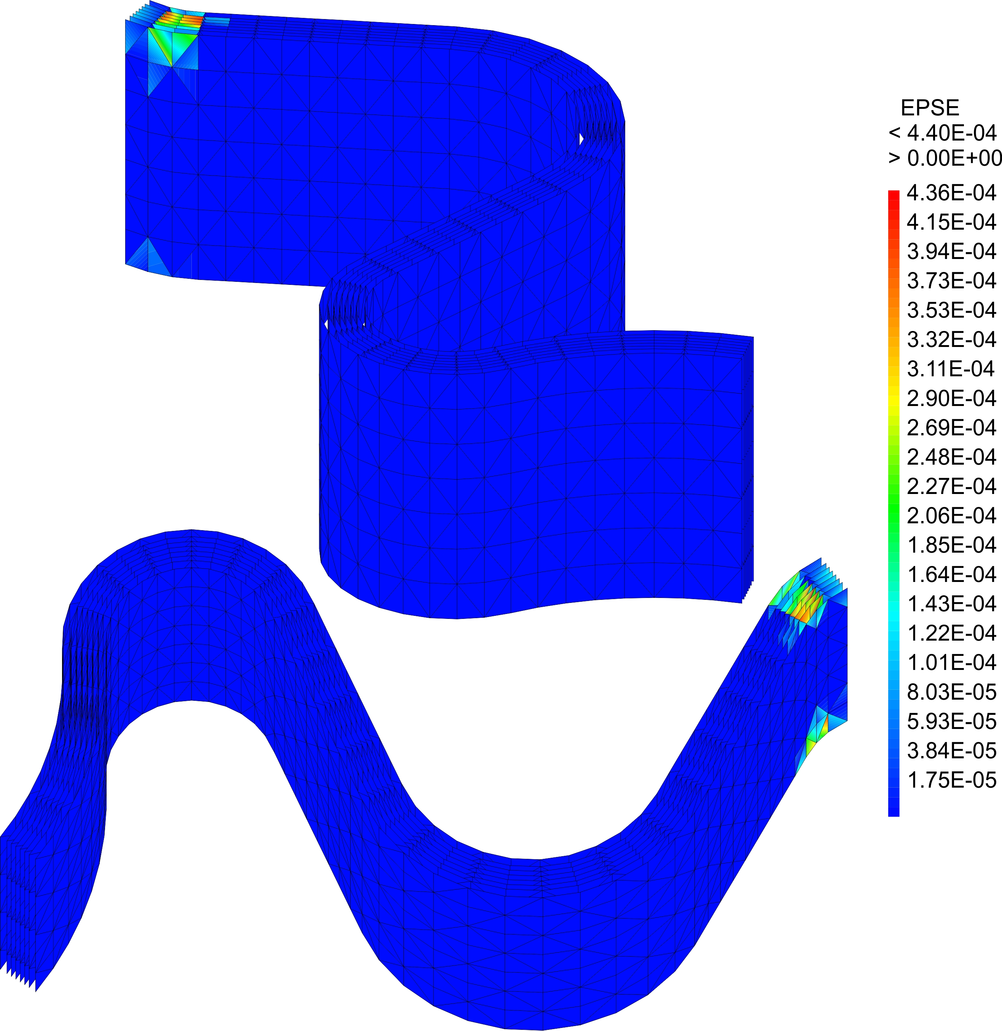
Thermal link (17.8 kA)
Deformation and eps of the updated geometry of the thermal link (2 x 0.2 + 6 x 0.1 mm)

Slide 34
Outline
Magnet quench test
Physics of the problem
Instrumentation
Results and comparison with simulations
Conclusions and next steps

Slide 35
Conclusions
The mechanical integrity of a Q1 beam screen prototype has been demonstrated. The behaviour of the beam screen remains elastic after 54 quenches up to 18.2 kA of current (ultimate current 17.8 kA)
The thermal links, the elastic rings and the centring pins have been inspected after the quench test and no damage nor unexpected deformation has been observed:
  The design of the thermal link has been slightly modified to further limit its deformation during a quench
The beam screen behaves as expected during a quench:
  The torque induced during the first phase of CLIQ has been observed;
  The beam screen goes in contact with the cold bore;
The mechanical response of the beam screen is directly correlated with the magnetic field measurements
A good agreement with simulation has been found;
;

Slide 36
Next steps
Test of a Q2 type beam screen with the correct material (P506 instead of 316 L) and
aC coating by May 2019:
  Magnetic field quality measurements;
  Quench test.

Slide 37
Thermal test - Outline
Thermal requirements at a glance
Supporting system & thermal link
Results and comparison with simulations
Conclusions and next steps

Slide 38

Thermal requirements at a glance
Maximum heat load to the cold mass: 0.5 W / m
Temperature inner copper layer:
60 K - 80 K
Maximum allowed ΔT from Q1 to D1: 15 K
(5 K in radial direction)
Q2 = 15 W/m
Heat load
Q1 = 25 W/m
M. Morrone, C. Garion
37

Slide 39



Supporting system & thermal link
Copper strip brazed on the W block and the interface plate (3 x block 40 cm long)
Interface plate laser welded
on the cooling tube
5 mm
Zirconia
Heat transferred to
the cold bore by conduction
through the supporting system
Titanium Grade 5
Courtesy of P. Borges de Sousa
M. Morrone, C. Garion
38

Slide 40


Nominal behaviour
(Simulation of the temperature profile)
Q2, T₀= 75 K, 15 W/m
Q1, T₀= 60 K, 25 W/m
Average temperature (K)
Average temperature (K)
W-Block | Inner Cu-layer
85.8 K (ΔT =10.3 K) | 75.8 K (ΔT =0.8 K)
W-Block | Inner Cu-layer
75.8 K (ΔT =15.8 K) | 60.45 K (ΔT =0.45 K)
M. Morrone, C. Garion
39

Slide 41


BS thermal test
-Q2 type-
80cm
Tests performed in the cryolab with WP9
Run 1: baseline configuration, parametric study (temperature, heat load)
Run 2: baseline config., reproducibility, varied pressure

Slide 42

Results: Beam screen temperature profile
EDMS 2042522
base T
Steady-state measurements
Homogeneously distributed heat load on all 4 quadrants (0 to 20 W/m)
Varied base (helium) temp. between 40 K and 80 K
Pressurised He II bath (cold bore) actively controlled at 1.9 K ± 1 mK
inner screen
tungsten block
15.8
0.8
0.45
10.3
FEM
FEM
Courtesy of P. Borges de Sousa
M. Morrone, C. Garion
41

Slide 43

Results: Heat load to the cold bore
EDMS 2042522
Max threshold
Static heat loads inherent to the cryostat removed
Nominal configuration
32 springs used
BS heaters used for different heat loads (ΔT between screen and tungsten blocks)
FEM (Conduction)
HL-LHC range
Results on specific setup
Courtesy of P. Borges de Sousa
M. Morrone, C. Garion
42

Slide 44
Conclusions
Maximum temperature rise on inner BS: 0.5 K
  Factor 10 lower than max. allowed (nominal conditions)
  Very good thermal decoupling between the absorbers and the beam screen tube
Maximum temperature rise on tungsten blocks: 9 K – 15 K (nominal conditions)
  Independent of base temperature
  Highly linear with increasing heat loads
Heat load to 1.9 K cold bore: 200 mW to 375 mW per meter (nominal conditions, 60 K to 90 K tungsten blocks temp.)
Very good agreement between simulations and experiments
Reproducibility of results confirmed
M. Morrone, C. Garion
43

Slide 45
Acknowledgements
  A big thanks to the colleagues of WP3, WP9, SM18 and EN-MME. In particular:
  P. Ferracin, E. Todesco, N. Bourcey, S. Izquierdo Bermudez, J.C. Perez, M. Bajko, F. Mangiarotti, J. Feuvrier, O. Sacristan, M. Guinchard, L. Fiscarelli, E. Ravaioli, L. Bortot, P. Borges de Sousa, T. Koettig, R. van Weelderen, J. Bremer, S. Claudet
M. Morrone, C. Garion
44

Slide 46
Back up slides

Slide 47


Slide 48


Slide 49

Numerical results: baseline (17.8 kA)
CLIQ phase 1
P506 Elastic limit 1350 MPa
(RED AREAS)
component | material | Elastic limit | Q1
 |  |  | F_{y max} [N/mm] -per eight- | σ_{max} [MPa] | δ_{max} [mm]
Cold bore | Ss 316 LN | 860 MPa (at 4 K) | 12.3 | 624 | 1.51
Heat absorber | Inermet | 1284 (at 77K) | 22 | > 1284 (loc.) | -
Octagonal pipe+ Cu layer | Ss P506 | 1350 MPa (at 50 K) | 5.3 | > 1350 (loc.) | -
Pin | Ss P506 | 1350 MPa (at 50 K) | - | > 1350 (loc.) | -

Slide 50

Numerical results: baseline (17.8 kA)
phase 2

Slide 51

signal of the compensator probe at 8.2 kA

Slide 52

Cold bore and beam screen instrumentation layout

Slide 53




Numerical results at 17.8 kA
  Integrated forces induced in the W block
Region 1: Most critical!!
1
2
3
component | Q1
 | Torque [N m/W block] | Tangential force [N/W block]
Cold bore | 253 | 3400
Heat absorber | 280 | 4200
Octagonal pipe | 81.5 | 1600
Region 2: Less severe than phase 1
Region 3: Less severe than without CLIQ
E.g. Fy for the tungsten block:
Q1_{NO CLIQ} ~233.5 [N/mm] > Q1_{CLIQ} ~200.5 [N/mm]
1
2
3
2

Slide 54
Assumption of the numerical model
No magnet coil modelled;
The electro-dynamic of the magnet is not considered (No IFCC, ISCC);
Magneto-resistivity of copper considered;
Heat load affecting the electrical properties considered;
Measured magnetic field assigned as input for the comparison of the experimental results with the simulations in this presentation.

Slide 55



Animations
First phase
Second phase *
* For visual purposes only as the W blocks are not welded.

Slide 56




Measuring probe
3 custom made displacement measuring heads inside the beam screen to measure:
Beam screen expansion
W block tilt
Magnetic field
Before the quench test
After the quench test
M. Morrone, C. Garion

