Slide 1
The development and application of digital BPM signal processors at SSRF
Longwei Lai*, Yongbin Leng, Yingbin Yan
lailongwei@sinap.ac.cn
BI, SSRF
DEELS2019 ESRF
June 2019

Slide 2
Outline
  Introduction
  Applications on SSRF
  Applications on FEL
  New processors for SHINE

Slide 3
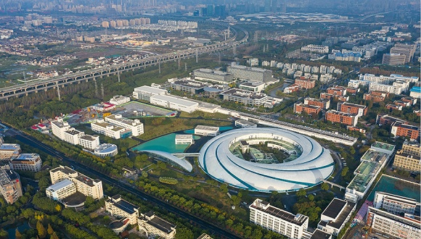
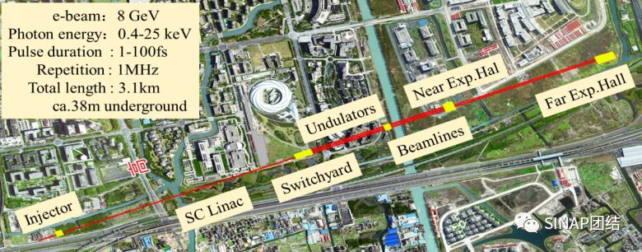
SSRF introduction
SSRF synchrotron radiation facility @ phase II
soft x-ray FEL @ user facility
hard x-ray FEL: SHINE @ tunnel construction
SHINE

Slide 4
BPM Signal Processor Milestones
2009.9 Project Start
2010.12 Principle Prototype: RF front-end and Digital Signal Processing
Lai Longwei, Leng Yongbin*, Yi Xing, et al. DBPM signal processing with field programmable gate arrays[J], NST 22(2011), 129-133.
Yi Xing, Leng Yongbin*, Lai Longwei, et al. RF front-end for digital beam position monitor signal processor[J], NST 22(2011), 65-69.
赖龙伟，冷用斌*，阎映炳，杨桂森等，数字BPM信号处理算法研究，核技术，2010年，第33卷第10期，734-739
2011.6 Version-I and Beam Tests
易星，冷用斌*，赖龙伟等. 基于软件无线电的新型数字束流位置处理器[J]，核技术，2012年，第35卷第5期
X. D. Sun, Y. B. Leng*, An DBPM Calibration Method Implemented on FPGA, IBIC 2012, Tsukuba, Japan
Leng Yongbin, Yi Xin, Lai Longwei, et al. Online Evaluation of New DBPM Processor at SINAP[C]// Prof of ICALEPCS2011,
冷用斌，易星，赖龙伟等. 新型数字BPM信号处理器研制进展[J]，核技术，2011年，第33卷第5期，326-330
X.D. Sun, Y.B. Leng. Implementation and integration of a systematic DBPM calibration [J], NST 25(2014), 020401-1-6.
X.D. Sun, Y.B. Leng. MATLAB Simulation of DBPM Digital Down Conversion [J] AMM, 333(2013), 680-683.
赖龙伟，冷用斌，易星等. 数字束流位置信号处理算法优化[J], 强激光与粒子束,2013年，第25卷第1期，109-113
2014.6 Small amount(5) tests
2015.6 Optimization, Intelligent Trigger Application Development
L.W. Lai, Y.B. Leng, AN INTELLIGIENT TRIGGER ABNORMAL BEAM OPERATION MONITORING PROCESSOR AT THE SSRF, IPAC2015
赖龙伟，冷用斌等. 数字BPM信号处理器研制进展[J], 原子能科学技术,2015
2016.6 Version-II, Volume Application on SXFEL, DCLS and Sirius LINAC
L.W. Lai, Y.B. Leng, BATCH APPLICATIONS OF DIGITAL BPM PROCESSORS FROM THE SINAP, IBIC2016
L.W. Lai, Y.B. Leng, DESIGN AND PERFORMANCE OF DIGITAL BPM PROCESSOR FOR DCLS AND SXFEL, IPAC2017
2017.12 Firmware and software upgrade for SXFEL
L.W.Lai, , et.al, UPGRADE OF DIGITAL BPM PROCESSOR AT DCLS AND SXFEL, IPAC2018
2017 Ideas on direct RF sampling BPM processor for C band cavity BPM
L.W.Lai, et.al, THE APPLICATION OF DIRECT RF SAMPLING SYSTEM ON CAVITY BPM SIGNAL PROCESSING, IBIC2017
2018.1 Firmware and software upgrade for SSRF
L.W.Lai , et.al, THE DEVELOPMENT AND APPLICATIONS OF THE DIGITAL BPM SIGNAL PROCESSOR AT SINAP, FLS2018
L.W.Lai , et.al, THE DEVELOPMENT AND APPLICATIONS OF DIGITAL BPM SIGNAL PROCESSOR ON SSRF, IBIC2018
2019.4 10 units on-line operation on SSRF
2019 Start new processor design for SHINE

Slide 5
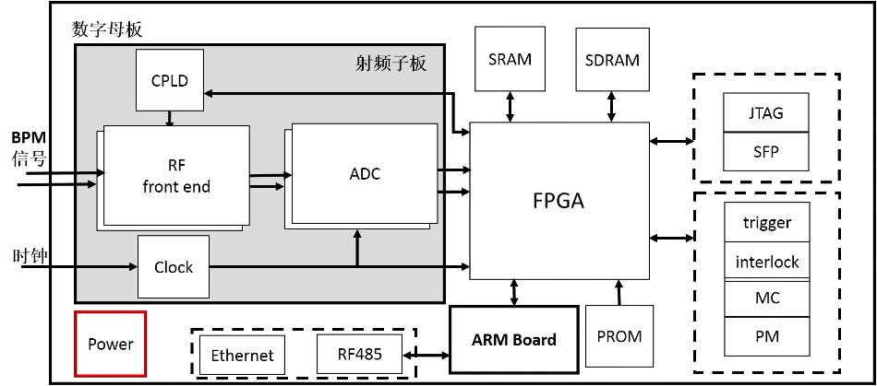
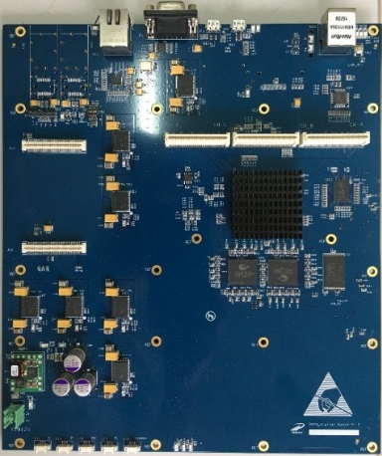
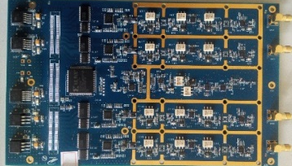
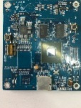
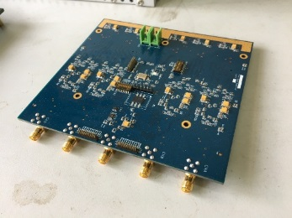
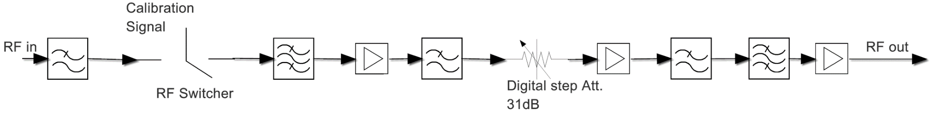
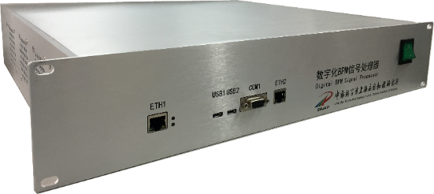
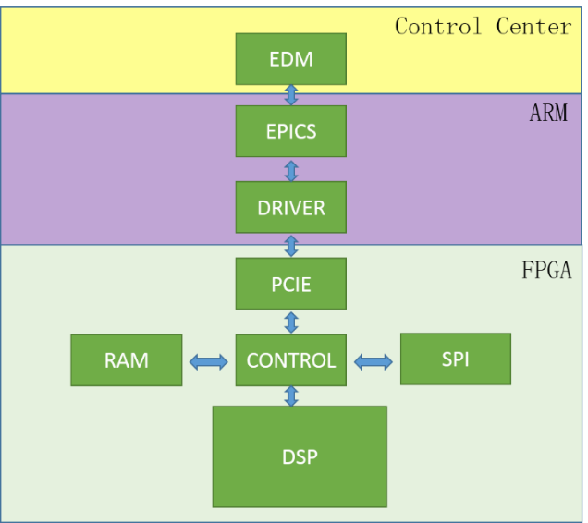
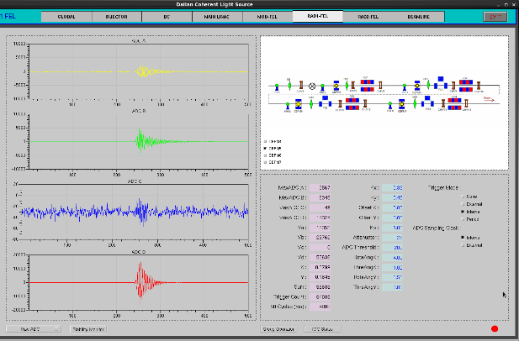
Processor Overview
Parameters | value
Channels | 4
Central Frequency | 500MHz/wideband
Bandwidth | ~20MHz/wideband
Dynamic range | 31dB/NA
ADC bits | 16
ADC bandwidth | 650MHz
Max ADC rate | 125MSPS
FPGA | Xilinx xc5vsx50t
Clock | Ext./Int.
Trigger | Ext./Self/Period
Software | Arm-Linux/EPICS

Slide 6
Applications on SSRF
Notes:
On SSRF, we have developed button BPM processor, operation monitor and charge monitor

Slide 7
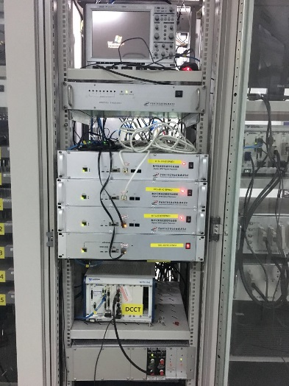
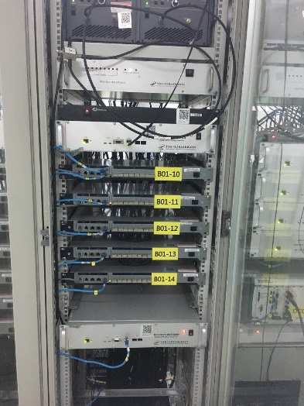
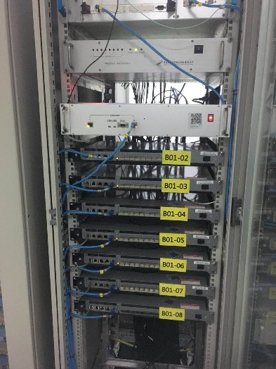
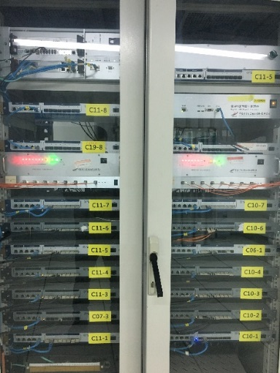
Applications on SSRF
Small amount of processors are installed on SSRF:
LINAC 1/3
LTB 1/3
Booster 3/30
BTS 4/5
Storage ring 1/140
More will be installed gradually…

Slide 8
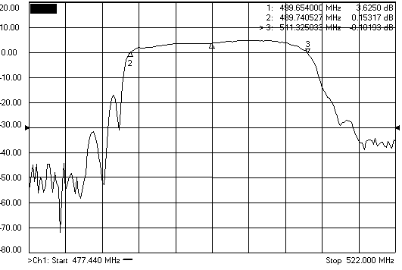
Version-I DBPM Beam Tests on SR@2012
RF 3dB bandwidth
ADC Spectrum
SA(injecting)
SA Spectrum(injecting)
TBT Spectrum
TBT Spectrum(injecting)
Current Meas. With SA
Life Meas. With SA
RMS Eval. At Lab
RMS Eval. On SSRF
FA Spectrum
FA Spectrum(zoom in)

Slide 9

Version-II DBPM Beam Tests on SR@Jan. 2018
DBPM
Power divider
Pickup RF signal
K=10mm, Turn-by-turn resolution:0.34μm

Slide 10
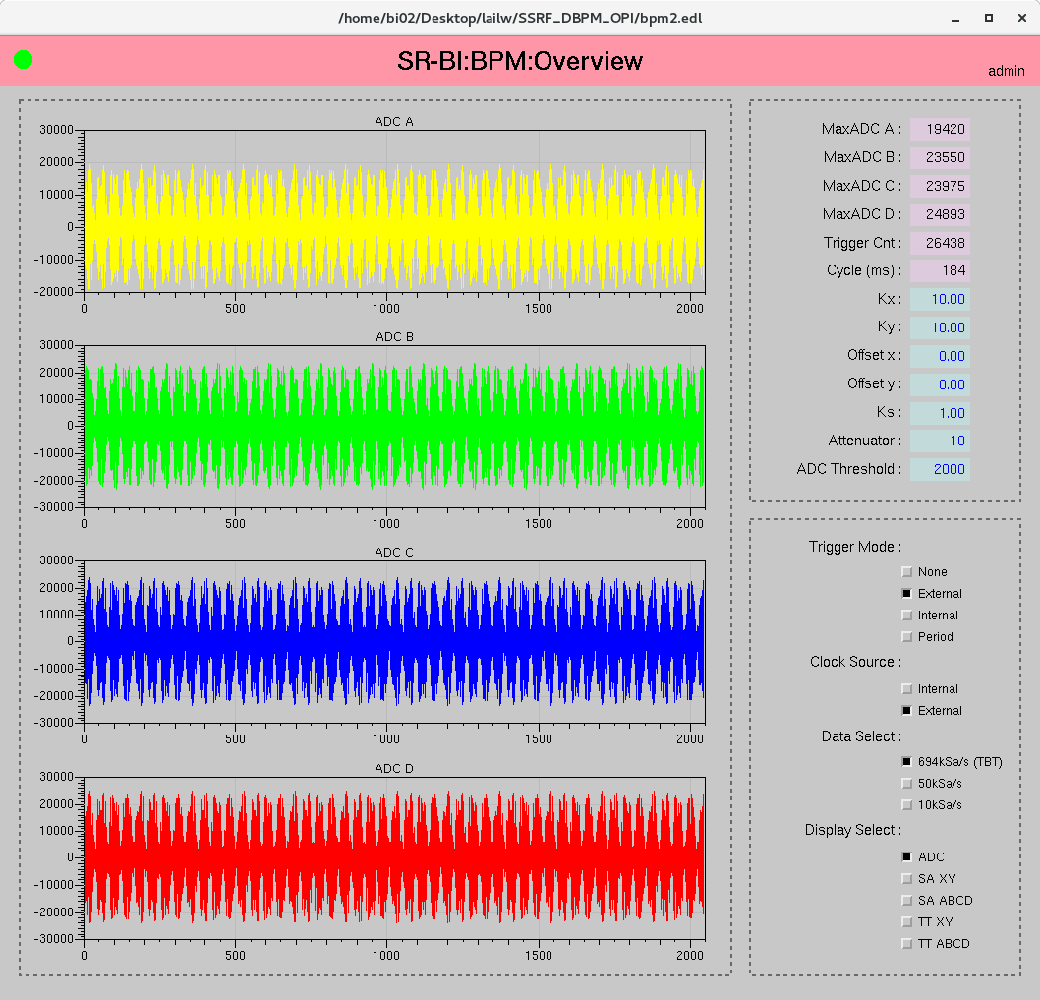
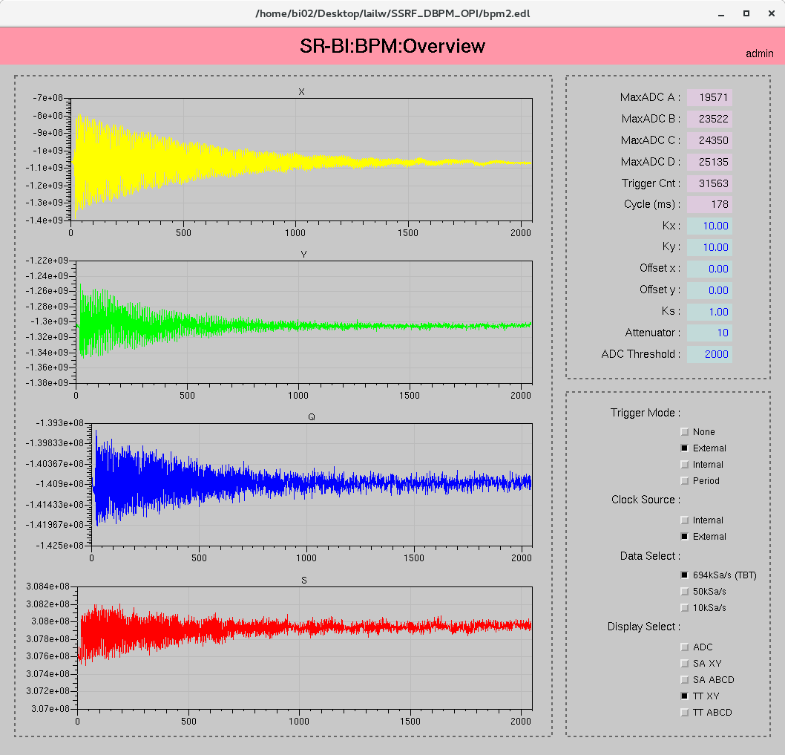
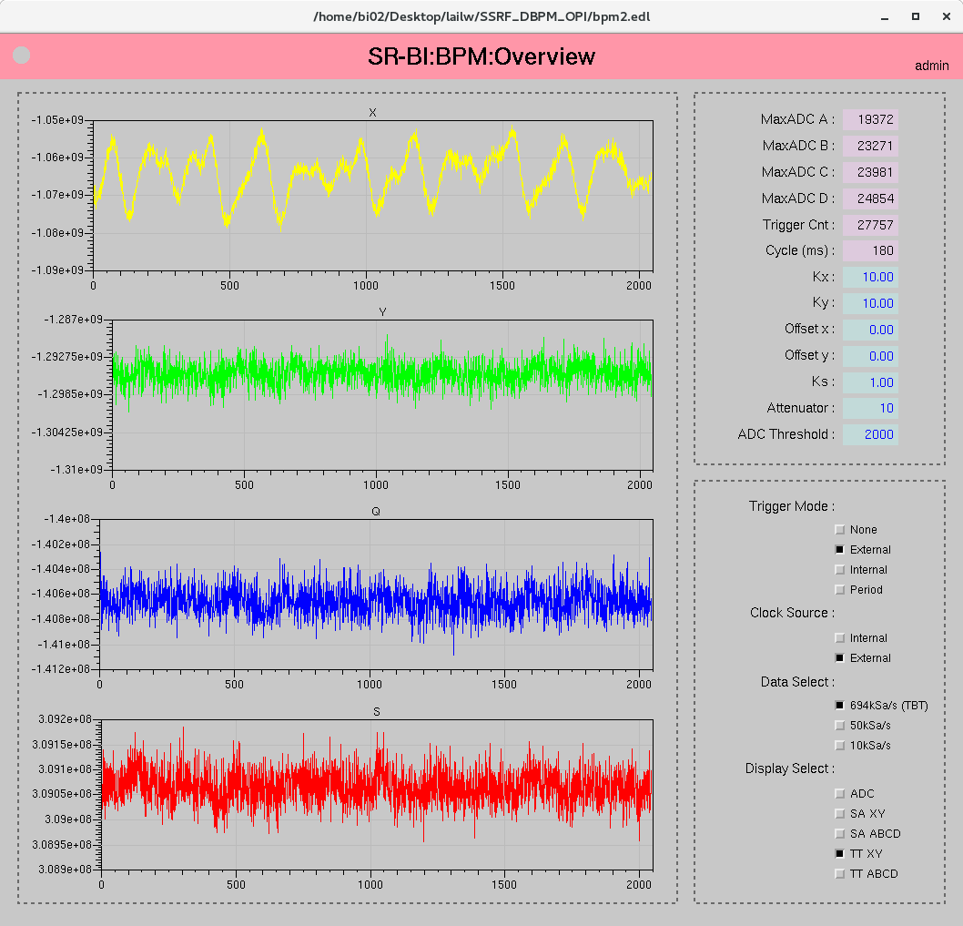
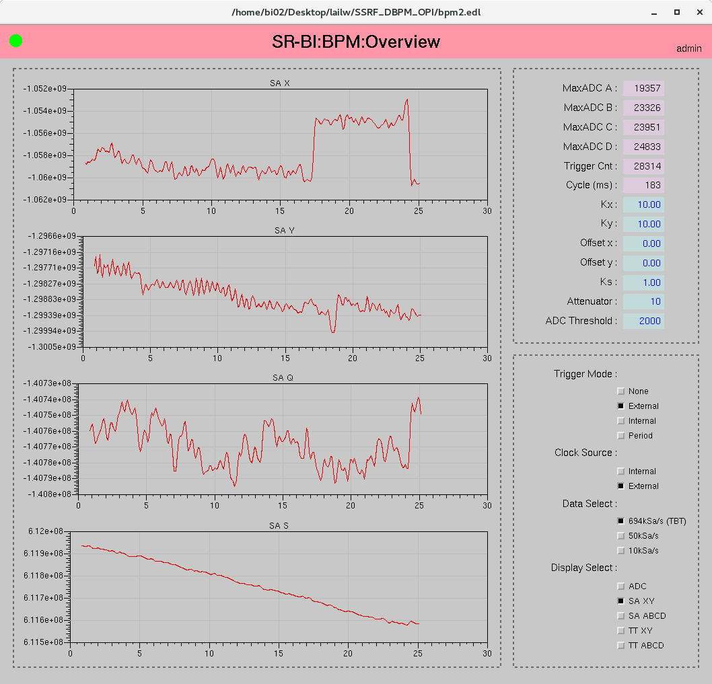
Control panel and data
ADC data
Turn-by-turn data during injection
Turn-by-turn data
SA data

Slide 11
SSRF Beam Test—Check With Brilliance
~2Hz injecting rate
TBT X
TBT X(zoom in)
SA X
TBT Y
TBT Y(zoom in)
SA Y
Assuming the Brilliance results are correct.
Data spectrums show they fit quite well.

Slide 12
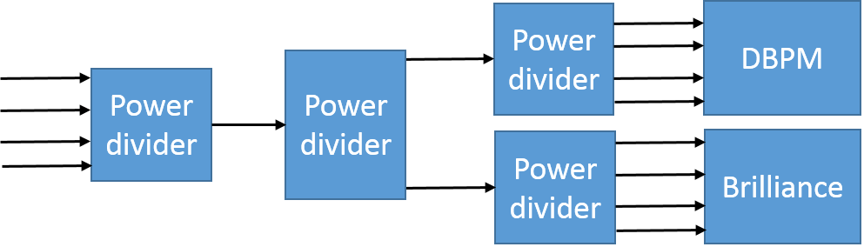
SSRF Beam Test—Current Dependency
SA X
SA Y
BPM pickup sum signal is divided into 8 channels and put into DBPM and Brilliance, similar to beam passing through BPM center. The output position value should be stable.
The DBPM output is drifting when beam current decays from 260mA to 200mA. Brilliance output is stable when crossbars are switched off.
The main reason is the inconsistency between the four channels.
Fit polynomial to data.
P = POLYFIT(X,Y,N), N=3
X: SA channel read out
Y: current, mA
Y=P(1)*X^3 + P(2)*X^2+P(3)*X + P(4)

Slide 13
SSRF Beam Test—Correction
X fits well after correction.
Y not very good.
Correction effect is obvious during injection.

Slide 14
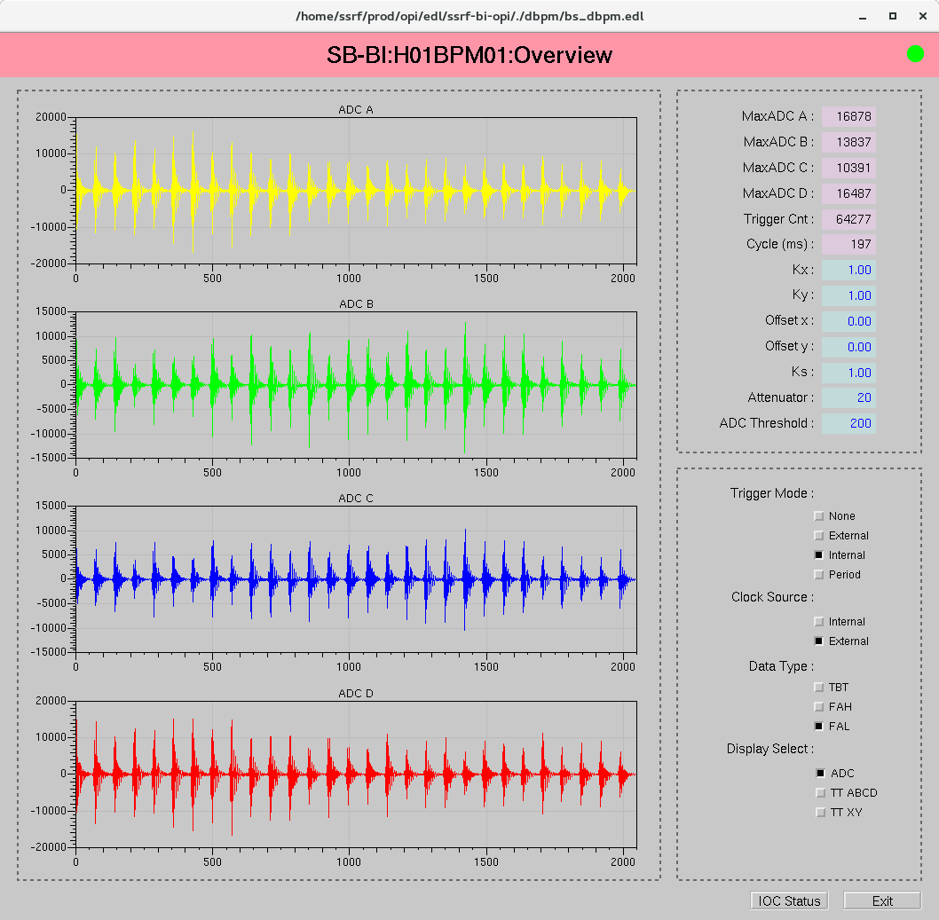
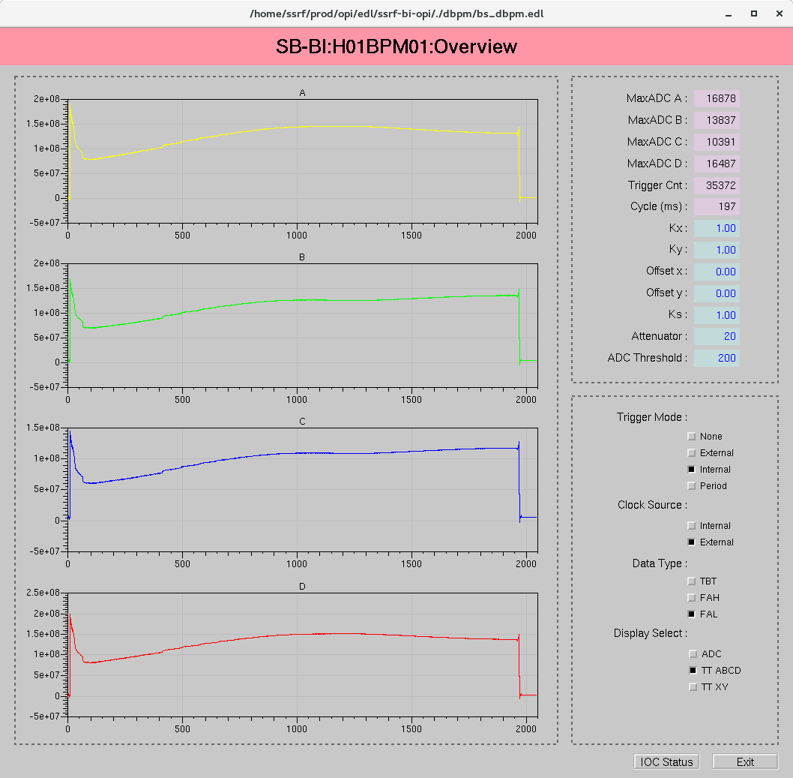
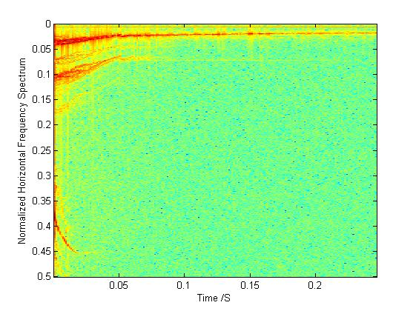
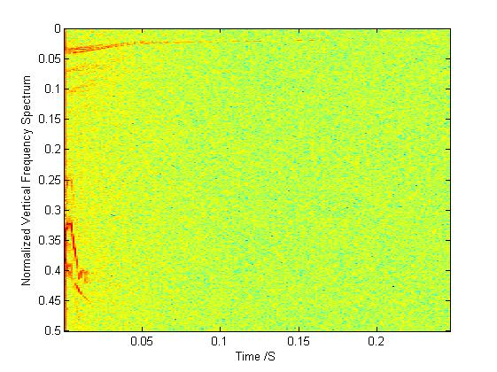
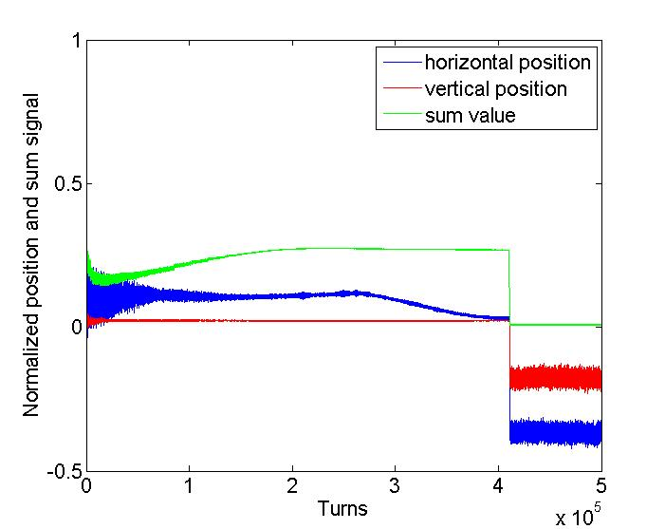
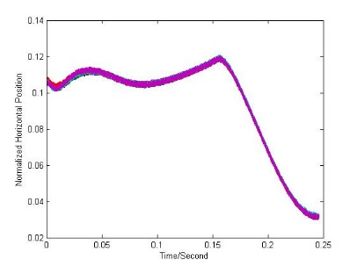
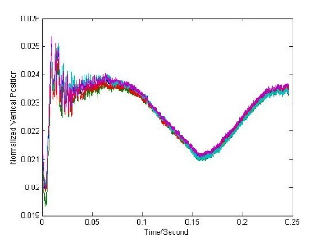
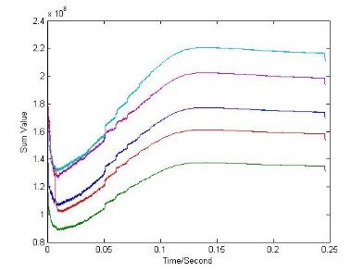
Beam test on booster
Streaming data or capture data for:
ADC raw data
turn-by-turn data
7.9kHz data(TBT/210), cover ramping period within 2000 points
TBT data spectrum during one injection
x/y/sum of one top-up period(five injections)

Slide 15
SSRF Operation Monitor
Monitoring beam status and capture data when injection is detected.
TBT data
Δ/∑
FIFO
FFT
Abnormal judge
∑
Beam loss judge
Trigger
& Tag
16384×4FIFO
Trigger
Tag
FPGA
ARM
TBT data waveform and spectrum during injecting.(Hor.)
Data
L.W. Lai, Y.B. Leng, Y.B. Yan, Z.C. Chen,An Intelligent Trigger Abnormal Beam Operation Monitoring Processor at the SSRF, IPAC2015
Tune monitoring.

Slide 16
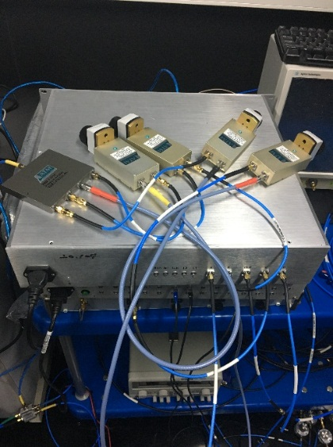
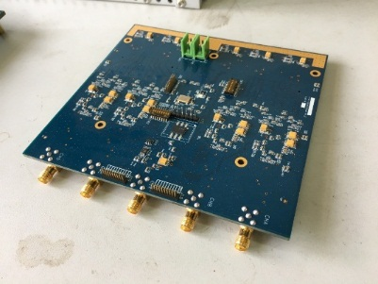
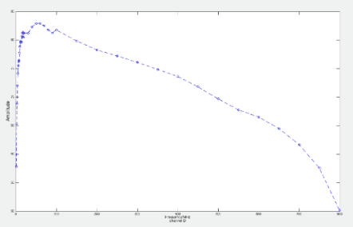
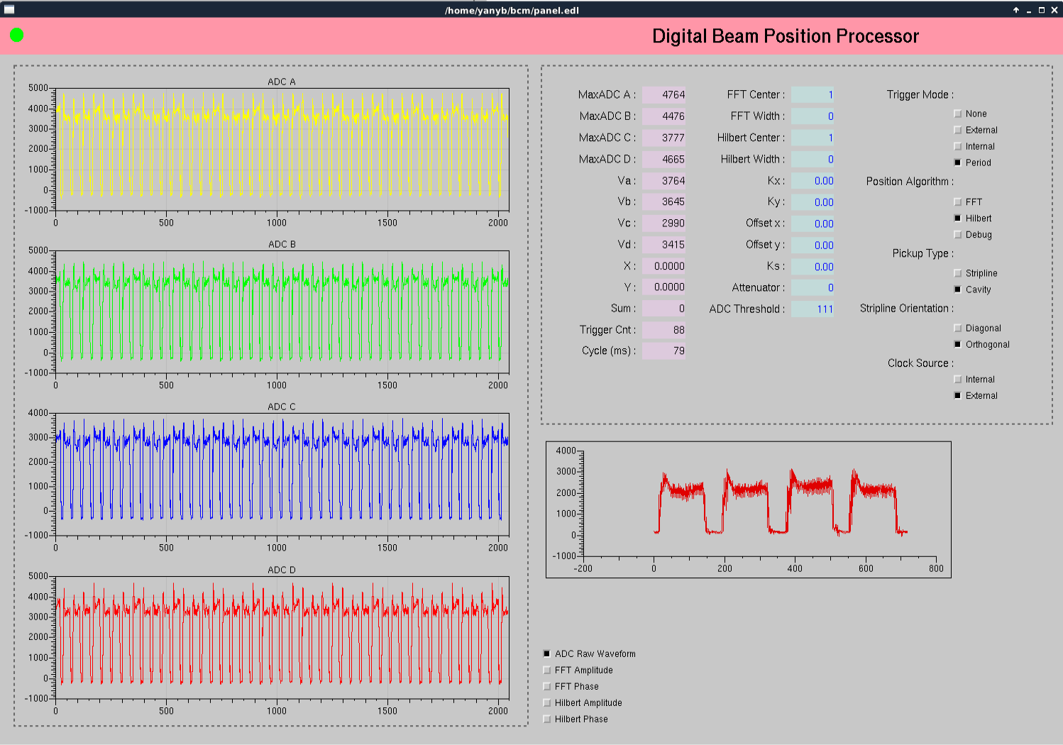
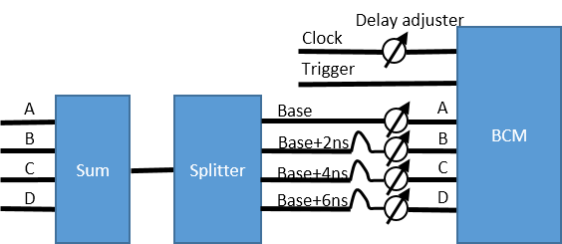
Bunch Charge Monitor
4 ADCs on wideband RF board make bunch-by-bunch charge measurement with interleaved sampling.
Optimization is ongoing.
Wideband ADC board
Interleaved Sampling

Slide 17
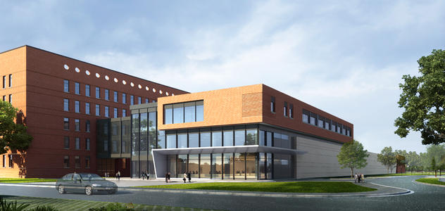
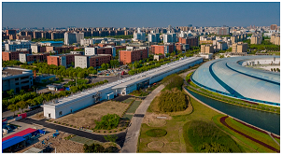
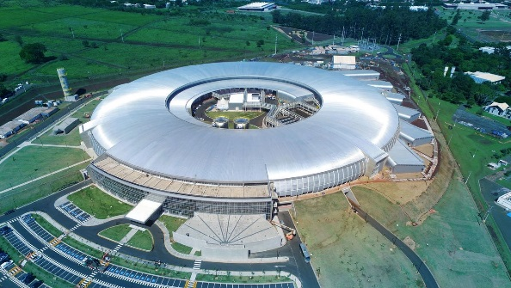
Applications on FEL/LINAC
Stripline BPM Processor
Cavity BPM Processor
BAM processor
DCLS
SXFEL
Sirius LINAC

Slide 18
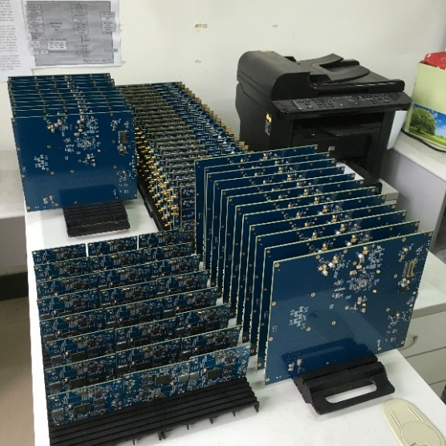
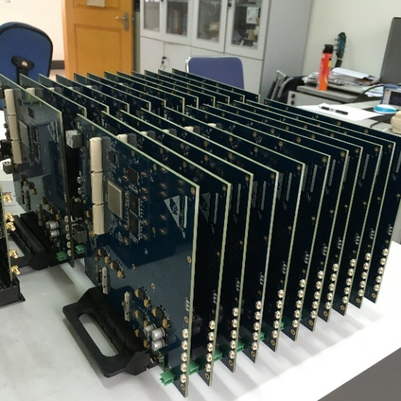
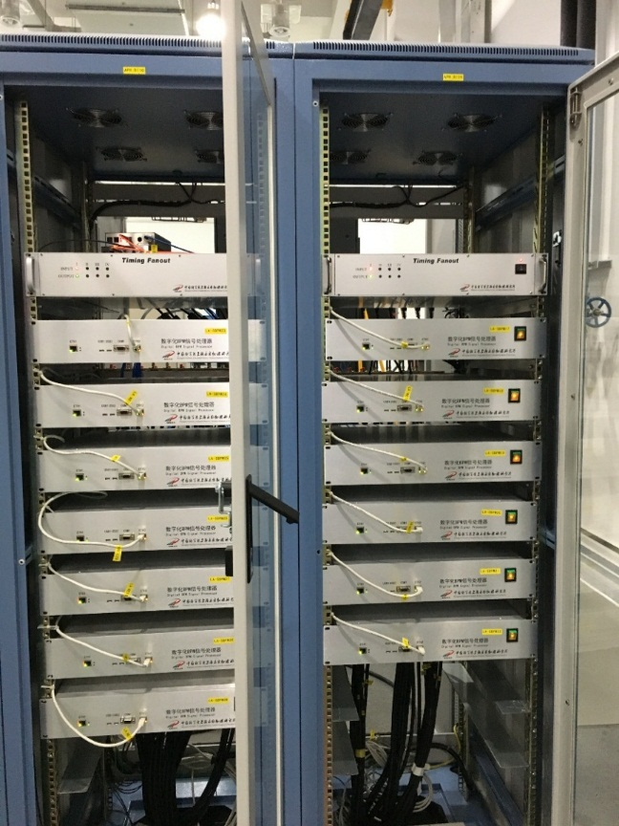
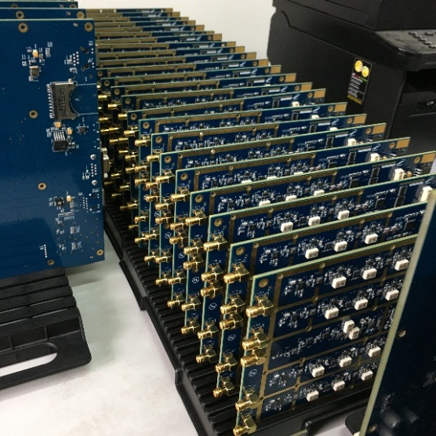
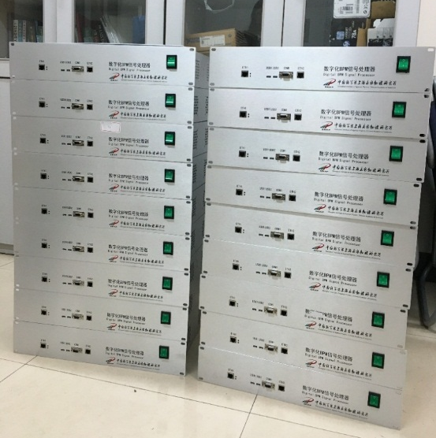
Mass Application on SXFEL/DCLS

Slide 19
SBPM Evaluation
K=5.24, 4.3μm@188pC
K=5.24, 0.18pC@188pC
Vertical displacement is getting larger along the beam direction.
Charge measurement accuracy is getting worse when the beam moving from center.

Slide 20
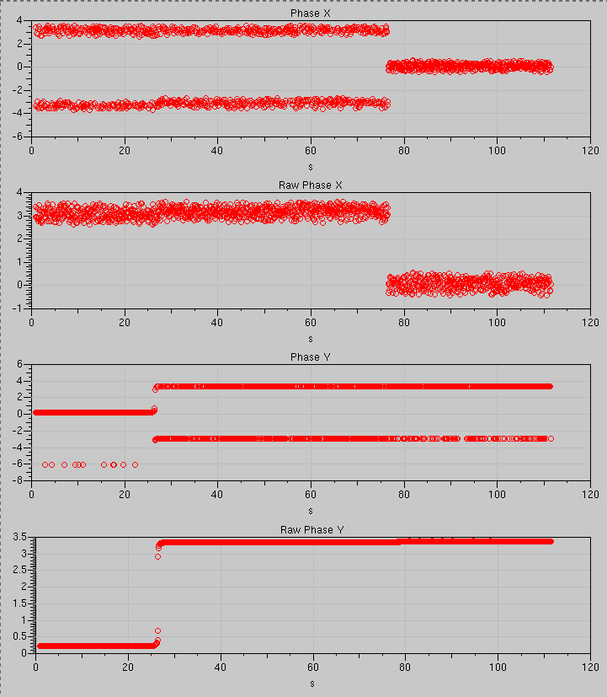
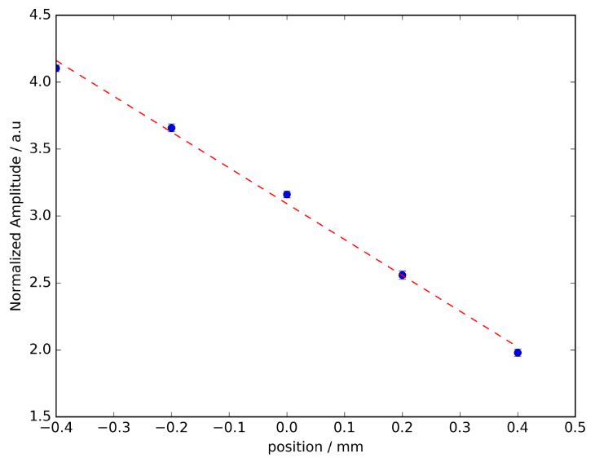
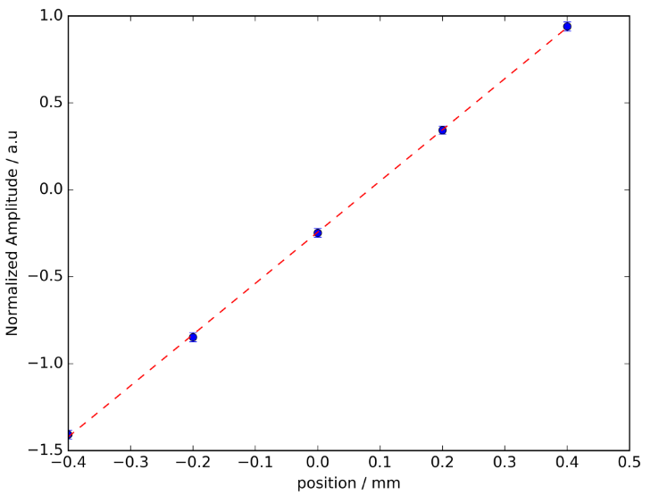
Phase and k Calibration
Before correction
X phase distribution is wider than Y, caused by beam tilt in X direction.
After correction
Kx = 0.37
Before correction
After correction
Ky = 0.34
Phase calibration tests.
K calibration tests.

Slide 21
Processor for SHINE
Cold button BPM processor
Stripline BPM processor
Cavity BPM processor
……
ADC+FPGA

Slide 22
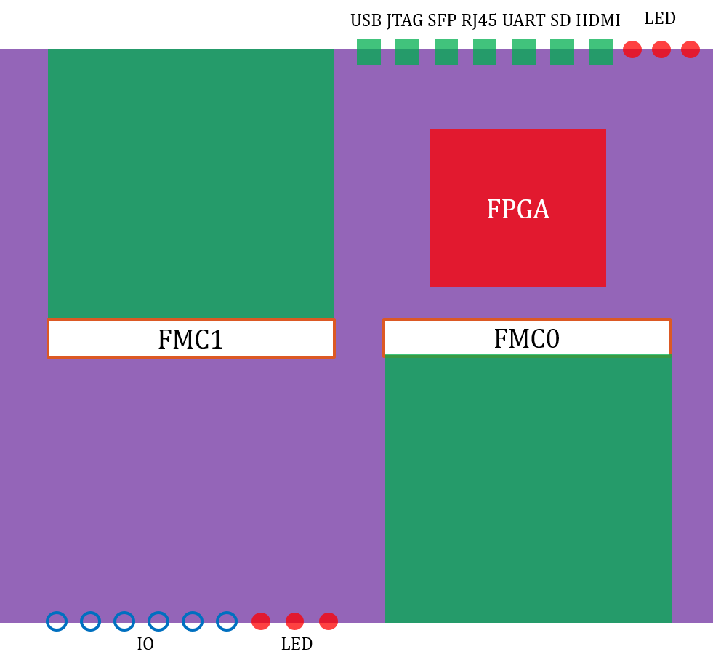
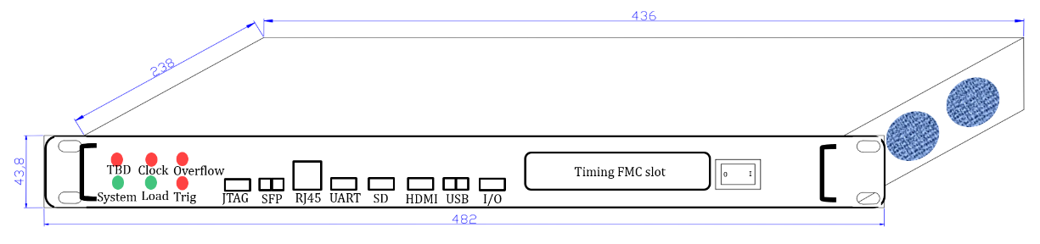

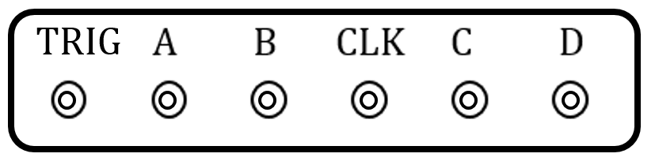
Processor Overview
standalone structure based on Xilinx SOC
common platform for beam signal processing…
FMC ADC and timing mezzanine cards
IF sampling / RF sampling ADC card, 1MHz repetition rate

Slide 23
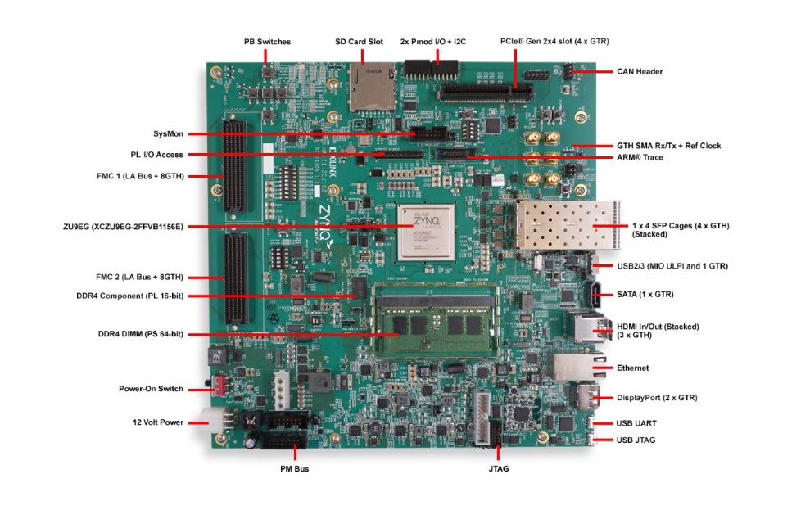
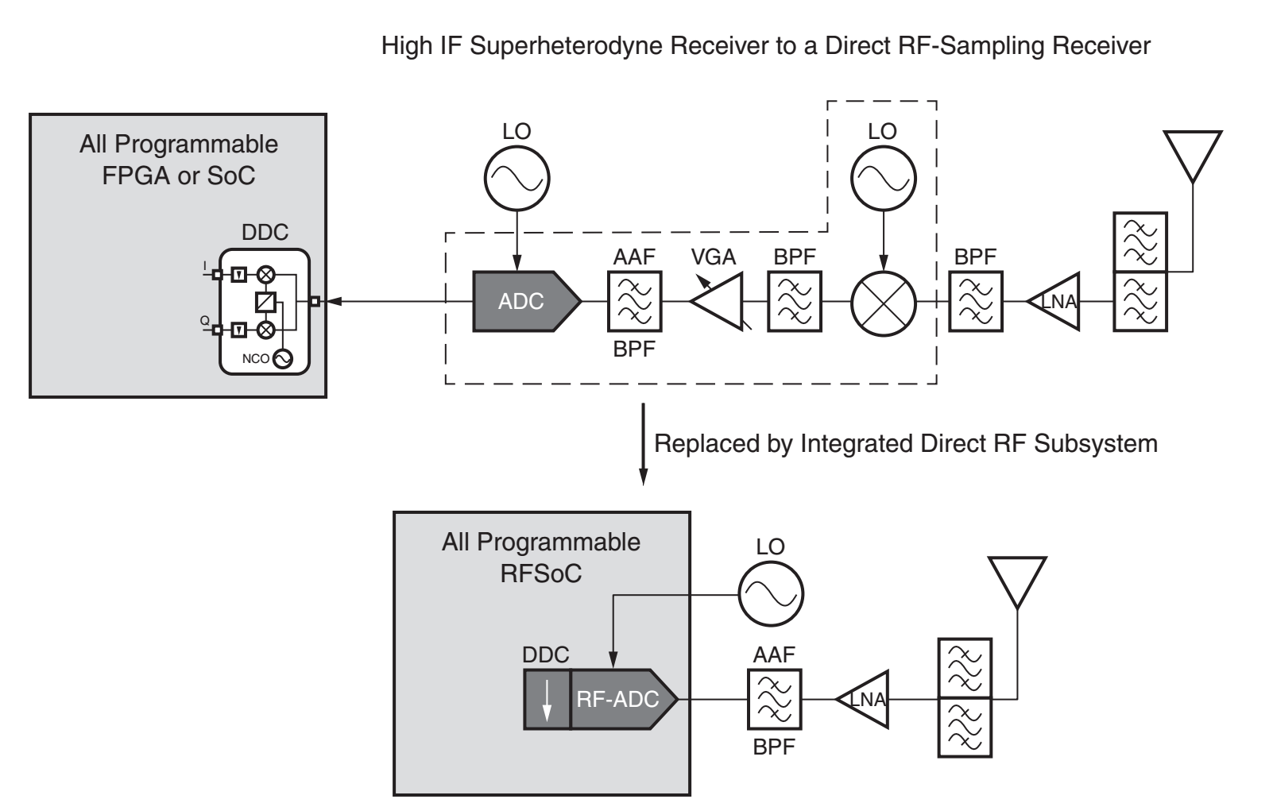

Hardware
Refer to the design of Xilinx ZCU102 evaluation board
Zynq Ultrascale SOC FPGA ZU19EG
≥500MSPS, ≥14bits IF sampling processor(AC&DC), also can be used as BxB processor on synchrotron facility
RF direct sampling technique (bandwidth >5GHz) is also studied for C band cavity BPM signal processor, ≥14bits
IF sampling
RF sampling

Slide 24


FPGA
ZU19EG VS. XC5VSX50T
≥ 16 times LUTs
6.8 times DSP
7.28 times block RAM
1.4 times user I/O
Quad-core Arm

Slide 25
FPGA design overview
ADC
Interface
Signal Processing
Module
(algorithm config.)
Data Flow Control
Manager
Timing
Interface
Clock Config.
Interlock
Module
DMA
Trigger
Config.
(delay control, mode config.
System
Monitor
User IO
& LED
SFP
Interface
SDRAM
Interface
Register
Control
Manager
PL
PS-PL Interface
APP
SD
QSPI
UART
ETH
USB
HDMI
Driver
OS
PS

Slide 26







BxB DBPM / PT Acc. DBPM / TBF Processor
SP Device PXI board.
BPM Processor on Proton Therapy Accelerator.
On-line.
Bunch-by-bunch transverse feedback processor.
Tested on SSRF.
500M bunch-by-bunch BPM processor
Tested on SSRF.

Slide 27
Facility | Number
Brazil Sirius LINAC | 2+
DCLS | 19+
SXFEL test facility | 60
SXFEL user facility | 50
SSRF | 10+
SHINE | 300+

Slide 28
Thanks for your attention

