Slide 1

ALBA optical fiber BLMs
Angel Olmos
(on behalf of the ALBA and ICCUB/SiUB teams)
DEELS19, ESRF - Grenoble

Slide 2
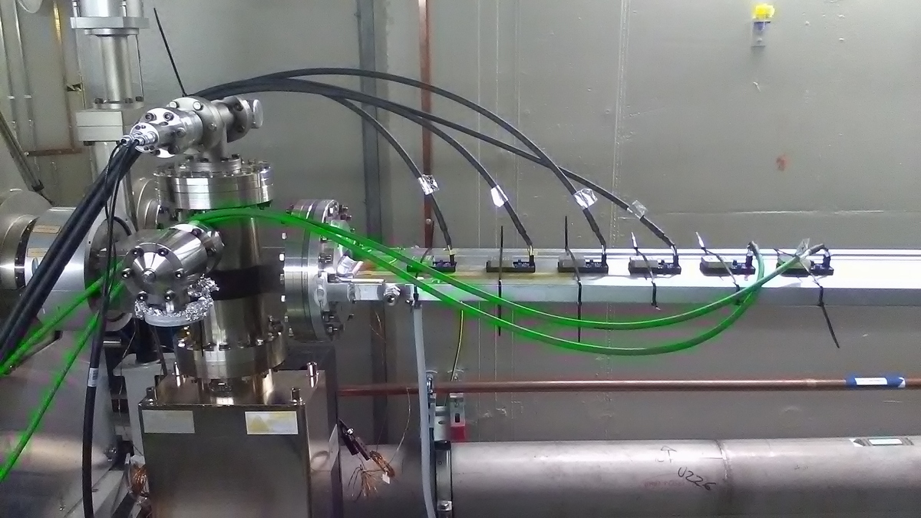
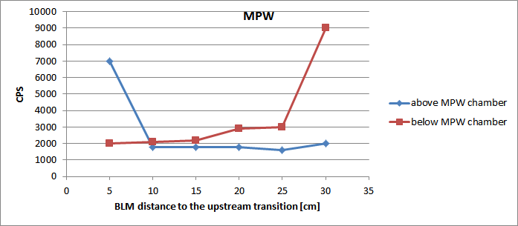
MOTIVATION
We suspected to have a Physical Aperture problem in our MPW chamber
Vertical bumps seem to point out towards a chamber misalignment
In order to diagnose, many Bergoz BLMs were placed on the chamber (top/bottom)
Results were contradictory and so we decided to look for other methods
Development of a BLM based on optical fibers, which will provide integrated losses all along the chamber and possibilities of losses location

Slide 3
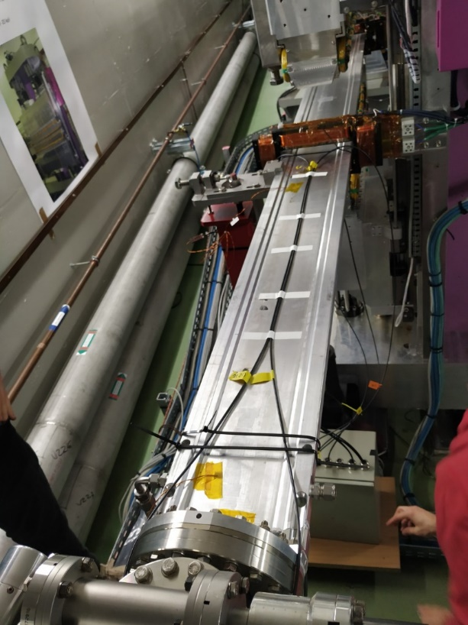
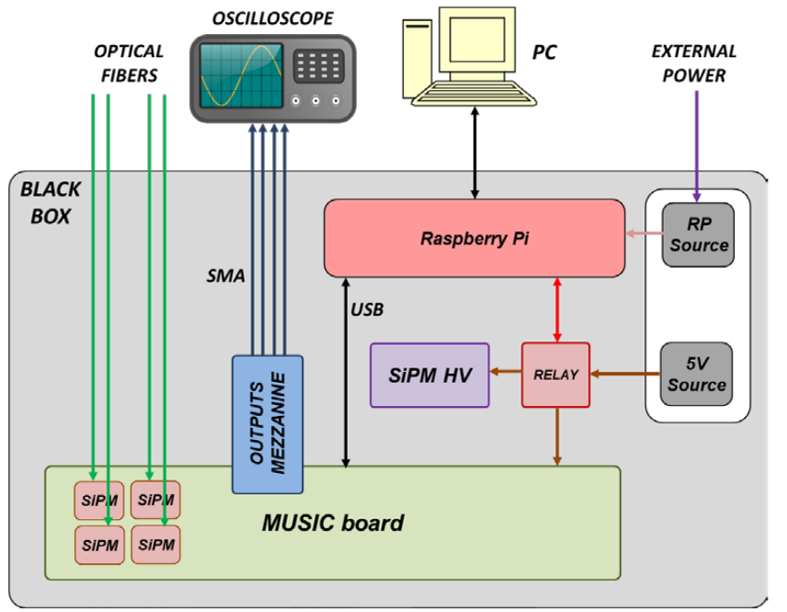
PARTS OF THE SYSTEM
Beam lost monitor system based on scintillating optical fibers + SiPM detectors
Possibility to identify the place of the losses
Preliminary tests of remote control done using a skippy-TANGO interface

Slide 4
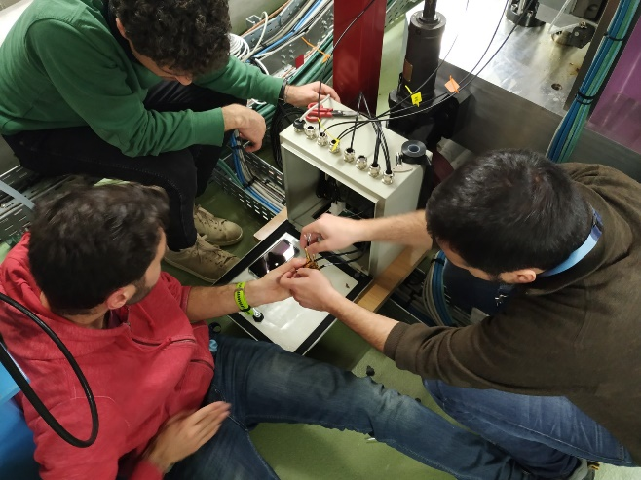
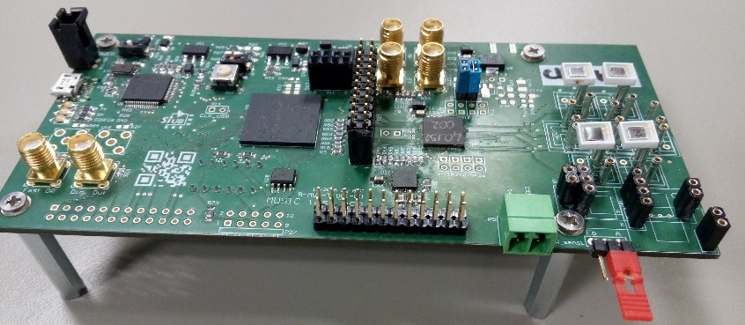
PARTS OF THE SYSTEM
MUSIC board developed by ICCUB/SiUB team
It takes care of the SiPM reading + digitalization
Provides analog/digital signals to scope (debugging) and data to Raspberry PI
4

Slide 5


LAB TESTS
+80V
+5V
MUSIC board
SiPM
SiPM
SiPM
SiPM
SCOPE

Slide 6
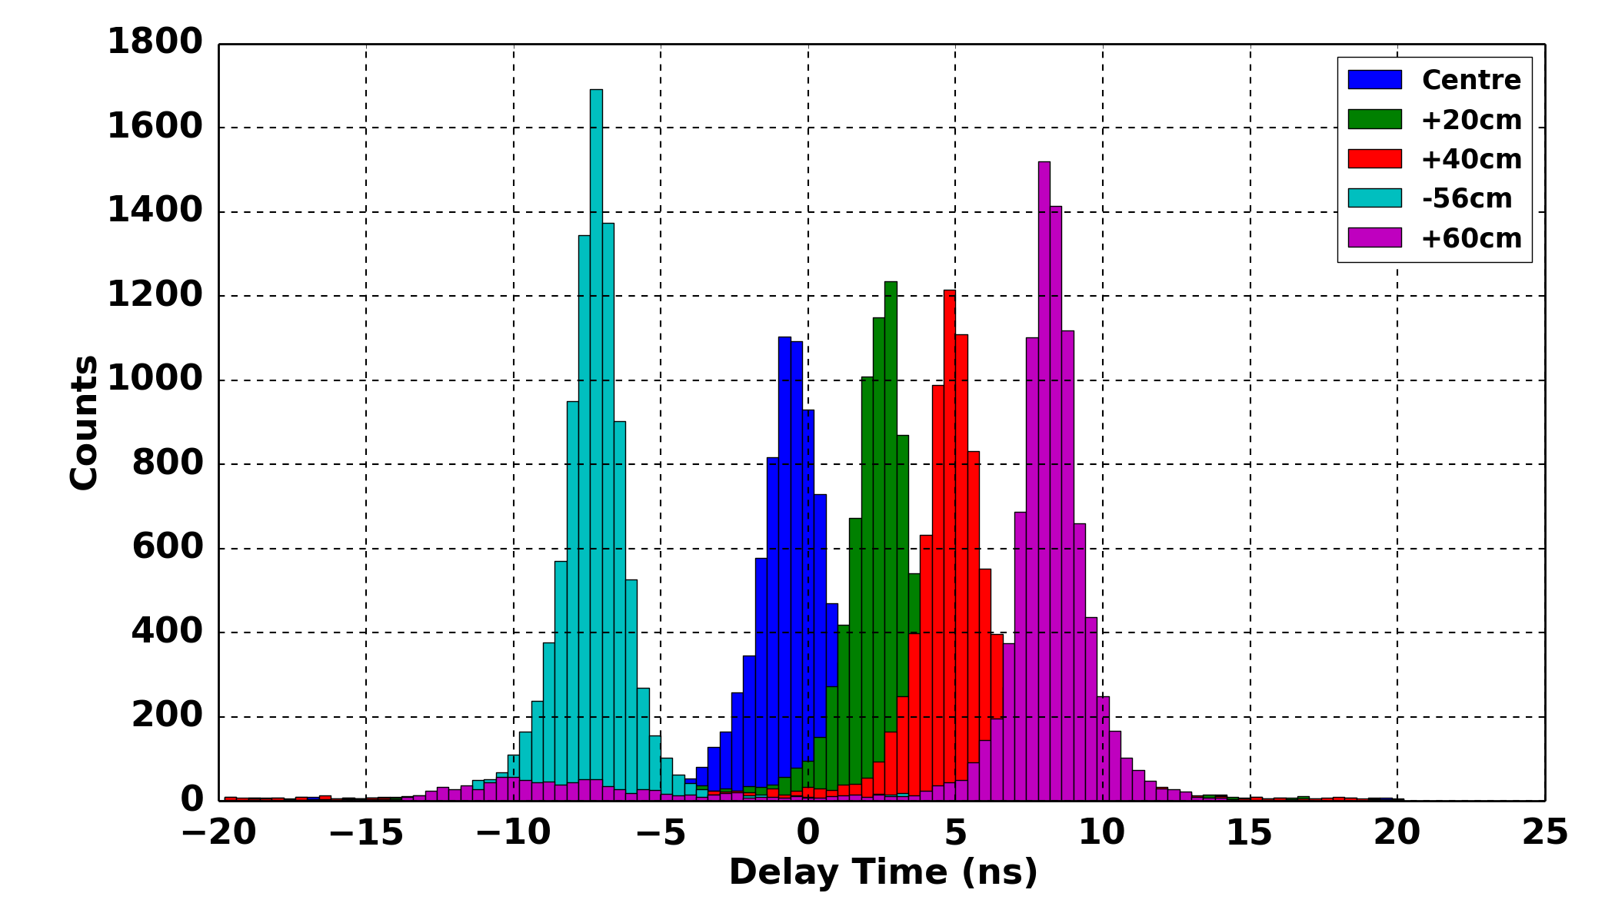
LAB TESTS
Losses location / Delay Distribution
Delay time between the signals from the SiPM at both ends of the fiber, processed with MUSIC ASIC and recorded with Scope.

Slide 7
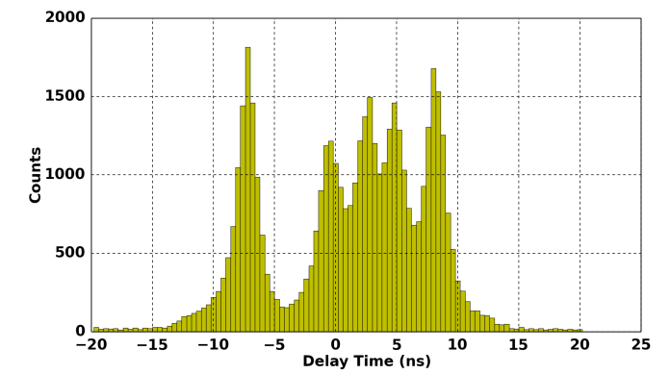
LAB TESTS
Losses location / Delay Distribution
Histogram summation for all the delay times from the different positions
20cm resolution
Enough resolution to distinguish two losses with 20cm of separation in a 2m optical fiber

Slide 8
TESTS WITH BEAM
Setup

Slide 9
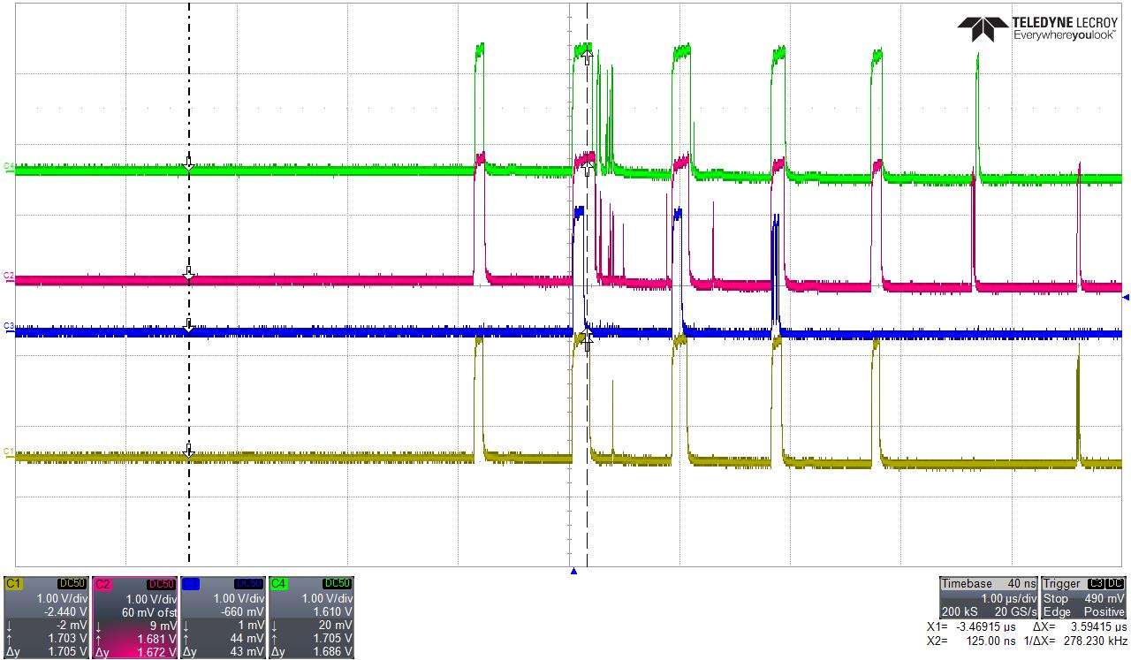
TESTS WITH BEAM
Scope Mode
Debug mode not intended for normal operation, just for calibration
Example of turn by turn losses during a TopUp injection cycle
1 turn
Digitalized pulses width ~ losses

Slide 10
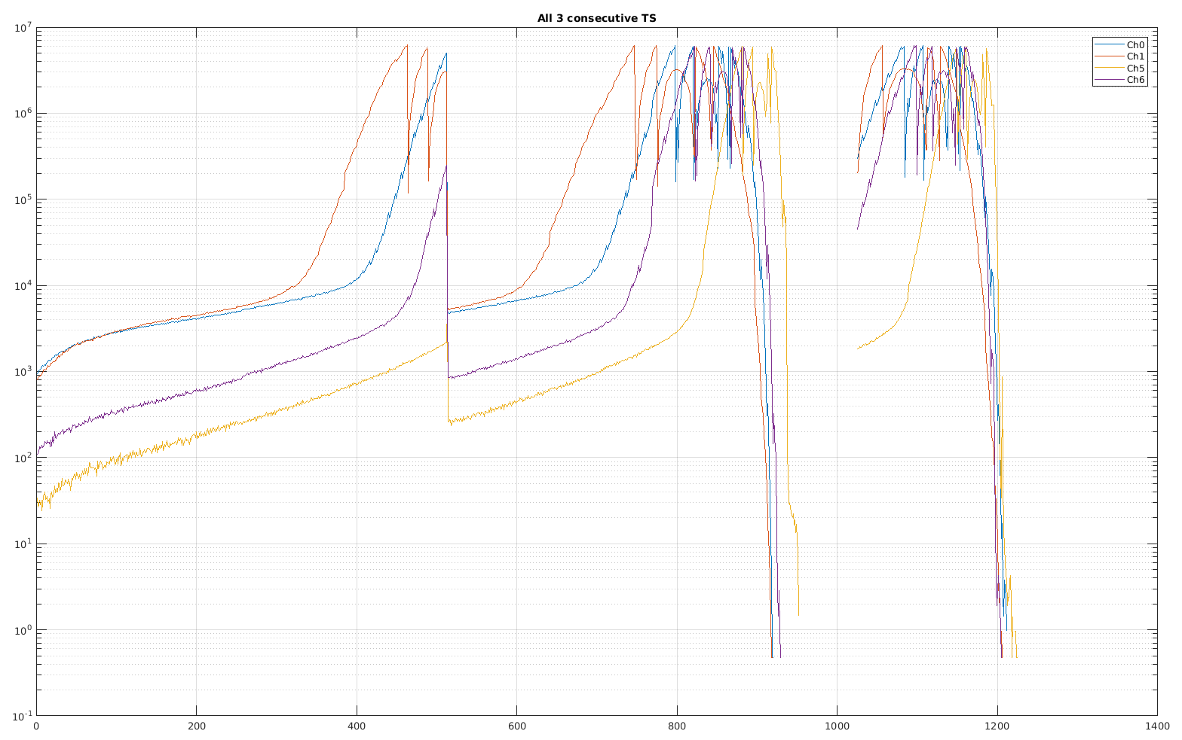
TESTS WITH BEAM
Calibration
SiPM response calibration with beam turned to be too complicated
Counts #
Difficult to find “good” SiPM thresholds providing same counts for all sensors
CH0 CH1 // CH5 CH6
V threshold [~mV]

Slide 11
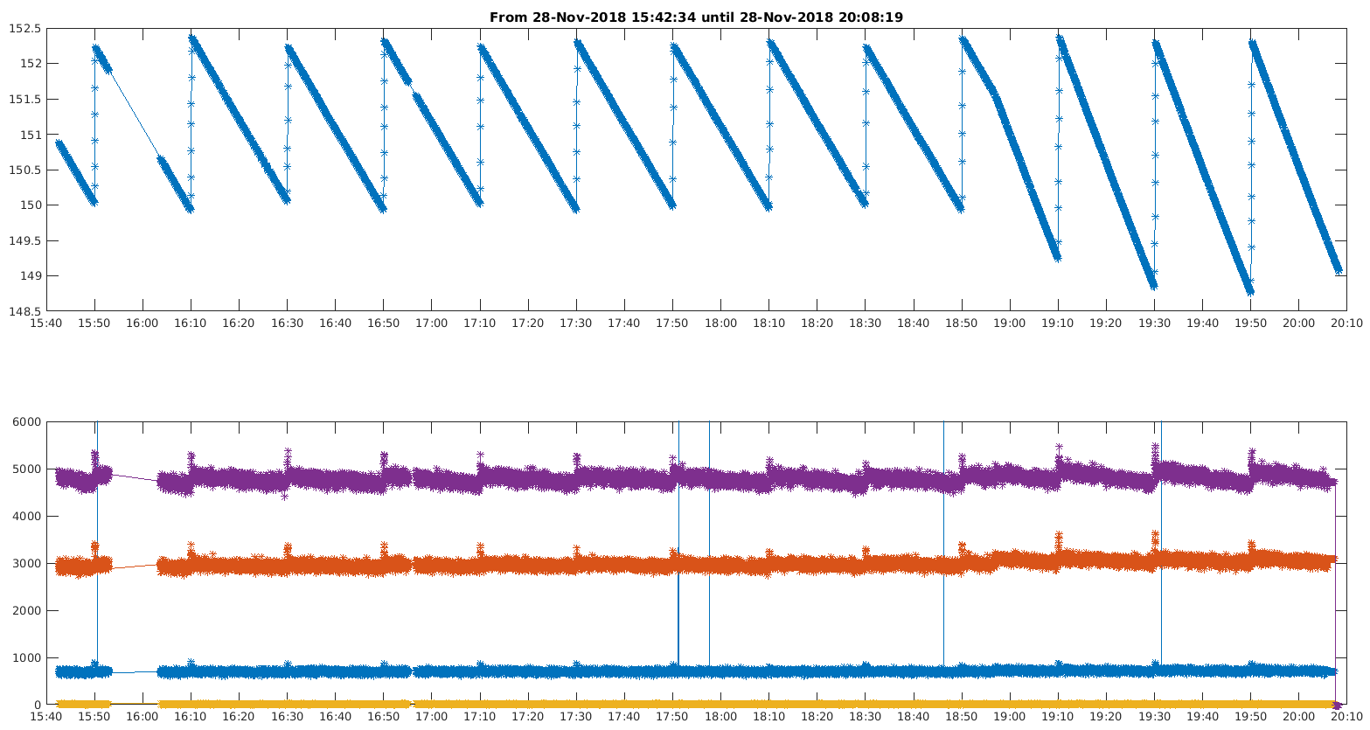
TESTS WITH BEAM
Counting Mode
Example: Losses during normal Beamlines operation
DCCT
CH0 CH1 // CH5 CH6

Slide 12
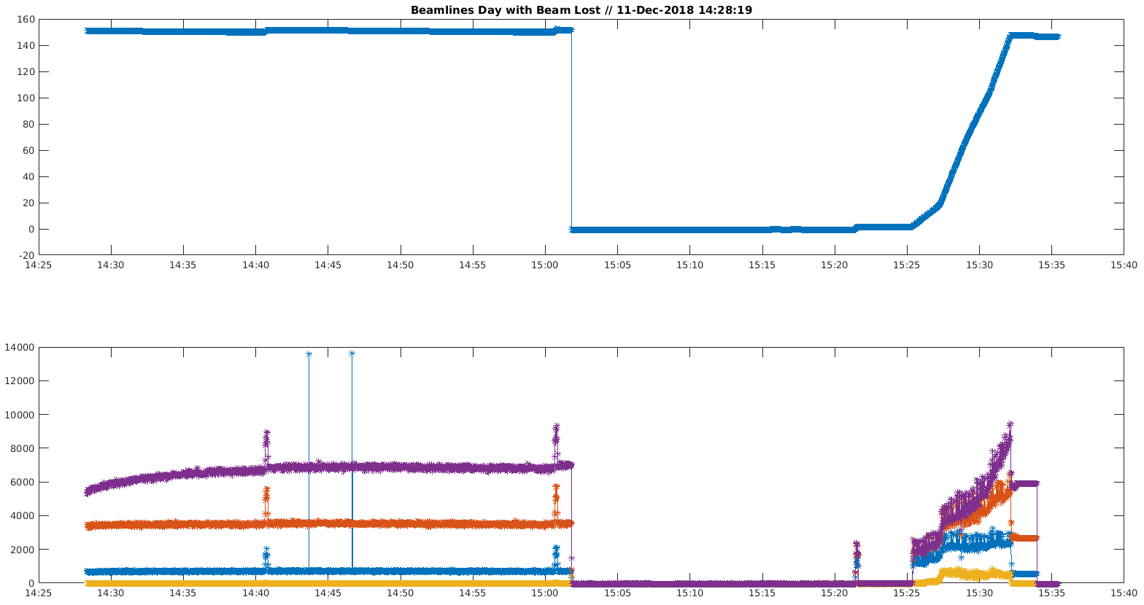
TESTS WITH BEAM
Counting Mode
Example: Beam lost and reinjection
DCCT
CH0 CH1 // CH5 CH6

Slide 13
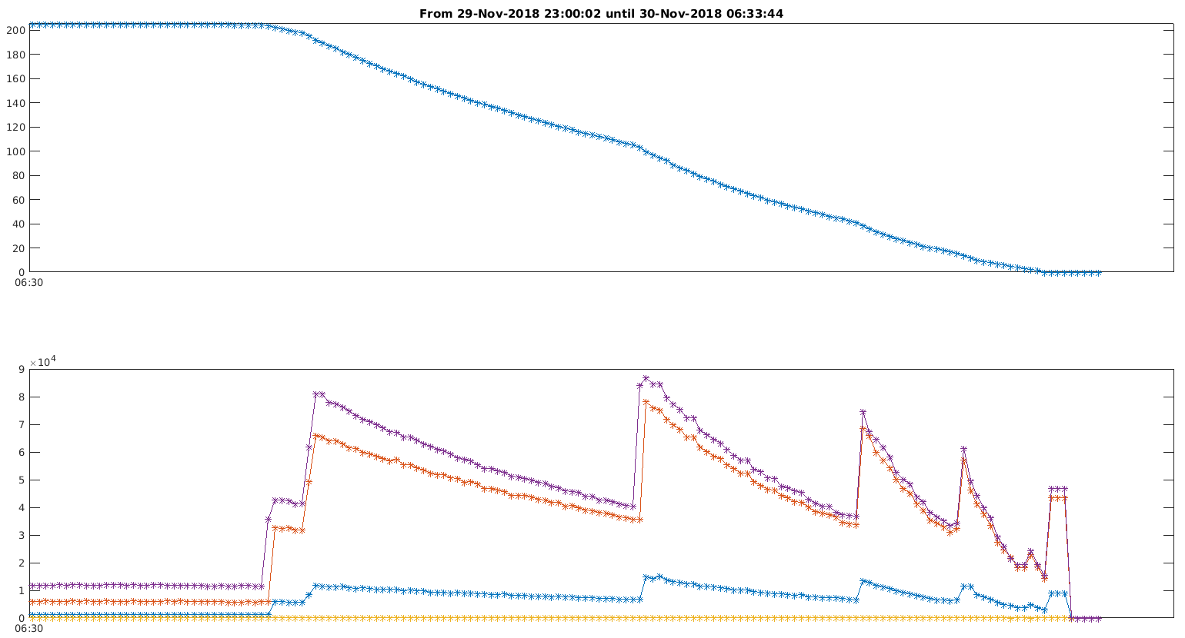
TESTS WITH BEAM
Counting Mode
Example: Acquired losses during a beam scraping
DCCT
Jaws inserted
CH0 CH1 // CH5 CH6

Slide 14
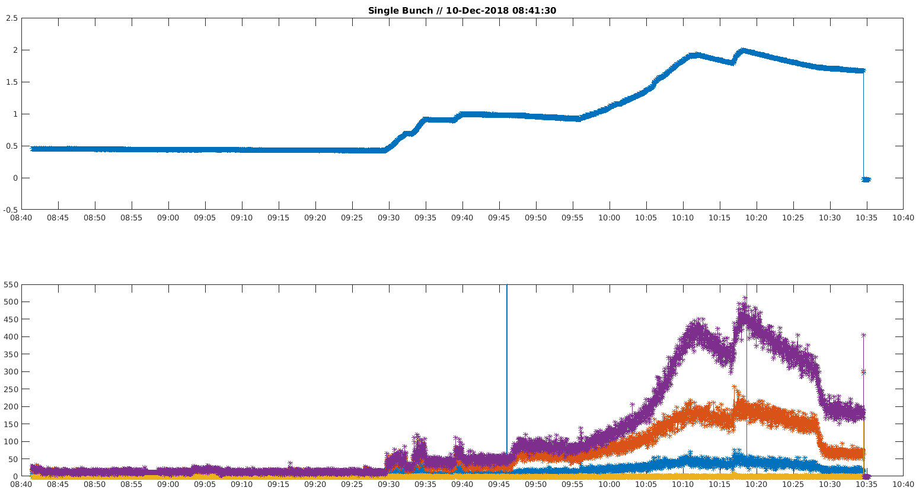
TESTS WITH BEAM
Counting Mode
Example: Single Bunch operation
DCCT
CH0 CH1 // CH5 CH6

Slide 15
TESTS WITH BEAM
Losses Location Mode
Not yet done !!!

Slide 16
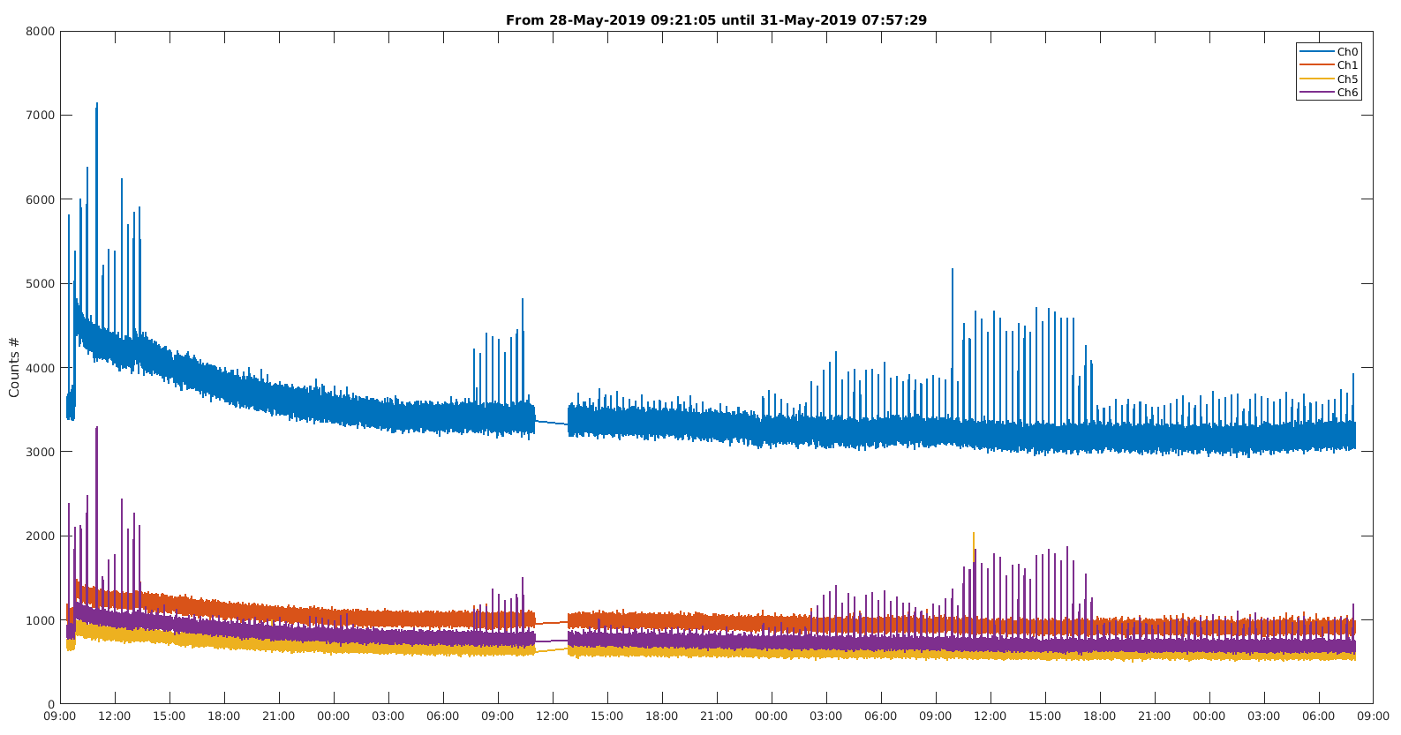
PROBLEMS / To be understood
Too different channels counts even after calibration
Calibration needs to be better understood and better performed
3days

Slide 17
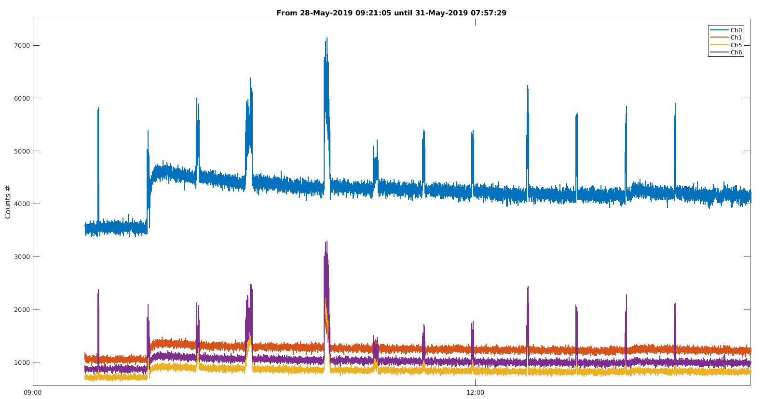
PROBLEMS / To be understood
Sudden counts increase w/o correlation to other machine parameters
… and it takes days to stabilize back
Is it real?
Seems to be an electronics issue
Orbit/Corrs/Lifetime … checked and no correlation observed
3days

Slide 18
PROBLEMS / To be understood
Counts fluctuation with time
3days

Slide 19
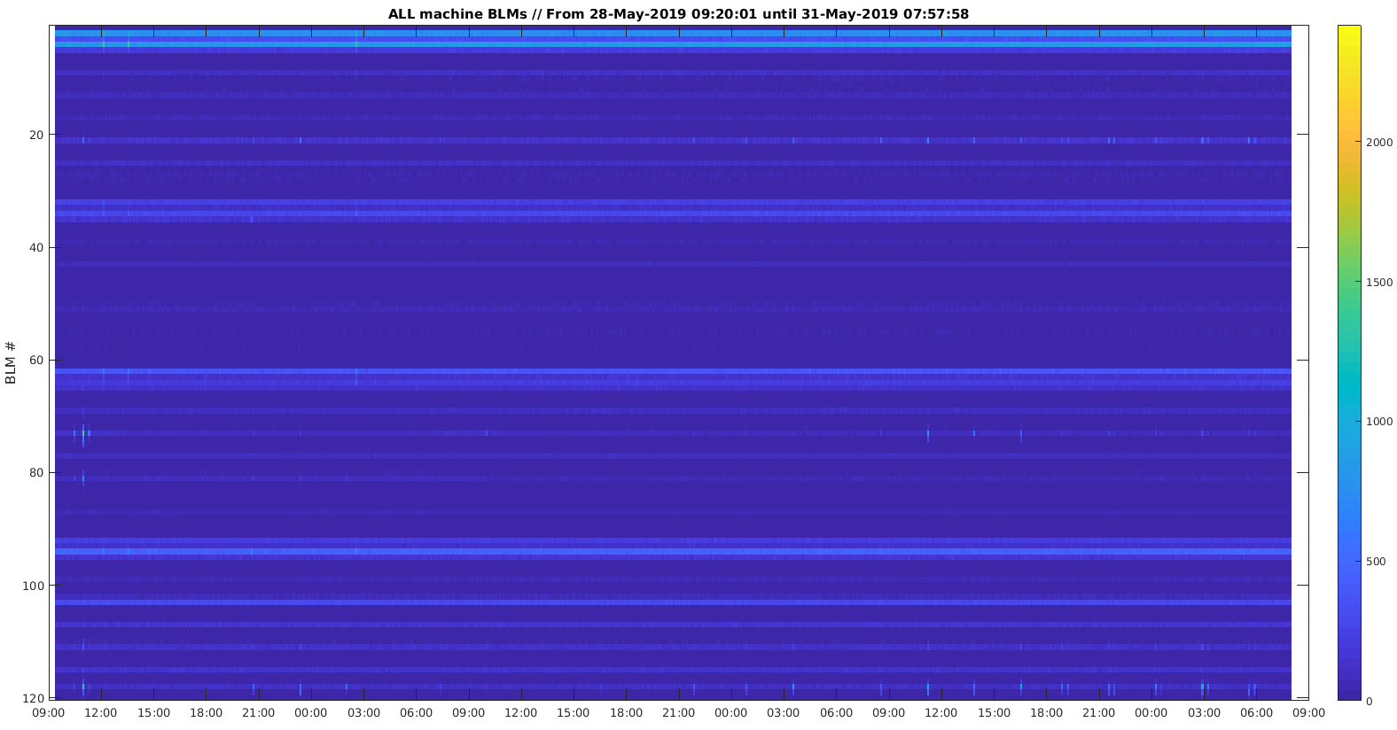
PROBLEMS / To be understood
Counts fluctuation with time
120 storage ring Bergoz BLMs
BLM #
3days

Slide 20
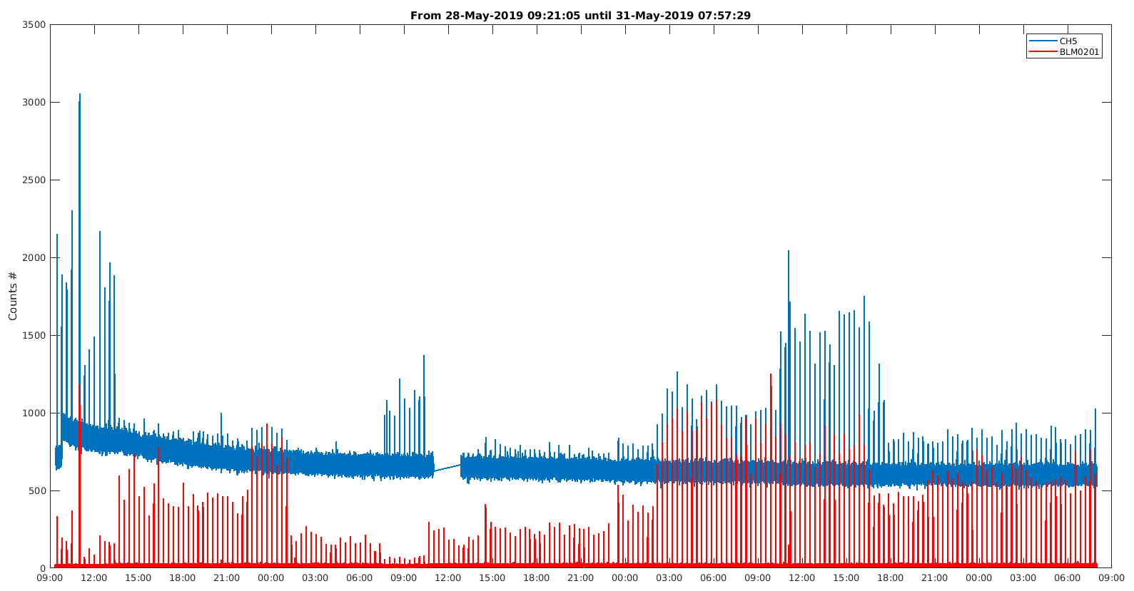
PROBLEMS / To be understood
Counts fluctuation with time
Comparison wrt Bergoz BLM with higher counts
SiPM BLM
Bergoz BLM
Sometimes they coincide, sometimes they don’t
sometimes they behave opposite (?)
3days

Slide 21
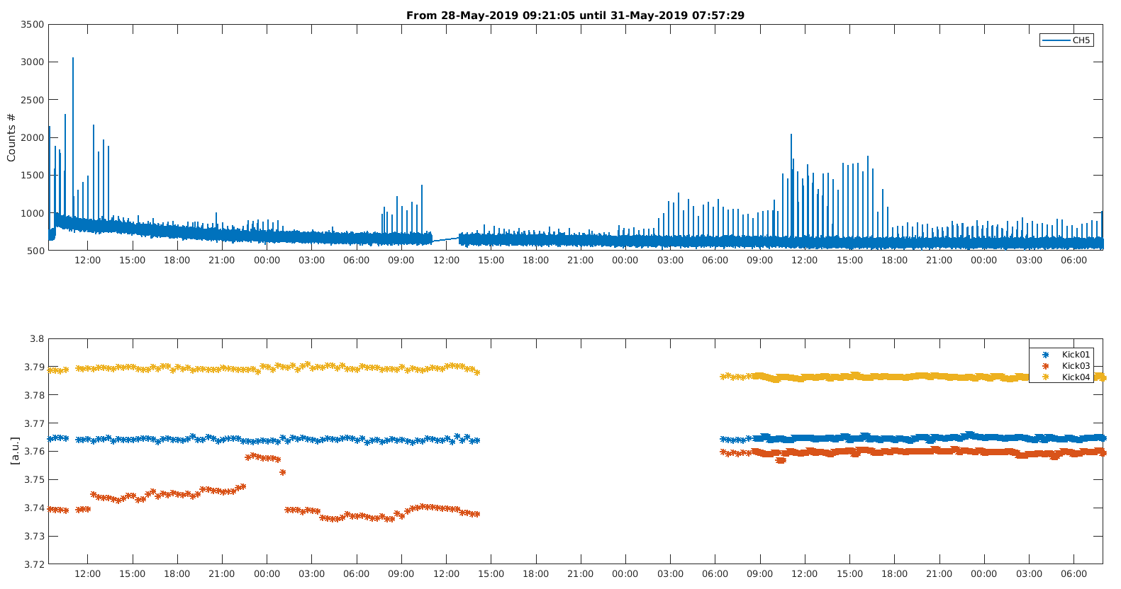
PROBLEMS / To be understood
Counts fluctuation with time
Comparison wrt Injection Bump
SiPM BLM
Not clear correlation
Maybe
Kicker01
Kicker03
Kicker04
3days

Slide 22
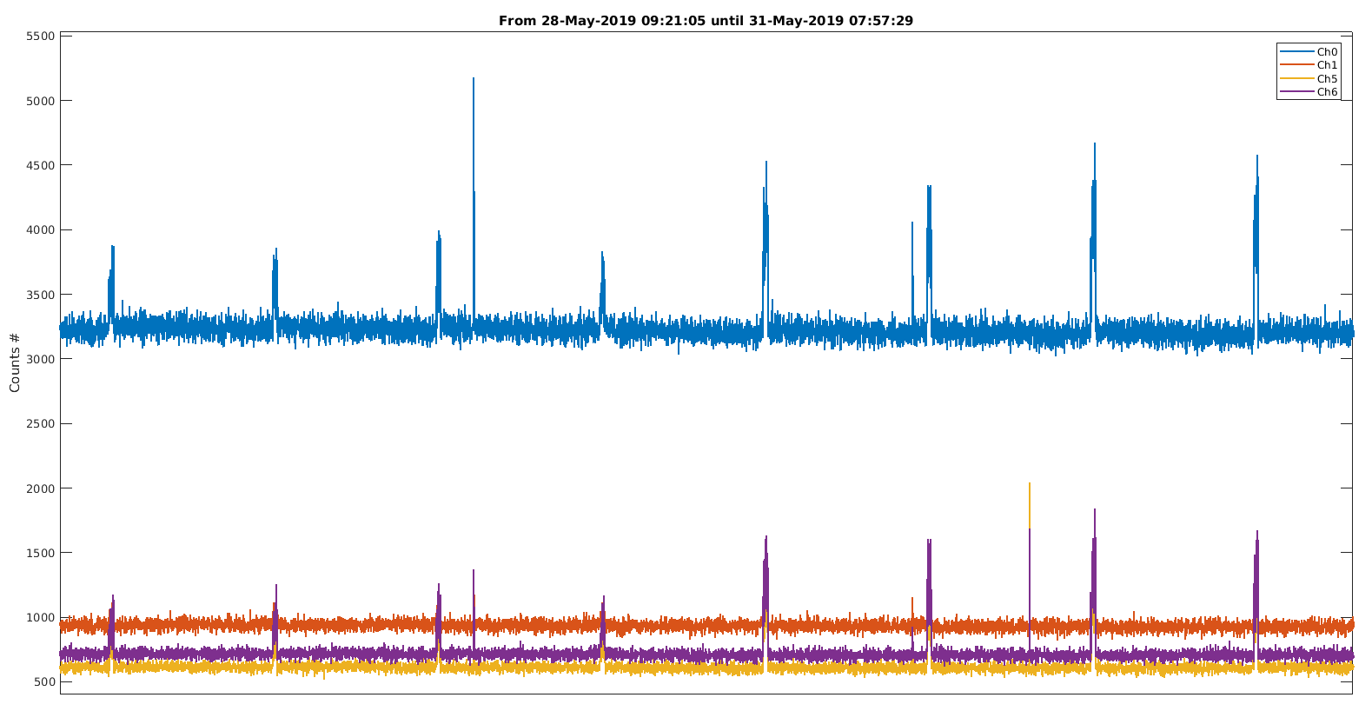
PROBLEMS / To be understood
Spurious counts / glitches
3days

Slide 23
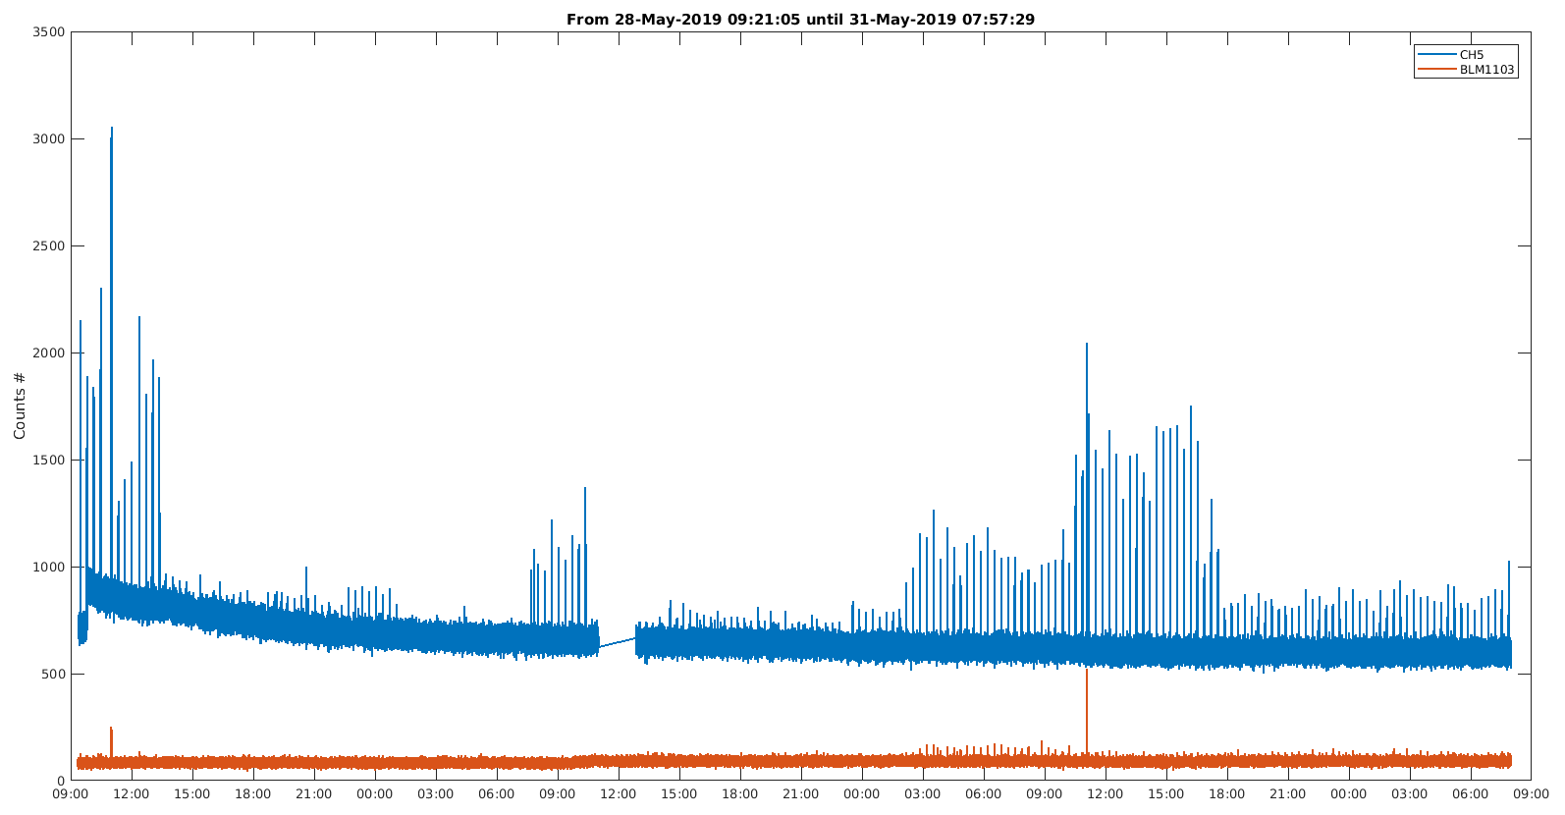
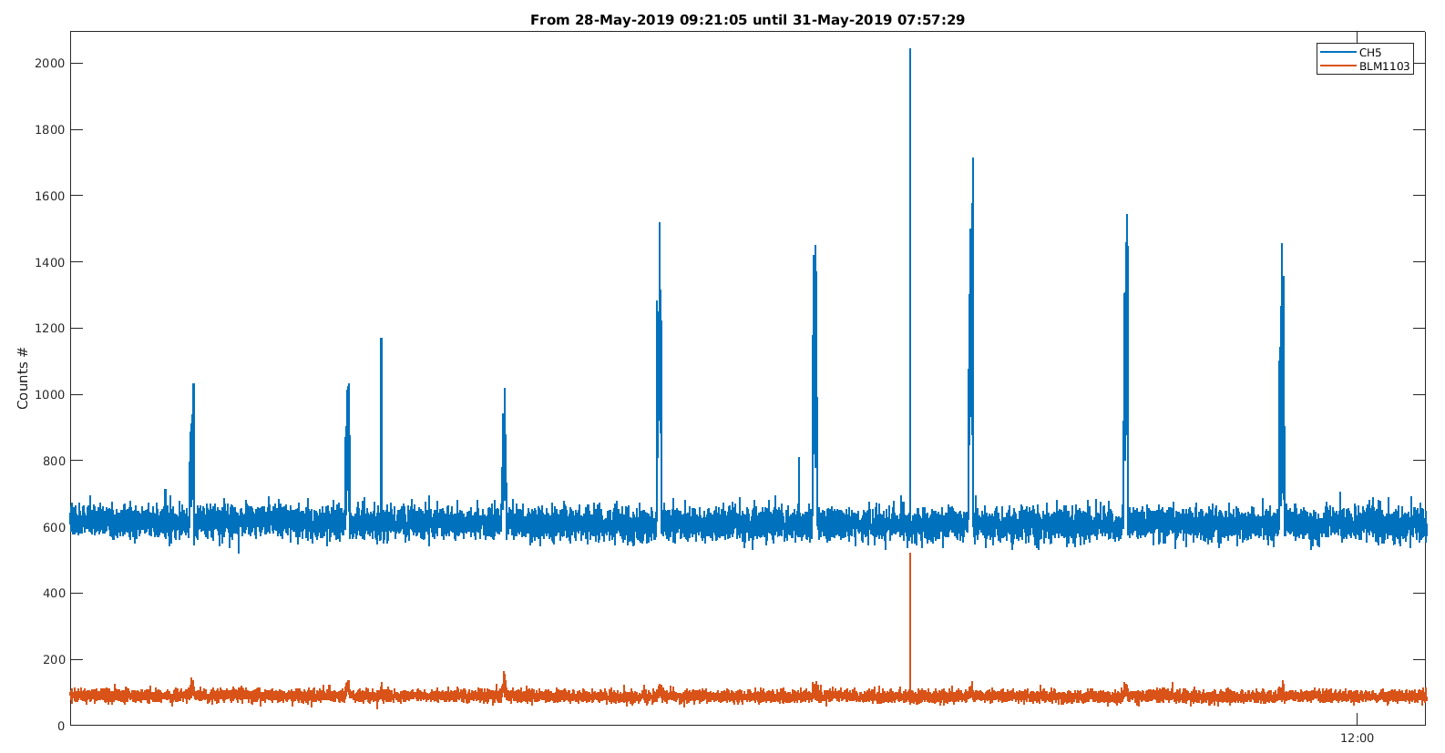
PROBLEMS / To be understood
Spurious counts / glitches
Comparison wrt closest Bergoz BLM
SiPM BLM
Bergoz BLM
These are real losses
... due to (?)
3days

Slide 24
SUMMARY
Preliminary results show that it should work as an standard BLM
Extra feature of losses location to be tested
Problems with RaspberryPI hanging → Replaced by NUC-PC seems to work … but it is Windows
Too different channels counts even after calibration
Extremely sensible to fibers placing on the SiPM → company needed to perform proper connectorized setup
Sudden counts increase w/o correlation to other machine parameters
TANGO Device Server not yet fully operational
Many thanks for you attention!!

Slide 25
EXTRA SLIDES

Slide 26
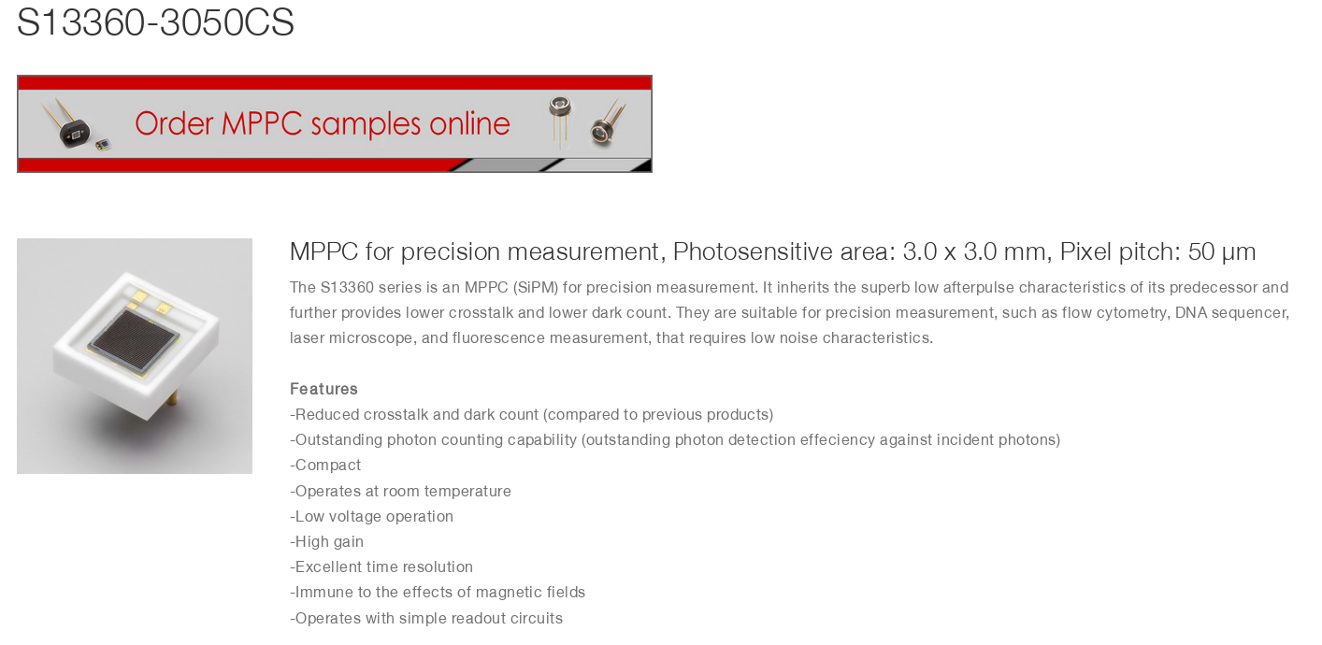
SiPM Hamamatsu

Slide 27
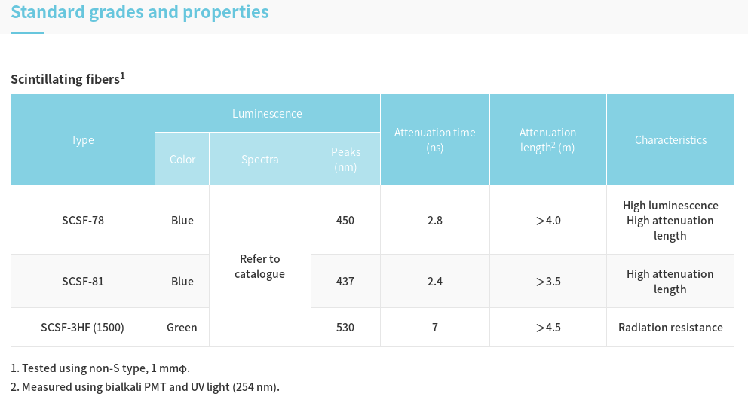
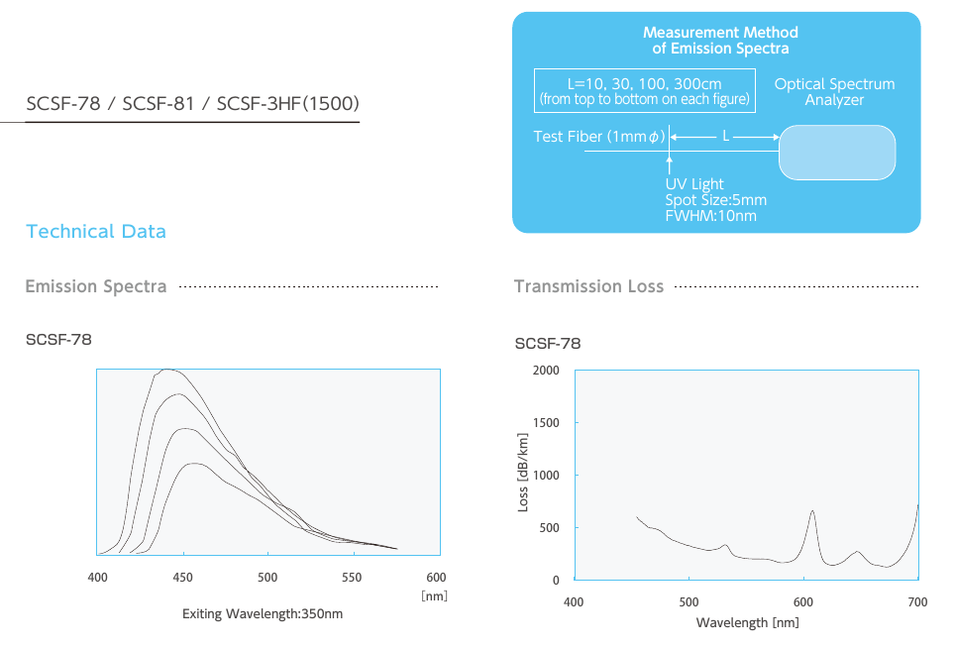
Fiber Kuraray SCSF-78
1mm diameter

Slide 28
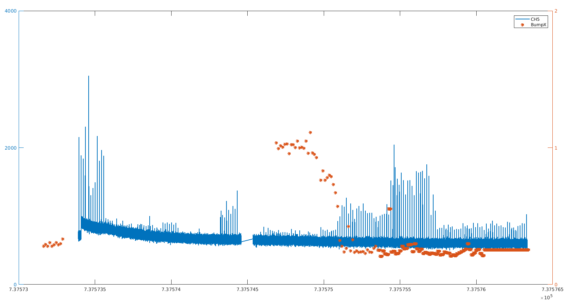

Slide 29
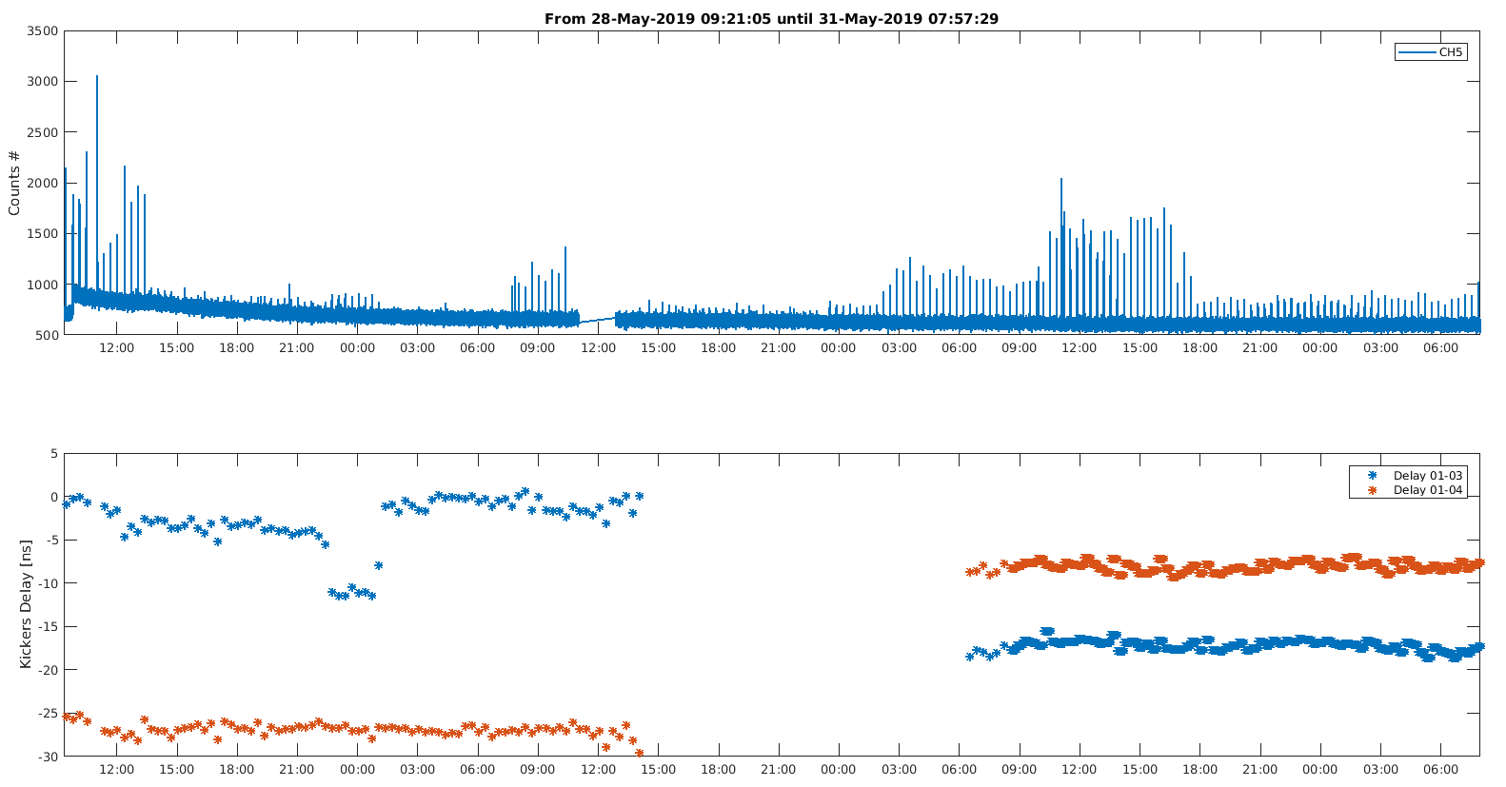

Slide 30
