Slide 1


ESRF, DEELS-2019
Calculation of corrected BPM data with polynomials obtained from BpmLab: ESRF and ALBA showcases
A. Nosych, K.B. Scheidt
Notes:
BpmLab is a 2D finite element-based tool for Matlab developed at ALBA and aimed at simulating the electrode response of BPMs of arbitrary geometry to emulated beam excitation. Lately, BpmLab has been thoroughly adapted to EBS BPM geometries to analyze the nonlinear effects and the remedies around them. More complicated situations have as well been studied, e.g. imperfect positioned BPM-buttons. Finally the 2-dimensional geometry-dependent polynomials were calculated to strongly minimize errors and coupling effects that are usually produced by the traditional Delta-over-Sum algorithms for beam position, sum signal and the incoherence (Q) values. Apart from the fast-data streams, all data & buffers of the new EBS will be calculated with such polynomial families, selectable inside the device server of the (Libera and Spark) BPM electronics. Specific beam tests were performed both in ESRF and ALBA to achieve high orbit offsets and study the effects of polynomials on the BPM data to better understand their efficiency.

Slide 2
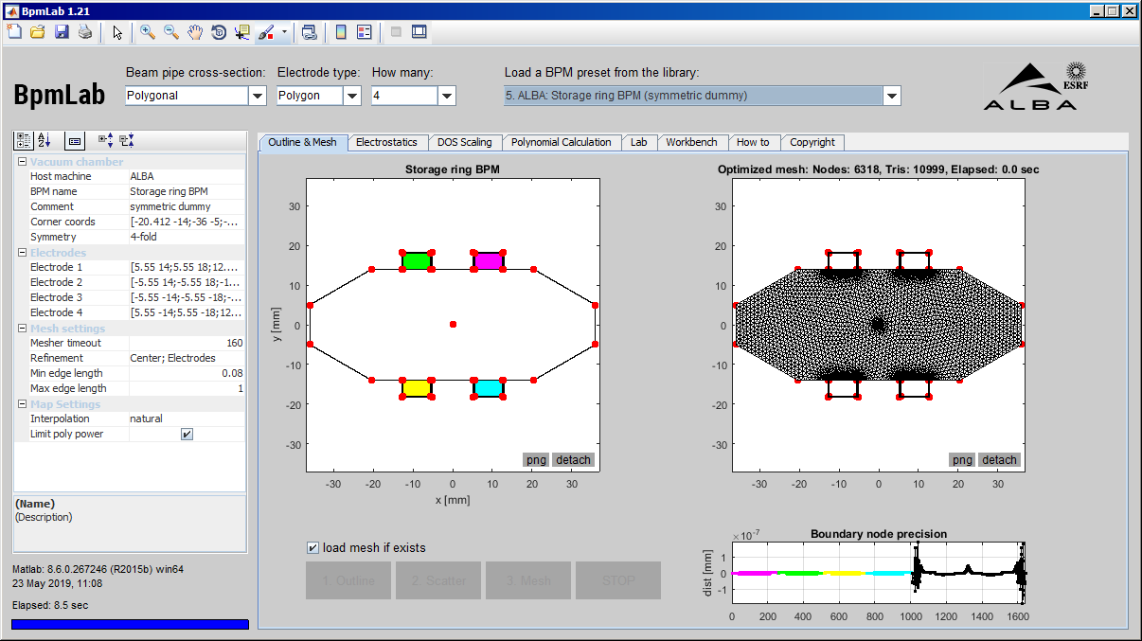
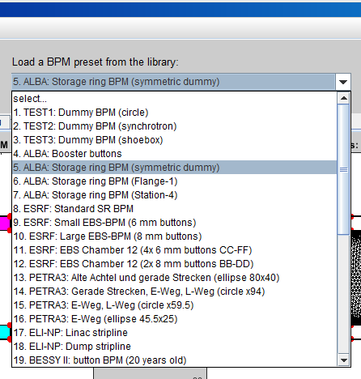
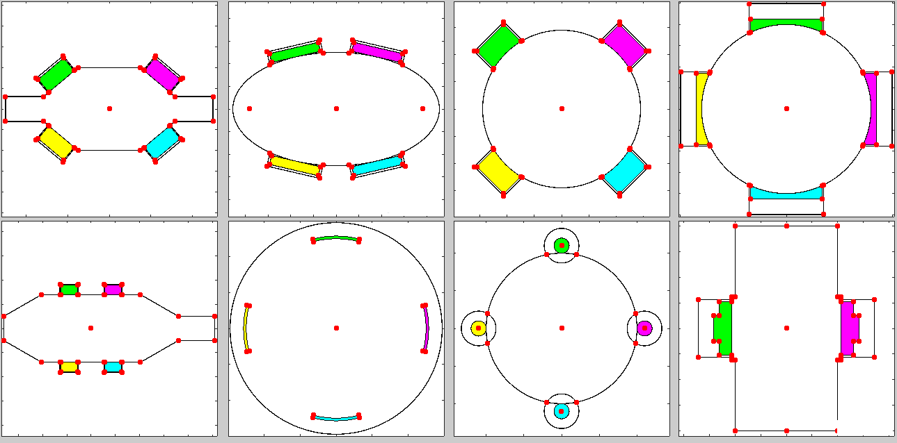
What is BpmLab?
a FEM-based Matlab tool for BPM response simulation and treatment
2D BPM slices are defined by combinations of simple shapes: circles, ellipses & polygons
ESRF, DEELS-2019
Library of many real BPMs (34 and counting…)
Geometry, mesh & map settings
Geometry outlines
Final mesh &
boundary nodes precision

Slide 3
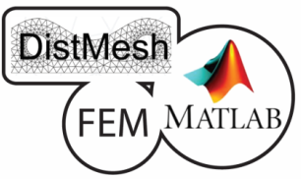
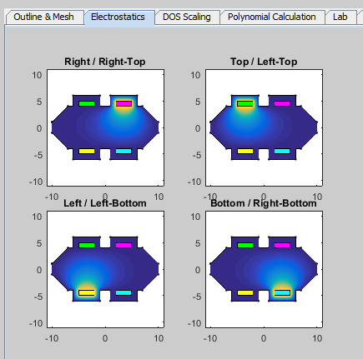
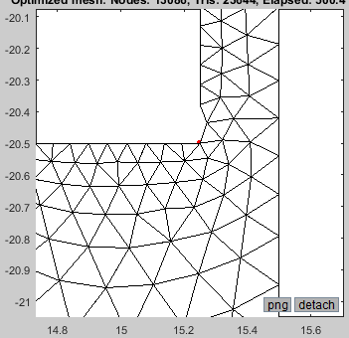
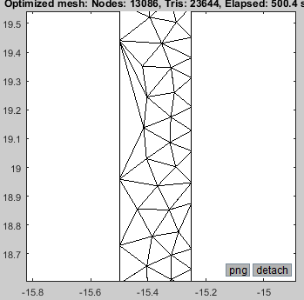
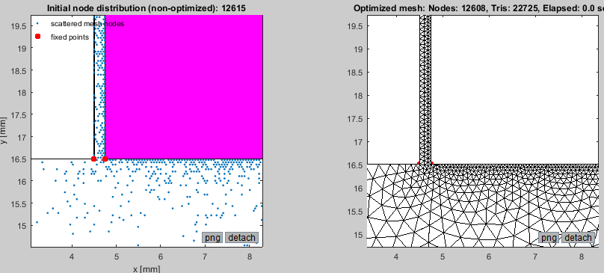
Meshing:
Open-source tetrahedral mesh generator
based on metric functions (DistMesh).
Uniform or non-uniform meshes
User-defined min/max mesh size
Extremely reliable inner mesh
Boundary mesh QA: by eye. Always check!
ESRF, DEELS-2019
FEM Solver:
2D electrostatic Poisson solver with linear basis functions and boundary electric potential excitation (Diriclet boundary conditions):
4 calculations for all beam positions
NOT OK
250 um
Examples of a badly converged mesh
OK
Green's reciprocity theorem: the surface charge induced on an electrode due to a test charge at (x,y) is proportional to the potential at that same position when the test charge is absent and the electrode is excited by a potential V.
Properly converged mesh

Slide 4
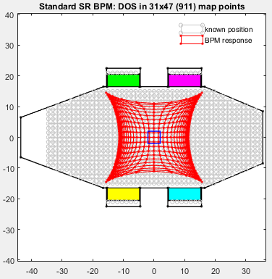
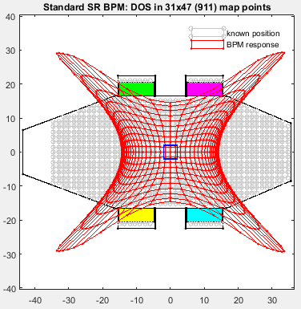
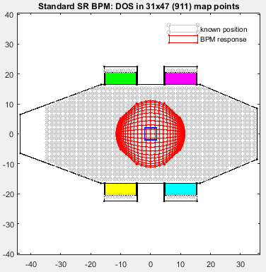
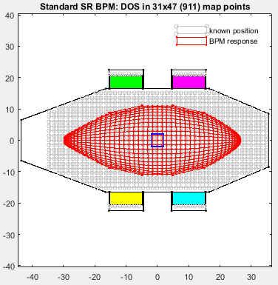
BpmLab: Response maps & DOS treatments
ESRF standard SR BPM
ESRF, DEELS-2019
δ/Σ
20log(δ/Σ)
diagonal
atanh(δ/Σ) (J.Chavanne, 2002)

Slide 5
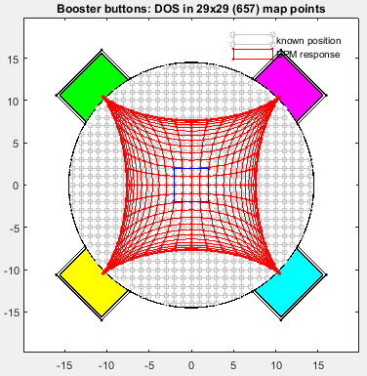
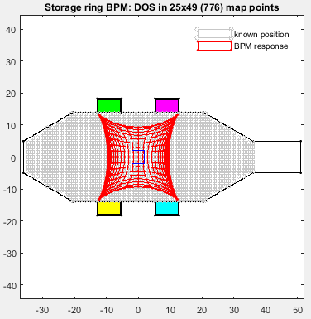
ALBA BPM family
ESRF, DEELS-2019
booster
storage ring

Slide 6
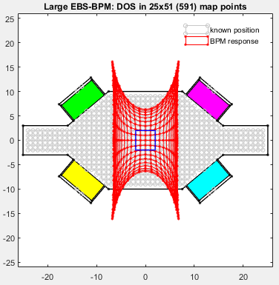
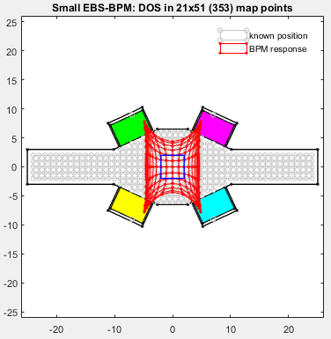
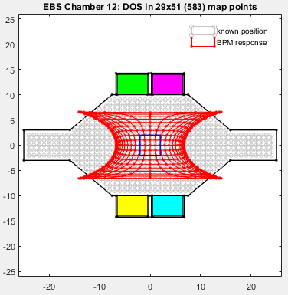
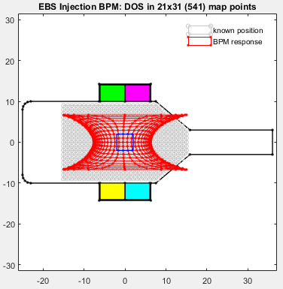
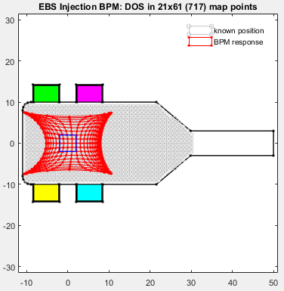
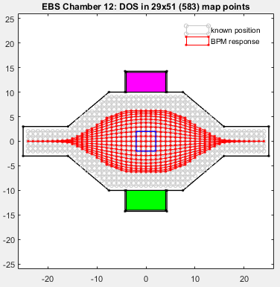
Upcoming EBS BPM family
ESRF, DEELS-2019
Large (8 mm button)
Small (6 mm button)
Chamber 12 (4b)
Injection: stored beam
Injection: bumped beam
Chamber 12 (2b)

Slide 7
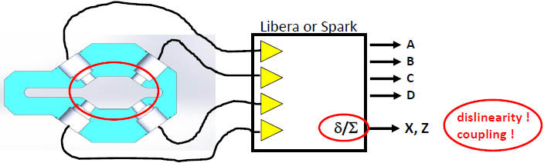
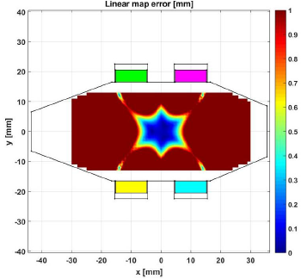
Perfect BPM & low noise stable electronics are still imperfect:
ESRF, DEELS-2019
Linearity error
How to correct?
Linear coefficient (real-time)
Polynomial families (real-time)
Specific formulae (real-time)
Lookup tables (post-process)
Voltage inversion (iterative optimization, so post-process)
At what level? (by DS/Libera? by end-user?)
How fast? (TbT 100x kHz, FA 10x kHz, SA 10x Hz)

Slide 8
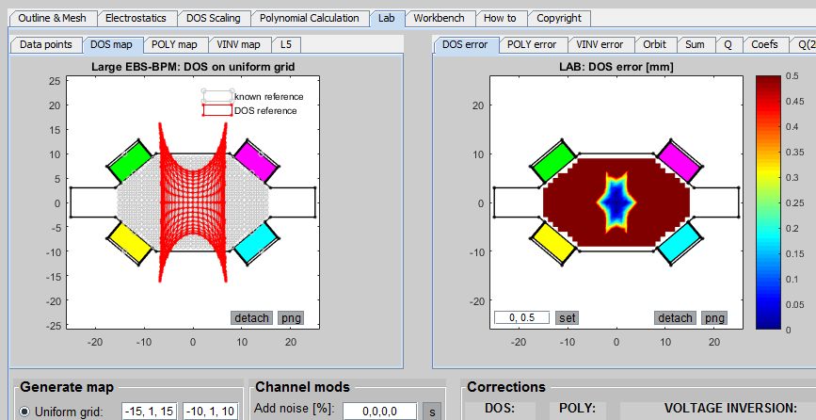
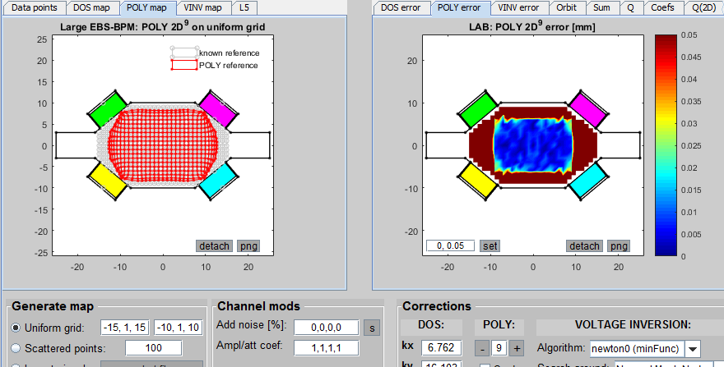

Linear correction by DOS
EBS large BPM
ESRF, DEELS-2019
Polynomial correction
Inverted voltages

Slide 9
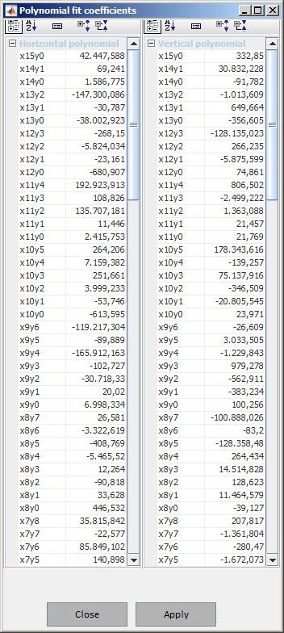
Polynomial correction seems to be the straight-forward solution if you want to have large beam drifts, and have fast real-time position nonlinearity suppression.
ESRF, DEELS-2019
2 polynomials need to be applied to each data sample:
A, B, C, D
δx/Σ
δy/Σ
Px(δx/Σ, δy/Σ)
Py(δx/Σ, δy/Σ)
Polynomials are coupled 2D type.
Higher power = more coefficients, e.g.:
Max pwr 7: 36 terms
Max pwr 13: 105 terms
etc.

Slide 10
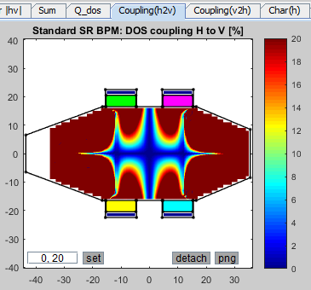
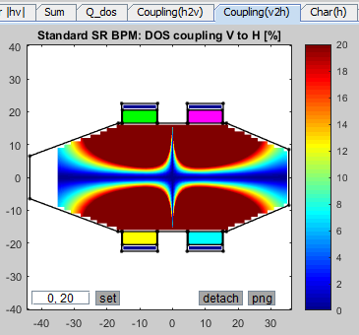
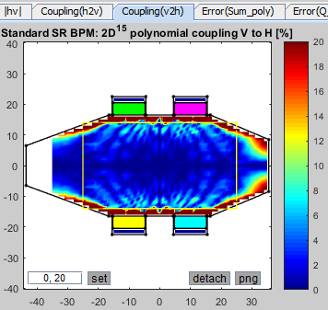
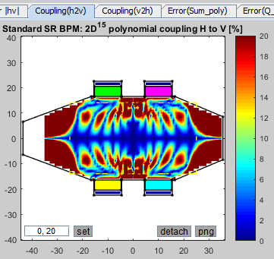
Sum signal + corrected sum (3D plot)
Coherence + corrected coherence (3D plot)
Coupling
BpmLab: Coupling
Coupling (DOS positions)
Coupling:
Ratio of how much the position change in one dimension affect its change in the other dimension.
Using the polynomial corrected positions can minimize the coupling effect.
ESRF, DEELS-2019
Coupling improved (Poly correction)

Slide 11
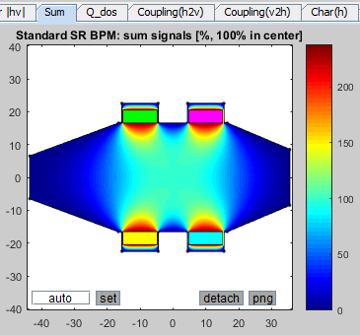
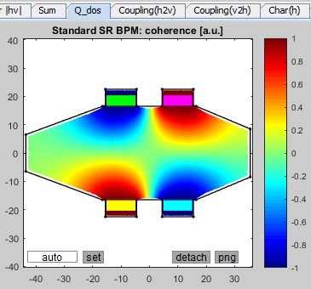
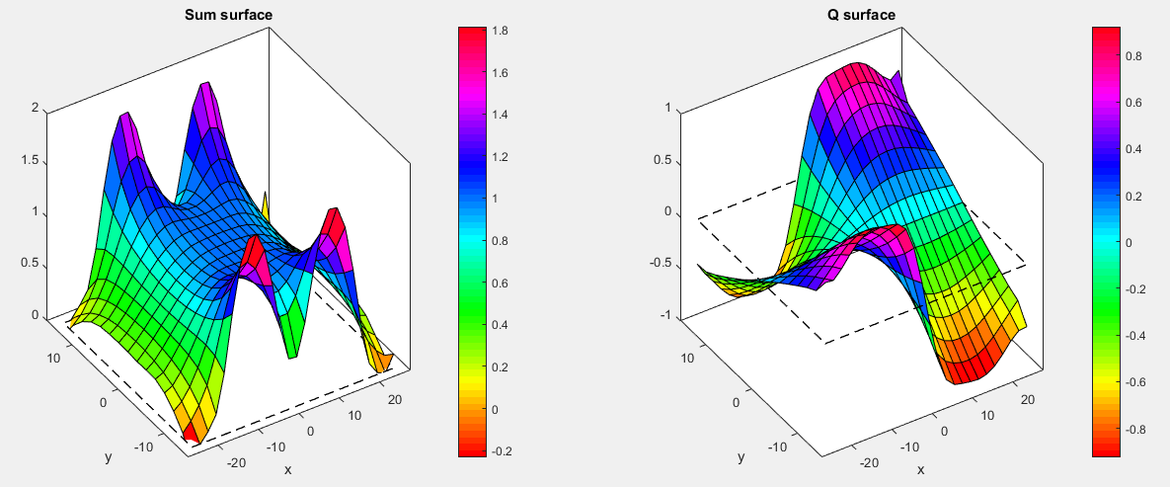
Sum signal + corrected sum (3D plot)
Coherence + corrected coherence (3D plot)
Coupling
BpmLab: Sum, coherence
Sum signal
Signal Coherence
ESRF, DEELS-2019
B A
C D
B A
C D
Σ = A+B+C+D
Q = (A+C-B-D) / Σ
Sum & Coherence:
Strongly nonlinear.
Can be linearized with higher-order polynomials.

Slide 12
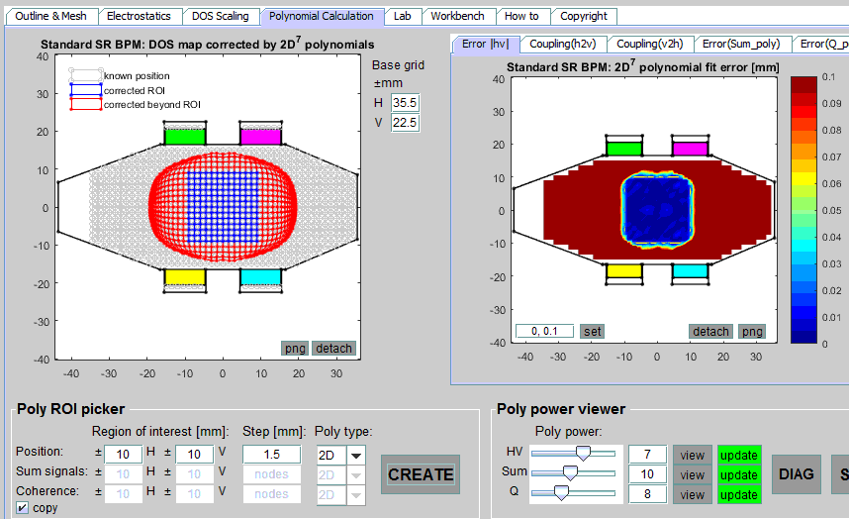
BpmLab: Polynomial ROI fitness
A polynomial is defined by its effective ROI and max power. Ho can we pick them?
Step 1) Fix max polynomial power (here: x⁷y⁷) and scan the ROI dimensions.
Accuracy starts to deteriorates as the poly needs to fit a more curvy surface:
ESRF, DEELS-2019

Slide 13
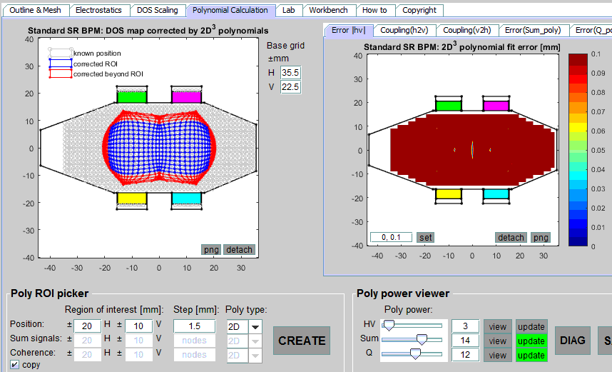
BpmLab: Polynomial power fitness
Step 2) Fix the ROI (here ±20 mm x ± 10 mm) and scan the poly power.
Step 3) Choose the power/ROI combination that fits your needs
Beware: speed of calculation can increase for higher power polynomials.
ESRF, DEELS-2019

Slide 14
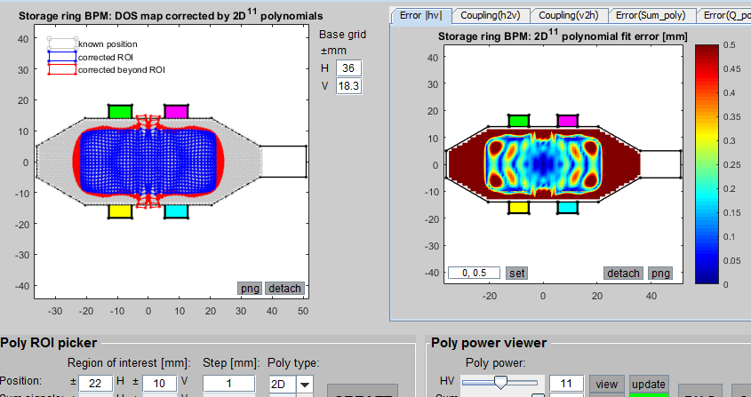
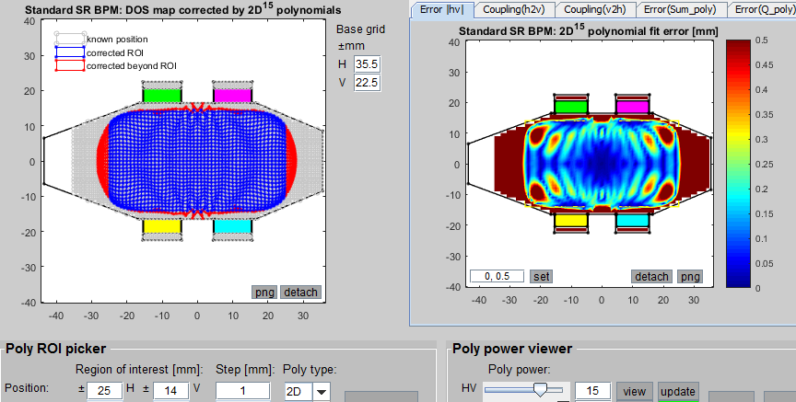
BpmLab: Polynomial fitness
Finally we have to stop somewhere, e.g.:
ALBA SR BPM
ROI = ±[22, 10] mm
max pwr = 11
ESRF SR BPM
ROI = ±[25, 14] mm
max pwr = 15
EBS BPM
Several Poly families
selectable in Libera DS.
max pwr = ??
ESRF, DEELS-2019

Slide 15
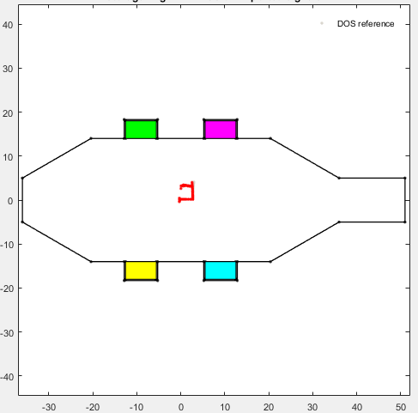
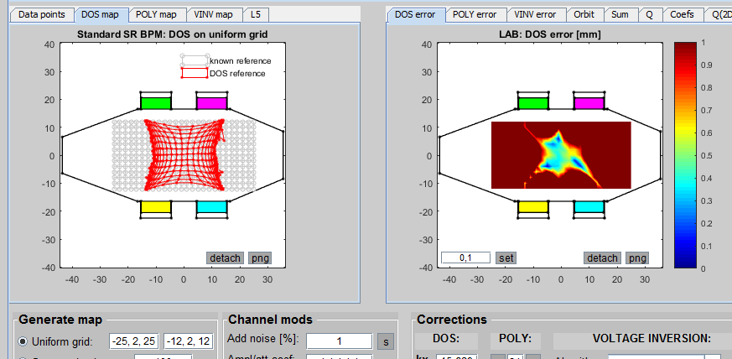
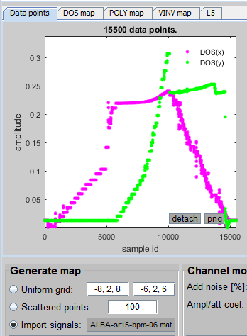
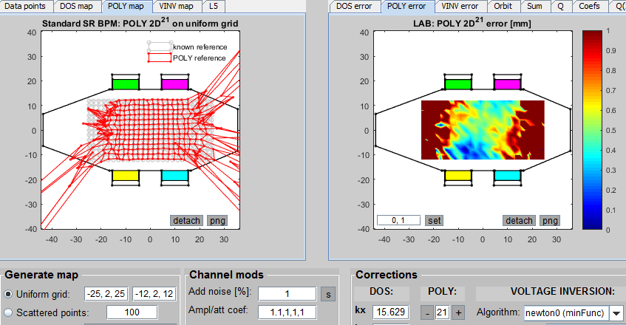
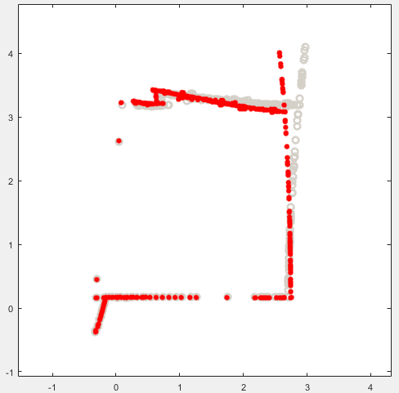
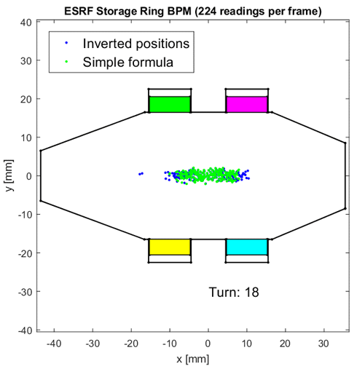
BpmLab: Post-processing real signals
Add noise (1%) to all channels: after DOS treatment
ALBA SR
Local bump, 4 orbit-correctors
Hor: 0 → 3 mm
Ver: 0 → 4 mm
ESRF, DEELS-2019
after Poly correction
Poly corrected
ESRF SR: injection with RF off
DOS
Each dot:
position in one BPM (224 BPMs total)
Each image: turn

Slide 16
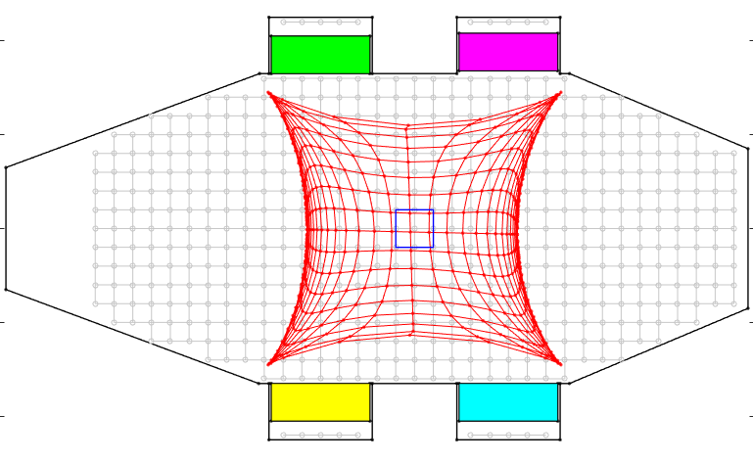
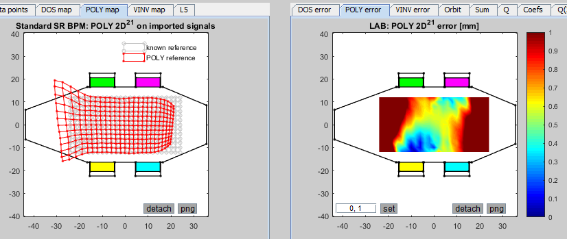
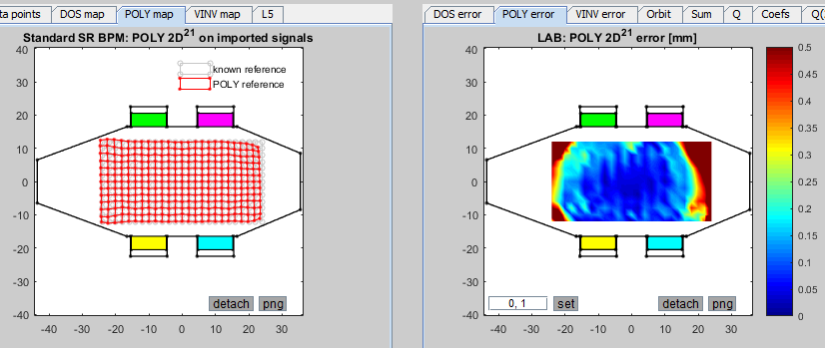
BpmLab: Button imperfections (retraction/protrusion)
300 um retracted
Add noise (1%) to all channels: after DOS treatment
ESRF, DEELS-2019
Use “perfect Poly” to correct this distortion
Poly correction: channel A as is
after Poly correction
Poly correction: channel A compensated

Slide 17
BpmLab: Signal manipulation
Add noise (1%) to all channels: DOS treatment
ESRF, DEELS-2019
Poly correction

Slide 18
BpmLab summary
Requires Matlab toolbox-free installation (versions range 2014b-2017)
Instruments:
meshing (DistMesh)
short 50-line 2D electrostatic FEM solver
optimization (minFunc)
Features:
Easy arbitrary geometry input & many presets
BPM response map calculation in 2D
Correction polynomial calculation (within ROI)
Direct voltage-to-position inversion (post-processing)
Introduce geometry imperfections
Signal manipulation (channel distortion, attenuation, amplification)
Import real BPM signals for studies and post-processing
ESRF, DEELS-2019
Download from here:
https://intranet.cells.es/Divisions/Accelerators/RF_Diagnostics/Diagnostics/OrbitPosition/Tools/bpmlab

Slide 19
Now the interesting stuff…
Experiments!
ESRF, DEELS-2019

Slide 20
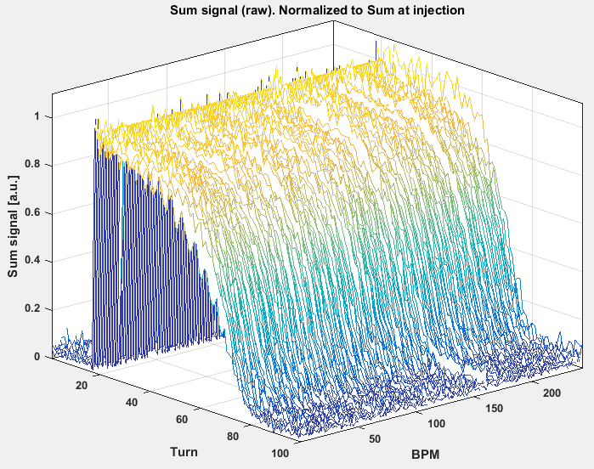
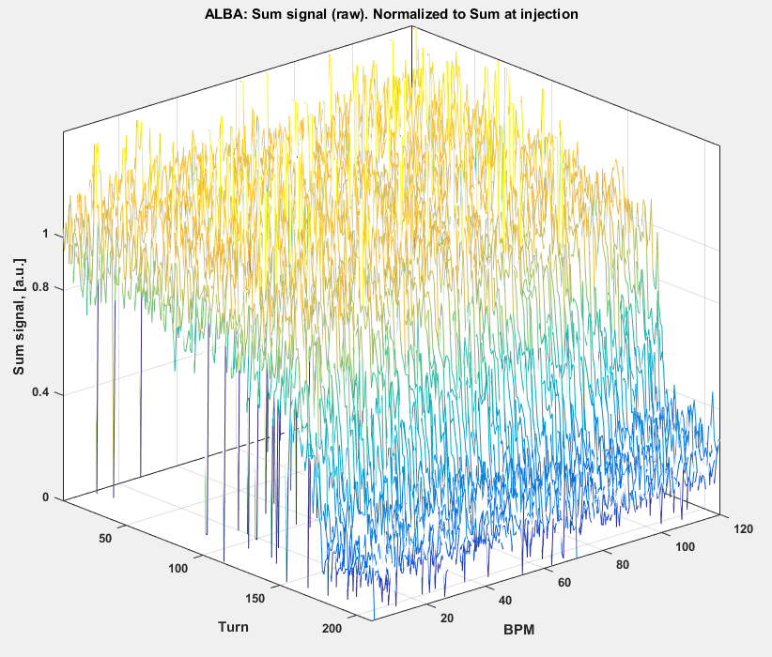
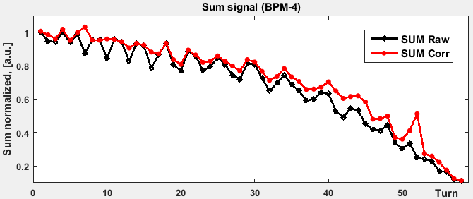
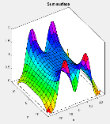
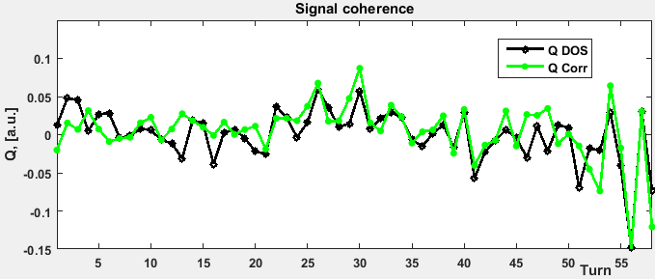

Injecting with RF off: Signal SUM & COHERENCE
ESRF (Nov 26, 2018) ALBA (May 2019)
ESRF, DEELS-2019
Corrected Sum =
SUM_{RAW} / (norm_coef * SUM_{model}) → 1
Q Corrected = Q_{DOS} – Q_{model} → 0
Compensation in the first turns.
Then becomes very noisy, why? Sum and Q are sensitive to beam size. It deteriorates without RF (blows up, bunch charge decrease, path & energy change).

Slide 21









Injecting with RF off: Polynomials vs. DOS
ESRF ALBA
ESRF, DEELS-2019
Polynomial power!!!
RF off → beam spirals inwards.
Linear formula underestimates beam offset.
Polynomial can see farther (depends on ROI).
So finally, polynomials or DOS?

Slide 22



Injecting with RF off: Scraper test
ALBA SR injection straight, PSA May2019
ESRF, DEELS-2019
first BPM
Each jaw kills beam at ±7 mm
DOS error ≤ 2.5 mm
Poly error ≤ 0.16 mm
kicker
kicker
septum
kicker
kicker
Septum blade
Last BPM
~8 meters

Slide 23



Beam kicks: vertical plane kick
ESRF MDT Nov27: big V-kick, partial loss
MAF off
Anti-smearing on
ESRF, DEELS-2019
Note the behavior of the Sum during the V-kick
(bunch length doesn’t change?)
Very nice Q suppression!

Slide 24




Beam kicks: horizontal plane kick
ESRF MDT Nov27: moderate H-kick, small loss
ESRF, DEELS-2019
View of all BPMs
Again a very nice Q suppression

Slide 25



Beam kicks: horizontal plane kicks
ESRF MDT Nov27: H-kicks, loss variation
3 mA → ~3 mA
3 mA → 1.5 mA
3 mA → 0.5 mA
ESRF, DEELS-2019
Sum jumps 5-20%!
Sum oscillates only during H-kicks! Why?
Gets under/over compensated by SumPoly correction.

Slide 26

Thank you for your attention!
ESRF, DEELS-2019

Slide 27
extras

Slide 28


Overlaying the measured Sum with the horizontal position -> no expected correlation:
1) black dots = simulated sum, so the sum does not get higher than 1 from beam moving left and right from the center.
2) beam goes right -> sum goes up, beam goes left -> sum goes down. How is this possible. The sum is supposed to behave symmetrically, going down in both cases after crossing zero?

Slide 29


Experimental application: ESRF (Nov 2018) kicks
MDT Nov27: H-kicks, loss variation

