Slide 1

IHEP BI Group
The design of
Bunch-by-bunch BPM
Jianshe Cao，Xinger Zhang
June 2019

Slide 2
content
IHEP BI Group
1 requirements
2 Hardware of bunch-by-bunch BPM
3 data acquisition
4 next step

Slide 3
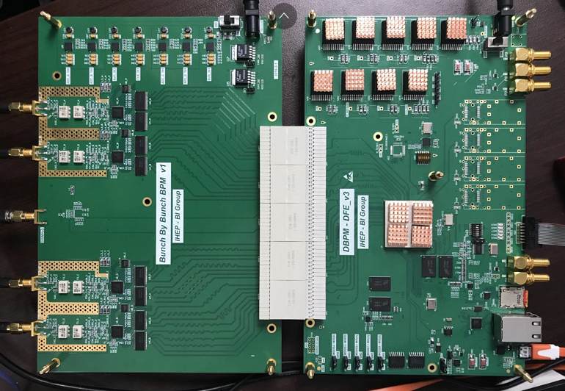
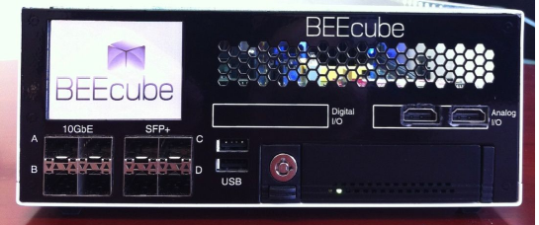
requirements
IHEP BI Group
1、Beam diagnostics :Self-developed BPM – BBB_board to replace the commercial board – Beecube on BEPCII.
Beecube
（Commercial board ）
BBB_board
（self developing board）
2、Technical reserve for bunch-by-bunch BPM research of HEPS (High Energy Photon Source )

Slide 4
IHEP BI Group
2 Hardware of bunch-by-bunch BPM

Slide 5
Function Block
IHEP BI Group
Trigger
Buffer of bunch by bunch raw ADC data

Slide 6
Hardware
IHEP BI Group
ADC : 500Msps - 12bits, AC coupled
Sampling clock: 500MHz,free running clock or externally clock locked with beam signal
ADC_a
ADC_b
AFE
DFE
clock
ADC_c
ADC_d

Slide 7
Hardware
IHEP BI Group
Interface: SMA, Ethernet, UART, JTAG, SFP
Memory : DDR3_PL, DDR3_PS, QSPI_flash, SD_card
ADC_a
ADC_b
AFE
DFE
clock
ADC_c
ADC_d

Slide 8
Hardware
IHEP BI Group
POWER
POWER
trigger
clock signal inputs
ZYNQ
BPM signal inputs
SD card
Ethernet
uart
ADC
QSPI flash
DDR3
(PL &PS)

Slide 9
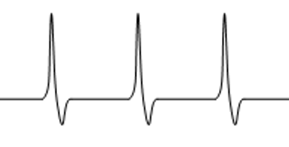

ADC CLOCK
IHEP BI Group
Clock chip Jitter ：100fs
Each clock output delay:
150ps step size ,
range from 0 to 2250ps
Automatic find the peak value of BPM signal ， No need to use a phase shifter
6ns
BPM signal
ADC CLOCK

Slide 10
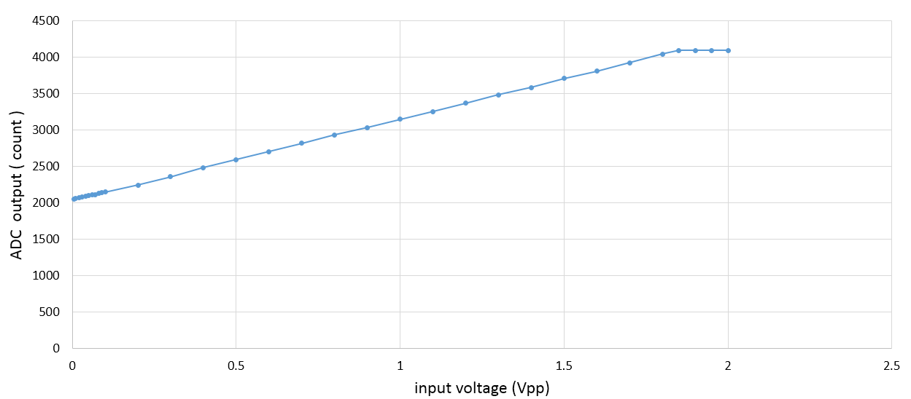
ADC signal linearity
IHEP BI Group
Input signal : 500MHz sine wave
Offset count : 2048 （offset binary 1000_0000_0000）
ADC linear range : 5mVpp to 1.8Vpp
-33dbm to 18dbm

Slide 11
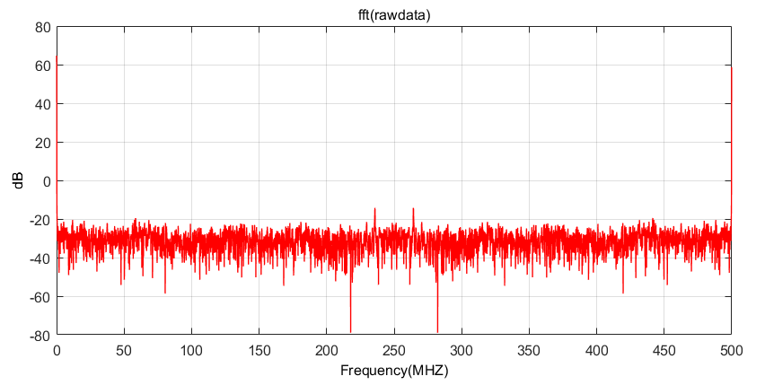
SNR
IHEP BI Group
SNR : 68dB
Input signal: 500MHz ， 13dbm
Terminated inputs: @50ohm

Slide 12
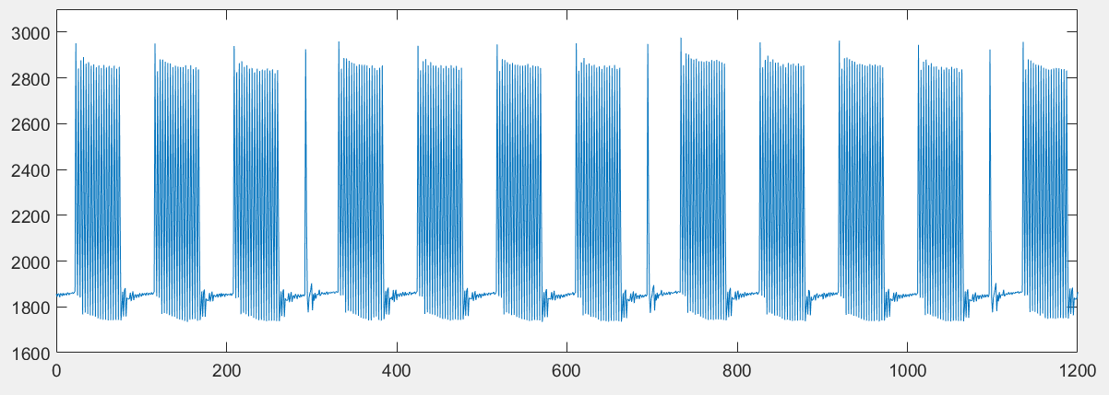
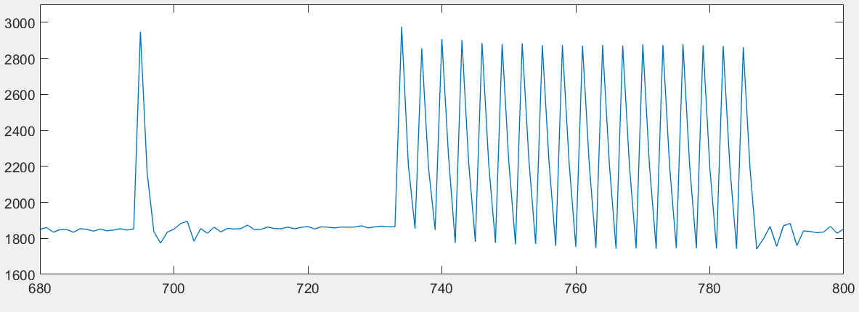
raw_ADC data
IHEP BI Group
Input: simulation pattern of BEPCII , repetition period 6ns

Slide 13
IHEP BI Group
3 data acquisition

Slide 14
Data acquisition
IHEP BI Group

Slide 15

Data acquisition
IHEP BI Group
AXI4 STREAM
AXI_HP
IP core
DMA
ARM
Raw-ADC data & Control signal

Slide 16
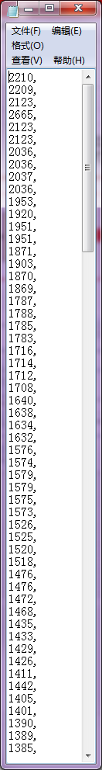
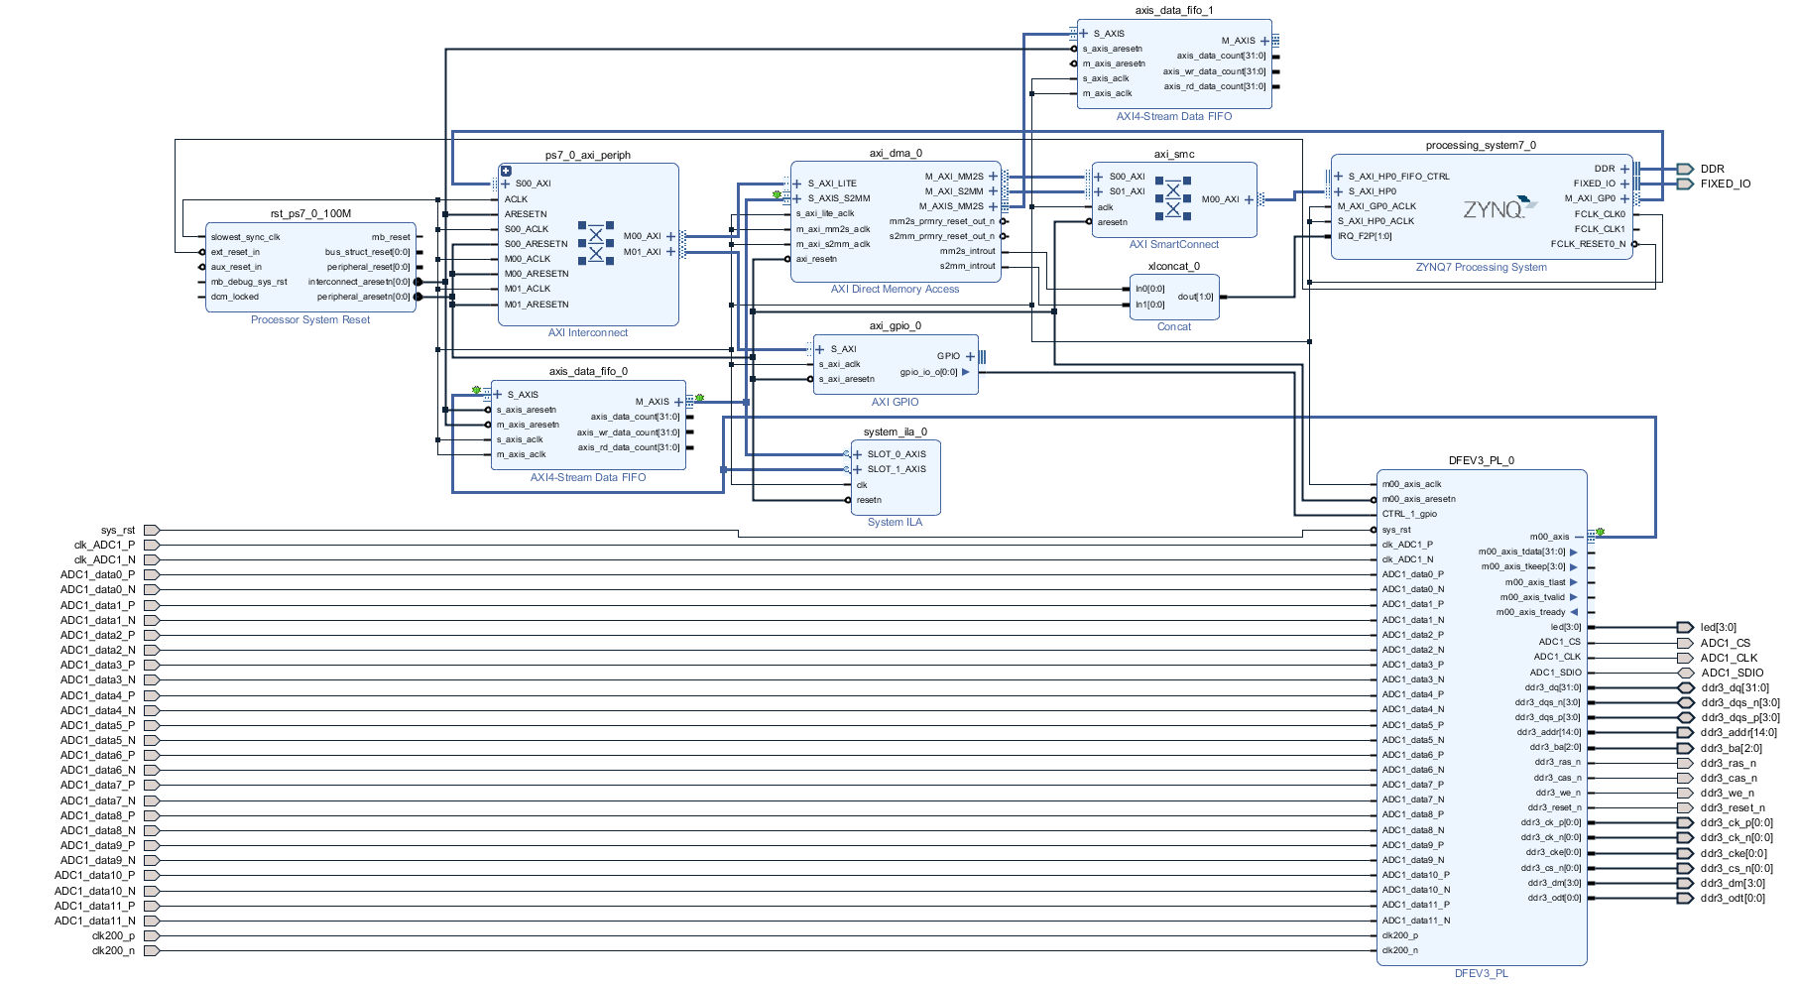
Data acquisition
IHEP BI Group

Slide 17
IHEP BI Group
4 next step

Slide 18
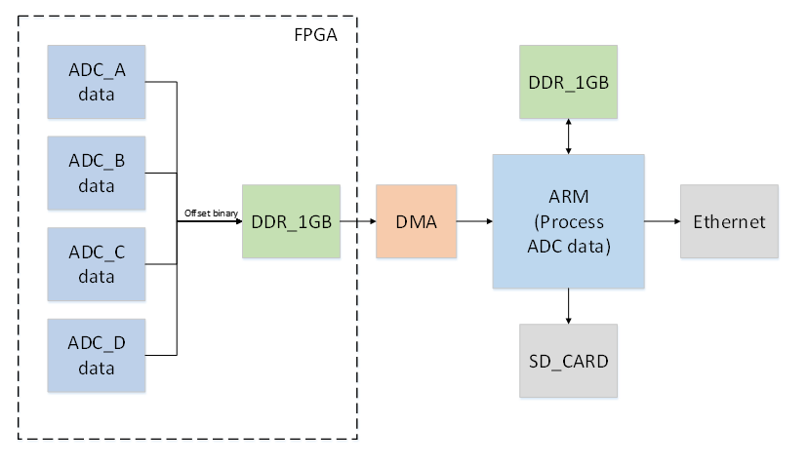
NEXT
IHEP BI Group
Software of Beam diagnostics
hardware
firmware

Slide 19


Thanks

Slide 21
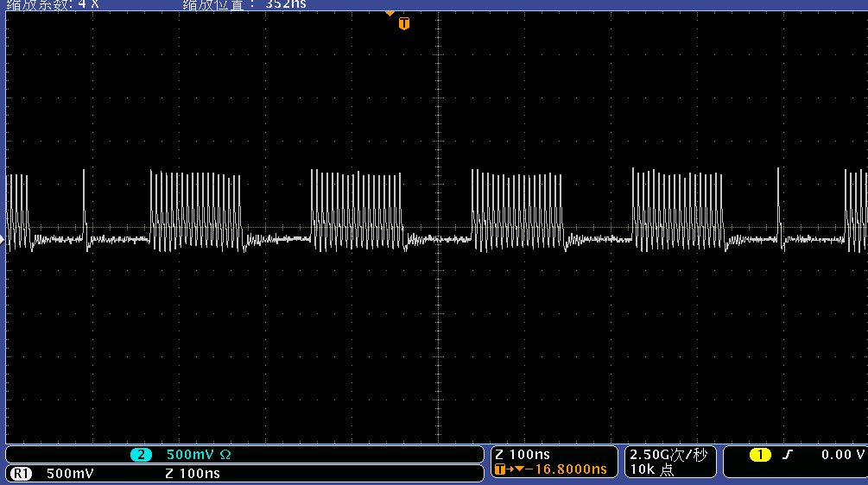

Slide 22
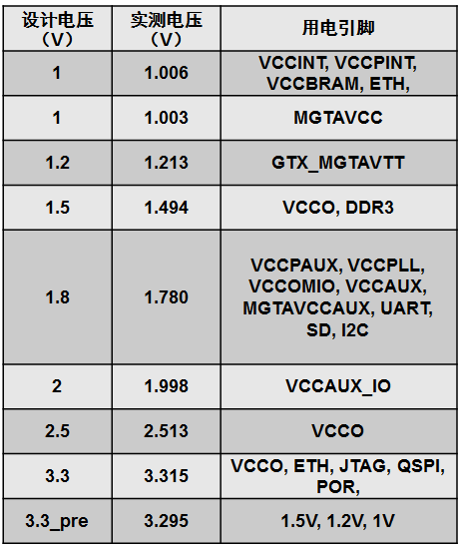
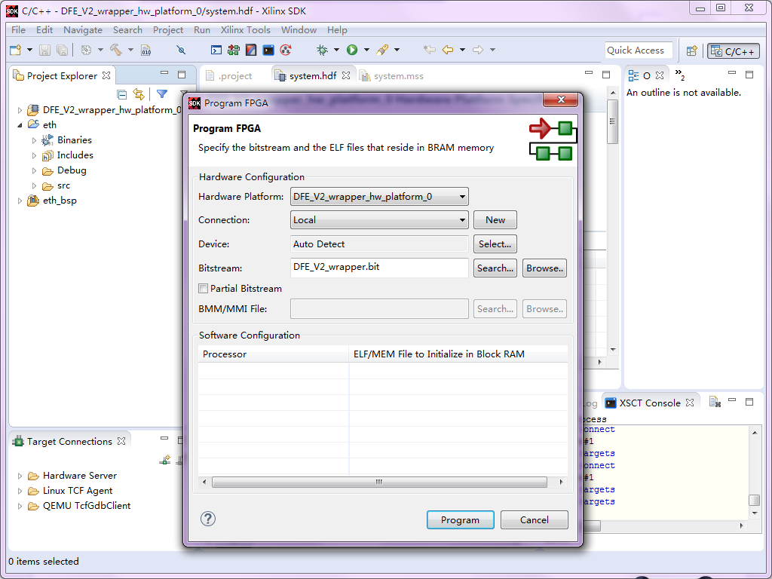
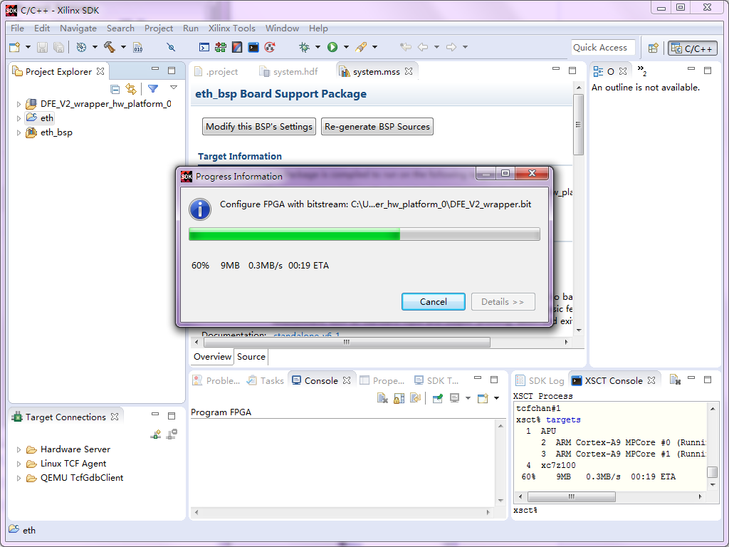
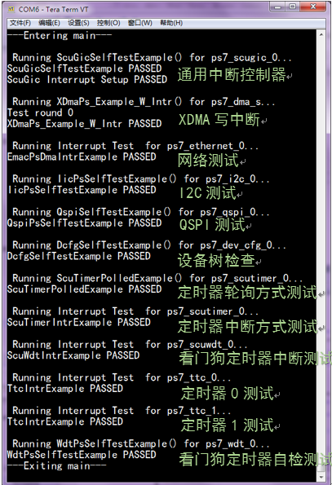
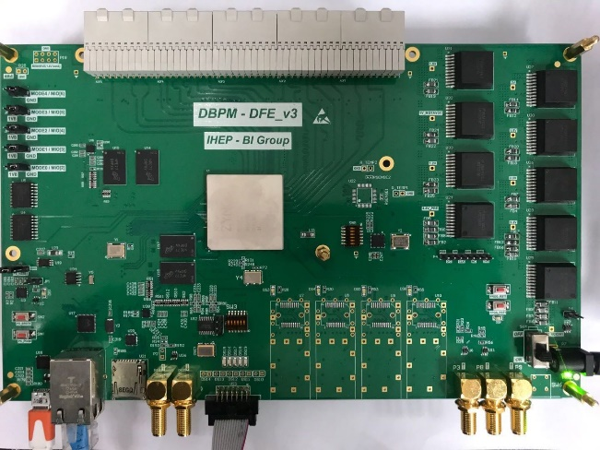
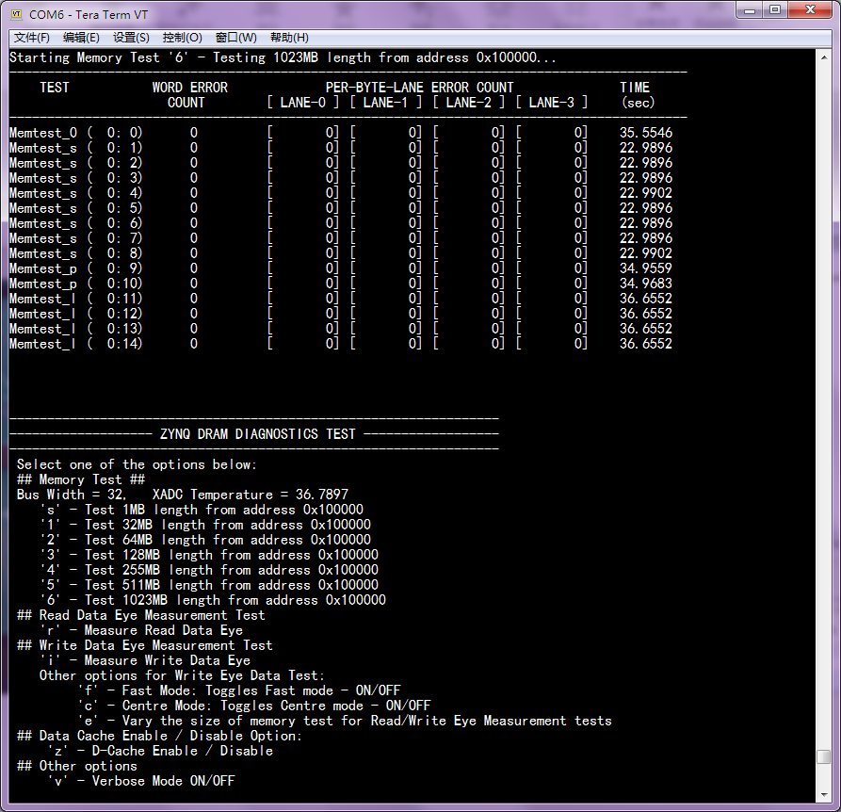
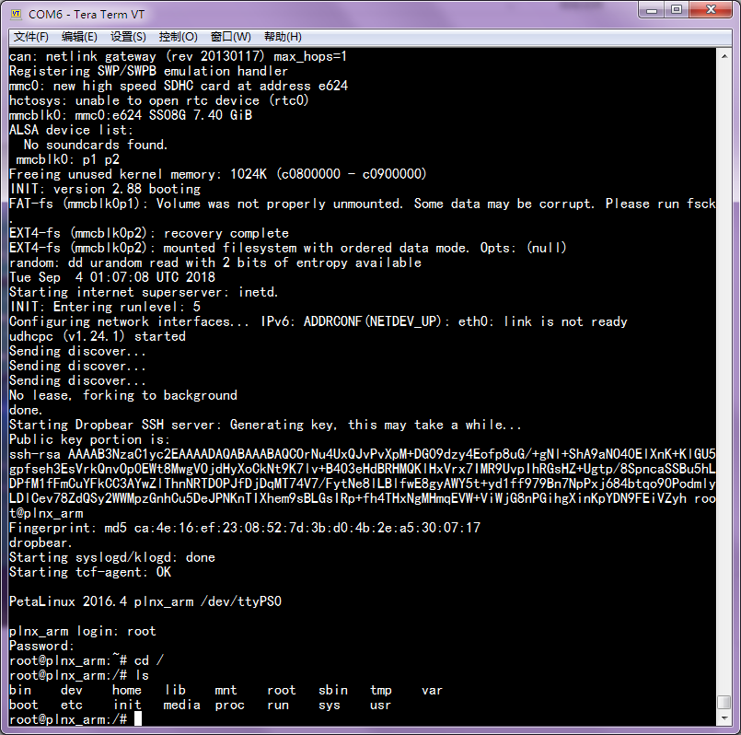
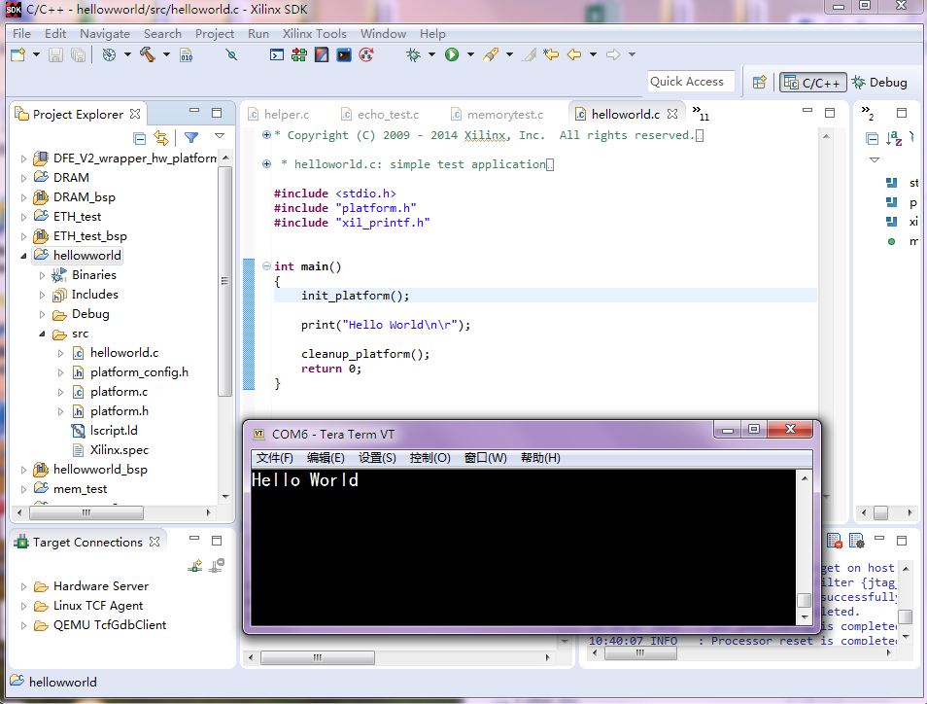
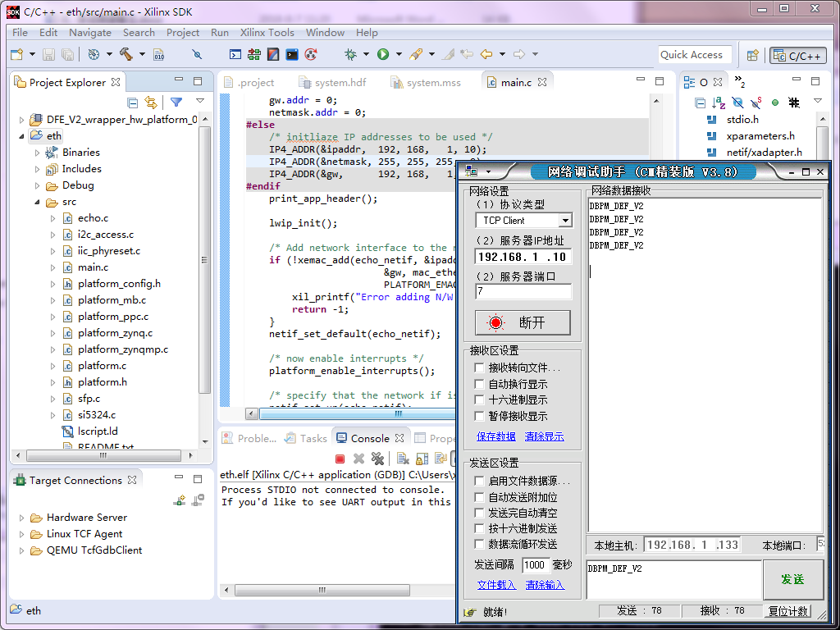
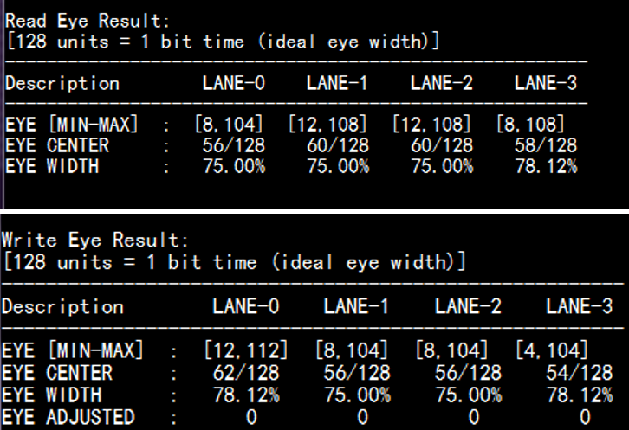
DFE test
IHEP BI Group
DFE POWER(√)
FPGA CONFIGURATION(√)
I2C BUS(√)
DDR3 (√)
UART (√)
DFE HW
LINUX (√)
GbE (√)

