Slide 1





BPM Resolution Studies at PETRA III
DEELS 2019
ESRF, 3. -5. June 2019
Gero Kube
DESY (MDI)
Introduction
Comments on BPM Resolution
„Three BPM“ Correlation & Prinicipal Components Analysis
Resolution Studies at PETRA III
Conclusion

Slide 2


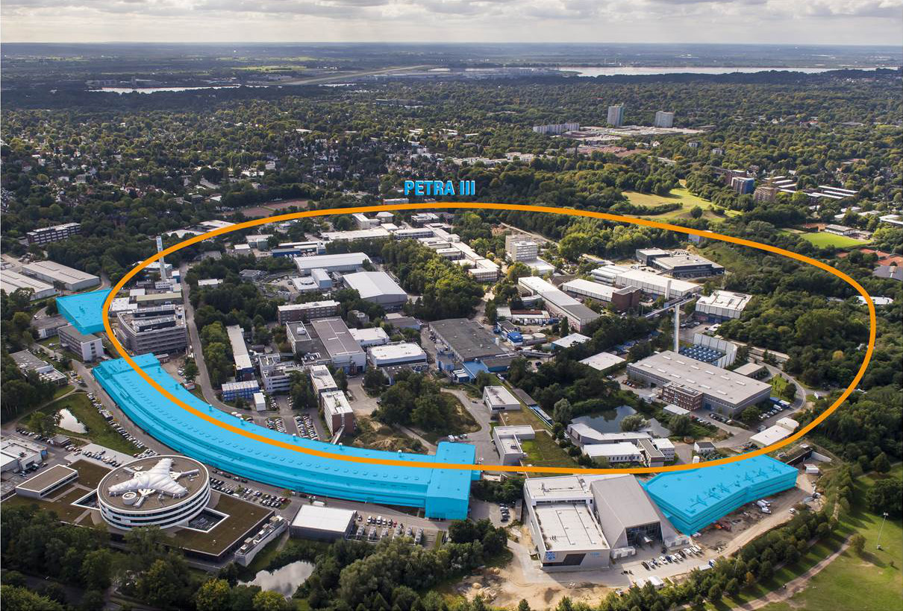
PETRA III @ DESY
PETRA history
1978 – 1986: e⁺e⁻ collider (up to 23.3 GeV / beam)
1988 – 2007: pre-accelerator for HERA (p @ 40 GeV, e @12 GeV)
since 2007: dedicated 3rd generation light source, commissioned in 2009 TDR: DESY 2004-035
→ 14 beamlines (15 experimental stations) operating in parallel
from 2014: staged extension project W. Drube et al., 2016 https://doi.org/10.1063/1.4952814
→ up to 12 additional beamlines (presently not all of them in operation)
Extension Hall East
Ada Yonath
Max von Laue Hall
Extension Hall North
Paul P. Ewald
Gero Kube, DESY / MDI
DEELS 2019 Workshop @ ESRF, 4.6.2019

Slide 3
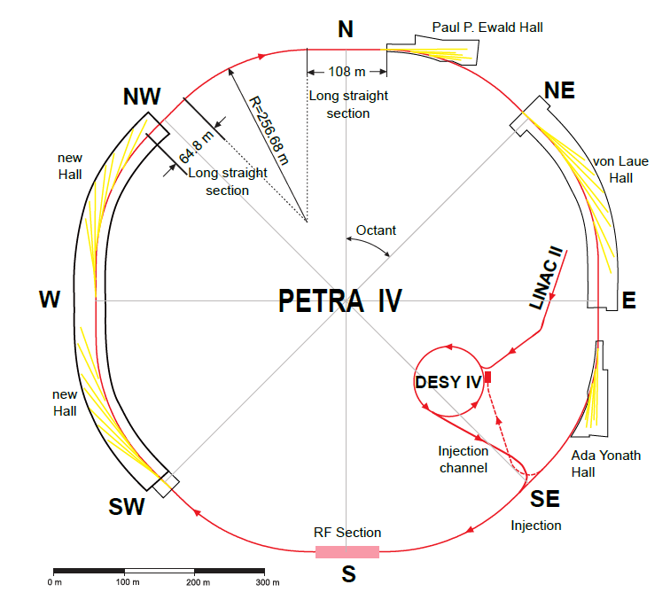
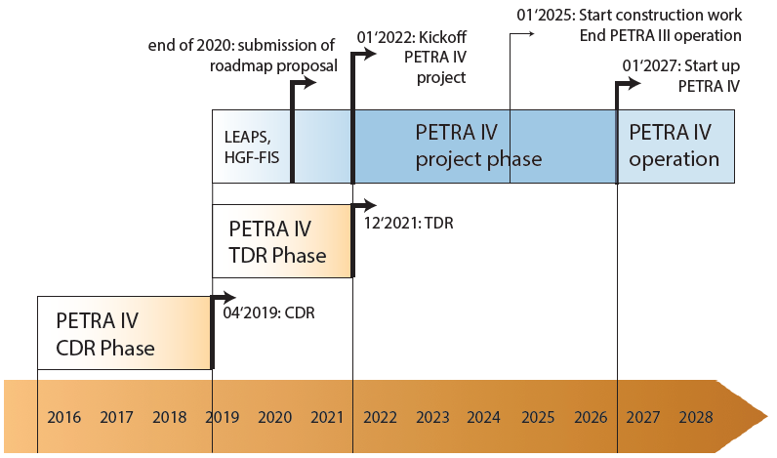
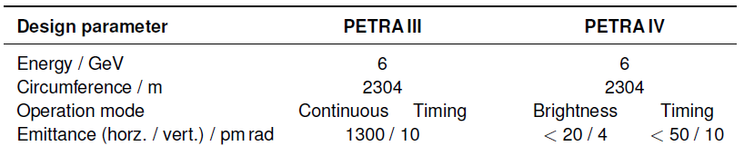
PETRA IV: Overview
PETRA IV storage ring and pre-accelerators
use of existing accelerator tunnel
→ asymmetric ring structure
additional experimental hall
→ 29 straight ID sections
time line
presently
→ preparation of Conceptual
Design Report
Gero Kube, DESY / MDI
DEELS 2019 Workshop @ ESRF, 4.6.2019

Slide 4
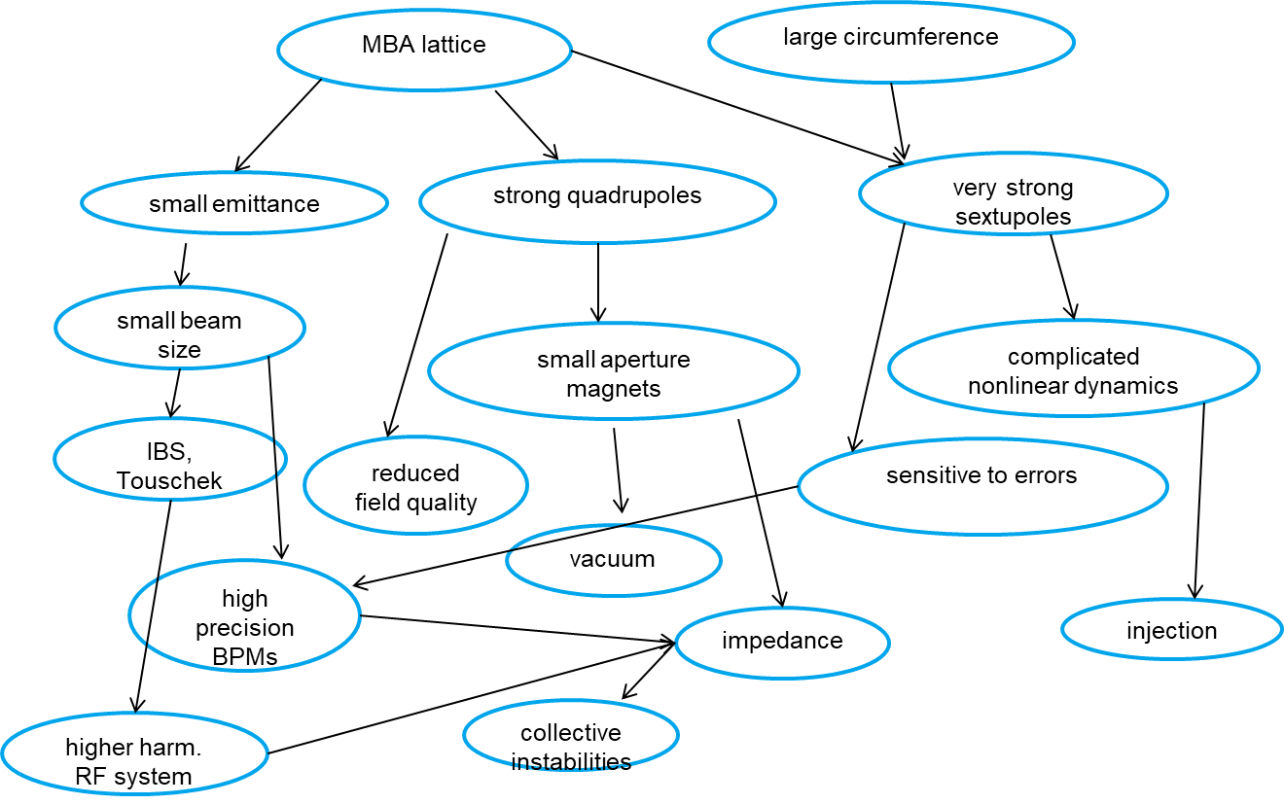
PETRA IV: Diffraction Limited Light Source
DLS design
courtesy: I. Agapov (DESY)
BPM resolution requirements
single bunch / single turn < 20 μm (assuming 0.5 mA in single bunch → 2.5×10¹⁰ particles bunch )
closed orbit < 100 nm (rms, 200 mA in 1600 bunches) at 300 Hz BW
Gero Kube, DESY / MDI
DEELS 2019 Workshop @ ESRF, 4.6.2019

Slide 5

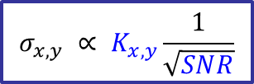

BPM Resolution
y
position determination in circular accelerator
x = K_{x}
(P₁+P₄) – (P₂+P₃)
y = K_{y}
(P₁+P₂) – (P₃+P₄)
P₁+P₂+P₃+P₄
P₁+P₂+P₃+P₄
x
beam
position resolution (small displacements from center)
$$σ_{x,y} ∝ K_{x,y}\frac{1}{\sqrt{SNR}}$$
$$K_{x,y}$$
: monitor constant
$$SNR$$
: signal-to-noise ratio
depends on
pickup geometry → beam pipe diameter
button size → small correction
geometry (button size) → signal strength
infrastructure → cable length & attenuation
read-out electronics
main focus: read-out electronics
goal
performance test → existing Libera Brilliance readout electronics @ PETRA III
Gero Kube, DESY / MDI
DEELS 2019 Workshop @ ESRF, 4.6.2019

Slide 6
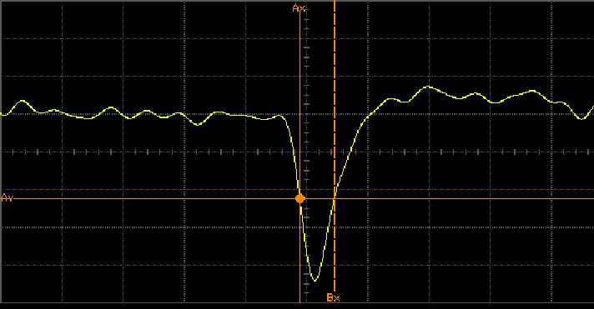
BPM Resolution Measurements
modern ADCs optimized for cw signals
signal from BPM button → far away from cw signal
BPM resolution with beam generated signals
BPM signal measurement with beam → 2 kinds of jitter
beam jitter
→ real change of beam angle and position caused by fluctuations in accelerator
(ground motion, energy fluctuation, kicks, …)
→ seen by several / all BPMs simultaneously
(correlation via beam optics)
noise of BPM electronics
→ quantitiy to be measured
→ no correlation between adjacent BPM readings
correlation analysis in order to disentangle both jitter sources
common methods for correlation analysis
„three BPM“ correlation method
Principal Components Analysis (PCA)
brief review
Gero Kube, DESY / MDI
DEELS 2019 Workshop @ ESRF, 4.6.2019

Slide 7


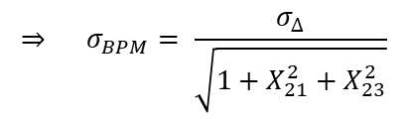







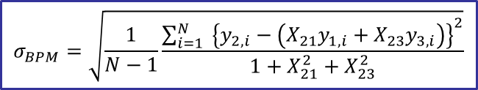
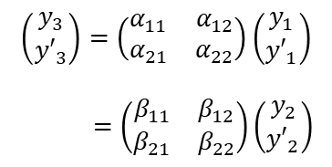

„Three BPM“ Correlation Method
principle setup: 3 adjacent BPMs
connection via transport matrices
BPM₁
BPM₂
BPM₃
no non-linear elements between BPMs
beam
$$\left(\begin{matrix}y_{3} \\ {y′}_{3}\end{matrix}\right)=\left(\begin{matrix}α_{11} & α_{12} \\ α_{21} & α_{22}\end{matrix}\right)\left(\begin{matrix}y_{1} \\ {y′}_{1}\end{matrix}\right)$$
$=\left(\begin{matrix}β_{11} & β_{12} \\ β_{21} & β_{22}\end{matrix}\right)\left(\begin{matrix}y_{2} \\ {y′}_{2}\end{matrix}\right)$
$$M_{γ}$$
$$M_{β}$$
$$M_{α}$$
$$\left(\begin{matrix}y_{2} \\ {y′}_{2}\end{matrix}\right)=\left(\begin{matrix}γ_{11} & γ_{12} \\ γ_{21} & γ_{22}\end{matrix}\right)\left(\begin{matrix}y_{1} \\ {y′}_{1}\end{matrix}\right)$$
BPM reads position information
$$y_{2}=γ_{11}y_{1}+γ_{12}{y′}_{1}$$
$$y_{2}=\left(γ_{11}−\frac{α_{11}γ_{12}}{α_{12}}\right)y_{1}+\frac{γ_{12}}{α_{12}}y_{3} ⇒{ y}_{2}=X_{21}y_{1}+X_{23}y_{3}$$
$$y_{3}=α_{11}y_{1}+α_{12}{y′}_{1}$$
difference: measured position vs. expectation
calculate variance (error propagation)
$$∆ =y_{2}−X_{21}y_{1}−X_{23}y_{3}$$
$$σ_{∆}^{2}=σ_{y_{2}}^{2}+X_{21}^{2}σ_{y_{1}}^{2}+X_{23}^{2}σ_{y_{3}}^{2}$$
all BPM readings with same error
σ_{Δ} → N consecutive position measurements
$σ_{y_{1}}\sim σ_{y_{2}}\sim$ $σ_{y_{3}}= σ_{BPM}$
$$⇒ σ_{BPM}= \frac{σ_{∆}}{\sqrt{1+X_{21}^{2}+X_{23}^{2}}}$$
$$σ_{BPM}=\sqrt{\frac{1}{N−1}\frac{\sum_{i=1}^{N}{ {\left\{y_{2,i}−\left(X_{21}y_{1,i}+X_{23}y_{3,i}\right)\right\}}^{2}}}{1+X_{21}^{2}+X_{23}^{2}}}$$
Gero Kube, DESY / MDI
DEELS 2019 Workshop @ ESRF, 3.- 5.6.2019

Slide 8
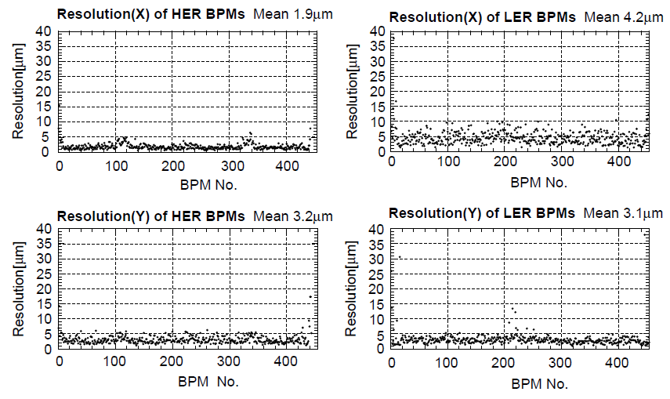
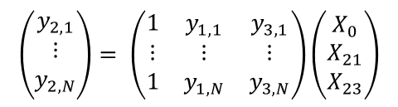
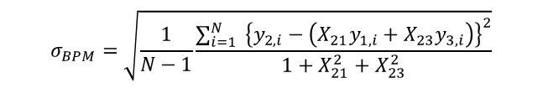
„Three BPM“ Correlation Method (2)
procedure
N consecutive position measurements with 3 adjacent BPMs
determination of transfer matrix elements X₂₁, X₂₃
→ straight forward: calculation according to beam optics
→ model independent: Moore-Penrose pseudo inverse
(least-square estimate for X)
BPM resolution
→ evaluate formula
constant
offset ≈ 0
$$\left(\begin{matrix}y_{2,1} \\ ⋮ \\ y_{2,N}\end{matrix}\right)= \left(\begin{matrix}1 & y_{1,1} & y_{3,1} \\ ⋮ & ⋮ & ⋮ \\ 1 & y_{1,N} & y_{3,N}\end{matrix}\right)\left(\begin{matrix}X_{0} \\ X_{21} \\ X_{23}\end{matrix}\right)$$
$$σ_{BPM}=\sqrt{\frac{1}{N−1}\frac{\sum_{i=1}^{N}{ {\left\{y_{2,i}−\left(X_{21}y_{1,i}+X_{23}y_{3,i}\right)\right\}}^{2}}}{1+X_{21}^{2}+X_{23}^{2}}}$$
successive application to all BPMs
→ grouping three adjacent BPMs
example: KEK-B M. Arinaga et al., NIM A499 (2003) 100
restrictions
no non-linear elements → difficult at DLS
same error of BPM readings → not possible at PETRA III
sometimes weak correlations with neighbour BPMs
→ large uncertainty in BPM resolution (especially with Moore-Penrose)
phase advance ≠ n/2 π
n = ±1, 3, 5, …
Gero Kube, DESY / MDI
DEELS 2019 Workshop @ ESRF, 4.6.2019

Slide 9
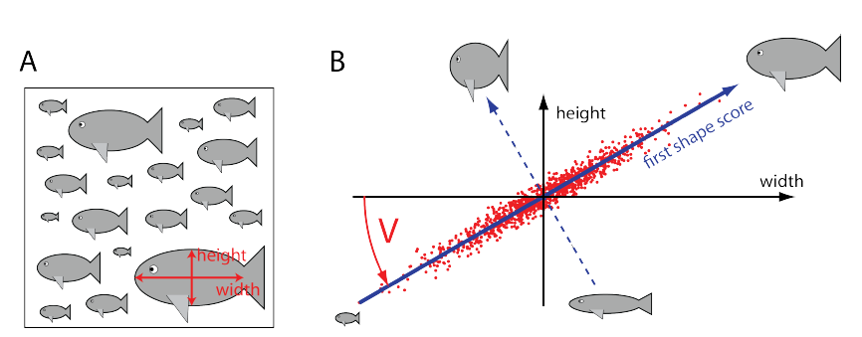
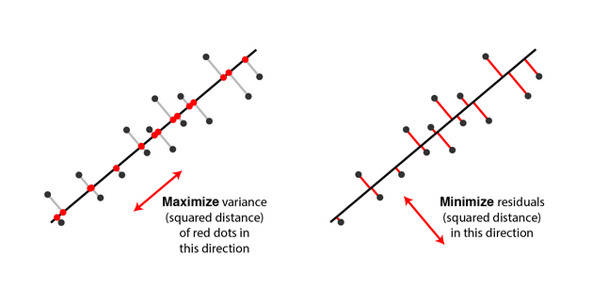
Principal Components Analysis (PCA)
method of multivariate statistics
conversion of set of correlated variables into set of linearly uncorrelated ones
→ principal components (PC)
cleansing of correlations in data sets
→ structuring of large data sets, compression, …
prinicipal axis determination
orientation of first principal axis
→ axis rotation such that overall data variance is maximized (requires centering of data)
→ alternative: minimize projections (hint: χ²)
orientation of second (third, …) principal axis
→ remove contribution of 1st PC from data
→ repeat rotation and variance maximization
condition: uncorrelated with (i.e., perpendicular to) first principal component
mathematics behind
form covariance matrix C → real & symmetric matrix
eigen vectors → principal components
eigen values (Λ) → amount of variance for PC
diagonalization of C → C = V Λ V^{T}
V : formed by orthonormal eigen vectors
sort eigen vectors according to eigen values
Gero Kube, DESY / MDI
DEELS 2019 Workshop @ ESRF, 4.6.2019

Slide 10
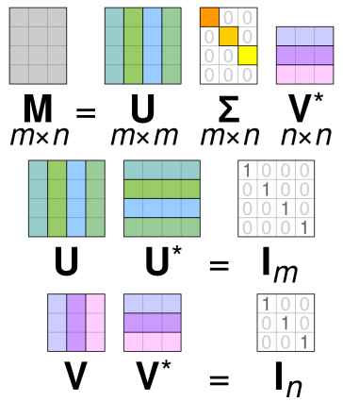


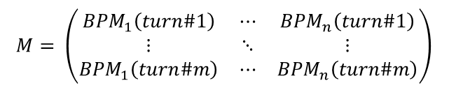

Principal Components Analysis (2)
alternative numerical method → Singular Value Decomposition (SVD)
instead of diagonalization of covariance matrix
→ SVD of data matrix M
relation between singular and eigen values:
→
$$M=U∙Σ{ ∙V}^{T}$$
(M real: V* → V^{T})
$$Λ=\frac{Σ^{2}}{n−1}$$
courtesy: Wikipedia
advantage
→ SVD numerically more stable (formation of MM^{T} can cause loss of precision → Läuchli matrix)
→ benefit: SVD provides additional information (accelerator physics)
application to BPM data
orbit (space coordinate)
construction of BPM matrix M
→ BPM data centered
→ normalization:
$$M= \left(\begin{matrix}{BPM}_{1}\left(turn\#1\right) & ⋯ & {BPM}_{n}\left(turn\#1\right) \\ ⋮ & ⋱ & ⋮ \\ {BPM}_{1}\left(turn\#m\right) & ⋯ & {BPM}_{n}\left(turn\#m\right)\end{matrix}\right)$$
turns
(time coordinate)
$$∝\frac{1}{\sqrt{n m}}$$
C.X. Wang, SLAC-R-547 (2003)
exploration of SVD matrix properties
→ U: column vectors contain information about temporal pattern (tune, …)
→ V: column vectors contain information about spatial pattern (orbit / β function, …)
comment: U/V as temporal/spatial vectors → depends on orientation of matrix M
Gero Kube, DESY / MDI
DEELS 2019 Workshop @ ESRF, 4.6.2019

Slide 11

PCA Example
test measurement @ PETRA III
SVD analysis
fill pattern: 960 bunches @ 5.6 mA
single vertical kick with excitation kicker
2048 turns recorded
dominant modes (singular values) → mode 1 & 2
temporal modes
information about tune
→ FFT of u_{1,} u₂
spatial modes
information about beam optics →
$$β∝\left(v_{1}^{2}+v_{2}^{2}\right)$$
BPM resolution
singular values σ₁, σ₂, …= 0 → calculate cleaned orbit data
Gero Kube, DESY / MDI
DEELS 2019 Workshop @ ESRF, 4.6.2019

Slide 12
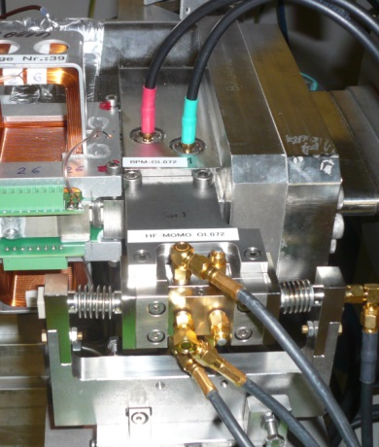
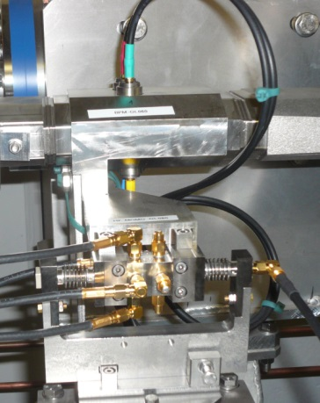
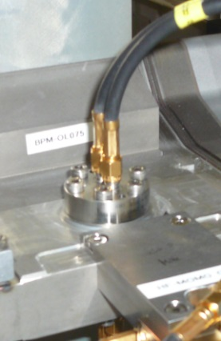
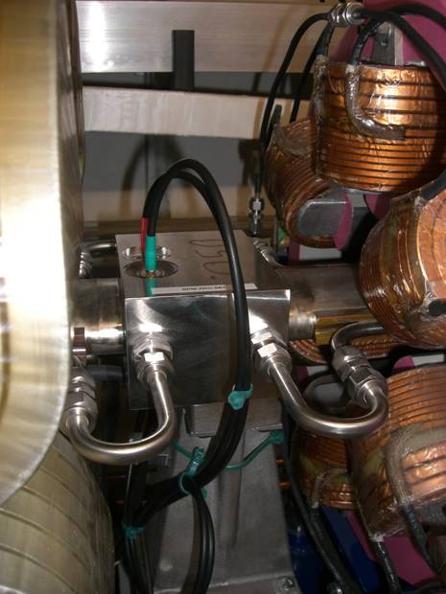
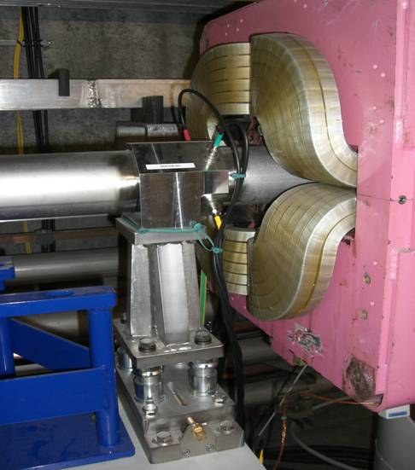
PETRA III BPM System
11 different pickup types:
Max von Laue hall
3 different cable types
RFA ½̋, ⅜̋ , ⅞̋ – 50 Ω
cable lengths: 10m … 200m
246 individual settings
standard octants:
normalize to K_{x,y} = 10 mm
RMS_{x,y} = f(signal power)
I. Krouptchenkov et al., Proc. DIPAC 2009, Basel, TUPD03, p. 291
Gero Kube, DESY / MDI
DEELS 2019 Workshop @ ESRF, 4.6.2019

Slide 13
BPM Resolution Studies
resolution studies @ PETRA III
single bunch with Q_{b} varying
single vertical kick with excitation kicker
2048 turns
PCA for
beam jitter
removement
K_{x,y}
normalization
plot as function
of signal power
combination of measurements for various Q_{b}
Gero Kube, DESY / MDI
DEELS 2019 Workshop @ ESRF, 4.6.2019

Slide 14
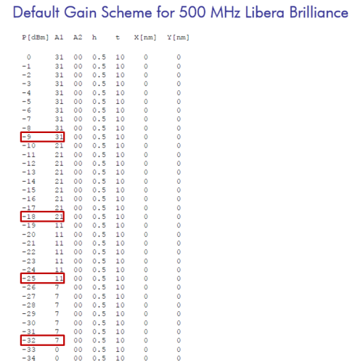
TbT Single Bunch Resolution
machine studies at PETRA III with existing BPM system
Libera Brilliance (Instrumentation Technologies)
min(RMS_{x,y}) ≈ 30 μm
Libera Brilliance resolution not sufficient for PETRA IV
PETRA IV CDR: rely on successor model → Libera Brilliance+
Gero Kube, DESY / MDI
DEELS 2019 Workshop @ ESRF, 4.6.2019

Slide 15
Test of Read-out Electronics
beam test @ PETRA III: december 2018
Libera Brilliance+
Libera Brilliance+
(old)
Libera Brilliance
Libera Spark
Libera Brilliance
→ BPM_SOL_24, in use at PETRA III
Libera Brilliance+
→ CDR: PETRA IV system
→ one system bought for DORIS / Olympus
→ one system recently bought
Libera Spark
→ new platform, no long-term stabilization
→ borrowed from I-Tech (thanks to Peter Leban)
Combiner / Splitter
Combiner / Splitter
Combiner / Splitter
Combiner / Splitter
Signal Combiner/Splitter
MACOM DS-409-4
Signal Combiner/Splitter
MACOM DS-409-4
~ 1 dB Attenuation
BPM TbT resolution determination
orbit data contain contributions due to
→ correlated beam jitter
→ noise of BPM electronics
10 dB Attenuator
disentangle contributions
correlation analysis → does not work for single BPM
eliminate correlated jitter → sum & split orbit data
BPM_SOL_24
Gero Kube, DESY / MDI
DEELS 2019 Workshop @ ESRF, 4.6.2019

Slide 16
Resolution Comparison
Libera Brilliance+
digital down conversion (DDC)
σ < 10 μm never achieved
σ = 19.8 μm @ I_{B} = 1.549 mA (-29 dB)
→ correct for attenuation: I_{B} = 0.38 mA (≈ -42 dB)
time domain processing (TDP)
σ = 10.3 μm @ I_{B} = 1.323 mA (-30 dB)
→ correct for attenuation: I_{B} = 0.38 mA
DDC mode < 20 μm (rms) → I_{B} ≈ 0.4 mA
TDP mode ≈ 10 μm (rms) → I_{B} ≈ 0.4 mA
would fulfil requirements
→ but Libera Spark is better…
Gero Kube, DESY / MDI
DEELS 2019 Workshop @ ESRF, 4.6.2019

Slide 17
Closed Orbit & Stability
long term stability
user operation: 480 bunches in 100 mA, top-up
all Liberas in closed orbit (SA) mode → drift compensation (digital signal conditioning, DSC) on
Spark:
no DSC available
Brilliance+ without DSC
good climatization (hutches, racks) mandatory
Gero Kube, DESY / MDI
DEELS 2019 Workshop @ ESRF, 4.6.2019

Slide 18
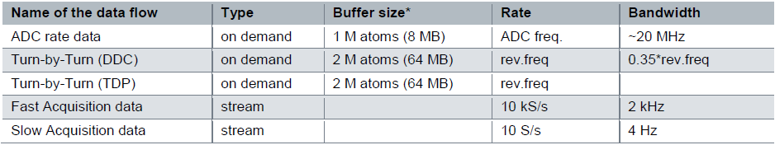
Closed Orbit Resolution
specification:
< 100nm (rms) in brightness mode (200mA in 1600 bunches) @ BW 300 Hz
horizontal orbit
first 12 hours (before beam dump):
σ_{rms} = 20.76 nm in SA mode (BW 4Hz, K_{x,y} = 10mm; BW 4Hz → see Brilliance+ User Manual, p.34)
→ scaling with band width:
× sqrt(300/4) = 8.66
→ σ_{rms} = 180 nm (@ BW 300Hz)
Gero Kube, DESY / MDI
DEELS 2019 Workshop @ ESRF, 4.6.2019

Slide 19
Conclusion
BPM resolution studies
require correlation analysis in order to disentangle noise and beam generated jitter
→ „three BPM“ correlation method & PCA
correlation analysis
„three BPM“ correlation method → not suitable for PETRA III BPM system
PCA → powerful tool, not only for resolution studies (e.g. BPM performance evaluation @ SSRF, …)
→ model independent, but limited by mode mixing
Z.-C. Chen et al., Chinese Physics 38 (2014) 077004
Nucl. Sci and Tech. 25 (2014) 020102
next step: Independent Component Analysis (ICA)
Libera Brilliance
single bunch resolution → specs not fulfilled for PETRA IV
Libera Brilliance+
single bunch resolution → specs fulfilled @ bunch curent I_{B} ≈ 0.4 mA and monitor constant K_{x,y} = 10 mm
DDC mode < 20 μm (rms), TDP mode ≈ 10 μm (rms)
closed orbit → specs not fulfilled (< 100 nm @ 300 Hz bandwidth)
σ_{y,rms} ≈ 180 nm @ 300 Hz bandwidth
and K_{x,y} = 10 mm
Libera Spark
single bunch resolution much better → closed orbit: needs stabilization
Gero Kube, DESY / MDI
DEELS 2019 Workshop @ ESRF, 4.6.2019

