Slide 1
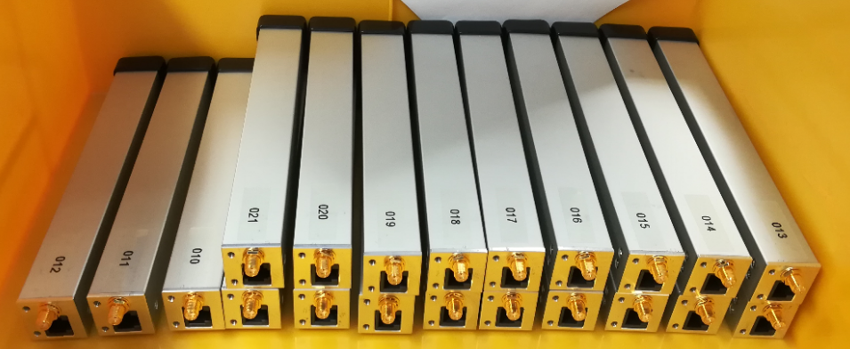
New Beam Loss Monitor Systems For SOLEIL
DEELS
3-5 June 2019
ESRF, Grenoble
Nicolas HUBERT on behalf of SOLEIL diagnostics group

Slide 2
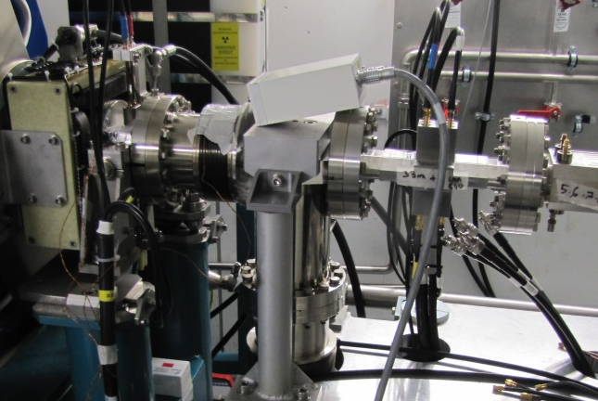
Loss Monitoring
Present beam loss monitor system:
  Coincidence pin diodes
    Insensitive (by conception) to SR
    Small angle of detection
    Counting mode only
    Slow losses only
Objective for the upgrade of the beam loss monitor system:
  Slow and fast losses
  Improve (-> reduce) the directivity
  Synchronized measurements
  Relative calibration between monitors is needed
    The new beam loss monitor system will be used by the radioprotection group to validate their simulation tools.
    Objective: have less that 10% dispersion in detectors sensitivity.
Status:
  Preliminary tests conducted last year
  Assembly and calibration of 20 modules
  Installation on 2 cells and first measurements

Slide 3
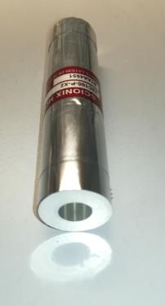
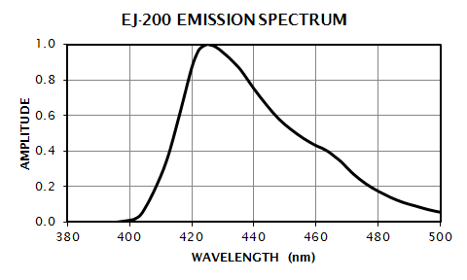
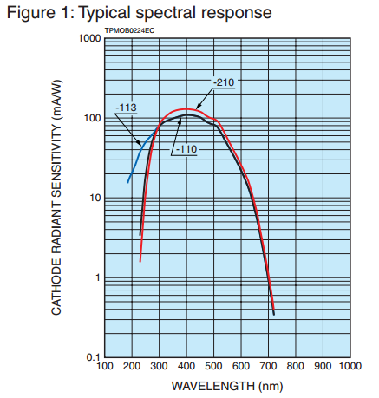
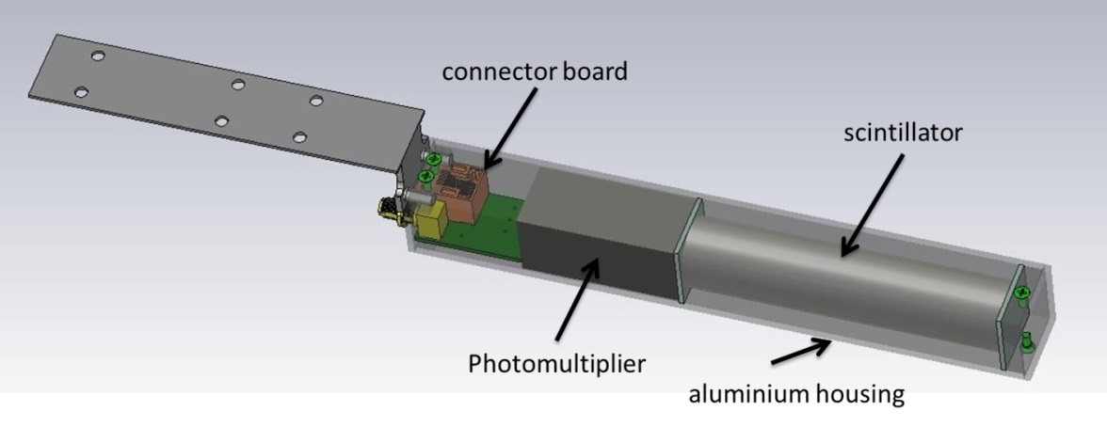
Detector
Re-use of the ESRF design:
  EJ-200 plastic scintillator 100 mm rod:
    Rise time: 0.9 ns
    Decay time: 2.1 ns
  Compact photosensor (Hamamatsu H10721-110):
    PMT
    High voltage power supply
    Rise-time: 0.6 ns
  Housed in a Al section

Slide 4
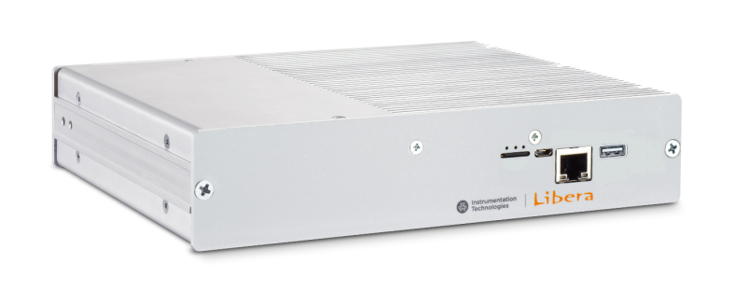

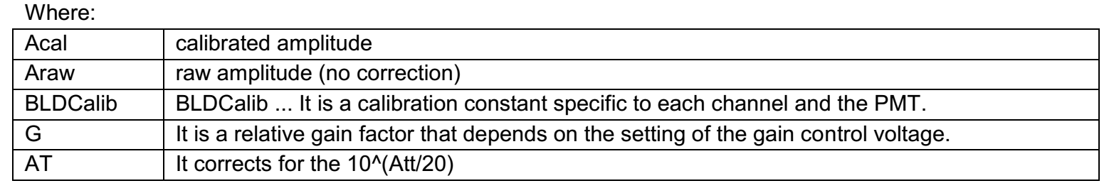
Electronics
Libera BLM
  4x125 MHz digitizers (14 bits)
  Several configurable data rates
    Triggered (ADC, TbT, averaged…)
    Continuous flow
    Counting mode
    Postmortem
  Power-supplies for the detectors
Relative calibration:
  Can be compensated by the electronics:
    Detector sensitivity compensation (scintillator yield and photomodule sensitivity)
    Variable photomodule gain compensation
    Variable attenuation compensation
Source: Libera BLM user guide

Slide 5
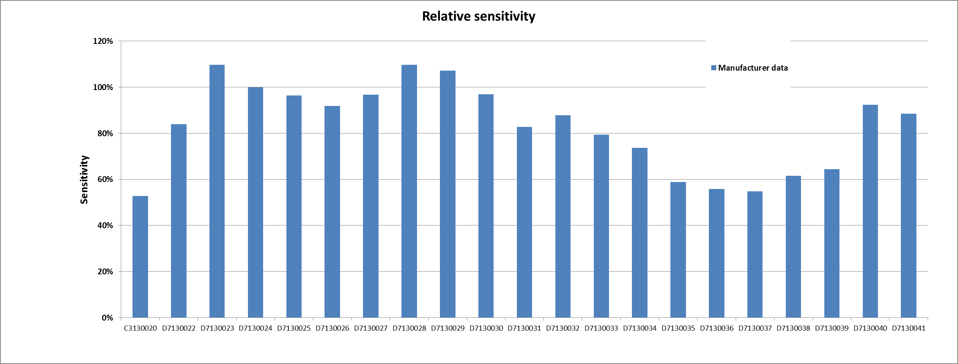
BLM Calibration
Diode based sensitivity measurement:
  High dispersion modules sensitivity: up to 50 % for the same reference.
Reference
Photomodule sensitivity provided by the manufacturer at delivery

Slide 6
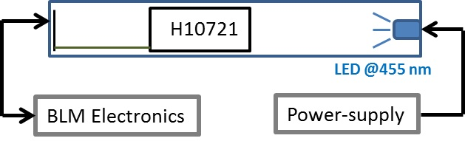
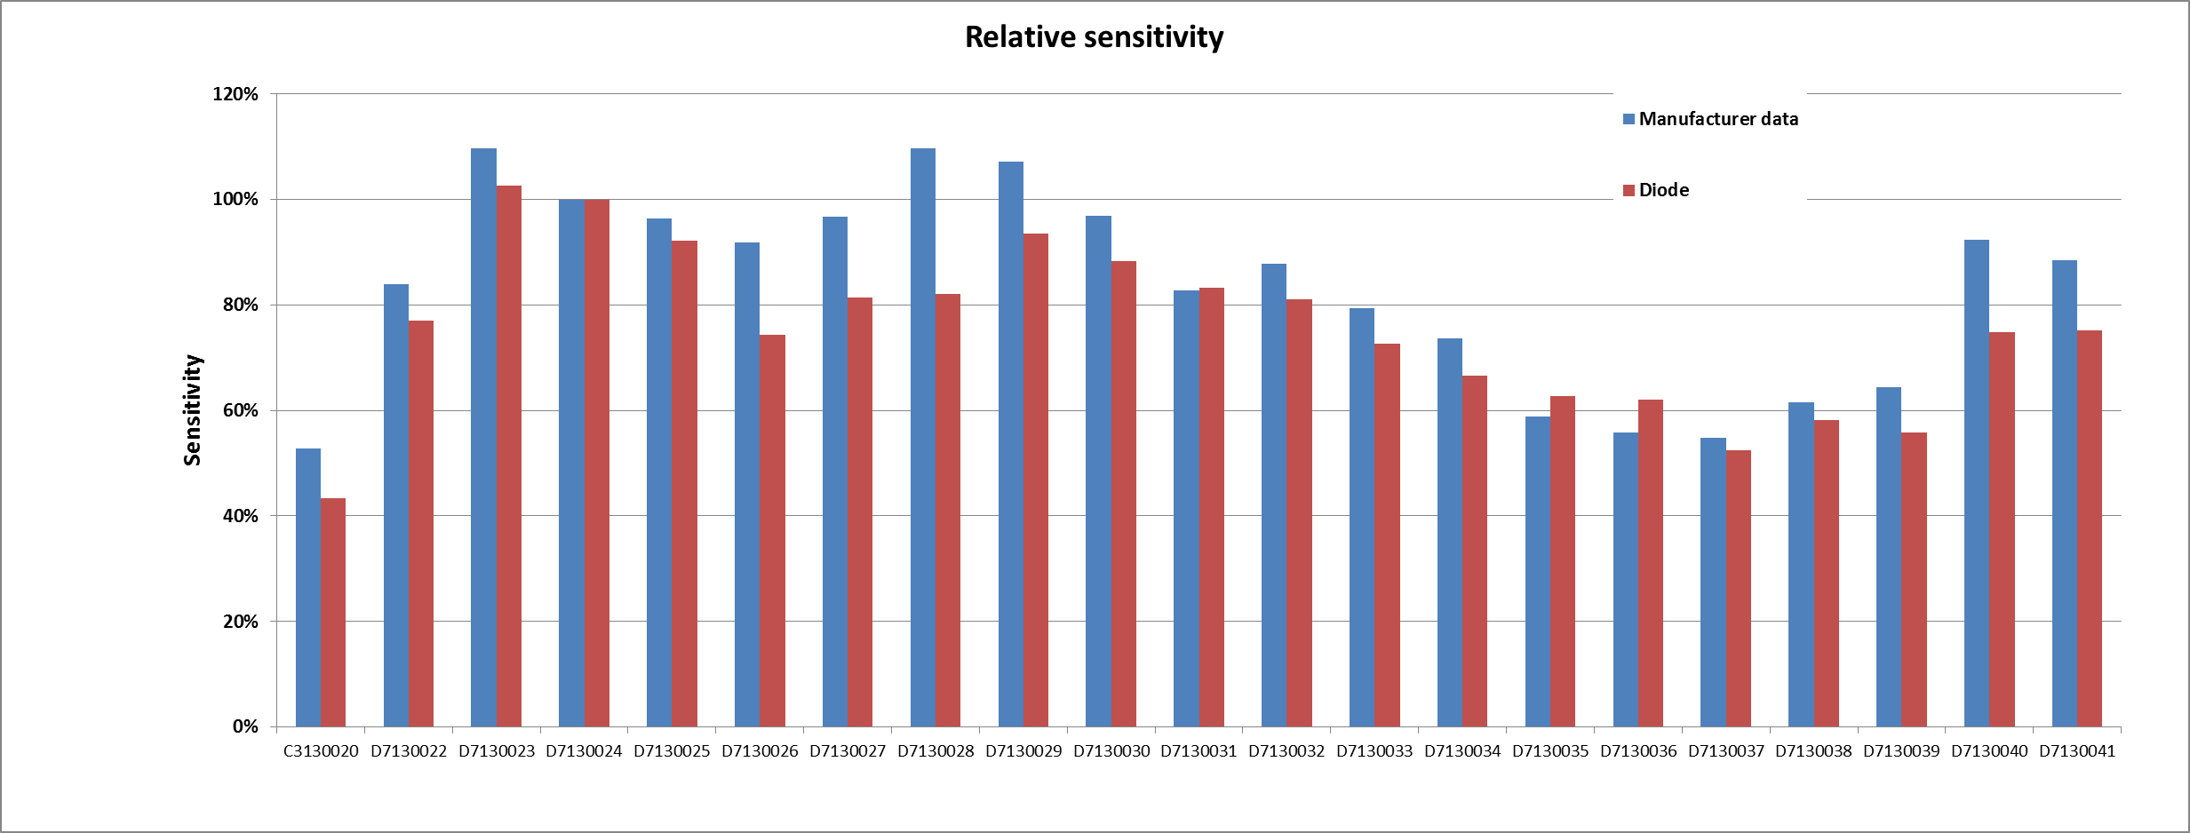
BLM Calibration
Diode based sensitivity measurement:
  Photomodule sensitivity
  High dispersion between modules
Reference
Photomodule sensitivity comparison (manufacturer data vs SOLEIL lab)

Slide 7
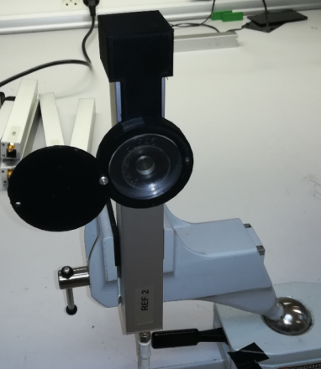
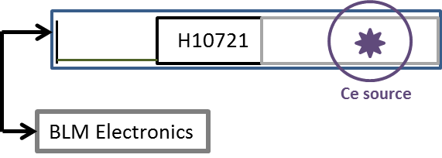
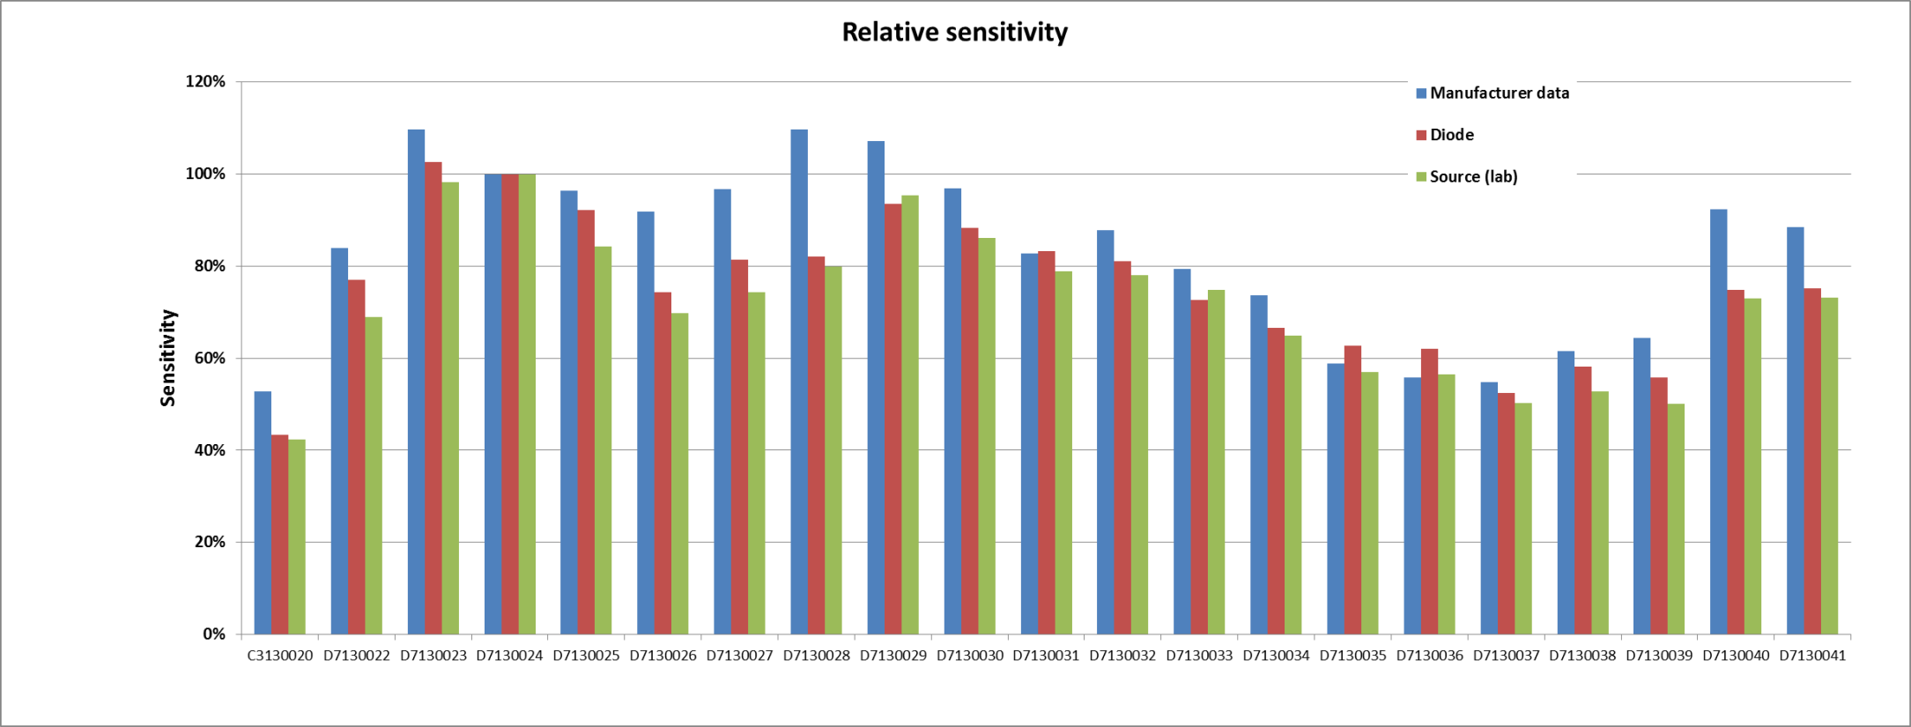
BLM Calibration
Cesium source based sensitivity measurement:
  3D-printed support adapted to BLM housing
  Lab measurement
    Same Libera BLM module and channel used for all sensors
    Includes scintillator response (see next slides).
Reference
Photomodule sensitivity comparison (manufacturer data vs SOLEIL lab)

Slide 8
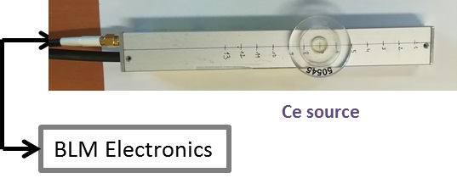
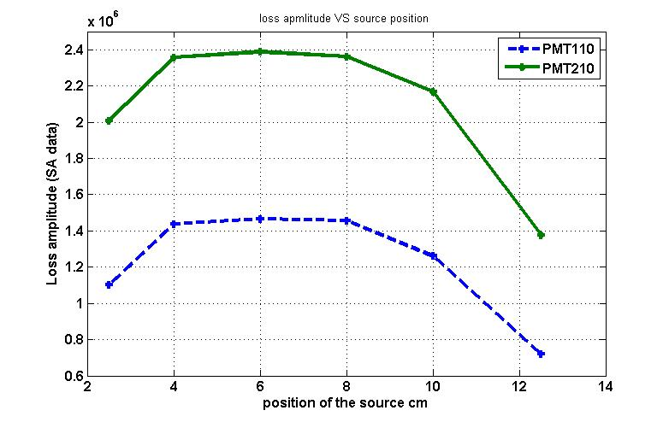
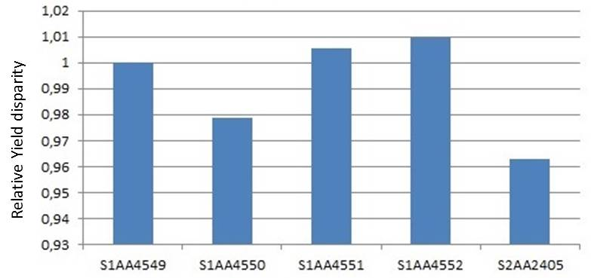
Scintillator sensitivity
Dependence to source position:
  To minimize the scintillation amplitude dependence to source position, this one must be placed in the middle region of the rod.
Sensitivity dispersion between scintillators
  Measured on 5 units with same electronics and photosensor.
  Relative dispersion is below 5 %
  Since the pair photosensor/scintillator is not supposed to be separated it has been decided to calibrate the pair together.

Slide 9
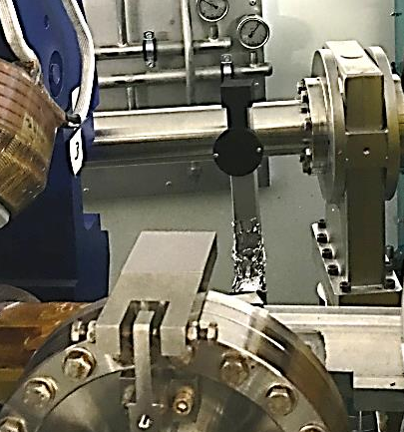
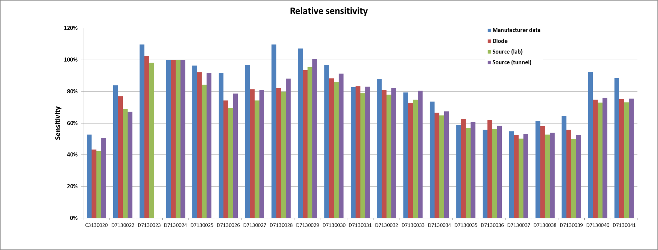
BLM Calibration
Cesium source based sensitivity measurement:
  3D-printed support adapted to BLM housing
  Tunnel measurement
    Includes cabling
    Includes electronics, after offsets compensation (see next slides)
Very good (<10%) reproducibility of the sensitivity measurements done in-house
  Compensation applied based on the measurement performed with Cs source in the tunnel
    Includes all components.
    Possibility to repeat the measurement periodically
Reference
Photomodule sensitivity comparison (manufacturer data vs SOLEIL lab)

Slide 10
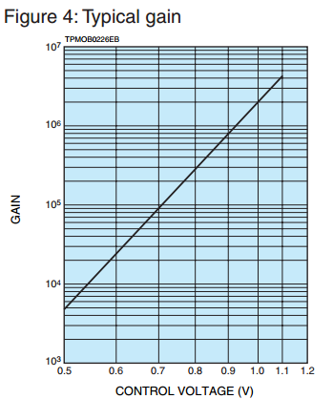
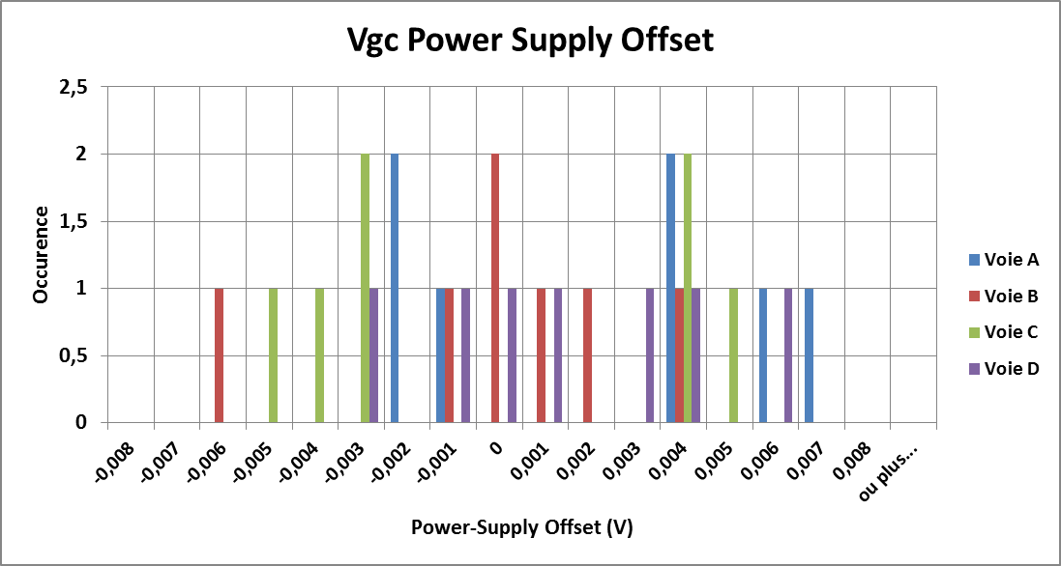
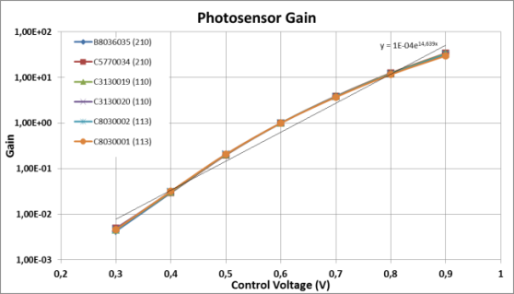
Electronics calibration
Gain power-supply offset:
  Constant whatever the required voltage
  Photomodule gain is very sensitive to it!
Libera BLM Vgc power-supply offset distribution ( 28 channels)
Gain vs Vgc voltage
A difference of 13 mV between 2 channels creates a 20% variation on the applied gain value.
-> Calibrate each module with its own electronics ->to be redone at each permutation (maintenance)
or
-> Compensate for this offset -> measured in the lab and corrected by the high-level application
Hopefully, we have in the electronics a discrete gain compensation table without interpolation between points

Slide 11
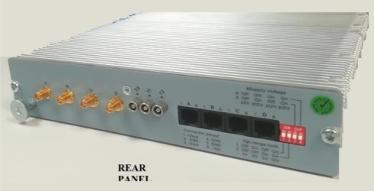
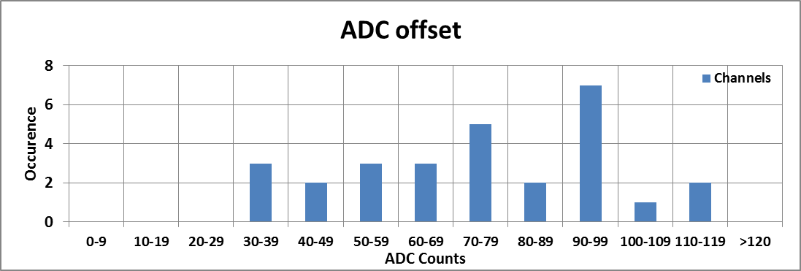
Electronics Calibration
ADC offset:
  Measured with 50 ohms termination at the channel inputs
  Compensated by the electronics
Libera BLM ADC offset distribution ( 28 channels)

Slide 12
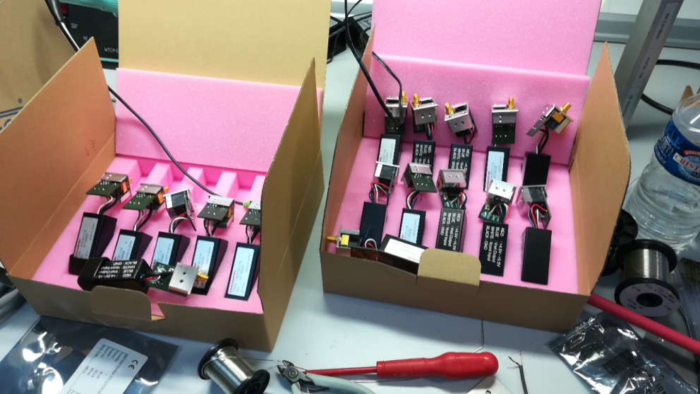
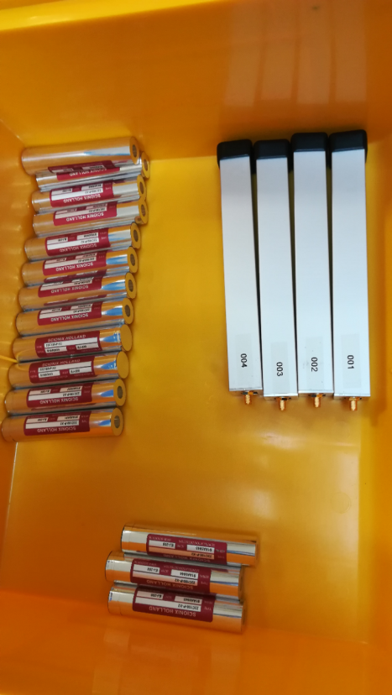
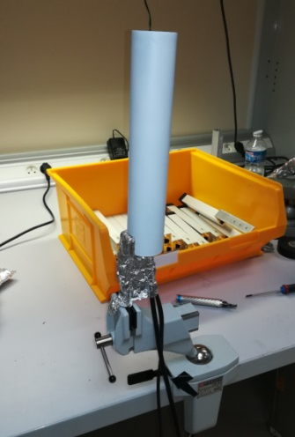
Installation
Assembly:
  Individual pieces produced externally
  Assembly/soldering done in-house
Photomodules soldered to their connector board
Shieding
  3mm thick lead shielding
  Damping of synchrotron radiation
Scintillators and first assembled BLM
3 mm lead shielding

Slide 13
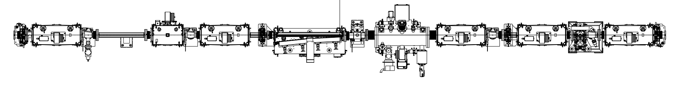
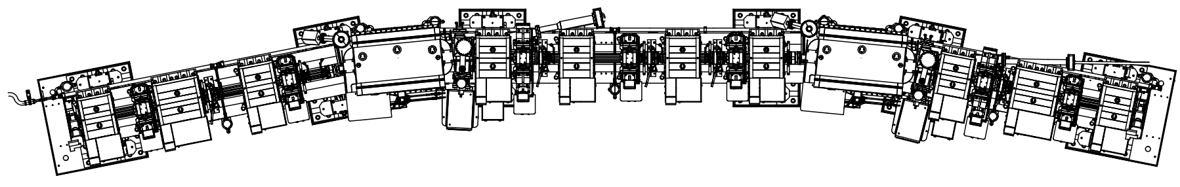
Installation
4
C01: Injection section -> 12 monitors
PHC
3
0
1
2
5
Zone inaccessible
8
6
7
9
10
Top view of BLMs installed in the injection section
11

Slide 14
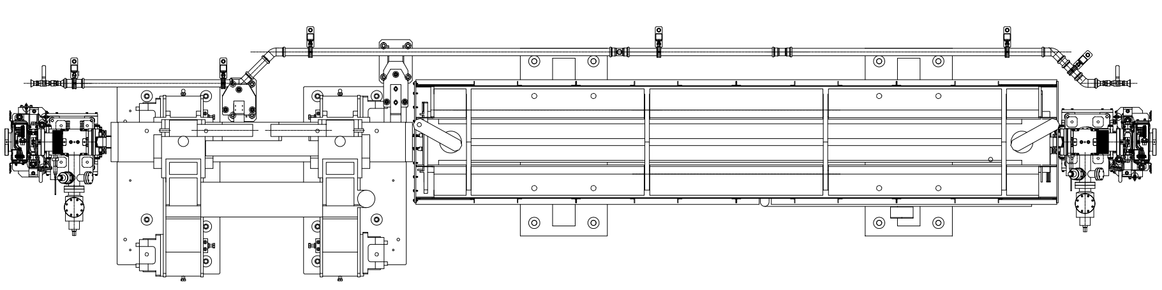
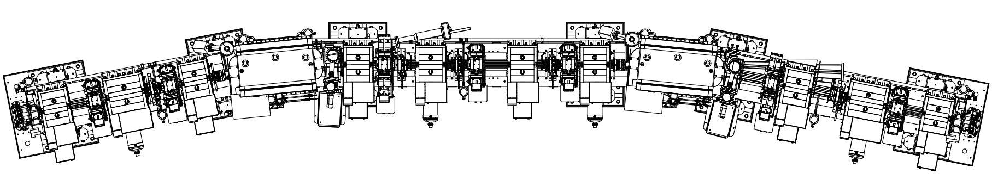
Installation
C04: standard section -> 8 monitors
12
13
14
15
16
17
18
19
Top view of BLMs installed in the Cell 04

Slide 15
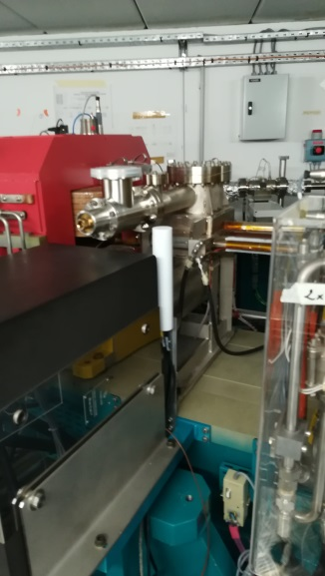
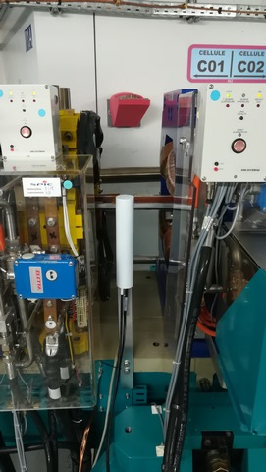
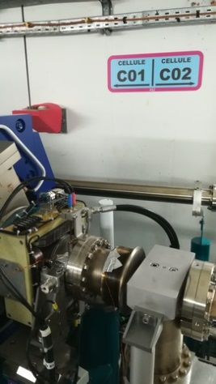
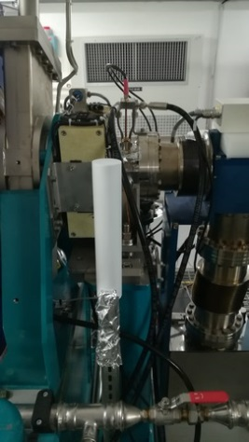
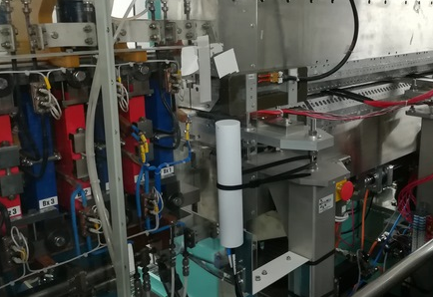
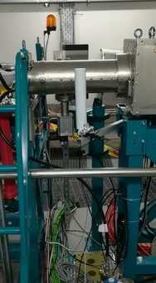
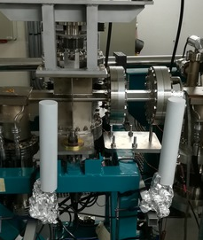
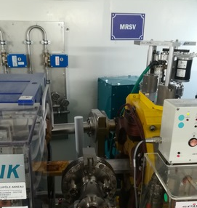
Installation
Upstream straight section
Downstream straight section
Between undulators
Middle of a straight section
Just after dipole
Arc location
Upstream septum
Upstream and in front of vertical scraper
In front of horizontal internal scraper

Slide 16
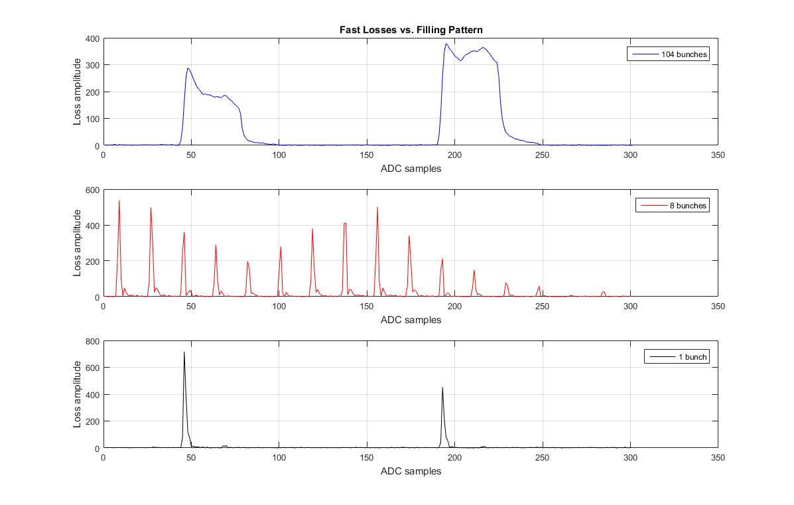
Beam Measurements
Fast Losses:
    Stored beam, scraper slightly inserted, vertical excitation
Turn N
Turn N+1
Losses measurement (ADC data) for 104 consecutive bunches (top), 8 bunches (middle) and single bunch (bottom). Records on BLM 1 in front of the vertical scraper.

Slide 17
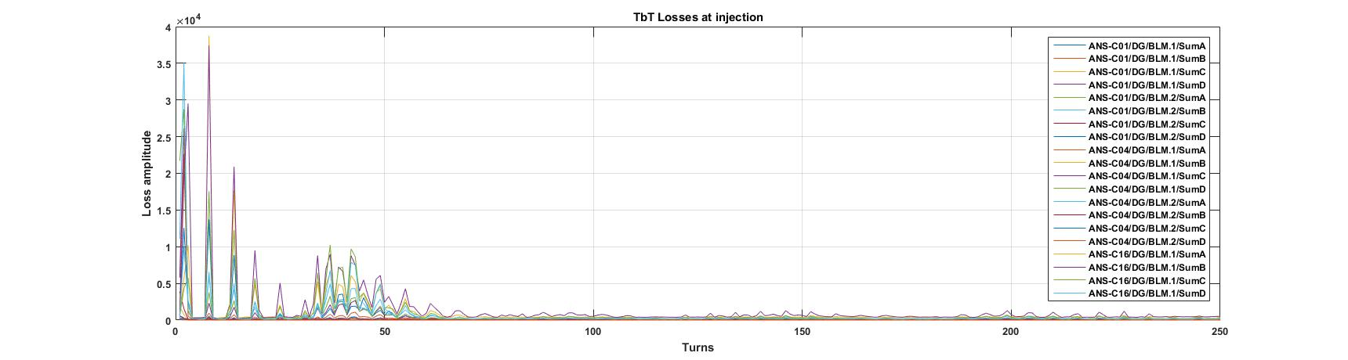
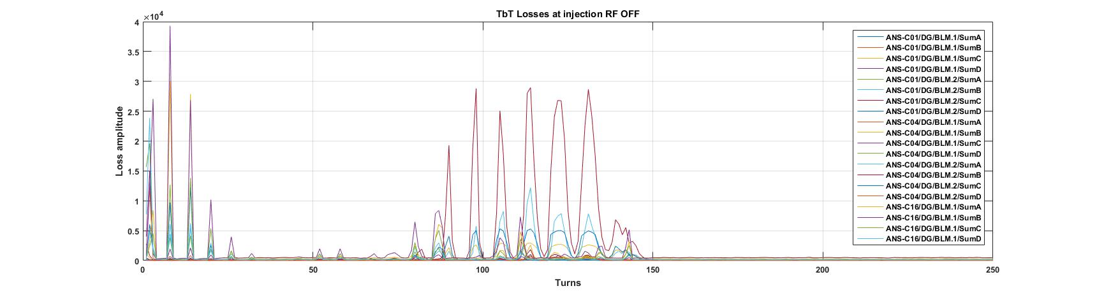
Beam Measurements
Fast Losses:
    Turn by turn losses at injection
Turn by turn losses measurement on the 20 detectors when injecting with RF switched ON (top) and OFF (bottom).

Slide 18
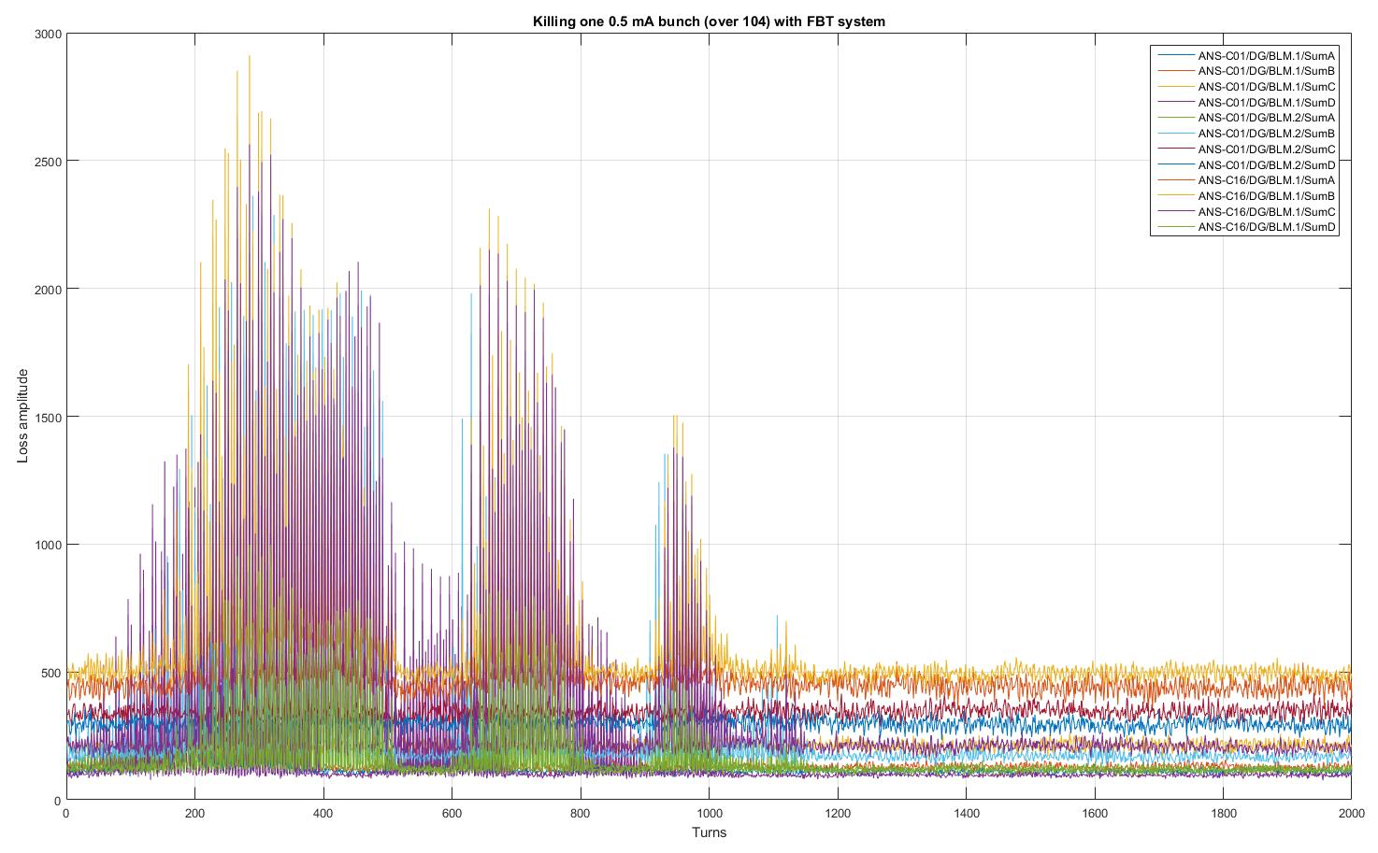
Beam Measurements
Fast Losses:
    Killing one (over 104) bunch with BbB feedback system
Turn by turn losses measurement on the 12 detectors of cell 01 when killing one over 104 bunches.

Slide 19
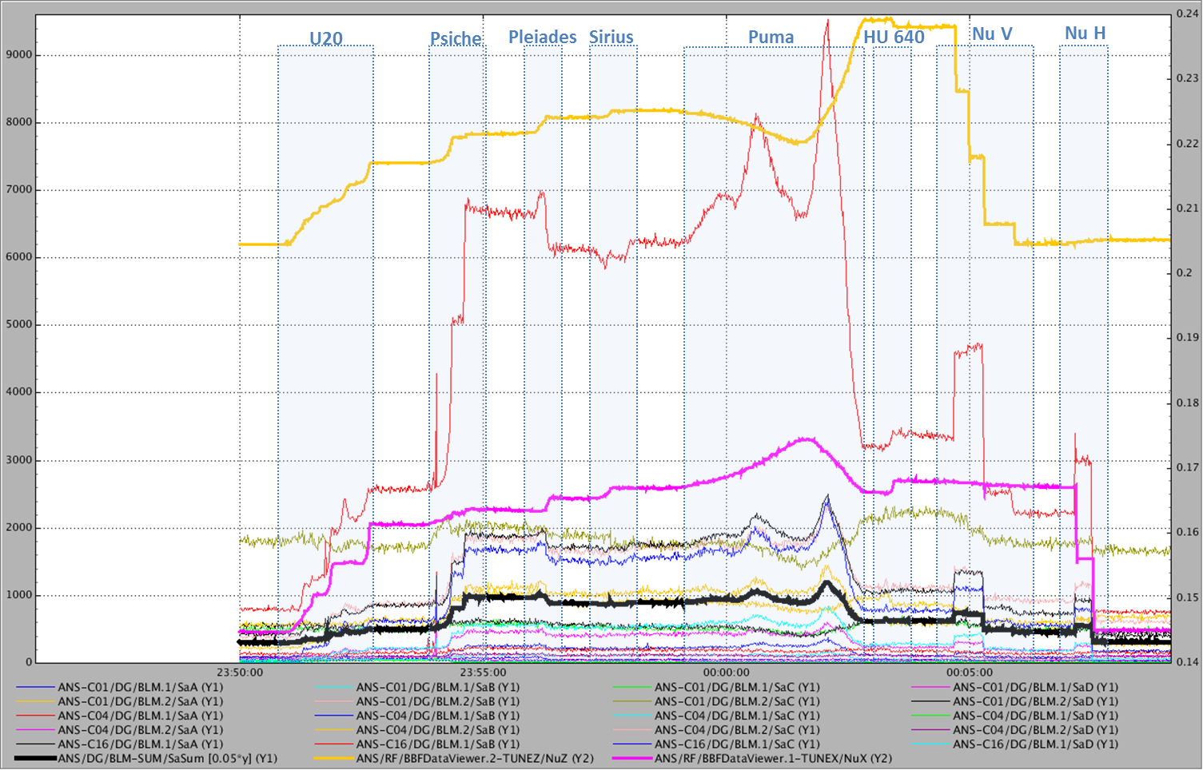
Beam Measurements
Slow Losses: tune shift and IDs
Nu V
Nu H
Slow acquisition losses measurement on the 20 detectors when closing or switching ON insertion devices at 500 mA.

Slide 20
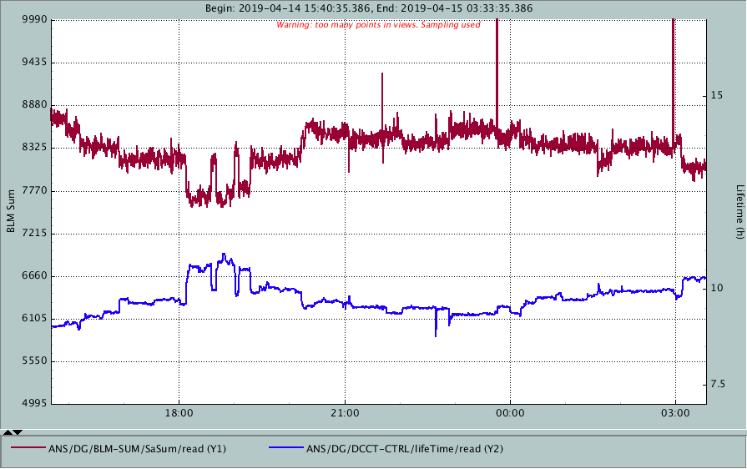
Beam Measurements
Slow Losses: Correlation with lifetime
Correlation between lifetime and losses (sum of the 20 BLMs)

Slide 21
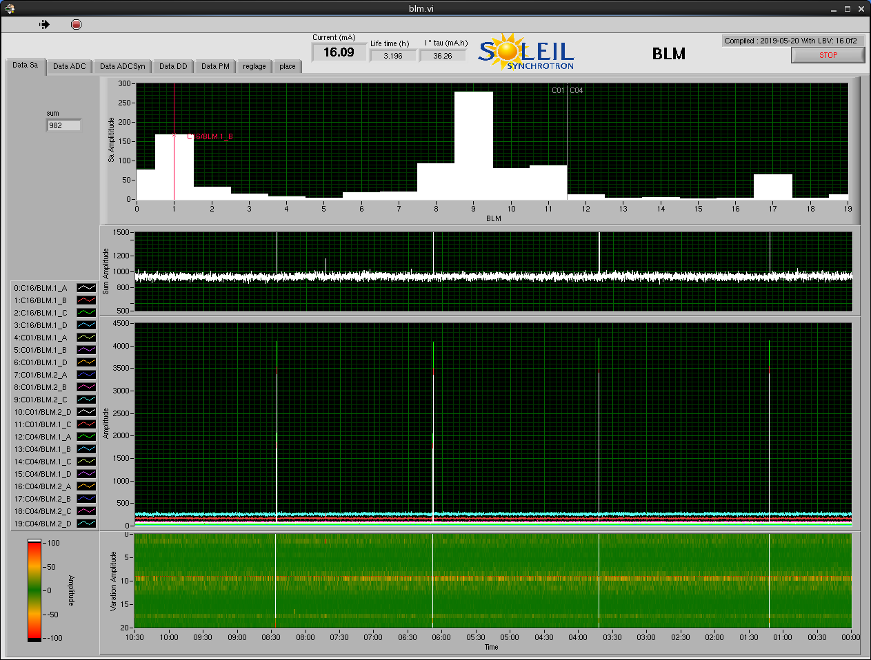
Beam Measurements
Daily operation: high level interface
Scraper V
Scraper H
Current loss value (SA)
10 minutes history of the sum of the 20 BLMs
10 minutes history of the 20 BLMs
10 minutes histogram of the 20 BLMs

Slide 22
Conclusion
20 monitors mounted and installed on 2 cells of the storage ring
Calibration based on diode and Cs source methods are in good agreement
  Compensation based on calibration with Cs source placed on detector in the tunnel:
    Take into account all parts from scintillator to electronics
    Easy to reproduce (typically every 2 years) to check possible evolutions (ageing, radiation damages…)
  Electronics gain power supply offset has to be compensated
Radioprotection group will start to use those detectors to cross check their radiation codes.
Full storage ring to be equipped by the end of the year:
  4 BLMs per cells

